Slide 1
Streaming Symmetric Norms Via Measure Concentration
Jarosław Błasiok (Havard)
Vladimir Braverman (Johns Hopkins)
Steve Chestnut (ETH Zurich)
Robert Krauthgamer (Weizmann Institute)
Lin F. Yang (Johns Hopkins)

Slide 2
Concentration of Measure
The usual way: Chernoff bound, Markov inequality
Predict the value for the summation of a list of random variables.
Can we predict the value of a function $f:ℝ^{n}→ℝ$ when a vector is draw randomly from a unit sphere?

Slide 3
Levy’s Lemma
For any norm $l:ℝ^{n}→ℝ$ and a random point $x$ from $S^{n−1}$, with high probability,
$$\left|\frac{l\left(x\right)}{Median}−1\right|≤ε\frac{Maximum}{Median}.$$
Milman & Schechtman (1986)

Slide 4
Modulus of Concentration
$$M_{l}=median_{x}\{l\left(x\right):x∈S^{n−1}\}$$
$$b_{l}=\sup{\{l\left(x\right):x∈S^{n−1}\} }$$
Modulus of concentration: $mc\left(l\right)=b_{l}/M_{l}$
“The highest mountain above sea level!”

Slide 5
Modulus of Concentration
Consider for $l_{p}$ norm
$p>2$: $mc\left(l_{p}\right)≈n^{\frac{1}{2}−\frac{1}{p}}$
$p≤2$: $mc\left(l_{p}\right)≈1$
$mc^{2}$ is the streaming complexity of $l_{p}$ norm!
Notes:
Add a story here. To speak how we started

Slide 6
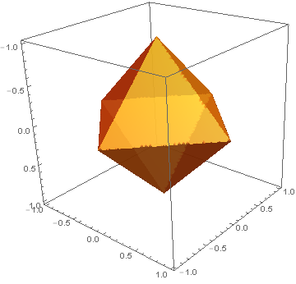
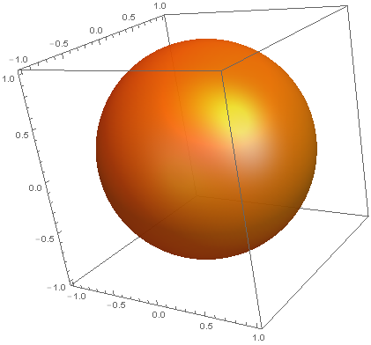
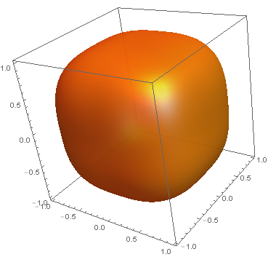
A random vector hits the maximum
A random vector hits the minimum
$$l_{1}$$
$$l_{2}$$
$$l_{p}:p>2$$
$$b=\sqrt{n}$$
$$M≈\sqrt{n}$$
$$mc\left(l_{1}\right)≈1$$
$$\tilde{Θ}(1)$$
$$b=1$$
$$M=1$$
$$mc\left(l_{2}\right)=1$$
$$\tilde{Θ}(1)$$
$$b=1$$
$$M≈n^{\frac{1}{p}−\frac{1}{2}}$$
$$mc\left(l_{p}\right)≈n^{\frac{1}{2}−\frac{1}{p}}$$
$$Θ(n^{1−2/p})$$
Streaming Complexity:

Slide 7
Is $mc {\left(l\right)}^{2}$ the streaming space complexity for norm $l: ℝ^{n}→ℝ$?

Slide 8
Yes*, if $l$ is a symmetric norm.
Symmetric norm $l$:
$l\left(x\right)$ is invariant under coordinate permutation
$l\left(x\right)$ is invariant under sign flips
Symmetric gauge function
* Please see the paper for the exact statement.
Notes:
p 15. I think it's a little confusing to say mc^2 is the optimal space complexity and then change it later on. Maybe someone at the talk has looked at the paper already. What about showing the hidden l_infinity norm and then explaining that this is only pathological behavior?

Slide 9
Our Result (Informal)
Let $l:ℝ^{n}→ℝ$ be a symmetric norm, to compute a $(1±ε)$ approximation of $l$
$\tilde{O}(mc^{2}(l))$ bits of memory suffices;
$Ω(mc^{2}\left(l\right))$ bits of memory is necessary!
* Please see the paper for the exact statement.

Slide 10
Algorithm Intuition
Partitions the coordinates of the input $x$ into “levels”. And approximate each level use Indyk-Woodruff 2005.
Not all levels can be approximated, but we only need to approximate the “important” ones.
Levy’s lemma (measure concentration) tells which levels are “important”. The space required to approximate these important levels is roughly $mc^{2}(l)$

Slide 11
Applications
Top-k norm, a special case of the Ky Fan norm,
$$Φ_{k}(x)=\sum_{i=1}^{k}{{\left|x\right|}_{[i]}};$$
$mc\left(Φ_{k}\right)=\tilde{Θ}\left(\sqrt{\frac{n}{k}}\right)$
Our result may be the first algorithm to estimate such norms

Slide 12
Applications
$k$-support norm (Argyriou, Foygel, and Srebro, NIPS 2012):
Regularizers for sparse recovery problems in Machine Learning.
No explicit formula, but we can do streaming using $poly\log{n}$ bits of memory.
$mc≈log n$
Unit ball:
$$C_{k} = conv\{x∈ℝ^{n}: |supp(x)| ≤ k and l_{2}(x) ≤ 1\}$$

Slide 13
Open problems
Extend this scheme to arbitrary norm/metric?
Earth Mover Distance
Matrix norms? E.g. Schatten-1 norm.

