Slide 1
Multi-Vector Retrieval
What? Why? And How (Efficiently)?
Rohan Jha · Adobe Research · May 19, 2026

Slide 2
1 / 2
2 / 2
Representation
Mechanism
What's the right way to encode a document to meet real retrieval needs?
How do we make these rich representations retrievable at scale?
Architecture, Scoring, Training
Generalization & Benchmarks
Index Size (↓)
Query Latency (↓)

Slide 3
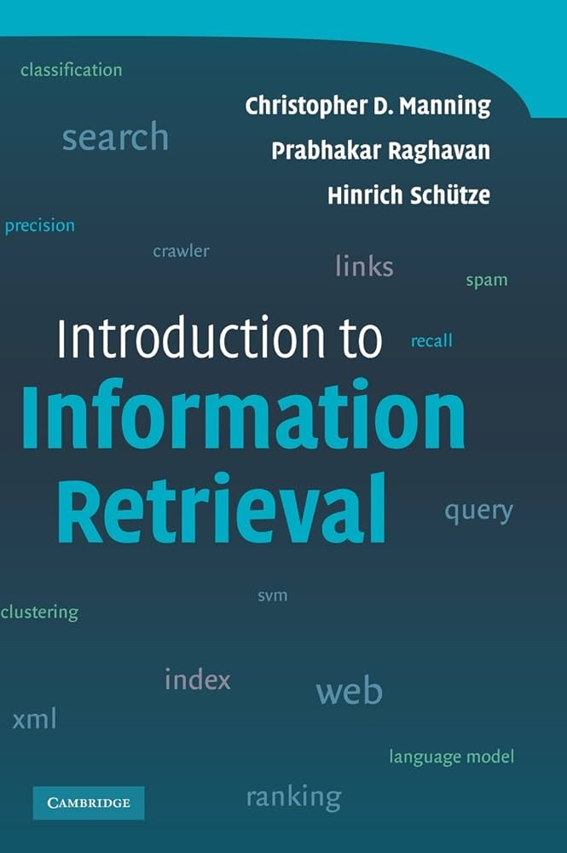
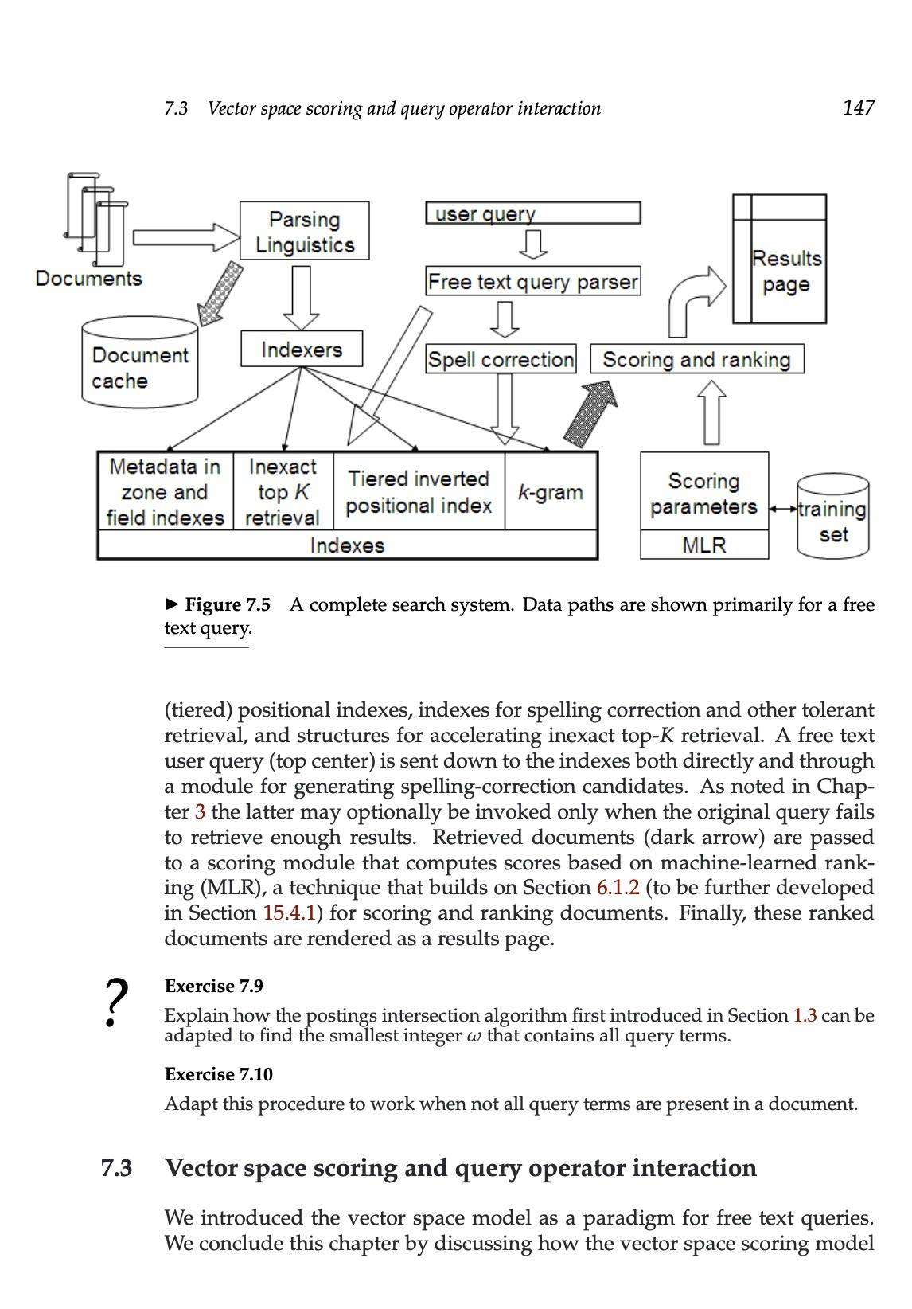
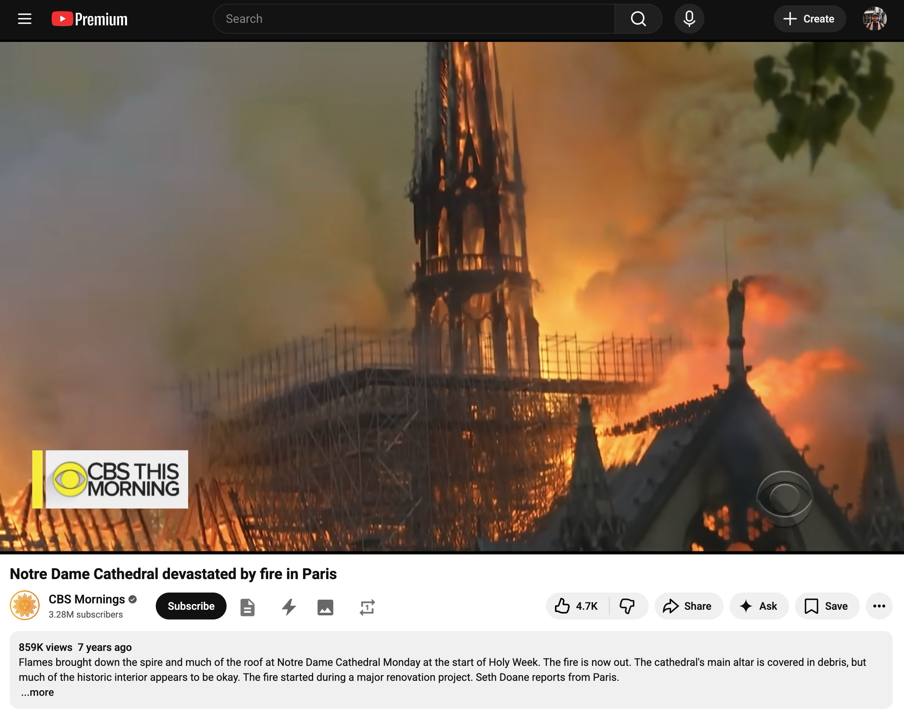
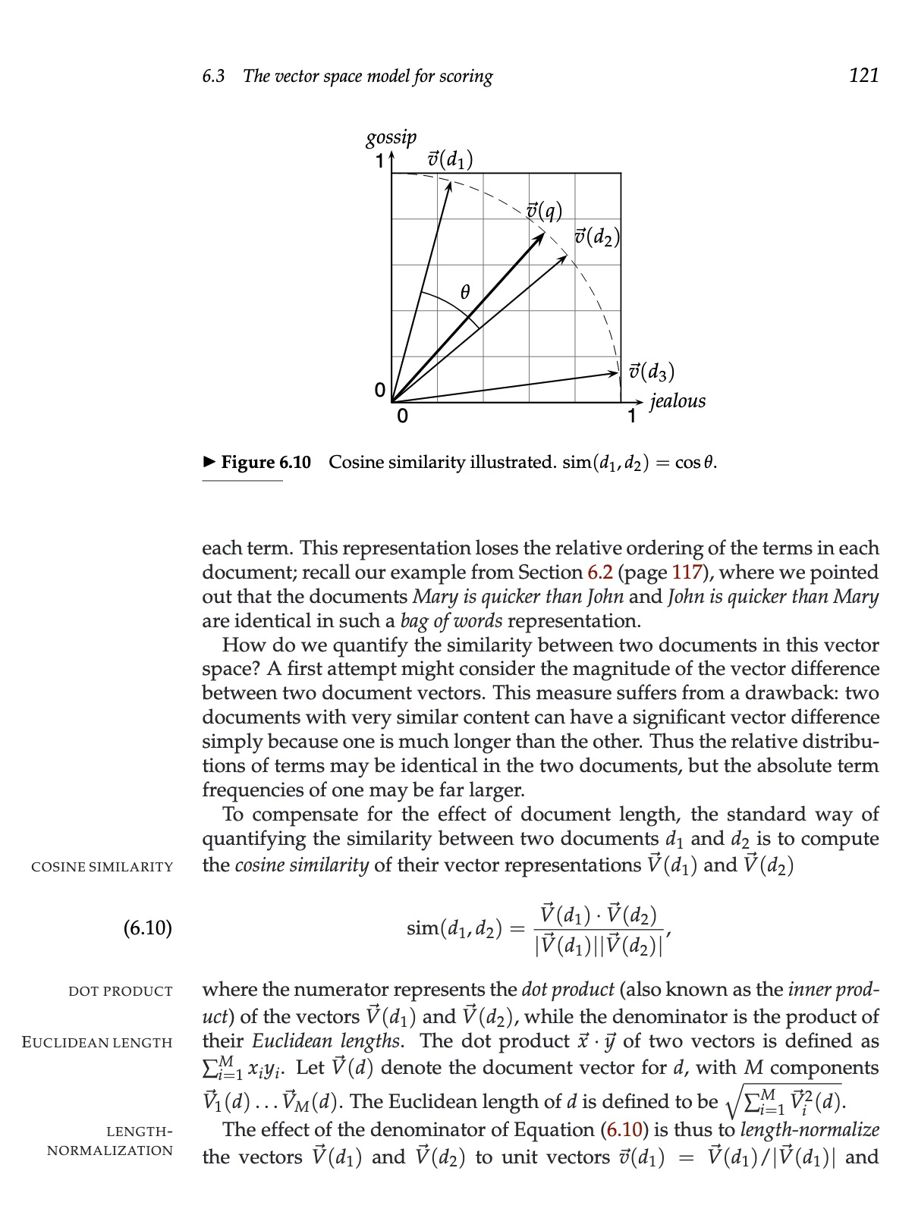
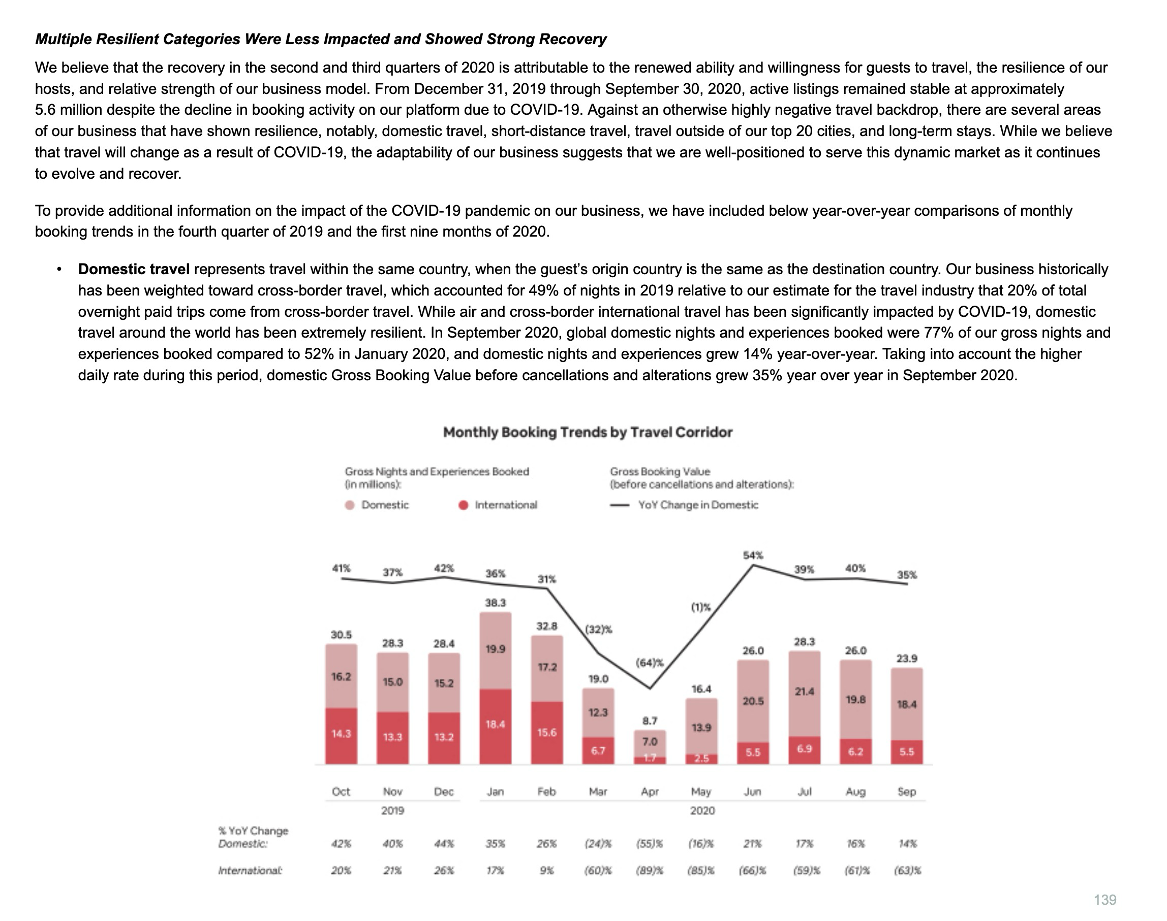
What’s our task?
Search is a core primitive of scalable systems that are grounded in evidence
Given a query that expresses an information need, retrieve documents from a corpus that are relevant to it
What do these information needs / evidence look like?
Explain inverse document frequency
Which part of Notre Dame had the most damage?
How did companies fare during COVID?
[Manning, Raghavan, Schütze, 2008; SEC – Airbnb S-1; CBS This Morning – Notre Dame Fire – YouTube]

Slide 4
A Spectrum of Retrieval Architectures
A linear spectrum with single vector (dense, but will mention sparse verbally) -> MV -> cross encoder. Spectrum encodes 1) representation granularity 2) lateness of interaction computation 3) approx. efficiency
MV approximates the attention computation of CE with the indexability of bi-encoder

Slide 5
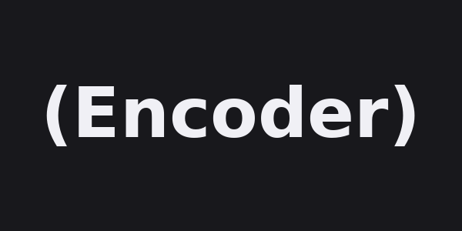
Indexable Offline
s
s
cos
MaxSim
s
s
s
…
pooled
pooled
Encoder
Encoder
Encoder
Encoder
LLM
Query
Document
Query
Document
Query + Document(s)
BM25
DPR
ColBERT
Cross-Encoder
Expressivity / Inference Cost
[Robertson et al. 1995; Nogueira & Cho, 2019; Karpukhin et al., 2020, Khattab & Zaharia, 2020]

Slide 6
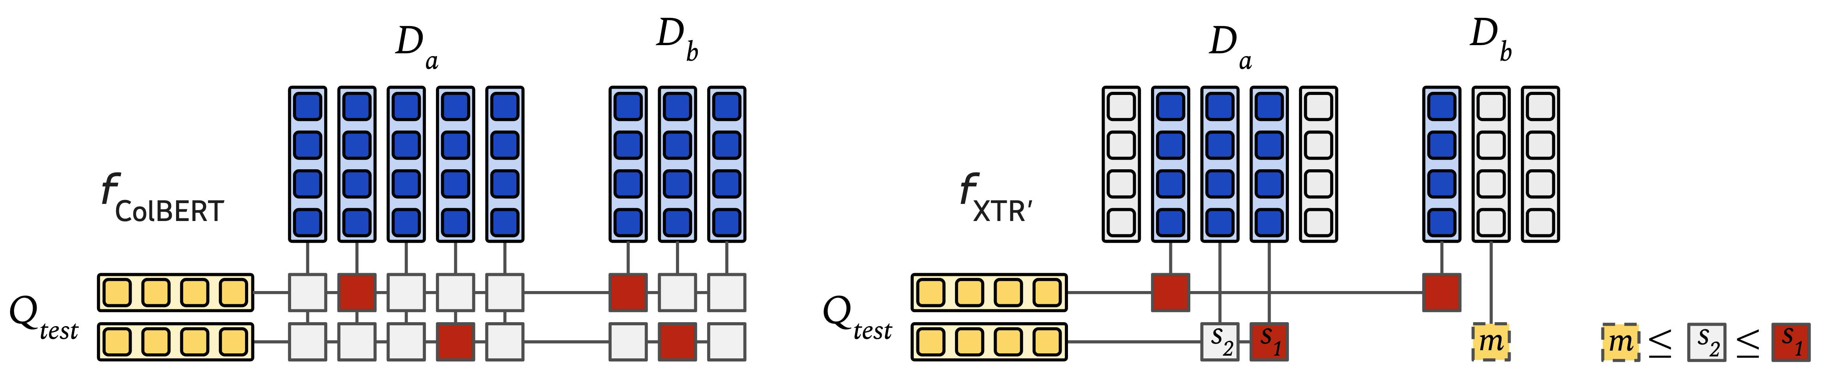
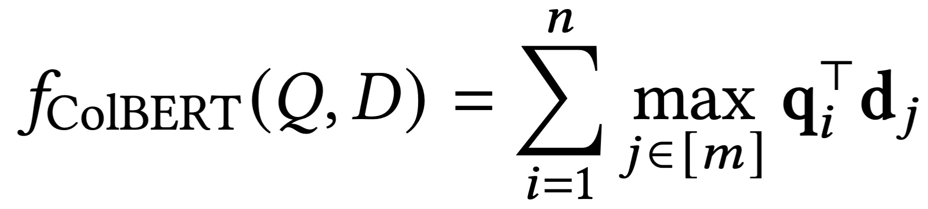
ColBERT’s MaxSim Scoring
0.3
0.8
0.2
0.6
0.7
0.6
0.8
0.6
0.3
0.5
0.3
0.8
0.3
0.9
0.4
0.8
0.9
0.5
0.8
0.4
0.8 + 0.9 = 1.7
0.6 + 0.8 = 1.4
[Khattab & Zaharia, 2020]

Slide 7
Training a Retriever
Q | D⁺ | Supervision
Sentence | Rest of Paragraph | In-document
Title | Abstract | In-document
Anchor Text | Linked Page | In-document
Web Query | Clicked Document | Search logs
Caption | Image | Alt-text / captioning
Transcript Excerpt | Video | Manual/auto transcription
Q_{i}
D⁺
Q_{i}
D⁺
Q_{i}
D⁺
Q_{i}
D⁺

Slide 8
Training a Retriever
InfoNCE
Contrastive Loss
D⁺
Q_{i}
D⁺
min
in-batch
negatives
Q
Q_{i}
D⁺
Q_{i}
D⁺
max
Q_{i}
D⁺
D⁻
Unsupervised Contrastive
Supervision / Effort
[InfoNCE - Van den Oord, 2019; SimCLR - Chen et al. 2020]

Slide 9
Training a Retriever
InfoNCE
Contrastive Loss
Mined hard negatives
D⁺
Q_{i}
D⁺
D⁻
…
D⁻
min
in-batch
negatives
Q
Q_{i}
D⁺
D⁻
…
D⁻
Q_{i}
D⁺
D⁻
…
D⁻
max
Q_{i}
D⁺
D⁻
…
D⁻
D⁻
Unsupervised Contrastive
Supervised Contrastive
Supervision / Effort

Slide 10

Training a Retriever
s
s
MaxSim
…
Reranker
0.95
0.34
0.46
Q_{i}
D⁺
D⁻
…
D⁻
0.89
0.80
0.38
Q_{i}
D⁺
D⁻
…
D⁻
Distillation Loss
0.92
0.59
0.32
Q_{i}
D⁺
D⁻
…
D⁻
0.74
0.19
0.35
Q_{i}
D⁺
D⁻
…
D⁻
D⁺
D⁻
D⁻
D⁻
D⁺
D⁻
D⁻
D⁻
$$KL(P_{Teacher} |\left|{ P}_{Student}\right)$$
Unsupervised Contrastive
Supervised Contrastive
Distillation
Supervision / Effort

Slide 11
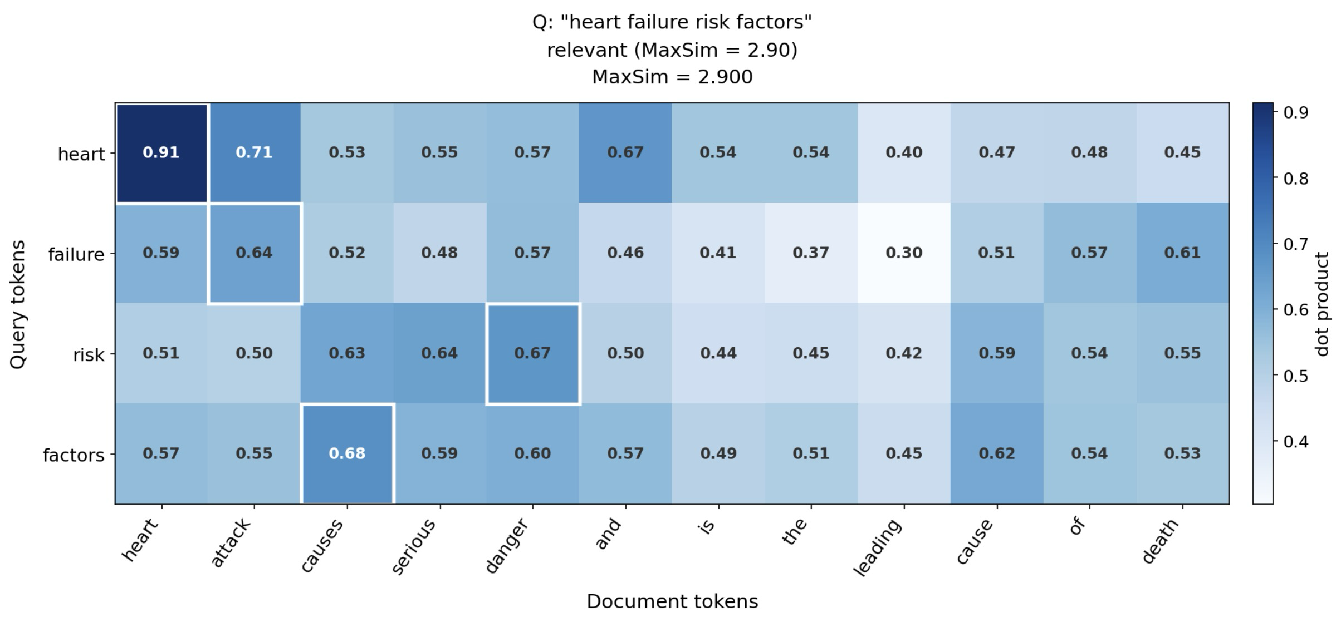
f_{ColBERT} combines lexical certainty with semantic expansion/disambiguation
Query: ”heart failure risk factors”
Document: “heart attack causes serious danger and is the leading cause of death”

Slide 12
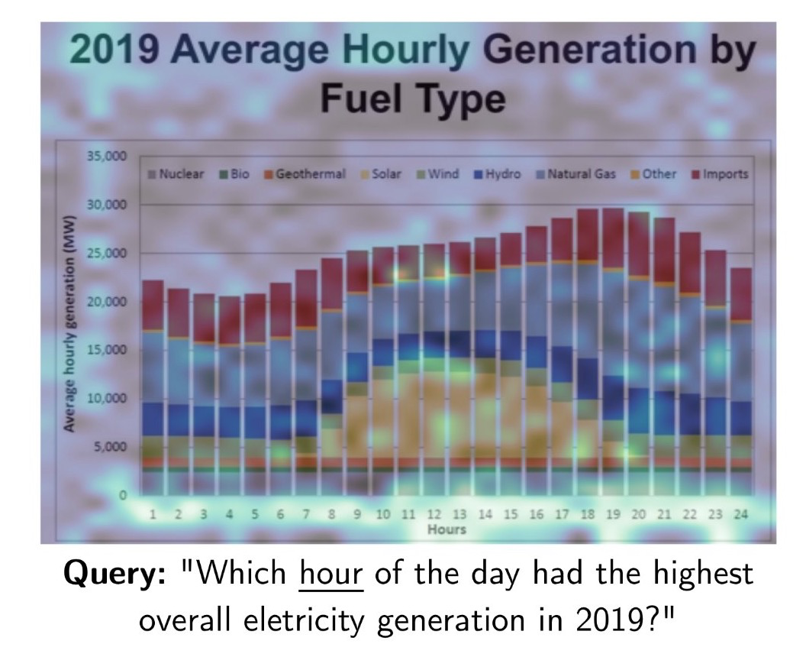
Even in visual document settings, approximating attention-like heatmaps
[ColPali - Faysse et al. 2024]

Slide 13
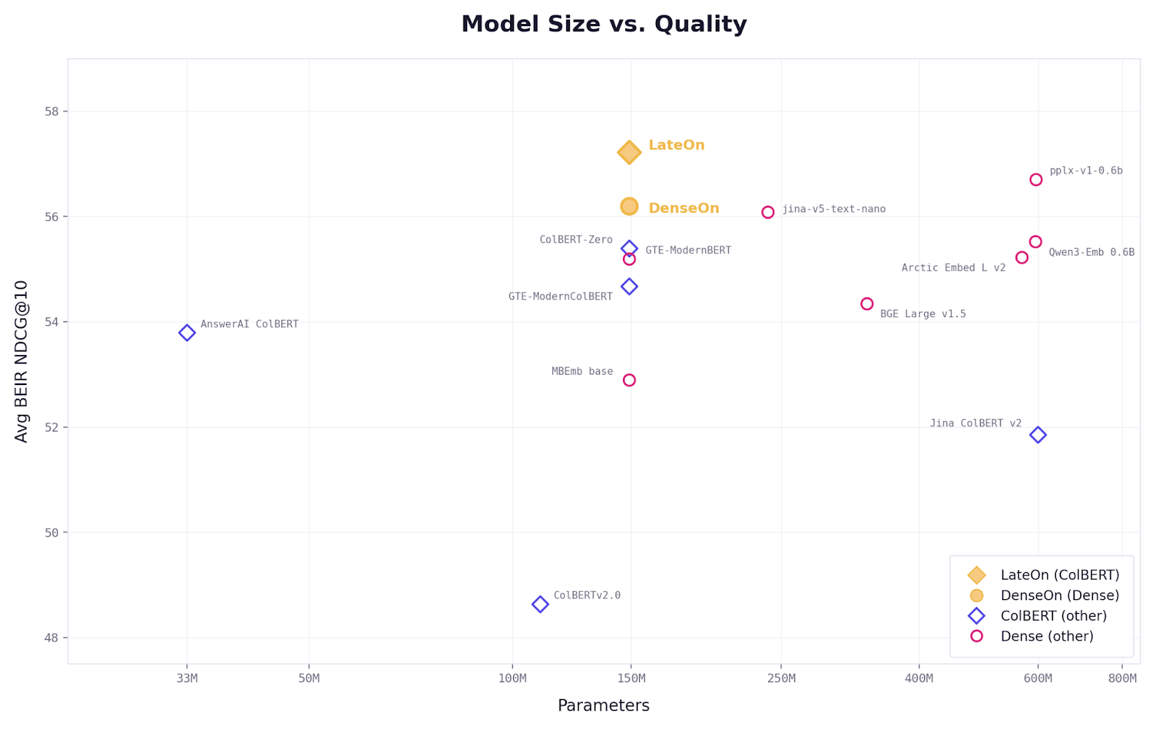
Identically trained multi-vector model does better on BEIR OOD text benchmark
Multi-vector retrievers punch above their parameter size
and generalize better than single-vector alternatives!
They also generalize better on cross/multi-lingual tasks
And with only 150M parameters beat even 8B parameter single-vector models as an agent search tool

Slide 14
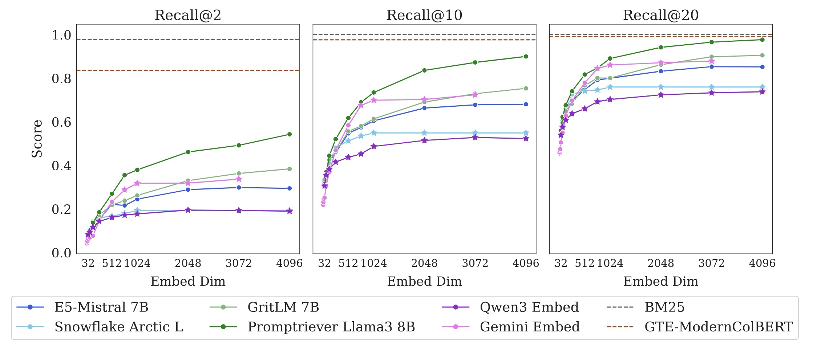
Weller et al. show with a small synthetic dataset (n=46) that single-vector embeddings are inherently limited
Single vector embeddings cannot properly rank candidates under combinatorially many information needs. Keyword search & ColBERT can.
[LIMIT - Weller et al. 2025]

Slide 15
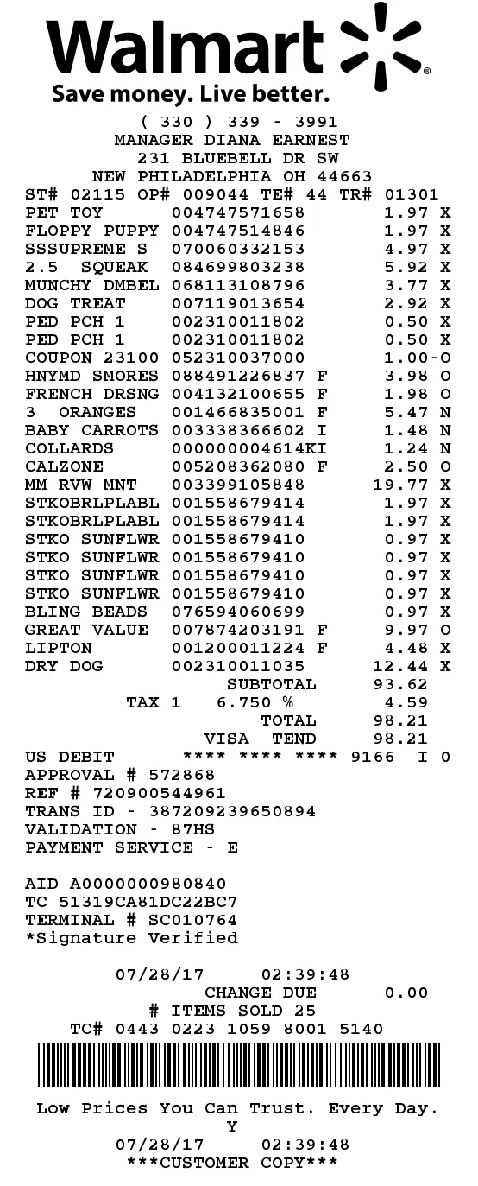
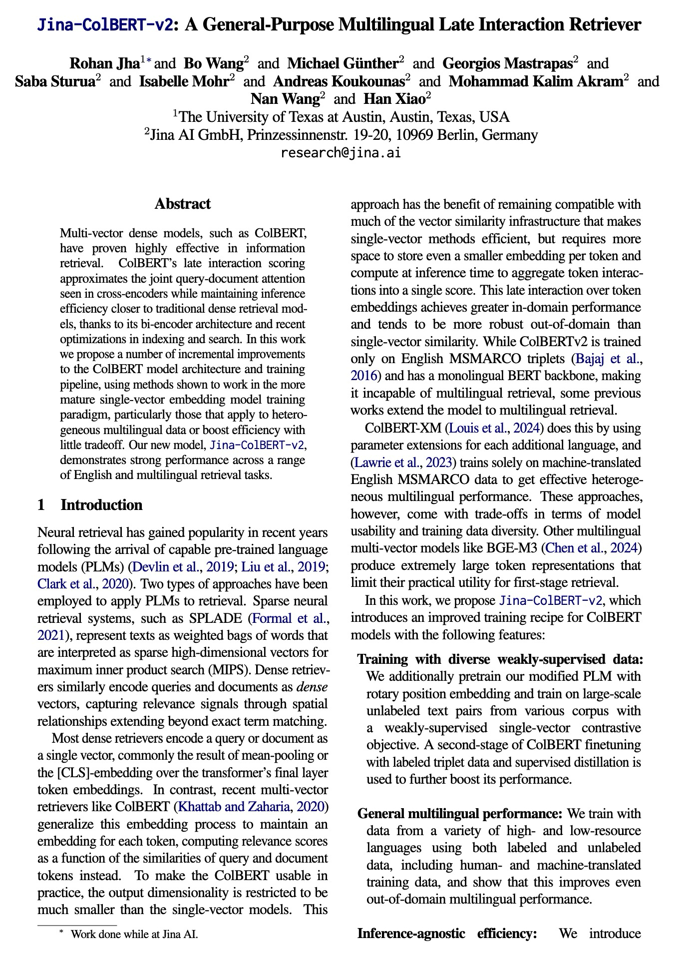
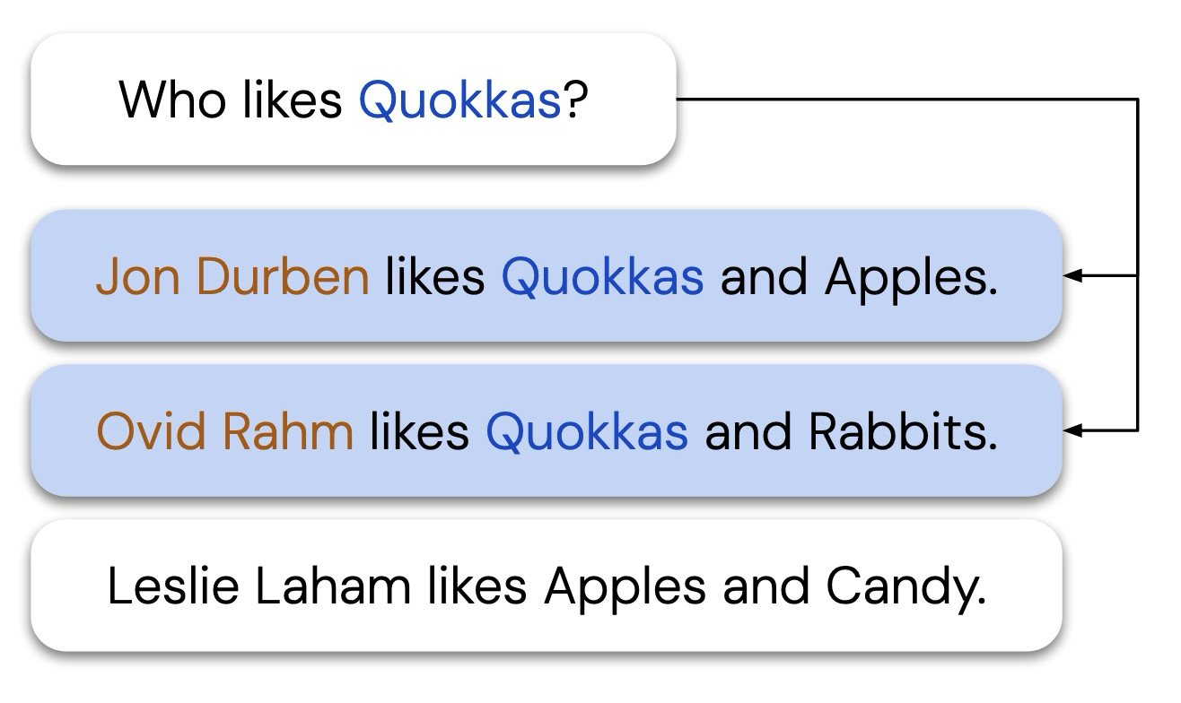
LIMIT is synthetic, but real data that is dense with heterogenous information (relevance) is common
Companies severely impacted by COVID?
suspicious purchases on company card
Retrievers that evaluate on BEIR?
[LIMIT - Weller et al. 2025]

Slide 16
Why is multi-vector retrieval better?
  Scales capacity approximately with information
  Generalizes (above not instead of) surface lexical features
  Doesn’t assume or flatten relevance info distribution
No forced commitment
under fixed capacity

Slide 17
1 / 2
2 / 2
Representation
Mechanism
What's the right way to encode a document to meet real retrieval needs?
How do we make these rich representations retrievable at scale?
Architecture, Scoring, Training
Generalization & Benchmarks
Index Size (↓)
Query Latency (↓)

Slide 18
Index Size (↓)
Query Latency (↓)
[AGC - Qin… Jha, et al. 2026]

Slide 19
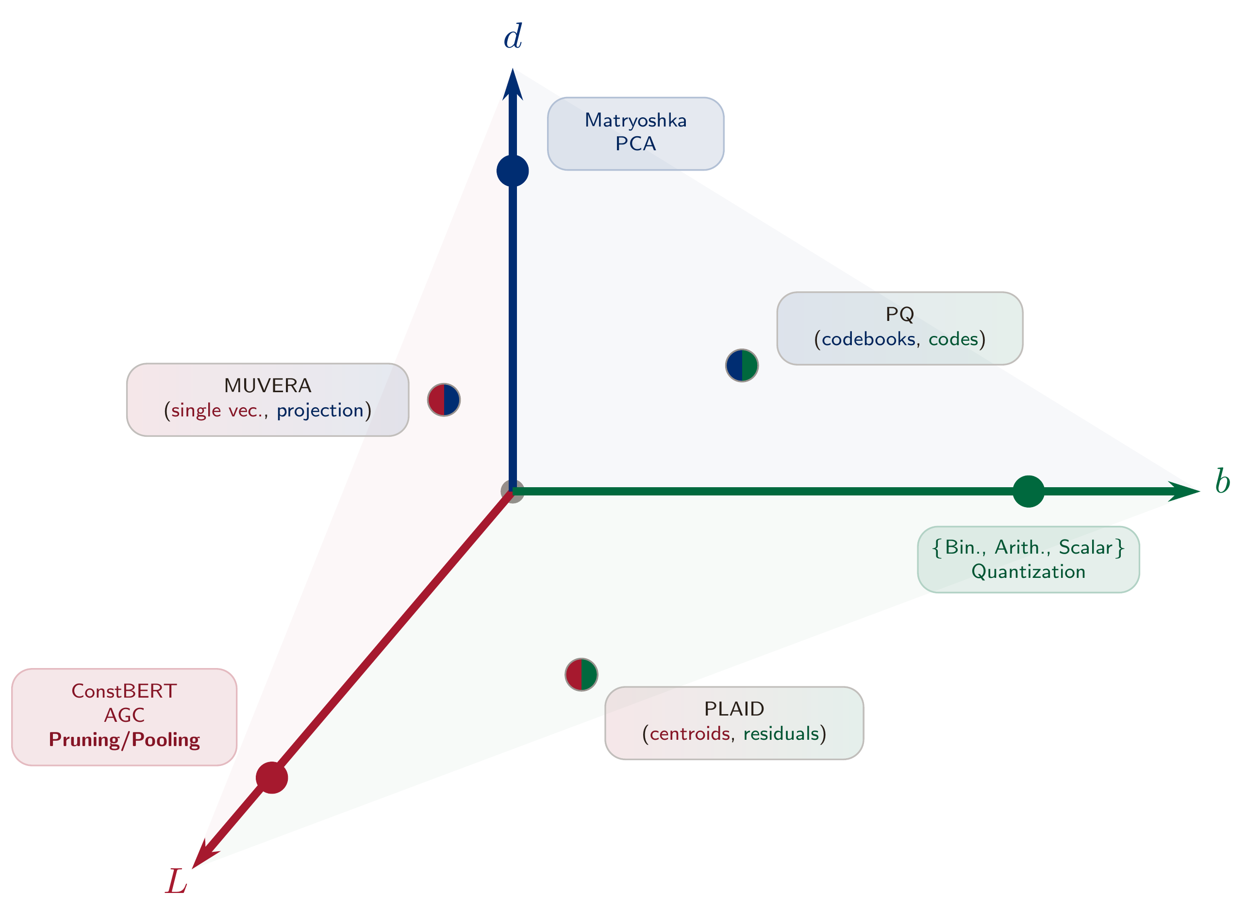
vector dimension
Index Size
~ O(dbL)
value size
Collection | Size
MS MARCO (8.9M text passages) | 150 GB
ViDoRe V3 (26K Multilingual PDFs) | 8.8 TB
YouTube (14B videos) | 140 PB
sequence length

Slide 20
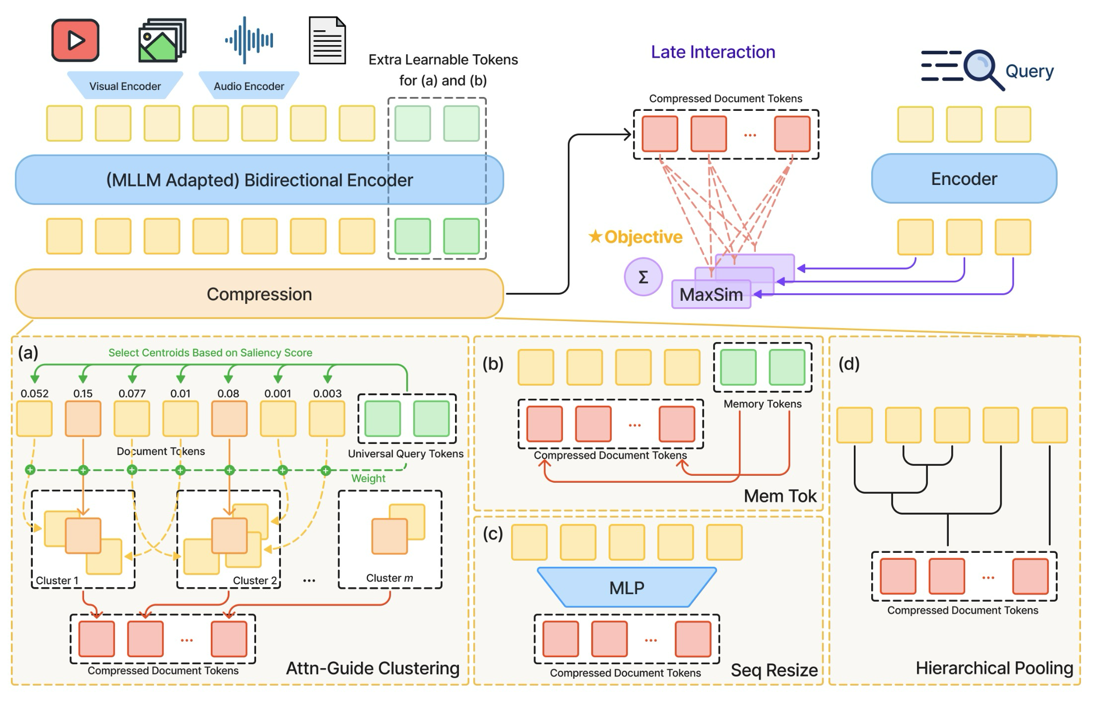
Bidirectional Encoder
Compression

Slide 21
[ConstBERT - MacAvaney et al. 2025]

Slide 22
[MetaEmbed – Xiao et al. 2026]

Slide 23
[Clavié et al. 2024]

Slide 24
(Ours)
[AGC - Qin… Jha, et al. 2026]

Slide 25
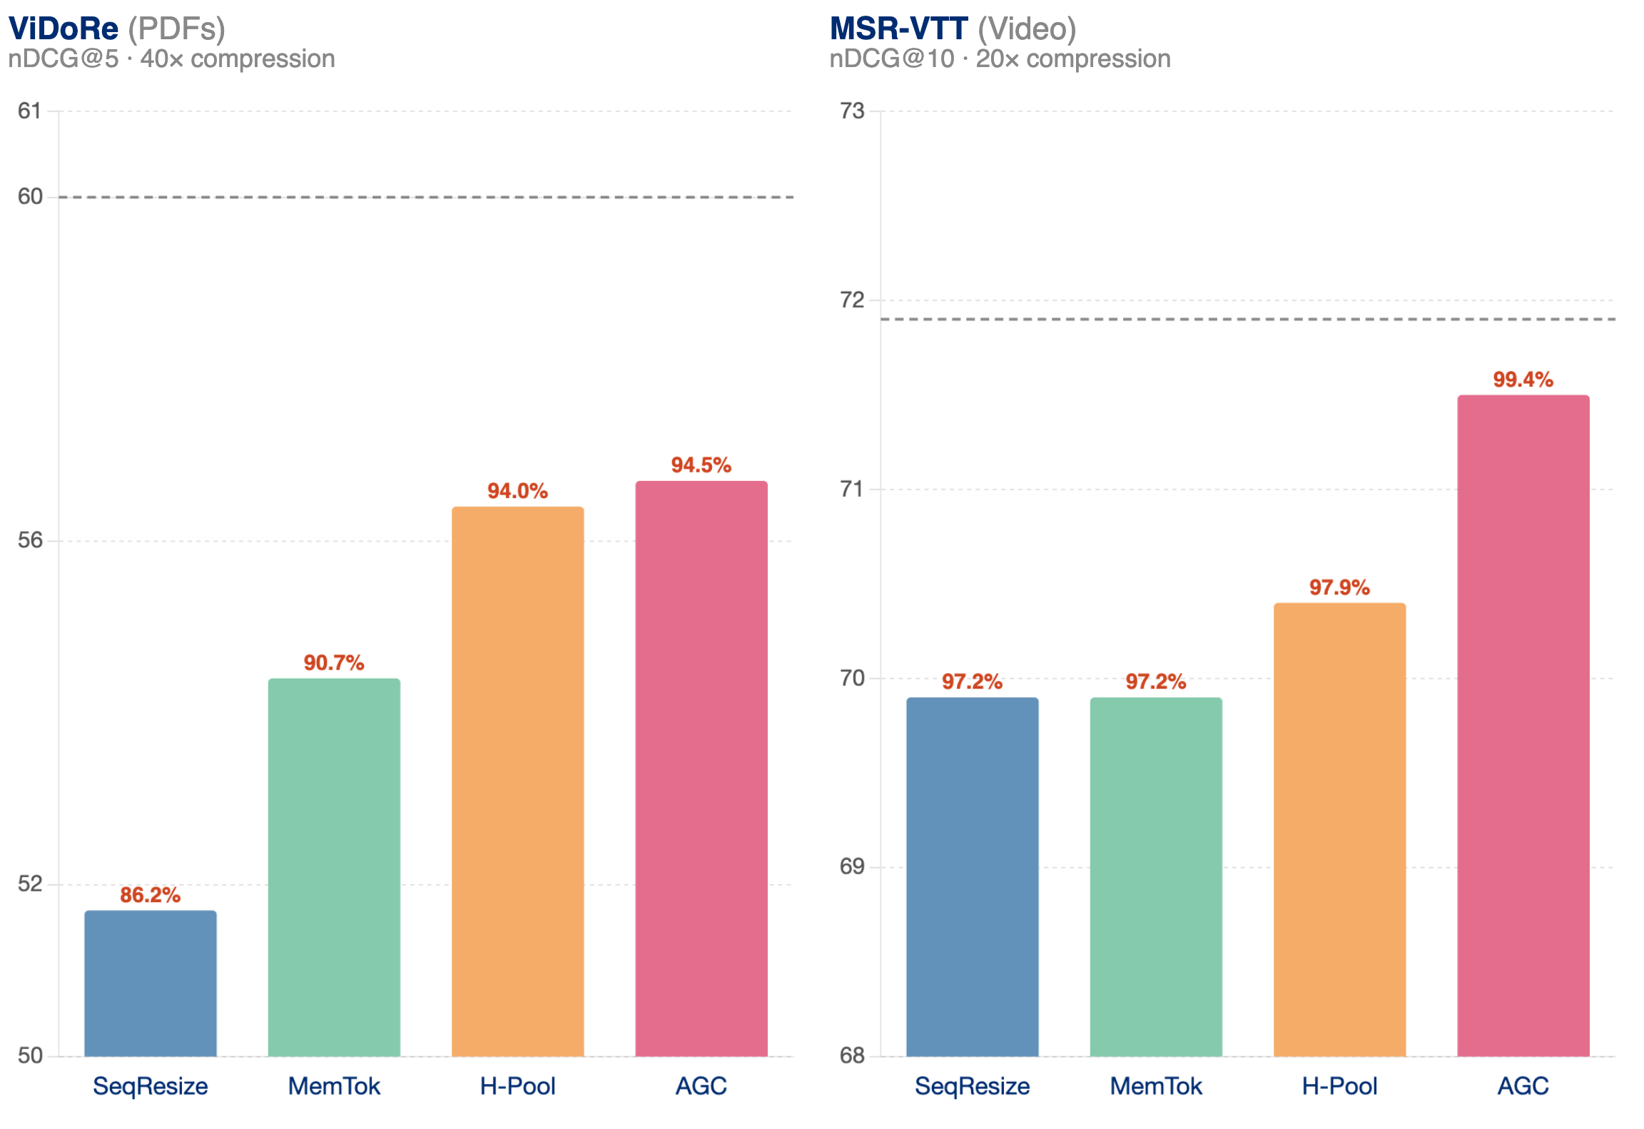
You can compress your vectors heavily, preserving most of their performance
Baseline
Baseline
Only 0.6% drop
at 20x compression
[AGC - Qin… Jha, et al. 2026]

Slide 26
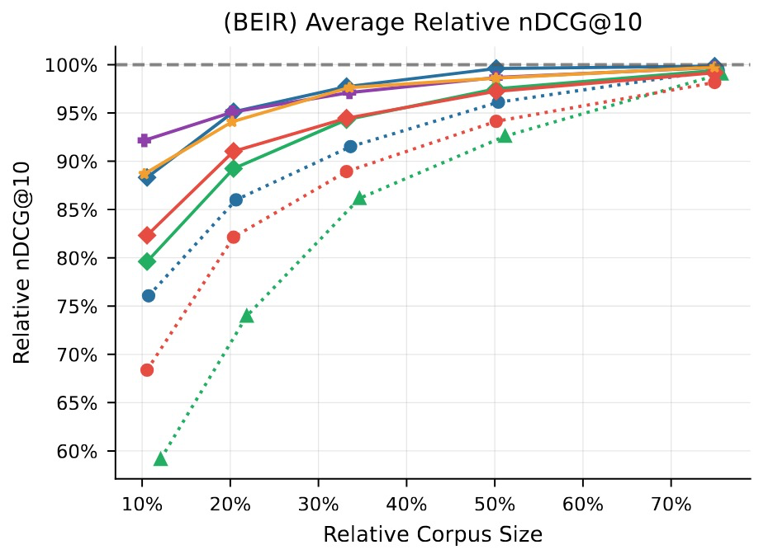
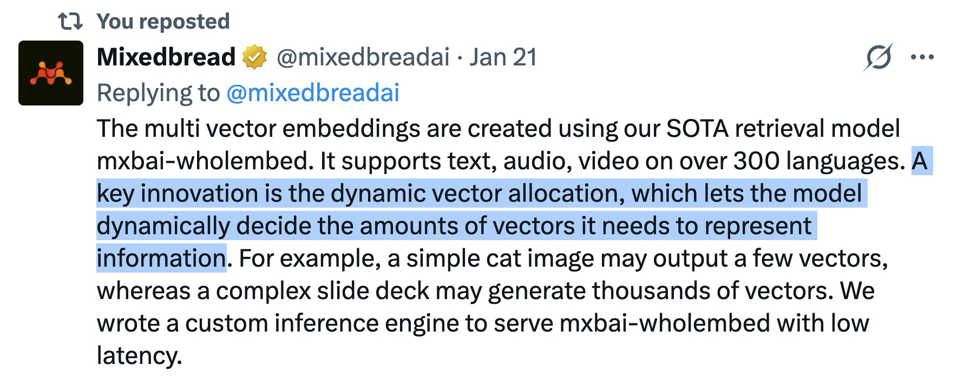
Pooling methods’ budget isn’t fixed at train time…
… and they don’t discard information as readily as pruning.
But a fixed compression budget/factor for every document is still a bit Procrustean!
Higher score and smaller corpus is better
[A Brief Comparison… Jha et al. 2026; Mixedbread AI – Twitter, 2026]

Slide 27
Index Size (↓)
Query Latency (↓)
[XTR Replicability – Jha et al. 2026]

Slide 28
We have token-level representations but want document-level scores
q₀
Candidate Generation
D₆₂₃
D₀₄₇
D₄₉₆
D₈₃₁
D₁₁₃
D₇₀₃
D₀₂₈
D₅₅₉
D₃₈₄
D₂₆₆
q₁
doc_496 : 26.25
MaxSim Scoring
doc_113 : 22.47
q₂
doc_028 : 20.88
q…
doc_623 : 16.04
get_embs()
q_{n}
search()
final doc scores
query token vectors
candidate document ids
Document Tokens

Slide 29
Original ColBERT Retrieval
q₀
Candidate Generation
D₆₂₃
D₀₄₇
D₄₉₆
D₈₃₁
D₁₁₃
D₇₀₃
D₀₂₈
D₅₅₉
D₃₈₄
D₂₆₆
q₁
doc_496 : 26.25
MaxSim Scoring
doc_113 : 22.47
q₂
doc_028 : 20.88
q…
doc_623 : 16.04
get_embs()
get_embs(D_{i})
search(q_{i}, k’)
q_{n}
search()
final doc scores
query token vectors
candidate document ids
Vector Index
ANN index
on document tokens
[ColBERT – Khattab & Zaharia, 2020]

Slide 30
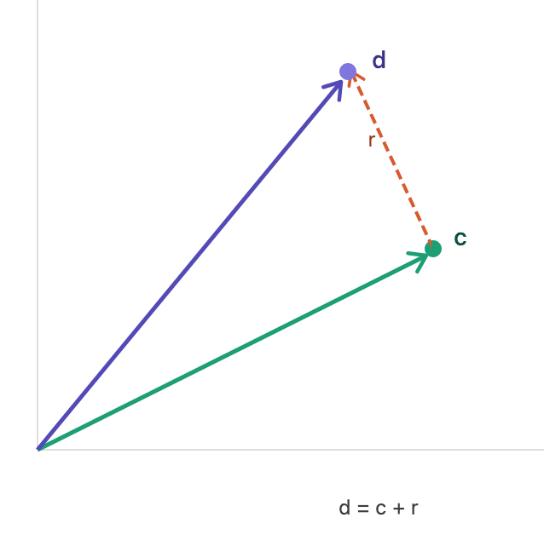
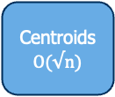
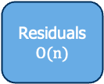
PLAID Retrieval
q₀
Candidate Generation
D₆₂₃
D₀₄₇
D₄₉₆
D₈₃₁
D₁₁₃
D₇₀₃
D₀₂₈
D₅₅₉
D₃₈₄
D₂₆₆
q₁
doc_496 : 26.25
Approx -> Full
MaxSim Scoring
doc_113 : 22.47
q₂
doc_028 : 20.88
q…
get_residuals(D_{i})
doc_623 : 16.04
search(q, n_{probe})
get_centroids(D_{i})
final doc scores
q_{n}
query token vectors
Centroids
$$O(√n)$$
Residuals
$$O(n)$$
[PLAID – Santhanam et al. 2022]

Slide 31
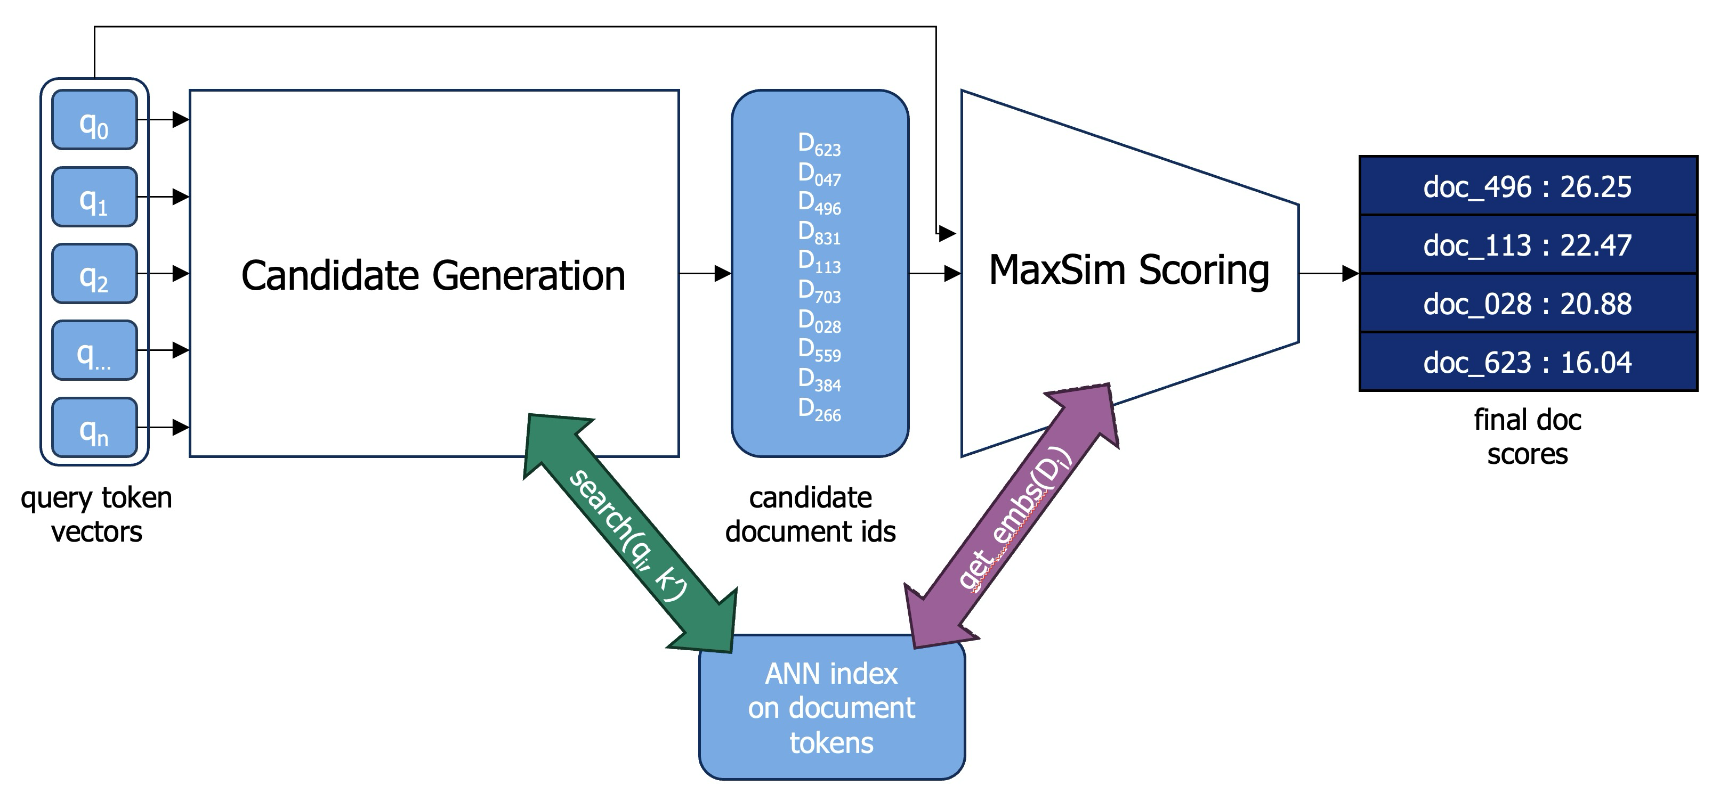
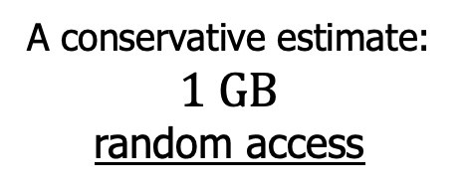
Original ColBERT Retrieval’s Costly Gather
get_embs(D_{i})
How expensive is ?
A conservative estimate: $1 GB$
random access

Slide 32
XTR Retrieval
q₀
Candidate Generation
D₆₂₃ : 0.91
D₀₄₇ : 0.87
D₄₉₆ : 0.94
D₈₃₁ : 0.78
D₁₁₃ : 0.83
D₇₀₃ : 0.96
D₀₂₈ : 0.72
D₅₅₉ : 0.88
D₃₈₄ : 0.81
D₂₆₆ : 0.75
q₁
doc_496 : 26.25
Approx.
doc_113 : 22.47
q₂
MaxSim
Scoring
doc_028 : 20.88
q…
doc_623 : 16.04
get_embs(D_{i})
q_{n}
search(q, k’)
final doc scores
query embs
candidate docids & token scores
ANN index
on doc embs
[XTR – Lee et al. 2023]

Slide 33


How can we get the full f_{ColBERT}(Q,D) without loading D’s embeddings?
s₂
s₂
= search($q_{i},k’=2$)
Impute document D’s missing q_{i} score as the minimum score retrieved anywhere for q_{i}
= get_embs($D$)
[Figs adapted from Lee et al. 2023]

Slide 34
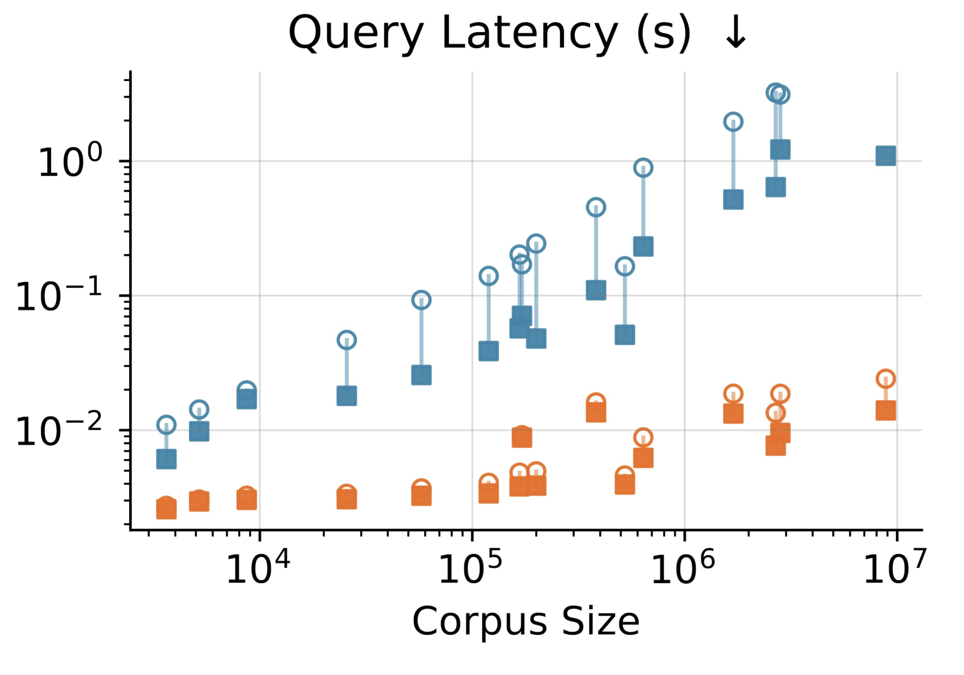
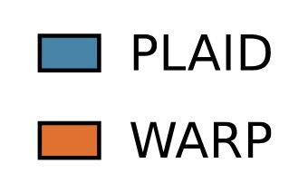
WARP = XTR + PLAID
[XTR Replicability – Jha et al. 2026]

Slide 35
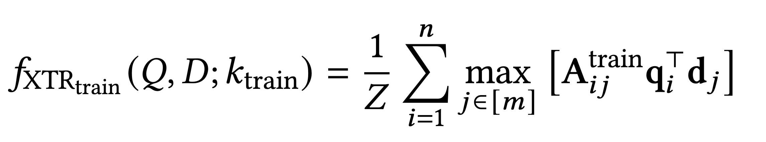


Q_{i}
D⁺
D⁻
…
D⁻
To achieve this sparser matching, XTR training requires a modification to “practice how you play” by masking tokens that aren’t “retrieved” in-batch
Q_{i}
D⁺
D⁻
…
D⁻
Q_{i}
D⁺
D⁻
…
D⁻
Q_{i}
D⁺
D⁻
…
D⁻
In-batch retrieval sparsity
0.3
0.7
0.9
0.4
0.2
0.5
0.3
0.2
0.3
0.2
0.4
0.1
0.5
0.9
0.6
0.7
$$K_{train}=3$$

Slide 36

Q_{i}
D⁺
D⁻
…
D⁻
To achieve this sparser matching, XTR training requires a modification to “practice how you play” by masking tokens that aren’t “retrieved” in-batch
Q_{i}
D⁺
D⁻
…
D⁻
Q_{i}
D⁺
D⁻
…
D⁻
Q_{i}
D⁺
D⁻
…
D⁻
In-batch retrieval sparsity
0
0.7
0.9
0
0
0.5
0.3
0.2
0
0
0
0
0
0.9
0.6
0.7
$$K_{train}=3$$

Slide 37
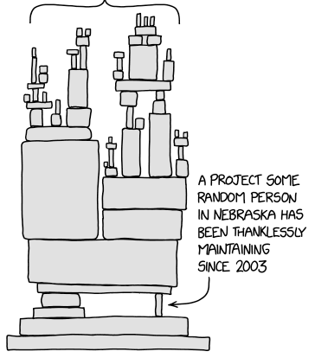
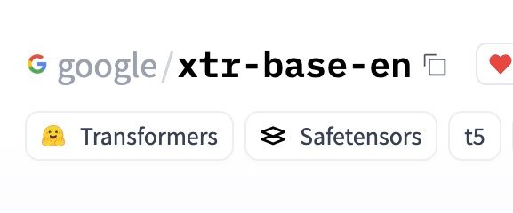

Motivation for Replication
All XTR follow-up
works & conclusions
MISSING
Paired ColBERT baseline
1st party / functioning training code
Modern trained/evaluated XTR
[XKCD 2347]

Slide 38
Is XTR a “Free Lunch”?
Setting | XTR | ColBERT
Theirs I (base, contrastive) | 49.1 | 46.8
Theirs II (large, contrastive) | 52.7 | 50.8
Ours I (small, contrastive) | 48.1 | 49.4
Ours II (base, distillation, IVF) | 48.2 | 48.6
We don’t replicate XTR’s 2 point nDCG@10 improvement over ColBERT
The opposite seems more intuitive:
XTR is an explicit approximation of ColBERT

Slide 39
Modernizing XTR: Distillation + IVF indices
XTR training achieves:
Consequence:
Usable performance with WARP
Must XTR-train for WARP efficiency

Slide 40
Modernizing XTR: Distillation + IVF indices
XTR training achieves:
Consequence:
Similar precision ranking-based performance to ColBERT with PLAID
XTR training doesn’t hurt PLAID-only pipeline

Slide 41
Modernizing XTR: Distillation + IVF indices
XTR training achieves:
Consequence:
Similar recall performance to ColBERT + PLAID with just WARP
Efficiency gains as a first stage that’s reranked

Slide 42

Token Retrieval : Behavior Changes
$$P(Gold | Token@k) ↑$$
XTR-trained models are more likely to retrieve tokens from gold relevant documents at any given rank

Slide 43

Token Retrieval : Lower Lexical Matching
$$P(Lexical | Token@k) ↓$$
XTR retrieved document tokens are less likely to be exact lexical matches with the query token
”what is the usual pay for stock associates at michaels?”
Rank | ColBERT | XTR
1 | usual | usual
2 | usual | usual
5 | usual | average
50 | usual | avg
100 | usual | average
[Table adapted from XTR – Lee et al. 2023]

Slide 44
Token Retrieval : Efficiency Impacts
ColBERT → XTR
XTR training also improves the skewed score distribution, making discrimination easier
Which has a direct effect on retrieval latency via candidate set size

Slide 45
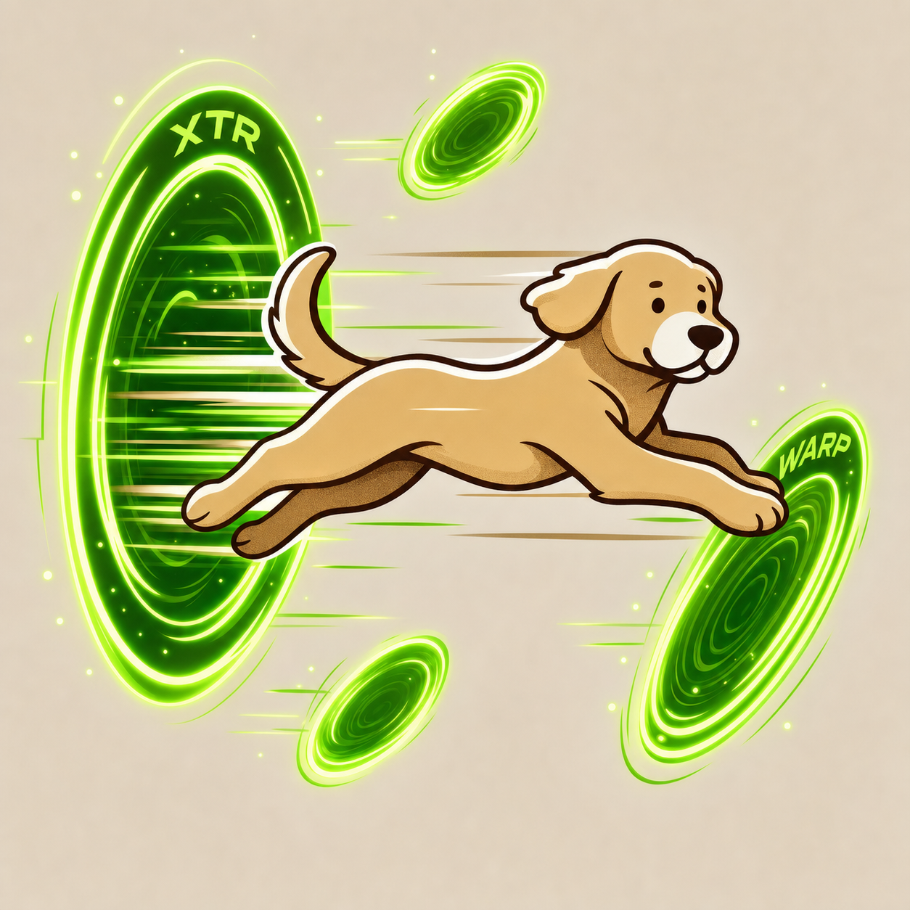


Try It Yourself!
Unified API for XTR/ColBERT
  Training (contrastive & distillation)
  Retrieval (ColBERT, XTR, PLAID, WARP)
  2 LOC change ColBERT → XTR
Trained XTR models
  robro612/xtr-replicability
  Coming soon:
    XTR-Zero
    LateOn-XTR
    Multimodal XTR
PyLate v1.5.0
Code
Models
[PyLate - Chaffin & Sourty, 2025]

Slide 46
Why is multi-vector retrieval better?
No forced commitment
under fixed capacity
It’s easier to gain efficiency than effectiveness after the fact

Slide 47
1 / 2
2 / 2
Representation
Mechanism
What's the right way to encode a document to meet real retrieval needs?
How do we make these rich representations retrievable at scale?
Architecture, Scoring, Training
Generalization & Benchmarks
Index Size (↓)
Query Latency (↓)

Slide 48
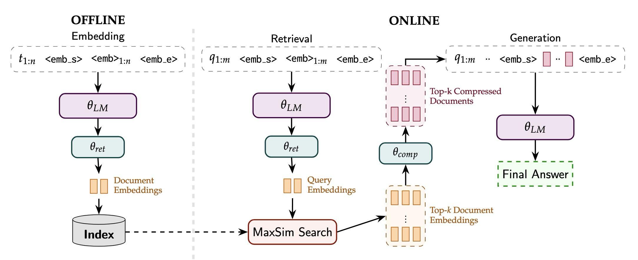
Multi-Vector Retrieval for…
Unified Retrieval and Generation Representations
Jointly optimizing token representations for retrieval and generation saves an expensive prefill step of “reading” the content into LLM context
[X-RAG – Cheng et al. 2024; CLaRa – He et al. 2026; Figure from Killingback et al. 2026]

Slide 49
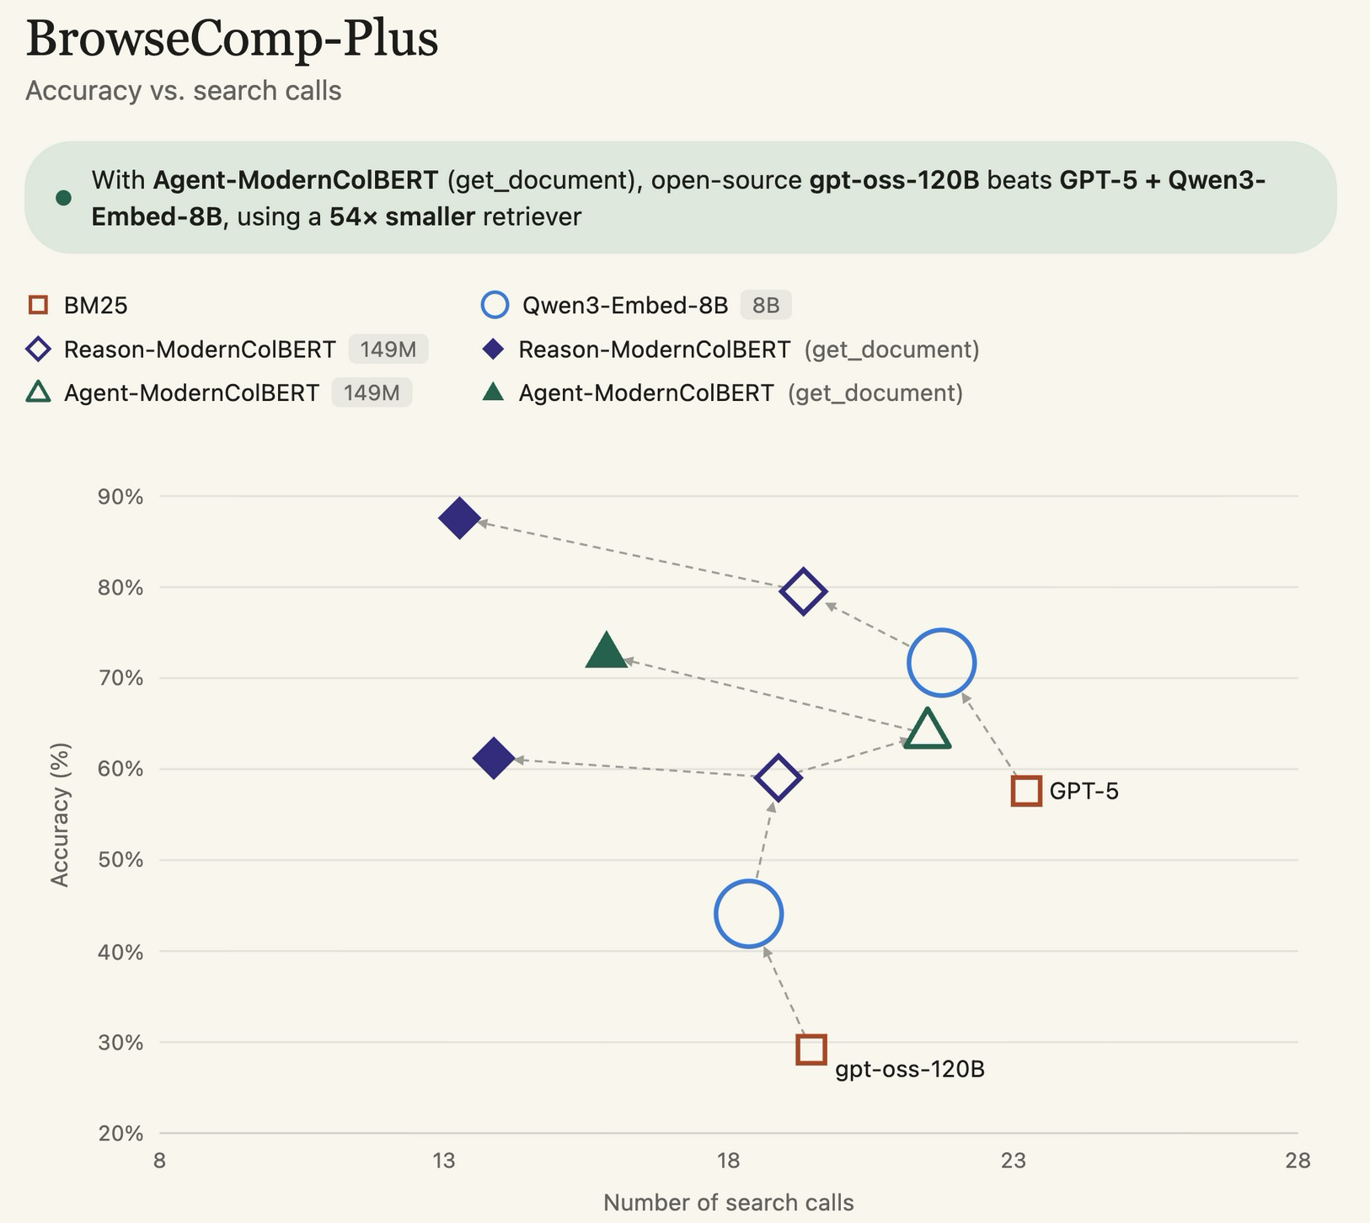
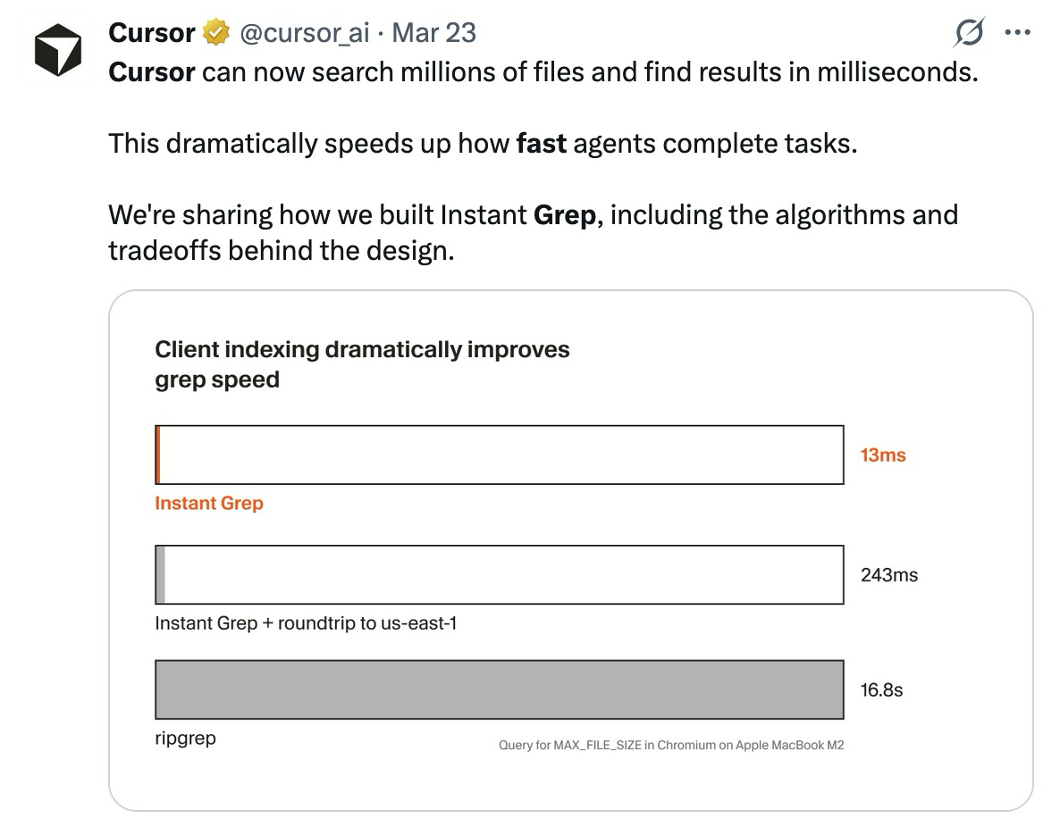
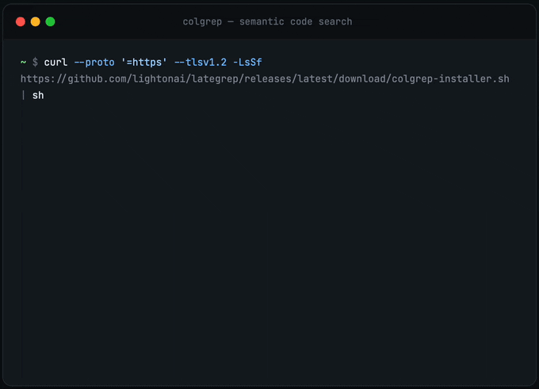
Multi-Vector Retrieval for…
Agent-Optimized Search Tools
150M param multi-vector retrievers are outperforming 8B single-vector on agentic search tasks
But frontier models/harnesses are over-relying on grep when stronger tools exist
Harness flexibility 🤝🏼 tool expressivity
[BC+ & ColGrep - LightOn AI, 2026; Fast Regex Search – Cursor, 2026]

Slide 50

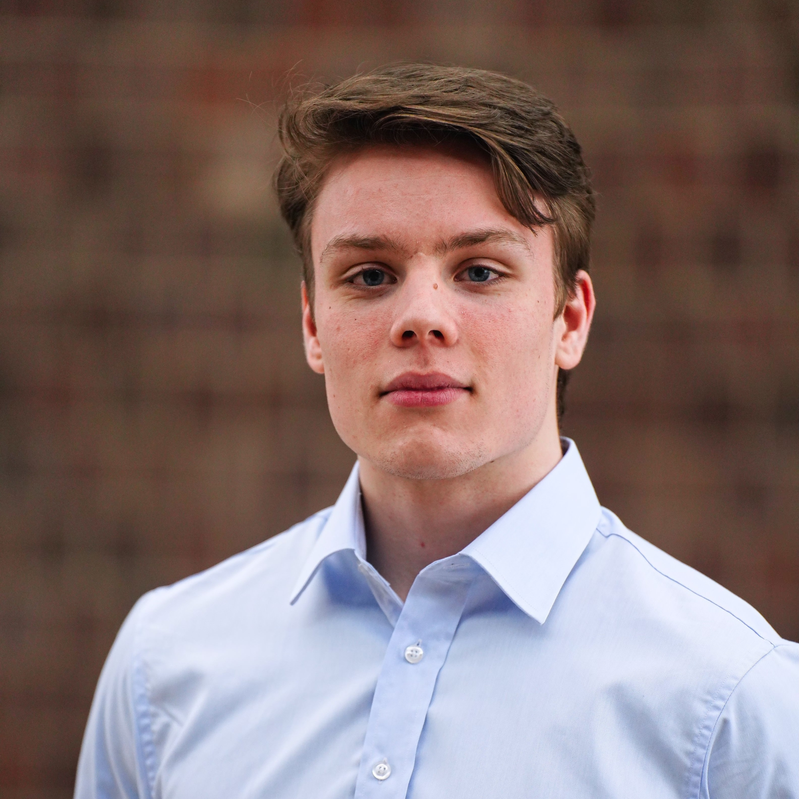



Thanks for Listening!
What's the right way to encode a document to meet real retrieval needs?
Multi-vector embeddings!
How do we make these rich representations retrievable at scale?
Compression + IVF indices + XTR
What’s next?
Tighter integration with generation
https://www.cs.jhu.edu/~rjha5/
Hanxiang Qin is on the job market!

