Slide 1
Moving on from OntoNotes: Coreference Resolution Model Transfer
Patrick Xia and Benjamin Van Durme
Notes:
Hello, I’m Patrick, and I’ll be presenting Moving on from OntoNotes: Coreference Resolution Model Transfer. This is work done at Johns Hopkins University with Ben Van Durme.

Slide 2
Background: Coreference Resolution
Determine which spans of text refer to the same entity
antecedent
Hong Kong Wetland Park, which is currently under construction, is also one of the designated new projects of the Hong Kong government for advancing the tourism industry.
This is a park intimately connected with nature, being built by the Hong Kong government for its people who live in a city of reinforced concrete.
mention span
Notes:
In coreference resolution, the task is to identify spans of text within documents that refer to the same entity, thereby forming clusters. In this example, we’ve highlighted some possible spans and the mention span “This” in orange refers to “Hong Kong Wetland Park.” Note that annotating for coreference is challenging because, naively, all pairs of spans need to be labeled.

Slide 3
Background: Dataset Differences
Annotation type:
Singletons
Entity types
And Jo shook the blue army sock till the needles rattled like castanets, and her ball bounded across the room.
Only coreferring mentions (OntoNotes)
Notes:
To simplify annotations, some datasets restrict the set of markable spans. The two main differences are how different guidelines handle singletons and entity types. Singletons are clusters of size 1, and in OntoNotes, these are not marked.

Slide 4
Background: Dataset Differences
Annotation type:
Singletons
Entity types
And Jo shook the blue army sock till the needles rattled like castanets, and her ball bounded across the room.
All mentions, including singletons (ARRAU)
Notes:
On the other hand, in the ARRAU dataset, all singletons are indeed marked. Furthermore, the ARRAU annotation guideline is broad: it covers all types of nouns and annotates fine-grained relations between pairs of noun phrases.

Slide 5
Background: Dataset Differences
Annotation type:
Singletons
Entity types
And Jo shook the blue army sock till the needles rattled like castanets, and her ball bounded across the room.
Only certain ACE entity types (LitBank)
Notes:
Meanwhile, some datasets, often domain-specific ones, are only focused on how coreference can be useful for downstream inference. Under this setting, they only annotate certain entity types, like how LitBank includes certain ACE entity types. Or, they may only annotate arguments for event and relation extraction or those that appear across documents.

Slide 6
Background: Dataset Differences
Domain
And Jo shook the blue army sock till the needles rattled like castanets, and her ball bounded across the room.
Invisible Man is Ellison’s best known work, most likely because it was the only novel he ever published during his lifetime…
Literature
News
(1) In general, The term “employer” means with respect to any calendar year, any person who -
Legal
Notes:
In addition to differences in annotation guidelines, there is also inherently a difference in domain. This is a common problem in NLP. For example, one document could be from literature, another from news, and a third one from legal statutes.

Slide 7
Background: Dataset Differences
Domain
Language
Cross-lingual transfer of coreference resolution
And Jo shook the blue army sock till the needles rattled like castanets, and her ball bounded across the room.
Invisible Man is Ellison’s best known work, most likely because it was the only novel he ever published during his lifetime…
Literature
News
Notes:
Finally, coreference resolution is a core NLP task in all languages, although research and data annotation is heavily focused on English texts. Modeling improvements have been skewed towards English data, and so we are also interested in seeing how well these models transfer to other languages.

Slide 8
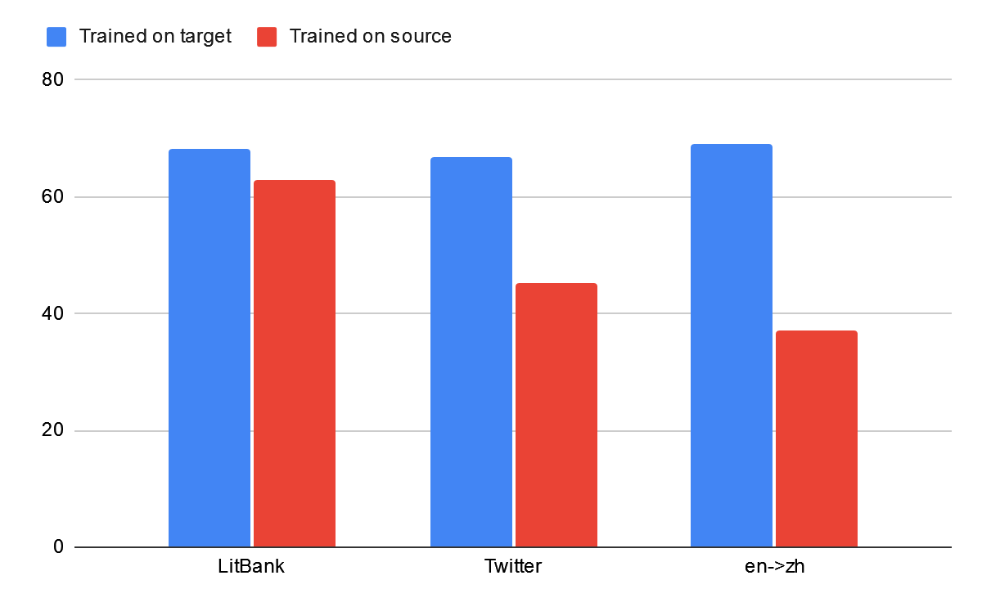
Background: Poor Transferability
Notes:
First, we present a motivating comparison of training an in-domain model against an off-the-shelf model trained on OntoNotes. Specifically, we can train a model purely on LitBank. Next, we can train a model on OntoNotes. When evaluated on LitBank, we see a performance drop, as measured by average F1. The same trend has been found with Twitter tweets. And, using a multilingual encoder, we can train a model in Chinese and one in English, and find that that zero-shot transfer performance is not particularly strong either.

Slide 9
Research Questions
Goal: reduce cost of creating a coref model on entirely new dataset
How effective is continued training for domain adaptation?
How to allocate annotated documents?
How much do source models forget?
Which encoder layers are important?
Notes:
However, our goal is to reduce the cost of training a coref model on a new domain, and a natural method of doing so is transferring a model via continued training.
This raises several questions. First, how effective is continued training for coreference resolution? We expect it to perform well, but no prior study has comprehensively studied the impact of continued training. Can it outperform in-domain training, and how many target documents do we need?
We ask additional questions considering several scenarios. For example, how many documents should be allocated for model selection? And, to what extent is there catastrophic forgetting? Finally, we explore whether we can get away with finetuning fewer encoder layers in the continued training setup, which would allow for quicker adaptation to new domains.

Slide 10
Methods: Source Models
Memory-efficient coreference model
Pretrained encoders only vs. fully-trained models
clusters
clusters
clusters
Linker
Linker
Linker
🎲
🎲
🎂
embeddings
VS.
embeddings
VS.
embeddings
Encoder
Encoder
Encoder
🎂
🎂
SpanBERT, Longformer, etc
text
SpanBERT-coref
text
text
Transfer model trained on source domain
Pretrained encoder only
Trained encoder only
Notes:
We explore this question by using a memory-efficient coreference model to accommodate datasets with long document lengths and consider three ways of initializing the model.
Typically a coref model consists of an encoder to encode the text. The encoder is not usually the focus of coref modeling. A linking coref model scores and ranks span embeddings, then scores and clusters pairwise spans, and there is a lot of prior work on better linking and clustering methods.
In the completely cold setup, we randomly initialize the linker and use off-the-shelf encoders, like SpanBERT or Longformer.
However, there are prior models released for coref – in particular, Joshi et al released a SpanBERT that has already been finetuned for OntoNotes coref. In this middle setting, we consider using that “baked” encoder instead, and randomly initialize the linker.
Finally, we illustrate the continued training setting. Here, we fully train the encoder and the linker and use that as a starting point for training on the target dataset.

Slide 11
Methods: Datasets
Source Datasets: OntoNotes, PreCo
Single domains: ARRAU (news), LitBank (books), SARA (legal), QBCoref (quiz questions)
Multi-lingual: OntoNotes (en, zh, ar), SemEval (ca, es, it, nl)
Notes:
As for data, our source datasets are OntoNotes and PreCo, both massive datasets covering a broad set of domains, although their annotation guidelines differ, and OntoNotes is license-requiring.
We consider additional, smaller, datasets that are more narrowly focused on different domains, like news, books, legal statutes, and quiz bowl questions. Not only are these domains different, their annotation guidelines also differ from the source datasets. These datasets are also substantially smaller than the source datasets.
Finally, we consider several non-English datasets in Chinese, Arabic, Catalan, Spanish, Italian, and Dutch. These are also relatively small datasets, although their annotation guidelines are similar to those of English OntoNotes.

Slide 12
Methods: Training
Use standard train/dev splits
Sample a subset of training set to simulate lower-data setting
Notes:
We use the standard train/dev splits for each of the datasets, and sample a subset of the training set to simulate a lower-data setting
This will let us plot curves of discovering when continued training is effective, because if we had infinite documents in the target dataset, we expect continued training to make little difference.

Slide 13
Research Question: How effective is continued training for domain adaptation in coref?
clusters
clusters
Linker
Linker
🎲
🎂
VS.
embeddings
embeddings
Encoder
Encoder
🎂
🎂
text
text
Off-the-shelf trained encoder only
Transfer model trained on source domain
Notes:
For the main question, we want to quantify the difference between retraining a model from off-the-shelf components and continued training from one of the source datasets.

Slide 14
RQ1: Continued training for domain adaptation
Transfer models usually outperform randomly initialized models
​PreCo is as effective as OntoNotes
PreCo is better with gold mention boundaries
Notes:
We find that model transfer is effective, usually outperforming the randomly initialized models by a substantial margin, especially in the low-data setting. In the figure below, we see the solid lines maintain a lead over the dashed lines until we have hundreds of documents.
We also find, perhaps surprisingly, that PreCo is as effective as OntoNotes. This is especially surprising for a dataset like ARRAU, which substantially overlaps in content with OntoNotes even though their annotations guidelines differ.
To level the playing field and account for the differences in marking singletons, we retrain both the PreCo and OntoNotes models with gold mention boundaries. But, we find that PreCo is generally even more effective when gold mention boundaries are provided.

Slide 15
Research Question: What’s better?
clusters
clusters
Linker
Linker
🎲
🎲
embeddings
VS.
embeddings
Encoder
Encoder
🎂
text
text
Untrained large encoder
Off-the-shelf trained small encoder
Notes:
Next, we consider the following scenario. Suppose we don’t have much training capacity, should we use a higher-capacity and newer encoder that needs to be finetuned from scratch, or should we use a publicly available encoder already finetuned for some version of coref?

Slide 16
RQ1: Pretraining and model size
Compare
SpanBERT (L): large unspecialized model ( + 🎲)
SpanBERT-On (b): small specialized model (🎂 + 🎲)
Continued training of small (publicly available) encoders is effective with low # training docs
Notes:
Specifically, we can compare SpanBERT large, which is a large unspecialized model against a finetuned SpanBERT base. We find that if the number of available documents in the target domain is small, using the pretrained encoder is effective. This suggests that as innovations improve the coref linking model, we can still reuse publicly available encoders, reducing the cost of first finetuning it on a larger coref dataset. However, with enough annotations, training with the large model would be preferred.

Slide 17
Additional Findings
Notes:
We have more detailed findings and analysis in the paper, next we’ll briefly highlight each of them.

Slide 18
RQ1: Continued training also improves cross-lingual transfer
Transfer model (🎂+🎂) outperforms XLM-R ( + 🎲)
Improves SOTA performance on cross-lingual coreference
Notes:
First, we use XLM-R, a strong multilingual encoder. We find that continued training consistently outperforms using an untrained XLM-R model as the encoder. This result attests to the powerful cross-lingual capabilities of multilingual encoders. Furthermore, we set fresh state-of-the-art benchmarks across many languages.

Slide 19
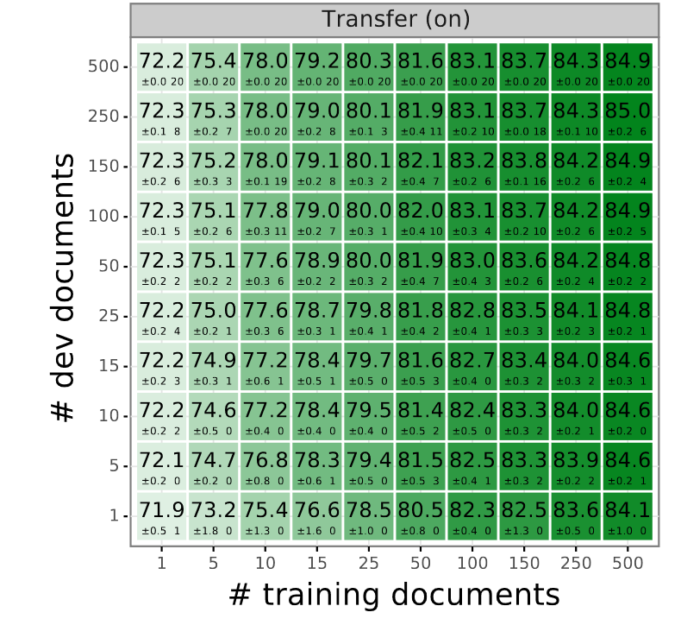
RQ2: How many documents should be in the dev set?
Answer: Increasing dev set from 5 to 500 documents only gains 0.3 F1
Notes:
Second, as our goal is to reduce the cost of training a coref model in a new domain, we look towards data efficiency. Since annotation is expensive, we asked how many documents should be allocated towards model selection. Across 20 runs, we simulate it using a small number of documents for model selection with a different number of training documents.
The answer is not obvious because for datasets like OntoNotes and PreCo, the dev set contains hundreds of documents. Meanwhile, many of the training datasets we studied in this work are not even that large. And, documents vary significantly in length, content, and types of coref annotated.
Nonetheless, we find that a small number, e.g. 5, is usually sufficient in the transfer setting and already reduces variance substantially. Thus, so more documents should be allocated towards training to improve performance.

Slide 20
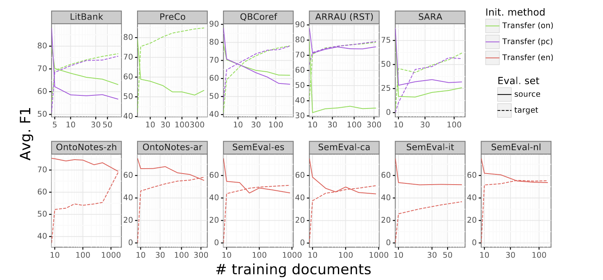
RQ3: How much do the models forget?
Largest drops:
Annotation guideline changes
Small(er) drops:
Cross-domain
Cross-lingual
Notes:
We also analyzed to what degree models experience catastrophic forgetting, to see whether models would be effective in a multitask-like setting. We find that the transferred models do drop substantially: the largest drops are likely due to annotation guideline changes, while there are comparatively smaller drops when transferring across domains or languages.

Slide 21
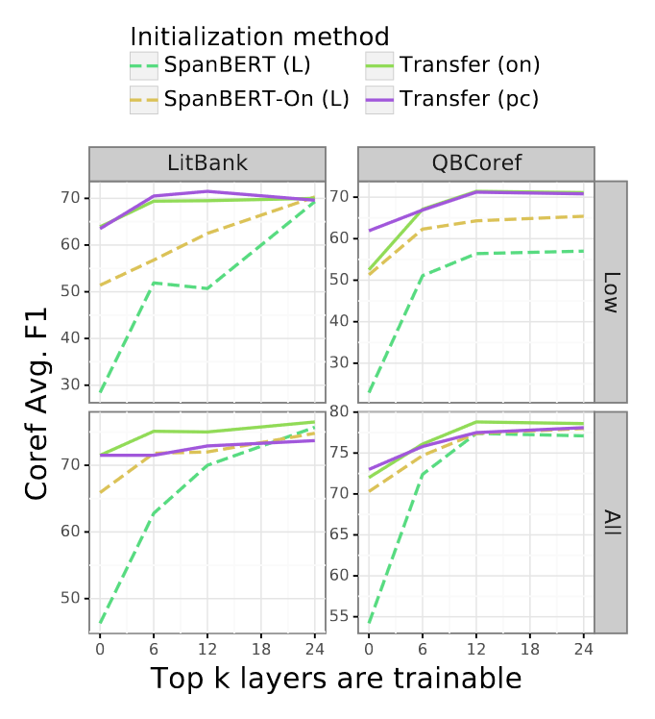
RQ4: Do we need to train the full encoder?
Answer:
For transfer (🎂+🎂) models, top 6-12 layers is probably enough
Not always true for other models
Notes:
Finally, we look towards training efficiency, and ask whether we need to finetune the entire encoder in continued training. The answer is no, the top half of the layers is probably enough regardless of how much target data there is. Note that this is not the case if we were training a randomly initialized linker!

Slide 22
Conclusions
Continued training is effective for coreference resolution:
Better overall performance
Good initial (zero-shot) performance
Cheaper training of new model
PreCo is as good as OntoNotes
OntoNotes requires a license
For coreference, use annotated documents for training
Fresh benchmarks on a wide set of datasets across domains and languages
Notes:
In conclusion, we find that continued training is an effective method for model transfer in coreference resolution. It achieves better overall performance and even good initial (zero-shot) performance. We also explored a variety of questions aimed at reducing the cost of training a new coref model.
Second, we find that for model transfer, training on PreCo is just as good as OntoNotes.
Third, we learn that we should prioritize annotations for training the model. And finally, we establish a new set of benchmarks on a several datasets across various domains and languages.

Slide 23
Questions? Come to poster session
Or email paxia@jhu.edu
Code/pretrained models at: https://nlp.jhu.edu/coref-transfer/
Notes:
Thank you, and if you have question, you can come to the poster session or email me.

