Slide 1
Incremental Neural Coreference Resolution in Constant Memory
Patrick Xia, João Sedoc, Benjamin Van Durme
Notes:
Hi, I’m Patrick and I’ll present this work with Joao Sedoc and Benjamin Van Durme on Constant Memory Coreference Resolution.

Slide 2
Outline
Background and Motivation
Algorithm and Model
Experiments and Results

Slide 3
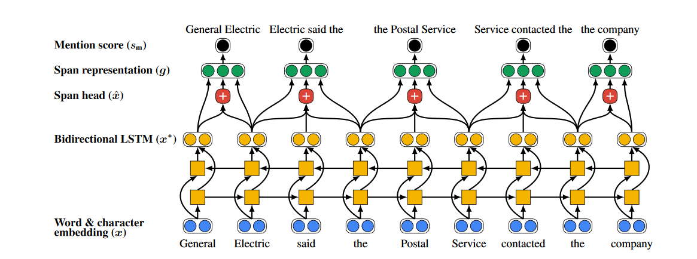
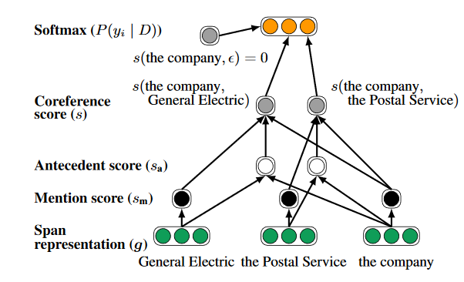
Background
Span Detection → Mention Pair Scoring (Lee et al., 2017)
Notes:
Neural models for coreference resolution consist of two stages: mention span detection and pairwise mention scoring. The span detection process embeds all possible spans of text up to a certain length and subsequently scores and ranks then.

Slide 4
Background
Span Detection → Mention Pair Scoring (Lee et al., 2017)
Notes:
Those exceeding a threshold score, usually a linear number with respect to the document length, are then scored pairwise, resulting in a possibly quadratic number of comparisons. In practice, the model aggressively prunes and this can be reduced to a linear number of expensive comparisons. The final scores matrix is then used in decoding, linking each span to its highest-scoring antecedent span.

Slide 5
Extensions
Higher-order resolution: re-score against cluster average (Lee et al., 2018)
ELMo/BERT/SpanBERT: Fine-tune pretrained encoders (Joshi et al., 2019)
“Machine reading comprehension” scorer (Wu et al., 2020)
Notes:
Further work has iterated on this concept by implementing smarter decoding techniques that aim for global cluster coherence, improving the input representation through better encoders like ELMo, BERT, or SpanBERT, or using an expensive reading comprehension scorer that better matches the training and finetuning data for encoders.

Slide 6
Motivation
For long documents (roughly >3000 tokens), GPUs run out of memory
The encoder is not always the bottleneck
Some documents (books) exceed 100K tokens
Model Loading
Encoder final layer + concat
Pairwise scoring
Memory Profile for a long document with model by Joshi et al., 2019
Notes:
However, all of these models suffer from space issues. For long documents, GPUs run out of memory. The bottleneck could be in a couple places: the encoder and embeddings themselves are big and the pairwise scorer uses, in theory, quadratic space.
This is not scalable to large, book-length documents

Slide 7
Some solutions…
Some fixes:
Sparse Transformer
Sequential pairwise scoring
… but they do not resolve:
Span ranking is linear in document size
All spans are needed in decoding
Even sparse Transformers need Ω(document size)
Notes:
Even if individual parts can be serialized or made more efficient via pruning or sparsification, the overall process of reading, span ranking, and decoding is still at least linear in document size

Slide 8
Outline
Background and Motivation
Algorithm and Model
Experiments and Results
Notes:
We propose a constant-memory algorithm.

Slide 9
Approach
Limited-memory incremental algorithm for coreference resolution (Webster and Curran, 2014)
Similar to shift-reduce algorithms
Neural components + explicit entity representations
Notes:
Our approach is similar to a limited-memory incremental algorithm from Webster and Curran, which itself is similar in style to shift-reduce algorithms used in parsing and other NLP tasks. Our approach uses modern neural components and keeps track of a fixed set of entities, whose representations are updated as more of the document is processed.

Slide 10
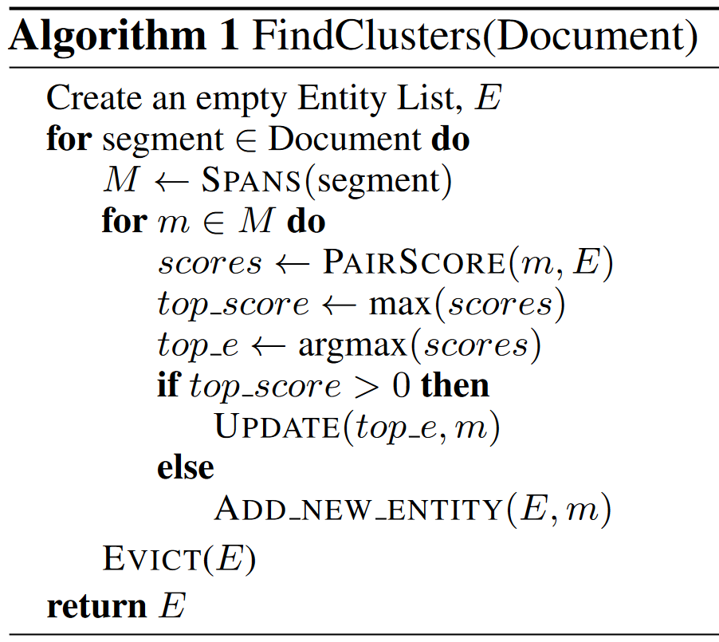
Entity List
Document
"Christmas won't be Christmas without any presents," grumbled Jo, lying on the rug.
"It 's so dreadful to be poor!" sighed Meg, looking down at her old dress.
Notes:
Here, we’ll walk through the main steps. We first initialize an empty list of entities. Each entity will be represented by a single embedding.

Slide 11
Entity List
Document
"Christmas won't be Christmas without any presents," grumbled Jo, lying on the rug.
"It 's so dreadful to be poor!" sighed Meg, looking down at her old dress.
Notes:
Next, we process the text segment by segment. Each segment fits within the window of a contextualized encoder.

Slide 12
Entity List
Document
"Christmas won't be Christmas without any presents," grumbled Jo, lying on the rug.
"It 's so dreadful to be poor!" sighed Meg, looking down at her old dress.
Notes:
We find and rank all the spans within a segment. Because we are limited just to this segment, our span detection and scoring is linear with respect to this segment size…
And since the segment size is a constant determined by the encoder, this is constant memory with respect to document length.

Slide 13
Entity List
Document
"Christmas won't be Christmas without any presents," grumbled Jo, lying on the rug.
"It 's so dreadful to be poor!" sighed Meg, looking down at her old dress.
Notes:
For each mention, we make a hard, greedy clustering decision with the entities in the entity list.

Slide 14
Entity List
{Christmas}
Document
"Christmas won't be Christmas without any presents," grumbled Jo, lying on the rug.
"It 's so dreadful to be poor!" sighed Meg, looking down at her old dress.
Notes:
The initial embedding of an entity in our entity list is the same as the span embedding. In this example, the Christmas entity will have the same embedding as the highlighted green Christmas span.

Slide 15
Entity List
{Christmas}
Document
"Christmas won't be Christmas without any presents," grumbled Jo, lying on the rug.
"It 's so dreadful to be poor!" sighed Meg, looking down at her old dress.
Notes:
We then move to the next mention span.
We score it against all the embeddings already in our entity list. If the score exceeds a threshold, we aim to attach it to the highest-scoring cluster. Otherwise, we add it as a new entity, like we did with Christmas the first time.

Slide 16
Entity List
{Christmas, Christmas}
Document
"Christmas won't be Christmas without any presents," grumbled Jo, lying on the rug.
"It 's so dreadful to be poor!" sighed Meg, looking down at her old dress.
Notes:
In this case, we will attach it to the preexisting Christmas span.
Each entity has a single embedding, so we need to update the embedding of the Christmas entity with the embedding of this second Christmas span. We can use an update rule like online averaging.

Slide 17
Entity List
{Christmas, Christmas}
Document
"Christmas won't be Christmas without any presents," grumbled Jo, lying on the rug.
"It 's so dreadful to be poor!" sighed Meg, looking down at her old dress.
Notes:
This continues for the entire segment, note that the remaining spans in this example would all score below the threshold and become their own entities.

Slide 18
Entity List
{Christmas, Christmas},
{any presents}
Document
"Christmas won't be Christmas without any presents," grumbled Jo, lying on the rug.
"It 's so dreadful to be poor!" sighed Meg, looking down at her old dress.
Notes:
This continues for the entire segment, note that the remaining spans in this example would all score below the threshold and become their own entities.

Slide 19
Entity List
{Christmas, Christmas},
{any presents}
Document
"Christmas won't be Christmas without any presents," grumbled Jo, lying on the rug.
"It 's so dreadful to be poor!" sighed Meg, looking down at her old dress.
Notes:
This continues for the entire segment, note that the remaining spans in this example would all score below the threshold and become their own entities.

Slide 20
Entity List
{Christmas, Christmas},
{any presents},
{Jo}
Document
"Christmas won't be Christmas without any presents," grumbled Jo, lying on the rug.
"It 's so dreadful to be poor!" sighed Meg, looking down at her old dress.
Notes:
This continues for the entire segment, note that the remaining spans in this example would all score below the threshold and become their own entities.

Slide 21
Entity List
{Christmas, Christmas},
{any presents},
{Jo}
Document
"Christmas won't be Christmas without any presents," grumbled Jo, lying on the rug.
"It 's so dreadful to be poor!" sighed Meg, looking down at her old dress.
Notes:
This continues for the entire segment, note that the remaining spans in this example would all score below the threshold and become their own entities.

Slide 22
Entity List
{Christmas, Christmas},
{any presents},
{Jo},
{the rug}
Document
"Christmas won't be Christmas without any presents," grumbled Jo, lying on the rug.
"It 's so dreadful to be poor!" sighed Meg, looking down at her old dress.
Notes:
This continues for the entire segment, note that the remaining spans in this example would all score below the threshold and become their own entities.

Slide 23
Entity List
{Christmas, Christmas},
{any presents},
{Jo},
{the rug}
Document
"Christmas won't be Christmas without any presents," grumbled Jo, lying on the rug.
"It 's so dreadful to be poor!" sighed Meg, looking down at her old dress.
Notes:
Between segments, we only need to remember the entities and their representations. However, the number of entities can grow, possibly linearly, with respect to the document.

Slide 24
Entity List
{Christmas, Christmas},
{any presents},
{Jo},
{the rug}
Document
"Christmas won't be Christmas without any presents," grumbled Jo, lying on the rug.
"It 's so dreadful to be poor!" sighed Meg, looking down at her old dress.
Notes:
So, at the end of each segment, we prune entities and evict them such that we maintain a fixed-size entity list.

Slide 25
Entity List
{Christmas, Christmas},
{Jo},
Document
"Christmas won't be Christmas without any presents," grumbled Jo, lying on the rug.
"It 's so dreadful to be poor!" sighed Meg, looking down at her old dress.
Notes:
Now we can continue this process for the full document, segment by segment. The eviction ensures that we carry only a fixed-sized entity list throughout.

Slide 26
Implementation
Encoder: SpanBERT
Spans: top-k spans based on learned scorer
PairScore: FFNN(m, e)
Update: learned average of spans
Evict: all old entities
Notes:
This algorithm is flexible. In our implementation for this paper, we reuse the components from Joshi et al, which was the easiest-to-adapt competitive system at the time.
We use SpanBERT, their top-k span scorer, and their feedforward architecture for scoring mentions. We initialize these modules with the parameters of their released model.
Our span update rule is an online weighted average of mention embeddings. These weights are predicted by a simple FFNN.
Our eviction policy is based on the distance between the entity and the current point in the document.
The entire model can be trained end-to-end. In this work, we do not update the SpanBERT parameters.

Slide 27
Outline
Background and Motivation
Algorithm and Model
Experiments and Results

Slide 28
Experiments
OntoNotes 5.0 (English)
Evaluated with average F1 (MUC, B³, and CEAF_{ϕ4})
Goal: compare performance between incremental algorithm vs. full-document model
Notes:
We experiment on the standard coreference resolution dataset, OntoNotes 5.0 and evaluate with the standard metrics. Our goal is to compare our incremental model to the batch model.

Slide 29
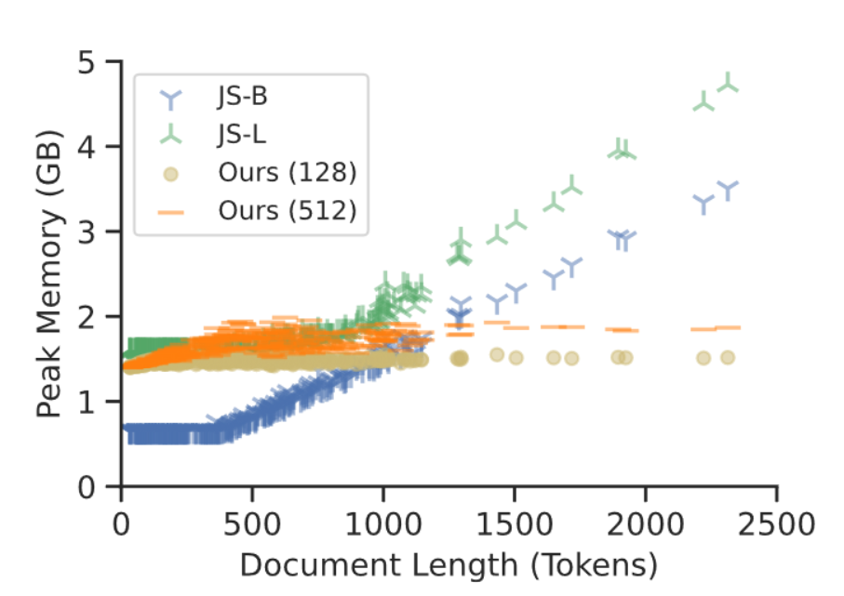
Results
79.6 F1 → 79.4 F1
Virtually no loss in performance
Constant space implementation at inference (2GB) and training (<10GB)
Our algorithm has O(1) space complexity
A fixed-sized set of entities kept across time
Notes:
In terms of task performance on the test set, we drop 0.2 points – this is only a tiny bit worse. We see the same drop even when we take out eviction. On single-speaker documents like newswire, we perform on par.
In terms of space, our implementation at inference uses 2GB of allocated tensors and has a clearly constant trend (and even at training we use under 10GB)
In practice, the baseline shown as JS-L in this chart, struggled to fit longer documents on our 11GB GPUs.
If it not hard to verify that our algorithm has O(1) space complexity with respect to document length, as the only memory we do need is the entity list.
Recall that the entity list is a fixed-sized set of entities that stores entities across the entire document…

Slide 30
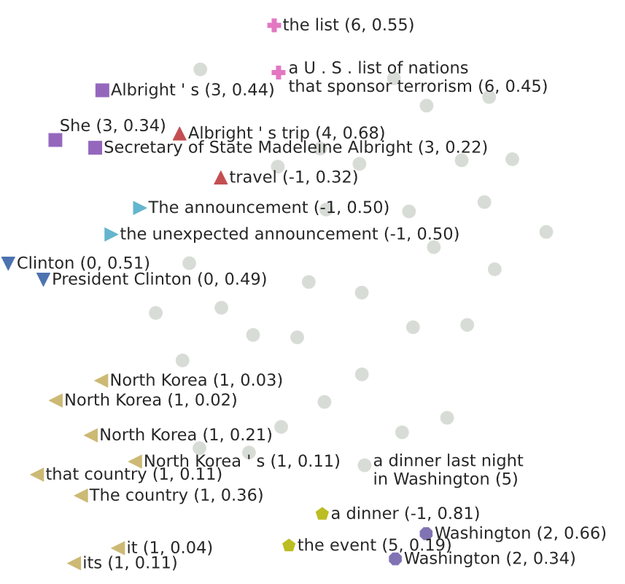
Entity Analysis
Coreference is well-suited for (online) clustering: coreferent mentions are close in embedding space
Notes:
… and each entity is represented by a single embedding. As mentioned, these embeddings are a learned weighted average of mentions. We can study the weights to see which mentions contribute most to an entity’s representation.
For example, we may be interested in whether pronouns contribute to the entity representation, or whether there is a recency bias in the online update rule.
In addition, we can see whether the mention embeddings are close in embedding space. If so, we may be able to incorporate better online clustering algorithms that outperform our greedy, one-pass solution.

Slide 31
Conclusions
Constant memory algorithm + model for coreference resolution
Can be applied to future SOTA models
Detailed analysis of document and segment lengths in paper!
Thanks!
Code and models at
github.com/pitrack/incremental-coref
Notes:
In summary, we have a constant memory algorithm and model for coreference resolution.
This algorithm can be applied to SOTA models or future coref models that follow the find and link span framework.
We have more results on document length, genre, and segment length in the paper.
And the code and models, written in pytorch, is available at this url.

