Slide 1
LOME: Large Ontology Multilingual Extraction
Patrick Xia*, Guanghui Qin*, Siddarth Vashishtha, Yunmo Chen, Tongfei Chen, Chandler May, Craig Harman, Kyle Rawlins, Aaron Steven White, Benjamin Van Durme
2021 EACL System Demonstrations
Notes:
Hello,
I’m Patrick and I will be presenting LOME, a system for multilingual and large ontology information extraction. This system was built by a large team of people, many of which spearheaded the specific components in this talk.

Slide 2
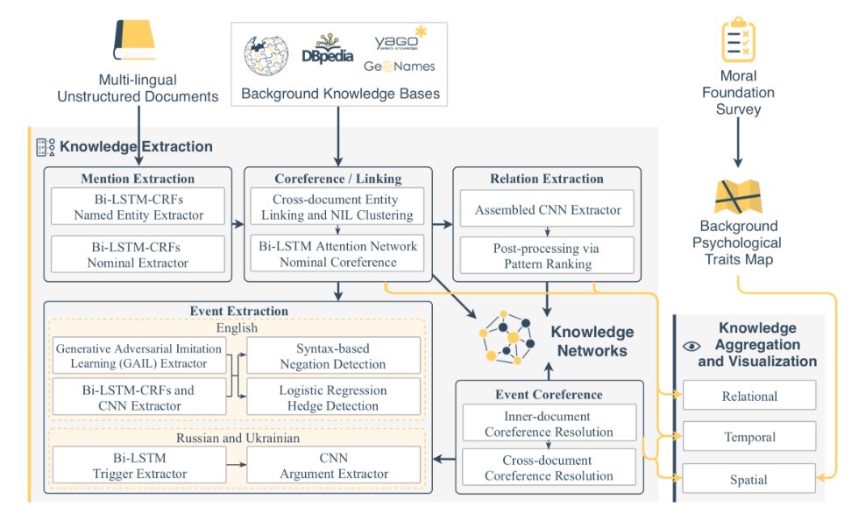
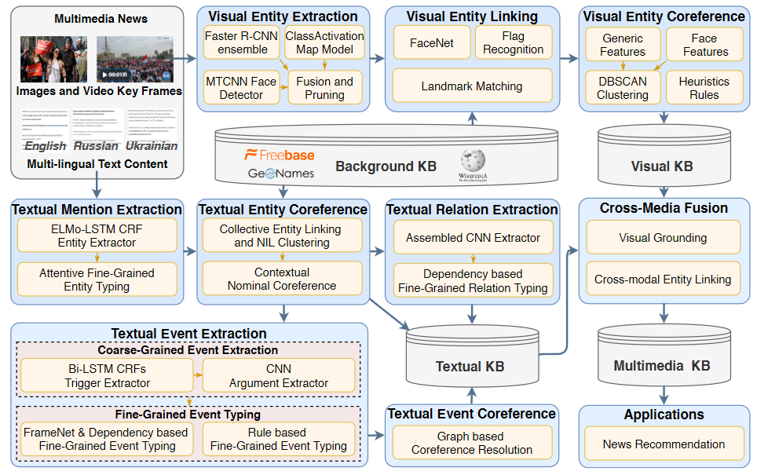
Background
Recent advances in IE →
More detailed and fine-grained predictions
Document-level > Sentence-level
Multilingual
Previous multilingual IE limitations:
separate subsystems per language (→)
limited scope of the task (Pan et al., 2017)
Li et al., 2019
Li et al., 2020 (GAIA)
Notes:
Recent advances in information extraction with improved encoders like BERT, fine-grained and hierarchical typing ontologies, and document-level annotations have spurred a growth of interest in systems for document-level, rich, and fine-grained information extraction. Furthermore, recent work from Li et al., has extended this into the multilingual and multimodal setting. These were the first systems to perform information extraction at that scale.
However, those systems used separate submodels for each language and were limited to three targeted languages, which would lead to challenges in scaling up the systems to more languages. Other work which has focused on extraction across many more languages usually consider only a single subtask, like entity recognition.

Slide 3
LOME: Large Ontology Multilingual Extraction
A single, modularized multilingual system
Input: document in any language (supported by XLM-R)
Output:
FrameNet parse (events and arguments)
Coreference linking
Entity typing (fine-grained, cluster-level)
Temporal relation between events
Notes:
In this talk, we present LOME, a single, modularized multilingual system. As input, the system supports a textual document in any language.
Our system performs a FrameNet parse, coreference clustering, fine-grained entity typing, and predicts temporal relations between events. This is all possible to do multilingually due to XLM-R, a multilingual encoder trained on CommonCrawl data in 100 languages.
Next, we’ll walk through more specifics for each of the modules. Some of the models themselves are benchmarked on monolingual data or encoders, but they are all retrained and use XLM-R in LOME itself.

Slide 4
LOME Architecture
Multilingual coreference resolution
Raw Text
Multilingual Tokenization
FrameNet Parser
e.g. Polyglot
Fine-grained hierarchical entity typing
The rabbit ate a carrot.
兔子喝了水
The rabbit ate a carrot.
兔子喝了水
Translation: The rabbit drank water
Entities
Events
Temporal relation prediction
the rabbit (animal)
Mentions: “The rabbit ate a carrot.”, “兔子喝了水”
Before
Ingestion:喝了
Ingestor:兔子
a carrot (nat)
Mentions: “The rabbit ate a carrot.”
Ingestion: ate
Ingestor: The rabbit
Ingestible: a carrot
Third-party systems (e.g. relation extraction)
水(nat)
Mentions: “兔子喝了水”
Notes:
Here is the architecture. Starting with raw, possibly untokenized text, we can tokenize and parse into the event mentions and arguments. The arguments are then clustered and labeled with entity types, while the events are compared and ordered chronologically. Since we use a consistent format for passing annotations across modules, it is also easy to insert or append third-party systems at any point.
The output of the system, as demonstrated by this example, is a set of typed entity clusters and ordered events with their arguments.
Next, we’ll take a closer look at each step.

Slide 5
LOME Architecture
Multilingual coreference resolution
Raw Text
Multilingual Tokenization
FrameNet Parser
e.g. Polyglot
Fine-grained hierarchical entity typing
The rabbit ate a carrot.
兔子喝了水
The rabbit ate a carrot.
兔子喝了水
Possibly mixed-language input
Translation: The rabbit drank water
Entities
Events
Temporal relation prediction
the rabbit (animal)
Mentions: “The rabbit ate a carrot.”, “兔子喝了水”
Before
Ingestion:喝了
Ingestor:兔子
a carrot (nat)
Mentions: “The rabbit ate a carrot.”
Ingestion: ate
Ingestor: The rabbit
Ingestible: a carrot
Third-party systems (e.g. relation extraction)
水(nat)
Mentions: “兔子喝了水”
Notes:
The input to the text can be in any language, and we have even seen some success with mixed-language input.

Slide 6
LOME Architecture
Multilingual coreference resolution
Raw Text
Multilingual Tokenization
FrameNet Parser
PolyGlot¹
e.g. Polyglot
Fine-grained hierarchical entity typing
The rabbit ate a carrot.
兔子喝了水
The rabbit ate a carrot.
兔子喝了水
Translation: The rabbit drank water
Entities
Events
Temporal relation prediction
the rabbit (animal)
Mentions: “The rabbit ate a carrot.”, “兔子喝了水”
Before
Ingestion:喝了
Ingestor:兔子
a carrot (nat)
Mentions: “The rabbit ate a carrot.”
Ingestion: ate
Ingestor: The rabbit
Ingestible: a carrot
Third-party systems (e.g. relation extraction)
水(nat)
Mentions: “兔子喝了水”
¹ https://github.com/aboSamoor/polyglot
Notes:
If the input is not tokenized, we run PolyGlot, a multilingual tokenizer.

Slide 7
LOME Architecture
Multilingual coreference resolution
Raw Text
Multilingual Tokenization
FrameNet Parser
e.g. Polyglot
Fine-grained hierarchical entity typing
The rabbit ate a carrot.
兔子喝了水
The rabbit ate a carrot.
兔子喝了水
Translation: The rabbit drank water
Entities
Events
Temporal relation prediction
the rabbit (animal)
Mentions: “The rabbit ate a carrot.”, “兔子喝了水”
Before
Ingestion:喝了
Ingestor:兔子
a carrot (nat)
Mentions: “The rabbit ate a carrot.”
Ingestion: ate
Ingestor: The rabbit
Ingestible: a carrot
Third-party systems (e.g. relation extraction)
水(nat)
Mentions: “兔子喝了水”

Slide 8
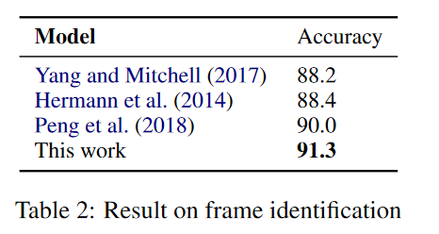
FrameNet Parser
Goal: Find trigger spans and arguments, then label with FrameNet roles
Model:
XLM-R encodings
BIO tagger to find trigger spans
Typing module for labeling spans
Data: FrameNet v1.7
SOTA on Frame ID
First to report on full FrameNet parsing
Notes:
For the FrameNet Parser, the goal is to find trigger spans and their argument spans and label them with FrameNet roles. We use a BIO tagger over input embeddings and a simple multilayered perceptron typing module for labeling spans. We compare our performance for frame identification to prior work, and we also report results on full FrameNet parsing in the paper.

Slide 9
LOME Architecture
Multilingual coreference resolution
Raw Text
Multilingual Tokenization
FrameNet Parser
e.g. Polyglot
Fine-grained hierarchical entity typing
The rabbit ate a carrot.
兔子喝了水
The rabbit ate a carrot.
兔子喝了水
Translation: The rabbit drank water
Entities
Events
Temporal relation prediction
the rabbit (animal)
Mentions: “The rabbit ate a carrot.”, “兔子喝了水”
Before
Ingestion:喝了
Ingestor:兔子
a carrot (nat)
Mentions: “The rabbit ate a carrot.”
Ingestion: ate
Ingestor: The rabbit
Ingestible: a carrot
Third-party systems (e.g. relation extraction)
水(nat)
Mentions: “兔子喝了水”

Slide 10
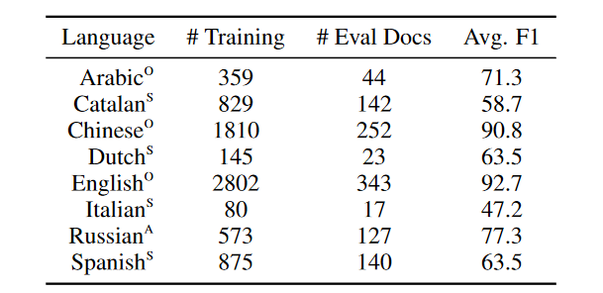
Coreference Resolution
Goal: Determine which given mentions refer to the same entity
Model: Modified Incremental Coreference Model (Xia et al., 2020) + XLM-R
Data: OntoNotes 5.0, SemEval 2011 Task 1, Russian RuCor/AnCor
Results: matches SpanBERT (Joshi et al., 2020) in English, comparable to RuBERT for Russian, sets neural baselines
Notes:
For coreference resolution, we are only considering linking, as we are given argument spans from the FrameNet parser. We use a modified off-the-shelf model and replace the encoder with XLM-R. We aggregate a dataset across multiple languages, and then train and benchmark on this multilingual dataset. We find that it matches a purely monolingual English SpanBERT model and sets strong neural baselines for less-studied datasets. To our knowledge, this is the first neural coreference system trained on multilingual data.

Slide 11
LOME Architecture
Multilingual coreference resolution
Raw Text
Multilingual Tokenization
FrameNet Parser
e.g. Polyglot
Fine-grained hierarchical entity typing
The rabbit ate a carrot.
兔子喝了水
The rabbit ate a carrot.
兔子喝了水
Translation: The rabbit drank water
Entities
Events
Temporal relation prediction
the rabbit (animal)
Mentions: “The rabbit ate a carrot.”, “兔子喝了水”
Before
Ingestion:喝了
Ingestor:兔子
a carrot (nat)
Mentions: “The rabbit ate a carrot.”
Ingestion: ate
Ingestor: The rabbit
Ingestible: a carrot
Third-party systems (e.g. relation extraction)
水(nat)
Mentions: “兔子喝了水”

Slide 12
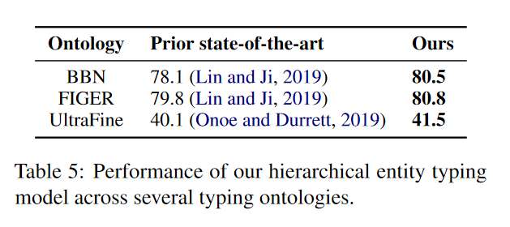
Hierarchical Entity Typing
Goal: associate entities (mention clusters) with fine-grained hierarchical entity types
Model: Coarse-to-fine decoder (Chen et al., 2020) + XLM-R + Borda Voting
Data: various (AIDA Ontologies, BBN, FIGER, UltraFine)
Notes:
For the entity typing model, the goal is to assign entity types to mention clusters. This uses a modified off-the-shelf fine-grained entity typing model. On several datasets, base model outperforms prior state of the art. Our modifications use the XLM-R encoder and the inclusion of a Borda voting process to decide on an entity type for a full cluster.

Slide 13
LOME Architecture
Multilingual coreference resolution
Raw Text
Multilingual Tokenization
FrameNet Parser
e.g. Polyglot
Fine-grained hierarchical entity typing
The rabbit ate a carrot.
兔子喝了水
The rabbit ate a carrot.
兔子喝了水
Translation: The rabbit drank water
Entities
Events
Temporal relation prediction
the rabbit (animal)
Mentions: “The rabbit ate a carrot.”, “兔子喝了水”
Before
Ingestion:喝了
Ingestor:兔子
a carrot (nat)
Mentions: “The rabbit ate a carrot.”
Ingestion: ate
Ingestor: The rabbit
Ingestible: a carrot
Third-party systems (e.g. relation extraction)
水(nat)
Mentions: “兔子喝了水”

Slide 14
Temporal Relation Prediction
Goal: given two events, predict their temporal relation (e.g. before, overlap, etc)
Model: Real-valued event pairs (Vashishtha et al., 2019) + XLM-R
Data: TimeBank Dense, TempEval3, Chinese corpus
Cross-lingual performance
Notes:
The goal here is to predict the temporal relation between two events, for example, whether an event appears before another. We use yet another off-the-shelf model and equip it with XLM-R. While there are English benchmarks in the paper, we want to highlight the cross-lingual results here. Using XLM-R, we train a model on a Chinese corpus and we train one on the English datasets. The zero-shot performance strongly outperforms a majority class baseline but still falls short of the in-language model. Nonetheless, this further demonstrates the cross-lingual capability of models trained with multilingual encoders.

Slide 15
LOME Architecture
Multilingual coreference resolution
Raw Text
Multilingual Tokenization
FrameNet Parser
e.g. Polyglot
Fine-grained hierarchical entity typing
The rabbit ate a carrot.
兔子喝了水
The rabbit ate a carrot.
兔子喝了水
Translation: The rabbit drank water
Entities
Events
Temporal relation prediction
the rabbit (animal)
Mentions: “The rabbit ate a carrot.”, “兔子喝了水”
Before
Ingestion:喝了
Ingestor:兔子
a carrot (nat)
Mentions: “The rabbit ate a carrot.”
Ingestion: ate
Ingestor: The rabbit
Ingestible: a carrot
Third-party systems (e.g. relation extraction)
水(nat)
Mentions: “兔子喝了水”

Slide 16
Applications
TAC SM-KBP 2020 Task 1
Pipeline: GAIA (Li et al., 2020) → Coref → Entity Type → argument linking
Schema inference tasks also needs relations
Attach OneIE (Lin et al., 2020) to output of LOME
LOME is modular: designed to be mix/matched with other systems
Notes:
We use LOME for two tasks: one is for a knowledge base population task. For that, we use GAIA as our starting point instead of the FrameNet parser, and performed an argument re-linking step at the end.
We also used LOME for a schema inference task, and once again, we attach a third-party module – in this case OneIE – to the output of LOME.
In both cases, rearranging and mixing other systems with LOME was possible because LOME was designed to be modular.

Slide 17
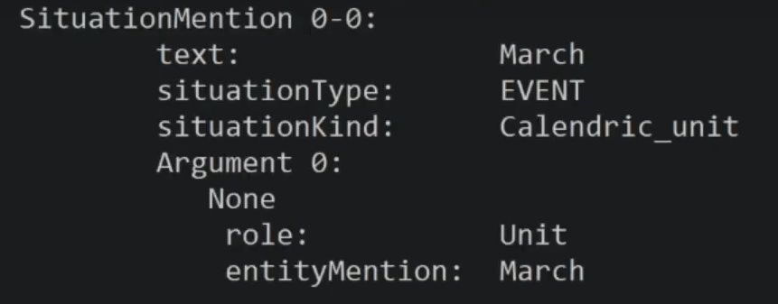
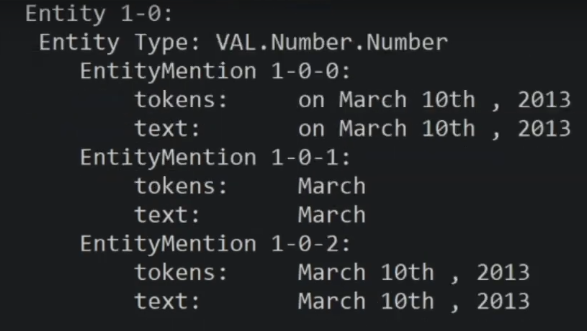
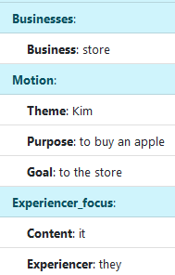
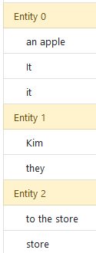
Website: https://nlp.jhu.edu/demos/
Available on Docker Hub
Concrete (Ferraro et al., 2014) format outputs
Web Demo
Interactive output visualization
Structured Frame/entity output
Notes:
The full system is available on DockerHub, the input/output format is specified in the README. We also have a limited web-demo which only incorporates the FrameNet parser and corefence resolution. Here’s an example of its usage.

Slide 18
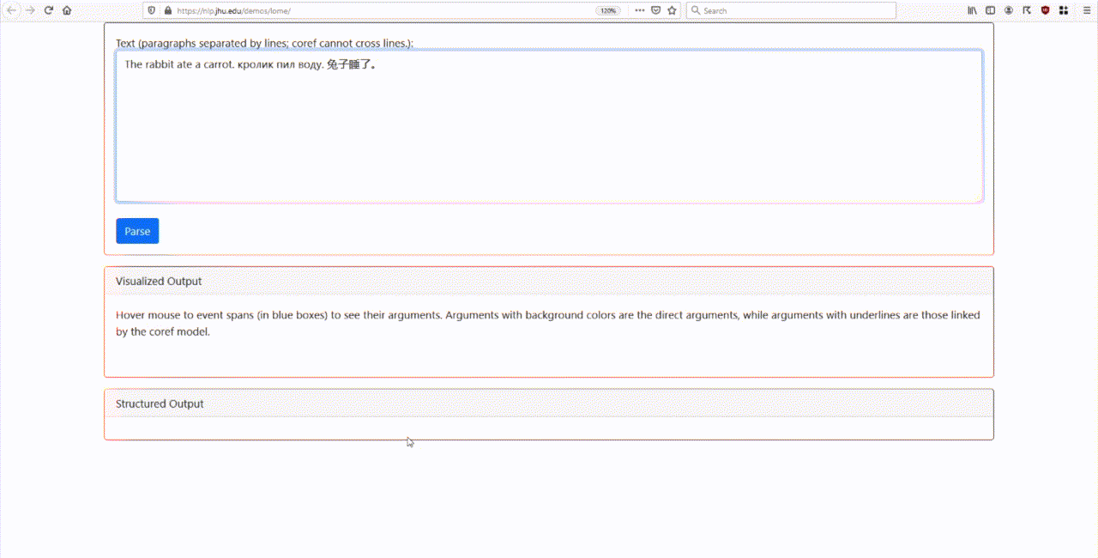
Notes:
Starting with an input document, the model can process it fairly quickly. The resulting output can be hovered over to easily see the frames and clusters. In addition, the detailed frame and cluster predictions are also available.

Slide 19
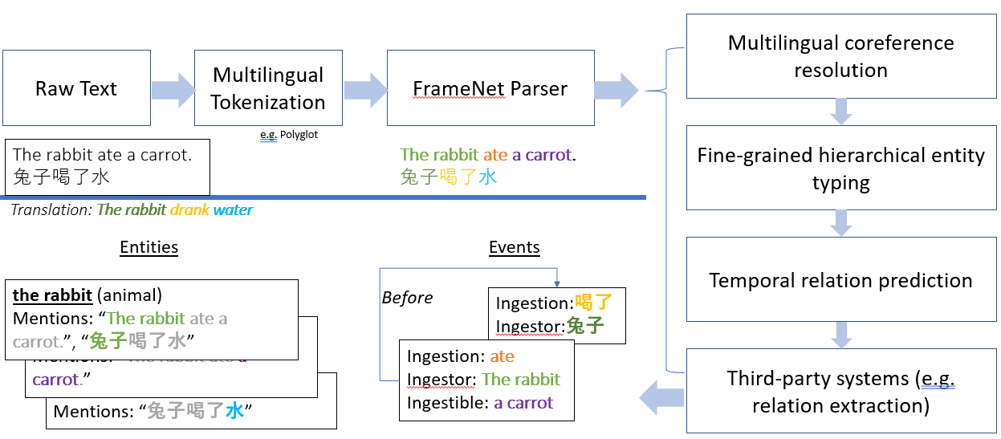
Summary
Single system for multilingual information extraction
Highly reliant on strong multilingual encoders and their cross-lingual transfer ability
Available as a web demo and on Docker
Website: https://nlp.jhu.edu/demos/
Notes:
In summary, we demonstrate a system LOME, for multilingual information extraction. This system is highly reliant on strong multilingual encoders, and it is made available both as a web demo and released on Docker. We hope this will spur further research and development of modularized extraction systems that prioritize multilinguality and making rich predictions.

