Slide 1
Multi-Sentence Argument Linking
Seth Ebner*, Patrick Xia*,
Ryan Culkin, Kyle Rawlins,
Benjamin Van Durme

Slide 2
Motivation
Data: Roles Across Multiple Sentences
Model
Results

Slide 3
Motivation

Slide 4
target
More than 50 protesters were gunned down in the Maidan, the center of the popular uprising.
place
Firearm-Attack
Attacker: ∅
Target: More than 50 protesters
Instrument: ∅
Place: Maidan
Traditional SRL:
in-sentence

Slide 5
target
More than 50 protesters were gunned down in the Maidan, the center of the popular uprising.
Until now the identity of the killers has been a mystery.
place
attacker
Firearm-Attack
Attacker: the killers
Target: More than 50 protesters
Instrument: ∅
Place: Maidan
Argument Linking:
cross-sentence

Slide 6
Cross-Sentence Links are Common

Slide 7
Cross-Sentence Links are Common
Beyond NomBank (Gerber and Chai, 2012)
71% relative increase in role coverage on NomBank

Slide 8
Cross-Sentence Links are Common
Beyond NomBank (Gerber and Chai, 2012)
71% relative increase in role coverage on NomBank
DARPA AIDA Phase 1
38% of events have an argument outside the same sentence as the trigger

Slide 9
Cross-Sentence Links are Common
Beyond NomBank (Gerber and Chai, 2012)
71% relative increase in role coverage on NomBank
DARPA AIDA Phase 1
38% of events have an argument outside the same sentence as the trigger
90% of arguments can be found within 2 sentences
of the trigger

Slide 10
Motivation
Data: Roles Across Multiple Sentences
Model
Results

Slide 11
Roles Across Multiple Sentences

Slide 12
Roles Across Multiple Sentences
Based on DARPA AIDA event ontology

Slide 13
Roles Across Multiple Sentences
Based on DARPA AIDA event ontology
9K+ examples from 4K news articles

Slide 14
Roles Across Multiple Sentences
Based on DARPA AIDA event ontology
9K+ examples from 4K news articles
Annotators mark spans in 5-sentence context window

Slide 15
Roles Across Multiple Sentences
Based on DARPA AIDA event ontology
9K+ examples from 4K news articles
Annotators mark spans in 5-sentence context window
Protocol and analysis in the paper!

Slide 16
RAMS Example
When Russian aircraft bombed a remote garrison in southeastern Syria last month, alarm bells sounded at the Pentagon and the Ministry of Defense in London.
The Russians weren’t bombarding a run-of-the-mill
rebel outpost, according to U.S. officials.
place
attacker
instrument
Conflict/Attack/
AirstrikeMissileStrike
target

Slide 17
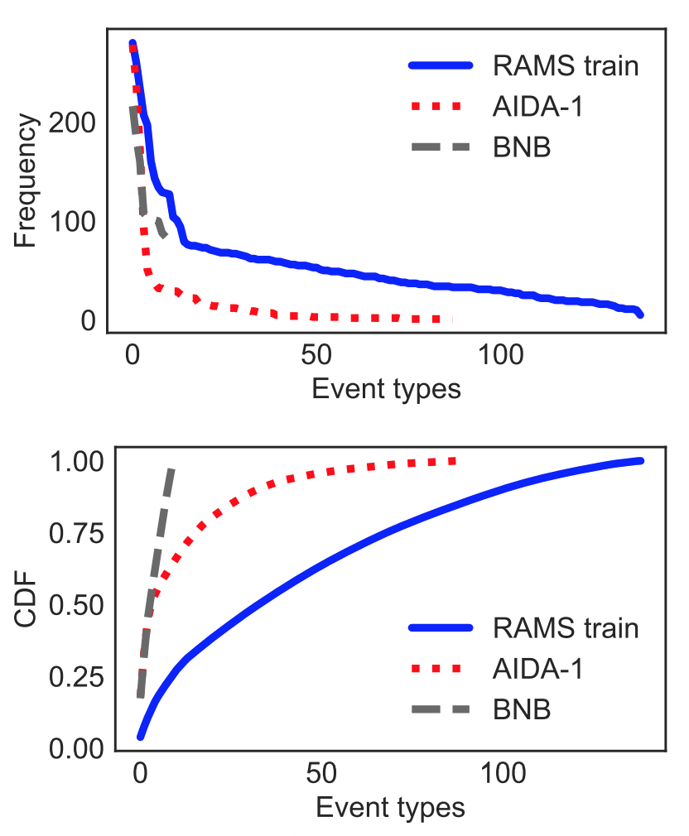
Broad + Diverse Coverage of Ontology

Slide 18
Broad + Diverse Coverage of Ontology

Slide 19
Broad + Diverse Coverage of Ontology

Slide 20
Motivation
Data: Roles Across Multiple Sentences
Model
Results

Slide 21
Approach

Slide 22
Approach
Roles are evoked by event triggers, forming implicit arguments (implicit discourse referents)

Slide 23
Approach
Roles are evoked by event triggers, forming implicit arguments (implicit discourse referents)
the place of a particular attack event

Slide 24
Approach
Roles are evoked by event triggers, forming implicit arguments (implicit discourse referents)
the place of a particular attack event
Implicit arguments linked to explicit mentions in text

Slide 25
Model

Slide 26
Model
Learn span representations for each trigger span and candidate argument span

Slide 27
Model
Learn span representations for each trigger span and candidate argument span
For each trigger, prune to top-k candidate arguments

Slide 28
Model
Learn span representations for each trigger span and candidate argument span
For each trigger, prune to top-k candidate arguments
Score reps of implicit arguments with reps of explicit arguments using a decomposable scoring function

Slide 29
Enumerate candidate argument spans up to a fixed width

Slide 30
Span representation:
BiLSTM hidden states at start and end of span (contextualized and type-level embeddings)
Soft “head word” vector from attention mask over type-level embeddings
Learned representation of span width
(Lee et al., 2017; i.a.)
Create argument representations for every span

Slide 31
Score each representation,
and keep the top 𝝀_{A}n
n: document length
𝝀_{A}: hyperparameter
Prune to find good spans

Slide 32
Span representation:
BiLSTM hidden states at start and end of span (contextualized and type-level embeddings)
Soft “head word” vector from attention mask over type-level embeddings
Learned representation of span width
(Lee et al., 2017; i.a.)
Create event trigger representations for every span

Slide 33
Score each representation,
and keep the top 𝝀_{E}n
n: document length
𝝀_{E}: hyperparameter
Prune to find good spans

Slide 35
Further prune to find good arguments for a particular event

Slide 36
Trigger representation
Argument representation
Argument representation
Further prune to find good arguments for a particular event

Slide 37
Role embeddings

Slide 38
Trigger representation
Role embeddings
Implicit argument representation

Slide 39
Trigger representation
Argument representation
Role embedding
Implicit argument representation

Slide 40
Motivation
Data: Roles Across Multiple Sentences
Model
Results

Slide 41
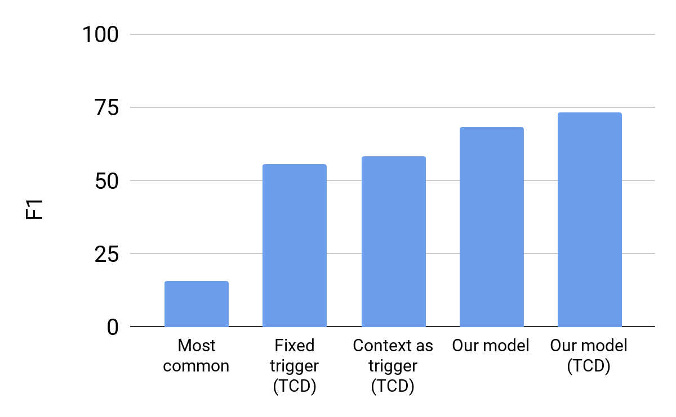
RAMS Results

Slide 42
RAMS Results

Slide 43
RAMS Results vs. Distance

Slide 44
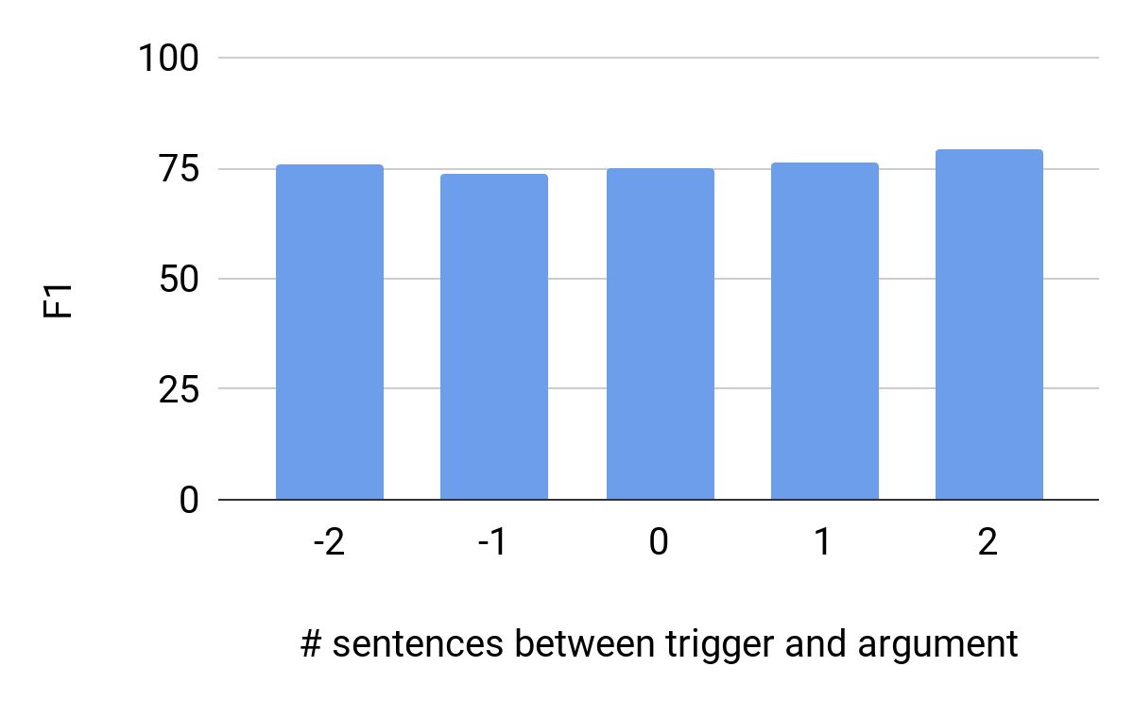
RAMS Results vs. Distance
Performance does not degrade over distance

Slide 45
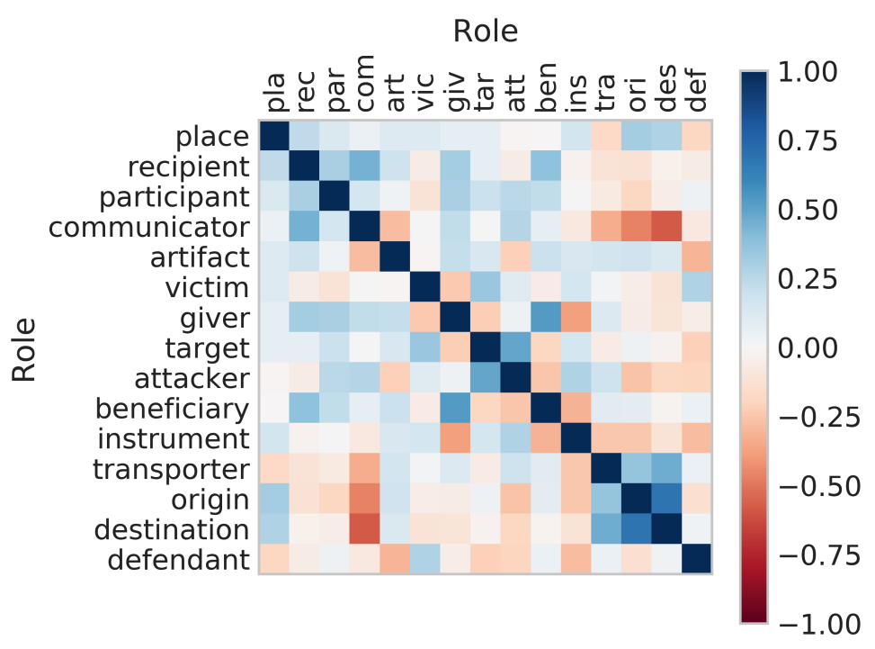
Role Embedding Similarity

Slide 46
Role Embedding Similarity

Slide 47
Role Embedding Similarity
Koum grew up in the Ukraine under Soviet rule
before immigrating to the US as a teenager…

Slide 48
Role Embedding Similarity

Slide 49
Role Embedding Similarity

Slide 50
Role Embedding Similarity
The US led coalition airstrike on Syrian soldiers
last month proved that much in reality.

Slide 51
Role Embedding Similarity
Russia is currently on a scorched-earth
bombing campaign in Syria…

Slide 52
Gun Violence Database
Pavlick et al., 2016
ST. LOUIS (KTVI) – The St. Circuit Attorney’s Office charged a 50-year-old Friday for allegedly gunning another man down in a north city neighborhood back in December. According to Schron Jackson, a spokeswoman for the St. Louis Metropolitan Police Department, the shooting happened at 12:10 p.m. on December 2, 2015 in the 3000 block of N. 20th Street in the St. Louis Place neighborhood. The victim, identified as 32-year-old Leonard Arnold, was found lying unconscious outside. Arnold had been shot multiple times and was pronounced dead at the scene, Jackson said. The suspect, Maurice Alexander, was charged with first-degree murder, first-degree assault, and two counts of armed criminal action. …
Victim Name: Leonard Arnold
Shooter Name: Maurice Alexander
Location: 3000 block of … Weapon: ∅
# Shots: shot multiple times
…

Slide 53
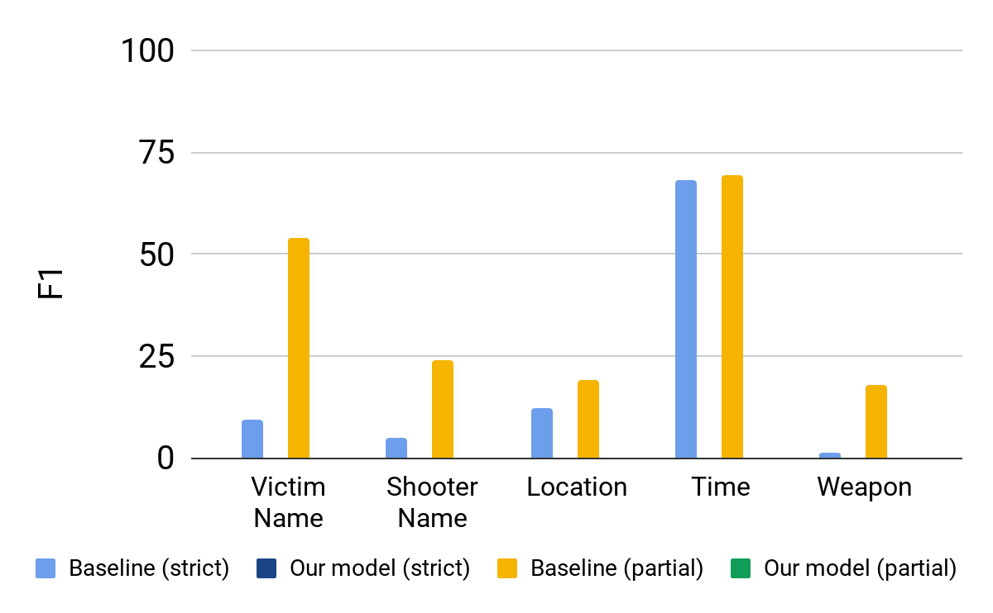
GVDB Results

Slide 54
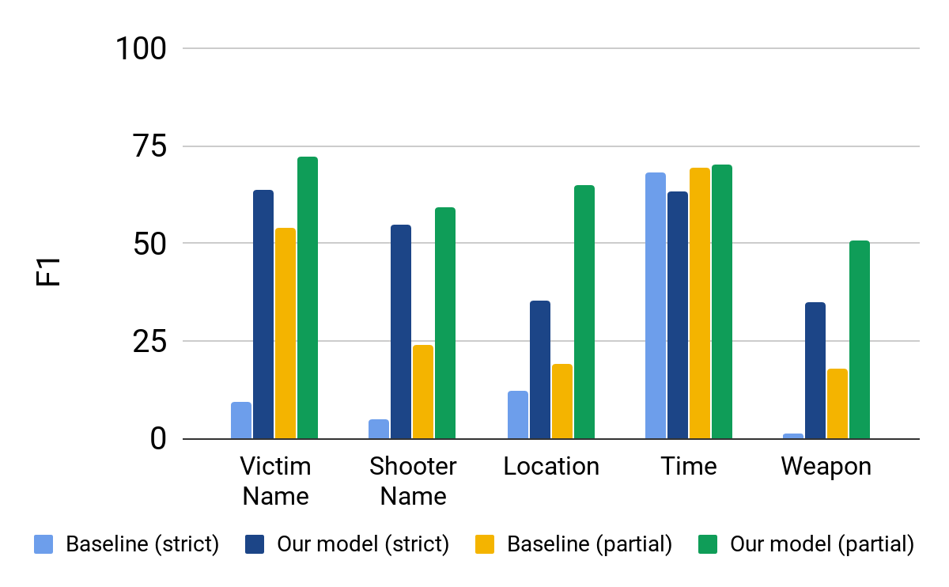
GVDB Results

Slide 55
Summary

Slide 56
Summary
Model finds argument spans anywhere in a document that fill roles for events

Slide 57
Summary
Model finds argument spans anywhere in a document that fill roles for events
RAMS dataset has broader coverage than prior datasets

Slide 58
Summary
Model finds argument spans anywhere in a document that fill roles for events
RAMS dataset has broader coverage than prior datasets
Model works well on other tasks too (more results in the paper!)

Slide 59
Thanks!
Data, code, and models
nlp.jhu.edu/rams

Slide 60
Additional Slides
Note: these slides may be either outdated or even incorrect (based on much earlier versions of the model or buggy graphing code). Use at your own risk.

Slide 61
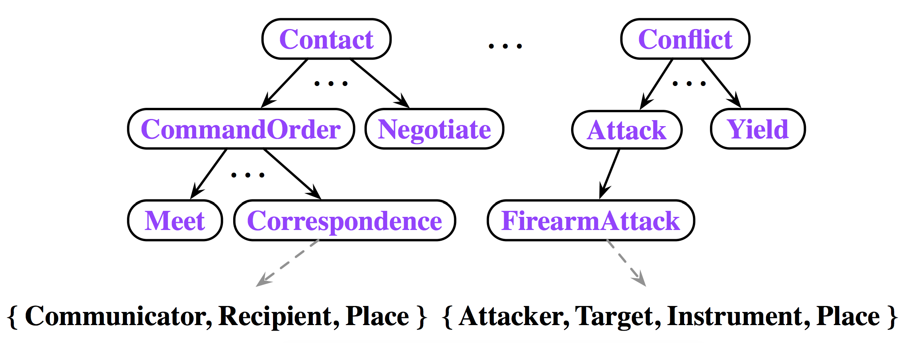
Motivation

Slide 62
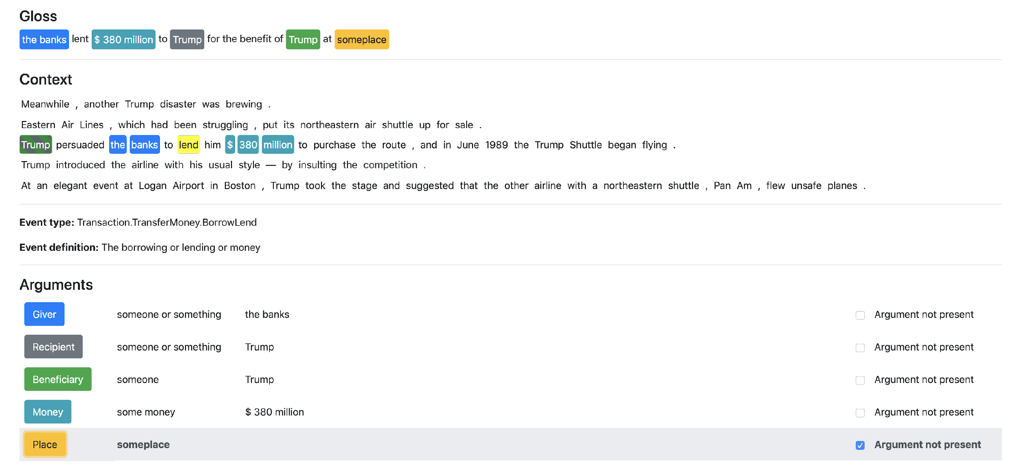
Roles Across Multiple Sentences (RAMS)

Slide 63
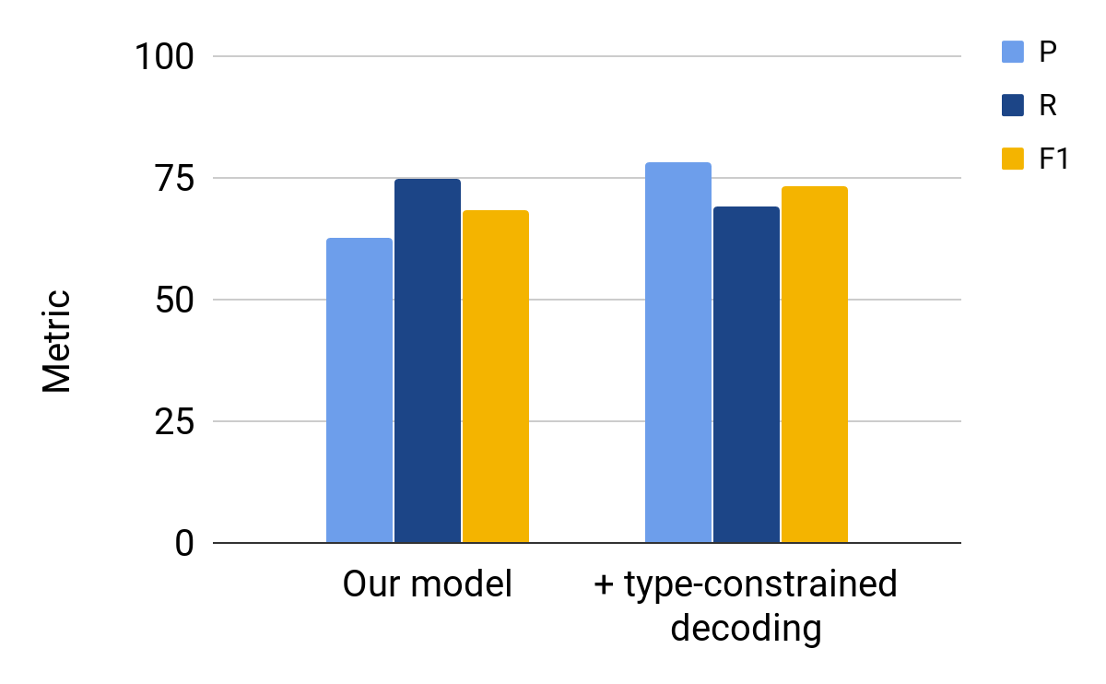
RAMS Results

Slide 64
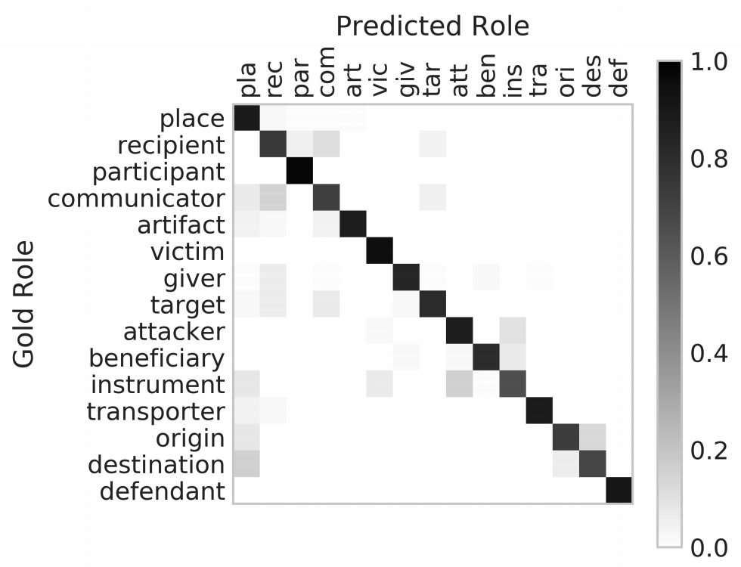
Error Analysis

Slide 65
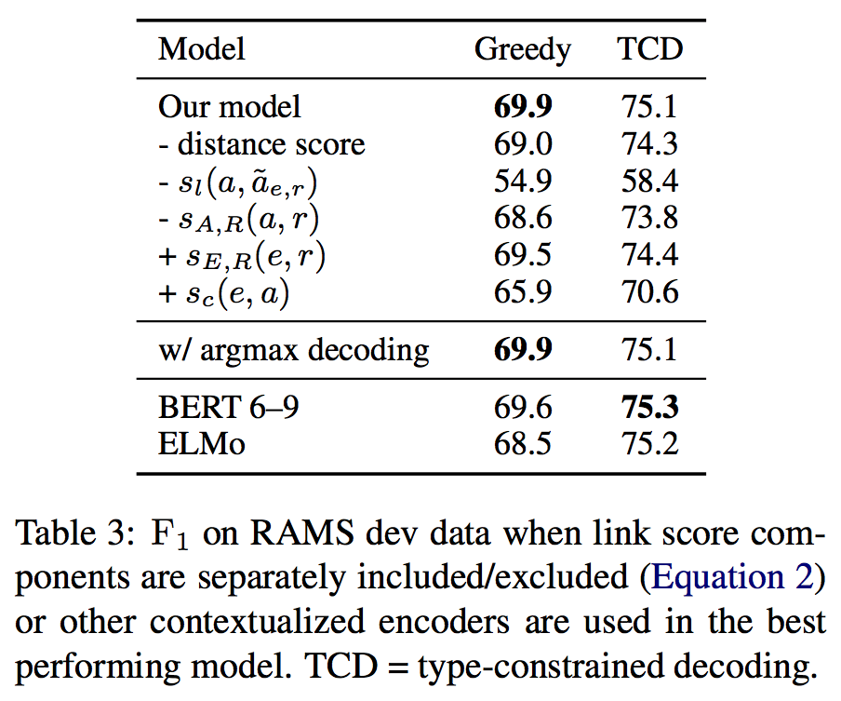
Ablations

Slide 66
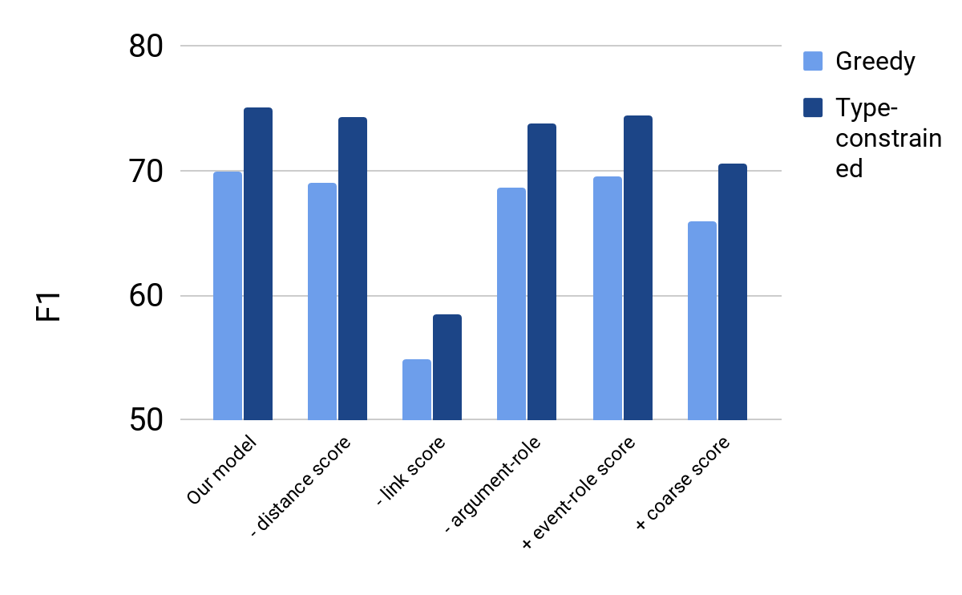
Ablations

Slide 67
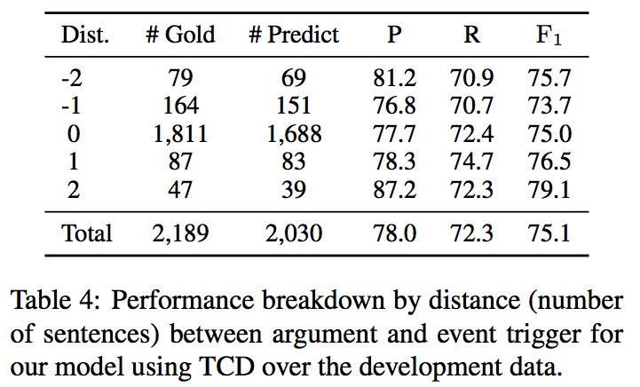
RAMS Results vs. Distance
Performance doesn’t degrade over distance

Slide 68
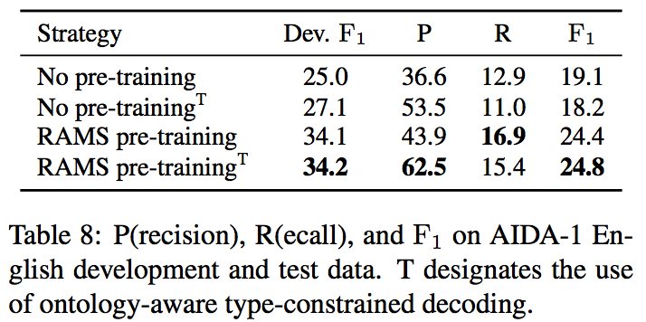
RAMS works as pre-training

Slide 69
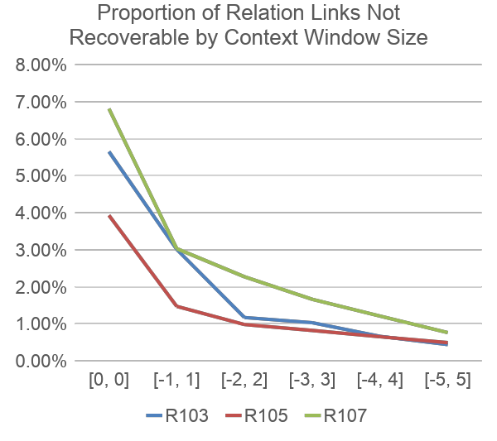
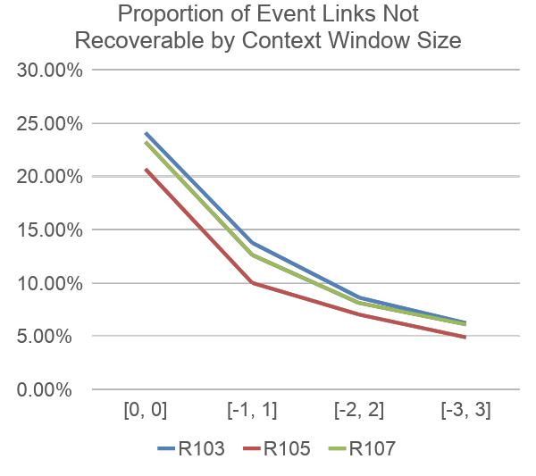

Slide 70
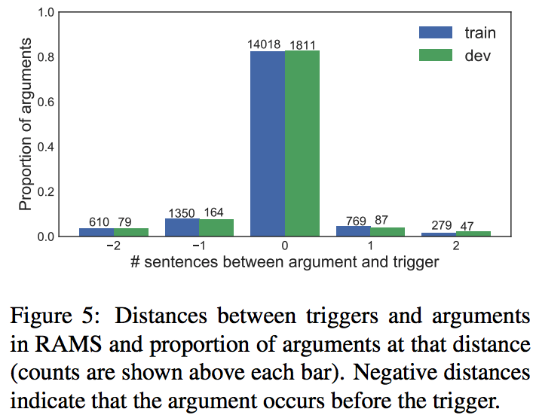

Slide 71
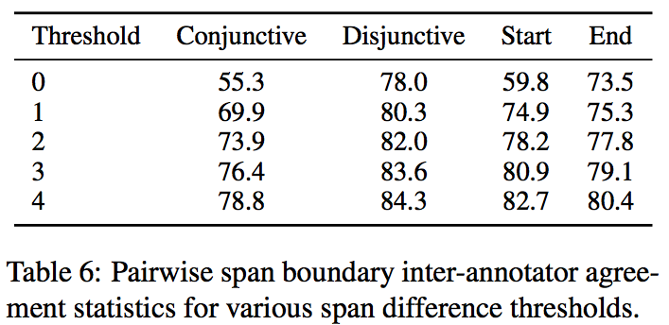

Slide 72
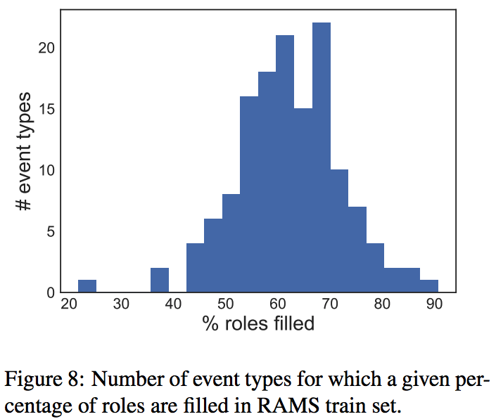

Slide 73
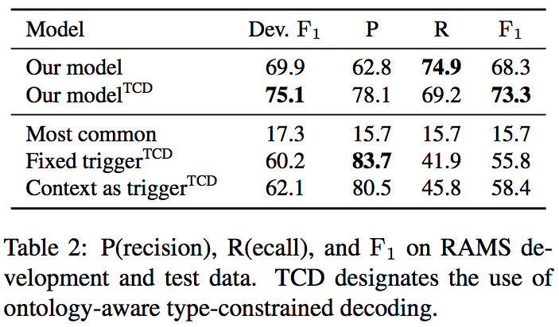
RAMS Results

Slide 74
RAMS Results

Slide 75
RAMS Results

Slide 76
Roles Across Multiple Sentences (RAMS)

Slide 77
Roles Across Multiple Sentences (RAMS)

Slide 78
Roles Across Multiple Sentences (RAMS)

Slide 79
Roles Across Multiple Sentences (RAMS)

Slide 80
Roles Across Multiple Sentences (RAMS)

Slide 81
Roles Across Multiple Sentences (RAMS)

Slide 82
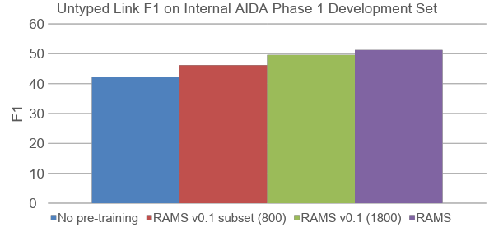
RAMS as a Pretraining Corpus
Fine-tuned on AIDA Phase 1 gold data

