Slide 1
Poisson Manifold Reconstruction (beyond co-dimension one)
w/ Max Kohlbrenner, Sing-Chun Lee, Marc Alexa

Slide 2
Outline
Poisson Surface Reconstruction (PSR)
Poisson Manifold Reconstruction (PMR)
Evaluation
Conclusion

Slide 3
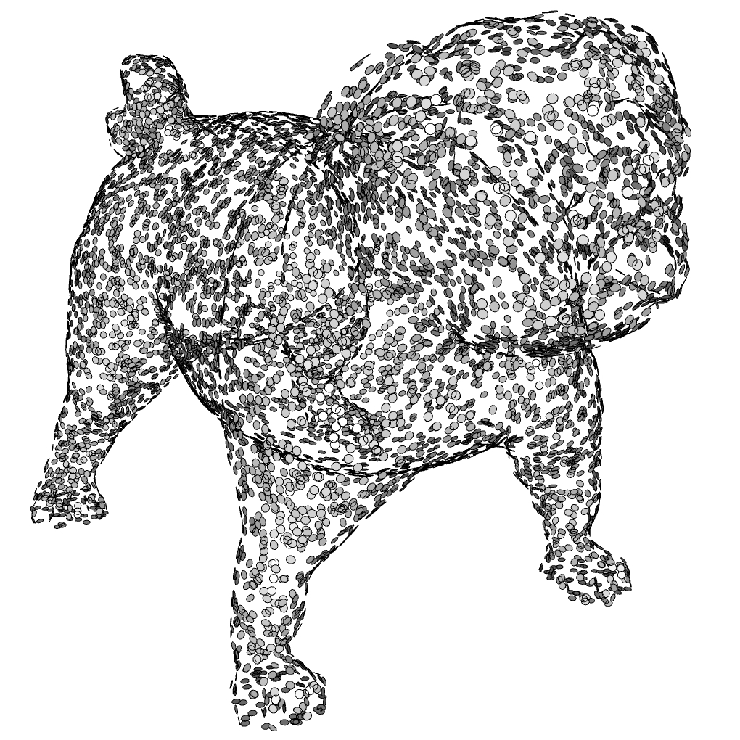
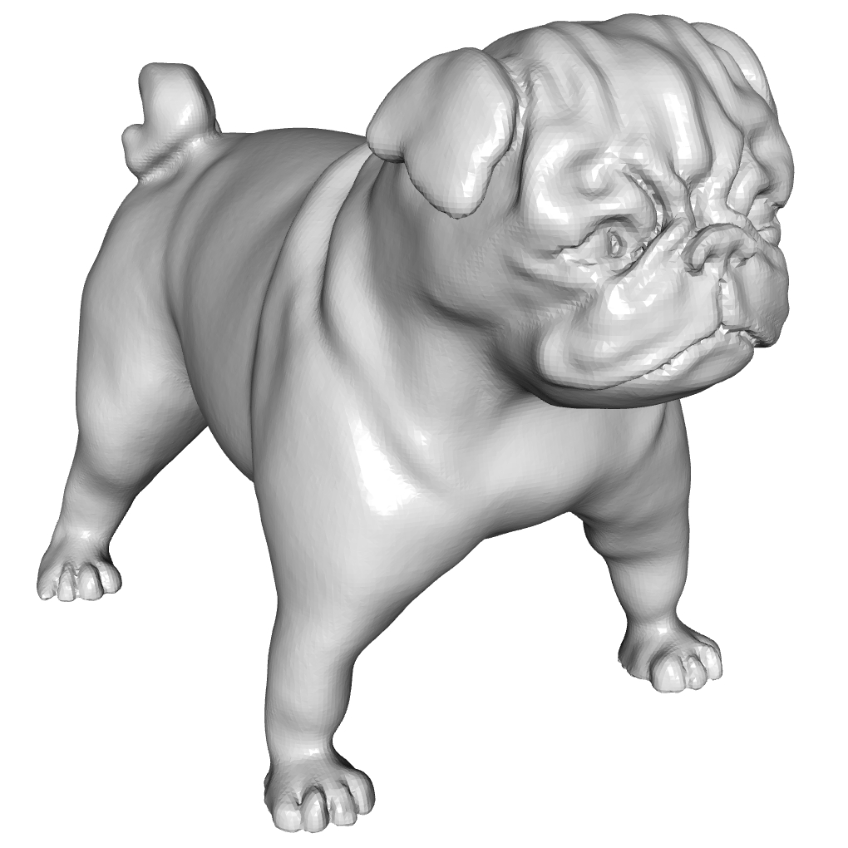
PSR: Review
oriented point cloud
water-tight surface
Notes:
Mention how the visualization is using disks to show the orientation of the surface (perpendicular to the normal)

Slide 4
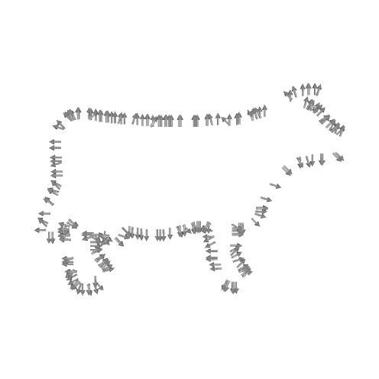
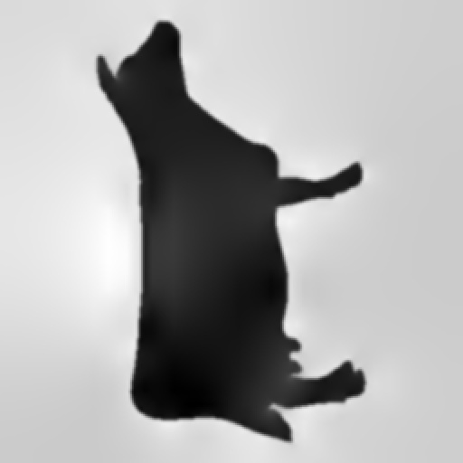



PSR: Approach
Given an oriented point set $𝒫⊂ℝ^{3}×ℝ^{3}$:
Compute the indicator function of the solid $χ\left(p\right)=\left\{\begin{matrix} 1 & p∈S \\ −1 & p∉S\end{matrix}\right.$
$$𝒫⊂ℝ^{3}×ℝ^{3}$$
$$χ:ℝ^{3}→ℝ$$

Slide 5
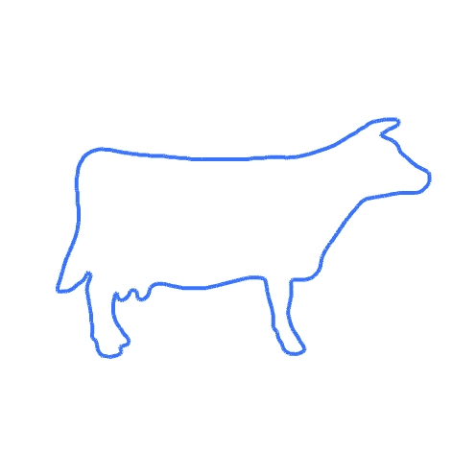


PSR: Approach
Given an oriented point set $𝒫⊂ℝ^{3}×ℝ^{3}$:
Compute the indicator function of the solid
Extract the zero level-set
$$𝒫⊂ℝ^{3}×ℝ^{3}$$
$$χ^{−1}\left(0\right)⊂ℝ^{3}$$

Slide 6

PSR: Key Idea
The oriented points match the gradients of the indicator function:
“Splat” the samples into a vector field ${\vec{V}}_{𝒫}:ℝ^{3}→ℝ^{3}$: ${\vec{V}}_{𝒫}\left(q\right)=\sum_{(p,\vec{n})∈𝒫}{K_{p}\left(q\right)⋅\vec{n}}$
Some (e.g. Gaussian-like) splatting kernel
$$𝒫⊂ℝ^{3}×ℝ^{3}$$
$$χ:ℝ^{3}→ℝ$$

Slide 7
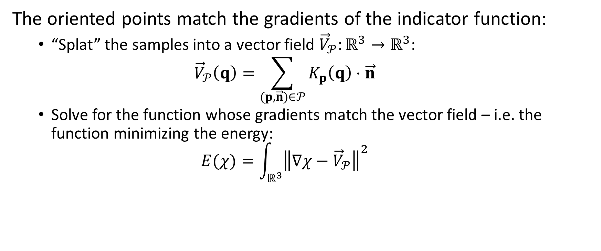
PSR: Key Idea
The oriented points match the gradients of the indicator function:
“Splat” the samples into a vector field ${\vec{V}}_{𝒫}:ℝ^{3}→ℝ^{3}$: ${\vec{V}}_{𝒫}\left(q\right)=\sum_{(p,\vec{n})∈𝒫}{K_{p}\left(q\right)⋅\vec{n}}$
Solve for the function whose gradients match the vector field – i.e. the function minimizing the energy: $E(χ)=\int_{ℝ^{3}}{{\left\|∇χ−{\vec{V}}_{𝒫}\right\|}^{2}}$
Notes:
Note that there is nothing about this formulation that is specific to 3-space.

Slide 8
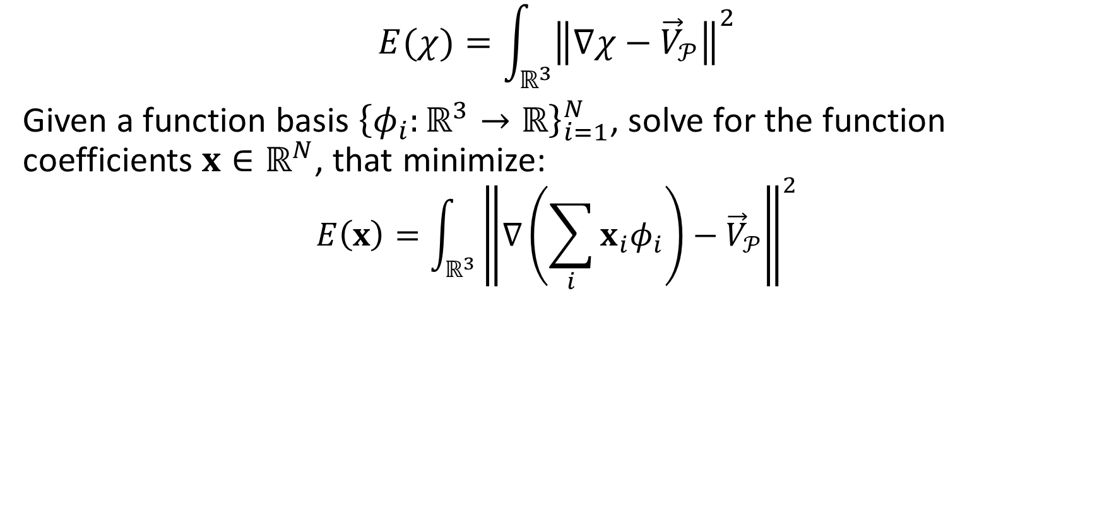
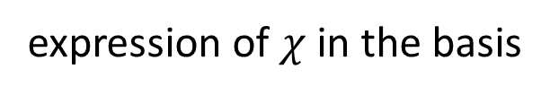
PSR: Discretization
$$E(χ)=\int_{ℝ^{3}}{{\left\|∇χ−{\vec{V}}_{𝒫}\right\|}^{2}}$$
Given a function basis ${\left\{φ_{i}:ℝ^{3}→ℝ\right\}}_{i=1}^{N}$, solve for the function coefficients $x∈ℝ^{N}$, that minimize:
$$E\left(x\right)=\int_{ℝ^{3}}{{\left\|∇\left(\sum_{i}{x_{i}φ_{i}}\right)−{\vec{V}}_{𝒫}\right\|}^{2}}$$
expression of $χ$ in the basis

Slide 9
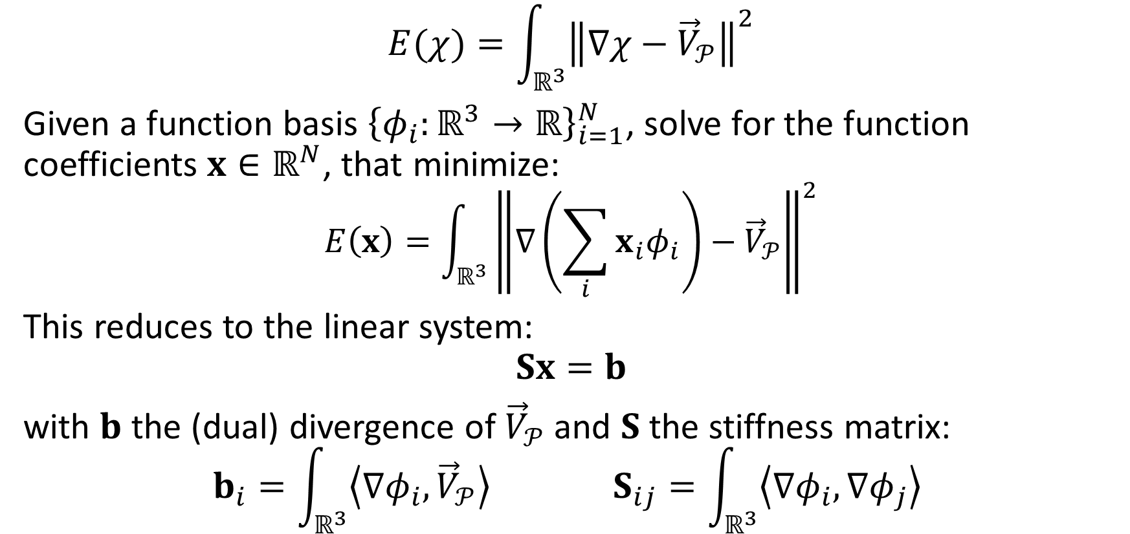
PSR: Discretization
$$E(χ)=\int_{ℝ^{3}}{{\left\|∇χ−{\vec{V}}_{𝒫}\right\|}^{2}}$$
Given a function basis ${\left\{φ_{i}:ℝ^{3}→ℝ\right\}}_{i=1}^{N}$, solve for the function coefficients $x∈ℝ^{N}$, that minimize:
$$E\left(x\right)=\int_{ℝ^{3}}{{\left\|∇\left(\sum_{i}{x_{i}φ_{i}}\right)−{\vec{V}}_{𝒫}\right\|}^{2}}$$
This reduces to the linear system:
$$Sx=b$$ with $b$ the (dual) divergence of ${\vec{V}}_{𝒫}$ and $S$ the stiffness matrix:
$$b_{i}=\int_{ℝ^{3}}{\left\langle ∇φ_{i},{\vec{V}}_{𝒫}\right\rangle } S_{ij}=\int_{ℝ^{3}}{\left\langle ∇φ_{i},∇φ_{j}\right\rangle }$$

Slide 10
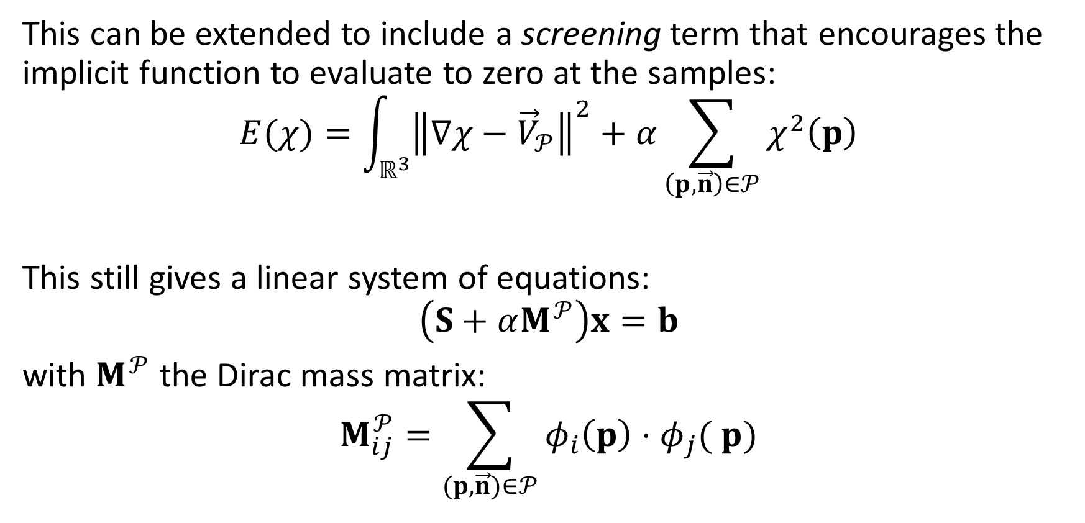
PSR: Screening
This can be extended to include a screening term that encourages the implicit function to evaluate to zero at the samples: $$E(χ)=\int_{ℝ^{3}}{{\left\|∇χ−{\vec{V}}_{𝒫}\right\|}^{2}}+α\sum_{\left(p,\vec{n}\right)∈𝒫}{χ^{2}\left(p\right)}$$
This still gives a linear system of equations:
$$\left(S+αM^{𝒫}\right)x=b$$ with $M^{𝒫}$ the Dirac mass matrix:
$$M_{ij}^{𝒫}=\sum_{(p,\vec{n})∈𝒫}{φ_{i}\left(p\right)⋅φ_{j}( p)}$$
interpolation energy

Slide 11
PSR: Screening
This can be extended to include a screening term that encourages the implicit function to evaluate to zero at the samples: $$E(χ)=\int_{ℝ^{3}}{{\left\|∇χ−{\vec{V}}_{𝒫}\right\|}^{2}}+α\sum_{\left(p,\vec{n}\right)∈𝒫}{χ^{2}\left(p\right)}$$
This still gives a linear system of equations:
$$\left(S+αM^{𝒫}\right)x=b$$ with $M^{𝒫}$ the Dirac mass matrix:
$$M_{ij}^{𝒫}=\sum_{(p,\vec{n})∈𝒫}{φ_{i}\left(p\right)⋅φ_{j}( p)}$$
interpolation energy
To solve efficiently, discretize over a (semi-)regular grid and use a hierarchical solver

Slide 12
PSR: Overview
Can use the approach to fit:
1D curves to oriented point samples in 2D

Slide 13
PSR: Overview
Can use the approach to fit:
1D curves to oriented point samples in 2D
2D surfaces to oriented points in 3D

Slide 14

PSR: Overview
Can use the approach to fit:
1D curves to oriented point samples in 2D
2D surfaces to oriented points in 3D
…
Co-dimension one manifolds to oriented points in $d$ dimensions
How about higher co-dimension manifolds?
Will focus on co-dimension two but the approach generalizes

Slide 15
Outline
Poisson Surface Reconstruction (PSR)
Poisson Manifold Reconstruction (PMR)
Terminology
Naïve approach
Alternate approach
Evaluation
Conclusion
Notes:
Mention how the visualization is using disks to show the orientation of the surface (perpendicular to the normal)

Slide 16
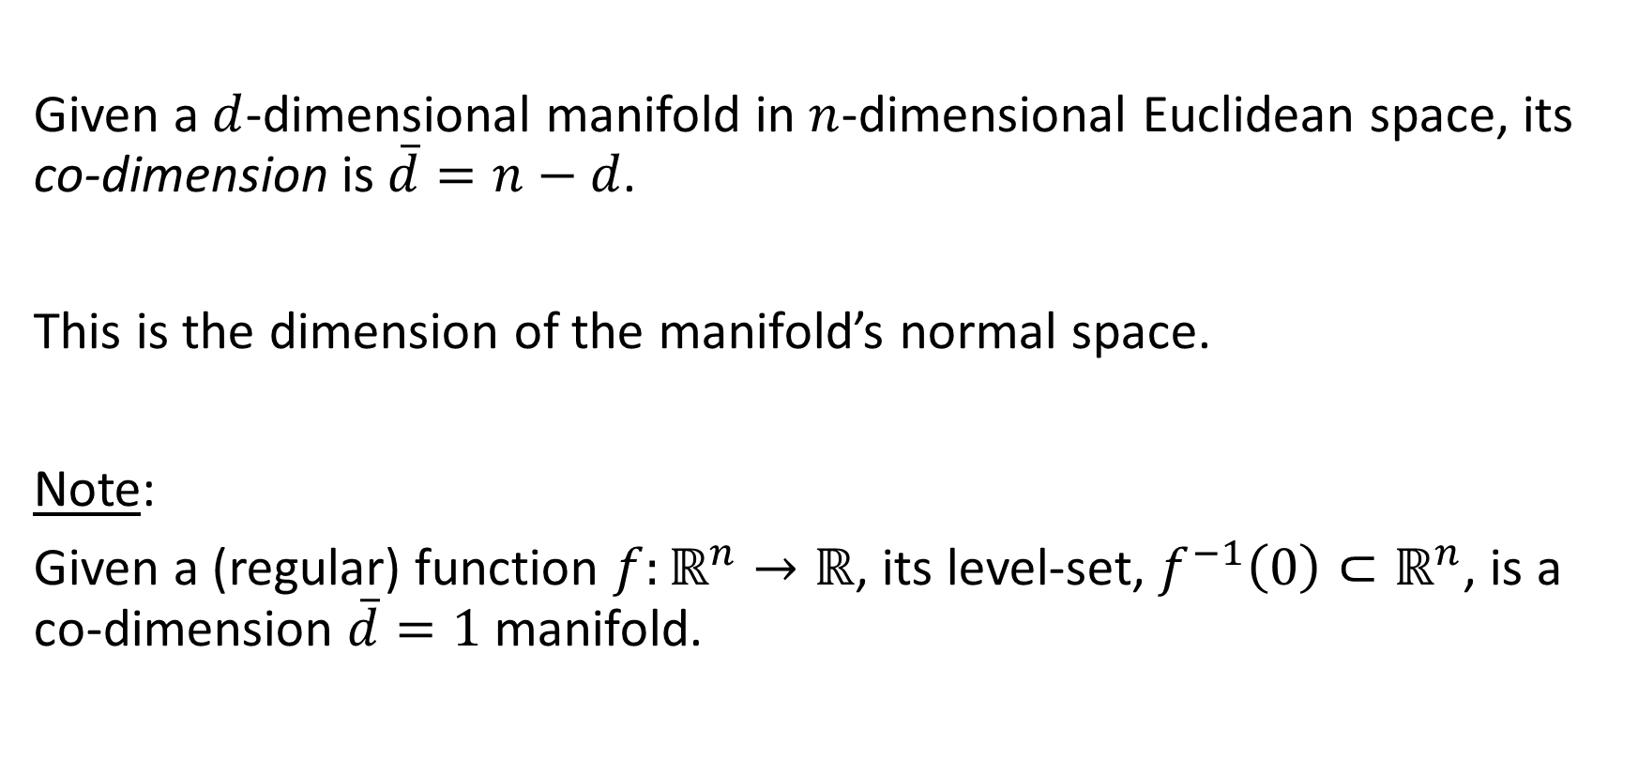
PMR: Definition
Given a $d$-dimensional manifold in $n$-dimensional Euclidean space, its co-dimension is $\overline{d}=n−d$.
This is the dimension of the manifold’s normal space.
Note:
Given a (regular) function $f:ℝ^{n}→ℝ$, its level-set, $f^{−1}\left(0\right)⊂ℝ^{n}$, is a co-dimension $\overline{d}=1$ manifold.

Slide 17

PMR: Definition
For a co-dimension $\overline{d}=2$ manifold:
$⇒$ At every point on the manifold, the normal space is two-dimensional
$⇒$ An oriented sampling should describe the position of points and the two-dimensional (oriented) normal space

Slide 18
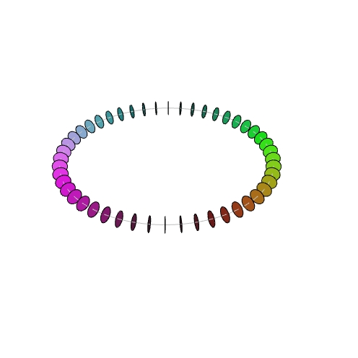
PMR: Naïve
Given a set of points with associated oriented normal spaces:

Slide 19
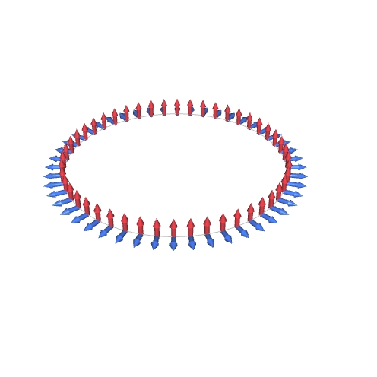
PMR: Naïve
Given a set of points with associated oriented normal spaces:
Frame

Slide 20
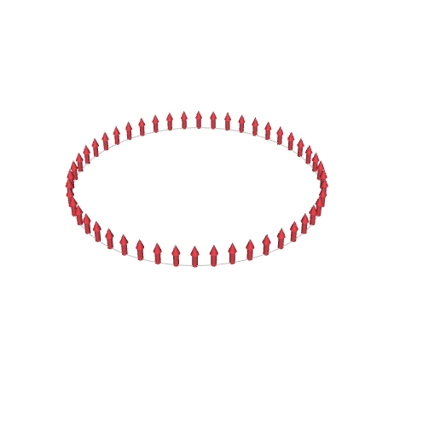
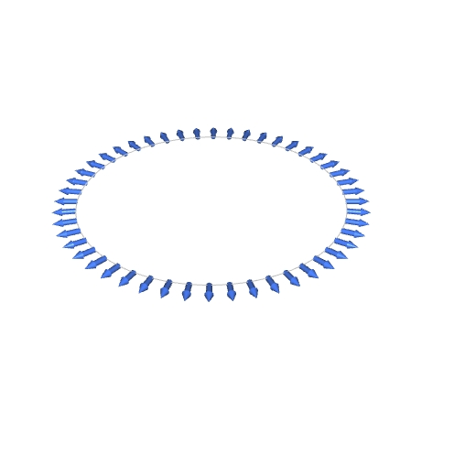
PMR: Naïve
Given a set of points with associated oriented normal spaces:
Frame
Split

Slide 21
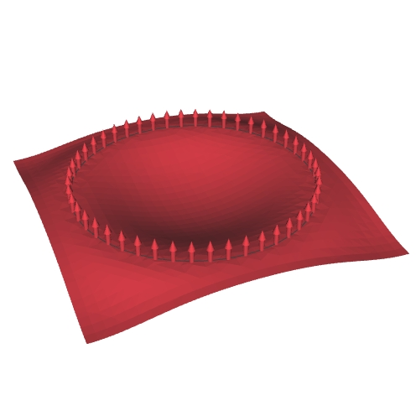
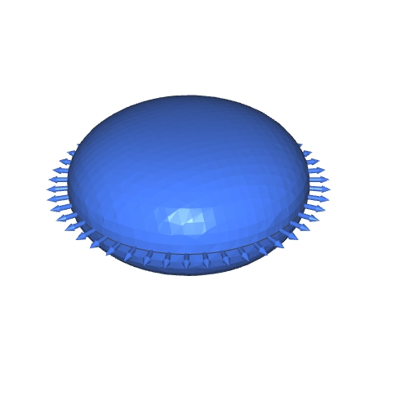
PMR: Naïve
Given a set of points with associated oriented normal spaces:
Frame
Split
Run PSR

Slide 22
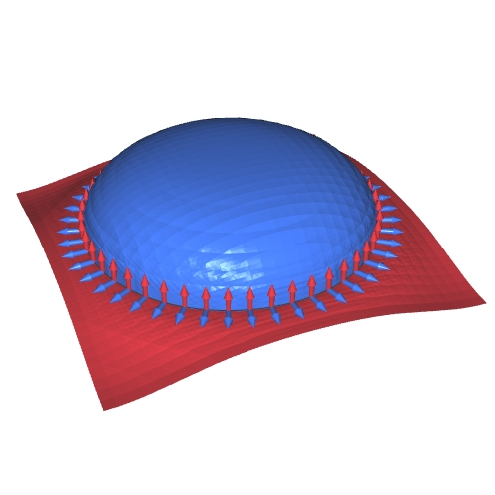
PMR: Naïve
Given a set of points with associated oriented normal spaces:
Frame
Split
Run PSR
Intersect

Slide 23
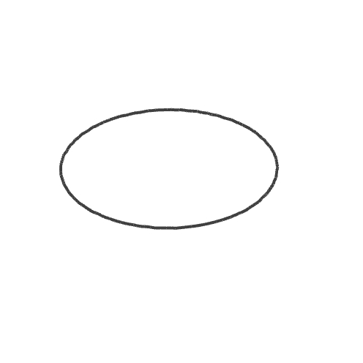
PMR: Naïve
Given a set of points with associated oriented normal spaces:
Frame
Split
Run PSR
Intersect

Slide 24
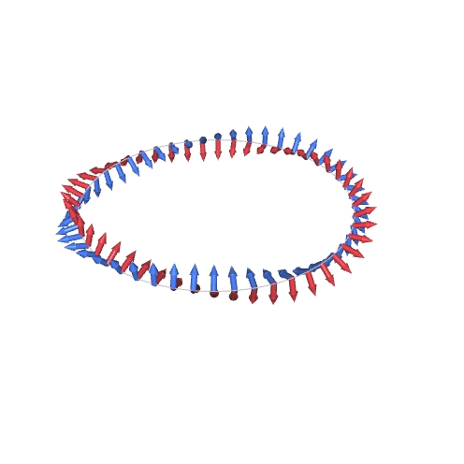
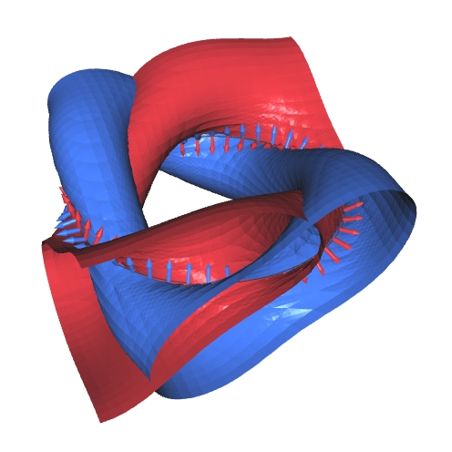
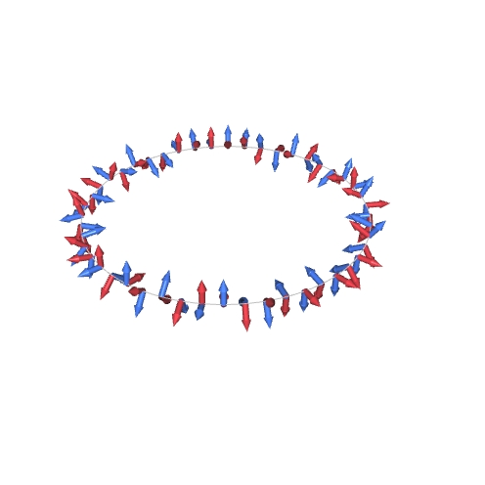
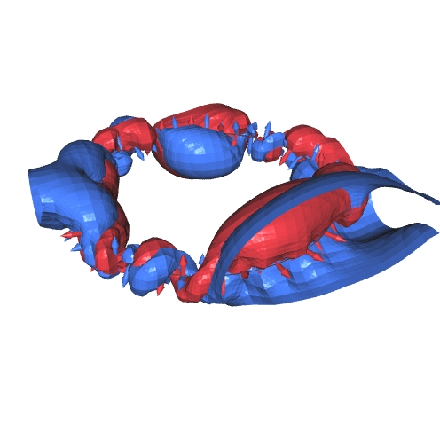
PMR: Naïve
Limitation:
Multiple ways to frame
The solution depends on the choice
Notes:
For example, if we have points sampled from a curve in 3D, we may have a good sense of what the tangents should be. But that does not give a frame.

Slide 25
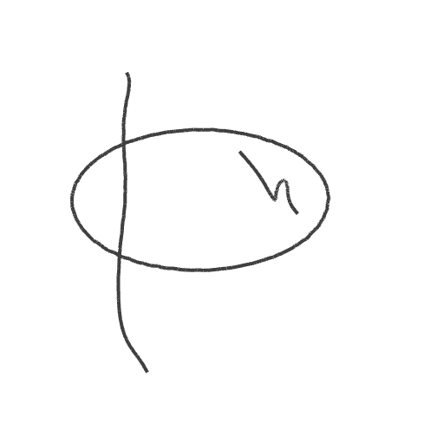
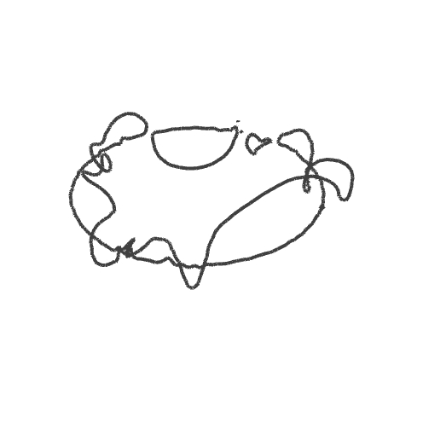
PMR: Naïve
Limitation:
Multiple ways to frame
The solution depends on the choice

Slide 26

PMR: Approach
As in the naïve approach:
The reconstructed manifold is the intersection of the level sets of $χ_{1}$ and $χ_{2}$: $χ_{1}^{−1}\left(0\right)∩χ_{2}^{−1}(0)$
Constrain $∇χ_{1}$ and $∇χ_{2}$ to match the frame vectors
Constrain the oriented span of $∇χ_{1}$ and $∇χ_{2}$ to match the oriented span of the frame vectors
How do we describe the oriented space spanned by a pair of vectors?

Slide 27
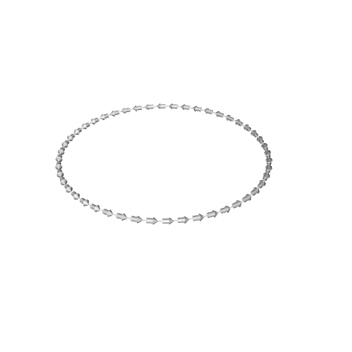
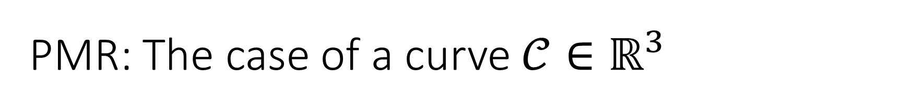
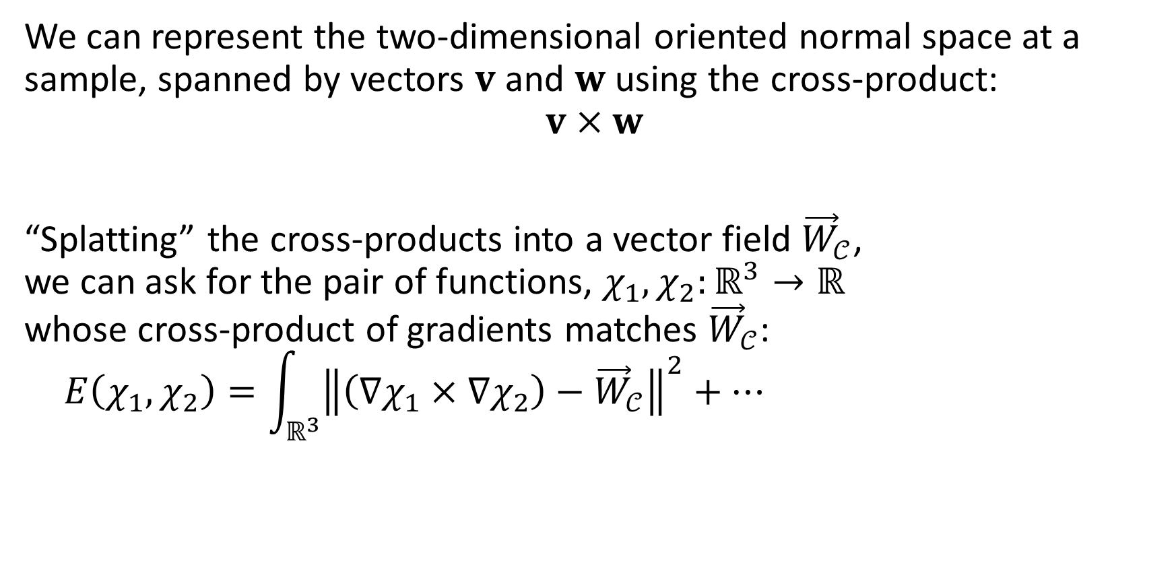
PMR: The case of a curve $𝒞∈ℝ^{3}$
We can represent the two-dimensional oriented normal space at a sample, spanned by vectors $v$ and $w$ using the cross-product:
$$v×w$$
“Splatting” the cross-products into a vector field ${\vec{W}}_{𝒞}$, we can ask for the pair of functions, $χ_{1},χ_{2}:ℝ^{3}→ℝ$ whose cross-product of gradients matches ${\vec{W}}_{𝒞}$:
$$E\left(χ_{1},χ_{2}\right)=\int_{ℝ^{3}}{{\left\|\left(∇χ_{1}×∇χ_{2}\right)−{\vec{W}}_{𝒞}\right\|}^{2}+…}$$

Slide 28

PMR: The case of a curve $𝒞∈ℝ^{3}$
The cross-products will be unchanged as long as the frames:
Span the same plane
Define the same area
Have the same orientation
$⇒$The representation is $SL(2)$-invariant.

Slide 29

PMR: Algebra
For vectors $v,w∈ℝ^{n}$, we can represent the plane spanned by the vectors using the alternating-product $v∧w$.
This can be represented by an $n×n$ matrix:
$$A=v⋅w^{⊤}−w⋅v^{⊤}$$

Slide 30
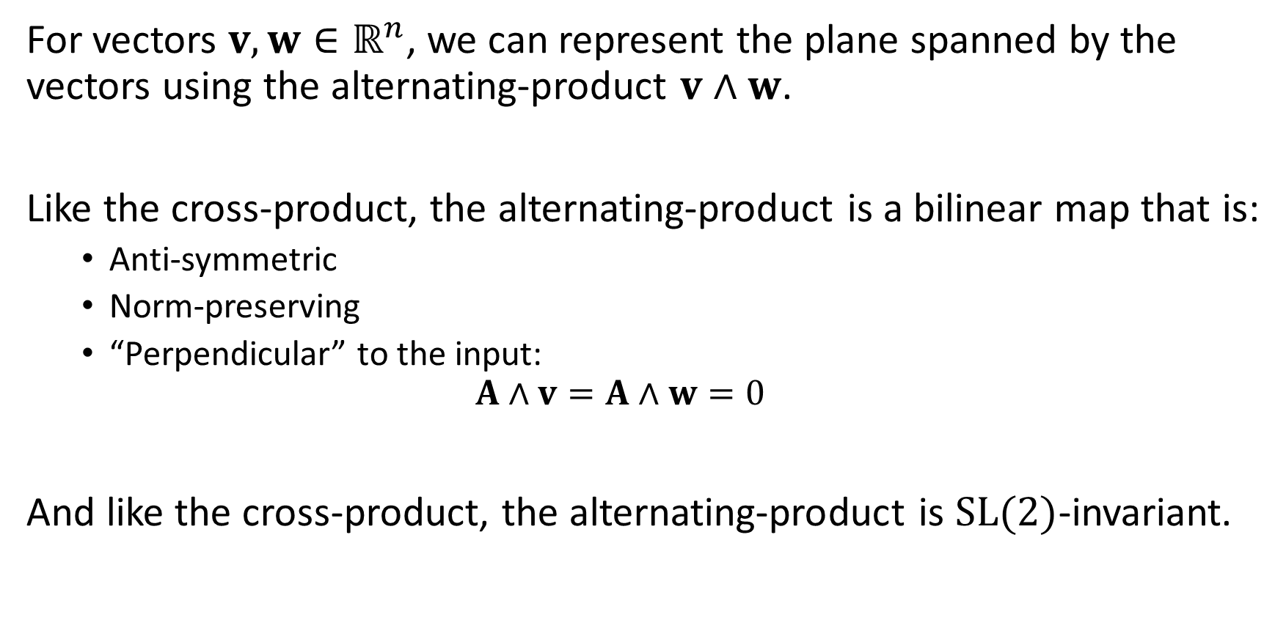
PMR: Algebra
For vectors $v,w∈ℝ^{n}$, we can represent the plane spanned by the vectors using the alternating-product $v∧w$.
Like the cross-product, the alternating-product is a bilinear map that is:
Anti-symmetric
Norm-preserving
“Perpendicular” to the input: $A∧v=A∧w=0$
And like the cross-product, the alternating-product is $SL(2)$-invariant.

Slide 31
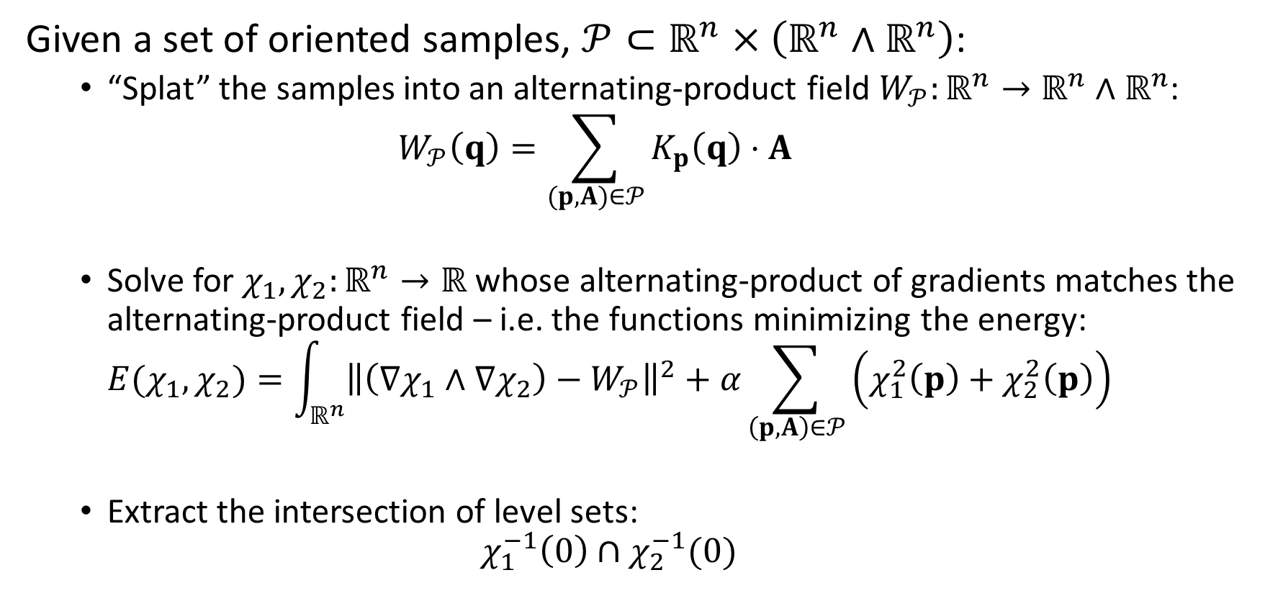
PMR: Approach
Given a set of oriented samples, $𝒫⊂ℝ^{n}×\left(ℝ^{n}∧ℝ^{n}\right)$:
“Splat” the samples into an alternating-product field $W_{𝒫}:ℝ^{n}→ℝ^{n}∧ℝ^{n}$: $W_{𝒫}\left(q\right)=\sum_{(p,A)∈𝒫}{K_{p}\left(q\right)⋅A}$
Solve for $χ_{1},χ_{2}:ℝ^{n}→ℝ$ whose alternating-product of gradients matches the alternating-product field – i.e. the functions minimizing the energy: $E(χ_{1},χ_{2})=\int_{ℝ^{n}}{{\left\|\left(∇χ_{1}∧∇χ_{2}\right)−W_{𝒫}\right\|}^{2}+α\sum_{\left(p,A\right)∈𝒫}{\left(χ_{1}^{2}\left(p\right)+χ_{2}^{2}\left(p\right)\right)}}$
Extract the intersection of level sets: $χ_{1}^{−1}\left(0\right)∩χ_{2}^{−1}(0)$

Slide 32
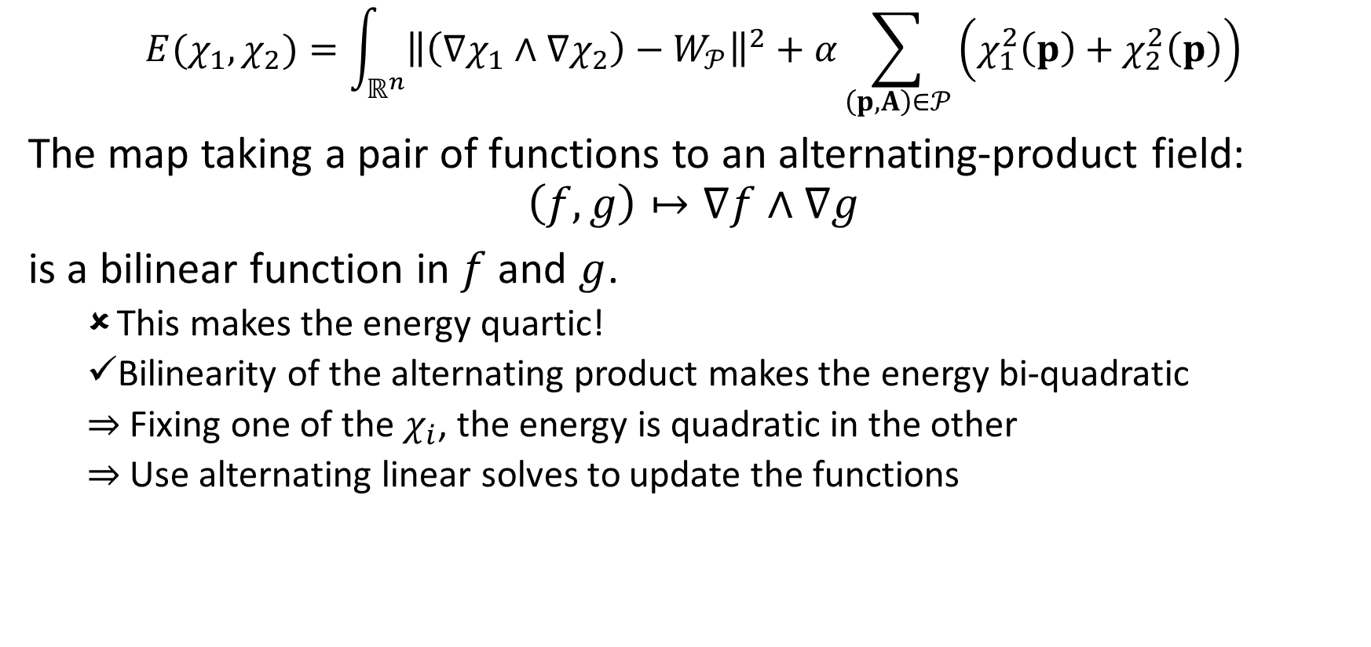
PMR: Implementation
$$E(χ_{1},χ_{2})=\int_{ℝ^{n}}{{\left\|\left(∇χ_{1}∧∇χ_{2}\right)−W_{𝒫}\right\|}^{2}}+α\sum_{\left(p,A\right)∈𝒫}{\left(χ_{1}^{2}\left(p\right)+χ_{2}^{2}\left(p\right)\right)}$$
The map taking a pair of functions to an alternating-product field: $$\left(f,g\right)↦∇f∧∇g$$
is a bilinear function in $f$ and $g$.
This makes the energy quartic!
Bilinearity of the alternating product makes the energy bi-quadratic
$⇒$ Fixing one of the $χ_{i}$, the energy is quadratic in the other
$⇒$ Use alternating linear solves to update the functions

Slide 33
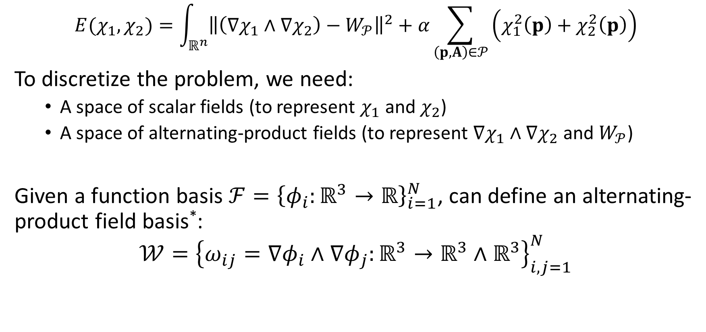
PMR: Discretization
$$E(χ_{1},χ_{2})=\int_{ℝ^{n}}{{\left\|\left(∇χ_{1}∧∇χ_{2}\right)−W_{𝒫}\right\|}^{2}}+α\sum_{\left(p,A\right)∈𝒫}{\left(χ_{1}^{2}\left(p\right)+χ_{2}^{2}\left(p\right)\right)}$$
To discretize the problem, we need:
A space of scalar fields (to represent $χ_{1}$ and $χ_{2}$)
A space of alternating-product fields (to represent $∇χ_{1}∧∇χ_{2}$ and $W_{𝒫}$)
Given a function basis ${ℱ=\left\{φ_{i}:ℝ^{3}→ℝ\right\}}_{i=1}^{N}$, can define an alternating-product field basis*: $$𝒲={\left\{ω_{ij}=∇φ_{i}∧∇φ_{j}:ℝ^{3}→ℝ^{3}∧ℝ^{3}\right\}}_{i,j=1}^{N}$$
*Can restrict to pairs of indices $(i,j)$ with $i<j$ and $Supp\left(φ_{i}\right)∩Supp\left(φ_{j}\right)≠∅$
Notes:
Note that this space of alternating-product fields is guaranteed to contain the altenerating-product of the gradients of any scalar functions we can represent.

Slide 34
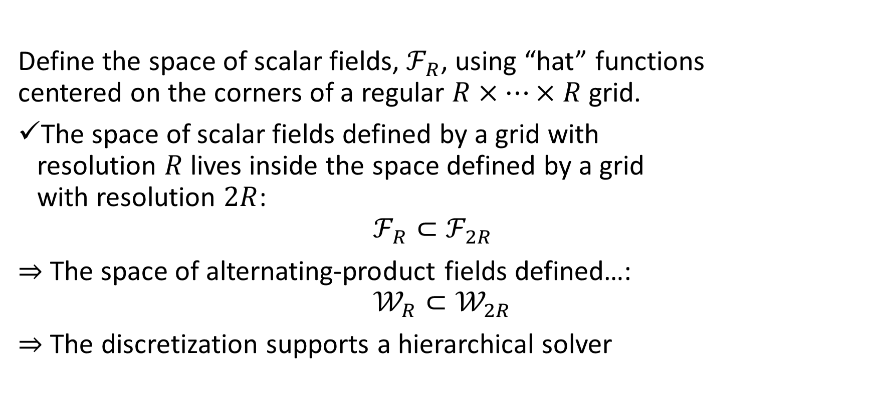
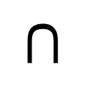
PMR: Discretization
Define the space of scalar fields, $ℱ_{R}$, using “hat” functions centered on the corners of a regular $R×⋯×R$ grid.
The space of scalar fields defined by a grid with resolution $R$ lives inside the space defined by a grid with resolution $2R$: $ℱ_{R}⊂ℱ_{2R}$
$⇒$ The space of alternating-product fields defined…: $$𝒲_{R}⊂𝒲_{2R}$$
$⇒$ The discretization supports a hierarchical solver
$$⊂$$

Slide 35

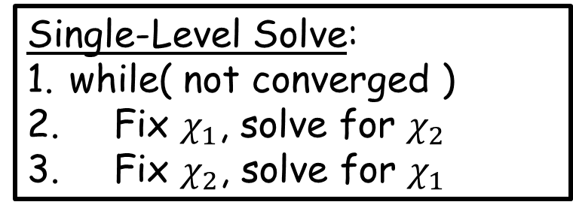
PMR: Implementation
Single-Level Solve:
while( not converged )
Fix $χ_{1}$, solve for $χ_{2}$
Fix $χ_{2}$, solve for $χ_{1}$
Single-Level Solve:
Directly solving to update each of $χ_{1}$ and $χ_{2}$is too expensive

Slide 36

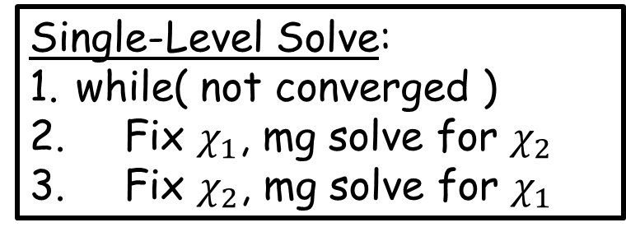
PMR: Implementation
Single-Level Solve:
while( not converged )
Fix $χ_{1}$, mg solve for $χ_{2}$
Fix $χ_{2}$, mg solve for $χ_{1}$
Single-Level Solve:
Directly solving to update each of $χ_{1}$ and $χ_{2}$is too expensive
$⇒$ Leverage the hierarchy to define a multigrid solver

Slide 37

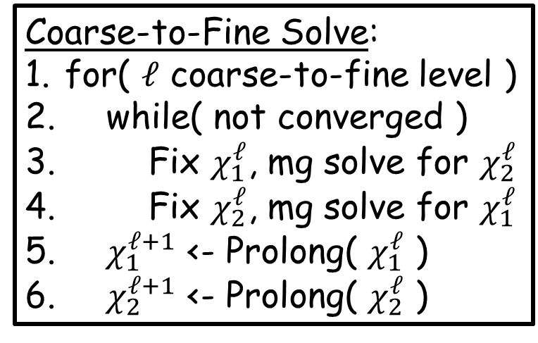
PMR: Implementation
Single-Level Solve:
while( not converged )
Fix $χ_{1}$, mg solve for $χ_{2}$
Fix $χ_{2}$, mg solve for $χ_{1}$
Coarse-to-Fine Solve:
Solve for $(χ_{1},χ_{2})$ hierarchically
$⇒$ Hierarchical solver within each level of a hierarchical solver
Coarse-to-Fine Solve:
for( $ℓ$ coarse-to-fine level )
while( not converged )
Fix $χ_{1}^{ℓ}$, mg solve for $χ_{2}^{ℓ}$
Fix $χ_{2}^{ℓ}$, mg solve for $χ_{1}^{ℓ}$
$χ_{1}^{ℓ+1}$ <- Prolong( $χ_{1}^{ℓ}$ )
$χ_{2}^{ℓ+1}$ <- Prolong( $χ_{2}^{ℓ}$ )
Notes:
[Note] Two nested hierarchical solves

Slide 38
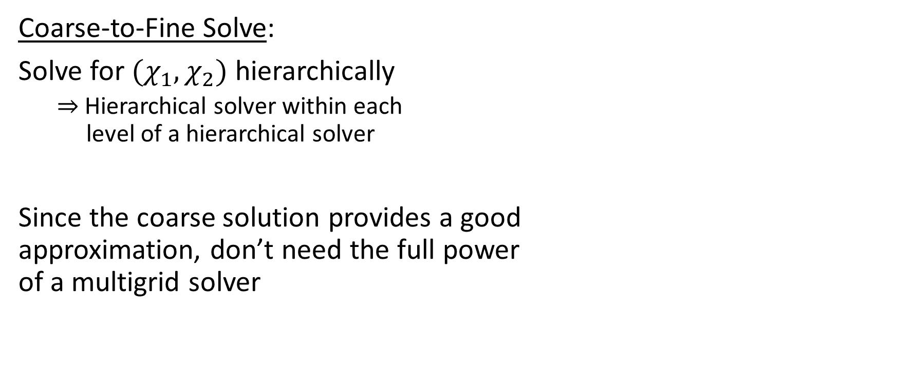

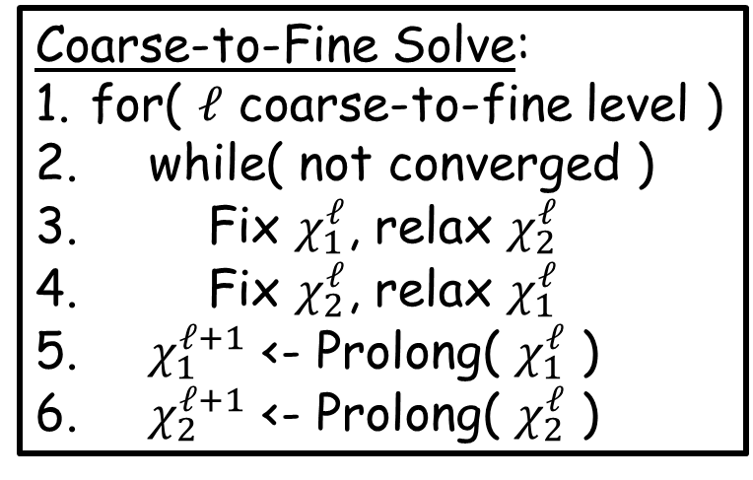
PMR: Implementation
Single-Level Solve:
while( not converged )
Fix $χ_{1}$, mg solve for $χ_{2}$
Fix $χ_{2}$, mg solve for $χ_{1}$
Coarse-to-Fine Solve:
Solve for $(χ_{1},χ_{2})$ hierarchically
$⇒$ Hierarchical solver within each level of a hierarchical solver
Since the coarse solution provides a good approximation, don’t need the full power of a multigrid solver
Coarse-to-Fine Solve:
for( $ℓ$ coarse-to-fine level )
while( not converged )
Fix $χ_{1}^{ℓ}$, relax $χ_{2}^{ℓ}$
Fix $χ_{2}^{ℓ}$, relax $χ_{1}^{ℓ}$
$χ_{1}^{ℓ+1}$ <- Prolong( $χ_{1}^{ℓ}$ )
$χ_{2}^{ℓ+1}$ <- Prolong( $χ_{2}^{ℓ}$ )

Slide 39



PMR vs. PSR
$$E\left(χ\right)=\int_{ℝ^{3}}{{\left\|∇χ−{\vec{V}}_{𝒫}\right\|}^{2}}+…$$
In ideal Poisson Surface Reconstruction, the reconstructed function is constrained everywhere:
Away from the samples the gradients are zero
$⇒$ The function should be constant away from the samples

Slide 40


PMR vs. PSR
$$E\left(χ\right)=\int_{ℝ^{3}}{{\left\|∇χ−{\vec{V}}_{𝒫}\right\|}^{2}}+…$$
In ideal Poisson Surface Reconstruction, the reconstructed function is constrained everywhere:
Away from the samples the gradients are zero
$⇒$ The function should be constant away from the samples
The input points are close to the level-set
The level-set is close to the input points

Slide 41



PMR vs. PSR
$$E\left(χ\right)=\int_{ℝ^{3}}{{\left\|∇χ−{\vec{V}}_{𝒫}\right\|}^{2}}+…$$
When data is missing, we have competing objectives:
Need to transition from interior to exterior
Gradients should vanish away from samples

Slide 42


PMR vs. PSR
$$E\left(χ\right)=\int_{ℝ^{3}}{{\left\|∇χ−{\vec{V}}_{𝒫}\right\|}^{2}}+…$$
When data is missing, we have competing objectives:
Need to transition from interior to exterior
Gradients should vanish away from samples
The input points are close to the level-set
The level-set may not be close to the input points

Slide 43



PMR vs. PSR
$$E\left(χ_{1},χ_{2}\right)=\int_{ℝ^{n}}{{\left\|\left(∇χ_{1}∧∇χ_{2}\right)−W_{𝒫}\right\|}^{2}}+…$$
In Poisson Manifold Reconstruction, we only have samples from the intersection curve, not the level-sets surfaces.
We don’t explicitly constrain the gradients of the $χ_{i}$:
Away from the samples the alternating product could be zero because the gradients of the functions are zero, or
It could be zero because the gradients are parallel
The input points are close to the intersection of level-sets
The intersection of level-sets could contain spurious geometry
Notes:
1. This is true even for an “ideal” point set.

Slide 44

PMR: (Non-)Uniqueness
$$E\left(χ_{1},χ_{2}\right)=\int_{ℝ^{n}}{{\left\|\left(∇χ_{1}∧∇χ_{2}\right)−W_{𝒫}\right\|}^{2}}+…$$
Recall:
The alternating-product is $SL(2)$-invariant.
$⇒$ The solution is unique up to the action of $SL(2)$.
Claim:
We can reduce to $SO(2)$-invariance, by adding a Dirichlet energy term:
$$E\left(χ_{1},χ_{2}\right)=…+β\int_{ℝ^{n}}{{\left\|∇χ_{1}\right\|}^{2}+{\left\|∇χ_{2}\right\|}^{2}}$$

Slide 45

PMR: (Non-)Uniqueness
$$E\left(χ_{1},χ_{2}\right)=…+β\int_{ℝ^{n}}{{\left\|∇χ_{1}\right\|}^{2}+{\left\|∇χ_{2}\right\|}^{2}}$$
Motivation:
Given $u∈ℝ^{3}$, solve for $v,w∈ℝ^{3}$ such that $u=v×w$.
$⇒$ The solution is unique up to the action of $SL(2)$
Of all solutions satisfying $u=v×w$, find the one minimizing: $$E\left(v,w\right)={\left\|v\right\|}^{2}+{\left\|w\right\|}^{2}$$
$⇒$ The optimal solution will satisfy ${\left\|v\right\|}^{2}={\left\|w\right\|}^{2}=\left\|u\right\|$ and $\left\langle v,w\right\rangle =0$
$⇒$ The solution will be an orthogonal frame, unique up to the action of $SO(2)$

Slide 46

PMR: (Non-)Uniqueness
Implications:
At a sample $\left(p,A\right)∈𝒫⊂ℝ^{n}×\left(ℝ^{n}∧ℝ^{n}\right)$:
Screening: $χ_{1}\left(p\right)=χ_{2}\left(p\right)=0$
Dirichlet: ${\left\|∇χ_{1}{\left.​\right|}_{p}\right\|}^{2}={\left\|∇χ_{2}{\left.​\right|}_{p}\right\|}^{2}=\left\|W_{𝒫}\left(p\right)\right\|$ $\left\langle ∇χ_{1}{\left.​\right|}_{p},∇χ_{2}{\left.​\right|}_{p}\right\rangle =0$
If we consider the sum of the squares of the functions:
$\left(χ_{1}^{2}+χ_{2}^{2}\right)\left(p\right)=χ_{1}^{2}\left(p\right)+χ_{2}^{2}\left(p\right)=0$
$∇\left(χ_{1}^{2}+χ_{2}^{2}\right){\left.​\right|}_{p}=2\left(χ_{1}\left(p\right)⋅∇χ_{1}{\left.​\right|}_{p}+χ_{2}\left(p\right)⋅∇χ_{2}{\left.​\right|}_{p}\right)=0$
$H_{\left(χ_{1}^{2}+χ_{2}^{2}\right)}\left(p\right)=2\left(∇χ_{1}{\left.​\right|}_{p}^{⊤}⋅∇χ_{1}{\left.​\right|}_{p}+∇χ_{2}{\left.​\right|}_{p}^{⊤}⋅∇χ_{2}{\left.​\right|}_{p}\right)=\left\|W_{𝒫}\left(p\right)\right\|⋅Id.$

Slide 47

PMR: (Non-)Uniqueness
Implications:
At a sample $\left(p,A\right)∈𝒫⊂ℝ^{n}×\left(ℝ^{n}∧ℝ^{n}\right)$:
$\left(χ_{1}^{2}+χ_{2}^{2}\right)\left(p\right)=0$
$∇\left(χ_{1}^{2}+χ_{2}^{2}\right){\left.​\right|}_{p}=0$
$H_{\left(χ_{1}^{2}+χ_{2}^{2}\right)}\left(p\right)=\left\|W_{𝒫}\left(p\right)\right\|⋅Id.$
$⇒$ Locally, the sum of squares $χ_{1}^{2}+χ_{2}^{2}$ should be radial, increasing with squared normal distance from $p$
$⇒$ Spurious zero level-set geometry should be nowhere close to the samples

Slide 48


PMR: (Non-)Uniqueness
Implications:
At a sample $\left(p,A\right)∈𝒫⊂ℝ^{n}×\left(ℝ^{n}∧ℝ^{n}\right)$:
$\left(χ_{1}^{2}+χ_{2}^{2}\right)\left(p\right)=0$
$∇\left(χ_{1}^{2}+χ_{2}^{2}\right){\left.​\right|}_{p}=0$
$H_{\left(χ_{1}^{2}+χ_{2}^{2}\right)}\left(p\right)=\left\|W_{𝒫}\left(p\right)\right\|⋅Id.$
$⇒$ Locally, the sum of squares $χ_{1}^{2}+χ_{2}^{2}$ should be radial, increasing with squared normal distance from $p$
$⇒$ Spurious zero level-set geometry should be nowhere close to the samples
Can use sampling density to identify spurious geometry

Slide 49
Outline
Poisson Surface Reconstruction (PSR)
Poisson Manifold Reconstruction (PMR)
Evaluation
Conclusion

Slide 50




Evaluation: Torus Knots in $ℝ^{3}$
Notes:
2/3 @ N=1024 D=6

Slide 51



Evaluation: Torus Knots in $ℝ^{3}$
Notes:
3/7 @ N=1024 D=6

Slide 52



Evaluation: Torus Knots in $ℝ^{3}$
Notes:
8/13 @ N=2048 D=7

Slide 53




Evaluation: Hopf Torus in $S^{3}$ (after stereo projection)
Notes:
0 / 0.75 @ N=1024^2 , D=5
[NOTE] In the visualization, disks represent the tangent space, not the normal space.

Slide 54




Evaluation: Hopf Torus in $S^{3}$ (after stereo projection)
Notes:
4 / 0.75 @ N=1024^2 , D=5
[NOTE] In the visualization, disks represent the tangent space, not the normal space.

Slide 55



Evaluation: Hopf Torus in $S^{3}$ (after stereo projection)
Notes:
8 / 0.75 @ N=1024^2 , D=5
[NOTE] In the visualization, disks represent the tangent space, not the normal space.

Slide 56
Evaluation: Stability
Because PMR is built on PSR, we expect it to inherit stability in the presence of:
Non-uniform sampling
Random spot noise
Inaccurate positions/normals

Slide 57









Evaluation: Links in $ℝ^{3}$ (non-uniform sampling)
Notes:
Inherit the robustness from PSR

Slide 58







Evaluation: Links in $ℝ^{3}$ (spot noise)

Slide 59







Evaluation: Links in $ℝ^{3}$ (position/normal noise)

Slide 60

Evaluation: Delaunay Techniques
Starting with a Delaunay triangulation:
Geometry as boundary (co-dimension 1)
Label $n$-dimensional cells as interior/exterior
Extract the boundary
Guarantees a water-tight solution
Direct to geometry (co-dimension $\overline{d}$)
Select the subset of $\overline{d}$-dimensional simplices that lie on the geometry
Guarantees a manifold solution if sampling conditions are met
Otherwise, the output may not be manifold

Slide 61












Samples
[Boissonnat et al. 2010]
PMR
Notes:
The approach is based on the cocone method which directly selects the simplices (rather than using the boundary).
As a result, there is no guarantee that the results are manifold if sampling conditions are not me.

Slide 62












Samples
[Boissonnat et al. 2010]
PMR
Notes:
The approach is based on the cocone method which directly selects the simplices (rather than using the boundary).
As a result, there is no guarantee that the results are manifold if sampling conditions are not me.

Slide 63





















Evaluation: Convergence (energy)
iters=1
iters=2
iters=4
iters=8
iters=16
$$E=0.50$$
$$E=0.37$$
$$E=0.32$$
$$E=0.27$$
$$E=0.23$$
Single-level solve
$$E=0.40$$
$$E=0.33$$
$$E=0.29$$
$$E=0.26$$
$$E=0.24$$
Hierarchical solve
Notes:
Note: Lower error for single-level solve does not translate into higher quality results.

Slide 64
Evaluation: Convergence (time)
iters=1
iters=2
iters=4
iters=8
iters=16
21.6 (s)
41.3 (s)
82.5 (s)
160.7 (s)
336.9 (s)
Single-level solve
0.9 (s)
1.8 (s)
3.6 (s)
7.1 (s)
13.9 (s)
Hierarchical solve
Notes:
More than 20x slower

Slide 65










Evaluation: Convergence (initialization)
Single-level solve (iters=32)
Hierarchical solve (iters=4)
Notes:
Note that this is after solving for the optimal rotation in SO(2) aligning to the first result.

Slide 66


Evaluation: Convergence (initialization)
Single-level solve (iters=32)
Hierarchical solve (iters=4)
Notes:
Note that this is after solving for the optimal rotation in SO(2) aligning to the first result.

Slide 67




Evaluation: Complexity
Discretizing using the hat basis at the corners of an $R×⋯×R$ grid:
The space of scalar/alternating-product fields has dimension $O\left(R^{n}\right)$
The system matrices are sparse and have $O(R^{n})$ non-zero entries
$⇒$ With a multigrid solver, space/time complexity is $O(R^{n})$
 | $$n=3$$ |  | $$n=4$$
Resolution ($R$) | Time (s) | Memory (MB) | Time (s) | Memory (MB)
$$16$$ | 0.4 | 14 | 93.4 | 748
$$32$$ | 2.5 | 64 | 1300.4 | 5522
$$64$$ | 21.5 | 420 | 23,361.3 | 60,698
$$128$$ | 188.5 | 3331 | --- | ---
$$256$$ | 1725.3 | 25,809 | --- | ---
$$×8$$
$$×16$$

Slide 68
Outline
Poisson Surface Reconstruction (PSR)
Poisson Manifold Reconstruction (PMR)
Evaluation
Conclusion

Slide 69

Conclusion
$$E\left(χ\right)=\int_{ℝ^{3}}{{\left\|∇χ−{\vec{V}}_{𝒫}\right\|}^{2}}+…$$
$$⇓$$
$$E\left(χ_{1},χ_{2}\right)=\int_{ℝ^{n}}{{\left\|\left(∇χ_{1}∧∇χ_{2}\right)−W_{𝒫}\right\|}^{2}}+…$$
Introduced a generalization of PSR to manifolds of higher co-dimension
Express optimization in terms of alternating products
Leverage the bi-quadratic nature of the energy
Benefits of the PSR framework carry over
screening
hierarchical solver
density estimation
stability to noise

Slide 70

Conclusion: Future Work
Use an adaptive hierarchy for efficiency: $O\left(R^{n}\right)→O(R^{d})$
Implement for co-dimension $\overline{d}>2$
Extend to the reconstruction of sub-manifolds
Better understand the energy landscape and convergence
Notes:
Winding Numbers on Discrete Surfaces [Feng, Gillespie, Crane; 2023]

Slide 71
Conclusion: Qualifier
The manifold must be orientable
The manifold must have a trivial normal bundle (projective 2-space is orientable but does not have a trivial bundle)
Must be the level set of an implicit functions (Akbulut [1985] shows that a trivial normal bundle is not sufficient)
Notes:
With a trivial normal bundle, we can define an implicit function in a tubular neighborhood.
But we may still have spurious geometry elsewhere.

Slide 72






Thank You
https://github.com/mkazhdan/ExteriorPoissonRecon

Slide 74

Higher co-dimension
In co-dimension $\overline{d}=2$, the alternating product of $u,v∈ℝ^{n}$ is represented by the anti-symmetric matrix:
$$A=v⋅w^{⊤}−w⋅v^{⊤}$$
$⇔$ $u∧v$ is represented by the anti-symmetric 2-tensor $A∈ℝ^{n×n}$ w/: $$A_{ij}=\sum_{σ∈S_{2}}{\operatorname{sgn}\left(σ\right)⋅u_{σ\left(i\right)}⋅v_{σ\left(j\right)}}$$
$⇒$ $u^{1}∧⋯∧u^{\overline{d}}$ is represented by the anti-symmetric $\overline{d}$-tensor $A∈ℝ^{n×⋯×n}$ w/: $$A_{i_{1}⋯i_{\overline{d}}}=\sum_{σ∈S_{\overline{d}}}{\operatorname{sgn}\left(σ\right)⋅u_{σ\left(i_{1}\right)}^{1}⋯u_{σ\left(i_{\overline{d}}\right)}^{\overline{d}}}$$

