Slide 1
Phong-Rodrigues Extrinsic Vector-Field Processing
Hongyi Liu, Oded Stein, Amir Vaxman, Mirela Ben-Chen, Misha Kazhdan
Notes:
Johns Hopkins
University of Edinburgh
Technion

Slide 2
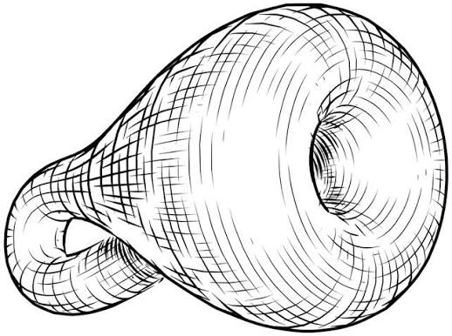
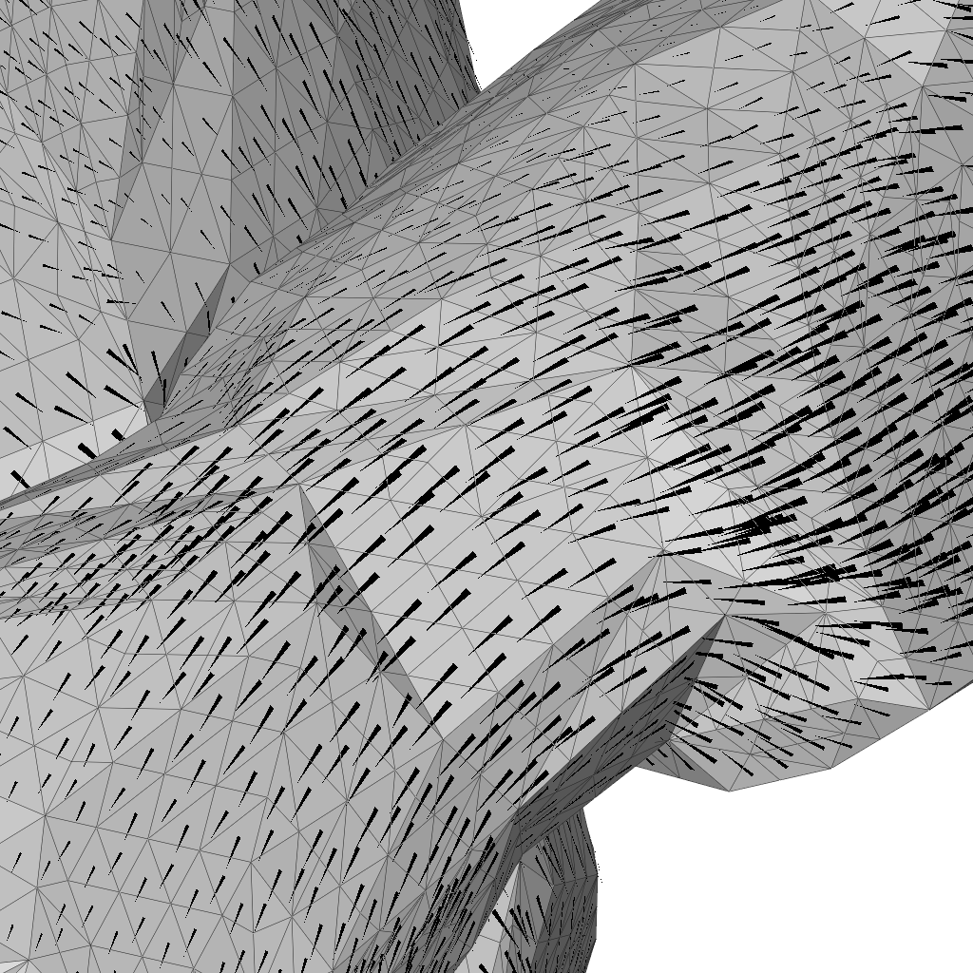
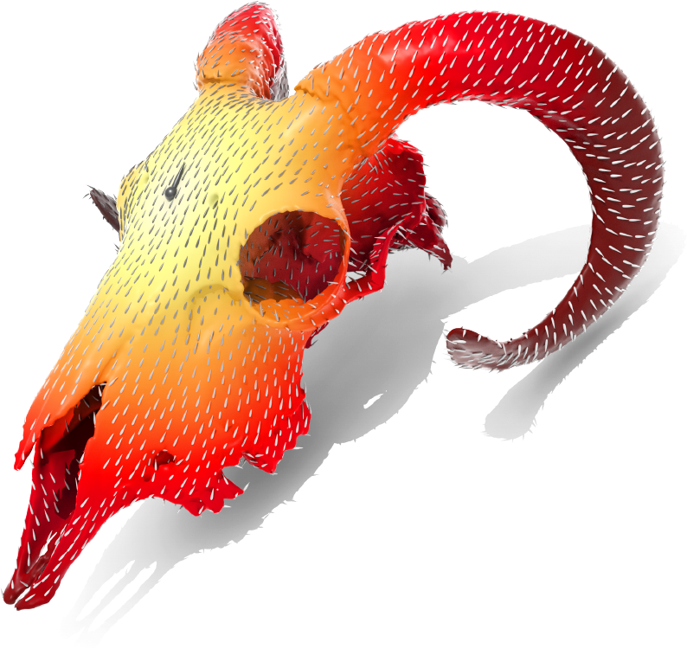
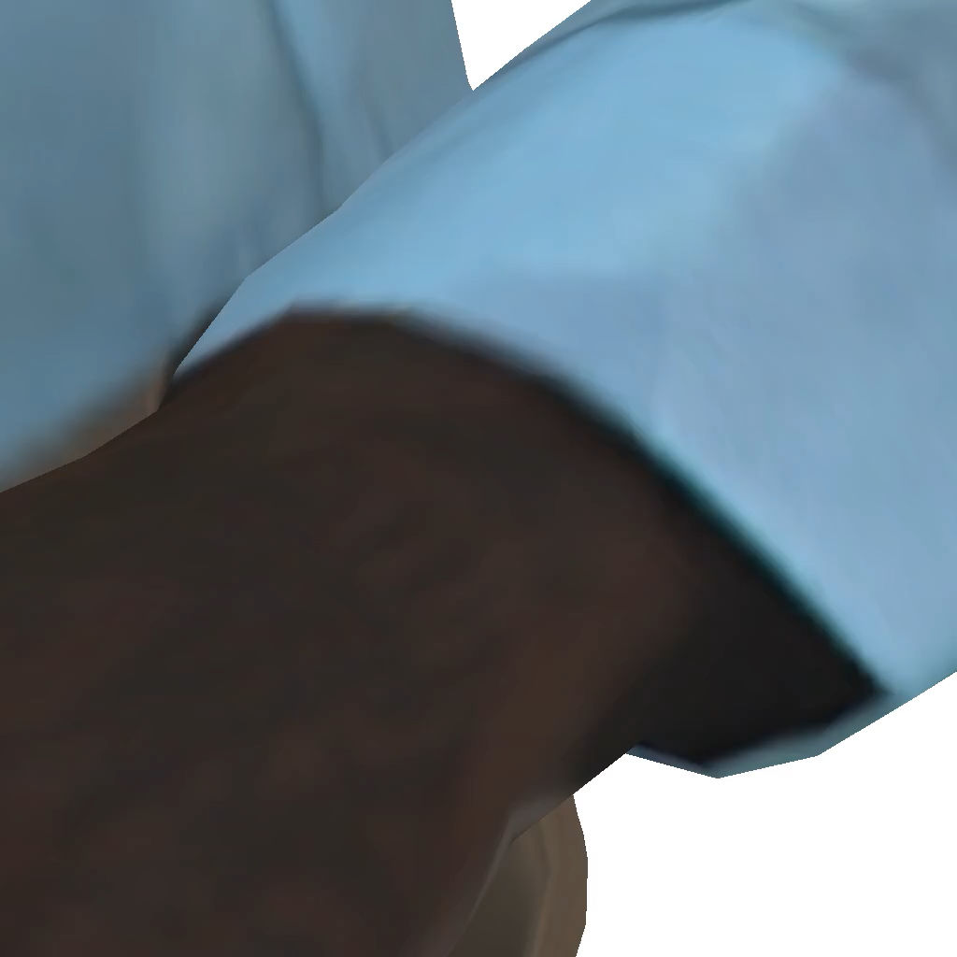

Vector Field Processing
  Frame-field design
  Diffeomorphisms
  Fluid simulation
  Etc.
[Hertzmann and Zorin, 2000]
[Praun et al., 2000]
Need to represent and differentiate
tangent vector fields on triangle meshes
[Palacios and Zhang, 2007]
[Elcott et al., 2007]
[Ben-Chen et al., 2010]
[Sharp et al., 2019]
[Prada et al., 2016]
[Bommes et al., 2009]

Slide 3
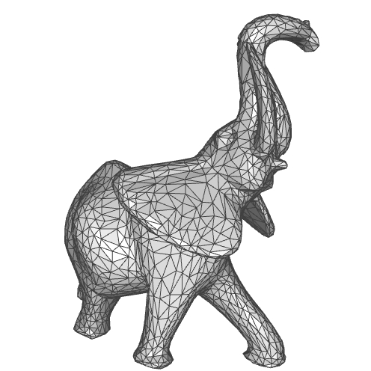


Vector Field Processing: Challenge
Direct approach:
  Represent as vector-valued functions, perpendicular to the normal
  The notion of “tangency” is consistent with the geometry
  The notion of “tangency” is discontinuous across edges
  $⇒$ Derivatives unbounded across edges
$$\vec{n}$$

Slide 4
Vector Field Processing: Challenge
Variety of approaches, discretizing over different elements
  Discrete Differential Geometry (intrinsic, vertices/faces)
    Couple representation/differentiation
      [Knöppel et al., 2015][Sharp et al., 2019][Boksebeld and Vaxman, 2022]
  Finite Elements (intrinsic, edges/vertices)
    Use “partially” continuous fields
      [Whitney, 1957][Stein et al., 2020]
    Explicitly define transport
      [Knöppel et al., 2013][Liu et al., 2016]
  Operator-Based (extrinsic, vertices)
    Represent vector-fields through their action as derivations
      [Azencot et al., 2015]
Notes:
Discrete Differential Geometry approaches bypass the problem by coupling representation and differentiation, thereby avoiding having to explicitly evaluate the vector-field.
Finite elements approaches either enforce partial continuity (either at the mid-point, or along the tangential direction) or introduce curvature into the geometry, indirectly, by modifying the notion of parallel transport
Operator-based approach re-formulate the discretization by treating vector-fields as linear operators.
And there are many more…

Slide 5
Vector Field Processing: Approach
Adress using an extrinsic formulation,
leveraging intuition from rendering
  Using geometric normals gives
  faceted shading
  Using interpolated (Phong) normals
  gives continuous shading
[Phong ,1975]

Slide 6
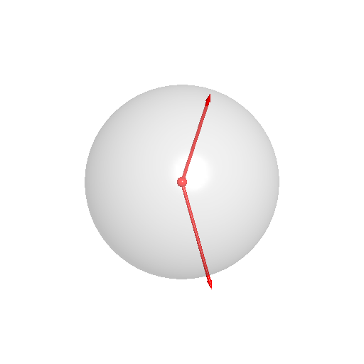



Vector Field Processing: Review
Definition:
  For non-antipodal vectors $\vec{v},\vec{w}∈S^{2}$, the Rodrigues rotation
  is the minimal angle rotation taking $\vec{v}$ to $\vec{w}$.
$$\vec{w}$$
$$\vec{v}$$

Slide 7
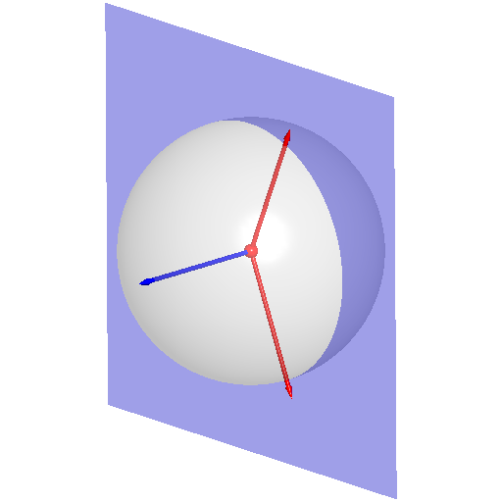


Vector Field Processing: Review
Definition:
  For non-antipodal vectors $\vec{v},\vec{w}∈S^{2}$, the Rodrigues rotation
  is the minimal angle rotation taking $\vec{v}$ to $\vec{w}$.
  This is a rotation about the perpendicular
$$\vec{w}$$
$$\vec{v}×\vec{w}$$
$$\vec{v}$$

Slide 8



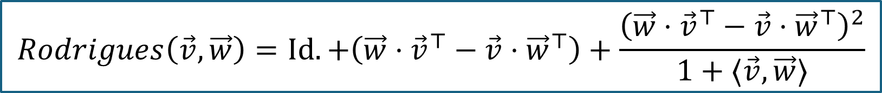
Vector Field Processing: Review
Definition:
  For non-antipodal vectors $\vec{v},\vec{w}∈S^{2}$, the Rodrigues rotation
  is the minimal angle rotation taking $\vec{v}$ to $\vec{w}$.
  This is a rotation about the perpendicular
  By the angle between the vectors
$$\vec{w}$$
$$∠\vec{v},\vec{w}$$
$$\vec{v}×\vec{w}$$
$$\vec{v}$$
$$Rodrigues\left(\vec{v},\vec{w}\right)=Id.+\left(\vec{w}⋅{\vec{v}}^{⊤}−\vec{v}⋅{\vec{w}}^{⊤}\right)+\frac{{\left(\vec{w}⋅{\vec{v}}^{⊤}−\vec{v}⋅{\vec{w}}^{⊤}\right)}^{2}}{1+⟨\vec{v},\vec{w}⟩}$$
Notes:
Note that this equation:
Generalizes to arbitrary dimensions
Does not use trigonometric functions, only requiring ratios of polynomials

Slide 9
1. How to compute the (covariant) derivative of a vector-field?

Slide 10
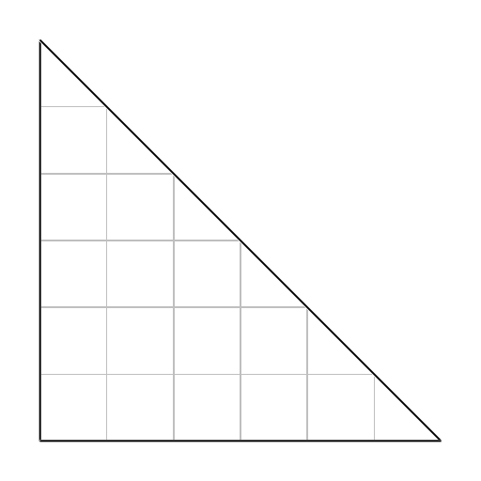
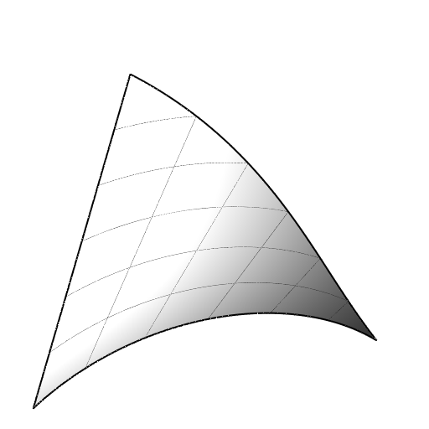
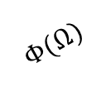



Differentiating: Review
$$Φ$$
Given:
  A domain $Ω⊂ℝ^{2}$
  A parameterization $Φ:Ω→ℝ^{3}$
$$Ω$$
$$Φ(Ω)$$

Slide 11
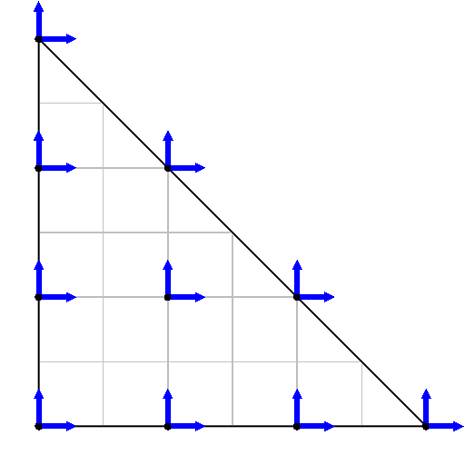
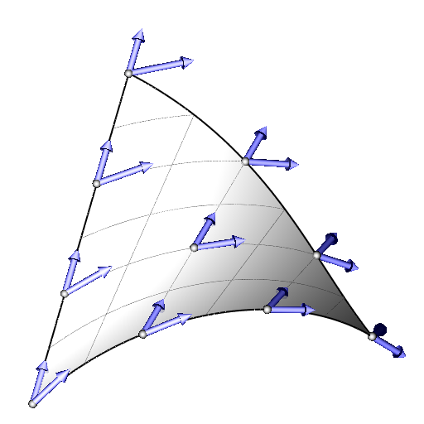

Differentiating: Review
$$Φ$$
Given:
  A domain $Ω⊂ℝ^{2}$
  A parameterization $Φ:Ω→ℝ^{3}$
The differential $dΦ{\left.​\right|}_{p}$ gives the change along coordinate directions
$$Ω$$
$$Φ(Ω)$$

Slide 12
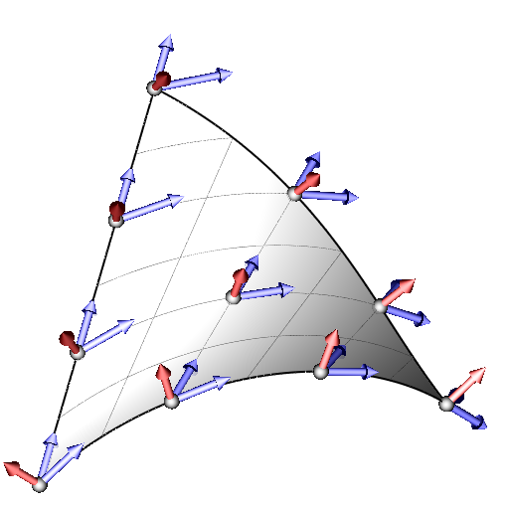
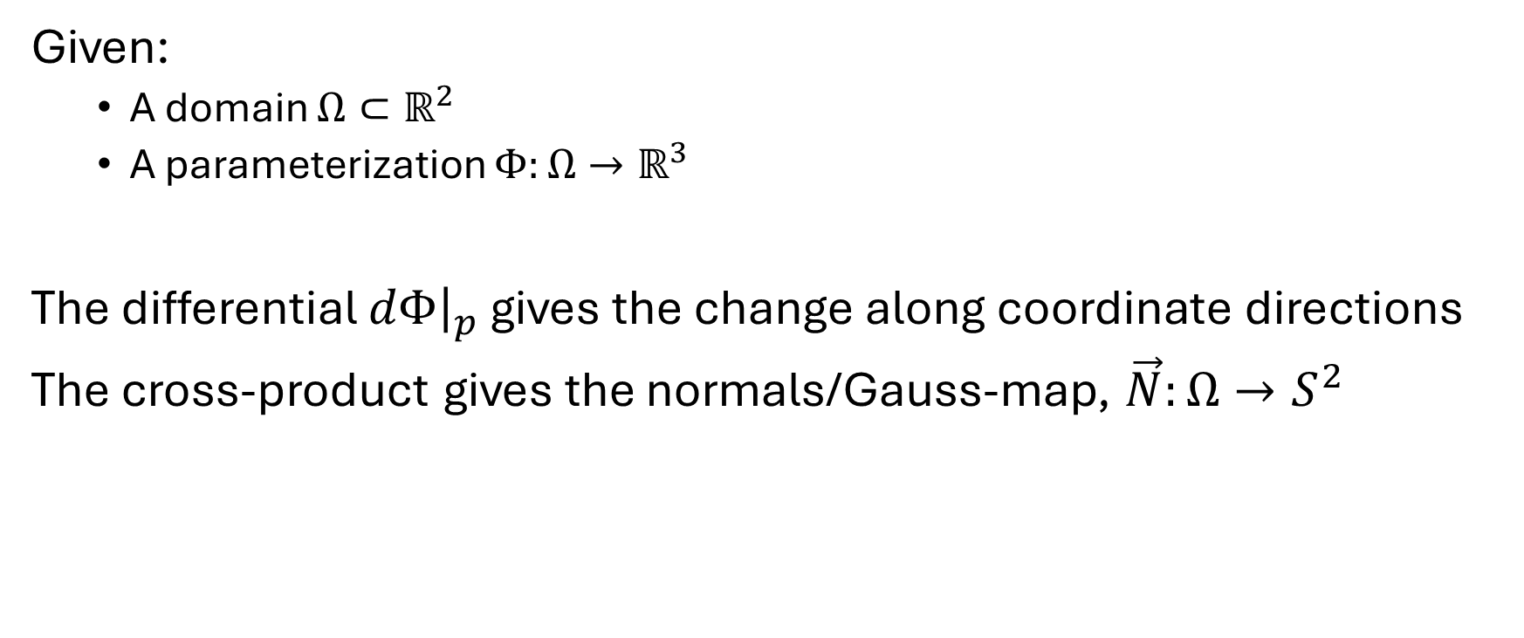
Differentiating: Review
$$Φ$$
Given:
  A domain $Ω⊂ℝ^{2}$
  A parameterization $Φ:Ω→ℝ^{3}$
The differential $dΦ{\left.​\right|}_{p}$ gives the change along coordinate directions
The cross-product gives the normals/Gauss-map, $\vec{N}:Ω→S^{2}$
$$Ω$$
$$Φ(Ω)$$

Slide 13


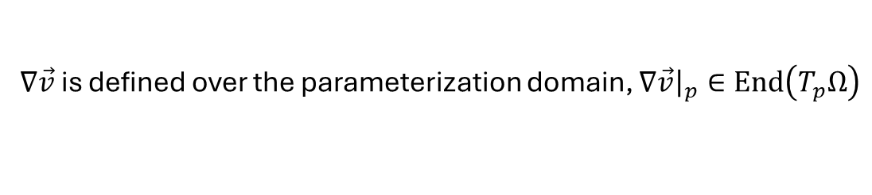
Differentiating: Review
$$Φ$$
Given:
  A domain $Ω⊂ℝ^{2}$
  A parameterization $Φ:Ω→ℝ^{3}$
The differential $dΦ{\left.​\right|}_{p}$ gives the change along coordinate directions
The cross-product gives the normals/Gauss-map, $\vec{N}:Ω→S^{2}$
$$Ω$$
$$Φ(Ω)$$
For a tangent vector field $\vec{v}:Ω→ℝ^{3}$, the covariant derivative is:
$$∇\vec{v}=dΦ^{+}∘d\vec{v}$$
$dΦ^{+}$ is the Moore-Penrose pseudoinverse
$∇\vec{v}$ is defined over the parameterization domain, $∇\vec{v}{\left.​\right|}_{p}∈End\left(T_{p}Ω\right)$
Notes:
Could apply $dΦ$ to $∇\vec{v}$ to get a (singular) $3×3$ matrix if we want to…

Slide 14
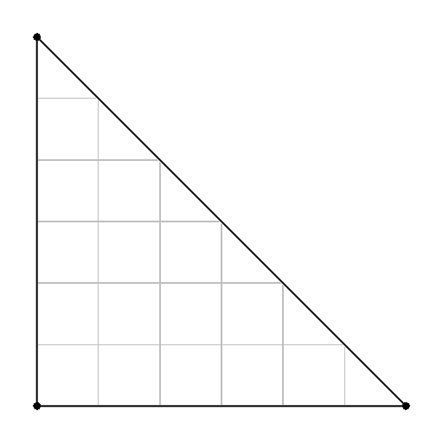
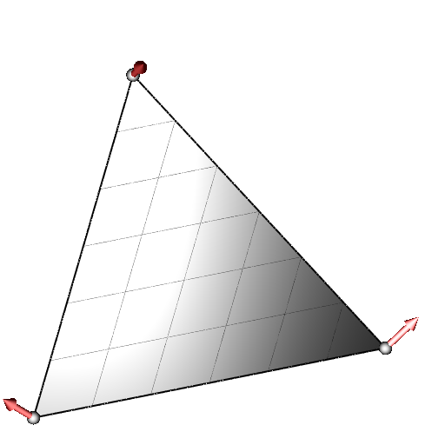



Differentiating: Backward
$$Φ$$
Given:
  A unit right triangle $𝕋⊂ℝ^{2}$
  A linear embedding $Φ:𝕋→ℝ^{3}$
  Normals at the triangle vertices
$$𝕋$$
$$Φ(𝕋)$$
Notes:
Note that the geometry of the surface is only approximated by the linear embedding.
The normals tell us more about how it curves.

Slide 15
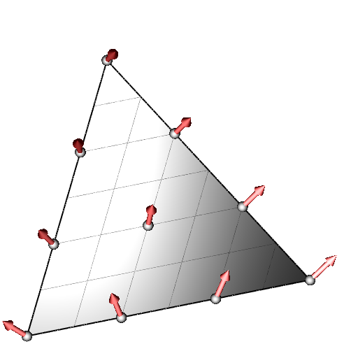
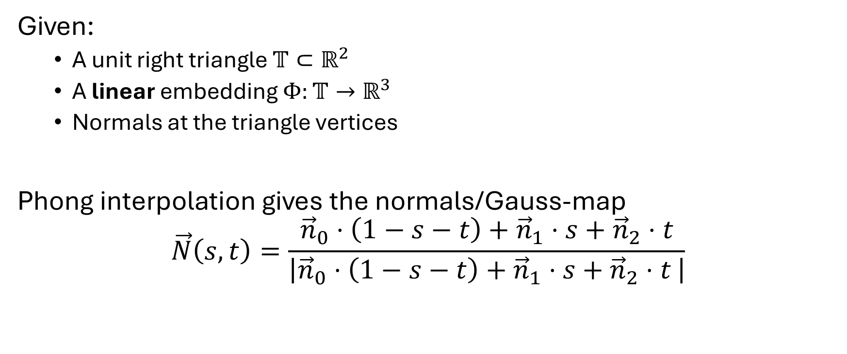
Differentiating: Backward
$$Φ$$
Given:
  A unit right triangle $𝕋⊂ℝ^{2}$
  A linear embedding $Φ:𝕋→ℝ^{3}$
  Normals at the triangle vertices
Phong interpolation gives the normals/Gauss-map
$$\vec{N}\left(s,t\right)=\frac{{\vec{n}}_{0}⋅\left(1−s−t\right)+{\vec{n}}_{1}⋅s+{\vec{n}}_{2}⋅t}{\left|{\vec{n}}_{0}⋅\left(1−s−t\right)+{\vec{n}}_{1}⋅s+{\vec{n}}_{2}⋅t \right|}$$
$$𝕋$$
$$Φ(𝕋)$$

Slide 16
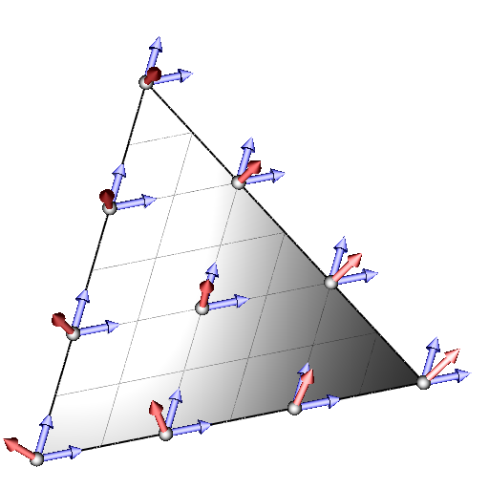
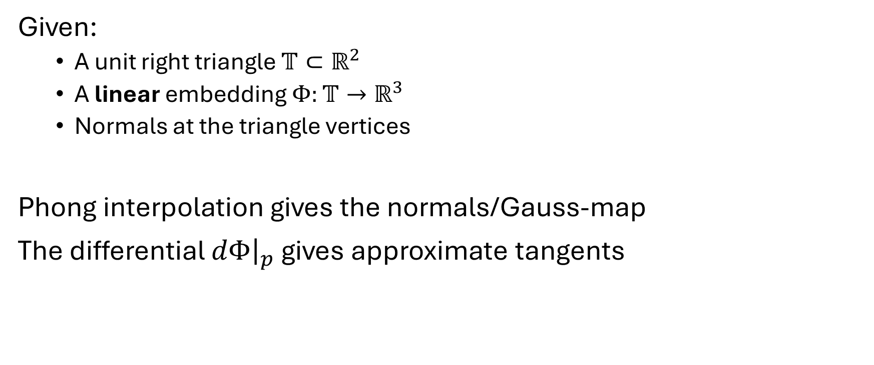
Differentiating: Backward
$$Φ$$
Given:
  A unit right triangle $𝕋⊂ℝ^{2}$
  A linear embedding $Φ:𝕋→ℝ^{3}$
  Normals at the triangle vertices
Phong interpolation gives the normals/Gauss-map
The differential $dΦ{\left.​\right|}_{p}$ gives approximate tangents
$$𝕋$$
$$Φ(𝕋)$$
Notes:
Note that (initially) the tangents are not perpendicular to the normals
Switch normals to red for consistency.
For Phong, show both normals
Make arrows wider

Slide 17
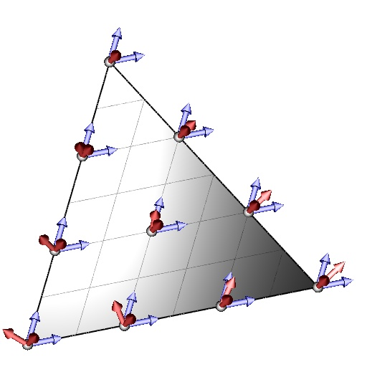
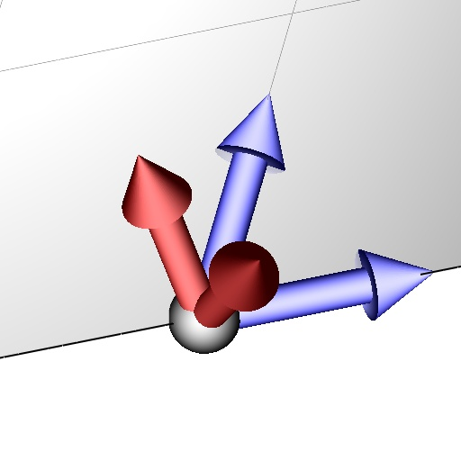
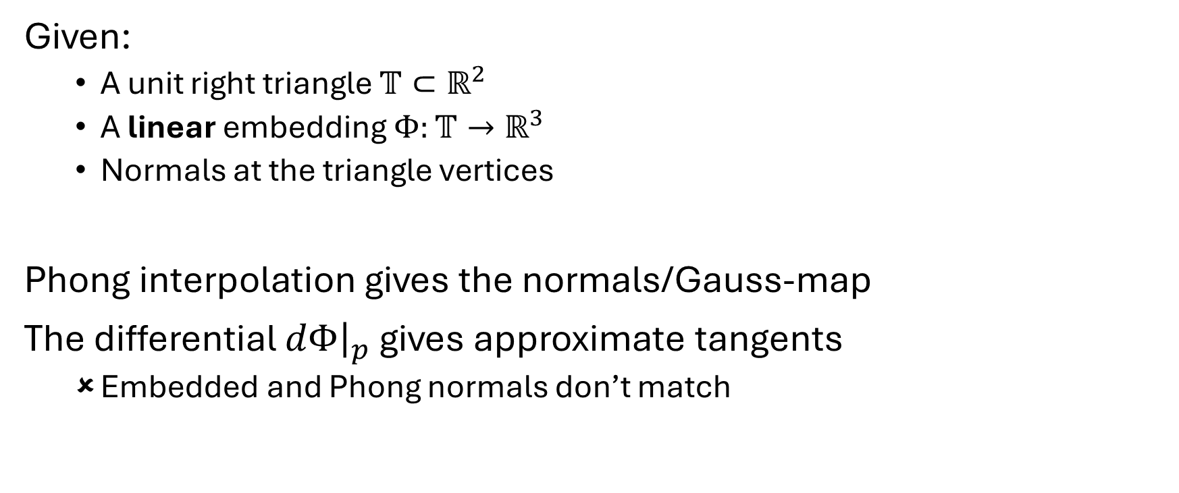


Differentiating: Backward
$$Φ$$
Given:
  A unit right triangle $𝕋⊂ℝ^{2}$
  A linear embedding $Φ:𝕋→ℝ^{3}$
  Normals at the triangle vertices
Phong interpolation gives the normals/Gauss-map
The differential $dΦ{\left.​\right|}_{p}$ gives approximate tangents
  Embedded and Phong normals don’t match
$$𝕋$$
$$Φ(𝕋)$$
$$\vec{N}(p)$$
$$\vec{n}$$
Notes:
Note that (initially) the tangents are not perpendicular to the normals

Slide 18


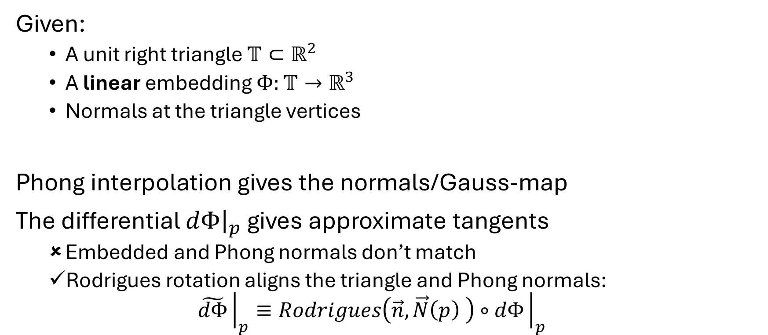
Differentiating: Backward
$$Φ$$
Given:
  A unit right triangle $𝕋⊂ℝ^{2}$
  A linear embedding $Φ:𝕋→ℝ^{3}$
  Normals at the triangle vertices
Phong interpolation gives the normals/Gauss-map
The differential $dΦ{\left.​\right|}_{p}$ gives approximate tangents
  Embedded and Phong normals don’t match
  Rodrigues rotation aligns the triangle and Phong normals:
  $\tilde{dΦ}{\left.​\right|}_{p}≡Rodrigues\left(\vec{n},\vec{N}\left(p\right) \right)∘dΦ{\left.​\right|}_{p}$
$$𝕋$$
$$Φ(𝕋)$$

Slide 19
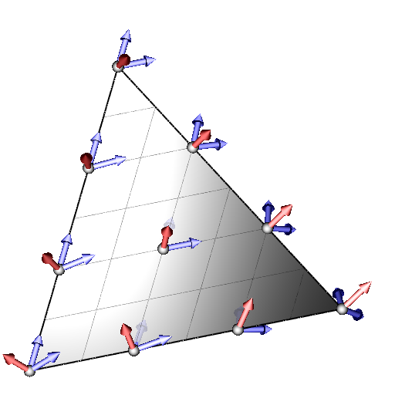
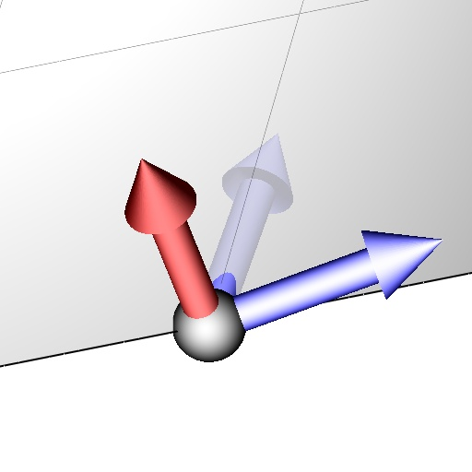

Differentiating: Backward
$$Φ$$
Given:
  A unit right triangle $𝕋⊂ℝ^{2}$
  A linear embedding $Φ:𝕋→ℝ^{3}$
  Normals at the triangle vertices
Phong interpolation gives the normals/Gauss-map
The differential $dΦ{\left.​\right|}_{p}$ gives approximate tangents
  Embedded and Phong normals don’t match
  Rodrigues rotation aligns the triangle and Phong normals:
  $\tilde{dΦ}{\left.​\right|}_{p}≡Rodrigues\left(\vec{n},\vec{N}\left(p\right) \right)∘dΦ{\left.​\right|}_{p}$
$$𝕋$$
$$Φ(𝕋)$$
For a tangent vector field $\vec{v}:𝕋→ℝ^{3}$, the covariant derivative is:
$$∇\vec{v}={\tilde{dΦ}}^{+}∘d\vec{v}$$

Slide 20
2. How to discretize the space of
(continuous) vector-fields?

Slide 21
Representing
As in [Knöppel et al., 2013][Liu et al., 2016], descretize by extending a tangent vector at a vertex into the incident triangles.
Given an extrinsic tangent vector at a vertex
  Parallel transport into incident triangles
  Linearly modulate within each triangle

Slide 22
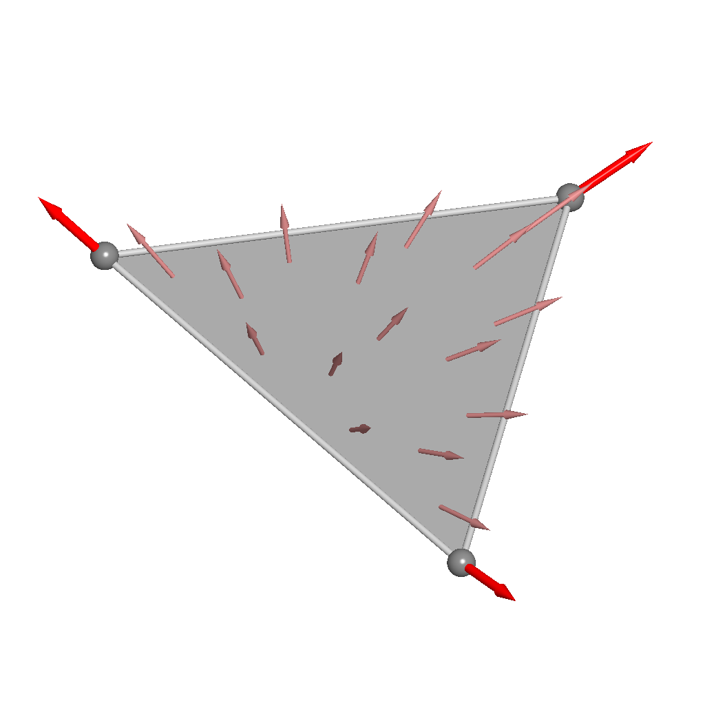
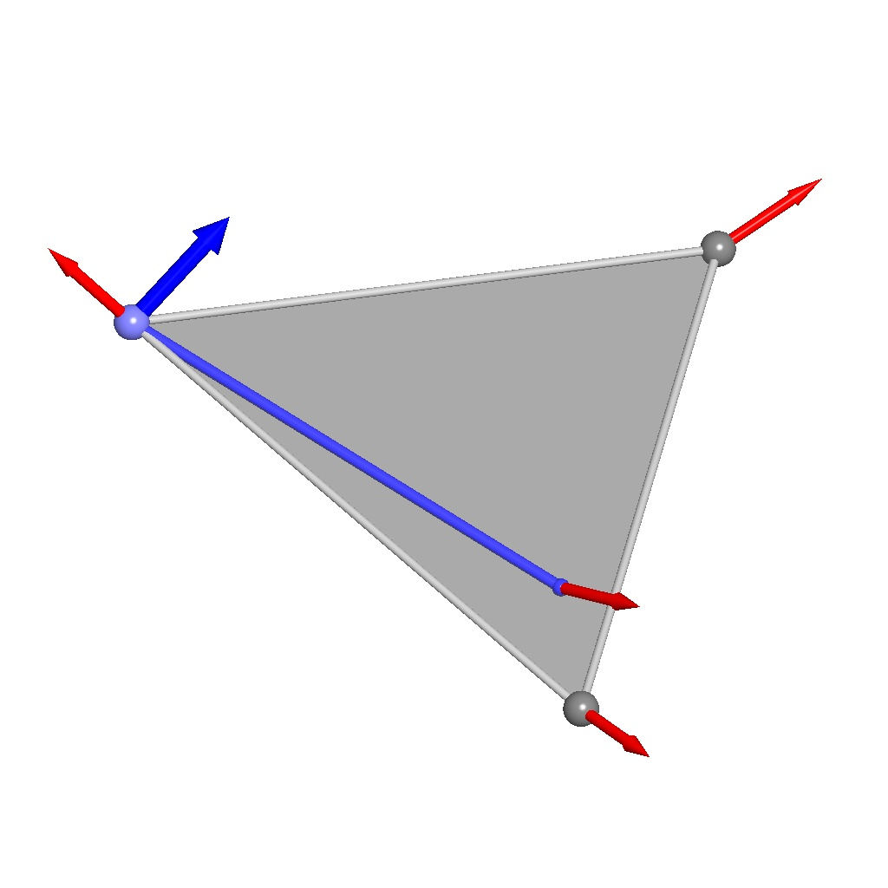




Representing
Parallel transport into incident triangles:
  Transport along a line segment on the Euclidean triangle
$$\vec{N}(v)$$
$$v$$
$$p$$
$$\vec{N}(p)$$

Slide 23
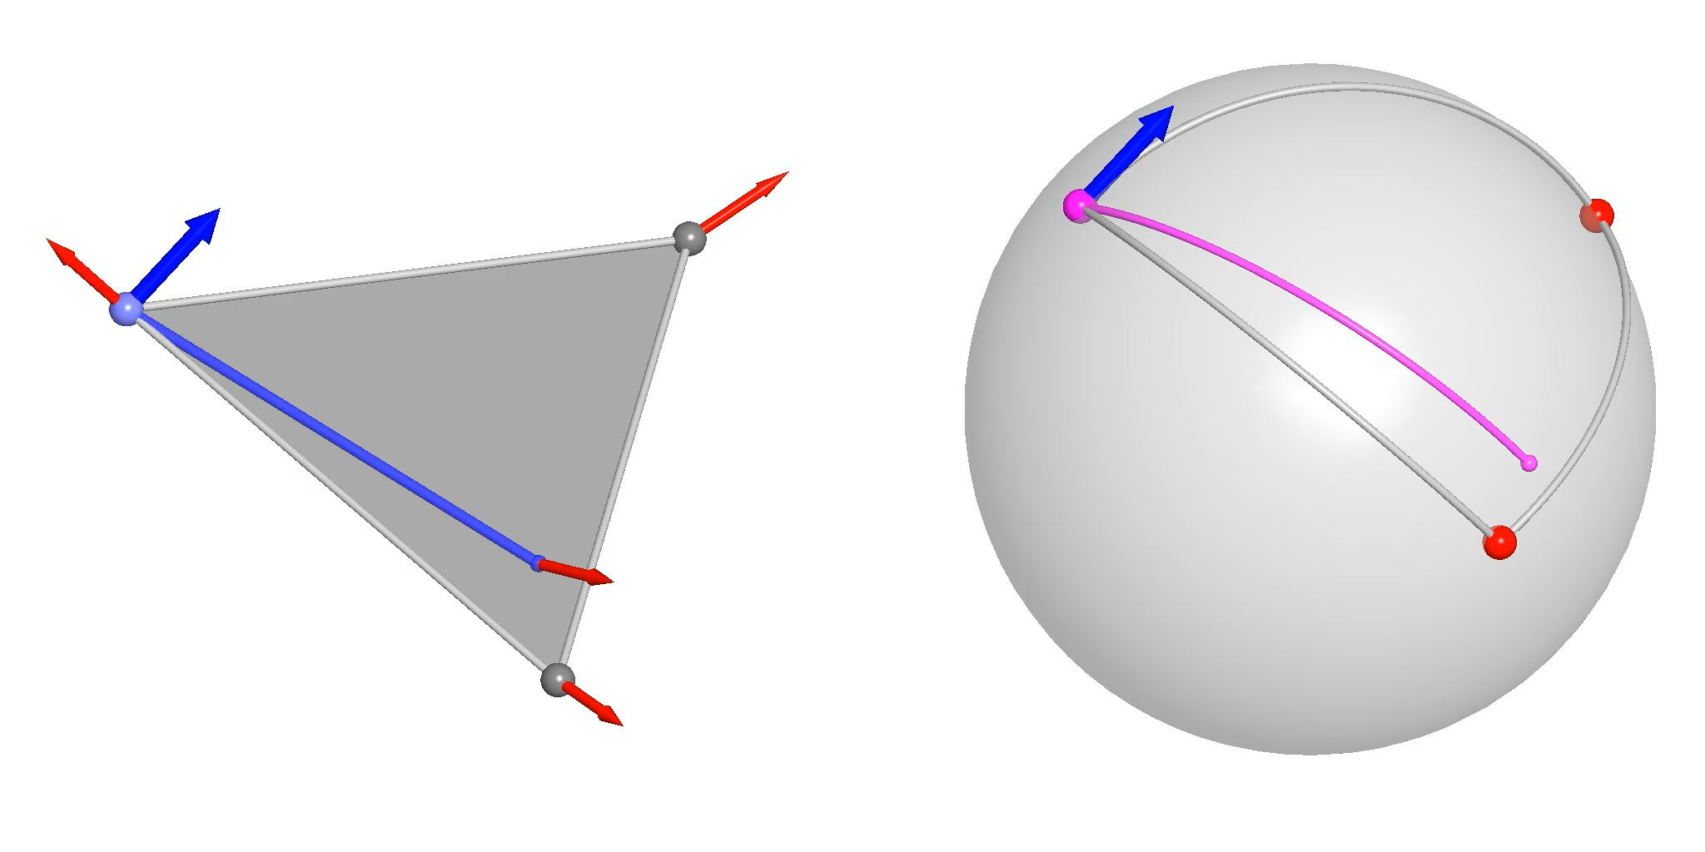



Representing
Parallel transport into incident triangles:
  Transport along a line segment on the Euclidean triangle
  $$⇕$$
  Transport along the image of the line segment on the Gauss map
$$\vec{N}(v)$$
$$\vec{N}(v)$$
$$v$$
$$\vec{N}(p)$$
$$p$$
$$\vec{N}(p)$$

Slide 24
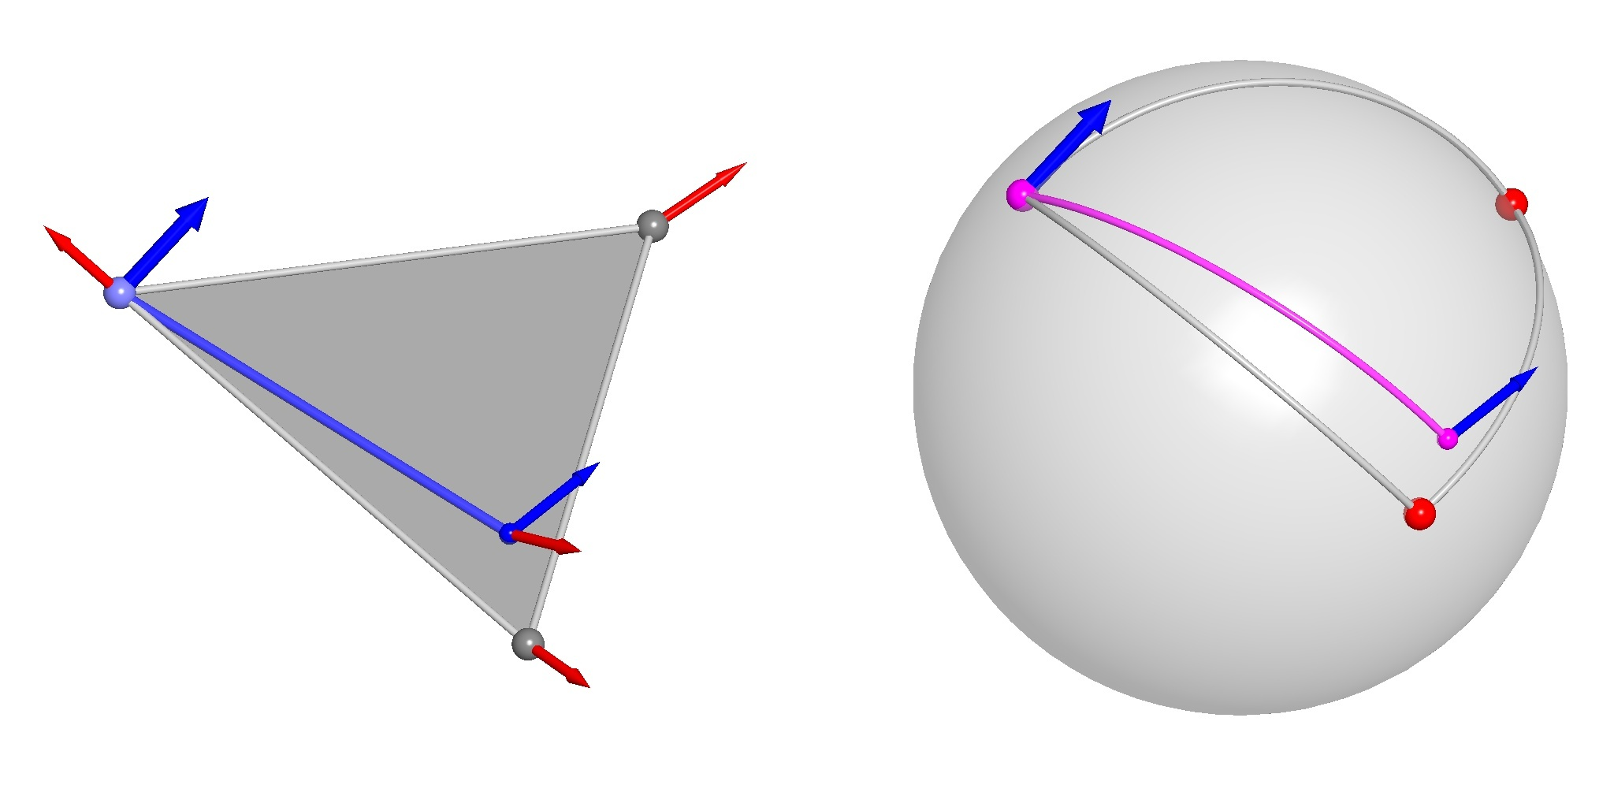
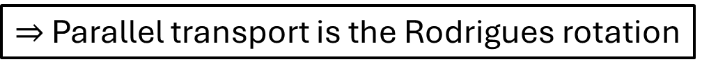
Representing
Parallel transport into incident triangles:
  Transport along a line segment on the Euclidean triangle
  $$⇕$$
  Transport along the image of the line segment on the Gauss map
$$\vec{N}(v)$$
$$\vec{N}(v)$$
$$v$$
$$\vec{N}(p)$$
$$p$$
$$\vec{N}(p)$$
With Phong interpolation, line segments map to great arcs
$⇒$ Parallel transport is the Rodrigues rotation

Slide 25
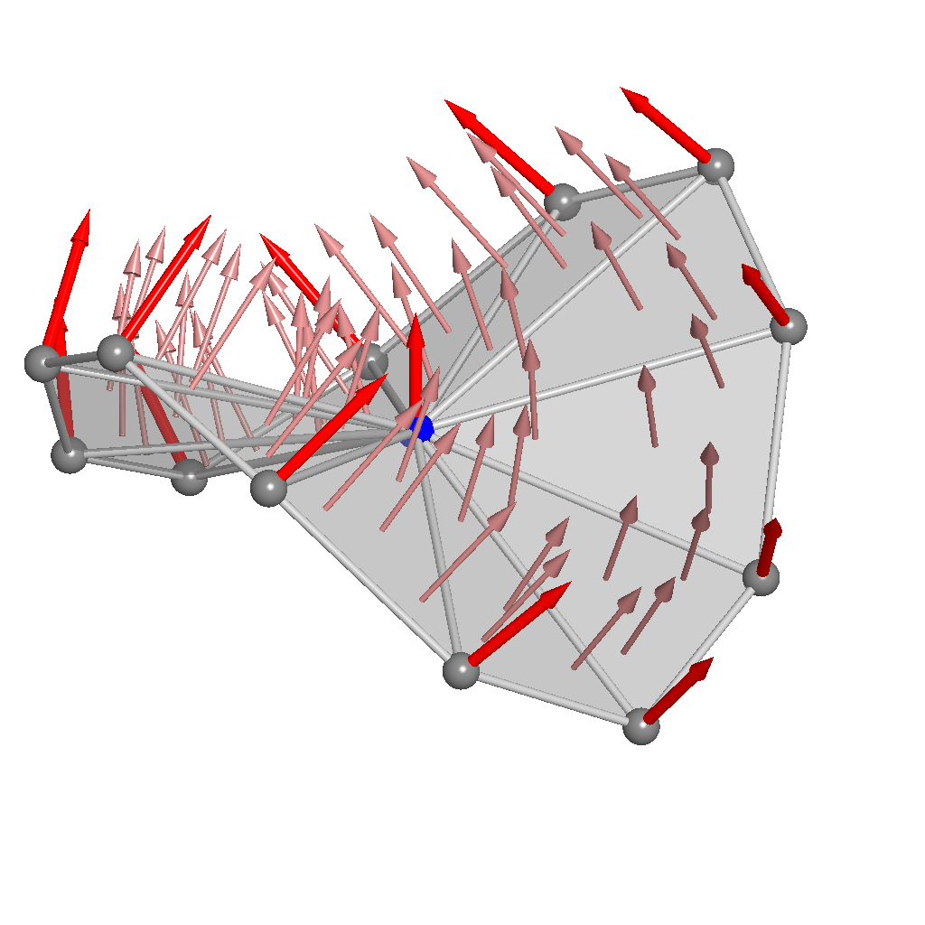
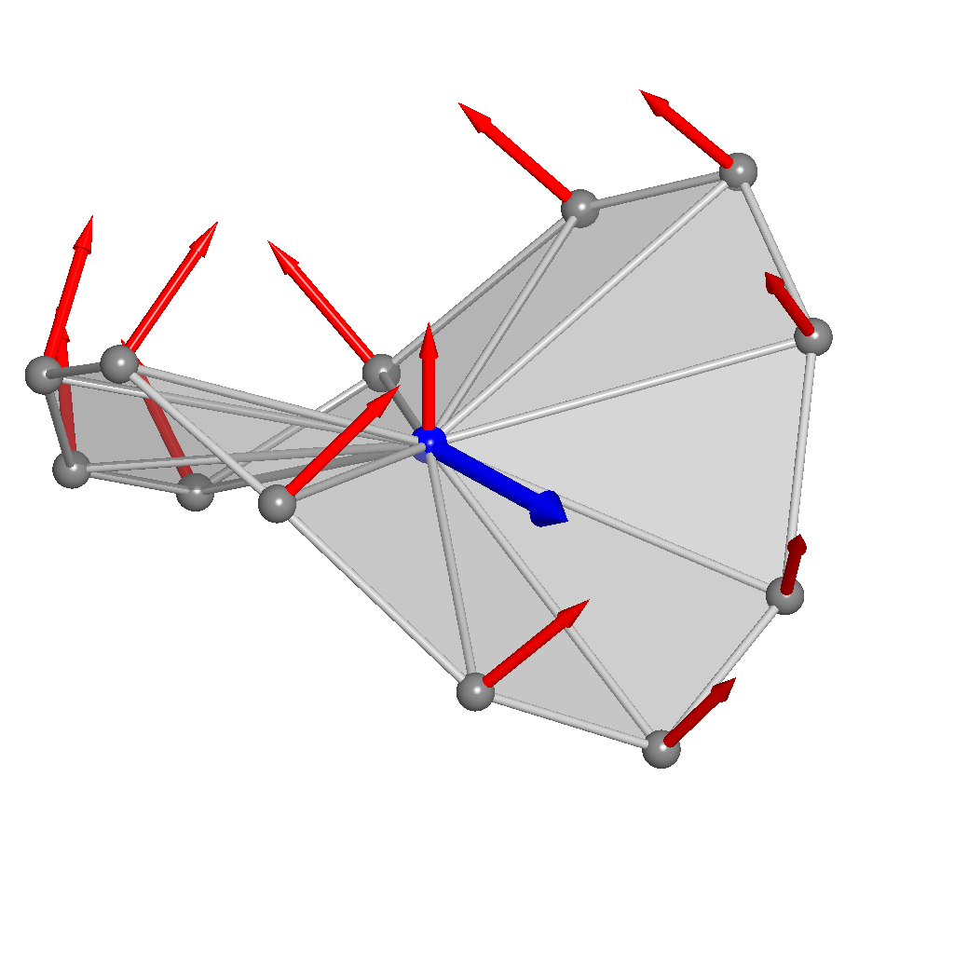
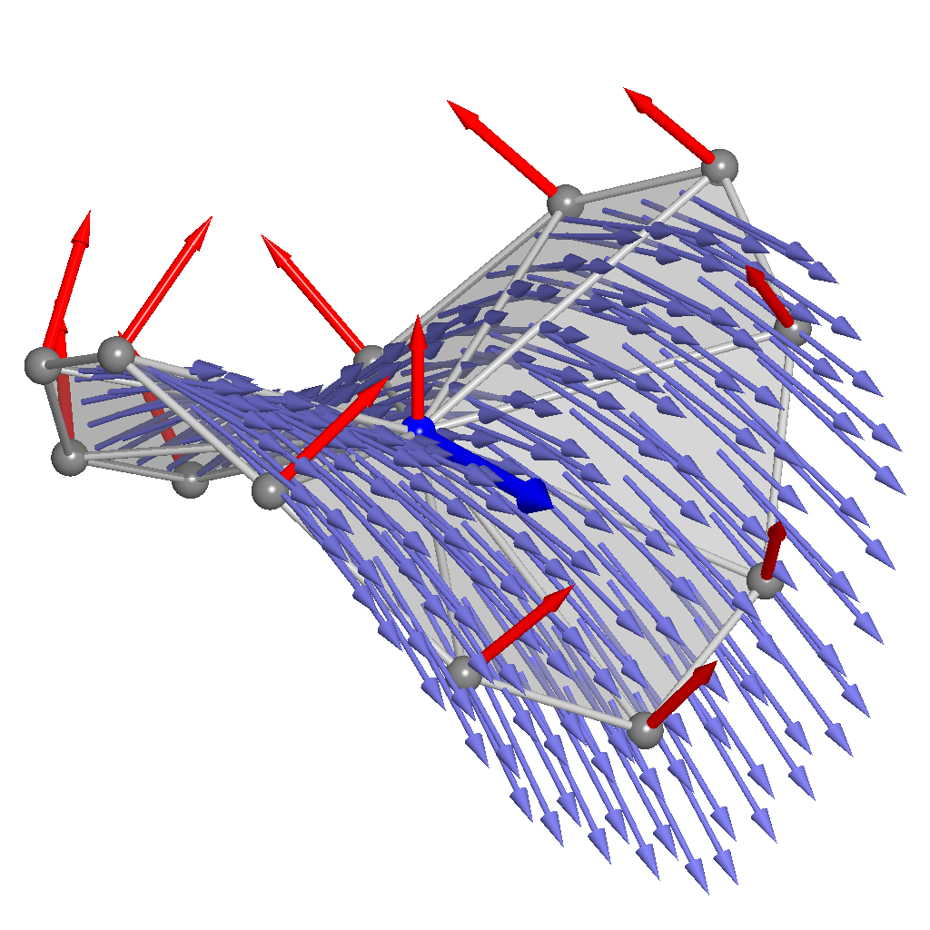
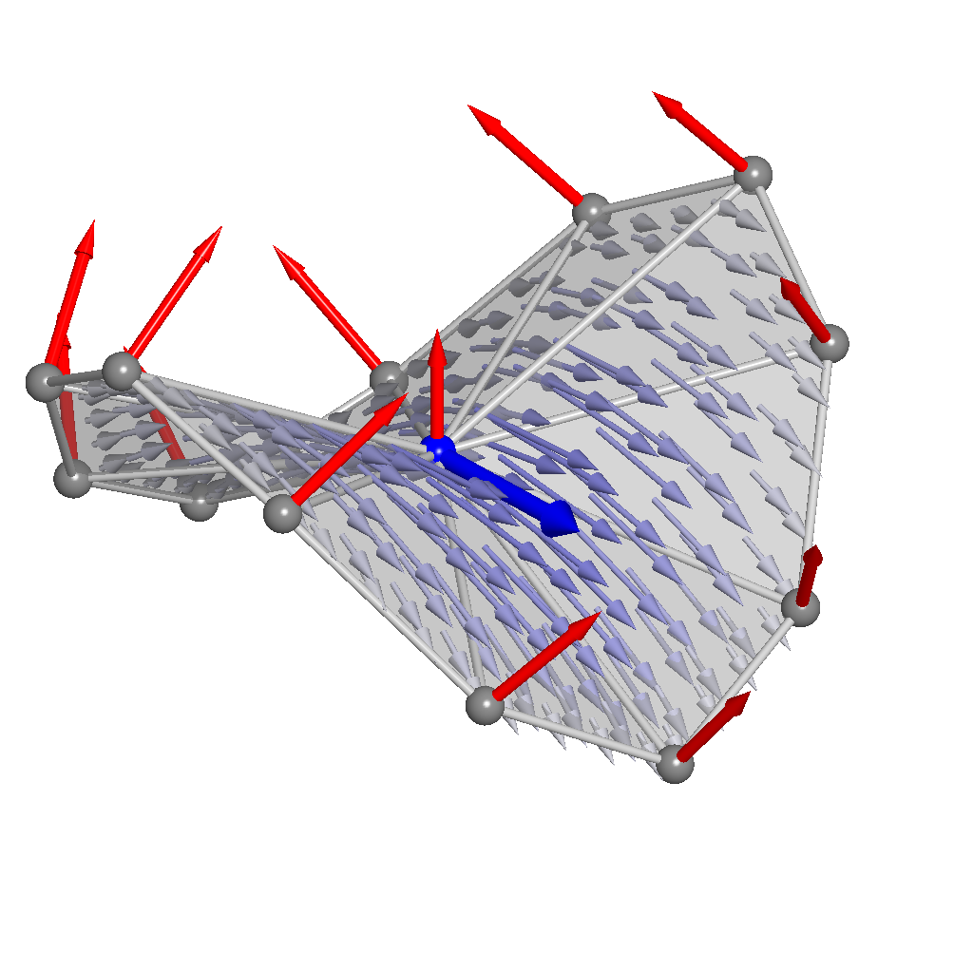

Representing
Parallel transport into incident triangles
  $⇒$ Continuous across edges incident on the vertex
Linearly modulate within each triangle
  $⇒$ Continuous across all edges
Notes:
Because the normals are continuous, the vector-field will be continuous across edges incident on the vertex

Slide 26
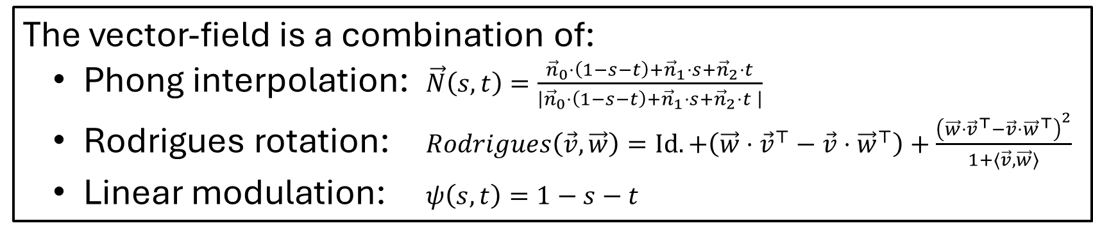
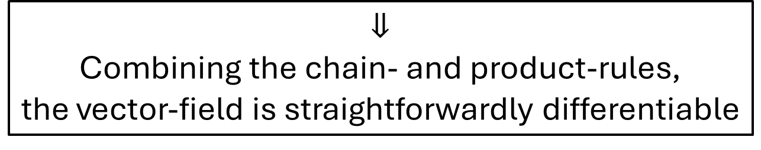
Representing
Parallel transport into incident triangles
  $⇒$ Continuous across edges incident on the vertex
Linearly modulate within each triangle
  $⇒$ Continuous across all edges
The vector-field is a combination of:
Phong interpolation: $\vec{N}\left(s,t\right)=\frac{{\vec{n}}_{0}⋅\left(1−s−t\right)+{\vec{n}}_{1}⋅s+{\vec{n}}_{2}⋅t}{\left|{\vec{n}}_{0}⋅\left(1−s−t\right)+{\vec{n}}_{1}⋅s+{\vec{n}}_{2}⋅t \right|}$
Rodrigues rotation: $Rodrigues\left(\vec{v},\vec{w}\right)=Id.+\left(\vec{w}⋅{\vec{v}}^{⊤}−\vec{v}⋅{\vec{w}}^{⊤}\right)+\frac{{\left(\vec{w}⋅{\vec{v}}^{⊤}−\vec{v}⋅{\vec{w}}^{⊤}\right)}^{2}}{1+⟨\vec{v},\vec{w}⟩}$
Linear modulation: $ψ\left(s,t\right)=1−s−t$
$$⇓$$
Combining the chain- and product-rules,
the vector-field is straightforwardly differentiable
Notes:
Each component is straightforwardly differentiable, with the Phong interpolation arguably being the most difficult because of the square-root function.

Slide 27
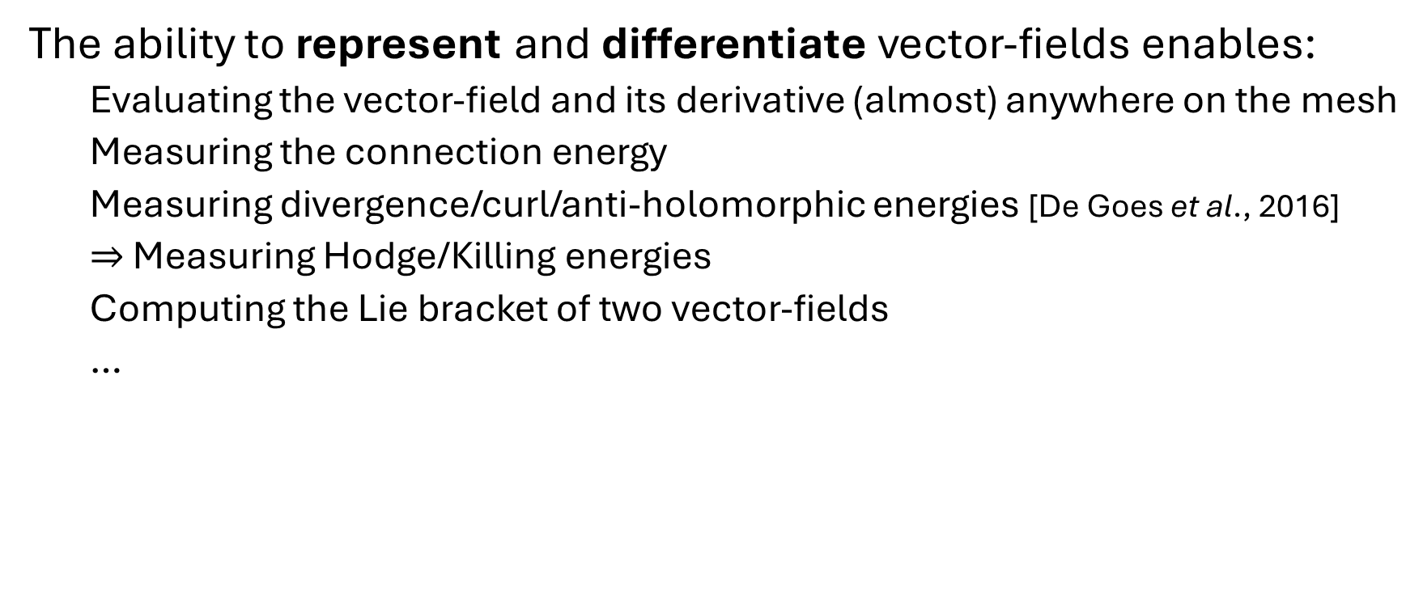
Summary
The ability to represent and differentiate vector-fields enables:
  Evaluating the vector-field and its derivative (almost) anywhere on the mesh
  Measuring the connection energy
  Measuring divergence/curl/anti-holomorphic energies [De Goes et al., 2016]
  $⇒$ Measuring Hodge/Killing energies
  Computing the Lie bracket of two vector-fields
  …
Notes:
We can measure the connection energy by evaluating the covariant derivative pointwise, computing the square norm, and integrating over the mesh using quadrature.
Separately considering the symmetric, anti-symmetric, and scalar multiple of the identity components, we get the divergence, curl, and anti-holomorphic energies.
It is then straightforward to combine the divergence and anti-holomorphic energies to get the Hodge and Killing energies.
Combining the ability to evaluate and measure the energy, we can solve problems like sparse interpolation
While the bracket is not itself in the discrete space of vector fields, it can be evaluated pointwise and therefore projected

Slide 28
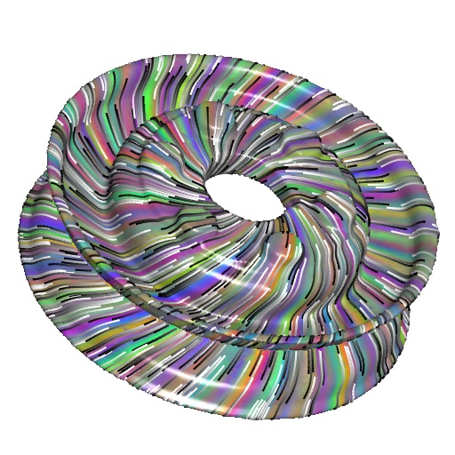

















Summary: Limitations
Our approach is not structure-preserving
  E.g. The defined Hodge energy does not have a kernel of dimension $2g$.
$$\left(dδ+δd\right)\vec{v}=λ⋅\vec{v}$$
$$λ_{0}=1.76$$
$$λ_{1}=1.76$$
$$λ_{2}=15.54$$
$$λ_{3}=15.54$$
$$λ_{4}=15.78$$
$$λ_{5}=15.78$$
$$λ_{6}=20.74$$
$$λ_{7}=20.74$$
Notes:
Note that these come in pairs, related by 90-degree rotation

Slide 29






Summary: Limitations
The map $\tilde{dΦ}$ between is not the derivative of an embedding
  Do not have “commutativity of second derivatives”
  $⇒$ The second fundamental form is not symmetric
  $⇒$ The connection coefficients $Γ_{ij}^{k}$ are not symmetric in the lower indices (i.e. not a metric connection)
$$dΦ$$
$$\tilde{dΦ}≡Rodrigues\left(\vec{n},\vec{N}\left(p\right) \right)∘dΦ$$

Slide 30

Summary: Future Work
Differentiation:
  How to map between triangle and Phong tangents?
Representation:
  How to set per-vertex normals?
$$\vec{N}$$
$$dΦ$$
$$\tilde{dΦ}≡Rodrigues\left(\vec{n},\vec{N}\left(p\right) \right)∘dΦ$$
Notes:
Note that ${\tilde{dΦ}}^{⊤}∘\tilde{dΦ}=dΦ^{⊤}∘dΦ$ so that the two define the same first fundamental form.
It is not clear if this is necessary/desirable.

Slide 31
Thank you!
https://github.com/mkazhdan/PhongRodriguesVF/ (coming soon)

Slide 33






Representing
Parallel transport into incident triangles:
  Transport along a line segment on the Euclidean triangle
$$v$$
$$\vec{N}(v)$$
$$p$$
$$\vec{N}(p)$$

Slide 34



Representing
Parallel transport into incident triangles:
  Transport along a line segment on the Euclidean triangle
  $$⇕$$
  Transport along the image of the line segment on the Gauss map
$$v$$
$$\vec{N}(v)$$
$$\vec{N}(p)$$
$$p$$
$$\vec{N}(v)$$
$$\vec{N}(p)$$

Slide 35

Representing
Parallel transport into incident triangles:
  Transport along a line segment on the Euclidean triangle
  $$⇕$$
  Transport along the image of the line segment on the Gauss map
$$v$$
$$\vec{N}(v)$$
$$\vec{N}(p)$$
$$p$$
$$\vec{N}(v)$$
$$\vec{N}(p)$$
With Phong interpolation, line segments map to great arcs
$⇒$ Parallel transport is the Rodrigues rotation

