Slide 1
Distributed Poisson Surface Reconstruction
Hugues Hoppe and Misha Kazhdan

Slide 2
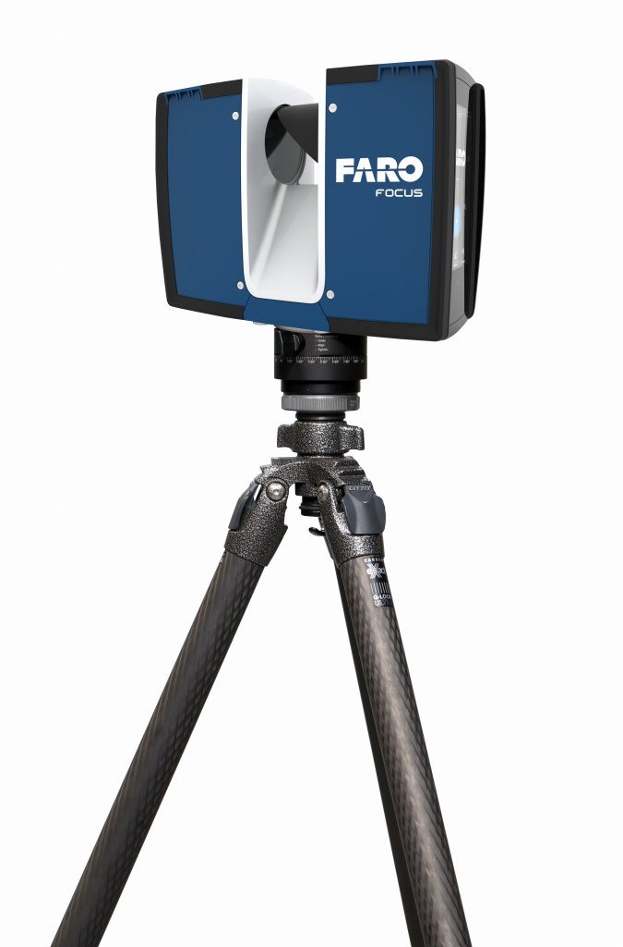
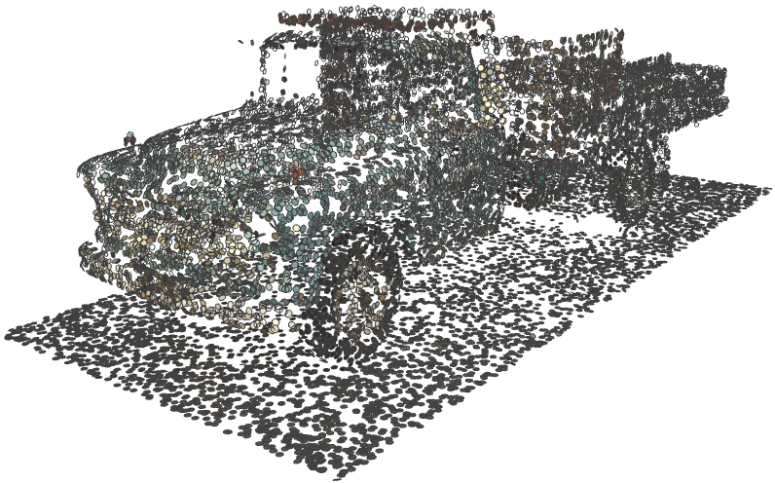
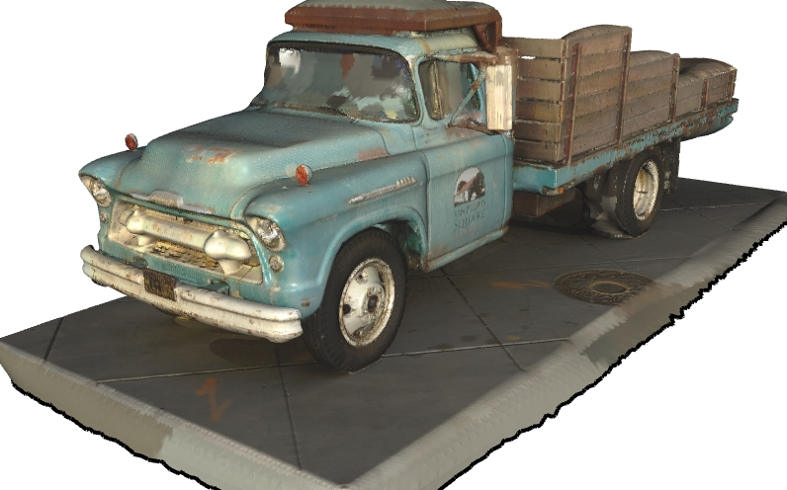
Motivation
Commodity scanners make it easy to acquire 3D point clouds.
Still need to convert the point clouds to meshes
[https://www.faro.com/]
[https://tanksandtemples.org/]

Slide 3
Motivation
This has driven a large body of work on surface reconstruction:
[Khanna and Rajpal, 2014] Survey of Curve and Surface Reconstruction…
[Alqudah, 2014] Survey of Surface Reconstruction…
[Berger et al., 2016] A Survey of Surface Reconstruction…
[Alireza and Arabnia, 2016] Survey on 3D Surface Reconstruction
[You et al., 2020] A Survey on Surface Reconstruction…
[Huang et al., 2022] Surface Reconstruction… A Survey and a Benchmark
[Sulzer et al., 2023] A Survey and Benchmark of…
[Farshian at al., 2023] Deep-Learning-Based 3D… – A Survey

Slide 4
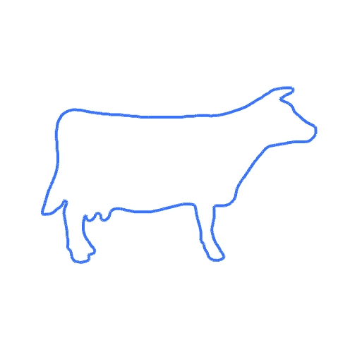
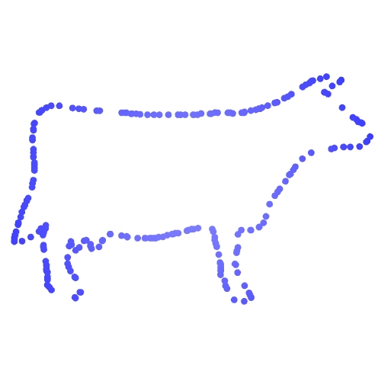
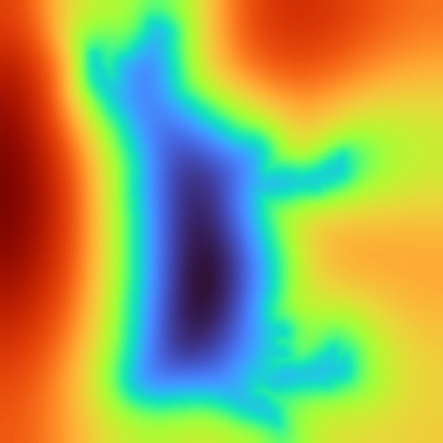





Motivation: Implicit Reconstruction
Given a set of (oriented) points:
Compute the implicit function
Extract the level-set
$$+1$$
(1)
(2)
$$−1$$
Input points
$$Φ:ℝ^{3}→ℝ$$
$$Φ^{−1}\left(0\right)⊂ℝ^{3}$$

Slide 5
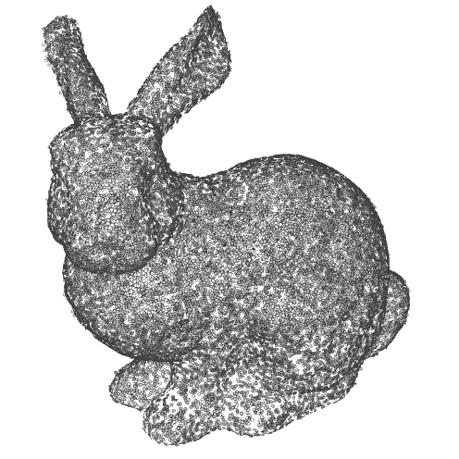
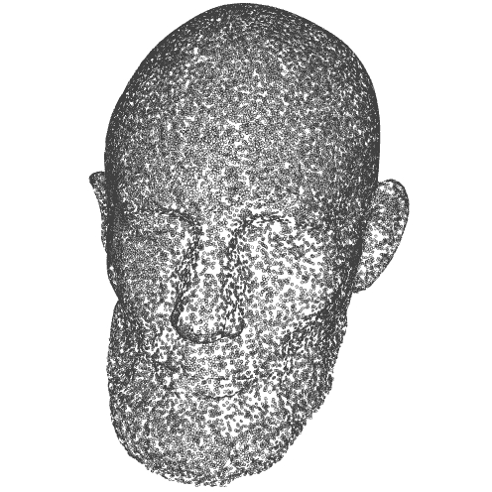
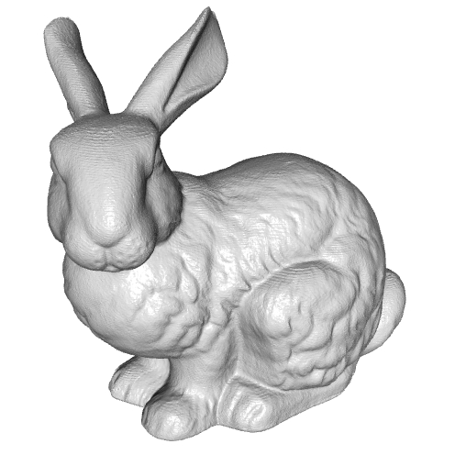
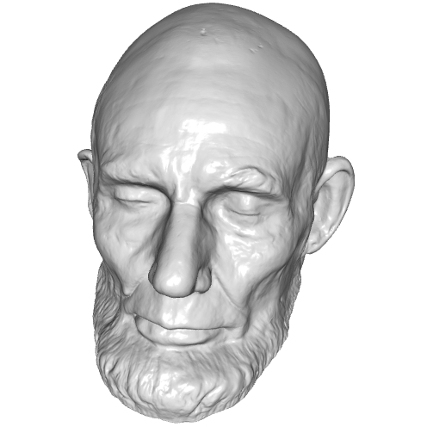

Motivation: Implicit Reconstruction
Global system $⇒$ robust to noise, missing data, etc.
Adaptive/hierarchical representation $⇒$linear complexity
360K Points
10M Points
16 seconds; 870MB
10 minutes; 20GB
https://3d.si.edu/explore/

Slide 6
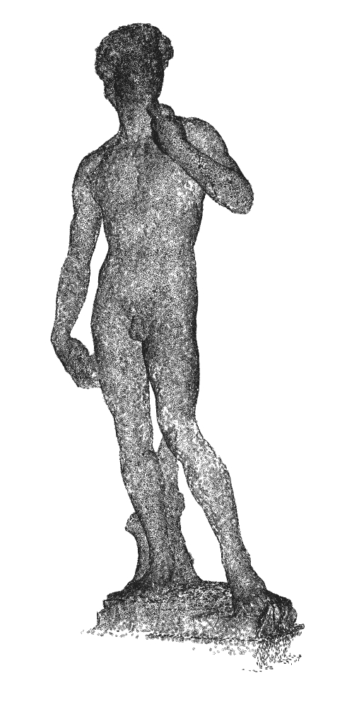
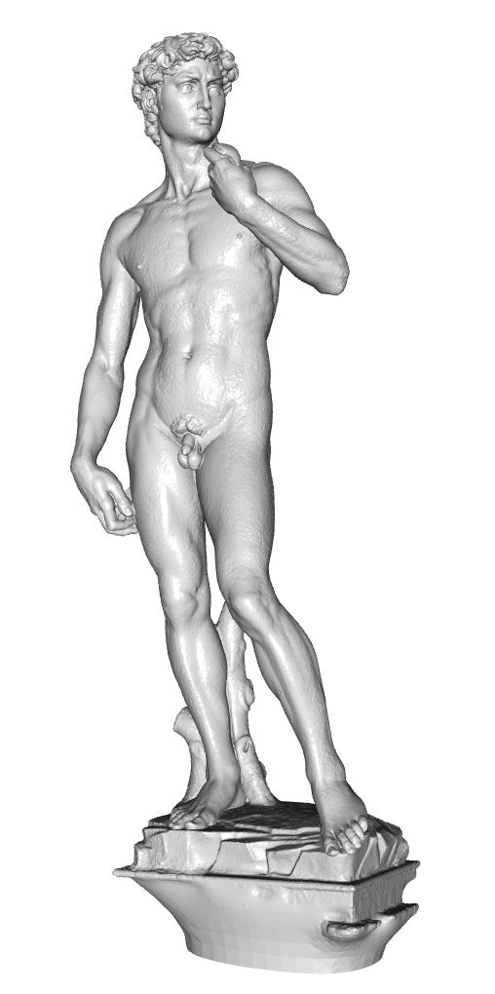

Motivation: Implicit Reconstruction
Global system $⇒$ robust to noise, missing data, etc.
Adaptive/hierarchical representation $⇒$linear complexity
Do not scale to large models
360K Points
10M Points
1B Points
16 seconds; 870MB
10 minutes; 20GB
~15 Hours; ~2TB
https://3d.si.edu/explore/

Slide 7


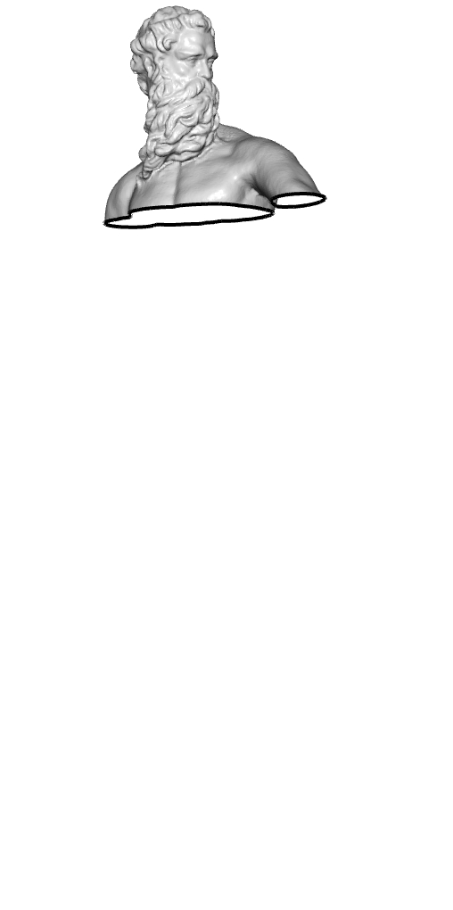
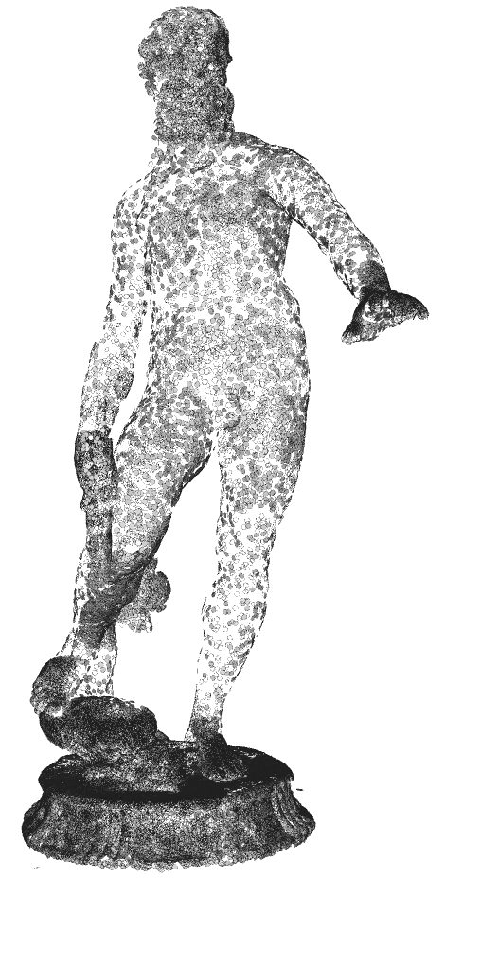
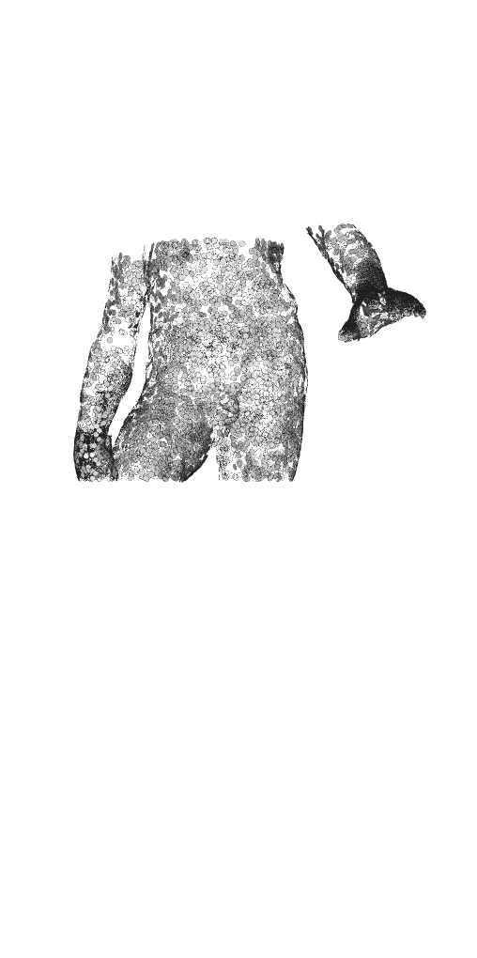
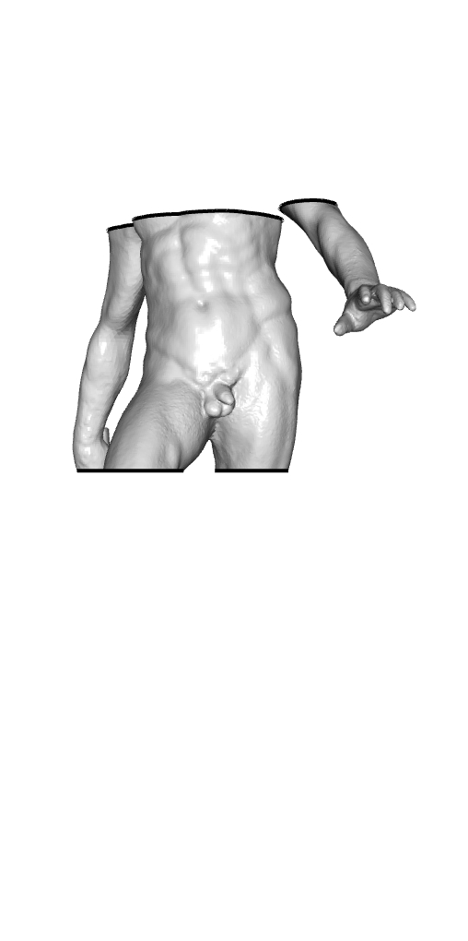
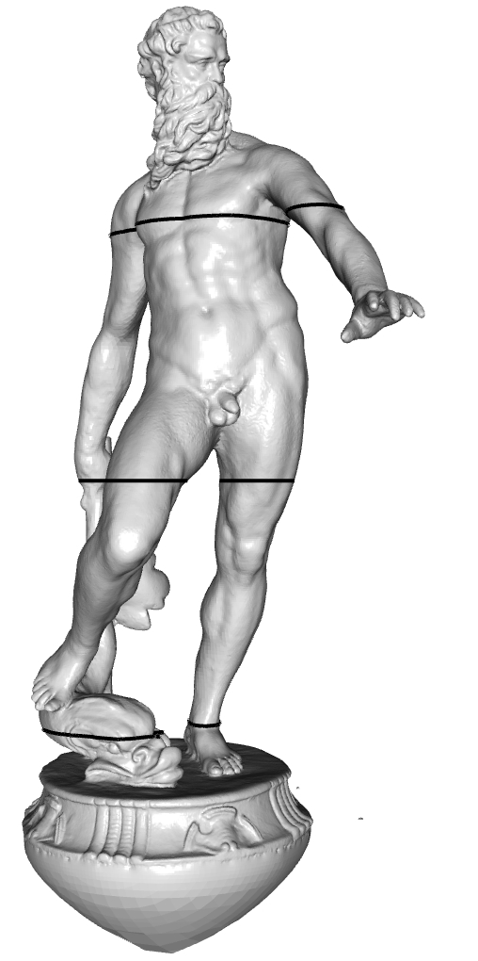
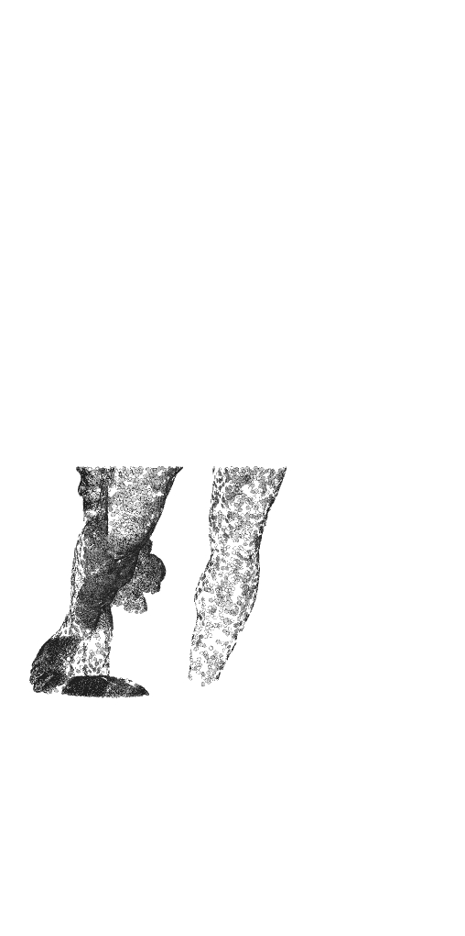
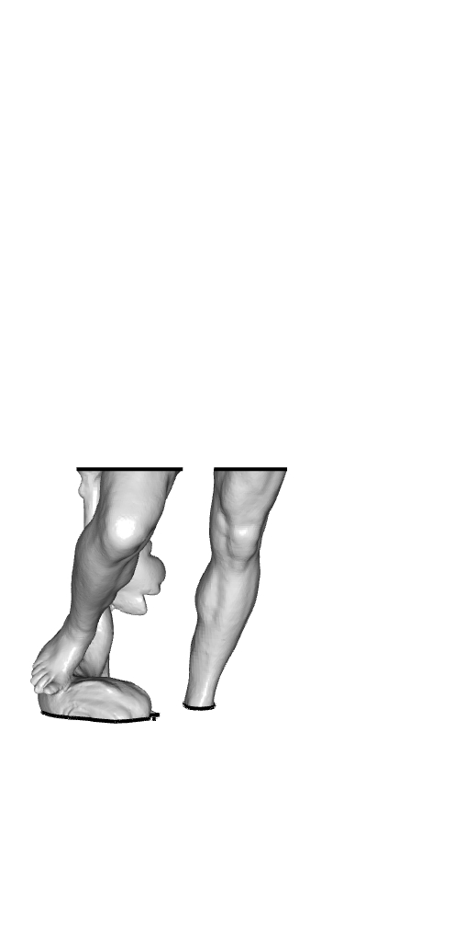
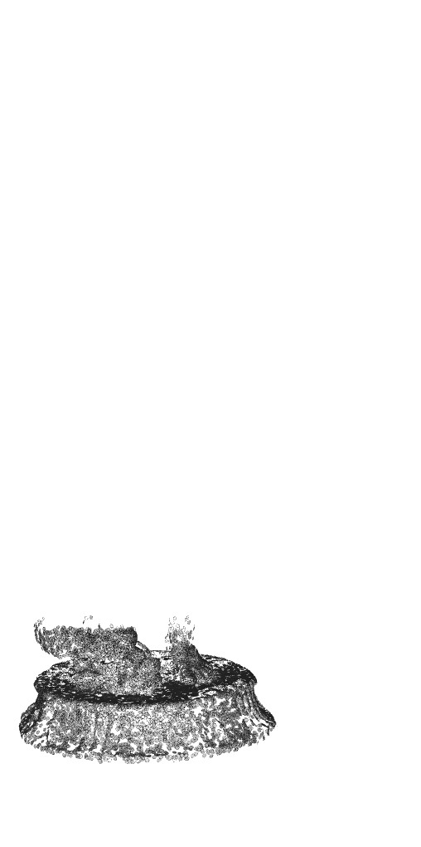
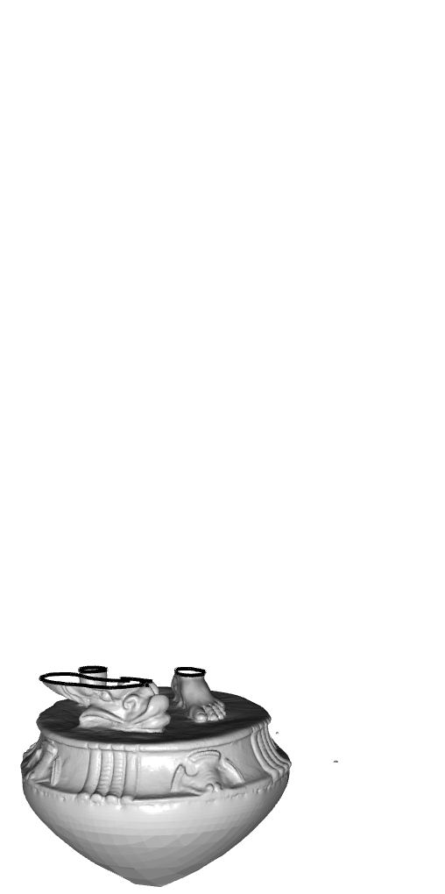
Approach
Leverage distributed computing:
Partition points
Distribute reconstruction
Merge reconstructed surfaces
Challenge:
Implicit functions need to agree
Extracted surfaces need to match
Want a global solution but processors only get a local view of the data!
Notes:
Splitting the work among independent processors:
Allows for parallelization, reducing the running time
Has every processor solve a smaller reconstruction problem, reducing the memory requirements

Slide 8
Outline
Motivation and Approach
Continuity
Defining the Function
Extracting the Surface
Evaluation
Summary

Slide 9
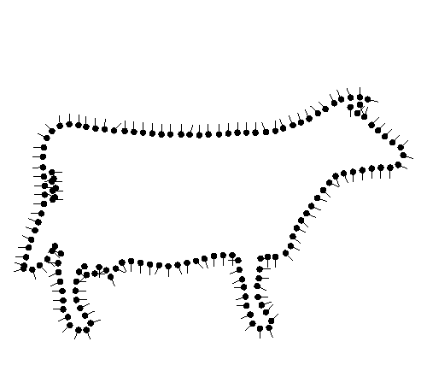
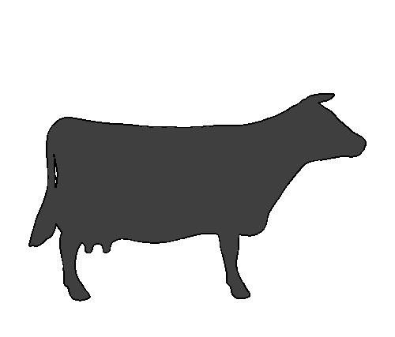




Poisson Surface Reconstruction
Given oriented points, reconstruct the indicator function: $$χ\left(q\right)=\left\{\begin{matrix}1 & q inside the shape \\ 0 & q outside the shape\end{matrix}\right.$$
$$χ\left(q\right)=0$$
$$χ\left(q\right)=1$$
Oriented points
$$χ\left(q\right)$$

Slide 10
Poisson Surface Reconstruction
Given oriented points, reconstruct the indicator function.
Observation:
The oriented input points sample the gradient of the indicator function.
$$χ\left(q\right)=0$$
$$χ\left(q\right)=1$$
Oriented points
$$χ\left(q\right)$$

Slide 11
Poisson Surface Reconstruction
Given oriented points, reconstruct the indicator function.
Observation:
The oriented input points sample the gradient of the indicator function.
Approach:
Fit a vector field to the samples
Find the function whose gradients best match

Slide 12
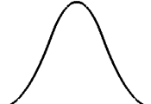
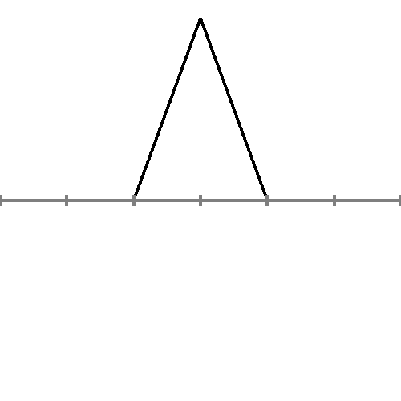
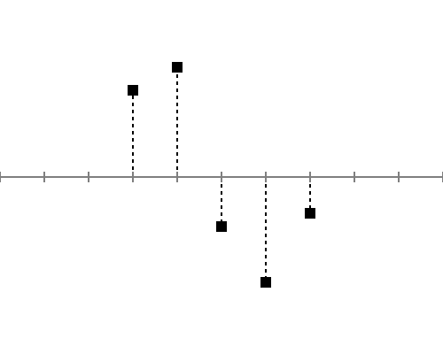
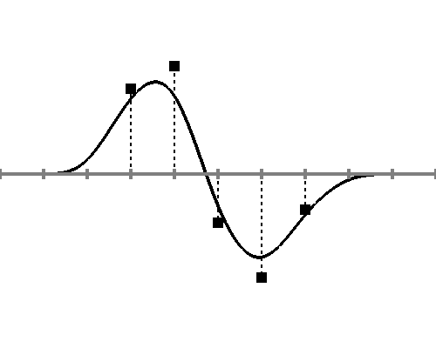
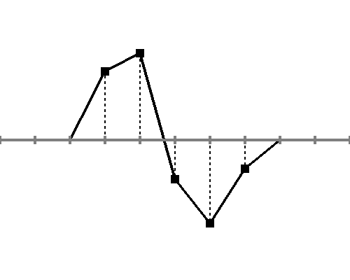
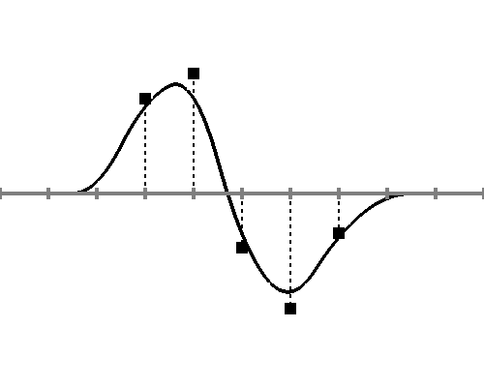
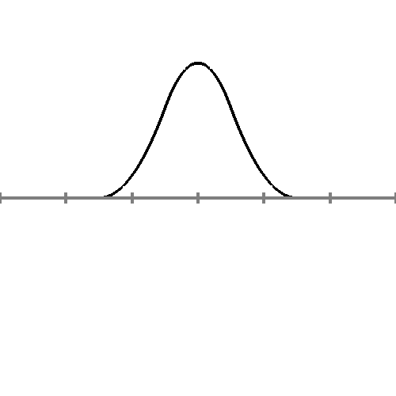
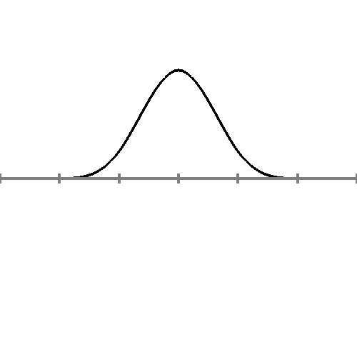
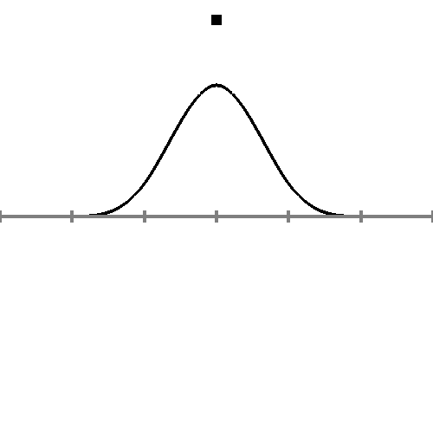

Poisson Surface Reconstruction
Implementation:
Use a B-spline basis to represent functions
$$B_{ij}\left(x,y\right)=B_{i}\left(x\right)⋅B_{j}(y)$$
Values
1st-order splines
2nd-order splines
3rd-order splines
B-Splines

Slide 13
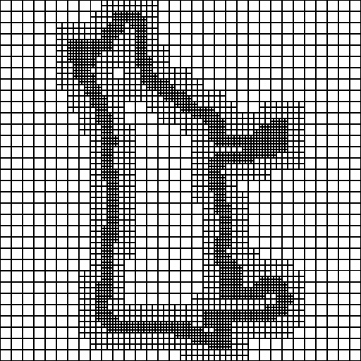
Poisson Surface Reconstruction
Implementation:
Use a B-spline basis to represent functions
Discretize over an adaptive representations

Slide 14






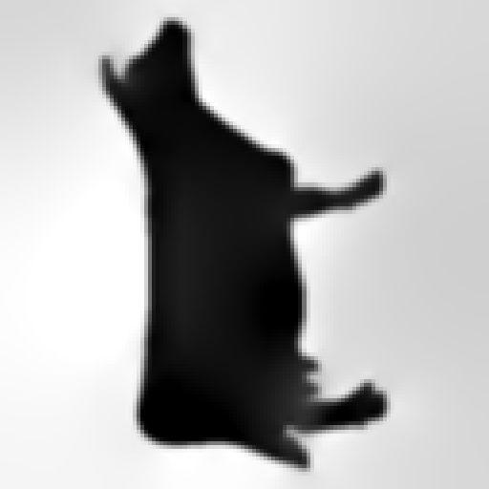
Poisson Surface Reconstruction
Implementation:
Use a B-spline basis to represent functions
Discretize over an adaptive representations
Use a hierarchy

Slide 15

Poisson Surface Reconstruction
Implementation:
Use a B-spline basis to represent functions
Discretize over an adaptive representations
Use a hierarchy $⇒$ global solve $→$ local updates

Slide 16
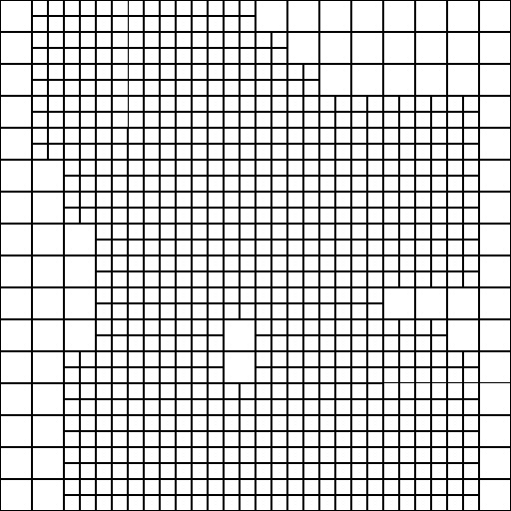
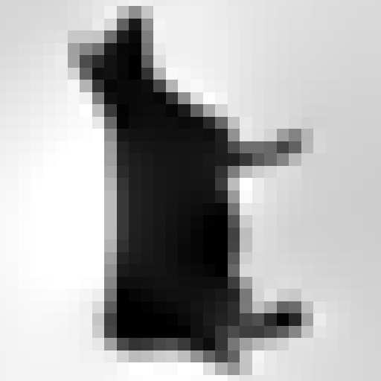

Continuity: Functions
Hierarchy $⇒$ global $→$ local:
Serial: Solve coarse system
server (global)

Slide 17
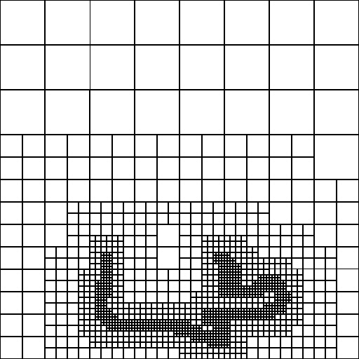
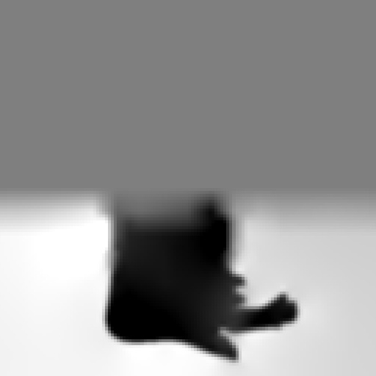
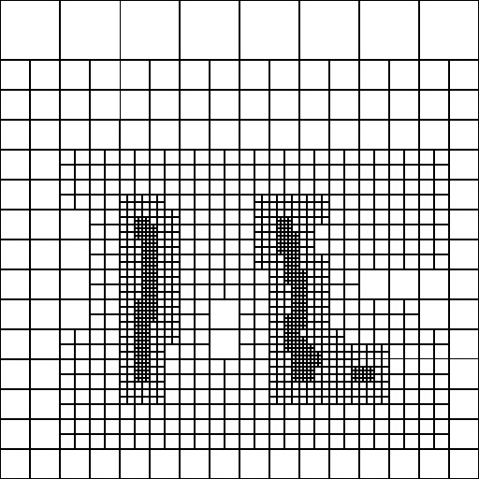

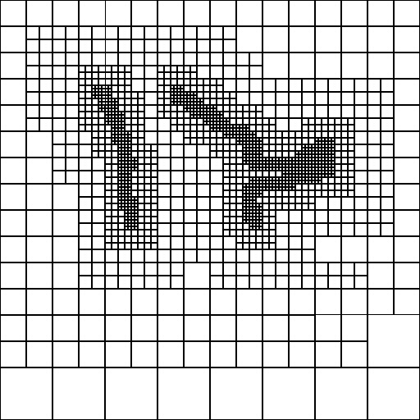
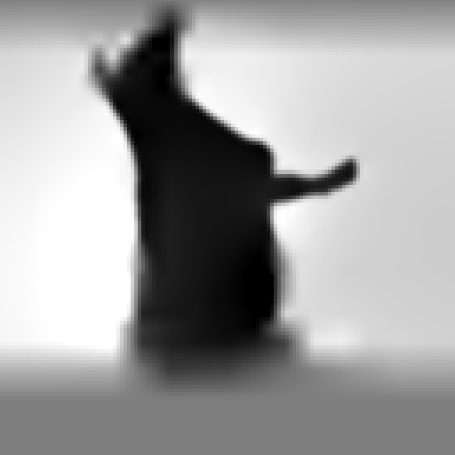
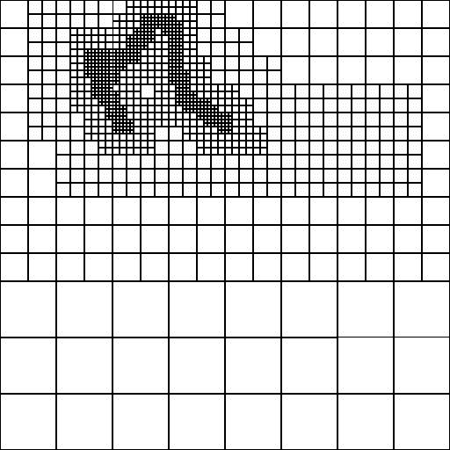
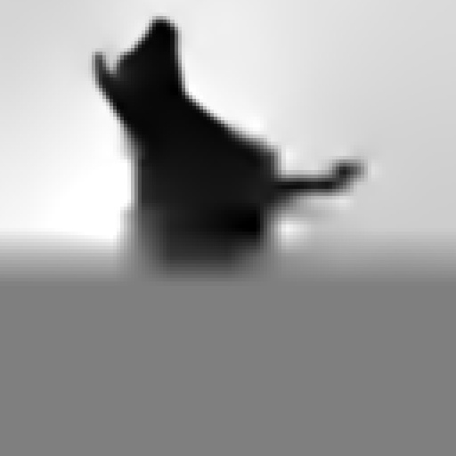

Continuity: Functions
Hierarchy $⇒$ global $→$ local:
Serial: Solve coarse system
Distributed:
Partition
Dilate
Refine
server (global)
clients (local)

Slide 18




Continuity: Surface
Challenge:
Once clients have computed implicit functions, need to extract the level-sets…
… such that the level-sets agree at the partition boundaries.

Slide 19
[Lorensen and Cline, 1987]
Given a function sampled on a regular grid:
Geometric: Compute the iso-vertices
Topological: Connect the iso-vertices

Slide 20
[Lorensen and Cline, 1987]
+
-
Given a function sampled on a regular grid:
Geometric: Compute the iso-vertices
Topological: Connect the iso-vertices
Starting with values at the corners
For each zero-crossing edge:
Fit a linear interpolant
Find the zero-crossing
+
+

Slide 21
[Lorensen and Cline, 1987]
Given a function sampled on a regular grid:
Geometric: Compute the iso-vertices
Topological: Connect the iso-vertices
Starting with values at the corners
For each zero-crossing edge:
Fit a linear interpolant
Find the zero-crossing

Slide 22
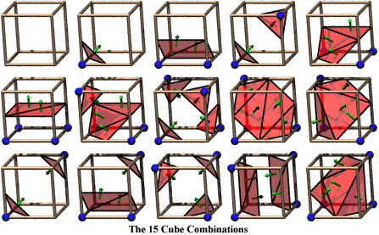
[Lorensen and Cline, 1987]
Given a function sampled on a regular grid:
Geometric: Compute the iso-vertices
Topological: Connect the iso-vertices
Pre-compute a case table for the different iso-vertex configurations and use it to define the triangulation

Slide 23
[Kazhdan et al., 2007]
Given a function sampled on a regular grid:
Geometric: Compute the iso-vertices
Topological: Connect the iso-vertices
Inductively:
1D: Compute iso-vertices
2D: Compute iso-edges by connecting iso-vertices
3D: Compute iso-polygons by connecting iso-edges
…
[Optionally] Minimal area triangulate
Notes:
Note that we are ignoring issues of fopology:
For 2D faces, if the corners have alternating signs, ambiguity in terms of how to create edges.
For 3D cells, if there are multiple curves on the boundary, should they be connected?

Slide 24
[Kazhdan et al., 2007]
Given a function sampled on a regular grid:
Geometric: Compute the iso-vertices
Topological: Connect the iso-vertices
For adaptive octrees, with face-adjacent leaf nodes at different levels

Slide 25
[Kazhdan et al., 2007]
Given a function sampled on a regular grid:
Geometric: Compute the iso-vertices
Topological: Connect the iso-vertices
For adaptive octrees, with face-adjacent leaf nodes at different levels
Copy iso-vertices/edges from finer

Slide 26
[Fuhrmann et al., 2007]
+
-
Given a function sampled on a regular grid:
Geometric: Compute the iso-vertices
Topological: Connect the iso-vertices
If samples also include derivative information:
Interpolate with higher-order polynomials
Use root-finding to get the iso-vertices
+
+
Note: Number of iso-vertices is unchanged
Linear
Cubic

Slide 27
[Fuhrmann et al., 2007]
Derivatives can be obtained:
Discretely approximating from sample values

Slide 28
[Fuhrmann et al., 2007]
Derivatives can be obtained:
Discretely approximating from sample values
Analytically evaluating B-Spline representation

Slide 29

Continuity: Surface
Goal:
Given implicit functions computed by individual processes, boundary iso-surfaces need to match.
$⇒$ Need the Hermite data on boundaries to be the same from both sides

Slide 30

Continuity: Surface
Restricting to 2D:
Representing the implicit function as a weighted sum of 3D B-splines:
$$χ\left(x,y,z\right)=\sum_{i,j,k}{B_{i}\left(x\right)⋅B_{j}\left(y\right)⋅B_{k}\left(z\right)⋅b_{ijk}}$$
The restriction to a 2D boundary is: $$χ_{z=z_{0}}\left(x,y\right)=\sum_{i,j}{B_{i}\left(x\right)⋅B_{j}\left(y\right)⋅\left(\sum_{k}{B_{k}\left(z_{0}\right)⋅b_{ijk}}\right)}$$
This is itself a representation as a weighted sum of 2D B-splines.
3D tensor B-spline
3D coefficient
2D tensor B-spline
2D coefficient

Slide 31

Continuity: Surface
Goal:
Given implicit functions computed by individual processes, boundary iso-surfaces need to match.
$⇒$ Restricted B-spline coefficients have to agree
Compute restricted B-spline coefficients
Average the coefficients
To extract a seamless surface:
Compute and send Hermite data to clients for iso-surfacing
Additionally, compute and send in-plane iso-edges
Guarantees the zero level-sets match across the boundary

Slide 32

Continuity: Surface
Challenges:
Restricting to a 2D plane, can’t compute partial derivatives in the $z$-direction.
The implicit function is represented over an adapted octree

Slide 33

Continuity: Surface
Partial derivatives in the $z$-direction:
The partial derivative in the $z$-direction is:
$$\frac{∂χ}{∂z}\left(x,y,z\right)=\sum_{i,j,k}{B_{i}\left(x\right)⋅B_{j}\left(y\right)⋅\frac{{∂B}_{k}}{∂z}\left(z\right)⋅b_{ijk}}$$
The restriction to a 2D boundary is: $$\frac{{∂χ}_{z=z_{0}}}{∂z}\left(x,y\right)=\sum_{i,j}{B_{i}\left(x\right)⋅B_{j}\left(y\right)⋅\left(\sum_{k}{\frac{∂B_{k}}{∂z}\left(z_{0}\right)⋅b_{ijk}}\right)}$$
This is still a weighted sum of 2D B-splines.
$⇒$ Average the coefficients of the restricted partial derivative.
2D tensor B-spline
2D coefficient

Slide 34



Continuity: Surface
The implicit function is represented over an octree:
The 2D restriction of a function represented over an octree is a function represented over a quadtree.

Slide 35








Continuity: Surface
The implicit function is represented over an octree:
The 2D restriction of a function represented over an octree is a function represented over a quadtree.
Quadtrees defined from the two sides of the boundary may not be consistent.
$⇒$ Mutually refine the quadtrees (zeroing new coefficients) before averaging
quadtree
2D restriction
quadtree
2D restriction

Slide 36
Outline
Motivation and Approach
Review of Marching Cubes
Cross-Processor Continuity
Evaluation
Summary

Slide 37

Evaluation: Continuity
Seamless
w/o overlap

Slide 38


Evaluation: Continuity
Seamless
Partitioning artifacts
w/o overlap
w/ overlap

Slide 39




Evaluation: Continuity
$$0$$
$$\sim 1/2$$
Seamless
Partitioning artifacts
Voxel distance from single-core solution
Notes:
Note: the blue regions are regions where there are no samples in the input.
The solution there is particularly dependent on (more) global information so failure to communicate that correctly results in pronounced geometric errors
Average/Maximum error without padding = 0.385 / 51.35 voxels
Average/Maximum error with padding = 0.002 / 0.22 voxels

Slide 40

Evaluation: Performance
Michelangelo’s David: 1 billion points
Digital Michelangelo Project [https://graphics.stanford.edu/papers/digmich_falletti/]
Safra Square: 2 billion points (w/ color)
Resonai [https://www.resonai.com/]

Slide 41

Evaluation: Performance
Expected single-core performance:
David: 15 hours; 2 TB
Safra: 30 hours; 4 TB
Actual performance distributed across 64 clients + 1 server:
David: 20 minutes; 44 GB
Safra: 22 minutes; 58 GB
Complexity reduction:
David: 45$×$ time; 50$×$ memory
Safra: 80$×$ time; 70$×$ memory
Michelangelo’s David: 1B points
Safra Square: 2B points

Slide 42







Evaluation: Performance

Slide 43





Evaluation: Performance

Slide 44
Outline
Motivation and Approach
Continuity
Evaluation
Summary

Slide 45

Summary
Partition the reconstruction among clients
Function continuity: Hierarchy $⇒$ global $→$ local
Surface continuity: Restriction + averaging
$⇒$ A distributed algorithm:
Seamless surfaces
In a fraction of the time/memory
Indistinguishable from single-core reconstructions

Slide 46

Observation
The distributed implementation minimizes the number/size of communications between the processors.
$⇒$ Caching state to disk, can serialize the clients
$⇒$ Memory-efficient single-core implementation
Notes:
This incurs a small computational overhead from:
The cost of disk I/O incurred by caching.
The duplicate processing of points near the boundary due to dilation

Slide 47



Questions
Empirically, only need a little redundancy for “smooth” reconstructions.
How does this depend on the PDE?
How does this depend on B-spline order?
w/o padding
w/ 4-ring padding
Notes:
No padding max error: 10.9 voxels
4-ring padding max error: 0.98

Slide 48
Questions
Marching cubes can be interpreted inductively
How does this extend to 4D (and higher)?
What kinds of topological ambiguities can arise (and how do we resolve them)?
+
-
-
+
?
?
+
-
+
-
-
+
-
+

Slide 49
Thank You
https://github.com/mkazhdan/PoissonRecon

