Slide 1
Signal-Processing within a Texture Atlas
w/ Fabian Prada, Ming Chuang, Hugues Hoppe

Slide 2
Outline
Motivation
Implementation
  Finite Elements
  Derivatives
  Metrics
Applications
Conclusion

Slide 3
Gradient-Domain: Image Processing
Image-processing often formulated as fitting a signal to target values and gradients

Slide 4
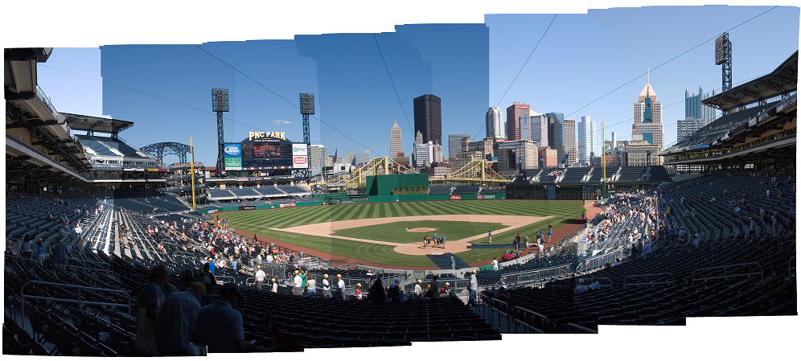
Gradient-Domain: Stitching
Create an image that:
  Reproduces detail within the images
  Is smooth across image boundaries
Image(s) courtesy of Uyttendaele

Slide 5
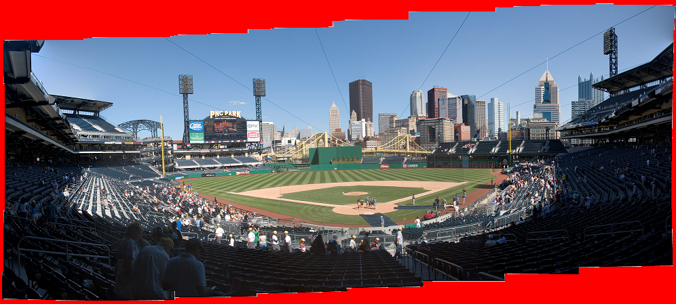

Gradient-Domain: Stitching
Create an image that:
  Reproduces detail within the images
  Is smooth across image boundaries
Setting $\vec{v}$ to be the composite of individual gradient fields:
$$E\left(f\right)=∫{\left\|\text{∇}f−\vec{v}\right\|}^{2}dp$$
Image(s) courtesy of Uyttendaele

Slide 6
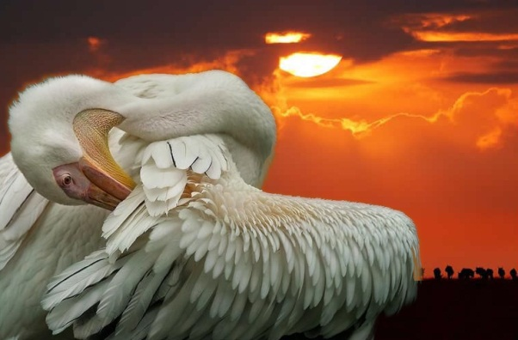
Gradient-Domain: Filtering
[Bhat et al. 2008]
Create an image similar to the input,
with amplified/dampened gradients.

Slide 7

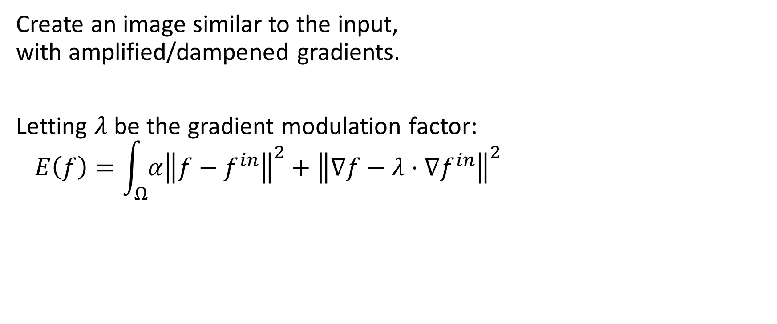

Gradient-Domain: Filtering
[Bhat et al. 2008]
Create an image similar to the input,
with amplified/dampened gradients.
Letting $λ$ be the gradient modulation factor:
$$E\left(f\right)=\int_{Ω}{{α\left\|f−f^{in}\right\|}^{2}+{\left\|\text{∇}f−λ⋅\text{∇}f^{in}\right\|}^{2}}$$
$$λ>1$$

Slide 8
Gradient-Domain: Geometry Processing
Discrete differential geometry allows us to extend this to triangle meshes

Slide 9
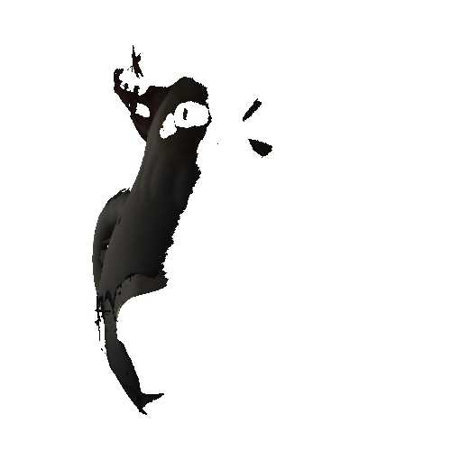
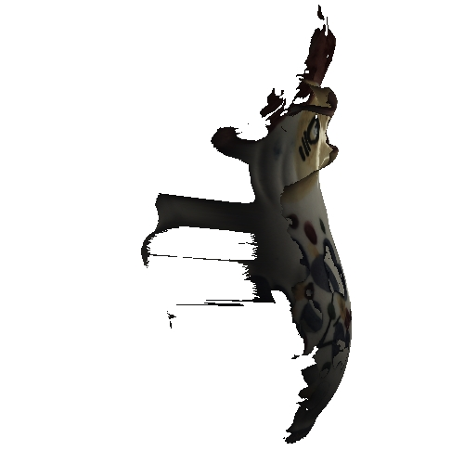
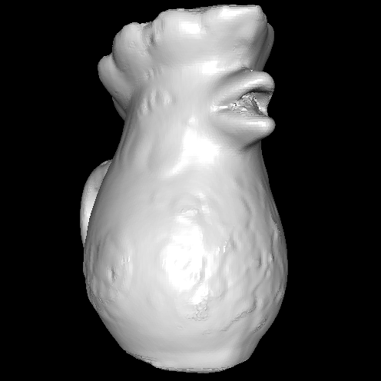
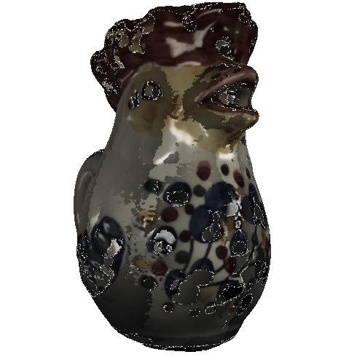
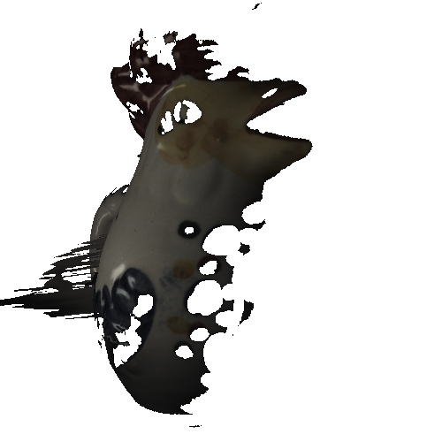
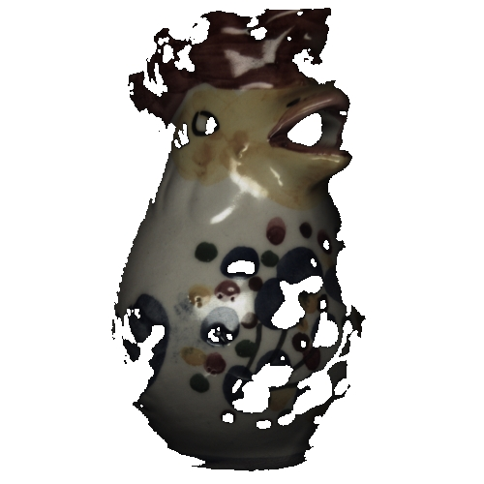
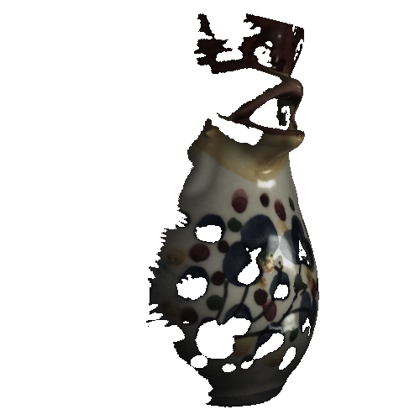
Gradient-Domain: Stitching
Create a signal that:
  Reproduces detail within the signals
  Is smooth across signal boundaries

Slide 10
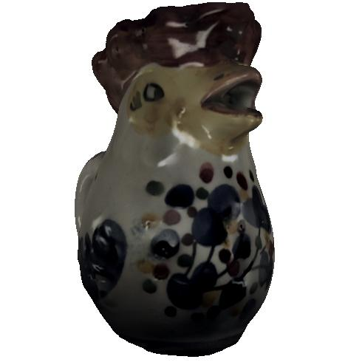

Gradient-Domain: Stitching
Create a signal that:
  Reproduces detail within the signals
  Is smooth across signal boundaries
  $$E\left(f\right)=∫{\left\|\text{∇}f−\vec{v}\right\|}^{2}dp$$

Slide 11
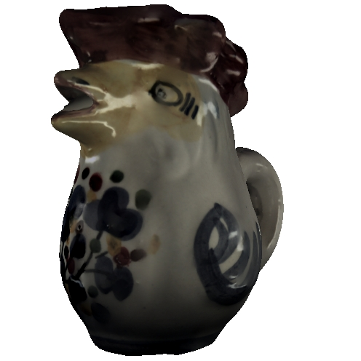

Gradient-Domain: Filtering
Create a signal similar to the input, w/ amplified/dampened gradients:
$$E\left(f\right)=\int_{Ω}{{α\left\|f−f^{in}\right\|}^{2}+{\left\|\text{∇}f−λ⋅\text{∇}f^{in}\right\|}^{2}}$$

Slide 12





Gradient-Domain: Filtering
Create a signal similar to the input, w/ amplified/dampened gradients:
$$E\left(f\right)=\int_{Ω}{{α\left\|f−f^{in}\right\|}^{2}+{\left\|\text{∇}f−λ⋅\text{∇}f^{in}\right\|}^{2}}$$
$$λ<1$$
$$λ>1$$

Slide 13
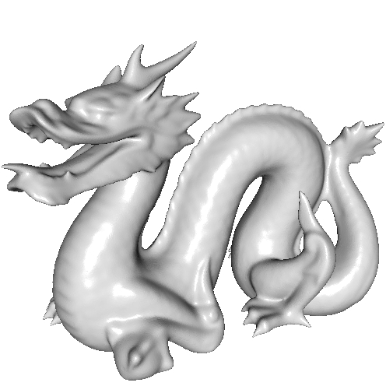
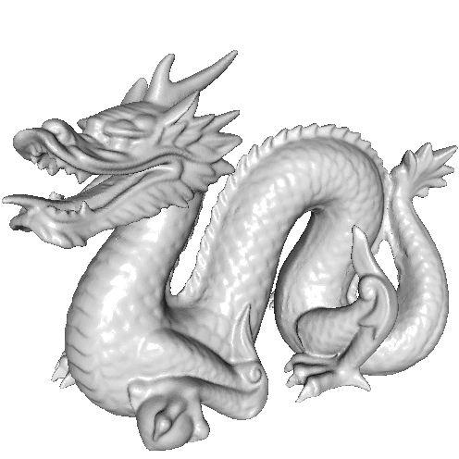
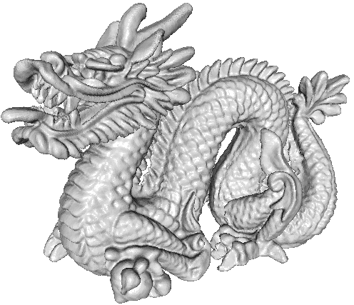



Gradient-Domain: Filtering
Create a signal similar to the input, w/ amplified/dampened gradients:
$$E\left(f\right)=\int_{Ω}{{α\left\|f−f^{in}\right\|}^{2}+{\left\|\text{∇}f−λ⋅\text{∇}f^{in}\right\|}^{2}}$$
Using the embedding coordinates as the signals:
$$λ<1$$
$$λ>1$$

Slide 14
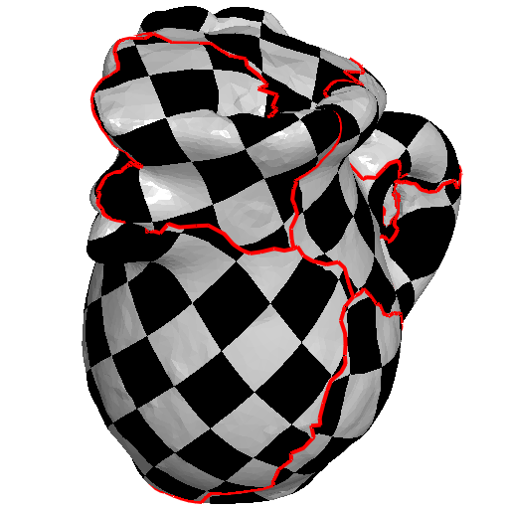
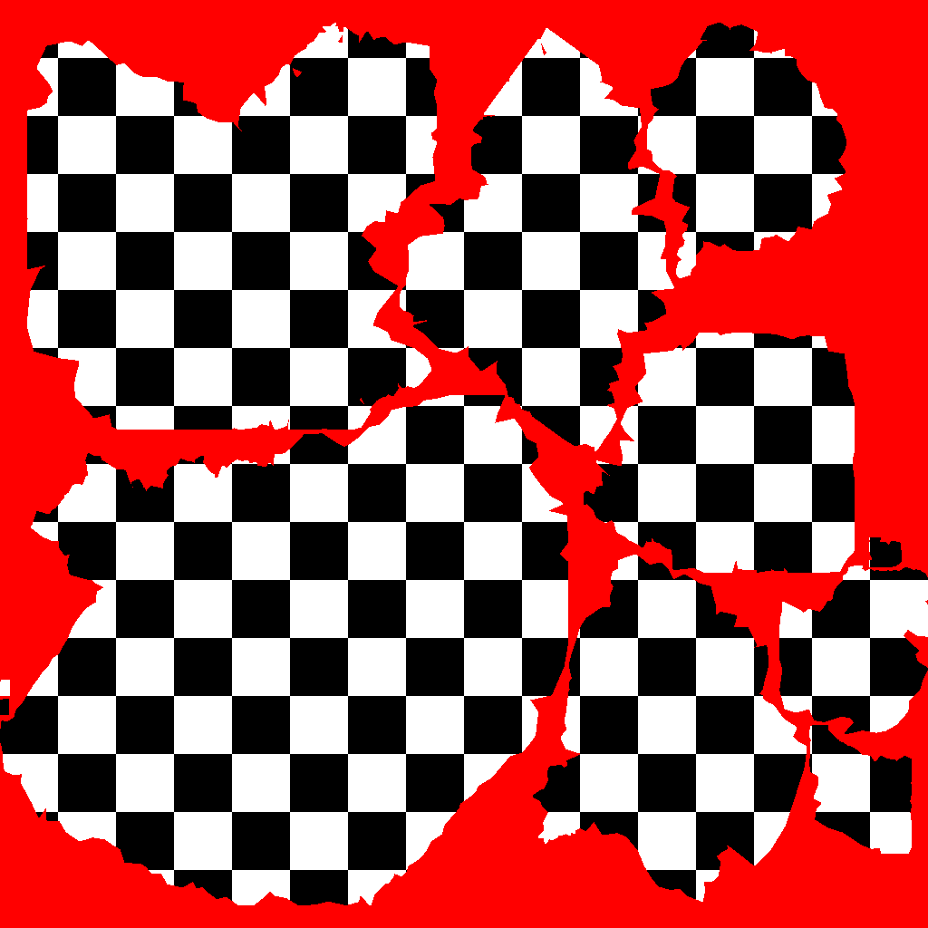
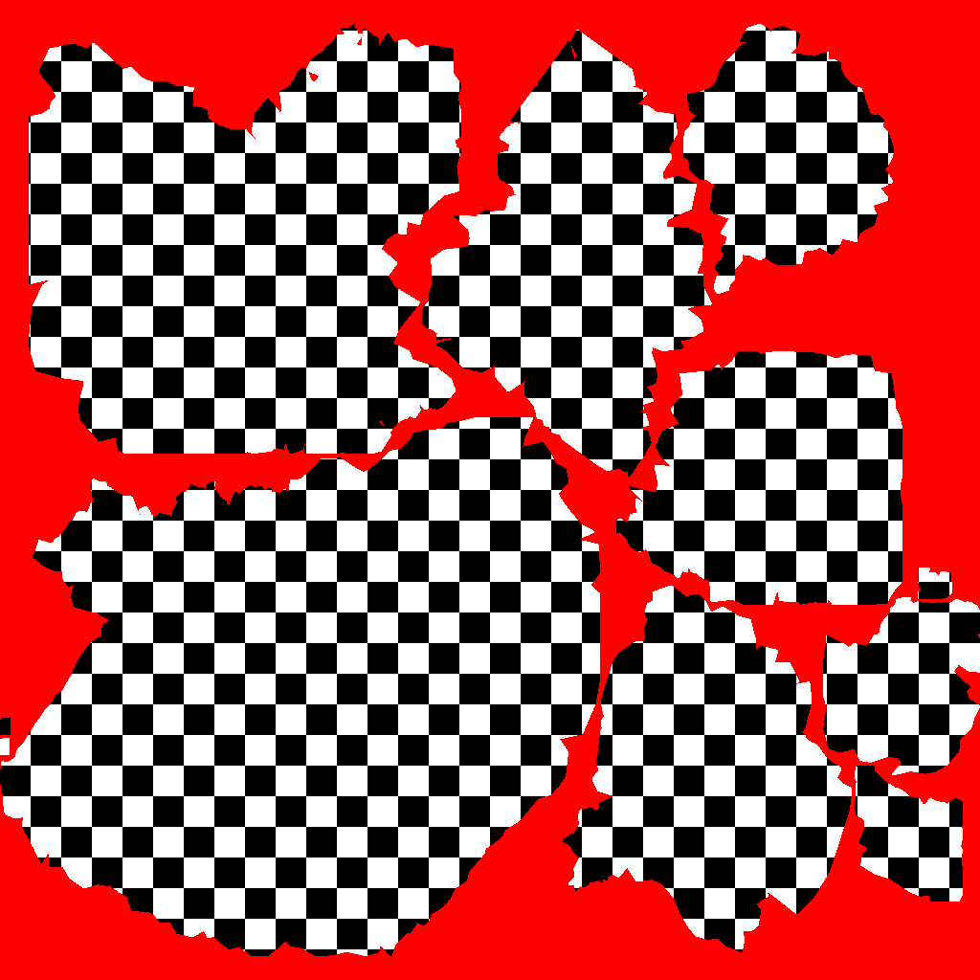

Motivation
Extend to support signals represented as texture maps:
  Standard representation for high-frequency signals
  In line with the output of AI-synthesis
  Correspondences across chart boundaries
  Parametric distortion
  Exhibits semi-regular structure
$$\left[0,1\right]×[0,1]$$

Slide 15
Outline
Motivation
Implementation
  Finite Elements
  Derivatives
  Metrics
Applications
Conclusion

Slide 16
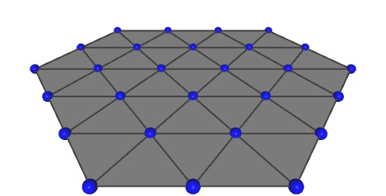
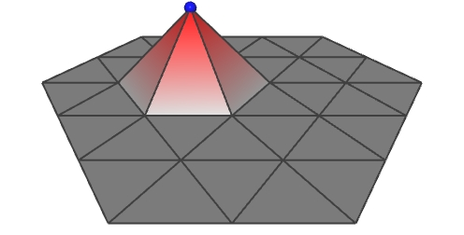
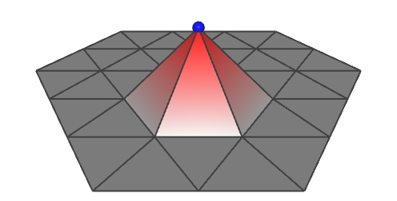
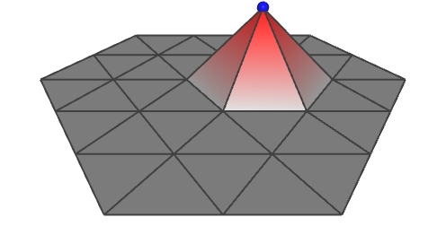
Lagrange Elements (Recall)
Discretizing functions on a triangle:
  Use continuous, interpolatory, piecewise-
  linear “hat functions” assigned
  to mesh vertices.
These form a partition of unity.

Slide 17
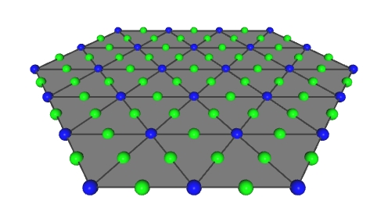
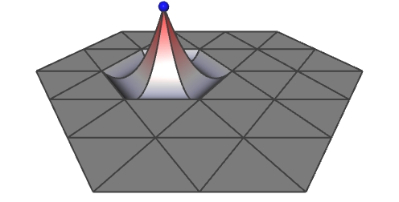
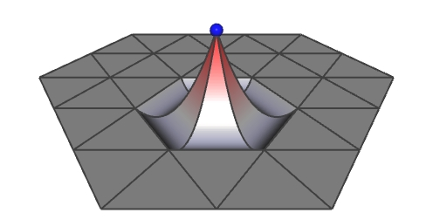
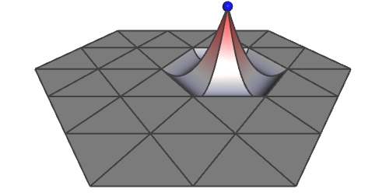
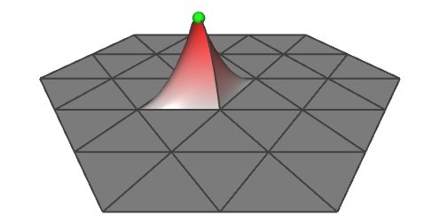
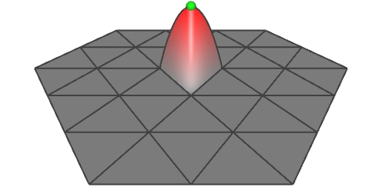
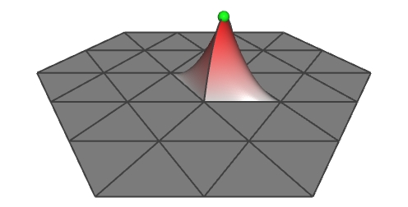
Lagrange Elements (Recall)
Discretizing functions on a triangle:
  Use continuous, interpolatory, piecewise-
  quadratic, Lagrange elements, assigned
  to mesh vertices and edge mid-points.
These also form a partition of unity.

Slide 18
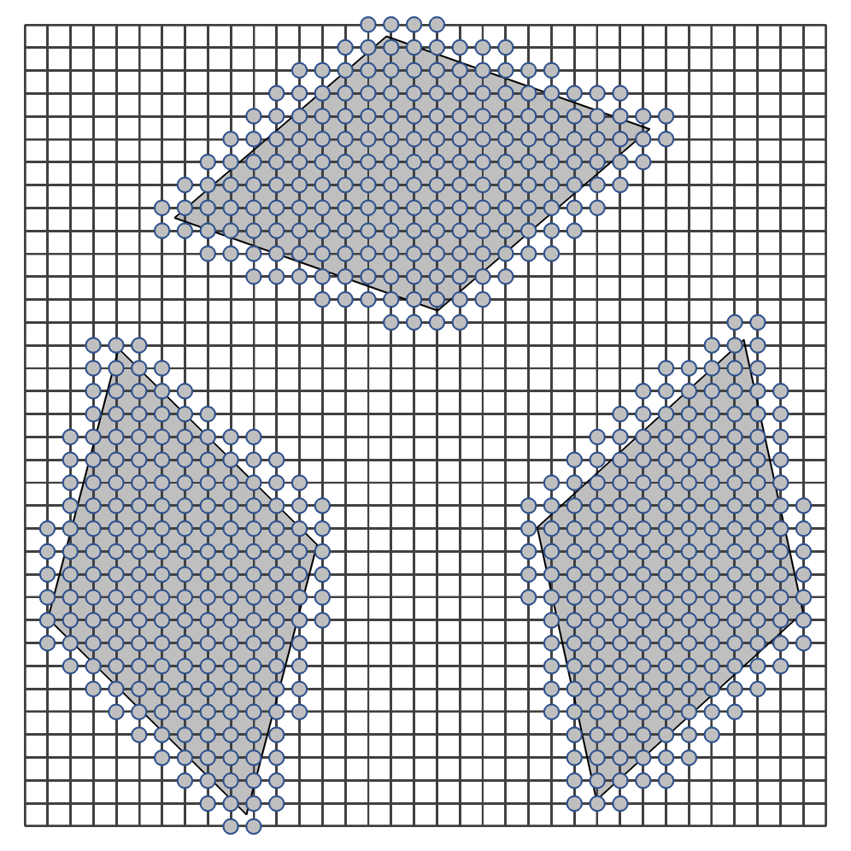
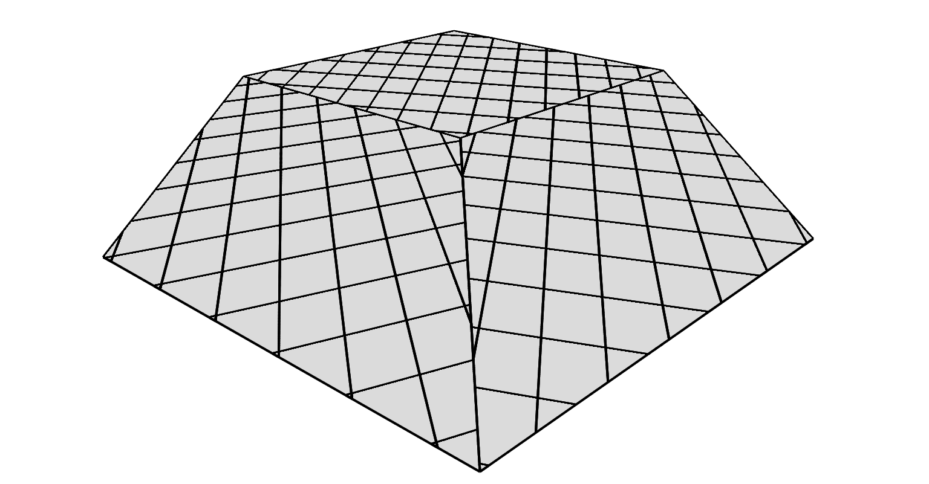

Finite Elements
Parameterization
$$\left[0,1\right]×[0,1]$$
Notes:
In this example we show the mesh of a hexagon in 3D, that is parameterized by three quadrilaterals charts in the texture domain.

Slide 19
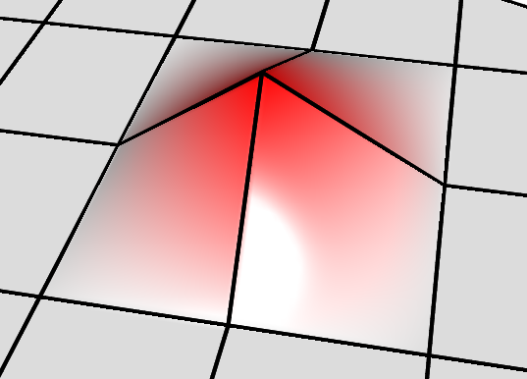
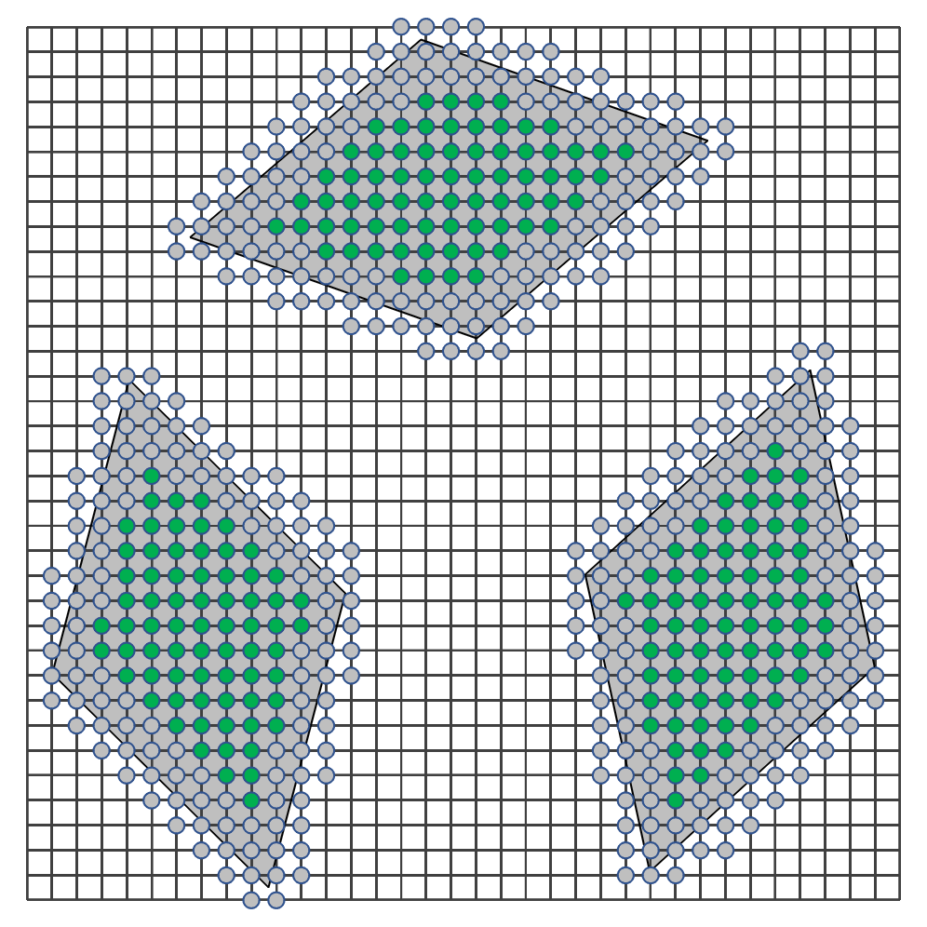
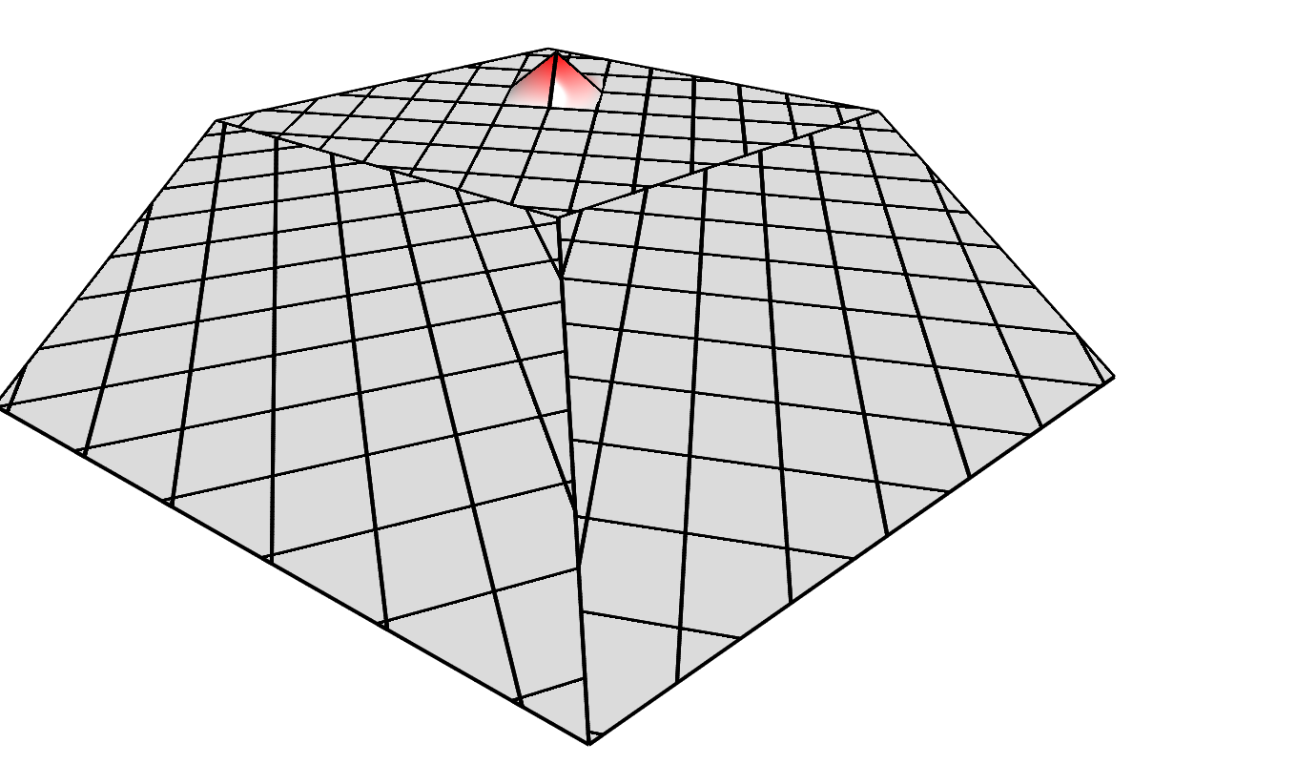
Finite Elements
Graphics hardware basis
Interior Texels
$$\left[0,1\right]×[0,1]$$
Notes:
For interior texels, highlighted in green the graphics hardware samples the texel values using a bilinear function that is continuous over the mesh.

Slide 20
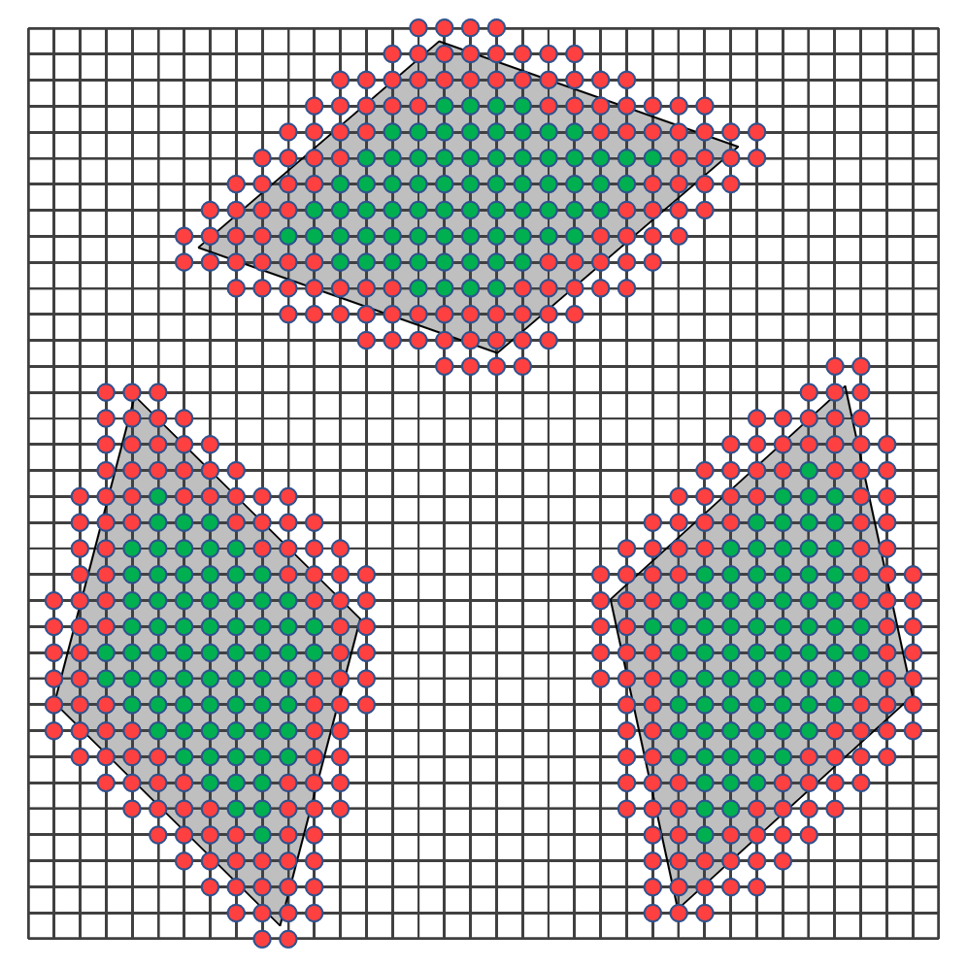

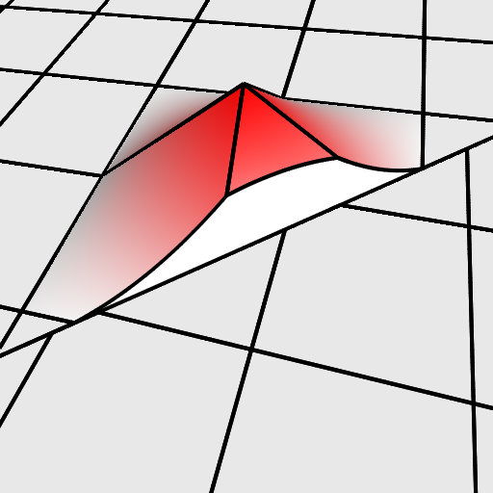
Finite Elements
Graphics hardware basis
Interior Texels
$$\left[0,1\right]×[0,1]$$
Boundary Texels
Notes:
However, for texels near the chart boundaries, highlighted in red, the graphics hardware samples the texel values using a discontinuous function.

Slide 21
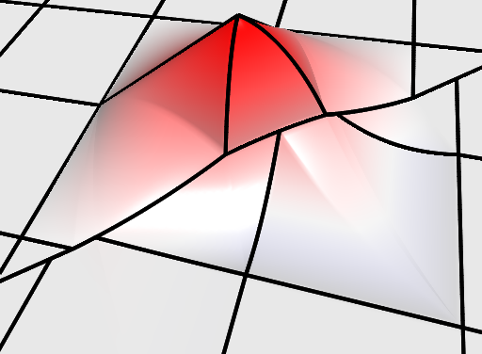
Finite Elements
Graphics hardware basis
Our (continuous) basis
reproduce
Interior Texels
approximate
$$\left[0,1\right]×[0,1]$$
Boundary Texels
Notes:
We want our processed signal to be reconstructed by the graphics hardware.
For this we define our finite elements basis to closely match the graphics hardware basis
[click] Our basis functions reproduce the graphics hardware in the interior
[click] and approximates the graphics hardware at the boundary, while enforcing continuity .

Slide 22
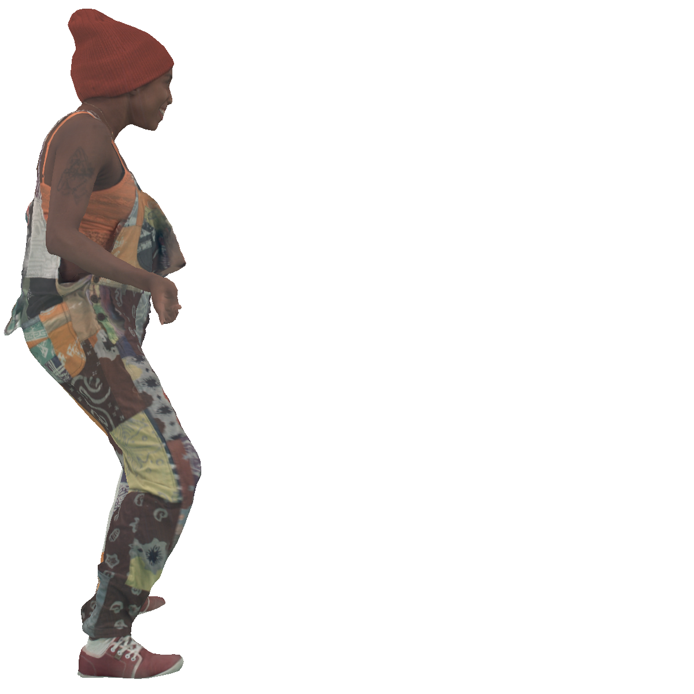




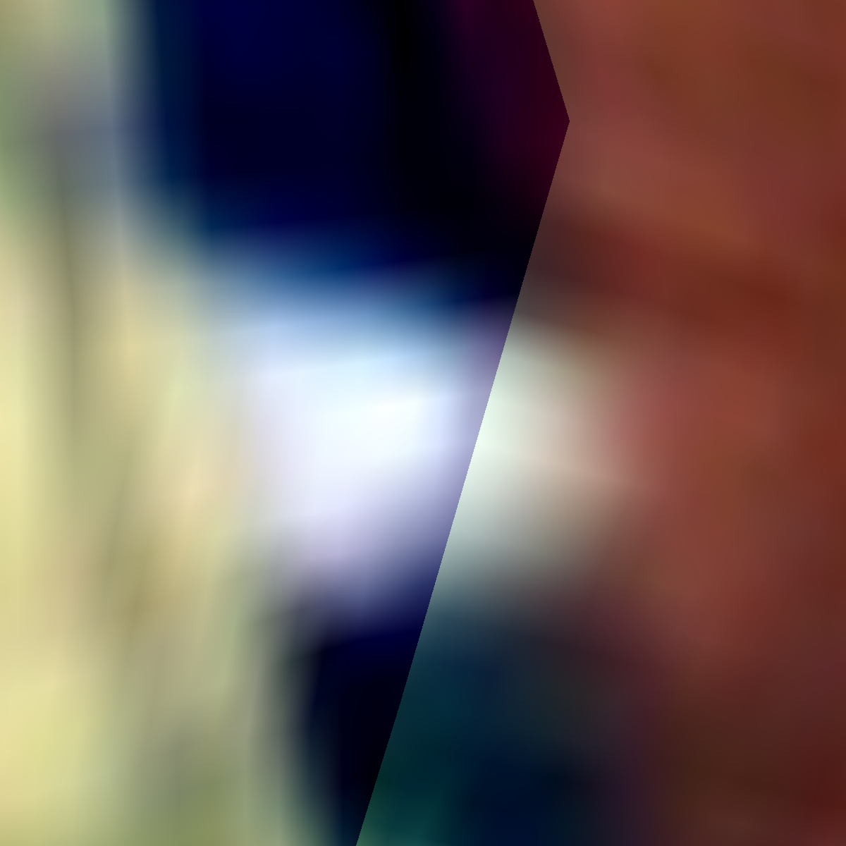
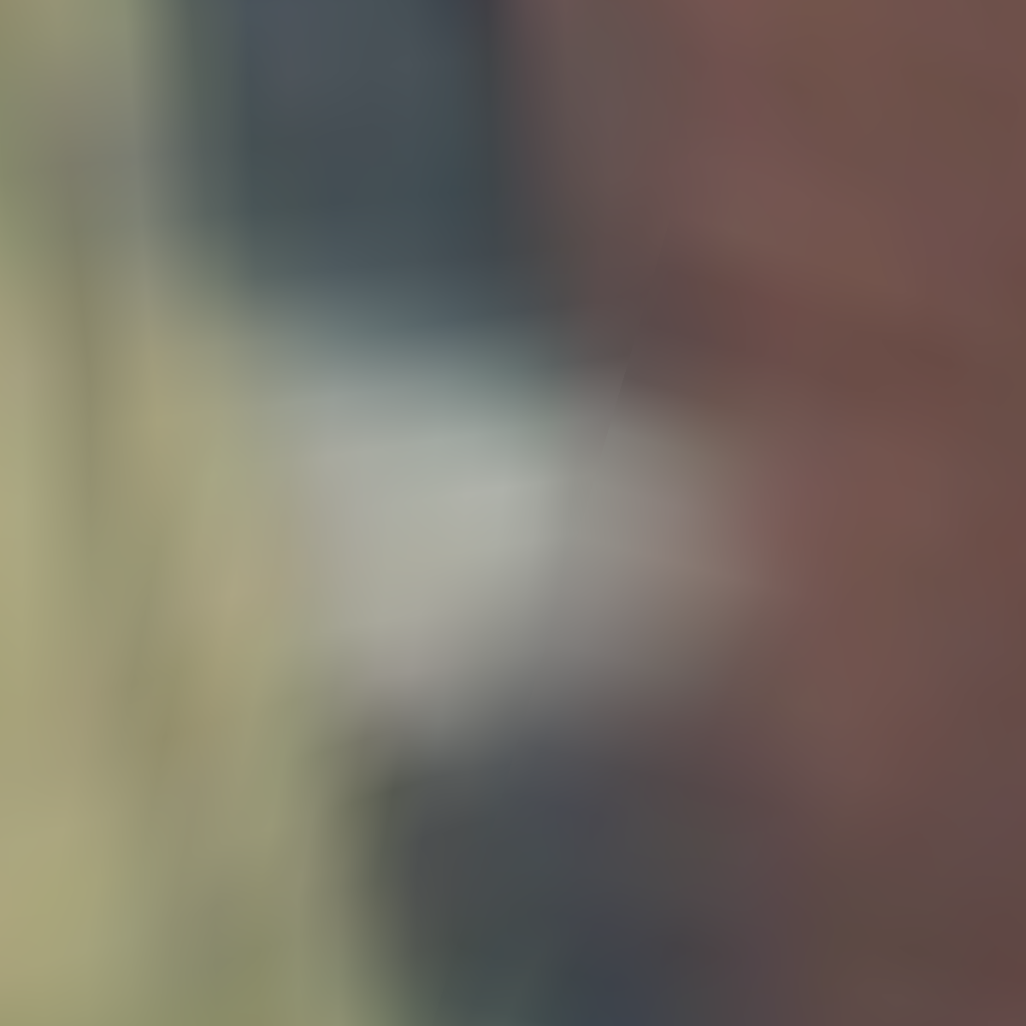
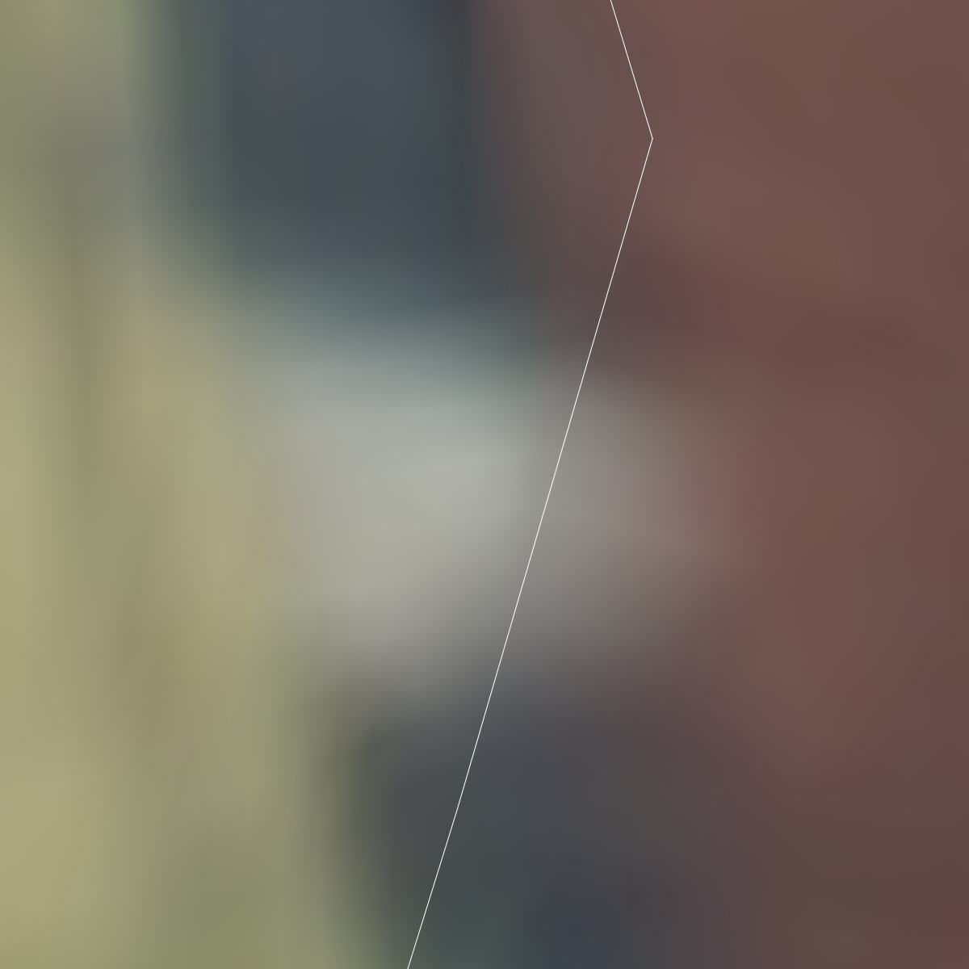
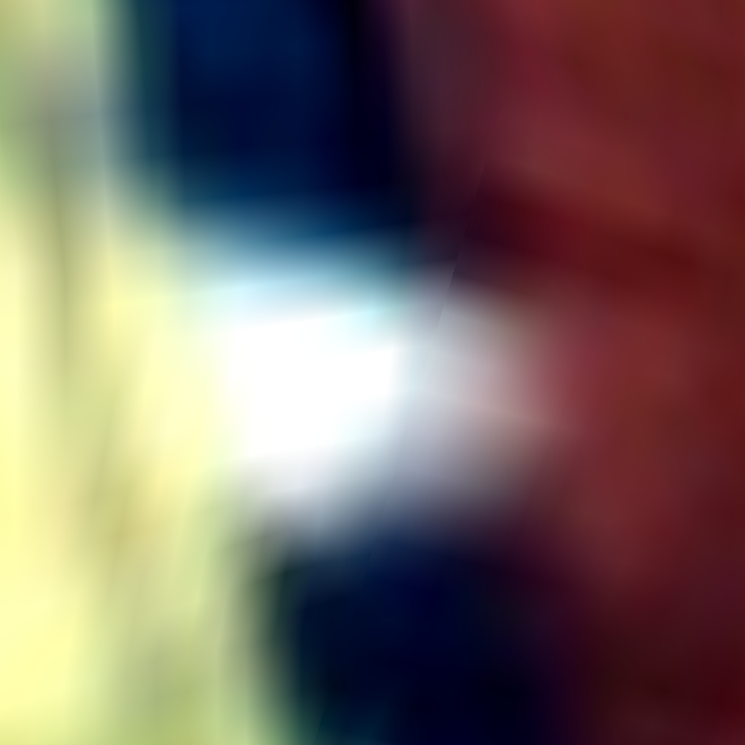

Finite Elements
Bilinear
Sharpening
Continuous
Sharpening
Software
texturing
GPU
texturing
Notes:
Lets motivate the importance of using a continuous basis for signal processing.
We show a textured model,
[click] and a zoom-in around the chart boundary, shown in white.
[click] Gradient domain sharpening with the standard bilinear basis produces a result that is not continuous across charts.
[click] Instead, our continuous basis allow information to flow across charts and produces a result that is perceptually smooth.
[click] These results reconstruct the processed signal using the standard bilinear sampling of the GPU.

Slide 23
Finite Elements
Goal:
Associate bilinear-like functions to texels.
Multigrid-driven approach:
  Define auxiliary function space on the mesh containing the texel functions.
  Define a prolongation operator expressing (coarse) texel functions as combinations of (fine) auxiliary functions.
Like a two-level multigrid:
  Coarse system defined by restricting from the finer system
  But only solve at the coarse resolution.

Slide 24
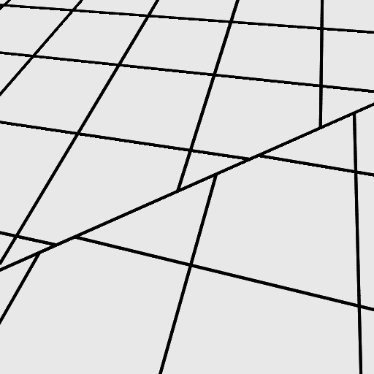
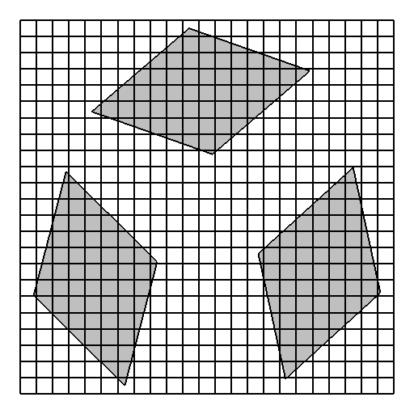


Mesh Domain
Texture Domain
Notes:
Let’s go back to the construction of our continuous function space.
We observe the tessellation that the texture grid induces on the surface, and highlight a region spanning the chart boundaries,
[click] In texture space the highlighted region is parameterized over two disconnected charts.

Slide 25
Mesh Domain
Texture Domain
Notes:
To construct a continuous function space we identify corresponding points along chart boundaries
[click] We clip the chart boundaries against the grid
[click] and introduce associated points on opposite sides of the seam.

Slide 26





Mesh Domain
Texture Domain
Notes:
We use these to define a finer triangulation of the surface that aligns with the texture grid and is free of t-junctions on the chart boundaries.
… So that now we can define second-order Lagrange elements on the vertices and edges of this finer triangulation.

Slide 27


Mesh Domain
Texture Domain
Notes:
For example,
[CLICK]
Here’s an element assigned to an interior vertex

Slide 28

Mesh Domain
Texture Domain
Notes:
And here’s an element associated to an interior edge

Slide 29

Mesh Domain
Texture Domain
Notes:
Elements defined on vertices along the chart boundary
[CLICK]
are supported on two or morch charts.

Slide 30

Continuous
Mesh Domain
Piecewise quadratic
Interpolatory
Partition of unity
Texture Domain
Notes:
Similarly,
[CLICK]
Elements defined on boundary edges are supported on two charts.
By construction each basis function in this triangulation is
[click] continuous,
[click] piecewise quadratic
[click] interpolatory,
and
[click] the basis forms a partition of unity.

Slide 31

Mesh Domain
Texture Domain
Notes:
We construct the basis function at a texel by taking linear combinations of these auxiliary functions
[click] We identify the auxiliary nodes in the texel vicinity,
[click] recalling that those along the seam are duplicated
[click] and add up together their basis functions scaled by corresponding bilinear weights

Slide 32

Continuous
Mesh Domain
Piecewise quadratic
Interpolatory
Partition of unity (after normalization)
Reproduces
bilinear in interior cells
Texture Domain
Notes:
We see an example of a texel exterior to the chart.
Again,
[click] we identify the auxiliary nodes at the vicinity of the texel,
and
[click] take linear combinations of their functions.
By construction the texel basis functions are
[click] continuous
[click] piece-wise quadratic
[click] bilinear at interior cells
and
[click] the basis forms a partition of unity.

Slide 33


Finite Elements
Given a texel node, $n∈𝒩$, denote by $φ_{n}:{\left[0,1\right]}^{2}→ℝ$ the associated function (continuous on the mesh, by construction).
$⇒$ Given $f∈ℝ^{\left|𝒩\right|}$, the associated scalar function,
$f:{\left[0,1\right]}^{2}→ℝ$ will be continuous on the mesh:
$$f\left(p\right)≡\sum_{n∈𝒩}{f_{n}⋅φ_{n}}\left(p\right)$$
$$\left[0,1\right]×[0,1]$$

Slide 34
Finite Elements [Variation]
Use quadratic polygonal Lagrange elements (e.g. [Bunge, et al., 2022]) to define continuous elements across the seam
  Avoid having to select a triangulation

Slide 35
Outline
Motivation
Implementation
  Finite Elements
  Derivatives
  Metrics
Applications
Conclusion

Slide 36


Derivatives
The differential describes how a signal changes as we move in different directions over the domain.
  Continuous: At each point, for each tangent direction,
  describes the change of the signal along the
  tangent direction

Slide 37


Derivatives
The differential describes how a signal changes as we move in different directions over the domain.
  Continuous: At each point, for each tangent direction,
  describes the change of the signal along the
  tangent direction
  Discrete: At a discrete set of points, for a discrete
  set of neighbors, describes the change of the signal
  between the neighbors

Slide 38

Finite Differences
Given a choice of finite elements, define a graph:
  Graph Nodes associated with the finite elements
    Signals represented by assigning a value/coefficient to each node
$$\left[0,1\right]×[0,1]$$

Slide 39


Finite Differences
Given a choice of finite elements, define a graph:
  Graph Nodes associated with the finite elements
  Graph Edges between elements w/ overlapping support
    Derivatives represented by differences along edges
$$\left[0,1\right]×[0,1]$$

Slide 40

Finite Differences
Given a choice of finite elements, define a graph:
  Graph Nodes associated with the finite elements
  Graph Edges between elements with overlapping support
    Derivatives represented by coefficient differences along edges
Letting $ℰ$ denote the set of graph edges, the finite differencing matrix $D∈ℝ^{\left|ℰ\right|×\left|𝒩\right|}$ is the matrix taking node coefficients to edge differences:
$$D_{en}=\left\{\begin{matrix}−1 & n=e.start \\ 1 & n=e.end \\ 0 & otherwise \end{matrix}\right.$$

Slide 41









Finite Differences vs. Finite Elements
Given a set of edge values $d∈ℝ^{\left|ℰ\right|}$, we would like to:
  Realize the values as a continuous function (1-form).
    $⇒$ This can be done by associating functions $ω_{e}:\left[0,1\right]→ℝ^{2}$ with each edge $e∈ℰ$.
  Have this be consistent with the continuous notion of differentiation
$$\{φ_{n}\}$$
$$ℝ^{\left|𝒩\right|}$$
$$Ω^{0}({\left[0,1\right]}^{2})$$
$$D$$
$$d$$
$$\{ω_{e}\}$$
$$ℝ^{\left|ℰ\right|}$$
$$Ω^{1}({\left[0,1\right]}^{2})$$

Slide 42

Finite Differences vs. Finite Elements
Given a set of edge values $d∈ℝ^{\left|ℰ\right|}$, we would like to:
  Realize the values as a continuous function (1-form).
    $⇒$ This can be done by associating functions $ω_{e}:\left[0,1\right]→ℝ^{2}$ with each edge $e∈ℰ$.
  Have this be consistent with the continuous notion of differentiation
Whitney (Basis) Functions:
Given scalar functions, ${\left\{φ_{n}\right\}}_{n∈𝒩}$, define 1-forms ${\left\{ω_{mn}\right\}}_{m,n∈𝒩}$:
$$ω_{mn}≡\frac{1}{2}\left(φ_{m}⋅dφ_{n}−dφ_{m}⋅φ_{n}\right)$$
If $\left\{φ_{n}\right\}$ forms a partition of unity $⇒$ difference-derivative consistency:
$$d\left(\sum_{n∈𝒩}{f_{n}}⋅φ_{n}\right)=\sum_{m,n∈𝒩}{\left(f_{n}−f_{m}\right)⋅ω_{mn}}$$

Slide 43


Whitney (Basis) Functions
$$ω_{mn}≡\frac{1}{2}\left(φ_{m}⋅dφ_{n}−dφ_{m}⋅φ_{n}\right)$$
Note:
The functions $ω_{mn}$ are not linearly independent:
  Anti-symmetry: $ω_{mn}=−ω_{nm}$
  Sparsity: $ω_{mn}=0$ when the supports of $φ_{m}$ and $φ_{n}$ do not overlap
$⇒$ It suffices to represent the finite differences over a directed graph with edges between nodes whose function supports overlap

Slide 44













Derivatives [Variation]
$$\{φ_{n}\}$$
$$ℝ^{\left|𝒩\right|}$$
$$Ω^{0}({\left[0,1\right]}^{2})$$
$$D$$
$$d$$
$$\{ω_{e}\}$$
$$ℝ^{\left|ℰ\right|}$$
$$Ω^{1}({\left[0,1\right]}^{2})$$
While the Whitney functions are sufficient for
satisfying a consistent notion of differentiation
they are not always necessary.
Example:
On a regular grid, we can define a tensor
product basis (e.g. bilinear functions).
  Whitney functions requires introducing
  diagonals when constructing the graph.
  Mixed-order elements are consistent
  only using horizontal/vertical edges.

Slide 45
Outline
Motivation
Implementation
  Finite Elements
  Derivatives
  Metrics
Applications
Conclusion

Slide 46

Metrics
Gradient-domain processing seeks the function minimizing an energy combining value and differential differences:
$$E\left(f\right)=\int{{\left\|f−h\right\|}^{2}+{\left\|df−ω\right\|}^{2} }$$
This requires a metric to define:
  Inner-product: How big is an individual (co-)tangent vector?
  Volume: How “big” is a patch of surface?

Slide 47







Metrics: Triangle Meshes
$$𝕋⊂ℝ^{2}$$
Approach:
  Parameterize the 3D triangle over the unit right triangle $𝕋$
  Pull-back the (embedding) metric to $𝕋$:
  $$g≡dΦ^{⊤}⋅dΦ$$
  For co-tangent vectors $v,w∈T_{p}^{∗}𝕋$, the inner-product w.r.t. $g$ is:
  $${\left\langle v,w\right\rangle }_{g}≡v^{⊤}⋅g^{−1}⋅w$$
  For a function $f:𝕋→ℝ$, the total square-norm w.r.t. $g$ is:
  $$\int_{𝕋}{f dg}≡\int_{𝕋}{f⋅\sqrt{\left|g\right|}} d𝕋$$
$$Φ$$
$$v_{2}$$
$$τ⊂ℝ^{3}$$
$$v_{1}$$
$$v_{0}$$

Slide 48

Metrics: Triangle Meshes
$$𝕋⊂ℝ^{2}$$
Approach:
  Parameterize the 3D triangle over the unit right triangle $𝕋$
  Pull-back the (embedding) metric to $𝕋$:
  $$g≡dΦ^{⊤}⋅dΦ$$
  For co-tangent vectors $v,w∈T_{p}^{∗}𝕋$, the inner-product w.r.t. $g$ is:
  $${\left\langle v,w\right\rangle }_{g}≡v^{⊤}⋅g^{−1}⋅w$$
  For a function $f:𝕋→ℝ$, the total square-norm w.r.t. $g$ is:
  $$\int_{𝕋}{f dg}≡\int_{𝕋}{f⋅\sqrt{\left|g\right|}} d𝕋$$
$$Φ$$
$$v_{2}$$
$$τ⊂ℝ^{3}$$
$$v_{1}$$
$$v_{0}$$
When $f:𝕋→ℝ$ is nice (e.g. polynomial), the integral can be computed analytically.
Otherwise, it can be approximated using quadrature.

Slide 49



Metrics: Textured Meshes
Integrating a function over a texel:
  Not all of the texel may be covered
  The mapping may distort
  different regions of the
  texel in different ways

Slide 50



Metrics: Textured Meshes
Integrating a function over a texel:
  Partition texels by the 2D image of the mesh triangles.
    $⇒$ Pull-back metric is constant within each cell.

Slide 51



Metrics: Textured Meshes
Integrating a function over a texel:
  Partition texels by the 2D image of the mesh triangles.
    $⇒$ Pull-back metric is constant within each cell.
  Triangulate the cells and
  integrate over sub-triangles
  using the pull-back metric.

Slide 52

Gradient Domain Processing
System Matrices:
  Scalar mass matrix $M∈ℝ^{\left|𝒩\right|×\left|𝒩\right|}$:
  $$M_{nm}≡\int{φ_{n}⋅φ_{m}}$$
  1-form mass matrix $M^{1}∈ℝ^{\left|ℰ\right|×\left|ℰ\right|}$
  $M_{ef}^{1}≡\int{⟨ω_{e},ω_{f}⟩}$
Using the finite-differencing matrix, $D∈ℝ^{\left|ℰ\right|×\left|𝒩\right|}$:
  Stiffness matrix $S=D^{⊤}⋅M^{1}⋅D∈ℝ^{\left|𝒩\right|×\left|𝒩\right|}$.
  Divergence matrix $Div=D^{⊤}⋅M^{1}∈ℝ^{\left|𝒩\right|×\left|ℰ\right|}$

Slide 53

Gradient Domain Processing
System Vectors:
  For a scalar function $h$ define the dual representation $h^{∗}∈ℝ^{\left|𝒩\right|}$:
  $h_{n}^{∗}=\int{φ_{n}⋅h}$
  For a 1-form $ω$ define the dual representation of the divergence $w^{∗}∈ℝ^{\left|𝒩\right|}$:
  $w_{n}^{∗}=\int{⟨ω,dφ_{n}⟩}$
When the constraint functions live in the function space:
  If $h=∑h_{n}⋅φ_{n}$, then $h^{∗}=M⋅h$
  If $ω=∑w_{e}⋅ω_{e}$, then $w^{∗}=Div⋅w$

Slide 54

Gradient Domain Processing
$$argmin E\left(f\right)=\int{α⋅{\left\|f−h\right\|}^{2}+{β⋅\left\|df−ω\right\|}^{2}}$$
$$⇕$$
$$f={\left(α⋅M+β⋅S\right)}^{−1}⋅(α⋅h^{∗}+β⋅w^{∗})$$

Slide 55
Metrics [Variation]
The pull-back metric defined need not be derived from the embedding.
  Allows incorporating anisotropy
?
?

Slide 56
Outline
Motivation
Implementation
  Finite Elements
  Derivatives
  Metrics
Applications
Conclusion

Slide 57




Applications: Filtering
$$f={\left(α⋅M+β⋅S\right)}^{−1}⋅(α⋅h^{∗}+β⋅w^{∗})$$
Input:
  Texel coefficients $f∈ℝ^{|𝒩|}$
  Gradient modulation factor $λ≥0$
  Gradient-fitting weight $β≥0$
Algorithm:
  Solve: $f^{new}={\left(M+β⋅S\right)}^{−1}⋅\left(M+β⋅λ⋅S\right)⋅f$
$$λ>1$$
Note:
Setting $λ=0$ (aggressive smoothing) gives the heat diffusion equation:
$$f^{new}={\left(M+β⋅S\right)}^{−1}⋅M⋅f$$
with the parameter $β$ playing the role of time.

Slide 58

Applications: Stitching
$$f={\left(α⋅M+β⋅S\right)}^{−1}⋅(α⋅h^{∗}+β⋅w^{∗})$$
Input:
  Composite texel coefficients $f∈ℝ^{|𝒩|}$
  Assignment of texels to source $ι:𝒩→ℕ$
  Gradient-fitting weight $β≥0$
Algorithm:
  Compute target differential, $w∈ℝ^{\left|ℰ\right|}$:
  $w_{e}=\left\{\begin{matrix}f_{e.end}−f_{e.start} & if ι\left(e.start\right)=ι(e.end) \\ 0 & otherwise \end{matrix}\right.$
  Solve: $f^{new}={\left(M+β⋅S\right)}^{−1}⋅\left(M⋅f+β⋅Div⋅w\right)$

Slide 59




Applications: Line Integral Convolution
$$f={\left(α⋅M+β⋅S\right)}^{−1}⋅(α⋅h^{∗}+β⋅w^{∗})$$
Input:
  Tangent vector field $\vec{v}$
  Diffusion time $β≥0$
Algorithm:
  Initialize a random texture $r∈ℝ^{\left|𝒩\right|}$
  Shrink the metric along the vector field direction
  Compute the mass and stiffness matrices w.r.t. the anisotropically scaled metric, $\hat{M},\hat{S}∈ℝ^{\left|𝒩\right|×\left|𝒩\right|}$
  Solve heat diffusion: $f={\left(\hat{M}+β⋅\hat{S}\right)}^{−1}⋅\hat{M}⋅r$
[Cabral and Leedom, 1993]

Slide 60



Applications: Geodesics in Heat
$$f={\left(α⋅M+β⋅S\right)}^{−1}⋅(α⋅h^{∗}+β⋅w^{∗})$$
Input:
  Source texel $n∈𝒩$
  Diffusion time $β≥0$
Algorithm (Diffuse):
  Approximate delta function at the source, $f∈ℝ^{\left|ℰ\right|}$: $f_{m}=δ_{mn}$
  Solve heat diffusion: $h={\left(M+β⋅S\right)}^{−1}⋅M⋅f$
Algorithm (Fit to Normalized Differential):
  Compute the dual divergence $w^{∗}∈ℝ^{\left|𝒩\right|}$ of $ω=dh/\left\|dh\right\|$
  Solve: $g=S^{−1}⋅w^{∗}$
$$n$$
[Crane et al., 2012]

Slide 61


Applications: Geodesics in Heat
$$f={\left(α⋅M+β⋅S\right)}^{−1}⋅(α⋅h^{∗}+β⋅w^{∗})$$
Input:
  Source texel $n∈𝒩$
  Diffusion time $β≥0$
Algorithm (Diffuse):
  Set the approximate delta function, $f∈ℝ^{\left|ℰ\right|}$: $f_{m}=δ_{mn}$
  Solve: $h={\left(M+β⋅S\right)}^{−1}⋅M⋅f$
Algorithm (Fit to Normalized Differential):
  Compute the dual divergence $w^{∗}∈ℝ^{\left|𝒩\right|}$ of $ω=dh/\left\|dh\right\|$
  Solve: $g=S^{−1}⋅w^{∗}$
$$n$$
Note:
The normalized differential $ω$ is not in the span of the 1-form basis.
$⇒$ The dual divergence $w^{∗}$ requires explicit integration.
[Crane et al., 2012]

Slide 62





Applications: Geodesics in Heat
$$f={\left(α⋅M+β⋅S\right)}^{−1}⋅(α⋅h^{∗}+β⋅w^{∗})$$
2D Euclidean Metric
3D Embedding Metric
Notes:
Let me highlight the importance of capturing the immersion metric in a simple example.
[click] The diffusion of a pulse on the texture domain using the Euclidean metric generates concentric circles
[click] which do not correspond to geodesic circles on the surface.
[click] By capturing the parametric distortion our texture domain approach generates a set of distorted contours
[click] that are mapped to geodesic circles on the surface.

Slide 63
Outline
Motivation
Implementation
  Finite Elements
  Derivatives
  Metrics
Applications
Conclusion

Slide 64
Conclusion
To support signal processing in the texture domain:
  Define seam-continuous, almost everywhere bilinear functions
  Integrate using the pull-back of the embedding metric
Enables applications like:
  Smoothing/sharpening
  Stitching
  Line integral convolution
  Geodesics in heat
  Etc.
Application: Provides system matrices
User: Iterates over nodes/edge to construct system constraints
Application: Provides system matrices
User: Interface into the quadrature-based integration

Slide 65
Conclusion
struct GradientDomain
{
  // The constructor…
  GradientDomain( … );
  // The number of texels
  size_t numNodes( void ) const;
  // The number of edges between texels
  size_t numEdges( void ) const;
  // The 2D index of a texel
  std::pair< size_t , size_t > node( size_t n ) const;
  // The indices of the texel end-points of the edge
  std::pair< size_t , size_t > edge( size_t e ) const;
  // The mass matrix
  Eigen::SparseMatrix< double > mass( void ) const;
  // The stiffness matrix
  Eigen::SparseMatrix< double > stiffness( void ) const;
  // The divergence matrix
  Eigen::SparseMatrix< double > divergence( void ) const;
  // The finite-differences matrix
  Eigen::SparseMatrix< double > finiteDifferences( void ) const;
};
v
To support signal processing in the texture domain, need to:
  Define seam-continuous, almost everywhere bilinear functions
  Integrate using the pull-back of the embedding metric
Enables applications like:
  Smoothing/sharpening
  Stitching
  Line integral convolution
  Geodesics in heat
  Etc.
v
Application: Provides system matrices
User: Iterates over nodes/edge to construct system constraints
Application: Provides system matrices
User: Interface into the quadrature-based integration

Slide 66

Conclusion
In Addition:
The semi-regular structure makes it possible:
  To support memory-efficient and parallel
  system matrix multiplication
  To leverage efficient hierarchical solvers.
$⇒$ Interactive simulation of PDEs like reaction/diffusion [Turing, 1952]

Slide 67
Limitations (1)
Numerical Stability:
  Refinement can introduce sliver triangles.

Slide 68
Limitations (1)
Numerical Stability:
  Refinement can introduce sliver triangles.
  Coupling through prolongation “merges” the
  triangles together

Slide 69


Limitations (2)
Numerical Stability:
  Clipping to the grid can introduce sliver triangles

Slide 70


Limitations (2)
Numerical Stability:
  Clipping to the grid can introduce sliver triangles
  $⇒$ Functions abruptly transition to zero
  (particularly when corresponding vertex is close to a texel node)

Slide 71





Thank You!
https://www.cs.jhu.edu/~misha/Code/TextureSignalProcessing/
https://github.com/mkazhdan/TextureSignalProcessing

