Slide 1
Conformalized Mean Curvature Flow and Möbius Registration
w/ Jake Solomon, Miri Ben-Chen
Alex Baden, Keenan Crane

Slide 2
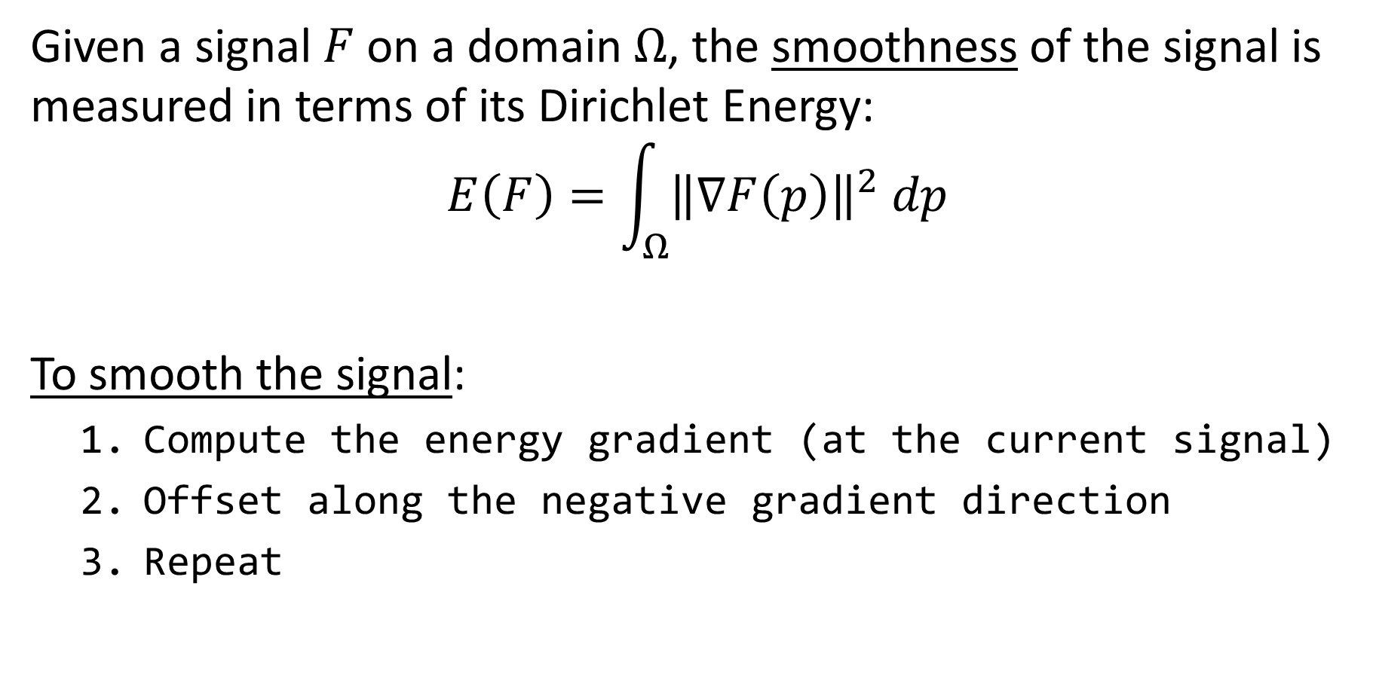
Signal Smoothing
Given a signal $F$ on a domain $Ω$, the smoothness of the signal is measured in terms of its Dirichlet Energy:
$$E\left(F\right)=\int_{Ω}{{\left\|\text{∇}F\left(p\right)\right\|}^{2} dp}$$
To smooth the signal:
  Compute the energy gradient (at the current signal)
  Offset along the negative gradient direction
  Repeat

Slide 3
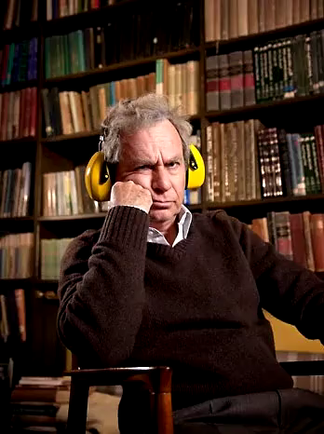

Signal Smoothing
Smooth by evolving the signal along the negative gradient of the Dirichlet energy:
$$E\left(F\right)=\int_{Ω}{{\left\|\text{∇}F\left(p\right)\right\|}^{2} dp}$$
… can be applied to images:

Slide 4
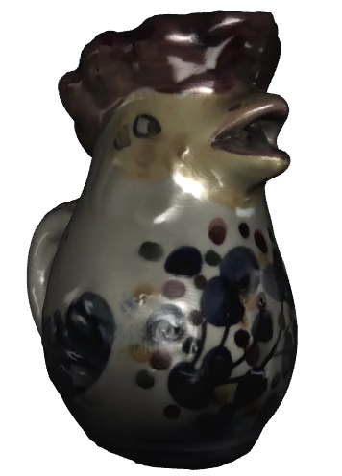

Signal Smoothing
Smooth by evolving the signal along the negative gradient of the Dirichlet energy:
$$E\left(F\right)=\int_{Ω}{{\left\|\text{∇}F\left(p\right)\right\|}^{2} dp}$$
… and signals on a surface:

Slide 5
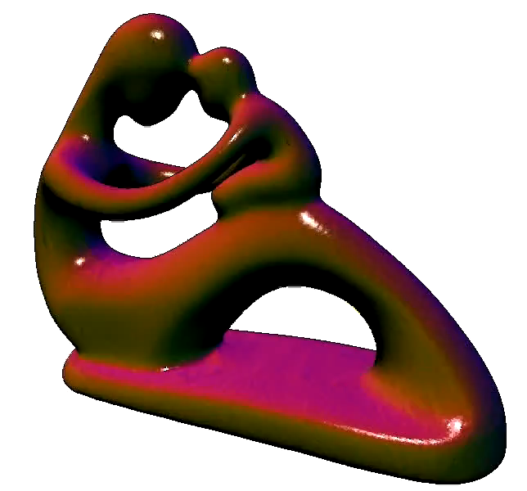

Signal Smoothing
Smooth by evolving the signal along the negative gradient of the Dirichlet energy:
$$E\left(F\right)=\int_{Ω}{{\left\|\text{∇}F\left(p\right)\right\|}^{2} dp}$$
… and even the geometry of the surface*:
*Cheating by “locking” vertices as they collapse

Slide 6
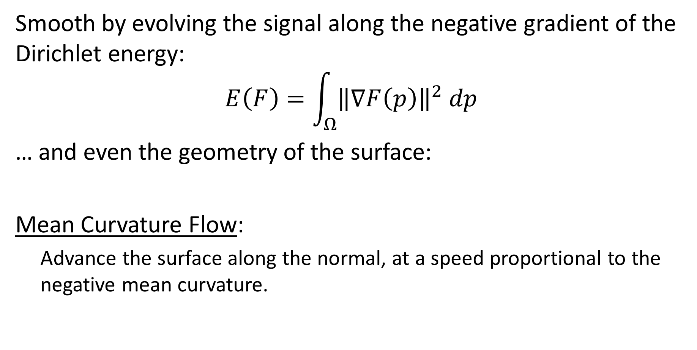
Signal Smoothing
Smooth by evolving the signal along the negative gradient of the Dirichlet energy:
$$E\left(F\right)=\int_{Ω}{{\left\|\text{∇}F\left(p\right)\right\|}^{2} dp}$$
… and even the geometry of the surface:
Mean Curvature Flow:
  Advance the surface along the normal, at a speed proportional to the negative mean curvature.

Slide 7
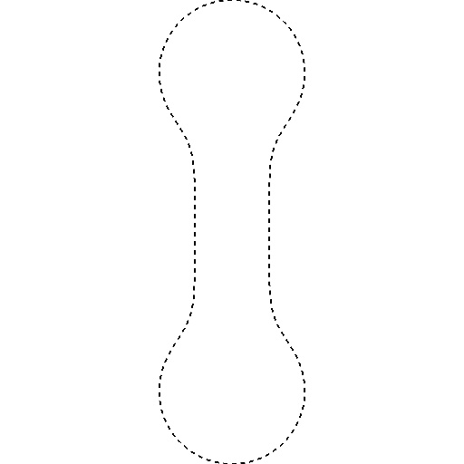
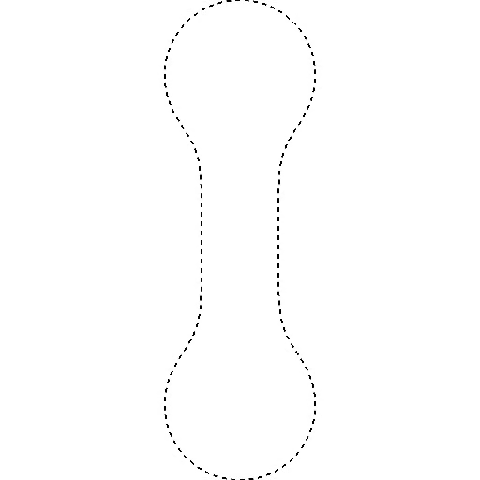
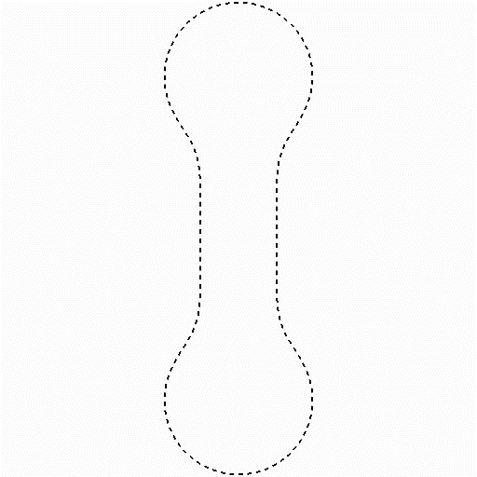
Mean-Curvature Flow (Curves)
Advance the surface along the perpendicular to the surface, at a speed proportional to the mean curvature.
  [Grayson ’87] For curves, this converges to a “round point”

Slide 8
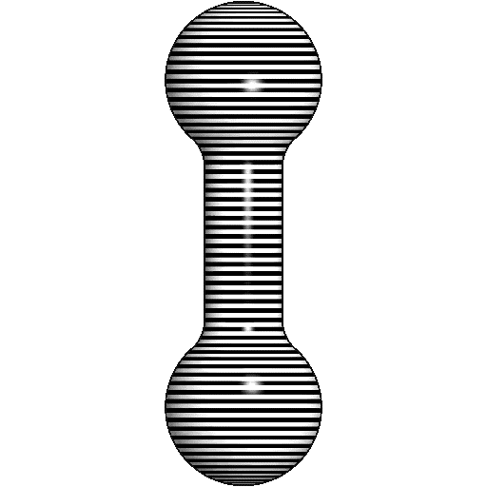
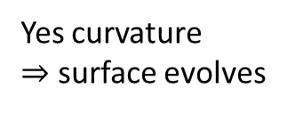
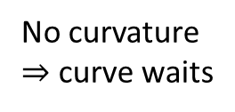
Mean-Curvature Flow (Surfaces)
Things don’t work as well with surfaces.
No curvature
$⇒$ curve waits
Yes curvature
$⇒$ surface evolves
Notes:
Note:
The figure on the right is a cut-away of a water-tight surface of revolution.
For the curve case, convex regions flow inward, concave regions flow out, and flat regions stay fixed. On surfaces the “flat” regions can still flow inward.

Slide 9
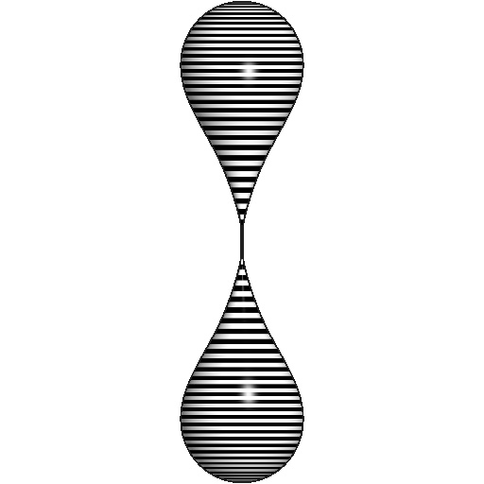
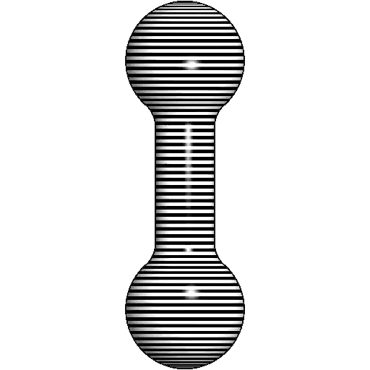
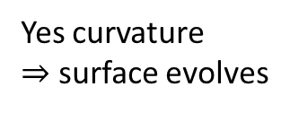
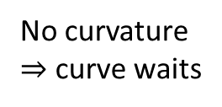
Mean-Curvature Flow (Surfaces)
Approach:
  Identify “singularities” in the flow
  Modify the flow to avoid them
No curvature
$⇒$ curve waits
Yes curvature
$⇒$ surface evolves

Slide 10
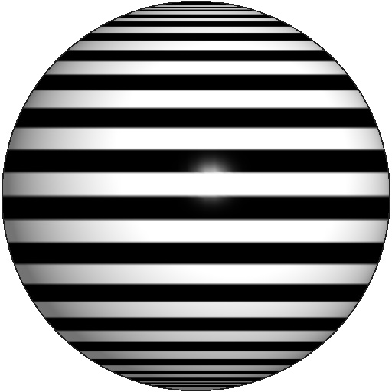

Mean-Curvature Flow (Surfaces)
Approach:
  Identify “singularities” in the flow
  Modify the flow to avoid them
No curvature
$⇒$ curve waits
Yes curvature
$⇒$ surface evolves
In CS speak: “singularity” $⇔$ “division by zero”

Slide 11
Outline
Conformalized Mean Curvature Flow
  Signal/Geometry Smoothing
  Discretization
  Identifying and Modifying
  Evaluation
Mobius Registration

Slide 12
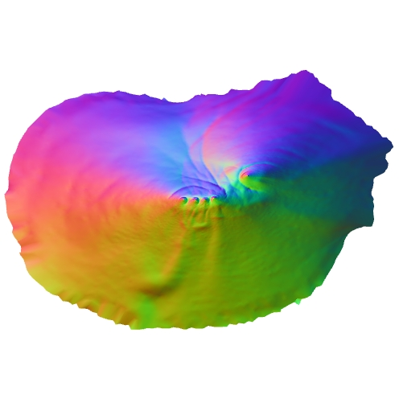
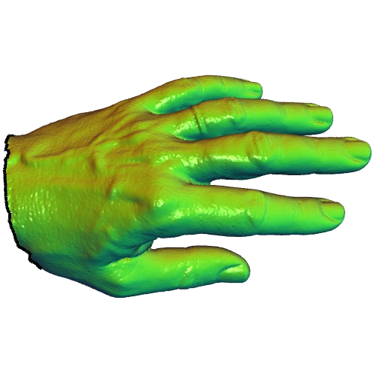




Discretization
Approach:
Starting with a 2-manifold $ℳ$, immersed via the mapping $Φ_{0}:ℳ→ℝ^{3}$…
$$ℳ$$
$$Φ_{0}$$
$Φ_{0}(ℳ$)
Notes:
Describe the normal/color visualization

Slide 13



Discretization
Approach:
Starting with a 2-manifold $ℳ$, immersed via the mapping $Φ_{0}:ℳ→ℝ^{3}$, we want to define a time-evolving family of maps:
$$Φ_{t}:ℳ→ℝ^{3}$$
describing a smoothing evolution:
$$\frac{∂Φ_{t}}{∂t}=Δ_{t}Φ_{t}$$
$$ℳ$$
$$Φ_{t}$$
$Φ_{t}(ℳ$)

Slide 14
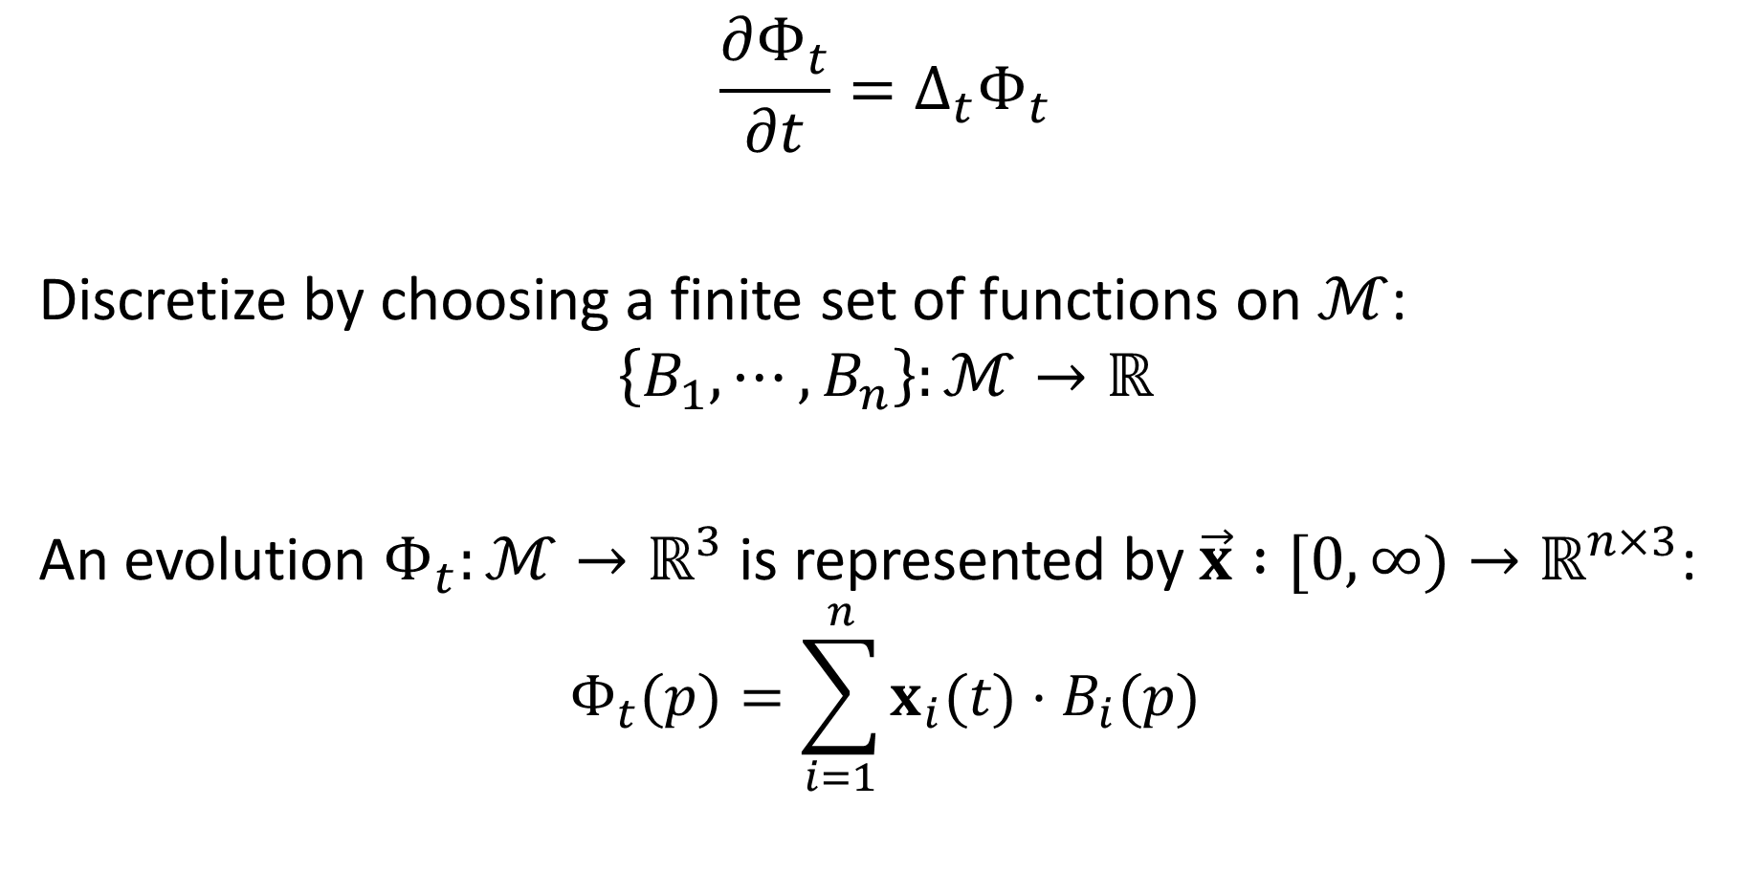
Spatial Discretization
$$\frac{∂Φ_{t}}{∂t}=Δ_{t}Φ_{t}$$
Discretize by choosing a finite set of functions on $ℳ$:
$$\left\{B_{1},⋯,B_{n}\right\}:ℳ→ℝ$$
An evolution $Φ_{t}:ℳ→ℝ^{3}$ is represented by $\vec{x} :[0,∞)→ℝ^{n×3}$:
$$Φ_{t}(p)=\sum_{i=1}^{n}{x_{i}(t)⋅B_{i}(p)}$$

Slide 15
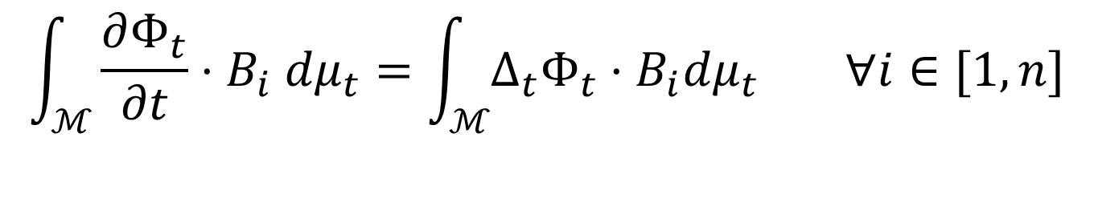
Spatial Discretization
$$\frac{∂Φ_{t}}{∂t}=Δ_{t}Φ_{t}$$
Discretize by choosing a finite set of functions on $ℳ$:
$$\left\{B_{1},⋯,B_{n}\right\}:ℳ→ℝ$$
An evolution $Φ_{t}:ℳ→ℝ^{3}$ is represented by $\vec{x} :[0,∞)→ℝ^{n×3}$:
$$Φ_{t}(p)=\sum_{i=1}^{n}{x_{i}(t)⋅B_{i}(p)}$$
$$\int_{ℳ}{\frac{∂Φ_{t}}{∂t}⋅B_{i} dμ_{t}}=\int_{ℳ}{Δ_{t}Φ_{t}⋅B_{i}dμ_{t}} ∀i∈[1,n]$$

Slide 16
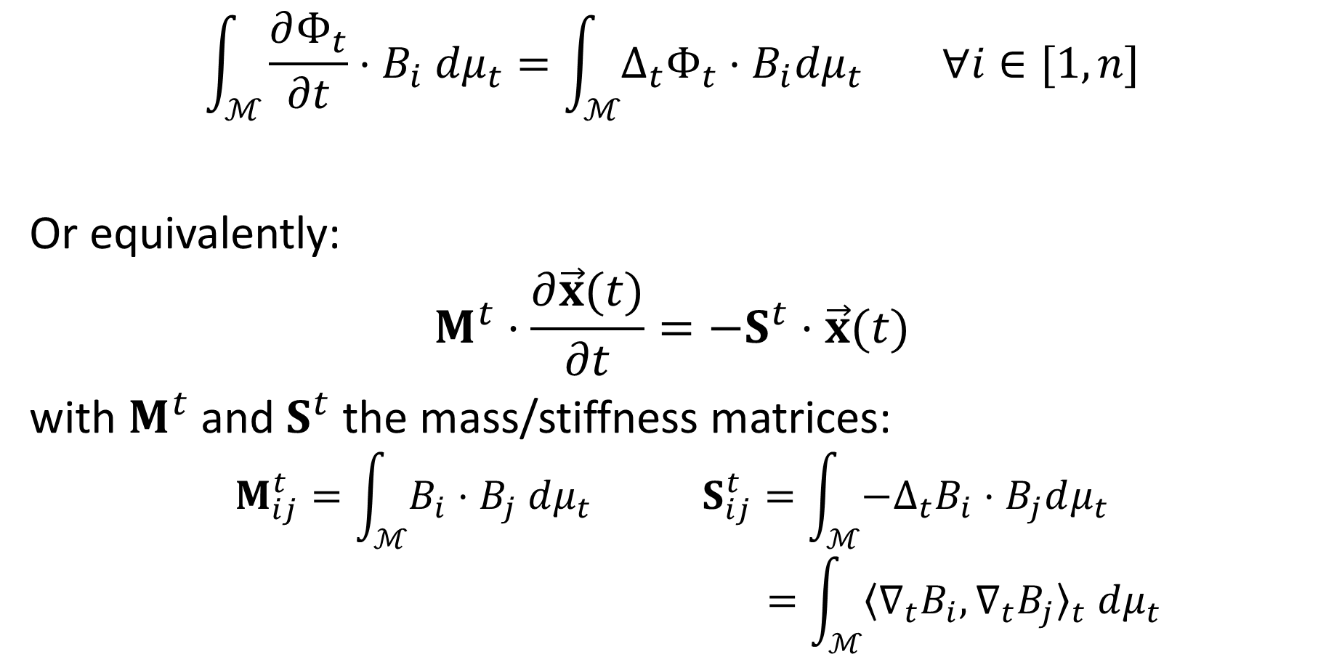
Spatial Discretization (MCF)
$$\int_{ℳ}{\frac{∂Φ_{t}}{∂t}⋅B_{i} dμ_{t}}=\int_{ℳ}{Δ_{t}Φ_{t}⋅B_{i}dμ_{t}} ∀i∈[1,n]$$
Or equivalently:
$$M^{t}⋅\frac{∂\vec{x}(t)}{∂t}=−S^{t}⋅\vec{x}(t)$$
with $M^{t}$ and $S^{t}$ the mass/stiffness matrices:
$$M_{ij}^{t}=\int_{ℳ}{B_{i}⋅B_{j} dμ_{t}} S_{ij}^{t}=\int_{ℳ}{−Δ_{t}B_{i}⋅B_{j}dμ_{t}}$$
$$=\int_{ℳ}{{〈{\text{∇}}_{t}B_{i},{\text{∇}}_{t}B_{j}〉}_{t} dμ_{t}}$$
Notes:
The mass matrix, AKA the Gram matrix, evolving with the metric.
Note that the equation is just saying that the projection of the temporal derivative onto the function space should match the projection of the the Laplacian onto the function space.

Slide 17
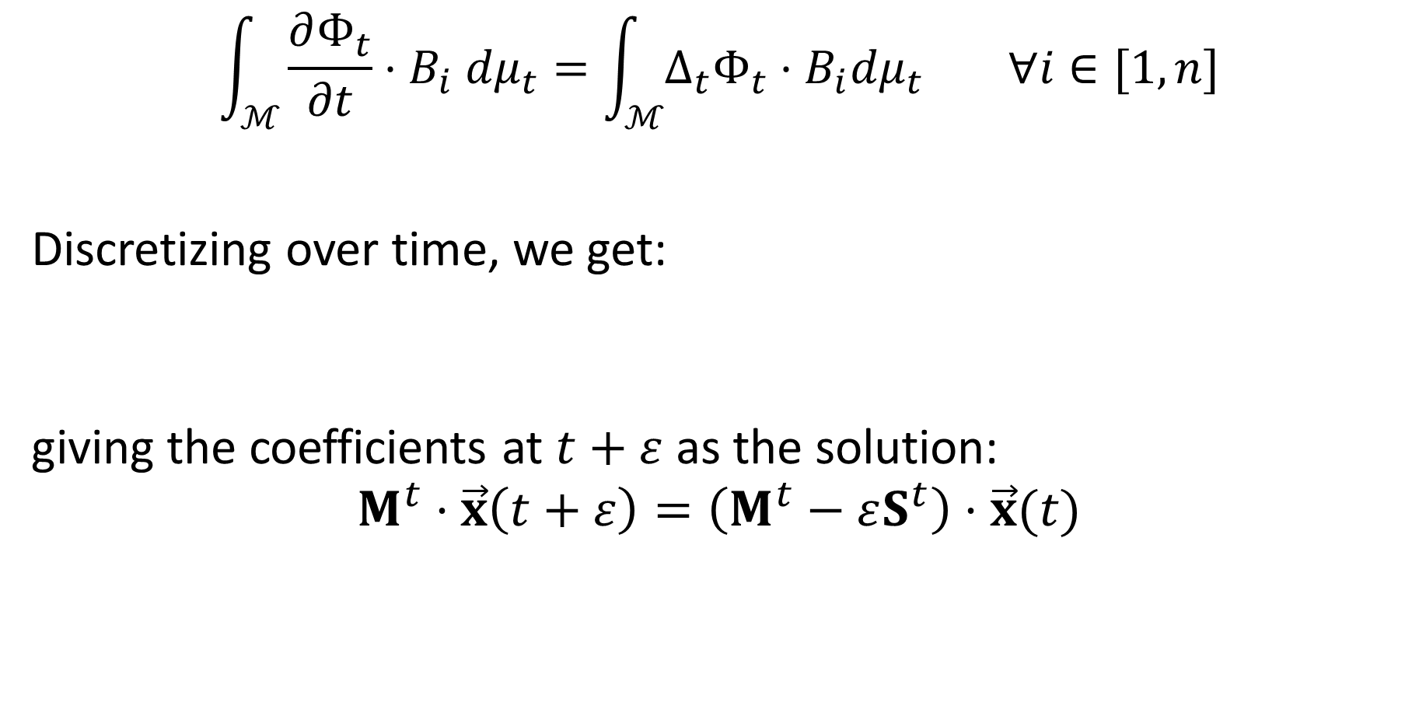
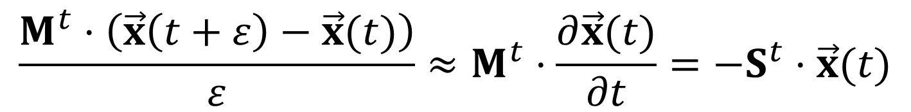
Temporal Discretization (MCF)
$$\int_{ℳ}{\frac{∂Φ_{t}}{∂t}⋅B_{i} dμ_{t}}=\int_{ℳ}{Δ_{t}Φ_{t}⋅B_{i}dμ_{t}} ∀i∈[1,n]$$
Discretizing over time, we get:
$$M^{t}⋅\frac{∂\vec{x}(t)}{∂t}=−S^{t}⋅\vec{x}(t)$$
giving the coefficients at $t+ε$ as the solution:
$$M^{t}⋅\vec{x}\left(t+ε\right)=\left(M^{t}−εS^{t}\right)⋅\vec{x}(t)$$
$$\frac{M^{t}⋅\left(\vec{x}\left(t+ε\right)−\vec{x}(t)\right)}{ε}≈M^{t}⋅\frac{∂\vec{x}(t)}{∂t}=−S^{t}⋅\vec{x}(t)$$
Notes:
Note: We are performing explicit integration. Analogous results hold when performing

Slide 18
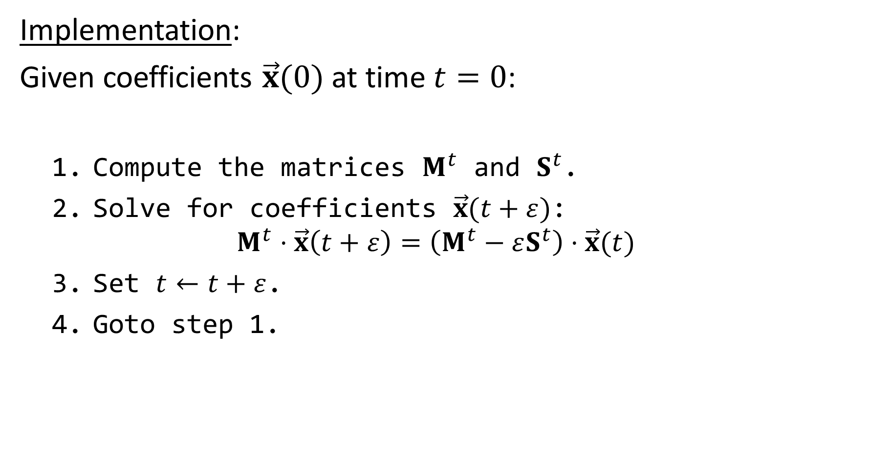
Discretization (MCF)
Implementation:
Given coefficients $\vec{x}(0)$ at time $t=0$:
  Compute the matrices $M^{t}$ and $S^{t}$.
  Solve for coefficients $\vec{x}(t+ε)$:
  $M^{t}⋅\vec{x}\left(t+ε\right)=\left(M^{t}−εS^{t}\right)⋅\vec{x}(t)$
  Set $t←t+ε$.
  Goto step 1.

Slide 19
Outline
Conformalized Mean Curvature Flow
  Signal/Geometry Smoothing
  Discretization
  Identifying and Modifying
    Division by zero
    Conformalization
  Evaluation
Möbius Registration

Slide 20
Analysis
As the surface evolves, the metric changes.
If we scale a patch of surface
  Areas increase
  Gradients decrease
When the scaling is uniform, the effects cancel.
Otherwise…

Slide 21
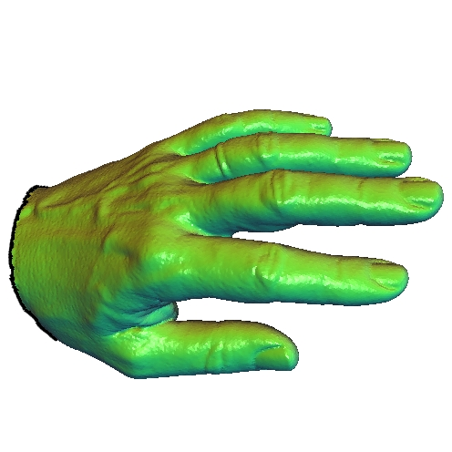
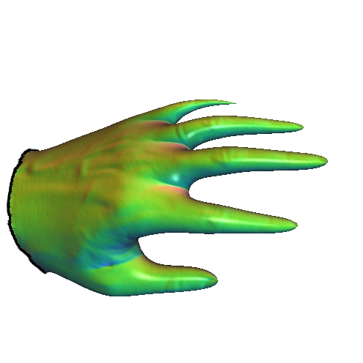








Analysis
Observation:
Given a point $p∈ℳ$...
$$p$$
$$Φ_{0}$$
$$Φ_{t}$$
$$ℳ$$
$$Φ_{0}(p)$$
$$Φ_{t}(p)$$
$$Φ_{0}(ℳ)$$
$Φ_{t}(ℳ$)

Slide 22


Analysis
Observation:
Given a point $p∈ℳ$, the map $Φ_{t}∘Φ_{0}^{−1}$ takes small circles around $Φ_{0}(p)$ to small ellipses around $Φ_{t}(p)$.
$$p$$
$$Φ_{0}$$
$$Φ_{t}$$
$$ℳ$$
$$Φ_{0}(p)$$
$$Φ_{t}(p)$$
$$Φ_{0}(ℳ)$$
$$Φ_{t}∘Φ_{0}^{−1}$$
$Φ_{t}(ℳ$)

Slide 23





Analysis
Observation:
There exist vectors $v_{1},v_{2}∈T_{p}ℳ$ such that:
  $v_{1}$ and $v_{2}$ are orthonormal with respect to the metric at time $0$:
  ${\left\langle v_{i},v_{j}\right\rangle }_{0}=δ_{ij}$
  $v_{1}$ and $v_{2}$ are orthogonal with respect to the metric at time $t$:
  ${\left\langle v_{i},v_{j}\right\rangle }_{t}=δ_{ij}⋅λ_{i}⋅λ_{j}$
$$Φ_{0}(p)$$
$$v_{2}$$
$$Φ_{t}(p)$$
$$v_{2}$$
$$v_{1}$$
$$v_{1}$$

Slide 24

Analysis
$${\left\langle v_{i},v_{j}\right\rangle }_{0}=δ_{ij} and {\left\langle v_{i},v_{j}\right\rangle }_{t}=δ_{ij}⋅λ_{i}⋅λ_{j}$$
In terms of the mapping at time $0$:
  Area measure scales by $λ_{1}λ_{2}$:
  $dμ_{t}=\left(λ_{1}λ_{2}\right)dμ_{0}$

Slide 25
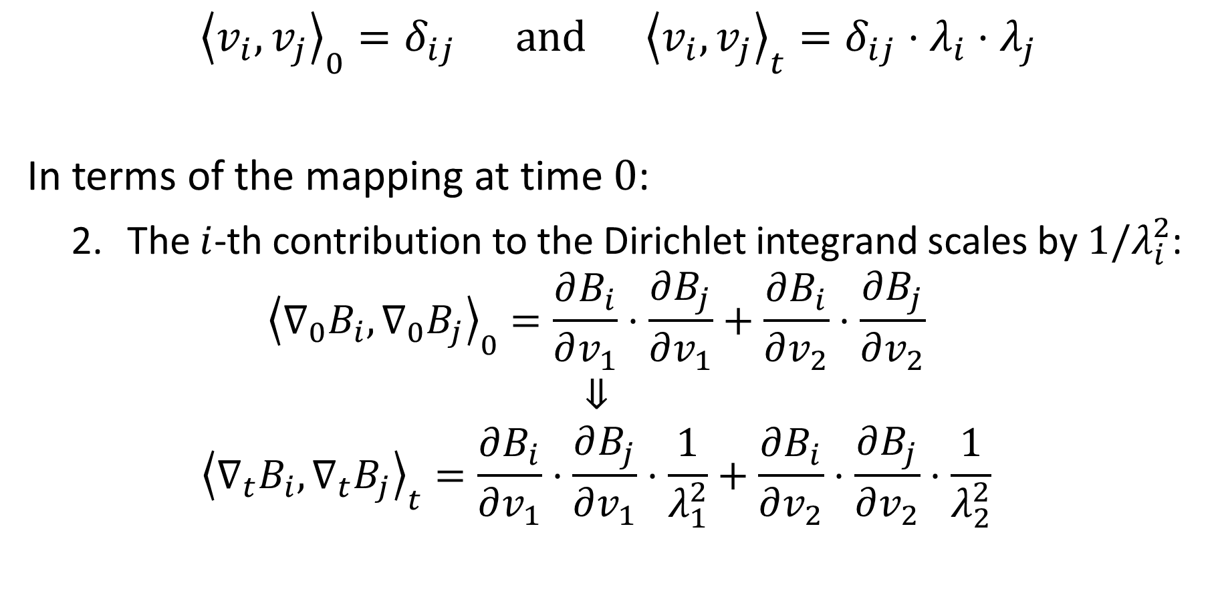
Analysis
$${\left\langle v_{i},v_{j}\right\rangle }_{0}=δ_{ij} and {\left\langle v_{i},v_{j}\right\rangle }_{t}=δ_{ij}⋅λ_{i}⋅λ_{j}$$
In terms of the mapping at time $0$:
  The $i$-th contribution to the Dirichlet integrand scales by $1/λ_{i}^{2}$:
  ${\left\langle ∇_{0}B_{i},∇_{0}B_{j}\right\rangle }_{0}=\frac{∂B_{i}}{∂v_{1}}⋅\frac{∂B_{j}}{∂v_{1}}+\frac{∂B_{i}}{∂v_{2}}⋅\frac{∂B_{j}}{∂v_{2}}$
  $$⇓$$
  $${\left\langle ∇_{t}B_{i},∇_{t}B_{j}\right\rangle }_{t}=\frac{∂B_{i}}{∂v_{1}}⋅\frac{∂B_{j}}{∂v_{1}}⋅\frac{1}{λ_{1}^{2}}+\frac{∂B_{i}}{∂v_{2}}⋅\frac{∂B_{j}}{∂v_{2}}⋅\frac{1}{λ_{2}^{2}}$$

Slide 26
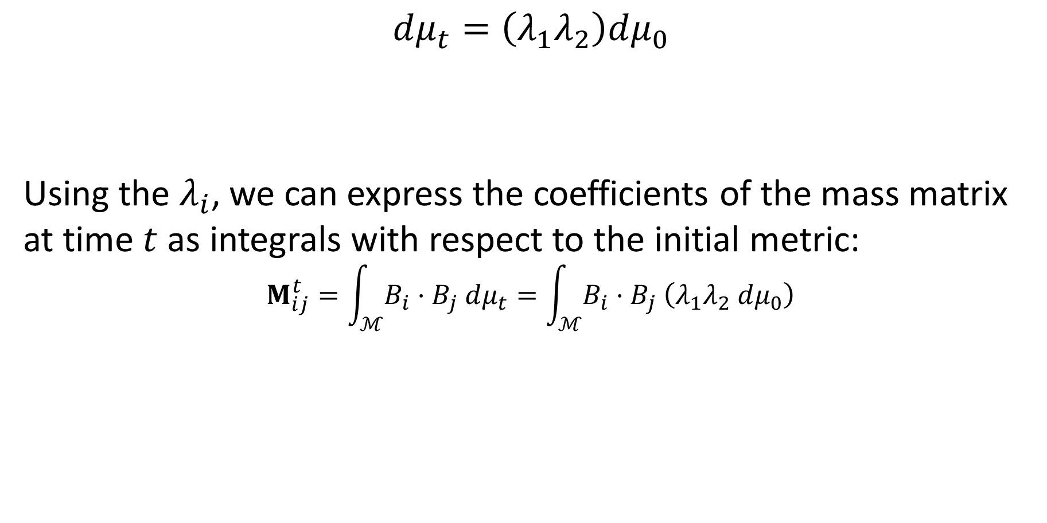
Analysis
$$dμ_{t}=\left(λ_{1}λ_{2}\right)dμ_{0}$$
Using the $λ_{i}$, we can express the coefficients of the mass matrix at time $t$ as integrals with respect to the initial metric:
$$M_{ij}^{t}=\int_{ℳ}{B_{i}⋅B_{j} dμ_{t}}=\int_{ℳ}{B_{i}⋅B_{j} \left(λ_{1}λ_{2} dμ_{0}\right)}$$

Slide 27
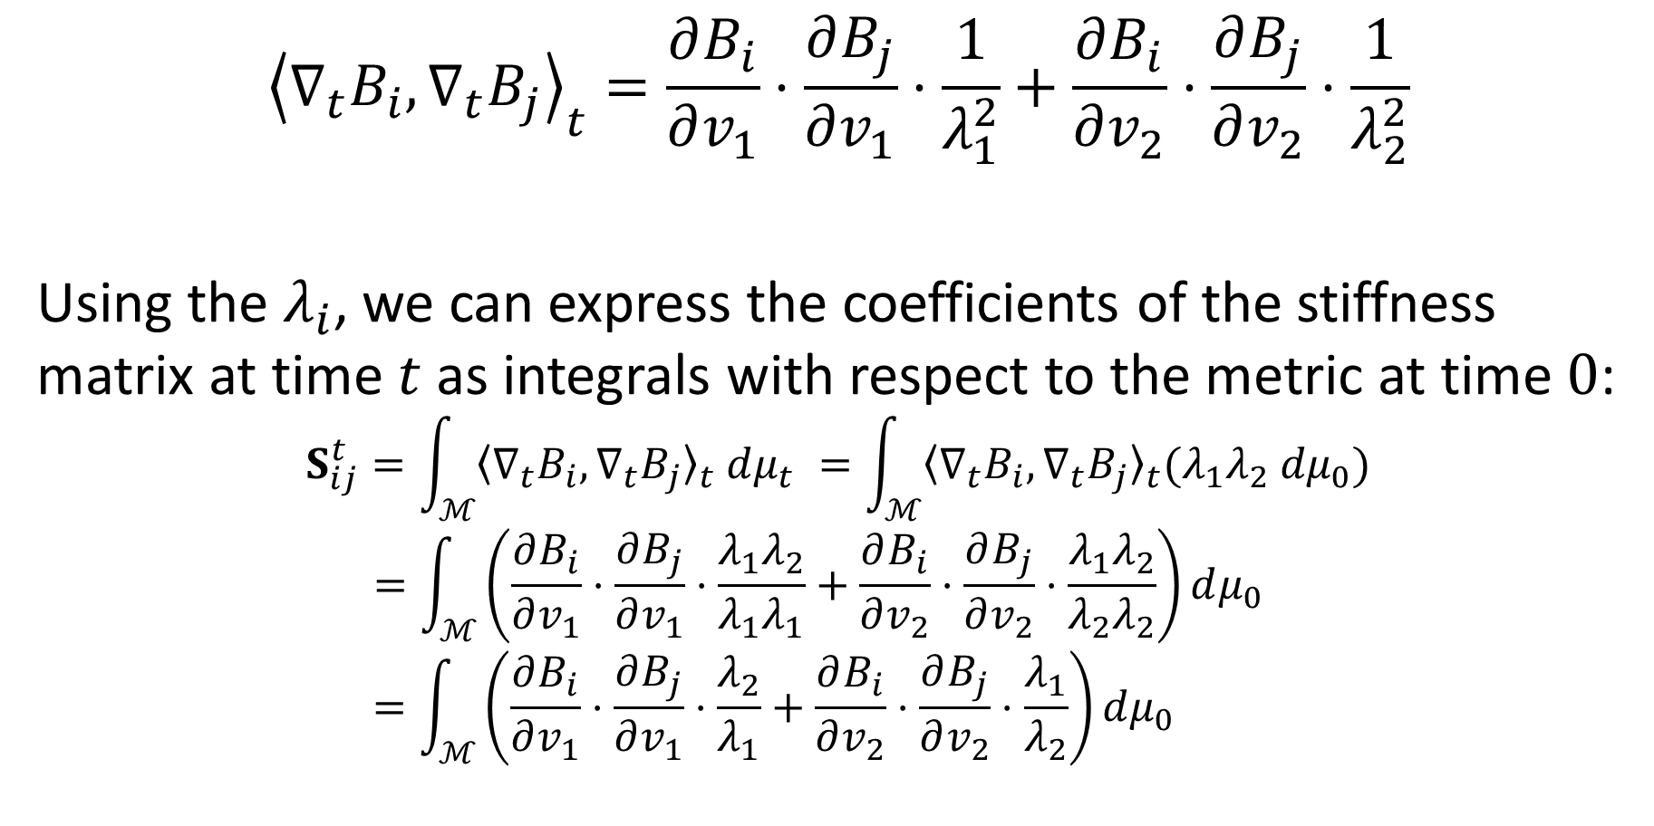
Analysis
$${\left\langle ∇_{t}B_{i},∇_{t}B_{j}\right\rangle }_{t}=\frac{∂B_{i}}{∂v_{1}}⋅\frac{∂B_{j}}{∂v_{1}}⋅\frac{1}{λ_{1}^{2}}+\frac{∂B_{i}}{∂v_{2}}⋅\frac{∂B_{j}}{∂v_{2}}⋅\frac{1}{λ_{2}^{2}}$$
Using the $λ_{i}$, we can express the coefficients of the stiffness matrix at time $t$ as integrals with respect to the metric at time $0$:
$$S_{ij}^{t}=\int_{ℳ}{{〈{\text{∇}}_{t}B_{i},{\text{∇}}_{t}B_{j}〉}_{t} dμ_{t}} =\int_{ℳ}{{〈{\text{∇}}_{t}B_{i},{\text{∇}}_{t}B_{j}〉}_{t}(λ_{1}λ_{2} dμ_{0})}$$
$$=\int_{ℳ}{\left(\frac{∂B_{i}}{∂v_{1}}⋅\frac{∂B_{j}}{∂v_{1}}⋅\frac{λ_{1}λ_{2}}{λ_{1}λ_{1}}+\frac{∂B_{i}}{∂v_{2}}⋅\frac{∂B_{j}}{∂v_{2}}⋅\frac{λ_{1}λ_{2}}{λ_{2}λ_{2}}\right)dμ_{0}}$$
$$=\int_{ℳ}{\left(\frac{∂B_{i}}{∂v_{1}}⋅\frac{∂B_{j}}{∂v_{1}}⋅\frac{λ_{2}}{λ_{1}}+\frac{∂B_{i}}{∂v_{2}}⋅\frac{∂B_{j}}{∂v_{2}}⋅\frac{λ_{1}}{λ_{2}}\right)dμ_{0} }$$

Slide 28
Analysis
$${\left\langle ∇_{t}B_{i},∇_{t}B_{j}\right\rangle }_{t}=\frac{∂B_{i}}{∂v_{1}}⋅\frac{∂B_{j}}{∂v_{1}}⋅\frac{1}{λ_{1}^{2}}+\frac{∂B_{i}}{∂v_{2}}⋅\frac{∂B_{j}}{∂v_{2}}⋅\frac{1}{λ_{2}^{2}}$$
Using the $λ_{i}$, we can express the coefficients of the stiffness matrix at time $t$ as integrals with respect to the metric at time $0$:
$$S_{ij}^{t}=\int_{ℳ}{{〈{\text{∇}}_{t}B_{i},{\text{∇}}_{t}B_{j}〉}_{t} dμ_{t}} =\int_{ℳ}{{〈{\text{∇}}_{t}B_{i},{\text{∇}}_{t}B_{j}〉}_{t}(λ_{1}λ_{2} dμ_{0})}$$
$$=\int_{ℳ}{\left(\frac{∂B_{i}}{∂v_{1}}⋅\frac{∂B_{j}}{∂v_{1}}⋅\frac{λ_{1}λ_{2}}{λ_{1}λ_{1}}+\frac{∂B_{i}}{∂v_{2}}⋅\frac{∂B_{j}}{∂v_{2}}⋅\frac{λ_{1}λ_{2}}{λ_{2}λ_{2}}\right)dμ_{0}}$$
$$=\int_{ℳ}{\left(\frac{∂B_{i}}{∂v_{1}}⋅\frac{∂B_{j}}{∂v_{1}}⋅\frac{λ_{2}}{λ_{1}}+\frac{∂B_{i}}{∂v_{2}}⋅\frac{∂B_{j}}{∂v_{2}}⋅\frac{λ_{1}}{λ_{2}}\right)dμ_{0} }$$
As the evolution becomes more anisotropic we approach a division by zero!

Slide 29

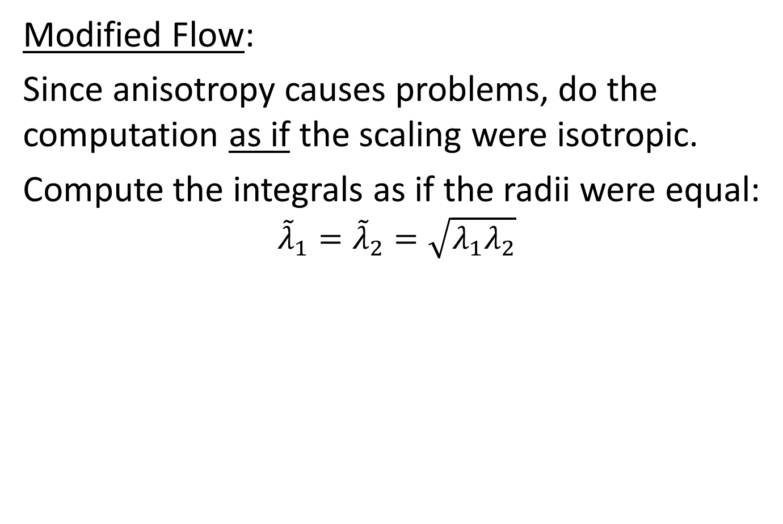


Conformalization
Modified Flow:
Since anisotropy causes problems, do the computation as if the scaling were isotropic.
Compute the integrals as if the radii were equal:
$${\tilde{λ}}_{1}={\tilde{λ}}_{2}=\sqrt{λ_{1}λ_{2}}$$
$$Φ_{0}(p)$$
$$v_{2}$$
$$Φ_{t}(p)$$
$$v_{2}$$
$$v_{1}$$
$$v_{1}$$

Slide 30

Conformalization
Modified Flow:
$${\tilde{λ}}_{1}={\tilde{λ}}_{2}=\sqrt{λ_{1}λ_{2}}$$
The mass matrix becomes:
$${\tilde{M}}_{ij}^{t}=\int_{ℳ}{B_{i}⋅B_{j}\left({\tilde{λ}}_{1}{\tilde{λ}}_{2} dμ_{0}\right)}$$
$$=\int_{ℳ}{B_{i}⋅B_{j}\left(λ_{1}λ_{2} dμ_{0}\right)}$$
$$=M_{ij}^{t}$$

Slide 31
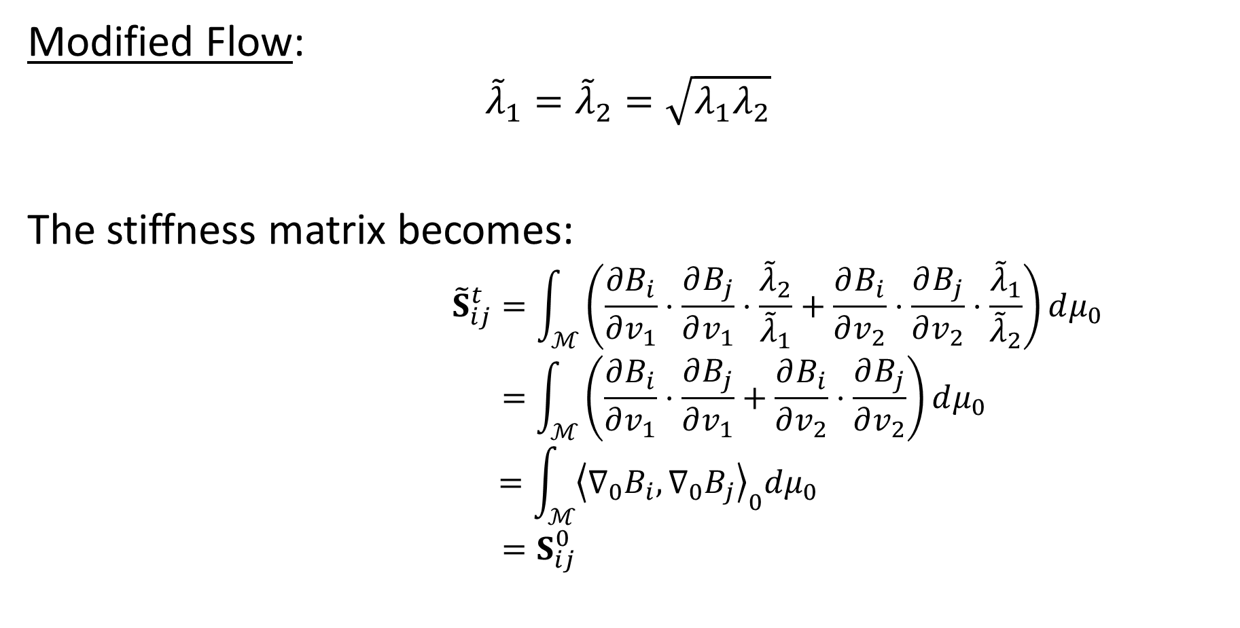
Conformalization
Modified Flow:
$${\tilde{λ}}_{1}={\tilde{λ}}_{2}=\sqrt{λ_{1}λ_{2}}$$
The stiffness matrix becomes:
$${\tilde{S}}_{ij}^{t}=\int_{ℳ}{\left(\frac{∂B_{i}}{∂v_{1}}⋅\frac{∂B_{j}}{∂v_{1}}⋅\frac{{\tilde{λ}}_{2}}{{\tilde{λ}}_{1}}+\frac{∂B_{i}}{∂v_{2}}⋅\frac{∂B_{j}}{∂v_{2}}⋅\frac{{\tilde{λ}}_{1}}{{\tilde{λ}}_{2}}\right)dμ_{0}}$$
$$=\int_{ℳ}{\left(\frac{∂B_{i}}{∂v_{1}}⋅\frac{∂B_{j}}{∂v_{1}}+\frac{∂B_{i}}{∂v_{2}}⋅\frac{∂B_{j}}{∂v_{2}}\right)dμ_{0}}$$
$$=\int_{ℳ}{{\left\langle ∇_{0}B_{i},∇_{0}B_{j}\right\rangle }_{0}dμ_{0}}$$
$$=S_{ij}^{0}$$

Slide 32
Outline
Conformalized Mean Curvature Flow
  Signal/Geometry Smoothing
  Discretization
  Identifying and Modifying
  Evaluation
Möbius Registration

Slide 33
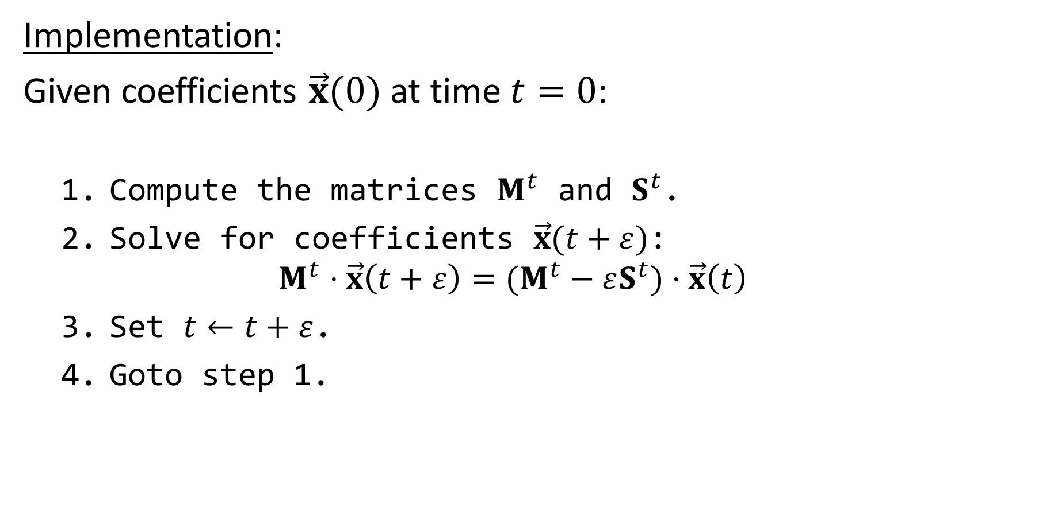
Discrete MCF
Implementation:
Given coefficients $\vec{x}(0)$ at time $t=0$:
  Compute the matrices $M^{t}$ and $S^{t}$.
  Solve for coefficients $\vec{x}(t+ε)$:
  $M^{t}⋅\vec{x}\left(t+ε\right)=(M^{t}−εS^{t})⋅\vec{x}\left(t\right)$
  Set $t←t+ε$.
  Goto step 1.

Slide 34
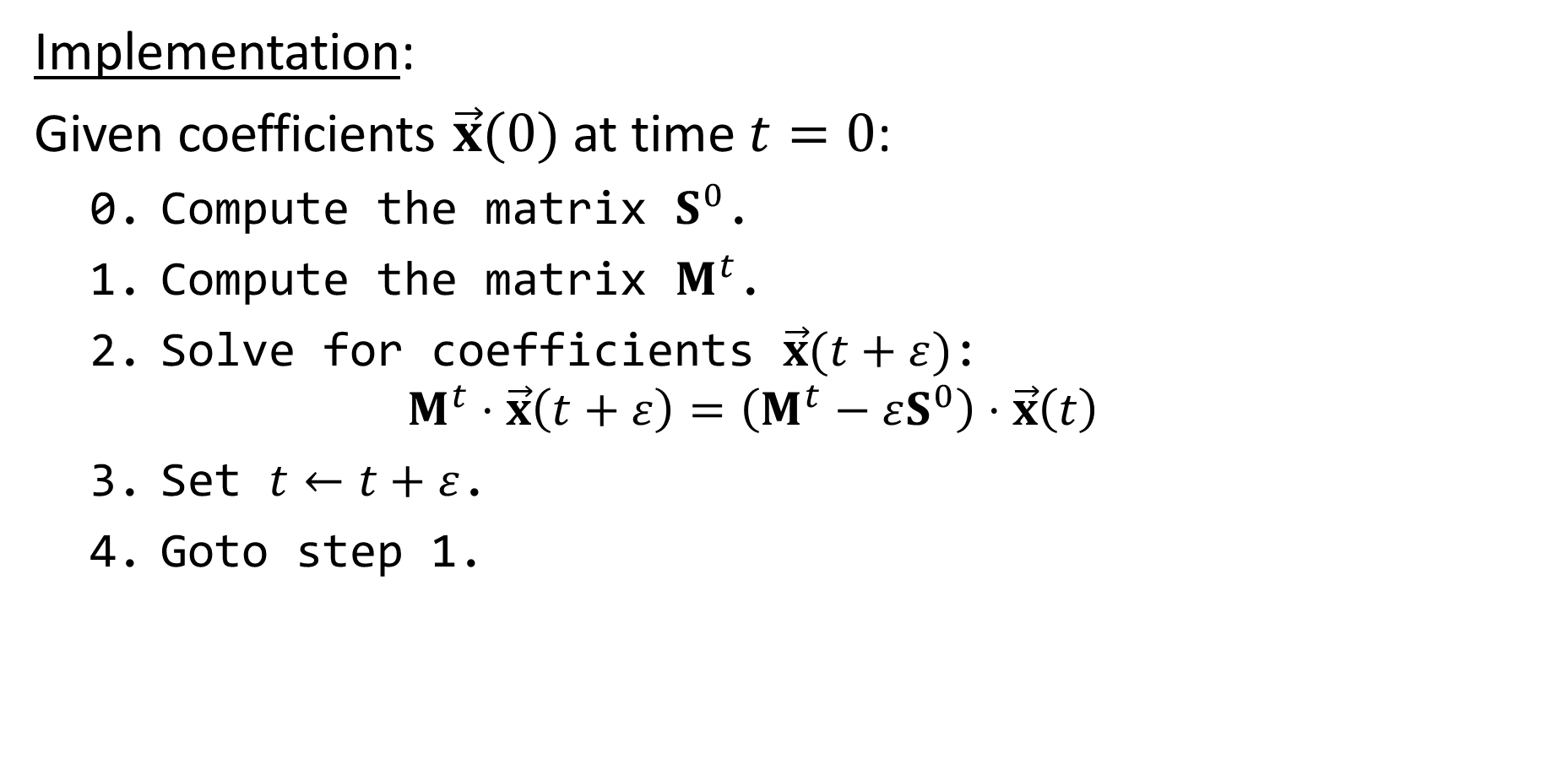
Discrete Conformalized MCF
Implementation:
Given coefficients $\vec{x}(0)$ at time $t=0$:
  0. Compute the matrix $S^{0}$.
  Compute the matrix $M^{t}$.
  Solve for coefficients $\vec{x}(t+ε)$:
  $M^{t}⋅\vec{x}\left(t+ε\right)=\left(M^{t}−εS^{0}\right)⋅\vec{x}\left(t\right)$
  Set $t←t+ε$.
  Goto step 1.

Slide 35
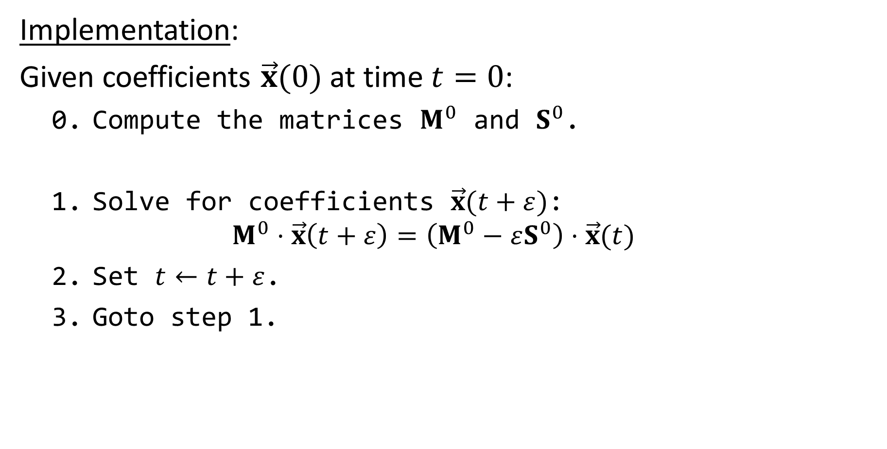
Discrete Heat Flow
Implementation:
Given coefficients $\vec{x}(0)$ at time $t=0$:
  0. Compute the matrices $M^{0}$ and $S^{0}$.
  Solve for coefficients $\vec{x}(t+ε)$:
  $M^{0}⋅\vec{x}\left(t+ε\right)=\left(M^{0}−εS^{0}\right)⋅\vec{x}(t)$
  Set $t←t+ε$.
  Goto step 1.

Slide 36
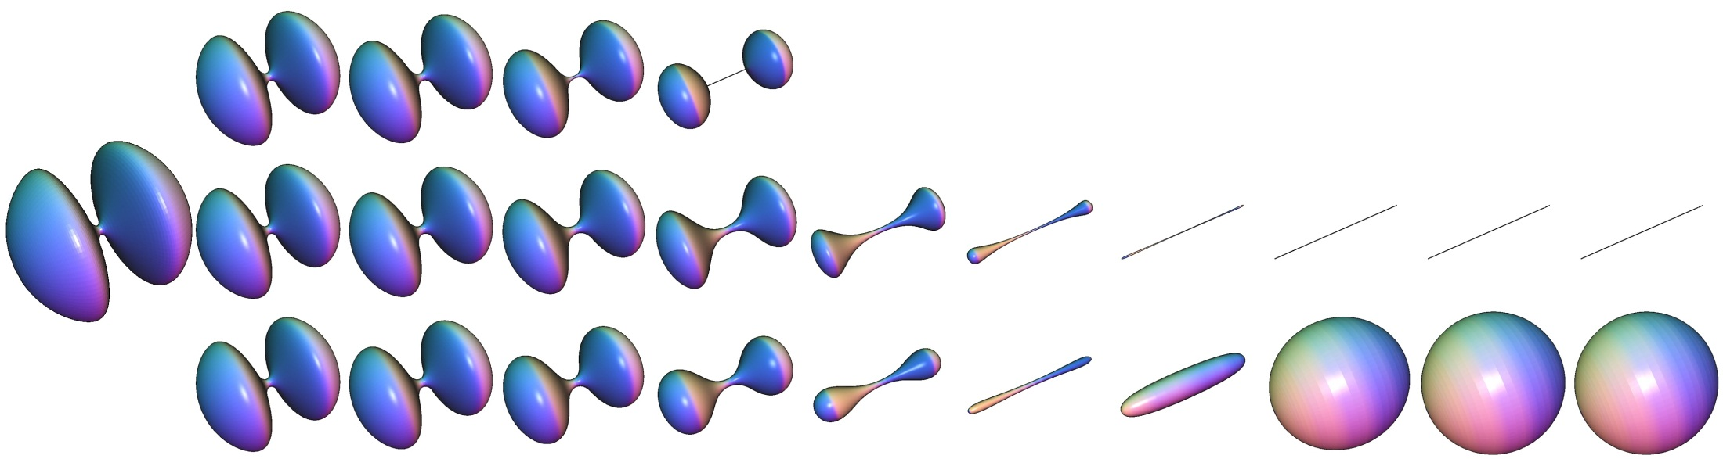
Empirical Evaluation
MCF
Heat Flow
Input
Conformalized MCF

Slide 37
Empirical Evaluation
MCF
Heat Flow
Input
Conformalized MCF

Slide 38
Empirical Evaluation
MCF
Heat Flow
Input
Conformalized MCF

Slide 39
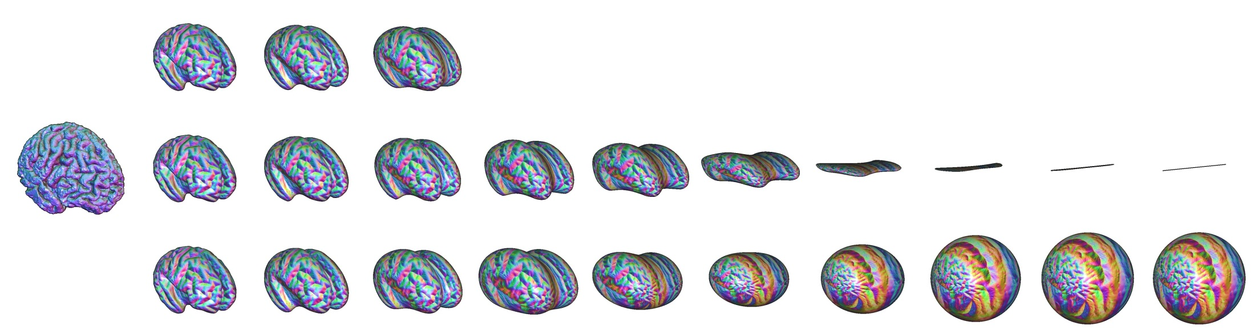
Empirical Evaluation
MCF
Heat Flow
Input
Conformalized MCF
MCF
Heat Flow
Input
Conformalized MCF

Slide 40
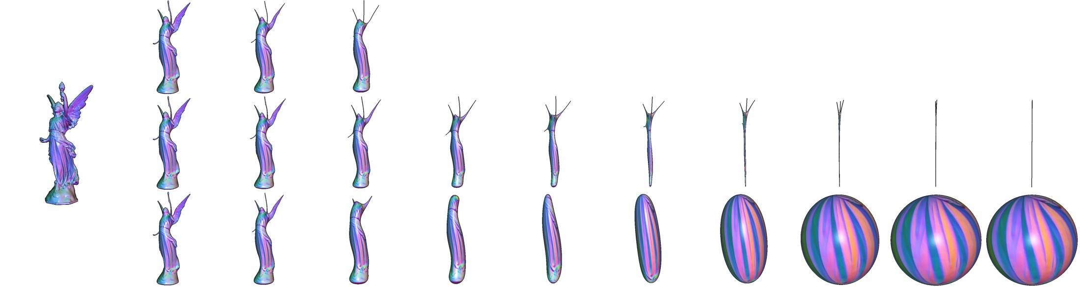
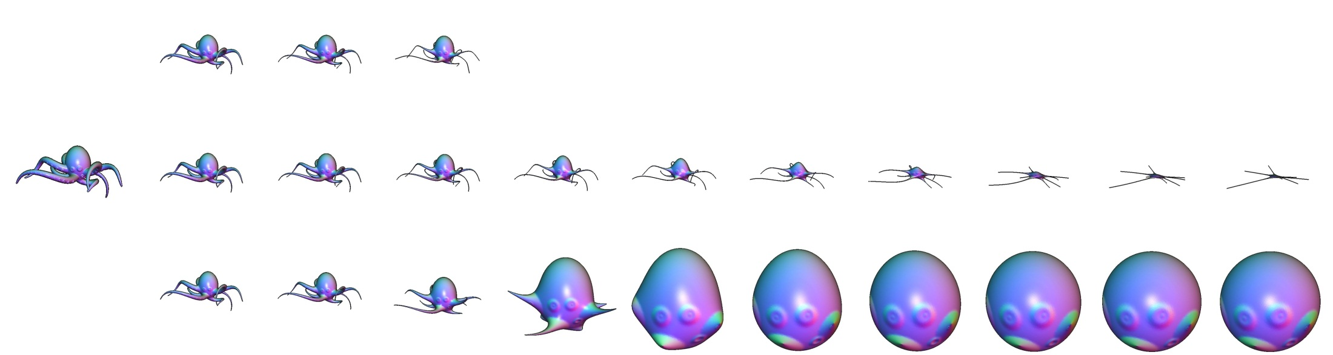
Empirical Evaluation
MCF
Heat Flow
Input
Conformalized MCF
MCF
Heat Flow
Input
Conformalized MCF

Slide 41

Variational/PDE Formulation
Conformalized MCF and Heat Flow both perform gradient descent on the same (Dirichlet) energy
  Mean-Curvature Flow
  $E\left(Φ_{t}\right)=\int_{ℳ}{{\left\|{\text{∇}}_{t}Φ_{t}\right\|}_{t}^{2}dμ_{t}} ⇒ \frac{∂Φ_{t}}{∂t}=Δ_{t}Φ_{t}$
  Conformalized MCF
  $E\left(Φ_{t}\right)=\int_{ℳ}{{\left\|{\text{∇}}_{0}Φ_{t}\right\|}_{0}^{2}dμ_{0}} ⇒ \frac{∂Φ_{t}}{∂t}=\sqrt{\left|μ_{t}^{−1}⋅μ_{0}\right|}Δ_{0}Φ_{t}$
  Heat Flow
  $E\left(Φ_{t}\right)=\int_{ℳ}{{\left\|{\text{∇}}_{0}Φ_{t}\right\|}_{0}^{2}dμ_{0}} ⇒ \frac{∂Φ_{t}}{∂t}=Δ_{0}Φ_{t}$

Slide 42
Variational/PDE Formulation
Conformalized MCF and Heat Flow both perform gradient descent on the same (Dirichlet) energy
  Mean-Curvature Flow
  $E\left(Φ_{t}\right)=\int_{ℳ}{{\left\|{\text{∇}}_{t}Φ_{t}\right\|}_{t}^{2}dμ_{t}} ⇒ \frac{∂Φ_{t}}{∂t}=Δ_{t}Φ_{t}$
  Conformalized MCF
  $E\left(Φ_{t}\right)=\int_{ℳ}{{\left\|{\text{∇}}_{0}Φ_{t}\right\|}_{0}^{2}dμ_{0}} ⇒ \frac{∂Φ_{t}}{∂t}=\sqrt{\left|μ_{t}^{−1}⋅μ_{0}\right|}Δ_{0}Φ_{t}$
  Heat Flow
  $E\left(Φ_{t}\right)=\int_{ℳ}{{\left\|{\text{∇}}_{0}Φ_{t}\right\|}_{0}^{2}dμ_{0}} ⇒ \frac{∂Φ_{t}}{∂t}=Δ_{0}Φ_{t}$

Slide 43
Variational/PDE Formulation
Conformalized MCF and Heat Flow both perform gradient descent on the same (Dirichlet) energy
  Mean-Curvature Flow
  $E\left(Φ_{t}\right)=\int_{ℳ}{{\left\|{\text{∇}}_{t}Φ_{t}\right\|}_{t}^{2}dμ_{t}} ⇒ \frac{∂Φ_{t}}{∂t}=Δ_{t}Φ_{t}$
  Conformalized MCF
  $E\left(Φ_{t}\right)=\int_{ℳ}{{\left\|{\text{∇}}_{0}Φ_{t}\right\|}_{0}^{2}dμ_{0}} ⇒ \frac{∂Φ_{t}}{∂t}=\sqrt{\left|μ_{t}^{−1}⋅μ_{0}\right|}Δ_{0}Φ_{t}$
  Heat Flow
  $E\left(Φ_{t}\right)=\int_{ℳ}{{\left\|{\text{∇}}_{0}Φ_{t}\right\|}_{0}^{2}dμ_{0}} ⇒ \frac{∂Φ_{t}}{∂t}=Δ_{0}Φ_{t}$
They differ in terms of the inner-product used to define the gradient
(cMCF defines the inner-product in terms of the current immersion)
Notes:
Because we are “zooming in” at every time-step, the point is not “what do they converge to?”. It’s “how do they get there?”

Slide 44
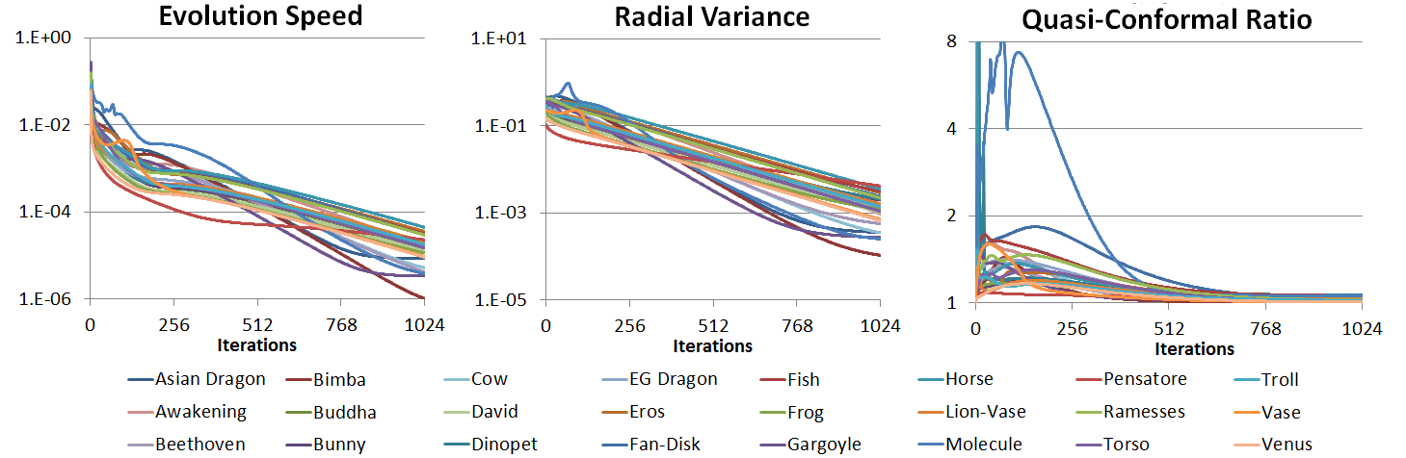




Empirical Evaluation
For Genus-Zero Surfaces:
Does it converge?
$${10}^{0}$$
$${10}^{−2}$$
$${10}^{−4}$$
$${10}^{−6}$$

Slide 45




Empirical Evaluation
For Genus-Zero Surfaces:
Does it converge?
What does it converge to?
$${10}^{0}$$
$${10}^{1}$$
$${10}^{−2}$$
$${10}^{−1}$$
$${10}^{−4}$$
$${10}^{−3}$$
$${10}^{−6}$$
$${10}^{−5}$$

Slide 46
Empirical Evaluation
For Genus-Zero Surfaces:
Does it converge?
What does it converge to?
How does it converge?
$${10}^{0}$$
$${10}^{1}$$
$${10}^{−2}$$
$${10}^{−1}$$
$${10}^{−4}$$
$${10}^{−3}$$
$${10}^{−6}$$
$${10}^{−5}$$
Notes:
Note that even though the limit is a conformal parameterization, the flow does not have to be conformal on its way there.

Slide 47
Empirical Evaluation
For Genus-Zero Surfaces:
Does it converge?
What does it converge to?
How does it converge?
$${10}^{0}$$
$${10}^{1}$$
$${10}^{−2}$$
$${10}^{−1}$$
$${10}^{−4}$$
$${10}^{−3}$$
$${10}^{−6}$$
$${10}^{−5}$$
For genus zero surface we find (empirically) that cMCF converges to a conformal parameterization over a sphere
Notes:
Note that even though the limit is a conformal parameterization, the flow does not have to be conformal on its way there.

Slide 48
Outline
Conformalized Mean Curvature Flow
Möbius Registration
  Motivation
  Inversions
  Canonical Centering
  Beyond Möbius

Slide 49




Shape Representation
In graphics shapes are considered “the same”:
  If they differ by an isometry
  If they differ in their triangulation
cMCF provides a representation over a
canonical domain that is isometry invariant

Slide 50




Shape Representation
In graphics shapes are considered “the same”:
  If they differ by an isometry
  If they differ in their triangulation
cMCF provides a representation over a
canonical domain that is isometry invariant
But the representation is only unique
up to Möbius transformation
inversions
rotations

Slide 51








Möbius Registration
Separately handle the two components
  Canonically pose each shape w.r.t. inversions [Springborn, 2005]
  Optimally align pairs of shapes w.r.t. rotations [Kostelec & Rockmore, 2003]
parametrization
canonical centering
optimal rotational alignment

Slide 52

Möbius Registration
Separately handle the two components
  Canonically pose each shape w.r.t. inversions [Springborn, 2005]
  Optimally align pairs of shapes w.r.t. rotations [Kostelec & Rockmore, 2003]
Rotations:
Apply standard FFT tricks over $S^{2}$ and $SO(3)$
Inversions:
As in Springborn’s work, we seek the inversion placing the center of mass at the origin.
  Simpler algorithm
  Exposes a more general structure
parametrization
canonical centering
optimal rotational alignment
More Generally:
Why are some types of transformations easy to pose canonically (e.g. translations) and others hard (e.g. rotations)?

Slide 53




Inversion
Represent inversions as maps on $ℝ^{3}$ that map $S^{2}$ to itself.
For a locus $c∈int\left(B^{3}\right)$, the inversion about $c$ is:
$$η_{c}\left(p\right)=\left(1−{\left|c\right|}^{2}\right)\frac{p+c}{{\left|p+c\right|}^{2}}+c$$
$$c$$
Notes:
Describe inversions in terms of inversions of the embedding space

Slide 54

Infinitesimal Inversion
Represent inversions as maps on $ℝ^{3}$ that map $S^{2}$ to itself.
For a locus $c∈int\left(B^{3}\right)$, the inversion about $c$ is:
$$η_{c}\left(p\right)=\left(1−{\left|c\right|}^{2}\right)\frac{p+c}{{\left|p+c\right|}^{2}}+c$$
When the locus of inversion is at the origin, the map $η_{c}$ (restricted to the sphere) is the identity.

Slide 55

Infinitesimal Inversion
Represent inversions as maps on $ℝ^{3}$ that map $S^{2}$ to itself.
For a locus $c∈int\left(B^{3}\right)$, the inversion about $c$ is:
$$η_{c}\left(p\right)=\left(1−{\left|c\right|}^{2}\right)\frac{p+c}{{\left|p+c\right|}^{2}}+c$$
Shifting the locus of inversion away from the origin:
$$\frac{dη_{c}(p)}{dc}{\left.​\right|}_{c=0}=2\left(Id.−p⊗p\right)$$

Slide 56


Infinitesimal Inversion
Represent inversions as maps on $ℝ^{3}$ that map $S^{2}$ to itself.
For a locus $c∈int\left(B^{3}\right)$, the inversion about $c$ is:
$$η_{c}\left(p\right)=\left(1−{\left|c\right|}^{2}\right)\frac{p+c}{{\left|p+c\right|}^{2}}+c$$
Shifting the locus of inversion away from the origin:
$$\frac{dη_{c}(p)}{dc}{\left.​\right|}_{c=0}=2\left(Id.−p⊗p\right)$$
$⇒$Moving the locus in direction $v∈ℝ^{3}$ shifts $p∈S^{2}$ along the projection of $v$ onto the tangent plane $T_{p}S^{2}$.
Projection onto the tangent at $p$

Slide 57





Infinitesimal Inversion
As we move the locus in direction $v∈ℝ^{3}$ the point $p∈S^{2}$ flows along the projection of $v$ onto the tangent plane at $p$
$$v$$
Flow field: $2\left(Id.−p⊗p\right)v$

Slide 58
Outline
Conformalized Mean Curvature Flow
Möbius Registration
  Motivation
  Inversions
  Canonical Centering
  Beyond Möbius

Slide 59




Canonical Centering
Given a spherical parametrization, the pull-back of the volume form onto the sphere – the stretch factors – gives the area of the surface “sitting” over
a point on the sphere.
dense
sparse
parametrization
$λ$: stretch factors

Slide 60


Canonical Centering
Given a spherical parametrization, the pull-back of the volume form onto the sphere – the stretch factors – gives the area of the surface “sitting” over
a point on the sphere.
dense
sparse
parametrization
$λ$: stretch factors

Slide 61



Canonical Centering
Goal:
Find the spherical inversion that makes the mass as uniformly distributed as possible
Measure uniformity by computing the
center of mass w.r.t. the stretch factors
$$μ\left(λ\right)=\int_{S^{2}}{p⋅λ\left(p\right)}$$
parametrization
$λ$: stretch factors

Slide 62




Canonical Centering
$$μ\left(λ\right)=\int_{S^{2}}{p⋅λ\left(p\right)}$$
Claim:
  There exists a unique Möbius inversion that puts the center of mass at the origin (and it’s easy to find).
$$λ$$
Notes:
In particular, if the center of mass is not at the origin, inverting along the direction opposite the center of mass will reduce the centering energy.

Slide 63





Canonical Centering
Recall:
  Since $λ$ is a volume form, its pull-back under (the inverse of) $η_{c}$ is:
  $${\left(η_{c}^{−1}\right)}^{∗}λ=\frac{λ∘η_{c}^{−1}}{\left|Dη_{c}\right|}$$
Notation:
  Given $λ$, denote by $μ_{λ}:ℝ^{3}→ℝ^{3}$ the center of mass defined by the pull-back of $λ$ using (the inverse of) the inversion about locus $c$:
  $$μ_{λ}\left(c\right)≡μ\left({\left(η_{c}^{−1}\right)}^{∗}λ\right)$$
$$η_{c}$$
$$λ$$
$$λ_{c}=\frac{λ∘η_{c}^{−1}}{\left|Dη_{c}\right|}$$

Slide 64

Canonical Centering
Sub-Claim:
  Given $λ$, the infinitesimal change in the center of mass resulting from an infinitesimal change in the locus of inversion is:
  $$\frac{dμ_{λ}}{dc}{\left.​\right|}_{c=0}=2\int_{S^{2}}{\left(Id.−p⊗p\right)⋅λ(p) }$$
$$η_{c}$$
$$λ$$
$$λ_{c}=\frac{λ∘η_{c}^{−1}}{\left|Dη_{c}\right|}$$

Slide 65

Canonical Centering
Proof of Sub-Claim:
  Given $λ$ and applying an inversion about $c$, the center of mass of the new stretch factors is:
  $$μ_{λ}\left(c\right)=\int_{S^{2}}{p⋅{\left(η_{c}^{−1}\right)}^{∗}λ}=\int_{S^{2}}{p⋅\frac{λ\left(η_{c}^{−1}\left(p\right)\right)}{\left|Dη_{c}\right|}}$$
  Applying a change of variables:
  $$=\int_{S^{2}}{η_{c}\left(p\right)⋅λ\left(p\right)}$$
$$η_{c}$$
$$λ$$
$$λ_{c}=\frac{λ∘η_{c}^{−1}}{\left|Dη_{c}\right|}$$

Slide 66


Canonical Centering
$$μ_{λ}\left(c\right)=\int_{S^{2}}{η_{c}\left(p\right)⋅λ\left(p\right) }$$
Proof of Sub-Claim:
  Recalling that:
  $$\frac{dη_{c}(p)}{dc}{\left.​\right|}_{c=0}=2\left(Id.−p⊗p\right)$$
  $$⇓$$
  $$\frac{dμ_{λ}}{dc}{\left.​\right|}_{c=0}=2\int_{S^{2}}{\left(Id.−p⊗p\right)⋅λ\left(p\right)}$$

Slide 67


Canonical Centering
$$\frac{dμ_{λ}}{dc}{\left.​\right|}_{c=0 }=2\int_{S^{2}}{\left(Id.−p⊗p\right)⋅λ\left(p\right) }$$
Computing the Inversion:
  Given $λ$, consider the centering energy:
  $$E_{λ}\left(c\right)={\frac{1}{2}\left|μ_{λ}(c)\right|}^{2} ⇒ \frac{dE_{λ}}{dc}{\left.​\right|}_{c=0}={\left(\frac{dμ_{λ}}{dc}{\left.​\right|}_{c=0 }\right)}^{⊤}⋅μ(λ)$$

Slide 68

Canonical Centering
$$\frac{dμ_{λ}}{dc}{\left.​\right|}_{c=0 }=2\int_{S^{2}}{\left(Id.−p⊗p\right)⋅λ\left(p\right) }$$
Computing the Inversion:
  Given $λ$, consider the centering energy:
  $$E_{λ}\left(c\right)={\frac{1}{2}\left|μ_{λ}(c)\right|}^{2} ⇒ \frac{dE_{λ}}{dc}{\left.​\right|}_{c=0}={\left(\frac{dμ_{λ}}{dc}{\left.​\right|}_{c=0 }\right)}^{⊤}⋅μ(λ)$$
  But $\frac{dμ_{λ}}{dc}{\left.​\right|}_{c=0 }$is symmetric positive definite*
  $⇒$ The gradient of the energy vanishes iff. $μ(λ)$ is the origin
  $⇒$ Gradient descent can’t get trapped at a local minimum
*Unless all the mass is concentrated at two antipodal points

Slide 69
Outline
Conformalized Mean Curvature Flow
Möbius Registration
  Motivation
  Inversions
  Canonical Centering
  Beyond Möbius

Slide 70

Beyond Möbius
  Shifting the locus of the inversion along $v∈ℝ^{3}$ is flow along the vector field $2(Id.−p⊗p)v$.
  This is the gradient of the linear function $L_{v}\left(p\right)=2⟨v,p⟩$ on $S^{2}$.
  Normalizing for inversions places the center of mass at the origin:
  $μ\left(λ\right)=\int_{S^{2}}{p⋅λ\left(p\right)}=0$
  This is equivalent to finding the inversion making the integral of the stretch factors against linear functions vanish.

Slide 71

Beyond Möbius
Given a space of (non-constant) functions $ℱ$ on $S^{2}$:
  Deformations: infinitesimal flow along gradients of functions in $ℱ$
  Centered: integral of the stretch factors against $ℱ$ vanishes
As above:
  The differential of the centering function is symmetric positive
  (semi-)definite
  $⇒$ The gradient of the centering energy vanishes (almost) only
  when the stretch factors are centered

Slide 72

Beyond Möbius
Notation:
  Let $ℳ$ be a compact, oriented, $d$-dimensional, Riemannian manifold without boundary.
  Let $ℱ$ be a finite-dimensional space of functions not containing (piecewise) constants.
  For a smooth vector field $X$ on $ℳ$, let:
  $Φ_{X,t}:ℳ→ℳ$
  be the flow map obtained by following the integral curves of $X$ for time $t$.

Slide 73

Beyond Möbius
Notation:
  Given $φ∈ℱ$, define the deformation $η_{φ}:ℳ→ℳ$ to be the result of flowing along the gradient of $φ$:
  $η_{φ}\left(p\right)≡Φ_{∇φ, 1}(p)$
  Let $μ:Ω^{d}(ℳ)→ℱ^{∗}$ be the centering map given by:
  $μ\left(ω\right)\left[ψ\right]≡\int_{ℳ}{ψ⋅ω}$
  Given $ω∈Ω^{d}\left(ℳ\right)$, define $μ_{ω}:ℱ→ℱ^{∗}$ to be the center after applying the flow $η_{φ}$ to $ω$:
  $μ_{ω}\left(φ\right)≡μ\left({\left(η_{φ}^{−1}\right)}^{∗}ω\right)$

Slide 74

Beyond Möbius
Claim:
  For $λ∈Ω^{d}\left(ℳ\right)$ positive, the differential $Dμ_{λ}{\left.​\right|}_{φ=0}:ℱ→ℱ^{∗}$ is symmetric positive definite.

Slide 75

Beyond Möbius
Proof:
  Given $ψ,ψ^{′}∈ℱ$, we have:
  $$Dμ_{λ}{\left.​\right|}_{φ=0}\left(ψ,ψ^{′}\right)=\frac{d}{dt}{\left.​\right|}_{t=0}μ\left({\left(η_{tψ}^{−1}\right)}^{∗}λ\right)[ψ^{′}]$$
  $$=\frac{d}{dt}{\left.​\right|}_{t=0}\int_{ℳ}{ψ^{′}\left({\left(Φ_{−∇ψ,t}\right)}^{∗}λ\right)}$$
  $$=−\int_{ℳ}{ψ^{′} \left(ℒ_{∇ψ}λ\right)}$$
  $$=\int_{ℳ}{\left(ℒ_{∇ψ}ψ^{′}\right) λ}$$
  $$=\int_{ℳ}{\left\langle ∇ψ,∇ψ^{′}\right\rangle λ}$$
  Since $λ$ is positive, and $ℱ$ does not contain constants, $Dμ_{λ}{\left.​\right|}_{φ=0}$ is SPD.

Slide 76

Beyond Möbius
Centering w.r.t. to Möbius inversions
$$⇕$$
Setting $ℱ$ to be the space of linear functions
(i.e. first-order spherical harmonics)
Could use higher order harmonics

Slide 77


Beyond Möbius
1st order harmonics:
  Uniform mass distribution
  subject to conformality
1st order

Slide 78


Beyond Möbius
Higher order harmonics:
  Trade conformality for more
  uniform area distribution
1st order
1st + 2nd order
1st + 2nd + 3rd order

Slide 79


Beyond Möbius
Q. Why are inversions easy to center but rotations hard?
  Inversions can be realized as flows along the gradients of functions
  Rotations cannot be realized as flows along the gradients of functions
Inversion
Rotation

Slide 80

Conclusion
Conformalized MCF
  “singularity” $⇔$ “division-by-zero”:
  A simpler algorithm
  An empirically better-behaved flow
Möbius Registration
  Centering formulated with respect to flow along function gradients defines an energy with only global minima

Slide 81
Conclusion
Conformalized MCF
  “singularity” $⇔$ “division-by-zero”:
  A simpler algorithm
  An empirically better-behaved flow
Möbius Registration
  Centering formulated with respect to flow along function gradients defines an energy with only global minima
Question:
  Does the conformalized mean curvature flow of genus-0 surfaces always converge?

Slide 82





Thank You

Slide 84



Canonical Centering
Uniqueness of Inversion (informal):
  Suppose $μ\left(λ\right)=0$ and there exists $c≠0$ such that $μ\left(λ_{c}\right)=0$.
  Moving the center of inversion from the origin to $c$, mass is moved towards $c$ and away from $−c$.
  By the time the locus of inversion reaches
  $c$, the mass cannot be centered
$$c$$

Slide 86









Analysis of Basic Shapes
Evolving over time we get:
Traditional MCF
Conformal MCF
Catenoid
$$r\left(t\right)=1$$
$$r\left(t\right)=1$$
Sphere
$$r\left(t\right)=\sqrt{1−4t}$$
$$r\left(t\right)=\sqrt{1−4t}$$
Cylinder
$$r\left(t\right)=\sqrt{1−2t}$$
$$r\left(t\right)=1−t$$

Slide 87






Analysis of Basic Shapes
Or, in terms of the temporal derivative:
Traditional MCF
Conformal MCF
Catenoid
$$r′\left(t\right)=0$$
$$r′\left(t\right)=0$$
Sphere
$$r^{′}\left(t\right)=−2/r(t)$$
$$r′\left(t\right)=−2/r(t)$$
Cylinder
$$r^{′}\left(t\right)=−1/r(t)$$
$$r′\left(t\right)=−1$$

Slide 88

Analysis of Basic Shapes
Evolving over time we get:
For traditional MCF, the cylinder collapses at
roughly the same rate as the sphere.
Traditional MCF
Conformal MCF
Catenoid
$$r′\left(t\right)=0$$
$$r′\left(t\right)=0$$
Sphere
$$r^{′}\left(t\right)=−2/r(t)$$
$$r′\left(t\right)=−2/r(t)$$
Cylinder
$$r^{′}\left(t\right)=−1/r(t)$$
$$r′\left(t\right)=−1$$

Slide 89

Analysis of Basic Shapes
Or, in terms of the temporal derivative :
For traditional MCF, the cylinder collapses at
roughly the same rate as the sphere.
If the cylinder is long enough, it will collapse
on itself before the top flows to the bottom.
Traditional MCF
Conformal MCF
Catenoid
$$r′\left(t\right)=0$$
$$r′\left(t\right)=0$$
Sphere
$$r^{′}\left(t\right)=−2/r(t)$$
$$r′\left(t\right)=−2/r(t)$$
Cylinder
$$r^{′}\left(t\right)=−1/r(t)$$
$$r′\left(t\right)=−1$$

Slide 90

Analysis of Basic Shapes
Or, in terms of the temporal derivative :
For conformalized MCF, the cylinder’s collapse does
not accelerate with time, while the sphere’s does.
Traditional MCF
Conformal MCF
Catenoid
$$r′\left(t\right)=0$$
$$r′\left(t\right)=0$$
Sphere
$$r^{′}\left(t\right)=−2/r(t)$$
$$r′\left(t\right)=−2/r(t)$$
Cylinder
$$r^{′}\left(t\right)=−1/r(t)$$
$$r′\left(t\right)=−1$$

Slide 91

Analysis of Basic Shapes
Or, in terms of the temporal derivative :
For conformalized MCF, the cylinder’s collapse does
not accelerate with time, while the sphere’s does.
⇒ This allows the top to flow to the bottom
without the shape collapsing in on itself.
Traditional MCF
Conformal MCF
Catenoid
$$r′\left(t\right)=0$$
$$r′\left(t\right)=0$$
Sphere
$$r^{′}\left(t\right)=−2/r(t)$$
$$r′\left(t\right)=−2/r(t)$$
Cylinder
$$r^{′}\left(t\right)=−1/r(t)$$
$$r′\left(t\right)=−1$$

Slide 93


Mean-Curvature Flow (Surfaces)
Approach:
  Identify “singularities” in the flow
  Modify the flow to avoid them
Notes:
Talk about normal/color visualization

Slide 94

Mean-Curvature Flow (Surfaces)
Approach:
  Identify “singularities” in the flow
  Modify the flow to avoid them
Notes:
Talk about normal/color visualization

