Slide 1
Dyna
Evaluation of Logic Programs with Built-Ins and Aggregation: A Calculus for Bag Relations
Matthew Francis-Landau, Tim Vieira, Jason Eisner
mfl@cs.jhu.edu
Johns Hopkins University
WRLA 2020 October 21
Notes:
Hello, I am Matthew Francis-Landau from Johns Hopkins University and thanks for attending my talk.
Today I am going to be talking about programming languages using a relational algebra and executing via term rewriting.

Slide 2
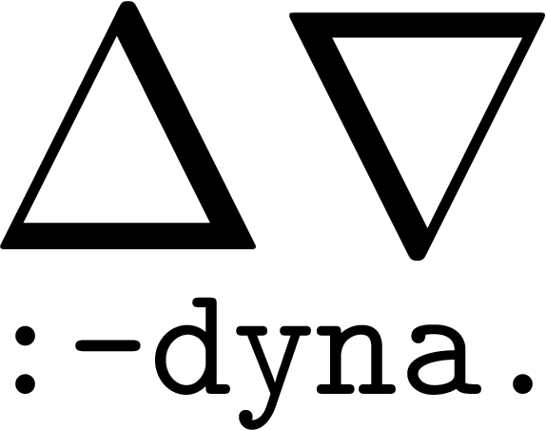
Care about what not how something is computed
Search
Machine Learning
Dynamic Programming
Database
AI
Deductive Databases
Logic Programming
Compile
Term Rewriting
(Hopefully) Useful Representation for User
R-exprs
(Relational expressions)
+ Queries
Term Rewriting
R-exprs (+ Query)
Results
Done
Notes:
So this talk is about our Relational Expression language or R-exprs for short that we have developed
(click) and are manipulate using Term Rewriting.
(click) Now the reason that we have developed R-exprs, is that we needed an intermediate representation for the programming language Dyna.
Dyna is a Logic programming language that generalizes Datalog and Prolog and it has been designed to be especially good (click) for representing weighted programs such as those commonly found in machine learning and artificial intelligence applications
(click) Now the reason that Dyna well suited for these particular problems is that all of these problems only care about what we are computing and not exactly how it is computed and R-exprs allow us to accomplish this.
(click) much like a database, we interact with a program by taking our original program, represented as a relational expression, and intersecting it with a query and further rewriting it
(click) once we have reached a normal form and there are no more rewrites we can apply, have hopefully reached a some form that is easily interpretable by the user

Slide 3

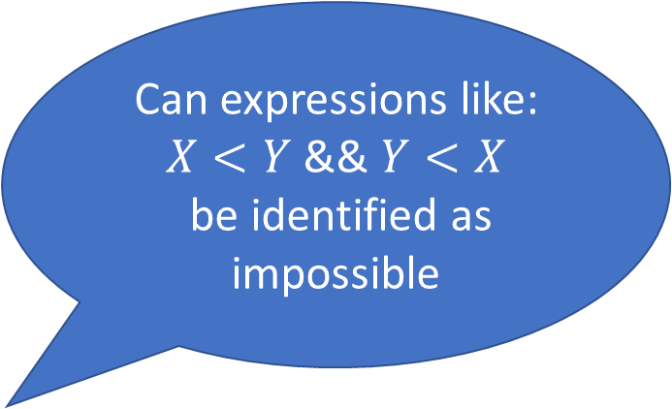
Dyna vs. Prior Work
WANT ALL THE THINGS
 | SQL | Datalog | Prolog | CLP | Dyna
Finite | ✓ | ✓ | ✓ | ✓ | ✓
Deductive | ✗ | ✓ | ✓ | ✓ | ✓
Infinite relations | ✗ | ✗ | ✓ | ✓ | ✓
Aggregation | ✓ | ✓ | ✗ | ✗ | ✓
Turing complete | ✗ | ✗ | ✓ | ✓ | ✓
Constraints | ✗ | ✗ | ✗ | ✓ | ✓
Is this a full programming language
Can expressions like:
$X<Y$ && $Y<X$
be identified as impossible
Supported by all.
Naïve strategies terminate due to finite.
Combining rules and “facts” to infer new “facts”
E.g. can we represent the set of all positive integers, or all prime numbers
SELECT sum(column) FROM x
Important for weighted programs
Hard to mix
Notes:
So, why did we develop a new programming language and invent a relational algebra for Dyna’s internal representation?
(click) to answer this, I am going to go through a quick feature matrix of well known tools including sql, datalog, prolog, constraint logic programming and dyna
(click) First we have that all of the systems support finite databases, as there always exists the option to simply loop over all the values which are contained in the database
(click) For deductive, only the logic programming systems suffice, as they are designed to combine rules together and discover new facts in the database.
(click) To support an infinite database, the system needs to have some strategy which can avoid expanding an infinite number of items in the database, essentially some early termination or higher order reasoning about the problem
(click) aggregation allows the system to combine the results from many different facts in the database. Here I have illustrated this as a SQL sum query. Aggregation also turns out to be necessary for making interesting weighted programs as we will see momentarily.
(click) Turing complete, or if this is a full programming language
(click) constrains or if the language supports solving expression such as X less than Y and Y less than X and identifying it as not possible without having to identify values for X and Y.
(click) Now, as you might have guessed, we would like to support all of this in Dyna
(click) and the reason that this hasn’t been done before is that aggregation and infinite databases are somewhat difficult to mix.

Slide 4
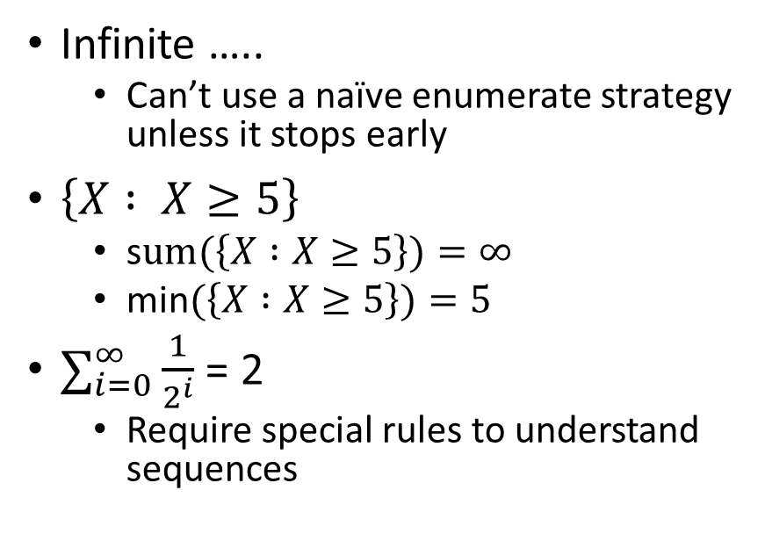
Aggregation + Infinite
Aggregators
Infinite Relations
OR – Exists A True Branch
  Used in Prolog (:-)
  Can stop early if find true value
AND – Not exist false branch
Sum/Product – exhaustive expansion of non-identity contributions
Max/Min – Structured Search problem or exhaustive search
Infinite …..
  Can’t use a naïve enumerate strategy unless it stops early
$\left\{X : X≥5\right\}$
  s$um(\left\{X :X≥5\right\})=∞$
  min$(\left\{X :X≥5\right\})=5$
$∑_{i=0}^{∞}\frac{1}{2^{i}}$ = 2
  Require special rules to understand sequences
Notes:
So why is aggregation and infinite relations hard to mix
(click) so some of the aggregators that we have are logical OR which is what is traditionally used in Logic programming, as it allows the system to early stop when it has found some true value
(click) we can also have logical AND, which would check that all the aggregated values are true, or could stop early in the case that a false value is found
(click) sum and product are also common when dealing with numerical or weighted programs.
(click) min and max are also common aggregators. Often they require expanding all values to select the one that is the smallest or largest. However, in some cases, such as linear programming for example, it might be possible to exploit structure in the problem to more efficiently find the solution
(click) In the case of infinite expressions, we can not enumerate all values as that never terminates. This makes it hard to use any aggregator except for logical OR which can stop enumerating values early.
(click) despite this, there is still some infinite sets where some aggregators are well defined. For example, we can represent the set of all numbers greater than or equal to 5, in which case, the minimum value is still well defined but computing the sum of this set would diverge. It might also be the case that we have an infinite set that is a converging sequence. As such, we need some way to be able to represent these infinite sets.

Slide 5
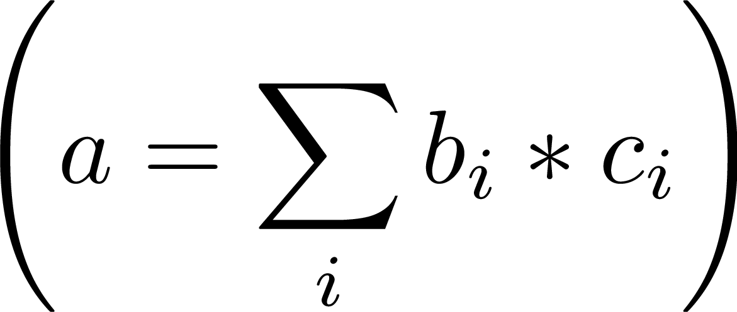
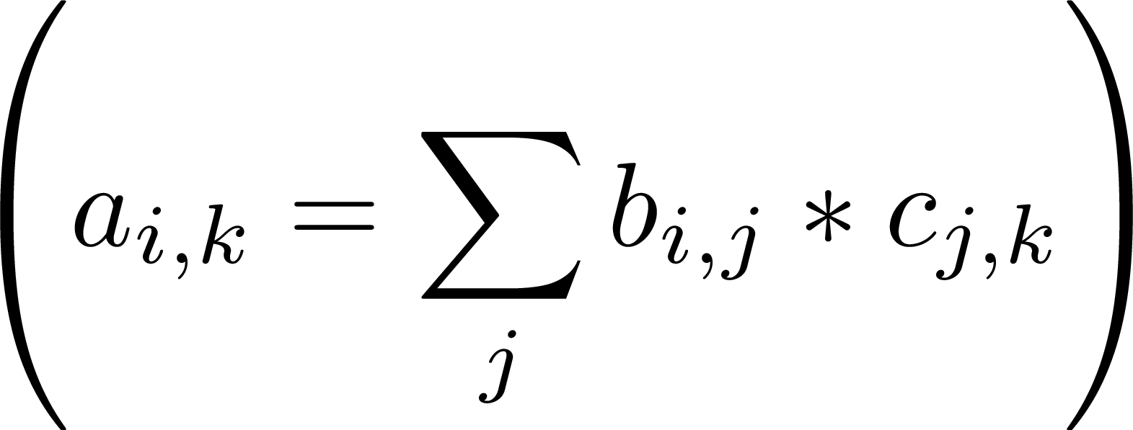
Dyna = Logic Programming + Aggregation
I can range over any value, not just integers
a(I) :- b(I), c(I).
  pointwise logical AND
a(I) = b(I) * c(I).
  pointwise multiplication
a += b(I) * c(I).
  dot product
a(I,K) += b(I,J) * c(J,K).
  matrix multiplication; could be sparse
  J is free on the right-hand side, so we sum over it
b(I,I) += 1. b(I,J) += 0.
  Infinite identity matrix
Notes:
To quickly convince you that aggregation is useful in logic programming, I have just a few quick examples.
(click) if you have ever written a Prolog or Datalog program, you have likely written a rule like this. In this case, for a given value of `I`, the rule `a(I)` will be defined if both `b(I)` and `c(I)` are defined for the same value of `I`. The aggregator here is the OR aggregator which can stop once it has found something that satisfies this expression
(click) Now, we might instead want to write pointwise multiplication where we require that both `b(I)` and `c(I)` return a value that can be used to assign another value or weight to the expression `a(I)`.
(click) If we remove I from the head of this expression, and replace the equals with the sum aggregator, we now have a dot product, where for every value of `I`, we are multiplying `b(I)` and `c(I)` together and summing all of the result.
(click) further note, that the value of `I` is not restricted to be over the integers. The variable `I` can be any value in the language or the herbrand universe. Also, depending on the definitions of `b(I)` and `c(I)` this could be an infinite sum, so we can not even determine from this one rule in the program if this is a finite sum or an infinite sum.
(click) one reason that we like Dyna, is that it lets us to concisely define mathematical equations. For example this single line defines a matrix multiplication.
(click) The variables `I` and `K` which appear in the head on the left hand side are the same as in the body,
(click) while the variable `J` which only appears on the right hand side is aggregator over using the sum aggregator.
(click) again, we do not know if this is an infinite sum given this single line of code. For example, if we were to define `b(I,J)` as I have written here at the bottom, then `b` is defined to be an infinite identity matrix, where anytime that its two arguments are equal to each other, it takes on the value 1, otherwise it takes on the value 0.

Slide 6
Example Program: Shortest path
Dyna programs are equivalent to the set of values they define
distance(Start, Y) min= distance(Start, X) + edge(X, Y).
distance(Start, Start) min= 0.
Defined for all cases where both arguments are equal
Here the “min=“ aggregator only keeps the minimal value that we have computed
Variables not present in the head of an expression are aggregated over like with the dot product example.
Start | Y | distance(Start, Y)
"a" | "a" | 0
"a" | "b" | 10
"a" | "c" | 12
"a" | "d" | 19
"b" | "b" | 0
"b" | "c" | 2
"b" | "d" | 9
"c" | "c" | 0
"c" | "d" | 7
"d" | "d" | 0
edge("a", "b") = 10.
edge("b", "c") = 2.
edge("c", "d") = 7.
Start | Y | distance(Start, Y)
"foo" | "foo" | 0
7 | 7 | 0
3.1415 | 3.1415 | 0
Notes:
To see a more involved example,
(click) lets look at the multi-source shortest path program. Here, I have written this program out using two lines of Dyna. Note, this program as written, can not be executed under Prolog or Datalog’s style of execution, instead it requires R-exprs or something isomorphic to R-exprs.
(click) Again, we have the variable `X` which is not present in the head of this expression is going to have to be aggregated over just like with the dot product example.
(click) here aggregator is min and will only keep around the minimal value that is computed.
(click) This program is going to be combined with a number of edge weight “facts” as I have shown here.
(click) All together, this program can be thought of as equivalent to all of the possible assignments to the variable `Start`, `Y` and the result of `distance(Start,Y)` as shown in this table.
(click) however, this program is also defined for a number of other values because of this second rule. Here, anytime that the first two arguments are equal to each other, then the distance is equal to the value zero. This is regardless of it was using an edge that we defined or some other value such as “foo” or 3.14

Slide 7
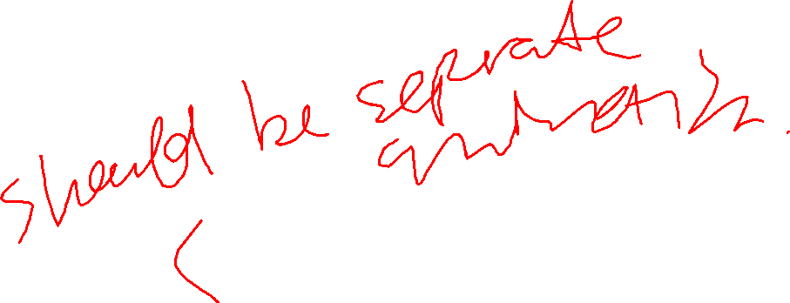
Shortest Path (cont.)
distance(S, S) = 0.
S | Y | distance(S, Y)
"foo" | "foo" | 0
7 | 7 | 0
3.1415 | 3.1415 | 0
$$\{\left\langle Arg_{1},Arg_{2},Result\right\rangle :Arg_{1}=Arg_{2} AND Result=0\}$$
Aggregator Omitted
for now
Tuple of Named Variables
Executable Code Defines the Rule
distance(S, Y) = distance(S, X) + edge(X, Y).
Because of recursion, it can not be expressed using the set builder notation
Notes:
So how do we represent a program such as shortest path?
(click) here, we have the base case for the shortest path program which is used anytime that both arguments are equal to each other
(click) we can represent this expression as a bag where (click) the arguments and the resulting variable have been mapped (click) to this tuple of named variables, (click) and we have body of this rule represented as a bit of executable code. Note, I am temporary ignoring the aggregator in this rule, but I will bring it back shortly.
(click) Now, we can also do this for the recursive shortest path rule (click) however, if we just do the same as the above line, this ends up being somewhat awkward. We really need some way that we can build this expression up

Slide 8




distance(Start, Y) = edge(X, Y) + distance(Start, X).
Intermediate results are mapped to variables
Normalize with standard names for all arguments
Result is distance(Arg1, Arg2) :-
Result = edge(Arg2, X) + distance(Arg1, X).
Intersect the bag by multiplying the multiplicities and joining these expressions using the same variable names
R-expr to Call function by name
(E is edge(Arg2, X))
$$∩$$
Recursive call to distance
*
$$∩$$
(D is distance(Arg1, X))
*
builtin_plus(Result, E, D)
Built-in represented in the R-expr
Project out all local variables
proj(E, proj(D, proj(X, )))
Now Over the tuple $⟨Arg1, Arg2, Result⟩$
Over the tuple $⟨Arg1, Arg2, Result, E,D,X⟩$
Notes:
So lets try again with this second rule
(click) the first step is to normalize all of the argument and Result’s variable name
(click) then we can start translating this program one term at a time, first we are taking the call to edge and translating that into an R-expr
(click) we introduce new variables which correspond with any intermediate values that exist in this computation
(click) we do the same thing for the recursive call to distance
(click) for the plus expression, we introduce a call to a builtin plus operator
(click) then we intersect all of these expressions where they are joined when they use the same variable names
(click) all together, this this expression is over the 6 variables `Arg1`, `Arg2`, `Result`, `E`, `D` and `X`
(click) so we use a projection operator to remove the local variables which sums the bag’s multiplicity for all assignments of a given variable. Now this expression over just `Arg1`, `Arg2` and `Result`

Slide 9
What about Aggregation?
distance(S, X) min= edge(X, Y) + distance(S, Y).
Any semi-group: min, max, sum, product, logical OR, logical AND
(Result=min(MinInputVariable, R))
Resulting value from aggregation
New intermediate variable introduced
(Like project)
R-expr composed on previous slide
Notes:
So how to we introduce the aggregator back into this program,
(click) well, we include this directly into the R-expr
(click) it wraps the R-expr that we have seen from the previous slide
(click) There is a variable which is introduced to identify which value is getting feed into the aggregator, just like with projection
(click) and then we also mark where the final result of aggregation will be stored.

Slide 10






Shortest Path All Together Now
distance(S, S) min= 0.
distance(S, X) min= edge(X, Y) + distance(S, Y).
Result is distance(Arg1, Arg2) min= Arg1=Arg2, Result=0.
Result is distance(Arg1, Arg2) min= Result=edge(Arg2, Y) + distance(Arg1, Y).
The complete distance rule as a R-expr
(Result=min(MinInput,
$$∩$$
$$( )$$
$$∪$$
(Arg1=Arg2) * (MinInput=0)
+
$$( )$$
proj(E, proj(D, proj(Y,
(E is edge(Arg2, Y)) * (D is distance(Arg1, Y)) * builtin_plus(MinInput, E, D)
)))
$$∩$$
$$∩$$
))
Notes:
So now that we have aggregation, lets show what the representation of the shortest path program is all together.
(click) first we normalize both of these rules such that they are over the same variables `Arg1`, `Arg2`, and `Result`
(click) here we have the conversion of the first rule
(click) here is the second rule from before
(click) now we take the union of these two expressions
(click) now wrap this entire expression in the aggregator which is going to select the minimum value which is assigned to the variable `MinInput` for a given assignment of `Arg1` and `Arg2`

Slide 11
Manipulating R-exprs via Rewrites
A series of semantic preserving rewrites which attempt to simplify the expression
  Look for a sub-R-expr which can be rewritten to be simpler, do so!
Non-deterministic: Any order of rewrites is acceptable
  Requires searching through the entire R-expr to identify what can be rewritten/run
Fair rewrites: non-normal form sub-expression are eventually rewritten
  Important in the case of recursive programs
Core rewrites are presented in the paper
Notes:
Alright, so now I am going to talk about how we manipulate and rewrite these expressions to execute our programs
(click) So our rewrites are all designed to be semantic preserving and to simplify the expression
(click) Our rewrites are non-deterministic as there may be many different rewrites that we could apply at any point. We are ok with any order of applying the rewrites even if this gives slightly different answers
(click) Our system is fair between any of the available rewrites that we can use on the expression. This is important as recursive program might not terminate if the system was unfair.
(click) and all of the core rewrite can be found in our paper

Slide 12
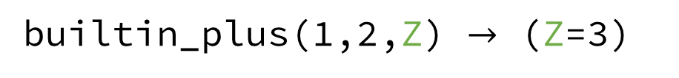
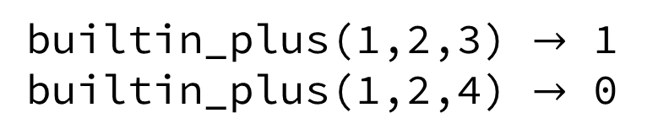
R-expr Rewrites—Built-ins
* and +
are over the bag’s multiplicity
Propagate the assignment to Z
builtin_plus(X,Y,Z) $≡\{\left\langle X,Y,Z\right\rangle :X+Y=Z\}$
Maps to the multiplicity of being contained in the bag
No rewrites available for: 1+Y=Z
builtin_plus(1,2,Z) $→$ (Z=3)
builtin_plus(1,Y,Z)
builtin_plus runs and its result is assigned Z
Y=1, Z=2
Y=2, Z=3
Y=3, Z=4
….
(Z=3)*builtin_plus(1,Y,Z)$→$(Z=3)*builtin_plus(1,Y,3)
(Z=3)*builtin_plus(1,Y,3)$→$(Z=3)*(Y=2)
Built-ins support multiple modes for computation
Check assignment is consistent
builtin_plus(1,2,3) $→$ 1
builtin_plus(1,2,4) $→$ 0
Notes:
To illustrate the core ideals of our rewriting system, we start with some small examples involving builtin expressions
(click) here we show the builtin_plus operator which operates over 3 variables and maps these variables to a bag of triples that corresponds with addition
(click) Our system is looking for a simpler representation that corresponds with this bag. So here, the first two variables have been assigned a value of 1 and 2 respectively. This means that the only value that the variable `Z` can take on is 3, so we have performed that rewrite here. This rewrite is semantically equivalent to the original expression, and it can be considered simpler as we can directly read the value of `Z`.
(click) Now, in the case that we have two variables unbound, such as Y and Z here, then there are no rewrites which are possible, as this corresponds with an entire set of assignments to `Y` and `Z`
(click) To eventually rewrite this builtin_plus, we need some other conjunctive rule to determine that `Z` is equal to 3. In which case, we can propagate the value 3 into any place where the variable `Z` appears
(click) Here, we are showing that builtins can support multiple modes. In this case, by having 2 of the 3 variables bound, we are able to perform a subtraction and determine the value for variable `Y` is 2. By leaving expressions unrewritten when there is not enough information and being able to run the builtins in multiple modes, this nearly gets us to constraint logic programming.
(click) finally, to complete this picture, in the case where all of the arguments to builtin_plus are known, we are able to simply check if assignment is correct. This expression is rewritten as 0 or 1, to indicate the multiplicity that a given assignment has in the bag at the top of this slide.

Slide 13
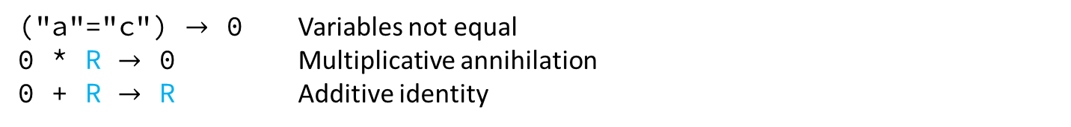
Rewriting Example: Shortest Path
Distance is distance("a", "c")
Recall the shortest path program does not work in either Prolog or Datalog’s execution style
Program
(Result=min(MinInput,
(Arg1=Arg2)*(MinInput=0) +
proj(E, proj(D, proj(X,
(E is edge(Arg2, X))*(D is distance(Argr1,X)*bultin_plus(E,D,MinInput))))
(Distance=min(MinInput,
("a"="c")*(MinInput=0) +
proj(E, proj(D, proj(X,
(E is edge("c", X))*(D is distance("a",X)*bultin_plus(E,D,MinInput))))
Rewrites Rules
("a"="c") $→$ 0 Variables not equal
0 * R $→$ 0 Multiplicative annihilation
0 + R $→$ R Additive identity
(Distance=min(MinInput, proj(E, proj(D, proj(X,
(E is edge("c", X))*(D is distance("a",X)*bultin_plus(E,D,MinInput))))
Notes:
So lets work through the shortest path example. Here we start with a query to the program which is written as an R-expr
(click) we then combine it with the definition of the shortest path from what we had a few slides ago
(click) when combine these two we rename the variables `Result`, `Arg1`, and `Arg2 `to match our query and substituting in the constants “a” and “c”
(click) we now apply a rewrite rule to check that the two constants are equal to each other. Because they are not equal, this is rewritten as 0 representing an empty bag
(click) we have that an empty bag intersected with any R-expr results in an empty bag
(click) and we have that the union of an empty bag with an R-expr results in the same R-expr
(click) together this simplifies the expression as follows where we have removed the first disjunctive branch of this R-expr

Slide 14
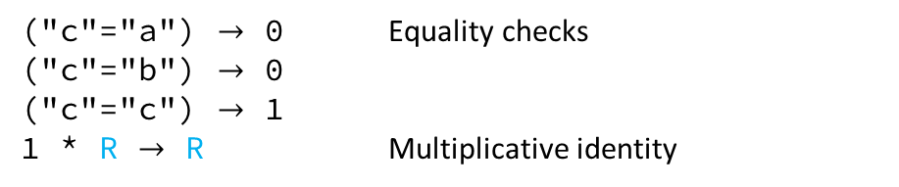
(Distance=min(MinInput, proj(E, proj(D, proj(X,
(E is edge("c", X))*(D is distance("a",X)*bultin_plus(E,D,MinInput))))
Program
(Result is edge(Arg1, Arg2)) :-
(Arg1="a")*(Arg2="b")*(Result=10) +
(Arg1="b")*(Arg2="c")*(Result=2) +
(Arg1="c")*(Arg2="d")*(Result=7)
(Distance=min(MinInput, proj(E, proj(D, proj(X,
(("c"="a")*(X="b")*(E=10)+
("c"="b")*(X="c")*(E=2)+
("c"="c")*(X="d")*(E=7))
*(D is distance("a",X)*bultin_plus(E,D,MinInput))))
("c"="a") $→$ 0 Equality checks
("c"="b") $→$ 0
("c"="c") $→$ 1
1 * R $→$ R Multiplicative identity
(Distance=min(MinInput, proj(E, proj(D, proj(X,
((X="d")*(E=7))
*(D is distance("a",X)*bultin_plus(E,D,MinInput))))
Propagate values
(Distance=min(MinInput, proj(D,
(D is distance("a","d")*bultin_plus(7,D,MinInput))))
Notes:
Now we are going to continue with this rule
(click) we again lookup the definition of the edge rule from the program
(click) and we rewrite the expression for edge substituting in the variables `E`, `X` and the constant “c”
(click) Now we are going to check the equality between the constants “c” and “a”, “b” and “c” where only the last one is equal, thus rewritten as a 1. This corresponds with a bag where all assignments to other variables are given multiplicity 1
(click) we can now use the multiplicative identity of 1 * R is R
(click) and now we get this simpler R-expr where only the matching branches of edge remain.
(click) now we propagate the values of `X` and `E` as they have been bound to constants. This allows us to remove the two projection rules for these variables. The system would continue doing rewrites on this new expression just like we have seen so far.

Slide 15
Rewrites for Aggregators
(Result=min(MinInput, (MinInput=789))) $→$ (Result=789)
A final value has been determined. Assign it to the Result Variable
(Result=min(MinInput, R+S)) $→$ builtin_min(MR, MS, Result)*
(MR=min(MinInput, R))*(MS=min(MinInput, S))
More “traditional” for aggregation to map empty to empty
(Result=min(MinInput, 0)) $→$ (Result=identity) $≡$ (Result=$∞$)
Two disjunctive
R-exprs can be split and processed individually
When the there are no contributed values, the result of an aggregator is not empty, but returns its identity value
not_identity(identity) $→$0
not_identity(V) $→$ 1 if ground(V) && V != identity
(Result=min(MinInput, 0))*not_identity(Result) $→$ 0
Notes:
So the rewrite steps that we have seen so far probably don’t seem too surprising, but we didn’t quite make it to seeing the aggregator itself running and it can take quite a few steps to see it do anything interesting. So I am just going to take a moment to illustrate our rewrite rules for dealing with aggregators.
(click) So here we have our min aggregator, where I have assigned 789 to the input variable for the aggregator. In this case, we can simplify this expression, by just removing the aggregator as there is only a single value.
(click) In the case that there are two disjunctive R-exprs, R and S, then we are able to split this into two different expressions where each is going to be aggregated over independently. This can be important as it is possible that only one of the two R-exprs can be rewritten and simplified. When combined with an aggregator that can stop early, such as logical OR, this can result in a significant runtime improvement.
(click) Here is the interesting rule, in the case that there are no contributions—meaning that it is aggregating over an empty bag represented by 0—then this does not rewrite as 0 an empty bag, but rather returns the identity element for the aggregator. In the case of the min aggregator, the identity is defined as positive infinity.
(click) now, this might seem a little strange compared to other relational algebras which include aggregation, but we can recover a more traditional view of bag relational algebras by filtering out the cases where nothing was aggregated over. The reason for this oddity is that allows us have additional flexibility--exhibited by the second rewrite rule--and others that are in the paper that are useful when dealing with infinite bags.

Slide 16
Ongoing and Future Work
Memoization and Mixed-chaining of computation
  R-exprs serve as a basis for representing incomplete computations and can be run in a myriad of different execution orders
  Extended version of this paper to (hopefully) appear soon
Exploring and learning different execution orders
  R-exprs capture what needs to be computed while leaving the order and how open to the runtime to decide
  Much like a database optimizer, but for full, long running programs
Compilation and optimization of R-exprs
github.com/matthewfl/dyna-R arxiv.org/abs/2010.10503
Notes:
R-exprs for us are the internal representation for dealing with Dyna and other Logic Programming Langauges
(click) we have ongoing work to integrate memorization, forward-chaining, and mixed-chaining based execution strategies using R-exprs and their associated rewrites. This is already in our implementation, and should appear in a future version of this paper.
(click) we are also working on exploring different execution orders, much like a database query optimizer, to figure out the most efficient way to execute a program given the flexibility we have in different rewrite orders
(click) We are also looking into compiling the sequence of rewrites

Slide 17
Thank you
Questions?
github.com/matthewfl/dyna-R
arxiv.org/abs/2010.10503
mfl@cs.jhu.edu

