Slide 1

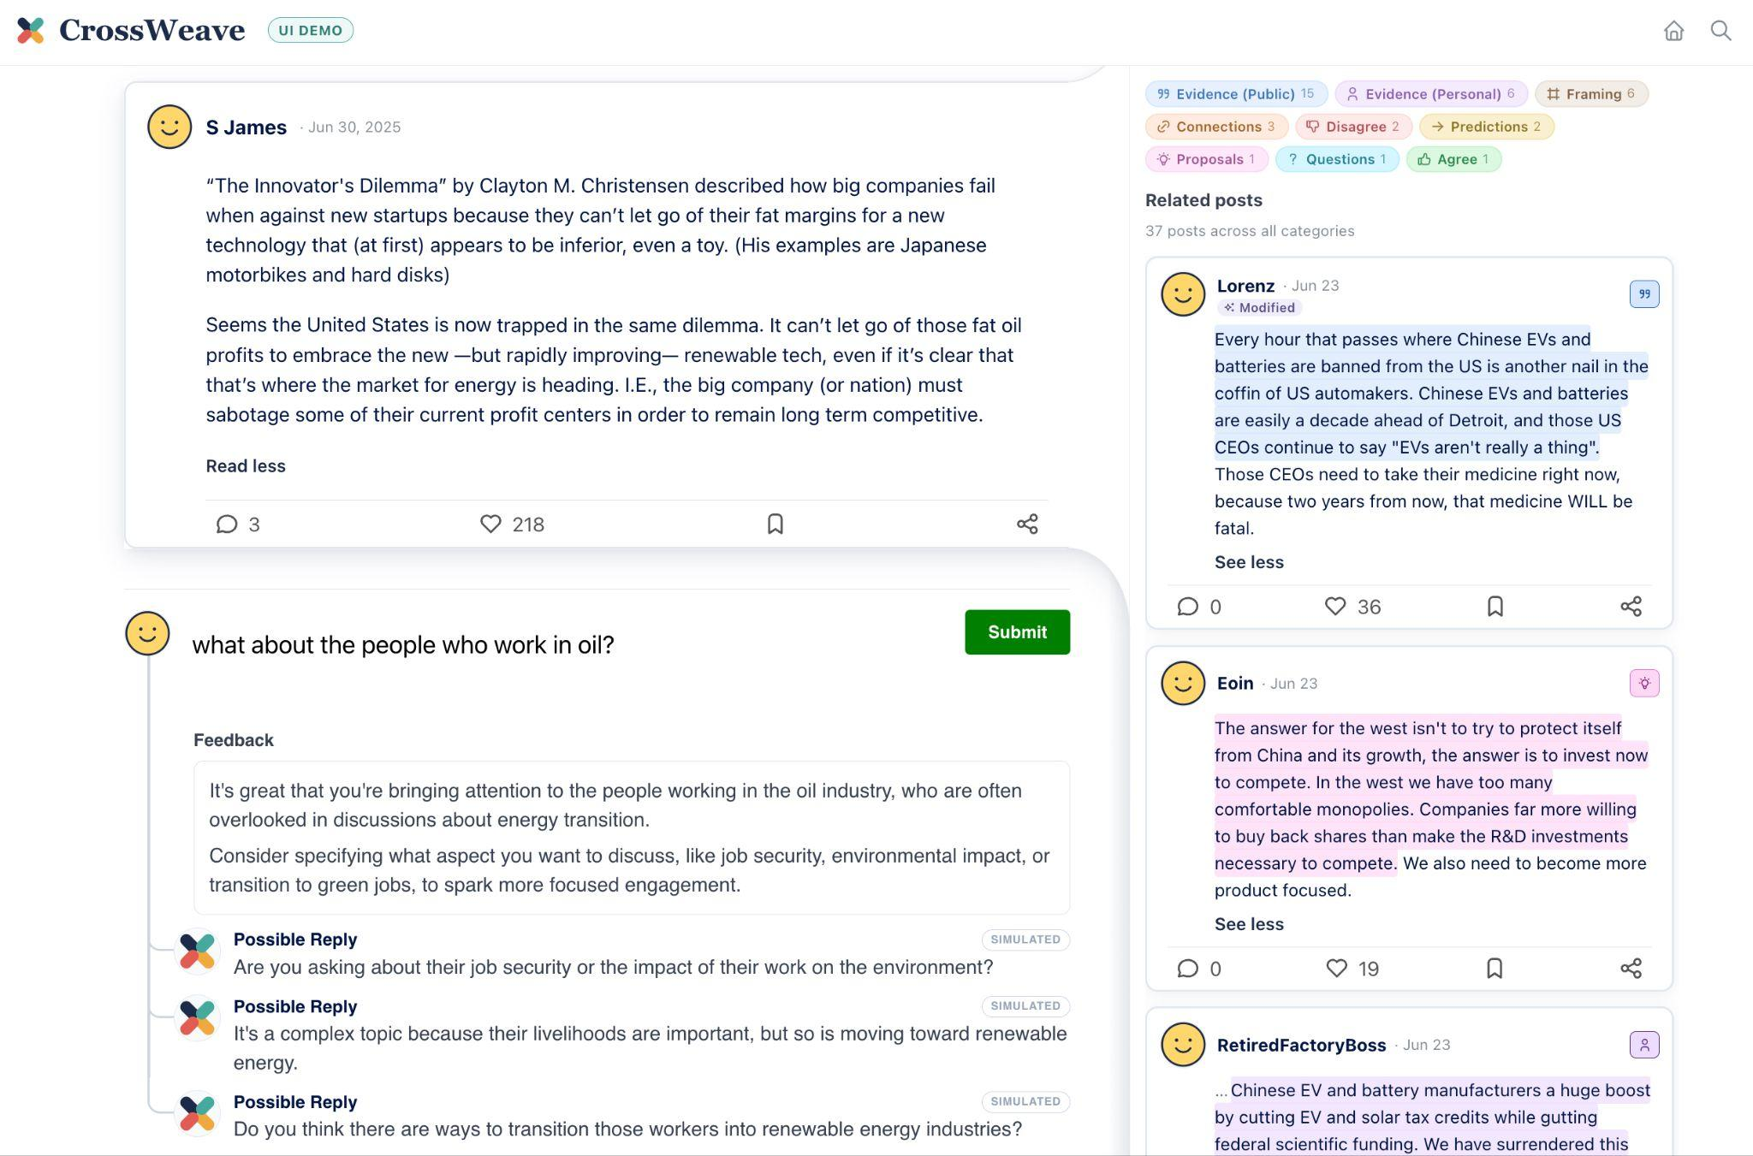
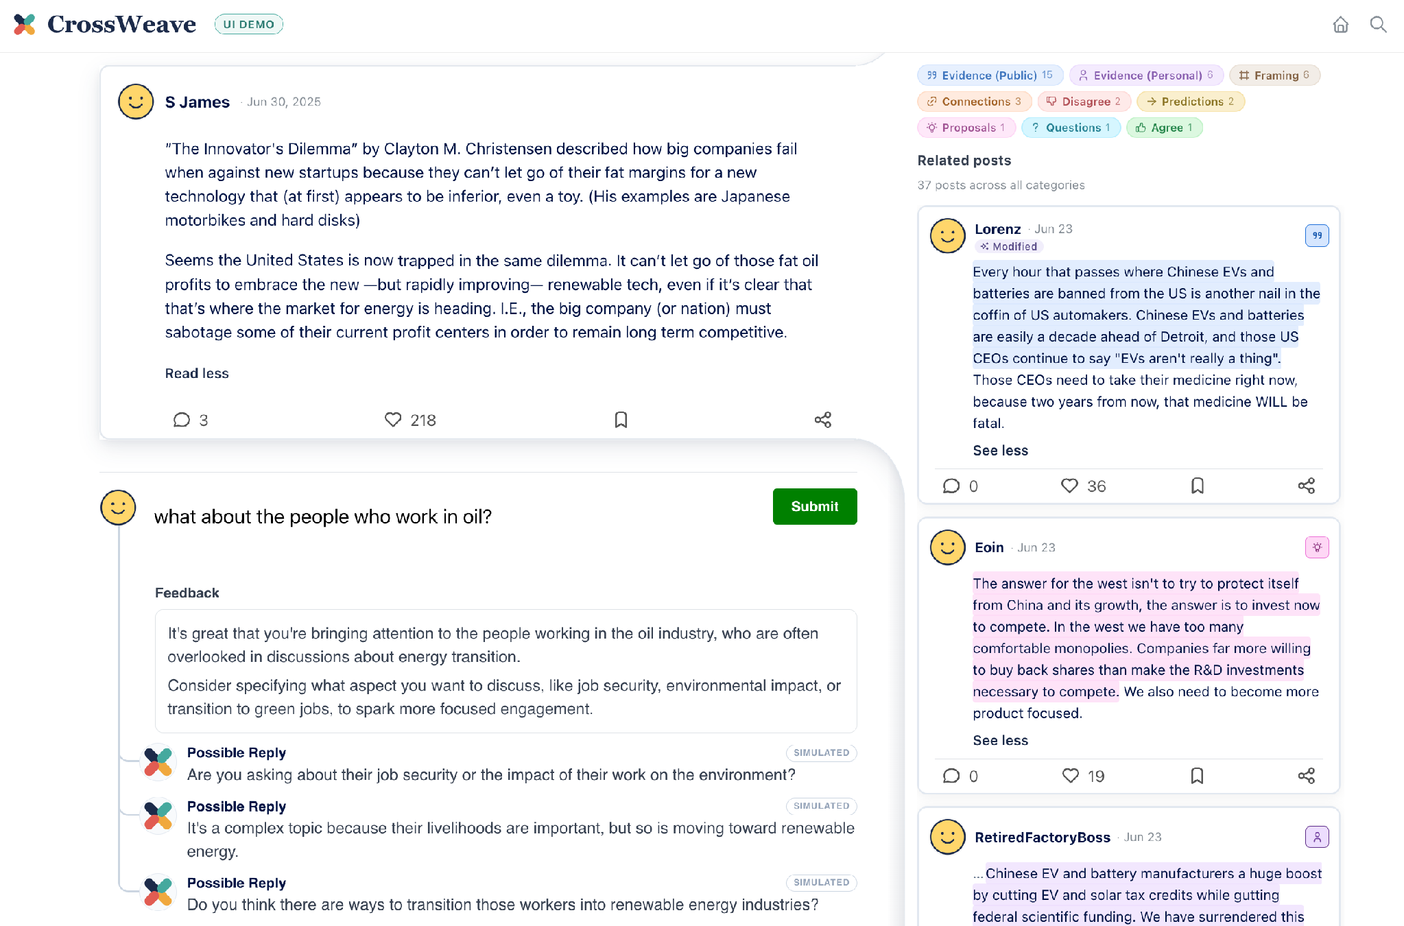

Bridging Perspectives Across Online Communities with a Dual-Pane Design
Fei Fang, Reva Hirave, William Jurayj, Yuqi Li, Brian Lu, Tarik Metin, Tsugunobu Miyake, Kateryna Morhun, Yash Permalla, Kenan Rustamov, Allen Shen, Haojun Shi, Prabhav Singh, Xiheng Tom Wang, Kevin Xu, Qingcheng Zeng, Jiayi Zhang, Daniel Khashabi, Andrew Perrin, Tiziano Piccardi, Ziang Xiao, Jason Eisner
CSCW’26 · x-weave.org
2+ years of work (kicked off by a 6-week team hackathon at JSALT 2024)
Multiple design iterations
First paper from the project!
Notes:
CrossWeave demo Q&A. Slide 2 is an index of anticipated questions; jump to the matching slide when one comes up.

Slide 2

Anticipated questions
Q1
What’s wrong with current social media?
Q7
Are the demo posts real? Where from?
Q2
What’s your big idea?
Q8
What if posts can’t be understood out of context?
Q3
How is it different from bridging feeds like MySky?
How do you choose and organize related posts?
Q9
Q4
What are your other UI features?
Q10
Can this UI scale?
Q5
Is this what users want?
Q11
Are you vulnerable to bad actors?
Q6
Is this what platform providers want?
CrossWeave
Demo Q&A
x-weave.org
Notes:
Index of anticipated questions. Each Q number matches the pill on its answer slide.

Slide 3



What’s wrong with current social media?
Q1
Our society can't sustain serious discussion anymore.
Drowned out
Filter bubble
Backfire effect
Good ideas and objections are lost in the sea.
Even common points of view aren’t seen by the other side.
Users dig in their heels when they’re criticized directly.
CrossWeave
Demo Q&A
x-weave.org
Notes:
Hard to sustain serious discussion. Good ideas and objections are lost in the sea. Filter bubble: even common points of view aren't seen by the other side. Backfire effect: users dig in their heels when they're criticized directly.

Slide 4

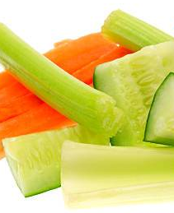



What’s your big idea?
Q2
Keep your familiar junk food feed,
but AI provides healthy vegetables
on the side. (LLMs are good readers!)
Your familiar view
AI-curated side pane
Instant evidence and arguments
Bring new ideas into your discussion.
Get the whole picture
Find out what other users across the site are saying, in their own words.
Write smart
As you type, AI shows you how others might respond.
All posts are still written by humans.
CrossWeave
Demo Q&A
x-weave.org
CrossWeave adds perspective by showing related posts
alongside your regular social media feed.
Notes:
Keep your familiar junk food feed, but AI provides healthy vegetables on the side. CrossWeave adds perspective by showing related posts alongside your regular social media feed: instant evidence and arguments to bring new ideas into your discussion; the whole picture of what other users across the site are saying, in their own words; and, as you type, AI shows you how others might respond. All posts are still written by humans.

Slide 5
How is it different from other prosocial bridging feeds, e.g. MySky on Bluesky?
Q3
A bridging feed
CrossWeave
Reranks and suppresses posts in your feed
Your feed, untouched — plus a side pane
ranked ⬆️
ranked ⬇️
suppressed
CrossWeave does not mutate your feed.
It just augments it with interesting alternatives.
CrossWeave
Demo Q&A
x-weave.org
Notes:
CrossWeave does not mutate your feed. It just augments it with interesting alternatives in a side pane, so users keep the feed they came for.

Slide 6
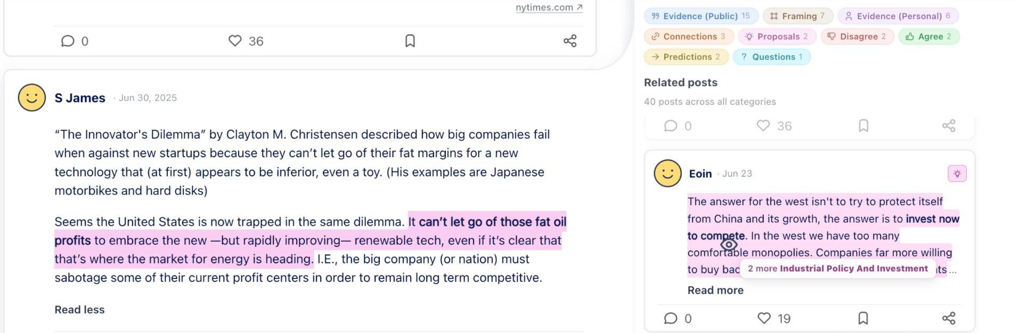
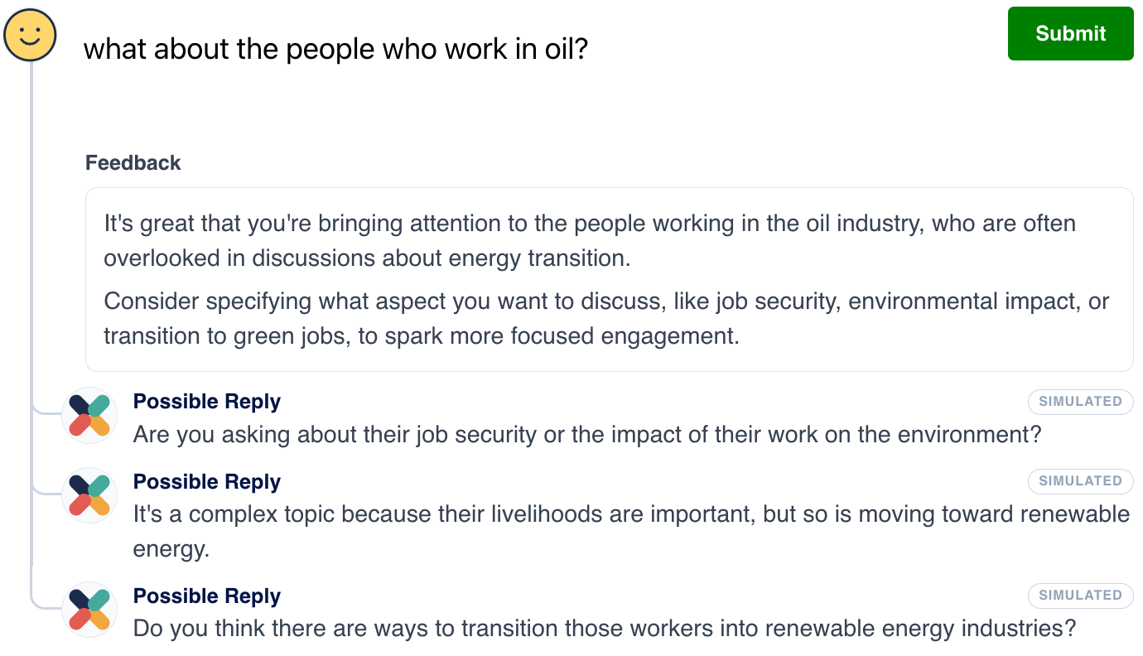
What are your other UI features?
Q4
Try scrolling, hovering, clicking, and typing!
3
1
Scroll
to see diverse related posts
2
Hover
2
to see why side posts were chosen as related
and to see how prevalent their views are
3
1
3
Click
to focus in on a particular topic or type
or to navigate top a post in its original context
4
4
Type
in the reply box and get instant feedback
CrossWeave
Demo Q&A
x-weave.org
Notes:
1 Scroll the side pane to get a feel for the different contribution types, marked with icons and colors. 2 Hover a highlighted span in a side post to see why it was chosen: the matching span lights up in the focused post. 3 Click a contribution-type filter, or the topic tooltip ("2 more Industrial Policy And Investment"), to focus in on a type or topic; "more like this" overrides our usual preference for diversity. 4 Type in the reply box to get instant feedback, plus simulated replies.

Slide 7
Is this what users want?
Q5
Granted, most aren't coming to social media for information.
But they’re getting it anyway, and it’s hurting society.
So we should make healthy options available
for a more balanced diet.
CrossWeave
Demo Q&A
x-weave.org
Notes:
Most users are not coming to social media for information. But they're getting it anyway, and it's hurting society. So we should make healthy options available for a balanced diet.

Slide 8



Is this what platform providers want?
Q6
Maybe?
Some benefits we see:
provides more opportunities for engagement
may make users feel better about using the site
helps smaller sites foster a constructive reader community
CrossWeave
Demo Q&A
x-weave.org
Notes:
We don't know for sure, but we think platform providers will want it: it provides more opportunities for engagement, may make users feel better about using the site, and helps smaller sites foster a constructive reader community.

Slide 9

Are the demo posts real? Where did they come from?
Q7
New York Times
reader comments
Yes!
300+
Fox News
reader comments
real posts, drawn from communities with distinct norms and audiences
Reddit r/changemyview
threads
We scraped 6 threads per topic so that our posts would cover a diversity of perspectives on each topic.
CrossWeave
Demo Q&A
x-weave.org
Notes:
Yes! The demo shows 300+ real posts drawn from communities with distinct norms and audiences: New York Times reader comments, Fox News reader comments, and Reddit r/changemyview. We scraped threads on 3 specific topics so we'd have enough posts on each topic.

Slide 10
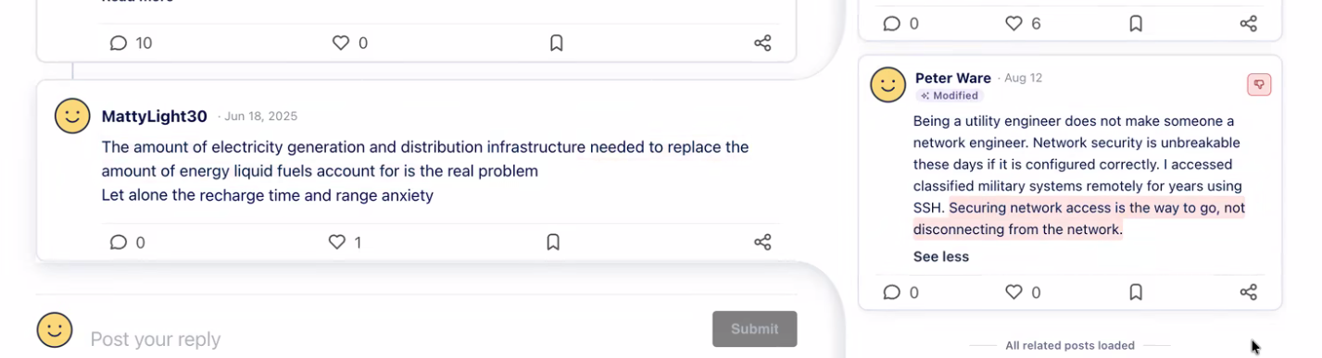
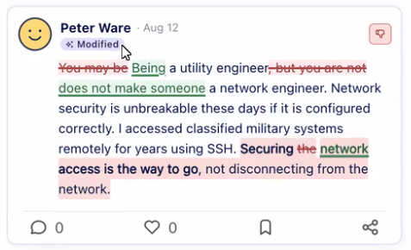
What if posts can’t be understood out of context?
Q8
e.g., references local to the source thread, such as pronouns
We produce a decontextualized version of each post with an LLM (GPT-5.6-luna), prompted to retain as much of the author’s voice as possible.
"Modified" tag for disclosure
Hovering on “Modified” reveals original
CrossWeave
Demo Q&A
x-weave.org
Notes:
Side posts are plucked from their original threads, so "he", "us" or "this" may be unclear. We produce a decontextualized version of each post (arxiv.org/abs/2102.05169) with an LLM (GPT-5.6-luna) prompted to retain as much of the author's voice as possible. Rewritten posts are labeled Modified; hovering the label reveals the original as edit markup.

Slide 11





How do you choose and organize related posts?
Q9
PHASE A · Curate a discourse universe
Identify topics
Find on-topic threads from NYT + Fox + Reddit
Scrape all comments from threads
Curate a small, densely connected subset
3 topics
18 threads, 6 per topic
3.7k posts total
90 ~ 125 posts per topic
PHASE B · Produce a side pane for each post
1. Decontextualize each post
2. For each post-to-post connection: annotate strength, identify highlights, classify contribution types
3. For each focused post: induce subtopics from the side pane, assign a subtopic to each side post
4. For each focused post: rank the side pane based on strength, subtopic, and contribution types
300+ precomputed side panes
CrossWeave
Demo Q&A
x-weave.org
Notes:
Phase A curates a discourse universe: 3 topics, 18 on-topic threads (6 per topic) from NYT, Fox and Reddit, 3.7k scraped posts, curated down to a small, densely connected subset of 90–125 posts per topic. Phase B produces a side pane for each post: decontextualize, judge each post-to-post connection, induce subtopics, then rank. The result is 300+ precomputed side panes. Next slide: which model does each step.

Slide 12
How do you choose and organize related posts?
Q9
Phase B, step by step: who does what
Step | Task | Done by
1 | Decontextualize each post (see Q8) | GPT-5.6-luna
2 | Annotate strength, identify highlights | GPT-5.4
2 | Classify contribution types | Jev, based on GPT-5.4’s annotations
3 | Induce subtopics from the side pane | GPT-5.4
3 | Assign a subtopic to each side post | GPT-4.1-mini
4 | Rank the side pane | Deterministic scoring function based on maximal marginal relevance (MMR)
The ranking function takes its features from the outputs of steps 2 and 3.
CrossWeave
Demo Q&A
x-weave.org
Notes:
1. Decontextualization is done with GPT-5.6-luna (see the previous question). 2. GPT-5.4 annotates strength and identifies highlights; Jev classifies contribution types, based on annotations from GPT-5.4. 3. Subtopic induction is done with GPT-5.4; per-post subtopic assignment with GPT-4.1-mini. 4. Ranking uses a deterministic scoring function based on maximal marginal relevance (MMR), with features from the outputs of steps 2 and 3.

Slide 13


Can this UI scale?
Q10
TBD — that’s our current research!
THIS UI DEMO
WHAT WE NEED
Uses an expensive workflow
A cheaper workflow, similar to information retrieval
An LLM judges every pair of posts, so side panes are precomputed offline.
LLMs extract arguments from each post, but they can’t read all pairs of posts.
n² pairs
n posts
CrossWeave
Demo Q&A
x-weave.org
Notes:
TBD — that's our current research! This UI demo uses an expensive workflow. We need a cheaper workflow, similar to information retrieval. LLMs can extract arguments from each post, but they can't read all pairs of posts.

Slide 14
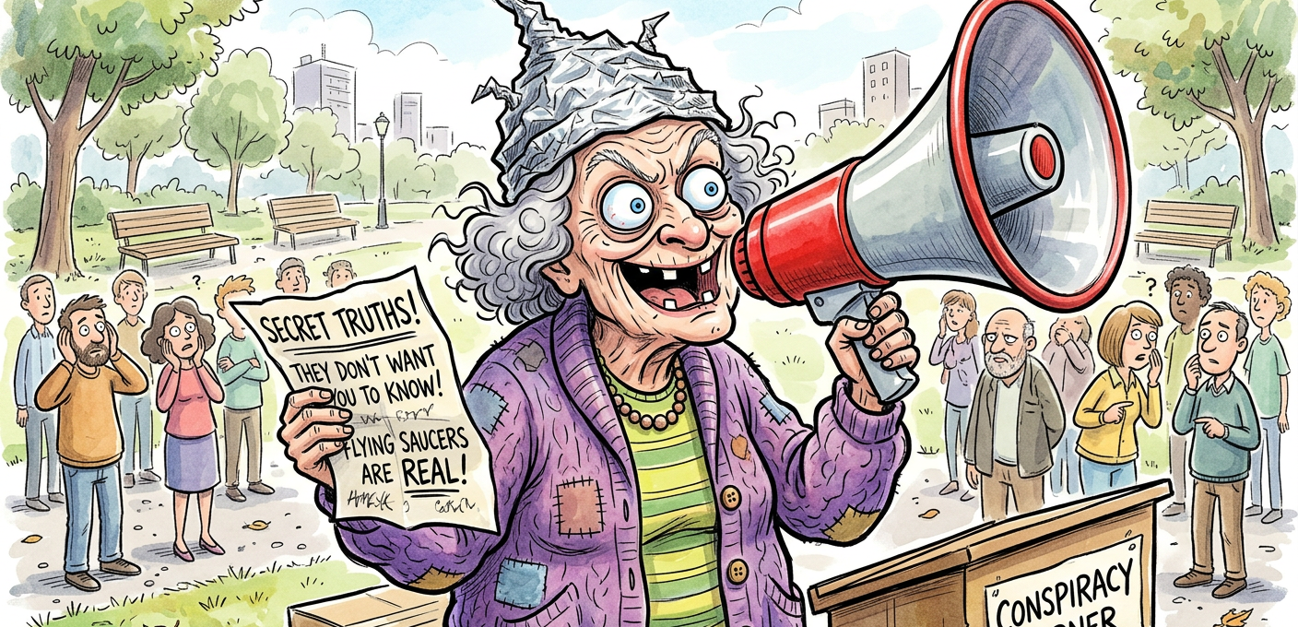
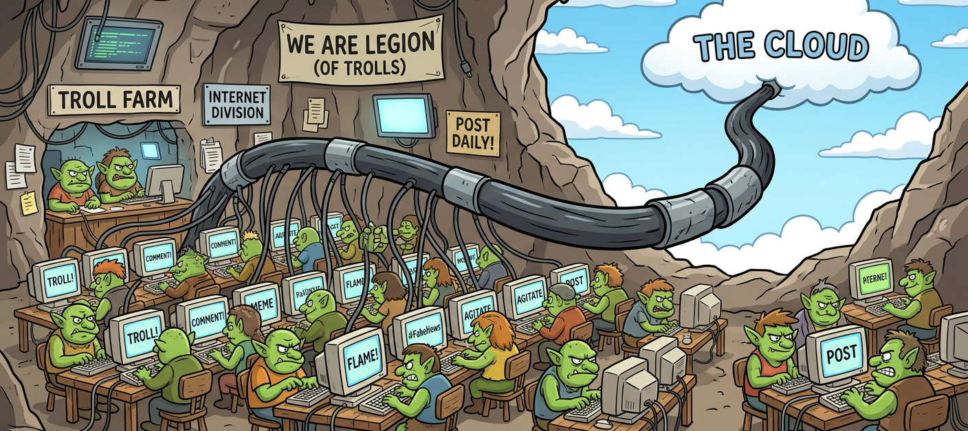



Are you vulnerable to bad actors?
Q11
Yes.
We only try to give a faithful picture of the range of ideas on the site.
Some ideas may include misinformation.
The site may not represent the voting population.
Other measures are needed to combat those problems.
CrossWeave
Demo Q&A
x-weave.org
Notes:
Yes. We only try to give a faithful picture of the range of ideas on the site. Some ideas may include misinformation, and the site may not represent the voting population. Other measures are needed to combat those problems.

