Slide 1
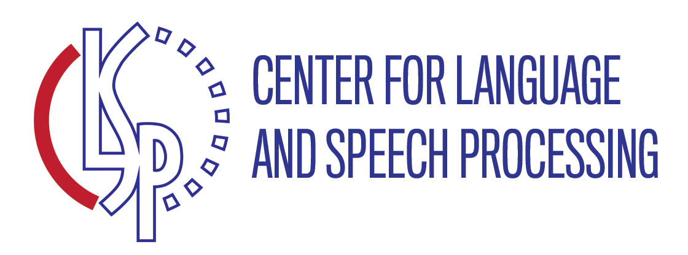
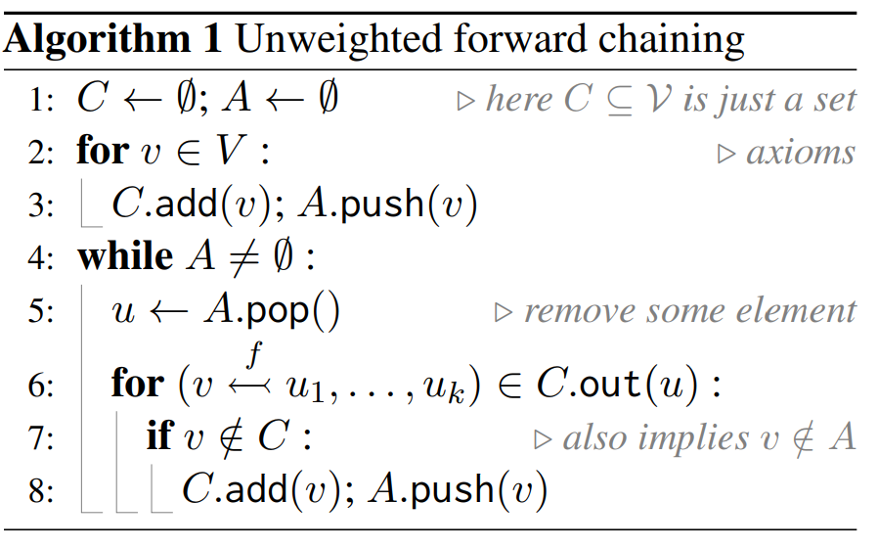
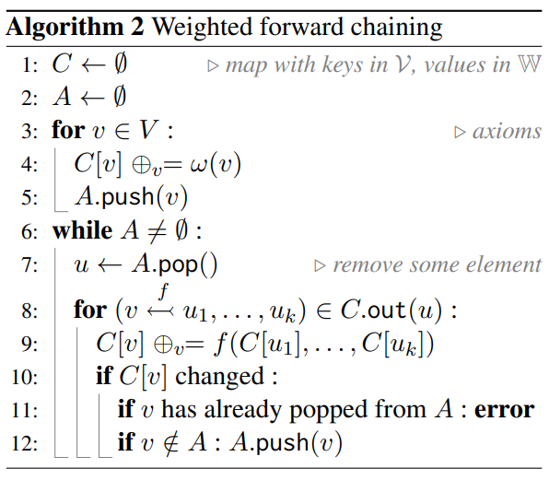
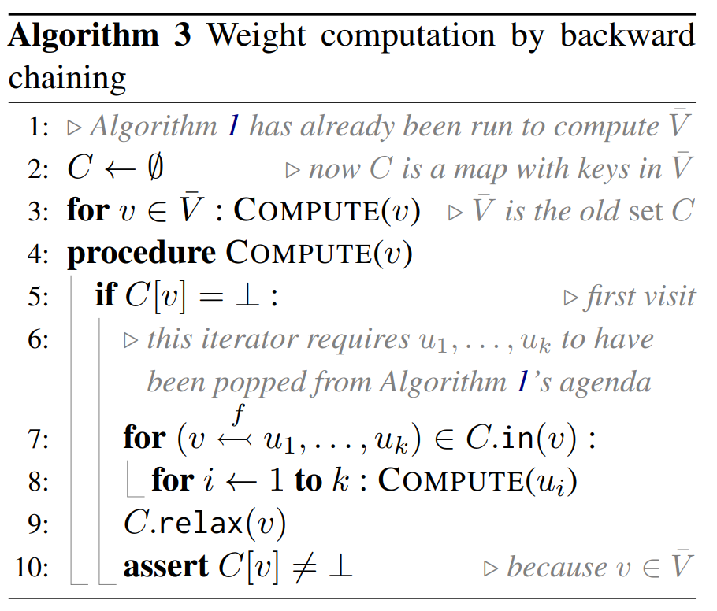
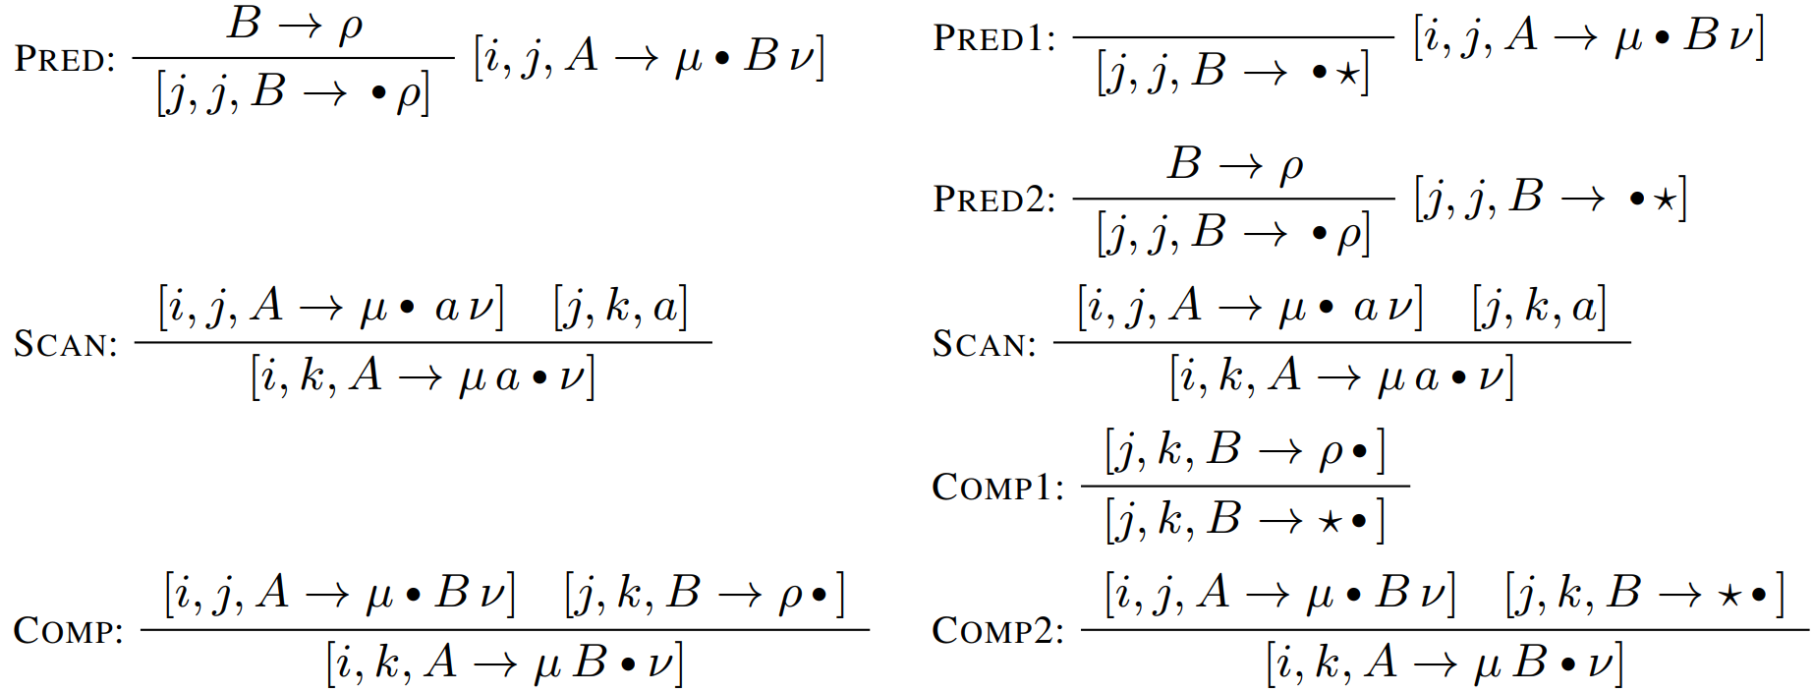
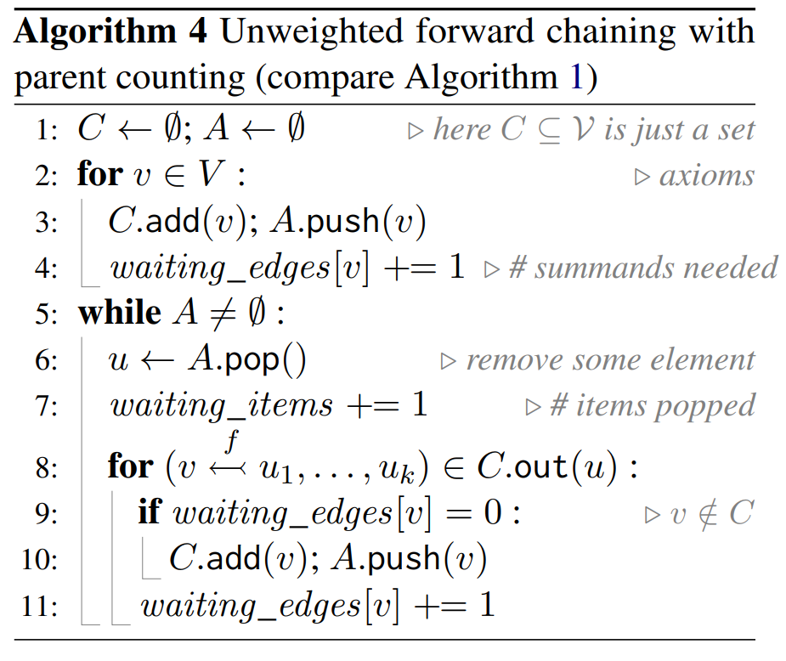
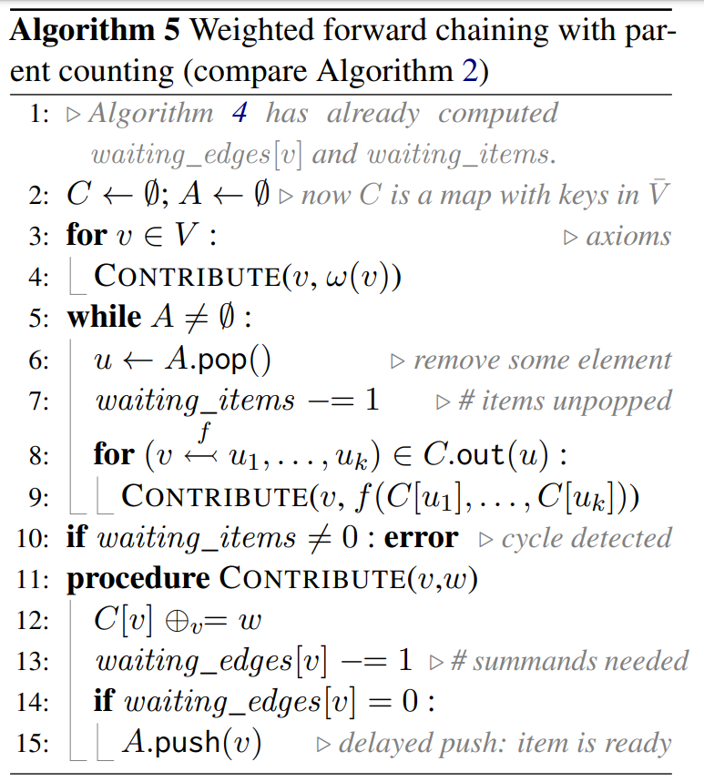
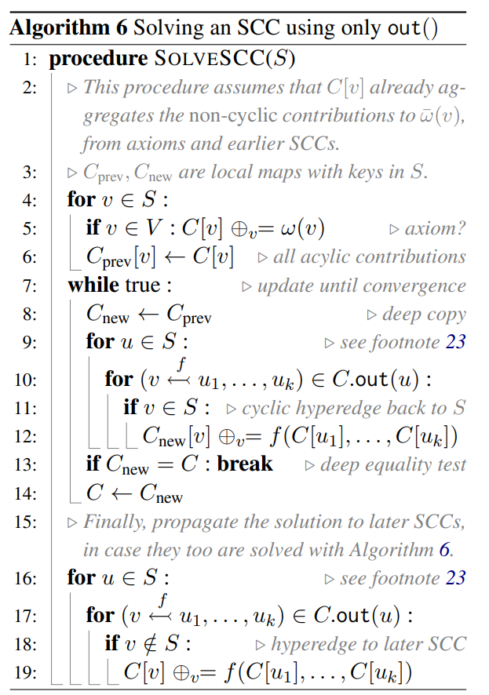
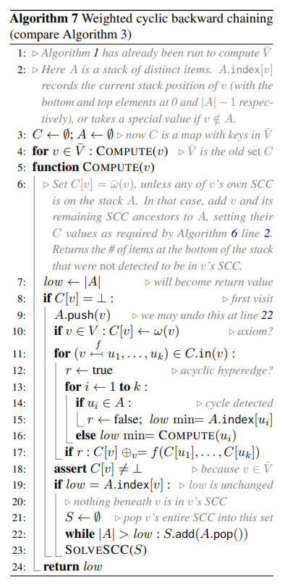
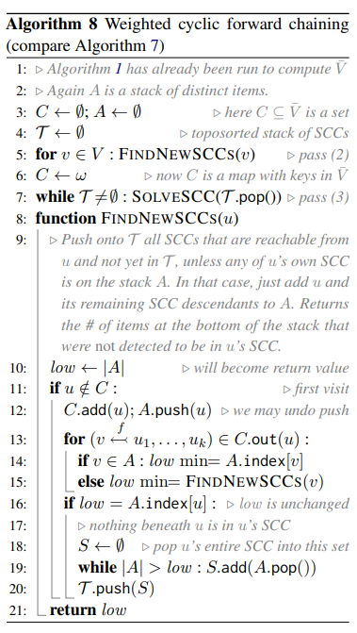
Time-and-Space-Efficient Weighted Deduction
Jason Eisner, JHU
See algorithm animations and dialogue in the talk video!
Meta-Theorem
How can we prove facts?
Forward chaining, starting at axioms (Alg 1)
Chart C is set of nodes found so far
Reached by following hyperedges that combine other nodes from C
Agenda A is a queue of nodes in C that still have unfollowed out-hyperedges
At each step, pop a node from A, combine with previously popped nodes (they are in C)
Add any resulting new nodes to C and A
Space $O\left(\left|V\right|\right)$
Time: $O(|V|+|E|)$
(assuming fast iterators and small weights)
Linear, hooray!
$V$ = vertices found
$E$ = hyperedges found
Example: Parsing
Opedal et al. (ACL 2023)
Regular Earley’s
$$O(n^{3}|𝒢||ℛ|)$$
Fast Earley’s
$$O(n^{3}|𝒢|)$$
How about weights?
C now maps each node v that has been found to its weight so far (the pooled value of its in-hyperedges found so far)
This pooled value at v is updated …
Each time a new in-hyperedge to v is found
But also, each time an existing hyperedge changes its value because its input weights have been updated!
We hope this never happens, as it increases our runtime to process the same node multiple times
If the hypergraph is acyclic, we can prevent it by popping nodes from A in topologically sorted order. (But how do we do that???)
Wait to propagate until value has converged (received all inputs)
1
1 6
1 6 10
But faster for some grammars and sentences, thanks to sparsity.
Not obvious how to extend this to probabilistic or weighted parsing,
achieving same runtime and space bounds for all classes of inputs.
Parsing as deduction
Multiple low-space forward passes
Deduce facts about which constituents exist (nodes)
Parse forest is really a proof forest
4
4 6
4 6 10
2
Unweighted forward chaining followed by weighted forward chaining
First pass discovers graph, finding all nodes
For space efficiency, don’t store the hyperedges, but each node does store its count of in-hyperedges (Alg 4)
Second pass decrements this counter as it finds the same hyperedges again (Alg 5)
Node is pushed onto the agenda only when its counter reaches 0 (weight converged)
Kahn 1962 but on an unmaterialized graph
Unweighted forward chaining followed by toposorted SCC decomposition
Needed for cyclic case
First pass as above (without the counting)
On second pass, use Tarjan’s (1972) algorithm to enumerate all SCCs in (reverse) topologically sorted order (Alg 8)
Derive each SCC only from SCCs that have already converged (Alg 6)
2
2 4
2 4
1
2
2
1 2
1
1 2
serve
red
onion
sauce
over
pasta
with
capers
1
1
1
1
1
1
1
Axioms are facts about input words and grammar rules
1
1
1
1
1
1
1
1
What’s a deduction system?
serve
red
onion
sauce
over
pasta
with
capers
Set of rules that deduce new facts from old
They’re translated into iterators that can give any node’s in-hyperedges and out-hyperedges
Rules are usually written in a pattern-matching language like Datalog or Dyna
repropagation!
How about weights?
rederivation
Turn the proof forest into a computation graph!
Each hyperedge is labeled with a function that will be applied to the hyperedge’s inputs
Each node’s weight pools the function values from all its in-hyperedges, using that node’s aggregation operator, such as + or min (must be associative & commutative)
Useful weight types
Embeddings
Counts
Probabilities
Beliefs
Entropies
Derivations
Translations
…
serve
red
onion
sauce
over
pasta
with
capers
Toposorting nodes only works on an acyclic graph …
Tarjan (1972) is like backward chaining (Alg 3) but discovers cycles. It returns SCCs in toposorted order (Alg 7).
To avoid expensive in-hyperedges, we can run it on reversed graph (same SCCs).
Can still be done in $O(|V|)$space.
9
Ideas that don’t quite work
7
Hopeful forward chaining (Alg 2)
No guarantee of topological order
So may throw an exception
Prioritized forward chaining (Goodman 1999)
Not generic – must devise a topologically sorting priority function for each deduction system
Bucket priority queue: visits every priority level, may do unnecessary work and break runtime
Heap priority queue: visits only occupied levels, but log-factor overhead, which breaks runtime
Dynamic programming tabulation
Visits underived nodes, which breaks runtime
Unweighted forward chaining followed by weighted backward chaining (Algs 1+3)
Goodman 1999
But backward pass must find in-edges
Store them on forward pass (more space)
Or recompute them (breaks runtime in pathological cases where in-edges are harder to compute than out-edges)
8
6
5
4
1
3
2
CKY parsing written with Dyna rules
Key references
Unweighted deduction
Prolog (Colmerauer & Roussel 1972), Datalog (Ceri et al. 1990)
Parsing as Deduction (Pereira & Warren 1983; Sikkel 1993; Shieber, Schabes, & Pereira 1995)
Transformations of deduction systems (e.g., Beeri & Ramakrishnan 1991)
Static analysis of deduction systems (McAllester, 2002; Vieira et al. 2021, 2022)
Weighted deduction
Min-weighted deduction (Nederhof 2003)
Probability-weighted deduction (Sato 1995)
Semiring-weighted deduction (Goodman 1999; Eisner et al. 2005)
Generalized weighted deduction (Filardo & Eisner 2011)
Transformations of deduction systems (Eisner & Blatz 2007)
Graph algorithms
Topological sorting (Kahn 1962)
Discovery & toposorting of strongly connected components (Tarjan 1972)
Solving strongly connected components (e.g., Lehmann 1977)
Applications (see Eisner & Filardo, 2011)
CKY tabulation can’t get $O(n)$ for easy cases since it always visits ${O(n}^{2})$ nodes
Nearly all algorithms in formal language theory (parsing, automata, grammar transforms, weighted edit distance, …)
Systematic search (backtracking with constraint propagation and branch & bound)
Neural networks (rules specify architecture)
Iterative methods (loopy belief propagation)
Reinforcement learning (MDP)
…
serve
red
onion
sauce
over
pasta
with
capers

