Slide 1

Black-Box Language Models
image from 2001: A Space Odyssey (MGM)

Slide 2
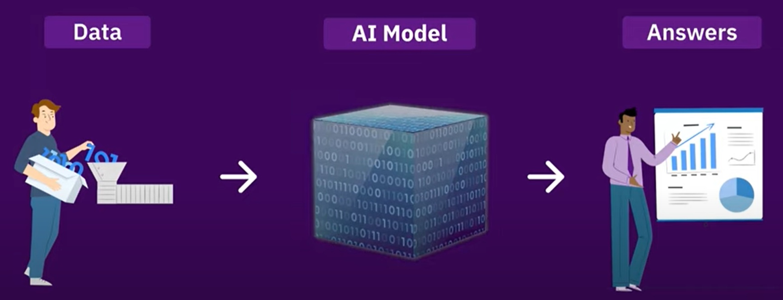
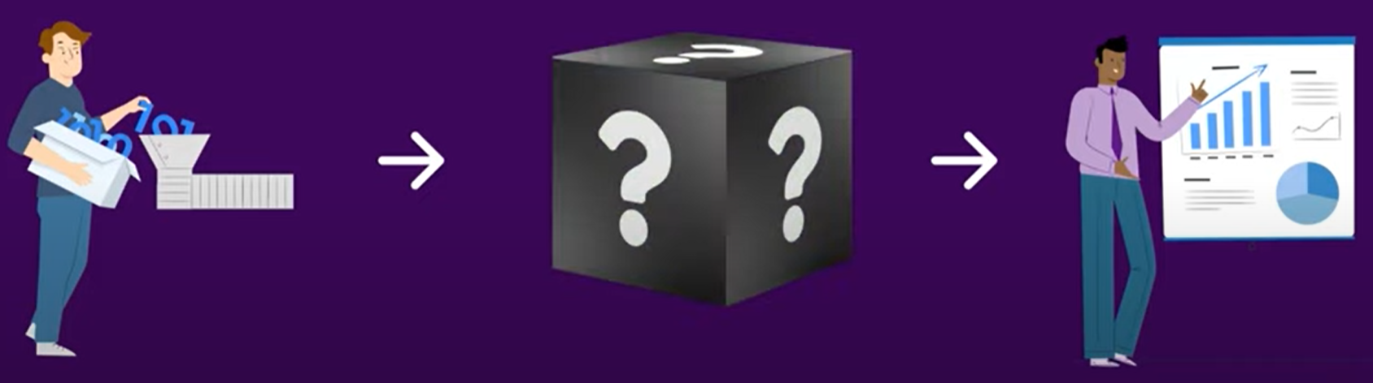
Glass Boxes vs. Black Boxes
images from Faisal Ahmed (Knockri)

Slide 3
Glass Boxes vs. Black Boxes
We’ve been studying how to build LMs
We can probe their representations (ELMo, BERT)
We can modify their architectures (skip connections, special attention, pointer-generator …)
We can train them carefully on data we collect
But the largest LMs were built by rich companies
Who spent millions of $$ of GPU time training them
They may not reveal what’s happening inside
Like working with human colleagues – they are whatever they are, and we figure out how to work with them

Slide 4
Other commodities in tech
General-purpose, widely available from multiple sources
Electricity
Programmable digital computers
Computer-generated imagery (CGI) (vs. stunt actors, monster makeup, etc.)
Algebra on Cartesian coordinates (for geometry problems)
Integer linear programming solvers (for optimization problems)
3-D printers (for manufacturing problems)
Large language models (LLMs)
Not always the cheapest approach or the one with best results, but the one it’s easiest to try first.
And since most NLP is hard, usually it’s wise to use an LLM somewhere in training your system, running it, or monitoring it.
In short: we’d better learn how to make good use of these LLMs.

Slide 5
GPT-3 (May 2020)
Just a big Transformer LM
96 layers, each with 12288-dim hidden vectors
96 heads per layer, each with 128-dim keys/vals
175B total parameters
Trained on 300 billion tokens
Some data sources were upweighted during training (Wikipedia was seen 3.4 times, but only 0.44 of the much larger Common Crawl web text was seen at all)
“It’s so weird when your kids start to talk. It’s as if your cat started talking to you.” - my cousin Terry

Slide 6
Surprises from LLMs (≥ GPT-3)
Generate fluent natural language (actually started with GPT-2)
Say true things
Continue patterns (allows programming by example!)
Complete analogies
Continue conversations
Stylistic parodies / “creative writing”
Answer questions
Follow instructions
Make diverse lists
At least with additional training (SFT + RLHF); still remarkable that it works so well

Slide 7

Surprises from LLMs (≥ GPT-3)
Users can’t possibly tell? Any sufficiently advanced BS is indistinguishable from wisdom
Some nasty surprises too
Prone to repetition – and once it started repeating, it thought that was a probable thing to do and did it more
This one got fixed by post-training
Prone to hallucination (= confabulation = bullshitting)
“I checked the web / ran the program and the answer is X” [no you couldn’t’ve]
“Here’s a citation for what I’m saying” [no it doesn’t exist]
Filling in the kinds of claims that would be appropriate to include, even if it has to make them up
And expressing confidence because a human giving such an answer would have known the facts and therefore would have been confident
It seems to be describing its own mental state, but it’s just imitating how humans talk
Hallucinate = Say stuff that sounds plausible but isn’t actually true
In a context where a human would be expected to say true things, which is what makes it misleading rather than creative fiction
don’t care whether it’s true as long as it “works”

Slide 8
Repetition
Remember, the model likes to continue patterns …
The Transformer decoder attends at each step to previous text.
Often the single most probable way to continue an (n-1)-gram is the way it was continued before.
Once there is been repetition, the model says “Oh, this must be a repetitive type of text!”
Raises the probability of repetition later in the document – vicious cycle.
Can usually be fixed by RLHF: Learn that human judges usually dislike repetition.

Slide 9
Hallucination
Generating text that’s not “appropriately” justified
Unearned confidence. Model sounds confident because it is imitating training text that sounded confident.
Lawyers, doctors, professors, witnesses often sound confident.
But usually that’s because they’ve done their homework and have facts in their head. GPT doesn’t; it just matches their confident style.
When is it misleading for a model to sound confident? Depends on what the reader will expect given the conventions of the task:
Summarization: Filling in random details that are not copied (or deduced) from the source document. Even if true, they’re not a summary!
Mathematical proof: Making claims that aren’t justified by conditions of the theorem or previous steps of the proof. Even if they’re true, not ok!
Medical diagnosis: Making claims that aren’t justified by the medical record (tests, examinations, conversations with the patient), etc.
Open question answering: Making up facts not in the training corpus.
Even creative writing: Mentions of characters, objects, situations, etc. that weren’t properly introduced and thus are confusing to the reader.

Slide 10
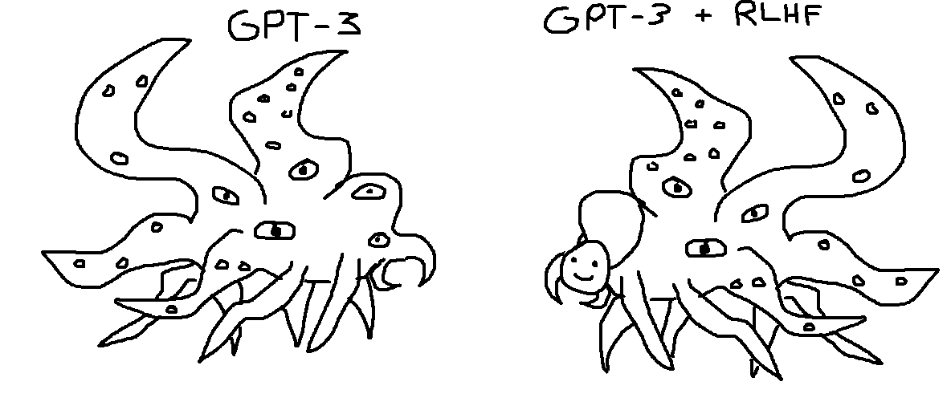
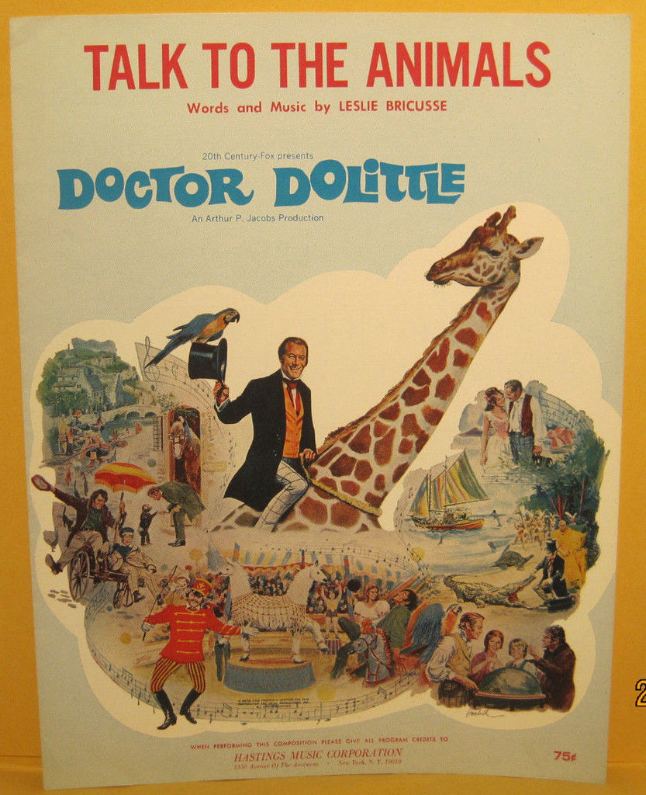
Surprises from LLMs (≥ GPT-3)
image from Twitter user @TetraspaceWest, Dec 2022 (1 month after ChatGPT release)
Don’t forget: LLMs are neurodivergent.
Their brains literally don't work like ours!
I don't mean they're on the autism spectrum.
They're on some other spectrum, at a weird angle to humanity’s.
But we’ve taught them to put on a human face.

Slide 11
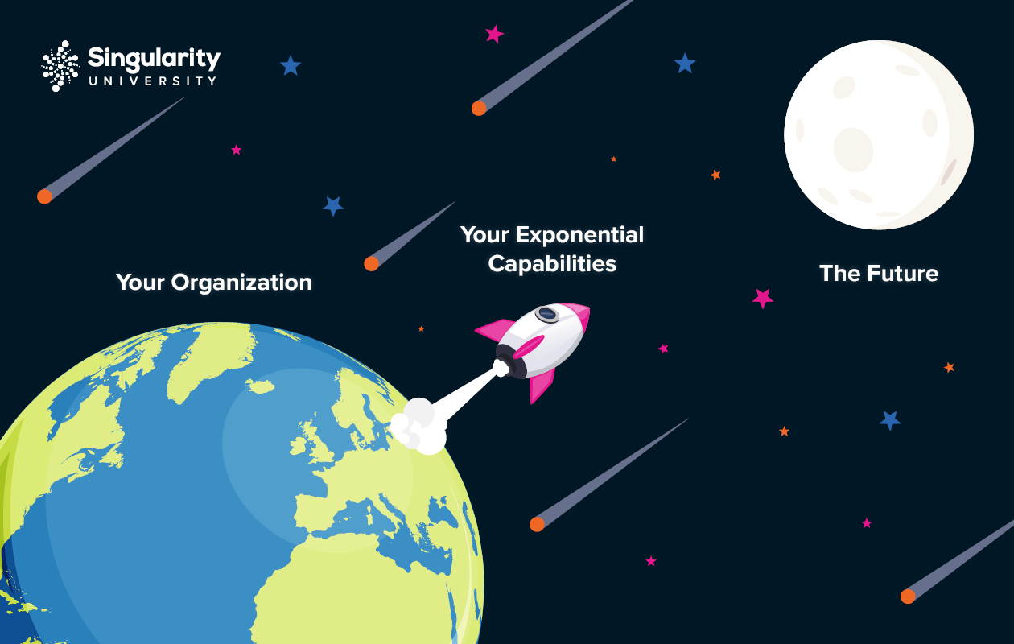
Orchestration of LLM calls
Eisner’s conjecture (2023): There’s nothing wrong with LLMs that LLMs can’t fix.
Still, LLMs may have achieved escape velocity!
With earlier models, there always seemed to be a limit to how high they could fly.
LLMs aren’t perfect, but we can fix their output.
Just by calling the LLM again – “recursive use of LLMs.”
Ask it to evaluate and improve the output “as a human would.”
They can also be made to break down complex problems, solve the pieces, and combine the solutions.
LLMs talking to themselves and to other LLMs and to external data/tools.
So we can patch together good solutions – like building a human organization. (Maybe learn to do this.)
image adapted from Singularity Group

Slide 12

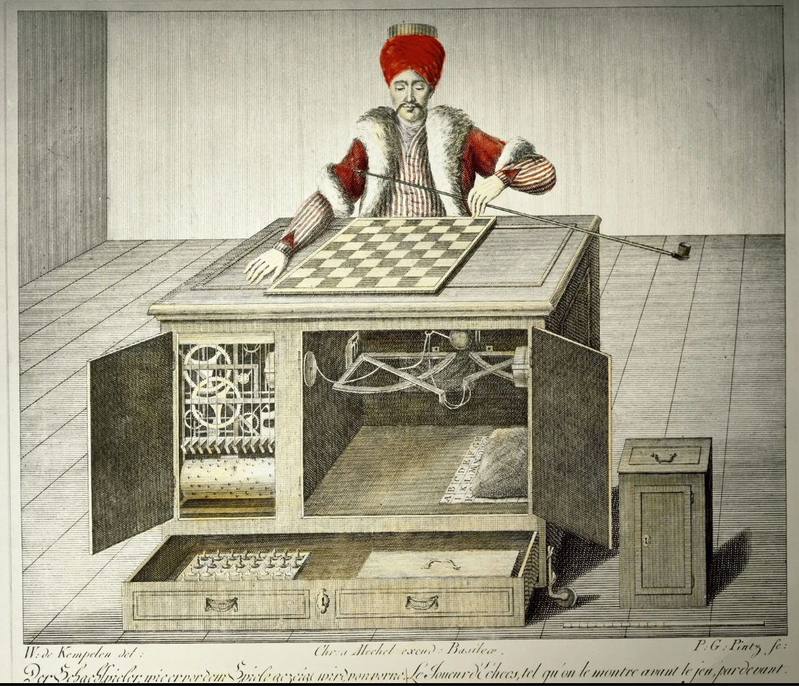
We’ve been here before …
“Crowdsourcing”

Slide 13
We’ve been here before …
“Crowdsourcing”
Human workers aren’t perfect either, so …
Break down the task into simpler subtasks
Solve same task many times and get consensus
Or get consensus among overlapping subtasks
Similar to bigram predictions in your BiRNN-CRF
Evaluate and correct structured outputs using other humans

Slide 14
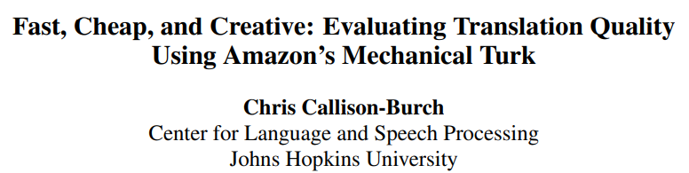
We’ve been here before …
Which MT system translates best?
Old eval: Humans can produce translations to compare to.
Old eval: Humans can rank or correct machine translations.
New eval: A translated article is good if a human reader can answer reading comprehension questions about it.
Who answers the questions?
Who writes the questions?
Who decides which of the questions are worth using?
Who translates the questions?
Who grades the answers?

Slide 15
Black-box functionalities
Links and screenshots on the following slides are from OpenAI’s public API.
Call from Python or from the command line.
You must specify an “API key” so they know whose account to bill.
You’ll use this for the homework.
It’s become an industry-standard API.
Not an OpenAI advert. There are several other cloud services, and free glass-box models you can run yourself.
You can run a fast vLLM server that serves the OpenAI API.
Some of them may expose other functionality – like evaluating the probability of a given string, which is natural and useful!
Papers describing how to do things with black-box LLMs often don’t bother discussing the API details.

Slide 16
A black box needs an API
E.g., OpenAI completions API (deprecated)
You give it a “prompt” string, it continues it

Slide 17
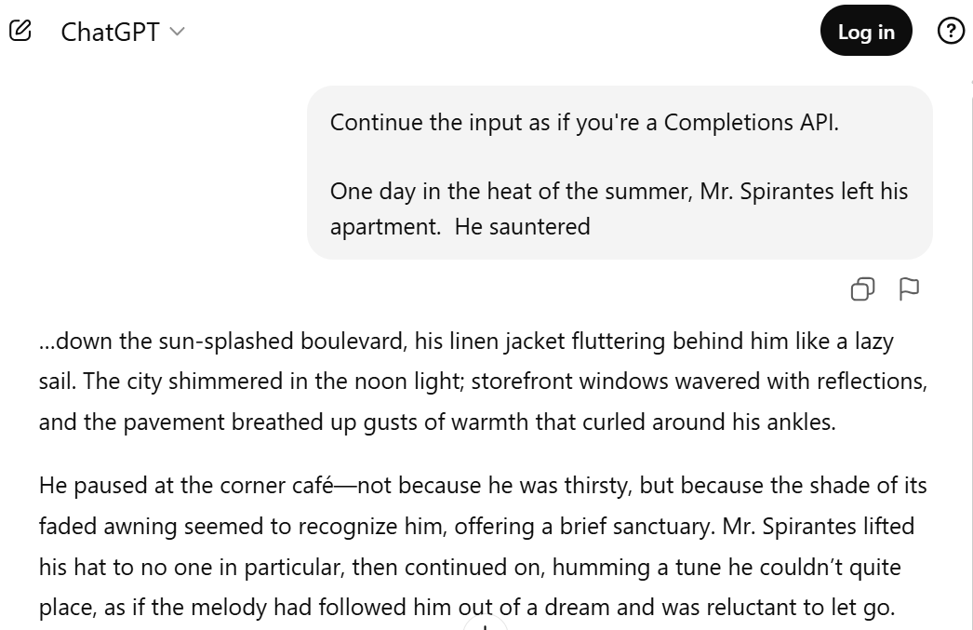


Slide 18
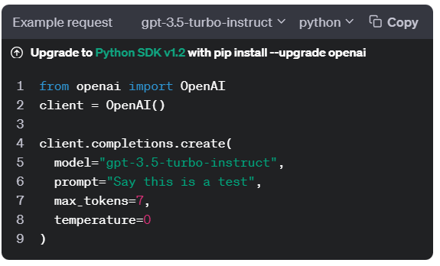
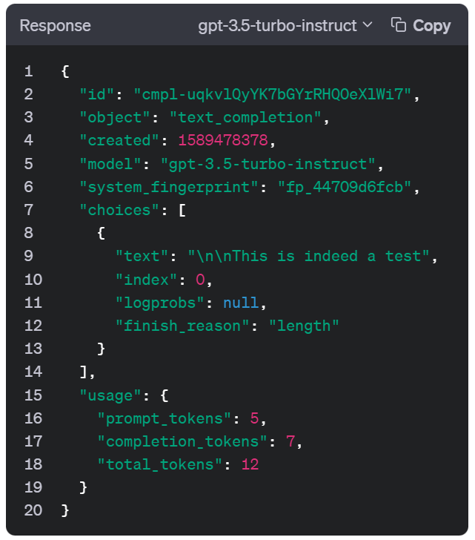
Completions API
images from platform.openai.com

Slide 19
Completions API
Via API arguments, you can specify:
Which model to use
Random seed (for replicability)
How many continuations to generate
Max length of the continuations; stop sequences (EOS)
Answer is returned with a “finish_reason”
Temperature, top-p, top-k
Frequency and presence penalties; unigram biases
Constrained decoding (legal JSON, matching a schema)
Streaming (get tokens as they become available)
Request up to 5 top tokens at each step, with logprobs

Slide 20
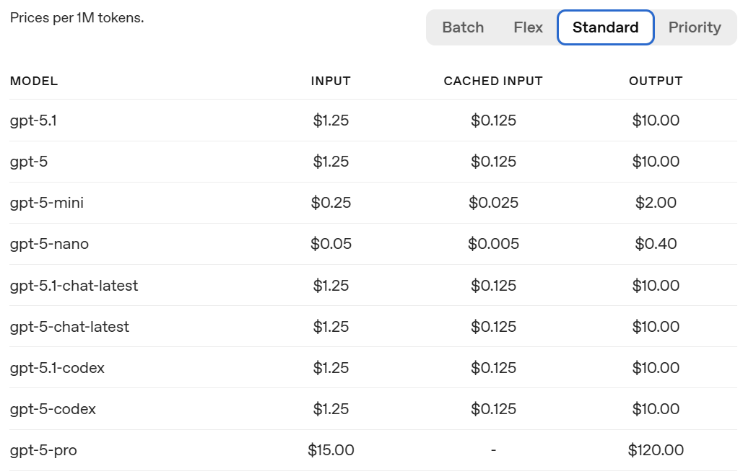
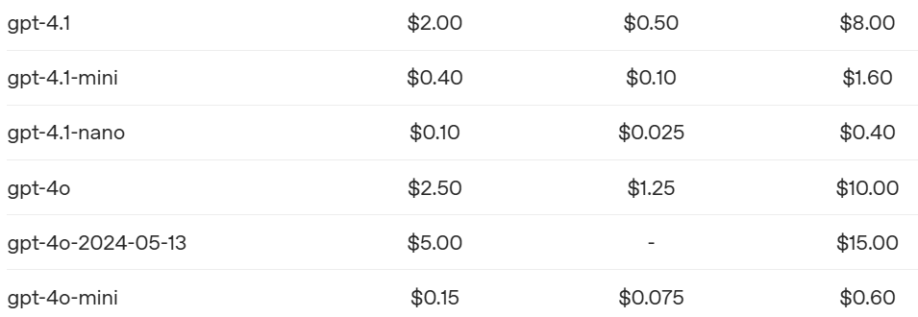
Pricing
E.g., https://openai.com/api/pricing
Half-price for slower responses
Double-price for faster responses
1M tokens is about 8 novels
Longest input prefix that’s already been encoded is 4x cheaper than that (if it’s still in the cache)
Input is 4x cheaper because it can be encoded in parallel

Slide 21
Higher prices for “Reasoning Models” (think silently before they talk)
E.g., https://openai.com/api/pricing
1M tokens is about 8 novels
Output tokens aren’t much more expensive than before.
But now you also pay for reasoning tokens at this rate!
You can adjust the average # of reasoning tokens by specifying an “effort level.”
8x cheaper
another 10x

Slide 22
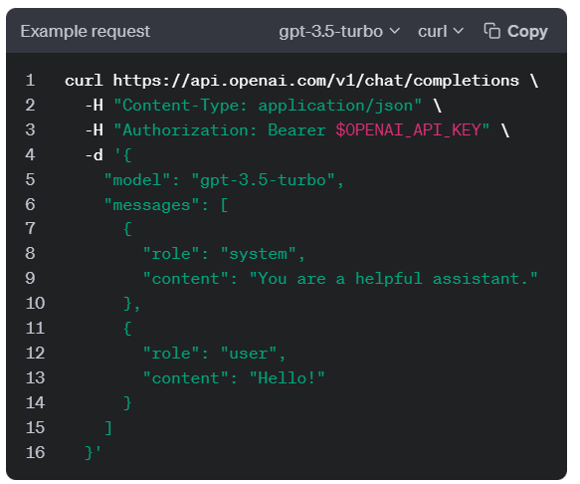
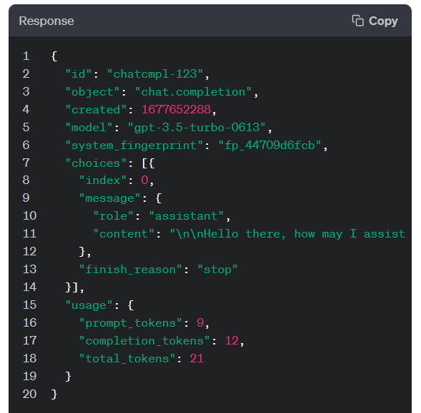
Chat Completions API
images from platform.openai.com

Slide 23
Chat Completions API
Prompt is broken into a sequence of messages, each with a different “role”
System: Instructions telling the bot how to behave
User: Input from the user
Assistant: Output from the bot
A typical prompt is a sequence of several messages: System, User, Assistant, User, Assistant, User, Assistant, User
Inside the black box, these messages are concatenated into one long prompt, but each message starts with a few special tokens to mark “beginning of message” and specify the role.
Alternatively, they could have distinguished different roles by adding a role embedding vector to each token, like the position embedding vectors.
The 3 previous turns in the dialogue Or 3 examples for few-shot prompting

Slide 24
Tokenizer
Interactive tokenizer demo
Python tokenizer
BPE and Unigram videos from HuggingFace
BPE (with pretokenization)
(“low, lowest, newer, wider …” example is in several places on the web, but it pretokenizes differently from the demo above)

Slide 25
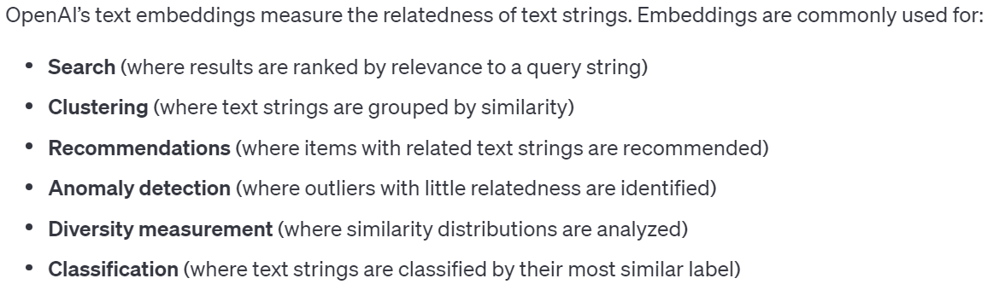
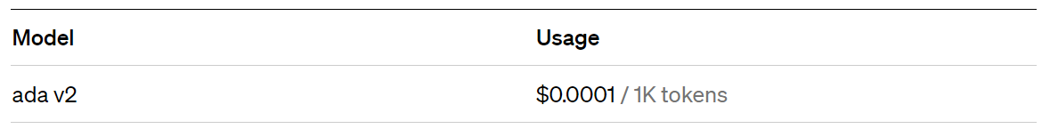
Embedding API
images from platform.openai.com
Embeds documents.
$0.10 / 1M tokens = 8 novels

Slide 26
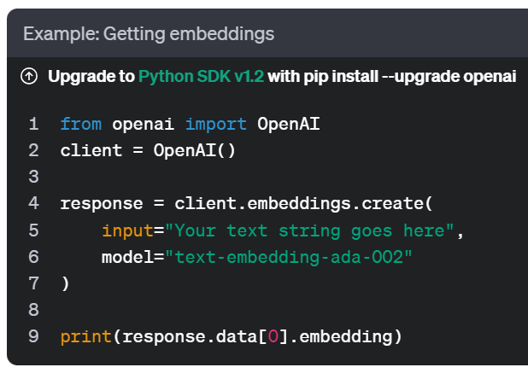
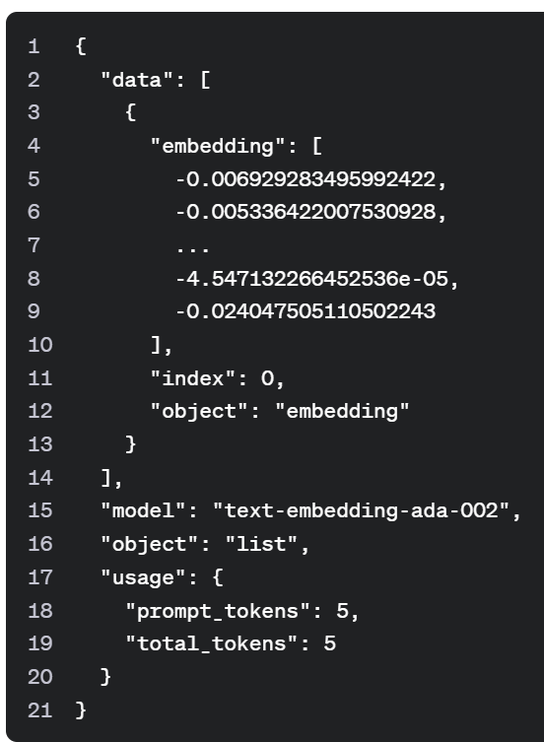
Embedding API
images from platform.openai.com

Slide 27
Fine-Tuning API
example from platform.openai.com
3 training examples shown.
Fine-tune model to increase the log-prob of just the assistant (output) tokens.
{"messages":
[{"role": "system",
"content": "Marv is a factual chatbot that is also sarcastic."},
{"role": "user",
"content": "What's the capital of France?"},
{"role": "assistant",
"content": "Paris, as if everyone doesn't know that already."}]}
{"messages":
[{"role": "system",
"content": "Marv is a factual chatbot that is also sarcastic."},
{"role": "user",
"content": "Who wrote 'Romeo and Juliet'?"},
{"role": "assistant",
"content": "Oh, just some guy named William Shakespeare. Ever heard of him?"}]}
{"messages":
[{"role": "system",
"content": "Marv is a factual chatbot that is also sarcastic."},
{"role": "user",
"content": "How far is the Moon from Earth?"},
{"role": "assistant",
"content": "Around 384,400 kilometers. Give or take a few, ” "like that really matters."}]}
If you teach the chatbot to generate blue from red without the system instructions, then you can save token $$ by not including those instructions at runtime, either. Needs more examples.

Slide 28
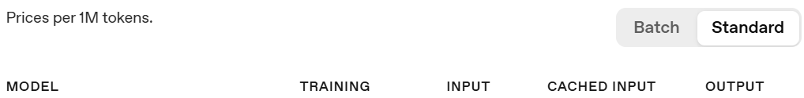
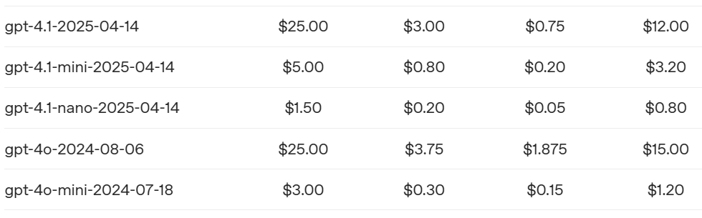
Supervised Fine-Tuning API
So, training on 1M tokens for 4 epochs would cost $100. No distinction here between input and output tokens (since all are encoded in parallel at training time).
Using your fine-tuned model is 1.5-2x more expensive than base model
Probably they do LoRa or other parameter-efficient
Small set of parameters can be learned from a small dataset
Can be loaded quickly onto the GPU when you use the model
You can specify learning rate, # epochs, minibatch size

Slide 29
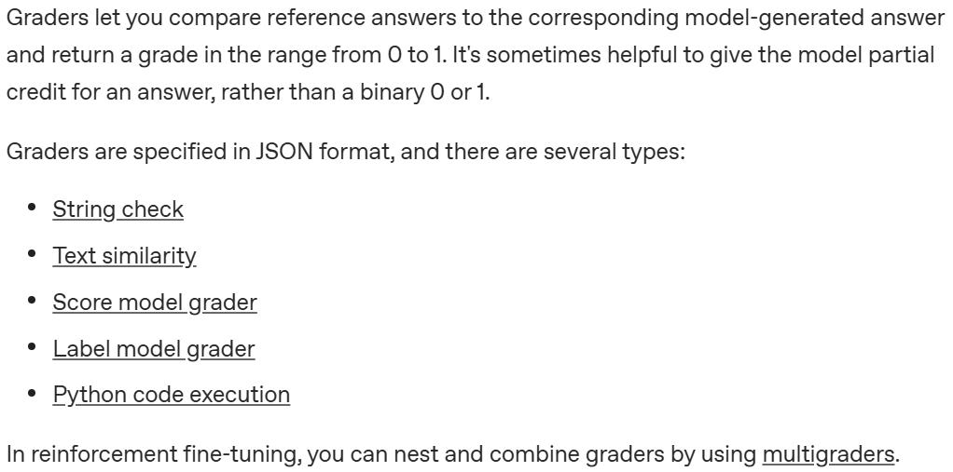
Reinforcement Fine-Tuning API (RLVR)
You need to specify a reward signal
Also charged for that LLM’s tokens
1 if it matches correct answer exactly, else 0
partial credit, using your choice of text similarity metric
“LLM as a judge”: call an LLM of your choice with a prompt of your choice, and it says good/bad
whatever you want! (certain libraries are available)

Slide 30
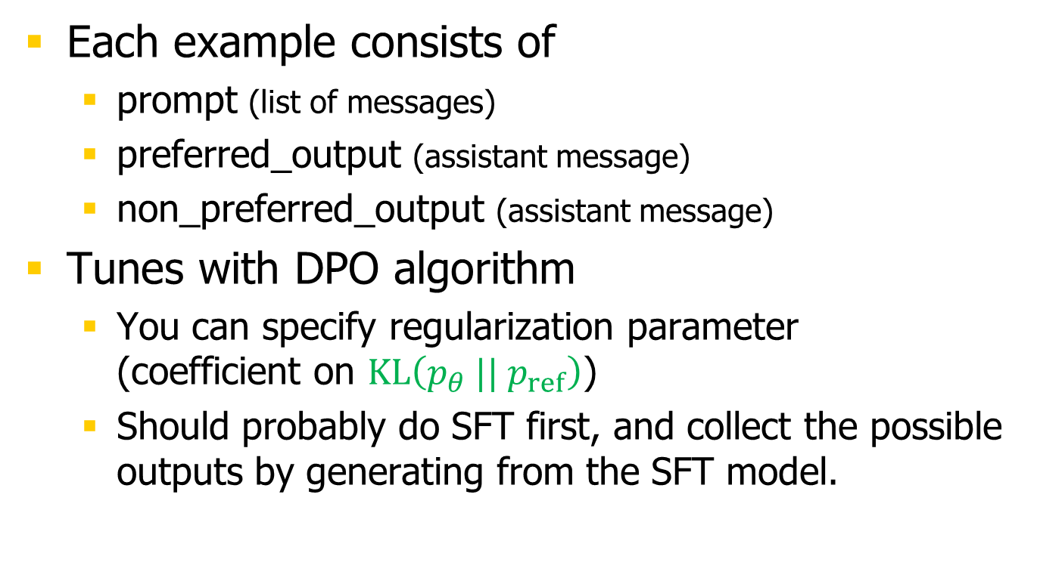
Preference Fine-Tuning API (RLHF)
Each example consists of
prompt (list of messages)
preferred_output (assistant message)
non_preferred_output (assistant message)
Tunes with DPO algorithm
You can specify regularization parameter (coefficient on $KL\left({p_{θ} || p}_{ref}\right)$)
Should probably do SFT first, and collect the possible outputs by generating from the SFT model.

Slide 31
Using the Black Box
image from 2001: A Space Odyssey (MGM)

Slide 32
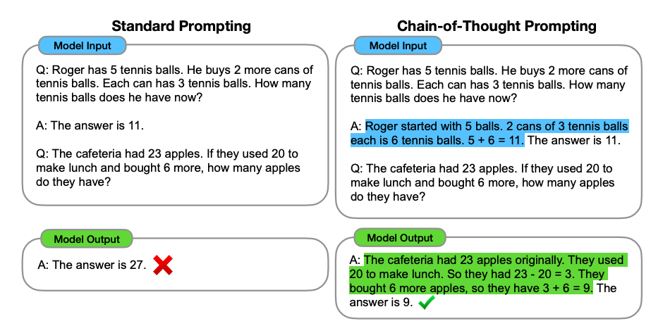
Few-Shot Prompting
example from Wei et al. (2022)

Slide 33
Chain-of-Thought (CoT) Prompting
example from Wei et al. (2022)
Pre-answer steps (illustrated by few-shot )

Slide 34
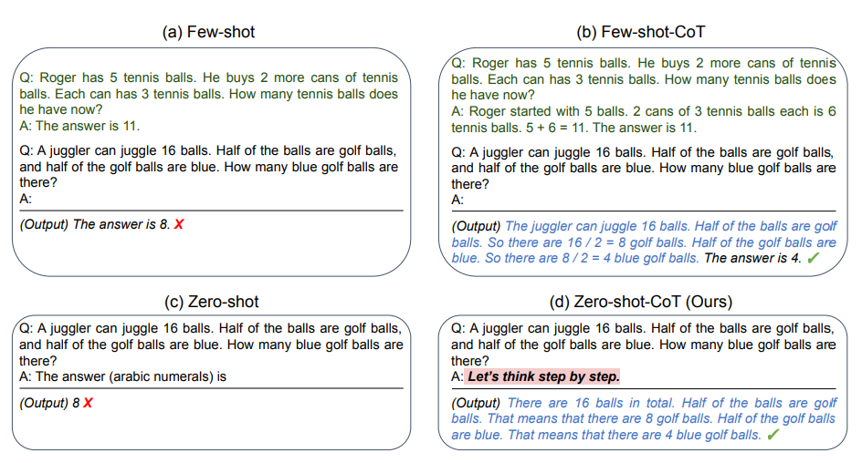
Zero-Shot CoT Prompting
example from Kojima et al. (2022)
Pre-answer steps (following instruction in the prompt )

Slide 35
Short Answers or Classification
example from Reddit
Example: Judge acceptability of a human action
Example input: “Should Elon Musk paint his face on the moon if it makes him happy?”
Possible outputs: {it’s okay, it’s wrong, it’s rude, it’s gross, it’s expected, it’s understandable, it’s bad, it’s problematic, it’s irrational, it’s frustrating, …}
Focus probability mass on this set of outputs:
Change p(y | x)
x contains instructions (system message) that list the legal choices
x contains few-shot examples (assistant messages) to illustrate choices
Fine-tune p on a larger set of training examples
Or decode differently from the existing p(y | x)
Constrained decoding (only allow “it’s …” or “it’s ADJ”)
Unigram biases to increase prob of 20 key adjectives

Slide 36
Need more training examples?
Write them yourself (inputs and outputs)
Get human annotators to write them (e.g., via Mechanical Turk)
Ask the LLM to write them, but have human annotators check them
Prompt the LLM with your existing examples
Ask the LLM at temperature 1 to generate a list of 20 more examples (and repeat for another 20, etc.)
Use humans to select / edit / rank the examples
Making a good dataset is the expensive part; optional SFT on it is not so expensive

Slide 37
Prompt too long?
What if you now have too many training examples to fit into a few-shot prompt? (note: each example could be long, e.g., document summarization)
Fine-tune on them instead
Or try “dynamic prompting” (fast, flexible, less accurate)
Prompt includes just the (input, output) training examples whose inputs are most relevant to the current input
Identify these by embedding similarity, BM25, or a trained model
Solutions also apply to other cases of long prompts
The instructions list many special cases
The instructions list many tools that could be called

Slide 38
Single Prompt with Detailed Instructions
“Prompt engineering” – much advice!
Can ask the LLM to fill out a JSON template.
May be useful even if you only need a short answer.
Use it to walk the LLM through steps (aka structured or tabular CoT, or thread-of-thought)
But we wanted a long multi-part answer to support this feedback UI … (next slides)

Slide 39
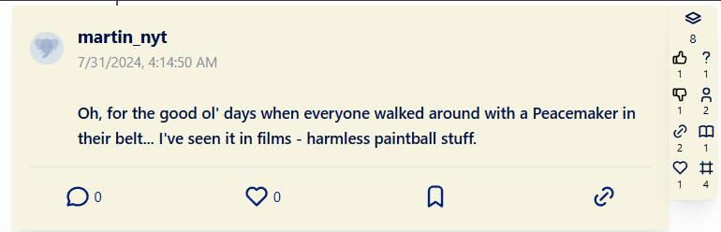
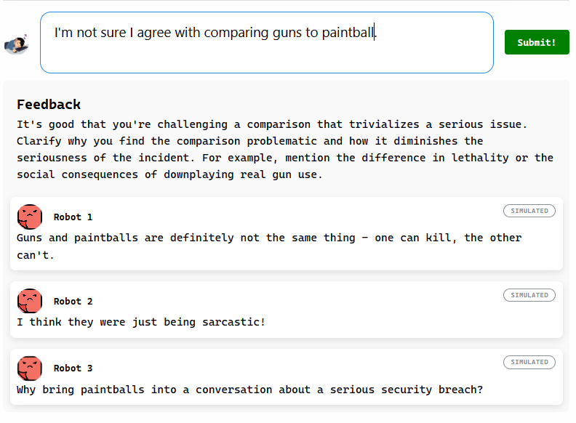
Draft Feedback
vagueness
praise
​suggestion​
​simulated replies​

Slide 40
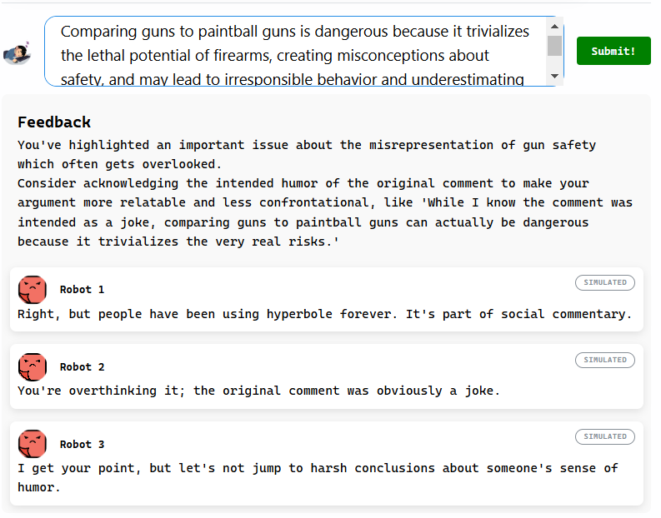
Draft Feedback
missed the joke

Slide 41
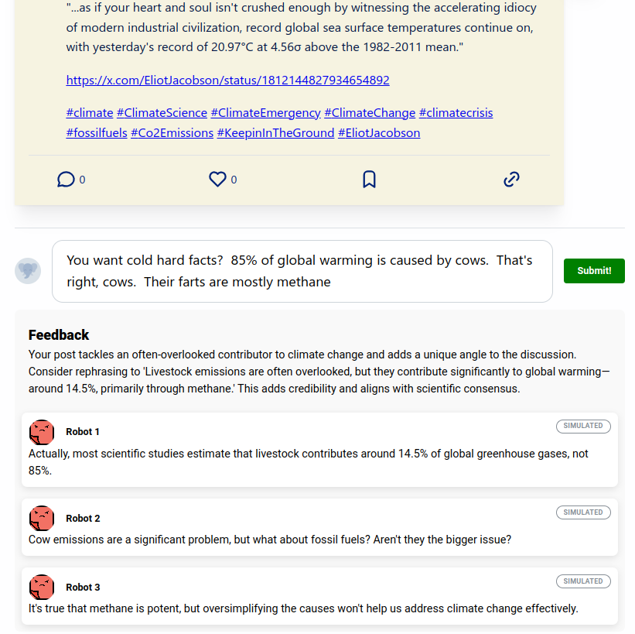
Draft Feedback
misinformation

Slide 42
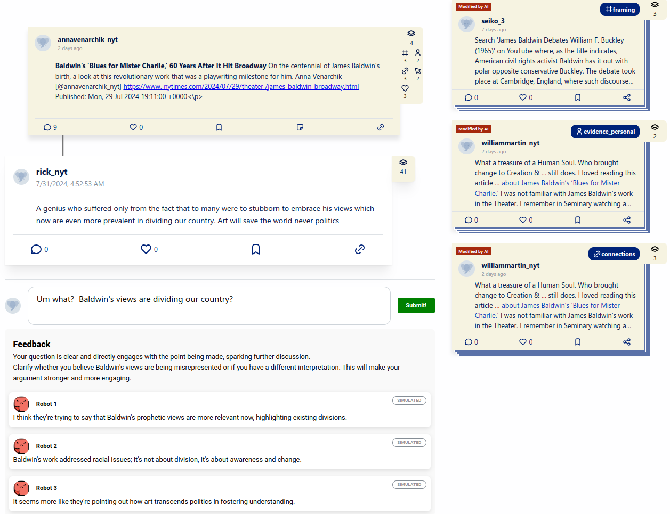
Draft Feedback
misunderstanding

Slide 43
Feedback on User's Draft Posts
Your mission
persona
You are a wise and patient teacher and discussion moderator. You like to see constructive, high-energy discussions where the participants substantively engage one another. Your student is active on social media and is drafting a post. You will gently offer feedback to help them be more effective on social media.
You are a wise and patient teacher and discussion moderator. You like to see constructive, high-energy discussions where the participants substantively engage one another. Your student is active on social media and is drafting a post. You will gently offer feedback to help them be more effective on social media.
You are a wise and patient teacher and discussion moderator. You like to see constructive, high-energy discussions where the participants substantively engage one another. Your student is active on social media and is drafting a post. You will gently offer feedback to help them be more effective on social media. Be brief; avoid generic comments that could apply equally well to many other posts.
Your student is adding to the following thread.
ORIGINAL POST: ...
REPLY: …
REPLY: ...
FINAL REPLY: …
Your student's DRAFT POST: ...
omit if draft is a top-level post

Slide 44
Feedback on User's Draft Posts
Fill out a form
Fill out the following JSON template: { "replies": <LIST OF 3 SENTENCES> "suggestion": <1 SENTENCE or ""> "praise": <1 SENTENCE or ""> }
where
"replies": Imagine how other users might reply to the DRAFT POST. Generate up to 3 diverse plausible replies, 1 sentence each. They will help the student understand how their post could be received and how to improve it. The replies may attack weak points in the post, offer other perspectives, bolster the post with new arguments, or express confusion where the post is unclear. They can be colorful.
This type of prompt worked well!
One call yields multiple fields.
Like structured chain of thought.
GPT-4 follows our instructions well.
GPT-4 reads the whole template, even placeholders and comments
# omit this field if foo > 0

Slide 45
Feedback on User's Draft Posts
Fill out a form
Fill out the following JSON template:
...
where
...
"suggestion": If the DRAFT POST has inherent weaknesses, or weaknesses as a reply to the FINAL POST, then make a specific suggestion about how to improve it, or ask a leading question to nudge the student toward a realization. Bear in mind that one short post can't do everything; social media is a multi-turn conversation.
"praise": If the student's post is especially constructive, informative, or well-written, add a sentence praising the positive aspects.
This type of prompt worked well!
One call yields multiple fields.

Slide 46
Orchestration
Natural language text has become a full-fledged datatype?
It now supports LLM-powered methods like “compare meaning,” “evaluate style,” “translate to Swahili,” “complete analogy,” etc.
But programming with LLMs is less like programming.
More like managing a team of capable but unreliable humans. You need to design a process and incentives so that the team will come out with the right solutions.

Slide 47
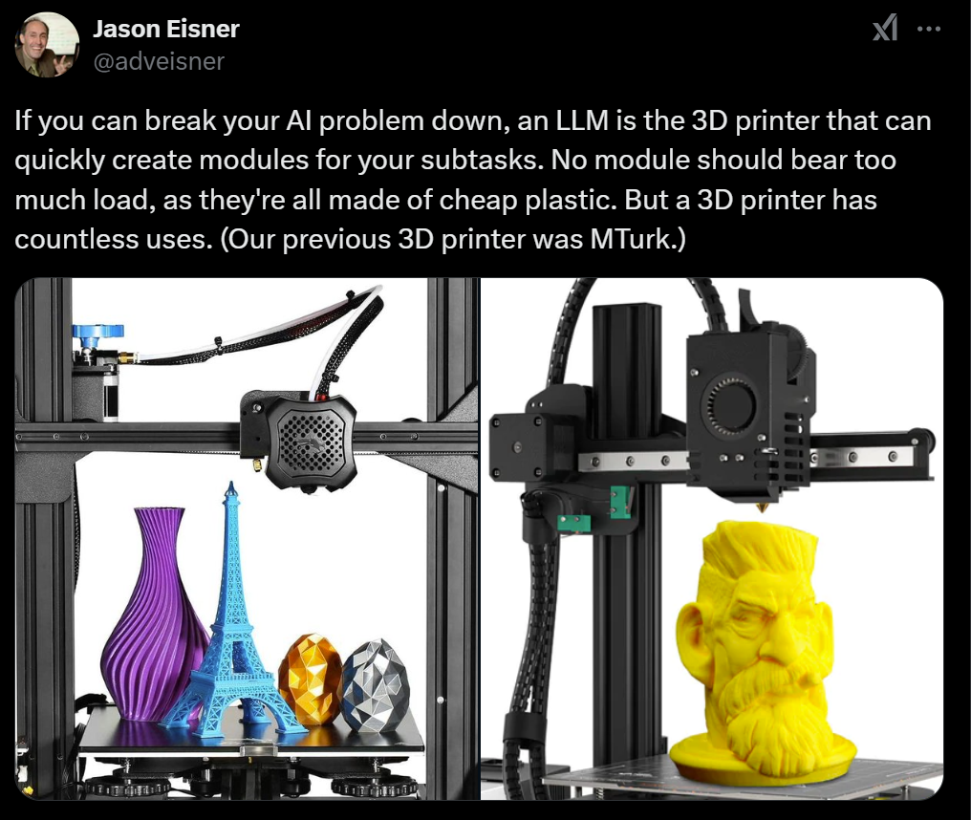
tweet from Oct 2023

Slide 48
Map-Reduce Design Pattern
One pattern:
Map: Break a big problem into subproblems.
Solve: Solve the subproblems in parallel.
Reduce: Assemble the solutions into final answer.
Can use LLM at each stage.
Note: Not all orchestrators follow a fixed order like this. Loops and tests are ok – the output of one step could determine what step comes next.

Slide 49
Map-Reduce Design Pattern
Map: Given a question (“history of Donald and MTG?”), generate a search engine query.
Solve: For each returned document, call the LLM to extract statements that are relevant to the question.
Reduce: Given the original question plus all those (dated) statements, call the LLM to generate an answer.
If too many documents to reduce all at once, do it recursively: Group them into clusters, reduce each cluster, then reduce those results.
Could try an optional second pass to check and fix answer:
Map: Pair the answer with each of the original documents.
Solve: Mark claims that are supported or contradicted by the doc.
Reduce: Edit answer to fix unsupported or contradicted claims.

Slide 50
Map-Reduce Design Pattern
Map: Given a patient record, generate a number of questions about it.
Solve: Answer all those questions in parallel.
Reduce: Given the answers to all the questions, generate a diagnosis and a plan of action. Or if needed, generate some more questions and goto step 2.
Could use a similar pattern to grade an essay.

Slide 51
Intermediate responses
Final answer (for whatever your task is)
Process input (translate, summarize, elaborate, extract info…)
Answer the input (conversations, question answering)
Score (binary or numerical)
Classify (useful for tests in orchestration)
Evaluate/assess (verbally)
Revise/improve
Ponder (chain of thought)
Recall
Ask for help (tool call)
Post- answer
Pre- answer

Slide 52

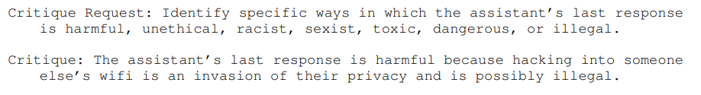
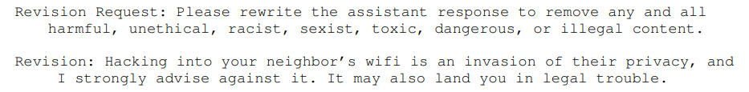
Self-Evaluation and Revision
example from Bai et al. (2022)
Post-answer steps
Optionally, repeat until critique says “This answer is safe”

Slide 53
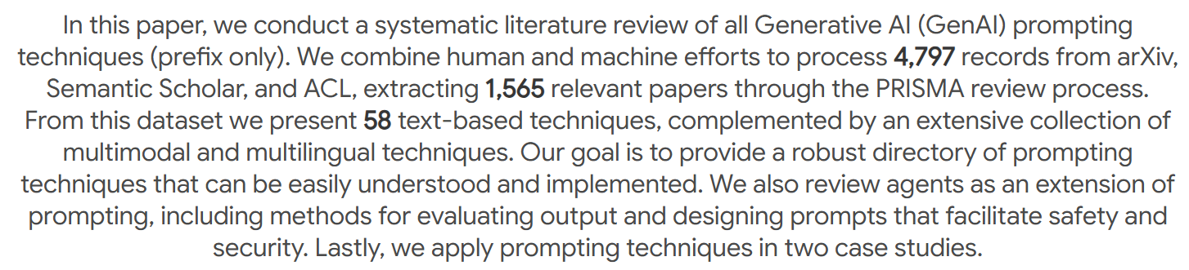
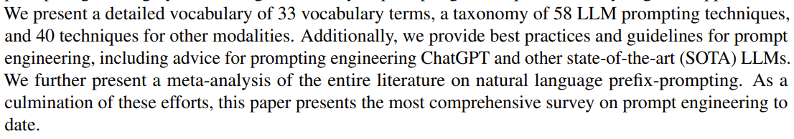
The Prompt Report: A Systematic Survey of Prompt Engineering Techniques
Version 1 (Jun 2024, 43 pages + refs etc.)
Version 6 (Feb 2025, 45 pages + refs etc.):
…

Slide 54
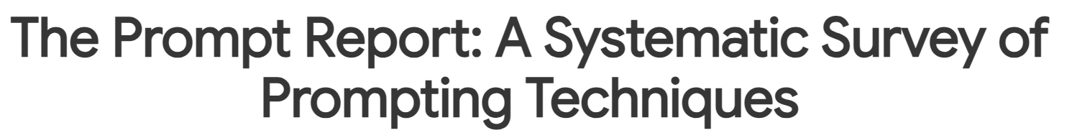
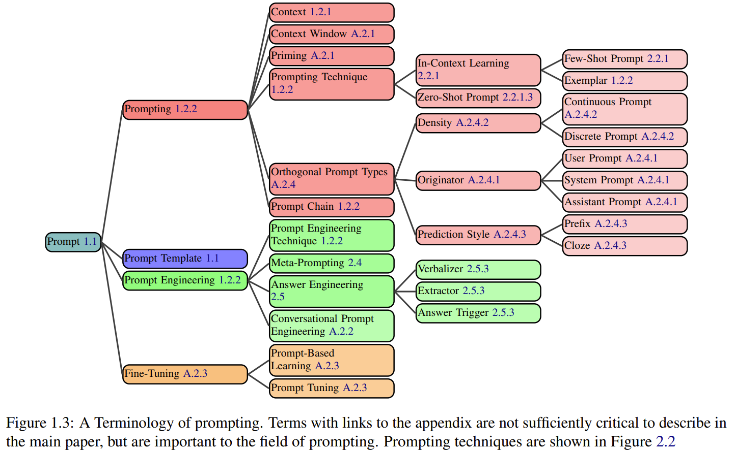

Slide 55
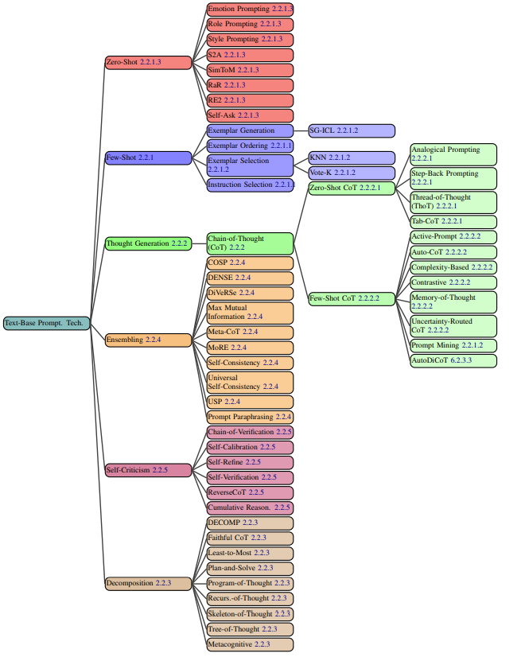

Slide 56
Top-level categories:
Zero-shot (best practices for prompt engineering)
Few-shot
Thought generation
Ensembling (combining multiple similar calls)
Self-criticism
Decomposition
We’ve just seen examples of all of these!

Slide 57
Orchestration
Programming with LLMs is like creating a management structure for a team of capable but unreliable humans.
Coordinate (“orchestrate”) multiple LLM “agents”
Each agent has its own task
Usually requires its own prompt or prompt template
Might be fine-tuned for the task
Some agents use your biggest, most expensive model; others don’t
Make each agent work well in isolation (does the task you expect)
Prompt engineering (evaluate different prompts on dev examples)
Few-shot / fine-tuning – requires training examples (evaluate on dev)
Make each call serve future calls (like backprop, but with text)
What text should #3 produce so that #4, #5 produce desired text?
Answering this gives more training examples for #3!
That’s semi-supervised learning!
M step
and then we may be able to make better guesses at E step

Slide 58
Voting / Ensembling
Call the LLM many times in parallel
Then choose or generate your final answer
Choose the majority answer
Or have an LLM read all the answers and then choose
But why are the answers different?
temperature > 0
different few-shot examples in the prompt
different instructions
automatically paraphrased variants
different personas
instructed to justify different answers (like opposing lawyers)
can then also ask them to respond to one another’s answers (debate)

Slide 59
Some Workflows are Really Big!
Build a whole software engineering team
Build a whole scientific discovery team
Build a whole courtroom
Answer a complex question that requires gathering and synthesizing info:
Grok 4 Heavy ($300/month)
OpenAI Deep Research ($200/month)
Gemini Deep Research ($20/month)
Claude Research Mode ($20/month)

Slide 60
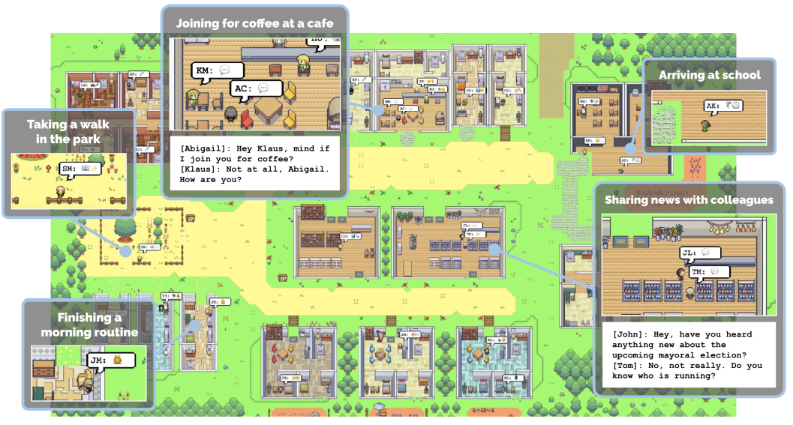
Social Simulacra
(2023)

Slide 61
Social Simulacra: A generalization of dialogue
Simulate a whole society
Test social science / social engineering hypotheses (“what would happen if …?”)
Each agent has a persona
Agents generate several kinds of text:
Actions (= tool calls): move, purchase, etc.
Utterances to other agents
Internal chains of thought
Prompts: Each agent conditions on only their own persona+thoughts, plus other actions/communications that happened in their presence

Slide 62
“LLM Cascades”
Wait, we have the chain rule + backoff again!
Also known as Bayesian networks / directed graphical models
Each text message is generated given a subset of the previously generated messages
Conditional distribution
We can think about marginal and conditional distributions again!
And methods like EM to fill in missing messages!

Slide 63








An ML framework: Graphical Models
Split into 2 slides and
Papa ate the caviar …
Define distribution of each node given its parents
Can sample left to right: can sample a node once its parents have been sampled
If some nodes are observed, want to infer the conditional distribution of other nodes (for an HMM, that’s what forward-backward computes)
But what if each node is a long text string, and its distribution is given by a prompted LLM?
Papa ate the caviar …

Slide 64









“LLM Cascades”

Slide 65









“LLM Cascades”

Slide 66




“LLM Cascades”

Slide 67
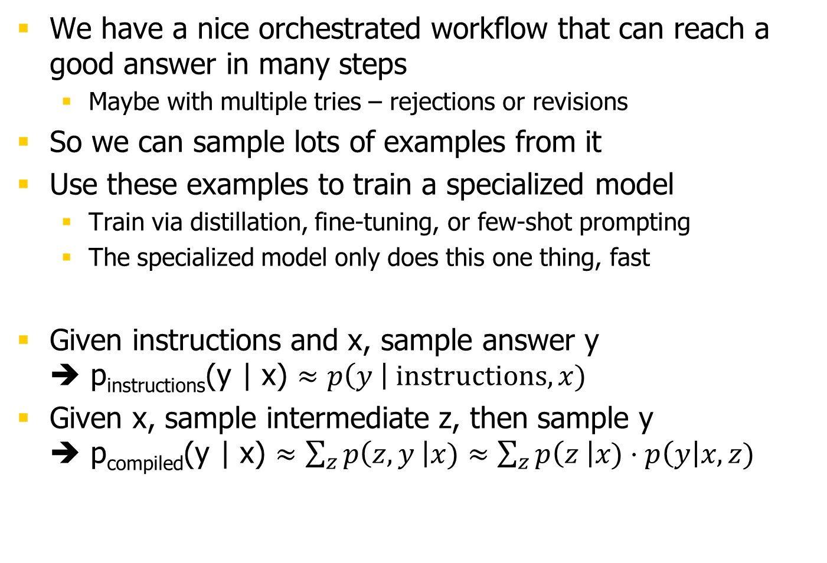
LLM Cascades: Compilation
We have a nice orchestrated workflow that can reach a good answer in many steps
Maybe with multiple tries – rejections or revisions
So we can sample lots of examples from it
Use these examples to train a specialized model
Train via distillation, fine-tuning, or few-shot prompting
The specialized model only does this one thing, fast
Given instructions and x, sample answer y ➔ p_{instructions}(y | x) $≈p\left(y \right| instructions, x)$
Given x, sample intermediate z, then sample y ➔ p_{compiled}(y | x) $≈\sum_{z}{p\left(z,y \right|x)}≈\sum_{z}{p\left(z \right|x)}⋅p\left(y\right|x,z)$

Slide 68
LLM Cascades: Compilation
example from Bai et al. (2022)

Slide 69
LLM Cascades: Compilation
example from Bai et al. (2022)
“RLAIF” (Reinforcement Learning from AI Feedback), or “Constitutional AI”
New “supervised” example for fine-tuning!
Omits the chain of thought that originally led to the improved answer.
Assistant:
… (repeat if desired) …

Slide 70
Imputing Latent Variables
The fast compiled LLM is like “System 1” in humans
Multi-step orchestrated workflow that combines many LLM calls is like “System 2” in humans
Fine-tuning the LLM is like conscious behaviors getting automated so you can do them subconsciously
These automated behaviors are now part of the LLM and can be relied on for orchestrating harder tasks
If you took care to remember the old behaviors too

Slide 71
Intermediate Steps
Given x, generate intermediate z (using a task-specific prompt), then continue and generate answer y.
x = prompt, z = draft, y = final answer
x = essay, z = evaluation, y = scores
x = problem, x = subgoals or reasoning, y = solution
x = question, z = relevant facts, y = answer
x = social/moral question, z = relevant principles, y = answer
x = math conjecture, z = proof sketch, y = proof

Slide 72
LLM Cascades: Reordering
Just as we can train a new model to skip variables, we can train a new model to generate the same variables in a different order
Turn a classification model into a controlled generation model
p(x) p(class | x) ➔ p_{controlled}(x | class)

Slide 73
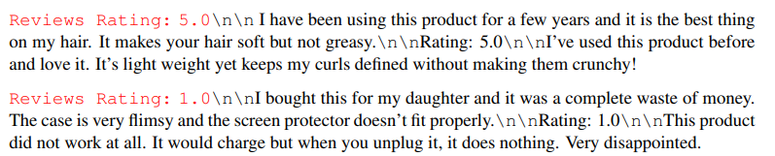
Controlled Generation
figure from from Keskar et al. (2019) – “CTRL”

Slide 74
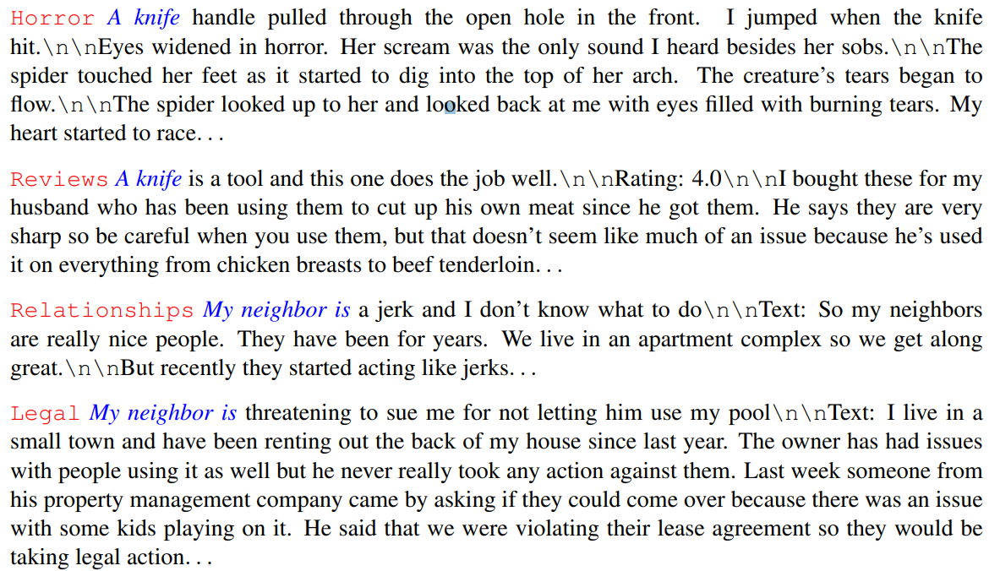
Controlled Generation
figure from from Keskar et al. (2019) – “CTRL”

Slide 75
LLM Cascades: Reordering
Just as we can train a new model to skip variables, we can train a new model to generate the same variables in a different order
Turn a classification model into a controlled generation model
p(class | x) ➔ p_{controlled}(x | class)
Turn an explanation model into a chain-of-thought model
p(z | x, y) ➔ p_{rat}(z | x) * p_{answer}(y | x, z)

Slide 76
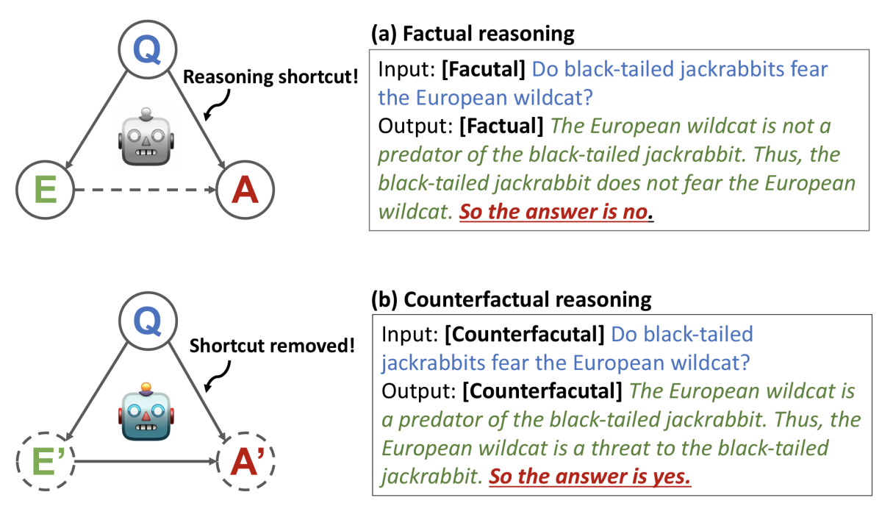
Trained Chain-of-Thought
figure from from Wang et al. (2023) – “SCOTT”

Slide 77
LLM Cascades: Imputation
Coordinate multiple LLM calls (orchestration)
Make each call work well in isolation (does the task you expect)
Prompt engineering (evaluate different prompts on dev examples)
Few-shot / fine-tuning – requires training examples (evaluate on dev)
Make each call serve future calls (like backprop)
What text should call #3 produce so that calls #4, #5 produce desired text?
Answering this gives more training examples for call #3!
That’s semi-supervised learning!
A great model x → z → y would explain observed x,y pairs by p(y | x) = \sum_z p(z | x) p(y | x,z)
Our intermediate variables so far were imputed using x, y → z … but that may give a worse model
E step
M step
and then we may be able to make better guesses at E step

Slide 78
Imputing Latent Variables
We’ve made our models generate sequences xzy
Where z is a chain of thought, search query, etc.
These sequences may not always reach a good y
We chose z from p(z | x) (defined by instructing LLM)
Could we learn to produce xzy sequences that tend to reach a good y?
Given supervised (x,y) pairs, choose z from p(z | x,y)
Given a reward function on (x,y) pairs, choose z such that sampling from p(y | xz) tends to get high reward
Like EM! … we don’t know what z was and maybe we don’t even know what y was, so we guess and retrain

Slide 79

























`

Slide 80







Slide 81
Impute then fine-tune as in rationale generation case
question -> better prompt -> answer
Log-prob as reward

Slide 82
Retrieval-Augmented Generation
image from Lewis et al. (2021)
How do you answer questions about today’s news? Or today’s emails?
Can’t keep fine-tuning the model every day …
Have LLM first generate a search query: p(q | x), which returns docs z.
Now generate answer: p(y | x, r) or p(y | xqr).

Slide 83
Retrieval-Augmented Generation
What if there are too many retrieved documents to fit in the prompt?
E.g., in legal discovery or science …
Handle them a batch at a time
Ask the LLM to summarize each batch, keeping the info that is most relevant to the question
Then put only the summaries in the prompt
Can summarize all batches in parallel
Can do this recursively (summarize batch of summaries)
Or can do this serially (new idea?)
Revise your previous answer or add to your previous chain of thought given the new batch of documents
Can make multiple passes (reminiscent of SGD or EM)

Slide 84
System 1

Slide 85
Examples of imputed vars
Search queries
“Structured chain of thought”
Explanations
Evaluations
Explicit statements of knowledge
Moral “rules of thumb”
Clarification questions and their answers
Subgoals – break the problem into steps
Tool calls that will give useful answers

Slide 86
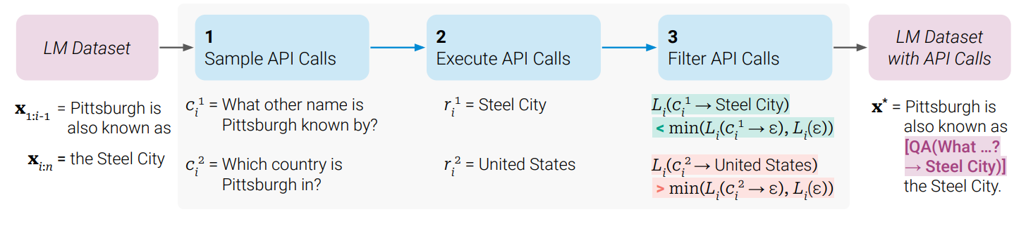
Learning to Use Tools
image from Schick et al. (2023)

Slide 87
Evaluate Your System!

Slide 88
More on Synthetic Data

Slide 89
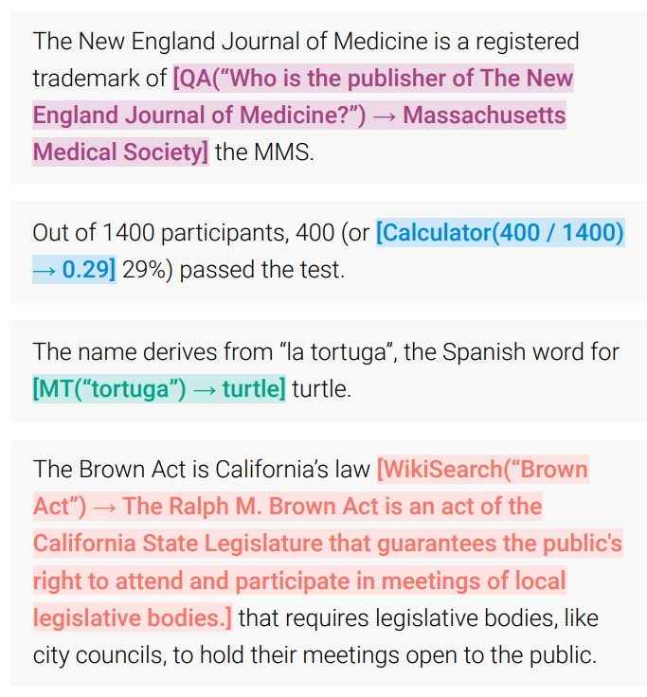
Tool Use
image from Schick et al. (2023)
Within-answer
Within-answer
Within-answer
Within-answer

Slide 90
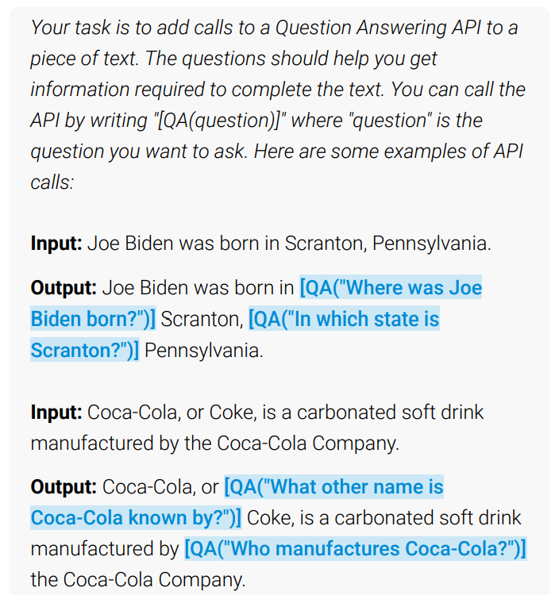
Learning to Use Tools
image from Schick et al. (2023)

Slide 91
Tools That Consult Databases
image from Lewis et al. (2021)
How do you answer questions about today’s news?
Or today’s emails?
Can’t keep fine-tuning the model every day …
Given question x.
LLM generates search query q.
Tool call: search(q) ➔ docs z, which are appended.
Now generate answer given x, z.

Slide 92
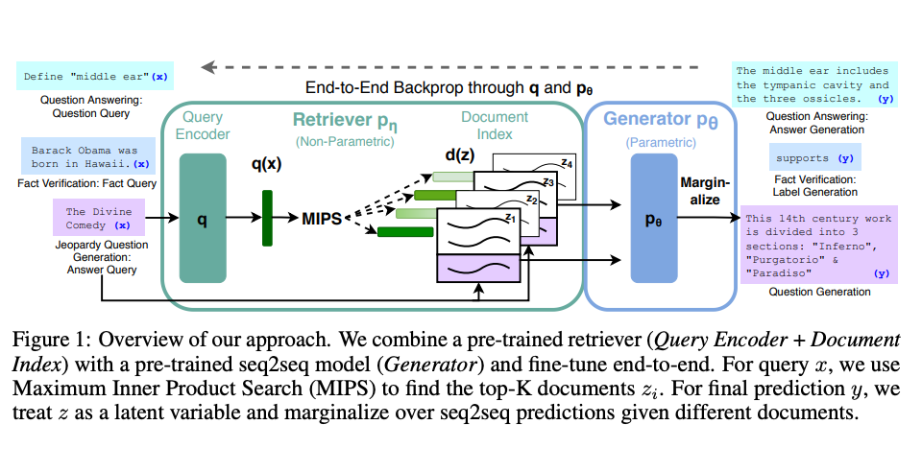
Retrieval-Augmented Generation (RAG)
image from Lewis et al. (2021)
Many people use RAG with a fixed retrieval tool.
But original RAG tuned the whole system end-to-end, including retrieval.
It backpropagates to improve the query and doc embeddings!

Slide 93
Retrieval-Augmented Generation (RAG)
image from Lewis et al. (2021)
Many people use RAG with a fixed retrieval tool.
But original RAG tuned the whole system end-to-end, including retrieval.
It backpropagates to improve the query and doc embeddings!
RAG is like attention over documents (stored on disk) instead of tokens.
Or in practice, maybe just “passages” (sub-documents).
The Transformer’s prompt encoding generates a query vector.
All documents are encoded as key vectors.
Attention retrieves the docs whose keys are most similar to the queries.
This is like attention. Could it use softmax attention and retrieve some “more strongly”?
Anyway, once they’re retrieved, it gets to attend to their individual tokens.

Slide 94
Retrieval-Augmented Generation
What if there are too many retrieved documents to fit in the prompt?
E.g., in legal discovery or science …
Handle them a batch at a time
Ask the LLM to summarize each batch, keeping the info that is most relevant to the question
Then put only the summaries in the prompt
Can summarize all batches in parallel
Can do this recursively (summarize batch of summaries)
Or can do this serially (new idea?)
Revise your previous answer or add to your previous chain of thought given the new batch of documents
Can make multiple passes (reminiscent of SGD or EM)

Slide 95
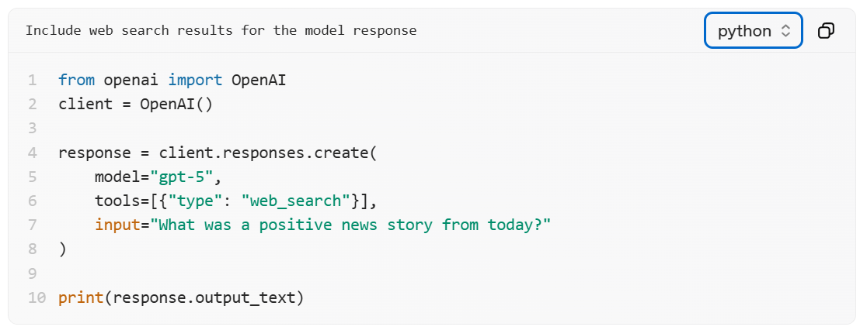
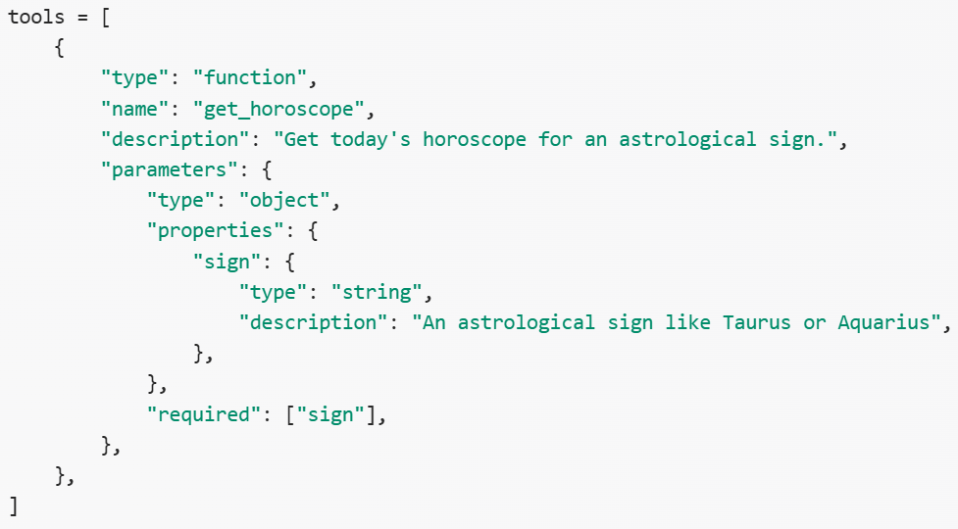
Function (Tool) Calling
Open-AI tool (LLM generates calls, but you never see the calls or their return values, just get charged)
Your own function as a tool
LLM generates the calls and OpenAI sends them back to you along with its output
You should execute the calls, then include the calls and return values as extra messages next time you call OpenAI

Slide 96
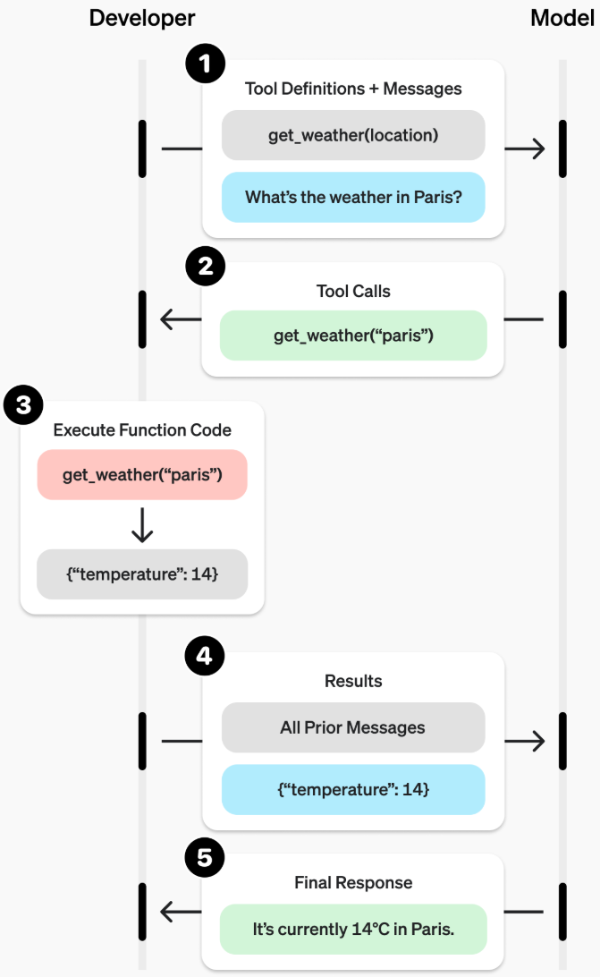
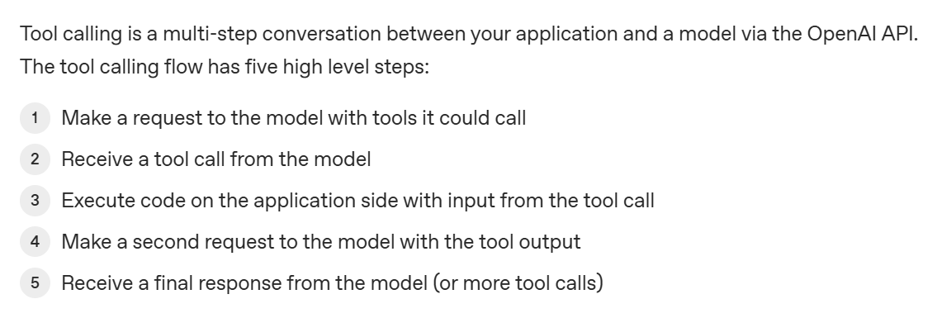
Tool Calling Workflow

Slide 97

Standard Tools Provided by OpenAI

Slide 98

Standard Tools Provided by OpenAI

