Slide 1

Fairness in an Unfair World:
Fair Multiparty Computation from Public Bulletin Boards
Arka Rai Choudhuri - Matthew Green - Abhishek Jain - Gabriel Kaptchuk - Ian Miers
Johns Hopkins University

Slide 2
Multi-Party Computation

Slide 3
Multi-Party Computation

Slide 4

Multi-Party Computation

Slide 5
Multi-Party Computation
Notes:
Malicious Security without abort
Imagine the auction scenario – the is a monetary value to the adversary to aborting early and re-running

Slide 6
Fair Multi-Party Computation

Slide 7
Fair Multi-Party Computation

Slide 8
Attempting to Achieve Fairness
General Fairness is impossible without an honest majority [Cleve 86]
Gradual Release Mechanisms [BeaGol89, BonNao00, GarJak02]
Restricted Class of functions [GHKL08]
Fairness with Penalties [BenKum14, ADMM14]
Δ-T fairness with Trusted Hardware [PST16]
Notes:
Restricted class is the class without XOR

Slide 9
Fairness with penalties
Each player puts money into escrow and forfeits that money when they abort
Uses Blockchains as payment channel
Requires each party to have sufficient liquid capital
Fundamentally isn’t fairness. Adversary can choose to abort after seeing the possible monetary gain associated with rerunning

Slide 10
Public Bulletin Boards

Slide 11
Public Bulletin Boards
Message are permanently available
Messages are visible to all parties
Produces a publicly verifiable proof that the message was posted publicly

Slide 12



Why Bulletin Boards?
Many existing technologies can be used as bulletin boards
Bulletin board implementation doesn’t know that it is being used for fair MPC
Certificate Transparency
Confirmation blocks act as “signature”
Once a transaction is confirmed, it cannot be removed from the state (no double spend)
Certificates presence in the log can be verified by root signature.
Log is append only
Notes:
Add “CT”

Slide 13

x₁
x₂

Slide 14

x₁
x₂

Slide 15
Conditional Release
Witness Encryption
Trusted Hardware

Slide 16


x₁
x₂

Slide 17
(Extractable) Witness Encryption
Notes:
CITATION [BCP14]

Slide 18
(Extractable) Witness Encryption

Slide 19

x₂
x₁
x₃
x₄

Slide 20
Practical Implementation Building Blocks
Bitcoin Network – Distributed ledger using proof of work
Certificate Transparency Log – Merkle tree with signed root containing all certificates issued by participating certificate authorities
SPDZ-2 – A Fast multiparty computation system that leverages homomorphic operations [DPSZ11]
Intel Software Guard Extensions (SGX) – Allows for protected code execution even in the presence of an adversarial operator. Also supports attested communication between enclave instances

Slide 21

Trusted Hardware?!?
But Gabe, if you are using Trusted Hardware, isn’t all of this trivial? Trusted Hardware solves all security problems!

Slide 22
Trusted Hardware?!?
Trusted Hardware alone cannot guarantee fairness [PST17]

Slide 23



Practical Implementation

Slide 24
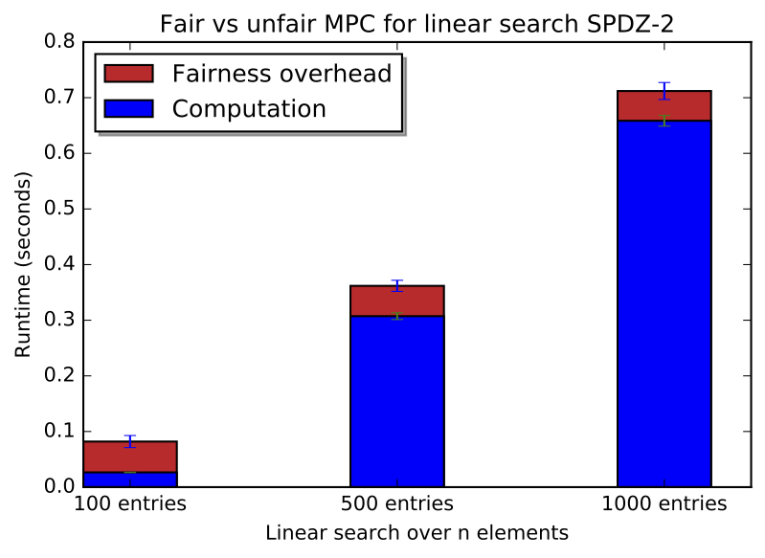
Practical Implementation
Notes:
Symmetric key is cheap, public key crypto is expensive
This is still where we incur the largest time cost of our protocol (SGX is super cheap)

Slide 25
Practical Implementation
Notes:
Differentiation between master enclave and the minion enclave

Slide 26
Practical Implementation
Notes:
Talk about Economic costs
Differences between
Confirmation time, if there is time left

Slide 27
Conclusions and Open Questions
Is it possible to weaken the type of witness encryption and still achieve the same result?
Can we further minimize the trust in the bulletin board?
Our proof is non-trivial – Go check it out in the paper!
  EPrint version with Certificate Transparency implementation details coming soon

Slide 28
THANK YOU!
Email: gkaptchuk@jhu.edu

