Slide 1
Recursive Compositional Models.
Alan Yuille (UCLA & Korea University)
Leo Zhu (NYU/UCLA) & Yuanhao Chen (UCLA)
Y. Lin, C. Lin, Y. Lu (Microsoft Beijing)
A. Torrabla and W. Freeman (MIT)

Slide 2
Motivation
A unified framework for vision in terms of probability distributions defined on graphs.
Related to Pattern Theory.
Grenander, Mumford, Geman, SC Zhu.
Related to Machine Learning….
Related to Biologically Inspired Models…

Slide 3
Three Examples
(1) Image Labeling: Segmentation and Object Detection. Datasets: MSRC, Pascal VOC07.
Zhu, Chen, Lin, Lin, Yuille (2008,2011)
(2) Object Category Detection. Datasets: Pascal 2010, earlier Pascal
Zhu, Chen, Torrabla, Freeman, Yuille (2010)
(3) Multi-Class,-View,-Pose. Datasets: Baseball Players, Pascal, LableMe.
Zhu, Chen, Lin, Lin, Yuille (2008,2011)
Zhu, Chen, Torrabla, Freeman, Yuille (2010)

Slide 4
Basic Ideas
Probability Distributions defined over structured representations.
General Framework for all Intelligence?
Graph Structure and State Variables. Knowledge Representation.
Probability Distributions.
Computation:
Inference Algorithms.
Learning Algorithms.

Slide 5
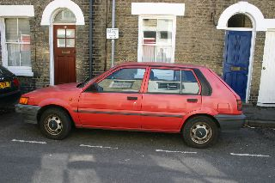

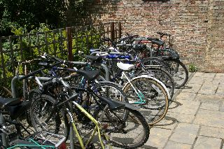

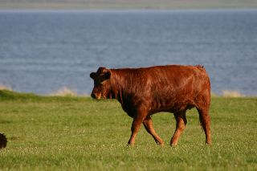
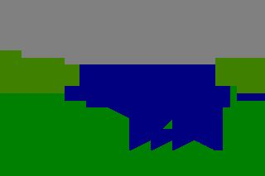
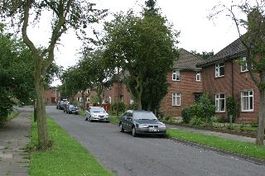
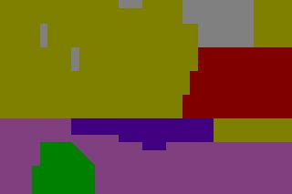
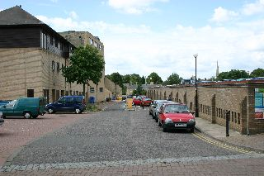
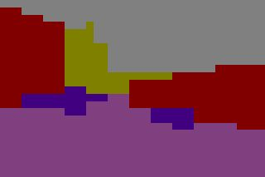
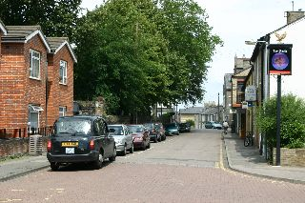
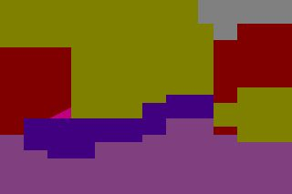
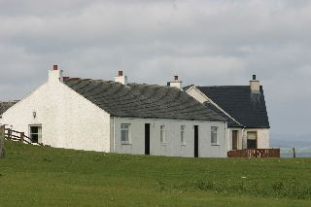
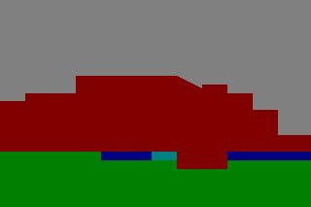
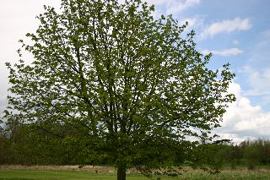

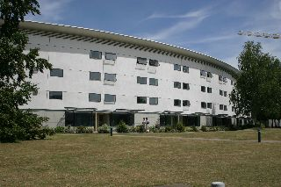
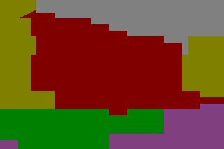
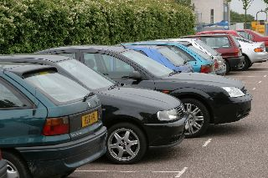

Example (1): Image Labeling
Goal: Label each image pixel as `sky, road, cow,…’ E.g. 21 labels.
Combines segmentation with primitive object recognition.
Zhu, Chen, Lin, Lin, Yuille 2008, 2011.

Slide 6
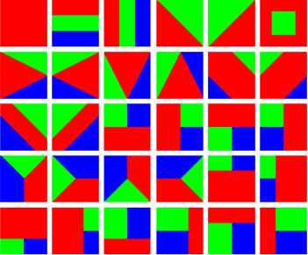

Graph Structure + State Variables
Hierarchical Graph (Quadtree).
Variables – Segmentation-recognition templates.

Slide 7
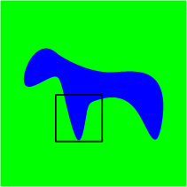
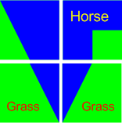
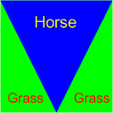
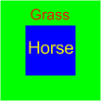
Segmentation-Recognition Template
Executive Summary: State variables have same complexity at all levels.
coarse to fine
Global: top-level summary of scene
e.g. object layout
Local: more details about
shape and appearance

Slide 8
Why Hierarchies?
(1) Captures short-, medium-, long- range context.
(2) Enables efficient hierarchical compositional inference.
(3) Coarse-to-fine representation of image (executive summary).
Note: groundtruth evaluations only rank fine scale representation.

Slide 9
Probability Distribution
X: input image.
Y State Variables of all nodes of the Graph:
Energy E(x,y) contains:
(i) Prior terms – relations between state variables Y independent of the image X.
(ii) Data terms – relation between state variables Y and image X.

Slide 10


Energy: Data and Prior Terms
Recursion
y=(segmentation, object)
f: appearance likelihood | g:object layout prior
homogeneity | layer-wise consistency
object texture color | object co-occurrence
 | segmentation prior
Horse
Grass

Slide 11
Recursive Formulation.
The hierarchical structure means that the energy for the graph can be computed recursively.
Energy for states (y’s) of the L+1 levels is the energy of L levels plus energy terms linking level L to L+1.

Slide 12
Recursive Inference
Inference task:
Recursive Optimization:
Recursion
Polynomial-time Complexity:

Slide 13
Learning the Model (supervised)
Specify factor functions g(.) and f(.)
Learn their parameters from training data (supervised).
Structure Perceptron -- a machine learning approximation to Maximum Likelihood of parameters of P(W|I).

Slide 14
Learning:Structure Perceptron
Input: a set of images with ground truth
. Set parameters
Training algorithm (Collins 02):
  Loop over training samples: i = 1 to N
  Step 1: find the best using inference:
  Step 2: Update the parameters:
  End of Loop.
Inference is critical for learning

Slide 15
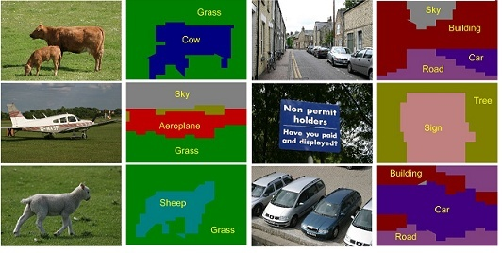
Examples: Image Labeling
Task: Image Segmentation and Labeling.
Microsoft (and PASCAL) datasets.

Slide 16
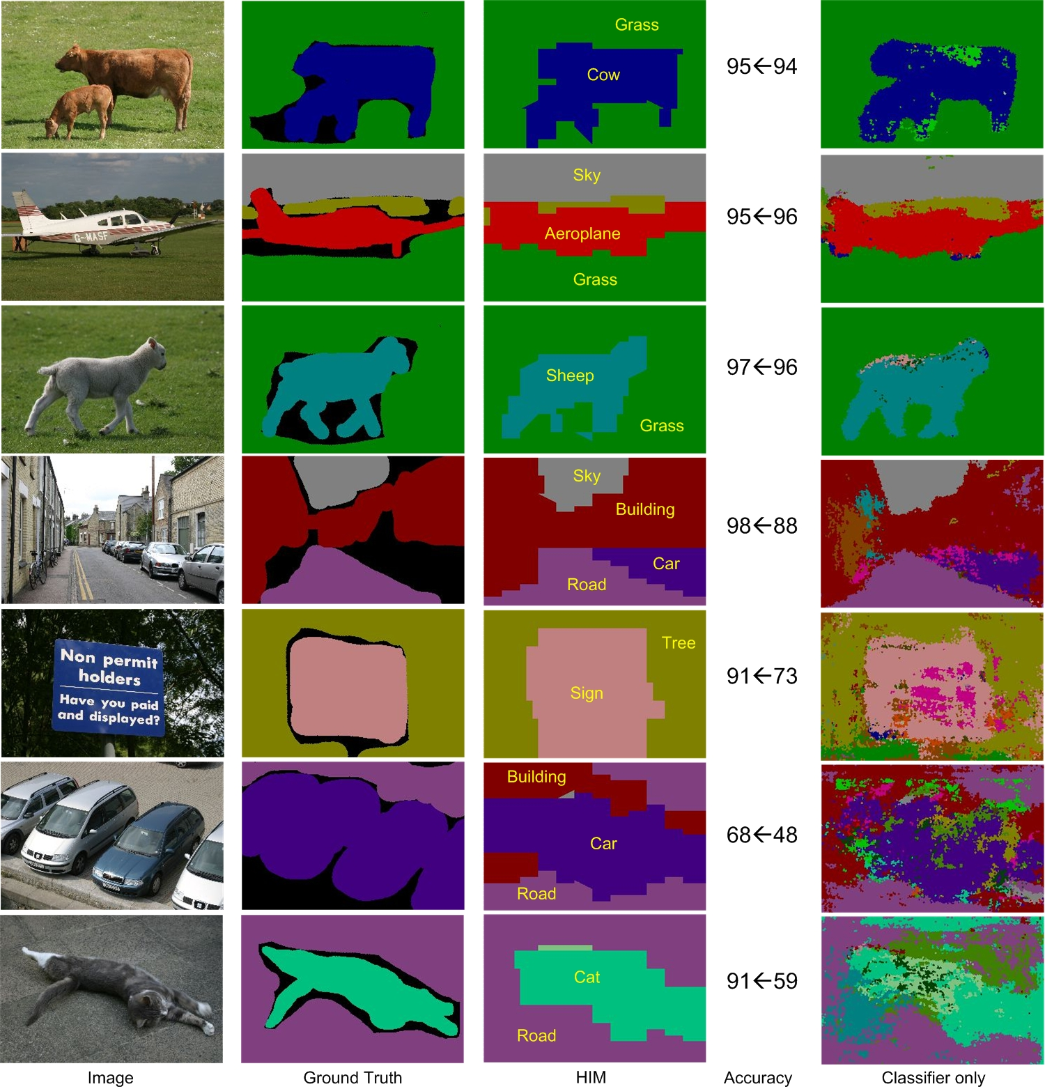

Slide 17
Performance
MSRC – Global 81.2%, Average 74.1%
(state-of-art in CVPR 2008).
Note: with lowest level only (no hierarchy):
Global 75.9%, Average 67.2%.
Note: accuracy very high approx 95% for certain classes (sky, road, grass).
Pascal VOC 2007:
Global 67.2%, Average 26.5% (comparable to state-of-art).
Ladicky et al ICCV 2009.

Slide 18
Example (2): Object Detection
Hierarchical Models of Objects.
Movable Parts.
Several Hierarchies to take into account different viewpoints.
Energy– data & prior terms.
Energy can be computed recursively.
Data partially supervised – object boxes.
Zhu, Chen, Torrabla, Freeman, Yuille (2010)

Slide 19
Overview
(1). Hierarchical part-based models with three layers. 4-6 models for each object to allow for pose.
(2). Energy potential terms: (a) HOGs for edges, (b) Histogram of Words (HOWs) for regional appearance, (c) shape features.
(3). Detect objects by scanning sub-windows using dynamic programming (to detect positions of the parts).
(4). Learn the parameters of the models by machine learning: a variant (iCCCP) of Latent SVM.
Notes:
Here are the main components of our work. We will describe them in the following slides. We use hierarchical part-based models, with 4-6 models for each object. We define an energy for each model which has three types of potential terms which model the appearance of the object and its shape. We detect an object by scanning the image using dynamic programming to detect the positions of the object parts. We learn the parameters of the model by a variant of latent SVM learning.

Slide 20
Graph Structure:
Each hierarchy is a 3-layer tree.
Each node represents a part.
Total of 46 nodes:
(1+9+ 4 x 9)
State variables -- each node has a spatial position.
Graph edges from parents to child – spatial constraints.
Notes:
Each hierarchical model is part-based. One part at the top level, nine parts at the middle level, and thirty six at the bottom level. Each part has a spatial position. The graph edges from parent to children impose spatial constraints on the positions of the parts.

Slide 21
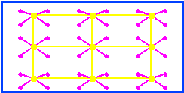
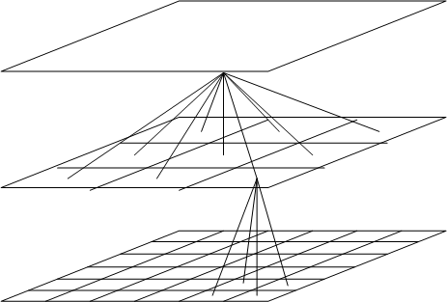
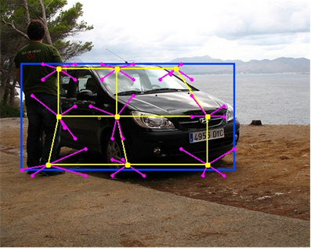
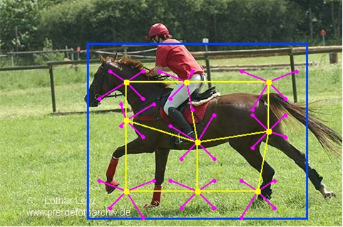
Graph Structure:
The parts can move relative to each other enabling spatial deformations.
Constraints on deformations are imposed by edges between parents and child (learnt).
Parent-Child spatial constraints
Parts: blue (1), yellow (9), purple (36)
Deformations of the Car
Deformations of the Horse
Notes:
The parts can move relative to each other allowing for spatial deformations of the object. Spatial constraints on these deformations will be learnt. We give two examples to illustrate these deformations representing the top, middle, and lower level parts by blue, yellow, and purple squares respectively.

Slide 22
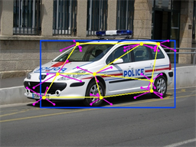
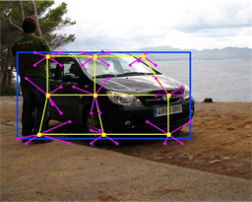
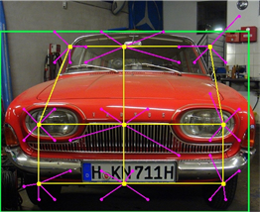
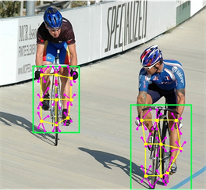
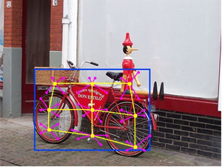
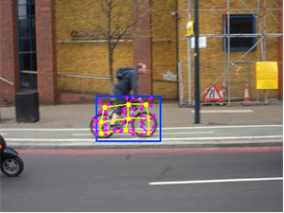
Multiple Models: Pose/Viewpoint:
Each object is represented by 4 or 6 hierarchical models (mixture of models).
These mixture components account for pose/viewpoint changes.
Notes:
Each object is represented by 4-6 hierarchical models – i.e. a mixture of models. The mixture components – each a hierarchical model – allow us to deal with different poses of the object, as illustrated in these figures.

Slide 23
Hierarchical Part-Based Models:
The object model has variables:
1. p – represents the position of the parts.
2. V – specifies which mixture component (e.g. pose).
3. y – specifies whether the object is present or not.
4. w – model parameter (to be learnt).
During learning the part positions p and the pose V are unknown – so they are latent variables and will be expressed as V=(h,p)
Notes:
The object model has variables p for the positions of each part, V for the mixture component, y specifies if the object is present or not, omega denotes the parameter values (to be learnt). During learning p and omega are unknown, so they are hidden variables represented by h.

Slide 24
Energy of the Model:
The “energy” of the model is defined to be:
where is the image in the region.
The object is detected by solving:
If then we have detected the object.
If so, specifies the mixture component and the positions of the parts.
Notes:
There is an energy function defined over the model. This energy is of form (negative) omega dot phi (x,y,h), where x is the image. To detect the object we minimize the energy with respect to y and h. If y*=+1, then we have found the object and h* specifies the positions p* of the parts and the mixture component V* (or pose).

Slide 25
Energy of the Model:
Three types of potential terms
  (1) Spatial terms specify the distribution on the positions of the parts.
  (2) Data terms for the edges of the object
  defined using HOG features.
  (3) Regional appearance data terms
defined by histograms of words
(HOWs – grey SIFT features and K-means).
Notes:
The energy is the sum of three types of potential terms. The first -- phi subscript shape -- specify the spatial distribution for the positions of the parts. The second – phi subscript HOG – specifies the edge-like appearance of the object. The third – phi subscript HOW – specifies regional features. It is a histogram of words using SIFT features.

Slide 26
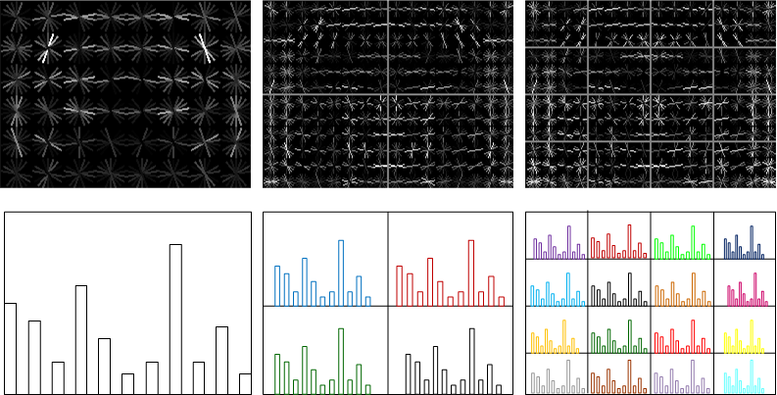
Energy : HOGs and HOWs
Edge-like: Histogram of Oriented Gradients (Upper row)
Regional: Histogram Of Words (Bottom row)
13950 HOGs + 27600 HOWs
Notes:
The HOG and the HOW potentials. The upper row illustrates the HOG potentials for a car (after the weights have been learnt). The bottom row shows the HOW histograms for some of the parts.

Slide 27
Object Detection
To detect an object requiring solving:
for each image region.
We solve this by scanning over the sub-windows of the image, use dynamic programming to estimate the part positions
and do exhaustive search over the
Notes:
To detect the object, we scan the subregions of the image. For each subregion we find the part position, mixture component, and state y which maximizes the negative energy. We use dynamic programming to estimate the part positions (exploiting the hierarchical tree structure).

Slide 28
Learning by Latent SVM
The input to learning is a set of labeled image regions.
Learning require us to estimate the parameters
While simultaneously estimating the hidden variables
Classically EM – approximate by machine learning, latent SVMs.
Notes:
The training data for the learning algorithm is a set of labeled image regions. Learning is used to estimate the model parameters omega while simultaneously estimating the hidden states p and V.

Slide 29
Latent SVM Learning
We use Yu and Joachim’s (2009) formulation of latent SVM.
This specifies a non-convex criterion to be minimized. This can be re-expressed in terms of a convex plus a concave part.
Notes:
We learn using Yu and Joachims formulation of latent SVM. This requires us to minimize a non-convex function of the weights omega. They observe that this function can be expressed as a convex plus a concave part.

Slide 30
Latent SVM Learning
Following Yu and Joachims (2009) adapt the CCCP algorithm (Yuille and Rangarajan 2001) to minimize this criterion.
CCCP iterates between estimating the hidden variables and the parameters (like EM).
We propose a variant – incremental CCCP – which is faster.
Result: our method works well for learning the parameters without complex initialization.
Notes:
Yu and Joachims propose using the CCCP algorithm to obtain a local minimum of the non-convex function. This algorithm is intuitive and iterates between estimating the hidden states and the weights (similar to the EM algorithm). We propose a variant incremental CCCP which is faster. This learning algorithm converges rapidly and yields good results without the need for complex initialization of the model.

Slide 31
Learning : Incremental CCCP
Iterative Algorithm:
  Step 1: fill in the latent positions with best score(DP)
  Step 2: solve the structural SVM problem using partial negative training set (incrementally enlarge).
Initialization:
  No pretraining (no clustering).
  No displacement of all nodes (no deformation).
  Pose assignment: maximum overlapping
Simultaneous multi-layer learning
Notes:
This slide sketches the incremental CCCP algorithm. (Drop this slide if you are short of time). The initialization is simple. The parameters associated with the nodes at all layers are learnt simultaneously.

Slide 32
Kernels
We use a quasi-linear kernel for the HOW features, linear kernels of the HOGs and for the spatial terms.
We use:
  (i) equal weights for HOGs and HOWs.
  (ii) equal weights for all nodes at all layers.
  (iii) same weights for all object categories.
Note: tuning weights for different categories will improve the performance.
The devil is in the details.
Notes:
We apply the kernel trick and use quasi-linear kernels of the HOWs, but linear kernels for the HOGs and spatial terms. We use equal weights for all nodes at all levels and the same weights for all object categories. We note that tuning these weights for different object categories might improve performance.

Slide 33
Post-processing: Context Modeling
Post-processing:
  Rescoring the detection results
Context modeling: SVM+ contextual features
  best detection scores of 20 classes, locations, recognition scores of 20 classes
Recognition scores (Lazebnik CVPR06, Van de Sande PAMI 2010, Bosch CIVR07)
  SVM + spatial pyramid + HOWs (no latent position variable)
Notes:
We use contextual cues to re-rank the detected subwindows. The context model is trained by SVM where the 44 contextual features are used, i.e. 20 detection scores, 4 location features and 20 recognition score. The recognition model is trained by SVM following the standard framework of spatial pyramid +HOWs.

Slide 34
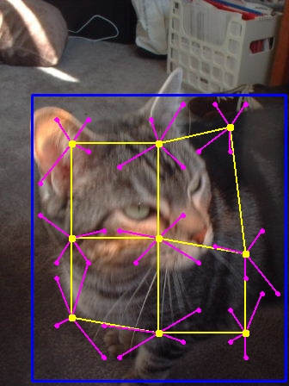
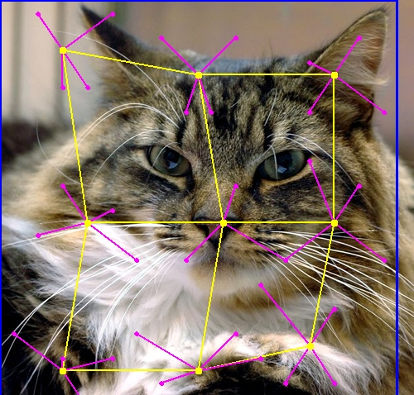
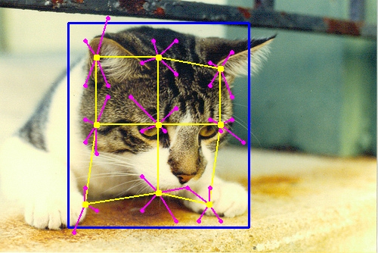
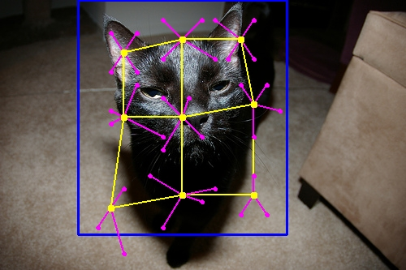
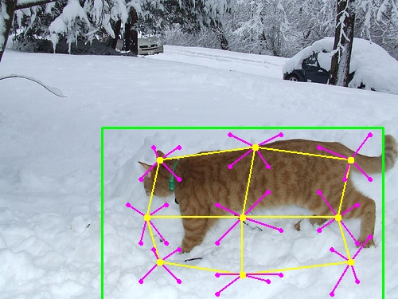
Detection Results on PASCAL 2010: Cats
Notes:
The blue/green rectangles show the bounding boxes. Different mixture hierarchical models account for pose changes. The yellow grids visualize the deformations.

Slide 35
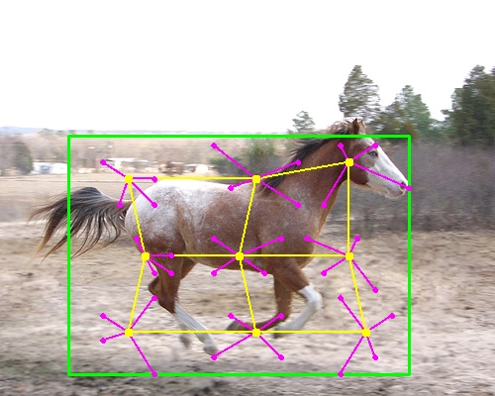
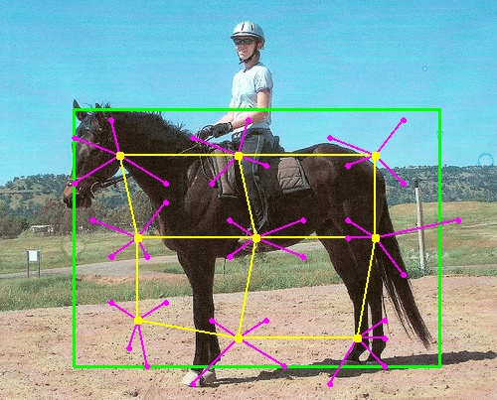
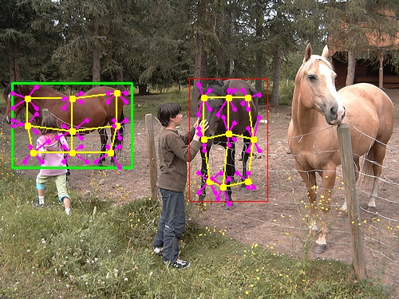
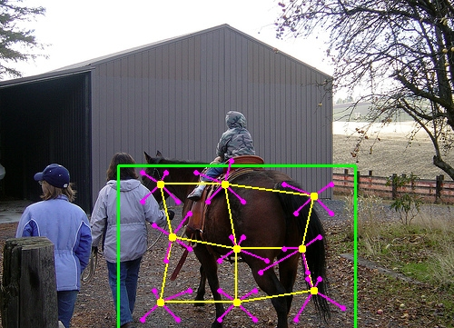
Horses
Notes:
In this case, the heads of horses are consistently aligned in different images. The detector misses one horse in the bottom-left image.

Slide 36
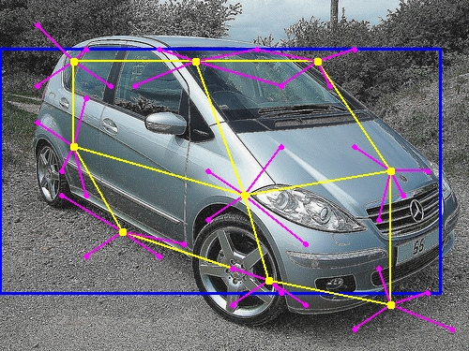
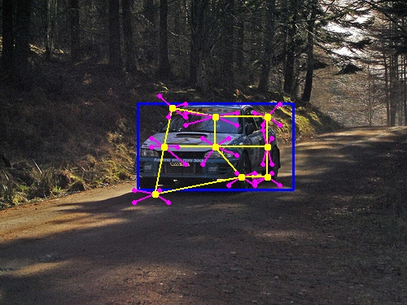
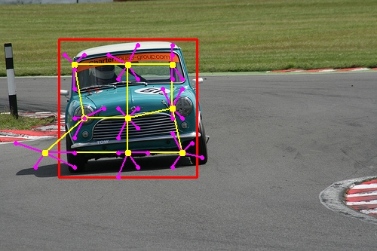
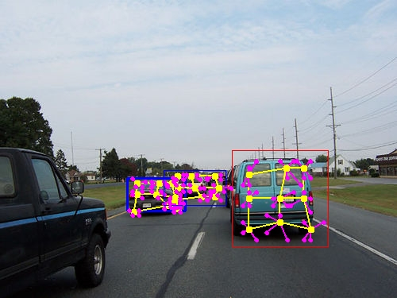
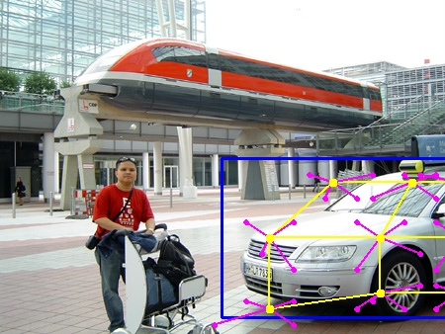
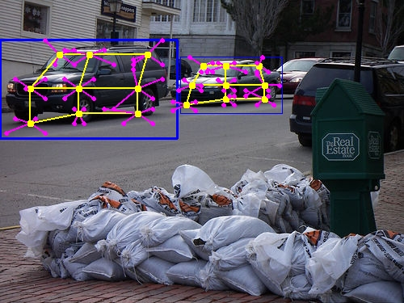
Cars
Notes:
Occlusion happens in the bottom-middle image.

Slide 37
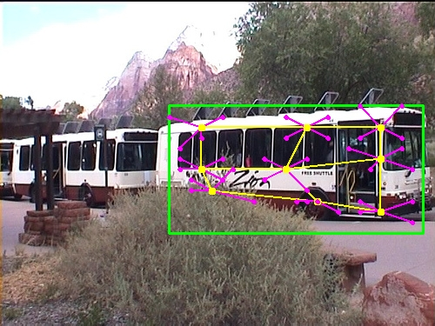

Buses
Notes:
More examples.

Slide 38
Comparisons on PASCAL 2010
Mean Average Precision (mAP).
Compare AP’s for Pascal 2010 and 2009.
Methods (trained on 2010) | MIT-UCLA | NLPR | NUS | UoCTTI | UVA | UCI
Test on 2010 | 35.99 | 36.79 | 34.18 | 33.75 | 32.87 | 32.52
Test on 2009 | 36.72 | 37.65 | 35.53 | 34.57 | 34.47 | 33.63
Notes:
This table shows the comparisons of several methods submitted to PASCAL 2010.

Slide 39
Example 3
Brief sketch of compositional models with shared parts.
Motivation – scaling up to multiple objects/viewpoints/poses.
Efficient representation, learning, and inference.
Zhu, Chen, Lin, Lin, Yuille (2008, 2011).
Zhu, Chen, Torrabla, Freeman, Yuille (2010).

Slide 40



Key Idea: Compositionality
Objects and Images are constructed by compositions of parts – ANDs and ORs.
The probability models for are built by combining elementary models by composition.
Efficient Inference and Learning.

Slide 41
Why compositionality?
(1). Ability to transfer between contexts and generalize or extrapolate (e.g. , from Cow to Yak).
(2). Ability to reason about the system, intervene, do diagnostics.
(3). Allows the system to answer many different questions based on the same underlying knowledge structure.
(4). Scale up to multiple objects by part-sharing.
“An embodiment of faith that the world is knowable, that one can tease things apart, comprehend them, and mentally recompose them at will.”
“The world is compositional or God exists”.

Slide 42

Horse Model (ANDs only).
Nodes of the Graph represents parts of the object.
Parts can move and deform.
y: (position, scale, orientation)

Slide 43

AND/OR Graphs for Horses
Introduce OR nodes and switch variables.
Settings of switch variables alters graph topology – allows different parts for different viewpoints/poses:
Mixtures of models – with shared parts.

Slide 44

AND/OR Graphs for Baseball
Enables RCMs to deal with objects with multiple poses and viewpoints (~100).
Inference and Learning as before:

Slide 45

Results on Baseball Players:
State of the art – 2008.
Zhu, Chen, Lin, Lin, Yuille CVPR 2008, 2010.

Slide 46

Part Sharing for multiple objects
Strategy: share parts between different objects and viewpoints.

Slide 47
Learning Shared Parts
Unsupervised learning algorithm to learn parts shared between different objects.
Zhu, Chen, Freeman, Torrabla, Yuille 2010.
Structure Induction – learning the graph structures and learning the parameters.
Supplemented by supervised learning of masks.

Slide 48

Many Objects/Viewpoints
120 templates: 5 viewpoints & 26 classes

Slide 49

Learn Hierachical Dictionary.
Low-level to Mid-level to High-level.
Learn by suspicious coincidences.

Slide 50

Part Sharing decreases with Levels

Slide 51
Multi-View Single Class Performance
Comparable to State of the Art.

Slide 52
Conclusions
Principle: Recursive Composition
  Composition -> complexity decomposition
  Recursion -> Universal rules (self-similarity)
  Recursion and Composition -> sparseness
A unified approach – object detection, recognition, parsing, matching, image labeling.
Statistical Models, Machine Learning, and Efficient Inference algorithms.
Extensible Models – easy to enhance.
Scaling up: shared parts, compostionality.
Trade-offs: sophistication of representation vrs. Features.
The Devil is in the Details.

Slide 53
References
Long Zhu, Yuanhao Chen, Antonio Torralba, William Freeman, AlanYuille. Part and Appearance Sharing: Recursive Compositional Models for Multi-View Multi-Object Detection. CVPR. 2010.
Long Zhu, Yuanhao Chen, Alan Yuille, William Freeman. Latent Hierarchical Structural Learning for Object Detection. CVPR 2010.
Long Zhu, Yuanhao Chen, Yuan Lin, Chenxi Lin, Alan Yuille. Recursive Segmentation and Recognition Templates for 2D Parsing. NIPS 2008.
Long Zhu, Chenxi Lin, Haoda Huang, Yuanhao Chen, Alan Yuille. Unsupervised Structure Learning: Hierarchical Recursive Composition, Suspicious Coincidence and Competitive Exclusion. ECCV 2008.
Long Zhu, Yuanhao Chen, Yifei Lu, Chenxi Lin, Alan Yuille. Max Margin AND/OR Graph Learning for Parsing the Human Body. CVPR 2008.
Long Zhu, Yuanhao Chen, Xingyao Ye, Alan Yuille. Structure-Perceptron Learning of a Hierarchical Log-Linear Model. CVPR 2008.
Yuanhao Chen, Long Zhu, Chenxi Lin, Alan Yuille, Hongjiang Zhang. Rapid Inference on a Novel AND/OR graph for Object Detection, Segmentation and Parsing. NIPS 2007.
Long Zhu, Alan L. Yuille. A Hierarchical Compositional System for Rapid Object Detection. NIPS 2005

Slide 54







Bottom-up Learning
Suspicious Coincidence
Composition
Clustering
Competitive
Exclusion

Slide 55

Unsupervised Structure Learning
Task: given 10 training images, no labeling, no alignment, highly ambiguous features.
  Estimate Graph structure (nodes and edges)
  Estimate the parameters.
Correspondence is unknown
?
Combinatorial Explosion problem

Slide 56

The Dictionary: From Generic Parts to Object Structures
Unified representation (RCMs) and learning
Bridge the gap between the generic features and specific object structures

Slide 57


Dictionary Size, Part Sharing and
Computational Complexity
Level | Composition | Clusters | Suspicious Coincidence | Competitive Exclusion | Seconds
0 |  |  |  | 4 | 1
1 | 167,431 | 14,684 | 262 | 48 | 117
2 | 2,034,851 | 741,662 | 995 | 116 | 254
3 | 2,135,467 | 1,012,777 | 305 | 53 | 99
4 | 236,955 | 72,620 | 30 | 2 | 9
More Sharing

Slide 58
What do the graph nodes represent?
Intuitively, receptive fields for parts of the horse.
From low-level
to high-level
Simple parts to
complex parts

Slide 59



RCMs: Appearance Potentials
Relate the parts to the image properties (e.g., edges)
[
Gabor,
Edge,
…]
*
=

Slide 60
RCMs: Shape Potentials
Relate positions of parent parts to those of child parts. Triplets enable invariance to scale/angle.
(position, scale, orientation)

Slide 61

Top-down refinement
Fill in missing parts
Examine every node from top to bottom

Slide 62

Objects Share Parts

