Slide 1
Compositional Models for Open-Set Activity Classification of Videos.
Alan Yuille
Bloomberg Distinguished Professor
Depts. Cognitive Science and Computer Science
Johns Hopkins University

Slide 2
Part 1. Closed-Set Activity Recognition
What about closed-set activity recognition from video sequences? This is a simple extension of Image Captioning to Videos.
Note: closed-set means that we classify the videos to a set of pre-defined labels. So we can train algorithms using many annotated videos with labels specified. This is the simplest possible video-language task. The language is the list of activity labels.
Neural network approaches have been extended to perform action recognition on videos (e.g., TSN and I3D) and perform well on benchmarks.
But surely closed-set activity should also need compositional models? Particularly if one activity was “dog biting man” and another was “man kicking dog”?
So what have these action recognition neural networks really learned? Are they really classifying the actions? Or are they fitting biases in the dataset?
And can these methods be extended to the more challenging task of open-set activity classification?
J. Lyu et al. Understanding What Activity Classification Models Have Learnt. CVPR Workshop. 2020.

Slide 3
Use Synthetic Data to Study Activity Recognition
We render synthetic videos of humans punching. We train state-of-the art activity recognition methods (TSN and I3D) for these tasks using the USC101 activity dataset.
Then we test performance of these trained models on our synthetic stimuli.
Why are the Deep Nets (TSN and I3D) so bad at generalizing to the synthetic data?
Note: there are always problems for algorithms trained on real to generalize to synthetic, but they are not usually as bad as this.
Model | Class Name | Top-1 accuracy | Top-5 accuracy
TSN | Punching | 0.00 | 0.00
I3D | Punching bag | 6.25 | 41.67
I3D | Punching person | 6.25 | 31.25

Slide 4
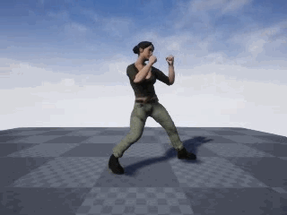
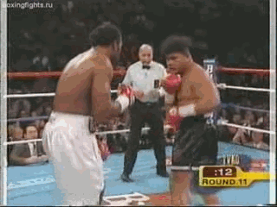
Why do Deep Nets fail to recognize synthetic punching ?
We conjecture that a deep network model trained on UCF101 (right) overfits to the background. Hence it is unable to detect the punching action in the synthetic data, which consists of a single boxer (left).
Note: videos from this class in UCF101 are mostly boxing matches and boxers punching sandbags.

Slide 5
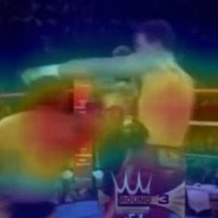
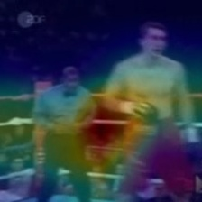
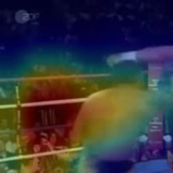
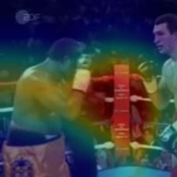
Diagnosing Deep Networks by CAMs.
Class Activation Maps (CAM) detect the discriminative image regions (red is most discriminative) used by a CNN to identify a specific activity class.
CAMs of punching videos from UCF101 test set. CNNs detect the ropes of the boxing ring and the torso of the humans. Not the boxers boxing!
Notes:
In other words, a class activation map lets us see which regions in the image were relevant to this class.

Slide 6
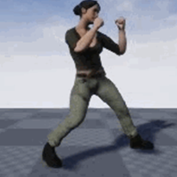
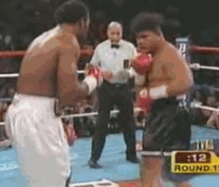
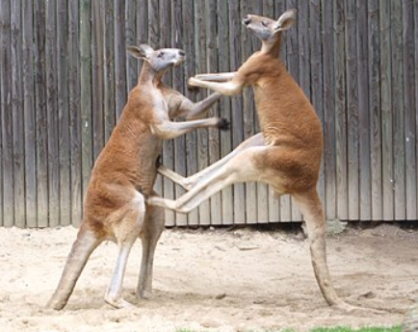
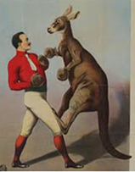
But what is Boxing? There are many variants.
Boxing involves actors (boxers, boxing bags, kangaroos) interacting with each other. Boxers have attributes (e.g., boxing gloves).
(1) A single person boxing.
(2) A professional boxing matching with a referee and spectators.
(3) Two kangaroos boxing.
(4) A kangaroo boxing a man.

Slide 7
A Boxer attacks by a composition of punches.
There are a several types of punches. E.g, left-jab, right-jab, left-upper-cut, right-upper-cut.
A boxer attacks with a sequence, or composition, of punches -- e.g., left-jab, right-jab, upper-cut – while the other boxer responds by appropriate defenses.
Both boxers also move and perform a complex dance of threats and counter-threats.
Modeling this requires compositional models of the boxers (their arms, legs, head), their attributes (boxing gloves), and their sequence of actions (movements and attacks/defenses) that they can make.
Note: this is particularly complicated because the boxers are typically heavily occluded.

Slide 8
Part 2. Open-Set Activity Classification
Current deep network approaches are already challenged for activity classification with closed-set labels. I’d argue we need compositional models for the actors, their attributes, and their spatiotemporal interactions.
Open-Set Activity Classification is an even harder task. It is also more interesting, from the language perspective, because it yields a combinatorial set of activity-labels.
The activity-labels only need to be defined only at test-time. We may be asked if the video contained a specific set of actors with specific attributes with a specific spatial-temporal sequence of interactions. And we may never have seen a video with this activity label before (i.e. we have had no opportunity to train on it).
For example, we might be asked if the video contained a monkey-riding-bicycle, even if we had never seen a video of this activity before. But “monkey” and “bicycle” would be members of our set of actors and “riding” would be in our set of spatial-temporal interactions.
The activity labels can also allow spatial-temporal changes. For example, man-with-box-walks-to-car, man-puts-box-on-ground, man-opens-trunk, man-picks-up-box-from-ground, man-puts-box-in-trunk, man-closes-trunk.

Slide 9
Open-Set Activity Classification
We formulate this by a compositional system which has hidden-states representing the actors, their attributes, and their spatial-temporal interactions.
An activity-label corresponds to a sequence of the hidden states with allowable transitions between states. There is “evidence”, or “scores” for the presence of actors/attributes/interactions which can be given by CNNs.
For example, an off-the-shelf CNN trained for monkey detection (on another dataset) can be used to detect if the actor “monkey” is present in a specific position in a video-frame.
This has many interesting properties and applications:
(1) Robot Surgery – and can be used to train a robot by watching a human surgeon.
(2) Surveillance – detect suspicious activities, even those which are defined at test-time.
(3) Ask Turing Test questions about the videos. Provided all questions can be expressed in terms of actors, attributes, and their spatial-temporal interactions.

Slide 10

Results of our Compositional Formulation
Zero-shot classification with dynamic attribute signatures
A new state-of-the-art on the Olympic Sports dataset.
We demonstrate zero-shot recognition of complex action sequences which jointly segment and classify fine-grained surgical activities.
Strong baseline joint classification and segmentation results on the JIGSAWS dataset.
We demonstrate zero-shot classification of human-object interactions requiring no supervised training of attributes using off-the-shelf object detectors.
A practical application on the DIVA dataset, outperforming supervised neural network baselines.

Slide 11

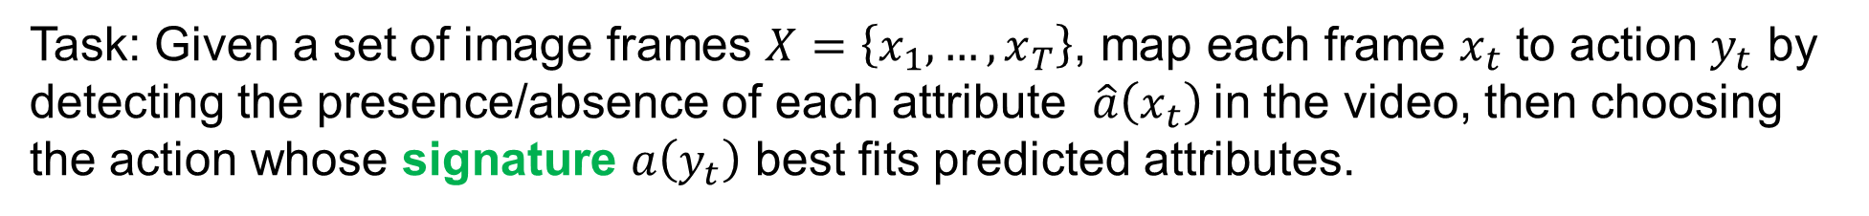
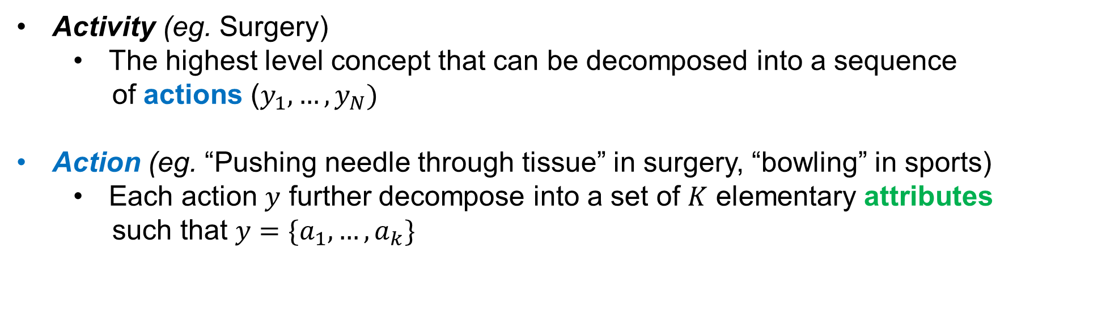
Definitions
Activity (eg. Surgery)
The highest level concept that can be decomposed into a sequence
of actions ($y_{1}, …, y_{N})$
Action (eg. “Pushing needle through tissue” in surgery, “bowling” in sports)
Each action $y$ further decompose into a set of $K$ elementary attributes
such that $y=\{a_{1},…, a_{k}\}$
Task: Given a set of image frames $X=\left\{x_{1},…, x_{T}\right\}$, map each frame $x_{t}$ to action $y_{t}$ by detecting the presence/absence of each attribute $\hat{a}\left(x_{t}\right)$in the video, then choosing the action whose signature $a\left(y_{t}\right)$ best fits predicted attributes.
Notes:
JON HERE!

Slide 12
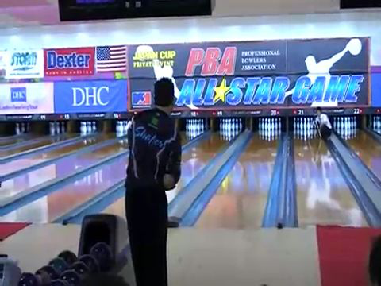
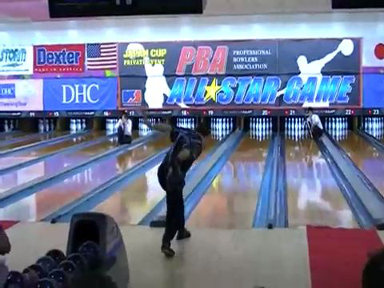
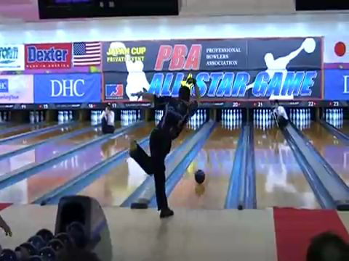
Dynamic Attribute Labeling
Bowling
Indoor | Water | Big Ball | One-arm Open | Throw Away | One-arm Swing
1 | 0 | 1 | 1 | 1 | 1
“Static”
Indoor | Water | Big Ball | One-arm Open | Throw Away | One-arm Swing
1 | 0 | 1 | From 0 to 1 | From 0 to 1 | From 0 to 1
“Dynamic”
Notes:
Previous work in zero-shot action recognition defines each signature over a set of attributes that are static—i.e. each attribute is presumed to be constant through the duration of the action. However, in many scenarios the actions of interest are distinguished by their time evolution rather than the presence or absence of static attributes

Slide 13
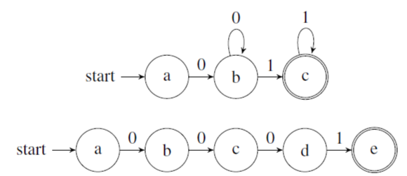
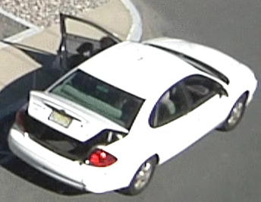
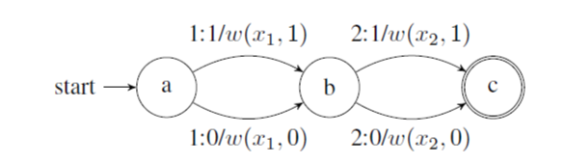
Dynamic Attribute Sequences by Hidden States (c.f., HMMs)
State machines implement dynamic attribute logic.
An example transducer mapping a length-two sequence to its detection scores.
Notes:
We define action signatures as finite-state acceptors that implement time-varying rules. Each signature accepts a sequence of attribute detections.
we have illustrated state machines implementing the two rules for “Person appears” seen on the left. Each edge is labeled with the token it accepts. TOP: The rule “absent, then present” implemented as a machine that accepts one or more non-detections followed by one or more detections. BOTTOM: The rule “absent for first 75%, then present for remaining 25%”, instantiated for a length-4 sequence.
At inference time we receive a sequence of attribute detection scores from some black-box system, and need to determine its compatibility with our set of pre-defined attribute signatures. To do so, for each detection sequence, we first instantiate a finite-state transducer that accepts sample indices as input, gives detections as output, and whose weights correspond to attribute detection scores.

Slide 14
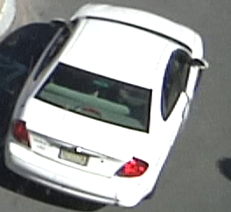
Temporal Rule 0
Temporal Rule (0): “Absence”
a
b
: 1
: 0
“Absence of Person. No person in frame”

Slide 15
Temporal Rule 1
Temporal Rule (1): “Throughout”
a
b
: 1
: 0
“Presence of vehicle, and vehicle present throughout the video”

Slide 16
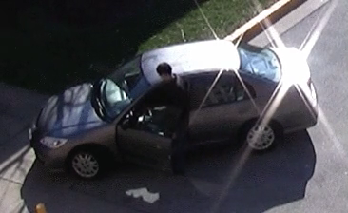
Temporal Rule 2
Temporal Rule (2): “at the beginning”
a
b
c
: 1
: 0
“A person disappears: presence of person , then absence of person”

Slide 17
Temporal Rule 3
Temporal Rule (3): “at the end”
a
b
c
: 1
: 0
“A person appears: absence of person (at start of video), then presence of person”

Slide 18
Bowling Sequence Example:
Temporal rules specify allowable sequences of hidden states.
Observations x_a, x_b, x_c, x_d from image frames a,b,c,d.
Evidence, scores, for these hidden states from CNNs applied to the image frames.

Slide 19
When does Throw-Away happen?
a
a
Throw
-away
Notes:
TK BACK HERE: This is show concretely how we perform our zero-shot action classification. Compared to previous works that consume the entire video as one piece

Slide 20
b
a
b
a
Throw
-away
Notes:
, we detect attribute signals per local video segments and model the video as a time series of such local snippets.

Slide 21
b
a
b
a
c
c
Throw
-away

Slide 22
b
b
d
a
d
a
c
c
Throw
-away
Notes:
Lets assume this video contains 4 segments. Note that we can work with arbitrary length segments.

Slide 23


P( Throw-away | $x_{a}$ )
a
b
c
d
Throw
-away
P($¬$Throw-away | $x_{a}$ )
Notes:
For each segment, we can compute the probability that we observe the given attribute.

Slide 24


0.05
P( Throw-away | $x_{b}$ )
a
b
c
d
Throw
-away
0.95
P($¬$Throw-away | $x_{b}$ )

Slide 25


0.05
0.13
P( Throw-away | $x_{c}$ )
a
b
c
d
Throw
-away
0.95
0.87
P($¬$Throw-away | $x_{c}$ )

Slide 26
0.05
0.13
0.97
a
b
c
d
Throw
-away
0.95
0.87
0.03

Slide 27
Rescale predictions
to ( -1 , 1 )
-0.9
-0.74
0.94
a
b
c
d
Throw
-away
0.9
0.74
-0.94

Slide 28
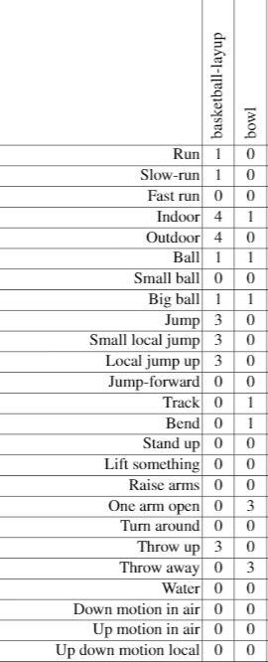

Dynamic Attribute Signatures
$$a_{ThrowAway}(bowl)$$
-0.9
-0.74
0.94
a
b
c
d
Throw
-away
0.9
0.74
-0.94
Notes:
Given attribute detection scores as input, we then refer to the expected temporal behavior of the attribute (or action signatures) defined for the query activity.

Slide 29
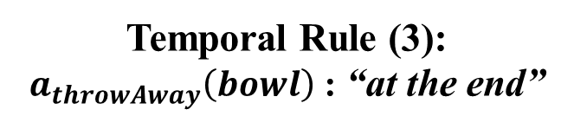
Dynamic Attribute Signatures
Temporal Rule (3):
$a_{throwAway}\left(bowl\right)$ : “at the end”
a
b
c
d
-0.9
-0.74
0.94
a
b
c
d
Throw
-away
0.9
0.74
-0.94
Notes:
We defined it as the ‘at-the-end’ sequence.

Slide 30
Dynamic Attribute Signatures
Temporal Rule (3):
$a_{throwAway}\left(bowl\right)$ : “at the end”
a
b
c
d
Compose
-0.9
-0.74
0.94
a
b
c
d
Throw
-away
0.9
0.74
-0.94
$$score_{ThrowAway}(Bowl)=\frac{1}{3} (0.9+0.74+0.94)=0.86$$
Notes:
The dynamic attribute, or the temporal rule defines how we score the input detection scores.

Slide 31

Dynamic Attribute Signatures
$$a_{indoor}(bowl)$$
Notes:
We can repeat this

Slide 32
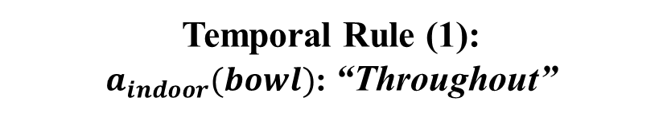
Dynamic Attribute Signatures
Temporal Rule (1):
$a_{indoor}(bowl)$: “Throughout”
a
b
c
d
Compose
0.87
0.99
0.98
a
b
c
d
Indoor
“Score closer to 1 means predictions match well with action signatures”
-0.87
-0.99
-0.98
$$score_{indoor}(Bowl)=\frac{1}{3} (0.87+0.99+0.98)=0.95$$

Slide 33
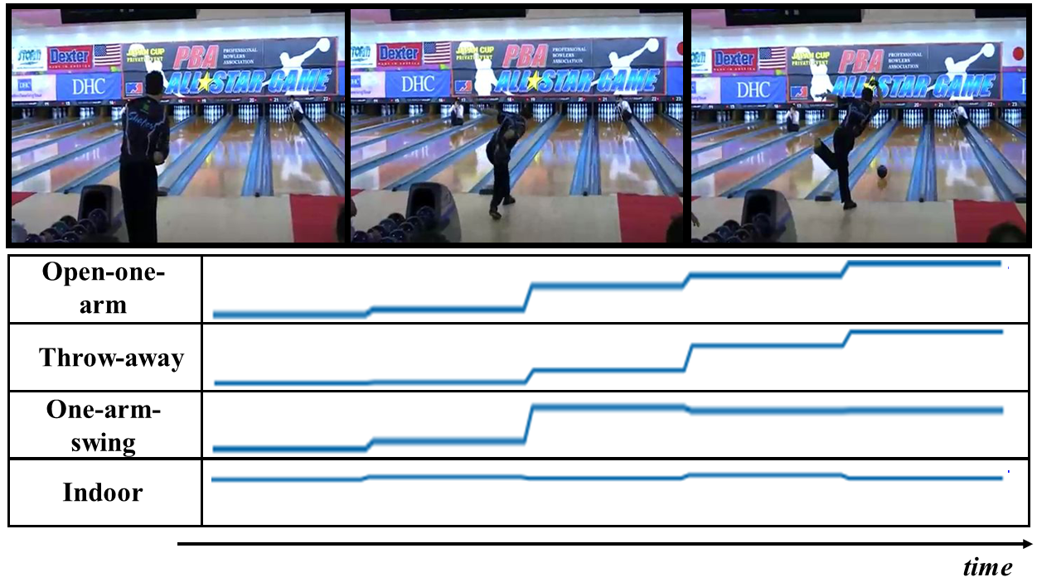
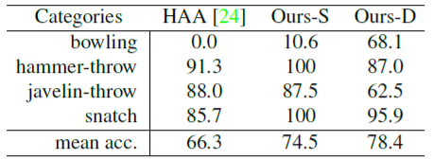
Dynamic attributes are effective for modeling actions
An attribute’s presence signal changes over time in an informative/discriminative way.
- Dynamic attribute signatures provide more discriminative representation than their static counterparts for zero-shot action classification.

Slide 34
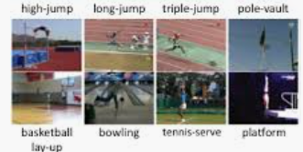
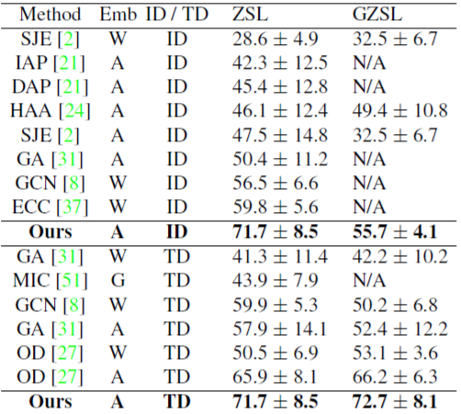
Olympic Sports Experiments
783 videos from 16 sport action categories
50 random independent trials to choose 8 seen and 8 unseen classes.
I3D is trained to predict all attributes from a video segment
W: word2vec embedding
A: attribute based embedding
ID: Inductive model
TD: Transductive model
ZSL: Zero-shot-learning evaluation GZSL: General ZSL evaluation
Notes:
The key idea here is to model an action as a sequence of temporally dynamic attributes.

Slide 35
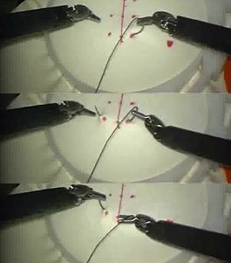

JIGSAWS Evaluation: Zero-shot Classification
39 Instances of instances of 8 surgeons performing a benchtop simulation training task of suturing a robot-assisted minimally invasive surgical using the da Vinci.
Dataset contains video of the performance as well as kinematics (only rgb video is used in this work)
Each instance has per-frame gesture class labels for 10 types of actions that occur during the task.
Dynamic attributes are manually labeled for zero-shot classification.
(G4): “Transferring needle from left to right”
Vrs.
(G6): “Pulling suture with left hand”
Notes:
We also perform zero-shot classification on a more fine-grained surgical gestures. Specifically, we map signatures (2) “at beginning” and (3) “at end” to (0) “never”. Notice that accuracy increases by almost 20% when dynamic signatures are used. This is due to an inherent confusion between gestures 4 and 6—the static-signature model overwhelmingly predicts gesture 4 for gesture 6, because these gestures’ signatures differ only in the temporal duration of a single attribute.

Slide 36


Zero-shot reasoning for complex activities
- We have shown our we can successfully model actions as sequences of attributes.
- Note that complex activities contain sequences of actions.
- Our framework is flexible: we can apply the same methodology to model sequence of actions: we can perform zero-shot segmentation (to find where actions start and end).
Notes:
JON IS BACK HERE
We can extend the zero-shot classification scenario to perform joint classification and segmentation in a zero-shot manner by defining a sequence-level score function over M hypothesized segments:

Slide 37
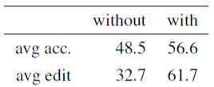
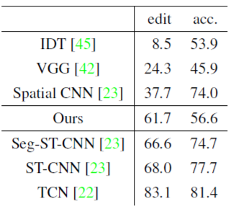
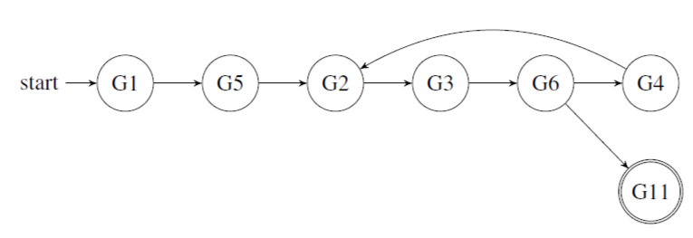
Zero-shot joint classification and segmentation
We often have prior knowledge of a) the typical sequence, b) the likely sequences or c) the ideal case. Our framework allows us to define and encode this type of prior knowledge:
“The practitioner begins by reaching for the needle (G1), then moves to the work area (G5), then executes a suture (G2 - G6). At this point they can either transfer the needle from the left to the right hand (G4) and perform another suture, or drop the suture and end the activity (G11).”
Effect of prior structural information about the action sequences
Comparison to fully-supervised SOTA

Slide 38
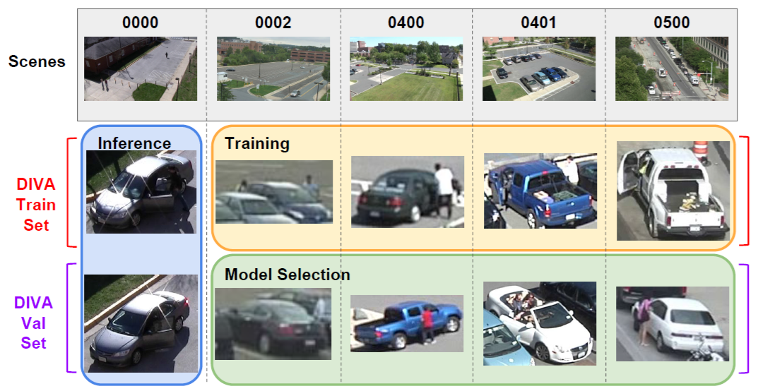
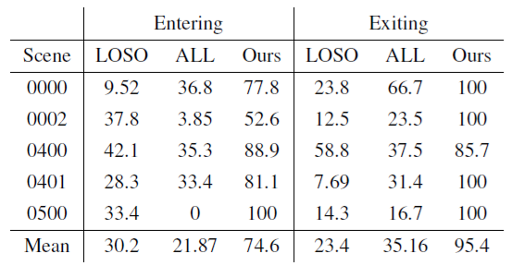
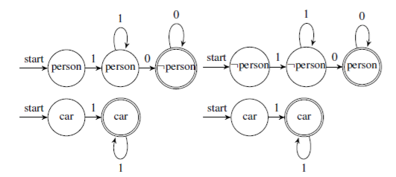
DIVA Evaluation: supervision-free zero-shot system
Given off-the-shelf object detectors and dynamic attribute signatures, we define a human Entering and Exiting a vehicle with the hidden state sequences shown below.
We compare against a fully supervised end-to-end baseline (TRN).
LOSO: Leave-One-Scene-Out Evaluation.
ALL: Training data contains samples from all scenes.
off-the-shelf Detectron implementation using the e2e mask rcnn X-101-64x4d-FPN 1x configuration

Slide 39
Conclusion
Open-set-activity-recognition is a very important task. It includes zero-shot learning and responding to questions asked after the videos. It has applications to medicine and surveillance. It is interesting from a Language perspective, particularly if the set of actors, attributes, and spatial-temporal interactions are large.
For open-set-activity-recognition the need for compositions of actors with attributes and spatial-temporal interactions are critical.
It requires underlying latent world representations and has a world model for the states of the world capturing physical and other knowledge.

Slide 40
Brief References (3) : Open-Set-Activity-Recognition
TS Kim, Y Zhang, Z Xiao, M Peven, W Qiu, J Bai, A Yuille, GD Hager. Safer: Fine-grained activity detection by compositional hypothesis testing. Arxiv. 2018.
Tae Soo Kim, Jonathan D Jones, Michael Peven, Zihao Xiao, Jin Bai, Yi Zhang, Weichao Qiu, Alan Yuille, Gregory D Hager. DAZSL: Dynamic Attributes for Zero-Shot Learning. Arxiv. 2020. To appear in AAAI 2021.

