Slide 1

Identifying Model Weakness with Adversarial Examiner
Michelle Shu, Chenxi Liu, Weichao Qiu, Alan Yuille
Oct 11th, 2019
Johns Hopkins University

Slide 2

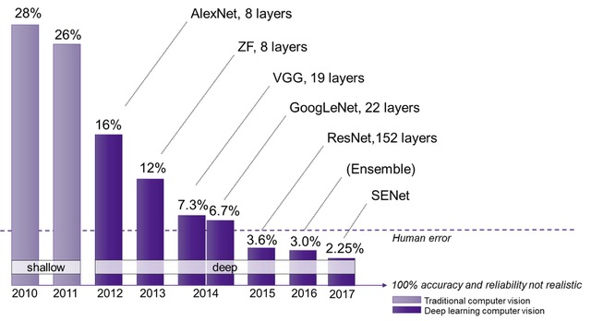
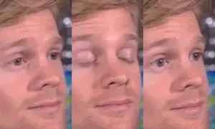
Identifying Model Weakness with Adversarial Examiner
Motivation:
The field of Machine Learning is advancing at unprecedented speed
Why is there a mismatch?
None of us actually believe that...
https://news.stanford.edu/2018/05/15/how-ai-is-changing-science/
Notes:
On one side, this evaluation metric has demonstrated better..
On the other side

Slide 3

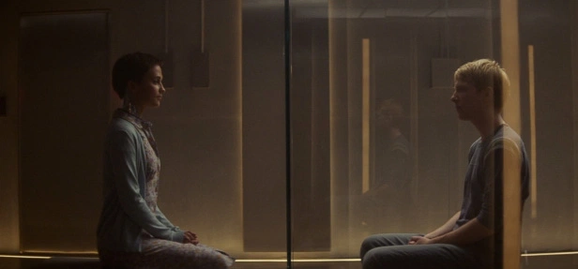

Identifying Model Weakness with Adversarial Examiner
Motivation:
Turing test
Notes:
Turing test: ask subject questions behind curtain What’s turing As mental experiment, current evaluation protocol

Slide 4


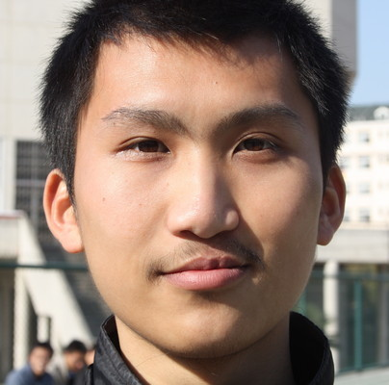
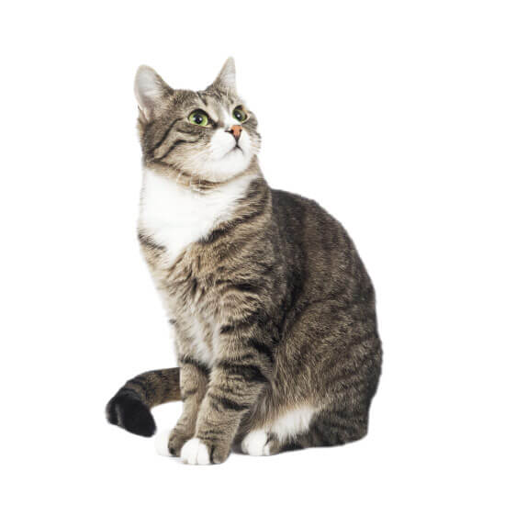



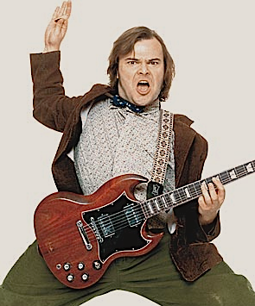
Identifying Model Weakness with Adversarial Examiner
ROCKSTAR.
80% Accuracy -> 99.9% Accuracy
CAT.
ROCKSTAR.
CAT.
CAT.
Lesson 1:
The test should focus more on worst case than average case.
CAT!
ROCKSTAR!
CAT!
ROCKSTAR!
ROCKSTAR!
100% Accuracy -> 100% Accuracy
999/1000
1/1000
Notes:
SEQUENTIAL SETTING
ALL OF A SUDDEN, A DIFFICULT IMAGE

Slide 5
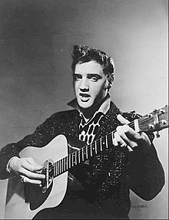
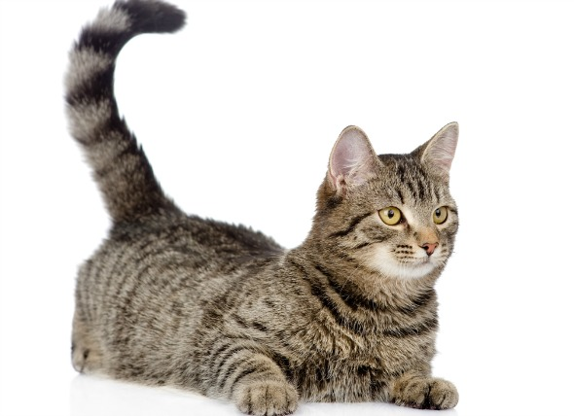
Identifying Model Weakness with Adversarial Examiner
ROCKSTAR.
CAT.
ROCKSTAR.
CAT.
Lesson 2:
The test should be dynamic instead of fixed
Random Sample: ~80% Confidence on Correct Answer
Dynamic Sample: ~60% Confidence on Correct Answer
61.2%
99.9%
59.2%
99.9%
999/1000
1/1000
Notes:
SEQUENTIAL SETTING
ALL OF A SUDDEN, A DIFFICULT IMAGE

Slide 6
Identifying Model Weakness with Adversarial Examiner
Solution: Adversarial Examiner (AE)
Worst case instead of average case
Dynamic test set based on test history instead of fixed test set
Notes:
FIX
Dynamic test set:
Story 1: weichao vs. alexnet
Story 2: first generation robot -> ignore butterfly

Slide 7
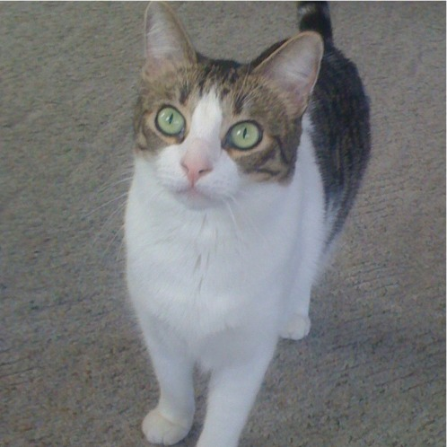
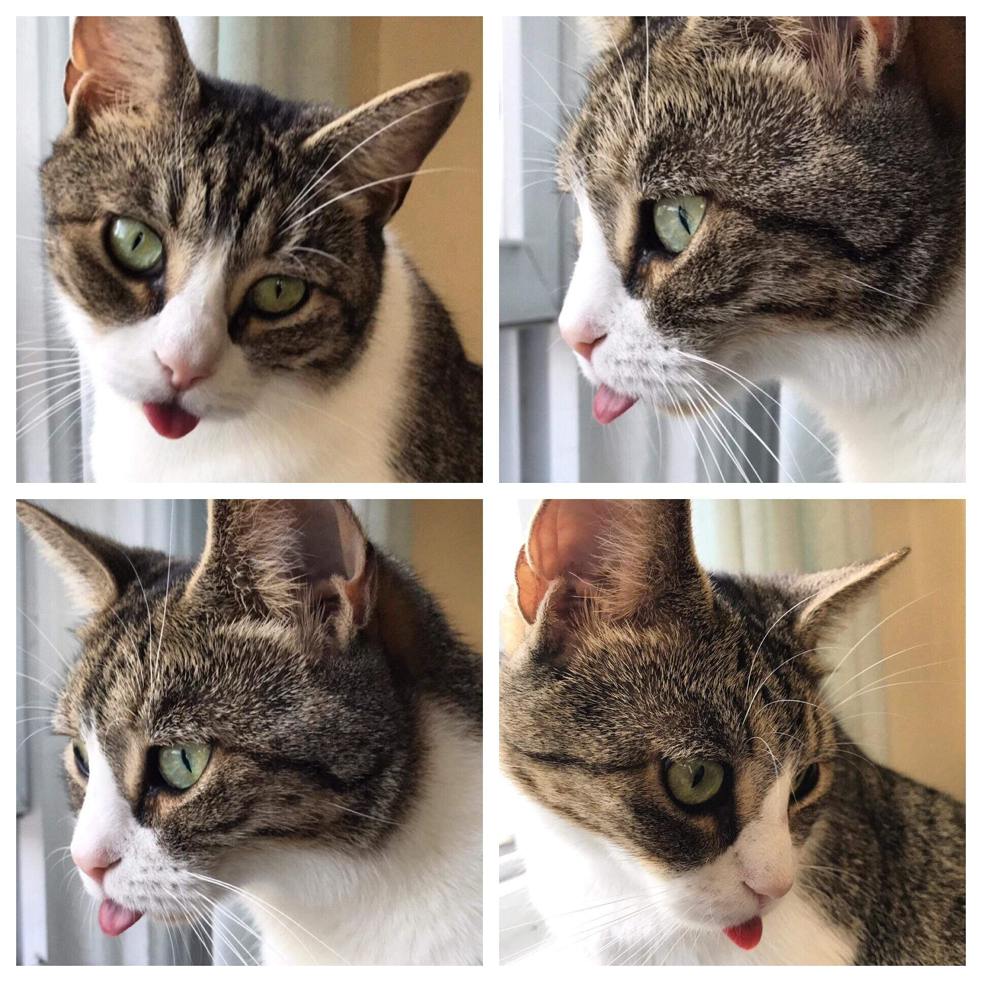
Identifying Model Weakness with Adversarial Examiner
Solution: Adversarial Examiner (AE) Definitions
Underlying Form z
Additional Information s
Surface Form x = g(z, s)
Is it bleping: yes
Viewing distance: close-up
…
State: cute
3D object: Cat
2D image: Cat
Notes:
Dynamic test set:
Story 1: weichao vs. alexnet
Story 2: first generation robot -> ignore butterfly

Slide 8
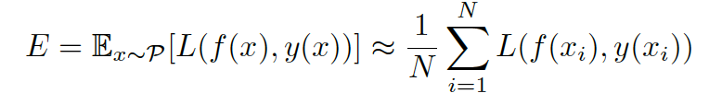

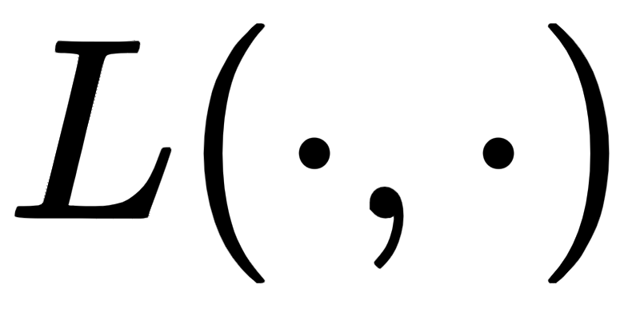

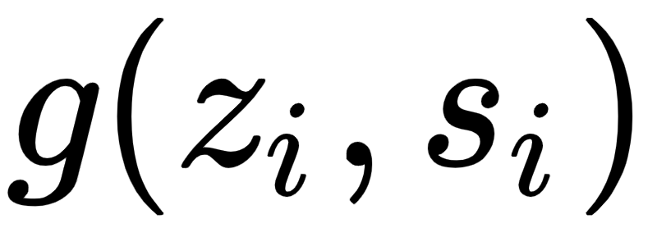
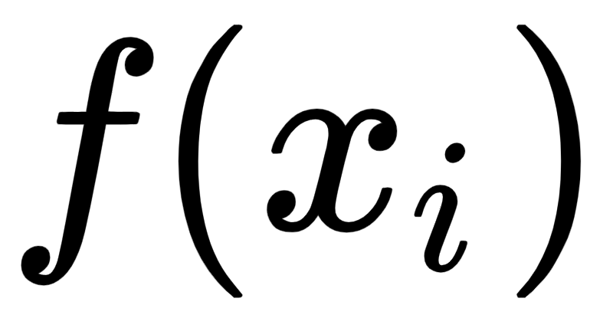

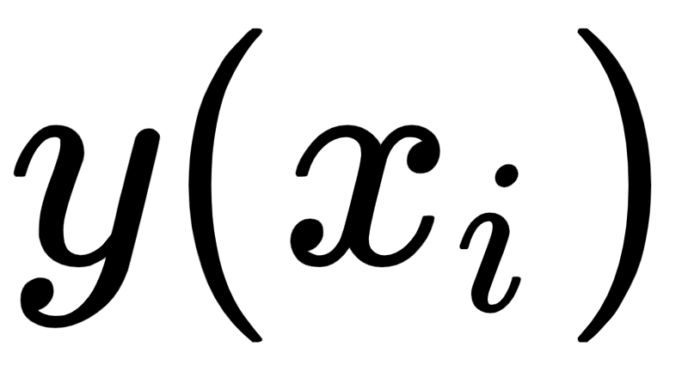

Identifying Model Weakness with Adversarial Examiner
Solution: Adversarial Examiner (AE)
In standard classification tasks:
Standard evaluation metric vs. AE’s evaluation metric
Loss function
Underlying Distribution for x
transform function
Predicted Label
Underlying Distribution for z
Groundtruth Label
Information to transform z to x
Notes:
Welcome
Introduce faculty and grad student
Explain how many people are in attendance?
Objective: Provide an overview of open house structure:
Intro to Johns Hopkins and the Whiting School of Engineering
Program info, including: academic objectives, program structure, specialization
What makes the program at JHU unique
Outcomes
Admissions criteria and tuition
Opportunity to ask questions

Slide 9
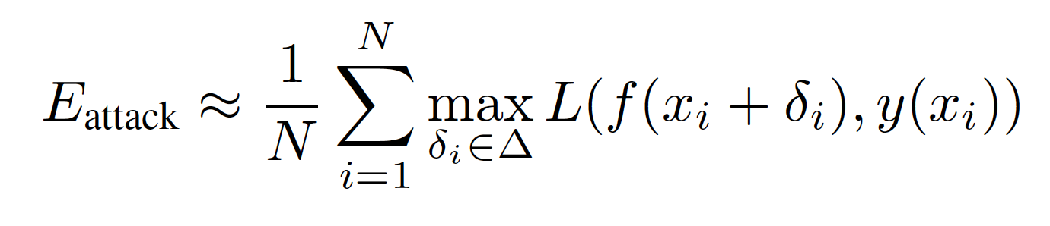
Identifying Model Weakness with Adversarial Examiner
Relationship: AA and AE
In standard classification tasks:
Adversarial Attack (AA) vs. Adversarial Examiner (AE)
Loss function
Underlying Distribution for x
transform function
Predicted Label
Underlying Distribution for z
Groundtruth Label
Information to transform z to x
AE deals with underlying form z while AA deals with surface form x.
There is a “canonical” starting point for AA but AE starts with the entire space S.
Notes:
So the variations of AE on the surface form is typically much larger.
Performing gradient descent starting from delta = 0, hence the sequence of delta is very local, while AE gives us a global picture.

Slide 10
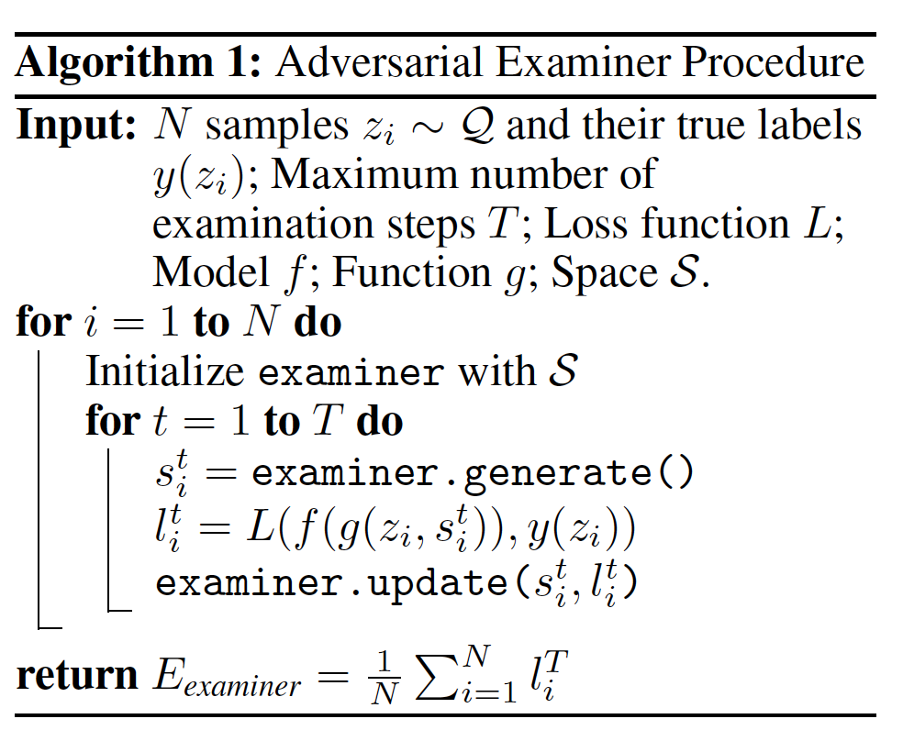
Identifying Model Weakness with Adversarial Examiner
Solution: Adversarial Examiner (AE)
Underlying Form z
Additional Information s
Is it bleping: yes
Viewing distance: close-up
…
State: cute
Surface Form x = g(z, s)
Notes:
Welcome
Introduce faculty and grad student
Explain how many people are in attendance?
Objective: Provide an overview of open house structure:
Intro to Johns Hopkins and the Whiting School of Engineering
Program info, including: academic objectives, program structure, specialization
What makes the program at JHU unique
Outcomes
Admissions criteria and tuition
Opportunity to ask questions

Slide 11
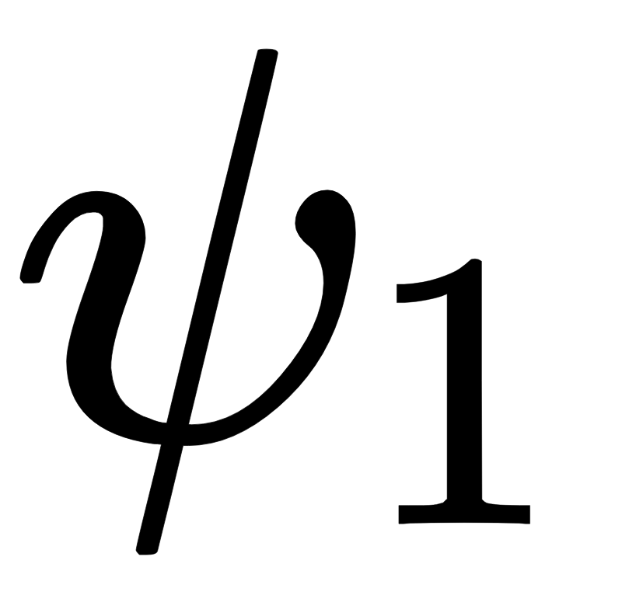
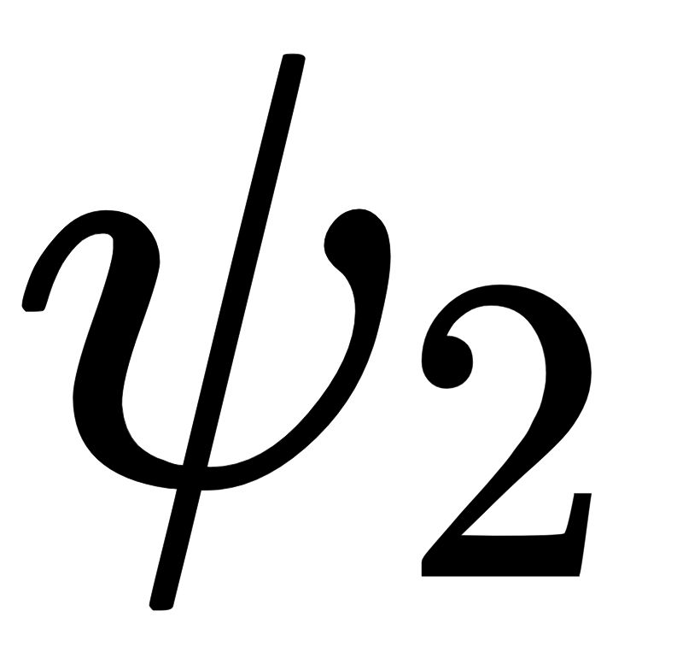
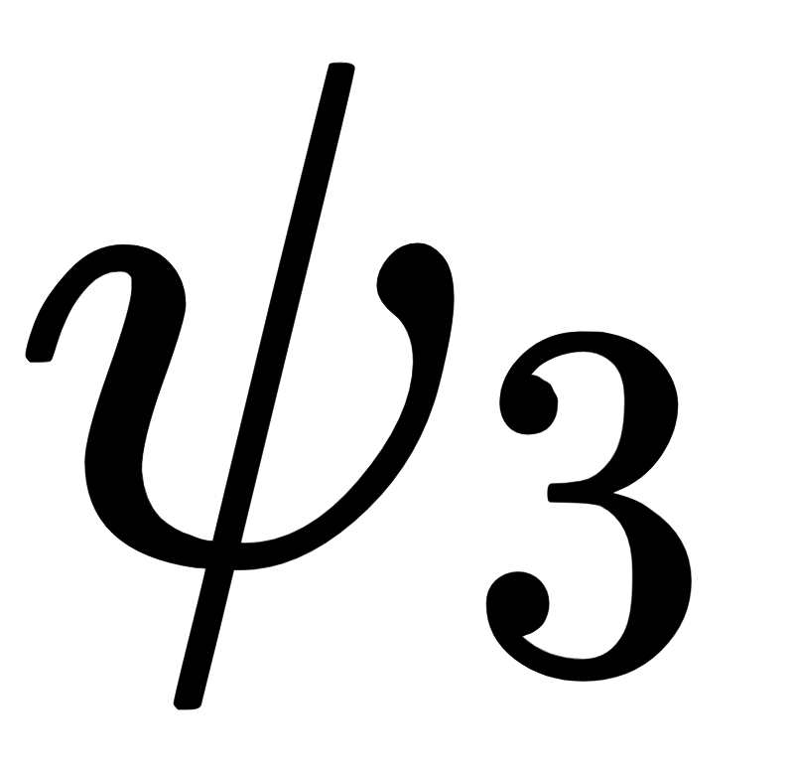
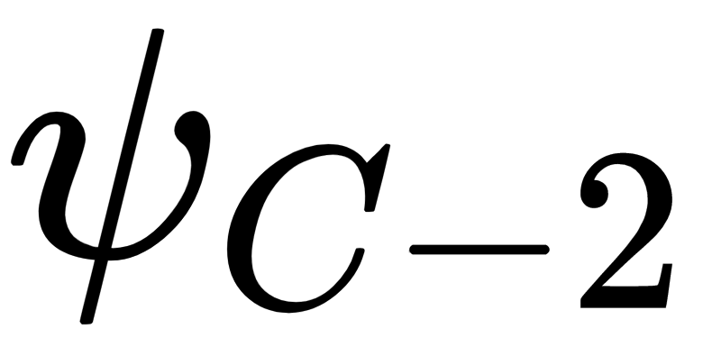
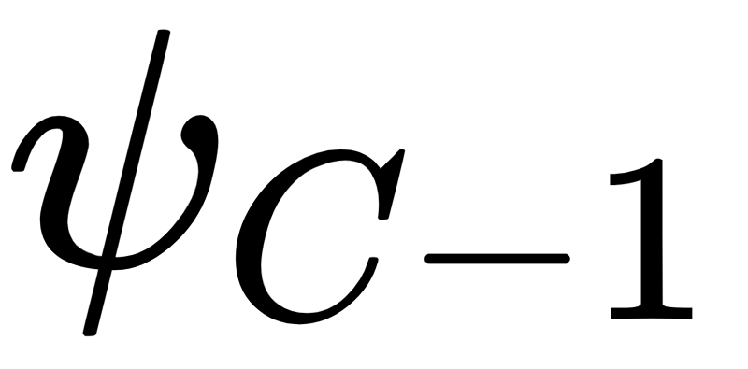
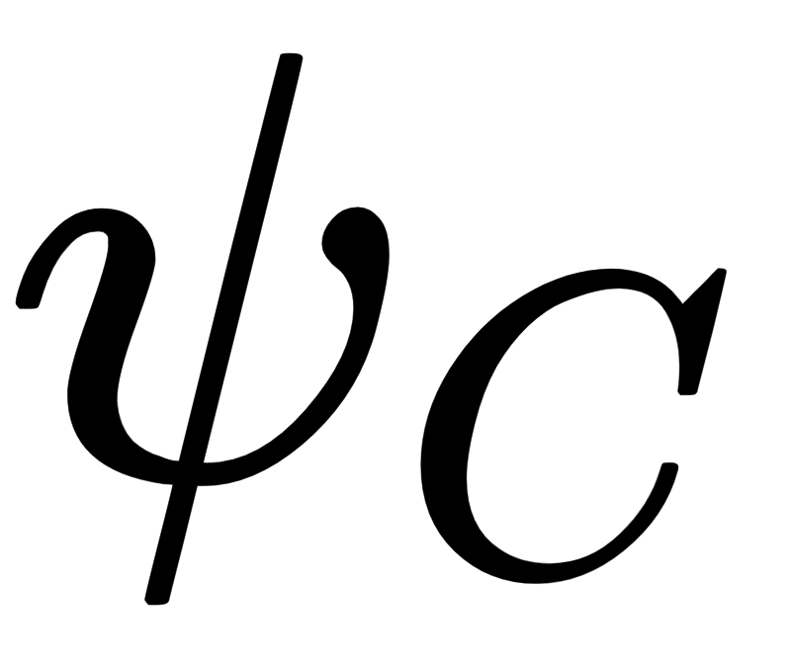
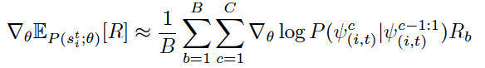
Identifying Model Weakness with Adversarial Examiner
Deep Learning Based AE (LSTM + Reinforcement Learning):
...
Sampled
Values
Predicted Distributions
Recurrent Network
Notes:
DOESN’T NECESSARILY NEED BAYESIAN OPTIMIZATION FORMULA, correspond to algorithm steps and add cyclic images

Slide 12

Identifying Model Weakness with Adversarial Examiner
Deep Learning Based AE (LSTM + Reinforcement Learning):
...
Reward signal
Notes:
DOESN’T NECESSARILY NEED BAYESIAN OPTIMIZATION FORMULA, correspond to algorithm steps and add cyclic images

Slide 13
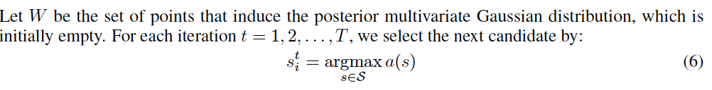
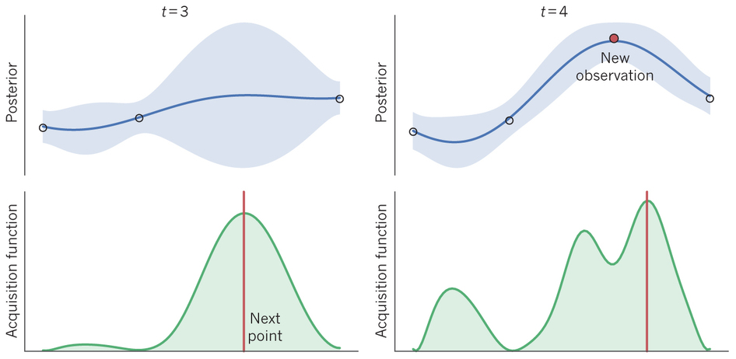
Identifying Model Weakness with Adversarial Examiner
Bayesian Optimization Based AE:
Notes:
Welcome
Introduce faculty and grad student
Explain how many people are in attendance?
Objective: Provide an overview of open house structure:
Intro to Johns Hopkins and the Whiting School of Engineering
Program info, including: academic objectives, program structure, specialization
What makes the program at JHU unique
Outcomes
Admissions criteria and tuition
Opportunity to ask questions

Slide 14
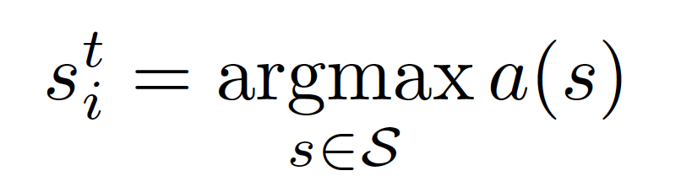

Identifying Model Weakness with Adversarial Examiner
Bayesian Optimization Based AE:
Newly Observed Point
Notes:
DOESN’T NECESSARILY NEED BAYESIAN OPTIMIZATION FORMULA, correspond to algorithm steps and add cyclic images

Slide 15
Identifying Model Weakness with Adversarial Examiner
Experiments on ShapeNet:
Model Type: ResNet34 vs. AlexNet
Training Set: Varied training set size
Multiple Weakness: Artificial Weakness
Reversed Examination: Identify Model Strength

Slide 16
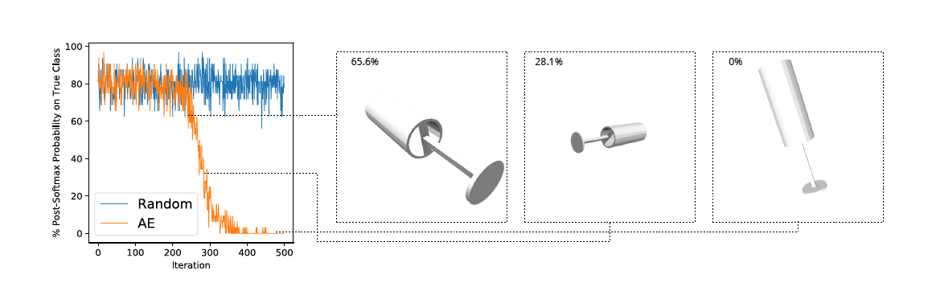
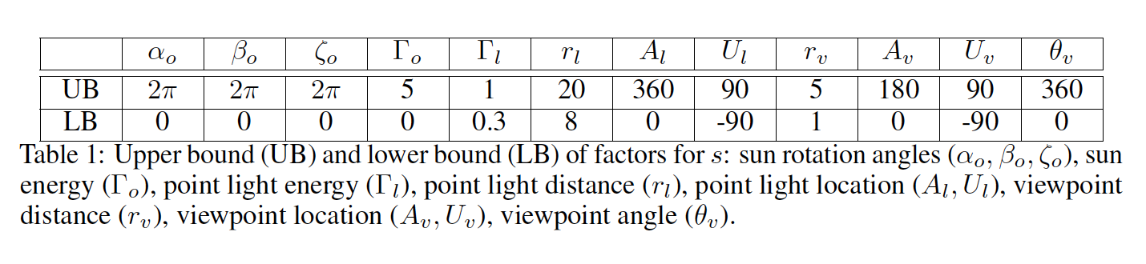
Identifying Model Weakness with Adversarial Examiner
Experiments on ShapeNet:

Slide 17
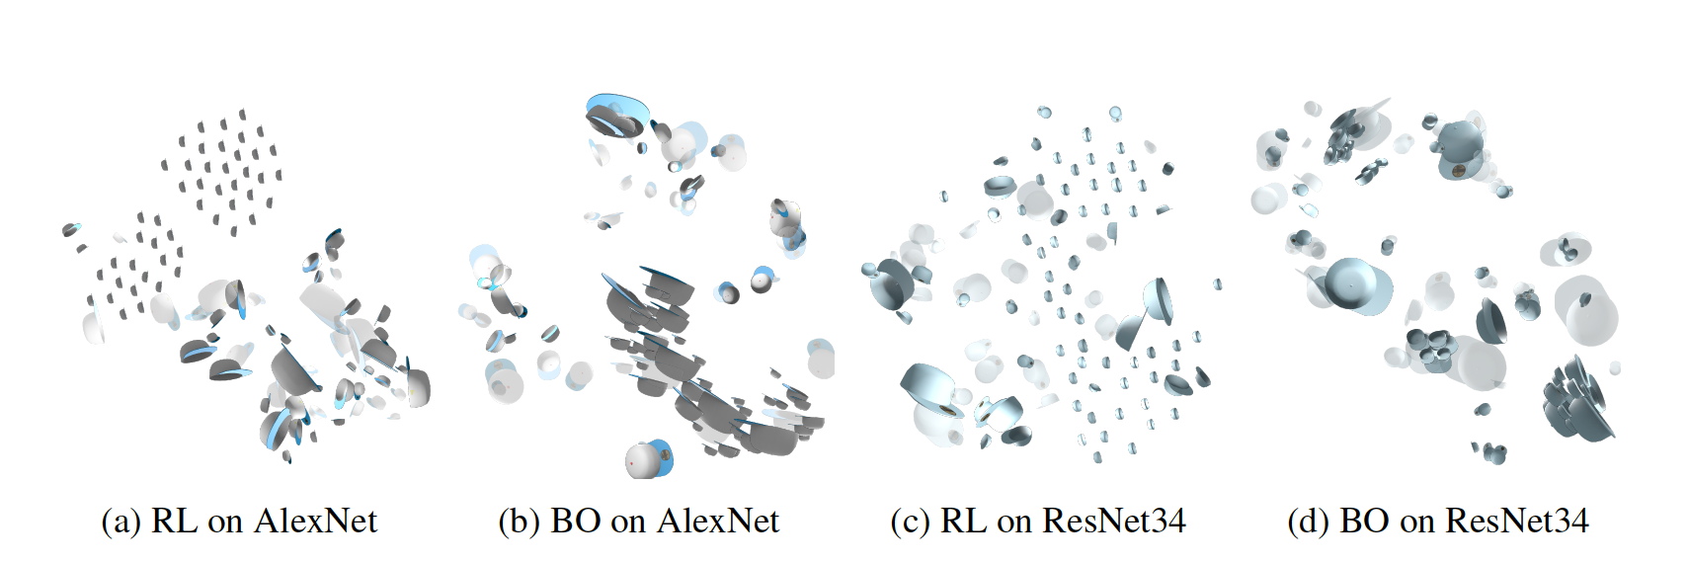
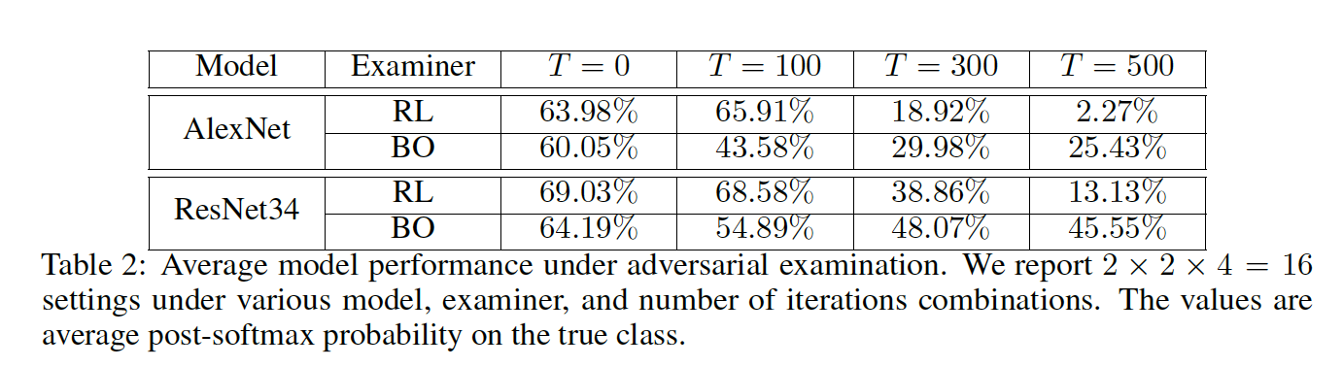
Identifying Model Weakness with Adversarial Examiner
Experiments on ShapeNet: ResNet34 vs. Alexnet
Notes:
NO CAPTIONS! Print my own captions

Slide 18
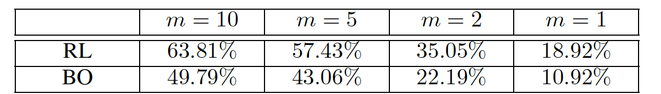
Identifying Model Weakness with Adversarial Examiner
Experiments on ShapeNet: Varied Training Size
Notes:
NO CAPTIONS! Print my own captions

Slide 19
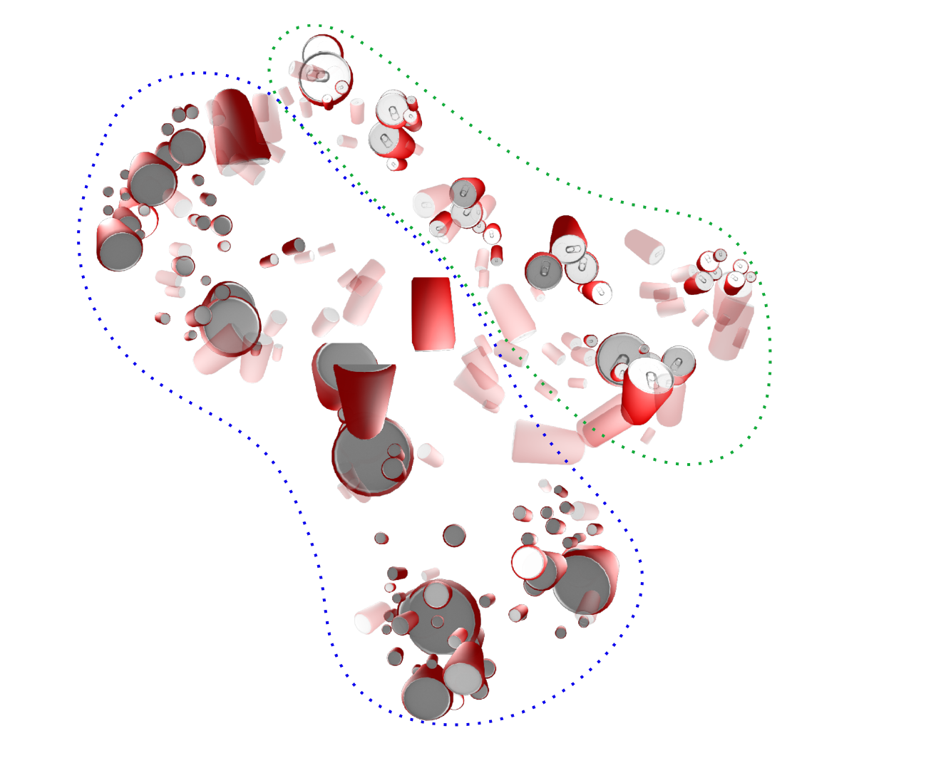
Identifying Model Weakness with Adversarial Examiner
Experiments on ShapeNet: Artificial Weakness

Slide 20
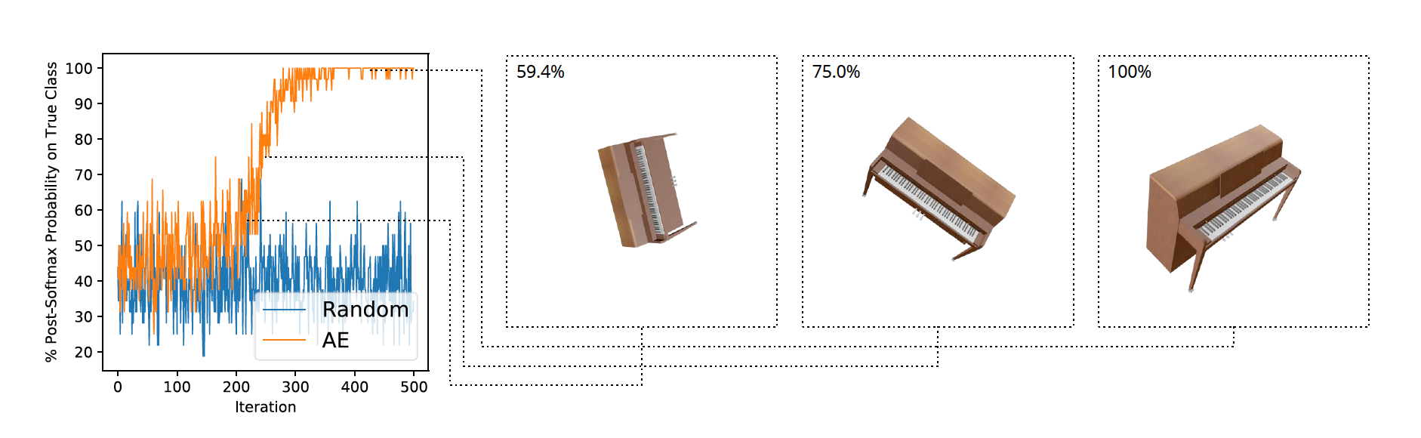
Identifying Model Weakness with Adversarial Examiner
Experiments on ShapeNet: Identifying Model Strength

Slide 21
Identifying Model Weakness with Adversarial Examiner
Take-Home Message:
Motivated by the mismatch, we try to mimic some aspects of turing test:
Worst case instead of average case
Dynamic test set based on test history instead of fixed test set
Notes:
Z (real object + its pose), s (viewing angle), x (image)

Slide 22
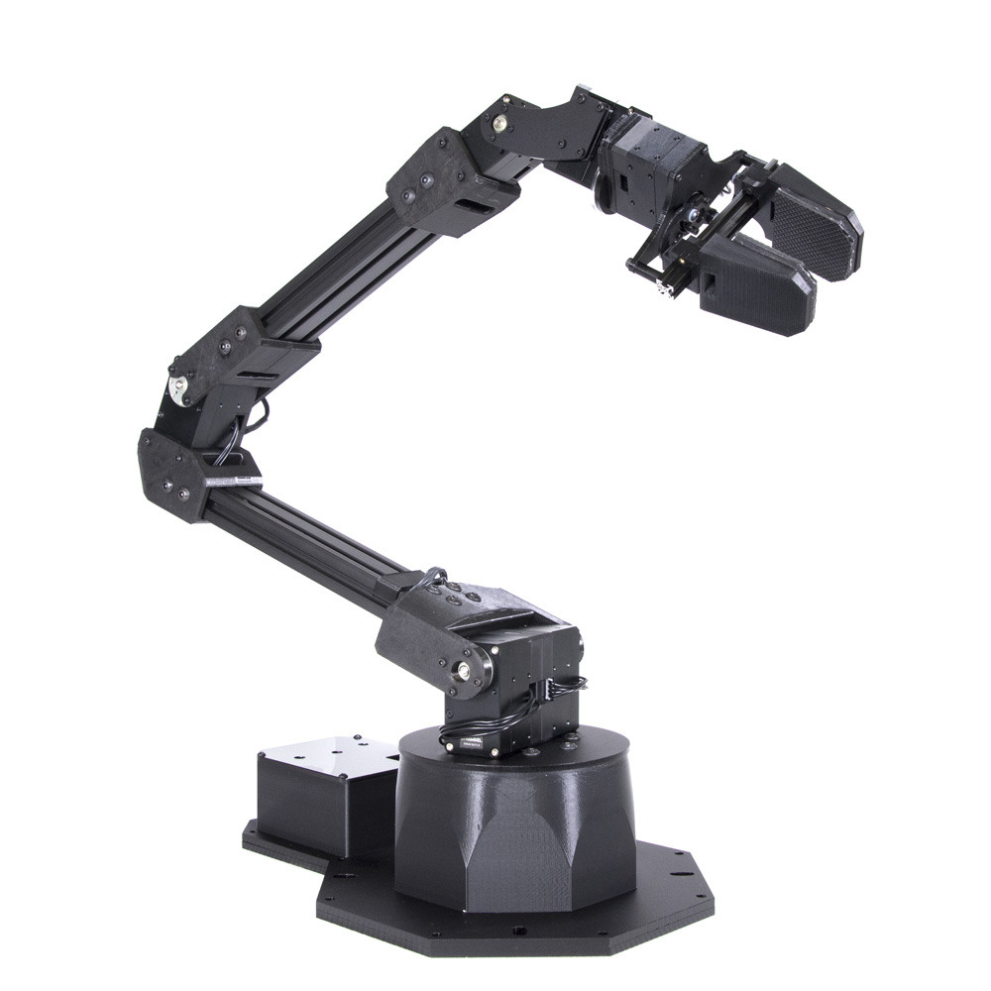
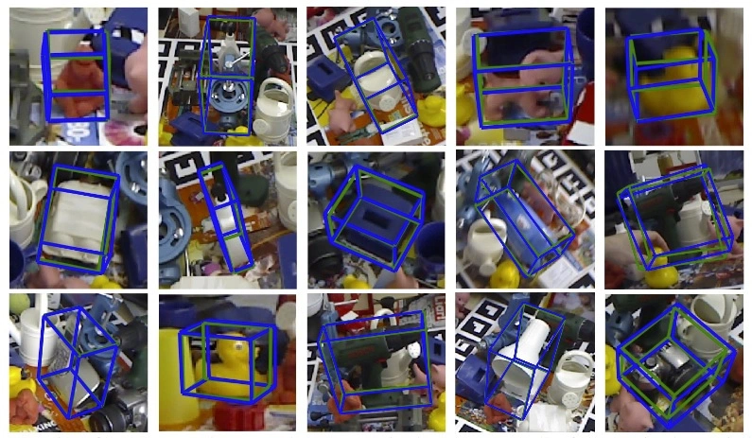
Identifying Model Weakness with Adversarial Examiner
Some Problems:
Implicit form z and transform function g(z, s) is hard to obtain in some tasks
CV People cannot abandon fixed datasets (yet)
Ongoing Experiment:
Apply AE to 6D Pose Estimation Task:
Notes:
Z (real object + its pose), s (viewing angle), x (image)

Slide 23
Identifying Model Weakness with Adversarial Examiner
Thank You!

