Slide 1
Lecture 14
Applications of Blockchains - II

Slide 2
Prediction markets & real-world data feeds

Slide 3
Assertions about the outside world
Idea: add a mechanism to assert facts
election outcomes
sports results
commodity prices
Bet or hedge results using smart contracts
Forwards, futures, options...
General formulation: prediction market

Slide 4
Prediction markets
Idea: trade shares in a potential future event
Shares worth X if the event happens, 0 if not
Current price / x = estimated probability

Slide 5





Example: World Cup 2014
pre-tournament
0.12 0.09 0.22 0.01 0.05
after group stage
0.18 0.15 0.31 0.06 0.00
0.26 0.21 0.45 0.00 0.00
before semis
Can immediately profit!
before finals
0.64 0.36 0.00 0.00 0.00
final
1 0 0 0 0
Should have shorted

Slide 6
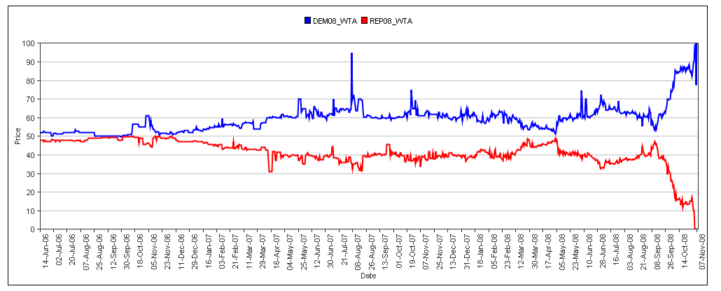
Example: 2008 US Presidential election
source: Iowa Electronic Markets

Slide 7
Prediction markets
Economists love them
reveal all knowledge about the future
(under a number of assumptions)
allows profit from accurate predictions
“a tax on BS”
Often beat polls and expert opinions
Significant regulatory hurdles
InTrade shut down in 2013

Slide 8
Decentralized prediction markets?
Decentralized payment & enforcement
Decentralized arbitration
Decentralized order book

Slide 9
Decentralized payment & settlement
Simple solution: Bitcoin + trusted arbiters
Better solution: altcoin with built-in support

Slide 10
Payment & settlement - FutureCoin
BuyPortfolio(event e)
one share in every outcome for $1
TradeShares(...)
exchange shares for each other or currency
one way of profiting
SellPortfolio(event e)
redeem one share in every outcome for $1
Clark et al. 2014

Slide 11
Arbitration models
Trusted arbiters
allow anybody to define & open a market
risk of incorrect arbitration, absconding
Users vote
requires incentives, bonds, reputation
Miners vote
may be disinterested or not know

Slide 12
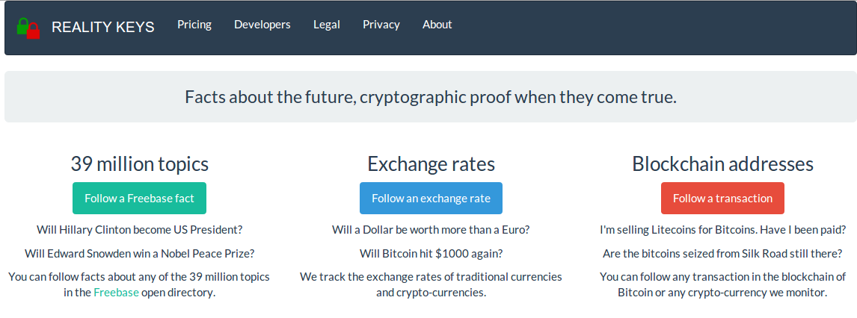
RealityKeys

Slide 13
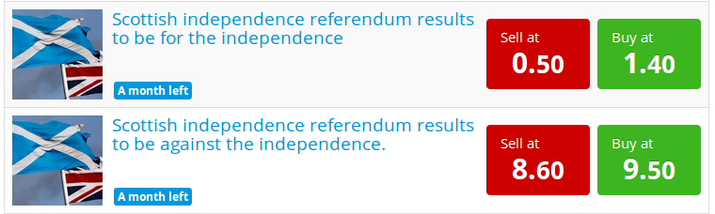
Order books
Goal: match best bid and ask offers
Predictious.com

Slide 14
Centralized order books
Traditional model
Promise to split surplus between buyer, seller
Front-running is considered a serious crime!
require regulation, auditing, monitoring

Slide 15
Decentralized order books
Idea: Submit orders to miners, let them match any possible trade
Spread is retained as a transaction fee
Front-running now not profitable!
May be less efficient
Higher fees
Slower trades to avoid higher fees

Slide 16
Decentralized order books
Idea: Submit orders to miners, let them match any possible trade
Spread is retained as a transaction fee
Front-running now not profitable!
May be less efficient
Higher fees
Slower trades to avoid higher fees

Slide 17
What can be built on Bitcoin?
payment | ✓
settlement | no trades
arbitration | trusted arbiter only
order books | must be external
Bitcoin isn’t enough

Slide 18
How to Use Bitcoin to Design Fair Protocols
Cryptocurrencies
Iddo Bentov, Ranjit Kumaresan
CRYPTO 2014
Slides based on Ranjit’s talk

Slide 19
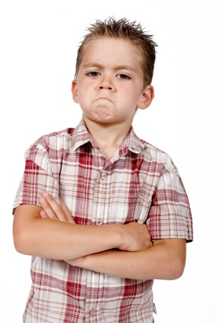

Secure Computation
x
y
f (x,y)
f (x,y)
Most general problem in cryptography
Feasibility results [Yao86,GMW87,…]
Moving fast from theory to practice

Slide 20



Secure Computation
x
y
≈
x
y
f (x,y)
f (x,y)
f (x,y)
f (x,y)
Ideally…
Protocol for secure computation emulates a trusted party
Privacy
Correctness
Fairness

Slide 21
Fairness in Secure Computation
f (x,y)
2-party fair coin tossing impossible [Cle86]
Fair secure computation possible only in restricted settings
For restricted class of functions [GHKL08,Ash14]
If majority of parties are honest [BGW88,RB89]

Slide 22

Fair Exchange
[Rab81,BGMR85,ASW97,ASW98,BN00,….]
E.g., contract signing, digital media
Special case of secure computation
Authenticity & fairness
Contract signing:
Two parties want to sign a contract
Neither wants to commit first
The other signer could be malicious…

Slide 23
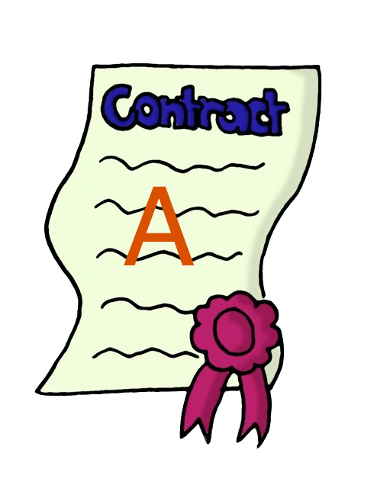

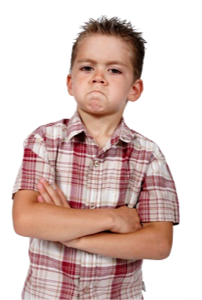
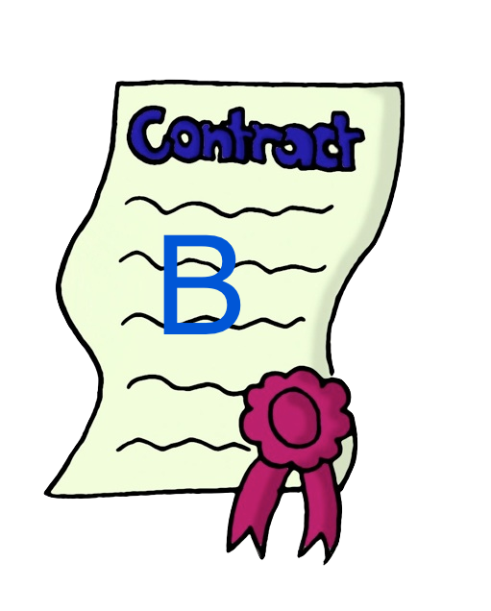
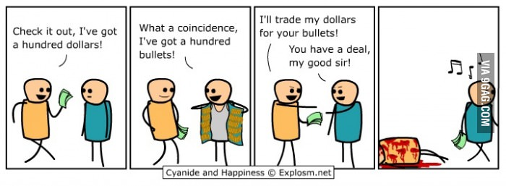
Fair Exchange
[Rab81,BGMR85,ASW97,ASW98,BN00,….]
Fair exchange is
impossible
[Cle86,PG99,BN00]

Slide 24
Workarounds I
Gradual release mechanisms [BG89,GL91,BN00,GJ02,GP03,Pin03,GMPY06,…]
Partial fairness [MNS09,GK10,BOO10,BLOO11]
Control adversary’s advantage in learning the output first
Requires lots of rounds

Slide 25
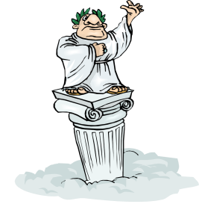
Workarounds II
Optimistic model [Rab81,BGMR85,ASW97,GJM99,Mic03,DR04,KL10…]
Trusted arbiter restores fairness
Contacted only when required
Requires trusting a third party
Potentially need to pay “subscription fee” to arbiter
f (x,y)
Bad guys get away with cheating

Slide 26
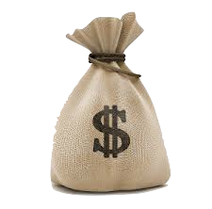
Workarounds III
Penalty model [ASW00,MS01,CLM07,Lin08,KL10]
Deviating party pays monetary penalty to honest party
lose money!
Bad guys get away with cheating
“Secure computation with penalties”

Slide 27
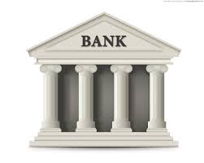

Penalty Model
“Legally enforceable fairness” [Lin08]
Requires central trusted bank
“Usable optimistic exchange” [ASW00,MS01,CLM07,KL10]
Requires trusted arbiter (+ e-cash)
Ideally…
Decentralized system; no trusted third party
Widely adopted

Slide 28

Secure computation with penalties
Can Bitcoin replace a trusted bank/arbiter?
x
y
f (x,y)
f (x,y)

Slide 29
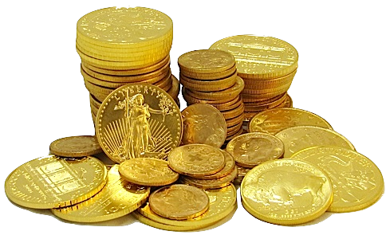
Defining Coins
Atomic entities
Indistinguishable from one another
(Unique) owner possesses given coin
Ownership changes upon transfer
Notation: coins(x)
coins(x) + coins(y) = coins(x + y)
coins(x) - coins(y) = coins(x - y)

Slide 30
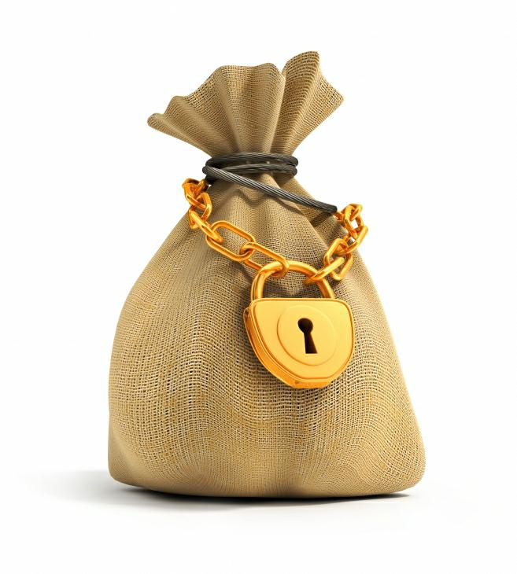
Claim-or-Refund Functionality
F_{CR}
Accepts from “sender”
Deposit: coins(x)
Time bound: τ
Circuit: ϕ
Designated “receiver” can claim this deposit
Produce witness T that satisfies ϕ
Within time τ
If claimed, then witness revealed to ALL parties
Else coins(x) returned to sender
T
ϕ, τ
Efficient realization via Bitcoin scripts

Slide 31
Secure Computation with Penalties
Honest parties submit
Inputs
Deposit: coins(d)
Ideal adversary S submits
Inputs of corrupt parties
Penalty deposit: coins(x)
Functionality F* does:
Return coins(d) to each honest party
Deliver output to S iff x = hq where h = #honest parties
If S returns abort, send coins(q) to each honest party
If S returns continue, send output to each honest party and return coins(x) to S
If x != hq, then send output to all parties
F*
q = penalty amount

Slide 32
Strategy
Reduce fair secure computation to fair reconstruction
Hybrid model with functionality F’
Computes output of f, say z
Secret share z into n additive shares sh₁,…,sh_{n}
Computes commitments on shares
c_{i} = com(sh_{i}; w_{i}) for every i
Delivers output: ({c₁,…,c_{n}}, T_{i} = (sh_{i}, w_{i})) to party P_{i}

Slide 33
Two Party Fair Reconstruction
denotes
P₂ must reveal witness T = (sh,w) within time τ to claim coins(q) from P₁
Secure computation with penalties
Honest parties never have to lose coins
If a party aborts after learning the output then every honest party is compensated
“Abort” Attack
P₂ aborts without making its deposit but claims P₁’s deposit
Honest P₁ loses money (although it learns output)

Slide 34
Two Party Fair Reconstruction
denotes
P₂ must reveal witness T = (sh,w) within time τ to claim coins(q) from P₁
Secure computation with penalties
Honest parties never have to lose coins
If a party aborts after learning the output then every honest party is compensated
Deposits made top to bottom
Claims made in reverse direction
If P₁ claims the 2nd deposit, then P₂ can always claim the 1st

Slide 35
Three Party Fair Reconstruction
denotes
P₂ must reveal witness T = (sh,w) within time τ to claim coins(q) from P₁
Secure computation with penalties
Honest parties never have to lose coins
If a party aborts after learning the output then every honest party is compensated
Malicious Coalitions
Coalition of P₁ and P₂ obtain T₃ from P₃
Then P₂ does not claim 1st transaction
P₁, P₂ learn output but P₃ is not compensated

Slide 36
Three Party Fair Reconstruction
denotes
P₂ must reveal witness T = (sh,w) within time τ to claim coins(q) from P₁
Secure computation with penalties
Honest parties never have to lose coins
If a party aborts after learning the output then every honest party is compensated
P₂ claims twice the penalty amount
Sufficient to deal with malicious coalition of P₁, P₃

Slide 37
Multiparty “Ladder” Protocol
Order of deposits/claims
Roof deposits made simultaneously
Ladder deposits made one after the other
Ladder claims in reverse
Roof claims at the end
Roof
High-level Intuition
At the end of ladder claims, all parties except P_{n} have “evened out”
If P_{n} does not make roof claims then honest parties get coins(q) via roof refunds
Else P_{n} “evens out”
Ladder

