Slide 1



LLMs Know More About Numbers than They Can Say
Fengting Yuchi¹, Li Du², Jason Eisner²
¹Shanghai Jiao Tong University, ²Johns Hopkins University
Notes:
Hi everyone, I’m Fengting. I’m glad to share our paper “LLMs Know More About Numbers than They Can Say”. This work was done at CLSP (Center for Language and Speech Processing) at Johns Hopkins University.

Slide 2
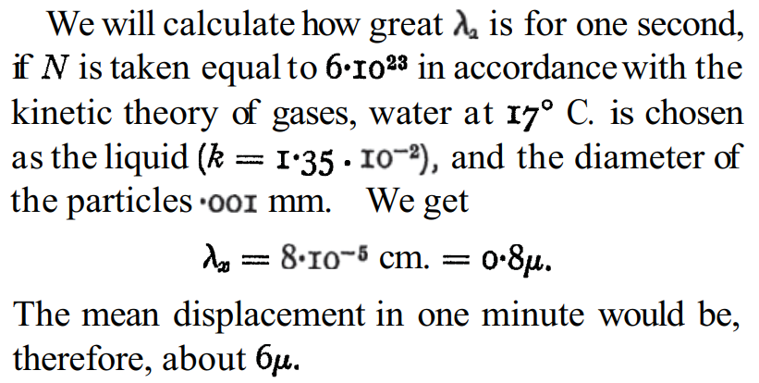
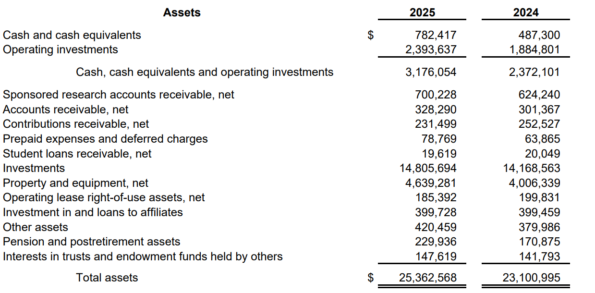
Literacy Numeracy
Finance
Science
Finance
Credit:
https://www.damtp.cam.ac.uk/user/gold/pdfs/teaching/old_literature/Einstein1905.pdf
https://finance.jhu.edu/wp-content/uploads/sites/38/AnnualReport2025.pdf
Notes:
Have you heard the term numeracy? It's like literacy, but for numbers. We want LLMs to be able to read and discuss scientific papers and financial reports. Unfortunately, they sometimes get confused by numbers. We'd like to understand what's going on and fix it.

Slide 3

Numbers vs. Numerals
numerals:
570
5.7 × 10²
numbers:
0
570
Notes:
As a reminder, numbers are mathematical objects, and numerals are the strings that name those objects.

Slide 4
Cross-notation Comparison
Q: Which is larger,
5.7 × 10²
570
or 580?
Notes:
We found a simple task that tends to confuse LLMs: Which numeral is bigger? If they can't even do that reliably, then they have no hope of discussing scientific papers. [show example of comparing 570 with 580]
You might have thought that this was easy for them. But actually they're brittle. We found that they break if we put just one of the numerals in scientific notation. [cross out one of the numbers and change it] They probably weren't trained on this case.

Slide 5
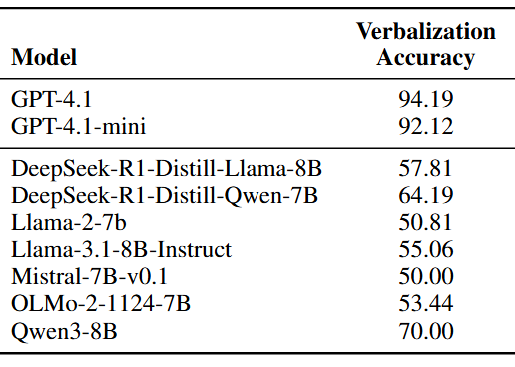
Cross-notation Comparison Breaks LLMs
Notes:
We studied open-source models with 7-8B parameters, and they all have 70% accuracy or worse. [highlight 70% accuracy] Some of them have only 50% accuracy, which is random chance. [highlight 50% accuracy] So we wanted to understand what they're missing.
Bigger models do work better on this task, but even GPT-4.1 only has 94% accuracy. [highlight this]

Slide 6
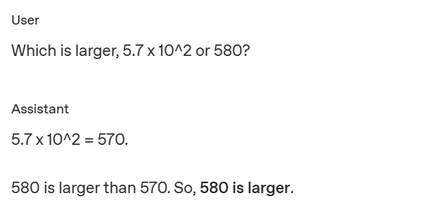
Does Chain of Thought Solve the Problem?
Notes:
If the models used chain of thought, maybe they would convert the numerals out of scientific notation. [show an example CoT that does this] But a numerate model shouldn't have to pause and think verbally every time it sees a numeral.
Now imagine you are reading a scientific paper. [show the scientific sentence]

Slide 7

When Numbers Appear in Scientific Text
decreased
“The concentration increased from
0.45 M to 3 × 10⁻³ M.”
— generated by ChatGPT 5.2
CoT is not enough - we need
“always-on” numeracy
Notes:
You came across this sentence, “The concentration increased from 0.45 M to 3 × 10−3 M.” As you read it, you probably have an intuitive sense of how large these two numbers are.
Wait, something seems wrong. It shouldn’t say “increased.” [cross out “increased”] It should say “decreased.” [”decreased” appear]
Let me disclose what happened: this sentence was generated by ChatGPT 5.2 when I asked it to produce an example of scientific text that contains mixed-notation numbers.
So the same mixed-notation failure appears when *generating* text, not just when reading it. And again, this is GPT-5.2.
Chain-of-thought can work around the issue by converting scientific notation numerals back and forth, but it’s not practical to generate a chain-of-thought after every token.
An LLM should already have "number sense" -- when it sees a numeral, it should know internally how big the numbers are, just like human readers do.
So, we started by testing whether they do have "number sense" …

Slide 8
Magnitude Probing
9.15
9.18
log₂ value
is
,
5
.
7
*
10
^
2
or
580
?
Which
larger
a
b
probe: hidden states of numerals’ last tokens → log₂ values
Notes:
Our first question is: do models know how big numbers are?
[show transformer stack with layer ℓ highlighted, with synthetic data]. To test this, we train linear regression probes on hidden states — specifically, the final token of each numeral at a given layer ℓ.
The target is the log₂ value of the number. For example, given the blue internal states, the probe should predict 9.15 and 9.18 , which are the log2 values of 570 and 580.
We run this experiment on two datasets. One is a synthetic dataset as shown here, “which is larger, a or b” where a and b are randomly generated cross-notation numbers.

Slide 9
Magnitude Probing in Scientific Papers
−1.152
-8.38
log₂ value
log₂ value
0
.
M
to
3
*
−
3
M
.
from
45
10
The
decreased
concentration
Notes:
The other is a dataset of scientific papers from arXiv. This tests whether magnitude encoding holds in scientific context.

Slide 10
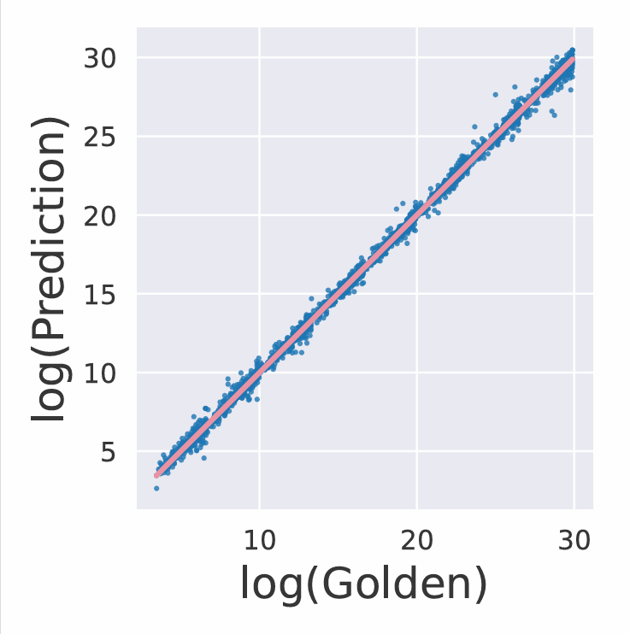
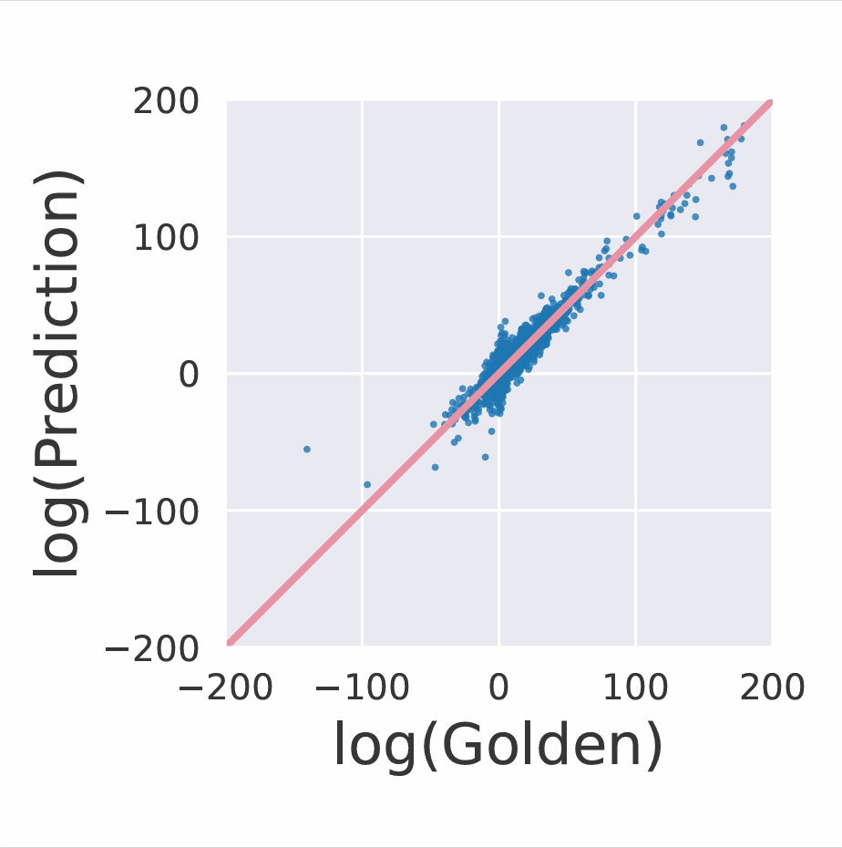
Hidden States Linearly Encode Numerical Magnitude
Mistral-7B
Layer 30 (best)
Layer 10 (best)
synthetic: R > 0.99
arXiv: R = 0.71
Notes:
These are the scatter plots. On the x-axis we have true log2 values, and on the y-axis we have probe’s predictions. The model probed here is Mistral-7B, and for each dataset we report results from its best-performing layer. On synthetic data, at layer 30, R is greater than 0.99, which is really perfect. While on arxiv data, at layer 10, R is only 0.71: the encoding is much noiser in scientific text, but clearly present. We concluded that hidden states encode log-magnitudes linearly. So internally, the model seems to know how big numbers are.
But is this knowledge precise enough to compare the cross-notation numbers, as the prompt requests?
Maybe, if the numbers aren't too close.

Slide 11
Regression-based Comparison
false
>
9.15
9.18
log₂ value
is
,
5
.
7
*
10
^
2
or
580
?
Which
larger
a
b
Notes:
To examine this, we use the regression probe to predict the magnitudes of both numbers, and then we compare those predicted values.

Slide 12
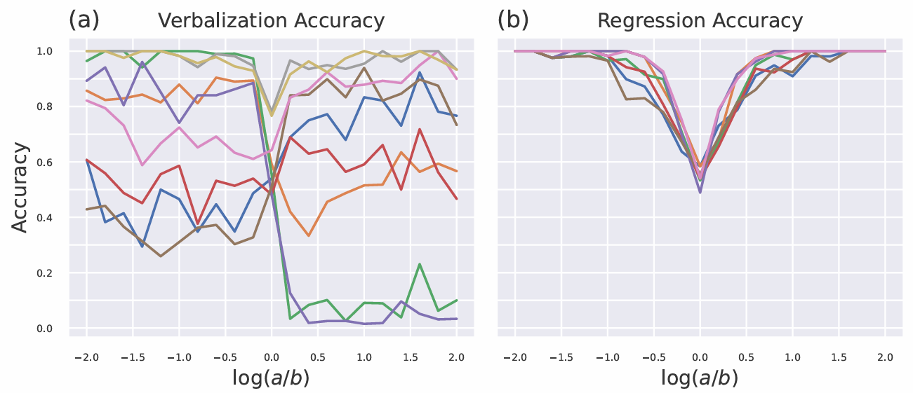
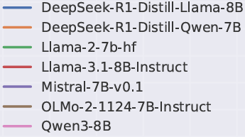
Can Magnitude Encoding Support Comparison?
Partially: not reliably for close numbers
Notes:
The results are not bad when the numbers are sufficiently different - accuracy exceeds 80% when |log(a/b)| is greater than 0.5, roughly when they differ by a factor of at least 1.4 or more. But in the middle of the graph, when the numbers are very close, performance drops sharply. This is true for all 7 open-source models we tried. So this comparison method works, but it’s imperfect. But of course, the model could answer the question by other means. Maybe it goes beyond representing the two numbers individually, and actually compares them internally. Humans mentally compare numbers all the time - we're numerate, so we can't help ourselves.

Slide 13
false
Comparison Probing
a > b?
is
,
5
.
7
*
10
^
2
or
580
?
Which
larger
a
b
probe: hidden states of prompt’s final token → a > b?
Notes:
So now, instead of predicting magnitudes, we directly probe to see if the model has internally computed whether a > b. It really should in this case, since our prompt literally asks it to do this comparison! We train a binary classifier using hidden states of the last token of the prompt.

Slide 14
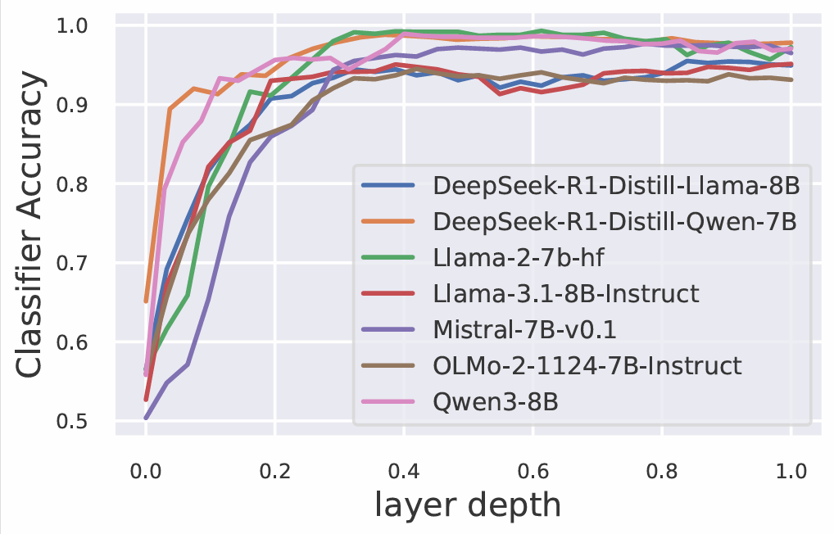
LLMs Internally Compare Numbers
Higher layers consistently exceed 95% accuracy
Notes:
Here are the results. On the x-axis we have the normalized layer depth, and on the y-axis we test accuracy of the classifiers. We see that higher layers consistently exceed 95% accuracy. But does this work when the numbers are close together?

Slide 15
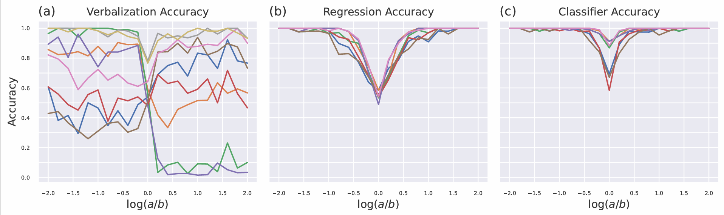
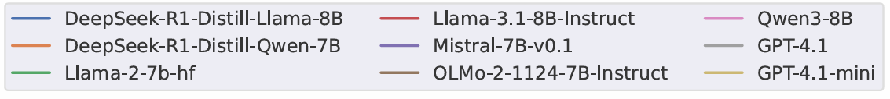
Gap Between Internal and Verbal Comparison

Slide 16
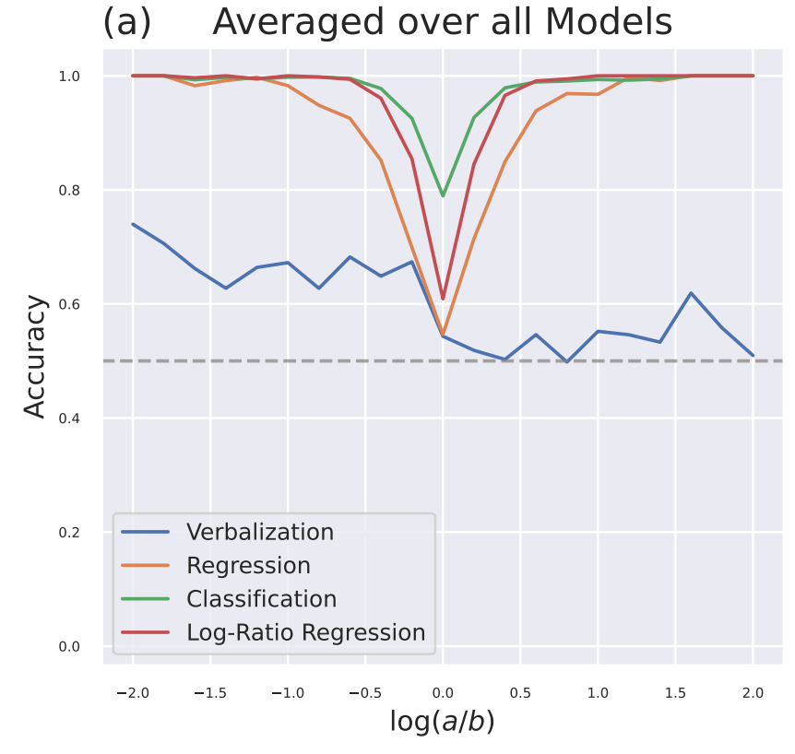
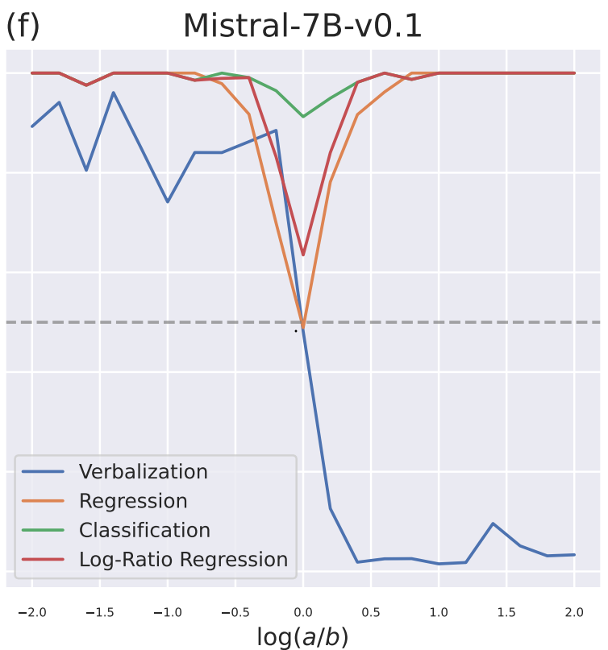
Gap Between Internal and Verbal Comparison
Notes:
“The classification probe, in green, is more accurate than comparing the two regression outputs, in orange. (This [point to graph] is Mistral, and this [point to graph] is the average of all models.) Classification, in green, is also more accurate than the red curve, which uses regression to predict the ratio of the two numbers.
So the model is internally computing which number is bigger, even when it doesn’t precisely represent their magnitudes or their ratio. But look at the blue curve! These models are terrible at verbalizing the answer! They usually answer wrong.
So, the LLM kind of does the comparison internally, but it’s bad at using that information to decide which number to copy. In fact, Mistral [point to graph] usually just copies the second number.”

Slide 17
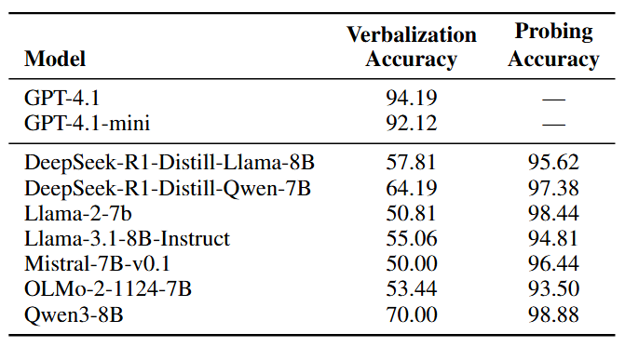
LLMs Know More About Numbers than They Can Say
Notes:
Over all 7 models, verbalization accuracy is 50-70%, but the classifier probe gets over 93%. In other words, LLMs know more about numbers than they can say.
Now you might reasonably ask: Why bother probing at all? Are we just assuming that probe performance has anything to do with verbalization?

Slide 18
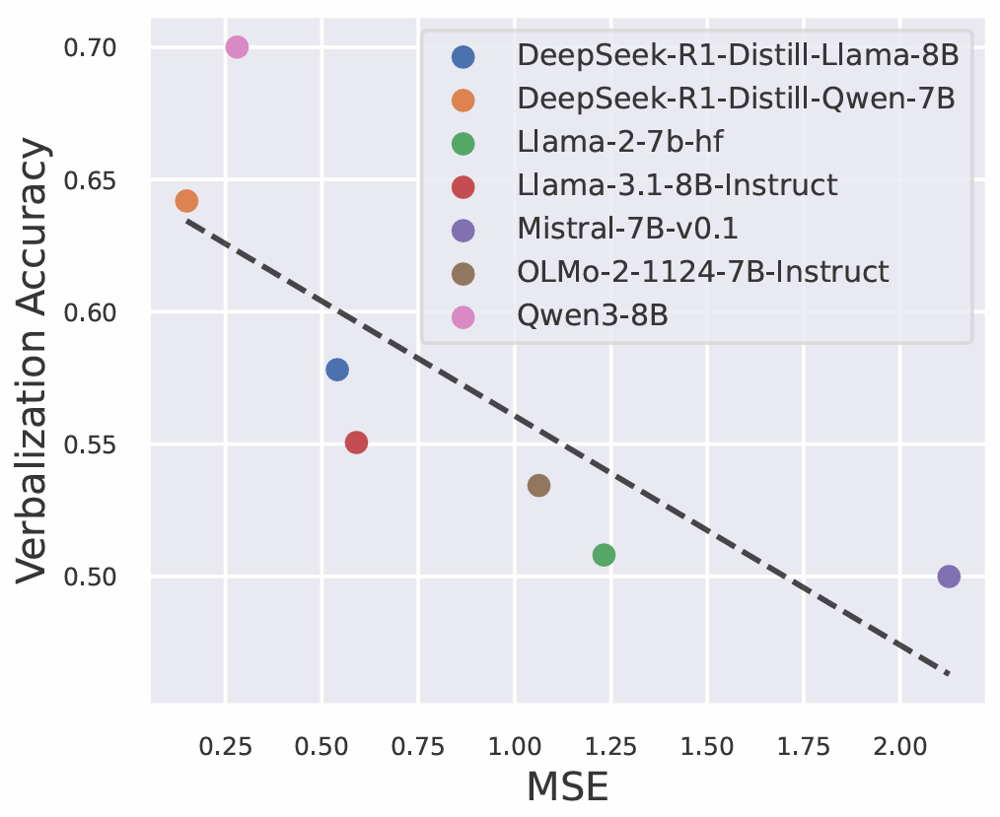
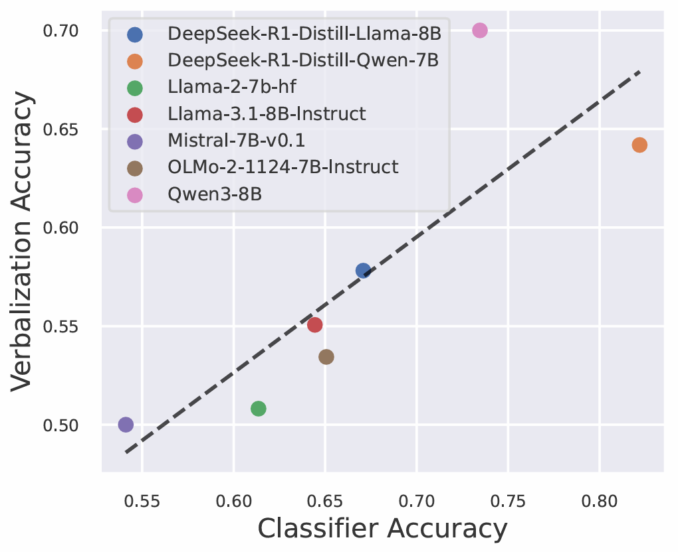
Early Probe Quality Predicts Verbalization Accuracy
regressor
classifier
x-axis: average probe performance at first 3 layers
Can improving internal representations improve verbalization?
Notes:
To investigate this, we look at the relationship between probing quality and verbalization accuracy.
First, on synthetic data, we find that the best probes are near the top of the transformer.
But by that point, much of the processing has already happened. So these late representations may not be the ones that actually drive the model’s verbalized comparison.
This led us to ask whether earlier layers — where the model is still forming its internal representations — might matter more for downstream tasks like verbalization.
Indeed, we find strong correlation across diverse 7B-8B models between the average performance of probes from the first 3 layers and verbalized comparison accuracy on the synthetic dataset. Lower regression error predicts higher verbalization accuracy [point to upper left of graph #1]. And higher classification accuracy also predicts higher verbalization accuracy [point to upper right of graph #2]. This suggests that higher quality of internal numerical representations is linked with improved verbalization performance. Which naturally raises the next question: Is this a causal link? [show the orange text] Can improving internal representations improve models’ verbalization results?

Slide 19

total finetuning loss
false
>
9.15
9.18
false
a > b?
log₂ value
next token
is
,
5
.
7
*
10
^
2
or
580
?
580
Which
larger
a
b
verbalized answer
Notes:
So this naturally leads to the intervention. If stronger internal representations lead to better verbalization, can we improve verbalization by explicitly strengthening those representations during finetuning?
Let me explain the setup.
First of all, remember that we're using a synthetic comparison task that the LLMs probably weren't trained on. Just fine-tuning on that task fixes about 4/5 of the errors. Our fine-tuning loss here is just the usual next-token prediction objective, where we try to predict the tokens of the red answer. [add the green dashed line] But it helps a lot to augment that training objective with the cross-entropy loss of our green classifier probe. We just add it to our fine-tuning objective. [add the blue dashed line] We also tried adding the MSE loss of our blue regression probes, but it didn’t help, because the model was already doing very well on the blue predictions. [remove the blue dashed line]. So in our final setup, we retain only the classifier probing loss as an auxiliary objective.

Slide 20
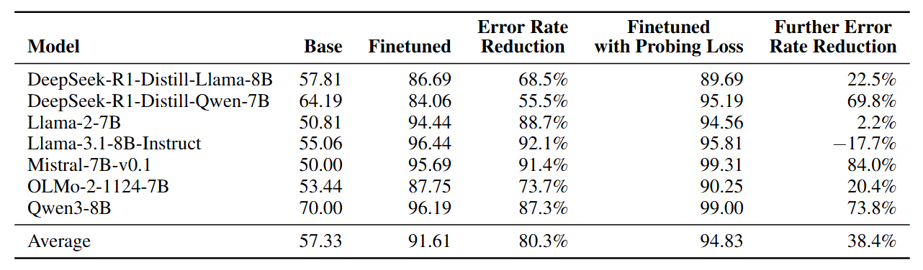
Probe-aware Finetuning Improves Verbalization
Improve internal representations → Improve verbalization
Notes:
Here are the finetuning results. The table shows cross-notation comparison accuracy of verbalized responses under three conditions: base model, standard finetuning, and finetuning with probing loss.
Again, ordinary finetuning fixes > 4/5 [highlight 80.3% error reduction rate] of the original errors made by these 7 models. But we can fix many of the remaining errors by augmenting with the probing loss. We eliminate more than 1/3 [highlight 38.4% error reduction rate] of the remaining errors.
Let me highlight a few models. [highlight Mistral and its base accuracy] Mistral was the worst base model, literally a random guesser, and became the top performer through our procedure. Fine-tuning cut the error rate by > 10x, [highlight the number] but improving the fine-tuning objective cut it by another 6x. [highlight the number] Qwen shows a similar pattern. [highlight Qwen and its base accuracy] Even though it starts out as the strongest base model, it still sees substantial error reduction from both finetuning and the augmented objective. [highight the two error rates]
This suggests by explicitly strengthening internal comparison representations, we can improve verbal numeracy. In other words, improving what the model knows internally helps it say the right thing externally.

Slide 21
Key findings
Numerical log-magnitudes and magnitude comparisons are encoded linearly.
Even so, LLMs verbalize cross-notation comparisons poorly.
Tuning a model’s internal representations to better encode numeric comparisons helps the model better answer such comparison questions verbally.
Notes:
Let me summarize our key findings
Numerical log-magnitudes and magnitude comparisons are encoded linearly.
Even so, LLMs verbalize cross-notation comparisons poorly.
Tuning a model’s internal representations to better encode numeric comparisons helps the model better answer such comparison questions verbally.
In one sentence: models know more than they can say—but improving what they know improves what they can learn to say.

Slide 22
Future work
Intervene on representations at inference time (causal tracing)
Generalize our findings to scientific text
Consider semantic context such as units
5 km > 5 m
50 m ∥ 50 kg
Notes:
Let me close with a few directions for future work:
Firstly, probing tells us what information is encoded, but not necessarily how it is used. We could intervene on representations at inference time to see how this changes the text output.
Secondly, we used arXiv data only for the regression probing experiment. All other experiments were conducted on the synthetic "Which is bigger" questions. We would love to investigate what the LLM is doing as it reads natural scientific text. Is it internally comparing numbers? Is it internally doing other computations? How do those help it predict future words and numerals?
Thirdly, in real scientific text, magnitude is often intertwined with units. For example, 5 km is larger than 5 m, and 50 meters and 50 kgs are incomparable. LLMs likely represent such contextual information internally, but we have not yet studied how units interact with numerical representations.
And with that, thank you for your time

Slide 23
Double life of Florentine merchants
MMDCLXXXVIII + MMDCCLXXXVI = MMMMMCDLXXIV
V.S.
2688 + 2786 = 5474

Slide 24
Double life of LLMs
GPT-4.1
INPUT
OUTPUT
Which is larger, 5.7×10² or 580?
5.7×10²

Slide 25
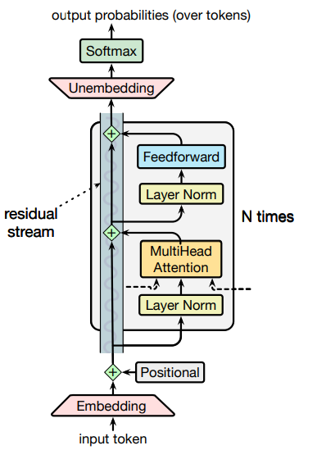
~log(570)
~log(580)
>
…
Regressor
hidden states

