Slide 1

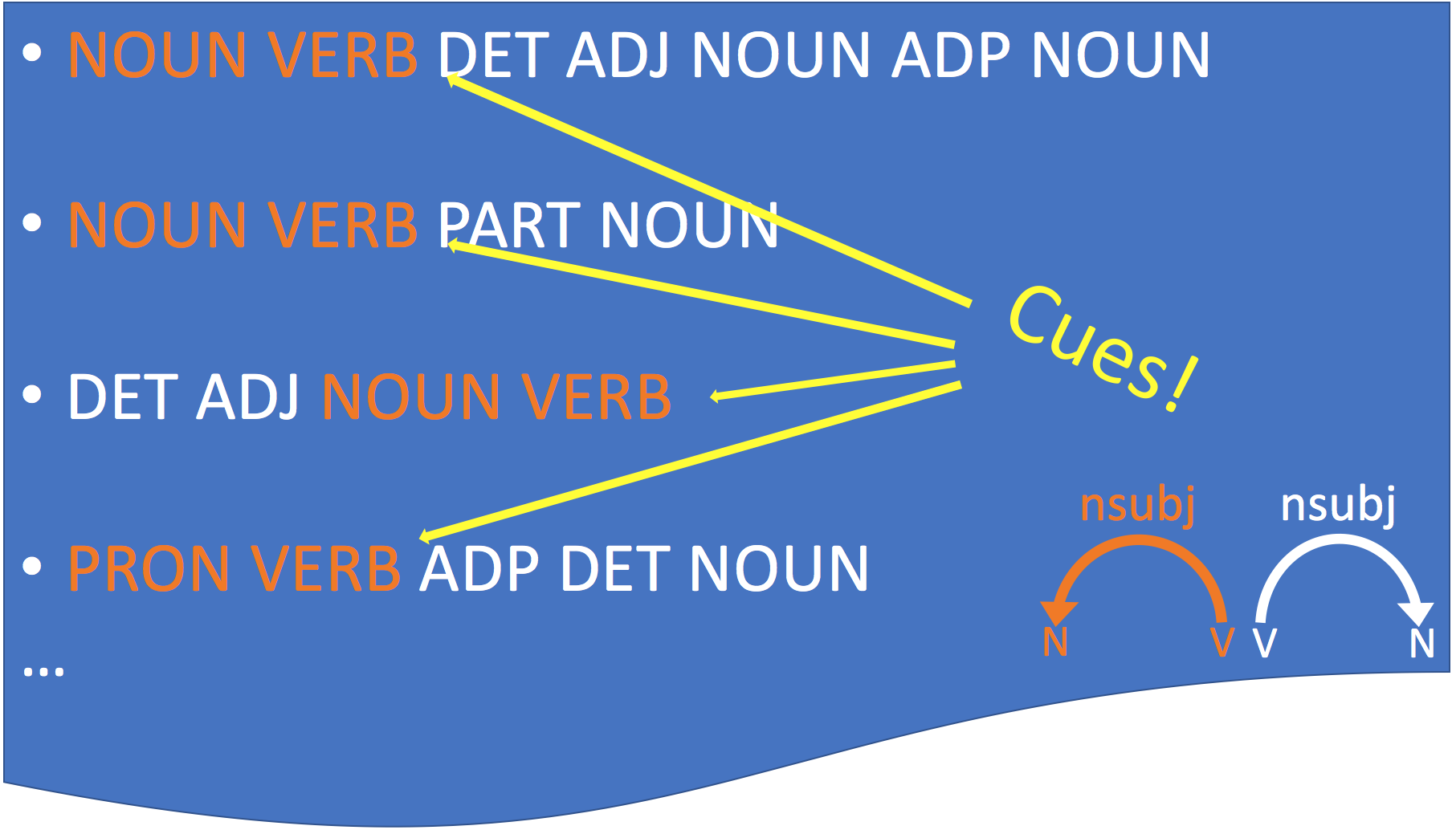
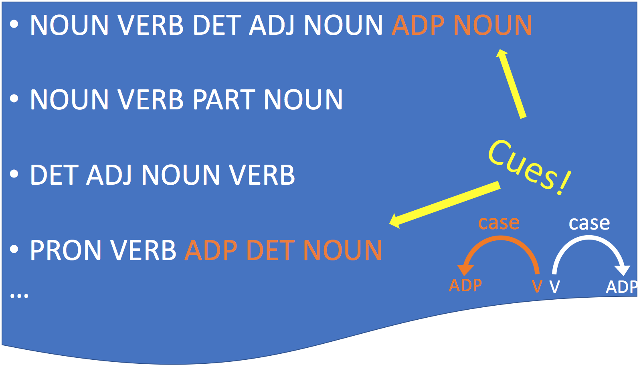
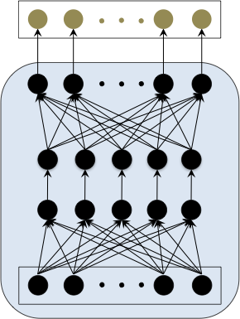
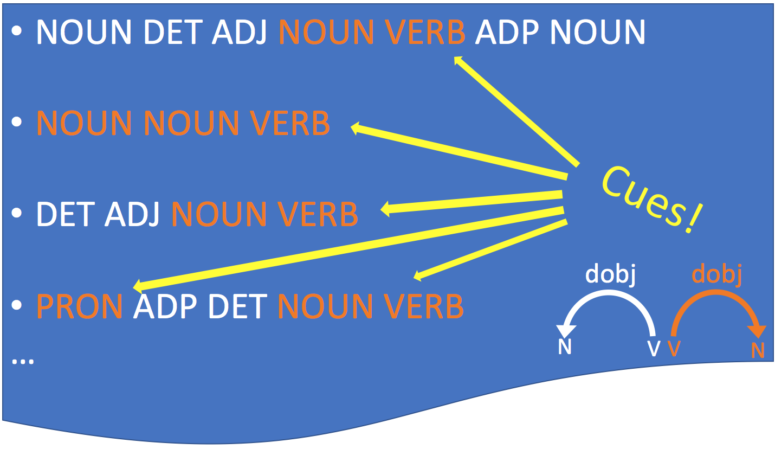
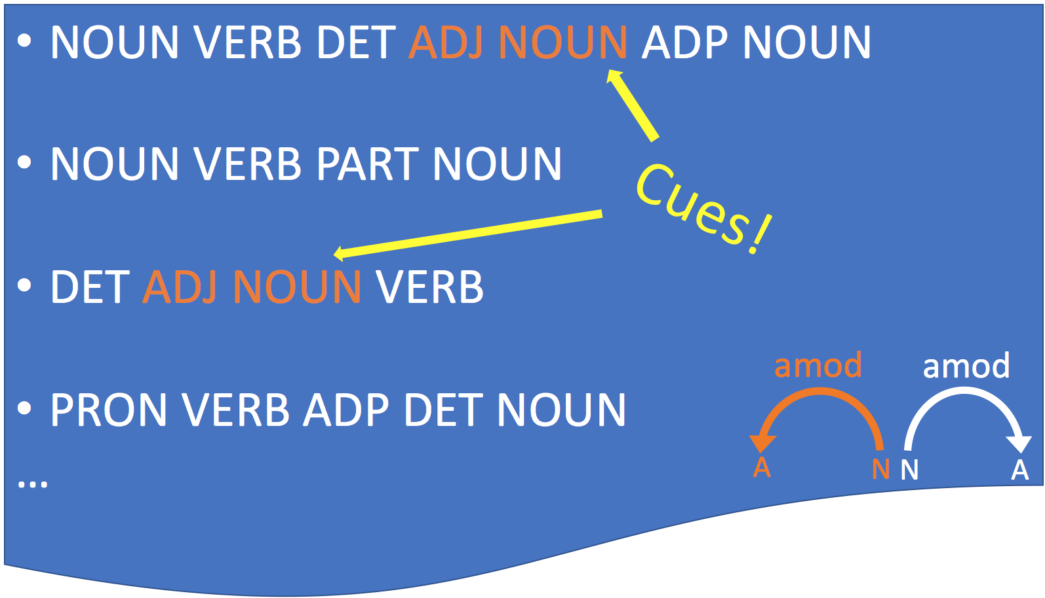
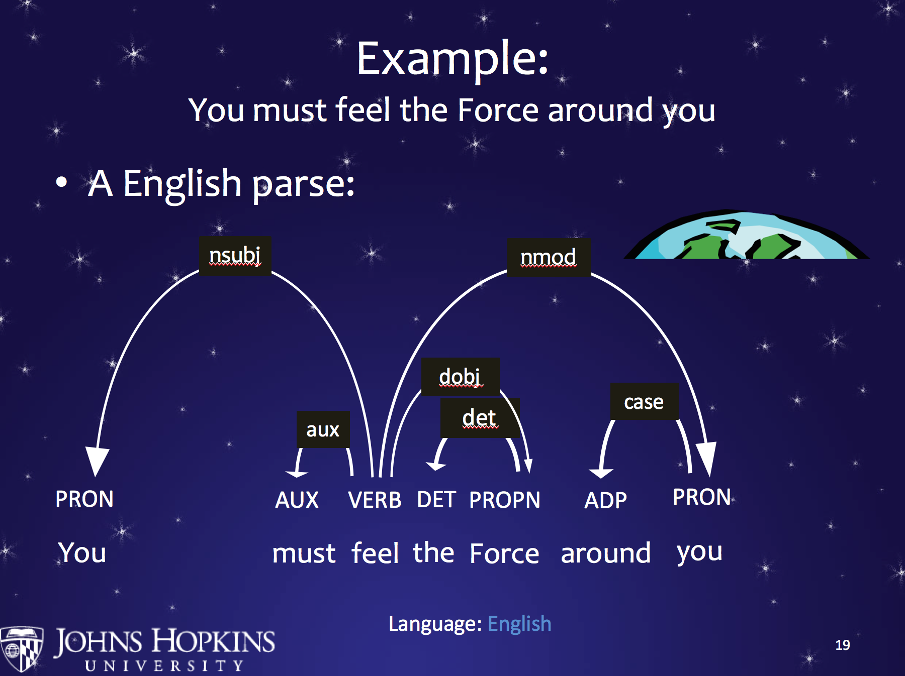
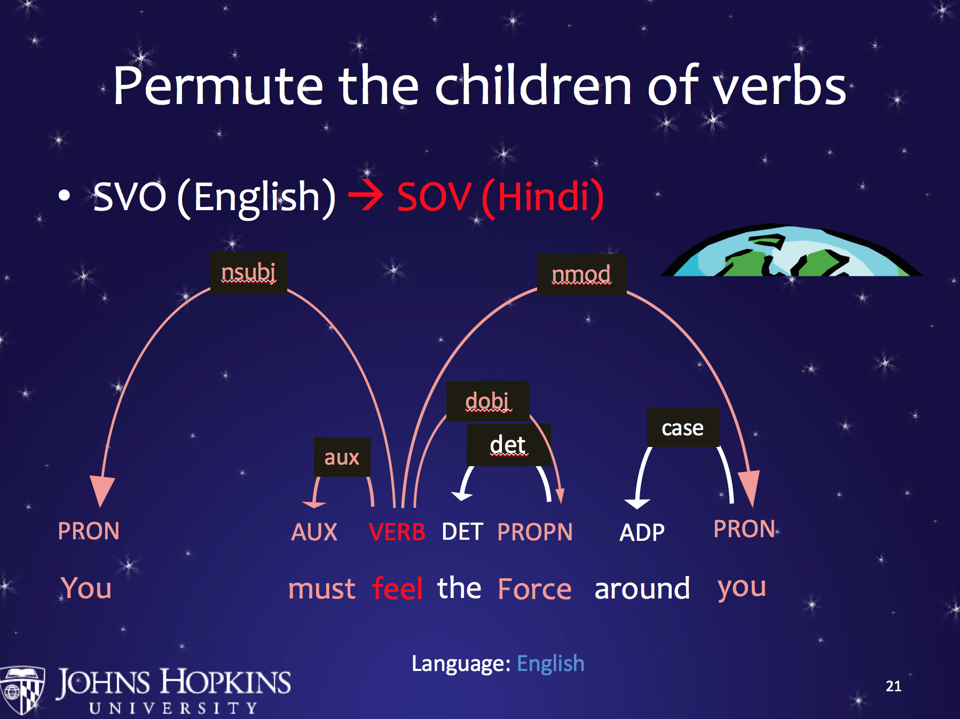
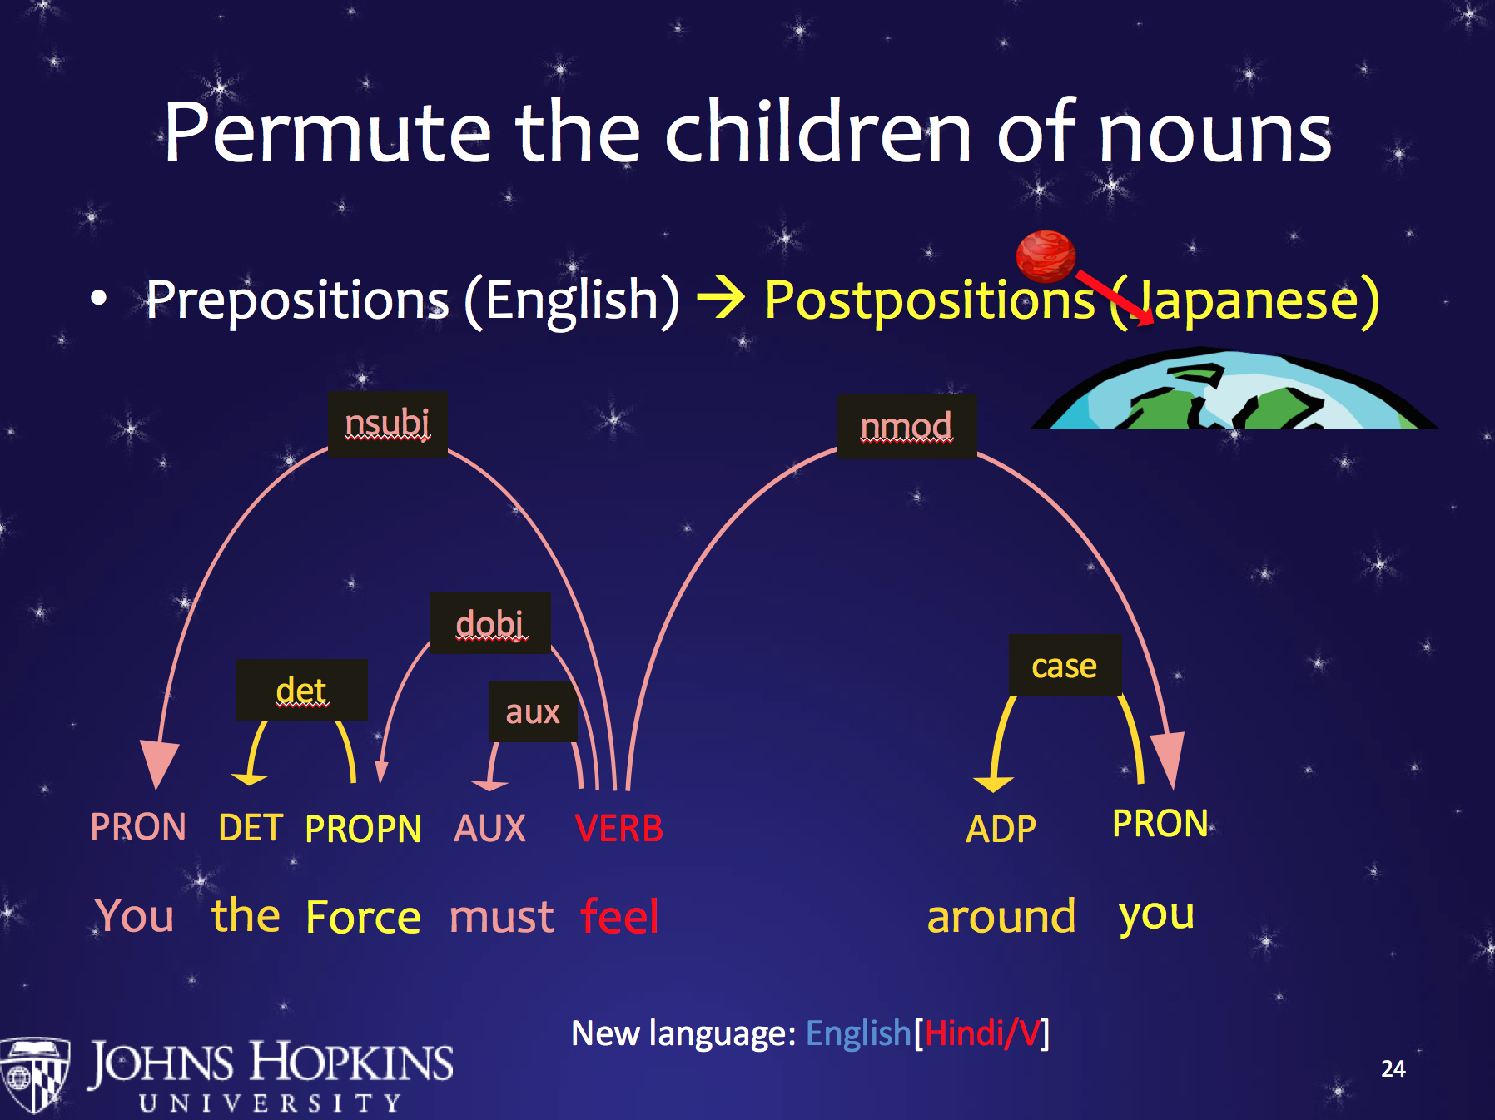
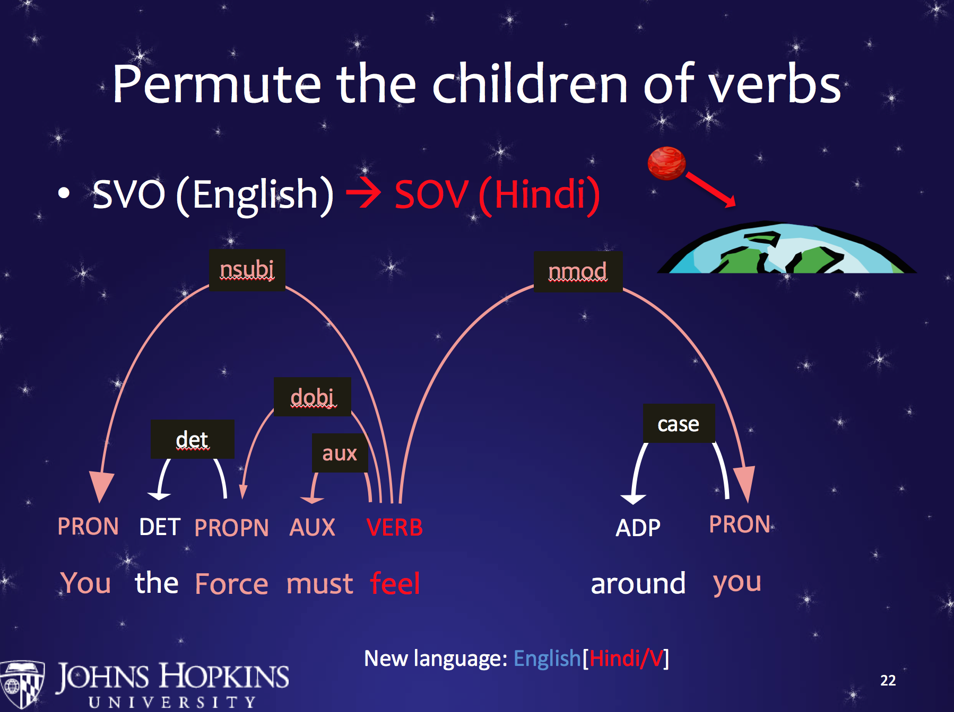
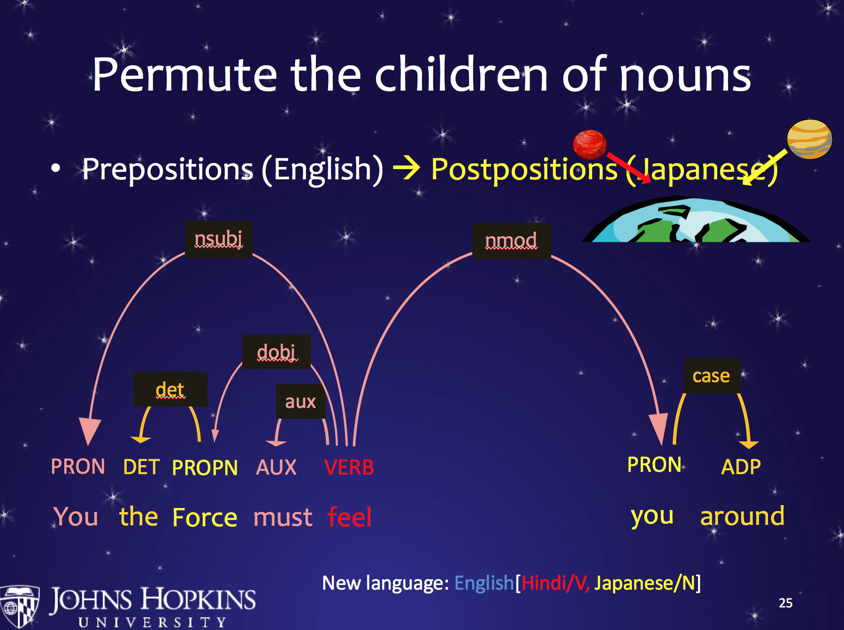
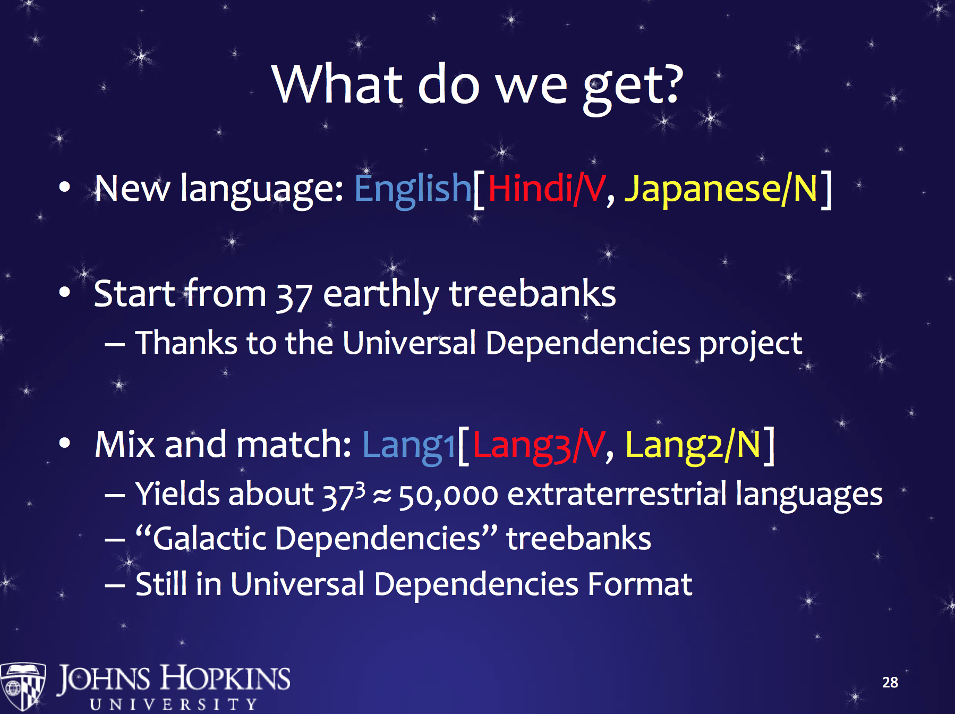
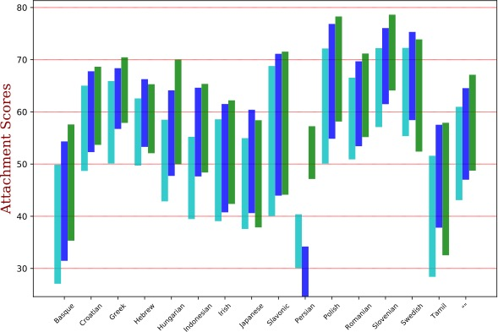
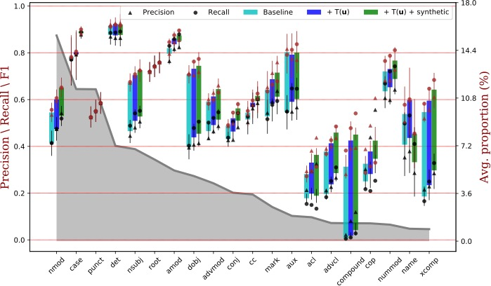
[TACL] Surface Statistics of an Unknown Language Indicate How to Parse It
Dingquan Wang and Jason Eisner
{wdd,eisner}@jhu.edu
You find a POS-tagged corpus of text in an unknown language.
Let's extract interesting features of the whole corpus ("surface cues to structure").
Our universal parser sees these corpus features, along with the input sentence.
The universal parser is trained end-to-end on diverse languages, with supervision from treebanks.
Including treebanks for thousands of synthetic training languages. This helps.
Our best method improved UAS and LAS on held-out test languages by an average of 5.6 percentage points over past work.
Each language is an example!
Can you parse this?
VERB DET NOUN ADJ DET NOUN
Surface Cues to Structure
The Typology Component
Neural features
Hand engineered features
How often do NOUNs tend to appear shortly before or after VERBs?
How often do ADJs tend to appear shortly before or after NOUNs?
How often do ADPs tend to appear shortly before or after NOUNs?
…
Galactic Treebanks (Wang & Eisner 2016)
More than 50,000 synthetic languages
  Resemble real languages, but not found on Earth
Each has a corpus of dependency parses
  In the Universal Dependencies format
  Vertices are words labeled with POS tags
  Edges are labeled syntactic relationships
Provide train/dev/test splits, alignments, tools
What are we building?
How do we train?
Results (each bar stretches from labeled to unlabeled score)
Avg.
Avg.

