Slide 1

Fine-grained prediction of syntactic typology: Discovering latent structure with supervised learning
Dingquan Wang and Jason Eisner
Notes:
Welcome everyone. Today, we introduce a new framework for predicting fine-grained syntactic typology. More broadly, we’d like to predict the syntactic structure of a language. **NEXT** (The traditional task for this is grammar induction. But no one has gotten it to work.)

Slide 2
Grammar Induction is Broken!
This work tries to fix it!
  Starting with syntactic typology induction
  Just do supervised learning!
Unsupervised methods (like EM)
  Only locally optimal
  Hard to harness linguistic knowledge & conventions
  Unusable performance in practice
Notes:
The traditional task for this is grammar induction. But no one has gotten it to work.
We propose to solve the problem with something that does work: supervised learning.
But wait **CLICK**, isn’t grammar induction fundamentally an unsupervised problem **CLICK**?
Sure, but it doesn’t work! So we have to change the problem somehow. Instead of untying the Gordian knot, let’s cut it **CLICK**.
**CLICK** Unsupervised methods usually try to maximize the log-likelihood, but that’s intractable and it’s not what linguists care about anyway. The grammars they learn aren’t good enough to be useful for anything.
Let me start with some background. What are we interested in? We are interested in turning a corpus into a parser **NEXT**

Slide 3

Turn a Corpus into a Parser
Input sentence: x
Spoon ate a caviar
Papa ate with the caviar a spoon .
Mama ate with the caviar a spoon .
Papa ate caviar a spoon .
Mama ate a spoon .
…
Corpus: u
Tree: y
Spoon ate a caviar
Notes:
That's is, a system that can map an unlabelled corpus **CLICK** of a language to a parser, that can parse new sentences **CLICK** of that language into trees **CLICK**.
This system is supposed to language-independent that works for any language without changing anything. For example, **CLICK**

Slide 4
Turn a Corpus into a Parser
Input sentence: x
er amos yjja Ajjx aat orr
Yer amos yjja Ajjx aat orrr .
Per anni inn se in hahh wee .
Con per aat Ajjx “tat “yue han .
Per anni inn se in hahh wee .
…
Corpus: u
Tree: y
Yer amos yjja Ajjx aat orr
Notes:
We can use the same system to turn a Dothraki corpus into a Dothraki parser.

Slide 5

Turn a Corpus into a Parser
Input sentence: x
愿 原力 与 你 同在
我早上吃了饭。
我中午吃了饭。
明天踢足球。
早上好！
…
Corpus: u
Tree: y
愿 原力 与 你 同在
Notes:
And for all the other languages like Chinese.
What did people do in the past? So HOW **CLICK** do you turn a corpus into a parser? **NEXT**

Slide 6
Previous Work: Grammar Induction
Hand-crafted
CFG rules
Corpus
Optimization (EM)
S → NP VP
VP → VP PP
…
u
Notes:
The grammar induction approach tells us: You extract a grammar from the corpus, and use THAT to parse.
It usually starts from a set of hand-crafted
rules **CLICK** which we call context free grammar or CFG. When this system is exposed to a corpus of language **CLICK**, we optimize **CLICK** some functions (usually by expectation-maximization algorithm) and assign each rule with a probability **NEXT**

Slide 7
Previous Work: Grammar Induction
Input sentence
x
Non-Convex Objective (e.g., MAP)
Hard!
Probabilistic-CFG
Corpus
Optimization (EM)
S → NP VP
VP → VP PP
…
0.9
0.2
Parser
u
CKY
Hard!
    Might not even model syntax
Tree
y
Notes:
And the CFG becomes Probablistic-CFG or PCFG. Then we take it as input to to build a parser **CLICK**, the parser is usually a CKY parser **CLICK**.
This approach has been intensively studied, most efforts were focusing on 2 challenges. First, most formulations of grammar induction involve optimizing a highly non-convex objective such as log-likelihood, which is very hard **CLICK**.
Second is, the objective function itself might not correct. It is very hard to model what linguists think when they are annotating the treebanks, we might end up with something other than syntactic structures. This is a usual problem of generative modelling and it is very hard **CLICK**
We are here to crack it! Let's make some generalization first. **NEXT**

Slide 8


Generalization
Input sentence
x
Corpus
Sufficient Statistic
$$g$$
Mapping:
$$g(\text{u})$$
0.9
0.2
Parser
S → NP VP
VP → VP PP
…
u
Tree
y
Notes:
Given a corpus u. **CLICK** We are looking for a mapper g **CLICK** that maps a corpus to its sufficient statistics g(u). And we use g(u) to build a parser **CLICK**.
For grammar induction, **NEXT**

Slide 9
Previous Work: Grammar Induction
Input sentence
x
Corpus
Sufficient Statistic
$$g$$
Mapping:
$$g(\text{u})$$
0.9
0.2
Parser
S → NP VP
VP → VP PP
…
u
Tree
y
Notes:
For grammar induction, the sufficient statistic is the PCFG of u, and the mapping g is EM **CLICK**

Slide 10
Previous Work: Grammar Induction
Input sentence
x
Corpus
Sufficient Statistic
Optimization (EM)
$$g(\text{u})$$
0.9
0.2
Parser
S → NP VP
VP → VP PP
…
u
Tree
y
Notes:
it is a hard-coded mapper with no parameters. In other words, it is basically a deterministic procedure
We propose a learned mapper **CLICK**

Slide 11
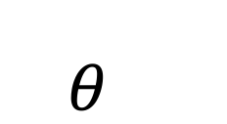
Our Proposal
Input sentence
x
Corpus
Learned Mapping
Sufficient Statistic
Optimization (EM)
$$g_{θ}(\text{u})$$
0.9
0.2
Parser
S → NP VP
VP → VP PP
…
u
Tree
y
Notes:
Which is parameterized by \theta to generate its sufficient statistic.
And \theta **NEXT** (is learned with supervision)

Slide 12
Our Proposal
Input sentence
x
Corpus
Learned Mapping
Sufficient Statistic
Optimization (EM)
$$g_{θ}(\text{u})$$
0.9
0.2
Parser
S → NP VP
VP → VP PP
…
u
Learned with supervision!
Tree
y
Notes:
is learned with supervision. In other words, we try to LEARN how to analyze the corpus, not just explain the corpus
In this paper, we are interested in this **CLICK** part
**NEXT**
(To be more specific)

Slide 13
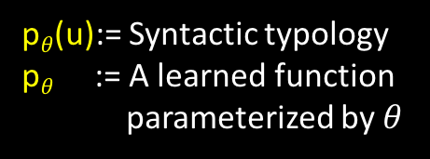

Prediction of Syntactic Typology
p$θ$(u):= Syntactic typology
p$θ$ := A learned function
parameterized by $θ$
Corpus
Learned Mapping
$$p_{θ}(\text{u})$$
S → NP VP
VP → VP PP
…
0.9
0.2
u
Notes:
To be more specific, let’s use p as an instance of g, which is a mapping from u to its syntactic typology. What is synthetic typology?
indent

Slide 14
Syntactic Typology
A set of word order facts of a language
Notes:
[READ] For example. [NEXT]

Slide 15
Syntactic Typology (of English)
Subject-Verb-Object
nsubj
nsubj
N
V
V
N
dobj
dobj
dobj
nsubj
N
V
V
N
Papa ate a red apple at home
15
Notes:
Let’s look at one syntactic typology of English. English has a dominant Subject-Verb-Object order **CLICK**. If we use the direction of dependency relations **CLICK**, could be **NEXT**

Slide 16
Syntactic Typology (of English)
Subject-Verb-Object
Prepositional
Adj-Noun
nsubj
nsubj
case
case
amod
amod
N
V
V
N
ADP
N
N
ADP
A
N
N
A
✔
✘
✔
✘
✔
✘
dobj
dobj
dobj
nsubj
amod
case
N
V
V
N
✘
✔
Papa ate a red apple at home
16
Notes:
That is the SUBJECT always precedes its VERB
and the direct OBJECT always follows its VERB
Similarly, the direction of these other **CLICK** labels shows that English is prepositional rather than postpositional, and uses ADJECTIVE-NOUN order. In this paper, we go beyond---we are interested in **NEXT** (fine-grained syntactic typology)

Slide 17
Fine-grained Syntactic Typology (of English)
Subject-Verb-Object
Prepositional
Adj-Noun
nsubj
nsubj
case
case
amod
amod
N
V
V
N
ADP
N
N
ADP
A
N
N
A
✔
✘
✔
✘
✔
✘
dobj
dobj
N
V
V
N
✘
✔
17
Notes:
Fine-grained syntactic typology
That is, instead of a hard decision of left vs. right, we predict how often the relation points left or right. **NEXT**

Slide 18
Fine-grained Syntactic Typology (of English)
Subject-Verb-Object
Prepositional
Adj-Noun
nsubj
nsubj
case
case
amod
amod
N
V
V
N
ADP
N
N
ADP
A
N
N
A
0.96
0.04
0.96
0.04
0.97
0.03
dobj
dobj
N
V
V
N
0.04
0.96
18
Notes:
Why aren't English direct objects ALWAYS on the right? probably because of relative clauses, movements and questions **NEXT**

Slide 19
Fine-grained Syntactic Typology (of English)
Subject-Verb-Object
Prepositional
Adj-Noun
nsubj
case
amod
V
N
N
ADP
N
A
0.04
0.04
0.03
Vector of length 57
dobj
V
N
nsubj | dobj | case | amod | …
0.96
0.04 | 0.96 | 0.04 | 0.03 | …
19
Notes:
And we use the probability of right direction in this work, because the left and right sum to 1. To this end, the fine-grained typology we are going to predict is a vector of probability **CLICK**, each dimension represents a relation. And we are predicting 57 relations **CLICK** for each language in this paper. For example, English is like this...
**NEXT**

Slide 20
Fine-grained Syntactic Typology (of Japanese)
Subject-Object-Verb
Postpositional
Adj-Noun
nsubj
case
amod
V
N
N
ADP
N
A
0.0
1.0
0.0
Vector of length 57
dobj
V
N
nsubj | dobj | case | amod | …
0.0
0.0 | 0.0 | 1.0 | 0.0 | …
20
Notes:
This is for Japanese

Slide 21
Fine-grained Syntactic Typology (of Hindi)
Subject-Object-Verb
Postpositional
Adj-Noun
nsubj
case
amod
V
N
N
ADP
N
A
0.01
0.98
0.03
Vector of length 57
dobj
V
N
nsubj | dobj | case | amod | …
0.25
0.01 | 0.25 | 0.98 | 0.03 | …
21
Notes:
Hindi

Slide 22
Fine-grained Syntactic Typology (of French)
Subject-Verb-Object
Prepositional
Noun-Adj
nsubj
case
amod
V
N
N
ADP
N
A
0.03
0.01
0.73
Vector of length 57
dobj
V
N
nsubj | dobj | case | amod | …
0.76
0.03 | 0.76 | 0.01 | 0.73 | …
22
Notes:
And French

Slide 23
Fine-grained Syntactic Typology
Language
Typology
nsubj | dobj | case | amod | …
English
0.04 | 0.96 | 0.04 | 0.03 | …
Japanese
0.0 | 0.0 | 1.0 | 0.0 | …
Hindi
0.01 | 0.25 | 0.98 | 0.03 | …
French
0.03 | 0.76 | 0.01 | 0.73 | …
Notes:
So in high level, our task is predicting the typology for each language, more precisely **NEXT**

Slide 24
The Task
Corpus: u
Typology
nsubj | dobj | case | amod | …
Papa ate with the caviar a spoon .
Mama ate with the caviar a spoon .
…
0.04 | 0.96 | 0.04 | 0.03 | …
パパはキャビアとスプーンを食。
ママはキャビアとスプーンを食。
…
0.0 | 0.0 | 1.0 | 0.0 | …
पापा ने कैवियार के साथ एक चम्मच
माँ कैवियार एक चम्मच के साथ
…
0.01 | 0.25 | 0.98 | 0.03 | …
Papa a mangé au caviar cuillère.
Maman a mangé au caviar cuillère.
…
0.03 | 0.76 | 0.01 | 0.73 | …
Notes:
We predict the typology given the corpus of that language. Now we look at the first challenge. **NEXT**

Slide 25







Challenge 1: Difference of Lexicon
You
must
feel
the
Force
around
you
你
必须
感受
到
你
周围
的
原力
Vous
devez
ressentir
la
Force
autour
de
vous
आपको
अपने
आसपास
फोर्स
को
महसूस
करना
चाहिए
あなた
は
あなた
の周りの
力
を感じ
なけれ
ばなりません
თქვენ
უნდა
იგრძნოთ
ძალა
ირგვლივ
jin
ave
sekke
verven
anni
m'orvikoon
Notes:
It is a challenge of lexicon, different language has different vocabulary. We must find a way to map the words to some universal representations so that the system could understand. Our way is delexicalization. **NEXT**

Slide 26
Delexicalization
Let’s cheat!
(like other grammar
induction systems)
You
must
feel
the
Force
around
you
PRON
AUX
VERB
DET
PROPN
ADP
PRON
你
必须
感受
到
你
周围
的
原力
PRON
AUX
VERB
PART
PRON
ADP
PART
PROPN
Vous
devez
ressentir
la
Force
autour
de
vous
PRON
AUX
VERB
DET
PROPN
ADP
PART
PRON
आपको
अपने
आसपास
फोर्स
को
महसूस
करना
चाहिए
PRON
PRON
ADP
PROPN
PART
VERB
AUX
AUX
あなた
は
あなた
の周りの
力
を感じ
なけれ
ばなりません
PRON
AUX
PRON
ADP
PROPN
VERB
PART
AUX
თქვენ
უნდა
იგრძნოთ
ძალა
ირგვლივ
PRON
AUX
VERB
DET
PROPN
ADP
jin
ave
sekke
verven
anni
m'orvikoon
VERB
DET
PROPN
ADP
PRON
AUX
PROPN
ADP
VERB
PRON
PRON
AUX
PART
Notes:
The delexicalization is replacing the words by POS tags **CLICK**, which is universal across languages. But how do we know the POS of each word? This is another difficult problem. In this paper, we cheat **CLICK** with gold-POS tags like grammar induction papers. With this delexicalization, **NEXT**

Slide 27
The Task
Corpus: u
Typology
nsubj | dobj | case | amod | …
Papa ate with the caviar a spoon .
Mama ate with the caviar a spoon .
…
0.04 | 0.96 | 0.04 | 0.03 | …
パパはキャビアとスプーンを食。
ママはキャビアとスプーンを食。
…
0.0 | 0.0 | 1.0 | 0.0 | …
पापा ने कैवियार के साथ एक चम्मच
माँ कैवियार एक चम्मच के साथ
…
0.01 | 0.25 | 0.98 | 0.03 | …
Papa a mangé au caviar cuillère.
Maman a mangé au caviar cuillère.
…
0.03 | 0.76 | 0.01 | 0.73 | …
Notes:
Our task becomes **NEXT**

Slide 28
The Task (Delex)
Corpus of tags: ũ
Typology
nsubj | dobj | case | amod | …
NOUN VERB ADP NOUN PUNCT
NOUN VERB PART NOUN PUNCT
…
0.04 | 0.96 | 0.04 | 0.03 | …
NOUN DET NOUN VERB PUNCT
NOUN NOUN VERB PART
…
0.0 | 0.0 | 1.0 | 0.0 | …
NOUN AUX NOUN ADP PUNCT
AUX NOUN NUM NOUN VERB
…
0.01 | 0.25 | 0.98 | 0.03 | …
NOUN VERB ADP NOUN PUNCT
NOUN VERB NOUN PUNCT
…
0.03 | 0.76 | 0.01 | 0.73 | …
Notes:
Takes POS sequences as inputs and predicts the typology. In other words, we are building a system to infer the high-level property from the surface form cue. How could this be possible? **NEXT**

Slide 29
Intuition
NOUN VERB DET ADJ NOUN ADP NOUN
NOUN VERB PART NOUN
DET ADJ NOUN VERB
PRON VERB ADP DET NOUN
…
nsubj
nsubj
N
V
V
N
Notes:
In fact, it is quite intuitive to us. For example, given a POS corpus like this. We want to decide whether this language is subject-left or right **CLICK**. There are cues show up. **NEXT**

Slide 30
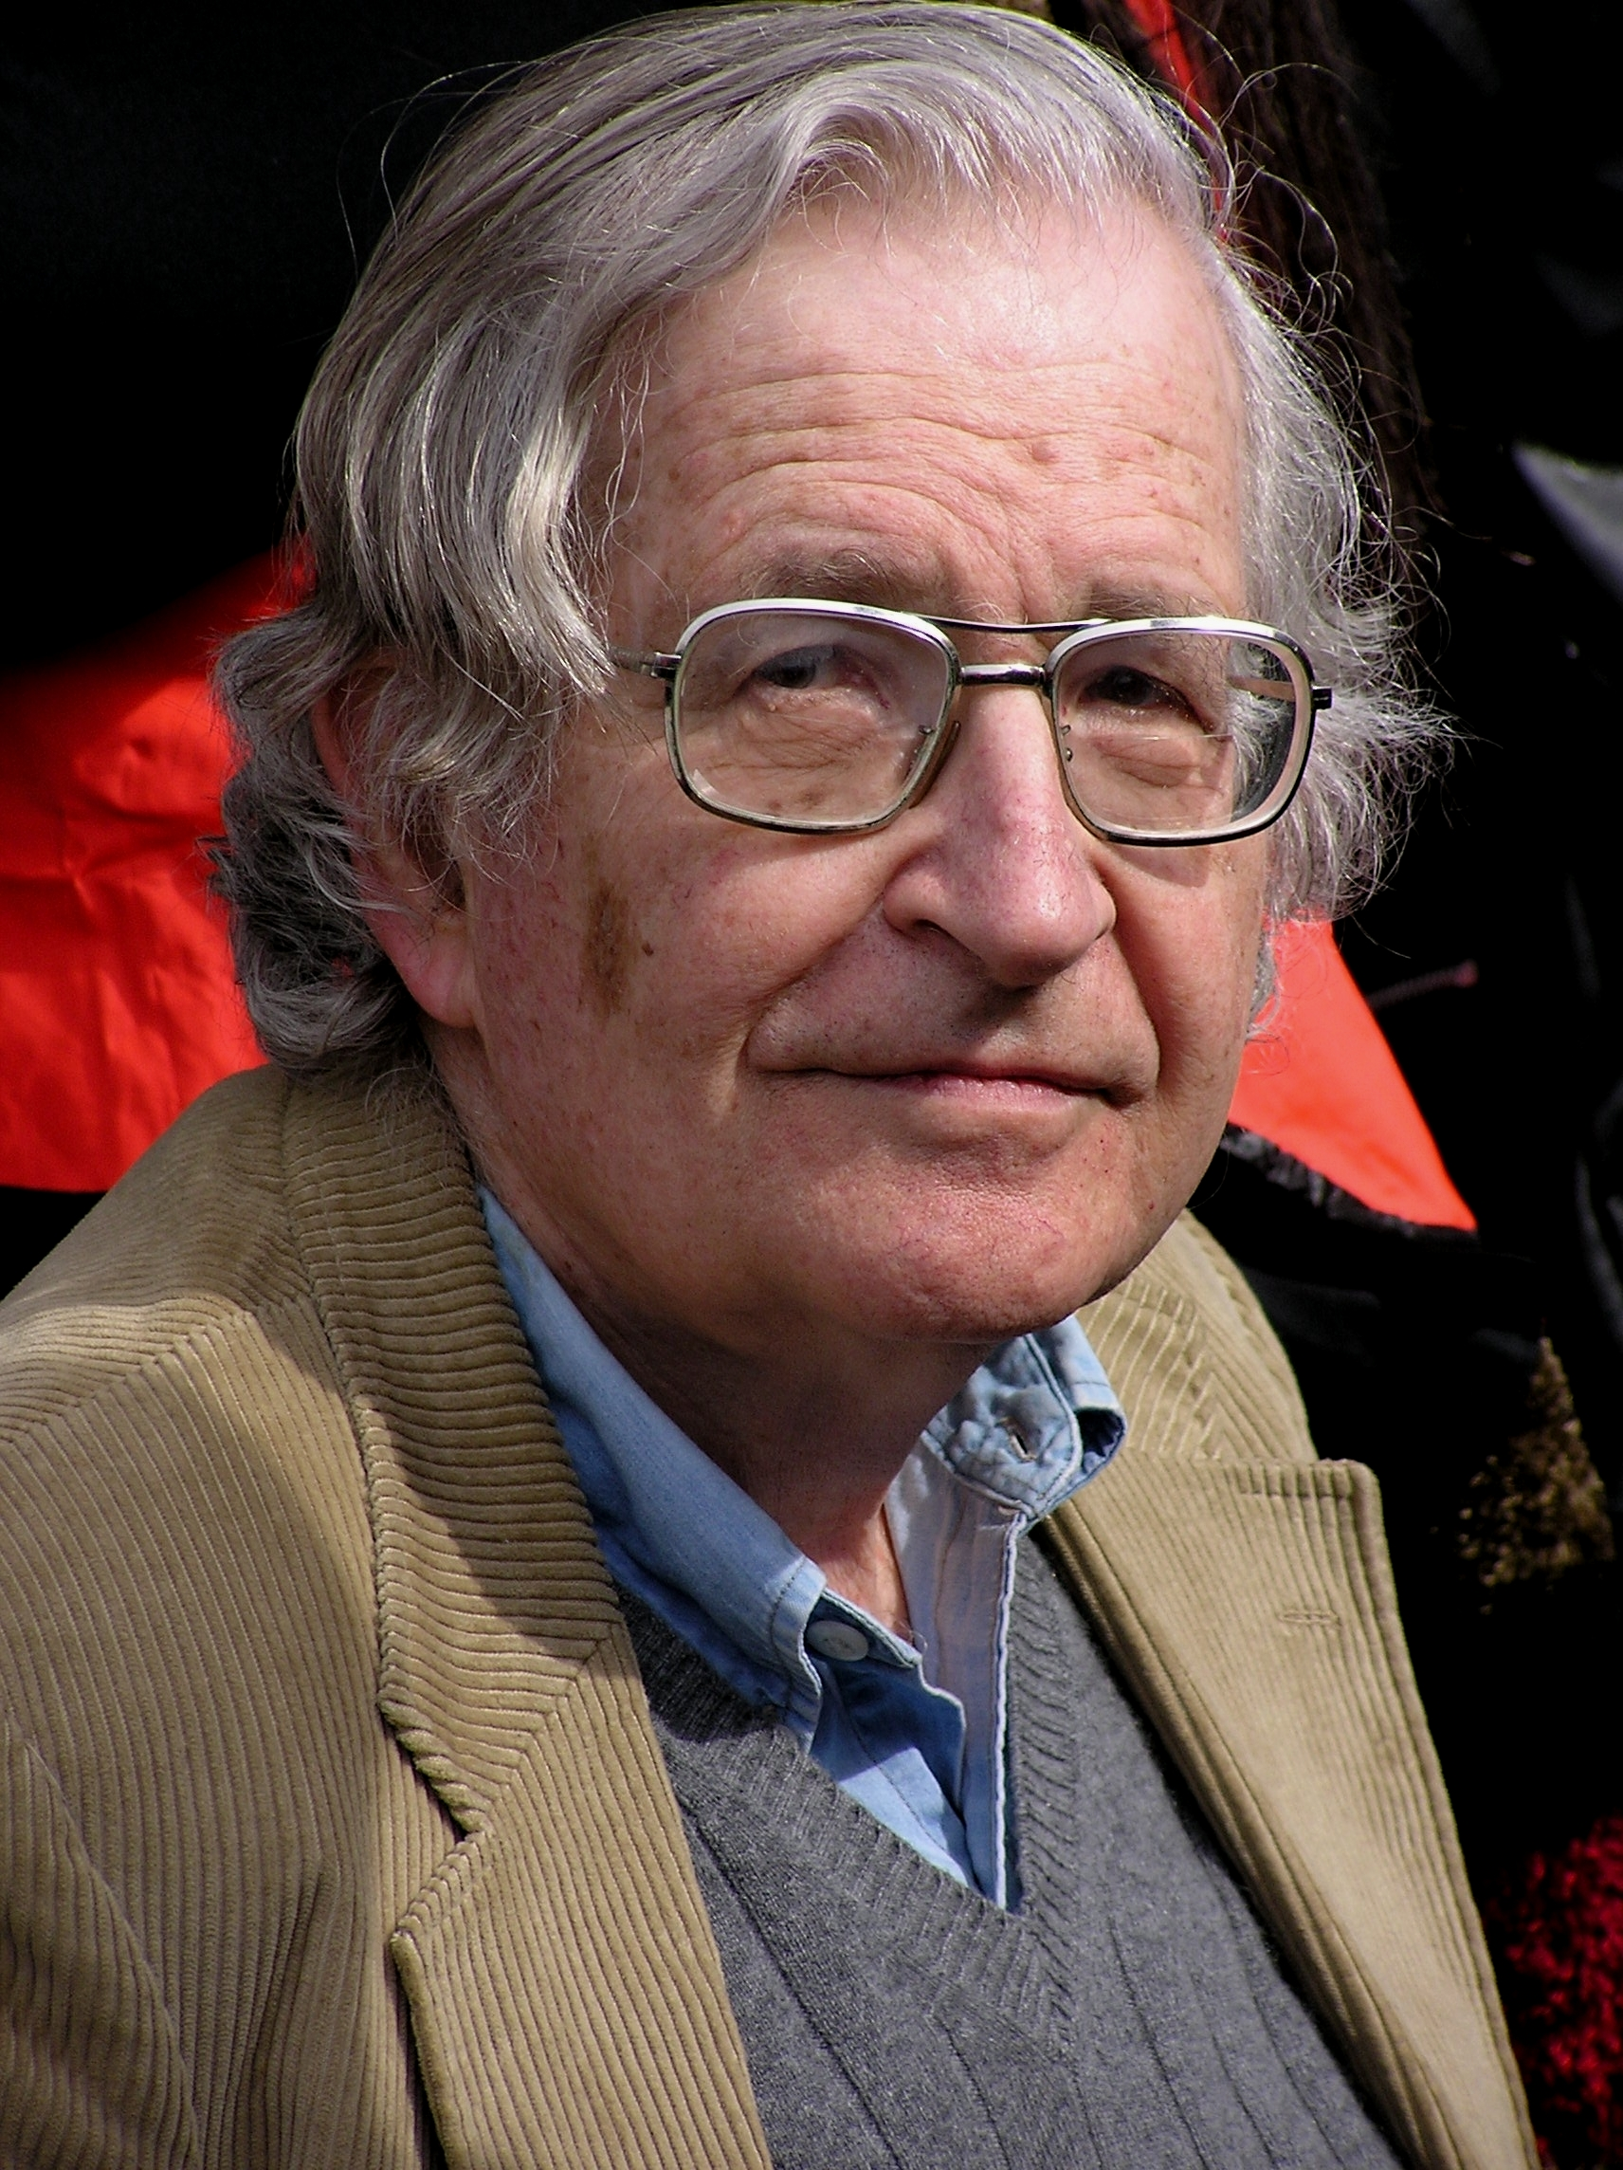
Surface Cues to Structure
NOUN VERB DET ADJ NOUN ADP NOUN
NOUN VERB PART NOUN
DET ADJ NOUN VERB
PRON VERB ADP DET NOUN
…
Cues!
nsubj
nsubj
Triggers for Principles & Parameters
N
V
V
N
Notes:
That is **CLICK**, there is always a noun precedes a nearby verb.
These **CLICK** are probably the Triggers for Principles & Parameters
**NEXT**

Slide 31
Surface Cues to Structure
NOUN VERB DET ADJ NOUN ADP NOUN
NOUN VERB PART NOUN
DET ADJ NOUN VERB
PRON VERB ADP DET NOUN
…
Cues!
case
case
Triggers for Principles & Parameters
ADP
V
V
ADP
Notes:
Similarly, there is always an ADP precedes a nearby NOUN.
This might be a cue that this language is case-left **NEXT**

Slide 32
Surface Cues to Structure
NOUN VERB DET ADJ NOUN ADP NOUN
NOUN VERB PART NOUN
DET ADJ NOUN VERB
PRON VERB ADP DET NOUN
…
Cues!
amod
amod
Triggers for Principles & Parameters
A
N
N
A
Notes:
And also for other relations, we can find different type of cues
**NEXT**

Slide 33
Surface Cues to Structure
NOUN DET ADJ NOUN VERB ADP NOUN
NOUN NOUN VERB
DET ADJ NOUN VERB
PRON ADP DET NOUN VERB
…
Cues!
dobj
dobj
Triggers for Principles & Parameters
N
V
V
N
Notes:
There is always an VERB after the nearby 2 Nouns

Slide 34
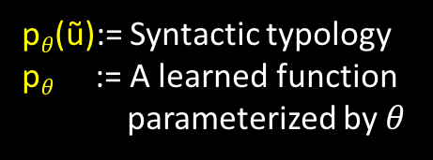


Prediction of Syntactic Typology
p$θ$(ũ):= Syntactic typology
p$θ$ := A learned function
parameterized by $θ$
Corpus of tags
$$p_{θ}(\text{ũ})$$
0.9
0.2
S → NP VP
VP → VP PP
…
ũ
How to estimate $θ$?
Notes:
The next question is how to estimate theta **CLICK** ? This comes to our key idea. **NEXT** (supervised learning)

Slide 35

Supervised Training
POS-corpus
Vector of length 57
ũ True Typology
( , )
Language 1
PRON AUX …
VERB PROPN … …
( , )
Language 2
VERB NOUN…
NOUN DET…
NOUN ADJ …
…
.
.
.
.
.
.
Directionality($r$) = $\frac{\# r from left to right}{\# r}$
Notes:
Each training example in this set up is an ENTIRE language with POS-corpus and its gold typology. Which is estimated from its treebank **CLICK**.
The supervised approach gave us a lot of freedom such like. **CLICK**

Slide 36
Supervised Training
Could use a convex objective (in principle)
Allows feature-rich discriminative model
Imitates how linguists annotated the training languages
Trained system is like a human baby (we hope)
  Knows the surface cues to deep structure (cf. Chomsky)
  In contrast to standard unsupervised learners, which have only a few hyperparameters to tune
If we have enough training languages
Notes:
[Read]
**NEXT** (We use...)

Slide 37
Data
Universal Dependencies version 1.2
  A collection of dependency treebanks for 37 languages
UD: 20 languages
Train | Test
cs, es, fr, hi, de, it, la itt, no, ar, pt en, nl, da, fi, got, grc, et, la proiel, grc proiel, bg | la, hr, ga, he, hu, fa, ta, cu, el, ro, sl, ja ktc, sv, fi ftb, id, eu, pl
Notes:
[Read]
**CLICK**
We use 20 languages for training and test on the rest 17 languages.
But wait, did I just say 20 languages for training? How 20 languages could possibly be enough **NEXT** (for our purpose)?

Slide 38
Supervised Training
Could use a convex objective (in principle)
Allows feature-rich discriminative model
Imitates how linguists annotated the training languages
Trained system is like a human baby (we hope)
  Knows the surface cues to deep structure (cf. Chomsky)
  In contrast to standard unsupervised learners, which have only a few hyperparameters to tune
If we have enough training languages
???
Notes:
(for our purpose)? This comes to the second challenge [N]

Slide 39
Challenge 2: Data Sparsity
Each language gives only ONE training example!
ũ Typology
( , )
Language 1
PRON AUX …
VERB PROPN … …
( , )
Language 2
VERB NOUN…
NOUN DET…
NOUN ADJ …
…
.
.
.
.
.
.
Notes:
[Read]
Luckily, this issue is addressed by our previous work **NEXT**

Slide 40
Wang and Eisner (2016)
More than 50,000 synthetic languages!
  Resemble real languages, but not found on Earth
  We call it the Galactic Dependencies Treebanks
nsubj
nmod
dobj
case
aux
det
PRON
AUX
VERB
DET
PROPN
ADP
PRON
You
must
feel
the
Force
around
you
Notes:
This work was done last year as a TACL paper, in which we have **CLICK**
[Read]
These new trees are generated by systematically permuting an input real trees **CLICK**

Slide 41
Wang and Eisner (2016)
More than 50,000 synthetic languages!
  Resemble real languages, but not found on Earth
  We call it the Galactic Dependencies Treebanks
nsubj
nmod
dobj
case
det
aux
PRON
DET
PROPN
AUX
VERB
ADP
PRON
You
the
Force
must
feel
around
you
Notes:
These new trees are generated by systematically permuting an input real trees **CLICK**

Slide 42
Wang and Eisner (2016)
More than 50,000 synthetic languages!
  Resemble real languages, but not found on Earth
  We call it the Galactic Dependencies Treebanks
nsubj
nmod
dobj
case
det
aux
PRON
DET
PROPN
AUX
VERB
PRON
ADP
You
the
Force
must
feel
you
around
Notes:
We released these in-domain permuted languages in an earlier paper. And we could make more!
But anyway **NEXT**

Slide 43
Data
Universal Dependencies version 1.2
  A collection of dependency treebanks for 37 languages
Galactic Dependencies version 1.0
UD: 20 languages
+ GD: about 8000 languages by mix-and-match
Train | Test
cs, es, fr, hi, de, it, la itt, no, ar, pt en, nl, da, fi, got, grc, et, la proiel, grc proiel, bg | la, hr, ga, he, hu, fa, ta, cu, el, ro, sl, ja ktc, sv, fi ftb, id, eu, pl
Notes:
With these new language, we have about 8000 languages **CLICK**. Now we probably can say enough. **NEXT**

Slide 44
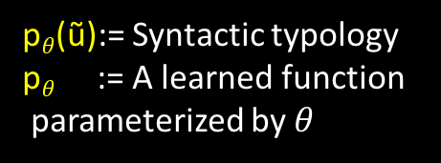
Prediction of Syntactic Typology
Wang and Eisner (2016)
p$θ$(ũ):= Syntactic typology
p$θ$ := A learned function
parameterized by $θ$
Corpus of tags
$$p_{θ}(\text{ũ})$$
0.9
0.2
S → NP VP
VP → VP PP
…
ũ
Notes:
Now, Let’s look **CLICK** at the architecture of the system **NEXT**.

Slide 45


Architecture
Corpus of tags (ũ)
PRON AUX …
VERB PROPN … …
Surface-form feature
p$θ$(ũ)
Sigmoid
$$θ$$
Notes:
Given a POS corpus. We first map **CLICK** it to a vector of surface-form feature. And then use a two layer neural network **CLICK** to predict the typology. The whole system is parameterized by \theta **CLICK**
(For the surface form features, we use 2 types. First is the hand features, which are some bigram statistics pre-calculated from u. The second is the neural features.)
Now let’s check out some results
**NEXT**

Slide 46
Surface-form Feature (Neural)
. . .
. . .
NOUN VERB NOUN . . . AUX VERB PUNCT
ũ₁
. . .
. . .
. . .
PRON ADV VERB . . . VERB PUNCT
ũ₂
. . .
. . .
. . .
. . .
NOUN AUX VERB . . . ADJ NOUN PUNCT
ũ_{K}
ũ
Notes:
We run a RNN in parallel on each POS squence and get the final vector by pooling.
Now let’s check out some results.[N]

Slide 47
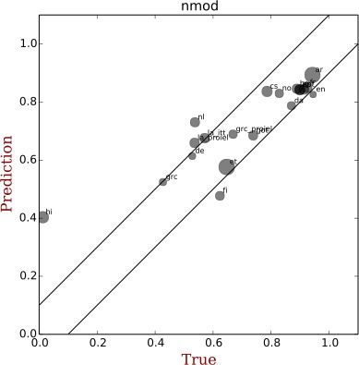
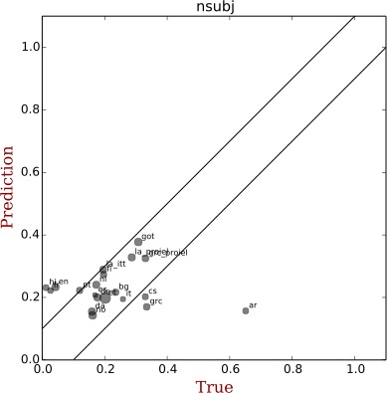
nmod: Head Noun -> Nominal Modifier
Predicted Directionality
True Directionality
Notes:
Here we, show the results of some popular relations. The first is the direction of a word and its nominal modifier. Each dot represents a language, the x-axis is the true direction and y is the predicted direction. We can see most dots fall nicely inside the error region.[N]

Slide 48
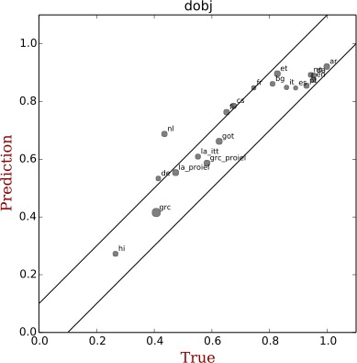
dobj: Head Verb -> Direct Object
Predicted Directionality
True Directionality
Notes:
Here we show the results of some important relations. This is the direction of a verb and its direct object. Each dot represents a language, the x-axis is the true directionality (between 0 and 1) and y is the predicted directionality. We can see most dots fall nicely inside the low-error region. **NEXT**

Slide 49
nsubj: Head Verb -> Subject
Predicted Directionality
True Directionality
Notes:
This is the relation between head verb to its subject

Slide 50
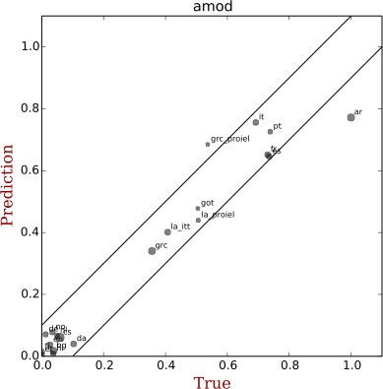
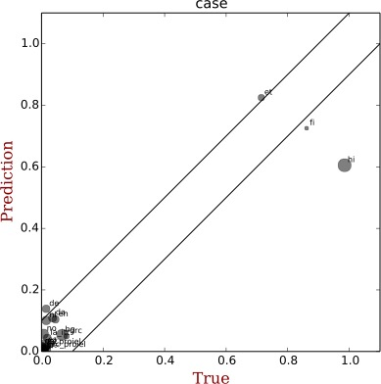
case: Head Noun -> Adposition
Predicted Directionality
True Directionality
Notes:
Notice that all the results so far are trained on about 8000 synthetic languages. Was this necessary? What if we only use the 20 real languages? **NEXT**

Slide 51
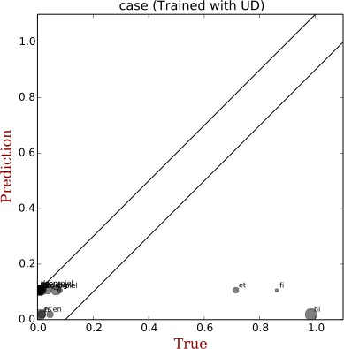
case (Trained on 20 Real Languages)
Predicted Directionality
True Directionality
Notes:
You can see the results is pretty bad. The predictor overfits the limited training languages and cannot generalized to the languages that are different. (Our evaluation is) **NEXT**

Slide 52
Evaluation
ε-insensitive loss
1.0
Loss
Loss
Prediction(p̂)
No Loss
Loss
ε
0
ε
1.0
-ε
ε
p*-p̂
True (p*)
Notes:
We use the epilson-insensitive loss whick looks at the previous plots I just showed. **CLICK**
If the dots fall inside the region **CLICK**, we won’t penalize. If not, the penalty is proportional to the difference **CLICK**
So how is the system compared to the grammar induction?
**NEXT**

Slide 53
Compared to Grammar Induction
Doesn’t even look at the corpus!
MS13
N10
Heuristic
Base Rate
20
8000
State-of-the-art
Dependency Grammar
Induction Systems
Simple Baselines
Supervised Training on n Languages
Notes:
We set epsilon to 0.1 and show the performance of different systems.
The first 2 bars are the STOA grammar induction systems.
(You don't have to get the directionalities perfectly, because you could fine-tune by EM. In general, epsilon depends on your downstream task.)
In the aggregate, its edges kind of have the right direction ...
But, I told you it doesn't work.
BECAUSE we can do better with very simple baselines **CLICK**, including one **CLICK** that doesn't even look at the corpus!
Our supervised method does better **CLICK**, particularly when we train on about 8000 **CLICK** synthetic languages **CLICK**.
So it means our method successfully learned to correlate surface cues with syntactic structure. To sum up of the whole system, **NEXT**

Slide 54

Summary: Training the System
discard trees
POS corpus
pl
en~hi@N~fr@V
en~fr@N~hi@V
train
$$θ$$
hi~fr@N~en@V
.
.
.
.
.
.
en
count
hi
fr
.
.
.
permute
prediction
20 langs
~8000 langs
typology
treebanks
Notes:
We start from 20 real treebanks **CLICK**, then we permute **CLICK** their word order to get about 8000 synthetic treebanks. **CLICK**
And then we count **CLICK** left and right dependencies in each treebank to get the true directionalities.
Now we train **CLICK** our neural net to predict the true directionalities from just the POS sequences.
The neural net can now make such predictions **CLICK** on a language it's never seen.
For the future **NEXT**

Slide 55
Summary and Future Work
Old: standalone “good” analysis (max likelihood)
New: learn how linguists analyze (mimic them!)
  Find surface cues that predict deeper structure
Future work
  Use our predicted syntactic typology for grammar induction and parsing
  Predict syntactic typology from raw word sequences
    Learning universal word representations
Notes:
[Read]

Slide 56
Thanks!
Notes:
Thanks

