Slide 1

The Galactic Dependencies Treebanks:
Getting More Data by Synthesizing New Languages
Dingquan Wang and Jason Eisner
Notes:
Hello everyone, it’s my great pleasure to be here. In this work, We…..

Slide 2
We created …
The Galactic Dependencies Treebanks!
More than 50,000 synthetic languages!
  Resemble real languages, but not found on Earth
Each has a corpus of dependency parses
  In the Universal Dependencies format
  Vertices are words labeled with POS tags
  Edges are labeled syntactic relationships
Provide train/dev/test splits, alignments, tools
Why???
Notes:
The Galactic Dependencies Treebanks. **** Seems a lot of work. But why we do this?

Slide 3







Puzzle
Basic word order – SVO or SOV?
Full syntactic grammar and morphology?
How about this one?
jin ave sekke verven anni m'orvikoon
Notes:
Let’s start with a puzzle.
READ OUT
If you know the game of throne, This language is called Dothraki. I don’t expect you to understand this. Just some earier question. it is a SVO or SOV language? Or even harder. Can you guess it’s grammar?
WAIT
How about this one? It is not even in Latin alphabet
WAIT
They are hard, right? So let’s cheat

Slide 4
Let’s cheat (for now)
Basic word order – SVO or SOV?
Full syntactic grammar?
How about this one?
AUX
VERB
PROPN
ADP
PRON
PRON
jin ave sekke verven anni m'orvikoon
PRON
DET
PROPN
AUX
VERB
PRON
ADP
Notes:
I will give you the pos-tag of each word.
WAIT
Feel better?
I saw said faces.
Let’s ask for some help.

Slide 5
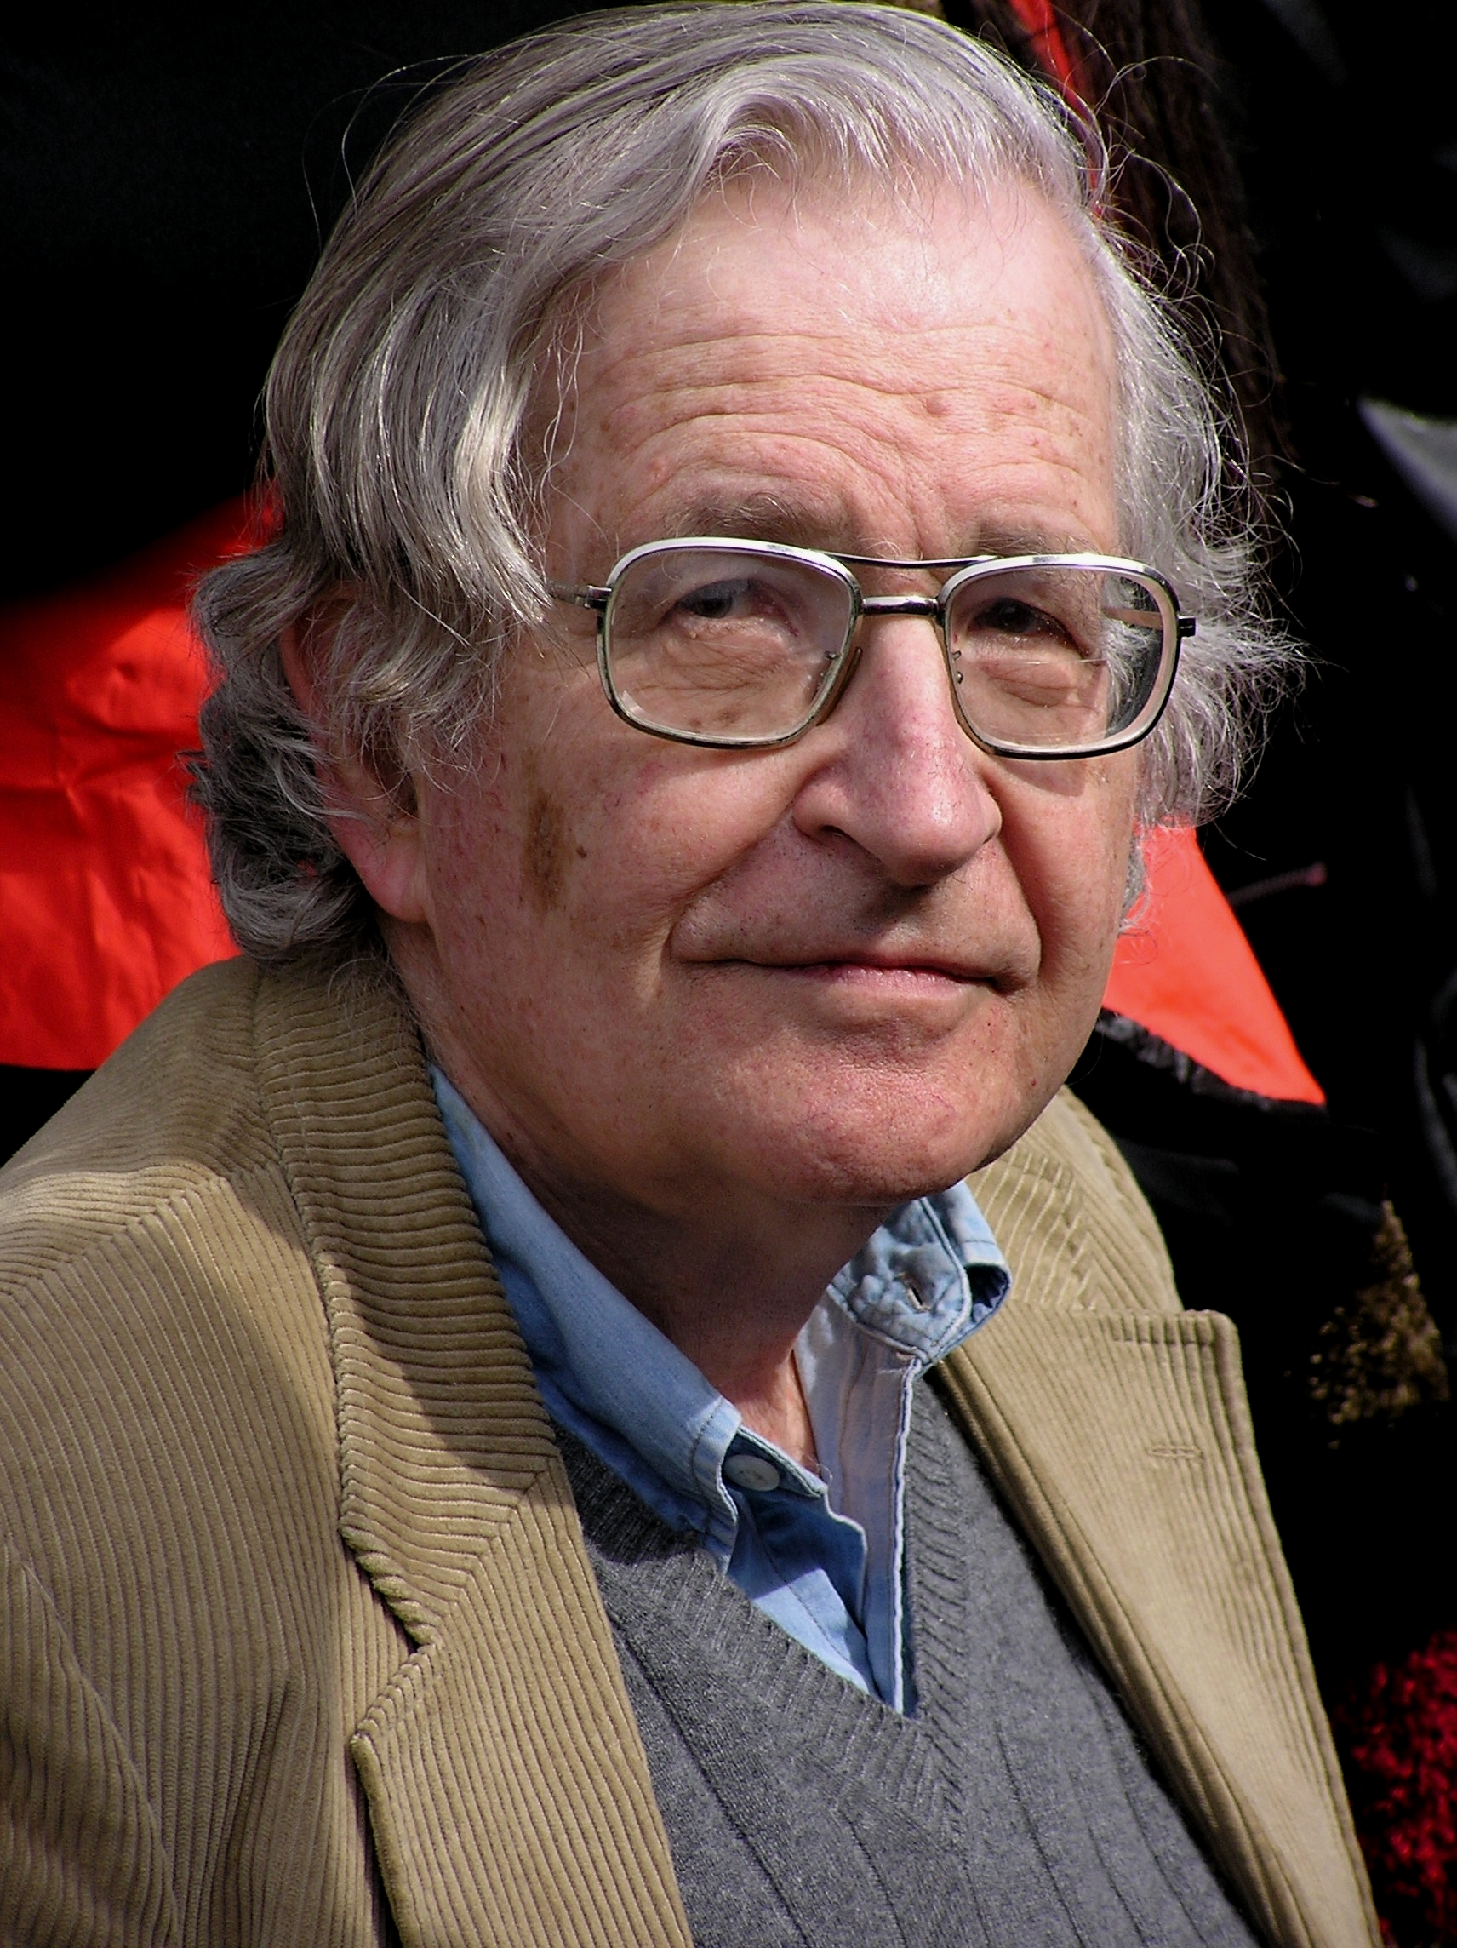


Help!
SVO
Yer/PRON amos/AUX yjja/VERB Ajjx/PROPN aat/ADP orrr/PRON ./PUNCT
Per/NOUN anni/VERB inn/ADP se/NOUN in/PART hahh/CASE wee/VERB ./PUNCT
Con/VERB per/NOUN aat/ADP Ajjx/PROPN “/PUNCT tat/PRON “/PUNCT yue/ADP han/NOUN ./PUNCT
…
?
S → NP VP
VP → VP PP
…
0.9
0.9
.
.
.
Notes:
We are looking for some devices that can map from a corpus of [tagged] sentences in a new language, to properties of that language.
In fact, we do have such devices and luckily, they are super cute[photo of baby]. Chomsky says that the human baby can do it because they have such built-in system as initial toolkit for learning a language. Thanks to evolution. Also, linguists like Chomsky himself probably can do this well, by making a grammar that's like previous grammars they've seen.
Here comes the question: Can machine do this well? No
Maybe someone has already know one of these tasks, which is called grammar induction. So let’s just focus on that for now.

Slide 6
Grammar Induction
Yer/PRON amos/AUX yjja/VERB Ajjx/PROPN aat/ADP orrr/PRON ./PUNCT
Per/NOUN anni/VERB inn/ADP se/NOUN in/PART hahh/CASE wee/VERB ./PUNCT
Con/VERB per/NOUN aat/ADP Ajjx/PROPN “/PUNCT tat/PRON “/PUNCT yue/ADP han/NOUN ./PUNCT
…
Yer/PRON amos/AUX yjja/VERB Ajjx/PROPN aat/ADP orrr/PRON ./PUNCT
Per/NOUN anni/VERB inn/ADP se/NOUN in/PART hahh/CASE wee/VERB ./PUNCT
Con/VERB per/NOUN aat/ADP Ajjx/PROPN “/PUNCT tat/PRON “/PUNCT yue/ADP han/NOUN ./PUNCT
…
S → NP VP
VP → VP PP
…
0.9
0.2
6
Notes:
We do have some unsupervised approaches that predict the latent structures by looking very carefully into the surface forms.

Slide 7
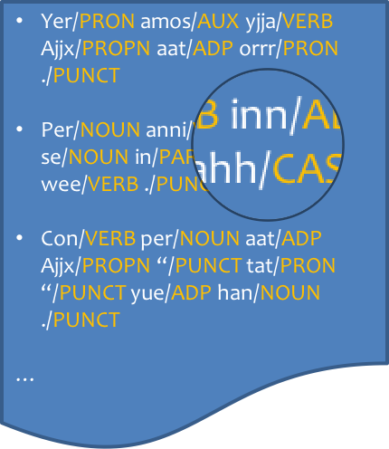

Grammar Induction
Unsupervised method (like EM)
Yer/PRON amos/AUX yjja/VERB Ajjx/PROPN aat/ADP orrr/PRON ./PUNCT
Per/NOUN anni/VERB inn/ADP se/NOUN in/PART hahh/CASE wee/VERB ./PUNCT
Con/VERB per/NOUN aat/ADP Ajjx/PROPN “/PUNCT tat/PRON “/PUNCT yue/ADP han/NOUN ./PUNCT
…
Yer/PRON amos/AUX yjja/VERB Ajjx/PROPN aat/ADP orrr/PRON ./PUNCT
Per/NOUN anni/VERB inn/ADP se/NOUN in/PART hahh/CASE wee/VERB ./PUNCT
Con/VERB per/NOUN aat/ADP Ajjx/PROPN “/PUNCT tat/PRON “/PUNCT yue/ADP han/NOUN ./PUNCT
…
S → NP VP
VP → VP PP
…
0.9
0.2
7
Notes:
We do have some unsupervised approaches that infer the latent structures from surface form clues. In this case, it is the tagged corpus.
But this approach have a lot limitations.

Slide 8

Grammar Induction
Unsupervised method (like EM)
  Locally optimal
  Hard to harness linguistic knowledge
  Might use the latent variables in the “wrong” way
    Won't follow syntactic conventions used by linguists
    Might not even model syntax, but other things like topic
How about a supervised method?
Notes:
But this approach have a lot limitations.

Slide 9
Grammar Induction
Supervised method
S → NP VP
VP → VP PP
…
0.9
0.2
( , )
You/PRON can/AUX …
Keep/VERB Google/PROPN …
In/ADP my/PRON office/NOUN …
…
S → NP VP
VP → VP PP
…
0.9
0.2
( , )
/PRON /AUX …
/VERB /PROPN …
/ADP /PRON /NOUN …
…
S → NP VP
VP → VP PP
…
0.1
0.01
9
Notes:
The supervised method looks at the same detail as unsupervised method do, but with training data. Each training example in this case is a X,Y pair where X is the tagged corpus of one language and Y is it’s correct grammar.

Slide 10

Grammar Induction
Unsupervised method (like EM)
  Locally optimal
  Hard to harness linguistic knowledge
  Might use the latent variables in the “wrong” way
    Won't follow syntactic conventions used by linguists
    Might not even model syntax, but other things like topic
How about a supervised method?
  Globally optimal (if objective is convex)
  Allows feature-rich discriminative model
  Imitates what it sees in supervised training data
Notes:
The supervised approach gave us a lot of freedom such like. However, it has a big problem.

Slide 11
What’s wrong?
Each supervised training example is a (language, structure) pair.
There are only about 7,000 languages on Earth.
Only about 60 languages on Earth are labeled
(have treebanks).
Why Earth?
Notes:
Seems frustrating. But why Earth?

Slide 12

Luckily
We are not alone
Notes:
Come on! Let’s go beyond earth. We are not alone and Master Yoda is waiting for us!

Slide 13

Luckily
Not alone, we are
Notes:
In their world, they speak a OVS language.

Slide 14
The Galactic Dependencies Treebanks v1.0
50,000+ synthetic languages
In Universal Dependencies (UD) format

Slide 15

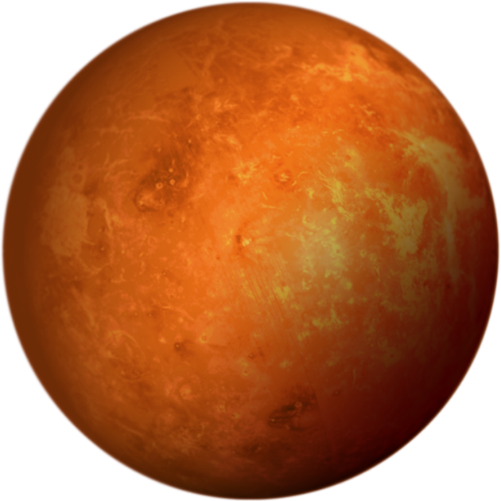

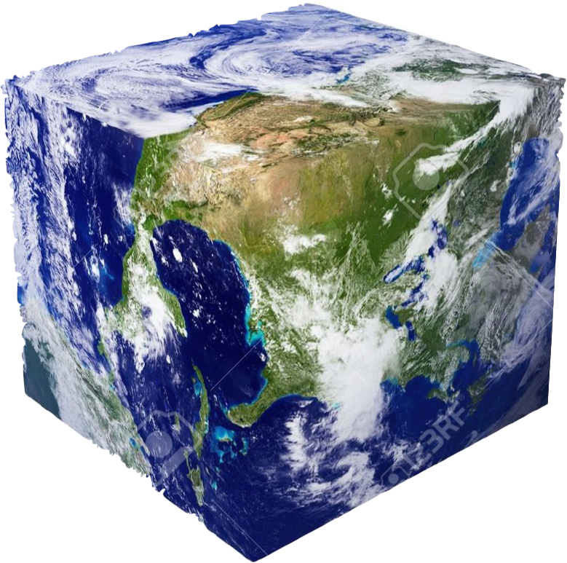
Back to Reality
The languages should be diverse enough.
The languages should be in the galaxy (in-domain)!

Slide 16


Synthetic data elsewhere
Computer Vision
  Generating more data by rotating, enlarging….
( , 6)
( , 6)
( , 6)
( , 6)
real
synthetic variants

Slide 17
Synthetic data elsewhere
Computer Vision
  Generating more data by rotating, enlarging….
Speech
  Vocal Tract Length Perturbation (Jaitly and Hinton, 2013)
NLP
  bAbI (Weston et al., 2016)
  The 30M Factoid Question-Answer Corpus (Serban et al., 2016)
Notes:
fix animation
color level-1 and level-2 bullets differently?

Slide 18
One Way to Synthesize Data
Suppose we have a real dataset:
We can diversify by “mix-and-match”:
Now do the same for languages!
Notes:
every language picks a clause order and some other stuff; we happen to have seen some of the combos and not others

Slide 19



Substrate & Superstrates
(terms come from linguistics of creole languages)
Japanese — Superstrate
Hindi — Superstrate
verb order
noun order
English — Substrate

Slide 20
You must feel the Force around you
Notes:
Luckily, we are not alone. Someone in our Galaxy is having the same trouble. Grand Jedi Master Yoda is from an unknown planet who speaks an OSV language, is recently fascinated in a NLP

Slide 21
Example:
You must feel the Force around you
A English parse:
nsubj
nmod
dobj
case
aux
det
PRON
AUX
VERB
DET
PROPN
ADP
PRON
You
must
feel
the
Force
around
you
Language: English
Notes:
Animate the red and yellow planets crashing into Earth. Red planet highlights the verbs in bright red and their dependents/deprels in dull red, then permutes them. Yellow planet does the same for the nouns, in yellow (maybe leave the red stuff in red).

Slide 22
Permute the children of verbs
SVO (English) → SOV (Hindi)
nsubj
nmod
dobj
case
aux
det
PRON
AUX
VERB
DET
PROPN
ADP
PRON
You
must
feel
the
Force
around
you
Language: English

Slide 23
Permute the children of verbs
SVO (English) → SOV (Hindi)
nsubj
nmod
dobj
case
aux
det
PRON
AUX
VERB
DET
PROPN
ADP
PRON
You
must
feel
the
Force
around
you
Language: English

Slide 24
Permute the children of verbs
SVO (English) → SOV (Hindi)
nsubj
nmod
dobj
case
det
aux
PRON
DET
PROPN
AUX
VERB
ADP
PRON
You
the
Force
must
feel
around
you
New language: English[Hindi/V]

Slide 25
Permute the children of nouns
Prepositions (English) → Postpositions (Japanese)
nsubj
nmod
dobj
case
det
aux
PRON
DET
PROPN
AUX
VERB
ADP
PRON
You
the
Force
must
feel
around
you
New language: English[Hindi/V]

Slide 26
Permute the children of nouns
Prepositions (English) → Postpositions (Japanese)
nsubj
nmod
dobj
case
det
aux
PRON
DET
PROPN
AUX
VERB
ADP
PRON
You
the
Force
must
feel
around
you
New language: English[Hindi/V]

Slide 27
Permute the children of nouns
Prepositions (English) → Postpositions (Japanese)
nsubj
nmod
dobj
case
det
aux
PRON
DET
PROPN
AUX
VERB
PRON
ADP
You
the
Force
must
feel
you
around
New language: English[Hindi/V, Japanese/N]

Slide 28
Permute the children of nouns
Prepositions (English) → Postpositions (Japanese)
nsubj
nmod
dobj
case
det
aux
PRON
DET
PROPN
AUX
VERB
PRON
ADP
You
the
Force
must
feel
you
around
New language: English[Hindi/V, Japanese/N]

Slide 29
What do we get?
New language: English[Hindi/V, Japanese/N]
Start from 37 earthly languages
  Thanks to the Universal Dependencies project
Mix and match: Lang1[Lang3/V, Lang2/N]
  Yields about 37³ ≈ 50,000 extraterrestrial languages
  “Galactic Dependencies” treebanks
  Still in Universal Dependencies Format
Notes:
Now I will briefly describe our model by permuting the verb order again.

Slide 30
SVO (English) → SOV (Hindi)
nsubj
nmod
dobj
aux
PRON
AUX
VERB
PROPN
PRON
You
must
feel
Force
you
Notes:
We are not doing the permutation by playing PPT. We are designing a systematic approach for computer to do that automatically

Slide 31
SVO (English) → SOV (Hindi)
nsubj
nmod
dobj
aux
PRON
PROPN
AUX
VERB
PRON
You
Force
must
feel
you
Notes:
We are not doing the permutation by playing these animations. We are designing a systematic approach for computer to do that automatically by sampling

Slide 32
Sampling
P( | ,Hindi)
nsubj
nmod
nsubj
nmod
dobj
dobj
aux
aux
PRON
PROPN
AUX
VERB
PRON
PRON
AUX
VERB
PROPN
PRON
How many possible orders?
5!
Notes:
We define a conditional probabilistic model which estimates the probability of an order given the original tree and the target language.
How many choices do we have? Not 5! It is 5 factorial. Exclamation point

Slide 33
p( · | , Hindi)
S
V
O
Order | Prob. | BOS S adj. | S<V | O<V | SO adj.
1
1
1
1
S
O
V
1
1
0
0
S
V
O
0
1
1
1
O
S
V
0
0
1
0
O
V
S
0
1
0
1
O
S
V
0
0
0
1
S
O
V
S:nsubj
O:dobj
V:VERB
BOS: Beginning of sentence
Notes:
Let’s simplify this even further by considering the tree that only has Subject, Verb and Object.
We first list some features
Then enumerate all the possible orders
And ask whether they have these features.

Slide 34
p( · | , Hindi)
S
V
O
Order | Prob. | BOS S adj. | S<V | O<V | SO adj.
SOV
SVO
OSV
OVS
VSO
VOS
1
1
1
1
1
1
0
0
0
1
1
1
0
0
1
0
0
1
0
1
0
0
0
1
Each order has features as shown
Train a log-linear model on Hind treebank
Sample from it to reorder English trees
S:nsubj
O:dobj
V:VERB
BOS: Beginning of sentence
Notes:
Let’s simplify this even further by considering the tree that only has Subject, Verb and Object.
We list some configurations that Hindi probably prefers.
Then enumerate all the possible orders
And ask how many such configurations do they have.

Slide 35
p( · | , Hindi)
S
V
O
Order | Prob. | BOS S adj. | S<V | O<V | SO adj.
0.8
1
1
1
1
S
O
V
0.03
1
1
0
0
S
V
O
0.1
0
1
1
1
O
S
V
0.02
0
0
1
0
O
V
S
0.03
0
1
0
1
O
S
V
0
0
0
1
0.02
S
O
V
S:nsubj
O:dobj
V:VERB
BOS: Beginning of sentence
Notes:
Let’s simplify this even further by considering the tree that only has Subject, Verb and Object.
We list some configurations that Hindi probably prefers.
Then enumerate all the possible orders
And ask how many such configurations do they have.

Slide 36
How “good” are the synthetic languages?
Notes:
So we have synthesized the data. But are they good enough? How do we evaluate them?

Slide 37
Evaluation: Parsability
Is this language functional enough to survive during human/alien evolution?
Less parsable ➔ worse for communication
Train a parser on some trees of the language
Evaluate UAS (unlabeled attachment score)
on held-out trees of the same language
Notes:
make clear that we train and test on the same language

Slide 38
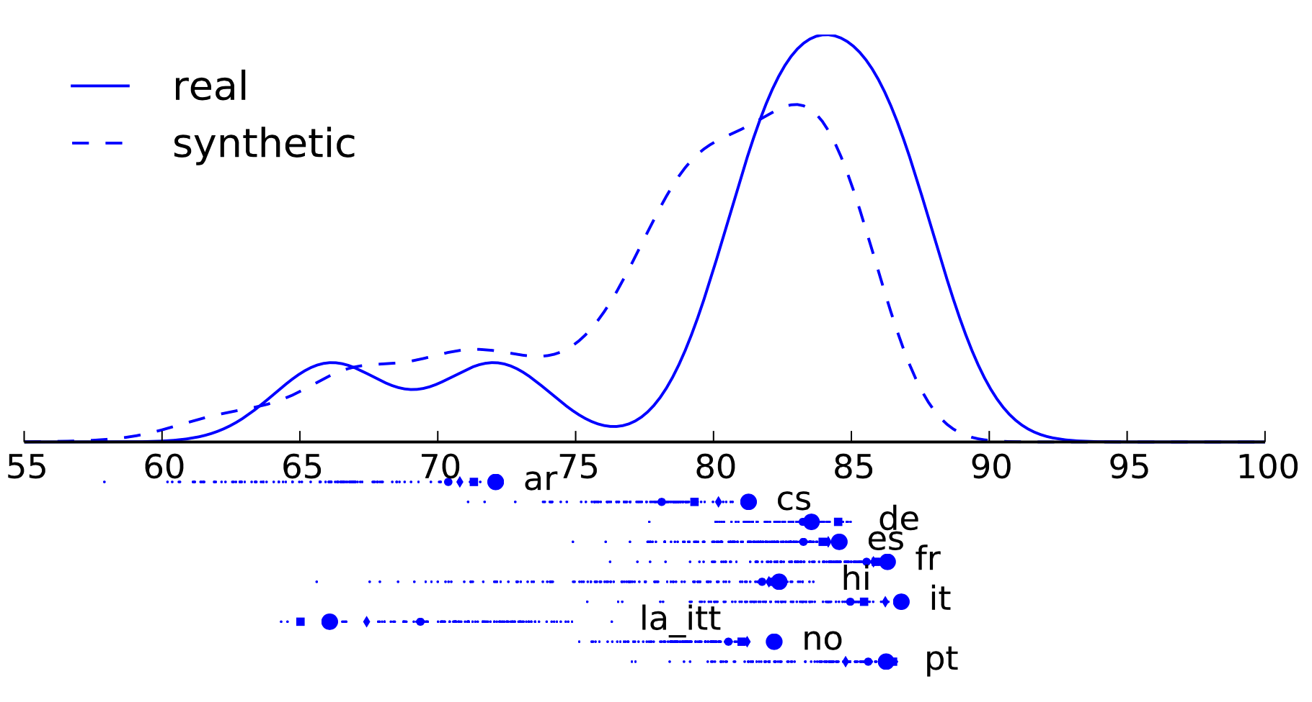
Evaluation: Parsability

Slide 39
Evaluation: Diversity
“Distance” between languages
  uas(Y | X) = how well can we parse POS sequences from language Y using a parser trained on language X?
  dissimilarity(X,Y) = uas(Y | Y) – uas(Y | X)
Let’s visualize the pairwise distances
  via a 2-D embedding (multidimensional scaling)
  are synthetic languages too boring? too weird?

Slide 40
Evaluation: Diversity
Notes:
Subsample of 100 languages.
our synthetic languages fill in the gaps nicely
use some animation to show this – point to relevant parts of diagram and make remarks. “These languages are close to real, so not everything is unrealistic. These languages are farther away, so not everything is redundant.”

Slide 41
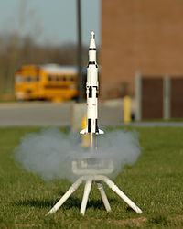
Are the synthetic languages useful?
(proof of principle)
(lots more fun we can all have in future!)

Slide 42
Single source transfer
1-nearest-neighbor
?
Notes:
mention that k-NN is great if your training data are pretty dense in the high-dim space

Slide 43
Single source transfer
?
Notes:
We propose a simple multi-lingual algorithm called, single source transfer. The idea is similar to 1-nearest-neighbor. If we have treebanks from 10 languages and want to parse an unknown language. We just select the model trained on closest language.

Slide 44
Single source transfer
?

Slide 45
Selection methods
(weakly) Supervised
  Ask whether a (source) language provides a good parsing model for 100 labeled trees of the target language
  Use POS sequence only (delexicalized)
Notes:
We want to pick the language whose parsing model get the highest score on parsing this 100 labled

Slide 46
Extend the learning curve
Supervised:71.38

Slide 47
Results on English
Notes:
We have more results and analysis in the paper.

Slide 48
Future Work

Slide 49
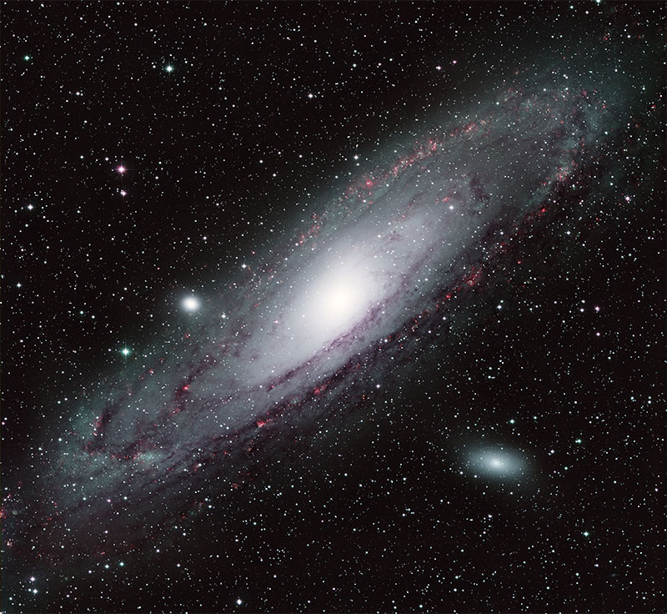

Limitations of version 1.0
Ideal
V1.0

Slide 50
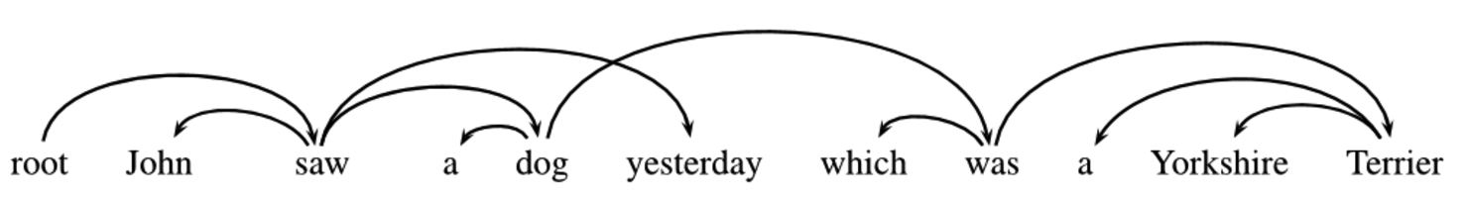
More adventurously
Generate non-projective trees

Slide 51
More adventurously
Generate non-projective trees
Beyond mix-and-match of real languages

Slide 52
More adventurously
Generate non-projective trees
Beyond mix-and-match of real languages
Change the substrate's vocabulary
You must feel the Force around you
a -> i
e -> u
i -> o
o -> e
u -> a
b -> d
g -> k
p -> q
…
Rea natr quum xdu Qelvu lzeabp rea

Slide 53
More adventurously
Generate non-projective trees
Beyond mix-and-match of real languages
Change the substrate's vocabulary
Beyond reordering: add/remove/relink words

Slide 54
More conservatively
Correctly handle punctuation
^{Jane loves her dog, Lexie.}
,
∧
^{her dog, Lexie Jane loves.}
^{Her dog, Lexie Jane loves.}

Slide 55
More conservatively
Correctly handle punctuation
Follow Greenberg’s Typological universals
Ensure appropriate parsability and perplexity
Finer-grained modeling of superstrate’s order
(features consider tree depth, dependency length, etc.)
"With overwhelmingly more than chance frequency, languages with dominant order VSO have the adjective after the noun."
nmod
I read a book which was a lot of fun by her.
nmod
I read a book by her which was a lot of fun.

Slide 56
Conclusion
New dataset: More than 50,000 high-resource languages! Use them for something!
How do we put linguistics back into NLP?
(inductive bias for training on small data)
  Traditional idea: Put it into ML objective
  Our idea: Put it into the extra (synthetic) training data!

Slide 57

Acknowledgement
Contributors to the Universal Dependencies project
Reviewers and editors of TACL
Conference organizers and audiences
Master Yoda

Slide 58
With you the Force may be!
Notes:
Thank you and may the Force be with you

