Slide 1
Searching for More Efficient Dynamic Programs
Tim Vieira, Ryan Cotterell, Jason Eisner
Notes:
Hi, I’m Tim Vieira and today I’m going to tell you about our EMNLP findings papers, “Searching for more efficient dynamic programs”

Slide 2
NLP Loves Dynamic Programming
It is the primary tool for devising efficient inference algorithms for numerous linguistic formalisms
finite-state transduction (Mohri, 1997)
dependency parsing (Eisner, 1996; Koo & Collins, 2010)
context-free parsing (Stolcke, 1995; Goodman, 1999)
context-sensitive parsing (Vijay-Shanker & Weir, 1989; Kuhlmann+, 2018)
machine translation (Wu, 1996; Lopez, 2009)
Notes:
NLP loves dynamic programming
It is the tool of choice for devising efficient inference algorithms for numerous linguistic formalisms such as
[CLICK x 5]

Slide 3
Speed-ups
Designing an algorithm with the best possible running time is challenging.
Bilexical dependency parsing: O(n⁵) → O(n⁴)
Split-head-factored dependency parsing: O(n⁵) → O(n³)
Linear index-grammar parsing: O(n⁷) → O(n⁶)
Lexicalized tree adjoining grammar parsing: O(n⁸) → O(n⁷)
Inversion transduction grammar: O(n⁷) → O(n⁶)
Tomita’s parsing algorithm: O(G nᵖ⁺¹) → O(G n³)
CKY parsing: O(k³ n³) → O(k² n³ + k³ n²)
We ask a simple question:
Can we automatically discover these faster algorithms?
Notes:
[CLICK] However, designing an algorithm with the best possible running time is challenging.
Often times, the initial or early papers present algorithms that are not as efficient as they can be, which leads to follow-up papers, often many years later.
Consider the following examples from the NLP literature
[CLICK]
Bi-lexical dependency parsing was originally presented with an n^5 algorithm by Collins and later sped-up to n^4 by Einser and Satta
[CLICK x 5] Many other algorithms similarly required speedups
[CLICK] In this work, we ask a simple question: Can we automatically discover these faster algorithms given an initial correct algorithm?

Slide 4
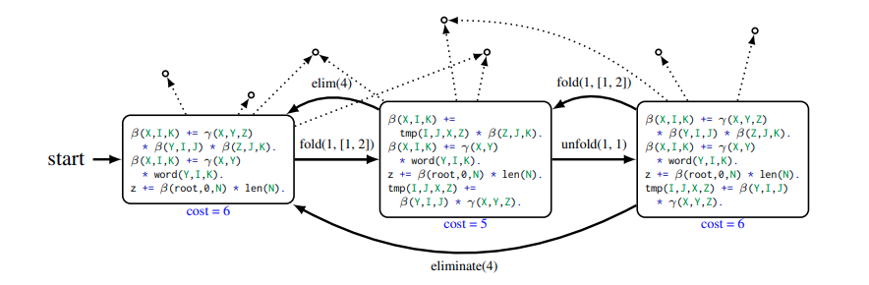
Our Approach
Cast program optimization as a graph search problem
Nodes are program variations
Edges are meaning-preserving transformations
Costs of each node measures its running time
Notes:
[CLICK]
Our approach to automatically optimizing dynamic programs is to cast program optimization as a graph search problem
where [CLICK]
the nodes are program variations [CLICK]
the edges are meaning meaning-preserving transformations between programs [CLICK]
and the cost of each node is a measures its running time [CLICK]
Here’s an example of such a graph [NEXT]

Slide 5
Step 1: Dyna
Represent algorithms in Dyna (Eisner et al. 2005), a domain-specific programming language for dynamic programming
Example (CKY parsing):
X
β(X,I,K) += γ(X,Y,Z) * β(Y,I,J) * β(Z,J,K).
β(X,I,K) += γ(X,Y) * word(Y,I,K).
total += β(“S”,0,N) * len(N).
Y
∑
Z
J,Y,Z
I
J
K
X
I
K
Notes:
We represent algorithms in Dyna, a high-level, domain-specific programming language for dynamic programming
The benefit of doing so is that it abstracts away low-level implementation details, which can all be worked out by the language’s compiler.
[CLICK]
Here we show CKY parsing -- or more precisely the inside algorithm
We see that the Dyna program looks just like the recurrence relations that are at the heart of the algorithm
Let’s look at the meaning of the first rule. [CLICK]
It tells us that
we can combine a constituent from I to J of type Y [CLICK]
with a constituent from J to K of type Z [CLICK]
and a grammar production which rewrites X -> Y Z [CLICK]
= to form a constituent from I to K of type X [CLICK]
To get the total weight, we sum over J, Y, Z [CLICK]
We have similar looking rules for the boundary cases
words are mapped to part-of-speech tags with the second rule [CLICK]
and we read off the total weight of derivations of type sentence from 0 to N where N is the length of the sentence [NEXT SLIDE]

Slide 6
Step 2: Runtime Bound From Code
Under some technical conditions, the running time of a Dyna program is proportional to the number of ways to instantiate its rules
For example,
β(X,I,K) += γ(X,Y,Z) * β(Y,I,J) * β(Z,J,K).
We use a simpler analysis
O(v⁶) where v = max(n, k)
O(k³ n³)
→ degree = 6
Why not run the code? WAY TOO SLOW!
Notes:
We now consider the costs of each node.
Under some technical conditions, the running time of a Dyna program is proportional to the number of ways to instantiate its rules
[CLICK]
Consider the CKY rule
The variables X,Y,Z are nonterminals which take on at most k different values
The variables I,J,K are sentence positions, which take on at most n different values
Therefore, there are at most n^3 k^3 ways to instantiate this rule.
In this paper, we use a simpler analysis, which treats all variables the same type.
Thus, this rule has a running time of v^6 where v is the larger of n and k
[CLICK]
We can now optimize the exponent, which we call the degree of the program, in our search problem.
Why not run the code on a benchmark dataset? We found that it was far too slow! Search often needs to evaluate thousands of nodes before it finds a good program
Additionally, it seems like the algorithm designers are using the asymptotics to design algorithms, so why shouldn’t we?

Slide 7
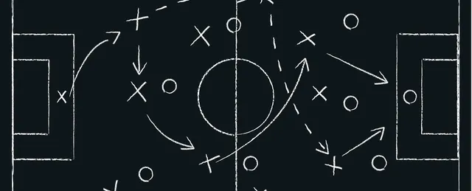
Step 3: Program Transformations
Each program transform maps a Dyna program to another Dyna program with the same meaning and (hopefully) a better running time.
We turn to the playbook: Eisner & Blatz (2007)
Notes:
Next we consider program transformations which are the edges our search graph.
Each program transform is a function that maps a Dyna program to another Dyna program with the same meaning and (hopefully) a better running time.
[CLICK]
We use some of the program transforms given in Eisner & Blatz (2007).
These transforms can recover the speed-ups that we mentioned in the introduction if they are applied in the right sequence.
One of the most useful transforms from that paper is folding [NEXT SLIDE]

Slide 8
Fold Transform
β(X,I,K) += γ(X,Y,Z) * β(Y,I,J) * β(Z,J,K).
O(k³ n³) or O(v⁶)
β(X,I,K) = ∑ γ(X,Y,Z) * β(Y,I,J) * β(Z,J,K).
J,Y,Z
β(X,I,K) = ∑(∑ γ(X,Y,Z) * β(Y,I,J))* β(Z,J,K).
J,Z
Y
= tmp(X,I,J,Z)
β(X,I,K) += tmp(X,I,J,Z) * β(Z,J,K).
tmp(X,I,J,Z) += γ(X,Y,Z) * β(Y,I,J).
Unfold Transform
O(n³ k² + n² k³) or O(v⁵)
Notes:
I’ll show an example of the fold transformation applied to the CKY rule.
Let’s put an explicit summation into the rule
Now, we reorganize the summation so that we first sum-out the Y variable.
if we create an intermediate quantity to store this sum, we get a faster algorithm!
Here is how we represent that faster program in Dyna
Here is the updated running time, which has a better dependence on k.
We can contrast it with the original version to see the speedup
--
Fold has an (approximate) inverse called unfold, which we also include in our search space.

Slide 9
Step 4: Search
Feed these ingredients to a graph search algorithm
We need search because the best sequence of transformations cannot be found greedily.
We experimented with beam search and Monte Carlo tree search.
Notes:
Feed these ingredients to a graph search algorithm
We need search because the best sequence of transformations cannot be found greedily.
We experimented with beam search and Monte Carlo tree search.

Slide 10
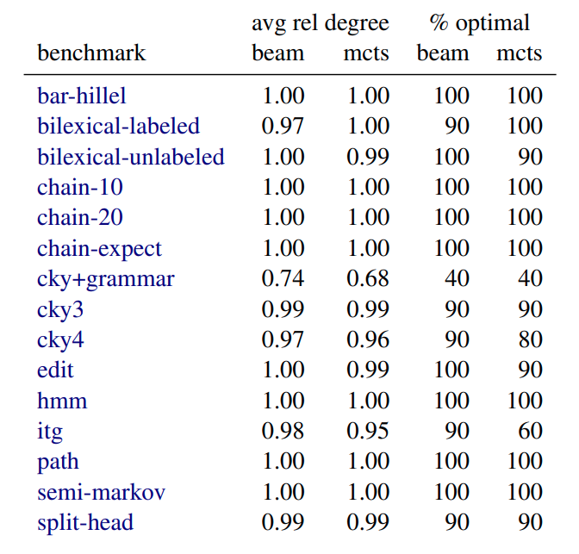
Experiments
Unit tests
100%
Stress tests
Notes:
[CLICK] We coded 15 different algorithms in Dyna and optimized them with our system. (We hope to implement even more in the near future.)
For each algorithm, we worked out what the best known degree is.
and we tested how well our system recovers the best degree given the initial program we coded.
Running our optimizer on these initial programs, we recovered the optimal degree in all cases with both beam search and mcts. [CLICK]
--
Since these were “too easy,” we created a stress test dataset by randomly applying transformations to get an more difficult initial program. We then see how well search can speed it back up.
The programs generated can be pretty difficult to optimize.
So we no longer recover the optimal degree 100% of the time.
Overall we found that beam search worked a bit better than mcts.
We hope that future work can improve search further.
[NEXT SLIDE]

Slide 11
Summary
Representing algorithms in a unified language allows us systematize the process of speeding them up.
We showed how to optimize dynamic programs with graph search on a program transformation graph.
We found that measuring running time efficiently was essential in order to explore enough of the search graph.

Slide 12


Thanks!
https://arxiv.org/abs/2109.06966
https://twitter.com/xtimv/status/1438611768868225026

Slide 13
Notes:
I’ll give the gist of one of these transformations, which is called folding.
Essentially, what folding does is it creates a useful intermediate quantity which can be reused.
Often times that quantity is so reusable that it reduces the running time.
---
Now instead of our pretty triangles connecting, we have blobozoids (aka “hook tricks”)

Slide 14
X
Fold Transform
Y
Z
I
J
K
β(X,I,K) += γ(X,Y,Z)
* β(Y,I,K) * β(Z,J,K).
∑
X
∑
Y
Z
J,Z
Y
creates an intermediate
item tmp(X,I,J,Z)
K
I
J
∑
X
β(X,I,K) +=
tmp(X,I,J,Z) * β(Z,J,K).
tmp(X,I,J,Z) +=
γ(X,Y,Z) * β(Y,I,K).
J,Z
Z
Y
I
J
K
Generalizes the “hook trick”
Notes:
I’ll give the gist of one of these transformations, which is called folding.
Essentially, what folding does is it creates a useful intermediate quantity which can be reused.
Often times that quantity is so reusable that it reduces the running time.
---
Now instead of our pretty triangles connecting, we have blobozoids (aka “hook tricks”)

