Slide 1




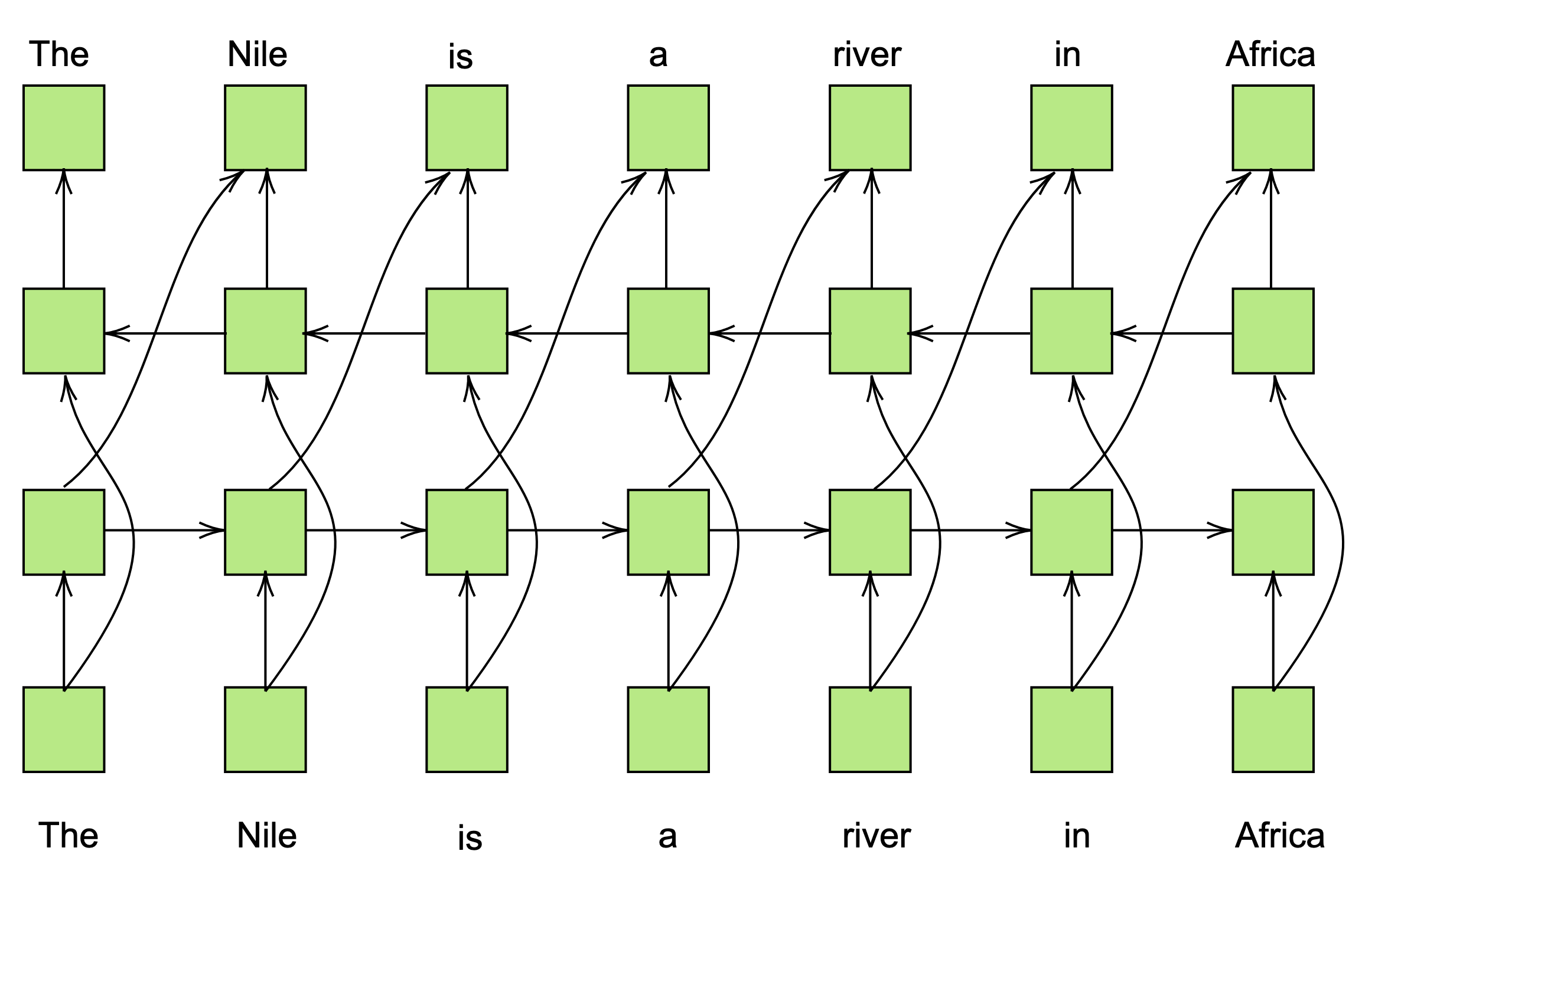


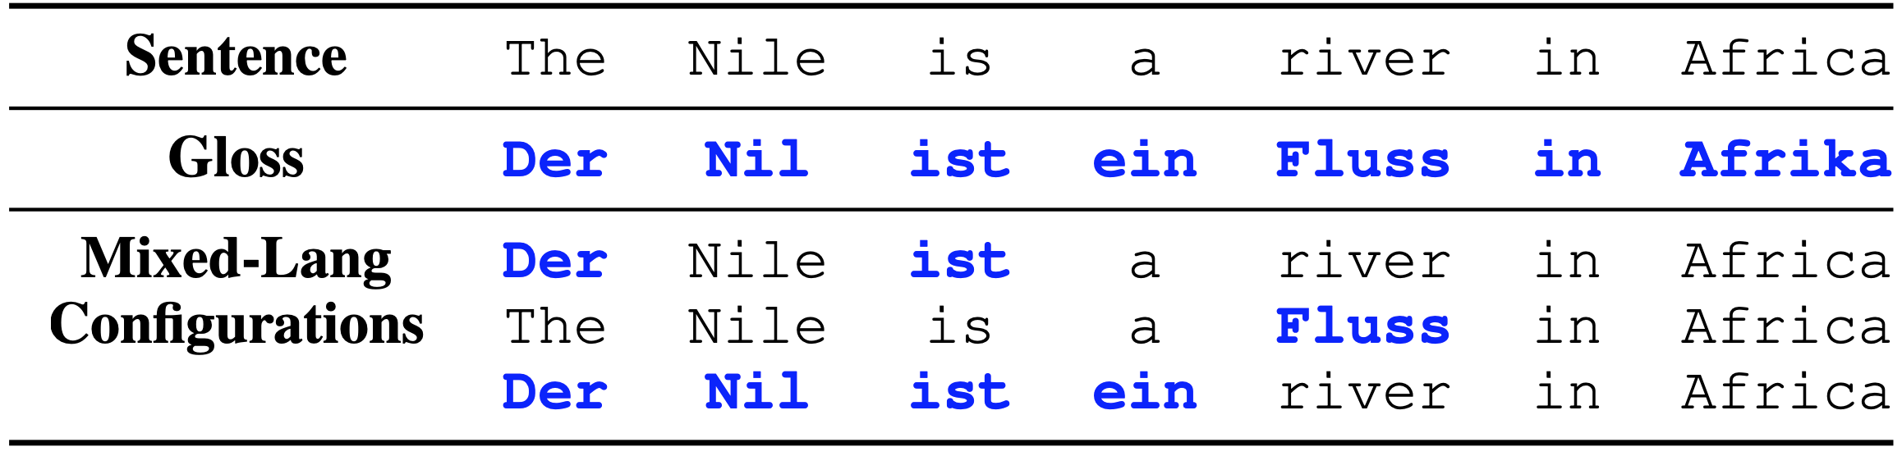
Spelling-aware construction of macaronic texts for teaching foreign-language vocabulary.
Adithya Renduchintala, Philipp Koehn and Jason Eisner
What if you could learn Spanish vocabulario just by reading enjoyable párrafos like this one? People learn new words en contexto all the tiempo. So nosotros have helped you by keeping mucho of English context. Nuestro model says que when tu see a frase, tu modificas the embeddings of all new words to improve cloze prediction of todos tokens in the sentence. It predicts that tu will learn embeddings para these Spanish words, in these contextos, that son similar to las embeddings of the original inglés words. Nosotros constructed this paragraph to ayudar you learn as más vocabulary as posible, using best-first search para choose a subconjuto de words para flip.
Search
We score macaronic configurations by how much they improve :
(L1,L2) reference word pairs
from the entire document
E.g. {(in, en),(all, todos),(time, tiempo),
(context, contexto), (you, tu), (the, la)…}
Rank threshold heuristic
Rank of in sorted order of
cosine similarities
Best-first left-to-right search (flipping one token at a time)
Initial search state
Research Goal
Proxy Student Model
People learn new words in context
Favor fewer L2 flips if tied
Personas learn new words in context
People learn new words in context
Incidental Learning is vital for native language (L1) acquisition (Krashen, 1989) and L2 acquisition (Huckin & Coady, 1999).
Challenge: For purely L2 incidental learning we (adults) must currently read below our “interest levels”.
Our Goal: Construct macaronic texts that are predicted to enable foreign vocabulary learning, without any human feedback.
How predictable and predictive are novel (L2) words in a sentence?
The embedding of “contexto” should make it more predictable…
Personas aprenden new words in context
Personas learn new words in context
Personas learn nuevos words in context
…
Personas learn new words in context
People learn nuevos words en contexto all the tiempo
Final macaronic configuration
(for next sentence
)
…and also more predictive of the embeddings of all other tokens, e.g. the embedding of “words”
Personas learn nuevos words in contexto
Setup
Experiments (Human Evaluations)
Proxy
Student Model
(Our Approach)
Are macaronic texts useful for human learners of an L2?
Native English (L1) Mturk “students” were given Spanish/German (L2) infused macaronic texts (short passages from novels) and we measured:
  a) comprehension of L2 vocabulary in context (participants guessed the meaning of L2 words in a macaronic sentence as they read the sentence)
  b) short-term retention without context (guessed the meanings of isolated L2 words at the end of the passage)
We assume the availability of L2 glosses with tokens in the original document (We do not yet replace phrases or reorder).
We use a cloze language model to model predictability and predictivity of tokens initially trained on a L1 corpus…
Ideal
Student Model
… and then incrementally learn embeddings of L2 (sub)words in a macaronic sentence:
What if you could learn Spanish vocabulario just by reading enjoyable párrafos like this one? People learn new words en contexto all the tiempo….
What if you could learn Spanish vocabulary just by reading enjoyable paragraphs like this one? People learn new words in context all the time…
frozen
L2 embeddings get updated
Closed-class
L1 params.
RNN params.
L1 Embeddings
Open-class
People learnlnuevosdsf en contexto all the tiempo
Mixed-Language
document
Machine
Teacher
Original
document (L1)
Fig 1: Overview of our “Machine Teacher” setup. The Machine Teacher can be viewed as a
Search algorithm with access to a Proxy Student Model which simulates the word guessing
And word learning behavior of real (Human) students.
Forward
computation
Gradient
(updates L2 subwords)
…
ways
things
music
words✔
…
en
nuevos
contexto
…
+
+
+
contexto
L1 | People | learn | new | words | in | context | all | the | time
L2-gloss | Personas | aprenden | nuevos | palabras | en | contexto | todo | el | tiempo
Macaronic configs. | Personas | learn | new | words | en | contexto | all | the | tiempo
 | People | learn | nuevos | palabras | in | context | all | the | time
 | Personas | aprenden | new | palabras | in | context | todo | the | tiempo
Future Work
Cloze prediction
…
Explore other spelling-aware representations (CNNs, RNNs etc.)
Extend model to allow reordering, partial word and phrasal substitutions.
Adapt online to student feedback in order to build personalized proxy student models and also model student’s learning and forgetting patterns similar to our prior work in Renduchintala et al. 2017.
Fig 2: An example English (L1) sentence with Spanish (L2) glosses and three example mixed-language configurations (there are exponentially many possible configurations).
co
con
on
ext
xt
to
xto
Notes:
To change this poster, replace our sample content with your own. Or, if you'd rather start from a clean slate, use the New Slide button on the Home tab to insert a new page, then enter your text and content in the empty placeholders. If you need more placeholders for titles, subtitles or body text, copy any of the existing placeholders, then drag the new one into place.

