Slide 1
Knowledge Tracing in Sequential Learning of Inflected Vocabulary
Adithya Renduchintala
Philipp Koehn
Jason Eisner
Notes:
Good Morning,
I am going to present our paper on knowledge tracing in sequential learning of inflected vocabulary.
… (next)

Slide 2




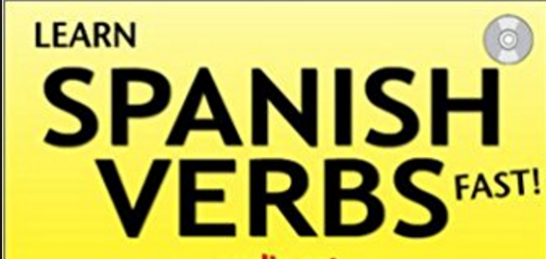


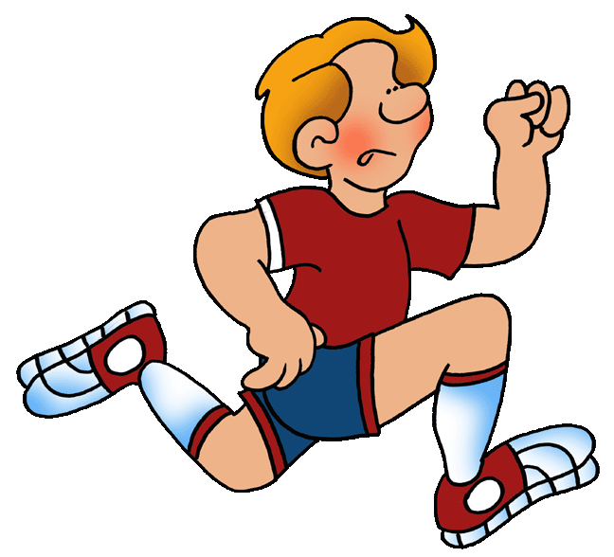



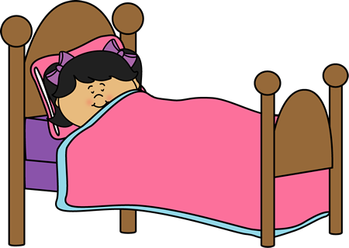


silla
correr
árbol
dormir
Libro
Gato
Notes:
Lets Imagine you are learning a second language – maybe you are a english speaker learning spanish.
You have acquired some vocabulary but if you want construct phrases and sentences
– learning the inflection paradigm of the second language becomes imperative.
Now perhaps, like many language learners you turn to [click] flash-cards as a method of learning and reviewing the inflection-paradigm of your target language.

Slide 3
silla
correr
árbol
dormir
Libro
Gato
Notes:
Lets Imagine you are learning a second language – maybe you are a english speaker learning spanish.
[click]
You have acquired some vocabulary but if you want construct phrases and sentences
[click]

Slide 4

Un gato está durmiendo
gato dormir
Notes:
Turns out even to build a simple phrase – learning the inflection paradigm [click] of the second language becomes imperative.

Slide 5
Notes:
Now perhaps, like many language learners you turn to flash-cards as a method of learning and reviewing the inflection-paradigm of your target language.

Slide 6
Our goal is to understand how the learner’s knowledge changes as they use Flash-cards to learn inflection.
If we can model this process, then we can plan more efficient flash card sequences.
Notes:
We want to understand your knowledge of the inflection-paradigm changes as you use flash cards.

Slide 7
Our goal is to understand how the learner’s knowledge changes as they use Flash-cards to learn inflection.
If we can model this process, then we can plan more efficient flash card sequences.
This talk
Future Work
Notes:
We want to understand your knowledge of the inflection-paradigm changes as you use flash cards.

Slide 8
θ₀
θ₁
θ₂
θ₃
θ₄
yo ganaré
θ₅
yo acepto
I accept
yo aceptaré
you win
I call
You will call
I will accept
tú ganas
you win
I call
You will call
I will accept
tú aceptas
You accept
yo aceptaré
you win
I call
You will call
I will accept
yo ganaré
tú ganas
you win
I call
You will call
I will accept
I will win
✖
✖
✔
θ₅
θ₄
θ₁
θ₂
θ₃
θ₀
Notes:
So lets begin by assuming that you have some knowledge at the beginning of your flash card session – [click] denoted by theta_0.
The flash-cars system delivers a card which affects your knowledge.[click to theta_1]
And similarly a subsequent card will also change your knowledge state in some way. [theta_3]
Since the FC system is an interactive one, (not physical cards) it can present MC FCs that elicits a response.
Maybe your first mistake confuses you, but you carry on – [click x2]
and the second mistake frustrates you, but it also resolved your confusion
and the resulting knowledge lets you correctly answer a harder “typing card”, where you have no explicit options shown.
So we assume that your knowledge changes with every interaction you have with the flash-card system.

Slide 9
θ₅
θ₅
θ₄
θ₄
θ₂
θ₁
θ₂
θ₁
θ₃
θ₃
θ₀
θ₀
Notes:
Ok, in this scenario we have pretended that we can “see” theta – your knowledge – but we can not.

Slide 10
yo acepto
I accept
tú aceptas
You accept
tú ganas
you win
I call
You will call
I will accept
tú ganas
you win
I call
You will call
I will accept
✖
yo aceptaré
you win
I call
You will call
I will accept
yo aceptaré
you win
I call
You will call
I will accept
θ₅
θ₄
✖
θ₁
θ₂
yo ganaré
yo ganaré
θ₃
I will win
✔
θ₀
Notes:
But what we do have is a detailed log of your interactions.

Slide 11
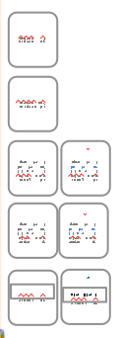
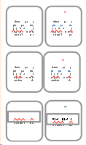





yo acepto
I accept
tú aceptas
You accept
tú ganas
you win
I call
You will call
I will accept
tú ganas
you win
I call
You will call
I will accept
✖
yo aceptaré
you win
I call
You will call
I will accept
yo aceptaré
you win
I call
You will call
I will accept
✖
yo ganaré
yo ganaré
I will win
✔
θ₅
θ₄
θ₁
θ₂
θ₃
θ₀
Notes:
In fact we have the data for several students! 120 students to be exact!

Slide 12
yo acepto
I accept
tú aceptas
You accept
tú ganas
you win
I call
You will call
I will accept
tú ganas
you win
I call
You will call
I will accept
✖
yo aceptaré
you win
I call
You will call
I will accept
yo aceptaré
you win
I call
You will call
I will accept
θ₅
θ₄
✖
θ₁
θ₂
yo ganaré
yo ganaré
θ₃
I will win
✔
θ₀
Notes:
(click to animate)
With this log of interactions we can come up with
estimates of your knowledge at all the different time steps???

Slide 13
Goal
From the interactions:
Construct θs that predict student responses
tú aceptas
You accept
θ₅
θ₄
yo ganaré
yo ganaré
θ₁
θ₂
θ₃
I will win
yo acepto
I accept
yo aceptaré
you win
I call
You will call
I will accept
yo aceptaré
you win
I call
You will call
I will accept
✔
✖
θ₀
tú ganas
you win
I call
You will call
I will accept
tú ganas
you win
I call
You will call
I will accept
✖
Notes:
So lets recast our Goal more precisely:
From the interactions:
* construct thetas that predict student behavior

Slide 14
Goal
From the interactions:
Construct θs that predict student responses
tú aceptas
You accept
θ₅
θ₄
yo ganaré
yo ganaré
θ₁
θ₂
θ₃
I will win
yo acepto
I accept
yo aceptaré
you win
I call
You will call
I will accept
yo aceptaré
you win
I call
You will call
I will accept
✔
✖
θ₀
tú ganas
you win
I call
You will call
I will accept
tú ganas
you win
I call
You will call
I will accept
✖
Notes:
But we don’t want to treat thetas and responses as isolated pairs…

Slide 15
Goal
From the interactions:
Construct updates that lead to θs that predict student responses
tú aceptas
You accept
θ₅
θ₄
yo ganaré
yo ganaré
θ₁
θ₂
θ₃
I will win
yo acepto
I accept
yo aceptaré
you win
I call
You will call
I will accept
yo aceptaré
you win
I call
You will call
I will accept
✔
✖
θ₀
tú ganas
you win
I call
You will call
I will accept
tú ganas
you win
I call
You will call
I will accept
✖
Notes:
we want to construct the updates (i.e. changes in knowledge) that ….

Slide 16

Goal
From the interactions:
Construct learning rule that constructs updates that lead to θs that predict student responses
tú aceptas
You accept
θ₅
θ₄
yo ganaré
yo ganaré
θ₁
θ₂
θ₃
I will win
yo acepto
I accept
yo aceptaré
you win
I call
You will call
I will accept
yo aceptaré
you win
I call
You will call
I will accept
✔
✖
θ₀
tú ganas
you win
I call
You will call
I will accept
tú ganas
you win
I call
You will call
I will accept
✖
Notes:
And we do this by trying to model a [click] “underlying learning rule” that generates updates which changes theta which in turn predicts student responses

Slide 17
What is a knowledge state?
Notes:
Ok so far we have talked about knowledge states in the abstract – what precisely are they?
i.e. How does our model imagine them to be?

Slide 18
Knowledge State θ is a weight vector
Log-linear model of student’s response
Student Response
A foreign phrase
Feature Function
Set of
answer options
Knowledge State
Notes:
In this model a knowledge state is a weight vector.
We model the students response as being generated from a log-linear distribution specified by the KS.
[walk through each variable] [feature function]

Slide 19
What are the features?
tú miras
tú miras
you watch
tú
you
tú
watch
miras
you
miras
watch
=
Words
you watch
-ú
-u
-ú
-ch
-as
-u
-as
-ch
Suffixes
Generalization
Memorization
t-
yo-
t-
wa-
mi-
yo-
mi-
wa-
Prefixes
…
“Reconstructive memory”
as structured prediction
tú
2ND
t-
2ND
-as
PRES
Morph
Notes:
Lets examine phi_x,y the feature function with the help of an example [click]
We use a range of features such as wor features, prefix and suffix feats and substring to English tag features and so on..
These features let the student generalize to new phrases they’ve never seen.
But flash cards are for memorization, so what if they have seen this phrase before –Do they always think of all these substring/prefix/suffix features? can’t they just memorize it?
Sure, then THIS feature [appears] will have positive weight. If they’ve only seen it once, that weight’s like .01 – but these other features will still help them remember it.
This realizes the theory of “reconstructive memory,” which says that recall isn’t just pulling a string out of a storage box, but is more like structured prediction.
----It contrasts to methods like Bayesian knowledge tracing, where you either have a skill or you don’t.
In such a featurization, your probability of getting it right goes up as you see the item and related items and learn a good weight vector.

Slide 20
Knowledge State θ is a weight vector
Log-linear model of student’s response
Structured prediction of new answer phrases.
  Generalization
Recall of memorized phrases also treated as structured prediction. “reconstructive memory”
➔
➔

Slide 21
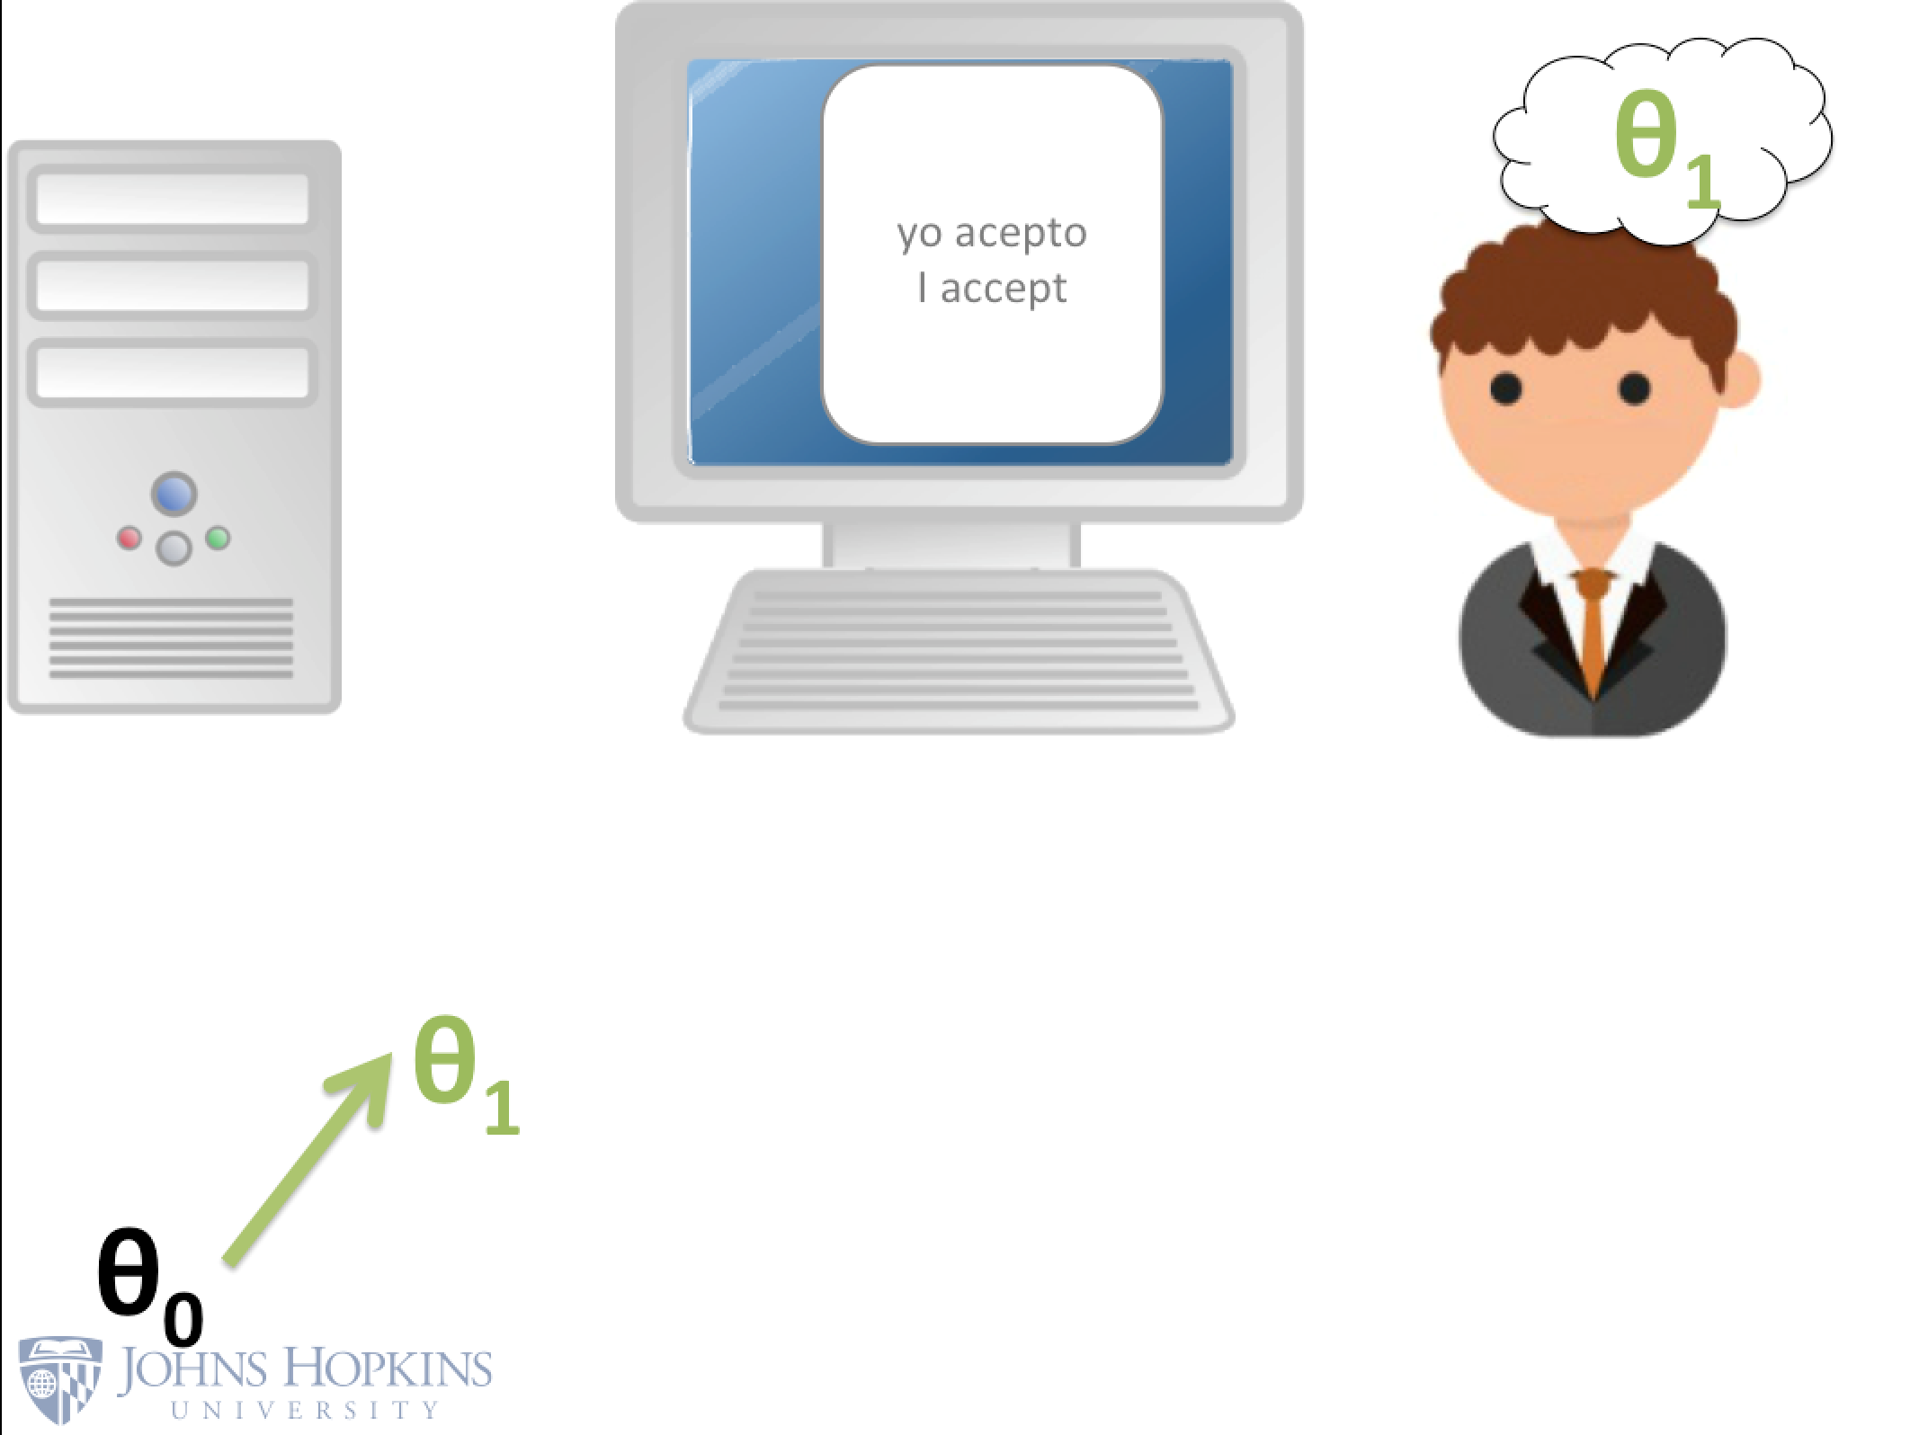
Suppose the flash-card system reveals the correct English phrase for a Spanish phrase
Notes:
So we seen how (our model) generates an answer given the knowledge state, now we are going to see how the students knowledge changes.
[Click Show image]
To discuss this let’s suppose our flash-card system gives an “Example Card” to the student. (click now, x 2)
Then they should update their knowledge state to increase their probability of correctly answering x with y* in the future.
(next)

Slide 22
Suppose the flash-card system reveals the correct English phrase for a Spanish phrase
Perhaps a student updates their knowledge state using SGD?
Notes:
So what kind of update to theta would satisfy this requirement? Maybe the students update their knowledge using GD just like an ML algorithm??
[goto next before any more discussion]

Slide 23
Observed Features
Expected
Features
Notes:
This is not as crazy as it sounds – the gradient _is_ going to move probability to y*
Lets look at the gradient… it’s points to a direction in which theta should change.
[animate]

Slide 24
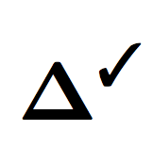
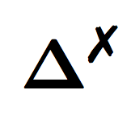
Observed Features
Expected
Features
Notes:
That direction is given by Observed features – Exp Features
these are point some points in hd space [click]
Let’s will annotate this gradient as delta + checkmark
When this is applied the theta (which is also some point in the space) moves along this direction.
[theta moved, till you see t+1]

Slide 25
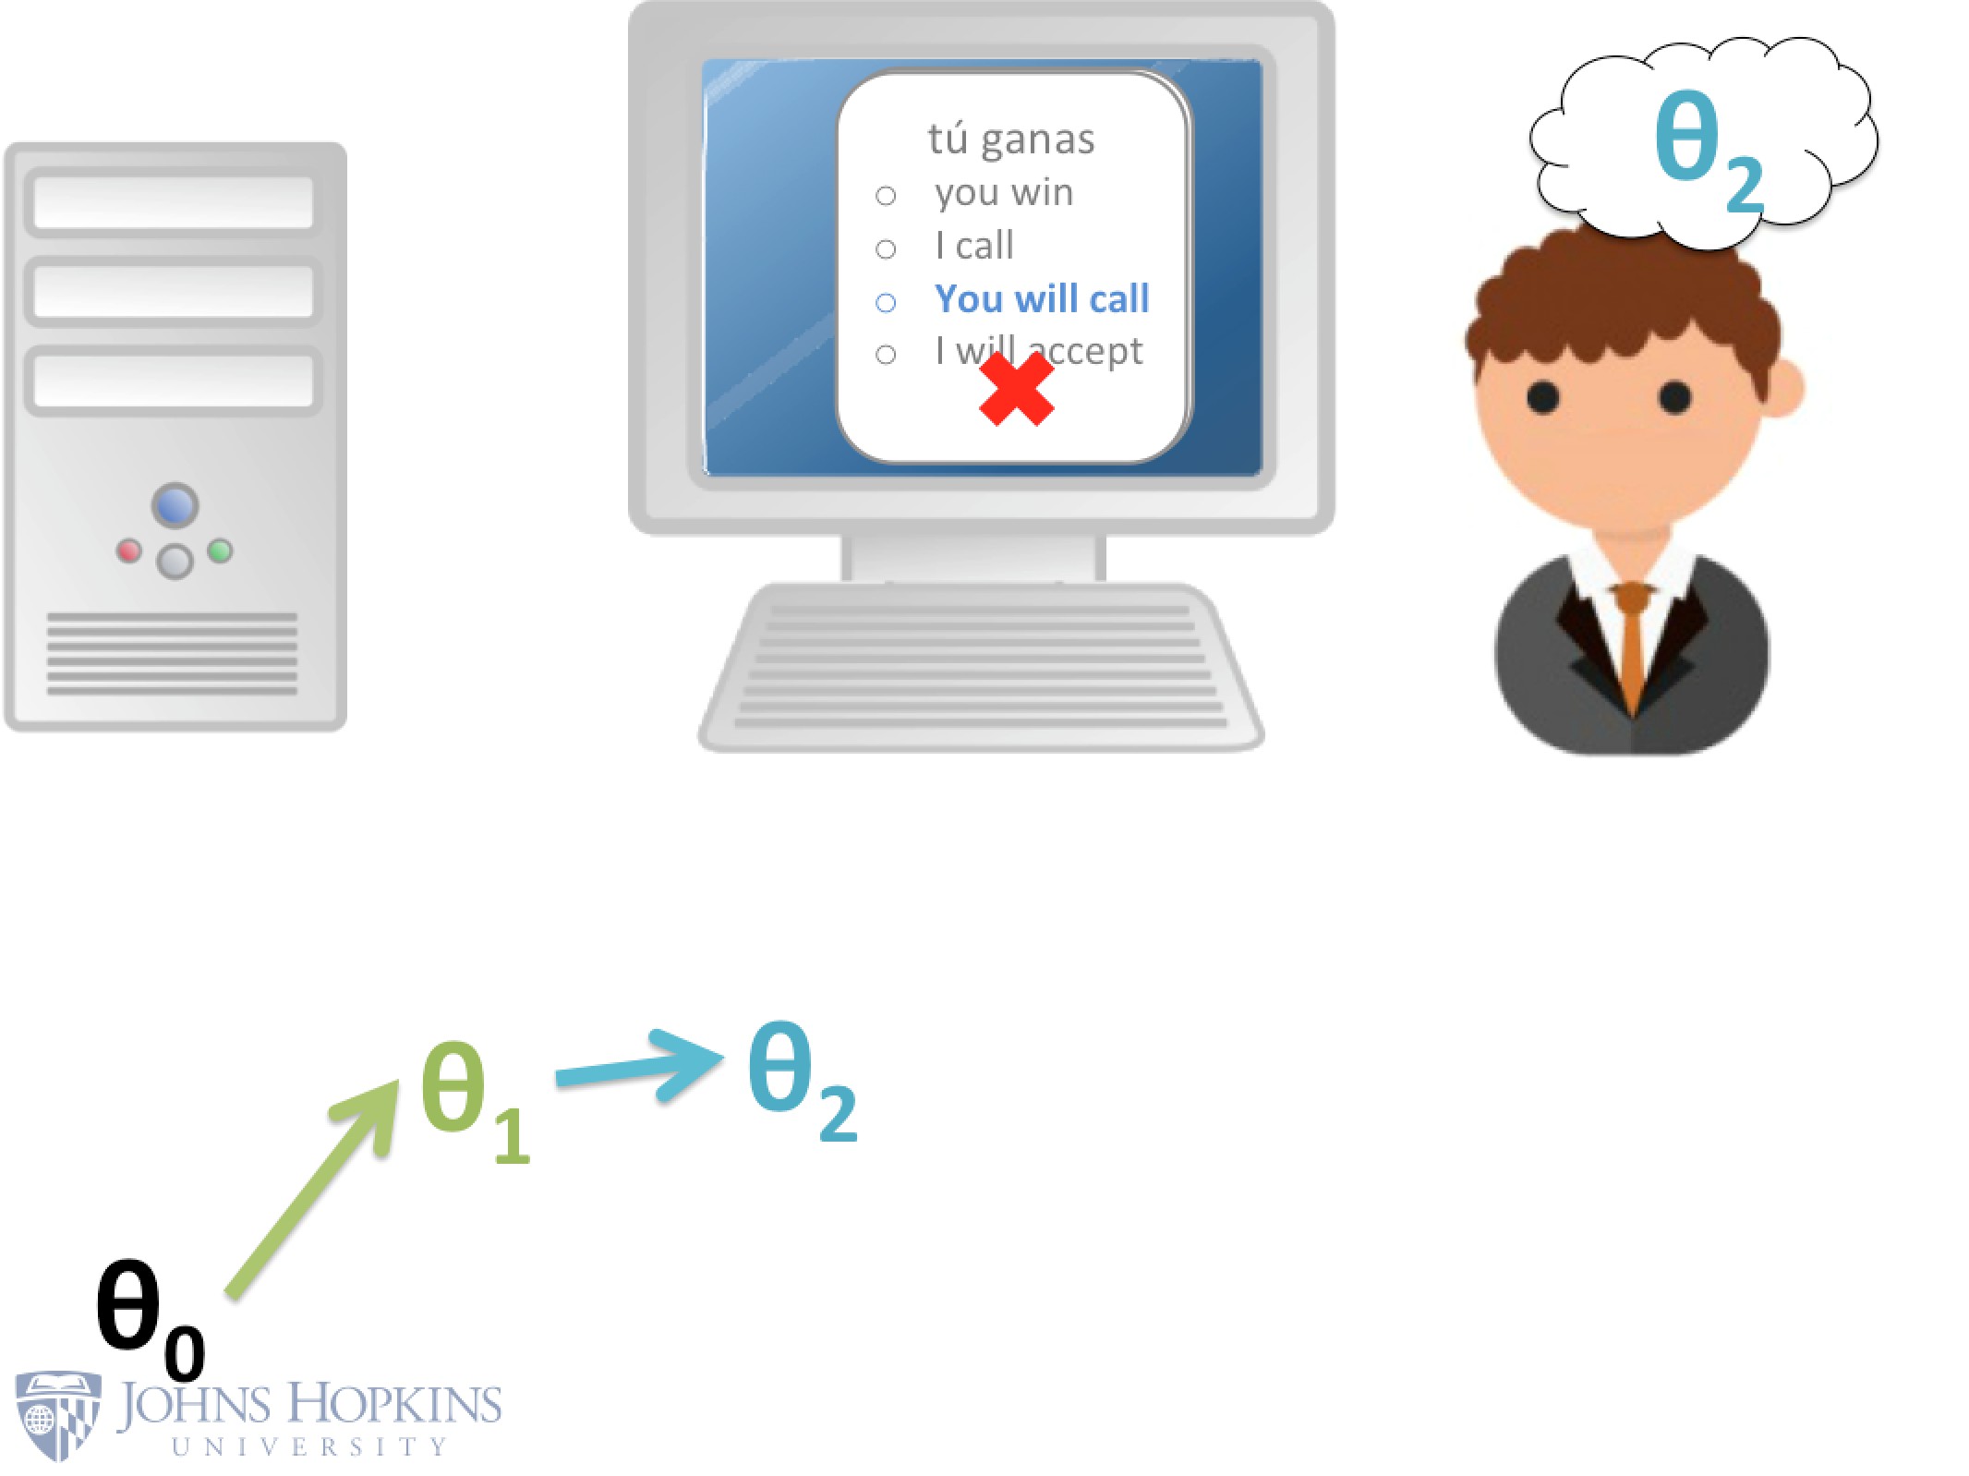
Suppose the flash-card system only reveals that the student’s response was incorrect.
Without indicating the correct answer. (no )
Notes:
What about the flip side? – what if they are not given the answer (no y*!) [CLICK for image]
instead all they get is some negative feedback i.e. all they know is that their answer is wrong.
They still can learn something!

Slide 26
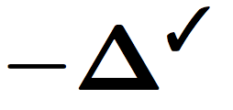
Observed Features
Expected Features
from remaining options
Expected
Features
Notes:
In this case we can simply replace the point of Obs Feats point with a new point, which is the Expected Feats from Remaining Options. [EMPH]
This is the grad of the incomplete data log likelihood.
[click]
So now we have a new gradient and we will annotate this gradient with delta cross.

Slide 27
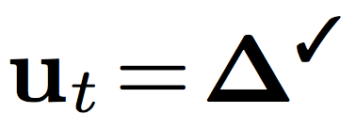
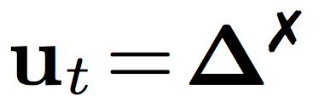
Update Scheme | Student Correct or Revealed | Student Incorrect
Redistribution (RG)
Hmm, I wonder which other option it could have been…
Notes:
We call this pair of gradients as an “update scheme” – it just defines 2 gradients for 2 cases correct and incorrect
[click]
The intuition that we hope this scheme captures is that the student is perhaps “strategizing” as to what they did wrong, and they are trying to identify the next best option.
Of course - there are many possible update schemes.
Are there other intuitions?

Slide 28

Observed Features
from incorrect selection
Observed Features
Expected
Features
Notes:
Another option is to just move probability mass away from the selected answer. [click animate]

Slide 29
Update Scheme | Student Correct or Revealed | Student Incorrect
Redistribution (RG)
Negative grad (NG)
Feature vector (FG)
I better not make that mistake again!
Notes:
This gradient perhaps suggests that the student might just remember to not make this mistake again –
Note that both these gradients move away from incorrect answers and toward other options -

Slide 30
Update Scheme | Student Correct or Revealed | Student Incorrect
Redistribution (RG)
Negative grad (NG)
Feature vector (FG)
Notes:
Finally we also tried using the observed feature as the magnitude of the gradient and just use +/-1 as the direction depending on whether the answer was correct or incorrect.
[click]
This is a reasonable way to model how students learn – we just have to find the “right” alpha to explain all the student responses – where alpha is the learning step size.
But alpha is just one parameter thus the model is not flexible to match what a student does.
The degrees of freedom for such a model is limited.

Slide 31
What is missing in the learning rule?
Students don’t’ just learn, they also forget.
Even ML algorithms “forget”
(L2-regularized online learning, a.k.a. “weight decay”)
Notes:
Whats missing here?
[click]
People don’t just learn they also forget.
[click]
In fact even in ML, regularization makes the model “forget” as well.
[click]
We introduce an explicit beta term to control how much of the knowledge from the previous time step is allowed into the current time step.
(now we are trying to learn 3 things update direction, learning rate alpha and retention rate beta)

Slide 32
What is missing in the learning rule? (ii)
Different learning and forgetting rates for different features?
Cognates maybe easier to learn and remember
Pronouns may be easy to learn but may also be easily forgotten, etc.
Again, similar to certain ML update rules (Adagrad).
Notes:
[click]
People will have different learning and forgetting rates for different _kinds_ features [click] – cognates might be easy to remember.
[click]
So we can extend alpha and beta allowing them to act on a per-feature basis. (lot more parameters to learn – and more flexibility to fit data from real students)

Slide 33
What is missing in the learning rule? (iii)
Learning and forgetting rates can depend on context.
Learning rate maybe high at the beginning and slow down
Learning might be more when students get an answer correct
May depend on the type of flash-card etc…
We now have gates that control learning and forgetting
Notes:
Next, the learning rate maybe affected by context – we can define context to mean many things –
Maybe students have a larger learning and smaller forget rate in the start of the session?
They may respond differently to getting an answer correct vs incorrect?
And many other contextual attributes could affect learning rate and forget rate.
So now instead of fixed vectors – we have gates alpha_t and beta_t that are informed by some “context”

Slide 34
Final Learning Rule
New set of weights
which control the gates

Slide 35
Final Learning Rule
New set of weights
which control the gates
7-d “Context vector” which summarize
events of a particular time step.
Notes:
How do we incorporate this context information into the learning and forgetting gates?
[click]
We use a new set of weights W alpha, and W beta that transform the context vectors and generate the learning and forgetting gates.
By the way – if you are familiar with gated RNNs, this should look like just another variation of the many gating mechanisms out there.

Slide 36
Final Learning Rule
New set of weights
which control the gates
7-d “Context vector” which summarize
events of a particular time step.
Notes:
How is the context vector specified?

Slide 37
Final Learning Rule
Finally, they can behave like gates
New set of weights
which control the gates
7-d “Context vector” which summarize
events of a particular time step.
Indicates type of Flash card

Slide 38
Final Learning Rule
Finally, they can behave like gates
New set of weights
which control the gates
7-d “Context vector” which summarize
events of a particular time step.
Correct, Incorrect or Revealed
Indicates type of Flash card

Slide 39
Final Learning Rule
Finally, they can behave like gates
New set of weights
which control the gates
7-d “Context vector” which summarize
events of a particular time step.
Correct, Incorrect or Revealed
Indicates type of Flash card
Chance probability

Slide 40
Learning Rule | Notation
 | Scalar Model(SM)
 | Vector Model(VM)
 | Context Model(CM)
Notes:
Quick Recap of the learning rules, we began with scalar learning and forgetting parameters and arrived at gated learning and forgetting mechanisms

Slide 41
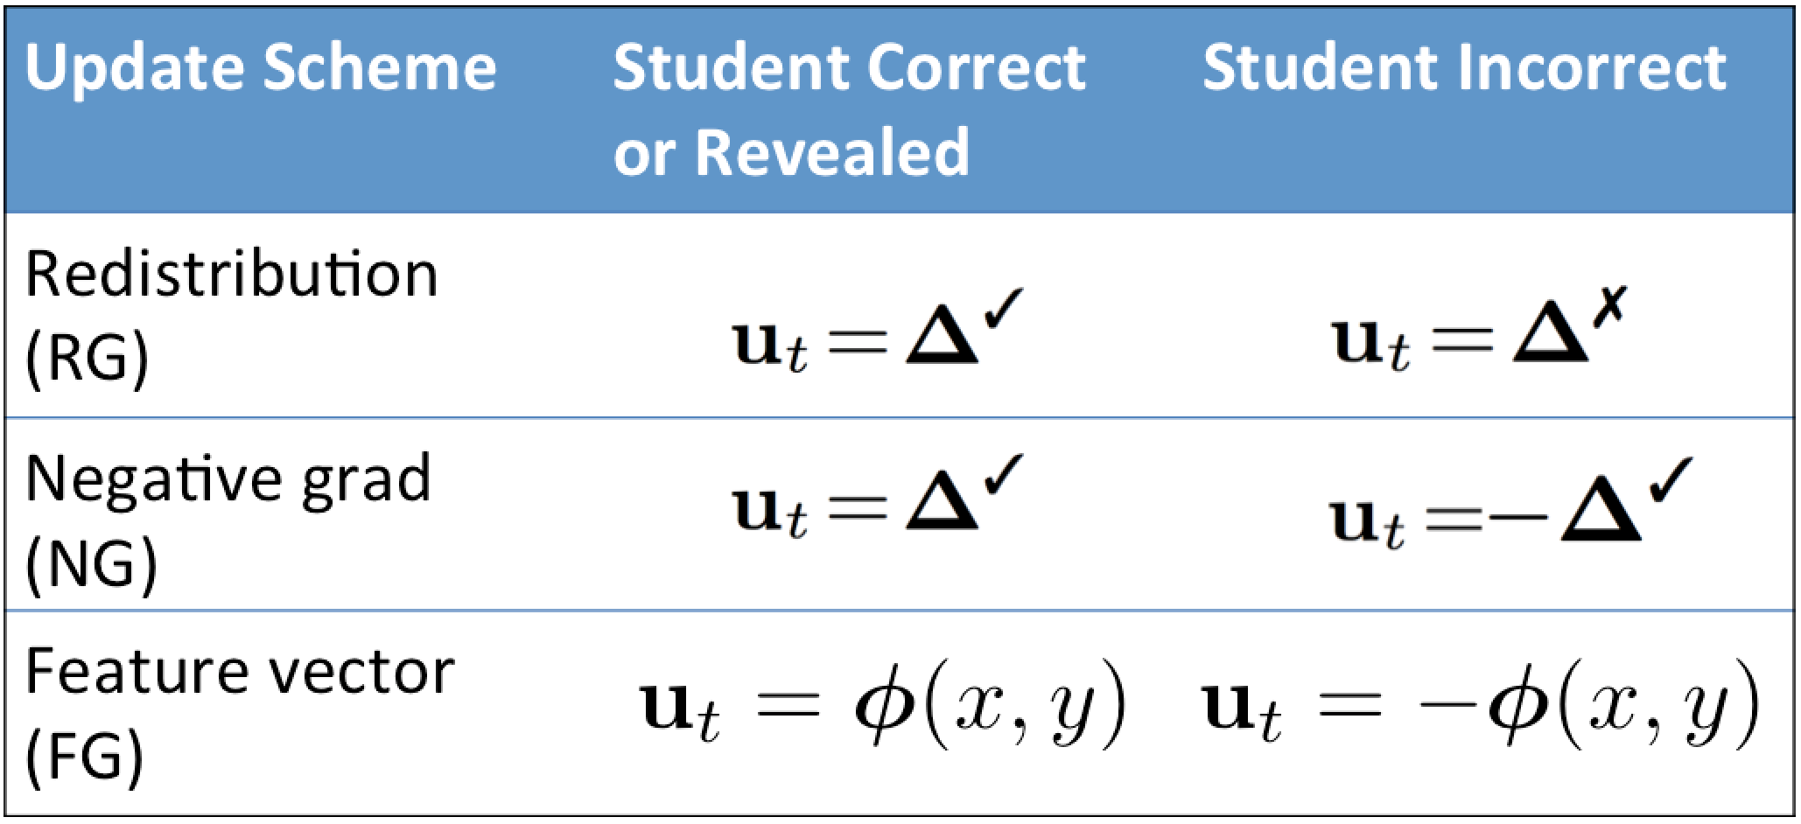
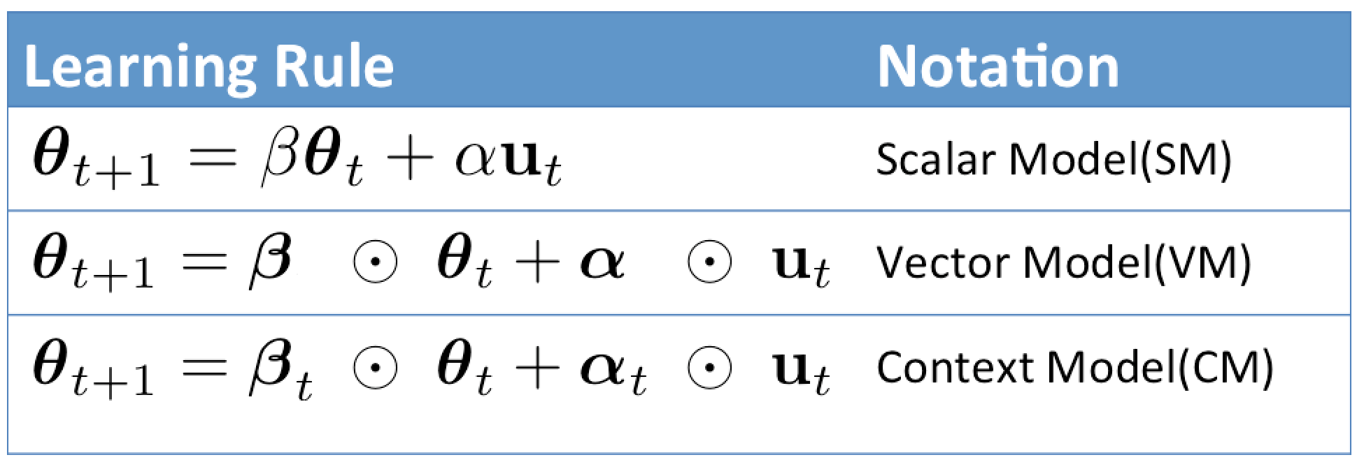
Notes:
Recall that the learning rules can co-exist with the possible update schemes that we have discussed.

Slide 42
Training Our Model of the Student
Collected flash-card interactions from 120 Mturk “students”.
Each student goes through:
  Practice phase: 35 flash-cards (Included Example cards, Multiple choice and typing)
  Quiz phase: 7 flash-cards (Only typing, with no feedback)
Parameter learning:
  Objective: Maximize log likelihood of all student generated responses
System revealed answer
Student generated answer
Notes:
Ok, we have our model, now how do we learn our model parameters?
We first collected data from Mturk – we employed 120 Mturk students and made them go through…
Then use the following MLE objective to learn our model params.

Slide 43
Evaluation: Predict Students’ Answers (both right & wrong answers; both practice & quiz phases)
 | Scalar Model (SM) | Vector Model (VM) | Context Model (CM)
Feature Grad. (FG) | 0.239 , 2.362 | 0.357 , 2.130 | 0.401 , 2.025
Redistribution Grad. (RG) | 0.135 , 3.194 | 0.397 , 1.909 | 0.401 , 1.938
Negative Grad. (NG) | 0.185 , 4.674 | 0.397 , 2.320 | 0.449 , 2.244
Improved accuracy
Uniform baseline : 0.133, 2.459
Accuracy, Cross-Entropy
Notes:
Here are our results:
Predictably, more complicated learning rules do better. [illustrate with arrow]
CM > VM > SM
[click]

Slide 44
Student Response Prediction
Accuracy, Cross-Entropy
 | Scalar Model (SM) | Vector Model (VM) | Context Model (CM)
Feature Grad. (FG) | 0.239 , 2.362 | 0.357 , 2.130 | 0.401 , 2.025
Redistribution Grad. (RG) | 0.135 , 3.194 | 0.397 , 1.909 | 0.401 , 1.938
Negative Grad. (NG) | 0.185 , 4.674 | 0.397 , 2.320 | 0.449 , 2.244
Uniform baseline : 0.133, 2.459
Notes:
As for the different update rules, it’s less clear - RG wins if you measure cross-entropy and NG wins if you measure accuracy,
and in fact we don’t have to follow each of these rules exclusively – there are other things to try.

Slide 45
Student Response Prediction
Accuracy, Cross-Entropy
 | Scalar Model (SM) | Vector Model (VM) | Context Model (CM)
Feature Grad. (FG) | 0.239 , 2.362 | 0.357 , 2.130 | 0.401 , 2.025
Redistribution Grad. (RG) | 0.135 , 3.194 | 0.397 , 1.909 | 0.401 , 1.938
Negative Grad. (NG) | 0.185 , 4.674 | 0.397 , 2.320 | 0.449 , 2.244
Mixed Grad. ϒ * RG + (1 – ϒ) NG | 0.183 , 3.502 | 0.427 , 1.855 | 0.449 , 1.888
Uniform baseline : 0.133, 2.459
Notes:
One thing we did try in the paper was a learn combination of RG and NG, which basically wins.
And im sure you are wondering, why even bother with update schemes and learning rules?
Why not just use an LSTM to track theta through time? [click to next slide]
Well, we tried it, and it works slightly worse, at least for a 1-layer LSTM.

Slide 46
Student Response Prediction
Accuracy, Cross-Entropy
 | Scalar Model (SM) | Vector Model (VM) | Context Model (CM)
Feature Grad. (FG) | 0.239 , 2.362 | 0.357 , 2.130 | 0.401 , 2.025
Redistribution Grad. (RG) | 0.135 , 3.194 | 0.397 , 1.909 | 0.401 , 1.938
Negative Grad. (NG) | 0.185 , 4.674 | 0.397 , 2.320 | 0.449 , 2.244
Mixed Grad. ϒ * RG + (1 – ϒ) NG | 0.183 , 3.502 | 0.427 , 1.855 | 0.449 , 1.888
Uniform baseline : 0.133, 2.459
Slightly worse!
1-layer LSTM : 0.429, 1.992

Slide 47
Summary
Cognitively plausible model of how a student’s knowledge changes in a flash-card tutoring system.
Arrived at a gated recurrent model where each ingredient has an underlying intuition.
  Interpretable knowledge state
  Interpretable Update schemes and learning rules
Empirically compared all combinations of update schemes and learning rules.
Notes:
The paper has more results and analysis of user responses.

Slide 48
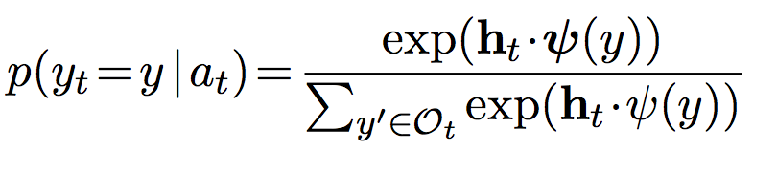
LSTM Comparison
Notes:
Y

Slide 49
