Slide 1
Noise-Contrastive Estimation for Multivariate Point Processes
Hongyuan Mei, Tom Wan, Jason Eisner
Johns Hopkins University
Notes:
hi everyone, welcome to my talk: noise contrastive estimation for multivariate point processes

Slide 2

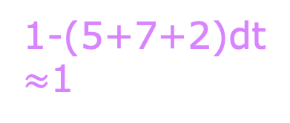
MLE: Max log prob of data
alternative:
noise-contrastive estimation
……
……
……
……
……
NOW
……
dt = infinitesimal
time=0
t
t + dt
B
A
C
A
A
5dt
B
7dt
C
2dt
Loop over all 50000 event types!
(A, B, C, …)
$$∅$$
1-(5+7+2)dt
$≈$1
Integrate over infinitely many non-events!
(often approx by sampling)
SLOW
Notes:
the data we consider in this paper is sequences of events in continuous time
here is an example
multivariate point process is a model for such data
at each time t, it reads the history of events up to time t
and predicts what we’ll see now
an event of each type may happen with a very small probability
and almost surely, nothing happens
here is a usual way of training this model:
if an event happens, its probability under the model is increased;
this has been done for all the past events;
if nothing happens, probabilities of all event types are decreased
this has been done for all the infinitely many past NON-events
this way is maximum log-likelihood estimation and it can be slow
in this paper, we propose an alternative noise-contrastive estimation

Slide 3






NCE: Max log prob of correct discrimination
time=0
real
B
A
$$∅$$
C
A
$$∅$$
Loop over real and noise events
finite & small ➔ faster SGD
noise
B
A
$$∅$$
C
$$∅$$
noise
B
$$∅$$
C
$$∅$$
A
$$∅$$
Which Is Real?
Notes:
our method relies on sequences of noise events drawn from a known distribution
at each time, conditioned on the true history,
which of these event and non-events is real?
in this example, the A event is real, so its model probability is increased
we consult the model probability and the known noise probability
to classify which of these events and non-events is the real one.
and we train the model to optimize the log-loss of this classifier.
let's see another example:
the 1st non-event is real
but the C event and the 2nd non-event are noise
then the model probability of type-C should be decreased so the classifier won't incorrectly think this event is real
let's see another example:
this time, the three choices are symmetric,
so the classifier must guess 1/3,
and we can't improve that by changing the parameters.
therefore, we only need to consider the tasks that there is a real or noise event
and there are only finitely many of them
the model probability of each real event is increased
the model probability of each noise event is decreased
this method is faster than MLE because it computes fewer probabilities
[maybe show some formula, but no talk]

Slide 4
NCE vs MLE: what it typically looks like
NCE
MLE
log-likelihood
# of probabilities computed
wall-clock time
Notes:
here is what their learning curves typically look like
as we can see, NCE is better: it achieves comparable log-likelihood with fewer # of probabilities computed and less wall-clock time

Slide 5
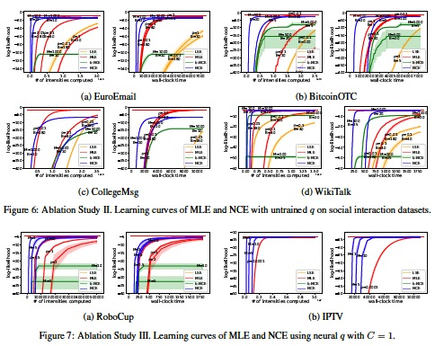
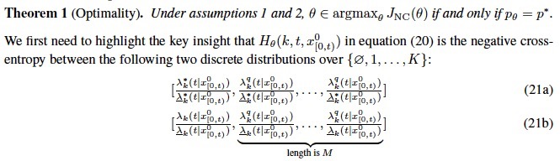
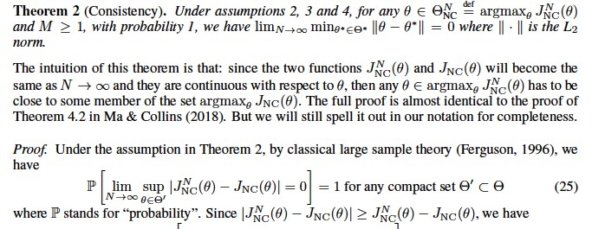
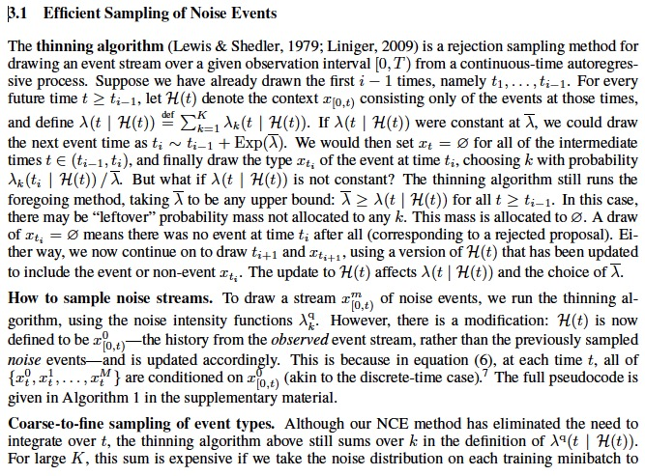
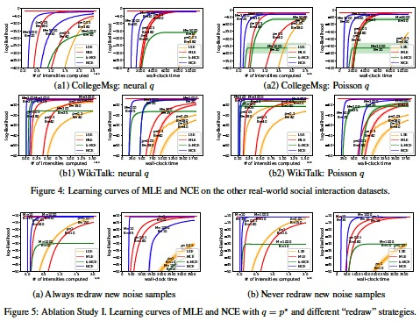
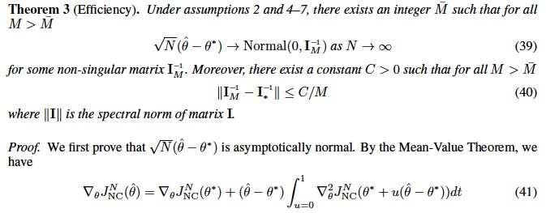
NCE: More in paper
how to draw noise fast
theorems
&
proofs
more results & analysis
Notes:
you can find more in paper
e.g., theorems & proofs, how to draw noise, more results and analysis

Slide 6
THANK YOU
Hongyuan Mei, Tom Wan, Jason Eisner
Johns Hopkins University
Notes:
THANK YOU!

