Slide 1

Specializing Word Embeddings (for Parsing) by Information Bottleneck
Threshing Word Embeddings
Xiang Lisa Li and Jason Eisner
Notes:
Hello everyone, I am Lisa, and this work is done jointly with my advisor Jason Eisner.
That’s a long title. here is one you can remember.

Slide 2
Pre-trained Word Embeddings
Syntactic Knowledge
Bert
ELMo
Notes:
Intro: Previous papers have used ELMo as a starting point for task-specific representations (basically they initialize with ELMo and fine-tune ). But the brilliant idea of ELMo is that it's based on language modeling, and the language model has to know everything about the language -- so whatever task you do, the relevant information is also needed by the language model so the information should “ALREADY” be in the ELMo embeddings: Now the question is: how do we get the task-specific information OUT?
[CLICK] We will focus on how to get syntactic knowledge out.

Slide 3
How to extract syntax automatically?
Specialize the Embeddings!
for the task (parsing)
Notes:
For this paper, we present a general framework of extracting task-relevant information from pre-trained ELMo embeddings. It is a form of specialization. We will take syntactic parsing as an example.

Slide 4


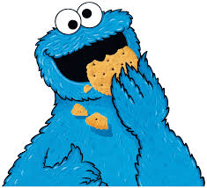


I would like the cookies to be sweeter.
back-prop
back-prop
wheat plant
cookies
wheat field
Factory
Fine-tuning
Notes:
Here is how people fine-tune word embeddings for a task.
Imagine a wheat field that sends wheat [CLICK] to the factory, that produces cookies [CLICK]. An evaluator[CLICK]’s feedback is propagated back to the factory and all the way back to the wheat field, aka genetic engineering.

Slide 5
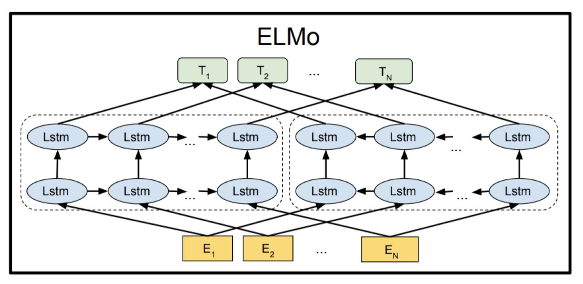


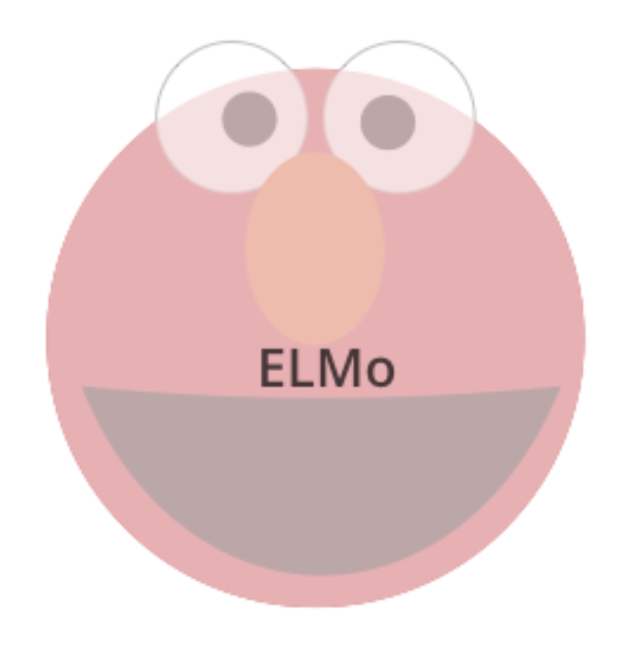
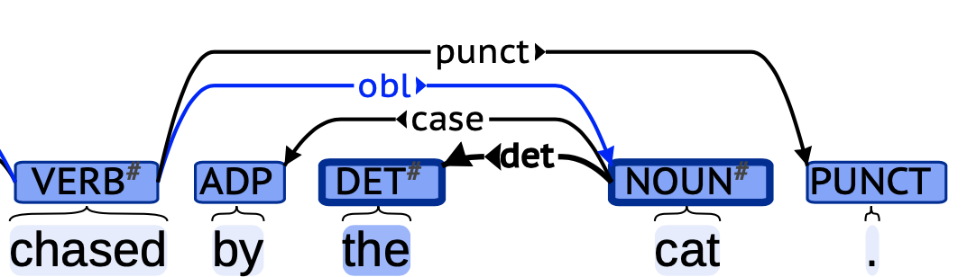
I would like the cookies to be sweeter.
back-prop
back-prop
wheat plant
cookies
wheat field
Factory
back-prop
Fine-tuning
back-prop
Parser
A blackbox
parser scorer
ELMo embeddings
parse tree
Notes:
In an NLP setting, the field is a pre-trained ELMo model, which passes word embeddings[CLICK] to the parser, which sends parse cookies[CLICK] to an evaluation script. The script could score labeled attachment or log-likelihood.
In the backward pass, [CLICK] people back-propagate to the parser and all the way back to the ELMo model, so it fine-tunes ELMo jointly with the parser.

Slide 6
Specializing
Word Embeddings
Sentiment,
Topic, Semantics …
Syntax
Notes:
Now we introduce our new idea, threshing.
Wheat has good parts — grain and useless parts — chaff. Threshing keeps only the grain.
[CLICK] In our case, [CLICK]Grain is the syntax, [CLICK]Chaff is “ALL” the other information that ELMo extracted. That’s useful for language modeling but not for us.

Slide 7







Specialization:
NO back-prop
I would like the cookies to be sweeter.
back-prop
back-prop
grain
cookies
wheat plant
wheat field
chaff
Factory
Notes:
Now let’s look at our specialization framework.
[CLICK] We introduce a new step of threshing, and a garbage can to keep the useless information.
In the forward pass, we still start with the wheat, but we keep the grain [CLICK] and throw away the chaff.
In the backward pass, [CLICK] we backprop through the threshing step, and what backprop is doing is to improve the thresher and get better separation of wheat from chaff.
Notice [CLICK] that we are not Back-prop all the way to wheat field.

Slide 8





Specialization:
NO back-prop
I would like the cookies to be sweeter.
back-prop
back-prop
cookies
wheat plant
grain
wheat field
chaff
Factory
chaff
Parser
A blackbox
parser scorer
ELMo
embeddings
specialized
embeddings
or tags
parse tree
Notes:
Similarly, for NLP tasks, the threshing step separates pre-trained ELMo embeddings into specialized taggings and chaff.

Slide 9
Specialization:
NO back-prop
I would like the cookies to be sweeter.
back-prop
back-prop
grain
cookies
wheat plant
wheat field
chaff
Factory
NO back-prop
chaff
back-prop
back-prop
Parser
A blackbox
parser scorer
ELMo
embeddings
specialized
embeddings
or tags
parse tree
Notes:
[CLICK] So Poor ELMo, but at least we don’t have to retrain him anymore [CLICK] .
The original ELMo already has all the body parts we might ever need, because ELMo was pre-trained for a LM task which is NLP complete. We just have to decide which parts of ELMo to keep.

Slide 10



Specialization:
NO back-prop
I would like the cookies to be sweeter.
back-prop
back-prop
grain
cookies
wheat plant
wheat field
chaff
Factory
NO back-prop
chaff
back-prop
back-prop
Parser
A blackbox
parser scorer
sentiment
analyzer
sentiment
scorer
ELMo
embeddings
specialized
embeddings
or tags
parse tree
sentiment
Our specialization technique is easily adaptable by
swapping blackboxes !
Notes:
[CLICK] This Embedding threshing framework can be easily generalizable by swapping blackbox models. [CLICK]
Now, because we have a different task, [CLICK] ELMo’s body will be split differently.
PULSE

Slide 11
Pros of Specialization
vs. Fine Tuning
Faster — trains on 100 sentences per second
Better generalization — few parameters, so harder to overfit.
Notes:
What are the advantages of our model? We only need to train the thresher not the ELMo parameters, this is much faster, we train on a hundred sentences per second, and since the thresher has a smaller parameter space, there is less danger of overfitting if we have a small training set for the task.

Slide 12


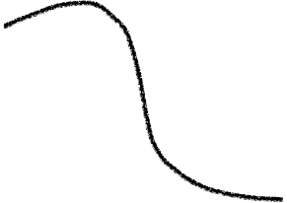


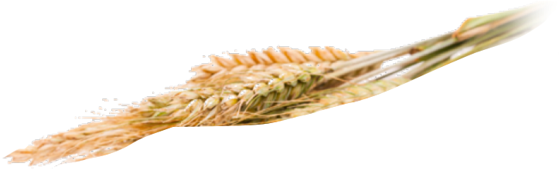
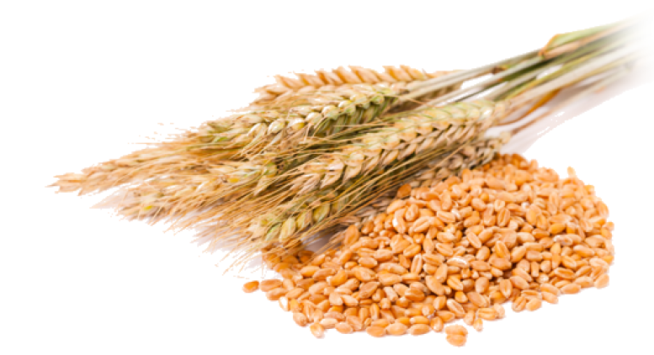
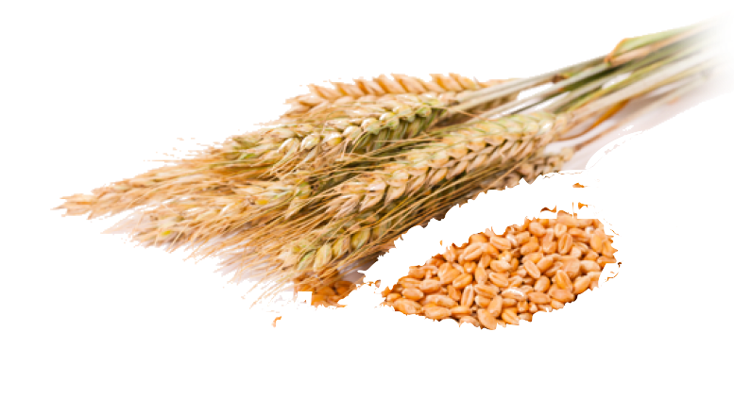

Accuracy
Information Kept
Best Accuracy
Worse Accuracy
Smaller representation
Baseline Accuracy
Bigger representation
Worse Accuracy
Smaller representation
Notes:
Let’s train a parser on full ELMo, that’s the star on the right. It is pretty accurate, but we overfit, because the treebank isn’t big enough.
As we gradually squeeze [NEXT] information from ELMo embeddings, it actually improves accuracy a little just as fine-tuning would.
[NEXT] As we keep squeezing, we start losing useful information too [NEXT] and this “lossy compression” hurts parsing accuracy.

Slide 13
Worse Accuracy
Smaller representation

Slide 14
Accuracy
Information Kept
Best Accuracy
Worse Accuracy
Smaller representation
Baseline Accuracy
Bigger representation
Worse Accuracy
Smaller representation
Notes:
Let’s train a parser on full ELMo, that’s the star on the right. It is pretty accurate, but we overfit, because the treebank isn’t big enough.
As we gradually squeeze [NEXT] information from ELMo embeddings, it actually improves accuracy a little just as fine-tuning would.
[NEXT] As we keep squeezing, we start losing useful information too [NEXT] and this “lossy compression” hurts parsing accuracy.

Slide 15
Accuracy
Information Kept
Best Accuracy
Worse Accuracy
Smaller representation
Baseline Accuracy
Bigger representation
Worse Accuracy
Smaller representation
Notes:
Let’s train a parser on full ELMo, that’s the star on the right. It is pretty accurate, but we overfit, because the treebank isn’t big enough.
As we gradually squeeze [NEXT] information from ELMo embeddings, it actually improves accuracy a little just as fine-tuning would.
[NEXT] As we keep squeezing, we start losing useful information too [NEXT] and this “lossy compression” hurts parsing accuracy.

Slide 16
Accuracy
Information Kept
Best Accuracy
Worse Accuracy
Smaller representation
Baseline Accuracy
Bigger representation
Worse Accuracy
Smaller representation
Notes:
Let’s train a parser on full ELMo, that’s the star on the right. It is pretty accurate, but we overfit, because the treebank isn’t big enough.
As we gradually squeeze [NEXT] information from ELMo embeddings, it actually improves accuracy a little just as fine-tuning would.
[NEXT] As we keep squeezing, we start losing useful information too [NEXT] and this “lossy compression” hurts parsing accuracy.

Slide 17
Accuracy
Information Kept
Best Accuracy
Worse Accuracy
Smaller representation
Baseline Accuracy
Bigger representation
Worse Accuracy
Smaller representation
Notes:
Let’s train a parser on full ELMo, that’s the star on the right. It is pretty accurate, but we overfit, because the treebank isn’t big enough.
As we gradually squeeze [NEXT] information from ELMo embeddings, it actually improves accuracy a little just as fine-tuning would.
[NEXT] As we keep squeezing, we start losing useful information too [NEXT] and this “lossy compression” hurts parsing accuracy.

Slide 18
Accuracy
Information Kept
Best Accuracy
Worse Accuracy
Smaller representation
Baseline Accuracy
Bigger representation
Worse Accuracy
Smaller representation
Notes:
Let’s train a parser on full ELMo, that’s the star on the right. It is pretty accurate, but we overfit, because the treebank isn’t big enough.
As we gradually squeeze [NEXT] information from ELMo embeddings, it actually improves accuracy a little just as fine-tuning would.
[NEXT] As we keep squeezing, [NEXT] we start losing useful information too and this “lossy compression” hurts parsing accuracy.

Slide 19
Accuracy
How exactly does the
specialization work?
Information Bottleneck
Information Kept
Information Kept
Best Accuracy
Worse Accuracy
Smaller representation
Baseline Accuracy
Bigger representation
Worse Accuracy
Smaller representation
Notes:
So how does specialization work? We use an information theoretic method, it’s called information bottleneck.

Slide 20
back-prop
NO back-prop
chaff
back-prop
back-prop
Parser
A blackbox
parser scorer
ELMo
embeddings
specialized
taggings
parse tree
Notes:
We introduce [CLICK] “Oscar” who stays actively at the garbage can, demanding and hoping for more trash…
[CLICK] Oscar’s feedback back propagates to make the thresher produce more chaff.

Slide 21
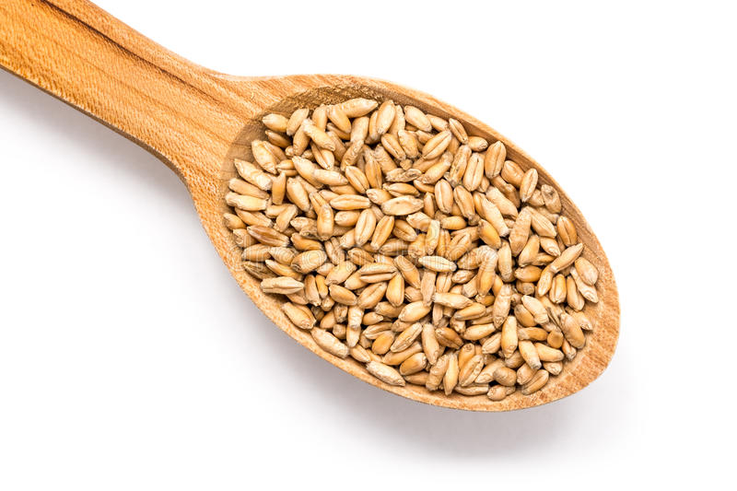





Information Bottleneck Objective
mutual information between
dependency parses
and our specialized taggings.
mutual information between
pre-trained ELMo embeddings
and our specialized taggings.
information to help parser
keep fewer information
more compression
make Oscar happy
bigger
Notes:
The second term weights more. We will keep fewer information and leave more leftover for Oscar.
See !!! We have a HAPPY OSCAR!

Slide 22

Information Bottleneck Objective
—
mutual information between
dependency parses
and specialized representation.
mutual information between
pre-trained ELMo embeddings
and specialized representation.
keep more syntactic information
discard more information
more compression
make Oscar happy
bigger
Notes:
This is the information bottleneck objective we want to minimize. This wants our thresher to discard as much ELMo information as possible [CLICK] while still keeping the syntactic information to help our task.[CLICK] .
1 [CLICK] The first term is the mutual info between our grain and dependency parses, indicating how much information our grain has about the true parse. We want to help the parser as much as possible to choose among parses.
[make the underbraced words appear ]
2 [CLICK] The second term is the MI between our grain and ELMo embeddings, indicating how much information our grain retains overall. We want to retain as little as possible.
3. Basically, the first term is to make the parser happy, and the second is to make Oscar happy.
[CLICK] Beta is the tradeoff parameter, [CLICK] when we have a bigger beta, we have more compression to make Oscar happy.
PULSE

Slide 23
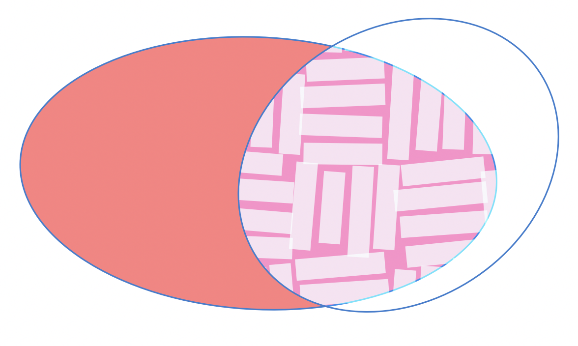
Information Bottleneck Objective
Grain
Venn interpretation:
Notes:
[head is the pink part, and body is the moon-shaped part.]
Venn Diagram animation to demonstrate how training looks like.
the red region is the information contained in ELMo.
The white region is the information required to parse.
The overlapping pink region is what we try to get.
The blue region is the information contained in our grain, and this is what we are trying to optimize.

Slide 24
Information Bottleneck Objective
Grain
Venn interpretation:
Notes:
As we train, the blue region will shrink and gradually move towards the pink region.

Slide 25
Information Bottleneck Objective
Grain
Venn interpretation:
Notes:
the blue region will shrink and gradually move towards the pink region.

Slide 26
Information Bottleneck Objective
Grain
Venn interpretation:
Notes:
the blue region will shrink and gradually move towards the pink region. Shrinking means we are pleasing Oscar, and getting closer to the pink region means that we are making the parser happy.

Slide 27





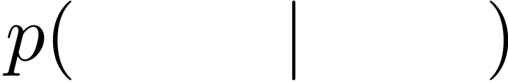

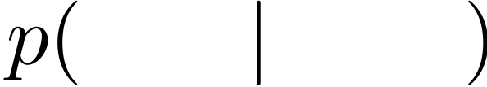
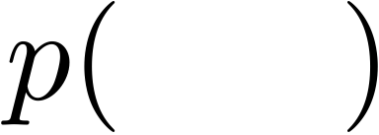
constant
need to know
need to know
and
Notes:
Let’s delve a little bit to the mathematical representation of each term.
1. The first term [CLICK] (by definition) could be rewritten as this: the difference between entropy of parse and conditional entropy of parse given grain.
2. [CLICK] The first term is constant w.r.t. the thresher parameters. To evaluate conditional entropy, we need a probabilistic parsing model.
3. The second term [CLICK] (by definition) could be rewritten as a KL divergence and to evaluate this, [CLICK] we need to know p(grain | elmo) and p(grain).
I will show you how these unknown terms appear in our model architecture.

Slide 28
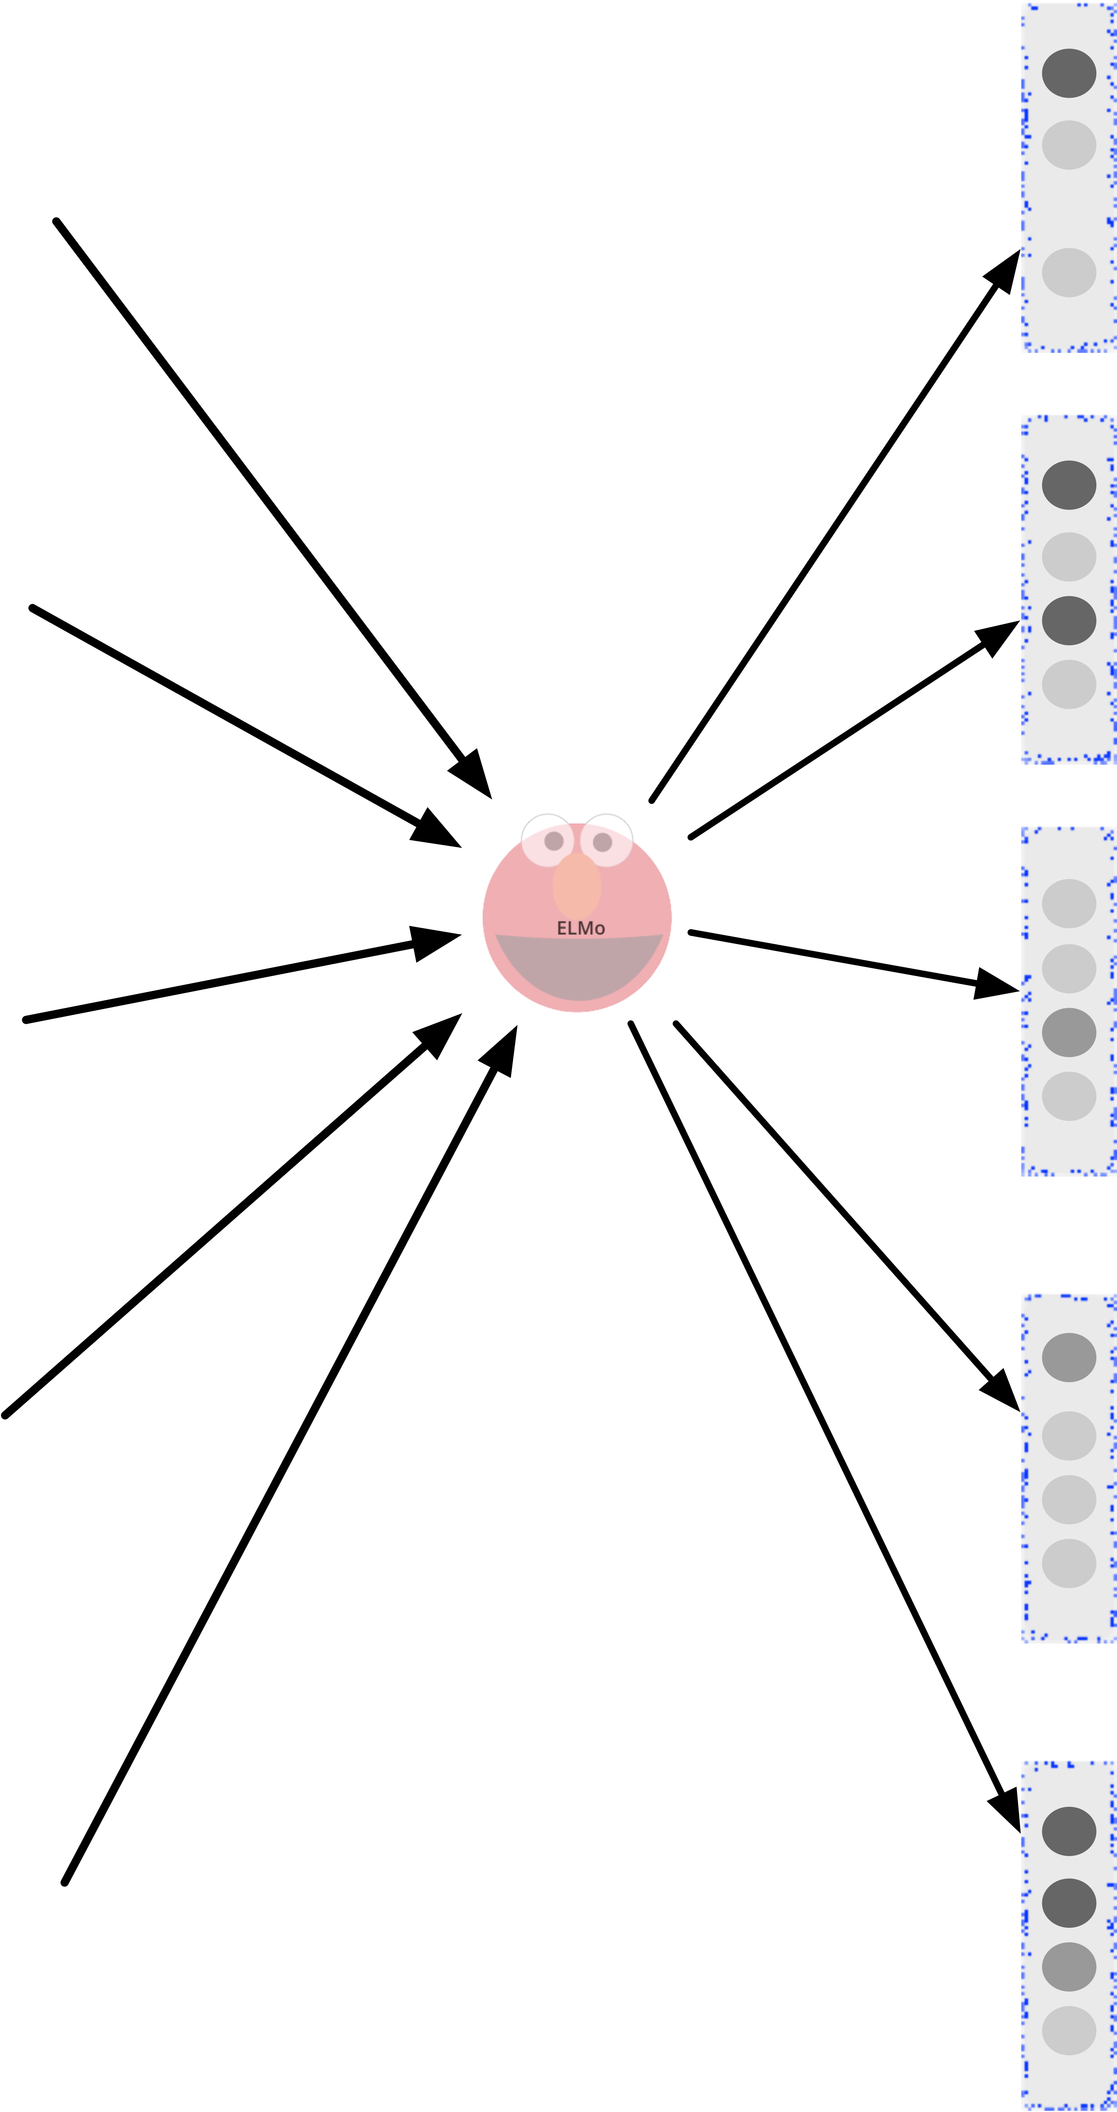
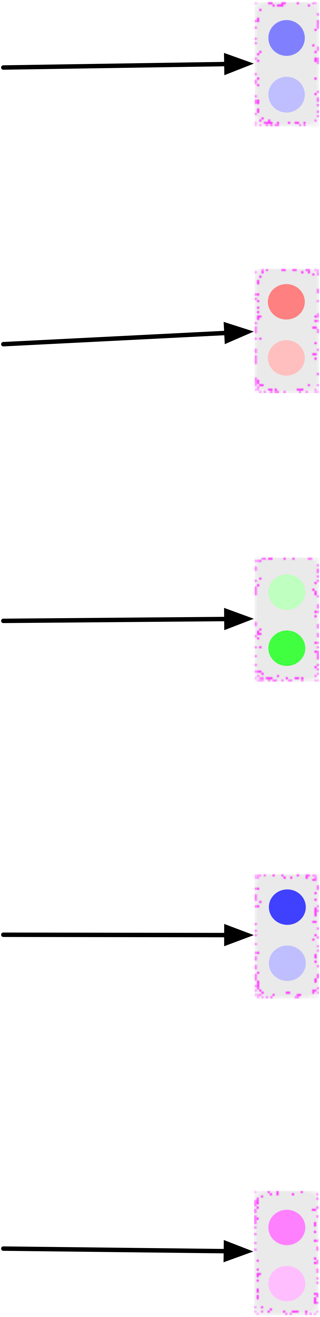
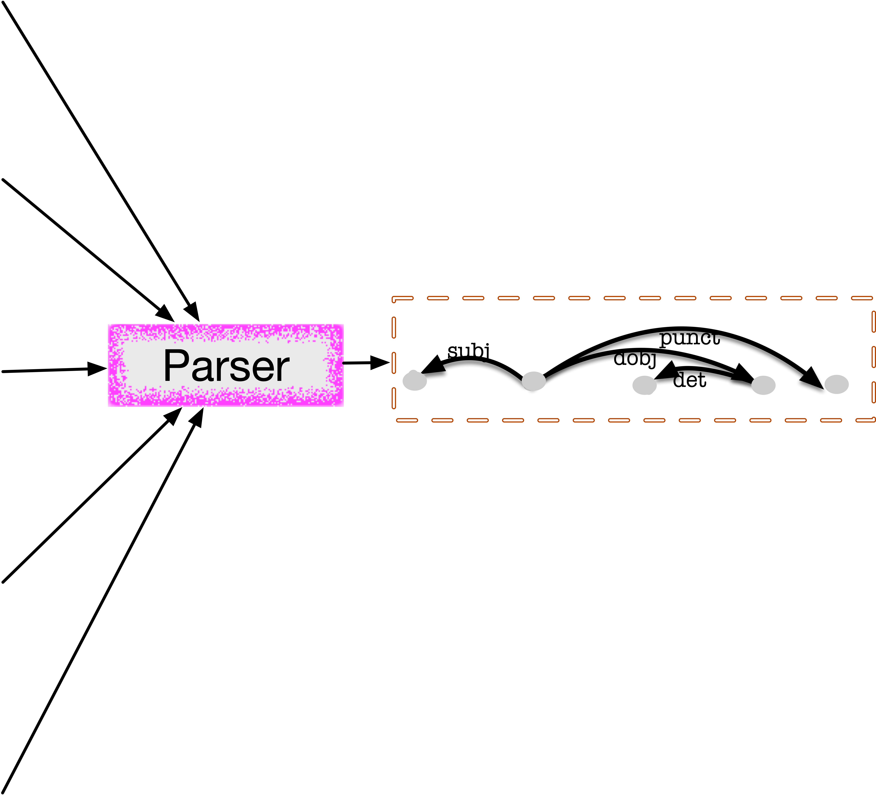
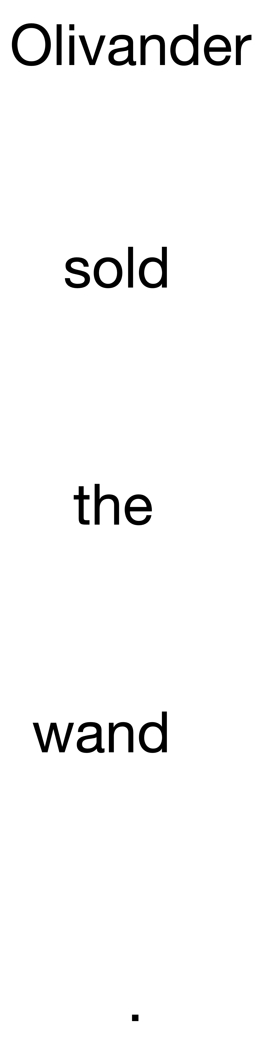
ELMo Layer
Token Encoder
Decoder
Notes:
This is our model architecture,
we start from an English sentence, [CLICK] pass it through a ELMo layer to produce the corresponding ELMo embeddings.
Then we pass through our token encoder, [CLICK] which parametrizes p(grain | elmo).
We get samples of specialized taggings from the token encoder, and pass them into the decoder [CLICK]. The decoder is essentially a parser that parametrized p(parse | grain).

Slide 29
ELMo Layer
Token Encoder
Decoder
Notes:
Now let’s zoom in to see the token encoder.

Slide 30
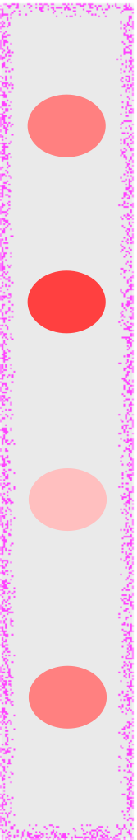

CCA
ELMo
Layer-1
IB
(stochastic)
PCA
one word token
Notes:
Recall that we are trying to squeeze out useless information.
One standard way to reduce dimensionality is PCA. The task specific version of PCA is CCA [CLICK] (Canonical Correspondence analysis).
Our method is different from CCA, because it’s stochastic. But what is the good about being stochastic?
We could choose to keep a different level of compression for each dimension.
A CCA could lose information by being non-injective, we could lose information by using the stochasticity and make some dimension noisier. [NEXT]

Slide 31
ELMo
Layer-1
IB
(stochastic)
CCA
For some tokens, we need all 4 dimensions
one word token
Notes:
For some word tokens, we really need all 4 dims.
As a result, the Gaussian distribution is very spiky and have less noise.

Slide 32
ELMo
Layer-1
IB
(stochastic)
CCA
For some tokens, retaining less information does not hurt parsing.
one word token
Notes:
but for other tokens, retaining less information will still allow a correct parse.
The gaussian at dim 3 and dim 1 becomes flatter and have more variance. We keep less information by introducing more noise to those dimensions.

Slide 33
ELMo
Layer-1
IB
(stochastic)
CCA
number:
accusative/
nominative:
Example: In English, we don’t care whether an object pronoun is singular or plural.
Notes:
For example, in English, [CLICK] we can throw away whether an object pronoun was singular or plural.
We care about the number of a subject pronoun but not an object pronoun.
[CLICK] We will have more chaff coming out of dimension number 3, making Oscar happy. [CLICK] And dimension 4 is enough to keep cookie monster happy[CLICK]. Basically, we use a coarser grained tag in the object position.
PULSE

Slide 34
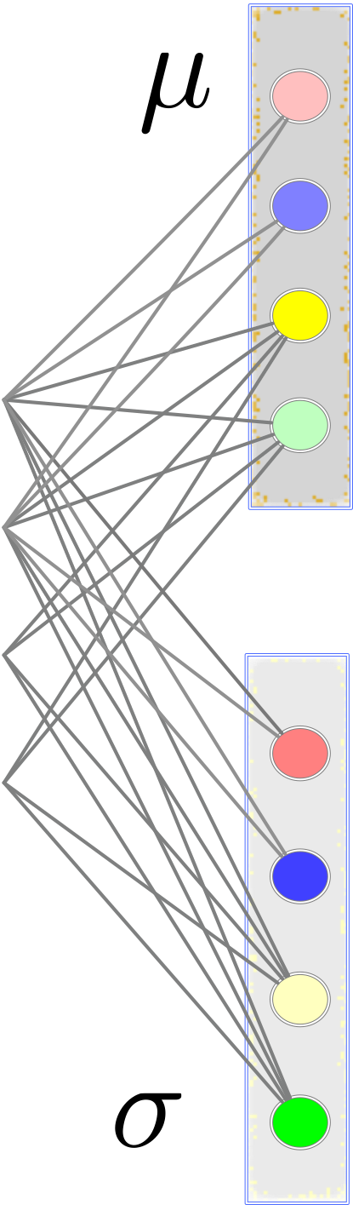
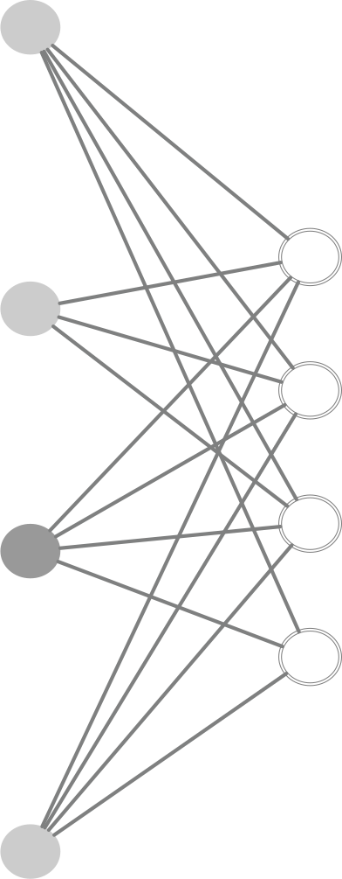





ELMo
Layer-1
IB
(stochastic)
one word token
Notes:
This is the architecture of our token encoder.
We pass the ELMo embeddings [CLICK] through a feedforward NN to produce a vector of mean and a vector of standard deviation for each dimensions.
[CLICK] We get the gaussian distributions for each dimensions respectively.

Slide 35
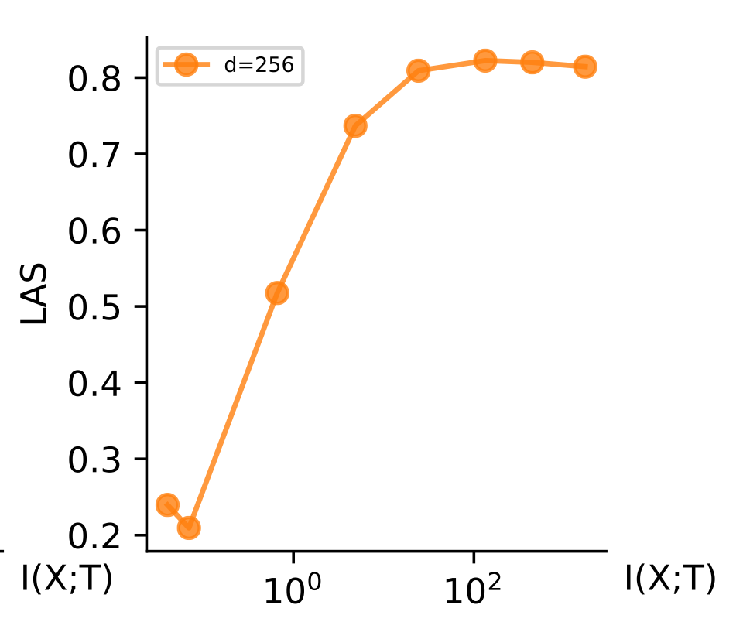
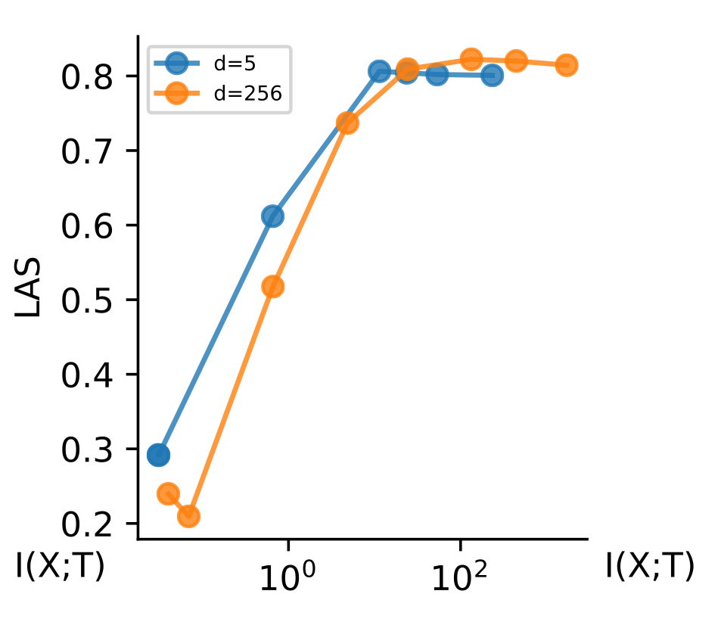
Cartoon
English
LAS
Information Kept
Worse Accuracy
Smaller representation
Notes:
Recall that we have the cartoon tradeoff curve. Now, we will show you an empirical one. The cartoon and empirical curves are consistent.
The orange line means that the specialized embeddings have 256 dimension. [CLICK]The blue line means that the specialized embeddings only have 5 dimensions.
Notice that when we keep less information, the blue line have better parsing accuracy than the orange line. This is because once we compress enough, we can keep all the information with a less noisy 5-dim compression and it’s easier to optimize in practice for a fixed # of samples.
For the same level of MI, the 256 dimension needs to contain more noise, so sampling would be bad.
—————
3. when d=256, we just keep Oscar fed by making the dimensions noisier, so we only keep as much information as when d=5, and our parsing performance is about the same

Slide 36
Q: Is our specialization contextual?
A: YES, because we compress ELMo layer 1, which depends on the context.
Notes:
Our specialization is contextual, because we are compressing from ELMo layer 1.
So, we achieve a specialized representation that’s contextual and contains syntactic information.
What do linguists do?

Slide 37
The purchase price
ELMo Embeddings
Structured Prediction
part-of-speech taggings
Det Noun Noun
Notes:
[CLICK] POS tags are the conventional syntactically compressed representations.

Slide 38
The purchase price
ELMo Embeddings
Structured Prediction
part-of-speech taggings
CCG taggings
NP/NN
NN/N
N
Notes:
[CLICK] Sometimes linguists use fine grained super-tags, like CCG tags, which are specifically supposed to guide parsing.
So could we get these discrete tags automatically?
Yes, we can, let’s extend our method to the discrete case.

Slide 39
Discrete
Continuous
ELMo
Layer-1
IB
(stochastic)
IB
(stochastic)
HMM
PCA
Tag 1
DET
0
0.05
Tag 2
ADJ
0
0.1
Tag 3
VERB
1
0.5
Tag 4
NOUN
0
0.35
…
0
0.0
one word token
Notes:
1. We put the continuous on the Right hand side as as comparison. [CLICK]
2. The deterministic counter part for discrete case is a one-hot vector, notice in this example that only VERB fires, and the other dimensions are 0.
3. Our IB method is stochastic in that we have a multinomial distribution for this token, whose probabilities sum up to 1.
4. But, actually, we don’t know the correspondence between dimensions and POS tags, and we don’t even know if there is a correspondence, so we will just call them by their indices.
Like, maybe dim 3 and dim 4 are different forms of nouns. So here we are again using randomness to forget whether the object pronoun is pl, or sing.

Slide 40
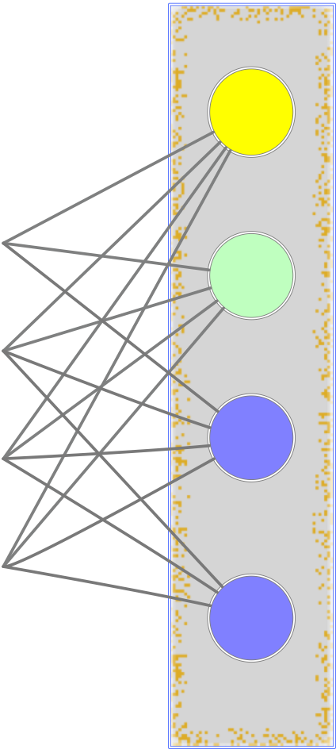
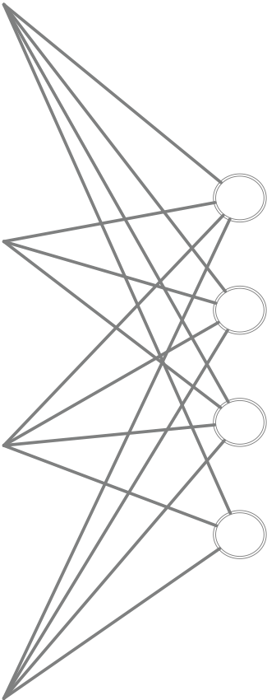

ELMo
Layer-1
IB
(stochastic)
Tag 1 0.05
Tag 2 0.1
Softmax
Tag 3 0.7
Tag 4 0.15
one word token
Notes:
discrete architecture.
similar structure, [CLICK] a feedforward non-linear NN to produce parameter for a softmax distribution and finally [CLICK] pass through a softmax layer to generate the multinomial distribution.

Slide 41
ELMo Layer
Token Encoder
Decoder
Notes:
Let’s zoom in to the parser.

Slide 42
What about discrete case ?
Same architecture — slightly different Token Encoder
ELMo Layer
Token Encoder
Decoder
Notes:
square, do not use embedding with color.
say DET, NOUN…

Slide 43
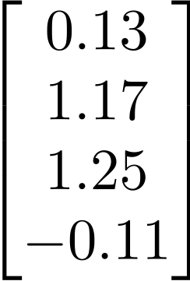
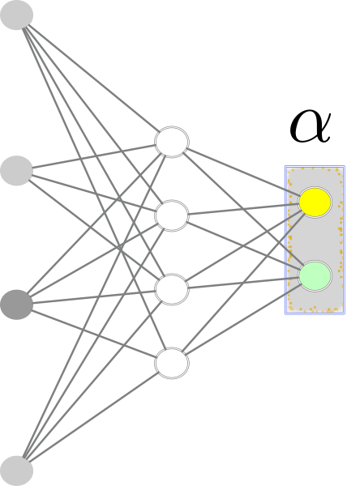
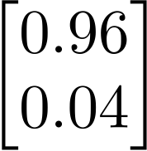
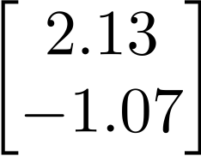
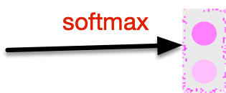
Token Encoder
(Discrete)
sample
VERB
ELMo Layer
Token Encoder
Decoder

Slide 44

Token Encoder
(Discrete)
tag 0
Back-prop
via Gumbel-softmax trick
please refer to our paper or (Jang et al., 2016; Maddison et al., 2017)
ELMo Layer
Token Encoder
Decoder

Slide 45
Token Encoder
(Discrete)
VERB
ELMo Layer
Token Encoder
Decoder

Slide 46
ELMo Layer
Token Encoder
Decoder
Notes:
zoom out.

Slide 47
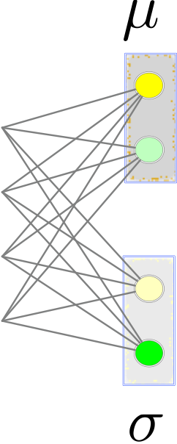
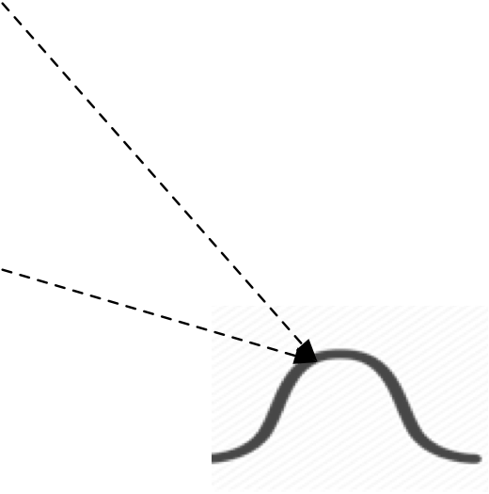
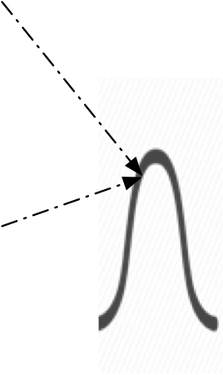

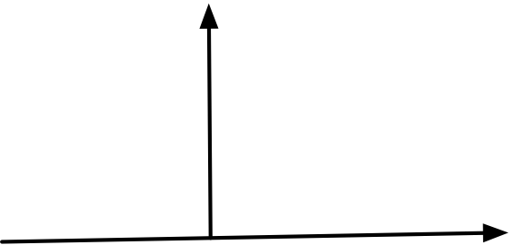

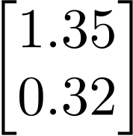
Token Encoder
sample
sample
ELMo Layer
Token Encoder
Decoder

Slide 48

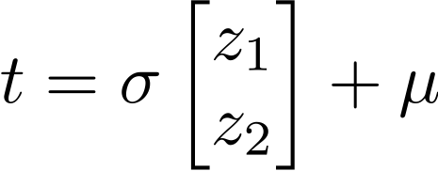

Token Encoder
sample
sample
Back-prop
via reparametrization trick
ELMo Layer
Token Encoder
Decoder
Notes:
highlight with green

Slide 49
Decoder
Dependency Parsing
the deep biaffine dependency parser (Dozat and Manning, 2016)
ELMo Layer
Token Encoder
Decoder
Notes:
We use a neural dependency parser that takes in a vector representation for each token.

Slide 50


reparametrization trick
or Gumbel-softmax trick
back-prop
threshing
Sampling
randomized
ELMo Layer
Token Encoder
Decoder
Notes:
Note there is a slight disparity, the output of our token encoder is a Gaussian distribution over specialized embedding vectors, or a multinomial distribution over discrete tags. [CLICK]
But the input to the parser isn’t a distribution. [CLICK] It’s specific vectors or tags. Our objective requires us to average parse log-probabilities over the distribution, so we need to sample and average. [CLICK]
Because we have a sampling step in the forward pass, we will have to consider how to estimate stochastic gradient in the backward pass. Luckily there are principled ways to do it. [CLICK] For continuous case, we use the re-parametrization trick. For discrete case, we use the Gumbel-Softmax trick.

Slide 51
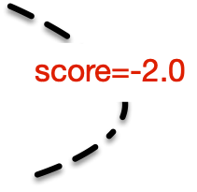
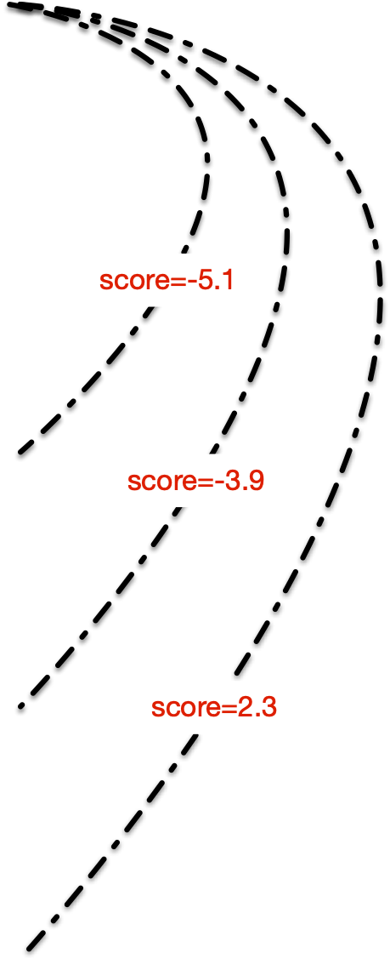
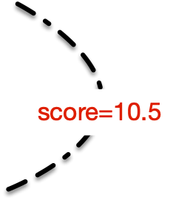


Decoder
ROOT
the deep biaffine dependency parser (Dozat and Manning, 2016)

Slide 52
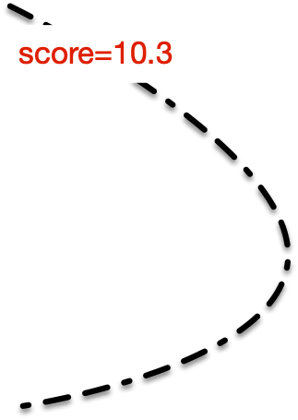
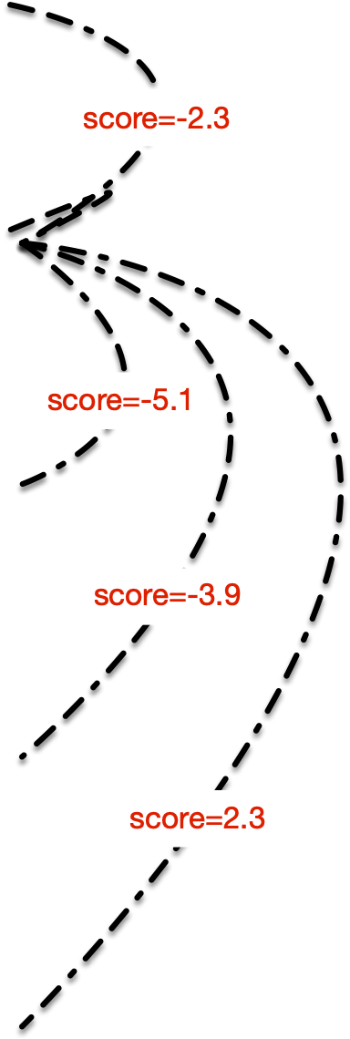
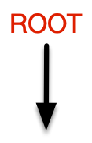
Decoder
ROOT
the deep biaffine dependency parser (Dozat and Manning, 2016)

Slide 53
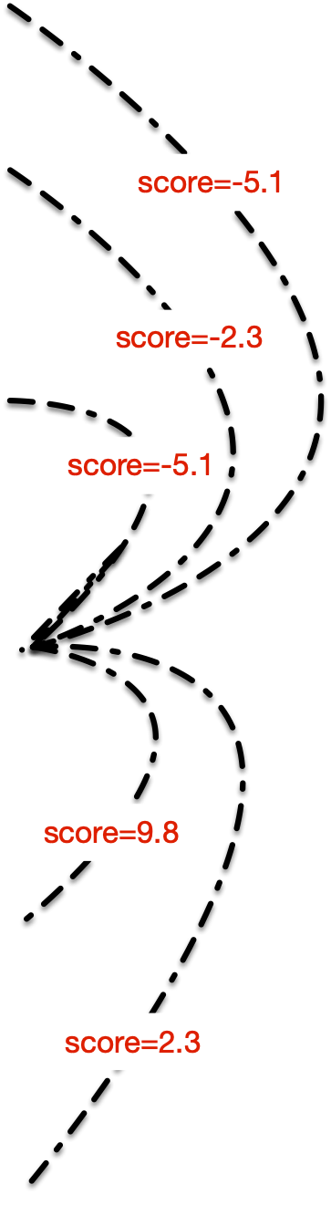

Decoder
ROOT
the deep biaffine dependency parser (Dozat and Manning, 2016)

Slide 54
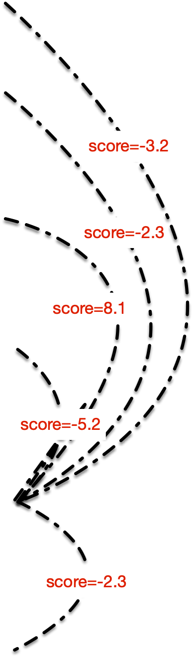
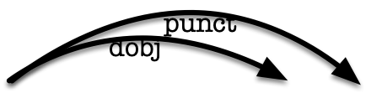
Decoder
ROOT
the deep biaffine dependency parser (Dozat and Manning, 2016)

Slide 55
Decoder
ELMo Layer
Token Encoder
Decoder

Slide 56
Variational Upper Bound
To minimize the IB objective directly, some terms are intractable.
So we instead minimize a variational upper bound.
  Which is what the previous slide estimated by sampling
For mathematical details, please refer to our paper ;)
and
Notes:
READ:
which is what the previous slide actually estimated.
For mathematical details about why these two terms are intractable, and the details of the upper bound, please refer to our paper.

Slide 57
Do our specialized tags correlate with traditional POS tags?
Yes!

Slide 58
Results

Slide 59
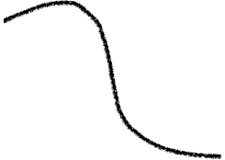

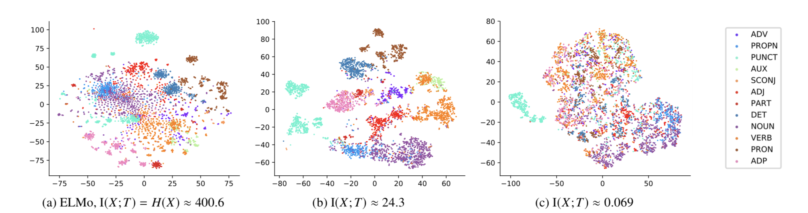
What do specialized tags
look like? [Continuous]
LAS
Information Kept
Too much
Compression
Moderate
Compression
All Information
Kept
Notes:
Let’s look at some T-sne plots, [CLICK] Each dot represents a word token, and it’s colored by the gold POS tags.
When we keep all information, we could see the clustering, but the boundary is not clearly separated.
When we have moderate compression (with a good beta value), we have very clear clustering of POS tags.
When we have too much compression, everything just mixed together.

Slide 60
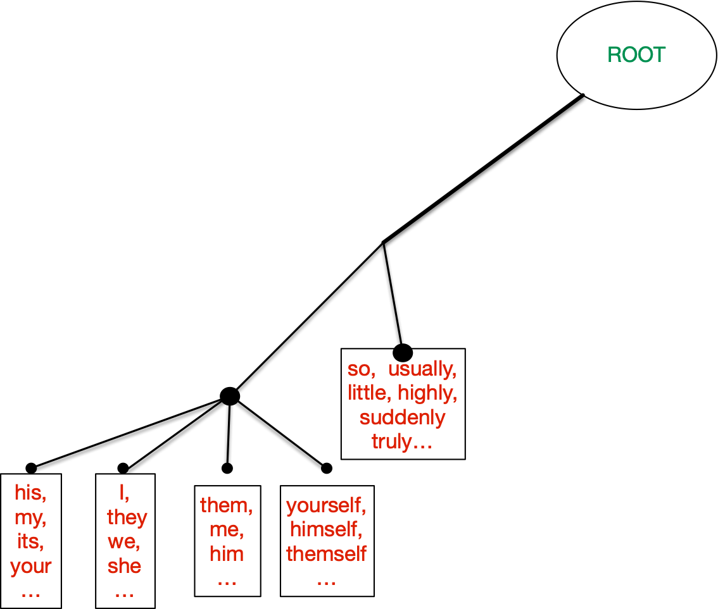
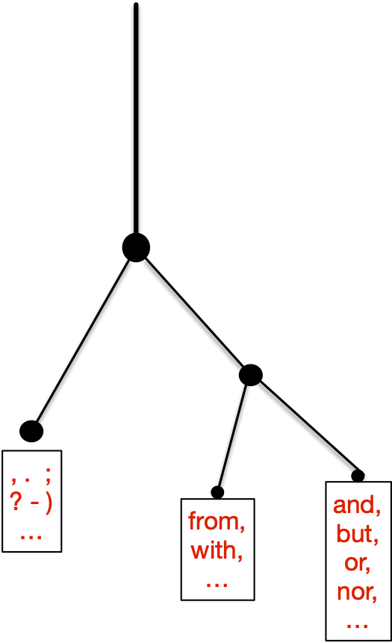
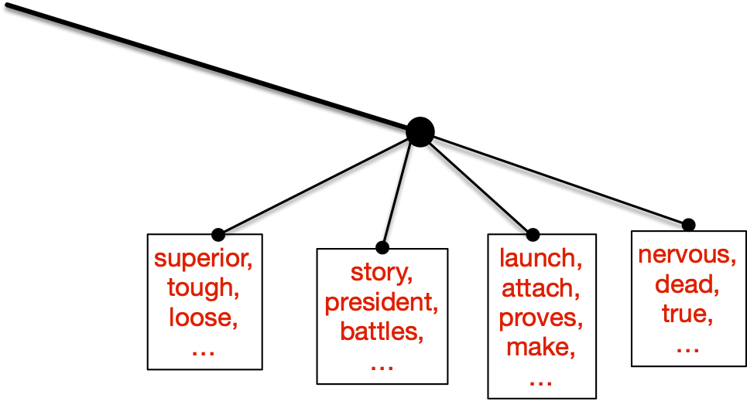
What do the specialized tags look like?
[Discrete]
NOM
(NOUN)
ADJ
NOUN
ADJ
VERB
ADV
anaphors
PUNCT
poss
(NOUN)
ACC
(NOUN)
PREP
CONJ
Notes:
gradually starve Oscar.
[TODO] turn horizontally,,,

Slide 61
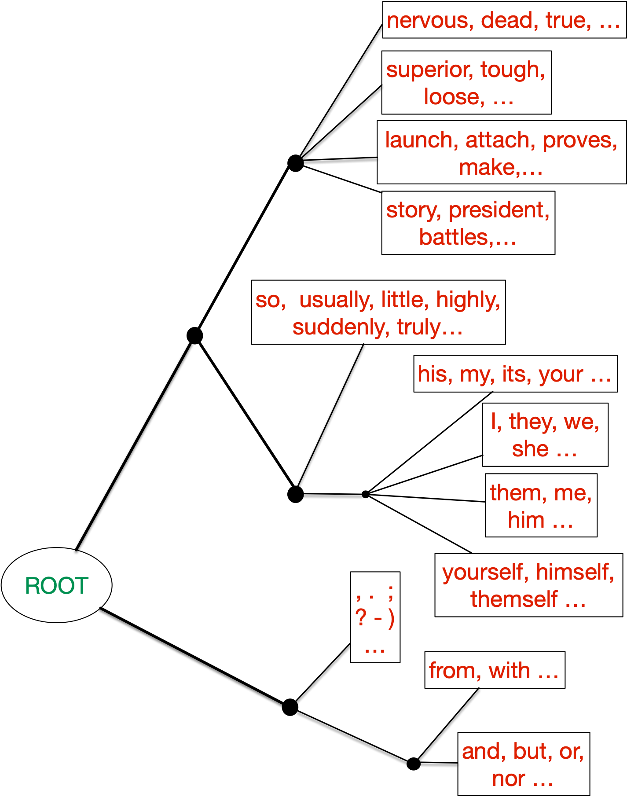

What our specialized
tags look like? [Discrete]
ADJ
ADJ
VERB
NOUN
ADV
poss (NOUN)
NOM (NOUN)
NOUN
ACC (NOUN)
PUNCT
anaphors
PREP
CONJ
Notes:
For the discrete case, we run deterministic annealing to get a hierarchical clustering of the discrete taggings.
We start from beta being very large [CLICK] (i.e. a happy Oscar) and we gradually anneal beta down, we keep more information which yields finer grained taggings at Oscar’s expense. [CLICK ] Poor Oscar…
The hierarchical clustering result successfully captures those big categories categories [CLICK ] like ADJ, VERB, NOUN, etc.
The cute part is that as we get more finer grained [CLICK], they also capture the clusters like possive pronouns, nominative cases, accusative cases, and anaphors.

Slide 62

Do our specialized tags correlate with POS tags?
Yes!
Our results agree with the intuition that POS keeps information about parsing.
POS is contextual. Our taggings are contextual as well !!!
WAIT!? The word type (without context) should also be a strong predictor of POS.
How do we specialize so that we mostly depend on type information?
Notes:
13:10
Our results agree with the intuition that POS keeps information about parsing.
POS is contextual. Our taggings are contextual as well !!!
[CLICK] However, word type should be strong predictor of POS tags. How do we specialize so that our specialized taggings mostly depend on type information.

Slide 63


We could use ELMo Layer-0.
ELMo layer-0 is based on a character-level convolutional network. Thus, it inherently does not contain contextual information.
Specializing is to extract from existing embeddings, which is also non-contextual.
2. We could do a softer version — make the specialized tagging depend “mostly” on its word type.
Notes:
READ: A simple solution is to use ELMo-0, it’s based on character level conv net, so ELMo-0 is not contextual. Specializing is to extract from existing embeddings, which is also non-contextual.
We propose a soft-version, making the specialized tagging depend MOSTLY on its word types. We add the conditional mutual information term.
To minimize this term is to say that as we introduce the context of each word, our specialized taggings do not contain much extra information than if we only look at the word type.

Slide 64






Slide 65
How Information Bottleneck Works?

Slide 66
How Information Bottleneck Works?
taggings T
embedding X

Slide 67
How Information Bottleneck Works?
taggings T
embedding X

Slide 68

How Information Bottleneck Works?
taggings T
embedding X

Slide 69
How Information Bottleneck Works?
taggings T
Avoids unnecessary use of the dimensions
By blurring unneeded capacity via randomness
embedding X

Slide 70
Discrete Version
taggings T
embedding X

Slide 71

Parsing Performance
[continuous]
LAS
ELMo : train by 1024 dimensional ELMo-layer2
PCA : train by 256 dimensional embeddings after applying PCA to ELMo-layer2
MLP: train a non-linear cleanup layer after the ELMo embeddings jointly with the parser.
VIBc: our method ;)
ELMo
PCA
MLP
VIBc
English
Wins or ties across 9 languages.
1.0 point improvement on average
Notes:
We compare to 3 baselines.
PCA in green is task agnostic, and does not help the blue baseline at all.
MLP in yellow is like our method, it helps ELMo, but it keeps the same amount of information for every token, whereas our method (in red) makes Oscar happy.
Our method outperforms the 3 baselines.
<SLOW>
Now this graph only shows English, but we run experiments on 9 languages.
[CLICK] Our method wins or statistically ties across all 9 languages. We have approximately 1 point improvement on labeled attachment score, on average .

Slide 72
Parsing Performance
[discrete]
LAS
POS: train the parser on gold POS tags
VIBd: Our discrete version.
POS
VIBd
Notes:
The gold POS tags are good for parsing, but the point of our method is to find the tagset that’s MOST useful for parsing.
And our result outperforms the POS baselines, unsurprisingly.

Slide 73
Parsing Performance
[continuous]
ELMo : train by 1024 dimensional ELMo-layer2
PCA : train by 256 dimensional embeddings after applying PCA to ELMo-layer2
MLP: train a non-linear cleanup layer after the ELMo embeddings jointly with the parser.
VIBc: our method ;)
finetune + mild hyperparameter tuning
ELMo
PCA
MLP
VIBc
finetune
English
Notes:
Now, we thought you might have a question. Sure, threshing works, but does it work as well as fine-tuning? So we ran an extra experiment yesterday on English. (Poor us.)
It turns out that we actually did a little BETTER than fine-tuning. The difference isn’t statistically significant.
Also, a caveat is we didn’t do an extensive hyperparameter search. We swept only one fine-tuning hyperparameter, namely weight decay, just as our threshing method swept only the beta hyperparameter. That’s how most people fine-tune in practice.
If you burn a lot more cycles, maybe fine-tuning will win. But if you want something cheap and effective, threshing is both cheaper and more effective than basic fine-tuning.

Slide 74

Thanks

