Slide 1

A Generative Model for Punctuation in Dependency Parsing
Xiang Lisa Li*, Dingquan Wang*, and Jason Eisner
* Equal Contribution
Notes:
Hello, everyone. I am Lisa. This work is done jointly with Dingquan and our advisor Jason Eisner.
We focus on a generative model for punctuation in dependency parsing.

Slide 2

NLP has neglected punctuation
Treebanks treat punctuation marks as ordinary tokens, but ARE THEY?
The Linguistics of Punctuation, Nunberg (1990)
Notes:
the NLP community has been neglecting punctuation.
The treebanks simply treat them as ordinary tokens.
But the few linguists who have bothered studying punctuation believe that it’s “a layer of” language with its own rules, just like MORPHOLOGY, phonology, syntax, semantics, pragmatics. Punctuation marks are not words.

Slide 3



Punctuation is useful
Punctuation marks are correlated with prosody and the syntactic tree structure.
Tree
parse
generation
Punctuation
Notes:
So what role does punctuation play?
[CLICK] punctuation marks are correlated with the syntactic tree structure.
[CLICK] Punctuation could help us parse.
[CLICK] When generating text in summarization, translation or editing, we’d better know where the punctuation goes, or we might have tragic result.
… let’s look at an example.

Slide 4



root
. . .
Hail
dobj
king
appos
rel-clause
wields
the
Pendragon
dobj
who
Excalibur
. . .
Arthur
,
,
,
,
Notes:
We start from a segment of a dependency tree. [CLICK, CLICK]
The dependency structure of the word tokens is well annotated, [CLICK] but what about the three commas in this sentence?
[CLICK] The first comma delimits the left boundary the appositive. [CLICK] The third comma delimits the right boundary of the relative clause.
But the middle comma kinda does both. [CLICK] It could be paired up with either the first comma, or [CLICK] it could pair up with the second comma. So which association choice should we make?We are stuck in a dilemma, so this can not be the right way to handle the punctuation. In the treebank annotation manual, where we consider comma as regular words, we have to make hard choice. ##CLICK## However, we loss the generalization that a relative clause should be SURROUNDED by commas, (not just TERMINATED by a comma). Really there should be two commas. ##NEXT##

Slide 5
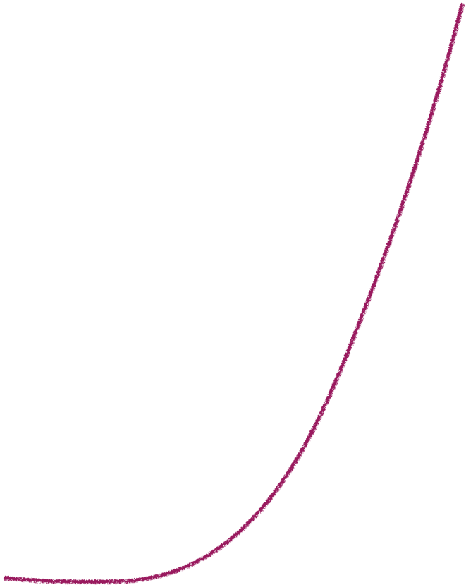


Point Absorption
root
Quote Transposition
dobj
Geoffrey Nunberg
appos
rel-clause
dobj
,
,
,
,
,
,
,
.
.
`
`
?
Hail
the
king
Arthur
Pendragon
who
wields
`
Excalibur
`
.
,
.
, ,
,
, .
.
`
`
`
`
?
.
.
.
`
`
`
`
`
?
`
`
`
Notes:
Now we have a theory that appositives and relative clauses can each be delimited by two commas [CLICK], and that sentences tend to end in a period [CLICK]. But the problem with our theory is that it’s not yet generating English. Normally English doesn’t have two punctuation marks in a row. [CLICK][CLICK]
We need to theorize a second step of string rewriting that applies at each slot between words.
We could rewrite 2 consecutive commas into a single one ##CLICK## ##CLICK##, or rewrite a comma and period into a single period ##CLICK## ##CLICK##.
Now the green punctuation marks look like grammatical Engli sh. [PULSE]
In fact, we are not the inventor of these rules ##CLICK##. Linguists like Nunberg ##CLICK## deduced this from observation, but we are going to learn them automatically from data, and we will learn these type of rules for 5 languages, including but not limited to English.
I said that English collapses multiple adjacent punctuation marks, but not always. [CLICK]
Here we keep both the period and the right quote from the quotation marks around Excalibur.
Logically, the period should go last. But every language has its own system, and American English moves the period inside the right quote.
This case actually needs TWO edits because we also still have to deal with the comma.
First, [CLICK] we again use the period to absorb the comma; second, [CLICK] we swap the quotation and the period. This swapping ##CLICK## is also described by Nunberg, as Quote Transposition ##CLICK##
There could be variation in the way a tree is punctuated. For example, what if we want this sentence to be a question ##CLICK##, then the root is associated with a question mark rather than a period;[CLICK, CLICK] and we do not swap position between a question mark and a closing quotation mark.
We will introduce a systematic and probabilistic approach to discover punctuation rules for a more general set of punctuation vocabulary.

Slide 6
Point Absorption
root
. . .
Quote Transposition
dobj
Geoffrey Nunberg
appos
rel-clause
dobj
. . .
,
,
,
,
,
,
,
.
.
`
`
?
Hail
the
king
Arthur
Pendragon
who
wields
`
Excalibur
`
,
.
, ,
,
, .
.
.
`
`
`
`
?
.
.
.
`
`
`
`
`
?
`
`
`
Notes:
Now we have a theory that appositives and relative clauses can each be delimited by two commas [CLICK], and that sentences tend to end in a period [CLICK]. But the problem with our theory is that it’s not yet generating English. Normally English doesn’t have two punctuation marks in a row. [CLICK][CLICK]
We need to theorize a second step of string rewriting that applies at each slot between words.
We could rewrite 2 consecutive commas into a single one ##CLICK## ##CLICK##, or rewrite a comma and period into a single period ##CLICK## ##CLICK##.
Now the green punctuation marks look like grammatical Engli sh. [PULSE]
In fact, we are not the inventor of these rules ##CLICK##. Linguists like Nunberg ##CLICK## deduced this from observation, but we are going to learn them automatically from data, and we will learn these type of rules for 5 languages, including but not limited to English.
I said that English collapses multiple adjacent punctuation marks, but not always. [CLICK]
Here we keep both the period and the right quote from the quotation marks around Excalibur.
Logically, the period should go last. But every language has its own system, and American English moves the period inside the right quote.
This case actually needs TWO edits because we also still have to deal with the comma.
First, [CLICK] we again use the period to absorb the comma; second, [CLICK] we swap the quotation and the period. This swapping ##CLICK## is also described by Nunberg, as Quote Transposition ##CLICK##
There could be variation in the way a tree is punctuated. For example, what if we want this sentence to be a question ##CLICK##, then the root is associated with a question mark rather than a period;[CLICK, CLICK] and we do not swap position between a question mark and a closing quotation mark.
We will introduce a systematic and probabilistic approach to discover punctuation rules for a more general set of punctuation vocabulary.

Slide 7
Summary…
Punctuation marks are not words.
    Just as prosody is not words.
They do not belong in the tree.
Only underlying punctuation marks are in the tree, where they surround certain phrases.

Slide 8
The Linguistics of Punctuation (Nunberg 1990)
Hail the King Arthur Pendragon who wields Excalibur
[
]
[
]
[
]
Hail the King Arthur Pendragon who wields Excalibur
underlying
,
,
,
,
”
,
.
”
Hail the King Arthur Pendragon who wields Excalibur
surface
,
,
,
.
”
”
Notes:
这里punct掉下来的动画会让周围的字模糊掉，能不能就掉下来？
黑箭头能不能替换成两个逗号移动合并到一起，然后句号和引号交换位置的动画？
excalibur.
proper noun, appos, use overbrace.

Slide 9




Tree
parse
generation
underlying
punct
Punctuation
surface
punct
The surface punctuation has a non-obvious correlation with the tree.
surface
The underlying punctuation has a more direct correlation with the tree.
underlying
Notes:
In other words, we have enhanced the previous correlation between punctuation and tree by splitting punctuation into two parts[CLICK] , underlying and surface.[CLICK]
The underlying form needs to explain [CLICK] the surface punctuation and in turn be explained by the tree structure.

Slide 10


Tree
Attach
underlying
punct
parse
generation
Rewriting
surface
punct
Let’s exploit the underlying punctuation
under a generative model !
Notes:
When we follow the up-arrows and go from the surface punct to recover the underlying punct, and eventually to recover the tree. We are essentially doing punctuation-aware parsing.
When we follow the down-arrows, we generate underlying punctuation form the tree and the surface from the underlying punctuation.
Now let’s focus on this generative process.
Step 1 is attach and step 2 is rewriting.

Slide 11


P(punctuated tree | unpunctuated tree)
.
= P( |root, unpunctuated tree)
Attach
.
.
root
dobj
appos
rel-clause
dobj
Hail
the
king
Arthur
Pendragon
who
wields
Excalibur
Notes:
In the attach step of the generative story. We traverse the tree, and each node independently chooses which left and right punctuation pairs to generate.
[CLICK] root can generate an empty string at its left boundary and period at its right boundary. In this case, [CLICK] we end the sentence with a period (not a question mark) and as usual, the beginning of the sentence is the empty string epsilon.

Slide 12
P(punctuated tree | unpunctuated tree)
.
P( |root, unpunctuated tree)
Attach
=
,
,
.
* P( |appos, unpunctuated tree)
root
dobj
,
,
,
,
appos
rel-clause
dobj
.
Hail
the
king
Arthur
Pendragon
who
wields
Excalibur
Notes:
appositive [CLICK] can generate a left and a right comma. In this case, [CLICK] we surround Authur Pendragon by commas.

Slide 13
P(punctuated tree | unpunctuated tree)
.
= P( |root, unpunctuated tree)
Attach
=
,
,
.
* P( |appos, unpunctuated tree)
,
,
root
* P( |rel-clause, unpunctuated tree)
dobj
,
,
,
,
,
,
appos
rel-clause
dobj
,
,
.
Hail
the
king
Arthur
Pendragon
who
wields
Excalibur
Notes:
[CLICK] [CLICK] [CLICK] Similar probabilistic attach happens for the relative clause.

Slide 14
P(punctuated tree | unpunctuated tree)
.
= P( |root, unpunctuated tree)
Attach
=
,
,
.
* P( |appos, unpunctuated tree)
,
,
root
* P( |rel-clause, unpunctuated tree)
`
`
`
`
* P( |dobj, unpunctuated tree)
dobj
,
,
,
,
appos
rel-clause
`
`
`
`
`
`
`
`
dobj
,
,
,
,
.
Hail
the
king
Arthur
Pendragon
who
wields
Excalibur
Notes:
[CLICK] almost any phrase could be surrounded by a pair of quotes [CLICK] . It’s rare, but in this case, it happened.

Slide 15
P(punctuated tree | unpunctuated tree)
.
P( |root, unpunctuated tree)
Attach
=
,
,
,
,
* P( |appos, unpunctuated tree)
.
P( |appos, unpunctuated tree)
,
,
root
* P( |rel-clause, unpunctuated tree)
`
`
`
`
* P( |dobj, unpunctuated tree)
dobj
,
,
,
,
appos
rel-clause
`
`
`
`
dobj
,
,
,
`
`
,
.
Hail
the
king
Arthur
Pendragon
who
wields
`
Excalibur
`
Notes:
How do we parametrize the probability for attach at each tree node?
We zoom in to a particular example.

Slide 16

,
,
P( | appos, unpunctuated tree)
=
0.4
appos
left punct | right punct
Prob
f1 | f2 | f3 | f4
,
,
0
1
2
1
0.4
`
`
0
1
0
0
`
`
0.3
,
0
0
0
1
0.05
. . .
,
0
0
0
1
0.05
1
0
0
0
0.2
f1: indicator feature for no punctuation ( ).
f2: indicator feature that checks for symmetry.
f3: span length feature for attaching commas.
f4: indicator feature that checks for internal comma.
…
1
Notes:
[CLICK] f1 and f2 are atomic features that directly score a pair of punctuation. [CLICK] [CLICK]
[CLICK] features like (f3, f4) help us model that short phrases are less often surrounded by commas, and phrases that already have an internal comma are sometimes surrounded by dashes or semicolons instead, to show the hierarchical structure.[CLICK] [CLICK]
We have further linguistically motivated features, and please refer to our paper for detail. [CLICK] [CLICK]
We apply the log-linear model to these scores [CLICK], and get a softmax distribution over the candidates.[CLICK]

Slide 17
P(surface punct | punctuated tree)
Rewriting
.
root
dobj
,
,
,
,
appos
rel-clause
`
`
`
`
dobj
,
,
,
`
`
,
.
Hail
the
king
Arthur
Pendragon
who
wields
`
Excalibur
`
.
,
,
`
`
`
`
Hail
the
king
Arthur
Pendragon
who
wields
Excalibur
Notes:
Now, we rewrite the blue underlying punctuation to the green surface form.
Nunberg gives a list of rewrite rules for English, and we will learn them automatically for English and 4 other languages.

Slide 18

Noisy Channel — A Sliding Window Model
, ,
,
,
,
Example (1)
Geoffrey Nunberg
Notes:
Example 1. comma collapse.

Slide 19
Noisy Channel — A Sliding Window Model
, .
.
,
.
.
.
`
`
`
`
`
`
Example (2)
Geoffrey Nunberg
Notes:
Example 2. comma absorption.

Slide 20

Rewriting — A Sliding Window Model
, ,
,
Left-absorb
P(
)
,
,
,
.
, ,
,
)
`
`
Left-absorb
P(
)
, )
)
Left-absorb
P(
)
identity
)
)
P(
)
`
Geoffrey Nunberg
`
`
`
.
.
swap
P(
)
`
`
`
`
Notes:
A long underlying string like this could result from a deep tree with several nested constituents ending or starting at the same position. [CLICK] We list the sequence of good punctuation rules that are involved in rewriting this punctuation string.
We have a sliding window model [CLICK] with window size of two to help us rewrite the sequence of punctuation.
For every pair of punctuation marks, our job is to apply the correct rule.
[CLICK] We have to deal with the fact that the rules are not perfect and the corpus is sometimes noisy, so we make them probabilistic,
Also, it’s easier to learn this way, because we could gradually adjust the probabilities.
But in general, the rules should be mostly deterministic, and we find that they do have low entropy.

Slide 21



Noisy Channel — A Sliding Window Model
(left-to-right)
We treat the directionality of the sliding window as a hyper-parameter
,
.
”
Example 2.
,
”
”
.
.
”
”
Notes:
the ,, -> ,
the ”,. -> .”
the ”
[toy example]
,,,),.
).
For every pair of punctuation marks … our job is to learn the rules. We have to deal with the fact that the rules are not perfect, so we make them probabilistic, Also, it’s easier to learn this way, because we could gradually adjust the probabilities. Generally low entropy.
Nunberg
some more examples. [write everywhere]

Slide 22
Summary
generative story
Underlying punctuation is generated at each tree node
(not quite independently).
Total underlying punctuation at each slot between words is rewritten into surface punctuation (independently).
Notes:
Summary of generative process.
underlying punctuation is generated at each tree node. It’s not quite independently because of the internal comma feature.
total underlying punctuation at each slot between words is rewritten into surface punctuation (independently).

Slide 23

Tree
Tree
infer
underlying
punct
parse
generation
surface
punct
surface
punct
In training, we observe the tree and surface punct.
Want to recover the underlying punctuation.
P(underlying punct | tree, surface punct)
Notes:
In parsing, we observe the words and the surface punctuation (so they’re shaded), and we have to infer the tree and its underlying punctuation. Instead, [CLICK] we will do an easier problem, where [CLICK] we also observe the gold tree. We are just trying to infer [CLICK] the underlying punctuation according to our generative model.
[CLICK] That’s the E step of EM. We can then use the inferred punctuation to IMPROVE the generative model. That’s the M step of EM.

Slide 24




Method 1. A Sampling Approach
. . .
.
root
P(underlying punct| tree, surface punct)
P(underlying | tree)
* P(surface | underlying)
`
`
`
`
`
`
`
`
dobj
,
,
,
,
appos
rel-clause
`
`
`
`
dobj
,
,
,
`
`
,
.
Hail
the
king
Arthur
Pendragon
who
wields
`
Excalibur
`
.
,
,
`
`
`
`
Hail
the
king
Arthur
Pendragon
who
wields
Excalibur
Notes:
Since we are trying to infer from the posterior of the underlying punctuation. One natural method is to do Gibbs sampling.
First, [CLICK, CLICK] we initialize the punctuated tree by randomly sampling the punctuation to attach at each tree node.
Second, we linearize these underlying punctuation. [CLICK] [CLICK]
[CLICK] We check their compatibility with the surface punctuation, aka, will it probably turn into the green punctuation under the stochastic rewrite rules.
In this example, the first slot is zero for any setting of the parameters. The last slot is close to zero once we have trained our model.
In the setting of Gibbs sampling, we keep randomly flipping underlying punctuation marks. The flips that increase likelihood are more probable, until we find underlying punctuation that does a good job of predicting the observed surface punctuation.

Slide 25
Method 1. A Sampling Approach
. . .
.
root
P(underlying punct| tree, surface punct)
P(underlying | tree)
* P(surface | underlying)
`
`
`
`
dobj
,
,
,
,
appos
rel-clause
`
`
`
`
dobj
,
,
,
`
`
,
.
Hail
the
king
Arthur
Pendragon
who
wields
`
Excalibur
`
.
,
,
`
`
`
`
Hail
the
king
Arthur
Pendragon
who
wields
Excalibur
Notes:
After two flips [CLICK], for example, we end up in a state where the higher dobj generates a right quotation and the lower dobj generates a left quotation.
Now the rewriting step has good probabilities[CLICK], but the attach step suffers from low likelihood[CLICK], because the quotes aren’t matched.

Slide 26
Method 1. A Sampling Approach
. . .
.
root
P(underlying punct| tree, surface punct)
P(underlying | tree)
* P(surface | underlying)
dobj
,
,
,
,
appos
rel-clause
`
`
`
`
dobj
,
,
,
`
`
,
.
Hail
the
king
Arthur
Pendragon
who
wields
`
Excalibur
`
.
,
,
`
`
`
`
Hail
the
king
Arthur
Pendragon
who
wields
Excalibur
Notes:
After several other flips, we could end up in this state [CLICK] [CLICK] , where both the attach and the rewriting steps are happy.
The sampler will spend most of its time in good underlying.
This gives Monte Carlo samples for the E step of EM.

Slide 27
Method 1. A Sampling Approach
. . .
.
root
P(underlying punct| tree, surface punct)
P(underlying | tree)
* P(surface | underlying)
dobj
,
,
,
,
appos
rel-clause
`
`
`
`
dobj
,
,
,
`
`
,
.
Hail
the
king
Arthur
Pendragon
who
wields
`
Excalibur
`
.
,
,
`
`
`
`
Hail
the
king
Arthur
Pendragon
who
wields
Excalibur
Notes:
The sampler will spend most of its time in good underlying.
We compute the posterior probability of the blue punctuation, which includes a likelihood term: will it probably turn into the green punctuation under the stochastic rewrite rules.
proposal 1. A sampling approach.
First, we initialize the punctuated tree by randomly sampling the punctuation to attach to each node.
Second, we linearize these underlying punctuation, and check their compatibility with the surface punctuation, aka, do have have high probability to be rewritten to look like the surface form. (mark the happy and frowny face)
We write their full score as P_attach * P_NC
Third, we try to randomly flipping one underlying punctuation marks generated by appos, it is now only generating the left comma, and we still get good rewriting rules.
If we change dobj to generate “” , we will get bad result. frowny faces at the first slot.
This is one epoch, and we pick to …
———————————————————————-
Gibbs sampling…. keep randomly flipping underlying punctuation marks, where flips that increase likelihood are more probable, until we find underlying punctuation that does a good job of predicting the observed surface punctuation.
happy and frowny faces.
We will first randomly attach punctuation to the tree.
(use animation to change some attachment, swapping in the tree note )
(get a list of blue underlying punctuation at the bottom )

Slide 28
Method 2. O(n) Dynamic Programming
Idea : Make a (weighted) CFG that generates just the possible underlyingly punctuated trees for this sentence
Soft constraint :Underlying punctuation fits the tree structure
1
2
Soft constraint :Underlying punctuation fits surface punctuation
Intersect
1
2
our CFG
Notes:
That was just to give you an intuition. We didn’t actually do Gibbs sampling because it’s approximate and really slow.
Actually, in the paper, we give an Order n dynamic programming algorithm, which is exact and efficient.
The idea is to make a weighted CFG that generates just the possible underlyingly punctuated trees for this sentence.
The weights reflect two soft constraints we saw the Gibbs sampler trying to satisfy. [CLICK] And we intersect them to get our CFG.
The first constraint [CLICK] is that the underlying punctuation should go with the tree label.

Slide 29
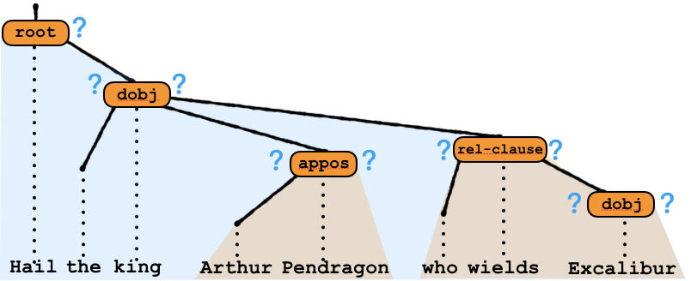
Method 2. O(n) Dynamic Programming
Idea : Make a (weighted) CFG that generates just the possible underlyingly punctuated trees for this sentence
Soft constraint :Underlying punctuation fits the tree structure
1
PCFG
2
Soft constraint :Underlying punctuation fits surface punctuation
Intersect
1
2
our CFG
Notes:
[CLICK] We will write a non-recursive PCFG [CLICK] that generates “just” the Arthur tree plus stochastic punctuation. It’s very easy.
The second constraint [CLICK] is that the underlying punctuation should go with the surface punctuation.

Slide 30
Method 2. O(n) Dynamic Programming
Idea : Make a (weighted) CFG that generates just the possible underlyingly punctuated trees for this sentence
Soft constraint :Underlying punctuation fits the tree structure
1
PCFG
2
Soft constraint :Underlying punctuation fits surface punctuation
weighted FSA
？
？
？
？
.
,
,
`
`
`
`
Hail
the
king
Arthur
Pendragon
who
wields
Excalibur
Intersect
1
2
our CFG
Notes:
We use a weighted FSA at each slot to describe all the punctuation strings that could be rewritten as the surface form.
This FSA is actually cyclic, because when you see a surface comma, there could be any number of underlying commas.

Slide 31

Method 2. O(n) Dynamic Programming
Idea : Make a (weighted) CFG that generates just the possible underlyingly punctuated trees for this sentence
Soft constraint :Underlying punctuation fits the tree structure
1
PCFG
2
Soft constraint :Underlying punctuation fits surface punctuation
weighted FSA
Intersect
1
2
our CFG
PCFG
weighted FSA
=
weighted CFG
Notes:
We intersect the PCFG and the weighted FSA to get our weighted CFG.

Slide 32
Method 2. O(n) Dynamic Programming
Idea : Make a (weighted) CFG that generates just the possible underlyingly punctuated trees for this sentence
Soft constraint :Underlying punctuation fits the tree structure
1
2
Soft constraint :Underlying punctuation fits surface punctuation
Intersect
1
2
our CFG
Now we can find the best underlyingly punctuated tree
          or sum over all of them for the model likelihood in training
For our CFG, this can be done in O(n) time
Notes:
[CLICK] Because it’s pretty much only has one tree structure, we can find the best underlying punctuated tree or sum over the underlying punctuation in order n time.

Slide 33
？
root
？
？
dobj
？
？
？
？
rel-clause
appos
？
？
dobj
Hail
the
king
Arthur
Pendragon
who
wields
Excalibur

Slide 34
Method 2. O(n) Dynamic Programming
Idea : Make a (weighted) CFG that generates just the possible underlyingly punctuated trees for this sentence
Soft constraint :Underlying punctuation fits the tree structure
1
2
Soft constraint :Underlying punctuation fits surface punctuation
Intersect
1
2
our CFG
Now we can find the best underlyingly punctuated tree
          or sum over all of them for the model likelihood in training
For our CFG, this could be done in O(n)
Notes:
Idea: Make a (weighted) CFG that generates just the possible underlyingly punctuated trees for this sentence
Soft constraint #1: Underlying punctuation fits tree structure
Soft constraint #2: Underlying punctuation fits surface punctuation
Intersect #1, #2 ==> our CFG
Now we can find best underlyingly punctuated tree
* or sum over all of them for the model likelihood in training
For this CFG, can be done in O(n) time (not O(n^3))
Now, open up space under #1 and show small version of tree, with blue ? to left and right of the orange nodes; write PCFG to the right
Next, close that and open up space under #2 and show small version of sentence with green surface punctuation, with blue ? above each slot; write “weighted cyclic FSA” to the right
Next, close that, and open up space below intersection line: “CFG \cap FSA = CFG” (in blue)
It’s difficult that once we see a surface comma, we could have an unbounded number of commas to generate that comma. There are several constituents …. show an example that it’s hard.

Slide 35
Results
Rules Learned from the Noisy Channel
Analysis of Attachment model
Punctuation Restoration
Syntactic Rephrasing
Notes:
We will discuss 2 model analysis and 2 engineering experiments.

Slide 36
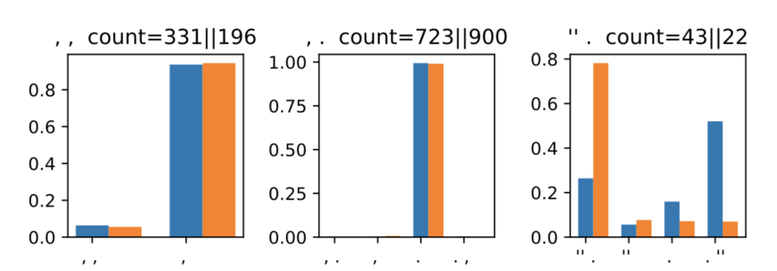




We learn high probability for Nunberg’s English Rules
American English
British English
,
,
,
.
.
`
underlying
`
,
,
,
,
.
,
.
.
,
.
.
.
`
`
`
`
`
surface
`
Distribution over rewrite rules
Notes:
The rewriting rules that we learned are consistent with Nunberg’s analysis of English.
These are bar plots of the distribution.
In the left most figure, [CLICK] the input is comma, comma, and we have high probabilities of collapsing into a single comma.
In the middle figure, the input is comma-period, and we have high probabilities of comma absorption.
In the right figure, the input is quotation period, and with high probability we rewrite into .” for American English but [CLICK] it stays as quote-period in British English.

Slide 37
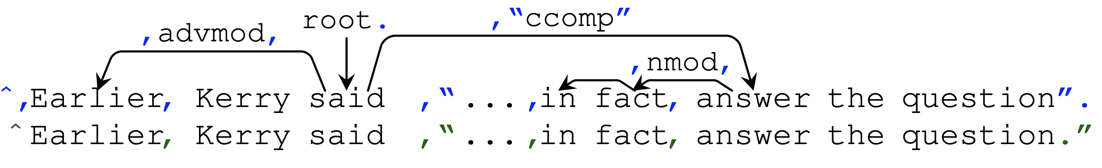
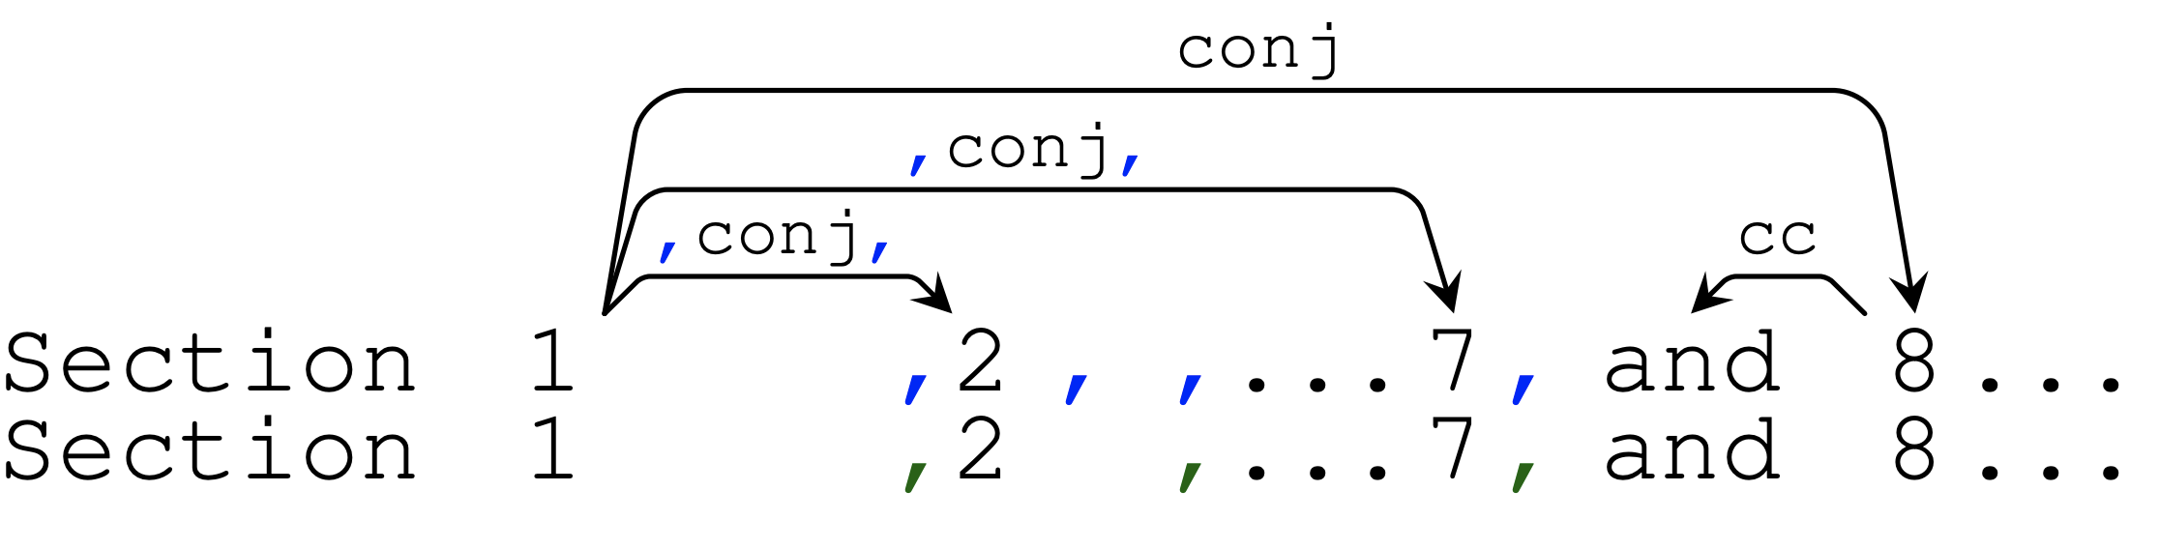
Real Examples (simplified for slide)
Case Study 2
Notes:
show in same format as Arthur example.
“Real Examples (simplified for slide)”

Slide 38
Viterbi recovers good underlying punctuation
.
Real Examples (simplified for slide)
root
,
,
,
`
`
advmod
`
`
ccomp
,
,
nmod
dobj
,
`
,
,
,
`
`
Earlier
,
Kerry
said
`
in
fact
answered
the
question
.
.
,
,
`
,
`
`
Earlier
Kerry
said
in
fact
answered
the
question
`
Notes:
Here is one case study. We find the One-best underlying punctuated tree according to our trained model.
The advmod is surrounded by a pair of commas, the treenode n-mod is also surrounded by a pair of commas. the treenode ccomp is surrounded by a pair of quotation, along with a left comma.
As you can see, the underlying punctuation intuitively is compatible with both the tree and the surface.

Slide 39
Viterbi recovers good underlying punctuation
.
Real Examples (simplified for slide)
root
Oxford Comma
dobj
,
,
,
,
conj
conj
conj
,
,
,
,
and
.
Section
1
2
7
8
,
,
,
.
Section
1
2
7
and
8
Notes:
For a case of Oxford Comma. The best underlying punctuation surrounds the middle conjunct with two commas, but leaves the last conjunct unsurrounded.

Slide 40
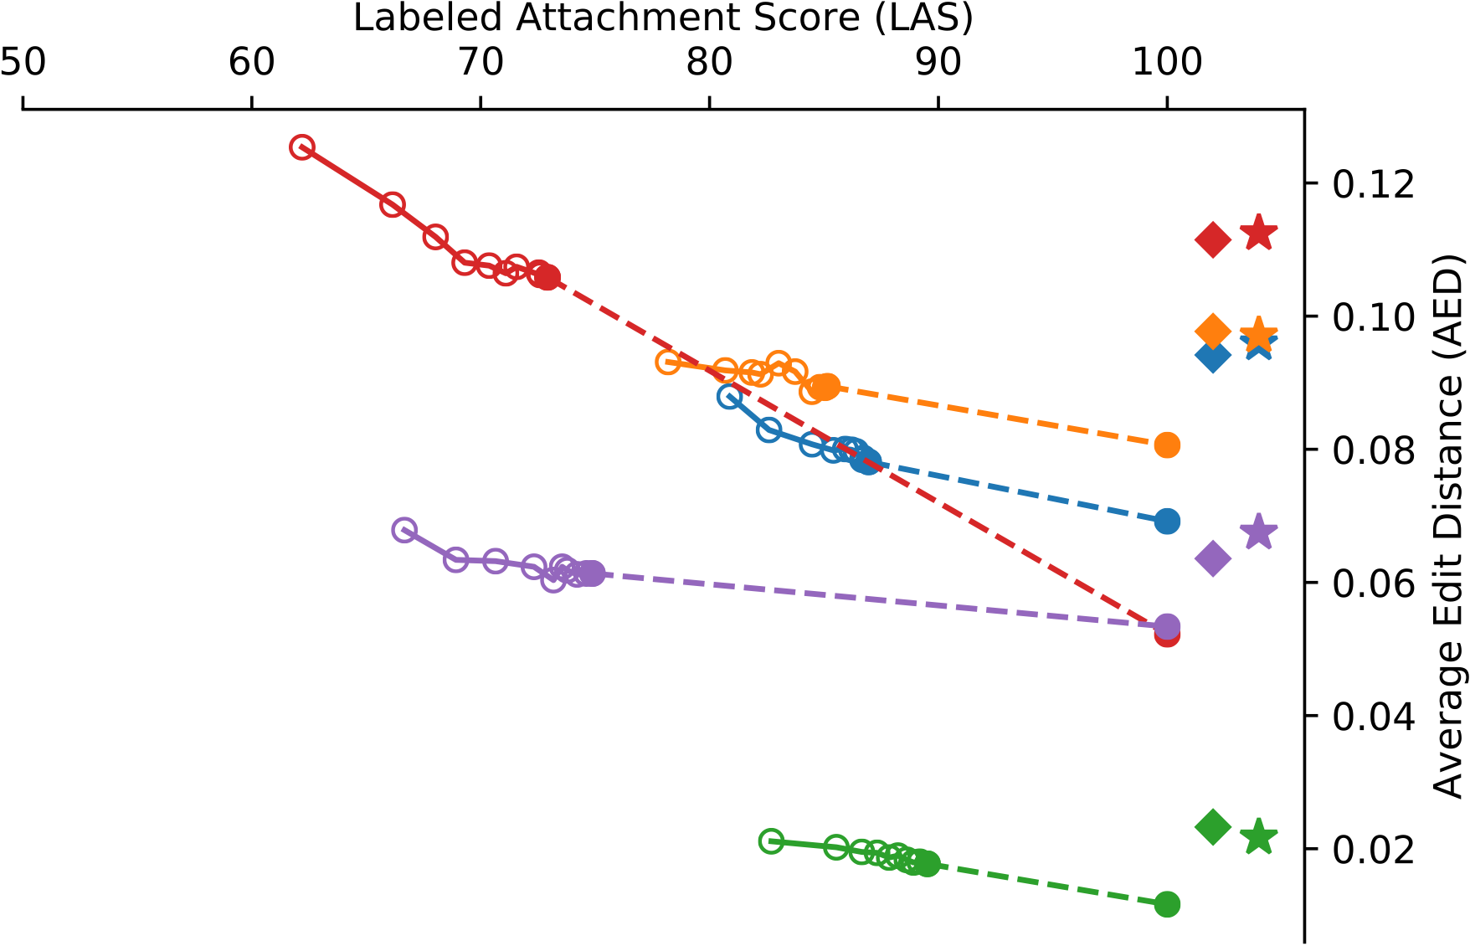

English
Spanish
Arabic
Chinese
Hindi
What if we don’t have gold parses?
BiLSTM-CRF tagger
Punctuation Restoration
Always Period tagger
average edit distance
[the lower the better]
Ours
Notes:
We experimented with the punctuation restoration task. Assume that we have a an unpunctuated sentence with its gold parse tree, we are trying to reconstruct the gold surface punctuation .
Our results are in the box. We have lower error rate than a Bilstm crf tagger, which struggles with this task and barely beats a trivial heuristic.
Since our method relies on having gold parse tree, we also investigate in the case where we do not have perfect parses.
This does hurt our method, but even when we don’t have the perfect parse, even around 80% parsing accuracy is good enough for us to reconstruct punctuation better than the baselines.

Slide 41
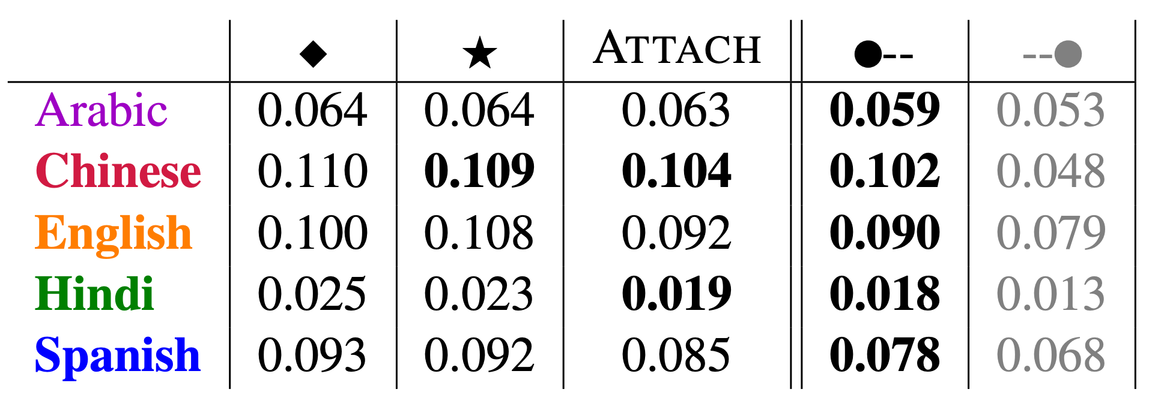

Slide 42
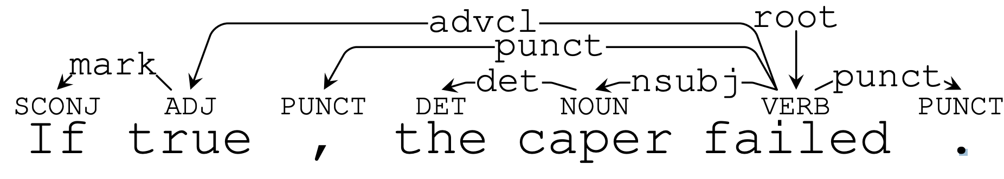
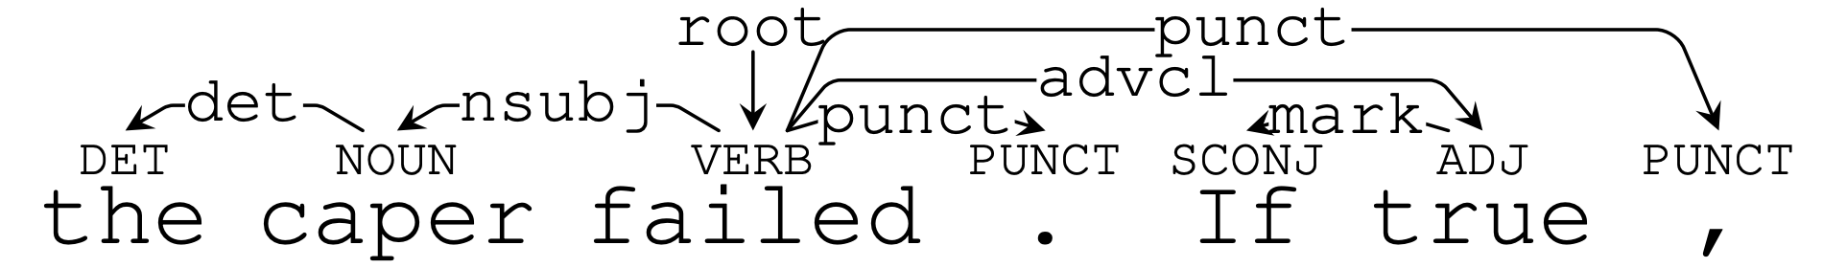
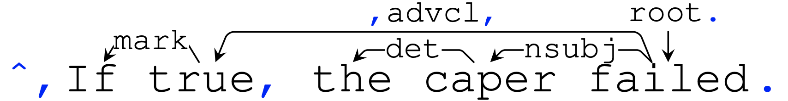
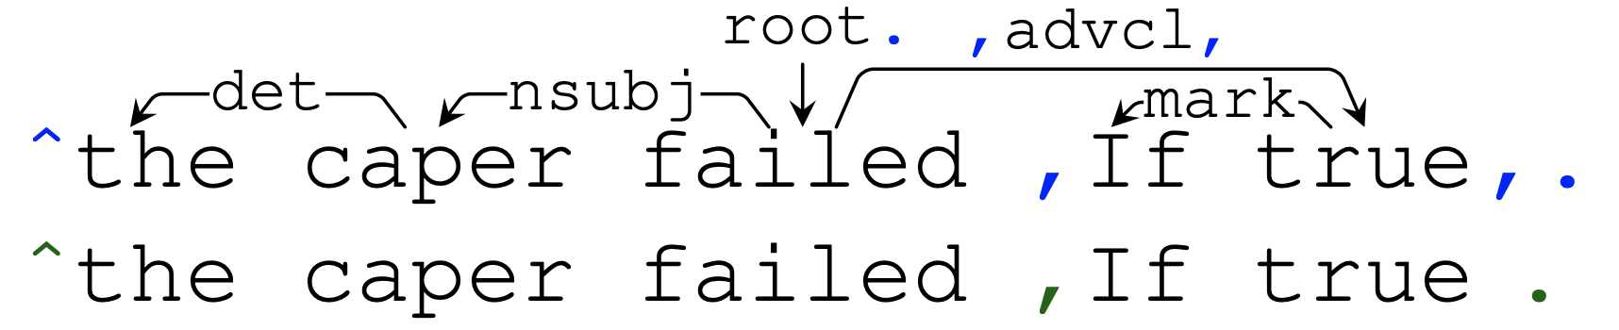
Wrong Method
Notes:
English dependencies come in different orders. There is some freedom in how you realize the surface order of constituents. In some of our other work, we learn a stochastic ordering model that we can use to propose rephrasings of a sentence. But if we use the silly treebank punctuation, the results are terrible. Our paper shows that it’s bad under a language model.
The right way to do it is to infer the underlying punctuation at all tree nodes, then permute the nodes, then generate new surface punctuation. And this method solves the

Slide 43
root
conj
punct
advcl
punct
dobj
punct
,
,
.
but
if
true
the
caper
failed
Syntactically Transform Sentence from Treebank
Notes:
Here is another experiment. If you edit your writing, you know that English gives you some freedom in how you realize the surface order of constituents. In some of our other work, we learn a stochastic dependent ordering model that we can use to propose rephrasings of a sentence. But if we just use the silly treebank treatment of punctuation, the results are terrible. [CLICK]. We can quantify “terrible” using language model perplexity.
The right way to do it is to infer the underlying punctuation at all tree nodes, [CLICK, CLICK, CLICK, CLICK,CLICK] like this. then permute the nodes, and finally generate the new surface punctuation. And this method generate correctly punctuated sentence as an output. [CLICK]

Slide 44
root
conj
dobj
punct
punct
advcl
punct
.
,
,
but
the
caper
failed
if
true
obviously ugly, and high perplexity under an LM
Syntactically Transform Sentence from Treebank
Notes:
If you edit your writing, you know that English gives you some freedom in how you realize the surface order of constituents. In some of our other work, we learn a stochastic dependent ordering model that we can use to propose rephrasings of a sentence. But if we just use the silly treebank treatment of punctuation, the results are terrible. [CLICK]. We can quantify “terrible” using language model perplexity.
The right way to do it is to infer the underlying punctuation at all tree nodes, [CLICK, CLICK, CLICK, CLICK,CLICK] like this. then permute the nodes, and finally generate the new surface punctuation. And this method generate correctly punctuated sentence as an output. [CLICK]

Slide 45
.
root
,
,
conj
punct
advcl
punct
dobj
punct
,
,
.
but
if
true
the
caper
failed
Syntactically Transform Sentence with our Annotation
Notes:
If you edit your writing, you know that English gives you some freedom in how you realize the surface order of constituents. In some of our other work, we learn a stochastic dependent ordering model that we can use to propose rephrasings of a sentence. But if we just use the silly treebank treatment of punctuation, the results are terrible. [CLICK]. We can quantify “terrible” using language model perplexity.
The right way to do it [CLICK] is to infer the underlying punctuation at all tree nodes, [CLICK, CLICK, CLICK, CLICK,CLICK] like this. then permute the nodes, and finally generate the new surface punctuation. And this method generate correctly punctuated sentence as an output. [CLICK]

Slide 46
.
root
conj
,
,
advcl
dobj
but
if
true
the
caper
failed
Syntactically Transform Sentence with our Annotation
Notes:
If you edit your writing, you know that English gives you some freedom in how you realize the surface order of constituents. In some of our other work, we learn a stochastic dependent ordering model that we can use to propose rephrasings of a sentence. But if we just use the silly treebank treatment of punctuation, the results are terrible. [CLICK]. We can quantify “terrible” using language model perplexity.
The right way to do it is to infer the underlying punctuation at all tree nodes, [CLICK, CLICK, CLICK, CLICK,CLICK] like this. then permute the nodes, and finally generate the new surface punctuation. And this method generate correctly punctuated sentence as an output. [CLICK]

Slide 47
.
root
,
,
conj
dobj
advcl
,
,
.
but
the
caper
failed
if
true
,
.
but
the
caper
failed
if
true
Syntactically Transform Sentence with our Annotation
Notes:
If you edit your writing, you know that English gives you some freedom in how you realize the surface order of constituents. In some of our other work, we learn a stochastic dependent ordering model that we can use to propose rephrasings of a sentence. But if we just use the silly treebank treatment of punctuation, the results are terrible. [CLICK]. We can quantify “terrible” using language model perplexity.
The right way to do it is to infer the underlying punctuation at all tree nodes, [CLICK, CLICK, CLICK, CLICK,CLICK] like this. then permute the nodes, and finally generate the new surface punctuation. And this method generate correctly punctuated sentence as an output. [CLICK]

Slide 48
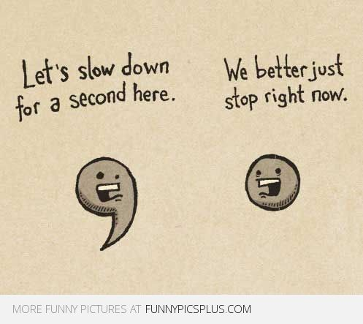
Notes:
Thank you page…
Question?

Slide 49
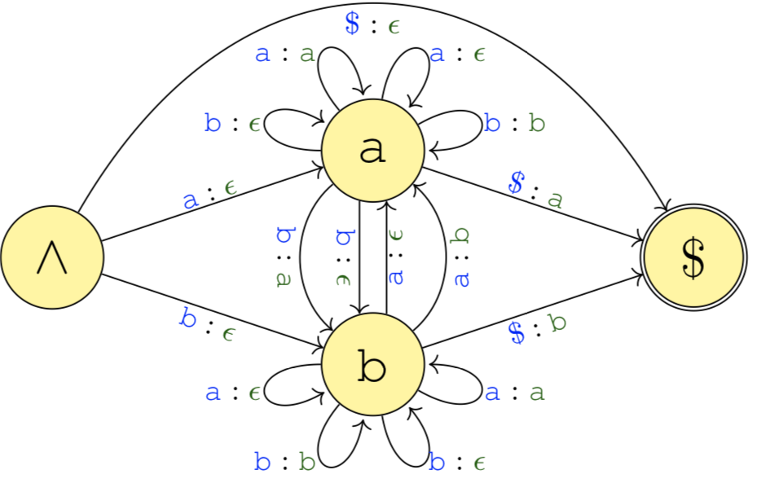








Implemented by
Finite State Transducer

Slide 50



Implemented by
Finite State Transducer

Slide 51






Slide 52





Implemented by
Finite State Transducer

