Slide 1
Approximation-aware
Dependency Parsing by
Belief Propagation
Matt Gormley
Mark Dredze
Jason Eisner
September 19, 2015
TACL at EMNLP

Slide 2
Motivation #1:
Approximation-unaware Learning
Problem: Approximate inference causes standard learning algorithms to go awry
(Kulesza & Pereira, 2008)
with exact inference:
with approx. inference:
Can we take our
approximations
into account?

Slide 3
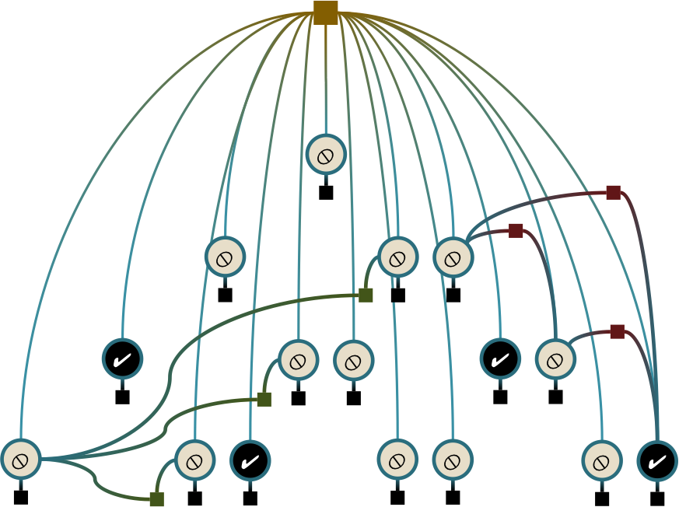
Motivation #2:
Hybrid Models
Graphical models let you encode domain knowledge
Neural nets are really good at fitting the data discriminatively to make good predictions
…
…
…
Could we define a neural net
that incorporates
domain knowledge?

Slide 4
Our Solution
Key idea: Treat your unrolled approximate inference algorithm as a deep network
…
…
…

Slide 5
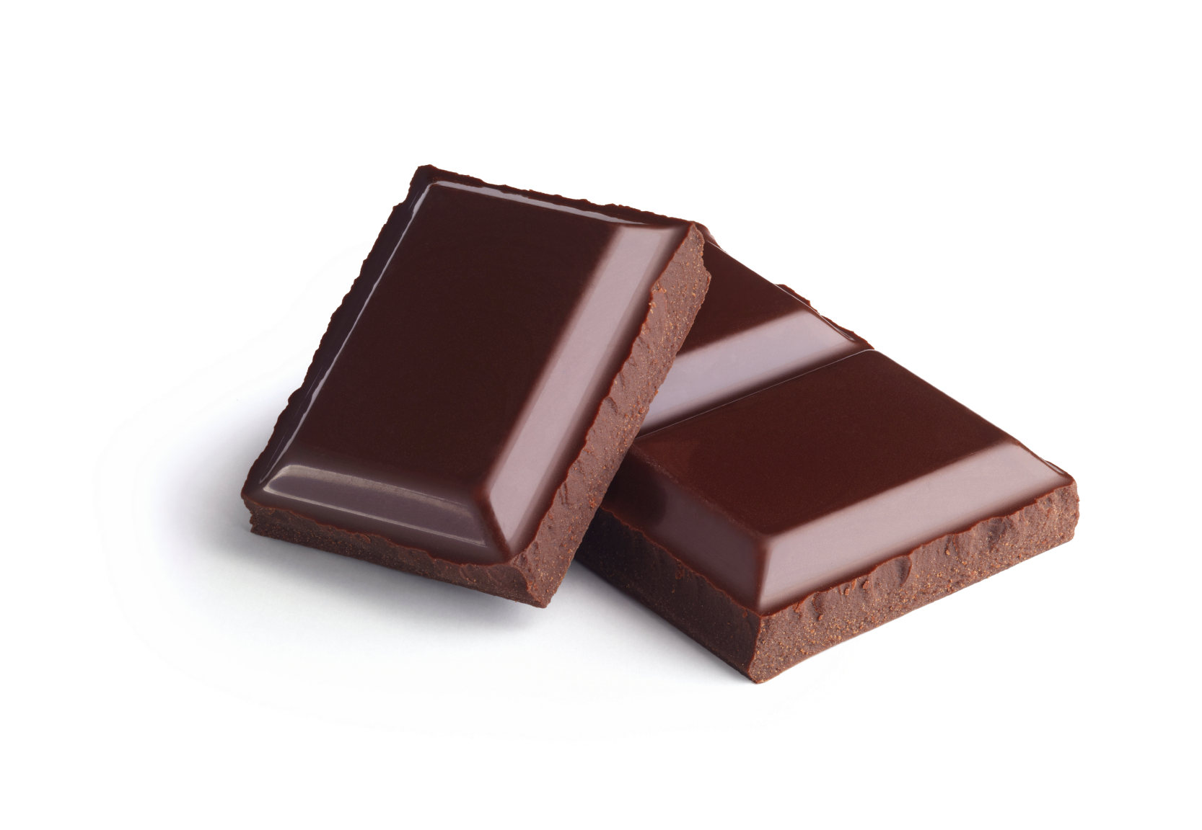
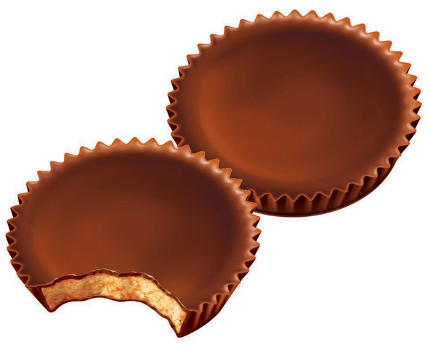
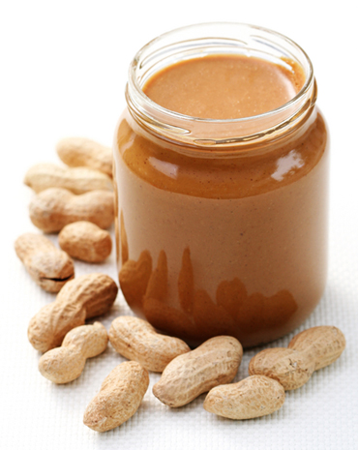
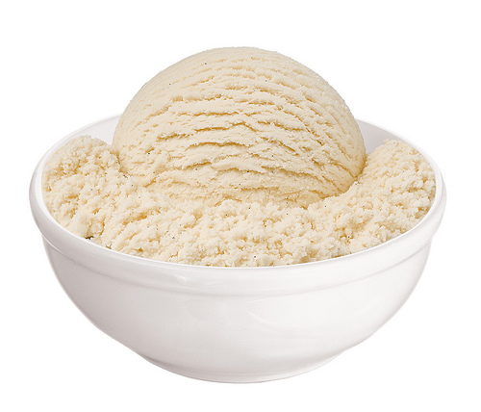
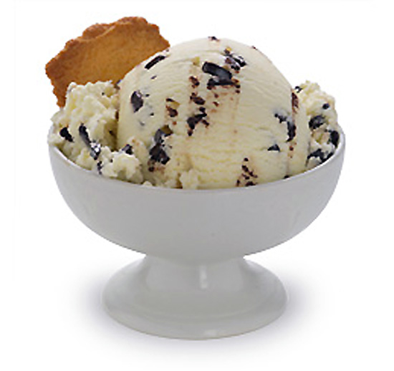
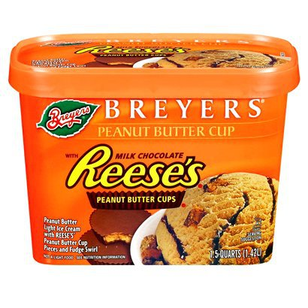
Talk Summary
(Smith & Eisner, 2008)
Loopy BP
+
Dynamic Prog.
=
Structured BP
(Eaton & Ghahramani, 2009)
(Stoyanov et al., 2011)
Loopy BP
+
Backprop.
=
ERMA / Back-BP
Loopy BP
+
Dynamic Prog.
+
Backprop.
=
This Talk

Slide 6
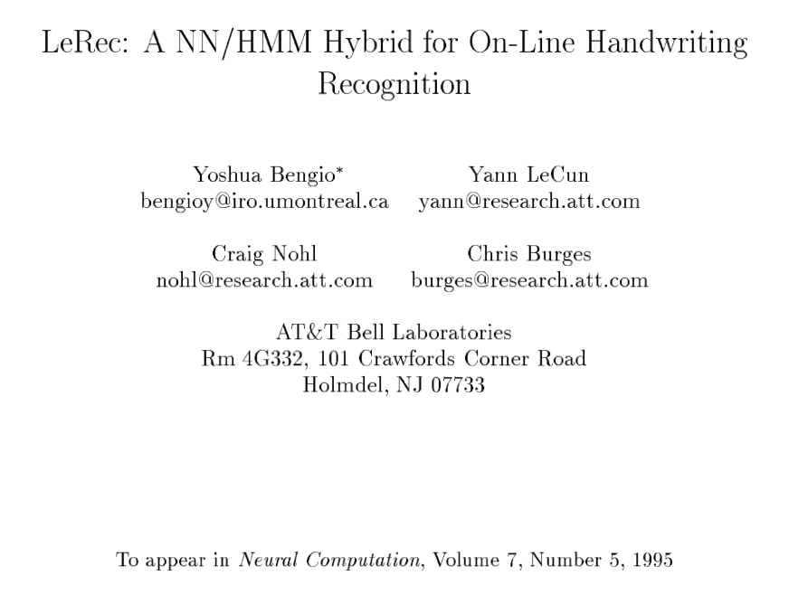
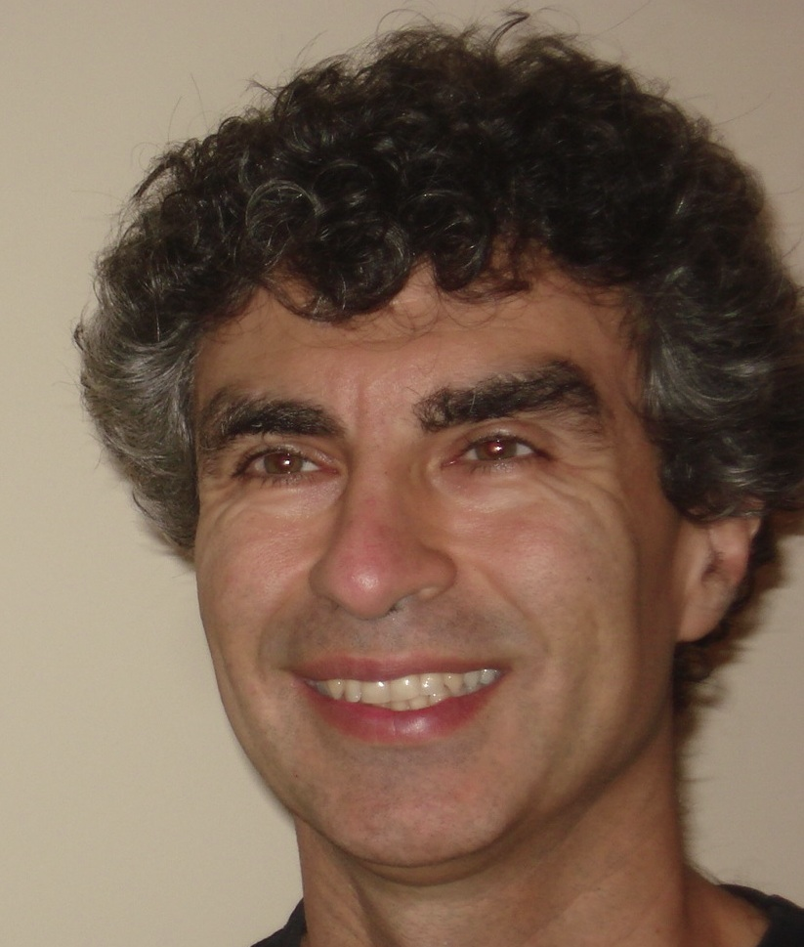


Loopy BP
+
Dynamic Prog.
+
Backprop.
=
This Talk
Graphical Models
+
Hypergraphs
+
Neural Networks
=
The models that interest me
If you’re thinking,
“This sounds like a great direction!”
Then you’re in good company
And have been since before 1995

Slide 7
Loopy BP
+
Dynamic Prog.
+
Backprop.
=
This Talk
Graphical Models
+
Hypergraphs
+
Neural Networks
=
The models that interest me
So what’s new since 1995?
Two new emphases:
  Learning under approximate inference
  Structural constraints

Slide 8
An Abstraction for Modeling
Mathematical Modeling
Factor Graph
(bipartite graph)
variables (circles)
factors (squares)
y₁
 | True | False
True | 2 | 9
False | 4 | 2
ψ₁₂
y₂
ψ₂
True | 0.1
False | 5.2

Slide 9
Factor Graph for Dependency Parsing
Y_{0,4}
Y_{0,3}
Y_{1,4}
Y_{4,1}
Y_{0,2}
Y_{1,3}
Y_{3,1}
Y_{2,4}
Y_{4,2}
Y_{0,1}
Y_{1,2}
Y_{2,1}
Y_{2,3}
Y_{3,2}
Y_{3,4}
Y_{4,3}

Slide 10
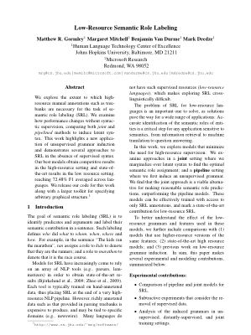
Factor Graph for Dependency Parsing
(Smith & Eisner, 2008)
Y_{0,4}
Y_{0,3}
Y_{1,4}
Y_{4,1}
Left
arc
Right
arc
Y_{0,2}
Y_{1,3}
Y_{3,1}
Y_{2,4}
Y_{4,2}
Y_{0,1}
Y_{1,2}
Y_{2,1}
Y_{2,3}
Y_{3,2}
Y_{3,4}
Y_{4,3}
0
1
2
3
4
<WALL>
Juan_Carlos
abdica
su
reino

Slide 11
Factor Graph for Dependency Parsing
(Smith & Eisner, 2008)




Left
arc
Right
arc
✔


✔



✔



✔
0
1
2
3
4
<WALL>
Juan_Carlos
abdica
su
reino

Slide 12
Factor Graph for Dependency Parsing
(Smith & Eisner, 2008)

Unary: local opinion about one edge



✔


✔



✔



✔
0
1
2
3
4
<WALL>
Juan_Carlos
abdica
su
reino

Slide 13
Factor Graph for Dependency Parsing
(Smith & Eisner, 2008)

Unary: local opinion about one edge



✔


✔



✔


✔
✔
0
1
2
3
4
<WALL>
Juan_Carlos
abdica
su
reino

Slide 14
Factor Graph for Dependency Parsing
(Smith & Eisner, 2008)
PTree: Hard constraint, multiplying in 1 if the variables form a tree and 0 otherwise.

Unary: local opinion about one edge



✔


✔



✔



✔
0
1
2
3
4
<WALL>
Juan_Carlos
abdica
su
reino

Slide 15
Factor Graph for Dependency Parsing
(Smith & Eisner, 2008)
PTree: Hard constraint, multiplying in 1 if the variables form a tree and 0 otherwise.

Unary: local opinion about one edge



✔


✔



✔



✔
0
1
2
3
4
<WALL>
Juan_Carlos
abdica
su
reino

Slide 16
Factor Graph for Dependency Parsing
(Smith & Eisner, 2008)
PTree: Hard constraint, multiplying in 1 if the variables form a tree and 0 otherwise.

Unary: local opinion about one edge



Grandparent: local opinion about grandparent, head, and modifier
✔


✔



✔



✔
0
1
2
3
4
<WALL>
Juan_Carlos
abdica
su
reino

Slide 17
Factor Graph for Dependency Parsing
(Riedel and Smith, 2010)
(Martins et al., 2010)
PTree: Hard constraint, multiplying in 1 if the variables form a tree and 0 otherwise.

Unary: local opinion about one edge



Grandparent: local opinion about grandparent, head, and modifier
✔


✔

Sibling: local opinion about pair of arbitrary siblings


✔



✔
0
1
2
3
4
<WALL>
Juan_Carlos
abdica
su
reino

Slide 18
Factor Graph for Dependency Parsing
(Riedel and Smith, 2010)
(Martins et al., 2010)
Y_{0,4}
Y_{0,3}
Y_{1,4}
Y_{4,1}
Now we can work at this level of abstraction.
Y_{0,2}
Y_{1,3}
Y_{3,1}
Y_{2,4}
Y_{4,2}
Y_{0,1}
Y_{1,2}
Y_{2,1}
Y_{2,3}
Y_{3,2}
Y_{3,4}
Y_{4,3}

Slide 19
Why dependency parsing?
Simplest example for Structured BP
Exhibits both polytime and NP-hard problems

Slide 20
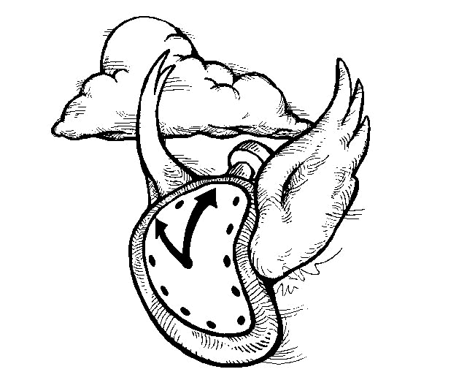
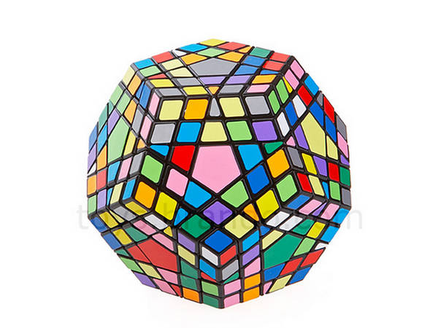
The Impact of Approximations
Linguistics
Model
p_{θ}(
) = 0.50
Inference
NP-hard
Learning
(Inference is usually called as a subroutine in learning)
Notes:
Linguistics inspires the structures we want to predict
Our model defines a score for each structure
It also tells us what to optimize
Inference finds the best structure for a new sentence
(Inference is usually called as a subroutine in learning)
Learning tunes the parameters of the model

Slide 21
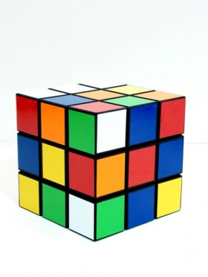
The Impact of Approximations
Linguistics
Model
p_{θ}(
) = 0.50
Inference
Poly-time
approximation!
Learning
(Inference is usually called as a subroutine in learning)

Slide 22
The Impact of Approximations
Linguistics
Model
p_{θ}(
) = 0.50
Poly-time
approximation!
Does learning know inference is approximate?
Inference
Learning
(Inference is usually called as a subroutine in learning)

Slide 23
Conditional Log-likelihood Training
Machine Learning
Choose model
Such that derivative in #3 is ea
Choose objective:
Assign high probability to the things we observe and low probability to everything else
Compute derivative by hand using the chain rule
Replace exact inference by approximate inference

Slide 24
Conditional Log-likelihood Training
Machine Learning
Choose model
(3. comes from log-linear factors)
Choose objective:
Assign high probability to the things we observe and low probability to everything else
Compute derivative by hand using the chain rule
Replace exact inference by approximate inference
Notes:
the "by hand" derivative gives the formula shown, but it contains an indigestible term - this marginal probability is hard to compute exactly.

Slide 25
What’s wrong with CLL?
Machine Learning
How did we compute these approximate marginal probabilities anyway?
By Structured Belief Propagation of course!

Slide 26
Everything you need to know about: Structured BP
It’s a message passing algorithm
The message computations are just multiplication, addition, and division
Those computations are differentiable
Notes:
Along with Jason Eisner, I just gave two tutorials on Structured BP at the last two ACLs.
So here, I’ll summarize everything you need to know about it FOR THIS TALK in one slide.

Slide 27
Structured Belief Propagation
Inference
(Smith & Eisner, 2008)
This is just another factor graph, so we can run Loopy BP
What goes wrong?
Naïve computation is inefficient
We can embed the inside-outside algorithm within the structured factor




✔


✔



✔



✔
0
1
2
3
4
<WALL>
Juan_Carlos
abdica
su
reino

Slide 28
Algorithmic Differentiation
Backprop works on more than just neural networks
You can apply the chain rule to any arbitrary differentiable algorithm
Alternatively: could estimate a gradient by finite-difference approximations – but algorithmic differentiation is much more efficient!
That’s the key (old) idea behind this talk.

Slide 29
Feed-forward Topology of
Inference, Decoding and Loss
Unary factor: vector with 2 entries
Binary factor: (flattened) matrix with 4 entries
Factors
…
Model parameters
…
Notes:
"I told you at the start that theta is the parameters of a probability model. We're going to forget that: we'll just interpret it as the parameters of a prediction procedure - like the parameters of an SVM or a neural net. In a way, you can think of our prediction procedure as a kind of neural net ...
Talk about WHAT BP DOES, not what we do

Slide 30
Feed-forward Topology of
Inference, Decoding and Loss
Messages from neighbors used to compute next message
Leads to sparsity in layerwise connections
…
Messages at time t=1
…
Messages at time t=0
Factors
…
Model parameters
…

Slide 31
Arrows in This Diagram:
A different semantics given by the algorithm
Feed-forward Topology of
Inference, Decoding and Loss
Arrows in Neural Net:
Linear combination, then a sigmoid
…
Messages at time t=1
…
Messages at time t=0
Factors
…
Model parameters
…
Notes:
a_i = \sigma\left(\sum_{j} \theta_j b_j \right)

Slide 32
Arrows in This Diagram:
A different semantics given by the algorithm
Feed-forward Topology of
Inference, Decoding and Loss
Arrows in Neural Net:
Linear combination, then a sigmoid
…
Messages at time t=1
…
Messages at time t=0
Factors
…
Model parameters
…

Slide 33
Feed-forward Topology
Decode / Loss
…
Beliefs
…
Messages
at time t=3
…
Messages at time t=2
…
Messages at time t=1
…
Messages at time t=0
Factors
…
Model parameters
…

Slide 34
Arrows in This Diagram:
A different semantics given by the algorithm
Feed-forward Topology
Decode / Loss
Messages from PTree factor rely on a variant of inside-outside
…
Beliefs
…
Messages
at time t=3
…
Messages at time t=2
…
Messages at time t=1
…
Messages at time t=0
Factors
…
Model parameters
…

Slide 35
Feed-forward Topology
Messages from PTree factor rely on a variant of inside-outside
…
…
…
Chart parser:
…
…
…
…

Slide 36
Approximation-aware Learning
Machine Learning
Key idea: Open up the black box!
Choose model to be the computation with all its approximations
Choose objective
to likewise include the approximations
Compute derivative by backpropagation (treating the entire computation as if it were a neural network)
Make no approximations!
(Our gradient is exact)

Slide 37
Experimental Setup
Goal: Compare two training approaches
  Standard approach (CLL)
  New approach (Backprop)
Data: English PTB
  Converted to dependencies using Yamada & Matsumoto (2003) head rules
  Standard train (02-21), dev (22), test (23) split
  TurboTagger predicted POS tags
Metric: Unlabeled Attachment Score
(higher is better)

Slide 38
Results
Speed-Accuracy Tradeoff
New training approach yields models which are:
Faster for a given level of accuracy
More accurate for a given level of speed
Dependency Parsing
More accurate
Faster

Slide 39
Results
Dependency Parsing
Increasingly Cyclic Models
As we add more factors to the model, our model becomes loopier
Yet, our training by Backprop consistently improves as models get richer
More accurate
Richer Models
Notes:
Why is there a drop in CLL?
It's not really following the gradient of log-likelihood, because of approximations - it's slow or intractable to compute the likelihood exactly;
our method instead follows the gradient of empirical risk or our objective

Slide 40
See our TACL paper for…
1) Results on 19 languages from CoNLL 2006 / 2007
2) Results with alternate training objectives
3) Empirical comparison of exact and approximate inference

Slide 41
Comparison of Two Approaches
Machine Learning
1. CLL with approximate inference
  A totally ridiculous thing to do!
  But it’s been done for years because it often works well
  (Also named “surrogate likelihood training” by Wainright (2006))

Slide 42
Comparison of Two Approaches
Machine Learning
Key idea: Open up the black box!
2. Approximation-aware Learning for NLP
  In hindsight, treating the approximations as part of the model is the obvious thing to do
  (Domke, 2010; Domke, 2011; Stoyanov et al., 2011;
  Ross et al., 2011; Stoyanov & Eisner, 2012; Hershey et al., 2014)
  Our contribution: Approximation-aware learning with structured factors
  But there's some challenges to get it right (numerical stability, efficiency, backprop through structured factors, annealing a decoder’s argmin)
  Sum-Product Networks are similar in spirit
  (Poon & Domingos, 2011; Gen & Domingos, 2012)

Slide 43
Takeaways
New learning approach for Structured BP maintains high accuracy with fewer iterations of BP, even with cycles
Need a neural network? Treat your unrolled approximate inference algorithm as a deep network

Slide 44
Questions?
Pacaya - Open source framework for hybrid graphical models, hypergraphs, and neural networks
Features:
  Structured BP
  Coming Soon: Approximation-aware training
Language: Java
URL: https://github.com/mgormley/pacaya

