Slide 1

A Virtual Manipulative for Learning Log-Linear Models
Francis Ferraro, and Jason Eisner
http://cs.jhu.edu/~jason/tutorials/loglin

Slide 2
Log-Linear Modeling, Or
How I Learned to Stop Worrying and Love (and Use) MaxEnt

Slide 3
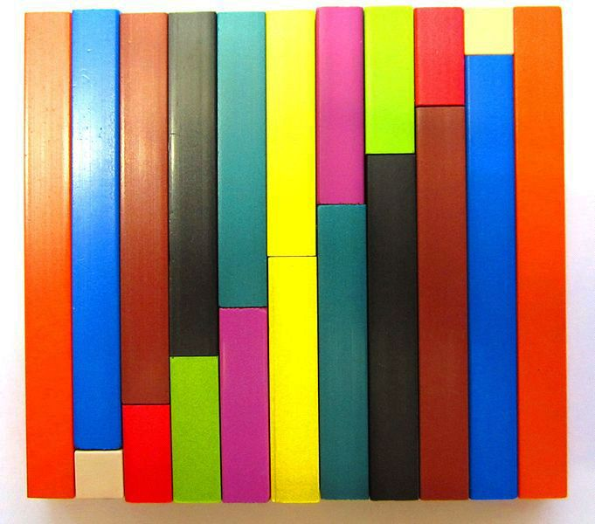
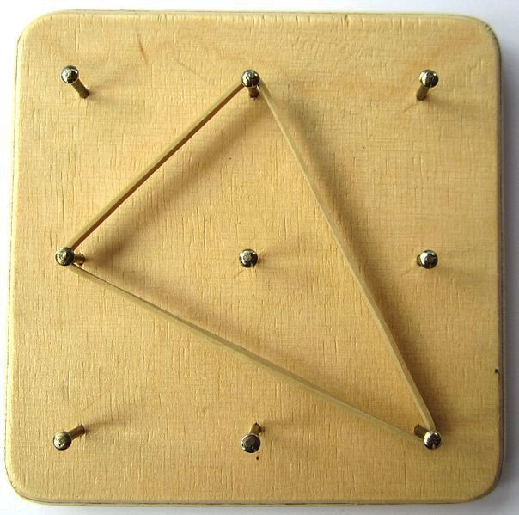
Manipulatives
Cuisenaire rods
Arithmetic concepts
Geoboards
Geometric concepts
http://commons.m.wikimedia.org/wiki/File:Cuisenaire_staircase.JPG
http://en.m.wikipedia.org/wiki/File:Geoboard.JPG

Slide 4
Virtual Manipulatives
National Library of Virtual Manipulatives (NLVM); see Clements and McMillen (1996), and Moyer (2002)
In NLP:
Parsing board game (van Halteren, 2002)
HMMs (Eisner, 2002)
Core NLP technology web interface (Light et al., 2005)
Model 1 stack decoder (github.com/mjpost/stack-decoder)
Speech and ML: see paper

Slide 5
Online Tutorial
http://cs.jhu.edu/~jason/tutorials/loglin/
Chrome, Firefox, Safari, IE 10+
Standard computers (touchscreens not fully supported yet)
Open source

Slide 6
Summary of Materials
18 lessons, including conclusion/summary
Auxiliary handout with some derivation details
"Additional resources" page with...
links to further readings, tutorials
code, toolkit pointers
additional materials (coming soon)
We welcome suggestions

Slide 7
Student Take-Aways
Internalize underlying log-linear concepts
Familiar objects to manipulate
Learn by playing

Slide 8


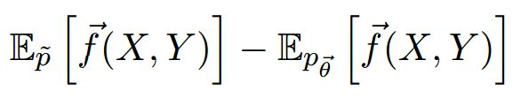
Student Take-Aways
Internalize underlying log-linear concepts
Familiar objects to manipulate
Learn by playing

Slide 9
Student Take-Aways
Internalize underlying log-linear concepts
Familiar objects to manipulate
Learn by playing

Slide 10
Student Take-Aways
Internalize underlying log-linear concepts
Familiar objects to manipulate
Learn by playing

Slide 11
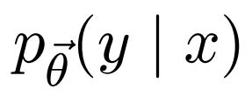
Student Take-Aways
Choosing an appropriate model

Slide 12
Student Take-Aways
P(
)
P(
|
)
Choosing an appropriate model
Unconditioned vs. conditional models

Slide 13
Student Take-Aways
P(
)
P(
|
)
Choosing an appropriate model
Unconditioned vs. conditional models
Feature design

Slide 14
Student Take-Aways
P(
)
P(
|
)
Choosing an appropriate model
Unconditioned vs. conditional models
Feature design
Feature counts

Slide 15
Student Take-Aways
P(
)
P(
|
)
Choosing an appropriate model
Unconditioned vs. conditional models
Feature design
Feature counts
P(
|
)
Generalization

Slide 16

Student Take-Aways
P(
)
P(
|
)
Choosing an appropriate model
Unconditioned vs. conditional models
Feature design
Feature counts
P(
|
)
Generalization
Statistical estimation

Slide 17
Student Take-Aways
P(
)
P(
|
)
Choosing an appropriate model
Unconditioned vs. conditional models
Feature design
Feature counts
P(
|
)
Generalization
Statistical estimation

Slide 18
Student Take-Aways
P(
)
P(
|
)
Choosing an appropriate model
Unconditioned vs. conditional models
Feature design
Feature counts
P(
|
)
Generalization
Statistical estimation

Slide 19
Student Take-Aways
P(
)
P(
|
)
Choosing an appropriate model
Unconditioned vs. conditional models
Feature design
Feature counts
P(
|
)
Generalization
Statistical estimation

Slide 20
Student Take-Aways
P(
)
P(
|
)
Choosing an appropriate model
Unconditioned vs. conditional models
Feature design
Feature counts
P(
|
)
Generalization
Statistical estimation

Slide 21
Our Experiences
Users with and without CS/NLP interests
JHU Fall 2012 NLP class
LSA Summer 2013 Intro to Computational Linguistics
Others with no technical/linguistic background

Slide 22
Our Experiences
Users with and without CS/NLP interests
JHU Fall 2012 NLP class
LSA Summer 2013 Intro to Computational Linguistics
Others with no technical/linguistic background

Slide 23
Use in Your Class, too!
Link to ours:
http://cs.jhu.edu/~jason/tutorials/loglin

Slide 24
Use in Your Class, too!
Link to ours:
http://cs.jhu.edu/~jason/tutorials/loglin
... or set up your own
Nothing to install
Extend/modify lessons with simple text file

Slide 25
Thanks!
http://cs.jhu.edu/~jason/tutorials/loglin
Questions?
Suggestions?
Comments?

Slide 26
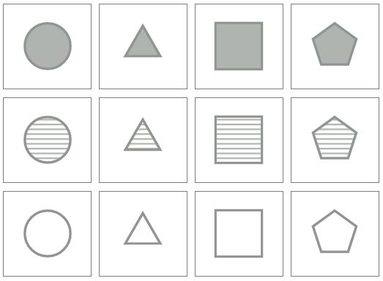
Available Shapes

