Slide 1


Time-and-Space-Efficient Weighted Deduction
Jason Eisner
TACL 2023 (at ACL 2023)

Slide 2
Meta-Theorem
?
Can weighted deduction be made as efficient
as unweighted deduction?
  Only a constant factor worse in time and space …
  … for every deduction system and every input?
For acyclic deduction: Yes!
For cyclic deduction: Almost!
  Plus time to solve the strongly connected components
  But you can find those fast, in toposorted order
!
Notes:
[no talking head]
This paper presents a meta-theorem.
Every year, I ask my class to build a weighted parser.
And they never make it as efficient as the unweighted algorithm!
But it’s always possible. I’m going to show you a general trick.

Slide 3
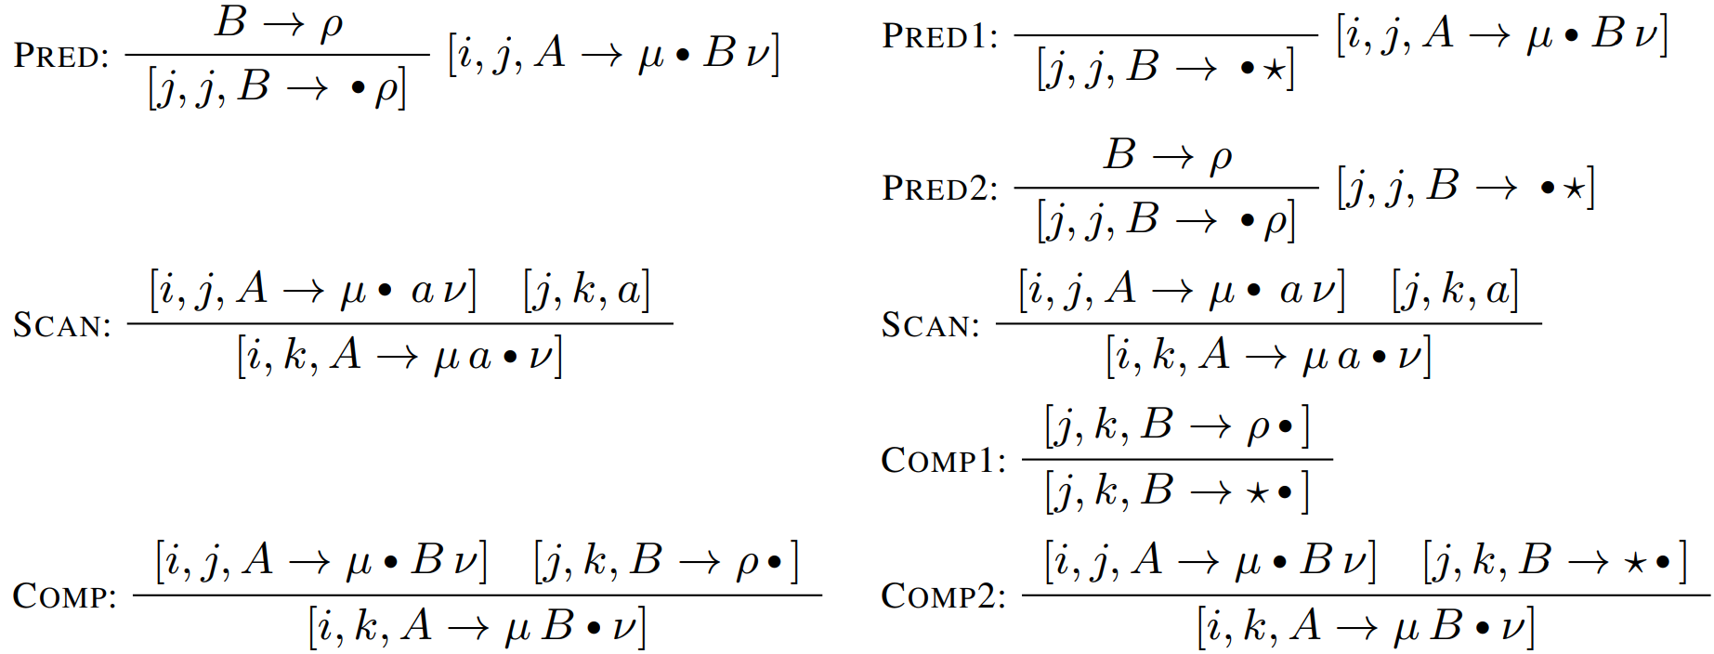


How to Parse Fast (Opedal et al., ACL 2023)
Using Deduction Rules
Regular Earley’s
$$O(n^{3}|𝒢||ℛ|)$$
Fast Earley’s
$$O(n^{3}|𝒢|)$$
Notes:
A: Here's how to speed up Earley's algorithm.
B: Wait a minute, this looks like some kind of deduction rules. How is that an algorithm?

Slide 4































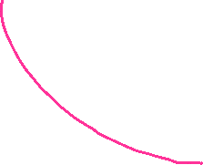








Deduce New Facts from Old Facts
Deducing these facts (nodes) = discovering syntactic
constituents.
Drawing actually shows simplified version of CKY
parsing, not Earley parsing.
serve
red
onion
sauce
over
pasta
with
capers
Notes:
A: Well, you just use them to deduce new facts by combining old facts. Till there’s nothing more you can deduce.
B: And how fast is that?

Slide 5
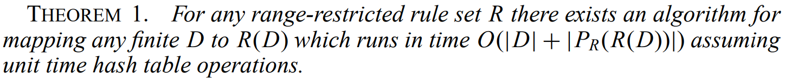
Meta-Theorem for Runtime of
Unweighted Deduction (McAllester, 2002)
serve
red
onion
sauce
over
pasta
with
capers
Notes:
A: McAllester says how to figure out the runtime for any set of deductive rules.

Slide 6
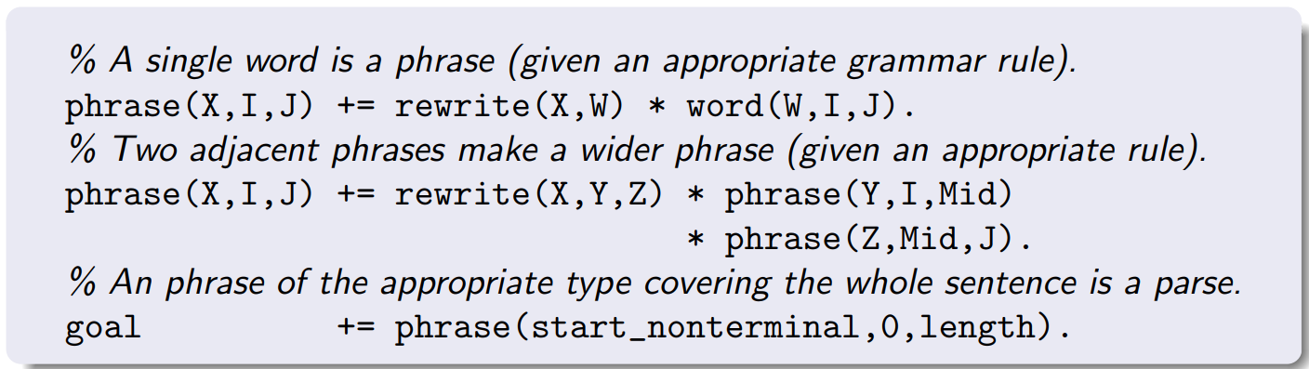
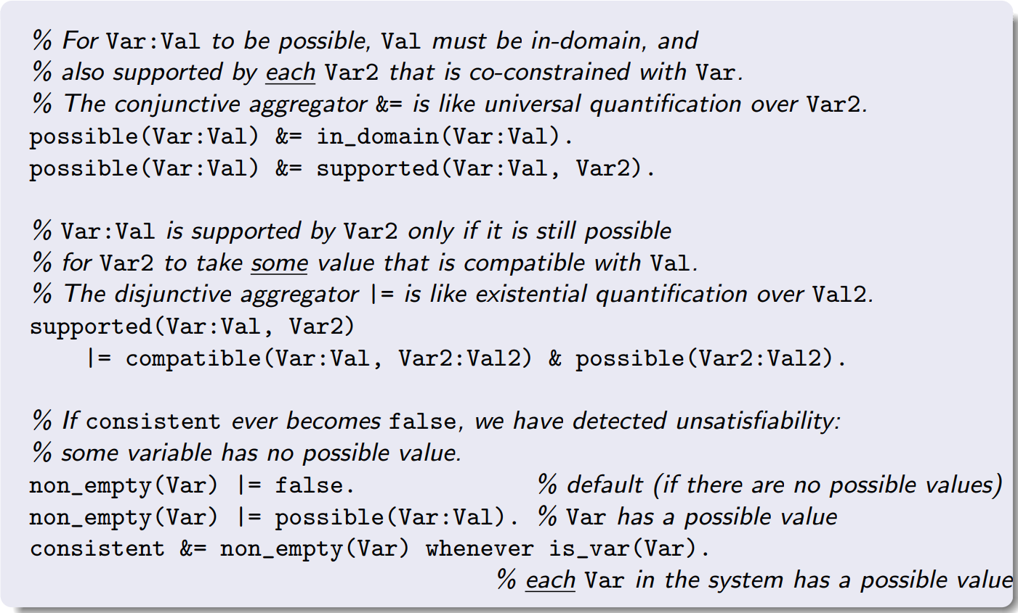
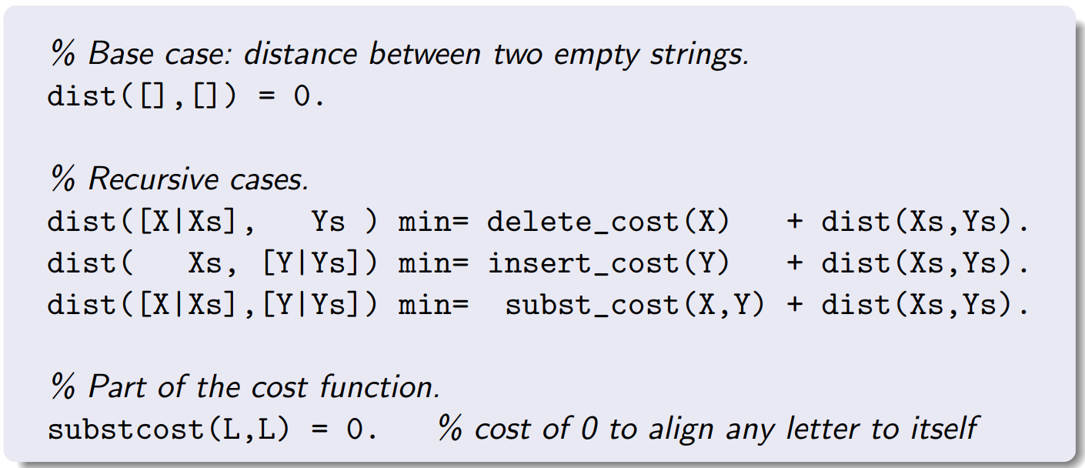
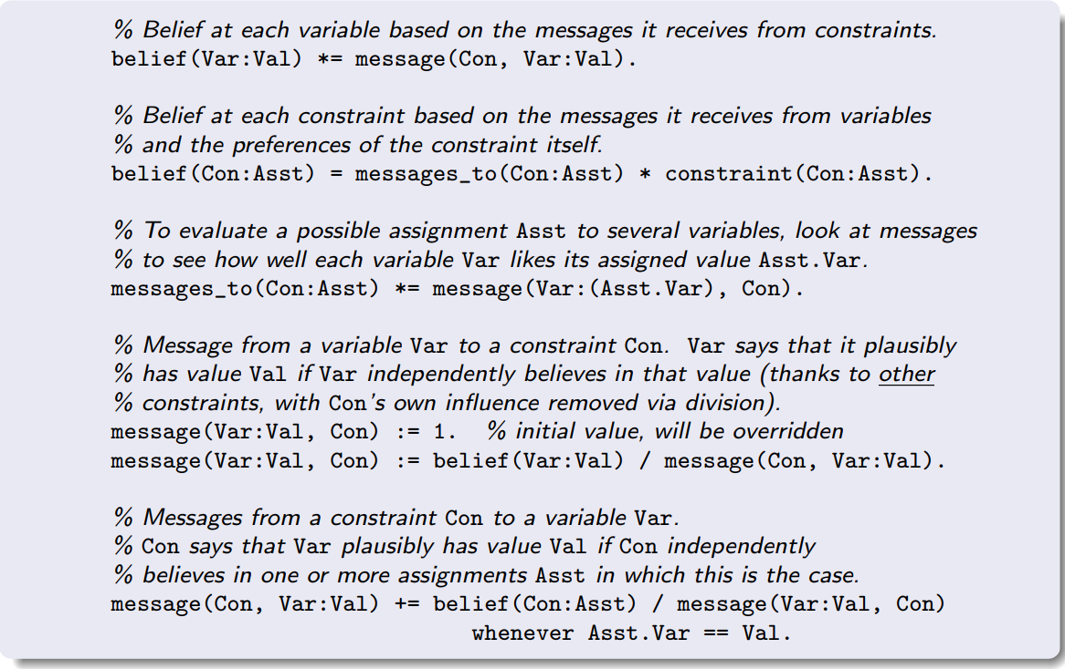

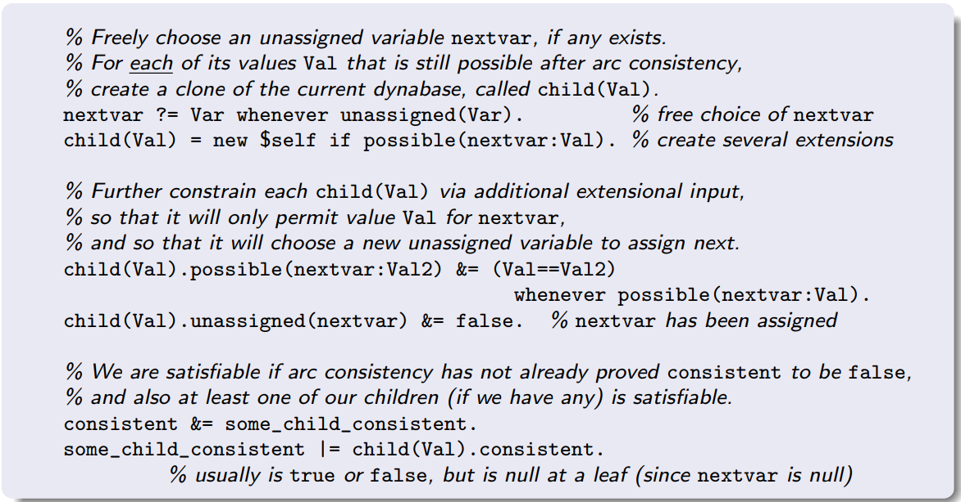
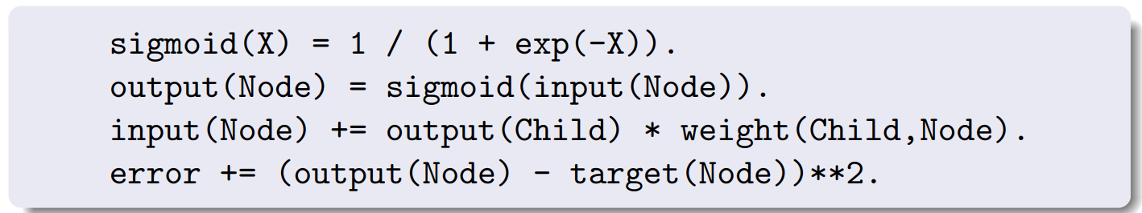
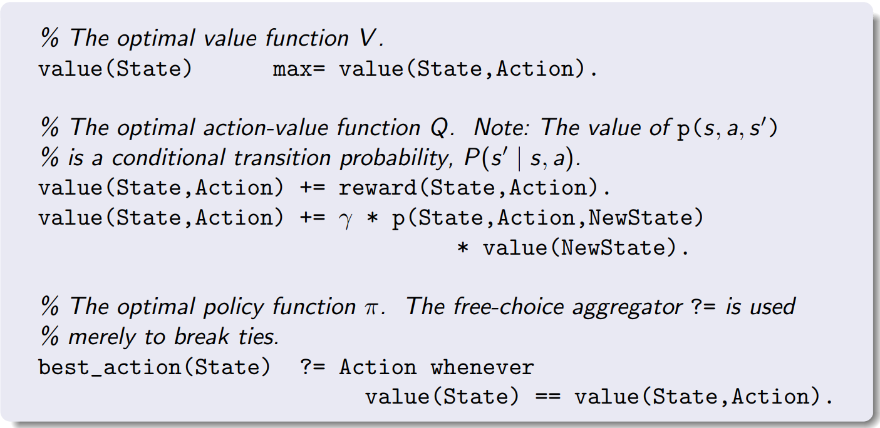

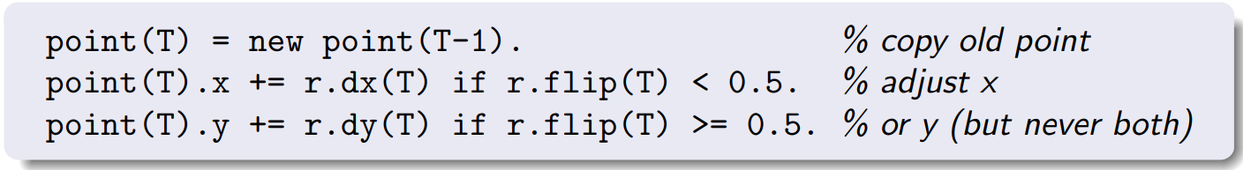
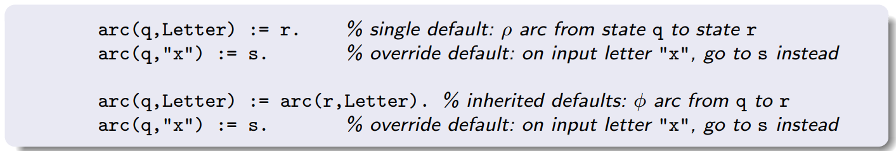
Deduction Systems Rock
(Eisner & Filardo, 2011)
Parsing
Arc Consistency
Edit Distance
Loopy Belief Propagation
Backtracking Search
Feed-Forward Neural Net
Markov Decision Process
Non-Monotonic Reasoning
Random Walk
Convolutional Net
Notes:
A: I showed you a parser, but the facts you deduce don’t have to be syntactic constituents.
They could be anything.
This is like the easiest way to write most algorithms.
So easy.
B: Well, can you sketch the deduction method?

Slide 7
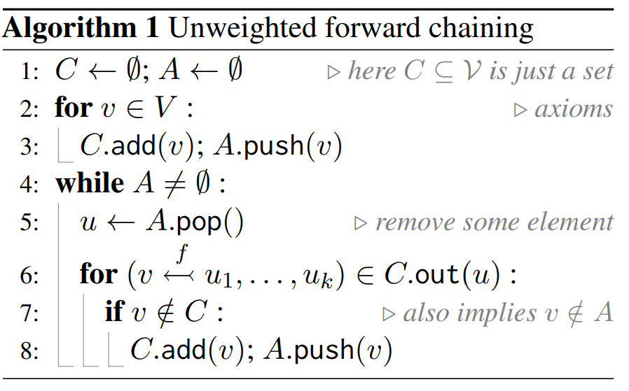
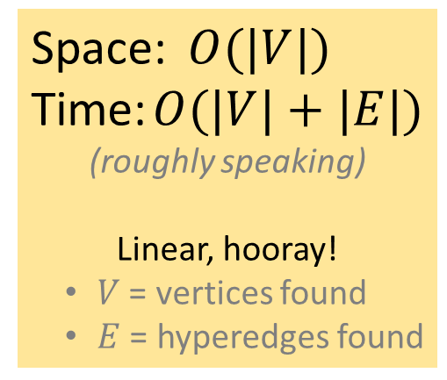
Forward Chaining
Space: $O(|V|)$
Time: $O(|V|+|E|)$
(roughly speaking)
Linear, hooray!
  $V$ = vertices found
  $E$ = hyperedges found
serve
red
onion
sauce
over
pasta
with
capers
Notes:
A: Forward chaining ... it works for lots of problems. Normally it's linear time, if you index the nodes right.

Slide 8










What Happens If You Visit A Node Again?
repropagation?
rederivation
serve
red
onion
sauce
over
pasta
with
capers
Notes:
B: What if you deduce the same fact twice?
A: Just remember it's a duplicate and don't deduce from it again. Like DFS.
B: But what if it changed its value? Like, you found a new way to derive this constituent, so its probability goes up? Then you have to send the new value onwards.

Slide 9


What Happens If You Visit A Node Again?
true
true
true
true
true
Cut off, like DFS
No repropagation needed
true
true
true
true
true
rederivation
true
true
true
true
true
true
true
true
true
true
true
true
serve
red
onion
sauce
over
pasta
with
capers
Notes:
A: Oh, I assumed the only value it can have is "true." If you derive it again, it doesn't get any truer.
B: But I want these facts to have weights.
A: Why?

Slide 10
What Happens If You Visit A Node Again?
Embeddings
repropagation!
serve
red
onion
sauce
over
pasta
with
capers
Notes:
B: Well, maybe vector embeddings.

Slide 11
What Happens If You Visit A Node Again?
Embeddings
Counts
Probabilities
Beliefs
Entropies
Derivations
Translations
…
6 10
6
3
3 4
2
2 4
repropagation!
1
1 2
2
1
1
1 2
1 2
1
1
1
1
1
1
1
1
1
1
1
1
1
1
1
serve
red
onion
sauce
over
pasta
with
capers
Notes:
B: Or I want to COUNT THE NUMBER OF PARSES.
Or sum their probabilities. Or get their entropy.
Or maybe *my* rules don't specify a parser, they specify a convnet or a probabilistic reasoner. No end of uses for weights.
A: Ok, if the value changes, then just send the new value onward.
B: But then the runtime will go up, because I followed the same edge multiple times.
A: Ok, you're right.

Slide 12
How to Parse Fast
Using Deduction Rules
???
Regular Earley’s
$$O(n^{3}|𝒢||ℛ|)$$
Fast Earley’s
$$O(n^{3}|𝒢|)$$
Notes:
B: So those runtimes you gave before, we can't actually get them for a weighted parser?

Slide 13
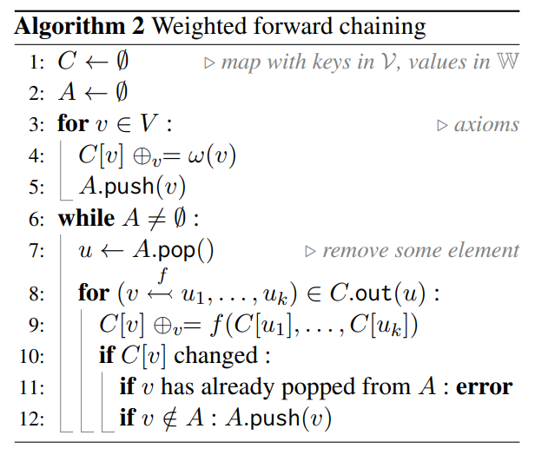






Wait to Propagate!
Wait until value
has converged
(received all inputs)
1
1 6
1 6 10
Notes:
A: Maybe we can fix it. Once a node has received ALL of its inputs, we know its final value.
So we should just wait until then to deduce anything downstream that depends on its value.
B: Sure. So if you don’t wait long enough, an assertion will fail …

Slide 14
Visit Nodes in Toposorted Order
(topologically sorted)
How to do this without extra time or space?
Prioritize by weights, like Dijkstra’s algorithm?
  Not general – only works for some weighting schemes
  Slowdown due to priority queue maintenance
Manually design an algorithm-specific order?
  Like dynamic programming
Notes:
B: So you need to visit the nodes in the “right” order.
A: Yeah. Dijkstra's algorithm uses a priority queue, so a node doesn't pop until its weight has converged.
B: That works for Viterbi parsing, but not for arbitrary weights.
A: Ok, new idea. This might not be an automatic general solution, but for Earley's algorithm specifically, I could probably figure out a toposort in advance, and then visit all the nodes in that order.
Like dynamic programming.

Slide 15

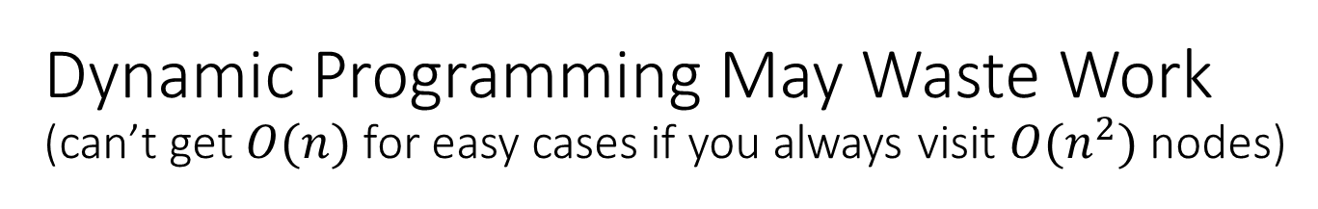
Dynamic Programming May Waste Work
(can’t get $O(n)$ for easy cases if you always visit ${O(n}^{2})$ nodes)
serve
red
onion
sauce
over
pasta
with
capers
Notes:
B: Designing that order could be tricky, and I don’t think it’s fast enough.
It’ll make you loop over n^2 nodes, like CKY, whereas unweighted Earley’s will run in linear time when the sentence isn’t too ambiguous.
Didn’t you want weighted Earley’s to do that too?

Slide 16
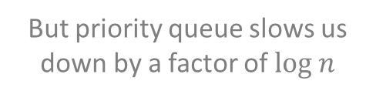
Prioritized Agenda-Based Deduction
(visits fewer nodes, but priority queue has overhead)
Visit only nodes that we build bottom-up, but visit them in a toposorted order
But priority queue slows us down by a factor of $log n$
serve
red
onion
sauce
over
pasta
with
capers
Notes:
A: No, I’ll only use my ordering to prioritize the nodes that I actually build bottom-up.
B: Ok, now you’re back to O(n) nodes for easy sentences. But their runtime will be O(n log n) because of the priority queue.
A: But do I really need a priority queue? Toposorting is possible in O(n).
B: That’s if you have the graph already.

Slide 17

Prioritized Agenda-Based Deduction
Do an Unweighted First Pass (Goodman 1999)
Build unweighted graph in any order
Toposort it in linear time
Fill in the weights in toposorted order
Pass 2
But materializing the graph blows up the space!
Pass 1
10
4
4
2
2
2
1
2
1
1
1
1
1
1
1
1
1
1
1
1
1
1
serve
red
onion
sauce
over
pasta
with
capers
Notes:
A: I can build the graph fast with the unweighted method. Then I can toposort it.
B: That’s ok on runtime, I guess. But storing the graph would take n^3 space!

Slide 18
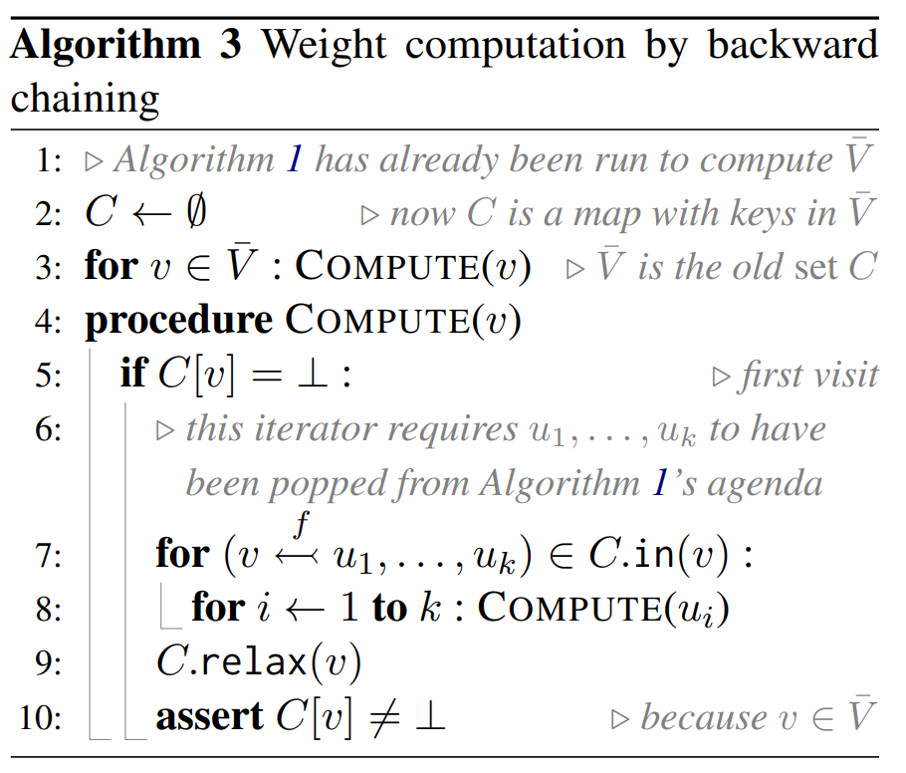
Prioritized Agenda-Based Deduction
Space-Efficient Two-Pass Method
Build unweighted items in any order (discard edges)
Fill in the weights by DFS
(iterate over same edges)
But 1. enumerates out-edges and 2. enumerates in-edges,
which could be slower …
Pass 2
Pass 1
4
4 6
4 6 10
2
2 4
2
2 4
1
2
1 2
2
1
1 2
1
1
1
1
1
1
1
1
1
1
1
1
1
1
1
serve
red
onion
sauce
over
pasta
with
capers
Notes:
A: Ok, so I won’t store the edges. I’ll just recompute them on the second pass.
B: Ok …can you toposort that way?
A: Yeah, just start at the root and fill in the weights recursively. It’s just DFS, like this ….
B: But is it as fast? Like, if finding the nodes going upward requires a cryptographic hash, you would have to undo it to go downward. Which is way slower.

Slide 19
Prioritized Agenda-Based Deduction
Final Space-Efficient Two-Pass Method
Pass 2
Build unweighted items in any order (remember # of in-edges)
Rebuild weighted items in toposorted order (ready when all in-edges have been re-found)
Pass 1
Toposort algorithm
of Kahn (1962)
4
4 6
4 6 10
2
2 4
2
2 4
1
2
1 2
2
1
1 2
1
1
1
1
1
1
1
1
1
1
1
1
1
1
1
serve
red
onion
sauce
over
pasta
with
capers
Notes:
A: So to be totally general, I’ll just go upward -- twice.
On the first pass, I’ll keep track of how many in-edges each node gets. I’ll just increment a counter at that node whenever I deduce its fact. This animation displays the counter as the number of arrowheads left at the node.
On the second pass, I’ll redo the work. But now, whenever I re-deduce a fact, I’ll update its weight and decrement the counter.
When the counter hits zero, the node has gotten all its inputs, so its weight has converged and is ready to propagate.
B: That works! It’s using Kahn’s algorithm.

Slide 20
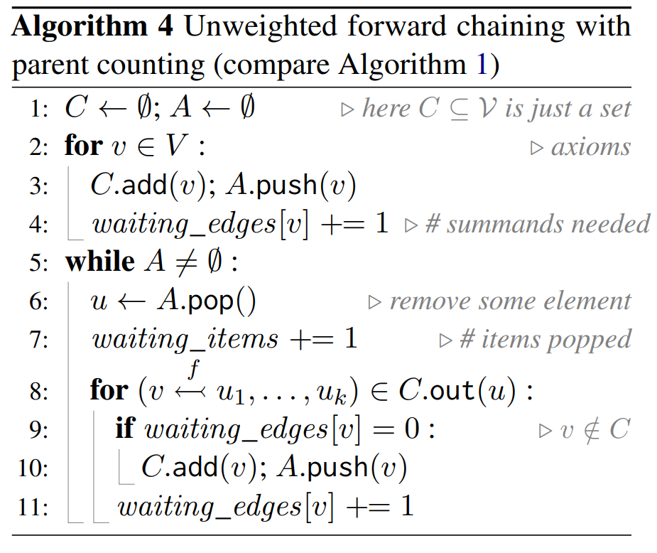
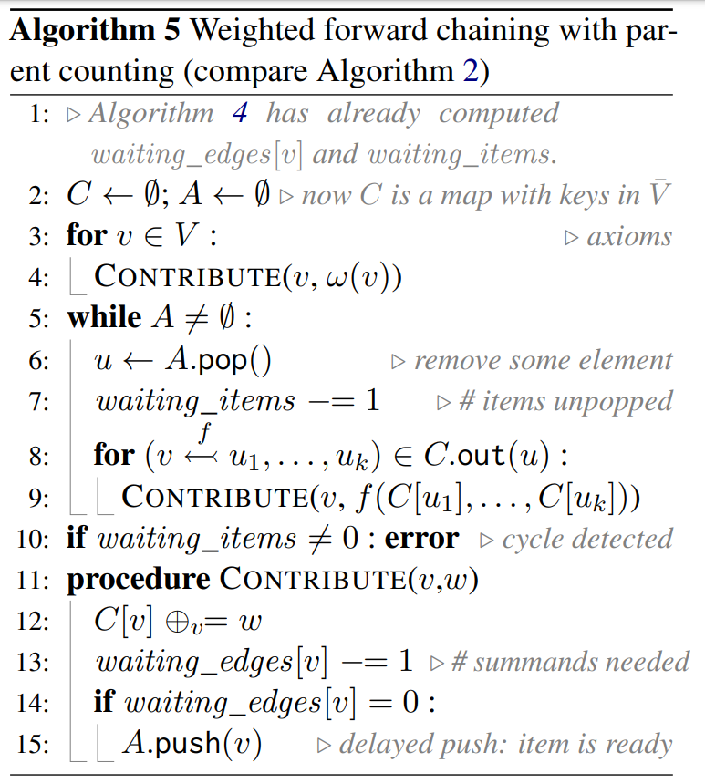
Prioritized Agenda-Based Deduction
Final Space-Efficient Two-Pass Method
Pass 1
Pass 2
Notes:
A: Yeah, funny how no one noticed before how it’s the perfect solution here.

Slide 21






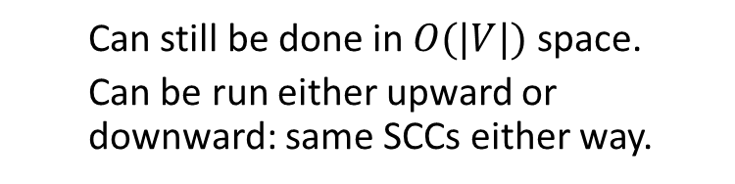
Handling Deduction Cycles
Toposorting nodes only works on an acyclic graph
Pass 2
Pass 1
9
7
For a cyclic graph, Tarjan’s algorithm will find and toposort the strongly connected components (SCCs)
  Upgraded version of DFS.
  Instead of recursing to get values of previous nodes, recurse to get values of previous SCCs.
8
5
6
4
1
3
2
  Can still be done in $O(|V|)$space.
  Can be run either upward or downward: same SCCs either way.
Notes:
B: You’ve been assuming an acylic graph, but Earley’s algorithm, for example, has predictive cycles. Unweighted deduction can handle those. Can you?
A: I could switch to Tarjan’s algorithm, which will detect the cycles. Instead of recursing to get the values of previous nodes, I’ll recurse to get the values of previous strongly connected components.
And, this can still be made efficient.

Slide 22
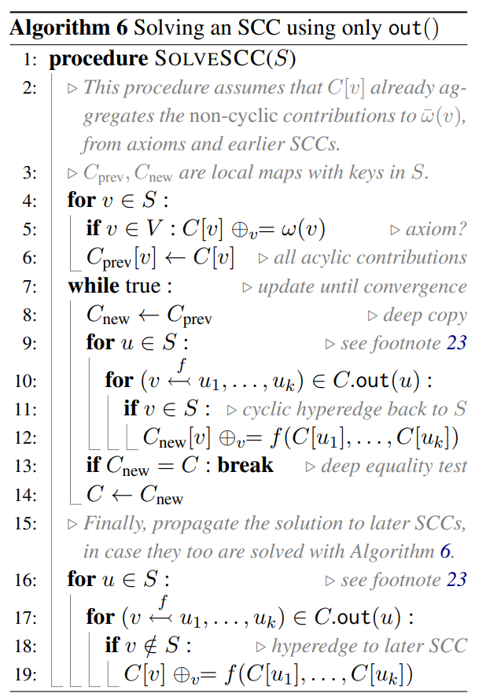
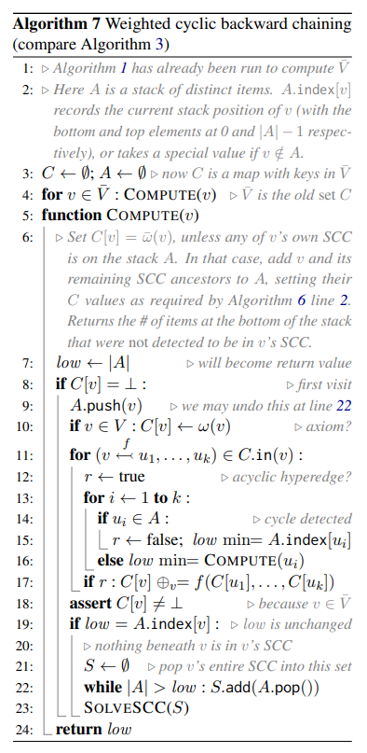
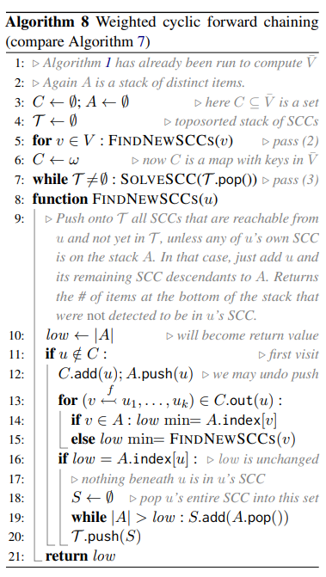

Handling Deduction Cycles
Pass 2
Pass 2
Pass 2

Slide 23
Reviewer Summaries
Very pleasurable to read … a very nice source for anyone interested in weighted deduction algorithms in general.
Invaluable:
  Very careful presentation of the existing literature on weighted deduction algorithms with careful analysis of shortcomings,
  very deep insight into the several aspects of the problem,
  brilliant choice of the formalization/notation, and
  extremely clear presentation.
  This work will be cited by most people working on NLP algorithms expressed as weighted deduction systems.
  I need to add that it was a pleasure for me to review this draft.
The presentation is elegant and rather clear
Notes:
B: We got to a result!
A: Yeah. The paper tries to survey all the algorithmic options. I’m told you’ll enjoy reading it.

Slide 24
Meta-Theorem
?
Can weighted deduction be made as efficient
as unweighted deduction?
  Only a constant factor worse in time and space …
  … for every deduction system and every input?
For acyclic deduction: Yes!
For cyclic deduction: Almost!
  Plus time to solve the strongly connected components
  But you can find those fast, in toposorted order
!
Notes:
And if your problem fits into our simple general framework,
then we have a simple general solution that gives you optimal runtimes automatically.

