Slide 1
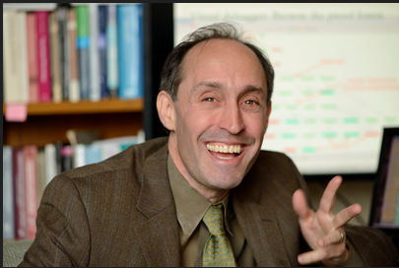


Inside-Outside &
Forward-Backward Algorithms are just Backprop
(tutorial paper)
Jason Eisner

Slide 2
“The inside-outside algorithm is the hardest
algorithm I know.”
– a senior NLP researcher,
in the 1990’s
What does inside-outside do?
It computes expected counts of substructures ...
… that appear in the true parse of some sentence w.
β
α

Slide 3
Where are the constituents?
p=0.5
coal
energy
expert
witness

Slide 4
Where are the constituents?
p=0.1
coal
energy
expert
witness

Slide 5
Where are the constituents?
p=0.1
coal
energy
expert
witness

Slide 6
Where are the constituents?
p=0.1
coal
energy
expert
witness

Slide 7
Where are the constituents?
p=0.2
coal
energy
expert
witness

Slide 8
Where are the constituents?
coal
energy
expert
witness
0.5
+0.1
+0.1
+0.1
+0.2
= 1

Slide 9
Where are NPs, VPs, … ?
NP locations
VP locations
S
VP
PP
NP
NP
V
P
Det
N
Time
Time
flies
flies
like
like
an
an
arrow
arrow

Slide 10
Where are NPs, VPs, … ?
NP locations
VP locations
Time
flies
like
an
arrow
Time
flies
like
an
arrow
(S (NP Time) (VP flies (PP like (NP an arrow))))
p=0.5

Slide 11
Where are NPs, VPs, … ?
NP locations
VP locations
Time
flies
like
an
arrow
Time
flies
like
an
arrow
(S (NP Time flies) (VP like (NP an arrow)))
p=0.3

Slide 12
Where are NPs, VPs, … ?
NP locations
VP locations
Time
flies
like
an
arrow
Time
flies
like
an
arrow
(S (VP Time (NP (NP flies) (PP like (NP an arrow)))))
p=0.1

Slide 13
Where are NPs, VPs, … ?
NP locations
VP locations
Time
flies
like
an
arrow
Time
flies
like
an
arrow
(S (VP (VP Time (NP flies)) (PP like (NP an arrow))))
p=0.1

Slide 14
Where are NPs, VPs, … ?
NP locations
VP locations
Time
flies
like
an
arrow
Time
flies
like
an
arrow
0.5
+0.3
+0.1
+0.1
= 1

Slide 15
How many NPs, VPs, … in all?
NP locations
VP locations
Time
flies
like
an
arrow
Time
flies
like
an
arrow
0.5
+0.3
+0.1
+0.1
= 1

Slide 16
How many NPs, VPs, … in all?
NP locations
VP locations
Time
flies
like
an
arrow
Time
flies
like
an
arrow
2.1 NPs
(expected)
1.1 VPs
(expected)

Slide 17
Where did the rules apply?
S → NP VP locations
NP → Det N locations
Time
flies
like
an
arrow
Time
flies
like
an
arrow

Slide 18
Where did the rules apply?
S → NP VP locations
NP → Det N locations
Time
flies
like
an
arrow
Time
flies
like
an
arrow
(S (NP Time) (VP flies (PP like (NP an arrow))))
p=0.5

Slide 19
Where is S → NP VP substructure?
S → NP VP locations
NP → Det N locations
Time
flies
like
an
arrow
Time
flies
like
an
arrow
(S (NP Time flies) (VP like (NP an arrow)))
p=0.3

Slide 20
Where is S → NP VP substructure?
S → NP VP locations
NP → Det N locations
Time
flies
like
an
arrow
Time
flies
like
an
arrow
(S (VP Time (NP (NP flies) (PP like (NP an arrow)))))
p=0.1

Slide 21
Where is S → NP VP substructure?
S → NP VP locations
NP → Det N locations
Time
flies
like
an
arrow
Time
flies
like
an
arrow
(S (VP (VP Time (NP flies)) (PP like (NP an arrow))))
p=0.1

Slide 22
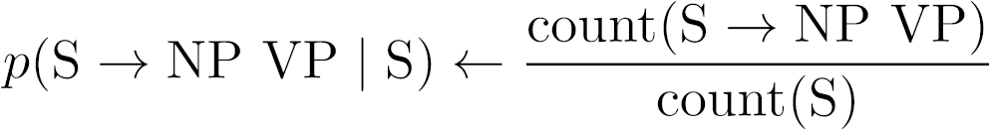
Why do we want this info?
Grammar reestimation by EM method
  E step collects those expected counts
  M step sets
Minimum Bayes Risk decoding
  Find a tree that maximizes expected reward,
  e.g., expected total # of correct constituents
  CKY-like dynamic programming algorithm
    The input specifies the probability of correctness
    for each possible constituent (e.g., VP from 1 to 5)

Slide 23
Why do we want this info?
Soft features of a sentence for other tasks
  NER system asks: “Is there an NP from 0 to 2?”
    True answer is 1 (true) or 0 (false)
    But we return 0.3, averaging over all parses
    That’s a perfectly good feature value – can be fed as to a CRF or a neural network as an input feature
  Writing tutor system asks: “How many times did the student use S → NP[singular] VP[plural]?”
    True answer is in {0, 1, 2, …}
    But we return 1.8, averaging over all parses

Slide 24
How do we compute it all?
How I usually teach it:
CKY recognizer
add weights
historically
accurate
inside algorithm
develop an analogy
to forward-backward
inside-outside algorithm
But algorithm is confusing, and I wave
my hands instead of giving a real proof
Notes:
Analogy to F-B: Total probability of all “paths” that get you to a “state” or from a “state”
Speech people came up with the algorithm in much the same way (Baker, 1979; Jelinek, 1986; Lari & Young, 1990).

Slide 25
Inside & Outside Probabilities
S
“outside” the VP
NP
time
VP
α_{VP}(1,5) = p(time VP today | S)
VP
NP
today
V
flies
PP
β_{VP}(1,5) = p(flies like an arrow | VP)
P
like
NP
α_{VP}(1,5) * β_{VP}(1,5)
= p(time [VP flies like an arrow] today | S)
Det
an
N
arrow
“inside” the VP

Slide 26
Inside & Outside Probabilities
S
NP
time
VP
α_{VP}(1,5) = p(time VP today | S)
VP
NP
today
V
flies
PP
β_{VP}(1,5) = p(flies like an arrow | VP)
P
like
NP
/ β_{S}(0,6)
α_{VP}(1,5) * β_{VP}(1,5)
= p(time flies like an arrow today & VP(1,5) | S)
Det
an
N
arrow
p(time flies like an arrow today | S)
= p(VP(1,5) | time flies like an arrow today, S)

Slide 27
Inside & Outside Probabilities
S
NP
time
VP
α_{VP}(1,5) = p(time VP today | S)
VP
NP
today
V
flies
PP
β_{VP}(1,5) = p(flies like an arrow | VP)
P
like
NP
analogous
to forward-backward
in the finite-state case!
Det
an
N
arrow
So α_{VP}(1,5) * β_{VP}(1,5) / β_{s}(0,6)
is probability that there is a VP here,
given all of the observed data (words)
C
C
C
Start
H
H
H

Slide 28
How do we compute it all?
How I usually teach it:
CKY recognizer
add weights
historically
accurate
inside algorithm
This step
for free
as
backprop!
develop an analogy
to forward-backward
inside-outside algorithm
But algorithm is confusing, and I wave
my hands instead of giving a real proof
Notes:
Analogy to F-B: Total probability of all “paths” that get you to a “state” or from a “state”
Speech people came up with the algorithm in much the same way (Baker, 1979; Jelinek, 1986; Lari & Young, 1990).

Slide 29
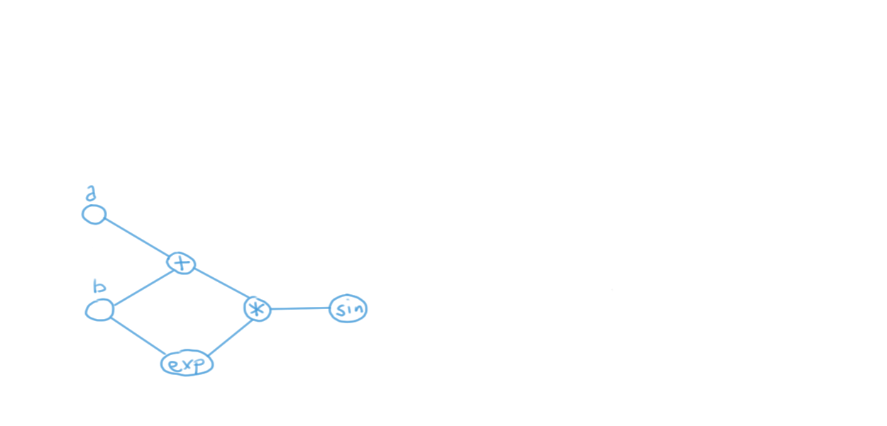
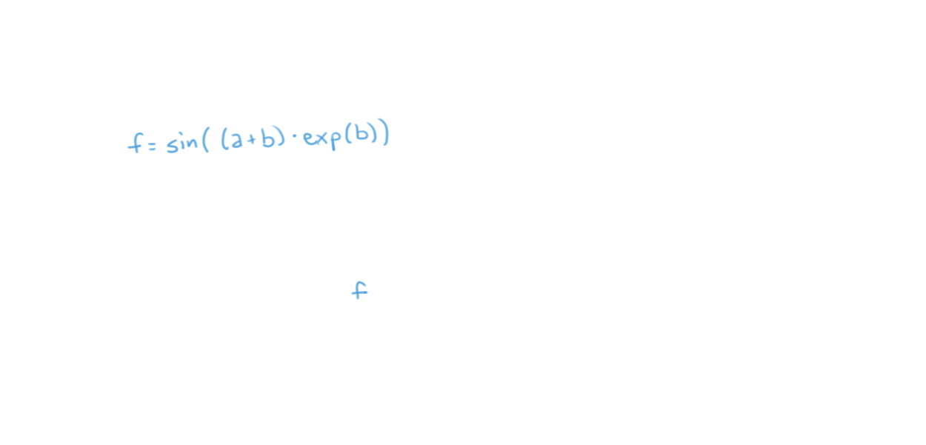

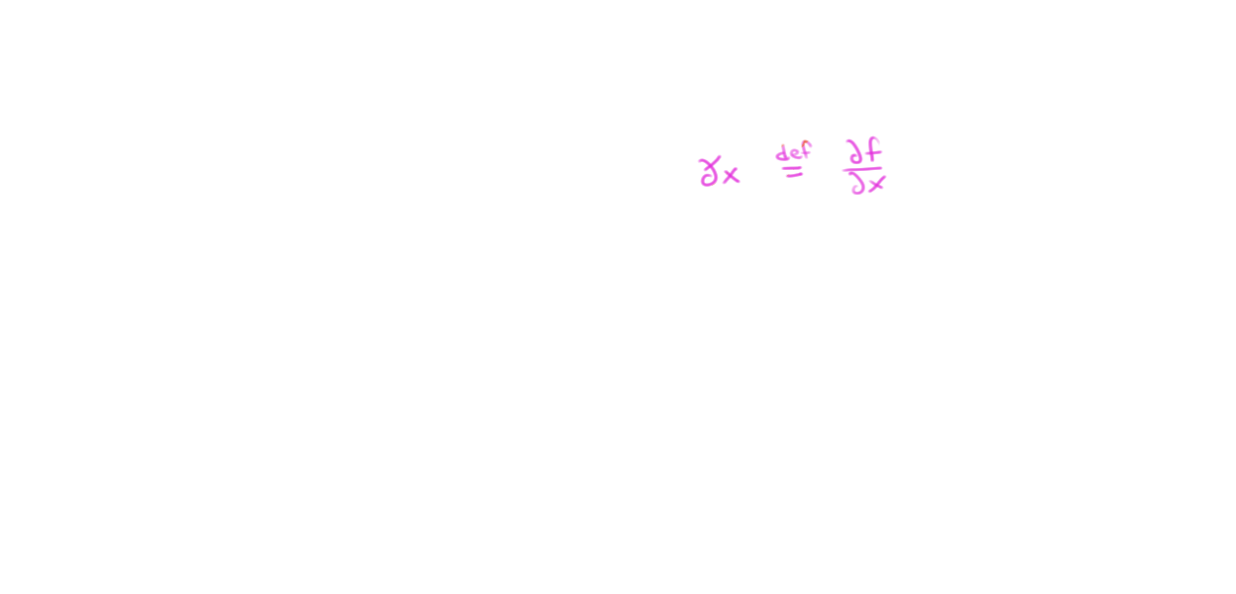
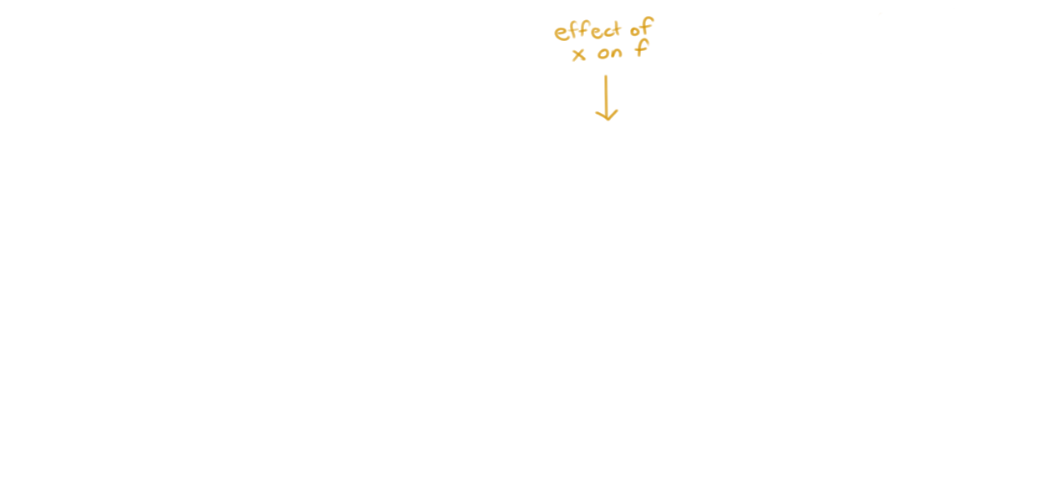
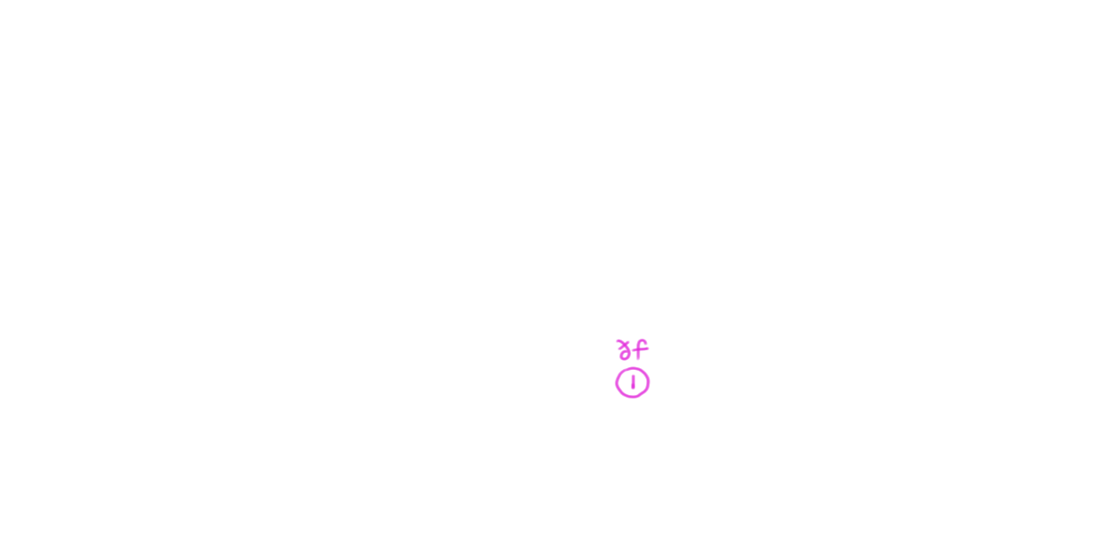
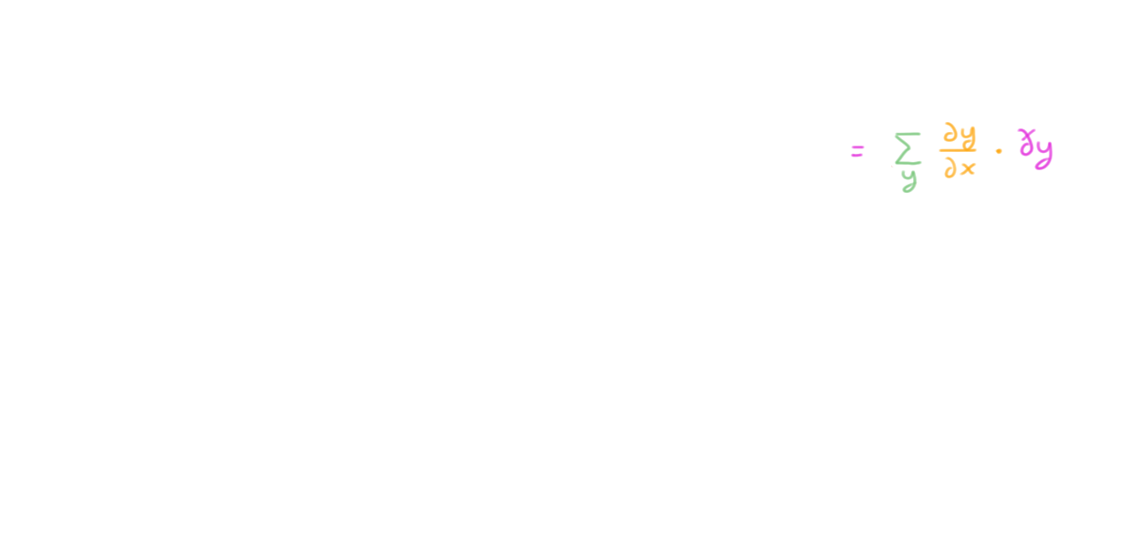
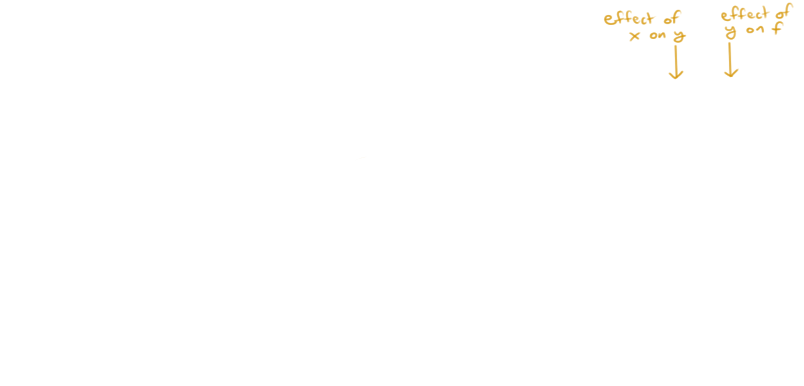

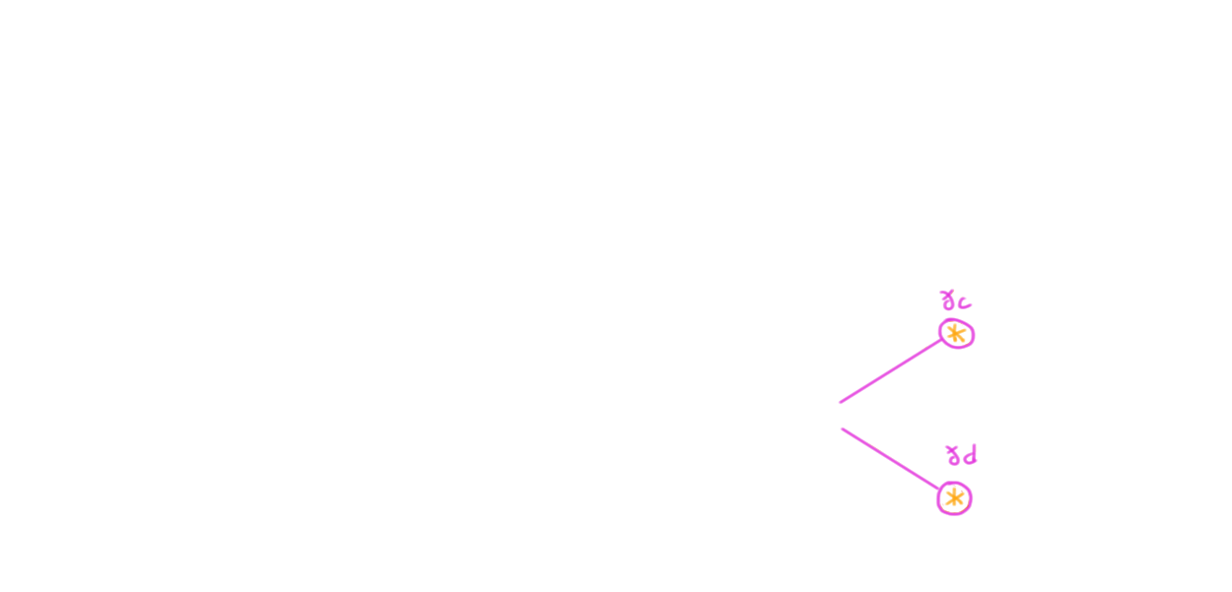

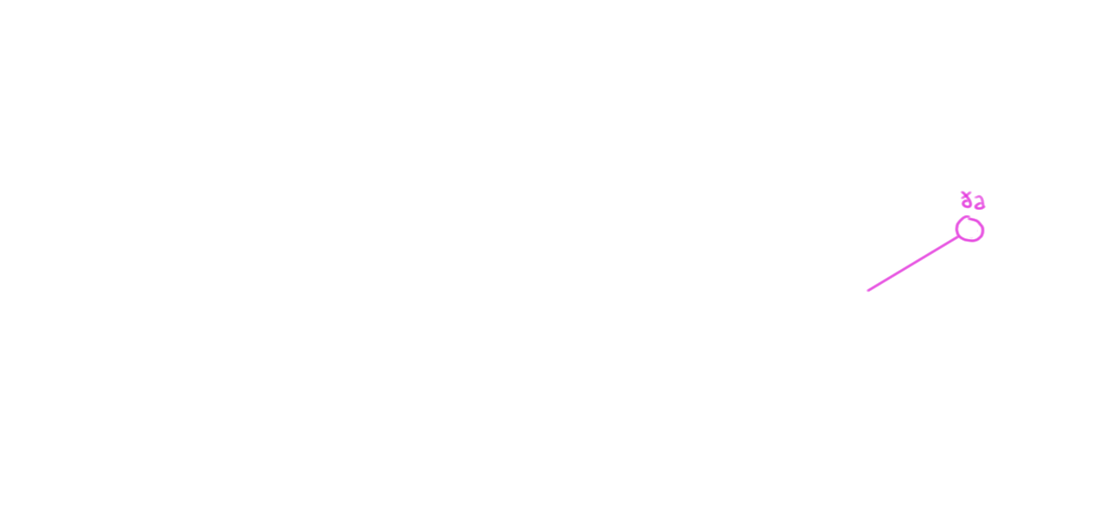

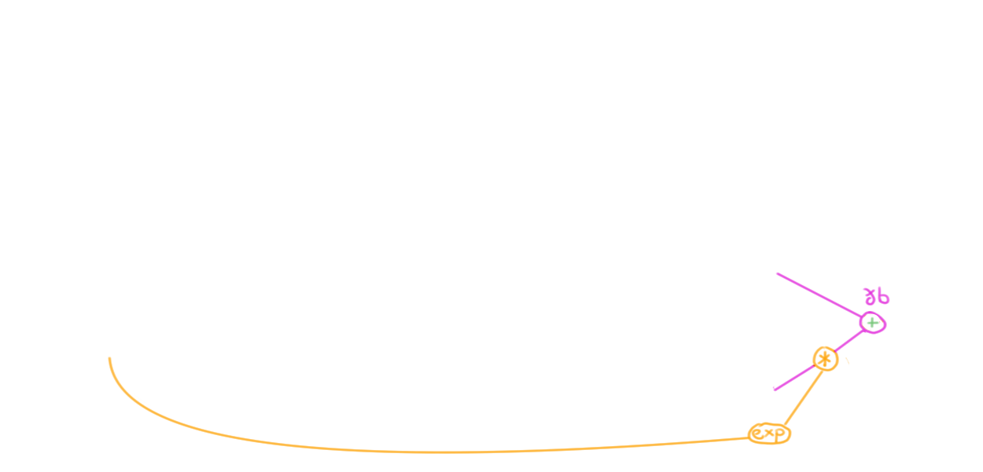


Back-Propagation
arithmetic circuit
(computation graph)

Slide 30
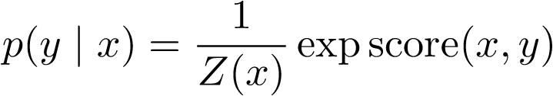
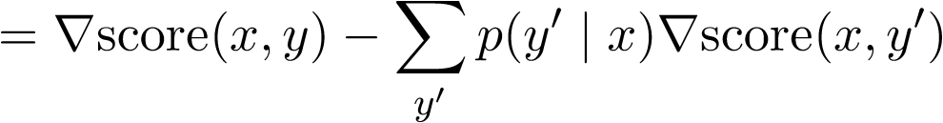

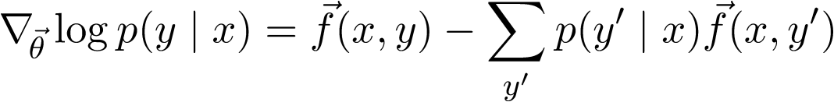
Energy-Based Models
Define
Then
Log-linear case:
Notes:
Connection to proteins
Pretty much every distribution you care about is one of these
(or a marginalization of one of these)
(or a product of these models - e.g., mixture model, n-gram model, Bayes net, probabilistic program)
And we'll see soon that parse forests are among these (in fact, the log-linear case)

Slide 31
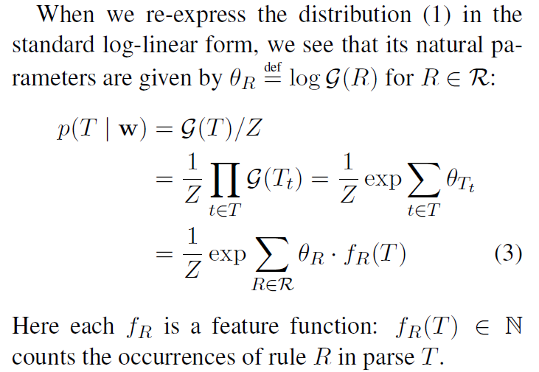
p(tree T | sentence w) is log-linear
total prob of all parses
Therefore, ∇ log Z will give expected rule counts.

Slide 32
∇log Z = Expected Counts
Optimization
Gradient
Expected counts
novel alg.

Slide 33
∇log Z = Expected Counts
Optimization
(EM) & MBR decoding & soft features
Expected counts
Gradient
Not only does this
get the same answer,
it actually gives the
identical algorithm!
backprop

Slide 34
Terminology
Automatic differentiation:
Given a circuit that computes a function f,
construct a circuit to compute (f, ∇f)

Slide 35
Terminology
Automatic differentiation:
Given a circuit that computes a function f,
construct a circuit to compute (f, ∇f)
Algorithmic differentiation:
Given code that computes a function f,
construct code to compute (f, ∇f)
Back-propagation:
One computational strategy that the new circuit or code can use

Slide 36
Inside algorithm computes Z
Essentially creates a circuit “on the fly”
  Like other dynamic programming algorithms
  Circuit structure gives parse forest hypergraph
O(Vn²) nodes in the circuit,
with names like β(VP,1,5)
Each node sums O(V²n) 3-way products
The 3-way products and the intermediate sums aren’t nodes of the formal circuit
  No names, not stored long-term

Slide 37
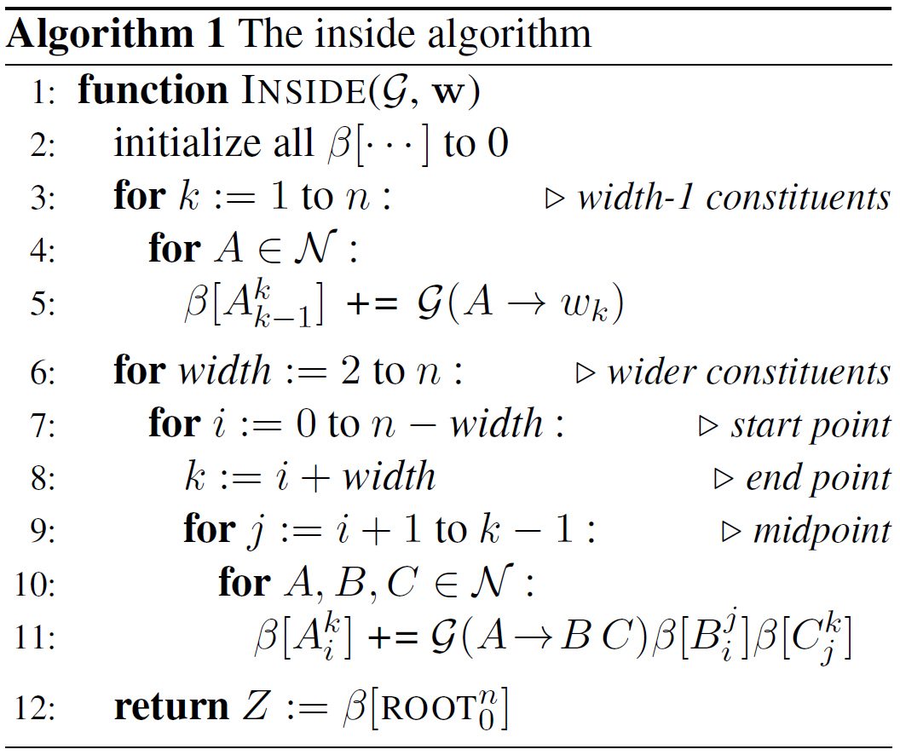
Inside algorithm computes Z
visit β nodes
bottom-up
(toposort)

Slide 38
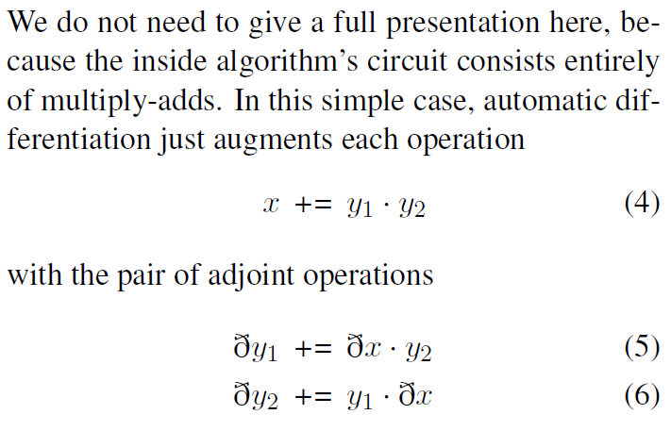
How to differentiate
(“swap” x, y₁)
(“swap” x, y₂)

Slide 39

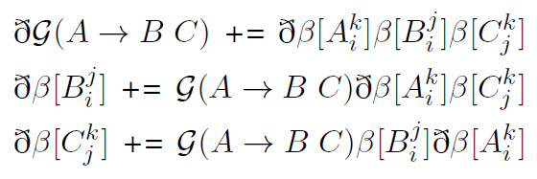
Inside algorithm has 3-way products
(A += G*B*C)
(swap A, G)
(swap A, B)
(swap A, C)

Slide 40
Inside algorithm has 3-way products
ðβ[…]
is traditionally
called α[…]
We’ll similarly write ðG[A → B C] as α[A → B C]

Slide 41
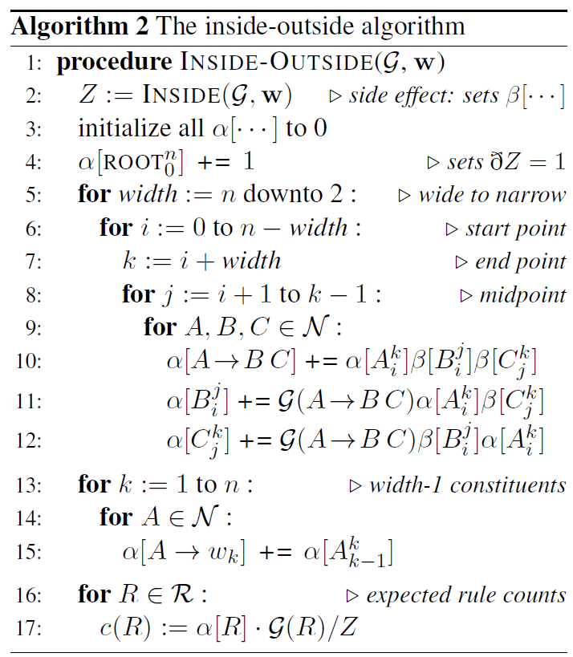
Differentiate to compute (Z, ∇Z)
visit ðβ nodes
in reverse
order of β
(so top-down)
wait, what’s this line?
Notes:
If you don’t like generating procedural code, we can do this transform on Dyna programs too – see our 2005 paper.

Slide 42
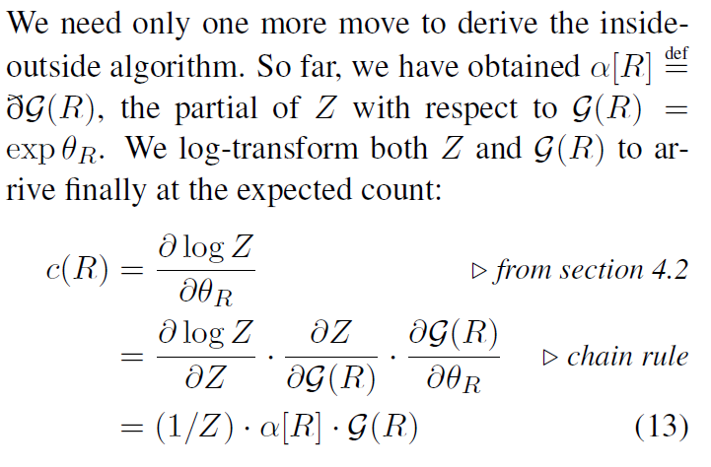
The final step: αβ / Z
we want this
but oops, we used backprop
to get this,
so fix it
could reasonably
rename G(R) to β(R)

Slide 43
The final step: αβ / Z
This final step is annoying. It’s more chain rule. Shouldn’t that be part of backprop?
We won’t need it if we actually compute
∇ log Z in the first place (straightforwardly).
We only did ∇Z for pedagogical reasons.
  It’s closer to the original inside-outside algorithm, and ensures ðβ = traditional α.
  But the “straightforward” way is slightly more efficient.

Slide 44
Inside algorithm has 3-way products
ðβ[…]
is traditionally
called α[…]
Paper spells out why the traditional “outer weight” interpretation of α is actually a partial derivative

Slide 45
Other algorithms! E.g.:
Formalism | How to compute Z (total weight of all derivations) | Expected counts of substructures = ∇log Z
HMM | backward algorithm | backprop
PCFG in CNF | inside algorithm | backprop
CRF-CFG in CNF | inside algorithm | backprop
semi-Markov CRF | Saragawi & Cohen 2004 | backprop
arbitrary PCFG | Earley’s algorithm | backprop
CCG | Vijay-Shankar & Weir 1990 | backprop
TAG | Vijay-Shankar & Joshi 1987 | backprop
dependency grammar | Eisner & Satta | backprop
transition-based parsing | PDA with graph-structured stack | backprop
synchronous grammar | synchronous inside algorithm | backprop
graphical model | junction tree | backprop

Slide 46
Other tips in the paper
An inside-outside algorithm should only be a few times as slow as its inside algorithm.
  People sometimes publish algorithms that are n times slower. This is a good reason to formally go through algorithmic differentiation.

Slide 47
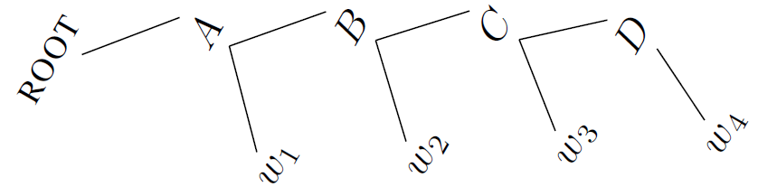
Other tips in the paper
An inside-outside algorithm should only be a few times as slow as its inside algorithm.
HMMs can be treated as a special case of PCFGs.
Notes:
oriented so that top-down generative process is left-to-right as usual
so you start with inside algorithm = backward algorithm. It should really be called backward-forward algorithm, for consistency!

Slide 48
Other tips in the paper
An inside-outside algorithm should only be a few times as slow as its inside algorithm.
HMMs can be treated as a special case of PCFGs.
There are 2 other nice derivations of inside-outside. All yield essentially the same code, and the other perspectives are useful too.
The Viterbi variant is useful for pruning (max-marginal counts) and parsing (Viterbi outside scores). It can be obtained as the 0-temperature limit of the gradient-based algorithm.
The gradient view makes it easy to do end-to-end training if the parser talks to / listens to neural nets.

