Slide 1

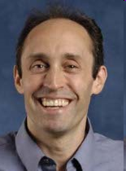


Recovering Syntactic Structure from Surface Features
@ Penn State University
January 2018
Jason
Eisner
Dingquan
Wang
with
1
Notes:
`

Slide 2
Linguistic structure
RNN
Traditional latent variables
<s>
the chief’s resignation was surprising
</s>
nsubj
nsubj
det
cop
case
case
case
DET
NOUN
PART
VERB
PART
VERB
VERB
PART
the chief resign was surprise
’s
-ation
-ing
Notes:
So I want to talk about the structure that linguists assign to words and sentences.
Of course, you could predict text with an RNN language model, either word-level or character-level.
This annotates every prefix of the sentence with a vector.
If language were completely mysterious to us, that would be quite reasonable.
In fact, I have a NIPS paper next week along those lines. Instead of finding the real underlying mechanisms, it just uses a neural net to predict the future.
But THAT paper is about event sequences, not language.
For language, we have the linguistics department and 60 years of generative linguistics, so we do have a good idea of the underlying mechanisms.
Linguists have looked at English quite closely, and their best descriptions involve structures like these. It’s not just a sequence of words but a sequence of morphemes, and they modify and mark one another in certain ways that are necessary to express a meaning.

Slide 3
How did linguists pick this structure?
Various observational & experimental data
  Structure should predict grammaticality & meaning
  Other languages – want cross-linguistic similarities
  Psycholinguistic experiments, etc.
Basically, multi-task active learning!
nsubj
nsubj
det
cop
case
case
case
DET
NOUN
PART
VERB
PART
VERB
VERB
PART
the chief ’s resign -ation was surprise -ing
Notes:
Multi-task active learning …

Slide 4
Why do we want to uncover structure?
Should help relate sentences to meanings
  MT, IE, sentiment, summarization, entailment, …
  sentence is a serialization of part of speaker’s mind
  tree is a partial record of the serialization process
nsubj
nsubj
det
cop
case
case
case
DET
NOUN
PART
VERB
PART
VERB
VERB
PART
the chief ’s resign -ation was surprise -ing
Notes:
In your mind, you have lots of interlocking facts and concepts
Could think of it as a big labeled graph with many entities and events and their properties and relationships
Visiting parts of that structure that you want to communicate
Once you’re talking about the resignation, you recursively fill in some more details to help the listener know which resignation, which is why this is a recursive structure.
If you like ML, you should like this problem of recovering underlying mechanisms. And we're doing computational linguistics, but this is the same kind of problem that we have in computational biology, or computational economics, or computational social science. It's doing some kind of scientific reconstruction of underlying mechanisms that could explain the data. In the dancing example, you may not know anything about the particular dance, but you know how human bodies work in general.

Slide 5
Why do we want to uncover structure?
Also a puzzle about learnability:
  What info about the structures
  can be deduced from just the sentences?
  For a whole family of formal languages?
  For the kinds of real languages that arise in practice?
nsubj
nsubj
det
cop
case
case
case
DET
NOUN
PART
VERB
PART
VERB
VERB
PART
the chief ’s resign -ation was surprise -ing
Notes:
Noam Chomsky and others have suggested that babies are solving a problem on strings, and there’s a whole grammatical inference community that’s trying to solve that kind of formal problem.
With some success in fact – in 2009, it was shown that HMMs could be learned, basically.

Slide 6
How can we recover linguists’ structure?
Assume something about p(x, y, θ)
This defines p(y, θ | x) … so guess y, θ given x
  θ = grammatical principles of the language
  x = observed data from the language, e.g., corpus
  y = latent analysis of x, e.g., trees, underlying forms
nsubj
nsubj
det
cop
case
case
case
θ
DET
NOUN
PART
VERB
PART
VERB
VERB
PART
the chief ’s resign -ation was surprise -ing

Slide 7
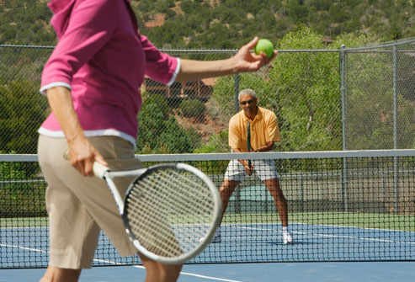
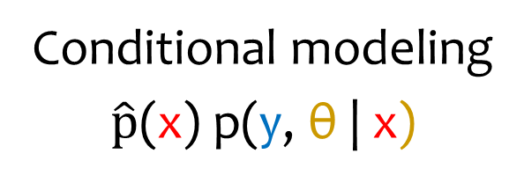
How can we recover 3D structure?
Trust optical
theory
Trust image
annotations
Generative modeling
p(θ) p(y | θ) p(x | y, θ)
Conditional modeling
$\hat{p}$(x) p(y, θ | x)
“Inverse
graphics”
(can figure out
strange new images)
“Segmentation
and labeling”
(trained for accuracy on past images)
Notes:
[left panel] Image x can be predicted if you only know the image structure y -- the objects and their arrangement.
And theta tells you what scenes y tend to be photographed and how those scenes y turn into pixels x.
[right panel] Assume that future images will be like past images, so train a structure predictor.
If you have a generative model, then use it to generate new images, and train your predictor even better.
So the big question of this talk is whether the knowledge lives in the parameters of a model,
or in the parameters of some “inference machine,” such as a conditional model.
Maybe both – your brain might actually use both strategies, “thinking fast” and “thinking slow.” And it’s possible to
[This is like RL, where there's a split between model-based RL where you try to learn how a model of how the environment will react, and policy-based RL where you just learn which actions are good to take. Model-based RL makes good use of the data, but it is computationally very hard in the POMDP situation where you don't fully observe what the environment is doing and where you may not even know the correct form of the model. Generally speaking, the model-based stuff is effective if you have a good model with a posterior that's sharply peaked at the right answer. If not, then learning how to predict might be better ... but we need evidence for that.]
Of course, hybrids are possible. You could use a geometric mean of these objectives.
Or you could use contrastive estimation, \hat{p}(N) p(theta) p(y | theta) p(x | y, theta, N)

Slide 8

How can we recover linguists’ structure?
Trust linguists’
theory
Trust linguists’
annotations
Generative modeling
p(θ) p(y | θ) p(x | y, θ)
Conditional modeling
$\hat{p}$(x) p(y, θ | x)
“Try to reason
like a linguist”
(can figure out
strange new languages)
“Mimic output
of linguists”
(trained for accuracy on past languages)
Notes:
[left case] We’re looking for y and theta that explain x.
Supervision comes from the theory – the structure of the model.
You might need other languages to train p(theta), but if the model has enough structure you can just ignore that term.
We don’t know which way children do it. Are they little linguists, or do they have a hardwired language acquisition device?
This dichotomy shows up elsewhere.
By the way, there are intermediate versions, like contrastive estimation

Slide 9








Puzzle
Can you parse it?
Basic word order – SVO or SOV?
How about this one?
jin ave sekke verven anni m'orvikoon
Notes:
And this brings us to the second part of the talk, which is kind of “out there,” hence the new slide background.
If you know the game of throne, This language is called Dothraki. I don’t expect you to understand this. Just some earier question. it is a SVO or SOV language? Or even harder. Can you guess it’s grammar?
WAIT
How about this one? It is not even in Latin alphabet
WAIT
They are hard, right? So let’s cheat

Slide 10
Let’s cheat (for now)
Can you parse it?
Basic word order – SVO or SOV?
How about this one?
AUX
VERB
PROPN
ADP
PRON
PRON
jin ave sekke verven anni m'orvikoon
PRON
DET
PROPN
AUX
VERB
PRON
ADP

Slide 11
Why can’t machines do this yet???
Given sequences of part-of-speech (POS) tags,
predict the basic word order of the language.
It seems like linguists might be able:
Verb Det Noun Adj Det Noun
What do you think?
Notes:
It’s very frustrating that despite decades of work, we can’t do this stripped-down version of what every toddler surely does.
It seems like a linguist has the experience to do that.
Let's try it:
V Det N Adj Det N
What can you tell me about the word order?
You say VSO, good. Or VOS, but you know that's less common.
And are adjectives prenominal or postnominal?
Postnominal, like French, because the Adj presumably modifies
a noun and it shouldn't come before the NP's specifier (Det).

Slide 12
Syntactic Typology
A set of word order facts of a language
Notes:
[READ]
For example. **NEXT**

Slide 13
Syntactic Typology (of English)
Subject-Verb-Object
nsubj
nsubj
N
V
V
N
dobj
dobj
dobj
nsubj
N
V
V
N
Papa ate a red apple at home
13
Notes:
Let’s look at one syntactic typology of English. English has a dominant Subject-Verb-Object order **CLICK**. If we use the direction of dependency relations **CLICK**, could be **NEXT**

Slide 14
Syntactic Typology (of English)
Subject-Verb-Object
Prepositional
Adj-Noun
nsubj
nsubj
case
case
amod
amod
N
V
V
N
ADP
N
N
ADP
A
N
N
A
✔
✘
✔
✘
✔
✘
dobj
dobj
dobj
nsubj
amod
case
N
V
V
N
✘
✔
Papa ate a red apple at home
14
Notes:
That is the SUBJECT always precedes its VERB
and the direct OBJECT always follows its VERB
Similarly, the direction of these other **CLICK** labels shows that English is prepositional rather than postpositional, and uses ADJECTIVE-NOUN order. In this paper, we go beyond---we are interested in **NEXT** (fine-grained syntactic typology)

Slide 15
Why?
If we can get these basic facts, we have a hope of being able to get syntax trees.
(See later in talk.)
If we can’t get even these facts, we have little hope of getting syntax trees.
Let’s operationalize the task a bit better …

Slide 16
Fine-grained Syntactic Typology (of English)
Subject-Verb-Object
Prepositional
Adj-Noun
nsubj
nsubj
case
case
amod
amod
N
V
V
N
ADP
N
N
ADP
A
N
N
A
✔
✘
✔
✘
✔
✘
dobj
dobj
N
V
V
N
✘
✔
16
Notes:
Fine-grained syntactic typology
That is, instead of a hard decision of left vs. right, we predict how often the relation points left or right. **NEXT**

Slide 17
Fine-grained Syntactic Typology (of English)
Subject-Verb-Object
Prepositional
Adj-Noun
nsubj
nsubj
case
case
amod
amod
N
V
V
N
ADP
N
N
ADP
A
N
N
A
0.96
0.04
0.96
0.04
0.97
0.03
dobj
dobj
N
V
V
N
0.04
0.96
17
Notes:
Why aren't English direct objects ALWAYS on the right? probably because of relative clauses, movements and questions **NEXT**

Slide 18
Fine-grained Syntactic Typology (of English)
Subject-Verb-Object
Prepositional
Adj-Noun
nsubj
case
amod
V
N
N
ADP
N
A
0.04
0.04
0.03
Vector of length 57
dobj
V
N
nsubj | dobj | case | amod | …
0.96
0.04 | 0.96 | 0.04 | 0.03 | …
18
Notes:
And we use the probability of right direction in this work, because the left and right sum to 1. To this end, the fine-grained typology we are going to predict is a vector of probability **CLICK**, each dimension represents a relation. And we are predicting 57 relations **CLICK** for each language in this paper. For example, English is like this...
**NEXT**

Slide 19
Fine-grained Syntactic Typology (of Japanese)
Subject-Object-Verb
Postpositional
Adj-Noun
nsubj
case
amod
V
N
N
ADP
N
A
0.0
1.0
0.0
Vector of length 57
dobj
V
N
nsubj | dobj | case | amod | …
0.0
0.0 | 0.0 | 1.0 | 0.0 | …
19
Notes:
This is for Japanese

Slide 20
Fine-grained Syntactic Typology (of Hindi)
Subject-Object-Verb
Postpositional
Adj-Noun
nsubj
case
amod
V
N
N
ADP
N
A
0.01
0.98
0.03
Vector of length 57
dobj
V
N
nsubj | dobj | case | amod | …
0.25
0.01 | 0.25 | 0.98 | 0.03 | …
20
Notes:
Hindi

Slide 21
Fine-grained Syntactic Typology (of French)
Subject-Verb-Object
Prepositional
Noun-Adj
nsubj
case
amod
V
N
N
ADP
N
A
0.03
0.01
0.73
Vector of length 57
dobj
V
N
nsubj | dobj | case | amod | …
0.76
0.03 | 0.76 | 0.01 | 0.73 | …
21
Notes:
And French

Slide 22
Fine-grained Syntactic Typology
Language
Typology
nsubj | dobj | case | amod | …
English
0.04 | 0.96 | 0.04 | 0.03 | …
Japanese
0.0 | 0.0 | 1.0 | 0.0 | …
Hindi
0.01 | 0.25 | 0.98 | 0.03 | …
French
0.03 | 0.76 | 0.01 | 0.73 | …
Notes:
So in high level, our task is predicting the typology for each language, more precisely **NEXT**

Slide 23
Fine-grained Syntactic Typology
Corpus of tags: ũ
Typology
nsubj | dobj | case | amod | …
NOUN VERB ADP NOUN PUNCT
NOUN VERB PART NOUN PUNCT
…
0.04 | 0.96 | 0.04 | 0.03 | …
NOUN DET NOUN VERB PUNCT
NOUN NOUN VERB PART
…
0.0 | 0.0 | 1.0 | 0.0 | …
NOUN AUX NOUN ADP PUNCT
AUX NOUN NUM NOUN VERB
…
0.01 | 0.25 | 0.98 | 0.03 | …
NOUN VERB ADP NOUN PUNCT
NOUN VERB NOUN PUNCT
…
0.03 | 0.76 | 0.01 | 0.73 | …
Notes:
The prediction is made by only looking at the surface-form POS-corpus of them.
Why is it possible? **NEXT**

Slide 24
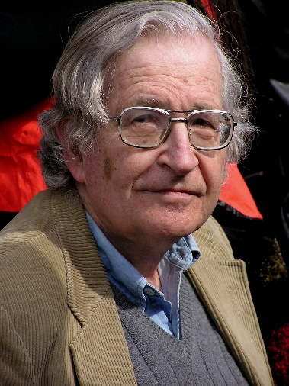


Traditional approach:
Grammar induction
SVO
Yer/PRON amos/AUX yjja/VERB Ajjx/PROPN aat/ADP orrr/PRON ./PUNCT
Per/NOUN anni/VERB inn/ADP se/NOUN in/PART hahh/CASE wee/VERB ./PUNCT
Con/VERB per/NOUN aat/ADP Ajjx/PROPN “/PUNCT tat/PRON “/PUNCT yue/ADP han/NOUN ./PUNCT
…
?
S → NP VP
VP → VP PP
…
0.9
0.9
.
.
.
Notes:
We are looking for some devices that can map from a corpus of [tagged] sentences in a new language, to properties of that language.
In fact, we do have such devices and luckily, they are super cute[photo of baby]. Chomsky says that the human baby can do it because they have such built-in system as initial toolkit for learning a language. Thanks to evolution. Also, linguists like Chomsky himself probably can do this well, by making a grammar that's like previous grammars they've seen.
Here comes the question: Can machine do this well? No
Maybe someone has already know one of these tasks, which is called grammar induction. So let’s just focus on that for now.

Slide 25
Grammar Induction
Yer/PRON amos/AUX yjja/VERB Ajjx/PROPN aat/ADP orrr/PRON ./PUNCT
Per/NOUN anni/VERB inn/ADP se/NOUN in/PART hahh/CASE wee/VERB ./PUNCT
Con/VERB per/NOUN aat/ADP Ajjx/PROPN “/PUNCT tat/PRON “/PUNCT yue/ADP han/NOUN ./PUNCT
…
Yer/PRON amos/AUX yjja/VERB Ajjx/PROPN aat/ADP orrr/PRON ./PUNCT
Per/NOUN anni/VERB inn/ADP se/NOUN in/PART hahh/CASE wee/VERB ./PUNCT
Con/VERB per/NOUN aat/ADP Ajjx/PROPN “/PUNCT tat/PRON “/PUNCT yue/ADP han/NOUN ./PUNCT
…
S → NP VP
VP → VP PP
…
0.9
0.2
25
Notes:
We do have some unsupervised approaches that predict the latent structures by looking very carefully into the surface forms.

Slide 26
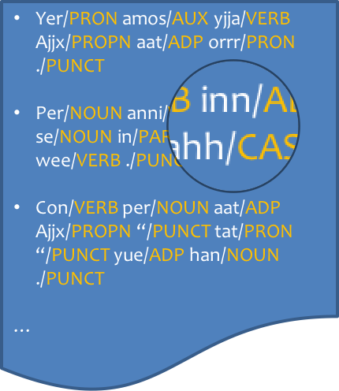

Grammar Induction
Unsupervised method (like EM)
Yer/PRON amos/AUX yjja/VERB Ajjx/PROPN aat/ADP orrr/PRON ./PUNCT
Per/NOUN anni/VERB inn/ADP se/NOUN in/PART hahh/CASE wee/VERB ./PUNCT
Con/VERB per/NOUN aat/ADP Ajjx/PROPN “/PUNCT tat/PRON “/PUNCT yue/ADP han/NOUN ./PUNCT
…
Yer/PRON amos/AUX yjja/VERB Ajjx/PROPN aat/ADP orrr/PRON ./PUNCT
Per/NOUN anni/VERB inn/ADP se/NOUN in/PART hahh/CASE wee/VERB ./PUNCT
Con/VERB per/NOUN aat/ADP Ajjx/PROPN “/PUNCT tat/PRON “/PUNCT yue/ADP han/NOUN ./PUNCT
…
S → NP VP
VP → VP PP
…
0.9
0.2
26
Notes:
We do have some unsupervised approaches that infer the latent structures from surface form clues. In this case, it is the tagged corpus.
But this approach have a lot limitations.

Slide 27
How can we recover linguists’ structure?
Trust linguists’
theory
Trust linguists’
annotations
Generative modeling
p(θ) p(y | θ) p(x | y, θ)
Conditional modeling
$\hat{p}$(x) p(y, θ | x)
“Try to reason
like a linguist”
(can figure out
strange new languages)
“Mimic output
of linguists”
(trained for accuracy on past languages)
Notes:
[left case] We’re looking for y and theta that explain x.
Supervision comes from the theory – the structure of the model.
You might need other languages to train p(theta), but if the model has enough structure you can just ignore that term.
We don’t know which way children do it. Are they little linguists, or do they have a hardwired language acquisition device?
This dichotomy shows up elsewhere.
By the way, there are intermediate versions, like contrastive estimation

Slide 28
How can we recover linguists’ structure?
Trust linguists’
theory
EM strategies …
given x
initialize θ
E step: guess y
M step: retrain θ
Trust linguists’
annotations
Generative modeling
p(θ) p(y | θ) p(x | y, θ)
Conditional modeling
$\hat{p}$(x) p(y, θ | x)
“Try to reason
like a linguist”
(can figure out
strange new languages)
“Mimic output
of linguists”
(supervised by
other languages)
Notes:
EM strategy, or really MAP-EM
Initialize θ in some simple way
Lots of useful info in x
Can home in on the answer

Slide 29

Grammar Induction
Unsupervised method (like EM)
  Converges on hypothesized trees
  Just read the word order off the trees!
  Alas, works terribly!
Why doesn’t grammar induction work (yet)?
  Locally optimal
  Hard to harness linguistic knowledge
    Doesn’t use any evidence outside the corpus
  Might use the latent variables in the “wrong” way
    Won't follow syntactic conventions used by linguists
    Might not even model syntax, but other things like topic
Notes:
You could try to solve it by grammar induction - look at the
hypothesized trees and count the dependencies on those.
But that does amazingly badly, worse than our baseline method.
Grammar induction doesn't work.
So why does grammar induction do so badly?
Two problems.
First, local optima ... if you initialize at 300 points ...
Second, we happen to know it's the wrong objective. If you initialize at the right grammar (supervised), you get worse.
* It doesn't know that it should use the latent variables for SYNTAX.
* It doesn't know how the names are conventionally used.
* It doesn't know stuff that's not in the corpus. For example,
the linguists also know what the sentences MEAN, so they know
that there are actual phrases that refer to actual objects and
events, and these should correspond to subtrees. And the linguists
sometimes do controlled experiments by thinking about sentences
that aren't in the corpus.
* It doesn't know about evidence or conventions that comes from other languages.
For example, in a language like English, SVO, we tend to group
VO together more tightly than SV. The arguments for this are subtle
and were originally made in English, but when we analyze a new language,
we tend to make the same
* It has no prior expectation about how languages TEND to be structured.
All languages have nouns and verbs. Verbs tend to have nouns as children
(Naseem et al. do know this.), and one of those, the subject, tends to come before the verb and also tends to come before the direct object.
(Could do hierarchical Bayes for this.)

Slide 30
So how were you able to do it?
It seems like linguists might be able:
Verb Det Noun Adj Det Noun
Verb at start of sentence
Noun-Adj bigram; Adj-Det bigram
Are simple cues like this useful?
  Principles & Parameters (1981)
  Triggers (1994, 1996, 1998)
Notes:
In fact, Chomsky argued that kids were looking for "triggers" ...
suggested very simple learning algorithms, also investigated by Gibson & Wexler 1994, Berwick & Niyogi 1996, Fodor 1998.
As Gibson & Wexler pointed out, this approach might be too simple.

Slide 31
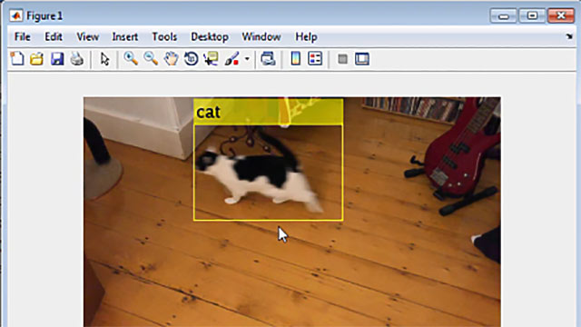
Not holding out hope for a single trigger
Notes:
It’s certainly too simple for other ML tasks. Given an video, you don’t wait for a magic configuration of pixels that tells you "aha, it's a cat video!”

Slide 32
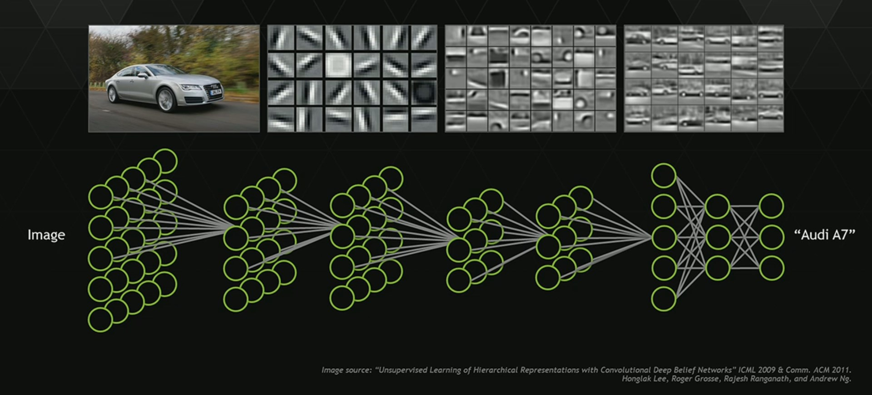

But a combination of cues might work
Notes:
But you can detect that it’s a cat video by the aggregation of weak evidence over time, and maybe there are similar weak cues for an SVO language.

Slide 33
Surface Cues to Structure
NOUN VERB DET ADJ NOUN ADP NOUN
NOUN VERB PART NOUN
DET ADJ NOUN VERB
PRON VERB ADP DET NOUN
…
nsubj
nsubj
N
V
V
N
Notes:
In fact, it is quite intuitive to us. For example, given a POS corpus like this. We want to decide whether this language is subject-left or right **CLICK**. There are cues show up. **NEXT**

Slide 34

Surface Cues to Structure
NOUN VERB DET ADJ NOUN ADP NOUN
NOUN VERB PART NOUN
DET ADJ NOUN VERB
PRON VERB ADP DET NOUN
…
Cues!
nsubj
nsubj
Triggers for Principles & Parameters
N
V
V
N
Notes:
That is **CLICK**, there is always a noun precedes a nearby verb.
These **CLICK** are probably the Triggers for Principles & Parameters
**NEXT**

Slide 35
Surface Cues to Structure
NOUN VERB DET ADJ NOUN ADP NOUN
NOUN VERB PART NOUN
DET ADJ NOUN VERB
PRON VERB ADP DET NOUN
…
Cues!
case
case
Triggers for Principles & Parameters
ADP
V
V
ADP
Notes:
Similarly, there is always an ADP precedes a nearby NOUN.
This might be a cue that this language is case-left **NEXT**

Slide 36
Surface Cues to Structure
NOUN VERB DET ADJ NOUN ADP NOUN
NOUN VERB PART NOUN
DET ADJ NOUN VERB
PRON VERB ADP DET NOUN
…
Cues!
amod
amod
Triggers for Principles & Parameters
A
N
N
A
Notes:
And also for other relations, we can find different type of cues
**NEXT**

Slide 37
Surface Cues to Structure
NOUN DET ADJ NOUN VERB ADP NOUN
NOUN NOUN VERB
DET ADJ NOUN VERB
PRON ADP DET NOUN VERB
…
Cues!
dobj
dobj
Triggers for Principles & Parameters
N
V
V
N
Notes:
There is always an VERB after the nearby 2 Nouns

Slide 38

Supervised learning
0.25 | 0.8 | 1.0 | …
training data
( , )
You/PRON can/AUX …
Keep/VERB Google/PROPN …
In/ADP my/PRON office/NOUN …
…
0.04 | 0.96 | 0.04 | …
( , )
/PRON /AUX …
/VERB /PROPN …
/ADP /PRON /NOUN …
…
0.03 | 0.76 | 0.01 | …
38
Notes:
So just like vision, now we need training examples to learn the cues.
We’re now in the supervised learning setting.
Each training example in this case is a X,Y pair where X is the tagged corpus of one language and Y is its typology.

Slide 39

From Unsupervised to Supervised
Unsupervised method (like EM)
  Locally optimal
  Hard to harness linguistic knowledge
  Might use the latent variables in the “wrong” way
    Won't follow syntactic conventions used by linguists
    Might not even model syntax, but other things like topic
How about a supervised method?
  Globally optimal (if objective is convex)
  Allows feature-rich discriminative model
  Imitates what it sees in supervised training data
Notes:
The supervised approach gave us a lot of freedom such like. However, it has a big problem.

Slide 40
How can we recover linguists’ structure?
Trust linguists’
theory
EM strategies …
given x
initialize θ
E step: guess y
M step: retrain θ
Trust linguists’
annotations
Generative modeling
p(θ) p(y | θ) p(x | y, θ)
Conditional modeling
$\hat{p}$(x) p(y, θ | x)
“Try to reason
like a linguist”
(can figure out
strange new languages)
“Mimic output
of linguists”
(supervised by
other languages)

Slide 41
How can we recover linguists’ structure?
Supervised strategies …
Can model how linguists like to use y
  Explain less than x:
  only certain aspects of x
  (cf. contrastive estimation)
  Explain more than x: Compositionality, cross-linguistic consistency
Trust linguists’
theory
Trust linguists’
annotations
Generative modeling
p(θ) p(y | θ) p(x | y, θ)
Conditional modeling
$\hat{p}$(x) p(y, θ | x)
“Try to reason
like a linguist”
(can figure out
strange new languages)
“Mimic output
of linguists”
(trained for accuracy on past languages)
Notes:
Again, a generative model of syntax tries to explain everything it sees.
But it doesn’t care about compositional semantics. It doesn’t care about paraphrase. Because they’re not in the corpus.
It might not know that subjects usually go before objects. It might not know that the things that modify nouns are traditionally called determines and adjectives.

Slide 42
What’s wrong?
Each supervised training example is a (language, structure) pair.
There are only about 7,000 languages on Earth.
Only about 60 languages on Earth are labeled
(have treebanks).
Why Earth?
( , )
You/PRON can/AUX …
Keep/VERB Google/PROPN …
In/ADP my/PRON office/NOUN …
…
0.04 | 0.96 | 0.04 | …
( , )
/PRON /AUX …
/VERB /PROPN …
/ADP /PRON /NOUN …
…
0.03 | 0.76 | 0.01 | …
Notes:
So, let's train on thousands of treebanks to learn what combination of cues works.
Problem: you don't have thousands of treebanks.
Seems frustrating. But why Earth?

Slide 43

Luckily
We are not alone
Notes:
Come on! Let’s go beyond earth. Now you are starting to understand the slide background.
We are not alone and Master Yoda is waiting for us!

Slide 44

Luckily
Not alone, we are
Notes:
In his world, they speak a OVS language.

Slide 45
We created …
The Galactic Dependencies Treebanks!
More than 50,000 synthetic languages!
  Resemble real languages, but not found on Earth
Each has a corpus of dependency parses
  In the Universal Dependencies format
  Vertices are words labeled with POS tags
  Edges are labeled syntactic relationships
Provide train/dev/test splits, alignments, tools
Notes:
Lots of uses, actually …
But if you have a Bayesian distribution over what treebanks tend to look like,
there's a way out. You want a decision function that works well on that distribution.
So just sample thousands of grammars from that distribution, and train a neural net
or whatever to do well in expectation.
So you might think we sampled these from a Bayesian prior.
Unfortunately we don't have a good prior model of what treebanks look like.
In fact, we don't even have a good model of what the Penn Treebank looks like:
if you train a PCFG with 40 nonterminals on the Penn Treebank, it generates crap.
It doesn't know what people tend to talk about, or the fact that object NPs
tend to be deeper than subject NPs, or lots of other correlations that break
the context-free assumption.
Related to other kinds of hybrid distributions where you come up with
some factors by hand but use empirical distributions for the others.

Slide 46
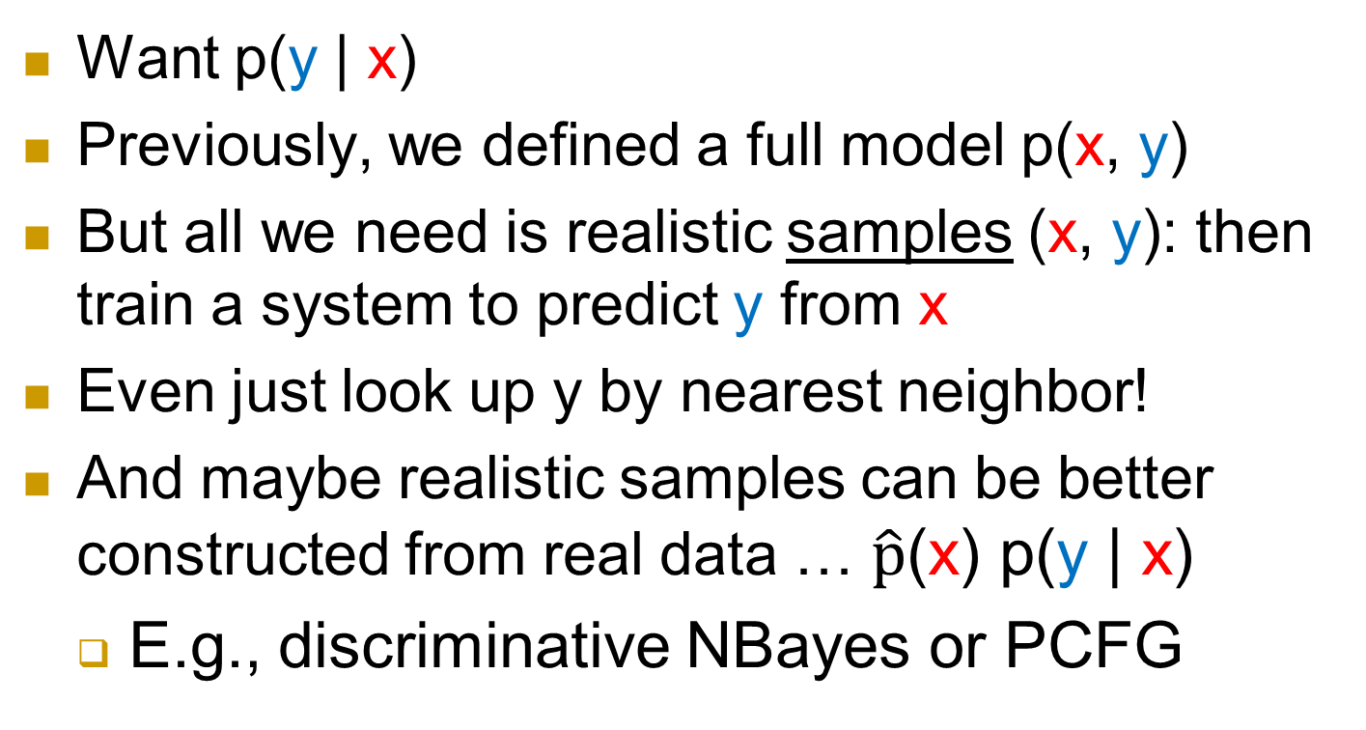
How can we recover x’s structure y?
Want p(y | x)
Previously, we defined a full model p(x, y)
But all we need is realistic samples (x, y): then train a system to predict y from x
Even just look up y by nearest neighbor!
And maybe realistic samples can be better constructed from real data … $\hat{p}$(x) p(y | x)
  E.g., discriminative NBayes or PCFG

Slide 47


Synthetic data elsewhere
Computer Vision
  Generating more data by rotating, enlarging….
( , 6)
( , 6)
( , 6)
( , 6)
real
synthetic variants

Slide 48
Synthetic data elsewhere
Computer Vision
  Generating more data by rotating, enlarging….
Speech
  Vocal Tract Length Perturbation (Jaitly and Hinton, 2013)
NLP
  bAbI (Weston et al., 2016)
  The 30M Factoid Question-Answer Corpus (Serban et al., 2016)
Notes:
fix animation
color level-1 and level-2 bullets differently?

Slide 49

How can we recover linguists’ structure?
All we need is realistic samples (x, y): then train a system to predict y from x
And maybe realistic samples can be better constructed from real data … $\hat{p}$(x) p(y | x)
  … keep the semantic relationships (not modeled)
  … just systematically vary the word order (modeled)
nsubj
nsubj
det
cop
case
case
case
DET
NOUN
PART
VERB
PART
VERB
VERB
PART
the chief ’s resign -ation was surprise -ing

Slide 50



Substrate & Superstrates
(terms come from linguistics of creole languages)
Japanese — Superstrate
Hindi — Superstrate
verb order
noun order
English — Substrate

Slide 51
You must feel the Force around you
Notes:
Luckily, we are not alone. Someone in our Galaxy is having the same trouble. Grand Jedi Master Yoda is from an unknown planet who speaks an OSV language, is recently fascinated in a NLP

Slide 52
Example:
You must feel the Force around you
A English parse:
nsubj
nmod
dobj
case
aux
det
PRON
AUX
VERB
DET
PROPN
ADP
PRON
You
must
feel
the
Force
around
you
Language: English

Slide 53
Permute the children of verbs
SVO (English) → SOV (Hindi)
nsubj
nmod
dobj
case
aux
det
PRON
AUX
VERB
DET
PROPN
ADP
PRON
You
must
feel
the
Force
around
you
Language: English

Slide 54
Permute the children of verbs
SVO (English) → SOV (Hindi)
nsubj
nmod
dobj
case
aux
det
PRON
AUX
VERB
DET
PROPN
ADP
PRON
You
must
feel
the
Force
around
you
Language: English

Slide 55
Permute the children of verbs
SVO (English) → SOV (Hindi)
nsubj
nmod
dobj
case
det
aux
PRON
DET
PROPN
AUX
VERB
ADP
PRON
You
the
Force
must
feel
around
you
New language: English[Hindi/V]

Slide 56
Permute the children of nouns
Prepositions (English) → Postpositions (Japanese)
nsubj
nmod
dobj
case
det
aux
PRON
DET
PROPN
AUX
VERB
ADP
PRON
You
the
Force
must
feel
around
you
New language: English[Hindi/V]

Slide 57
Permute the children of nouns
Prepositions (English) → Postpositions (Japanese)
nsubj
nmod
dobj
case
det
aux
PRON
DET
PROPN
AUX
VERB
ADP
PRON
You
the
Force
must
feel
around
you
New language: English[Hindi/V]

Slide 58
Permute the children of nouns
Prepositions (English) → Postpositions (Japanese)
nsubj
nmod
dobj
case
det
aux
PRON
DET
PROPN
AUX
VERB
PRON
ADP
You
the
Force
must
feel
you
around
New language: English[Hindi/V, Japanese/N]

Slide 59
What do we get?
New treebank: English[Hindi/V, Japanese/N]
Start from 37 earthly treebanks from UD v1.2
  Thanks to the Universal Dependencies project
Mix and match: Lang1[Lang3/V, Lang2/N]
  Yields about 37³ ≈ 50,000 extraterrestrial treebanks
  “Galactic Dependencies” treebanks
  Still in Universal Dependencies Format
nsubj
nmod
dobj
case
det
aux
PRON
DET
PROPN
AUX
VERB
PRON
ADP
You
the
Force
must
feel
you
around

Slide 60
How exactly do we permute?
nsubj
nmod
dobj
aux
PRON
AUX
VERB
PROPN
PRON
You
must
feel
Force
you
Notes:
We are not doing the permutation by playing PPT. We are designing a systematic approach for computer to do that automatically

Slide 61
SVO (English) → SOV (Hindi)
nsubj
nmod
dobj
aux
PRON
PROPN
AUX
VERB
PRON
You
Force
must
feel
you
Notes:
We are not doing the permutation by playing these animations. We are designing a systematic approach for computer to do that automatically by sampling

Slide 62
Sampling
P( | ,Hindi)
nsubj
nmod
nsubj
nmod
dobj
dobj
aux
aux
PRON
PROPN
AUX
VERB
PRON
PRON
AUX
VERB
PROPN
PRON
How many possible orders?
5!
Notes:
We define a conditional probabilistic model which estimates the probability of an order given the original tree and the target language.
How many choices do we have? Not 5! It is 5 factorial. Exclamation point

Slide 63
p( · | , Hindi)
S
V
O
Order | Prob. | BOS S adj. | S<V | O<V | SO adj.
1
1
1
1
S
O
V
1
1
0
0
S
V
O
0
1
1
1
O
S
V
0
0
1
0
O
V
S
0
1
0
1
O
S
V
0
0
0
1
S
O
V
S:nsubj
O:dobj
V:VERB
BOS: Beginning of sentence
Notes:
Let’s simplify this even further by considering the tree that only has Subject, Verb and Object.
We first list some features
Then enumerate all the possible orders
And ask whether they have these features.

Slide 64
p( · | , Hindi)
S
V
O
Order | Prob. | BOS S adj. | S<V | O<V | SO adj.
SOV
SVO
OSV
OVS
VSO
VOS
1
1
1
1
1
1
0
0
0
1
1
1
0
0
1
0
0
1
0
1
0
0
0
1
Each order has features as shown
Train a log-linear model on Hind treebank
Sample from it to reorder English trees
S:nsubj
O:dobj
V:VERB
BOS: Beginning of sentence
Notes:
Let’s simplify this even further by considering the tree that only has Subject, Verb and Object.
We list some configurations that Hindi probably prefers.
Then enumerate all the possible orders
And ask how many such configurations do they have.

Slide 65
p( · | , Hindi)
S
V
O
Order | Prob. | BOS S adj. | S<V | O<V | SO adj.
0.8
1
1
1
1
S
O
V
0.03
1
1
0
0
S
V
O
0.1
0
1
1
1
O
S
V
0.02
0
0
1
0
O
V
S
0.03
0
1
0
1
O
S
V
0
0
0
1
0.02
S
O
V
S:nsubj
O:dobj
V:VERB
BOS: Beginning of sentence
Notes:
Let’s simplify this even further by considering the tree that only has Subject, Verb and Object.
We list some configurations that Hindi probably prefers.
Then enumerate all the possible orders
And ask how many such configurations do they have.

Slide 66

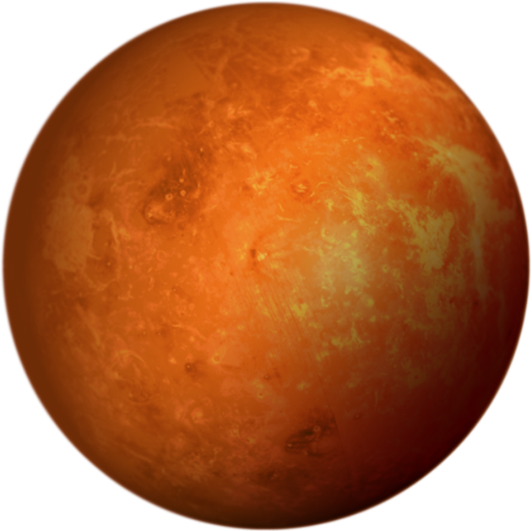

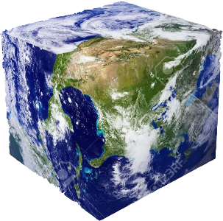
Are Synthetic Languages Useful??
The languages should be diverse enough.
The languages should be in the galaxy (in-domain)!

Slide 67
Evaluation: Parsability
Is this language functional enough to survive during human/alien evolution?
Less parsable ➔ worse for communication
Train a parser on some trees of the language
Evaluate UAS (unlabeled attachment score)
on held-out trees of the same language
Notes:
make clear that we train and test on the same language

Slide 68
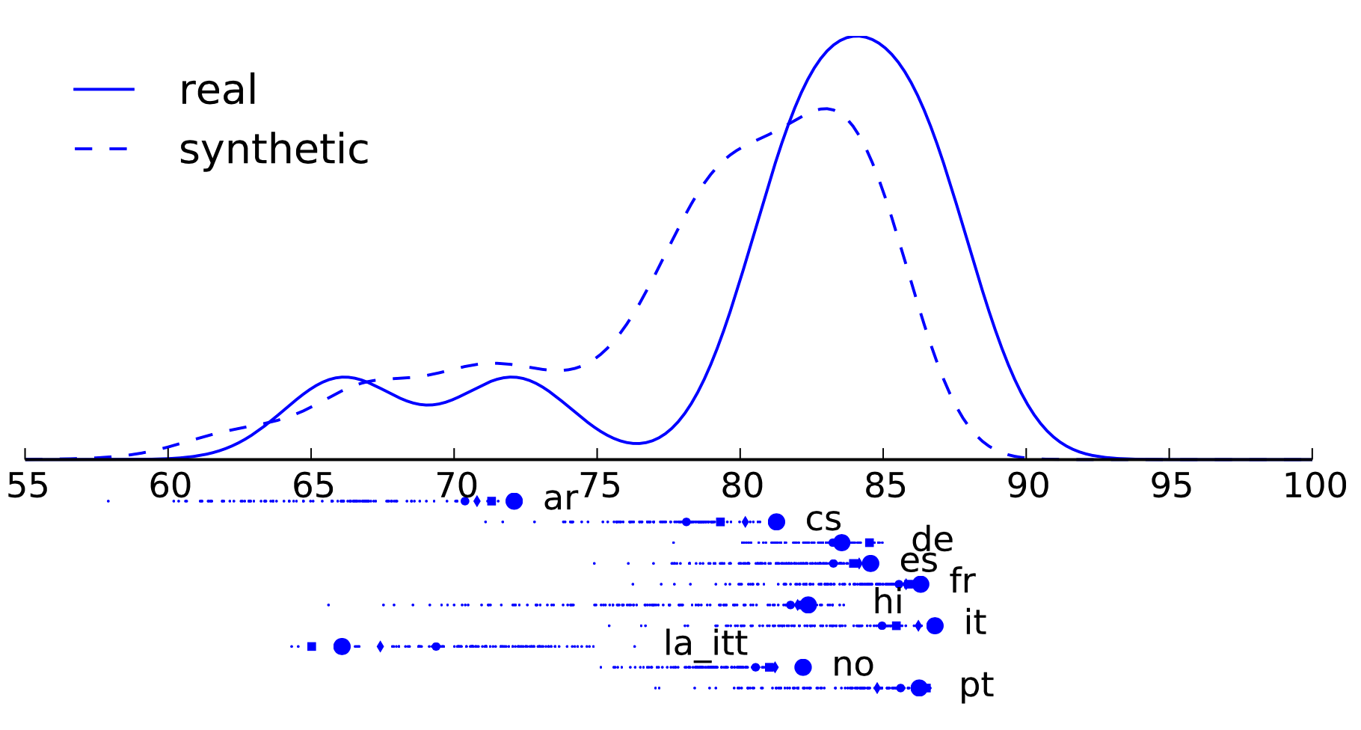

Evaluation: Parsability

Slide 69
Evaluation: Diversity
“Distance” between languages
  uas(Y | X) = how well can we parse POS sequences from treebank Y using a parser trained on treebank X?
  dissimilarity(X,Y) = uas(Y | Y) – uas(Y | X)
Let’s visualize the pairwise distances
  via a 2-D embedding (multidimensional scaling)
  are synthetic languages too boring? too weird?

Slide 70
Evaluation: Diversity
distance ≈ parsing transfer accuracy
Notes:
Are our synthetic languages too boring? too weird?
“Black dots are test treebanks ….”
“Colored circles are real training treebanks, and the diamonds are some of the synthetic treebanks derived from them (only 100).”
Our synthetic diamonds fill in the gaps nicely
Animation:
“These synthetic treebanks are close to real ones, so not everything is unrealistic. In fact, some of them are close to the black circles – our test treebanks.
“These languages are farther away, so not everything is redundant.”

Slide 71
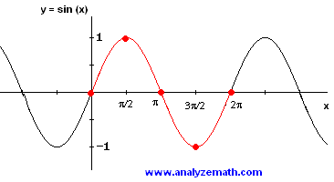
Stats works backward from data to parameters.
So it’s like function inversion … so,
How do you compute sin⁻¹(y)?

Slide 72
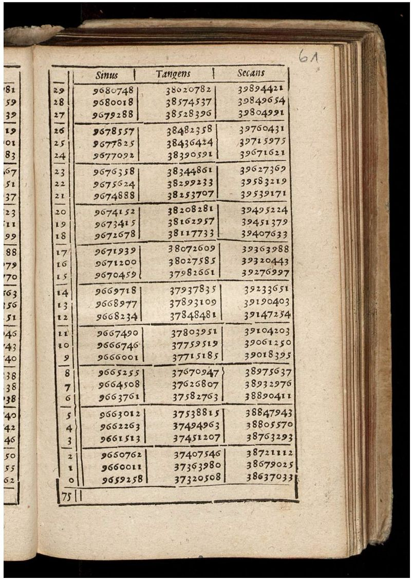
How do you compute sin⁻¹(y)?
Method 1: Use the Taylor series formula.
  In ML: Such closed-form methods occasionally exist for fitting a model, e.g., spectral learning of HMMs.
Method 2: Local search for a root of y=sin(x).
  In ML: This is what we usually do! Sadly, no multi-dim bisection method exists: use EM, MAP, HMC, etc.
Method 3: Precompute a table of all (x,sin(x)), look up rows where sin(x) ≈ y, and interpolate.
  In ML: This work! “Scattershot” pre-computation of many reasonable observed sequences, and then learn how to work backwards from y to x …
grammar
corpus

Slide 73
POS-corpus
ũ POS-treebank
( , )
Language 1
PRON AUX …
VERB PROPN … …
…
( , )
VERB NOUN…
NOUN DET…
NOUN ADJ …
…
…
Language 2
.
.
.
.
.
.
If we have enough training examples
Do we???
YES!!!
Notes:
Now we probably can say we have enough data. Let go back to the framework. **CLICK**

Slide 74

Corpus of POS-tags
ũ
Galactic Dependencies
Learned mapper
$$T_{θ}(\text{ũ})$$
S → NP VP
VP → VP PP
…
0.9
0.2
Language features
POS
sequence
Tree
x̃
Parser
y
Notes:
The next step is to test whether our approach will work. Before extracting (green) cues to help a parser, instead, we started by asking whether such approach can at least predict some reasonable language features

Slide 75
Corpus of POS-tags
ũ
Galactic Dependencies
Learned mapper
$$T_{θ}(\text{ũ})$$
S → NP VP
VP → VP PP
…
0.9
0.2
Language features
POS
sequence
Tree
x̃
Parser
y

Slide 76
Wang and Eisner (2017)
Corpus of POS-tags
ũ
Galactic Dependencies
Learned mapper
$$T_{θ}(\text{ũ})$$
S → NP VP
VP → VP PP
…
0.9
0.2
Language features
Fine-grained syntactic typology
Notes:
In our follow-up TACL paper presented at ACL, we built just this, which aims to predict the **CLICK** fine-grained syntactic typology from the uparsed corpus.
So, what is the syntactic typology? **NEXT**

Slide 77
Prediction of Syntactic Typology
Corpus of POS-tags
ũ
Galactic Dependencies
Learned mapper
$$T_{θ}(\text{ũ})$$
S → NP VP
VP → VP PP
…
0.9
0.2
Language features
Notes:
In our approach, we want a systematic way to extract such cues to predict the high-level syntactic information of the language. And again. It is trained with supervision **CLICK**

Slide 78

Prediction of Syntactic Typology
Corpus of POS-tags
ũ
Galactic Dependencies
Learned mapper
$$T_{θ}(\text{ũ})$$
S → NP VP
VP → VP PP
…
0.9
0.2
Language features
Trained with
supervision!
Notes:
And our training data is like this.

Slide 79

Supervised Training
POS-corpus
Vector of length 57
ũ True Typology
( , )
Language 1
PRON AUX …
VERB PROPN … …
( , )
Language 2
VERB NOUN…
NOUN DET…
NOUN ADJ …
…
.
.
.
.
.
.
Directionality($r$) = $\frac{\# r from left to right}{\# r}$
Notes:
Each training example in this set up is an ENTIRE language with POS-corpus and its gold typology. Which is estimated from its treebank **CLICK**.

Slide 80
Prediction of Syntactic Typology
Corpus of POS-tags
ũ
Galactic Dependencies
Learned mapper
$$T_{θ}(\text{ũ})$$
S → NP VP
VP → VP PP
…
0.9
0.2
Language features
Notes:
Now come to the least interesting part, let zoom into the system to see the architecture. **NEXT**

Slide 81


Hand-designed features
Corpus of tags (ũ)
PRON AUX …
VERB PROPN … …
Local-window POS
counts and ratios
$$T_{θ}(\text{ũ})$$
Sigmoid
$$θ$$
Notes:
Given a POS corpus. We first map **CLICK** it to a vector of surface-form feature. And then use a two layer neural network **CLICK** to predict the typology. The whole system is parameterized by \theta
For the surface form features, we use 2 types. First is the hand features, which are some bigram statistics pre-calculated from u. The second is the neural features.
**CLICK**
Now let’s check out some results
**NEXT**

Slide 82
LSTM features
. . .
. . .
NOUN VERB NOUN . . . AUX VERB PUNCT
ũ₁
. . .
. . .
. . .
PRON ADV VERB . . . VERB PUNCT
ũ₂
. . .
. . .
. . .
max-pooling,
(also softmax-pooling by varying β,
including mean-, geometric-,
harmonic-mean-,
softmin-, and min-pooling)
. . .
NOUN AUX VERB . . . ADJ NOUN PUNCT
ũ_{K}
ũ
Notes:
We run a RNN in parallel on each POS squence and get the final vector by pooling.
Now let’s check out some results.[N]

Slide 83
Data
Universal Dependencies version 1.2
  A collection of 37 dependency treebanks for 33 languages
Galactic Dependencies version 1.0
UD: 20 treebanks drawn from above
+ GD: about 8000 treebanks by mix-and-match
Train | Test
cs, es, fr, hi, de, it, la itt, no, ar, pt en, nl, da, fi, got, grc, et, la proiel, grc proiel, bg | hr, ga, he, hu, fa, ta, cu, el, ro, sl, ja ktc, sv, id, eu, pl
Notes:
We use two datasets. The first is UD [EXPLAIN the split]
The second is the GD,

Slide 84
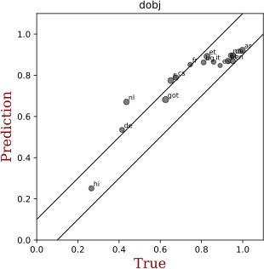
dobj: Head Verb -> Direct Object
Predicted Directionality
True Directionality
Notes:
Cross-validation results on 16 languages (20) treebanks

Slide 85
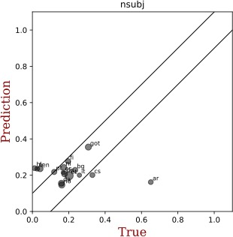
nsubj: Head Verb -> Subject
Predicted Directionality
True Directionality
Notes:
Cross-validation results on 16 languages (20) treebanks

Slide 86
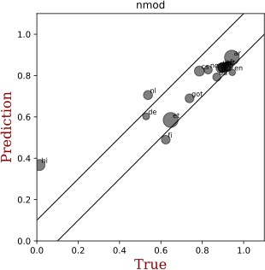
nmod: Head Noun -> Nominal Modifier
Predicted Directionality
True Directionality
Notes:
Cross-validation results on 16 languages (20) treebanks

Slide 87
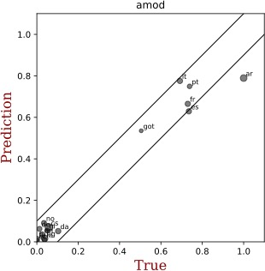
amod: Head Noun -> Adjectival Modifier
Predicted Directionality
True Directionality
Notes:
Cross-validation results on 16 languages (20) treebanks

Slide 88
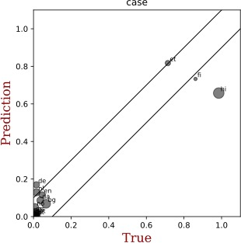
case: Head Noun -> Adposition
Predicted Directionality
True Directionality
Notes:
Cross-validation results on 16 languages (20) treebanks

Slide 89
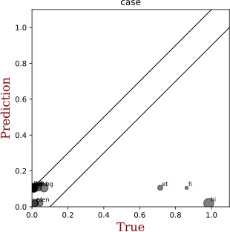
case (Trained on 16 Real Languages)
Predicted Directionality
True Directionality
Notes:
Cross-validation results on 16 languages (20) treebanks

Slide 90
Evaluation
ε-insensitive loss
1.0
Loss
Loss
Prediction(p̂)
No Loss
Loss
ε
0
ε
1.0
-ε
ε
p*-p̂
True (p*)
Notes:
We use the epilson-insensitive loss whick looks at the previous plots I just showed. **CLICK**
If the dots fall inside the region **CLICK**, we won’t penalize. If not, the penalty is proportional to the difference **CLICK**
So how is the system compared to the grammar induction?
**NEXT**

Slide 91
Compared to Grammar Induction
Doesn’t even look at the corpus!
MS13
N10
Heuristic
Base Rate
16
~8000
State-of-the-art
Dependency Grammar
Induction Systems
Simple Baselines
Supervised Training on n Languages
Notes:
Cross-validation results on 16 languages (20) treebanks

Slide 92


Summary: Training the System
discard trees
POS corpus
pl
en~hi@N~fr@V
en~fr@N~hi@V
train
$$θ$$
hi~fr@N~en@V
.
.
.
.
.
.
en
count
hi
fr
.
.
.
permute
prediction
20
~8000
typology
treebanks
Notes:
We start from 20 real treebanks **CLICK**, then we permute **CLICK** their word order to get about 8000 synthetic treebanks. **CLICK**
And then we count **CLICK** left and right dependencies in each treebank to get the true directionalities.
Now we train **CLICK** our neural net to predict the true directionalities from just the POS sequences.
The neural net can now make such predictions **CLICK** on a language it's never seen.

Slide 93
From Typology to Parsing
Corpus of POS-tags
ũ
Galactic Dependencies
Learned mapper
$$T_{θ}(\text{ũ})$$
S → NP VP
VP → VP PP
…
0.9
0.2
Extracted features
POS
sequence
Tree
x̃
Parser
y
Notes:
Now we at least know the upper part of this approach works well. How about the lower part **CLICK**?

Slide 94
Our Typology or Standard Typology?
Corpus of POS-tags
ũ
Galactic Dependencies
Learned mapper
$$T_{θ}(\text{ũ})$$
S → NP VP
VP → VP PP
…
0.9
0.2
Extracted features
POS
sequence
Tree
x̃
Parser
y
Notes:
That is, if we know the gold typology, can we build a nice parser? Can we also publish a paper about that?
Sorry, you are scooped **NEXT**

Slide 95
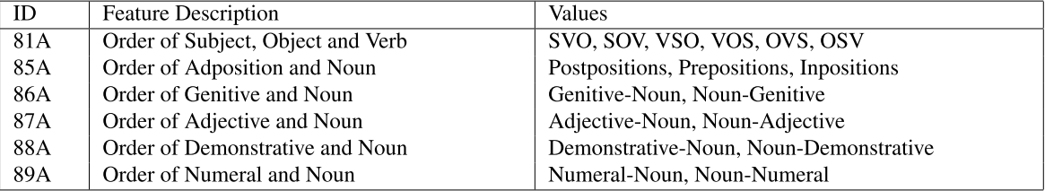

Our Typology or Standard Typology?
$$T$$
0.9
0.2
S → NP VP
VP → VP PP
…
WALS features
POS
sequence
Tree
x̃
Parser
y
Notes:
People have done that before, call multi-source transfer. Instead of exploiting the unparsed corpus, these works assume a set of gold typological features are available for the target language, which the most well known one is WALS. **CLICK**
**NEXT**

Slide 96
Replacing the Typology Vector
Corpus of POS-tags
ũ
Galactic Dependencies
Learned mapper
$$T_{θ}(\text{ũ})$$
S → NP VP
VP → VP PP
…
0.9
0.2
Language features
POS
sequence
Tree
x̃
Parser
y
Notes:
So let’s do some real work. In our recent TACL submission, we proposed a parser just in this sort. Different from the previous paper, the typology in this work only serves as a submodule which is tuned specifically useful for parsing by end-to-end training. That is **NEXT**

Slide 97

Replacing the Typology Vector
Corpus of tags (ũ)
PRON AUX …
VERB PROPN … …
Surface-form feature
Sigmoid
$$θ$$
$$T_{θ}(\text{ũ})$$
Notes:
In the past work, we used a sigmoid to enforce each output to be a probability, which it not necessary in this work **NEXT**

Slide 98
Replacing the Typology Vector
Corpus of tags (ũ)
PRON AUX …
VERB PROPN … …
Surface-form feature
$$θ$$
$$T_{θ}(\text{ũ})$$
Notes:
The difference betwee

Slide 99
Corpus of POS-tags
ũ
Galactic Dependencies
Learned mapper
$$T_{θ}(\text{ũ})$$
S → NP VP
VP → VP PP
…
0.9
0.2
Language features
POS
sequence
Tree
x̃
Parser
y
Notes:
Now lets look **CLICK** at the architecture of the parser. In fact, it could be very flexible by simply introducing the typology vector into an existing local parser. **NEXT**

Slide 100
3
*
2
0
+
1
1
0
2
*
Kiperwasser and Goldberg (2016)
Notes:
In our work, we use the arc-factored graph-based parser by Kiperwasser, which was the STOA parser by the time of publishing. The modification is simple **NEXT**

Slide 101
*
3
*
3
+
0
+
2
0
2
1
1
1
1
0
0
2
2
*
Kiperwasser and Goldberg (2016)
*
Notes:
By concatenenate the Typology vector to the 1-hot embedding of each POS tag.

Slide 102
3
*
2
0
+
1
1
0
2
*
Notes:
To be more specific in our work, let’s use p as a instance of g, which is a mapping from u to its syntactic typology. And the parser also has parameter \gama which is learnt to incorporate this p(u). Now let’s face the first challenge of this work.

Slide 103
Supervised Training
POS-corpus
POS-treebank
ũ
(x̃, y)-pairs
( , )
Language 1
PRON AUX …
VERB PROPN … …
…
( , )
VERB NOUN…
NOUN DET…
NOUN ADJ …
…
…
Language 2
.
.
.
.
.
.
Notes:
And again, the parser is trained on many languages. At each time, we first sample a language, and sample a tree from the treebank for training.

Slide 104


Avg. Parsing Performance
Directionality($r$) = $\frac{\# r from left to right}{\# r}$
UAS
Noisy POS
Grammar
Induction
LAS
✔
✔
✔
$$T_{θ}$$
Syn. Lang.
✘
gold
✘
✘
✔
✔
✔
Notes:
Cross-validation results on 16 languages (20) treebanks

Slide 105
Compared to Grammar Induction
Baseline
N10
Heuristic
Base Rate
20
8000
State-of-the-art
Dependency Grammar
Induction Systems
Simple Baselines
Supervised Training on n Languages
Notes:
We set epsilon to 0.1 and show the performance of different systems.
The first 2 bars are the STOA grammar induction systems.
(You don't have to get the directionalities perfectly, because you could fine-tune by EM. In general, epsilon depends on your downstream task.)
In the aggregate, its edges kind of have the right direction ...
But, I told you it doesn't work.
BECAUSE we can do better with very simple baselines **CLICK**, including one **CLICK** that doesn't even look at the corpus!
Our supervised method does better **CLICK**, particularly when we train on about 8000 **CLICK** synthetic languages **CLICK**.
So it means our method successfully learned to correlate surface cues with syntactic structure. To sum up of the whole system, **NEXT**

Slide 106
How can we recover linguists’ structure?
Assume form of p(x, y, θ) – or get samples
Now guess y, θ given x – or learn to guess
  θ = grammatical principles of the language
  x = observed data from the language, e.g., corpus
  y = latent analysis of x, e.g., trees, underlying forms
nsubj
nsubj
det
cop
case
case
case
θ
DET
NOUN
PART
VERB
PART
VERB
VERB
PART
the chief ’s resign -ation was surprise -ing

Slide 107
How can we recover linguists’ structure?
Trust linguists’
theory
Trust linguists’
annotations
Generative modeling
p(θ) p(y | θ) p(x | y, θ)
Conditional modeling
$\hat{p}$(x) p(y, θ | x)
“Try to reason
like a linguist”
(can figure out
strange new languages)
“Mimic output
of linguists”
(trained for accuracy on past languages)
Notes:
[left case] We’re looking for y and theta that explain x.
Supervision comes from the theory – the structure of the model.
You might need other languages to train p(theta), but if the model has enough structure you can just ignore that term.
We don’t know which way children do it. Are they little linguists, or do they have a hardwired language acquisition device?
This dichotomy shows up elsewhere.
By the way, there are intermediate versions, like contrastive estimation

Slide 108
Future challenges
Discover morphology and syntax jointly
Work on raw text,
rather than tagged text or analyzed words
In designing p(x, y, θ), how do we best incorporate neural nets to fit the true distribution more closely?
How do we incorporate semantics?

Slide 109

Thanks!
Notes:
Thanks

