Slide 1
A Deep Generative Model of Vowel Formant Typology
Ryan Cotterell and Jason Eisner

Slide 2
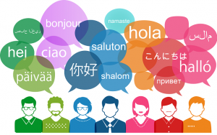
Language Are Different!

Slide 3
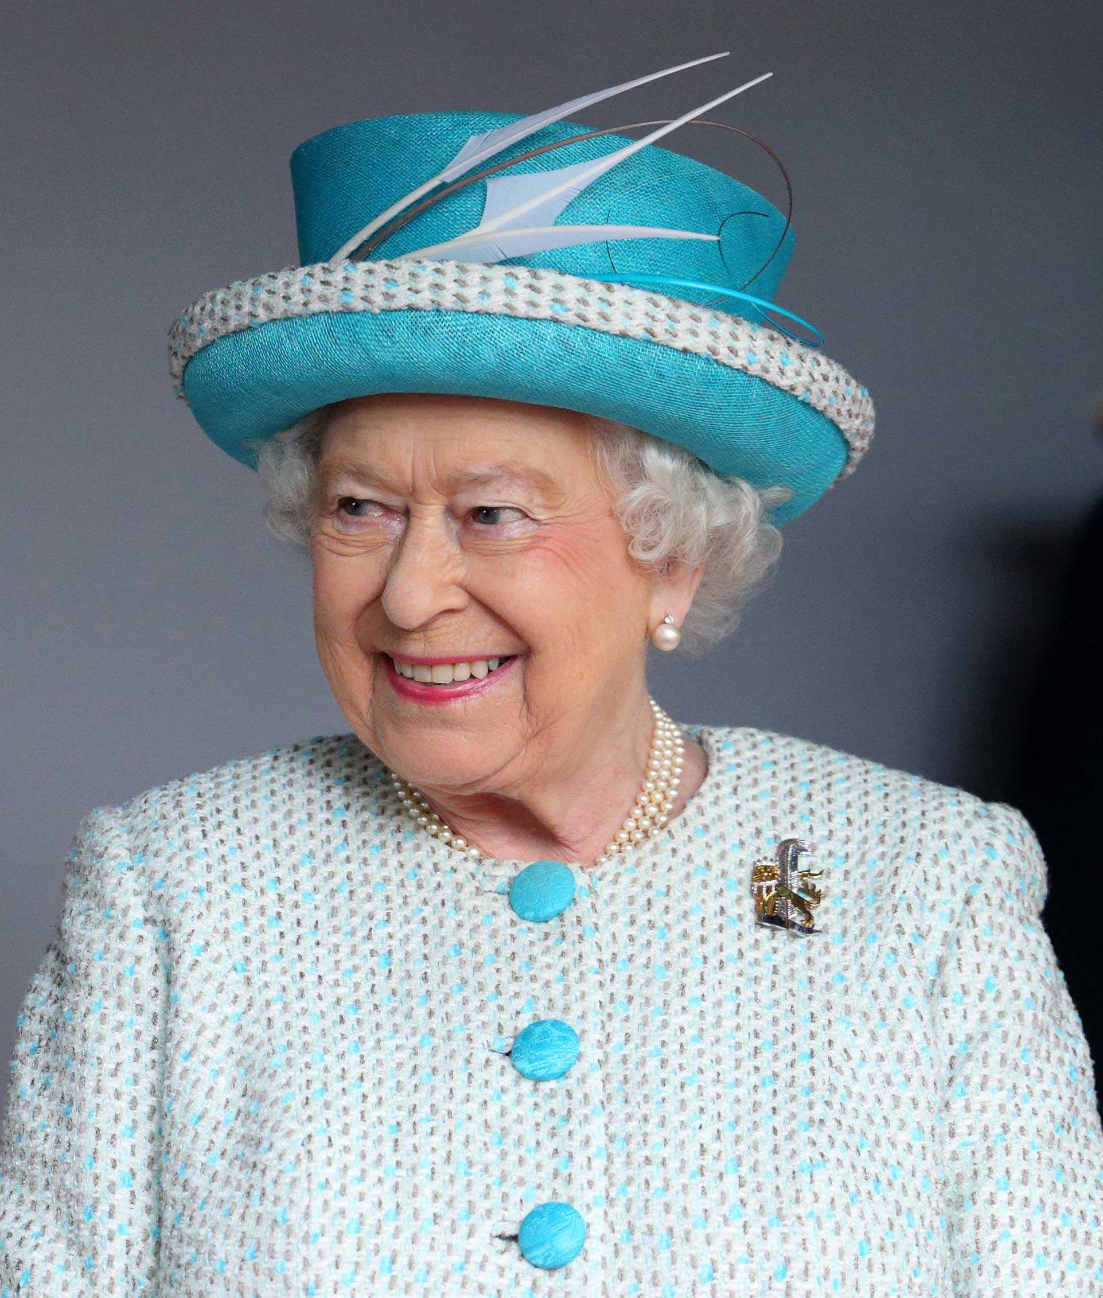
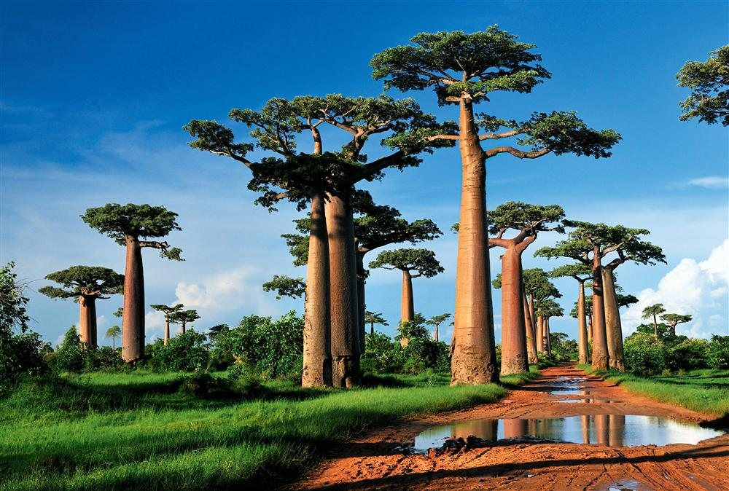

They Use Different Word Orders…
English (SVO)
  I wish you a happy birthday.
Malagasy (VSO)
Tratry ny tsingerin-taona nahaterahanao.
Dothraki (SVO)
  Anha zalak asshekhqoyi vezhvena yeraan!

Slide 4
They Build Words Differently…
English (no first person ending)
  I wish you a happy birthday.
Malagasy (no first person ending)
Tratry ny tsingerin-taona nahaterahanao.
Dothraki (first person ending)
  Anha zalak asshekhqoyi vezhvena yeraan!

Slide 5
They Use of Different Sounds…
English (no velar fricative)
  I wish you a happy birthday.
Malagasy (no velar fricative)
Tratry ny tsingerin-taona nahaterahanao.
Dothraki (velar fricative)
  Anha zalak asshekhqoyi vezhvena yeraan!

Slide 6
Great Scientific Question: Why are some types of languages more common than others?
Notes:
This leads us to the fundamental scientific question behind our paper. Why are some human languages more common than others?
[PAUSE]

Slide 7
Possible Typology
possible human languages
Every point is a language
adverb on right?
Notes:
Traditionally, linguistic typology has focused on which languages are possible. Here I’ve shown you a graph where every blue dot is a language. This is measured from the universal
The x-axis is how often the direct object appears to the right of a verb in a corpus and the y-axis is how often the adverb appears to the right of the verb. A typologist might draw a box like this and say this is the set of human languages.
-underlying mechanisms
-somethings do not occur and correlated
interesting structure to this distribution over languages

Slide 8
Possible Typology
possible human languages?
adverb on right?
Notes:
The typologist would also notice that these properties are CORRELATED, and might propose that THESE are the possible human languages. But these outliers mean that it’s not impossible to be outside the ellipse, just improbable.

Slide 9
Probabilistic Typology
````
probable human languages
what’s the generative probability model?
what scientific ideas are in it?
does it predict held-out languages?
adverb on right?
NLP/ML methods for linguistics!
Notes:
In this work, we relax the notion to possible to probable and place a distribution over the space of languages. The question we ask in this paper are: what’s the generative probability model that created these data

Slide 10
Vowel System Typology (This Paper)
Typological Universal: all languages have vowels
What makes a good vowel system?
Really simple: if we can’t estimate a model for just picking vowel types, how can we handle the rest of language?
Perfect starting point for probabilistic typology
Notes:
4:30
This work focuses on a very narrow slice of linguistic typology. We try to answer what sort of vowels a language will have. It is a typological universal that all spoken languages have vowels

Slide 11
Phonetics 101: What is Vowel Space?
The sound quality of a vowel can be measured
  think of vowels as vectors in an acoustic space
conventional drawing
Notes:
Standard trapozoid
{\boldsymbol f}\left(\text{\textipa{\ae}}\right) = \left[690, 1660\right]
{\boldsymbol f}\left(\text{\textipa{U}}\right) = \left[450, 1030\right]

Slide 12
Example Vowel Systems
Turkish
Chinese
Romanian
Quechua
Polish
Bulgarian

Slide 13
Unattested Vowel Systems
Mostly Infrequent Vowels
Vowels not Spread Out
Notes:
We never see vowels systems that look like this

Slide 14
Linguistic Principles of Vowel Systems

Slide 15
What makes a good vowel system?
Principle 1: Focalization
Some vowels are phonetically “better”
Dataset of
~ 300 languages
Percentage of Languages
IPA Symbols
Notes:
What makes a good vowel system?

Slide 16
What makes a good vowel system?
Principle 2: Dispersion
Good vowel systems are “spread-out”

Slide 17
This system is comparatively worse
Principle 2: Dispersion
Good vowel systems are “spread-out”

Slide 18
Generative Probabilistic Typology
We want to construct a trainable generative probability distribution over the world’s languages, starting with vowel systems

Slide 19
Previous Work: Generate a Well-Dispersed Vowel System

Slide 20
This Paper: Generate a Well-Dispersed Vowel Formants
(280, 2230)
(400, 1100)
(600, 1930)
(860, 1550)
(830, 1170)

Slide 21
Generative Model of Vowel Inventories
We have a base set of vowels
  (all the IPA symbols you’ve never heard of)
We have a distribution over subsets of the vowels
  Example:
Estimation: train on hundreds of languages
Evaluation: test on held-out portion
Notes:
Change

Slide 22
The Generative Model
probability
measure
“goodness” of
a vowel system
How do we define ?
  How do we quantify focalization and dispersion?
Question in linguistics, but we use tools from NLP/ML

Slide 23
High-Level Goal:
Distribution over All Subsets of
generate IPA symbols
generate pairs of reals
(280, 2230)
(400, 1100)
(600, 1930)
(860, 1550)
(830, 1170)
Notes:
Choose subset of a discrete set with a DPP
Choose subset of R^2 with a DPP
Computatonal trick

Slide 24
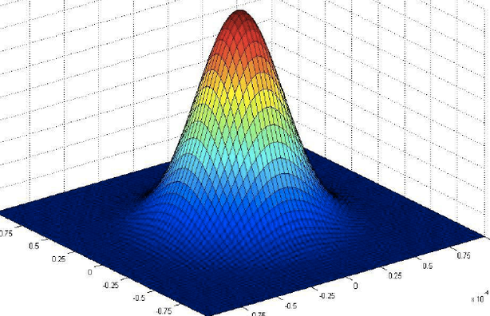
Key Idea: Universal Gaussian Phones
generate IPA symbols
generate distributions
(280, 2230)
(400, 1100)
(600, 1930)
(860, 1550)
(830, 1170)
Notes:
Bullet points to add
Computational trick to get it back to a discrete set

Slide 25
Fixed universal set of phone
  IPA set of fixed
  learn the position of the Gaussians

Slide 26
How to choose the Gaussians?

Slide 27
Diverse Distributions
Measure diversity by how much the distributions overlap
clumped together
spread out
Not Diverse
Diverse
Notes:
Fix to fewer Gaussians

Slide 28
Measure Dispersion with the Probability Kernel

Slide 29
Determinantal Point Process
Notes:
Let’s say that a pair of vowels is good if they form a large parallelogram.
So we can increase the probability by choosing vowels with longer vectors
(we’ll have to assign long vectors to good vowels).
But also by choosing vowels that are more orthogonal
(we’ll have to assign orthogonal vectors to vowels that are easy to tell apart).
This is an insight that we can generalize to multiple vowels. So instead of spanning a large-area parallelogram, a group of vowels will span a large-volume parallelepiped.
s/Another approach /many vowels/g
\text{score}\left(V\right) = \text{Volume}^2
Jason No

Slide 30
Determinantal Point Process
Prefer longer vectors (“quality”= focalization)
Notes:
Let’s say that a pair of vowels is good if they form a large parallelogram.
So we can increase the probability by choosing vowels with longer vectors
(we’ll have to assign long vectors to good vowels).
But also by choosing vowels that are more orthogonal
(we’ll have to assign orthogonal vectors to vowels that are easy to tell apart).
This is an insight that we can generalize to multiple vowels. So instead of spanning a large-area parallelogram, a group of vowels will span a large-volume parallelepiped.
s/Another approach /many vowels/g
\text{score}\left(V\right) = \text{Volume}^2
Jason No

Slide 31
Determinantal Point Process
Prefer longer vectors (“quality”= focalization)
Prefer more orthogonal vectors (“diversity”= dispersion)
Notes:
Let’s say that a pair of vowels is good if they form a large parallelogram.
So we can increase the probability by choosing vowels with longer vectors
(we’ll have to assign long vectors to good vowels).
But also by choosing vowels that are more orthogonal
(we’ll have to assign orthogonal vectors to vowels that are easy to tell apart).
This is an insight that we can generalize to multiple vowels. So instead of spanning a large-area parallelogram, a group of vowels will span a large-volume parallelepiped.
s/Another approach /many vowels/g
\text{score}\left(V\right) = \text{Volume}^2
Jason No

Slide 32
Compute Pair-wise Similarity Matrix (Gram Matrix)
Notes:
Jason Notes:

Slide 33
The Determinantal Point Process
(L-Ensemble)
Notes:
\text{score}\left(V\right) = \det\left(L_V\right)
%p(\left\{\text{\textschwa}, \text{\textipa{\ae}}, \text{u},\text{i} \right\}) =
%L_{\text{\textschwa}, \text{\textschwa}}
%L_{\text{\textschwa}, \text{\textipa{\ae}}}
%L_{\text{\textschwa}, \text{\textipa{u}}}
%L_{\text{\textschwa}, \text{\textipa{i}}}
%
%L_{\text{\textipa{\ae}}, \text{\textschwa}}
%L_{\text{\textipa{\ae}}, \text{\textipa{\ae}}}
%L_{\text{\textipa{\ae}}, \text{\textipa{u}}}
%L_{\text{\textipa{\ae}}, \text{\textipa{i}}}
%
%L_{\text{u}, \text{\textschwa}}
%L_{\text{u}, \text{\textipa{\ae}}}
%L_{\text{u}, \text{\textipa{u}}}
%L_{\text{u}, \text{\textipa{i}}}
%
%L_{\text{i}, \text{\textschwa}}
%L_{\text{i}, \text{\textipa{\ae}}}
%L_{\text{i}, \text{\textipa{u}}}
%L_{\text{i}, \text{\textipa{i}}}

Slide 34
Prototype DPP
Each vowel is a vector
inner product
Each vowel is a distribution
probability kernel

Slide 35
Compute Pair-wise Similarity Matrix (Gram Matrix)
Probability Kernel
Notes:
L({\cal N}_i, {\cal N}_j) = \frac{2}{\sqrt{2\pi\sigma^2}} \exp\left(-\frac{||{\boldsymbol \mu_i} - {\boldsymbol \mu_j}||^2}{4\sigma^2}\right)

Slide 36
The Determinantal Point Process over Prototypes
(L-Ensemble)
Notes:
\text{score}\left(V\right) = \det\left(L_V\right)
%p(\left\{\text{\textschwa}, \text{\textipa{\ae}}, \text{u},\text{i} \right\}) =
%L_{\text{\textschwa}, \text{\textschwa}}
%L_{\text{\textschwa}, \text{\textipa{\ae}}}
%L_{\text{\textschwa}, \text{\textipa{u}}}
%L_{\text{\textschwa}, \text{\textipa{i}}}
%
%L_{\text{\textipa{\ae}}, \text{\textschwa}}
%L_{\text{\textipa{\ae}}, \text{\textipa{\ae}}}
%L_{\text{\textipa{\ae}}, \text{\textipa{u}}}
%L_{\text{\textipa{\ae}}, \text{\textipa{i}}}
%
%L_{\text{u}, \text{\textschwa}}
%L_{\text{u}, \text{\textipa{\ae}}}
%L_{\text{u}, \text{\textipa{u}}}
%L_{\text{u}, \text{\textipa{i}}}
%
%L_{\text{i}, \text{\textschwa}}
%L_{\text{i}, \text{\textipa{\ae}}}
%L_{\text{i}, \text{\textipa{u}}}
%L_{\text{i}, \text{\textipa{i}}}

Slide 37
But wait, we don’t observe the pronunciation-phone alignment!
(400, 3200)
(400, 3200)
(400, 3200)
Notes:
Gibbs sampling
Show bipartite graph
Trick: marginalize out the phones

Slide 38
Putting It All Together
(400, 3200)
(400, 3200)
(400, 3200)
Notes:
Gibbs sampling
Show bipartite graph
Trick: marginalize out the phones

Slide 39
Putting it All Together
p(f1, f2, f3) =

Slide 40
Neural Transformed Gaussian
Show picture

Slide 41
Why a Neural Gaussian?
The human ear performs a non-linear transformation of the acoustic vowel space into perceptual vowel space
We learn a universal similarity function that helps us predict which vowel systems are attested
Notes:
Do the “I lied”. I told you we are measuring the similarity between two vowels. I lied, we actually *learn* a similarity function.

Slide 42
A Diffeomorphic Multi-Layer Perceptron
We choose a network that is a diffeomorphism
  an invertible function with both it and its inverse smooth
  this won’t warp the space too much (no transposition)
same dimensionality
full rank
smooth and invertible
(not ReLU)
Notes:
We did try computing high-dimensional embeddings with a neural net, but it’s also fun to get this nice interpretable picture, which stretches and compresses the distances. For models like like, we choose a neural network that is a diffeomorhism.

Slide 43
Neural Vowel Embeddings
690
1660
-3.02
2.01

Slide 44
Neural Vowel Embeddings
690
1660
-3.02
2.01

Slide 45
Neural Vowel Embeddings
690
1660
-3.02
2.01

Slide 46
Results

Slide 47
Analysis

Slide 48
Conclusion

Slide 49
Model 3: All Vowels Together
(Determinantal Point Process)
Prefer longer vectors (“quality”= focalization)
Prefer more orthogonal vectors (“diversity”= dispersion)
Notes:
Let’s say that a pair of vowels is good if they form a large parallelogram.
So we can increase the probability by choosing vowels with longer vectors
(we’ll have to assign long vectors to good vowels).
But also by choosing vowels that are more orthogonal
(we’ll have to assign orthogonal vectors to vowels that are easy to tell apart).
This is an insight that we can generalize to multiple vowels. So instead of spanning a large-area parallelogram, a group of vowels will span a large-volume parallelepiped.
s/Another approach /many vowels/g
\text{score}\left(V\right) = \text{Volume}^2
Jason No

Slide 50
Make Me a Vowel System
(Sampled Independently)
Nothing :-(
Too Similar:-(

Slide 51
Make Me a Diverse Vowel System
(Sampled from MPP/DPP)
Well-Dispersed! :-)

Slide 52
Probabilistic Linguistic Typology
Let’s Play a Game: create a new language that sounds natural
ICK!
Notes:
I'd like to start this talk off with a game. I want everyone in the audience to think about making up a new language. Importantly, I want it to be a natural language. By that, I mean that you could fool someone into thinking it was actually a human production. We don't want it to look like computer code.

Slide 53
How about Dothraki?
Here is Khal Drogo wishing you a happy birthday
Why does it sound like a natural language?
  Invented by aa a a linguist
Anha zalak asshekhqoyi vezhvena yeraan!
Notes:
Let’s consider Dothraki For those who don't know, Dothraki is a made up language that is featured on HBO's TV series Game of Thrones.
Importantly, this language is fully-fledged -- it has a full lexicon and grammar. So here is Khal Drogo wishing you a Happy Birthday.
As Dothraki has a complete lexicon and grammar, we can easily get the answer: “Anha zalak asshekhqoyi vezhvena yeraan!”
So, why does Dothraki sound natural?

Slide 54
A Computational David Peterson
Dothraki was designed by linguist David Peterson
  He used linguistic typology to construct new languages
Wouldn’t it be fun to build David_Peterson.py?
  Sample a new language from a distribution!
  If we knew which distribution, we would have Universal Grammar
  David’s brain has a good approximation
Why just generate text, when you could generate an entire language!
Notes:
David Peterson, the inventor of Dothraki, used a lot of linguistic knowledge to come up with a very human-sounding language. In fact, he's invented tens of languages for various TV shows and movies. While most linguists analyze languages, David Peterson generates languages.
He relies on a branch of linguistics known as typology, that seeks to categorize the possible and probable structure in human language
The ultimate goal of our work is to write a program that generates new languages -- let's call it David Peterson dot py.
This program should be able to sample a new language on command from some probability distribution.
But which distribution?
This is a really hard problem. NLP has a hard enough time generating text from a known language, it's a lot harder to generate a fully-functioning new language.

Slide 55
Designing a new language is complicated!
(Many Choices)
Notes:
Designing a new language is really complicated. Here are some choices we will have to make.

Slide 56
Syntactic Choice: Word Orders
English: Subject Verb Object
David invented 13 languages
Yoda: Object Subject Verb
13 languages David invented
Notes:
We also have to choose a syntax for our new language. Let's consider word order.
English has a subject-verb-object word-order. For example, I wish you a happy birthday.
Yoda-ese, on the other hand, uses a object-subject-verb word order. He would say: "You a happy birthday I wish."

Slide 57
Distribution over Word Orders
Word Order | English Equivalent | % of Langs | Examples
SOV | She him loves | 45% | Japanese, Latin, Tamil
SVO | She loves him | 42% | English, Mandarin, Russian
VSO | Loves she him | 9% | Hebrew, Irish, Zapotec
VOS | Loves him she | 3% | Malagasy, Baure
OVS | Him loves she | 1% | Apalai, Hixkaryana
OSV | Him she loves | <1% | Warao
Notes:
Our new language will have to have a word order. We should sample it from a distribution over word orders obtained from natural language data. Most languages are other subject-object-verb or subject-verb-object.
Khal Drogo's word order is very common...
whereas Yoda's is not.

Slide 58
Distribution over Morphology
Do you want verbal inflection in your morphological system?
Most English verbs mark four distinctions
  run, runs, running, ran
Spanish marks close to 100
Notes:
We have to make similar choices in terms of morphology.
Do you want your verbs to inflect?
Most English verbs mark 4 forms.
Spanish, on the other hand, marks close to 100.

Slide 59
Distribution over Phonology
Does your language have a velar fricative?
  Voiced [ɣ] or unvoiced [x]?
  Dothraki has both!
Does your language allow word-final voiced obstruents?
English: bug [bʌg], bugs [bʌgz]
German: Zug [zuk], Züge [zygə]
Notes:
Finally, we have the same deal in the realm of phonology.
Do you want your language to have a velar fricative?
Voiced or unvoiced
Dothrakii has both
Do you have your language to allow word-final voiced obstruents?
Compare English and ...
German

Slide 60
Three Models of Vowel Inventories
They differ in how they define
  and how they quantify focalization and dispersion
We’ll present different models:
  Score 1 vowel at a time (baseline)
  Score 2 vowels at a time
  Score all vowels together

Slide 61
Model 1: One Vowel At a Time
(Bernoulli Point Process )
Independent weighted coin flips (not i.i.d.)
  The vowel is included in the vowel system with probability
No interaction between the vowels
  Only focalization, no dispersion
Notes:
So the coin for the vowel /i/ must have high probability because it shows up in a lot of systems.
\text{score}(V) = \prod_{i \in V} p_i \prod_{i \not\in V} (1 - p_i)

Slide 62
Make Me a Vowel System
(Sampled Independently)
Nothing :-(
Too Similar:-(

Slide 63
What about dispersion?

Slide 64
Geometry of Vowel Space
Dispersion: “similar” vowels tend not to co-appear
Let’s use the vectorial representation of vowels!
Notes:
{\boldsymbol f}\left(\text{\textipa{\ae}}\right) = \left[690, 1660\right]
{\boldsymbol f}\left(\text{\textipa{U}}\right) = \left[450, 1030\right]

Slide 65
Model 2: Two Vowels at a Time
(Boltzmann Machine, Markov Point Process)
encourages
high focalization
encourages dispersion
inspired by Coulomb’s law
Notes:
The binary potential is inspired by Coulomb’s law. Notice that as the vowels get closer, they are like repelling electrons – the probability of their co-appearing goes to zero.
{\color[rgb]{0.501961,0.000000,0.000000}\phi\left(\text{\textipa{\ae}}\right)} {\color[rgb]{0.000000,0.000000,0.000000}= ||{\boldsymbol f}(\text{\textipa{\ae}})|| \geq 0}
{\color[rgb]{0.000000,0.000000,0.000000}\text{score}(V)} \propto \prod_{i \in V} {\color[rgb]{0.501961,0.000000,0.000000}\phi(i)} \prod_{i, j \in V} {\color[rgb]{0.000000,0.000000,0.501961}\psi(i, j)}
mention annealing parameter?

Slide 66
Can we model more than pairwise interactions?

Slide 67
Model 3: All Vowels Together
(Determinantal Point Process)
Notes:
Let’s say that a pair of vowels is good if they form a large parallelogram.
So we can increase the probability by choosing vowels with longer vectors
(we’ll have to assign long vectors to good vowels).
But also by choosing vowels that are more orthogonal
(we’ll have to assign orthogonal vectors to vowels that are easy to tell apart).
This is an insight that we can generalize to multiple vowels. So instead of spanning a large-area parallelogram, a group of vowels will span a large-volume parallelepiped.
s/Another approach /many vowels/g
\text{score}\left(V\right) = \text{Volume}^2
Jason No

Slide 68
Model 3: All Vowels Together
(Determinantal Point Process)
Prefer longer vectors (“quality”= focalization)
Notes:
Let’s say that a pair of vowels is good if they form a large parallelogram.
So we can increase the probability by choosing vowels with longer vectors
(we’ll have to assign long vectors to good vowels).
But also by choosing vowels that are more orthogonal
(we’ll have to assign orthogonal vectors to vowels that are easy to tell apart).
This is an insight that we can generalize to multiple vowels. So instead of spanning a large-area parallelogram, a group of vowels will span a large-volume parallelepiped.
s/Another approach /many vowels/g
\text{score}\left(V\right) = \text{Volume}^2
Jason No

Slide 69
Model 3: All Vowels Together
(Determinantal Point Process)
Prefer longer vectors (“quality”= focalization)
Prefer more orthogonal vectors (“diversity”= dispersion)
Notes:
Let’s say that a pair of vowels is good if they form a large parallelogram.
So we can increase the probability by choosing vowels with longer vectors
(we’ll have to assign long vectors to good vowels).
But also by choosing vowels that are more orthogonal
(we’ll have to assign orthogonal vectors to vowels that are easy to tell apart).
This is an insight that we can generalize to multiple vowels. So instead of spanning a large-area parallelogram, a group of vowels will span a large-volume parallelepiped.
s/Another approach /many vowels/g
\text{score}\left(V\right) = \text{Volume}^2
Jason No

Slide 70
Compute Pair-wise Similarity Matrix (Gram Matrix)
Notes:
Jason Notes:

Slide 71
The Determinantal Point Process
(L-Ensemble)
Notes:
\text{score}\left(V\right) = \det\left(L_V\right)
%p(\left\{\text{\textschwa}, \text{\textipa{\ae}}, \text{u},\text{i} \right\}) =
%L_{\text{\textschwa}, \text{\textschwa}}
%L_{\text{\textschwa}, \text{\textipa{\ae}}}
%L_{\text{\textschwa}, \text{\textipa{u}}}
%L_{\text{\textschwa}, \text{\textipa{i}}}
%
%L_{\text{\textipa{\ae}}, \text{\textschwa}}
%L_{\text{\textipa{\ae}}, \text{\textipa{\ae}}}
%L_{\text{\textipa{\ae}}, \text{\textipa{u}}}
%L_{\text{\textipa{\ae}}, \text{\textipa{i}}}
%
%L_{\text{u}, \text{\textschwa}}
%L_{\text{u}, \text{\textipa{\ae}}}
%L_{\text{u}, \text{\textipa{u}}}
%L_{\text{u}, \text{\textipa{i}}}
%
%L_{\text{i}, \text{\textschwa}}
%L_{\text{i}, \text{\textipa{\ae}}}
%L_{\text{i}, \text{\textipa{u}}}
%L_{\text{i}, \text{\textipa{i}}}

Slide 72
Make Me a Diverse Vowel System
(Sampled from MPP/DPP)
Well-Dispersed! :-)

Slide 73
Complexity of Inference
probability
measure
sum over all vowel
systems’ scores
Exponentially many summands :-(

Slide 74
Complexity of Inference
No interactions between the vowels
Inference Complexity
Fancy Name
1 vowel at a time:
Bernoulli Point Process
2 vowels at a time:
#P-hard
Markov Point Process
All vowels together:
Determinantal Point Process
Only allows negative interactions between vowels
Notes:
Since we’re at a computer science conference, so let’s talk a bit about the complexity of our methods. The 1-vowel-at-a-time network (the Bernoulli point process) admits a linear-time inference algorithm. However, it is NP-hard to do 2-at-a-time network – the Markov Point Process. Finally In the Determinantl Point Process the all-together model, we can do inference in quadratic time. Note that Bernoulli point process does not allow interactions between the vowels, hence the linear time. The Determinantal point process only allows negative interactions between the vowels, hence the cubic time algorithm

Slide 75
Neural Vowel Embeddings
690
1660
-3.02
2.01
Notes:
Computa
Now, a general neural net could scramble the vowel space and learn arbitrary embeddings for each vowel. It could fold the space so that /i/ was close to /a/, with the vowels in between being far away. To prevent that, we can restrict the NN topology. If we have only 2 hidden nodes, then the map is smoothly invertible (a diffeomorphism), which forces it to be a funhouse mirror like this. That reduces the # of parameters, but we can make it up by deepening the network, and it still works.

