Slide 1
Signal Processing From Images to Surfaces
Misha Kazhdan Johns Hopkins University

Slide 2
Goal
Extend image-processing techniques to surfaces:
Gradient Domain

Slide 3
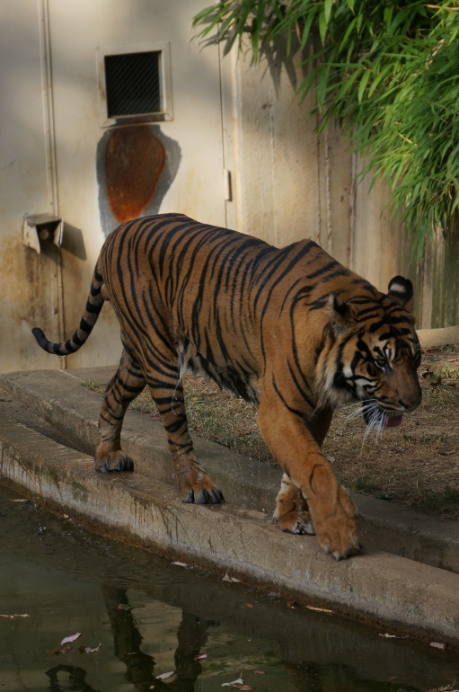
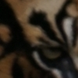
Goal
Extend image-processing techniques to surfaces:
Gradient Domain
Shock Filters

Slide 4
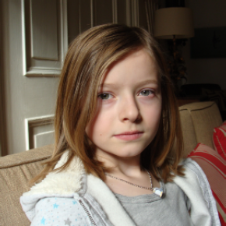
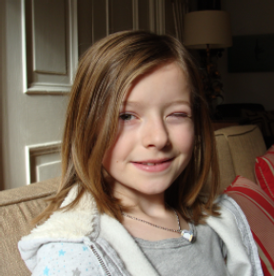
Goal
Extend image-processing techniques to surfaces:
Gradient Domain
Shock Filters
Optical Flow
Source
Optical Flow Interpolation
Target
Moving Gradients: A Path Based Method for Plausible Image Interpolation. [Mahajan et al., 2009]

Slide 5
Outline
Motivation
Processing Tools
Screened Poisson Equation
Flow Fields/Lines
Extensions to Signals on Surfaces
Conclusion

Slide 6
Image-Processing Tools
1. Screened Poisson Equation:
Given a 2D domain $Ω$, a function $g$, and a vector field $\vec{v}$, solve for the function $f$ minimizing: $$E\left(f\right)=\int_{Ω}{α{\left\|f−g\right\|}^{2}+{\left\|\text{∇}f−\vec{v}\right\|}^{2}}$$
value-fitting
gradient-fitting

Slide 7
Image-Processing Tools
1. Screened Poisson Equation:
Given a 2D domain $Ω$, a function $g$, and a vector field $\vec{v}$, solve for the function $f$ minimizing: $$E\left(f\right)=\int_{Ω}{α{\left\|f−g\right\|}^{2}+{\left\|\text{∇}f−\vec{v}\right\|}^{2}}$$
$$⇓$$
$$\left(α⋅1−Δ\right)f=α⋅1⋅g−div(\vec{v})$$

Slide 8
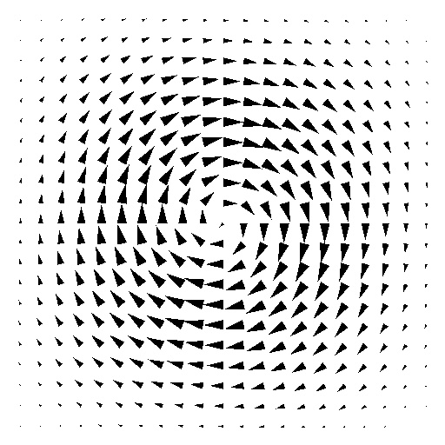
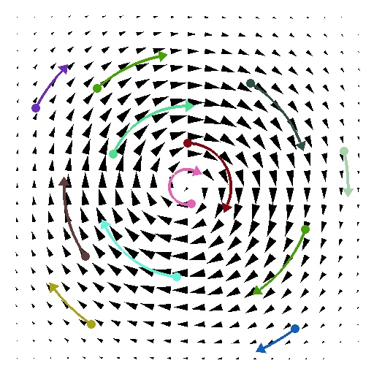
Image-Processing Tools
2a. Flow Fields/Lines:
Given a 2D domain $Ω$ and a vector field $\vec{v}$, a flow-line of $\vec{v}$ is a curve $γ_{p}$ such that:
$$γ_{p}\left(0\right)=p and γ_{p}^{′}\left(t\right)=\vec{v}\left(γ_{p}\left(t\right)\right).$$
$$γ_{p}(t)$$
$$\vec{v}(p)$$

Slide 9
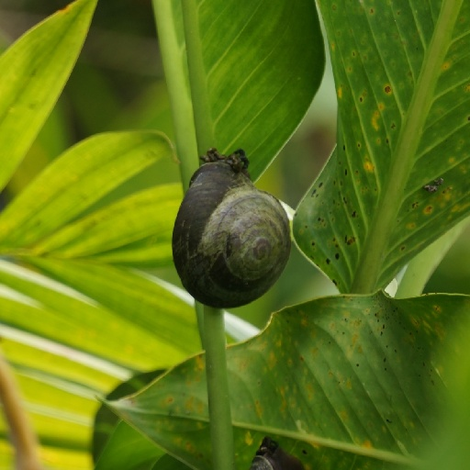
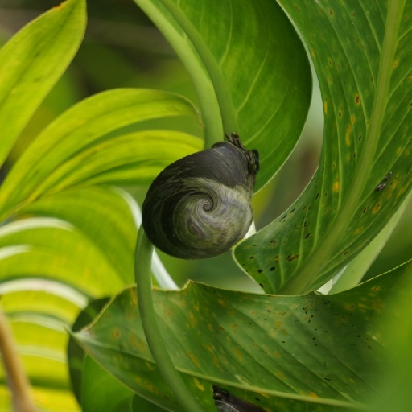
Image-Processing Tools
2b. Flow Fields/Lines:
Given a 2D domain $Ω$ and a vector field $\vec{v}$, the advection of a function $f$ along $\vec{v}$ is the function: $$\left[{Adv}_{\vec{v}}\left(f\right)\right](p)=f\left(γ_{p}\left(−1\right)\right).$$
$$f(p)$$
$$\vec{v}(p)$$
$$\left[{Adv}_{\vec{v}}\left(f\right)\right](p)$$

Slide 10
Image-Processing Tools
2c. Flow Fields/Lines:
Given..., for small $t$ we have: $${Adv}_{t⋅\vec{v}}\left(f\right)−f≈−t⋅〈\text{∇}f,\vec{v}〉$$
$$⇓$$
$${∂f}/{∂t}=−〈\text{∇}f,\vec{v}〉$$
$$f(p)$$
$$\vec{v}(p)$$
$$\left[{Adv}_{\vec{v}}\left(f\right)\right](p)$$

Slide 11
Geometry-Processing Tools
1. Screened Poisson Equation:
$$\left(α⋅1−Δ\right)f=α⋅1⋅g−div(\vec{v})$$
On a mesh:

Slide 12
Geometry-Processing Tools
1. Screened Poisson Equation:
$$\left(α⋅1−Δ\right)f=α⋅1⋅g−div(\vec{v})$$
On a mesh:
$f,g$ $→$ maps from vertices to real values
$$p_{i}$$

Slide 13
Geometry-Processing Tools
1. Screened Poisson Equation:
$$\left(α⋅1−Δ\right)f=α⋅1⋅g−div(\vec{v})$$
On a mesh:
$f,g→$ maps from vertices to real values
$\vec{v}$ $→$ a map from triangles to tangent vectors

Slide 14
Geometry-Processing Tools
1. Screened Poisson Equation:
$$\left(α⋅1−Δ\right)f=α⋅1⋅g−div(\vec{v})$$
On a mesh:
$f,g→$ maps from vertices to real values
$\vec{v}$ $→$ a map from triangles to tangent vectors
$Δ$ $→$ the cotangent Laplacian
$$α$$
$$p_{i}$$
$$β$$
$$p_{j}$$

Slide 15
Geometry-Processing Tools
1. Screened Poisson Equation:
$$\left(α⋅1−Δ\right)f=α⋅1⋅g−div(\vec{v})$$
On a mesh:
$f,g→$ maps from vertices to real values
$\vec{v}$ $→$ a map from triangles to tangent vectors
$Δ$ $→$ the cotangent Laplacian
$1$ $→$ the mass-matrix
$$p_{i}$$

Slide 16
Geometry-Processing Tools
1. Screened Poisson Equation:
$$\left(α⋅1−Δ\right)f=α⋅1⋅g−div(\vec{v})$$
On a mesh:
$f,g→$ maps from vertices to real values
$\vec{v}$ $→$ a map from triangles to tangent vectors
$Δ$ $→$ the cotangent Laplacian
$1$ $→$ the mass-matrix
$div$ $→$ $d^{t}⋅Λ$:
$Λ$: diagonal with triangle areas
$d$: the gradient operator
$$p_{i}$$
$$p_{k}$$
$$p_{j}$$

Slide 17
Geometry-Processing Tools
2. Flow Fields/Lines:
$$γ_{p}\left(0\right)=p and γ_{p}^{′}\left(t\right)=\vec{v}\left(γ_{p}\left(t\right)\right)$$
Iteratively:
Sample the flow field at $p$.
Take a small step in a straight line along the flow direction.
$$\vec{v}(p)$$
$$p$$

Slide 18
Geometry-Processing Tools
2. Flow Fields/Lines:
$$γ_{p}\left(0\right)=p and γ_{p}^{′}\left(t\right)=\vec{v}\left(γ_{p}\left(t\right)\right)$$
Iteratively:
Sample the flow field at $p$.
Take a small step in a straight line along the flow direction.
$$\vec{v}(p)$$
$$p$$

Slide 19
Geometry-Processing Tools
2. Flow Fields/Lines:
$$γ_{p}\left(0\right)=p and γ_{p}^{′}\left(t\right)=\vec{v}\left(γ_{p}\left(t\right)\right)$$
Iteratively:
Sample the flow field at $p$.
Take a small step in a straight line along the flow direction.
$$\vec{v}(p)$$
$$p$$

Slide 20
Geometry-Processing Tools
2. Flow Fields/Lines:
$$γ_{p}\left(0\right)=p and γ_{p}^{′}\left(t\right)=\vec{v}\left(γ_{p}\left(t\right)\right)$$
Iteratively:
Sample the flow field at $p$.
Take a small step in a straight line along the flow direction.
$$\vec{v}(p)$$
$$p$$

Slide 21
Outline
Motivation
Tools of the Trade
Extensions to Signals on Surfaces
Gradient Domain [Poisson]
Shock Filters [Advection]
Optical Flow [Poisson + Advection]
Conclusion

Slide 22
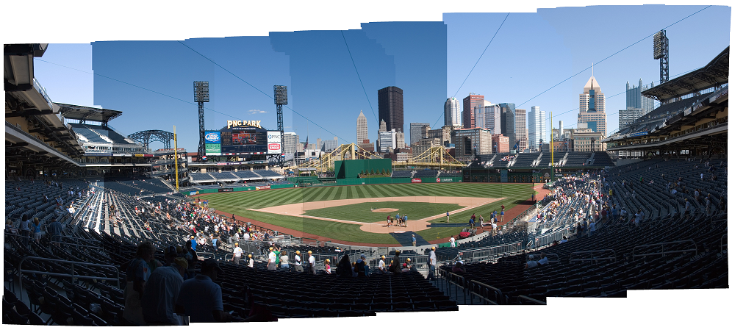
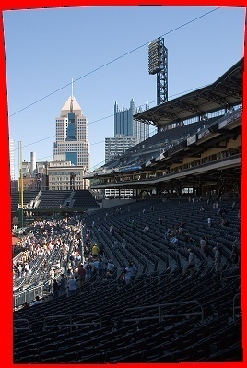
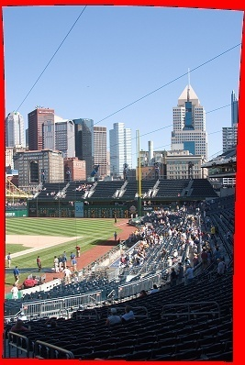
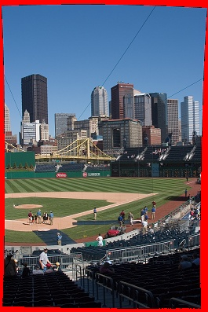
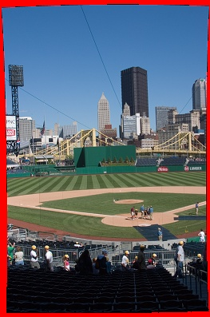
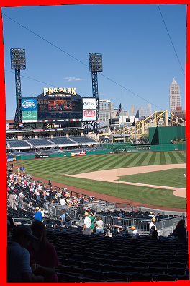
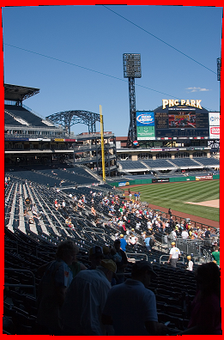
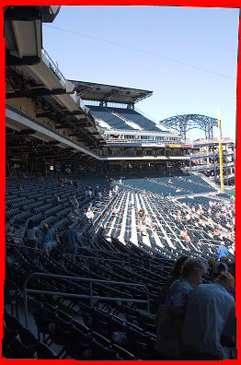
Gradient Domain (Stitching)
Different exposures ⇒ Seams in the panorama
Image(s) courtesy of Uyttendaele

Slide 23
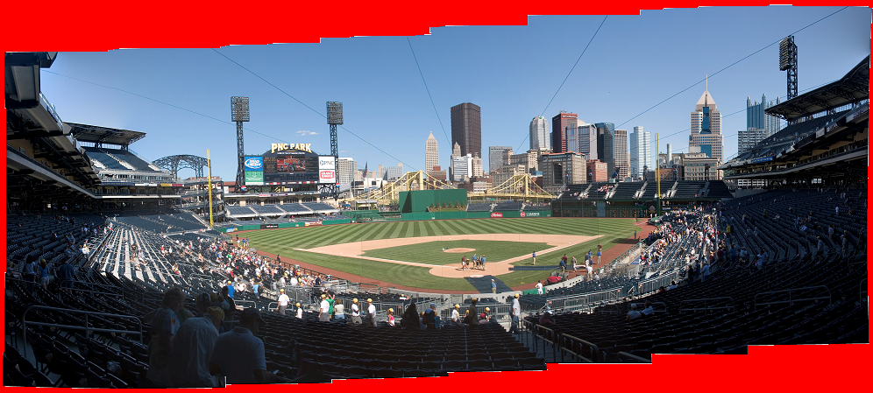
Gradient Domain (Stitching)
Copy interior gradients into $\vec{v}$
Set seam-crossing gradients to zero
$$f^{out}=\underset{f:Ω→ℝ}{argmin}{∫{\left\|\text{∇}f−\vec{v}\right\|}^{2}dp}$$
Image(s) courtesy of Uyttendaele

Slide 24
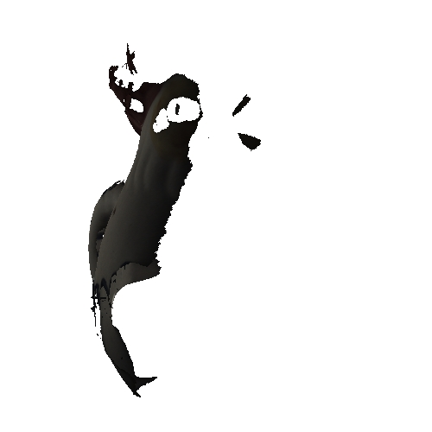
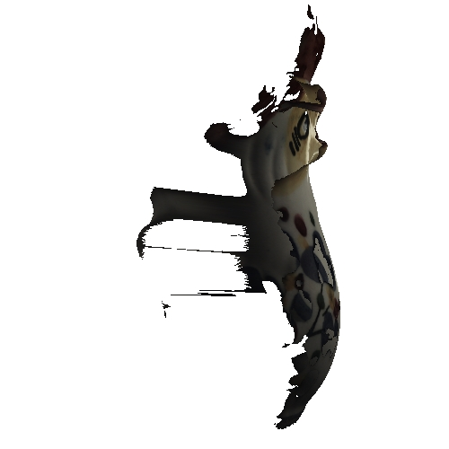
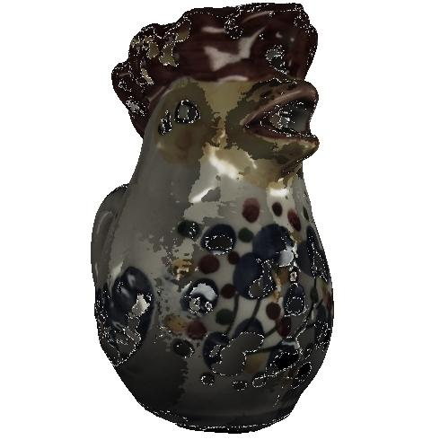
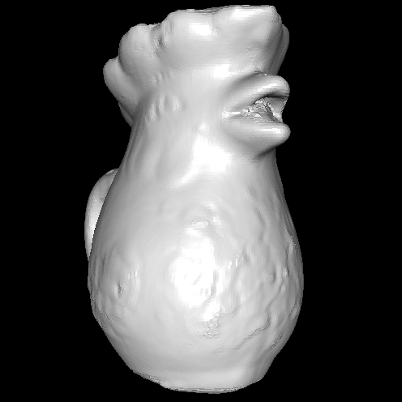
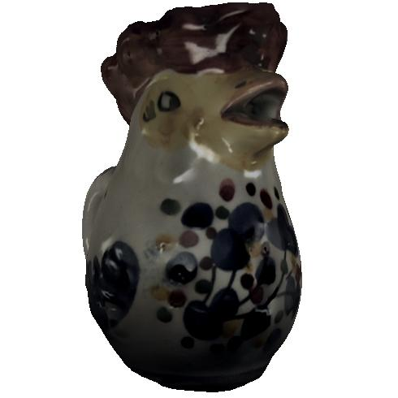
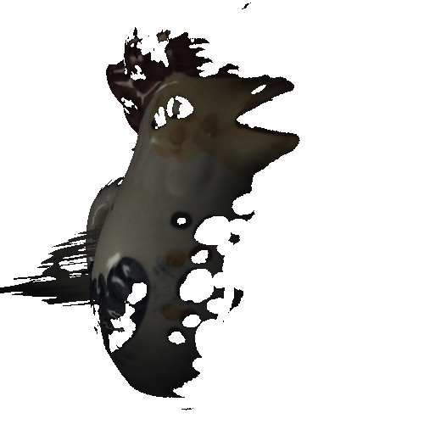
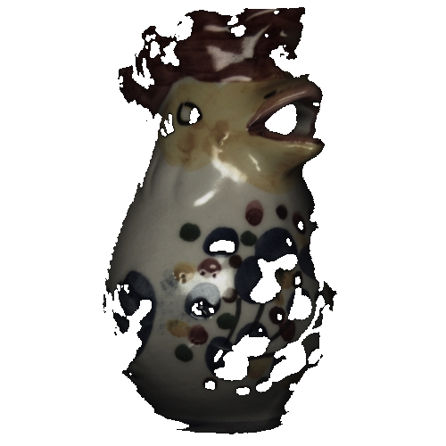
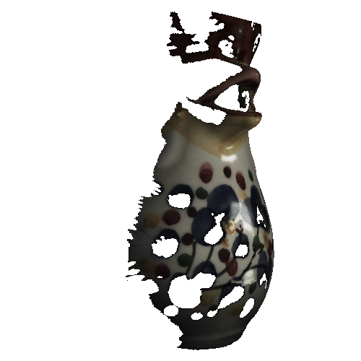
Gradient Domain (Stitching)
Copy interior gradients into $\vec{v}$
Set seam-crossing gradients to zero $f^{out}=\underset{f:Ω→ℝ}{argmin}{∫{\left\|\text{∇}f−\vec{v}\right\|}^{2}dp}$

Slide 25
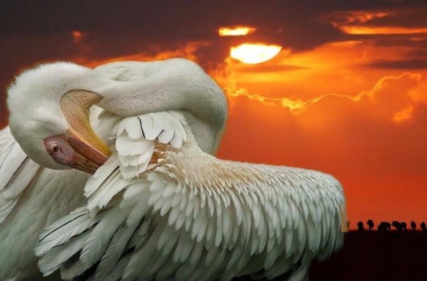
Gradient Domain (Sharpening)
Fit input colors: $g=f^{in}$
Amplify input gradients: $\vec{v}=β⋅\text{∇}f^{in}$
$$f^{out}=\underset{f:Ω→ℝ}{argmin}{\int_{Ω}{{α\left\|f−f^{in}\right\|}^{2}+{\left\|\text{∇}f−β⋅\text{∇}f^{in}\right\|}^{2}} }$$
value-fitting
gradient-fitting
$$β>1$$
Fourier Analysis of the 2D Screened Poisson Equation for Gradient Domain Problems. [Bhat et al. 2008]

Slide 26
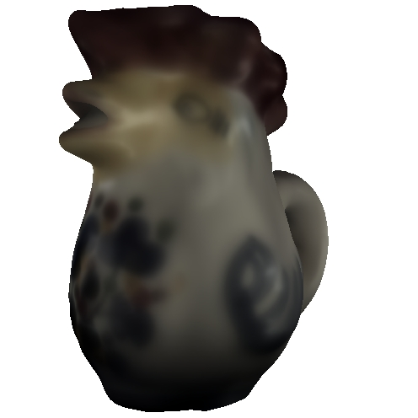
Gradient Domain (Sharpening)
Fit input colors: $g=f^{in}$
Amplify input gradients: $\vec{v}=β⋅\text{∇}f^{in}$
$$f^{out}=\underset{f:Ω→ℝ}{argmin}{\int_{Ω}{{α\left\|f−f^{in}\right\|}^{2}+{\left\|\text{∇}f−β⋅\text{∇}f^{in}\right\|}^{2}} }$$
value-fitting
gradient-fitting
$$β<1$$
$$β>1$$

Slide 27
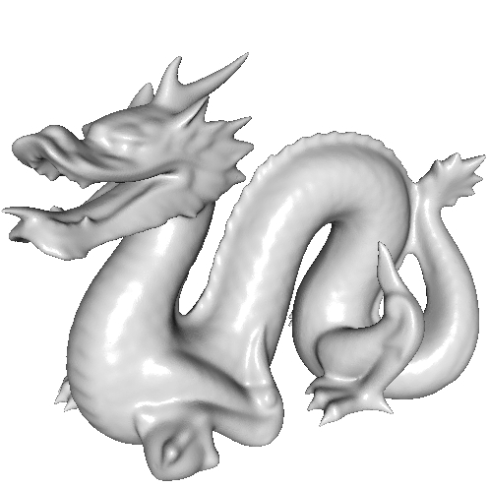
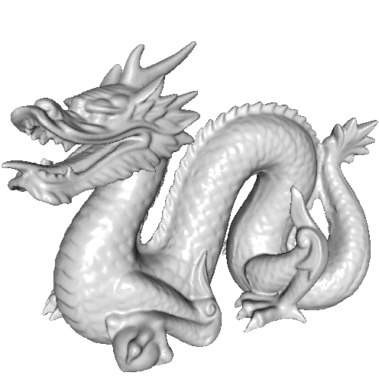
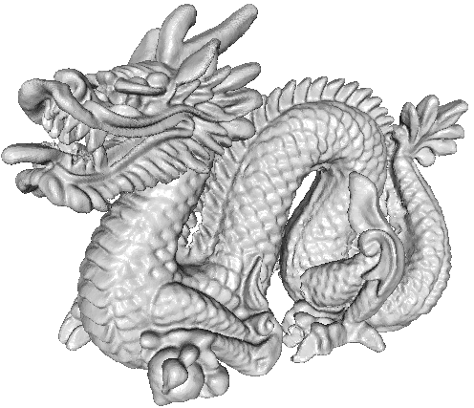
Gradient Domain (Sharpening)
Fit input colors: $g=f^{in}$
Amplify input gradients: $\vec{v}=β⋅\text{∇}f^{in}$
$$f^{out}=\underset{f:Ω→ℝ}{argmin}{\int_{Ω}{{α\left\|f−f^{in}\right\|}^{2}+{\left\|\text{∇}f−β⋅\text{∇}f^{in}\right\|}^{2}} }$$
value-fitting
gradient-fitting
$$β<1$$
$$β>1$$
Setting $f^{in}$ to the positions of the vertices in 3D

Slide 28
Outline
Motivation
Tools of the Trade
Extensions to Signals on Surfaces
Gradient Domain [Poisson]
Shock Filters [Advection]
Optical Flow [Poisson + Advection]
Conclusion

Slide 29
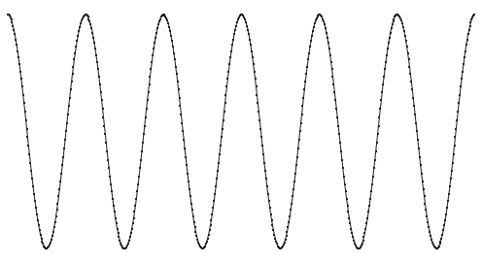
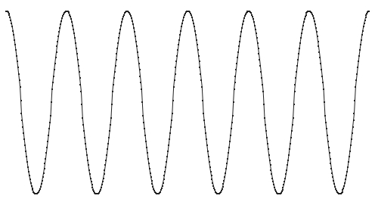
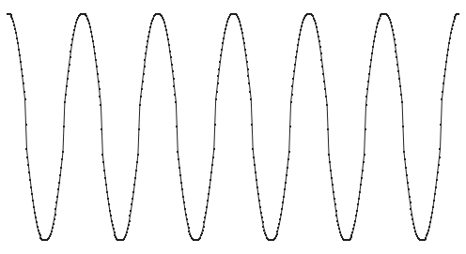
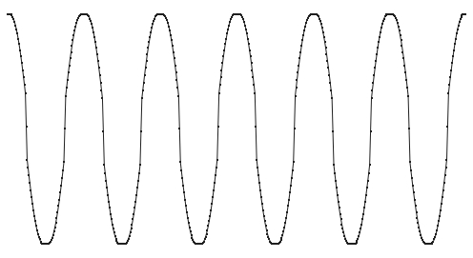
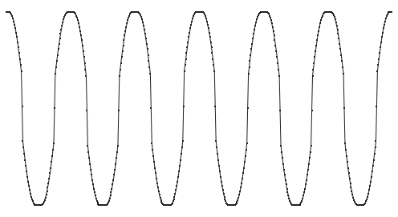
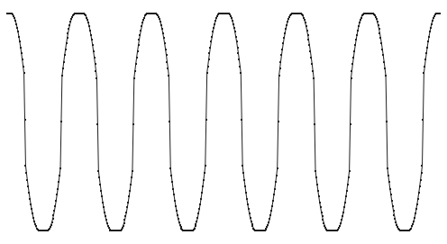
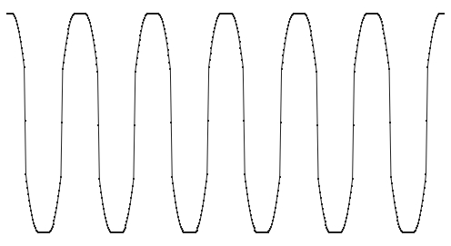
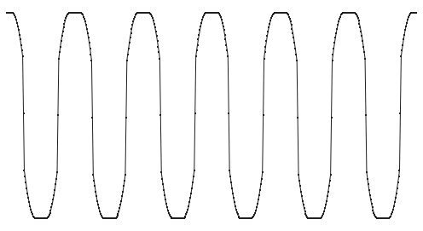
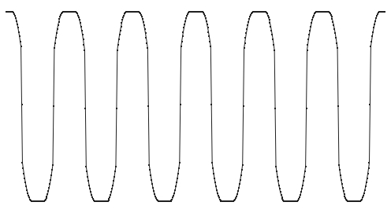
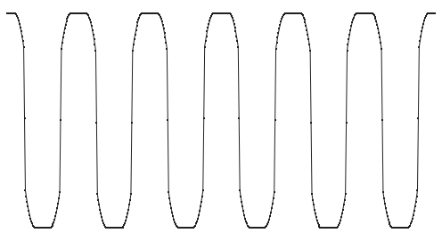
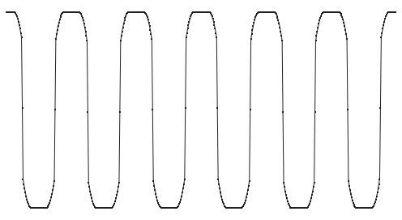
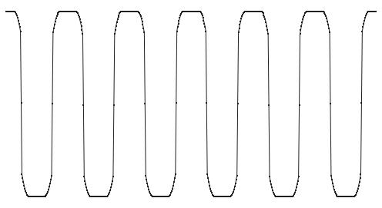
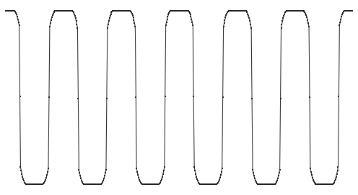
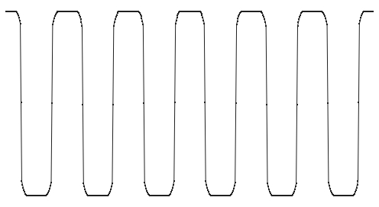
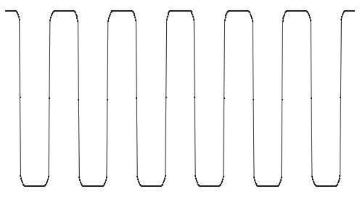
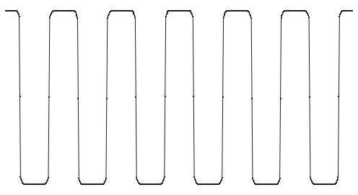
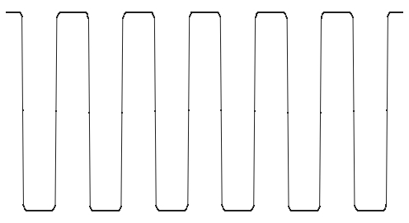
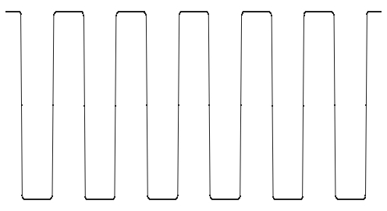
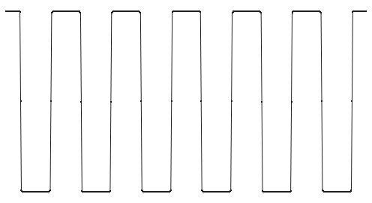
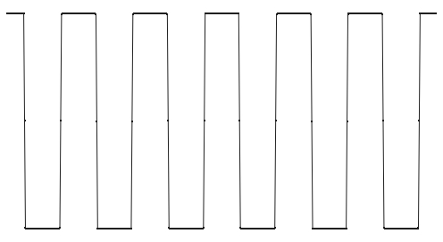
Shock Filters
[Osher and Rudin, 1990]:
Progressively sharpen a signal so that:
Extrema preserved
Edges pronounced
Lower-valued side $→$ local minimum
Higher-valued side $→$ local maximum

Slide 30
Shock Filters
[Osher and Rudin, 1990]:
Progressively sharpen a signal so that:
Extrema preserved
Edges pronounced
$→$ $ℱ$ vanishes with the gradient
$→$ $𝒢$ gives the sign w.r.t. the edge
[Osher and Rudin, 1990] Solve the PDE by carefully adapting step-sizes.
$$\frac{df}{dt}=ℱ\left(f\right)⋅𝒢(f)$$
$$ℱ\left(f\right)={\left\|\text{∇}f\right\|}^{2}$$
$$𝒢\left(f\right)=−\frac{∂^{2}f}{∂{\left({\text{∇}f}/{\left\|\text{∇}f\right\|}\right)}^{2}}$$
(Second derivative in the gradient direction)

Slide 31
Shock Filters
Method of Characteristics:
We can re-write the PDE: $$\frac{df}{dt}=ℱ\left(f\right)⋅𝒢(f)$$
$$=−\left\langle \text{∇}f,H_{f}⋅\text{∇}f\right\rangle$$
This describes the advection of $f$ along the flow: $$\vec{v}=H_{f}⋅\text{∇}f=\frac{1}{2}\text{∇}{\left\|\text{∇}f\right\|}^{2}$$
$$ℱ\left(f\right)={\left\|\text{∇}f\right\|}^{2}$$
$$𝒢\left(f\right)=−\frac{∂^{2}f}{∂{\left({\text{∇}f}/{\left\|\text{∇}f\right\|}\right)}^{2}}$$
$$=−\frac{1}{{\left\|\text{∇}f\right\|}^{2}}\left\langle \text{∇}f,H_{f}⋅\text{∇}f\right\rangle$$

Slide 32
Shock Filters
$$f$$
Sharpen $f$ by advecting along the flow: $$\vec{v}=\frac{1}{2}\text{∇}{\left\|\text{∇}f\right\|}^{2}$$
ShockAdvect( $f$ , $t$ )
$P←{\left\|\text{∇}f\right\|}^{2}$ // potential
$\vec{v}←\frac{1}{2}\text{∇}P$ // flow field
return Advect( $f$ , $\vec{v}$ , $t$ )
$$P={\left\|\text{∇}f\right\|}^{2}$$
$$\vec{v}={\text{∇}P}/2$$

Slide 33
Shock Filters
Intuitively:
Values are transported along flow lines of the potential’s gradient, moving from the (local) minima to maxima:
[Minima] Critical points of the input
[Maxima] Edges of the output
$⇒$ “Piecewise constant” image with input extrema advected out to the edges.
$$f$$
$$P={\left\|\text{∇}f\right\|}^{2}$$
$$\vec{v}={\text{∇}P}/2$$

Slide 34
Shock Filters
Sharpen $f$ by advecting along the flow: $$\vec{v}=\frac{1}{2}\text{∇}{\left\|\text{∇}f\right\|}^{2}$$
Input
Output

Slide 35
Shock Filters
Sharpen $f$ by advecting along the flow: $$\vec{v}=\frac{1}{2}\text{∇}{\left\|\text{∇}f\right\|}^{2}$$
Input
Output

Slide 36
Shock Filters
Sharpen $f$ by advecting along the flow: $$\vec{v}=\frac{1}{2}\text{∇}{\left\|\text{∇}f\right\|}^{2}$$
Input
Output
Setting $f$ to the normals of the vertices

Slide 37
Outline
Motivation
Tools of the Trade
Extensions to Signals on Surfaces
Gradient Domain [Poisson]
Shock Filters [Advection]
Optical Flow [Poisson + Advection]
Conclusion

Slide 38
Optical Flow
Video Textures:
Given a video, generate “a continuous, infinitely varying stream of video images”.
Video Textures. [Schödl, Szeliski, Salesin, and Essa, 2000]

Slide 39
Optical Flow
Extend video textures [Schödl et al., 2000] to 3D:

Slide 40
Optical Flow
Extend video textures [Schödl et al., 2000] to 3D:
Identify similar windows in the video
Fit a template to the windows
Interpolate geometries
Interpolate textures

Slide 41
Optical Flow
Image Interpolation:
Source
Target

Slide 42
Optical Flow
Image Interpolation (Linear):
Linear interpolation causes ghosting.
Source
Linear Blend
Target

Slide 43
Optical Flow
Image Interpolation (Advected):
Estimate optical flow field.
Source
Optical Flow Field
Target
Linear Blend

Slide 44
Optical Flow
Image Interpolation (Advected):
Estimate optical flow field.
Advect forward/backward and blend.
Source
Optical Flow Blend
Target
Linear Blend

Slide 45
Optical Flow
Brightness Constancy [Lucas and Kanade, 1981]:
Solve for $\vec{v}$ that advects the source/target towards each other:
$$E\left(\vec{v}\right)={\left\|{Adv}_{−\vec{v}}\left(f^{t}\right)−{Adv}_{\vec{v}}\left(f^{s}\right)\right\|}^{2}$$
$$≈{\left\|\left(f^{t}−f^{s}\right)+〈\text{∇}\left(f^{t}+f^{s}\right),\vec{v}〉\right\|}^{2}$$
Estimate $\vec{v}$ hierarchically (coarse-to-fine):
Advance the source/target along $\vec{v}$
Solve for the correcting flow
Add the correcting flow to $\vec{v}$
Advance to the next level of the hierarchy
Smooth signals/vector-fields are implicitly mandated by working in a space that does not have high-frequencies.

Slide 46
Optical Flow
Scale Space Formulation:
Smooth solutions are explicitly encouraged by:
Smoothing the source and target at each level: $E\left({\tilde{f}}^{s/t}\right)={\left\|{\tilde{f}}^{s/t}−f^{s/t}\right\|}^{2}+{\frac{α}{4^{l}}\left\|\text{∇}{\tilde{f}}^{s/t}\right\|}^{2}$
Incorporating a smoothness term in the energy:
$$E\left(\vec{v}\right)={\left\|{Adv}_{\vec{v}}\left({\tilde{f}}^{s}\right)−{Adv}_{−\vec{v}}\left({\tilde{f}}^{t}\right)\right\|}^{2}+\frac{α}{4^{l}}{\left\|\text{∇}\vec{v}\right\|}^{2}$$
Solve two Poisson equations per level.*
fitting term
level-weighted smoothness term
brightness constancy term
level-weighted smoothness term
*In the second, the Laplacian is the vector-field (Hodge) Laplacian.

Slide 47
Optical Flow
Optical Flow Field
Texture Interpolation:
Source
Target
Synthesized

Slide 48
Optical Flow
Texture Interpolation:
Linear Blend
Optical Flow Blend

Slide 49
Outline
Motivation
Tools of the Trade
Extensions to Signals on Surfaces
Conclusion

Slide 50
Conclusion
Extend fundamental image-processing operators to the context of surfaces [Differential Operators / Flows]
Well-established image-processing techniques carry over [Gradient Domain / Shock Filters / Optical Flow]
Much of the heavy lifting has already been done for us

Slide 51
Conclusion
Working with images makes simple things easier.
0
1
0
x[i][j+1]
v[i][j]
1
-4
1
x
x[i-1][j]
x[i][j]
x[i+1][j]
=
h[i-1][j]
h[i][j]
v[i][j-1]
0
1
0
x[i][j-1]
Fixed stencil Laplacian / Gradient / Divergence Parallelization / Out-of-Core Streaming
Fast Fourier Transform

Slide 52
Conclusion
Working with images makes simple things easier.
Working with meshes makes hard things easier.
$$f^{out}=\underset{f:Ω→ℝ}{argmin}{\int_{Ω}{{α\left\|f−f^{in}\right\|}^{2}+{\left\|\text{∇}f−β⋅\text{∇}f^{in}\right\|}^{2}} }$$
$$β=0$$
$$α=1$$
$$β=0$$
$$α={|κ}_{1}|+|κ_{2}|$$
Setting $α$ be a spatially varying weighting function

Slide 53
Estimating the Laplace-Beltrami Operator by Restricting 3D Functions. [Chuang et al., 2009]
Fast Mean-Curvature Flow via Finite Elements Tracking. [Chuang et al., 2011]
Interactive and Anisotropic Geometry Processing Using the Screened Poisson Equation. [Chuang et al., 2011]
Unconditionally Stable Shock Filters for Image and Geometry Processing. [Prada et al., 2015]
Motion Graphs for Unstructured Textured Meshes. [Prada et al., 2016]
Thank You!
Ming Chuang , Fabian Prada, Alvaro Collet, Linjie Luo, Benedict Brown
Szymon Rusinkiewicz, Hugues Hoppe
http://www.cs.jhu.edu/~misha/Code/PoissonMesh/GeometryEditor/
http://www.cs.jhu.edu/~misha/Code/AdvectionSharpening/
http://www.cs.jhu.edu/~misha/Code/SurfaceOpticalFlow/

Slide 55
Shock Filter Advection
Properties:
Lagrangian Implementation Sampling $→$ antialised output edges
One-Step Integration Use a single (long) stream-line per pixel
Input
PDE [O&R]
Advection

Slide 56
Gradient Domain (Sharpening)
Fit input colors: $g=f^{in}$
Amplify input gradients: $\vec{v}=β⋅\text{∇}f^{in}$
$$f^{out}=\underset{f:Ω→ℝ}{argmin}{\int_{Ω}{{α\left\|f−f^{in}\right\|}^{2}+{\left\|\text{∇}f−β⋅\text{∇}f^{in}\right\|}^{2}} }$$
Setting $α$ to be an anisotropic scaling of the metric

