Slide 1
The Poisson System:
From Images to Geometry
Misha Kazhdan

Slide 2
Outline
  Why the Poisson Equation?
  Applications in Detail
  Summary

Slide 3
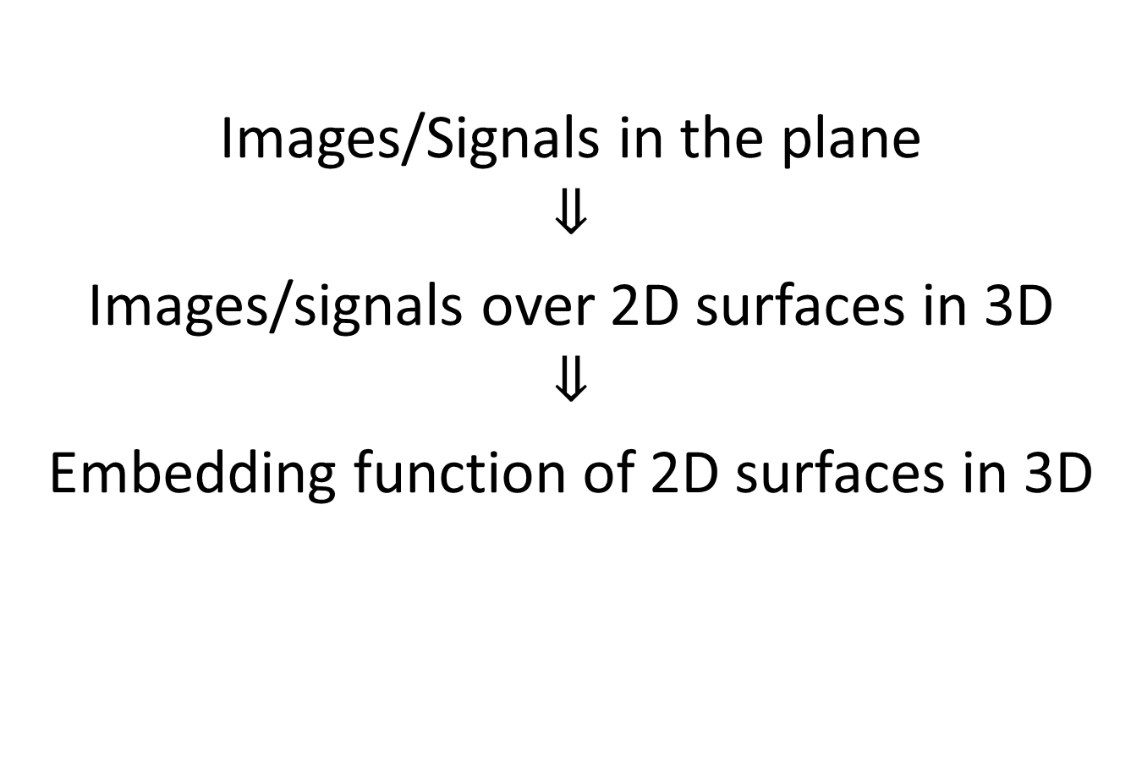
Images/Signals in the plane
$$⇓$$
Images/signals over 2D surfaces in 3D
$$⇓$$
Embedding function of 2D surfaces in 3D

Slide 4
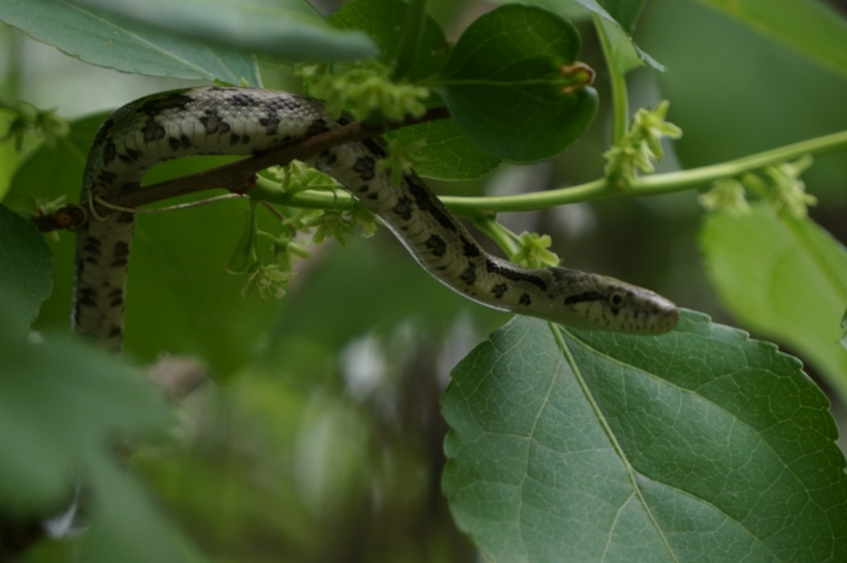
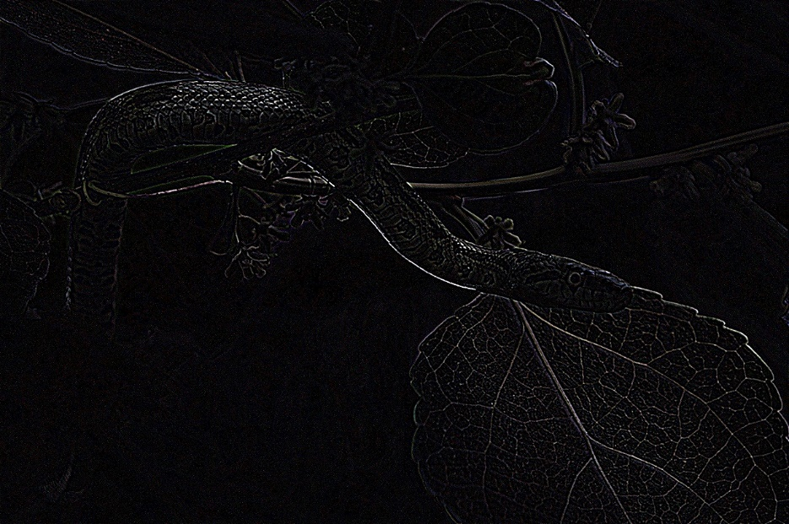





The Laplacian
[Analytic] Divergence of the gradient:
$Δu=div\left(grad\left(u\right)\right)$
[Geometric] Difference from local average:
$Δu\left(p\right)=\lim_{r→0}{\frac{4}{r^{2}}\left(Avg_{B_{r}\left(p\right)}\left(u\right)−u\left(p\right)\right)}$
$$B_{r}(p)$$
$$p$$
$$u$$
$$Δu$$

Slide 5
Why the Poisson Equation?
  Spectra and isometry
  Vector-fields
  Heat diffusion
  Gradient-fitting

Slide 6
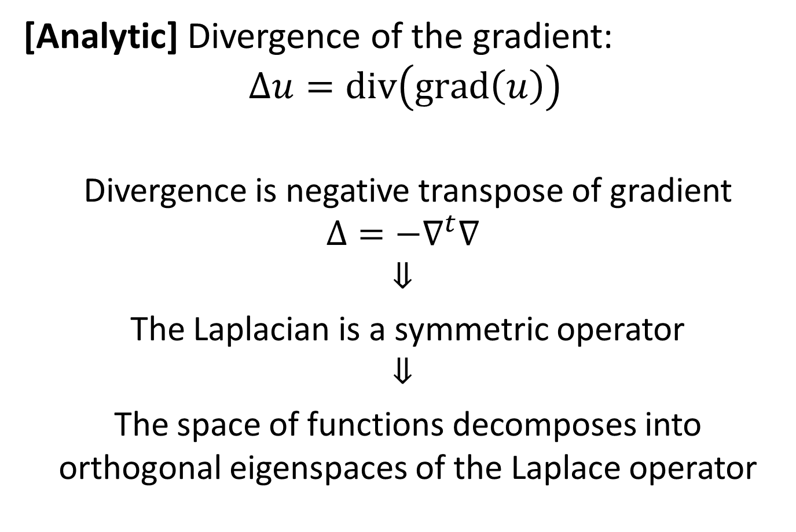
Spectra and Isometry
[Analytic] Divergence of the gradient:
$$Δu=div\left(grad\left(u\right)\right)$$
Divergence is negative transpose of gradient
$$Δ=−∇^{t}∇$$
$$⇓$$
The Laplacian is a symmetric operator
$$⇓$$
The space of functions decomposes into orthogonal eigenspaces of the Laplace operator

Slide 7
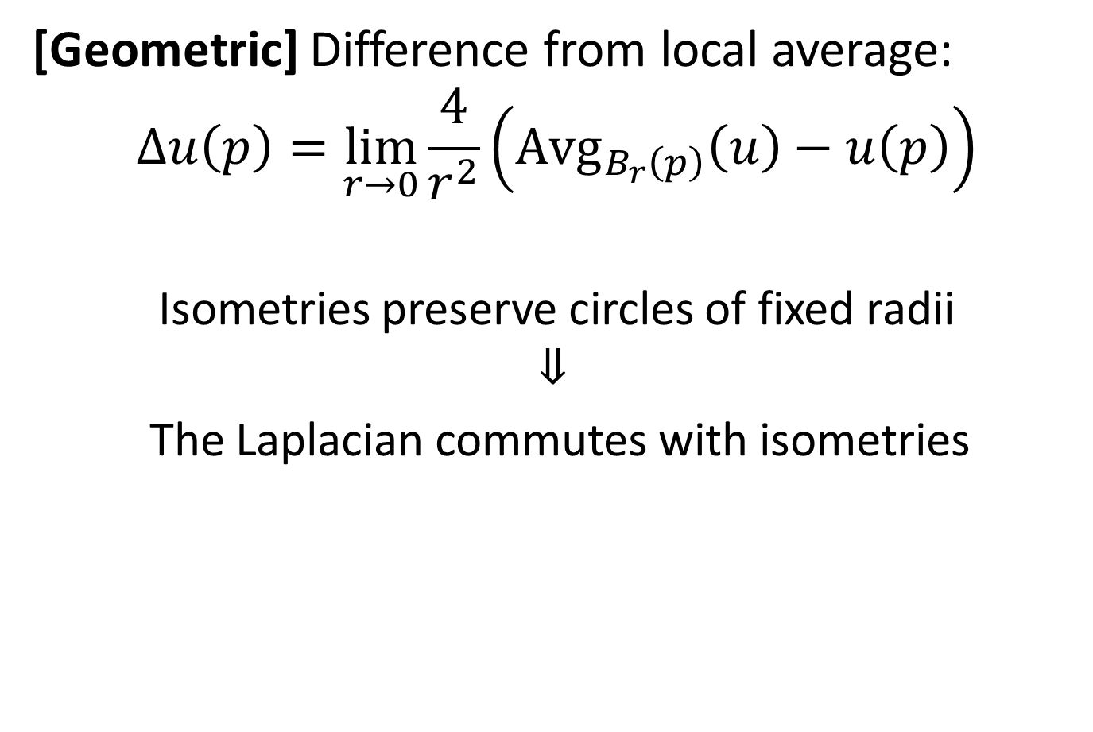
Spectra and Isometry
[Geometric] Difference from local average:
$$Δu\left(p\right)=\lim_{r→0}{\frac{4}{r^{2}}\left(Avg_{B_{r}\left(p\right)}\left(u\right)−u\left(p\right)\right)}$$
Isometries preserve circles of fixed radii
$$⇓$$
The Laplacian commutes with isometries

Slide 8
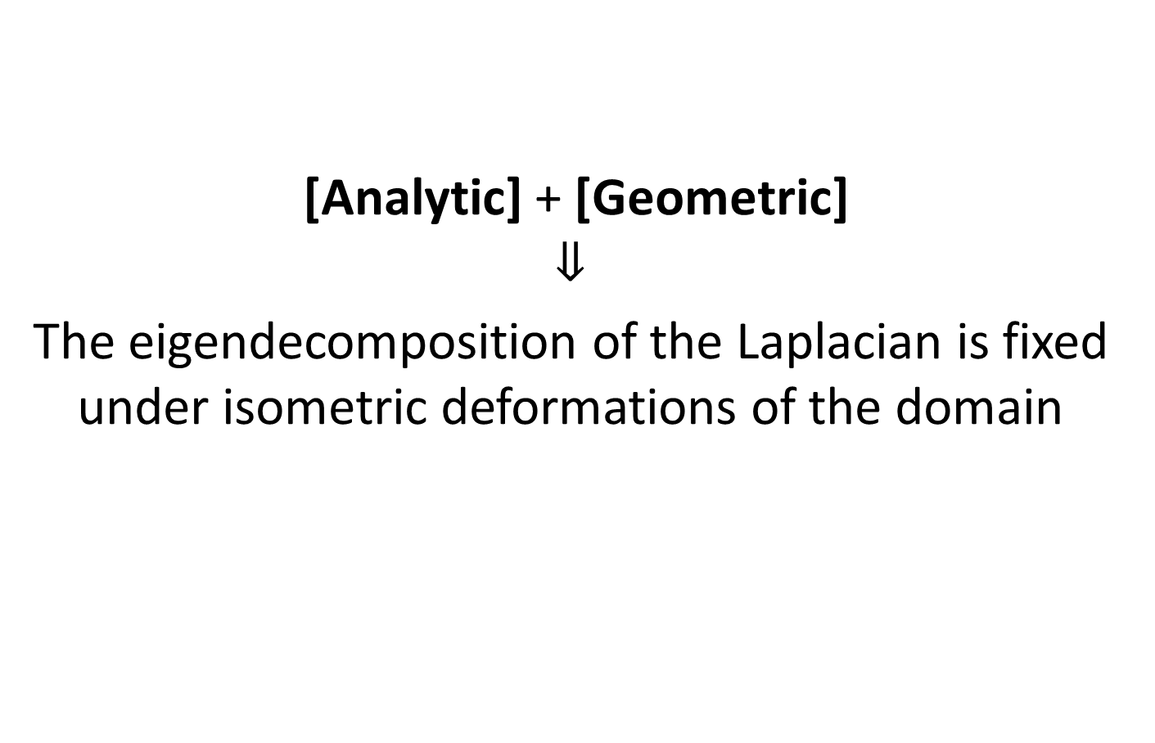
Spectra and Isometry
[Analytic] + [Geometric]
$$⇓$$
The eigendecomposition of the Laplacian is fixed under isometric deformations of the domain

Slide 9
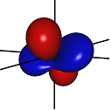
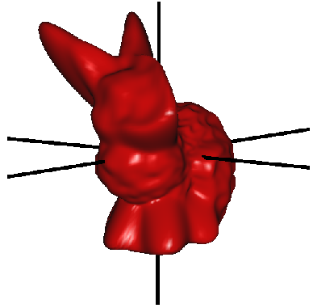
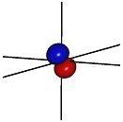
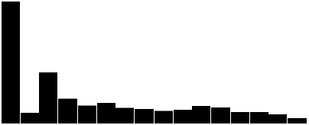
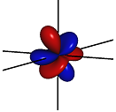
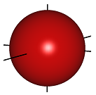
Spectra and Isometry: Applications
Isometry invariant representations
  Amplitudes of a signal
Spherical
Signal
Constant
1st Order
2nd Order
3rd Order
…
=
+
+
+
+
Notes:
Hint at spherical harmonics as defined in terms of the Laplacian

Slide 10
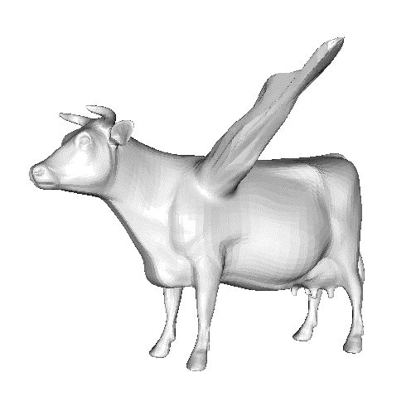
Spectra and Isometry: Applications
Isometry invariant representations
  Amplitudes of a signal
  Modes of vibration
  [Kac, 1966] [Reuter et al., 2005]
Notes:
Hint at spherical harmonics as defined in terms of the Laplacian

Slide 11
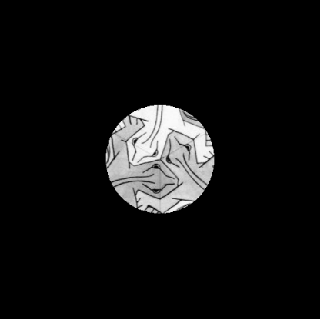
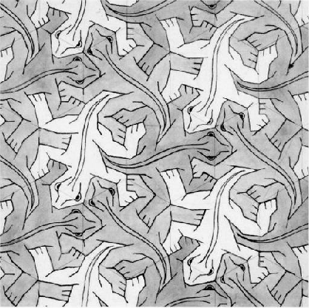
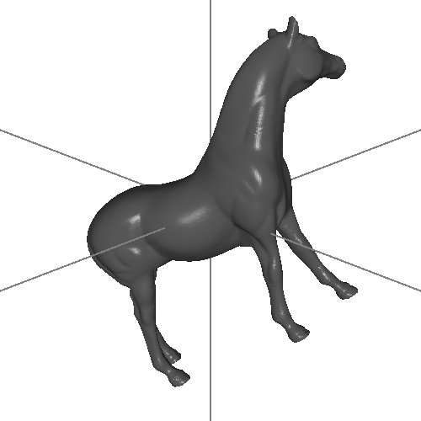
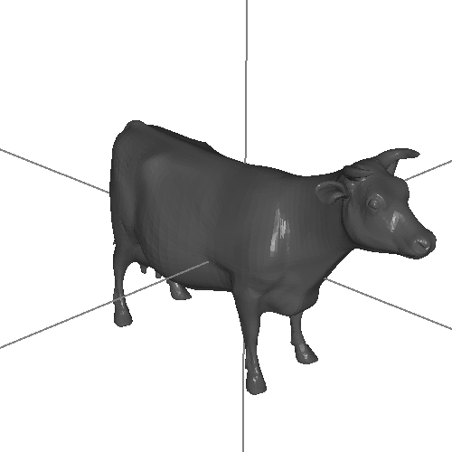
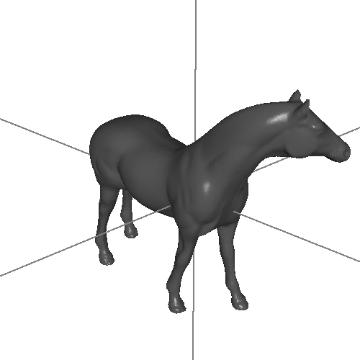


Spectra and Isometry: Applications
Convolution is multiplication in frequency space:
  Matching/Registration
$$⊂$$

Slide 12
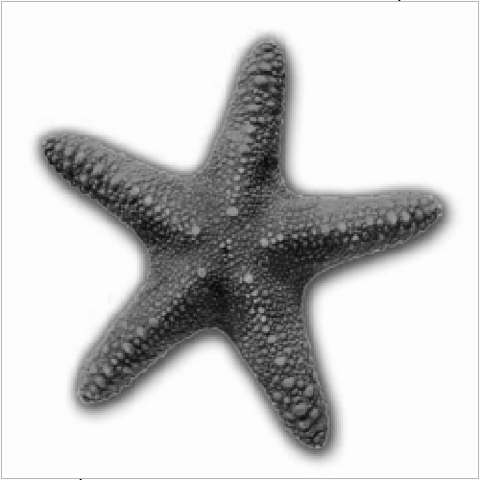
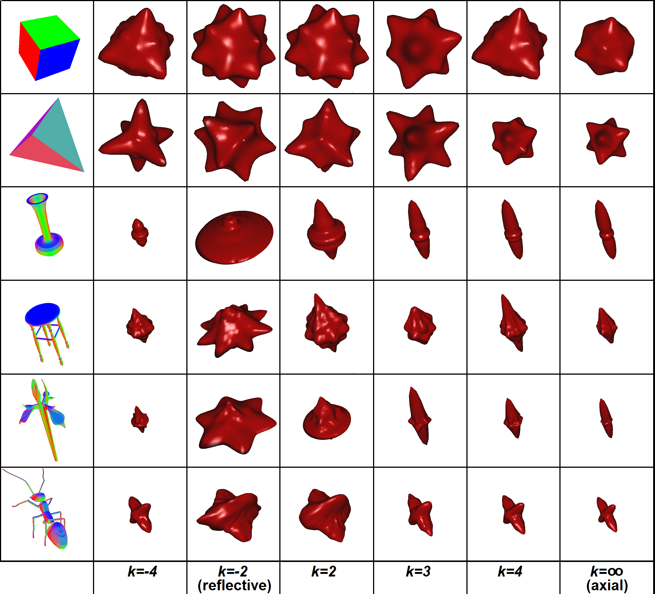
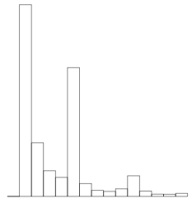
Spectra and Isometry: Applications
Convolution is multiplication in frequency space:
  Matching/Registration
  Symmetry detection
1
2
3
4
5
6
Rotational Symmetry
Notes:
Hint at spherical harmonics as defined in terms of the Laplacian

Slide 13
Why the Poisson Equation?
  Spectra and isometry
  Vector-fields
  Heat diffusion
  Gradient-fitting

Slide 14
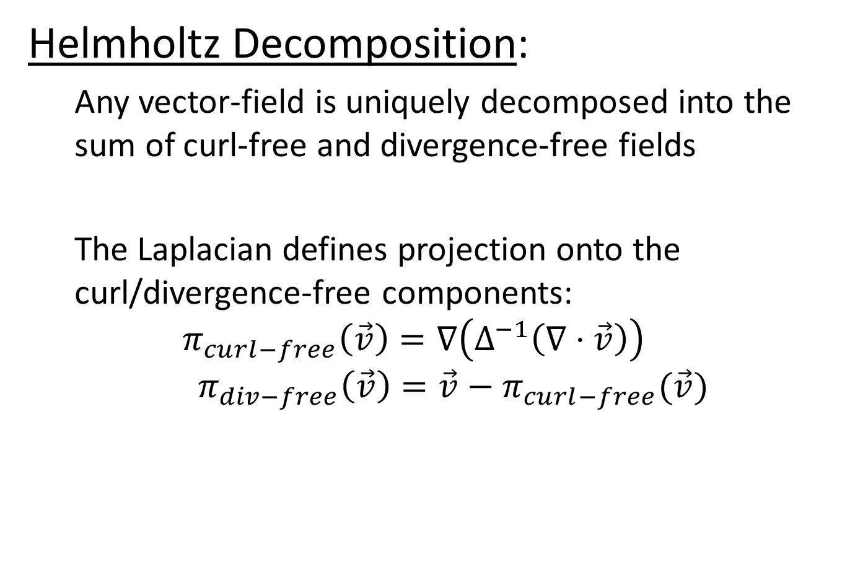
Vector Fields
Helmholtz Decomposition:
  Any vector-field is uniquely decomposed into the sum of curl-free and divergence-free fields
  The Laplacian defines projection onto the curl/divergence-free components:
  $$π_{curl−free}\left(\vec{v}\right)=∇\left(Δ^{−1}\left(∇⋅\vec{v}\right)\right)$$
  $${ π}_{div−free}\left(\vec{v}\right)=\vec{v}−π_{curl−free}(\vec{v})$$

Slide 15
Vector Fields: Applications
Stable Fluids [Stam, 1999]
  Advect the velocity field
  Add external forces
  Project onto divergence-free fields
The Poisson equation in the plane can be solved efficiently using the FFT
It can be solved on the sphere using the fast spherical harmonic transform
And it can be solved with a general-purpose solver to simulate fluids on surfaces of arbitrary topology

Slide 16
Why the Poisson Equation?
  Spectra and isometry
  Vector-fields
  Heat diffusion
  Gradient-fitting

Slide 17
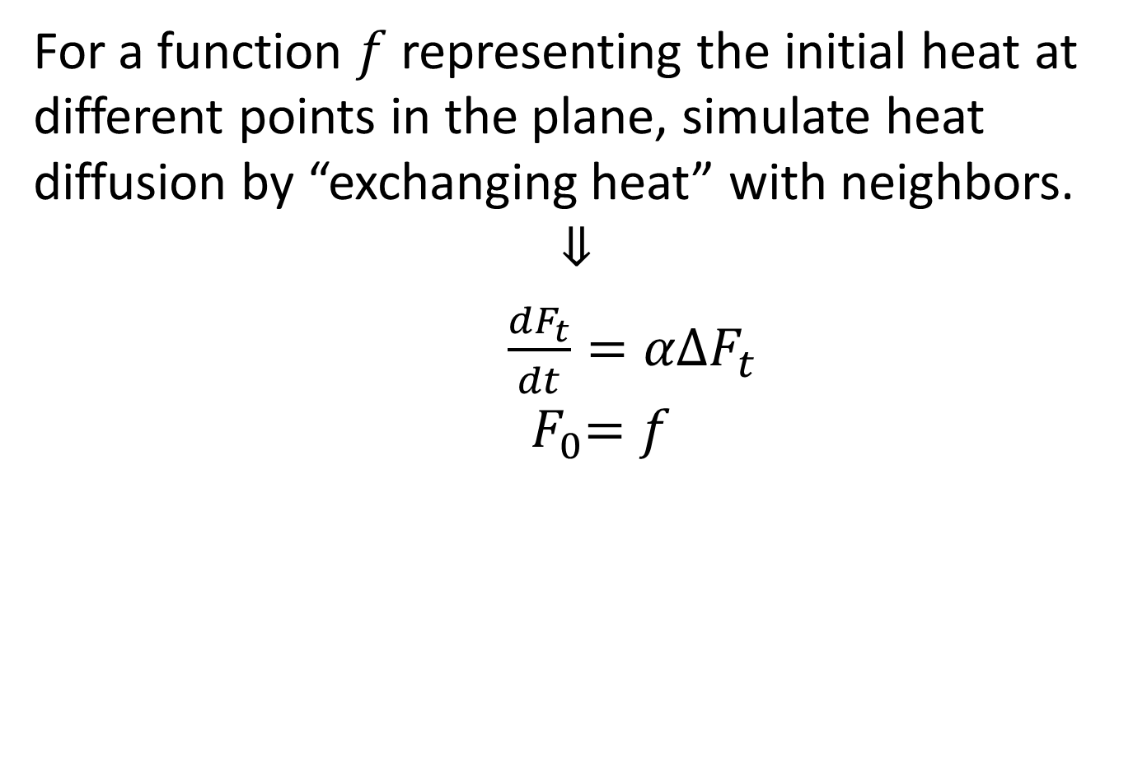
Heat-Diffusion
For a function $f$ representing the initial heat at different points in the plane, simulate heat diffusion by “exchanging heat” with neighbors.
$$⇓$$
$\frac{dF_{t}}{dt}=αΔF_{t}$
$${ F}_{0}=f$$
Notes:
Point to the fact that this derives from the “difference from neighbors” interpretation

Slide 18
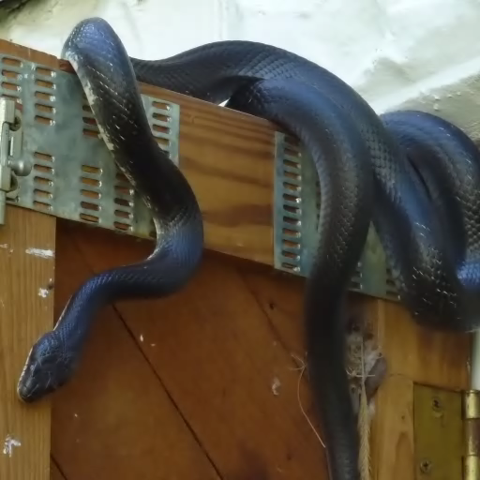
Heat-Diffusion: Applications
Function smoothing:
  Images in the plane

Slide 19
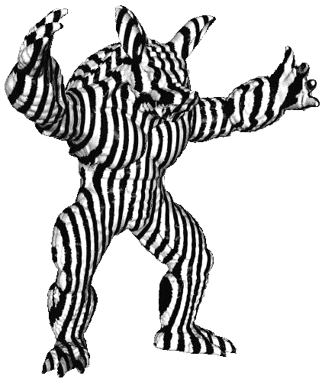
Heat-Diffusion: Applications
Function smoothing:
  Images in the plane
  Textures on a surface

Slide 20
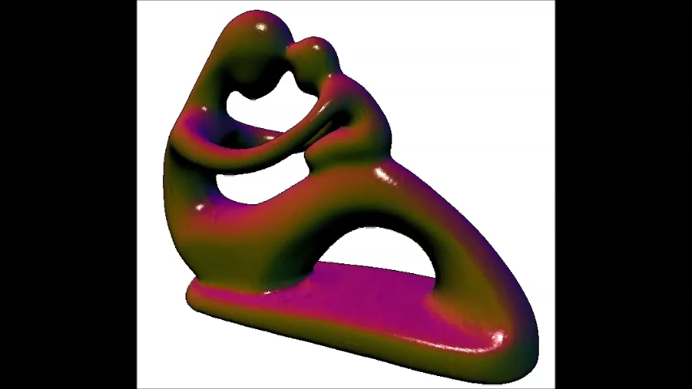
Heat-Diffusion: Applications
Function smoothing:
  Images in the plane
  Textures on a surface
  The surface embedding
    This is mean-curvature flow
    Applications in skeletonization
    [Au et al. ’08] [Tagliasacchi et al. ’12]
Notes:
Hint at heat kernel signatures

Slide 21
Why the Poisson Equation?
  Spectra and isometry
  Vector-fields
  Heat diffusion
  Gradient-fitting

Slide 22
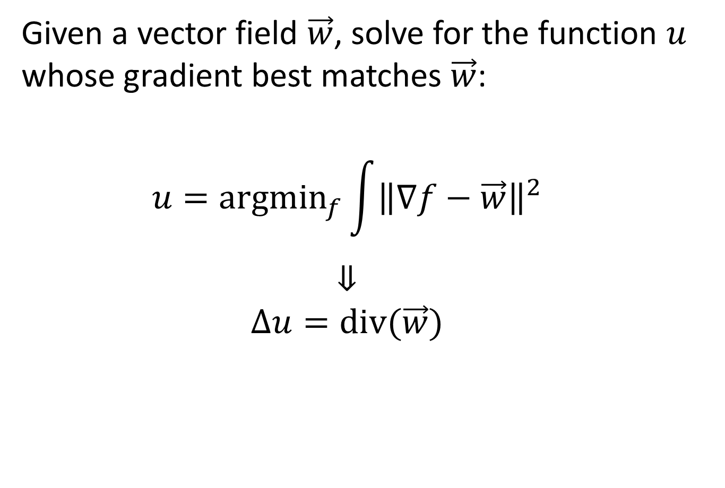
Gradient-Fitting
Given a vector field $\vec{w}$, solve for the function $u$ whose gradient best matches $\vec{w}$:
  $$u=argmin_{f}\int{{\left\|∇f−\vec{w}\right\|}^{2}}$$
  $$⇓$$
  $$Δu=div(\vec{w})$$
Notes:
Point to the fact that this derives from the “divergence of gradient” interpretation

Slide 23
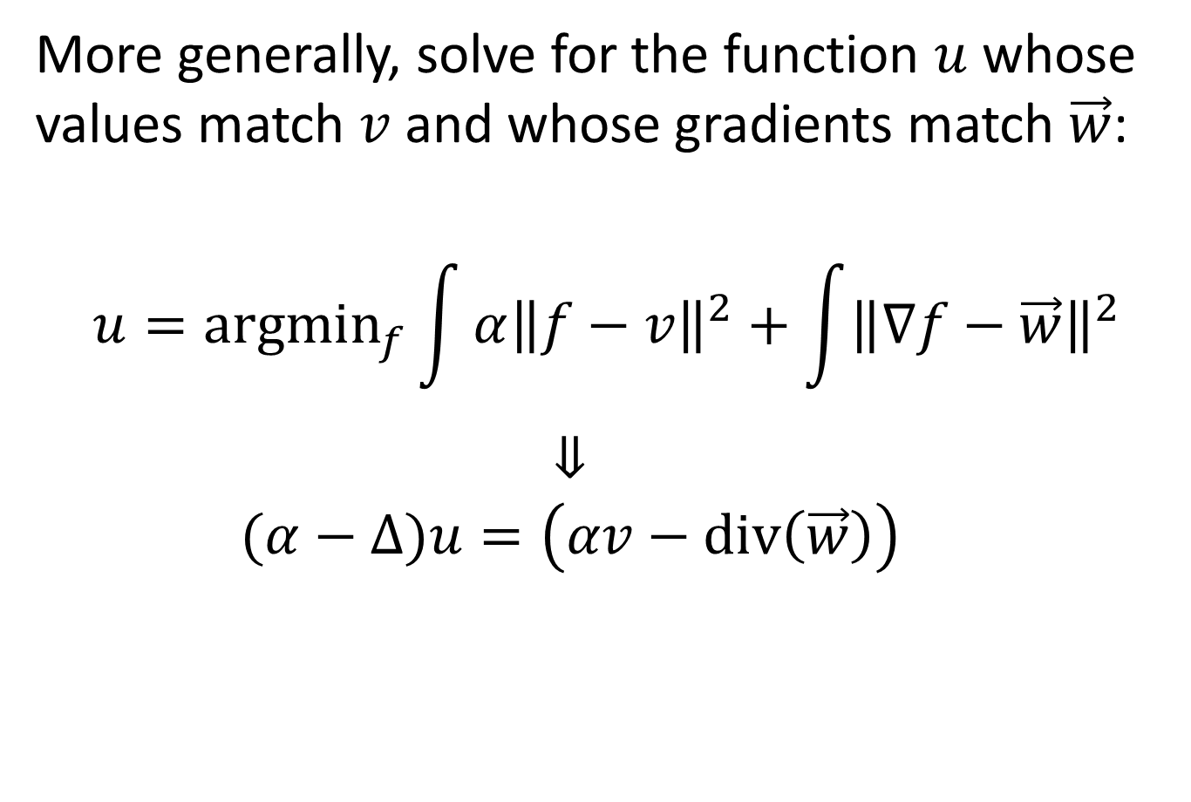
Gradient-Fitting
More generally, solve for the function $u$ whose values match $v$and whose gradients match $\vec{w}$:
  $$u=argmin_{f}\int{α{\left\|f−v\right\|}^{2}}+\int{{\left\|∇f−\vec{w}\right\|}^{2}}$$
  $$⇓$$
  $$(α−Δ)u=\left(αv−div\left(\vec{w}\right)\right)$$
Notes:
Point to the fact that this derives from the “divergence of gradient” interpretation

Slide 24
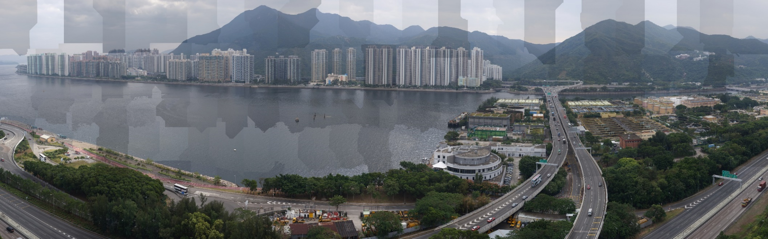
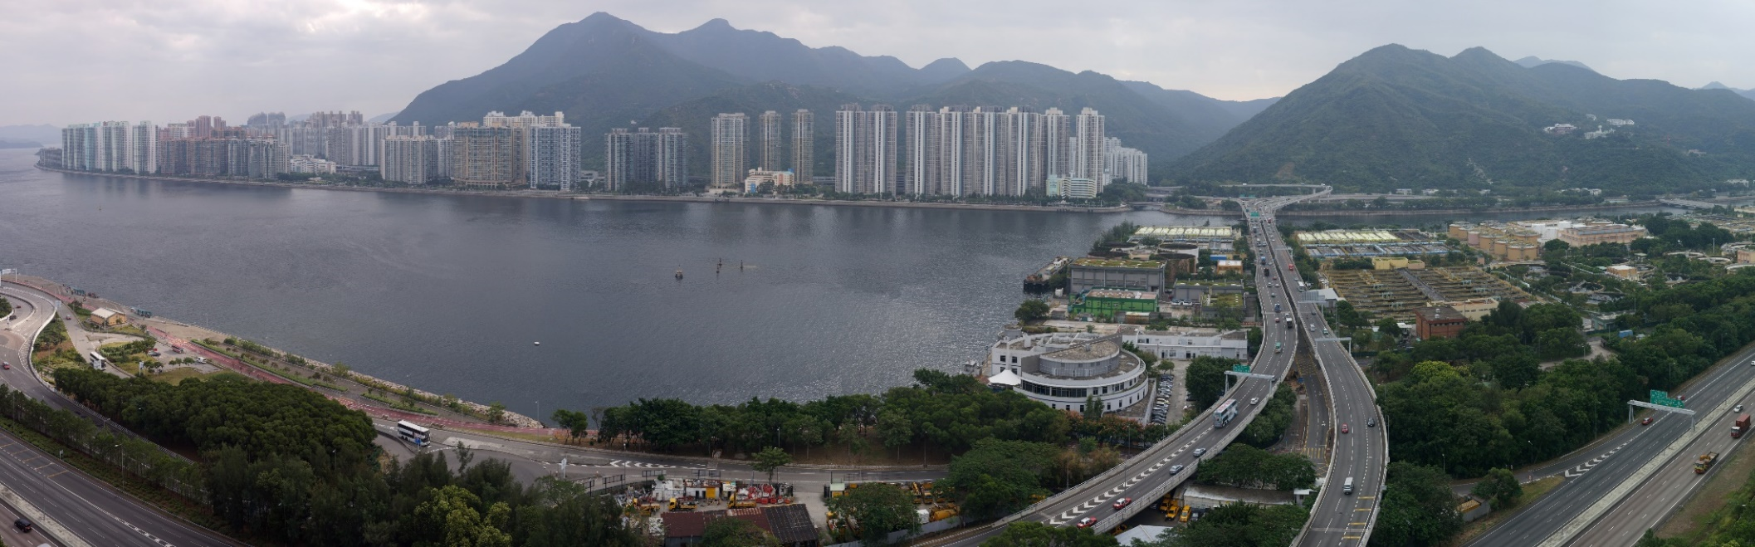

Gradient-Fitting: Applications
Gradient-Domain Stitching:
  Define the gradients of the desired signal
  Solve for the best fitting signal.
  $$u=argmin_{f}∫{\left\|∇f−\vec{w}\right\|}^{2}$$

Slide 25
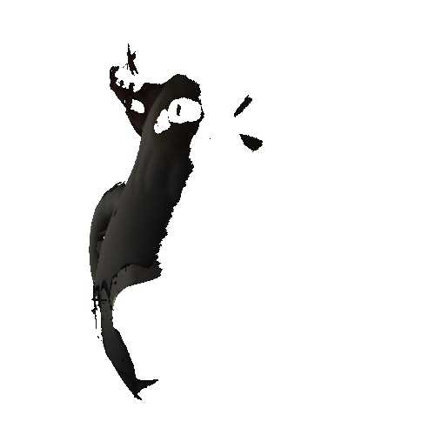
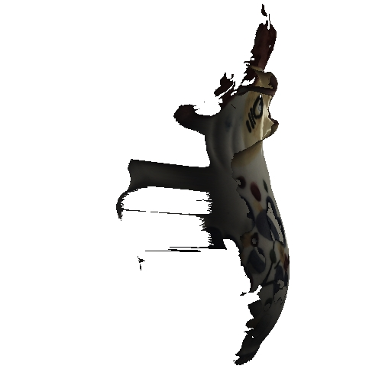
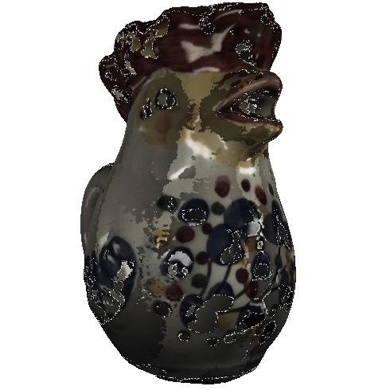
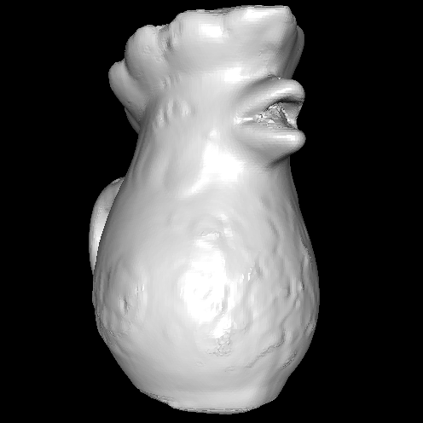
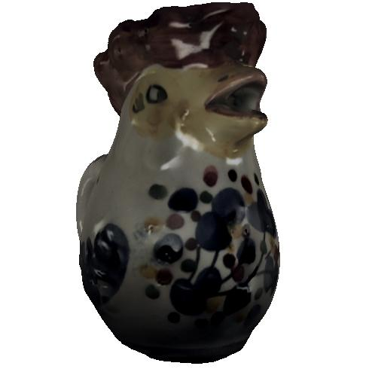
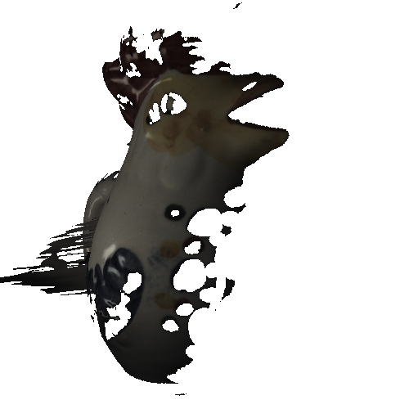
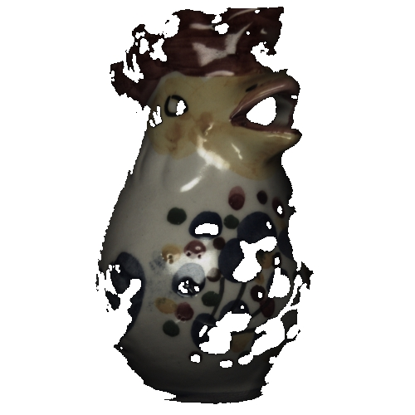
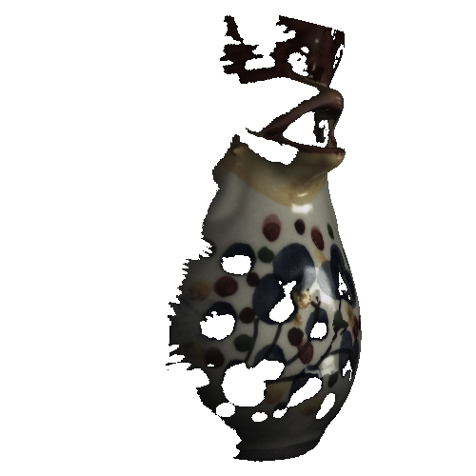
Gradient-Fitting: Applications
Gradient-Domain Stitching:
  Define the gradients of the desired signal
  Solve for the best fitting signal.
  $$u=argmin_{f}∫{\left\|∇f−\vec{w}\right\|}^{2}$$

Slide 26
Gradient-Fitting: Applications
Gradient-Domain Stitching:
  Define the gradients of the desired signal
  Solve for the best fitting signal.
  $$u=argmin_{f}∫{\left\|∇f−\vec{w}\right\|}^{2}$$
[Yu et al. 2004]

Slide 27
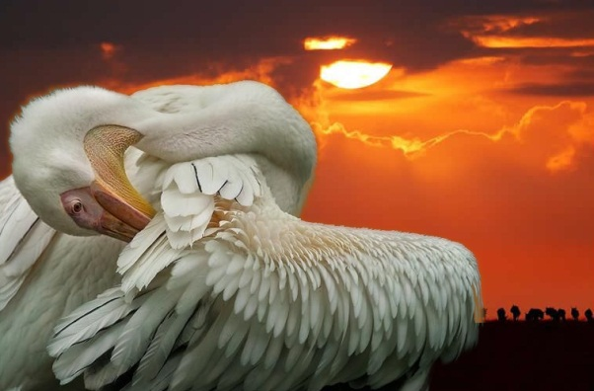



Gradient-Fitting: Applications
Gradient-Domain Smoothing/Sharpening:
  Solve for a new signal that matches:
    The values of the old signal
    The scaled gradients of the old signal
$$u^{new}=argmin_{f}∫α{\left\|f−u^{old}\right\|}^{2}+∫{\left\|∇f−β∇u^{old}\right\|}^{2}$$
$$β>1$$
[Bhat et al. 2008]

Slide 28
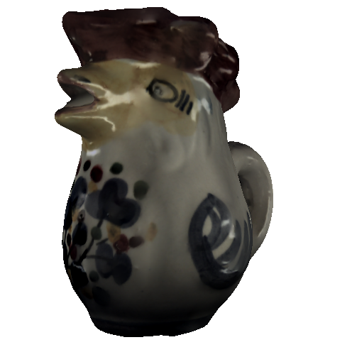
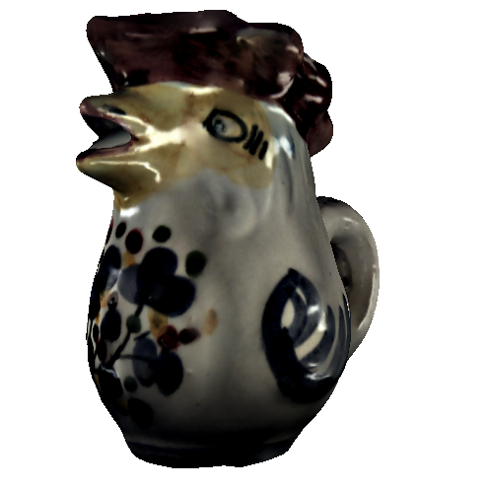
Gradient-Fitting: Applications
Gradient-Domain Smoothing/Sharpening:
  Solve for a new signal that matches:
    The values of the old signal
    The scaled gradients of the old signal
$$u^{new}=argmin_{f}∫α{\left\|f−u^{old}\right\|}^{2}+∫{\left\|∇f−β∇u^{old}\right\|}^{2}$$
$$β>1$$

Slide 29
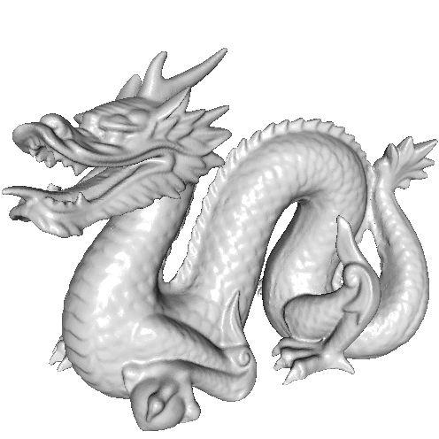
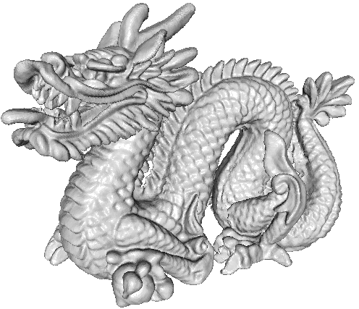
Gradient-Fitting: Applications
Gradient-Domain Smoothing/Sharpening:
  Solve for a new signal that matches:
    The values of the old signal
    The scaled gradients of the old signal
$$u^{new}=argmin_{f}∫α{\left\|f−u^{old}\right\|}^{2}+∫{\left\|∇f−β∇u^{old}\right\|}^{2}$$
$$β>1$$

Slide 30
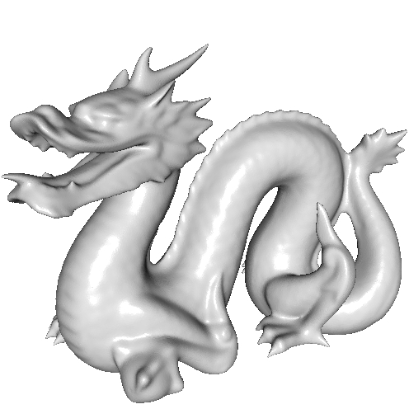


Gradient-Fitting: Applications
Gradient-Domain Smoothing/Sharpening:
  Solve for a new signal that matches:
    The values of the old signal
    The scaled gradients of the old signal
$$u^{new}=argmin_{f}∫α{\left\|f−u^{old}\right\|}^{2}+∫{\left\|∇f\right\|}^{2}$$
$$β=0$$
This can be interpreted as an integration step in heat-diffusion.
Notes:
Hint at the relationship to mean-curvature flow.

Slide 31
Applications in Detail
  Mean Curvature Flow
    [Kazhdan, Solomon, and Ben-Chen. SGP 2012]
  Interactive Surface Editing
http://www.cs.jhu.edu/~misha/Code/ConformalizedMCF/

Slide 32
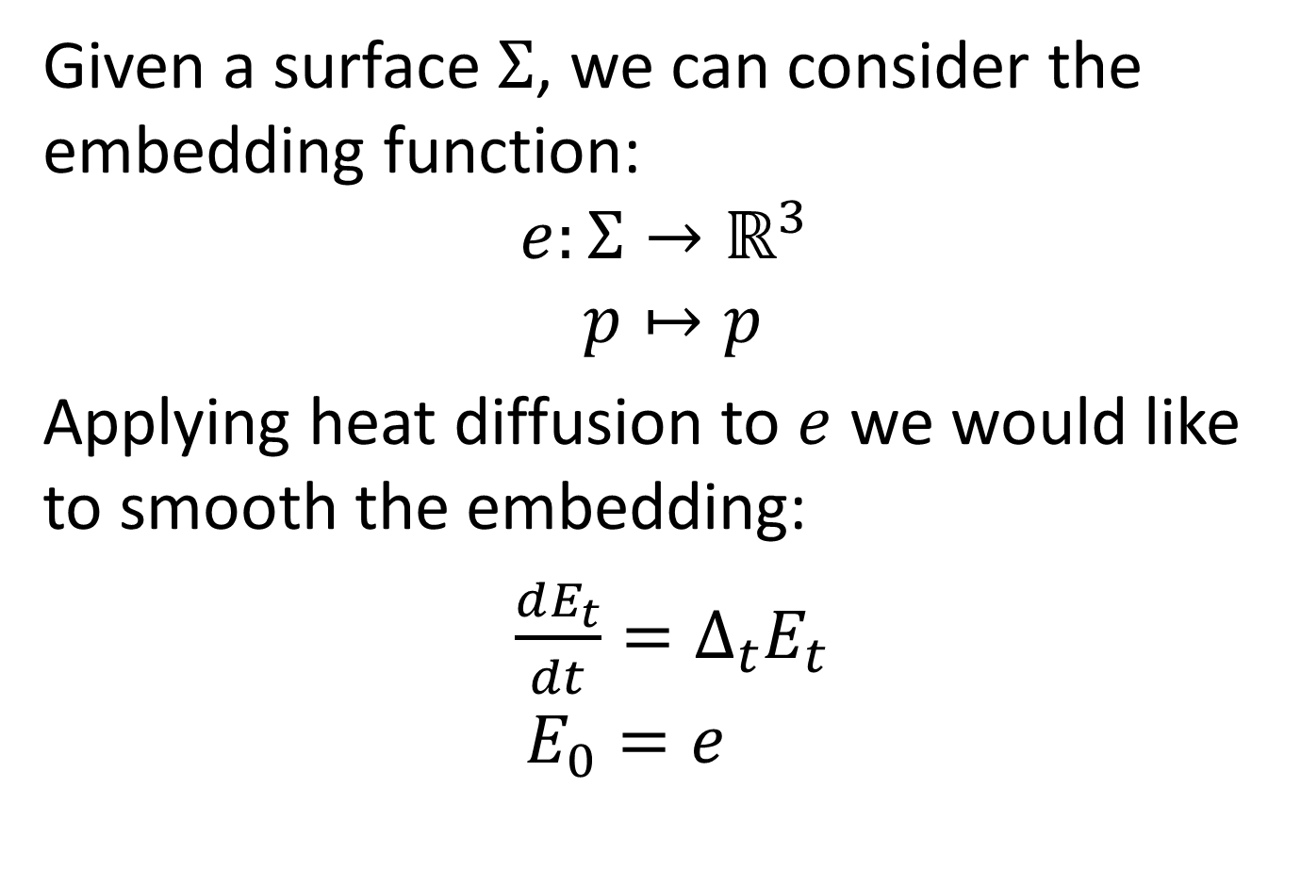
Mean Curvature Flow
Given a surface $Σ$, we can consider the embedding function:
$$e:Σ→ℝ^{3} \\ p↦p$$
Applying heat diffusion to $e$ we would like to smooth the embedding:
$\frac{dE_{t}}{dt}=Δ_{t}E_{t}$
$$E_{0}=e$$

Slide 33

Mean Curvature Flow
But mean curvature flow results in “neck pinches” which are not smooth…

Slide 34

Mean Curvature Flow
But mean curvature flow results in “neck pinches” which are not smooth…

Slide 35

Mean Curvature Flow
But mean curvature flow results in “neck pinches” which are not smooth…
We would like the
surface to evolve
so that geometry
becomes smoother.

Slide 36

Mean Curvature Flow
But mean curvature flow results in “neck pinches” which are not smooth…
We would like the
surface to evolve
so that geometry
becomes smoother.

Slide 37


Discretization
Given a finite function basis on $Σ$:
$$\left\{B_{1},…,B_{n}\right\}:Σ→ℝ$$
we express the mapping at time $t$ as:
$$E_{t}\left(p\right)=\sum_{i}{c_{i}^{t}B_{i}(p)} with c_{i}^{t}∈ℝ^{3}$$
0
0
0
1
0
0
0
hat basis

Slide 38

Discretization
Discretizing the spatial part of the diffusion PDE by projecting onto the basis gives:
$$\frac{dE_{t}}{dt}=Δ_{t}E_{t}$$
$$⇓$$
$$\left\langle \frac{dE_{t}}{dt},B_{i}\right\rangle =〈Δ_{t}E_{t},B_{i}〉 ∀ 1≤i≤n$$

Slide 39

Discretization
Discretizing the spatial part of the diffusion PDE by projecting onto the basis gives:
$$M^{t}\frac{d{\vec{c}}^{t}}{dt}=−S^{t}{\vec{c}}^{t}$$
with $M^{t}$ and $S^{t}$ the mass/stiffness matrices:
$$M_{ij}^{t}=\int_{M_{t}}{B_{i}⋅B_{j}} and S_{ij}^{t}=\int_{M_{t}}{〈∇_{t}B_{i},∇_{t}B_{j}〉}$$
For the hat-basis, this gives the cotan Laplacian.

Slide 40

Discretization
Semi-implicitly discretizing the temporal part of the diffusion PDE gives:
$$M^{t}\frac{d{\vec{c}}^{t+ε}}{dt}=−S^{t}{\vec{c}}^{t+ε}$$
$$M^{t}\frac{\left({\vec{c}}^{t+ε}−{\vec{c}}^{t}\right)}{ε}≈$$
So the coefficients at $t+ε$ are the solution to:
$$\left(M^{t}+εS^{t}\right){\vec{c}}^{t+ε}=M^{t}{\vec{c}}^{t}$$
$$⇓$$
$${\vec{c}}^{t+ε}={\left(M^{t}+εS^{t}\right)}^{−1}M^{t}{\vec{c}}^{t}$$

Slide 41

MCF Implementation
Given coefficients ${\vec{c}}^{t=0}$ of the initial embedding:
  Compute the matrices $M^{t}$ and $S^{t}$,
  Solve for the coefficients at time $t+ε$:
  $\left(M^{t}+εS^{t}\right){\vec{c}}^{t+ε}=M^{t}{\vec{c}}^{t}$
  Set $t←t+ε$.
  Go back to step 1.

Slide 42





Analysis
Observation:
If we apply a linear transformation to a domain:
  Area is scaled by the determinant
  $∫(f⋅g)→∫(f⋅g)λ_{1}λ_{2}$
  Gradients are multiplied by the inverse
  $\left(\frac{∂f}{∂x},\frac{∂f}{∂y}\right)→\left(\frac{1}{λ_{1}}\frac{∂f}{∂x},\frac{1}{λ_{2}}\frac{∂f}{∂y}\right)$
$$\left[\begin{matrix}λ_{1} & 0 \\ 0 & λ_{2}\end{matrix}\right]$$
$$f\left(\frac{x}{λ_{1}},\frac{y}{λ_{2}}\right)$$
$$f(x,y)$$

Slide 43

Analysis
Observation:
If we apply a linear transformation to a domain:
  Area is scaled by the determinant
  $∫(f⋅g)→∫(f⋅g)λ_{1}λ_{2}$
  Gradients are multiplied by the inverse
  $\int{\frac{∂f}{∂x}\frac{∂g}{∂x}+\frac{∂f}{∂y}\frac{∂g}{∂y}}→\int{\left(\frac{1}{λ_{1}λ_{1}}\frac{∂f}{∂x}\frac{∂g}{∂x}+\frac{1}{λ_{2}λ_{2}}\frac{∂f}{∂y}\frac{∂g}{∂y}\right)λ_{1}λ_{2}}$
$$\left[\begin{matrix}λ_{1} & 0 \\ 0 & λ_{2}\end{matrix}\right]$$
$$f\left(\frac{x}{λ_{1}},\frac{y}{λ_{2}}\right)$$
$$f(x,y)$$

Slide 44

Analysis
Observation:
If we apply a linear transformation to a domain:
  Area is scaled by the determinant
  $∫(f⋅g)→∫(f⋅g)λ_{1}λ_{2}$
  Gradients are multiplied by the inverse
  $\int{\frac{∂f}{∂x}\frac{∂g}{∂x}+\frac{∂f}{∂y}\frac{∂g}{∂y}}→\int{\frac{λ_{2}}{λ_{1}}\frac{∂f}{∂x}\frac{∂g}{∂x}+\frac{λ_{1}}{λ_{2}}\frac{∂f}{∂y}\frac{∂g}{∂y}}$
When the scale is isotropic, the integral of the dot-product of gradients is unchanged.
As the scale gets more anisotropic, one of the components explodes.
$$\left[\begin{matrix}λ_{1} & 0 \\ 0 & λ_{2}\end{matrix}\right]$$
$$f\left(\frac{x}{λ_{1}},\frac{y}{λ_{2}}\right)$$
$$f(x,y)$$

Slide 45


Challenge
Anisotropic scaling is what happens as cylindrical regions form flow:
  Geometry collapses perpendicular to the axis
  And is unscaled parallel to it

Slide 46

Conformalization
Compute the new mass and stiffness matrices
as though the underlying transformation scales geometrically isotropically:
$$\left[\begin{matrix}λ_{1} & 0 \\ 0 & λ_{2}\end{matrix}\right]→\sqrt{λ_{1}λ_{2}}\left[\begin{matrix}1 & 0 \\ 0 & 1\end{matrix}\right]$$
  Since the determinant is unchanged, the new mass matrix is the same as the old one.
  Since the new transform is isotropic, the new stiffness matrix is constant over time.

Slide 47

Conformalized MCF Implementation
Given coefficients ${\vec{c}}^{t=0}$ of the initial embedding:
  0. Compute the matrix $S0$,
  Compute the matrix $Mt$,
  Solve for the coefficients at time $t+ε$:
  $\left(M^{t}+εS^{0}\right){\vec{c}}^{t+ε}=M^{t}{\vec{c}}^{t}$
  Set $t←t+ε$.
  Go back to step 1.

Slide 48



Results
Empirically, the modified mean curvature flow evolves genus-zero surfaces to conformal parameterizations over the sphere.

Slide 49
Applications in Detail
  Mean Curvature Flow
  Interactive Geometry Processing
    [Chuang, Luo, Brown, Rusinkiewicz, and Kazhdan. SGP 2009]
    [Chuang and Kazhdan. SIGGRAPH 2011]
http://www.cs.jhu.edu/~misha/Code/PoissonMesh/TextureStitcher/
http://www.cs.jhu.edu/~misha/Code/PoissonMesh/GeometryEditor/

Slide 50
Interactive Processing
For image processing, multigrid can be used to solve the system efficiently.

Slide 51





Interactive Processing
For image processing, multigrid can be used to solve the system efficiently:
Relax the high-res image
Compute the residual constraints
Down-sample, solve, and up-sample
Sum the low-res and high-res results
Relax the high-res image
Desired
+
Best-Guess
Best-Guess
Relaxed
Relaxed
-
Desired
Residual
Solved
Up-Sampled

Slide 52
Implementing Multigrid
  Relax the system at the finest resolution
  Down-sample the residual
  Solve at the coarser resolution
  Up-sample the coarse correction
  Relax the system at the finest resolution
Relax: Jacobi/Gauss-Seidel
Solve: Recurse/direct-solve
Up/Down-sample: ???
Relax
Relax
Down-
Sample
Up-
Sample
Solve

Slide 53




Up/Down-Sample
Define a coarser surface/graph and a
mapping from the coarser topology
into the finer:
  Geometric Multigrid
    [Kobbelt et al., 1998] [Ray and Lévy, 2003]
    [Aksolyu et al., 2005] [Ni et al., 2004]
  Algebraic Multigrid
    [Ruge and Stueben, 1987] [Cleary et al., 2000]
    [Brezina et al., 2000] [Chartier et al. 2003]
    [Shi et al., 2006]

Slide 54

Approach
Impose regular structure by restricting functions to be defined on a regular grid.

Slide 55









Defining the System (Regular Grids)
In one dimension, use translates of B-splines:
In higher dimensions, use
translates of tensor-products:
$B_{ij}\left(x,y\right)=B_{i}\left(x\right)⋅B_{j}(y)$
…
…
$$B_{i−1}(x)$$
$$Bi(x)$$
$$B_{i+1}(x)$$
$$B(x)$$
-1
1
$$(i,j)$$
$$Bi(x)$$
$$Bj(y)$$
Notes:
Note that within each interval/square, the basis functions are linear/bilinear

Slide 56



Up/Down-Sampling (Regular Grids)
Use the fact that the B-splines nest, so that coarser elements can be expressed as linear combinations of finer elements:
1
1/2
1/2

Slide 57



Grid-Based Finite Elements
Define a function space by considering the restriction of regular B-splines to the surface.

Slide 58



Grid-Based Finite Elements
Advantages:
  Supports multigrid
Relax
Relax
Down-
Sample
Up-
Sample
Solve

Slide 59



Grid-Based Finite Elements
Advantages:
  Supports multigrid
  Tessellation independent

Slide 60
Grid-Based Finite Elements
Advantages:
  Supports multigrid
  Tessellation independent
  Controllable dimension

Slide 61

Grid-Based Finite Elements
Advantages:
  Supports multigrid
  Tessellation independent
  Controllable dimension
  Supports streaming/parallelization
Thread 1
Thread 2

Slide 62

System Coefficients
Defining the System
  Given functions $\left\{B_{1},…,B_{n}\right\}:Σ→ℝ$ defined on a regular grid, we define the system matrices as:
  $$M_{ij}=\int_{Σ}{B_{i}\left(p\right)⋅B_{j}\left(p\right)dp} and S_{ij}=\int_{Σ}{〈∇B_{i}(p),∇B_{j}(p)〉dp}$$

Slide 63


System Coefficients
Defining the System
  Given functions $\left\{B_{1},…,B_{n}\right\}:Σ→ℝ$ defined on a regular grid, we define the system matrices as:
  $$M_{ij}=\int_{Σ}{B_{i}\left(p\right)⋅B_{j}\left(p\right)dp} and S_{ij}=\int_{Σ}{〈∇B_{i}(p),∇B_{j}(p)〉dp}$$
  Split triangles to grid cells

Slide 64



System Coefficients
Defining the System
  Given functions $\left\{B_{1},…,B_{n}\right\}:Σ→ℝ$ defined on a regular grid, we define the system matrices as:
  $$M_{ij}≈\sum_{k}{w_{k}⋅B_{i}\left(p_{k}\right)⋅B_{j}\left(p_{k}\right)} and S_{ij}≈\sum_{k}{w_{k}〈{∇B}_{i}\left(p_{k}\right),∇B_{j}\left(p_{k}\right)〉}$$
  Split triangles to grid cells
  Use quadrature rules to integrate

Slide 65


Fast Surface Editing
  $$u^{new}=argmin_{f}\int{α{\left\|f−u^{old}\right\|}^{2}}+\int{{\left\|∇f−β∇u^{old}\right\|}^{2}}$$
Smoothing/sharpening with:
  $α$: Balancing of value and gradient weights
  $β$: Amplification/dampening of gradients

Slide 66

Fast Surface Editing
  $$u^{new}=argmin_{f}\int{α{\left\|f−u^{old}\right\|}^{2}}+\int{{\left\|∇f−β∇u^{old}\right\|}^{2}}$$
Smoothing/sharpening with spatially varying:
  $α$: Balancing of value and gradient weights
  $β$: Amplification/dampening of gradients

Slide 67


Fast Surface Editing
  $$u^{new}=argmin_{f}\int{α{\left\|f−u^{old}\right\|}^{2}}+\int{{\left\|∇f−β∇u^{old}\right\|}^{2}}$$
Smoothing/sharpening with spatially varying:
  $α$: Balancing of value and gradient weights
  $β$: Amplification/dampening of gradients
α=10
β=0
α=1

Slide 68


Fast Surface Editing
  $$u^{new}=argmin_{f}\int{α{\left\|f−u^{old}\right\|}^{2}}+\int{{\left\|∇f−β∇u^{old}\right\|}^{2}}$$
Smoothing/sharpening with spatially varying:
  $α$: Balancing of value and gradient weights
  $β$: Amplification/dampening of gradients
β=2
β=0

Slide 69



Fast Surface Editing
  $$u^{new}=argmin_{f}\int{α{\left\|f−u^{old}\right\|}^{2}}+\int{{\left\|∇f−β∇u^{old}\right\|}^{2}}$$
Requirements:
  Differentiable basis functions
  Integrable scale and modulation
    $α$ and $β$ can be piecewise constant
$M_{ij}=\int_{Σ}{B_{i}\left(p\right)⋅B_{j}\left(p\right)⋅α\left(p\right)dp}$
$S_{ij}=\int_{Σ}{β\left(p\right)〈{∇B}_{i}\left(p\right),∇B_{j}\left(p\right)〉dp}$
$$B(p)$$
$$α(p)|β(p)$$

Slide 70


Fast Surface Editing
  $$u^{new}=argmin_{f}\int{α{\left\|f−u^{old}\right\|}^{2}}+\int{{\left\|∇f−β∇u^{old}\right\|}^{2}}$$
Integration is done per-element
  Integrals can be computed off-line.
  Editing can be interactive.
$$B(p)$$
$$α(p)$$
Run-time
Pre-processing

Slide 71



Fast Surface Editing
  $$u^{new}=argmin_{f}\int{α{\left\|f−u^{old}\right\|}^{2}}+\int{{\left\|∇f−β∇u^{old}\right\|}^{2}}$$
Integration is done per-element
  Integrals can be computed off-line.
  Editing can be interactive.
  With a little more work,
  this can be extended to
  anisotropic edits.
400K triangle mesh

Slide 72

Summary
Poisson Equation $→$ Geometry Processing:
    Registration/symmetry
    Shape DNA
    Fluid simulation
    Smoothing/sharpening
    Mean curvature flow
    Gradient domain stitching
    Interactive mesh editing
    Laplacian surface editing
    Manifold harmonics
    Isometric embedding
    Intrinsic symmetries
    Heat kernel signatures
    Cage-based animation
    Surface reconstruction

Slide 73

Summary
Image Processing $→$ Geometry Processing
  Some things carry over directly
    Spectrum-based frequency decompositions
    Signal sharpening
    Gradient fitting
  Some require more care
    Helmholtz decomposition includes harmonics
    The Laplacian evolves with the geometry
    Geometry is not uniformly tessellated
  Some are a real headache
    Geodesics can terminate and bifurcate
    No fast frequency decomposition for signal filtering
    How to define high-order derivatives on PL surfaces

Slide 74
Thank You!

