Slide 1
Dense Point-to-Point Correspondences Between Genus-Zero Shapes
Sing Chun Lee, Misha Kazhdan
Symposium on Geometry Processing 2019 (SGP 2019)

Slide 2
Outline
Introduction & Related Work
Our Approach
Results
Limitations & Future Work
SGP 2019 - Dense Point-to-Point Correspondences Between Genus-Zero Shapes – S.C. Lee, M. Kazhdan

Slide 3
Outline
Introduction & Related Work
Our Approach
Results
Limitations & Future Work
SGP 2019 - Dense Point-to-Point Correspondences Between Genus-Zero Shapes – S.C. Lee, M. Kazhdan

Slide 4
Dense Correspondence Between Genus-Zero Shapes
Given genus-zero shapes $M,N⊂ℝ^{3}$ , find a dense correspondence map
Shape $M$
Shape $N$
SGP 2019 - Dense Point-to-Point Correspondences Between Genus-Zero Shapes – S.C. Lee, M. Kazhdan

Slide 5
Related Work
Rigid Registration
Procrustes Method [Horn, 1987]
Iterative Closest Points [Besl and McKay, 1992] [Rusinkiewicz and Levoy, 2001]
Fast Correlation [Funkhouser et al., 2004]
Isometry Invariant Embedding
Generalized Multi-Dimensional Scaling [Bronstein et al., 2006]
Functional Maps [Ovsjanikov et al., 2012] [Ovsjanikov et al., 2017] [Litany et al., 2016] [Cosmo et al., 2019]
SGP 2019 - Dense Point-to-Point Correspondences Between Genus-Zero Shapes – S.C. Lee, M. Kazhdan

Slide 6
Related Work
Map Refinement
Bijective Continuous ICP [Ren et al., 2018]
Reversible Harmonic Maps [Ezuz et al., 2019]
Conformal Parameterization
Möbius Voting [Lipman and Funkhouser, 2009]
Blended Intrinsic Maps [Kim et al., 2011]
Möbius Registration [Baden et al., 2018]
SGP 2019 - Dense Point-to-Point Correspondences Between Genus-Zero Shapes – S.C. Lee, M. Kazhdan

Slide 7
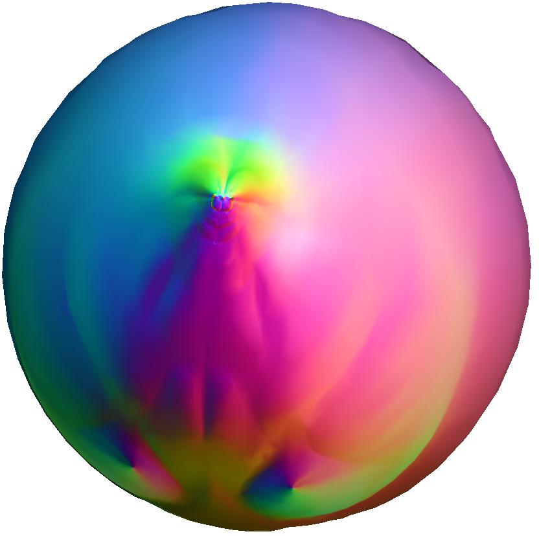
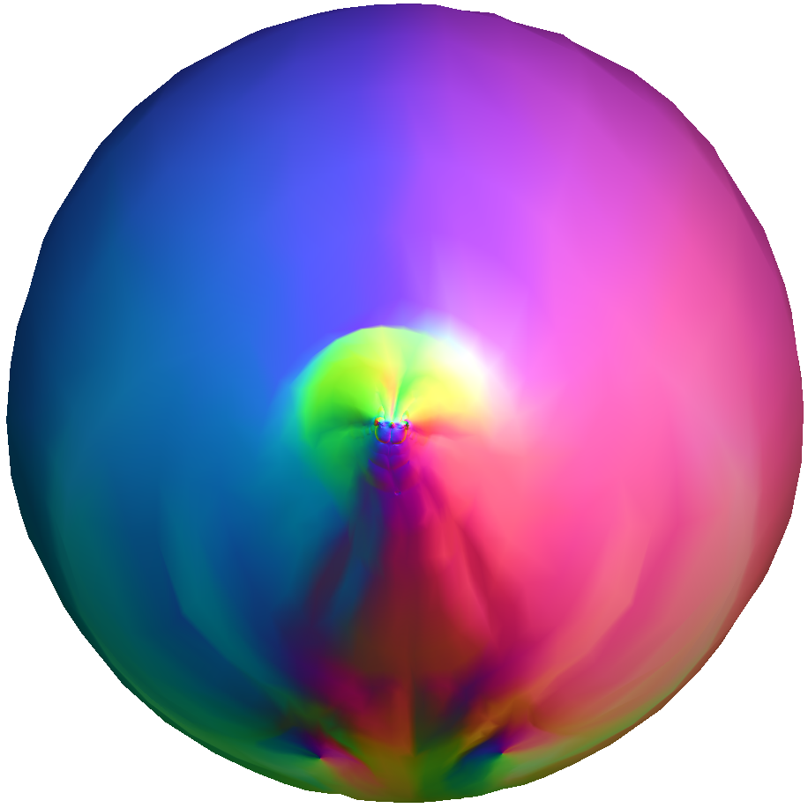
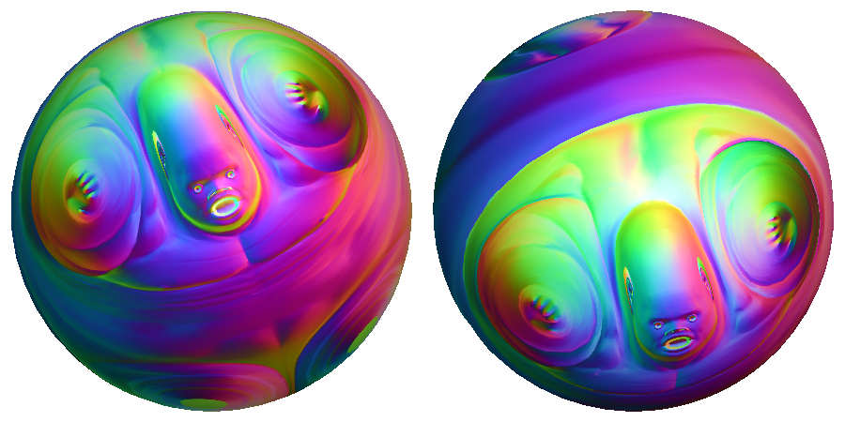
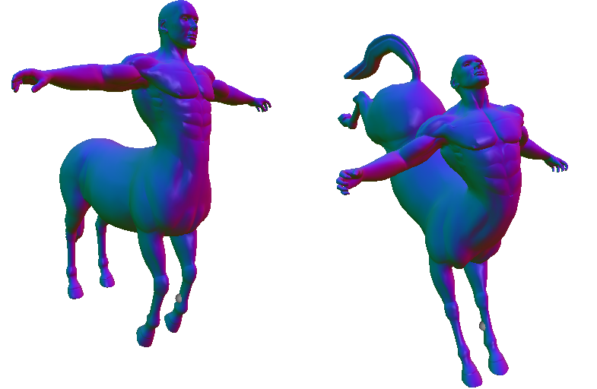
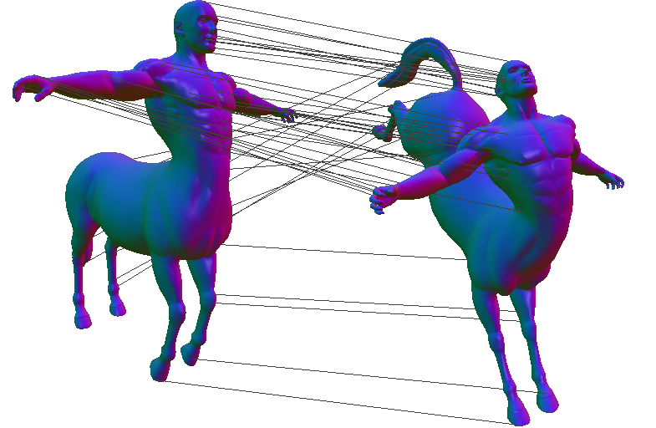
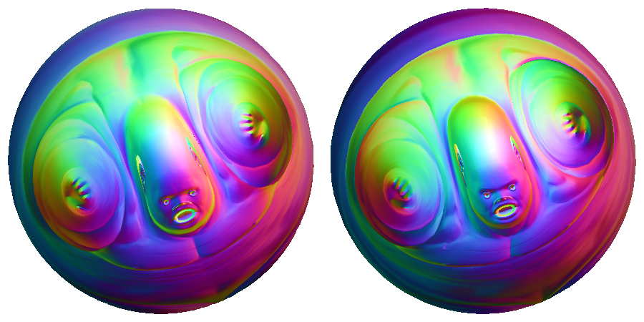
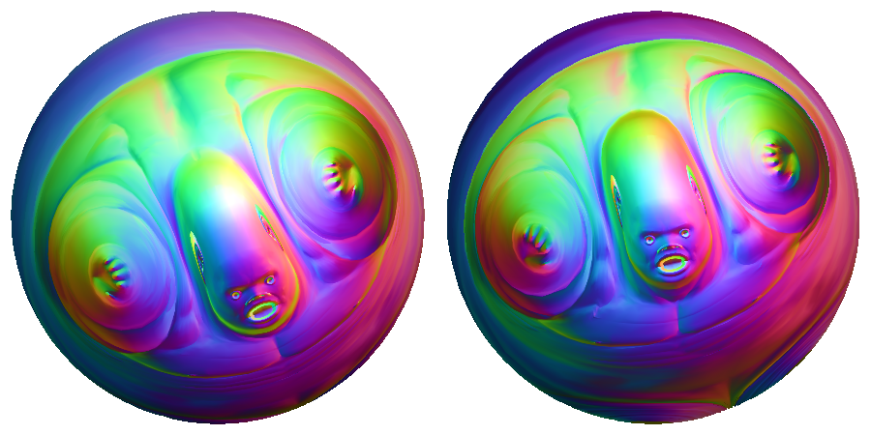
Outline
Introduction & Related Work
Our Approach
Results
Limitations & Future Work
centered conformal parametrization
authalic evolution
Per shape
rotational alignment
Per pair
dense correspondence
optical flow
SGP 2019 - Dense Point-to-Point Correspondences Between Genus-Zero Shapes – S.C. Lee, M. Kazhdan

Slide 8
Our Approach (Per Shape)
Conformal Parameterization
Goal: Parameterize the input shape over $S^{2}$
Method: (Conformalized) mean curvature flow [Kazhdan et al., 2012]
SGP 2019 - Dense Point-to-Point Correspondences Between Genus-Zero Shapes – S.C. Lee, M. Kazhdan

Slide 9
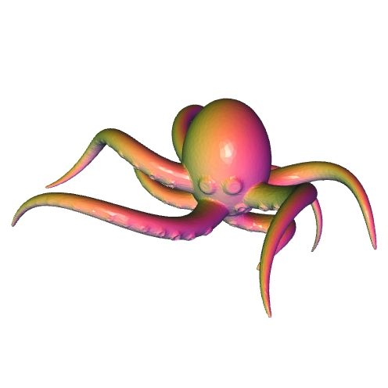
Our Approach (Per Shape)
Conformal Parameterization
Normalize for inversion by Möbius centering [Baden et al., 2018]
Scale factors $λ$ $:=$ how much surface area sits over a region of $S^{2}$
Approach: find the inversion making the scale factors uniformly distribute
dense
sparse
Input shape
w/o centering
w/ centering
SGP 2019 - Dense Point-to-Point Correspondences Between Genus-Zero Shapes – S.C. Lee, M. Kazhdan

Slide 10
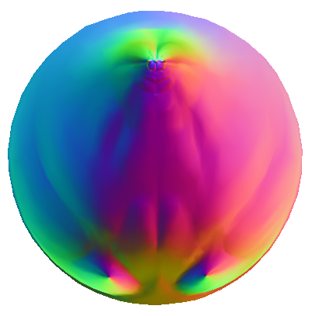
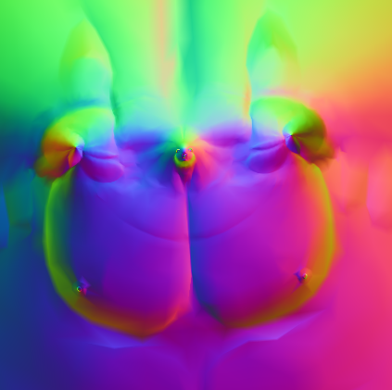
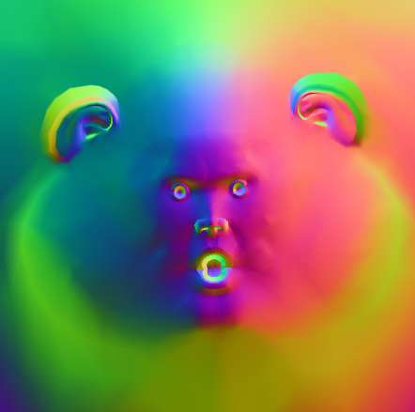
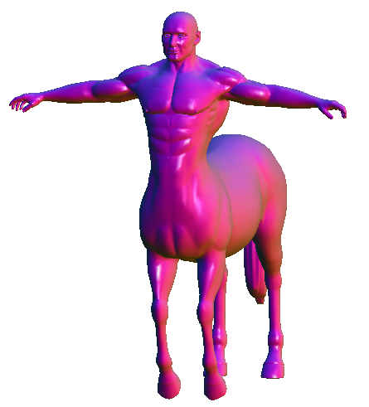
Our Approach (Per Shape)
Authalic Evolution [Zou et al., 2011]
Challenge: Extremities in the parameterization
Small spherical mis-registrations $→$ big correspondence errors
SGP 2019 - Dense Point-to-Point Correspondences Between Genus-Zero Shapes – S.C. Lee, M. Kazhdan

Slide 11
Our Approach (Per Shape)
Authalic Evolution [Zou et al., 2011]
Idea: Decompress the dense regions
Approach: Diffuse scale factors $λ$ to make them uniform
Implementation: Advect along a vector field pointing away from denser regions
Advected Parametrization
$$\vec{V}=−∇logλ$$
SGP 2019 - Dense Point-to-Point Correspondences Between Genus-Zero Shapes – S.C. Lee, M. Kazhdan

Slide 12
Our Approach (Per Pair of Shapes)
Rotational Alignment
Find the best rotation alignment by maximizing the signals’ correlation using fast signal processing [Baden et al., 2018]
Heat Kernel Signatures [Sun et al., 2009]
Rotational Alignment
SGP 2019 - Dense Point-to-Point Correspondences Between Genus-Zero Shapes – S.C. Lee, M. Kazhdan

Slide 13
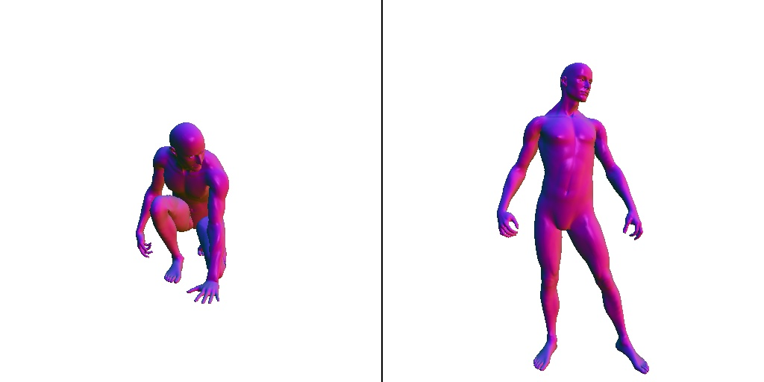
Our Approach (Per Pair of Shapes)
Rotational Alignment
Near ${180}^{∘}$ (intrinsically) symmetric shapes
Compute the $K$best rotation candidates
Refine each one with optical flow
Return the one that best aligns the signals
Best Rotation
Human Shape
2 Rotation Candidates
SGP 2019 - Dense Point-to-Point Correspondences Between Genus-Zero Shapes – S.C. Lee, M. Kazhdan

Slide 14
Our Approach (Per Pair of Shapes)
Optical Flow
Solve for a vector field that best registers the signals [Prada et al., 2016]
Coarse-to-fine approach
Vector Field
Advected Parameterization
Level 0
SGP 2019 - Dense Point-to-Point Correspondences Between Genus-Zero Shapes – S.C. Lee, M. Kazhdan

Slide 15
Our Approach (Per Pair of Shapes)
Optical Flow
Solve for a vector field that best matches the signals [Prada et al., 2016]
Coarse-to-fine approach
Vector Field
Advected Parameterization
Level 1
SGP 2019 - Dense Point-to-Point Correspondences Between Genus-Zero Shapes – S.C. Lee, M. Kazhdan

Slide 16
Our Approach (Per Pair of Shapes)
Optical Flow
Solve for a vector field that best matches the signals [Prada et al., 2016]
Coarse-to-fine approach
Vector Field
Advected Parameterization
Level 2
SGP 2019 - Dense Point-to-Point Correspondences Between Genus-Zero Shapes – S.C. Lee, M. Kazhdan

Slide 17
Our Approach (Per Pair of Shapes)
Optical Flow
Solve for a vector field that best matches the signals [Prada et al., 2016]
Coarse-to-fine approach
Vector Field
Advected Parameterization
Level 3
SGP 2019 - Dense Point-to-Point Correspondences Between Genus-Zero Shapes – S.C. Lee, M. Kazhdan

Slide 18
Our Approach
Dense Correspondence
Composition of the
Component maps are symmetric $→$ composition is symmetric
spherical parameterization,
rotation alignment,
optical flow
centered conformal parametrization
authalic evolution
rotational alignment
dense correspondence
optical flow
SGP 2019 - Dense Point-to-Point Correspondences Between Genus-Zero Shapes – S.C. Lee, M. Kazhdan

Slide 19
Outline
Introduction & Related Work
Our Approach
Results
Limitations & Future Work
SGP 2019 - Dense Point-to-Point Correspondences Between Genus-Zero Shapes – S.C. Lee, M. Kazhdan

Slide 20
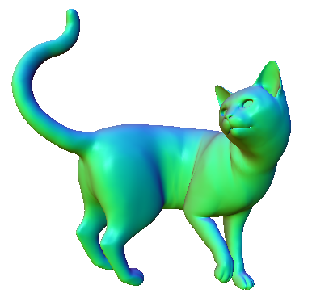
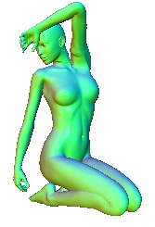
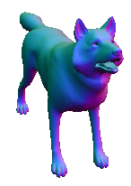
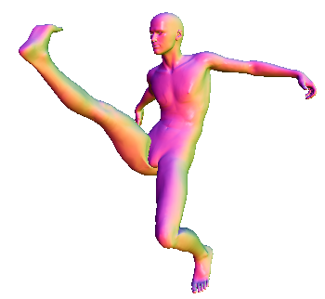
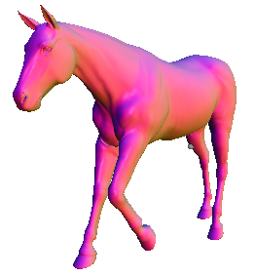
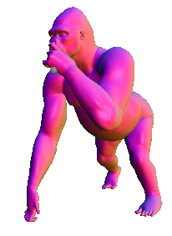
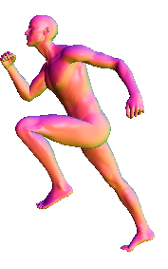
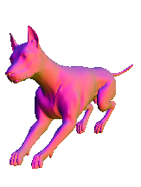
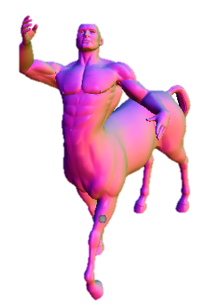
Results (1): Intra-class Correspondences
Run on TOSCA benchmark with correspondence ground truth [Bronstein et al., 2008]
Use biharmonic distance for fast geodesic distance approximation [Lipman et al., 2010]
Compare with
Blended Intrinsic Maps (BIM) [Kim et al., 2011]
Möbius Registration (MR) [Baden et al., 2018]
SGP 2019 - Dense Point-to-Point Correspondences Between Genus-Zero Shapes – S.C. Lee, M. Kazhdan

Slide 21
Results (1): Intra-class Correspondences
SGP 2019 - Dense Point-to-Point Correspondences Between Genus-Zero Shapes – S.C. Lee, M. Kazhdan

Slide 22
Results (1): Intra-class Correspondences
SGP 2019 - Dense Point-to-Point Correspondences Between Genus-Zero Shapes – S.C. Lee, M. Kazhdan

Slide 23
Results (1): Intra-class Correspondences
Time for entire dataset
Ours: 4 hours
BIM: 31 hours
SGP 2019 - Dense Point-to-Point Correspondences Between Genus-Zero Shapes – S.C. Lee, M. Kazhdan

Slide 24
Results (2): Intrinsic Bilateral Symmetry
Run on TOSCA benchmark [Bronstein et al., 2008]
Ground truth generated by correspondences from extrinsically bilateral symmetry
Use geodesic distance from 100 randomly sampled vertices
Compare with
Blended Intrinsic Maps (BIM) [Kim et al., 2011]
Bijective Continuous ICP (BCICP) [Ren et al., 2018]
Reversible Harmonic Maps (RHM) [Ezuz et al., 2019]
SGP 2019 - Dense Point-to-Point Correspondences Between Genus-Zero Shapes – S.C. Lee, M. Kazhdan

Slide 25
Results (2): Intrinsic Bilateral Symmetry
+ 180º Rotation
Reflection $=$
Antipodal Map
Antipodal map
180º Rotation
Correspondence
Input
Antipode
Reflection
SGP 2019 - Dense Point-to-Point Correspondences Between Genus-Zero Shapes – S.C. Lee, M. Kazhdan

Slide 26
Results (2): Intrinsic Bilateral Symmetry
SGP 2019 - Dense Point-to-Point Correspondences Between Genus-Zero Shapes – S.C. Lee, M. Kazhdan

Slide 27
Results (2): Intrinsic Bilateral Symmetry
5K Model | BIM | BCICP | RHM | Ours
Per Shape | 268.43s | 111.25s | 169.00s | 43.35s
SGP 2019 - Dense Point-to-Point Correspondences Between Genus-Zero Shapes – S.C. Lee, M. Kazhdan

Slide 28
Outline
Introduction & Related Work
Our Approach
Results
Limitations & Future Work
SGP 2019 - Dense Point-to-Point Correspondences Between Genus-Zero Shapes – S.C. Lee, M. Kazhdan

Slide 29
Limitation
Poor rotation selection
Correspondence error: 8.18
Biharmonic distance: 0.03
Candidate #1
Correspondence error: 8.16
Biharmonic distance: 0.44
Candidate #2
SGP 2019 - Dense Point-to-Point Correspondences Between Genus-Zero Shapes – S.C. Lee, M. Kazhdan

Slide 30
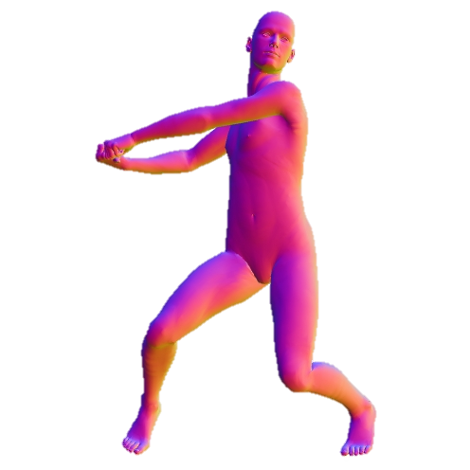
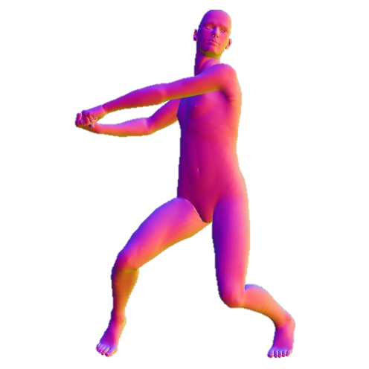
Limitation
Greedy optical flow
✗
✓
SGP 2019 - Dense Point-to-Point Correspondences Between Genus-Zero Shapes – S.C. Lee, M. Kazhdan

Slide 31
Conclusion & Future Work
Conclusion
Fully automatic system for dense correspondences between genus-zero shapes
Competitive with most state-of-the-art methods
Faster
Future Work
Use other signals
Use pull-back metric
SGP 2019 - Dense Point-to-Point Correspondences Between Genus-Zero Shapes – S.C. Lee, M. Kazhdan

Slide 32
Thank You
Source codes available at: https://github.com/mkazhdan/DenseP2PCorrespondences
SGP 2019 - Dense Point-to-Point Correspondences Between Genus-Zero Shapes – S.C. Lee, M. Kazhdan

