Slide 1
Möbius Registration
Alex Baden, Keenan Crane, and Misha Kazhdan

Slide 2
Shape Registration
Shape registration is essential
Matching
Correspondence
Detail transfer
Co-analysis
etc.

Slide 3
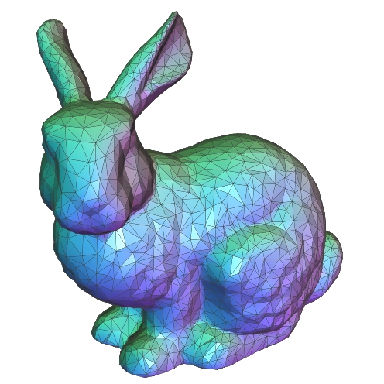
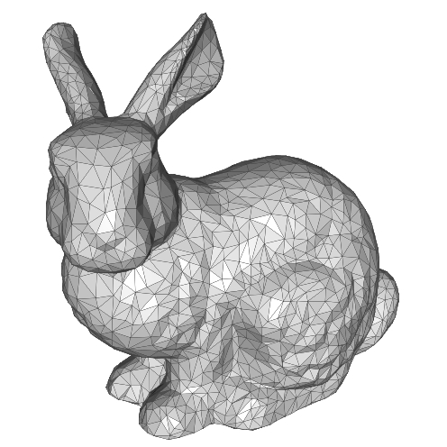
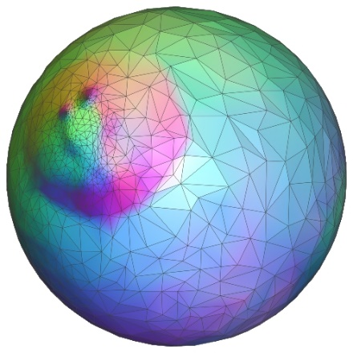
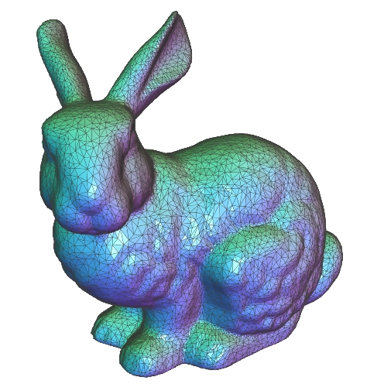
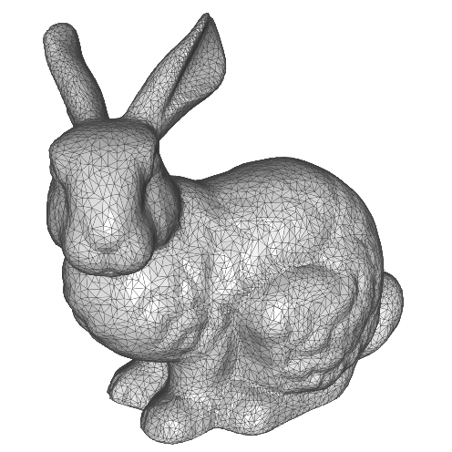
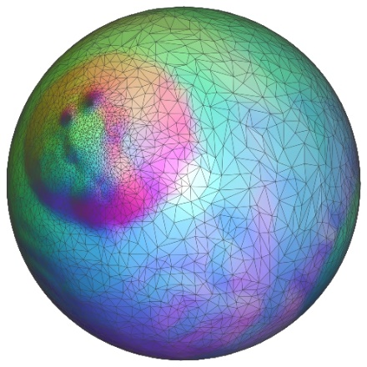
Shape Registration
Challenge:
Consistent representation
Shape-preserving deformations
Prior work*:
Conformal spherical param.
[Haker et al., 2000]
[Gu et al., 2003]
[Gotsman et al., 2003]
[Friedel et al., 2005]
[Kharevych et al., 2006]
[Springborn et al., 2008]
[Kazhdan et al., 2012]
[Crane et al., 2013]
[Prada et al., 2016]
etc.
*For genus-zero surfaces

Slide 4
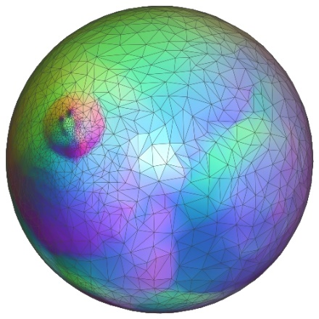
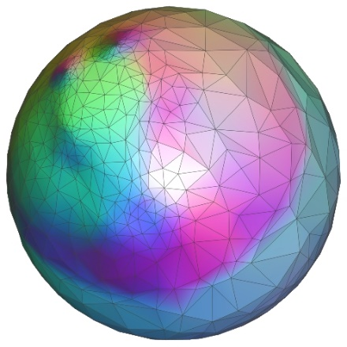
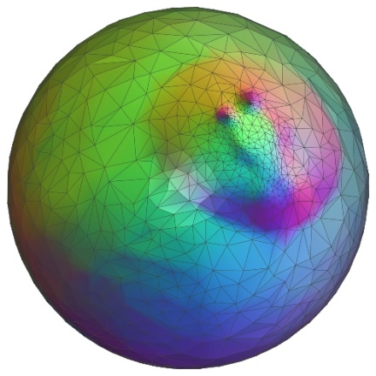
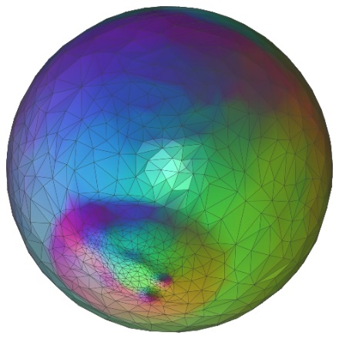
Shape Registration
Prior work*:
Conformal spherical param.
Representation invariant
Same parametrization for isometric deformations of the same shape…
Up to Möbius transformation
inversions
rotations
Registration requires alignment over the group of Möbius transformation
*For genus-zero surfaces

Slide 5
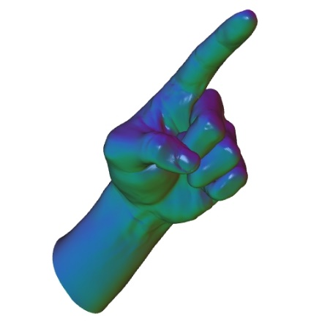
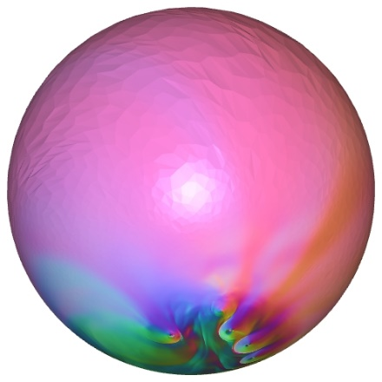
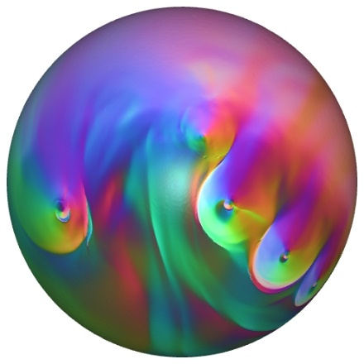
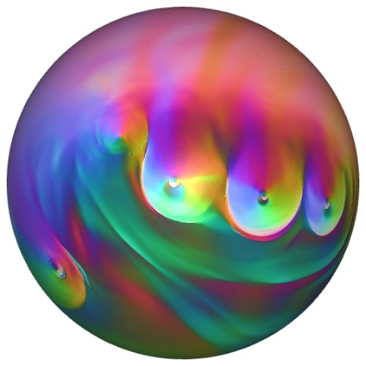
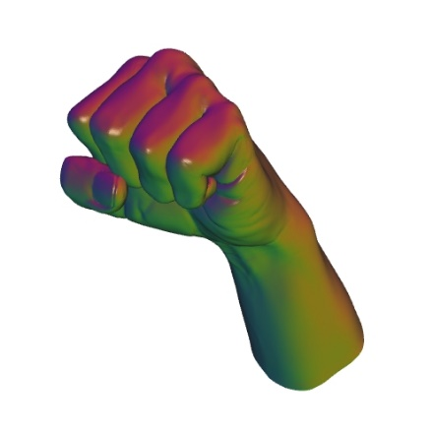
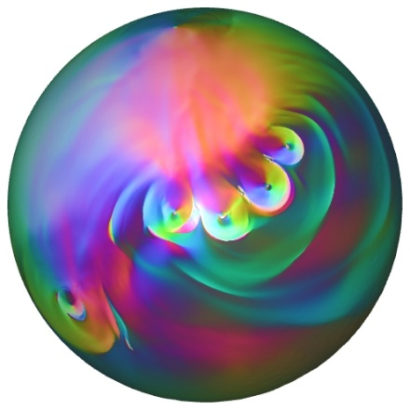
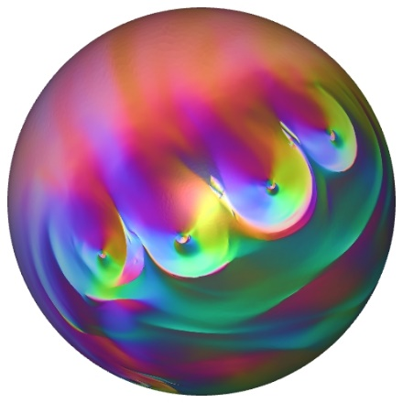
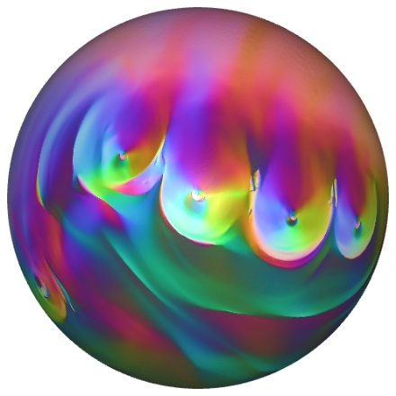
Möbius Registration
Separately handle the two components
Canonically center each shape w.r.t. inversions
Optimally align pairs of shapes w.r.t. rotations
parametrization
canonical centering
optimal alignment

Slide 6
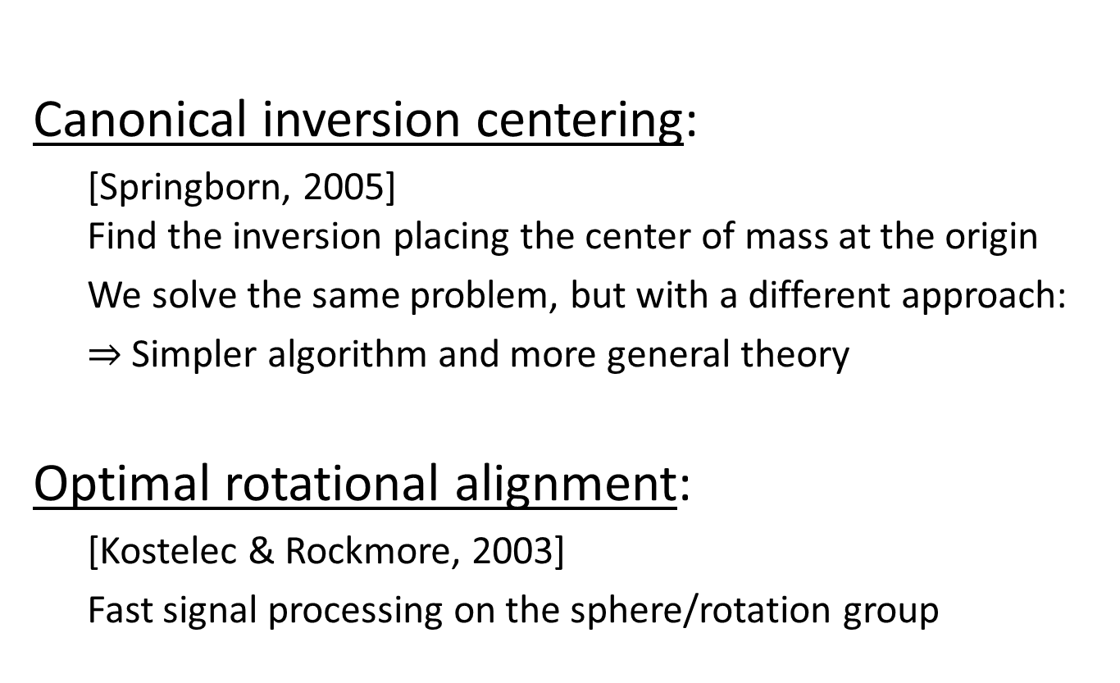
Related Work
Canonical inversion centering:
[Springborn, 2005] Find the inversion placing the center of mass at the origin
We solve the same problem, but with a different approach:
$⇒$ Simpler algorithm and more general theory
Optimal rotational alignment:
[Kostelec & Rockmore, 2003]
Fast signal processing on the sphere/rotation group

Slide 7
Outline
Motivation
Registration
Inversions: canonical centering
Rotations: optimal alignment
Applications
Conclusion

Slide 8
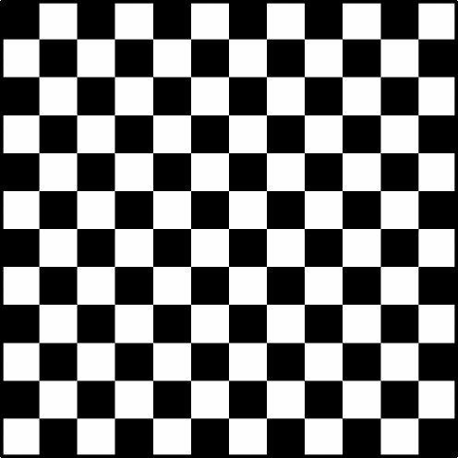

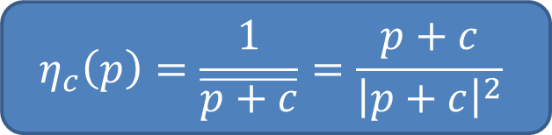

Circular Inversion (2D)
$$η_{c}\left(p\right)=\frac{1}{\overline{p+c}}=\frac{p+c}{{\left|p+c\right|}^{2}}$$
Invert the embedding space:
Angle preserving map in 2D
Takes circles to circles
$$c$$
$$c$$

Slide 9
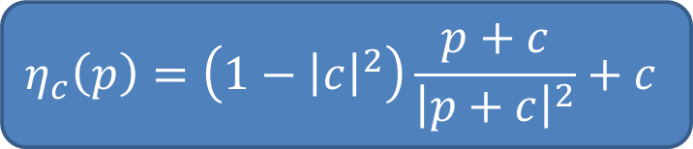
Circular Inversion (2D)
$$η_{c}\left(p\right)=\left(1−{\left|c\right|}^{2}\right)\frac{p+c}{{\left|p+c\right|}^{2}}+c$$
Invert the embedding space:
Angle preserving map in 2D
Takes circles to circles
$$c$$
$$c$$
Composing with scaling and translation, it takes the unit circle to itself

Slide 10
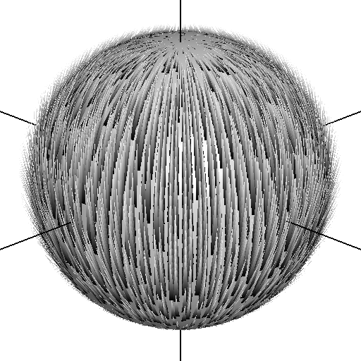
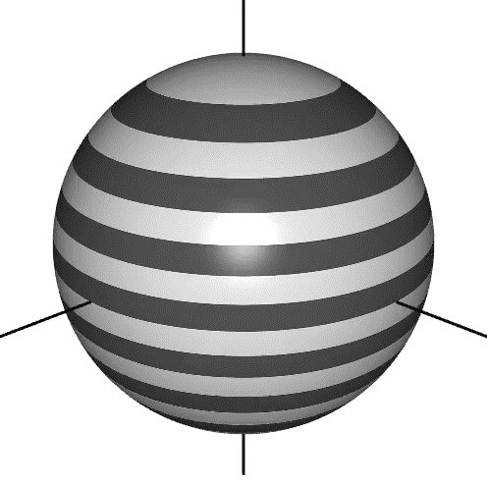



Spherical Inversion (3D)
As we move the center towards $c$…
… points on the sphere "flow" in direction $c$
$$c$$
$$c$$
Flow field: $\vec{v}\left(p\right)=2(Id.−p⋅p^{⊤})c$

Slide 11
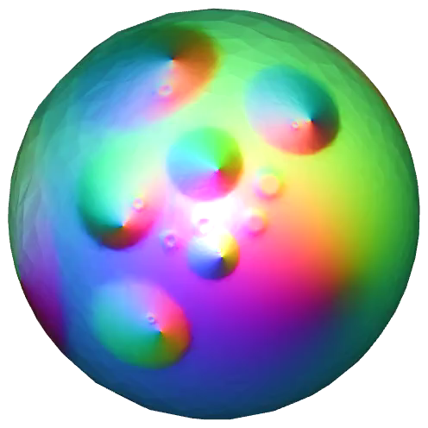
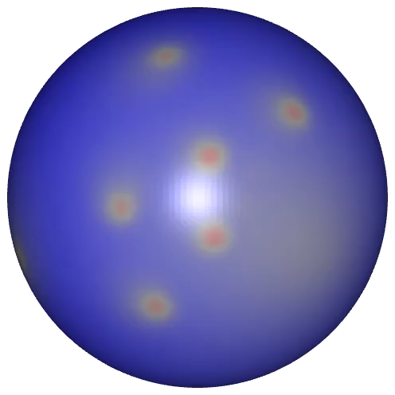
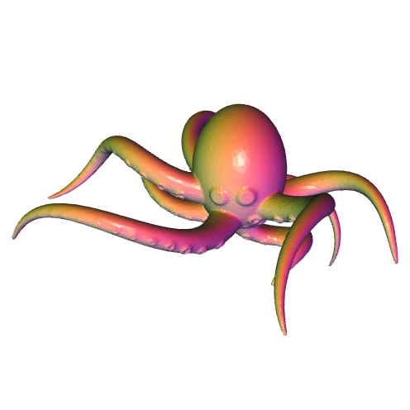

Canonical Centering
(Area) stretch factors:
Given a spherical parametrization:
How much surface sits over a point on the sphere?
dense
sparse
parametrization
$λ$: scale factors

Slide 12
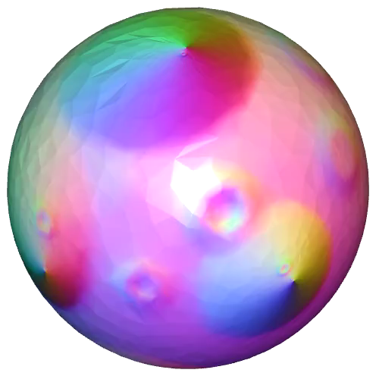
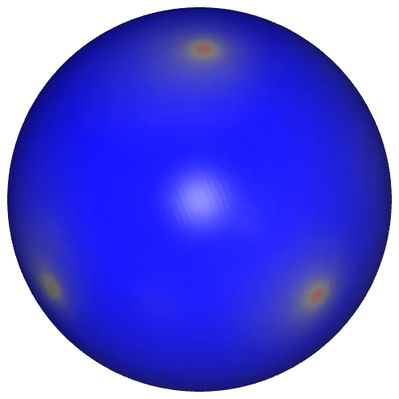

Canonical Centering
(Area) stretch factors:
Given a spherical parametrization:
How much surface sits over a point on the sphere?
dense
sparse
parametrization
$λ$: stretch factors

Slide 13
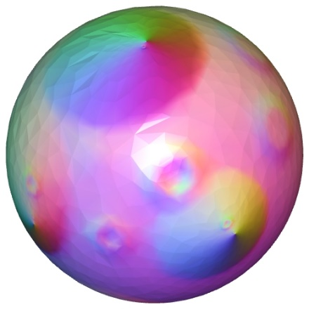
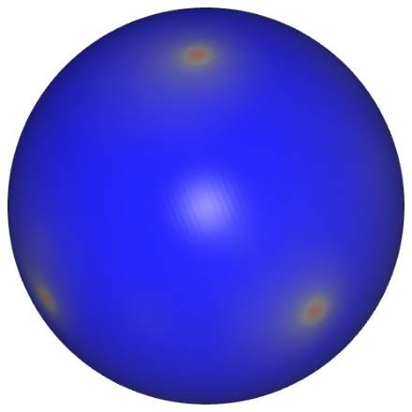

Canonical Centering
Goal:
Find the spherical inversion that makes the mass as uniformly distributed as possible
Measure uniformity by computing the center of mass w.r.t. the stretch factors
$$μ=\int_{S^{2}}{p λ\left(p\right) dp}$$
parametrization
$λ$: stretch factors

Slide 14

Canonical Centering
Claim:
There is a unique Möbius inversion that puts the center of mass at the origin.
$$μ=\int_{S^{2}}{p λ\left(p\right) dp}$$

Slide 15

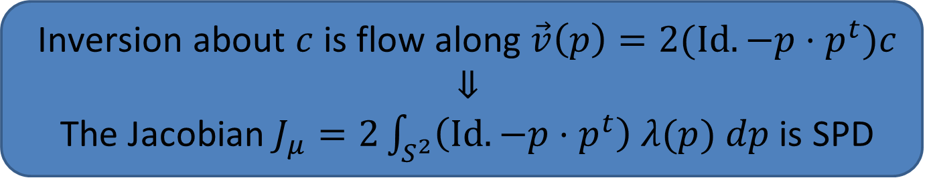
Canonical Centering
Existence proof (sketch):
Considering the centering energy: $$E={\frac{1}{2}\left|μ\right|}^{2} ⇒ ∇E=J_{μ}^{⊤}μ$$
$⇒$ The gradient only vanishes when $μ$ is centered
$⇒$ Local minima put the center of mass at the origin
$⇒$ Gradient descent and you're there
Inversion about $c$ is flow along $\vec{v}\left(p\right)=2(Id.−p⋅p^{t})c$
Inversion about $c$ is flow along $\vec{v}\left(p\right)=2(Id.−p⋅p^{t})c$ $$⇓$$ The Jacobian $J_{μ}=2\int_{S^{2}}{\left(Id.−p⋅p^{t}\right) λ(p) dp}$ is SPD

Slide 16



Canonical Centering
Uniqueness proof:
Suppose the mass is centered
$⇒$ For any $c$, mass is "balanced" above and below $c$
An inversion along $c$ shifts the mass towards $c$
$⇒$ The mass will no longer be centered
$$c$$

Slide 17
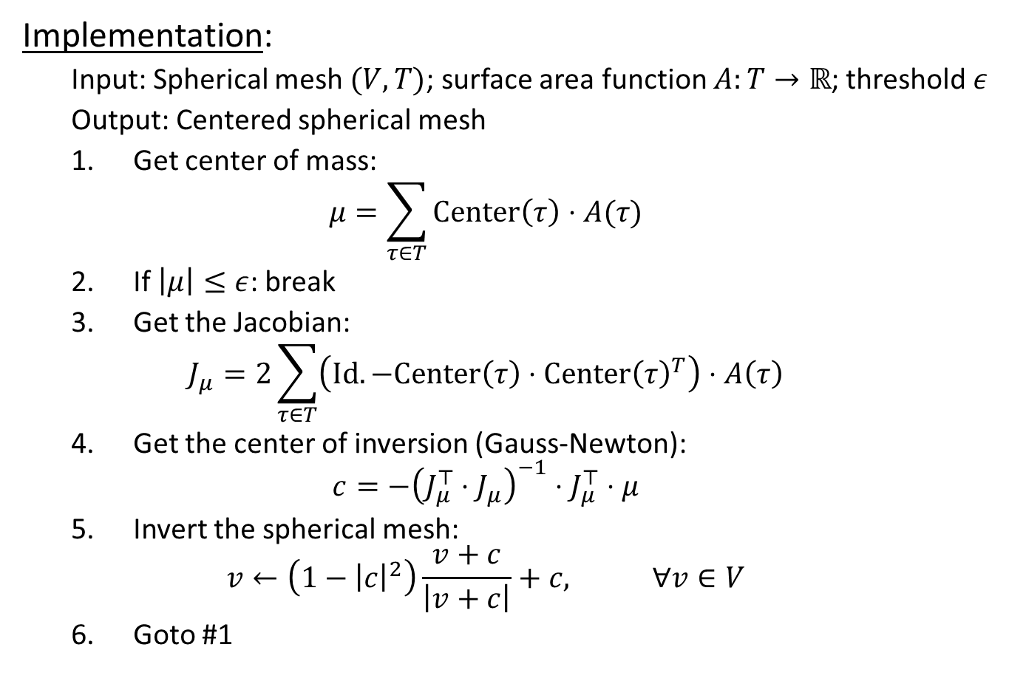
Canonical Centering
Implementation:
Input: Spherical mesh $(V,T)$; surface area function $A:T→ℝ$; threshold $ε$
Output: Centered spherical mesh
Get center of mass: $μ=\sum_{τ∈T}{Center\left(τ\right)⋅A(τ)}$
If $\left|μ\right|≤ε$: break
Get the Jacobian: $J_{μ}=2\sum_{τ∈T}{\left(Id.−Center\left(τ\right)⋅Center{\left(τ\right)}^{T}\right)⋅A\left(τ\right)}$
Get the center of inversion (Gauss-Newton): $c={−\left(J_{μ}^{⊤}⋅J_{μ}\right)}^{−1}⋅J_{μ}^{⊤}⋅μ$
Invert the spherical mesh: $v←\left(1−{\left|c\right|}^{2}\right)\frac{v+c}{\left|v+c\right|}+c, ∀v∈V$
Goto #1

Slide 18
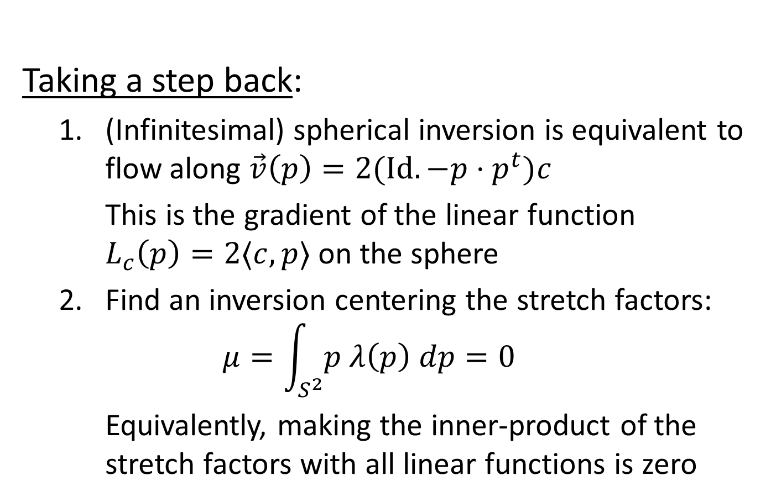
Canonical Centering
Taking a step back:
(Infinitesimal) spherical inversion is equivalent to flow along $\vec{v}\left(p\right)=2(Id.−p⋅p^{t})c$
This is the gradient of the linear function $L_{c}\left(p\right)=2⟨c,p⟩$ on the sphere
Find an inversion centering the stretch factors: $μ=\int_{S^{2}}{p λ\left(p\right) dp}=0$
Equivalently, making the inner-product of the stretch factors with all linear functions is zero

Slide 19
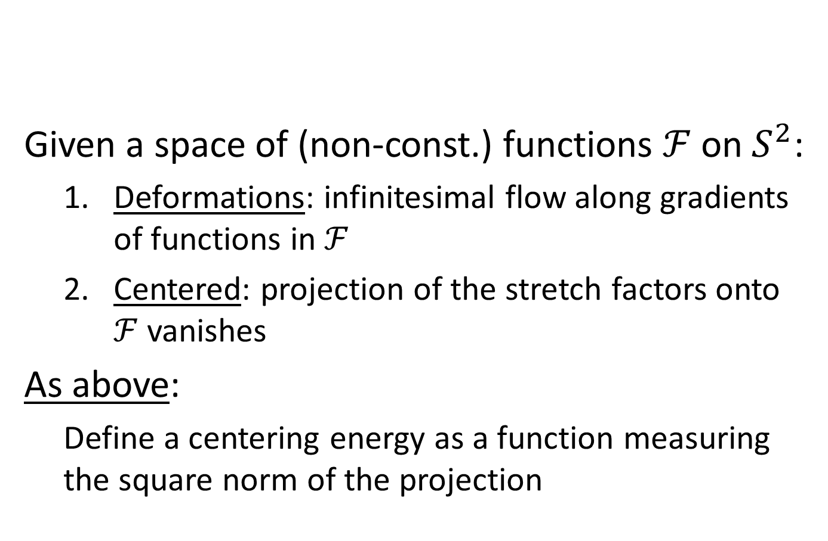
General Formulation
Given a space of (non-const.) functions $ℱ$ on $S^{2}$:
Deformations: infinitesimal flow along gradients of functions in $ℱ$
Centered: projection of the stretch factors onto $ℱ$ vanishes
As above:
Define a centering energy as a function measuring the square norm of the projection

Slide 20
General Formulation
Theorem:
The gradient of the centering energy vanishes if and only if the stretch factors are centered.
[Identical proof: Show that the Jacobian is SPD]

Slide 21
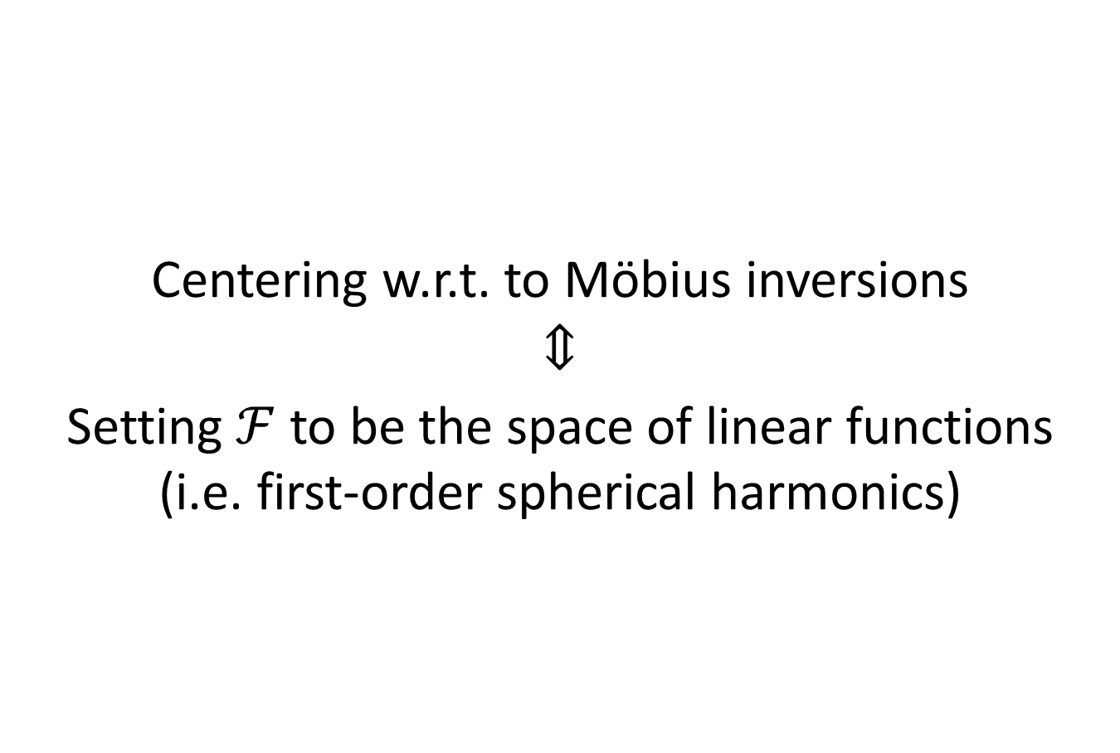
General Formulation
Centering w.r.t. to Möbius inversions
$$⇕$$
Setting $ℱ$ to be the space of linear functions (i.e. first-order spherical harmonics)
We could use higher-order harmonics!

Slide 22
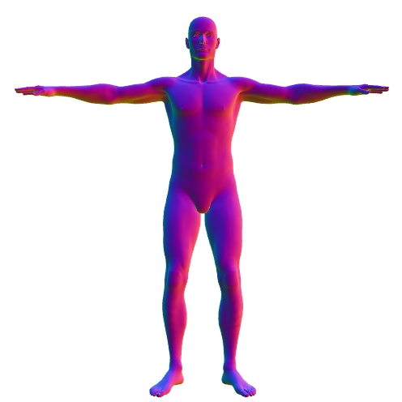
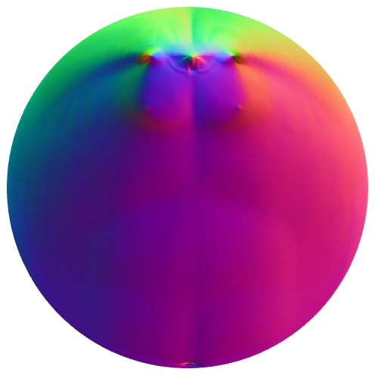
General Formulation
1st order harmonics:
Uniform mass distribution subject to conformality
1st order

Slide 23
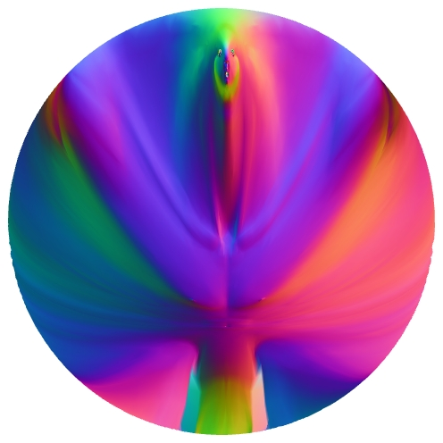
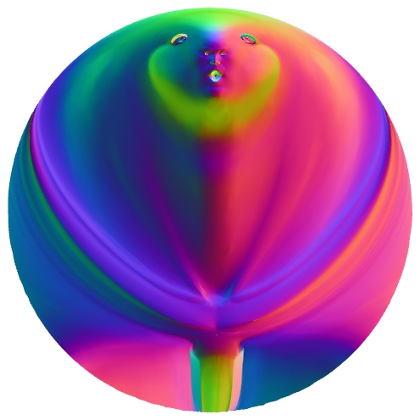
General Formulation
Higher order harmonics:
Trade conformality for more uniform area distribution
1st order
1st + 2nd order
1st + 2nd + 3rd order

Slide 24
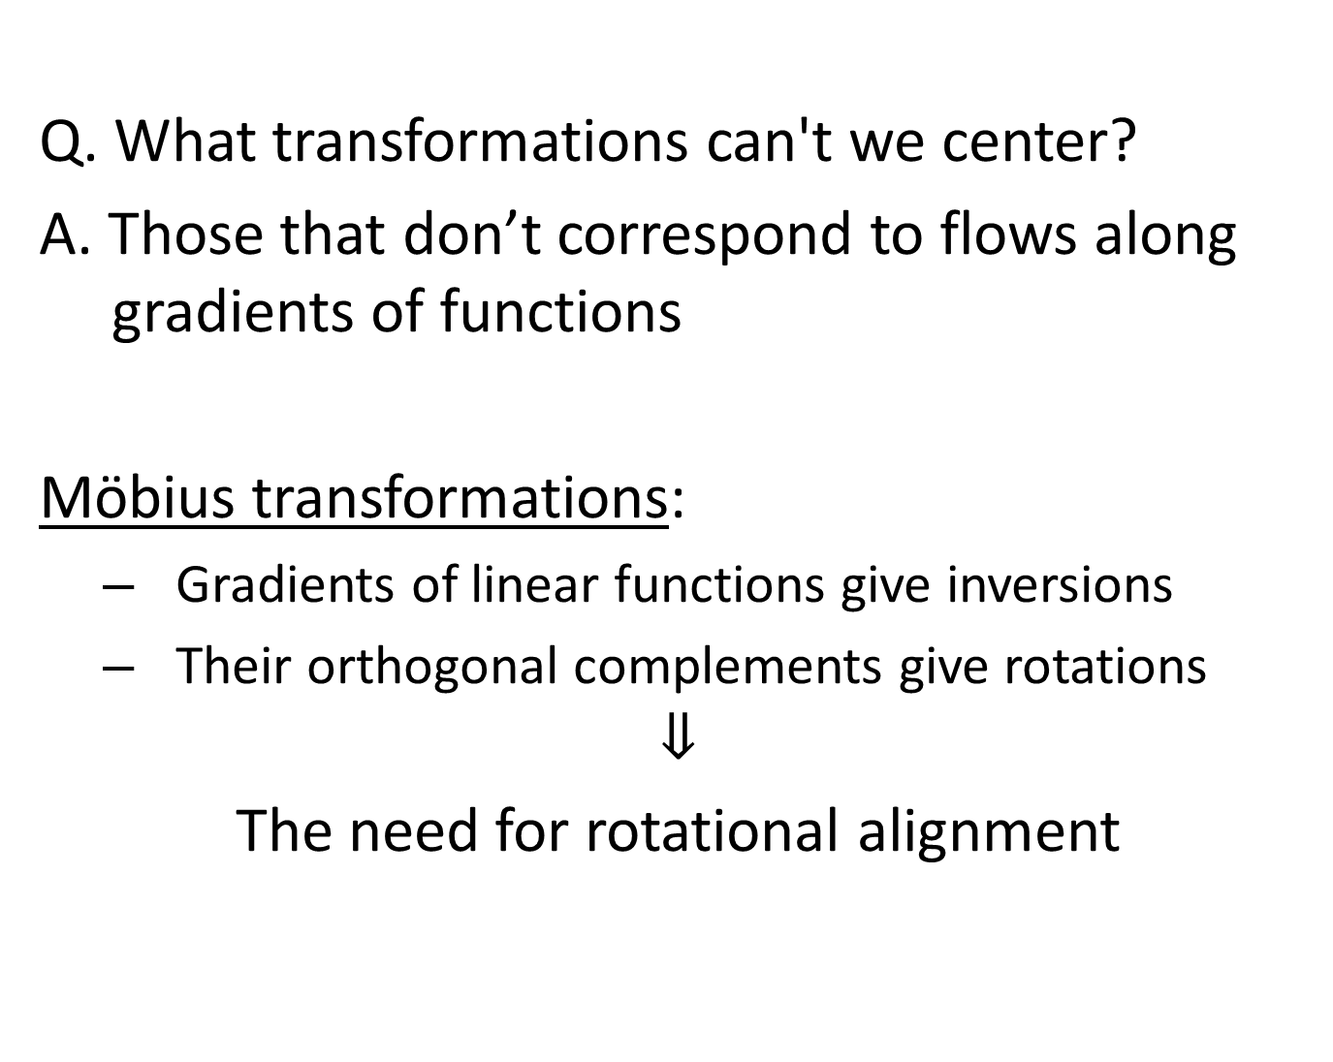
General Formulation
Q. What transformations can't we center?
A. Those that don’t correspond to flows along gradients of functions
Möbius transformations:
Gradients of linear functions give inversions
Their orthogonal complements give rotations
$$⇓$$
The need for rotational alignment

Slide 25


Rotational Alignment
Find the rotation that best aligns the centered stretch factors of two parameterizations
$$λ_{s}$$
?
$$λ_{t}$$
parametrization + centering

Slide 26
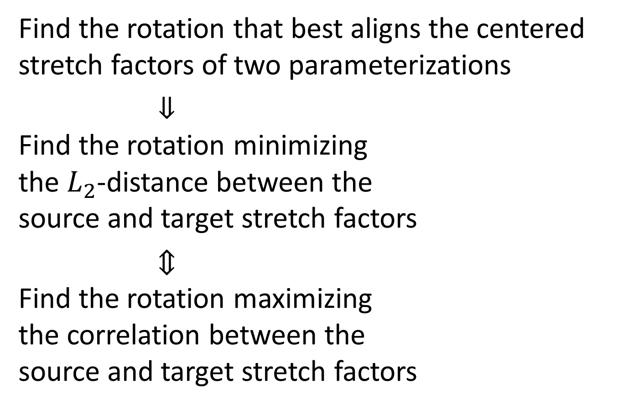
Rotational Alignment
Find the rotation that best aligns the centered stretch factors of two parameterizations
$⇓$ Find the rotation minimizing the $L_{2}$-distance between the source and target stretch factors
$⇕$ Find the rotation maximizing the correlation between the source and target stretch factors
?

Slide 27
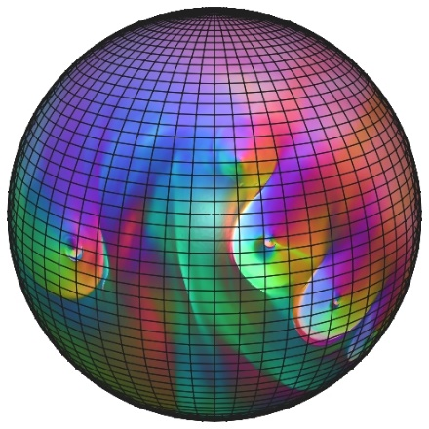
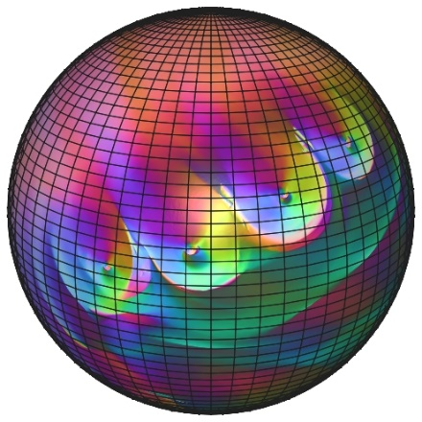
Rotational Correlation
Sample the stretch factors to a spherical grid
?

Slide 28
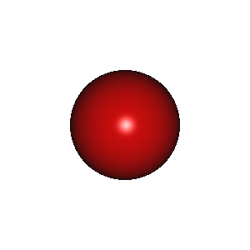








Rotational Correlation
Compute the forward (spherical) Fourier transform
?

Slide 29
Rotational Correlation
Get the rotational harmonic coefficients of the correlation by cross-multiplying within the bands
?

Slide 30

Rotational Correlation
Compute the inverse (rotational) Fourier transform and find the maximizing rotation
?

Slide 31
Outline
Motivation
Registration
Applications
Orbifolds
Correspondences
Conclusion

Slide 32
Spherical Orbifolds
[Aigerman et al., 2017]
Compute a conformal map from the sphere to a simply connected surface w/ prescribed symmetries
Guaranteed fold-over-free
Non-convex minimization with linear equality constraints

Slide 33
Spherical Orbifolds
Can we use an off-the-shelf conformal parameterization algorithm?

Slide 34
Spherical Orbifolds
Approach:
Stitch together multiple copies of the surface to have the required symmetric topology
Conformally map the stitched surface to the sphere

Slide 35
Spherical Orbifolds
Spherical orbifold demo
Notes:
Highlight the drift…
Hit "+" to step through the iterations.
Hit "N" to force normalization.
Hit "B" to balance

Slide 36








Point-to-Point Correspondences
Extremities are close, but not quite…
source 1
source 2
target

Slide 37



Point-to-Point Correspondences
source 1
source 2
target

Slide 38



Point-to-Point Correspondences
Small non-isometric deformations have small, but far-reaching impacts on the parameterization.
This can have significant impact on regions that compress under the mapping!
source 1
source 2
target

Slide 39
Summary
Möbius transformations:
Inversions
Correspond to smooth curl-free vector fields
Can center canonically
Rotations
Correspond to smooth divergence-free vector fields
Cannot center canonically
But we can align efficiently using fast signal processing
Centering extends to other function spaces and manifolds

Slide 40
Summary
Properties:
Inversion centering is trivial to implement
Rotational alignment is well-understood
Nice underlying theory
"Nearly isometric" may not be good enough

Slide 41
Future Work
Explore higher-frequency centering
Use as initializer for more complex distance
Consider centering other functions

Slide 42
Thank You!
http://www.cs.jhu.edu/~misha/Code/MoebiusRegistration/

