Slide 1
Unconditionally Stable Shock Filters for Image and Geometry Processing
Fabian Prada and Misha Kazhdan Johns Hopkins University

Slide 2
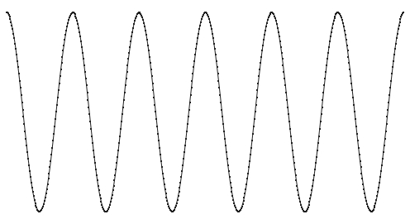
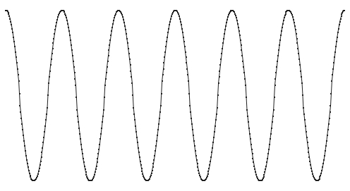
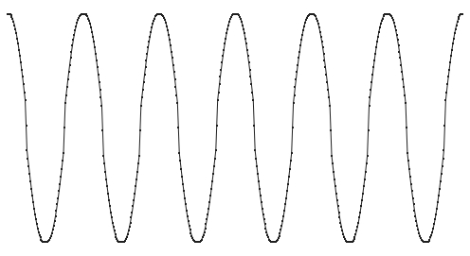
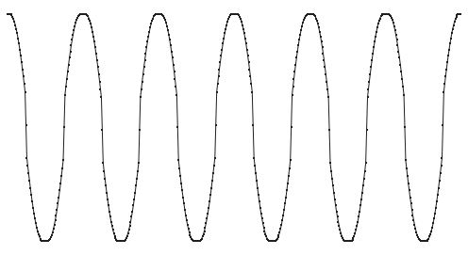
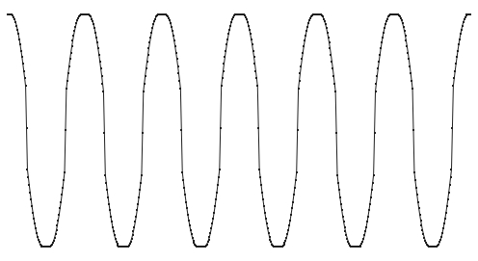
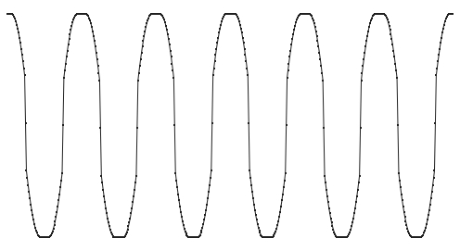
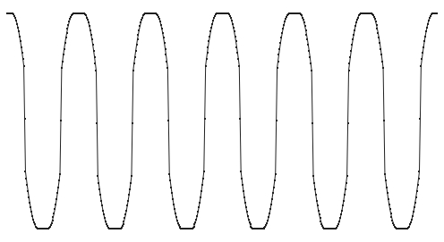
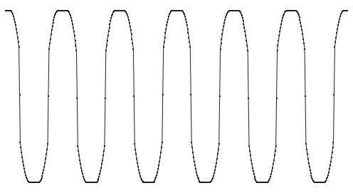
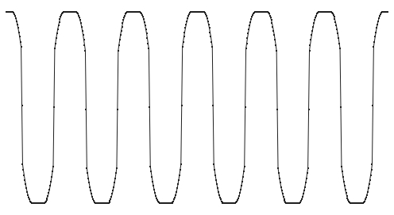
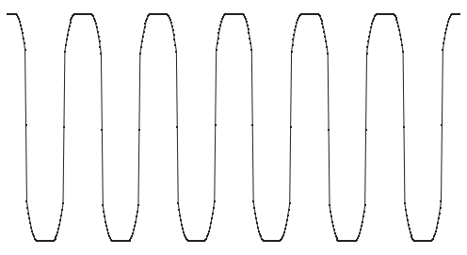
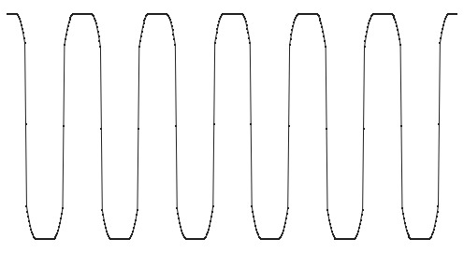
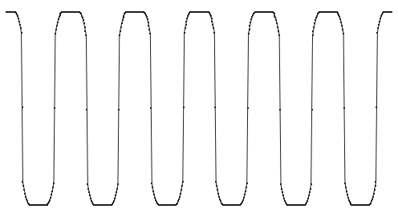
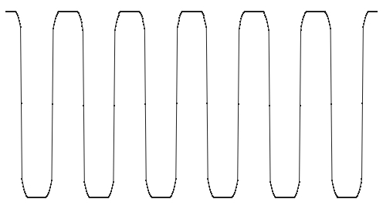
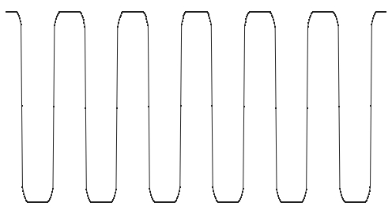
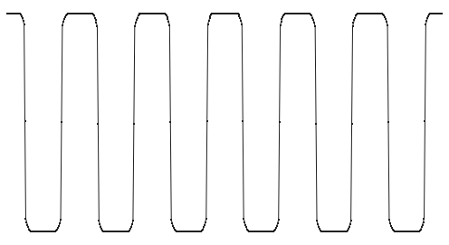
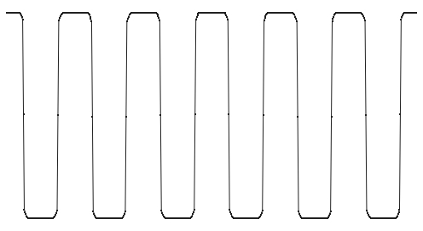
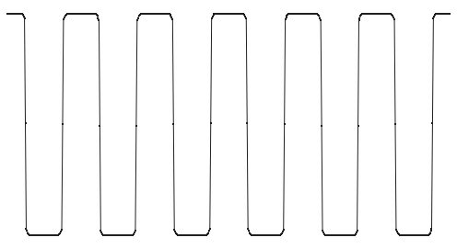
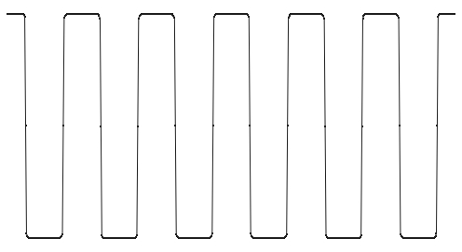
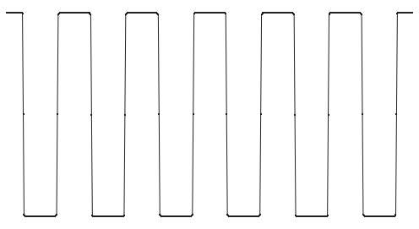
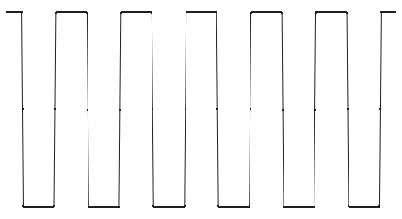
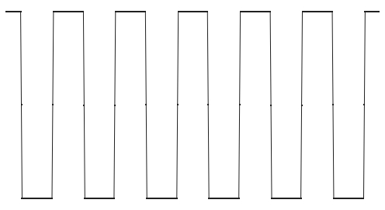

Shock Filters
[Osher and Rudin, 1990]:
Progressively sharpen a signal so that:
Extrema preserved
Edges pronounced
Lower-valued side $→$ local minimum
Higher-valued side $→$ local maximum

Slide 3
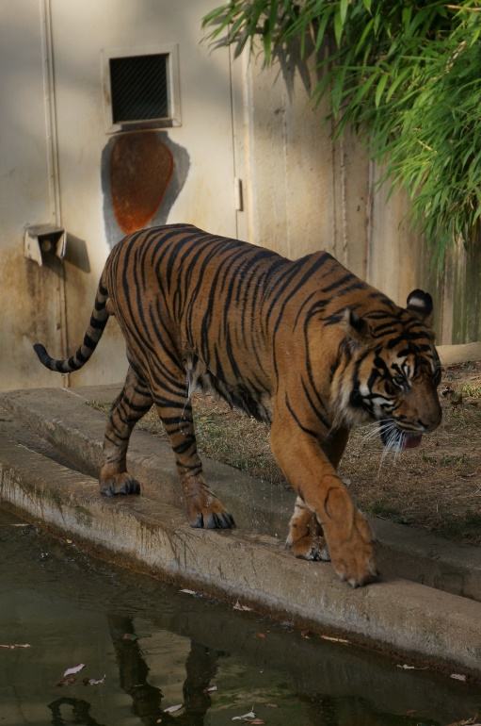
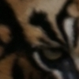











Shock Filters
[Osher and Rudin, 1990]:
Progressively sharpen a signal so that:
Extrema preserved
Edges pronounced

Slide 4


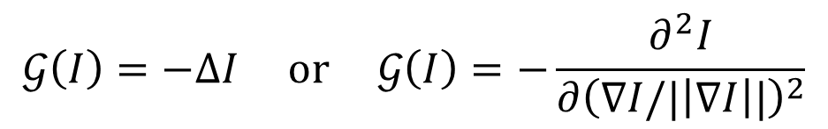
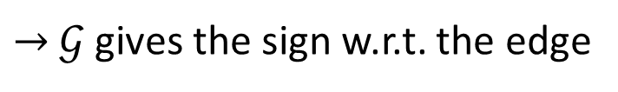
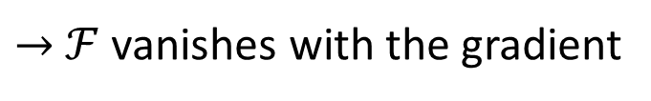
Shock Filters
[Osher and Rudin, 1990]:
Progressively sharpen a signal so that:
Extrema preserved
Edges pronounced
$→$ $ℱ$ vanishes with the gradient
$→$ $𝒢$ gives the sign w.r.t. the edge
$$\frac{dI}{dt}=ℱ\left(I\right)⋅𝒢(I)$$
$$ℱ\left(I\right)=\left\|\text{∇}I\right\|$$
$$𝒢\left(I\right)=−ΔI or 𝒢\left(I\right)=−\frac{∂^{2}I}{∂{\left(\text{∇}I/|\left|\text{∇}I\right||\right)}^{2}}$$

Slide 5
Shock Filters
[Osher and Rudin, 1990]:
Explicitly integrate the non-linear PDE using locally adapted step-sizes to ensure stability.
[In Theory] Challenging to prove properties
[In Practice] Challenging to extend
$$\frac{dI}{dt}=ℱ\left(I\right)⋅𝒢(I)$$
$$ℱ\left(I\right)=\left\|\text{∇}I\right\|$$
$$𝒢\left(I\right)=−ΔI or 𝒢\left(I\right)=−\frac{∂^{2}I}{∂{\left(\text{∇}I/|\left|\text{∇}I\right||\right)}^{2}}$$

Slide 6
Outline
Shock Filters
Advection
Analysis
Extensions
Conclusion

Slide 7

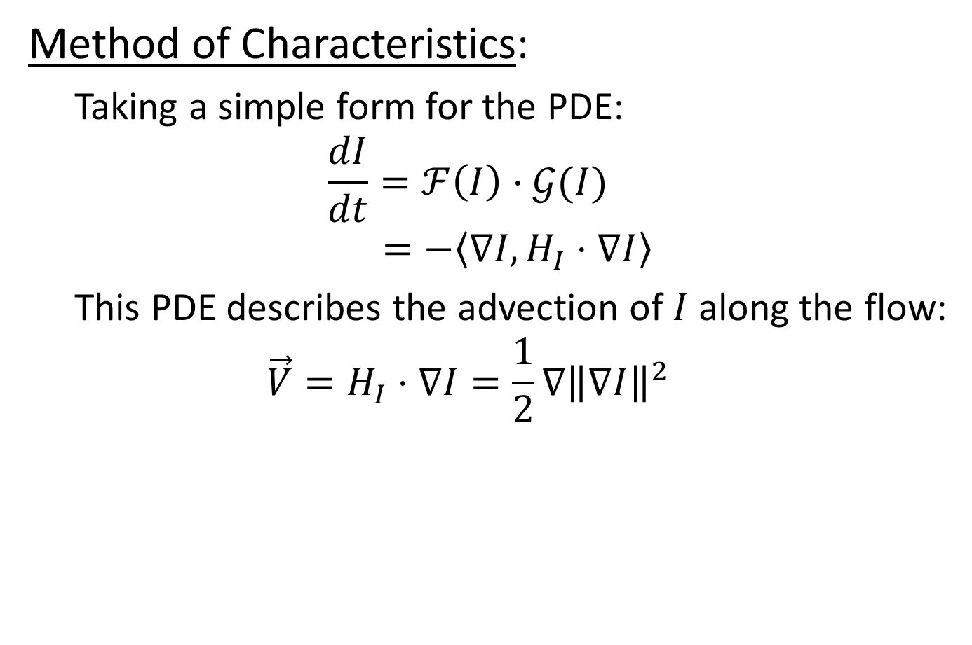
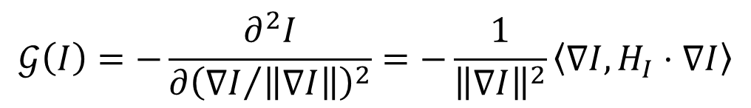
Shock Filters
Method of Characteristics:
Taking a simple form for the PDE: $$\frac{dI}{dt}=ℱ\left(I\right)⋅𝒢(I)$$
$$=−\left\langle \text{∇}I,H_{I}⋅\text{∇}I\right\rangle$$
This PDE describes the advection of $I$ along the flow: $$\vec{V}=H_{I}⋅\text{∇}I=\frac{1}{2}\text{∇}{\left\|\text{∇}I\right\|}^{2}$$
$$ℱ\left(I\right)={\left\|\text{∇}I\right\|}^{2}$$
$$𝒢\left(I\right)=−\frac{∂^{2}I}{∂{\left({\text{∇}I}/{\left\|\text{∇}I\right\|}\right)}^{2}}=−\frac{1}{{\left\|\text{∇}I\right\|}^{2}}\left\langle \text{∇}I,H_{I}⋅\text{∇}I\right\rangle$$

Slide 8
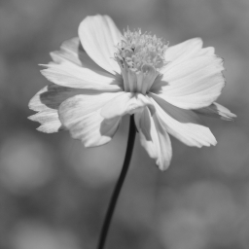
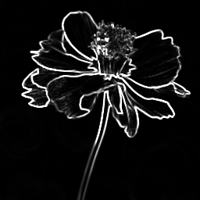
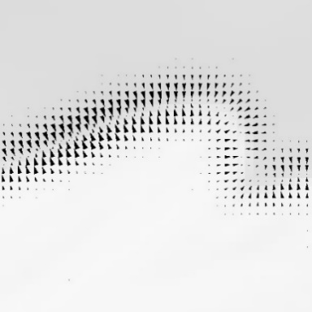
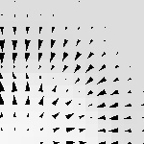

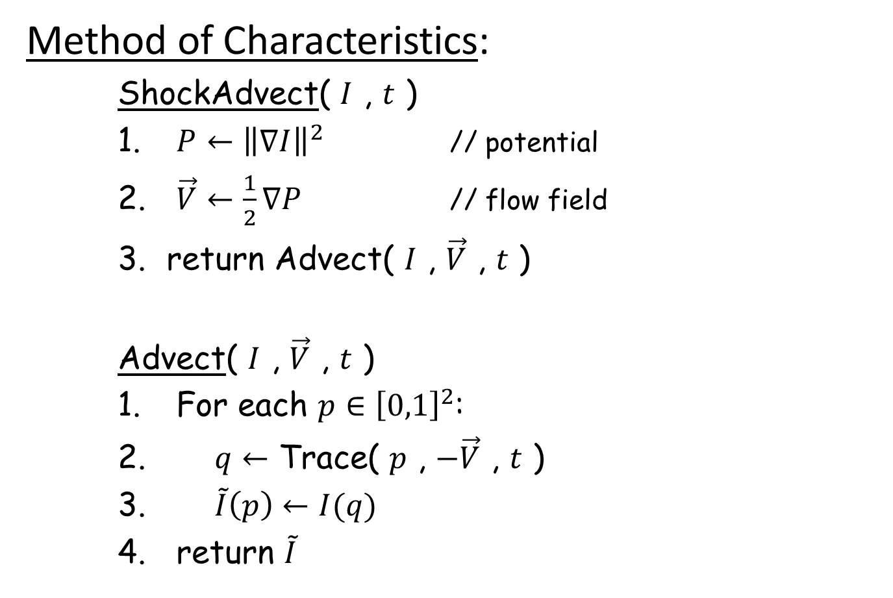

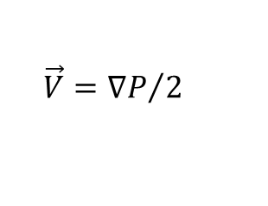


Shock Filter Advection
$$I$$
Method of Characteristics:
ShockAdvect( $I$ , $t$ )
$P←{\left\|\text{∇}I\right\|}^{2}$ // potential
$\vec{V}←\frac{1}{2}\text{∇}P$ // flow field
return Advect( $I$ , $\vec{V}$ , $t$ )
Advect( $I$ , $\vec{V}$ , $t$ )
For each $p∈{\left[0,1\right]}^{2}$:
$q←$ Trace( $p$ , $−\vec{V}$ , $t$ )
$\tilde{I}\left(p\right)←I(q)$
return $\tilde{I}$
$$P={\left\|\text{∇}I\right\|}^{2}$$
$$\vec{V}={\text{∇}P}/2$$
$$q$$
$$p$$

Slide 9
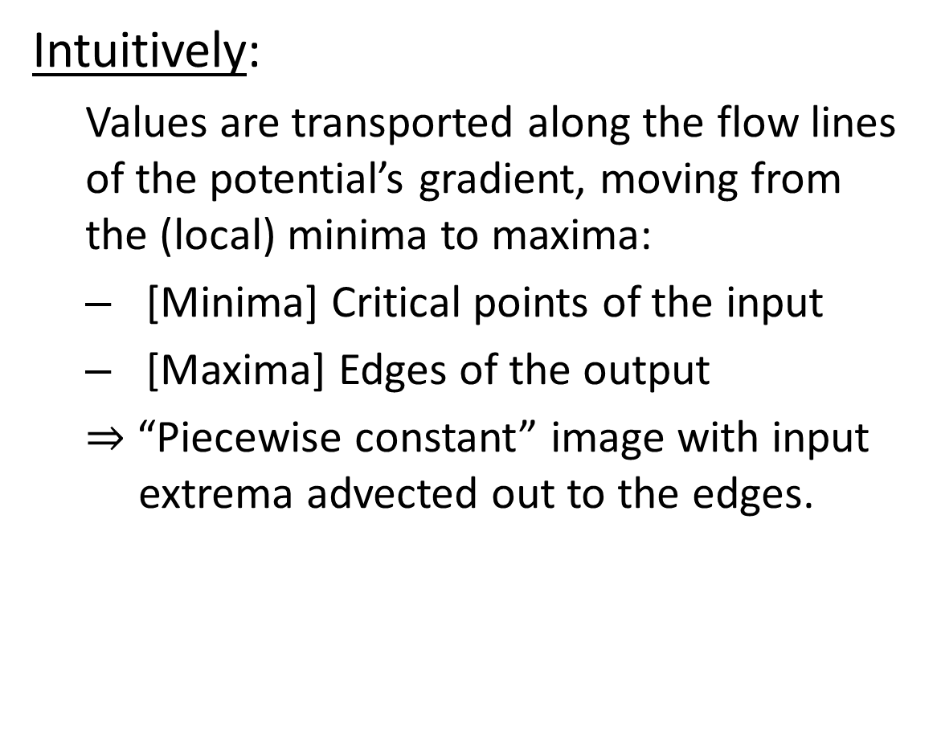
Shock Filter Advection
Intuitively:
Values are transported along the flow lines of the potential’s gradient, moving from the (local) minima to maxima:
[Minima] Critical points of the input
[Maxima] Edges of the output
$⇒$ “Piecewise constant” image with input extrema advected out to the edges.
$$I$$
$$P={\left\|\text{∇}I\right\|}^{2}$$
$$\vec{V}={\text{∇}P}/2$$
$$q$$
$$p$$

Slide 10
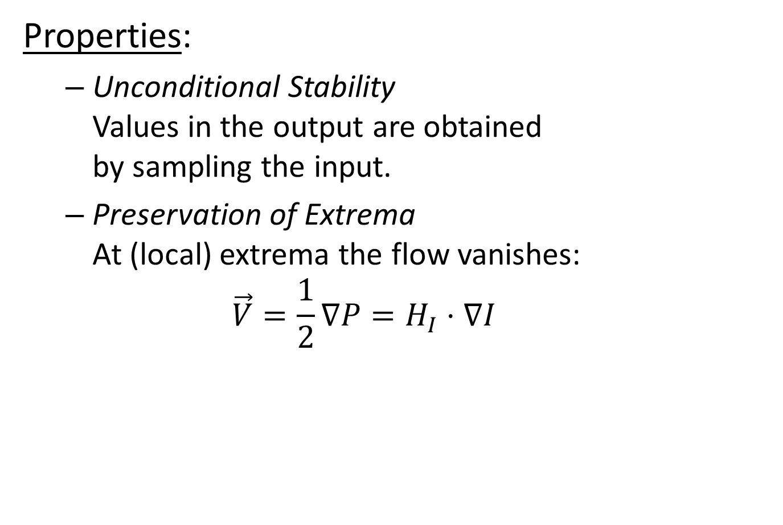
Shock Filter Advection
$$I$$
Properties:
Unconditional Stability Values in the output are obtained by sampling the input.
Preservation of Extrema At (local) extrema the flow vanishes: $\vec{V}=\frac{1}{2}\text{∇}P=H_{I}⋅\text{∇}I$
$$P={\left\|\text{∇}I\right\|}^{2}$$
$$\vec{V}={\text{∇}P}/2$$
$$q$$
$$p$$

Slide 11
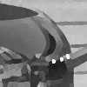
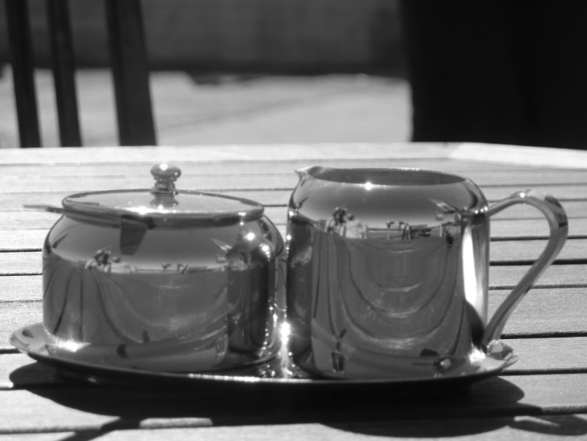
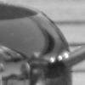

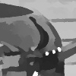

Shock Filter Advection
Properties:
Lagrangian Implementation Sampling $→$ antialised output edges
One-Step Integration Use a single (long) stream-line per pixel
Input
PDE [O&R]
Advection

Slide 12
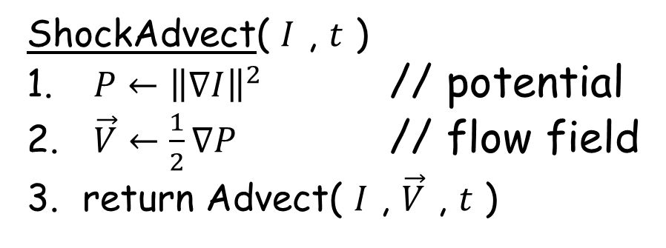

Shock Filter Advection
Extensions:
Multichannel Images Consistent processing by using a single flow-field: $P←\sum_{c∈C}{{\left\|\text{∇}I_{c}\right\|}^{2}}$
ShockAdvect( $I$ , $t$ )
$P←{\left\|\text{∇}I\right\|}^{2}$ // potential
$\vec{V}←\frac{1}{2}\text{∇}P$ // flow field
return Advect( $I$ , $\vec{V}$ , $t$ )

Slide 13

Shock Filter Advection
Extensions:
Multichannel Images
Noisy Input Robust processing by filtering the potential: $P←P∗e^{−{{\left\|x\right\|}^{2}}/{2σ^{2}}}$
ShockAdvect( $I$ , $t$ )
$P←{\left\|\text{∇}I\right\|}^{2}$ // potential
$\vec{V}←\frac{1}{2}\text{∇}P$ // flow field
return Advect( $I$ , $\vec{V}$ , $t$ )

Slide 14
Shock Filter Advection
Extensions:
Multichannel Images
Noisy Input
Triangle Meshes Extension to signals on surfaces requires computing gradients, norms, and stream-lines
ShockAdvect( $I$ , $t$ )
$P←{\left\|\text{∇}I\right\|}^{2}$ // potential
$\vec{V}←\frac{1}{2}\text{∇}P$ // flow field
return Advect( $I$ , $\vec{V}$ , $t$ )

Slide 15





Shock Filters on Surfaces
Differential Geometry:
Given a mesh $(𝒱,𝒯)$, use the hat functions to represent:
$$vi$$
$$vk$$
$$Bi(p)$$
$$vj$$
ShockAdvect( $I$ , $t$ )
$P←{\left\|\text{∇}I\right\|}^{2}$ // potential
$\vec{V}←\frac{1}{2}\text{∇}P$ // flow field
return Advect( $I$ , $\vec{V}$ , $t$ )

Slide 16

Shock Filters on Surfaces
Differential Geometry:
Given a mesh $(𝒱,𝒯)$, use the hat functions to represent:
Signals $I:𝒱→ℝ$
ShockAdvect( $I$ , $t$ )
$P←{\left\|\text{∇}I\right\|}^{2}$ // potential
$\vec{V}←\frac{1}{2}\text{∇}P$ // flow field
return Advect( $I$ , $\vec{V}$ , $t$ )

Slide 17

Shock Filters on Surfaces
Differential Geometry:
Given a mesh $(𝒱,𝒯)$, use the hat functions to represent:
Signals $I:𝒱→ℝ$
Gradients $\text{∇}I:𝒯→ℝ^{2}$
ShockAdvect( $I$ , $t$ )
$P←{\left\|\text{∇}I\right\|}^{2}$ // potential
$\vec{V}←\frac{1}{2}\text{∇}P$ // flow field
return Advect( $I$ , $\vec{V}$ , $t$ )

Slide 18

Shock Filters on Surfaces
Differential Geometry:
Given a mesh $(𝒱,𝒯)$, use the hat functions to represent:
Signals $I:𝒱→ℝ$
Gradients $\text{∇}I:𝒯→ℝ^{2}$
Gradient Norms ${\left\|\text{∇}I\right\|}^{2}:𝒯→ℝ$
ShockAdvect( $I$ , $t$ )
$P←{\left\|\text{∇}I\right\|}^{2}$ // potential
$\vec{V}←\frac{1}{2}\text{∇}P$ // flow field
return Advect( $I$ , $\vec{V}$ , $t$ )

Slide 19

Shock Filters on Surfaces
Differential Geometry:
Given a mesh $(𝒱,𝒯)$, use the hat functions to represent:
Signals $I:𝒱→ℝ$
Gradients $\text{∇}I:𝒯→ℝ^{2}$
Gradient Norms ${\left\|\text{∇}I\right\|}^{2}:𝒯→ℝ$
To transform gradient norms to signals, average over the adjacent triangles: $$P\left(v\right)←\frac{\sum_{T∈𝒯(v)}{\left|T\right|⋅{\left\|{\left.\text{∇}I\right|}_{T}\right\|}^{2}}}{\sum_{T∈𝒯(v)}{\left|T\right|}}$$
ShockAdvect( $I$ , $t$ )
$P←{\left\|\text{∇}I\right\|}^{2}$ // potential
$\vec{V}←\frac{1}{2}\text{∇}P$ // flow field
return Advect( $I$ , $\vec{V}$ , $t$ )

Slide 20


Shock Filters on Surfaces
Advection:
To trace a path from a point:
Advance the point along the triangle’s vector
$$p$$
Advect( $I$ , $\vec{V}$ , $t$ )
For each $p$:
$q←$ Trace( $p$ , $−\vec{V}$ , $t$ )
$\tilde{I}\left(p\right)←I(q)$
return $\tilde{I}$

Slide 21

Shock Filters on Surfaces
Advection:
To trace a path from a point:
Advance the point along the triangle’s vector
If the ray crosses an edge:
Unfold the neighboring triangle and continue
$$q$$
$$p$$
Advect( $I$ , $\vec{V}$ , $t$ )
For each $p$:
$q←$ Trace( $p$ , $−\vec{V}$ , $t$ )
$\tilde{I}\left(p\right)←I(q)$
return $\tilde{I}$

Slide 22



Shock Filters on Surfaces
Signal Processing:
Given per-vertex colors:
Shock filter advection sharpens the signal
Input
Advection

Slide 23








Shock Filters on Surfaces
Geometry Processing:
Given surface normals:
Shock filter advection sharpens the normals
A Poisson solve reconstructs the sharpened geometry [Yu et al., 2004]
For normals, the potential is the total curvature: $$P\left(v\right)←{\left\|\text{∇}{\vec{n}}_{x}\right\|}^{2}+{\left\|\text{∇}{\vec{n}}_{y}\right\|}^{2}+{\left\|\text{∇}{\vec{n}}_{z}\right\|}^{2}=κ_{1}^{2}+κ_{2}^{2}$$
Input
$$⇓$$
Output is a “piecewise flat” surface with normal discontinuities pushed to regions with high curvature.
Advection

Slide 24




Performance
Mesh | Vertices | Pre-Processing | Advection | Solve
Pleo | 213,618 | 0.1 (s) | 0.5 (s) | *
Rooster | 696,416 | 0.4 (s) | 0.9 (s) | *
Neptune | 499,416 | 1.3 (s) | 0.9 (s) | 0.9 (s)
Asian Dragon | 3,609,455 | 13.6 (s) | 6.3 (s) | 5.5 (s)

Slide 25
Outline
Shock Filters
Advection
Analysis
Extensions
Conclusion

Slide 26
Conclusion
Shock Filters as Value Advection:
Alternate implementation
New intuition/analysis
New extensions/applications

Slide 27





Future Work
Performance:
GPU-based recursive up-sampling
More accurate streamline tracing
Extensions:
Gradient flow
Coupled image editing
Curvature advection
Texture map processing

Slide 28



Thank You!

