Slide 1
Surface Reconstruction
Misha Kazhdan

Slide 2
Outline
Introduction
Preliminaries
A sampling of methods
Why is reconstruction hard?

Slide 3
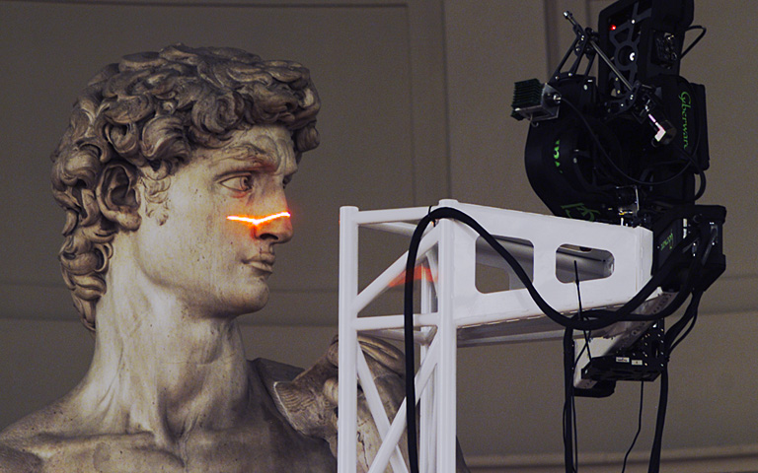
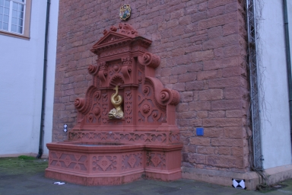
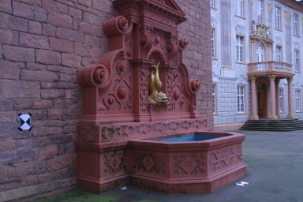
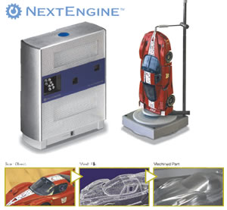
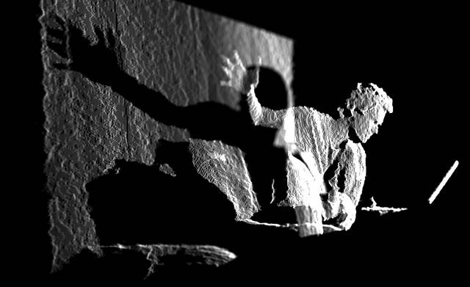
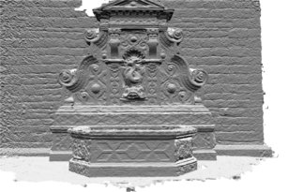
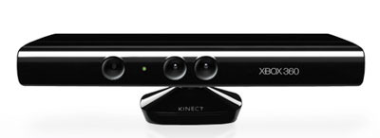
Motivation
3D Scanners are ubiquitous (and cheap)
[Images courtesy of Rusinkiewicz, Strecha, createdigitalmotion.com, and NextEngine]

Slide 4
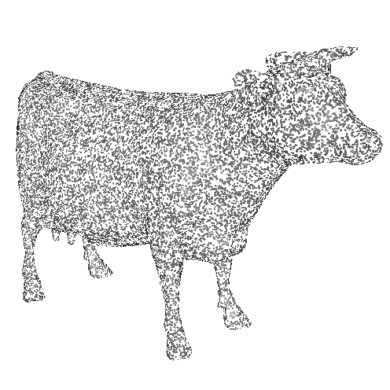
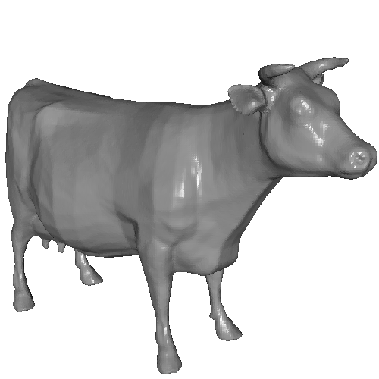
Motivation
Scanners typically produce un/semi-structured sets of points that need to be connected into a single (water-tight) model.

Slide 5
Related Work
[1] GVU Center Georgia Tech, Graphics Research Grupo, Variational Implicit Surfaces Web site: http://www.cc.gatech.edu/gvu/geometry/implicit/. [6] T. Gentils R. Smith A. Hilton, D. Beresford and W. Sun. Virtual people: Capturing human models to populate virtual worlds. In Proc. Computer Animation, page 174185, Geneva, Switzerland, 1999. IEEE Press. [7] Anders Adamson and Marc Alexa. Approximating and intersecting surfaces from points. In Proceedings of the Eurographics/ACM SIG- GRAPH Symposium on Geometry Processing 2003, pages 230{239. ACM Press, Jun 2003. [8] Anders Adamson and Marc Alexa. Approximating bounded, nonorientable surfaces from points. In SMI '04: Proceedings of Shape Modeling Applications 2004, pages 243{252, 2004. 153 [9] U. Adamy, J. Giesen, and M. John. Surface reconstruction using umbrella ¿ters. Computational Geometry, 21(1-2):63{86, 2002. [10] G. J. Agin and T. O.Binford. Computer description of curved objects. In Proceedings of the International Joint Conference on ArtiÌial In- telligence, pages 629{640, 1973. [11] Irene Albrecht, Jorg Haber, and Hans-Peter Seidel. Construction and Animation of Anatomically Based Human Hand Models. In Proceedings ACM SIGGRAPH/Eurographics Symposium on Computer Animation (SCA '03), pages 98{108, July 2003. [12] M. Alexa, J. Behr, D. Cohen-Or, S. Fleishman, D. Levin, and C. T. Silva. Point set surfaces. In IEEE Visualization 2001, pages 21{28, October 2001. [13] Marc Alexa and Anders Adamson. On normals and projection operators for surfaces de¿ed by point sets. In Marc Alexa, Markus Gross, Hanspeter P¿ter, and Szymon Rusinkiewicz, editors, Proceedings of Eurographics Symposium on Point-based Graphics, pages 149{156. Eurographics, 2004. [14] Marc Alexa, Johannes Behr, Daniel Cohen-Or, Shachar Fleishman, David Levin, and Claudio T. Silva. Computing and rendering point set surfaces. IEEE Transactions on Computer Graphics and Visualization, 9:3{15, 2003. [15] International 2003, pages 49{58, Seoul, Korea, May 2003. [17] H. Alt, B. Behrends, and J. Blomer. Approximate matching of polygonal shapes. Annals of Mathematics and ArtiÌial Intelligence, pages 251{265, 1995. 154 [18] N. Amenta, M. Bern, and M. Kamvysselis. A new Voronoi-based Surface Reconstruction Algorithm. In Proceedings of ACM SIGGRAPH' 98, pp.415-421, 1998. [19] N. Amenta, M. Bern, and M. Kamvysselis. A new Voronoi-based surface reconstruction algorithm. In Proceedings of ACM SIGGRAPH 1998, pages 415{421, 1998. [20] N. Amenta, S. Choi, T. K. Dey, and N. Leekha. A simple algorithm for homeomorphic surface reconstruction. In Proc. 16th Annu. ACM Sympos. Comput. Geom., pages 213{222, 2000. [21] N. Amenta, S. Choi, and R. Kolluri. The power crust. In Proceedings of 6th ACM Symposium on Solid Modeling, pages 249{260, 2001. [22] N. Amenta, S. Choi, and R. Kolluri. The power crust. In ACM Solid Modeling, 2001. [23] N. Amenta, S. Choi, and R. K. Kolluri. The power crust, unions of balls, and the medial axis transform. Comput. Geom. Theory Appl., 19:127{153, 2001. [24] N. Amenta and Y. Kil. De¿ing point-set surfaces. Acm Transactions on Graphics, 23, Aug 2004. [25] N. Amenta and Y. Kil. The domain of a point set surface. In Symposium on Point-Based Graphics 2004, 2004. [26] N. Amenta, S.Choi, t. K. Dey, and N. Leekha. A Simple Algorithm for Homeomorphic Surface Reconstruction, International Journal of Computational Geometry and Applications, vol.12 n.1-2, pp.125-141, 2002. [27] Nina Amenta and Marshall Bern. Surface reconstruction by Voronoi ¿tering. Discrete Comput. Geom., 22(4):481{504, 1999. [28] P. Anandan. A computational framework and an algorithm for the measurement of visual motion. Int. Journal of Computer Vision, 2:283{ 310, 1989. [29] Anonymous. The Anthropometry Source Book, volume I & II. NASA Reference Publication 1024. 155 [30] Anonymous. Nasa man-systems integration manual. Technical Report NASA-STD-3000. [31] H.J. Antonisse. Image segmentation in pyramids. Computer Vision, Graphics and Image Processing, 19(4):367{383, 1982. [32] A. Asundi. Computer aided moire methods. Optical Laser Engineering, 17:107{116, 1993. [33] D. Attali. r-regular Shape Reconstruction from Unorganized Points. In Proceedings of the ACM Symposium on Computational Geometry, pp.248-253, 1997. [34] D. Attali and J. O. Lachaud. Delaunay conforming iso-surface; skeleton extraction and noise removal, Computational Geometry: Theory and Applications. 19(2-3): 175-189, 2001. [35] D. Attali and J.-O. Lachaud. Constructing Iso-Surfaces Satisfying the Delaunay Constraint; Application to the Skeleton Computation. In Proc. 10th International Conference on Image Analysis and Processing (ICIAP'99), Venice, Italy, September 27-29, pages 382-387, 1999. [36] Dominique Attali and Jean-Daniel Boissonnat. Complexity of the Delaunay triangulation of points on polyhedral surfaces. In Proc. 7th ACM Symposium on Solid Modeling and Applications, 2002. [37] M. Attene, B. Falcidino, M. Spagnuolo, and J. Rossignac. Sharpen & bend: Recovering curved edges in triangle meshes produced by featureinsensitive sampling. Technical report, Georgia Institute of Technology, 2003. GVU-GATECH 34/2003. [38] M. Attene and M. Spagnuolo. Automatic Surface Reconstruction from point sets in space. In EUROGRAPHICS 2000 Proceedings, pp. 457- 465, Vol.19 n.3, 2000. [39] M. Attene and M. Spagnuolo. Automatic surface reconstruction from point sets in space. Computer Graphics Forum, 19(3):457{465, 2000. Proceedings of EUROGRAPHICS 2000. [40] Marco Attene, Bianca Falcidieno, Jarek Rossignac, and Michela Spagnuolo. Edge-sharpener: Recovering sharp features in triangulations of non-adaptively re-meshed surfaces. 156 [41] Marco Attene and Michela Spagnuolo. Automatic surface reconstruction from point sets in space. Computer Graphics Forum, 19(3):457{ 465, 2000. [42] C.K. Au and M.M.F. Yuen. Feature-based reverse engineering of mannequin for garment design. Computer-Aided Design 31:751-759, 1999. [43] S. Ayer and H. Sawhney. Layered representation of motion video using robust maximum-likelihood estimation of mixture models and mdl encoding. International Conference on Computer Vision, pages 777{784, 1995. [44] Z. Popovic B. Allen, B. Curless. Articulated body deformation from range scan data. In Proceedings SIGGRAPH 02, page 612619, San Antonio, TX, USA, 2002. Addison-Wesley. [45] Z. Popovic B. Allen, B. Curless. The space of all body shapes: reconstruction and parameterization from range scans. In Proceedings SIGGRAPH 03, page 587594, San Diego, CA, USA, 2003. Addison- Wesley. [46] ed B. M. ter haar Romeny. Geometry-Driven Di¯sion in Computer Vision. Kluwer Academic Pubs., 1994. [47] A. Bab-Hadiashar and D. Suter. Robust optic ow estimation using least median of squares. Proceedings ICIP-96, September 1996. Switzerland. [48] C. Bajaj, Fausto Bernardini, and Guoliang Xu. Automatic reconstruction of surfaces and scalar Îlds from 3d scans. In International Confer- ence on Computer Graphics and Interactive Techniques, pages 109{118, 1995. [49] C .L. Bajaj, F. Bernardini, J. Chen, and D. Schikore. utomatic Reconstruction of 3D Cad Models. In Proceedings of Theory and Practice of Geometric Modelling, 1996. [50] C.L. Bajaj, E.J. Coyle, and K.N. Lin. Arbitrary topology shape reconstruction from planar cross sections. Graphical.Models.and Image Processing., 58:524{543, 1996. 157 [51] G. Barequet, M.T. Goodrich, A. Levi-Steiner, and D. Steiner. Contour interpolation by straight skeletons. Graphical.models., 66:245{260, 2004. [52] G. Barequet, D. Shapiro, and A. Tal. Multilevel sensitive reconstruction of polyhedral surfaces from parallel slices. The Visual Computer, 16(2):116{133, 2000. [53] G. Barequet and M. Sharir. Piecewise-linear interpolation between polygonal slices. Computer Vision and Image Understanding, 63(2):251{272, 1996. [54] G. Barequet and M. Sharir. Partial surface and Beraldin. Practical considerations for a design of a high precision 3d laser scanner system. Proceedings of SPIE, 959:225{246, 1988. [74] B. Blanz and T. Vetter. A morphable model for the synthesis of 3d faces. In Proceedings SIGGRAPH 99, page 187194, Los Angeles, CA, USA, 1999. Addison-Wesley. [75] Volker Blanz, Curzio Basso, Tomaso Poggio, and Thomas Vetter. Reanimating Faces in Images and Video. In Pere Brunet and Dieter Fellner, editors, Computer Graphics Forum (Proceedings of Eurographics 2003), volume 22, pages 641{650, September 2003. [76] Volker Blanz and Thomas Vetter. A Morphable Model for the Synthesis of 3D Faces. In Alyn Rockwood, editor, Computer Graphics (SIGGRAPH '99 Conference Proceedings), pages 187{194. ACM SIGGRAPH, August 1999. [77] J. F. Blinn. A generalization of algebraic surface drawing. ACM Trans- actions on Graphics, 1(3):235{256, July 1982. [78] J. Bloomenthal, editor. Introduction to Implicit Surfaces. Morgan Kaufmann, 1997. [79] J. D. Boissonnat. Geometric Structures for Three-dimensional Shape Representation. ACM Transaction on Graphics, pp.266-286, Vol.3, 1984. [80] J.-D. Boissonnat. Geometric structures for three-dimensional shape representation. ACM Transactions on Graphics, 3(4):266{286, October 1984. [81] J.D. Boissonnat. Shape reconstruction from planar cross sections… [403] M.J. Zyda, A.R. Jones, and P.G. Hogan. Surface construction from planar contours. Computers.and Graphics, 11:393{408, 1987.
…/… [403]
[List courtesy of Alliez]

Slide 6
Related Work
Classification:
Computational Geometry vs. Implicit Surfaces
Oriented vs. Unoriented Points
Structured vs. Unstructured Data
Water-tight vs. Surface with Boundary Output
Etc.

Slide 7
Related Work
Classification:
Computational Geometry
Uses input to partition space
Use a subset of the partition to define the shape
Implicit Surfaces
Fit implicit function to the input
Extract iso-surface

Slide 8
Outline
Introduction
Preliminaries
Convex Hulls
Delaunay Triangulations
Voronoi Diagrams
Medial Axes
A sampling of methods
Why is reconstruction hard?

Slide 9
Computational Geometry
Convex Hulls:
A set S is convex if for any two points a,b∈S, the line segment between a and b is also in S.
p
p
p
p
q
q
q
q
convex
non-convex
[Notes courtesy of Alliez]

Slide 10
Computational Geometry
Convex Hulls:
A set S is convex if for any two points a,b∈S, the line segment between a and b is also in S.
The convex hull of a set of points is the smallest convex set containing S.
p
p
p
p
q
q
q
q
convex
convex
non-convex
non-convex
S
CH(S)
[Notes courtesy of Alliez]

Slide 11
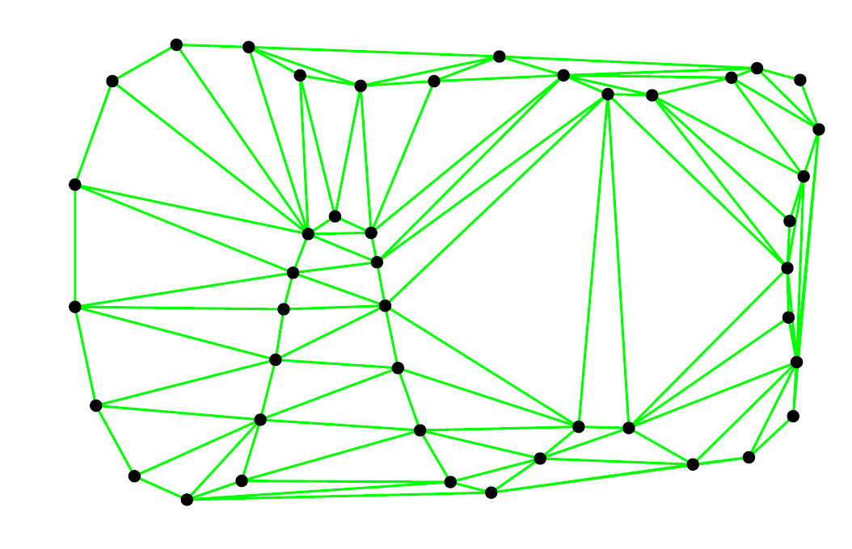
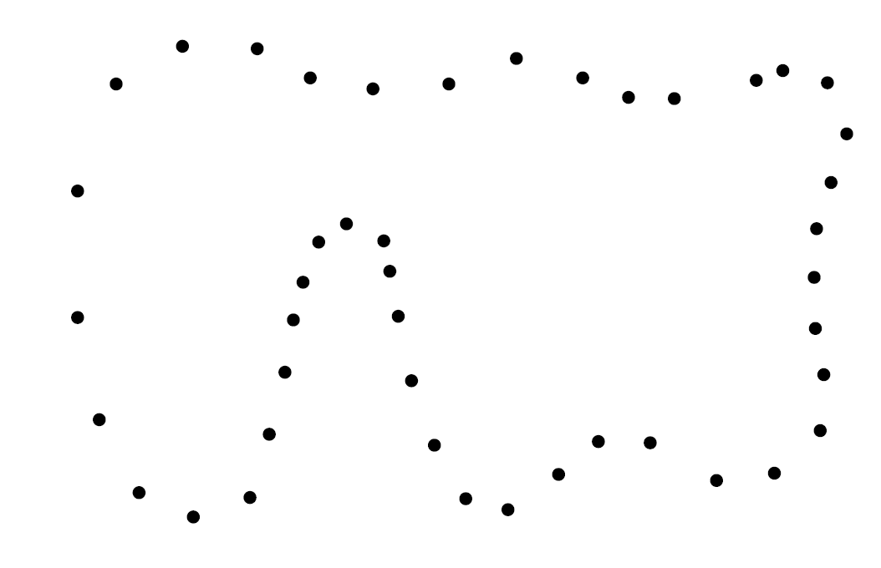
Computational Geometry
Delaunay Triangulation:
A Delaunay Triangulation of S is the set of all triangles with vertices in S whose circumscribing circle contains no other points in S*.
Compactness Property:
This is a triangulation that minimizes the max angle.
[*Assuming general position]
[Notes courtesy of Alliez]

Slide 12
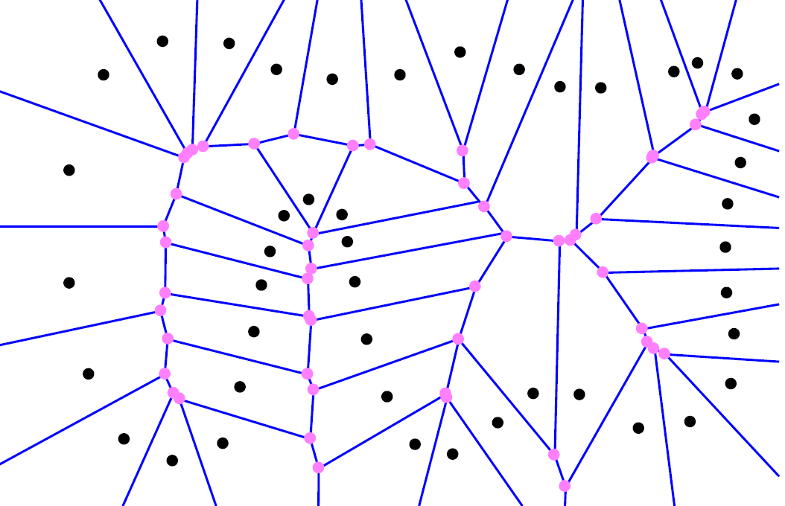
Computational Geometry
Voronoi Diagrams:
The Voronoi Diagram of S is a partition of space into regions V(p) (p∈S) such that all points in V(p) are closer to p than any other point in S.
For a point on an edge, we can draw an empty circle that only touches the points in S separated by the edge.
[Notes courtesy of Alliez]

Slide 13
Computational Geometry
Voronoi Diagrams:
The Voronoi Diagram of S is a partition of space into regions V(p) (p∈S) such that all points in V(p) are closer to p than any other point in S.
For a vertex, we can draw an empty circle that just touches the three points in S around the vertex.
[Notes courtesy of Alliez]

Slide 14
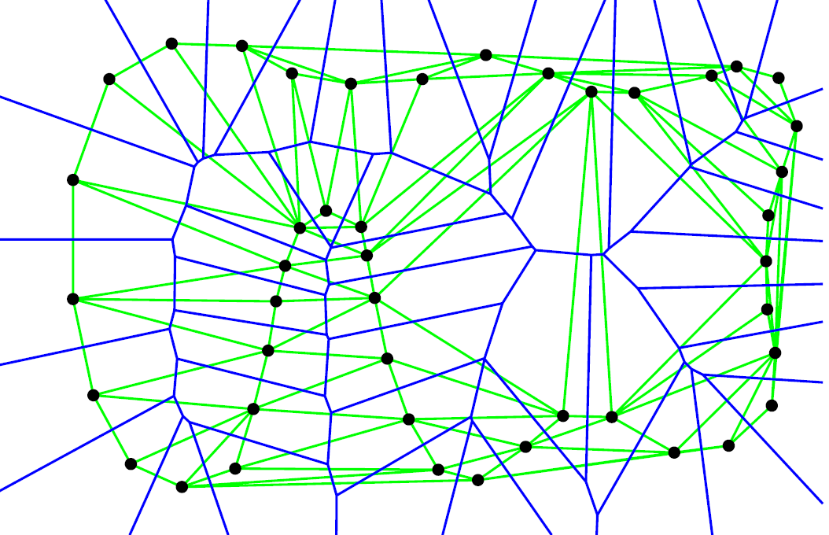
Computational Geometry
Voronoi Diagrams:
The Voronoi Diagram of S is a partition of space into regions V(p) (p∈S) such that all points in V(p) are closer to p than any other point in S.
Duality:
Each Voronoi vertex is in one-to-one correspondence with a Delaunay triangle.
[Notes courtesy of Alliez]

Slide 15
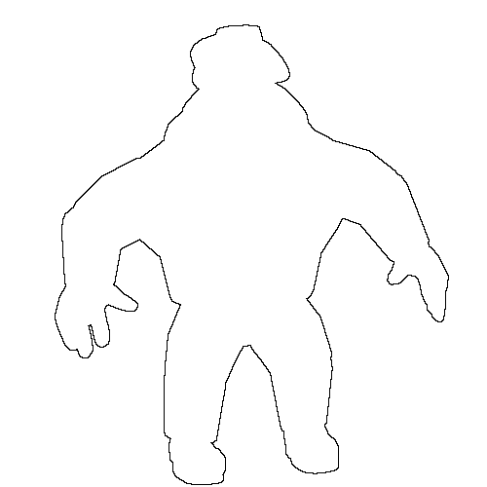
Computational Geometry
Medial Axis:
For a shape (curve/surface) a Medial Ball is a circle/sphere that only meets the shape tangentially, in at least two points.

Slide 16
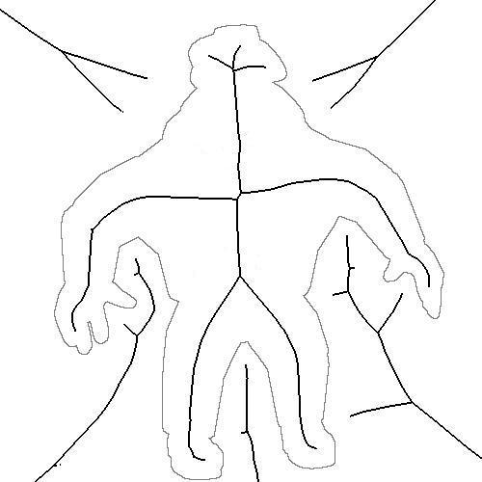
Computational Geometry
Medial Axis:
For a shape (curve/surface) a Medial Ball is a circle/sphere that only meets the shape tangentially, in at least two points.
The centers of all such balls make up the medial axis/skeleton.

Slide 17
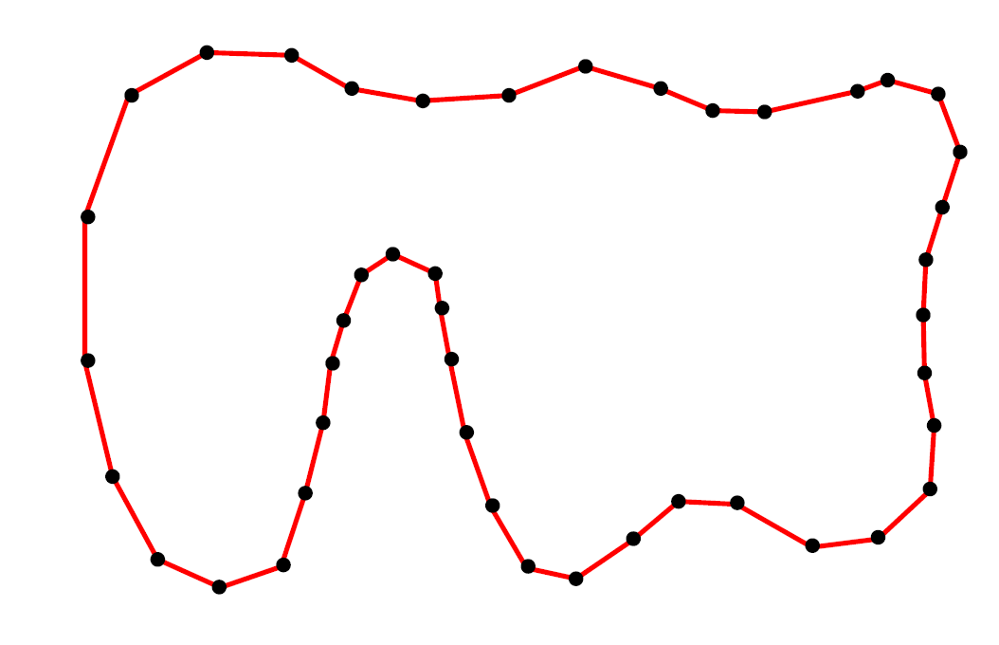
Computational Geometry
Observation*:
For a reasonable point sample, the medial axis is well-sampled by the Voronoi vertices.
*In 3D, this is only true for a subset of the Voronoi vertices – the poles.

Slide 18
Outline
Introduction
Preliminaries
A sampling of methods
Space Partitioning
Crust
… from Unorganized Points
Poisson Reconstruction
Why is reconstruction hard?
Computational Geometry
Implicit Surfaces

Slide 19
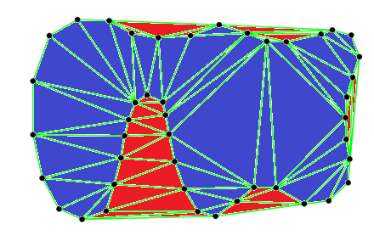
Space Partitioning
Given a set of points, we can construct the Delaunay triangulation.
If we label each triangle as inside/outside, then the surface of interest is the set of edges that lie between inside and outside triangles.

Slide 20
Space Partitioning
Q: How to assign labels?
A: Spectral Partitioning [Kolluri et al. 2004]
Assign a weight to each edge indicating if the two triangles are likely to have the same label.
Find a partition into roughly even pieces that minimizes the cut-weight.

Slide 21
Space Partitioning
Assigning Edge Weights:
Q: When are triangles on opposite sides of an edge likely to have the same label?
A: If the triangles are on the same side, their circumscribing circles intersect deeply.
Use the angle of intersection to set the weight.
Large Weight
Small Weight

Slide 22
Crust [Amenta et al. 1998]
If we consider the Delaunay Triangulation of a point set, the shape boundary can be described as a subset of the Delaunay edges.
Q: How do we determine which edges to keep?
A: Two types of edges:
Those connecting adjacent points on the boundary
Those traversing the shape.
Discard those that traverse.

Slide 23
Crust [Amenta et al. 1998]
Observation:
Edges that traverse cross the medial axis.
Although we don’t know the axis, we can sample it with the Voronoi vertices.
Edges that traverse must be near the Voronoi vertices.

Slide 24
Crust [Amenta et al. 1998]
Algorithm:
Compute the Delaunay triangulation.
Compute the Voronoi vertices
Keep all edges for which there is a circle that contains the edge but no Voronoi vertices.

Slide 25
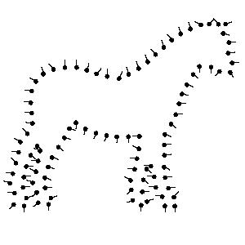
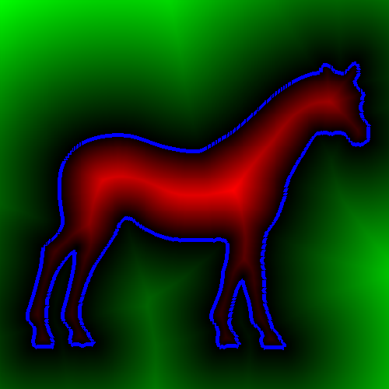
Implicit Surface Reconstruction
Key Idea:
Use the point samples to define a function whose values at the sample positions are zero.
Extract the zero level set. [Lorensen and Cline, 1987]
>0
F(x,y) =0
F(x,y)<0
0
F(x,y)>0
<0
Sample Points
F(x,y)=0

Slide 26
… Unorganized Points [Hoppe et al. 1992]
Computes a local signed distance transform by using the sample normals to define a linear approximation to the function.
Extracts the zero level (where defined).

Slide 27
… Unorganized Points [Hoppe et al. 1992]
Q: How do we get the normals?

Slide 28
… Unorganized Points [Hoppe et al. 1992]
Q: How do we get the normals?
A1: Fit a line to the neighbors of each point.

Slide 29
… Unorganized Points [Hoppe et al. 1992]
Q: How do we get the normals?
A1: Fit a line to the neighbors of each point.
This doesn’t guarantee a consistent orientation!
For the orientation to be consistent, neighboring points should point in the same direction.

Slide 30
… Unorganized Points [Hoppe et al. 1992]
Q: How do we get the normals?
A1: Fit a line to the neighbors of each point.
A2: Build a (Euclidian) minimal spanning tree and propagate the orientation from a root.

Slide 31
… Unorganized Points [Hoppe et al. 1992]
Q: How do we get the normals?
A1: Fit a line to the neighbors of each point.
A2: Build a (Euclidian) minimal spanning tree and propagate the orientation from a root.
Note:
In 2D, building a good spanning tree is the same as fitting a closed curve, it’s not in 3D.

Slide 32
… Unorganized Points [Hoppe et al. 1992]
Q: How do we get the normals?
A1: Fit a line to the neighbors of each point.
A2: Build a (Euclidian) minimal spanning tree and propagate the orientation from a root.
Note:
If the spanning graph is not a tree, can prioritize propagation based on confidence.

Slide 33
Poisson Reconstruction [Kazhdan et al. 2006]
Reconstructs the indicator function of the surface and then extracts the boundary.
Q: How to fit the function to the samples?
A: Normals are samples of function’s gradients.
0
0
0
0
0
1
0
1
0
0
0
0
1
0
Indicator function
Oriented points
Indicator gradient

Slide 34

Poisson Reconstruction [Kazhdan et al. 2006]
To fit a scalar field F to the gradients $\vec{V}$: we take the divergence of both sides, which results in a Poisson equation:
0
0
0
0
0
0
Oriented points
Indicator gradient

Slide 35
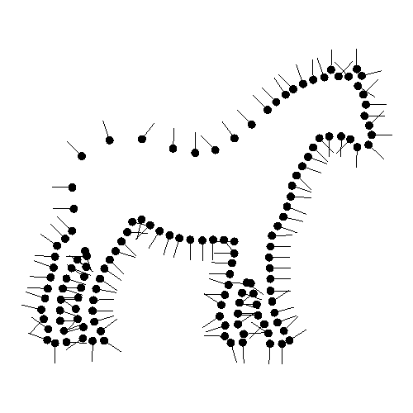
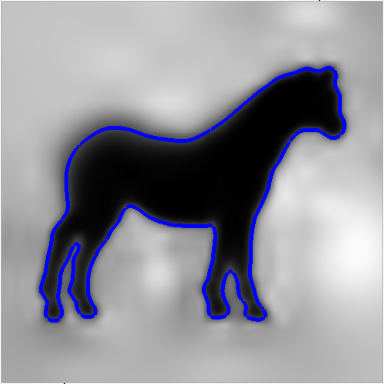
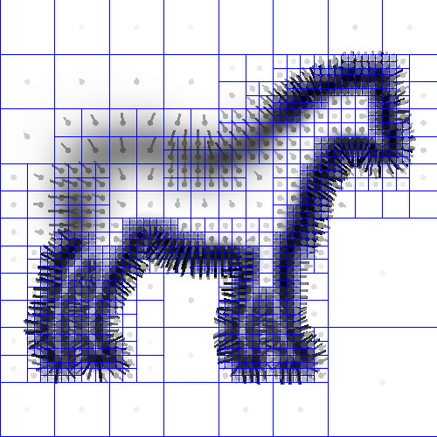

Poisson Reconstruction [Kazhdan et al. 2006]
Algorithm:
Transform samples into a vector field.
Fit a scalar-field to the gradients.
Extract the isosurface.

Slide 36
Outline
Introduction
Preliminaries
A sampling of methods
Why is reconstruction hard?

Slide 37

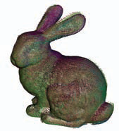
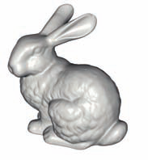

Why is Reconstruction Hard?
The point-set is often the result of:
Scanning
Registering
Warping
Etc.
Individual Scans
Registered Scans
Reconstructed Model
[Image courtesy of Bolitho]

Slide 38
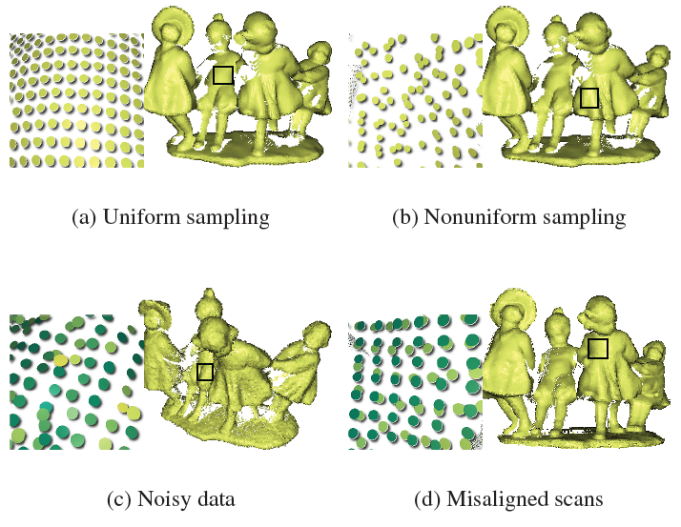
Why is Reconstruction Hard?
Susceptible to:
Scanner noise
Misalignment
Nonuniform sampling
[Image courtesy of Berger et al.]

Slide 39
Concerns
Performance in the presence of bad data
Interpolating vs. Approximating
Efficiency of reconstruction
Quality Guarantees
Input constraints
Manifoldness
Etc.

