Slide 1
Registering Genus-zero Surfaces
Misha Kazhdan
Johns Hopkins University
[M. Kazhdan, J. Solomon, and M. Ben-Chen. SGP 2012]
[F. Prada, M. Kazhdan, M. Chuang, A. Collet, and H . Hoppe. SIGGRAPH 2016]
[A. Baden, K. Crane, and M. Kazhdan. SGP 2018]
[S. Lee and M. Kazhdan. In progress]

Slide 2
Outline
Parametrizing Genus-Zero Surfaces
  (Conformalized) Mean Curvature Flow
Registering the Parametrizations
  Mobius Registration
Refining the Registration
  Optical Flow

Slide 3
Outline
(Conformalized) Mean Curvature Flow
  Harmonic Flow
  Discretization
  Identifying and Modifying
  Evaluation
Mobius Registration
Optical Flow

Slide 4
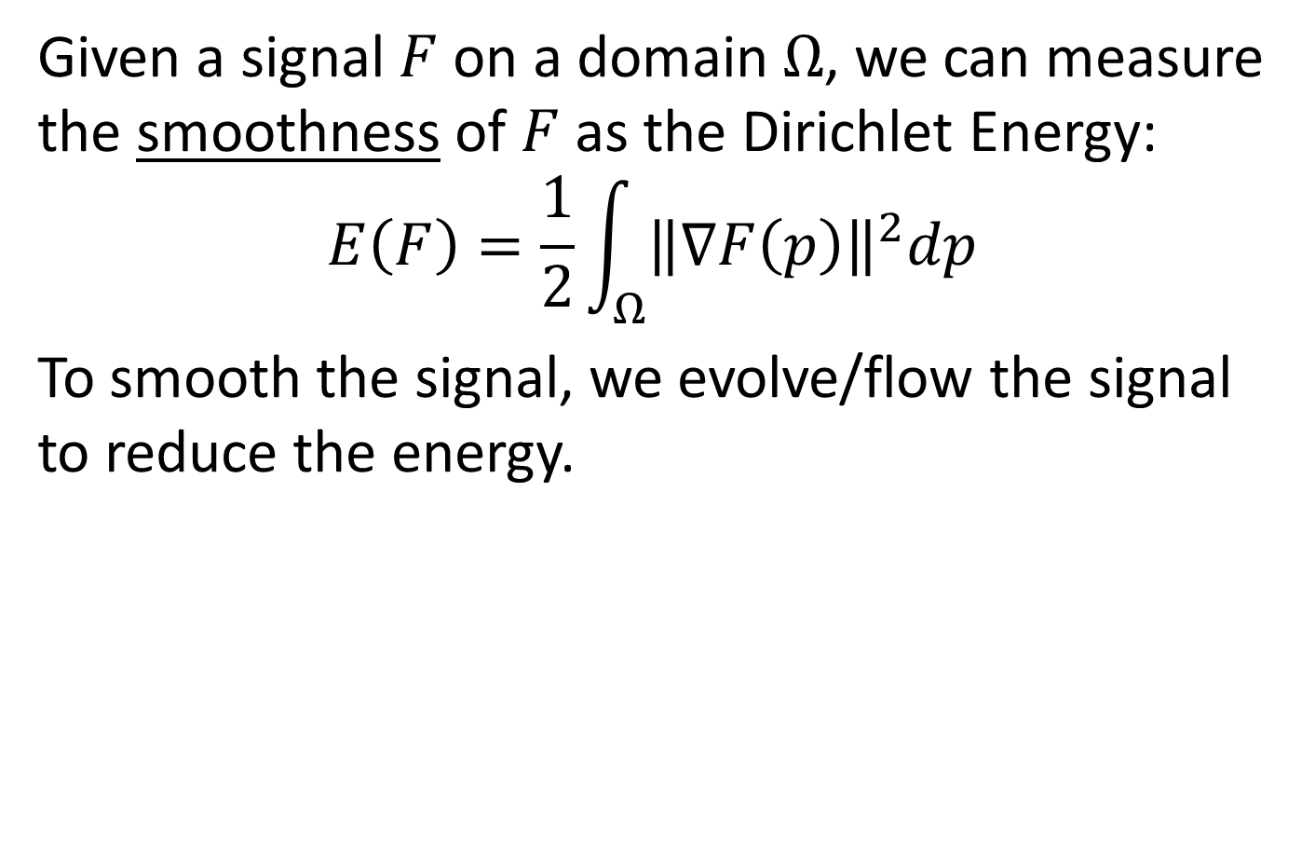
Harmonic Flow
Given a signal $F$ on a domain $Ω$, we can measure the smoothness of $F$ as the Dirichlet Energy:
$$E\left(F\right)=\frac{1}{2}\int_{Ω}{{\left\|\text{∇}F\left(p\right)\right\|}^{2}dp}$$
To smooth the signal, we evolve/flow the signal to reduce the energy.

Slide 5
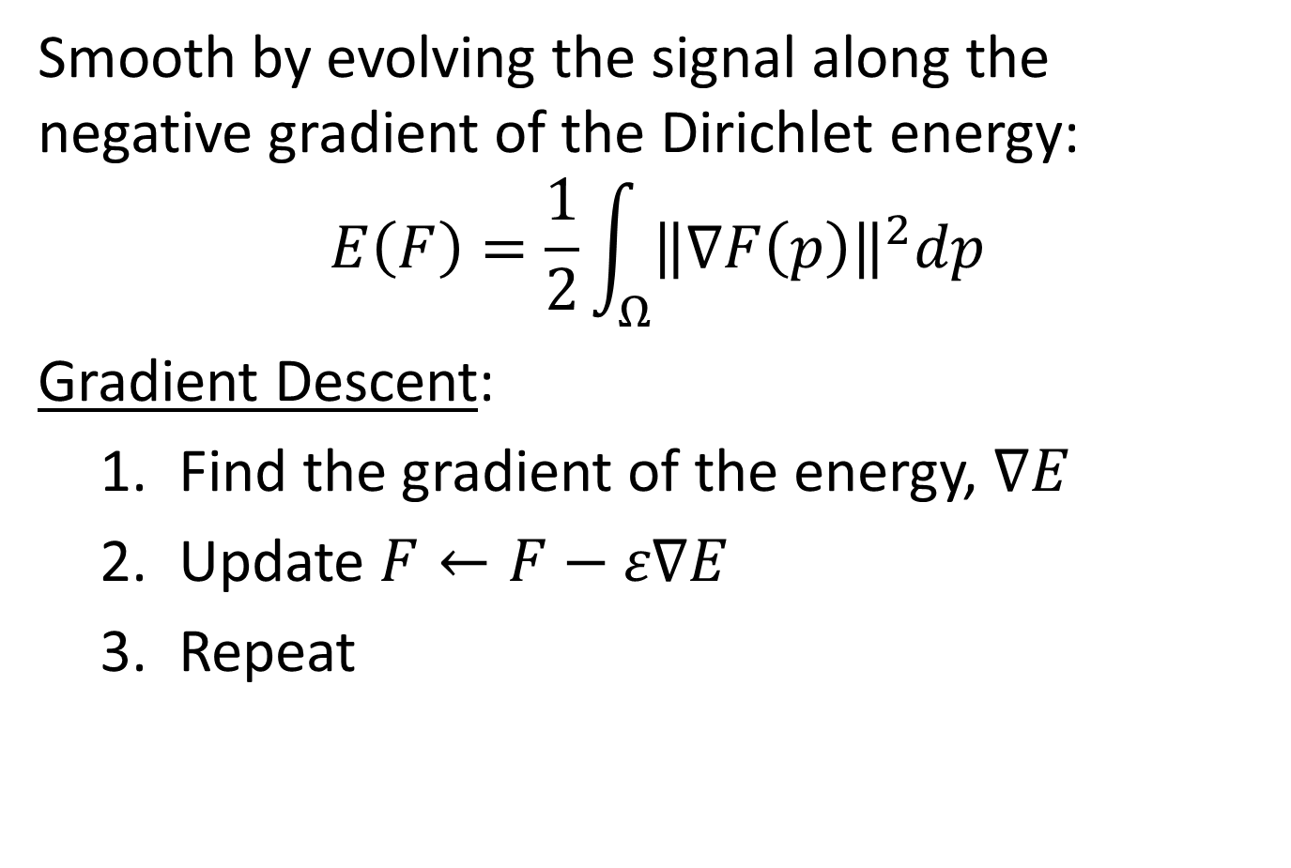
Harmonic Flow
Smooth by evolving the signal along the negative gradient of the Dirichlet energy:
$$E\left(F\right)=\frac{1}{2}\int_{Ω}{{\left\|\text{∇}F\left(p\right)\right\|}^{2}dp}$$
Gradient Descent:
  Find the gradient of the energy, $\text{∇}E$
  Update $F←F−ε\text{∇}E$
  Repeat

Slide 6
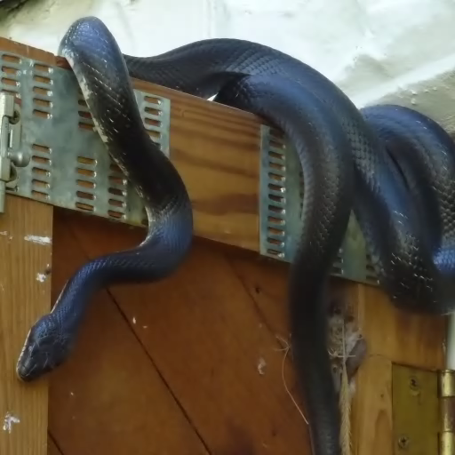

Harmonic Flow (on Images)
Smooth by evolving the signal along the negative gradient of the Dirichlet energy:
$$E\left(F\right)=\frac{1}{2}\int_{Ω}{{\left\|\text{∇}F\left(p\right)\right\|}^{2}dp}$$
… can be applied to images:

Slide 7
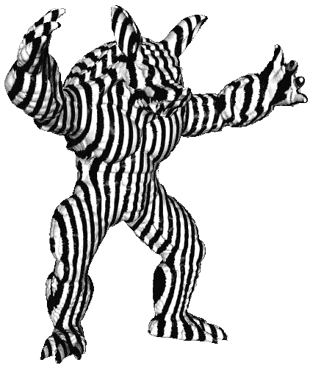

Harmonic Flow (on Surfaces)
Smooth by evolving the signal along the negative gradient of the Dirichlet energy:
$$E\left(F\right)=\frac{1}{2}\int_{Ω}{{\left\|\text{∇}F\left(p\right)\right\|}^{2}dp}$$
… and signals on meshes:

Slide 8
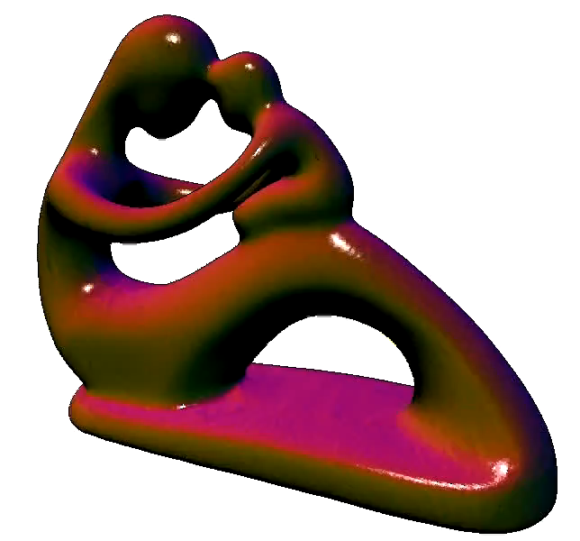

Harmonic Flow (on Surfaces)
Smooth by evolving the signal along the negative gradient of the Dirichlet energy:
$$E\left(F\right)=\frac{1}{2}\int_{Ω}{{\left\|\text{∇}F\left(p\right)\right\|}^{2}dp}$$
… and even the geometry of the mesh:

Slide 9
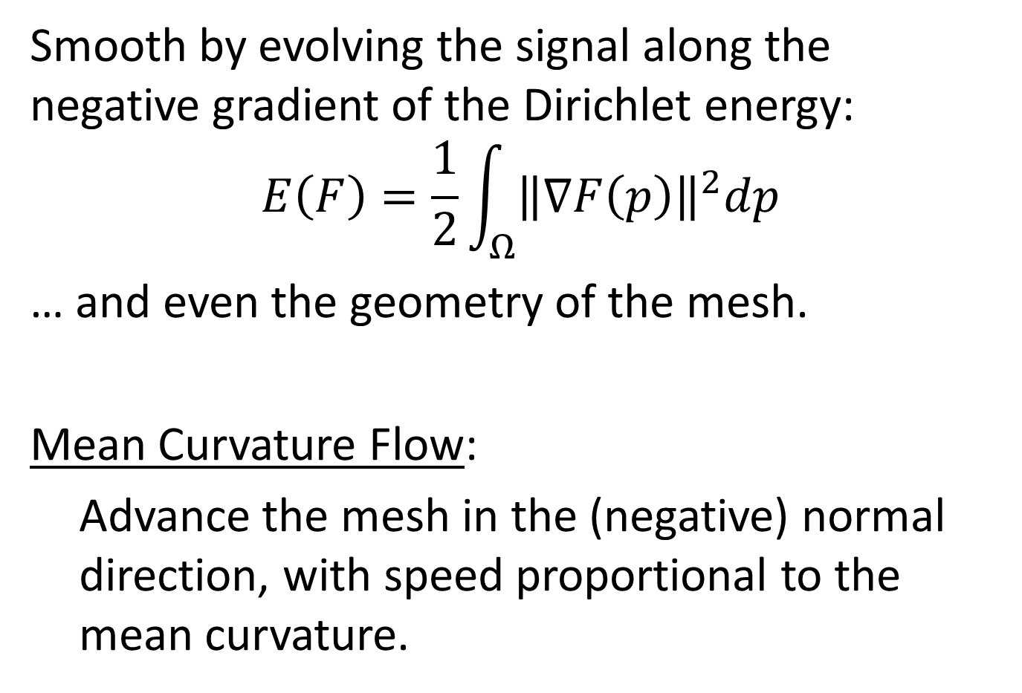
Harmonic Flow (on Surfaces)
Smooth by evolving the signal along the negative gradient of the Dirichlet energy:
$$E\left(F\right)=\frac{1}{2}\int_{Ω}{{\left\|\text{∇}F\left(p\right)\right\|}^{2}dp}$$
… and even the geometry of the mesh.
Mean Curvature Flow:
  Advance the mesh in the (negative) normal direction, with speed proportional to the mean curvature.
Notes:
Note: The definition of the normal/curvature changes as the surface evolves, so we need to recompute as we evolve.

Slide 10
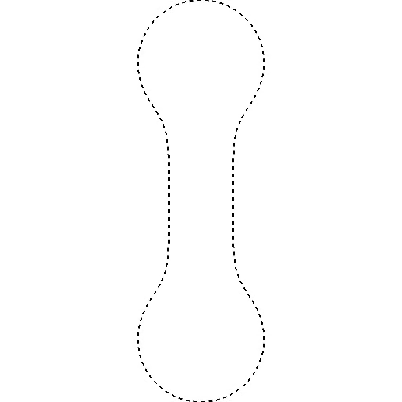
Mean-Curvature Flow (Curves)
Advance the mesh along the normal, at a speed proportional to the mean curvature.
... And rescale the curve
after each step of the
flow [Huisken ’84].
The evolution always
converges to a “round
point” [Grayson ’87].

Slide 11
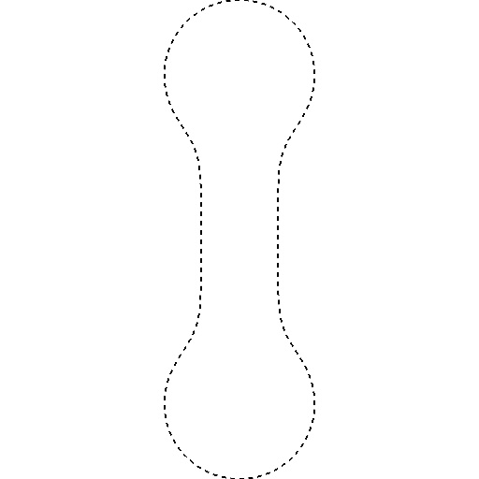
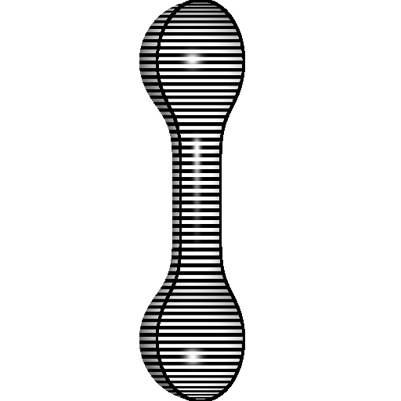
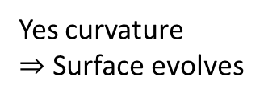
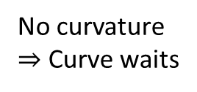
Mean-Curvature Flow (Surfaces)
Things don’t work as well with surfaces.
No curvature
$⇒$ Curve waits
Yes curvature
$⇒$ Surface evolves
Notes:
Note:
The figure on the right is a cut-away of a water-tight surface of revolution.
For the curve case, convex regions flow inward, concave regions flow out, and flat regions stay fixed. On surfaces the “flat” regions can still flow inward.

Slide 12
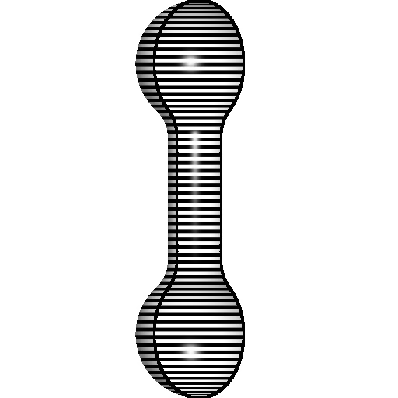
Mean-Curvature Flow (Surfaces)
Things don’t work as well with surfaces.
Neck-pinches can form in concave regions.
Proof of convergence of
Mean-Curvature flow on
2D-manifolds restricted
to simple (mean-convex)
shapes [Huisken 1984].

Slide 13
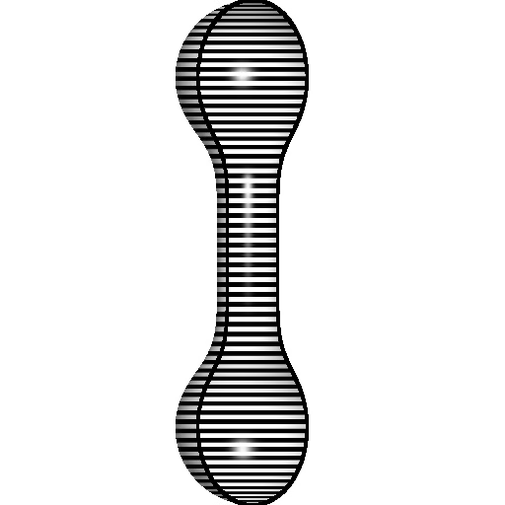
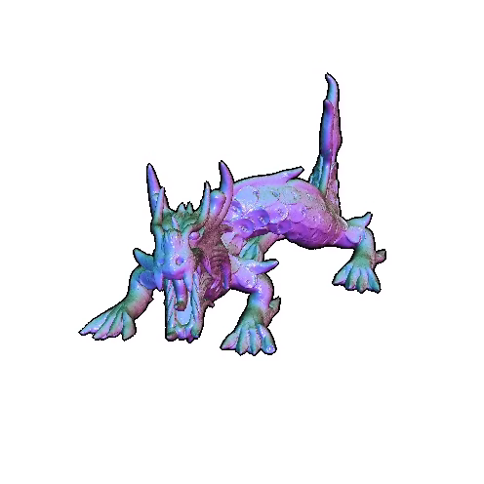
Mean-Curvature Flow (Surfaces)
Approach:
Identify “numerical instabilities” in the flow.
Modify the flow to avoid them.

Slide 14
Outline
(Conformalized) Mean Curvature Flow
  Harmonic Flow
  Discretization
    Inner products
    Discrete MCF
  Identifying and Modifying
  Evaluation
Mobius Registration
Optical Flow

Slide 15
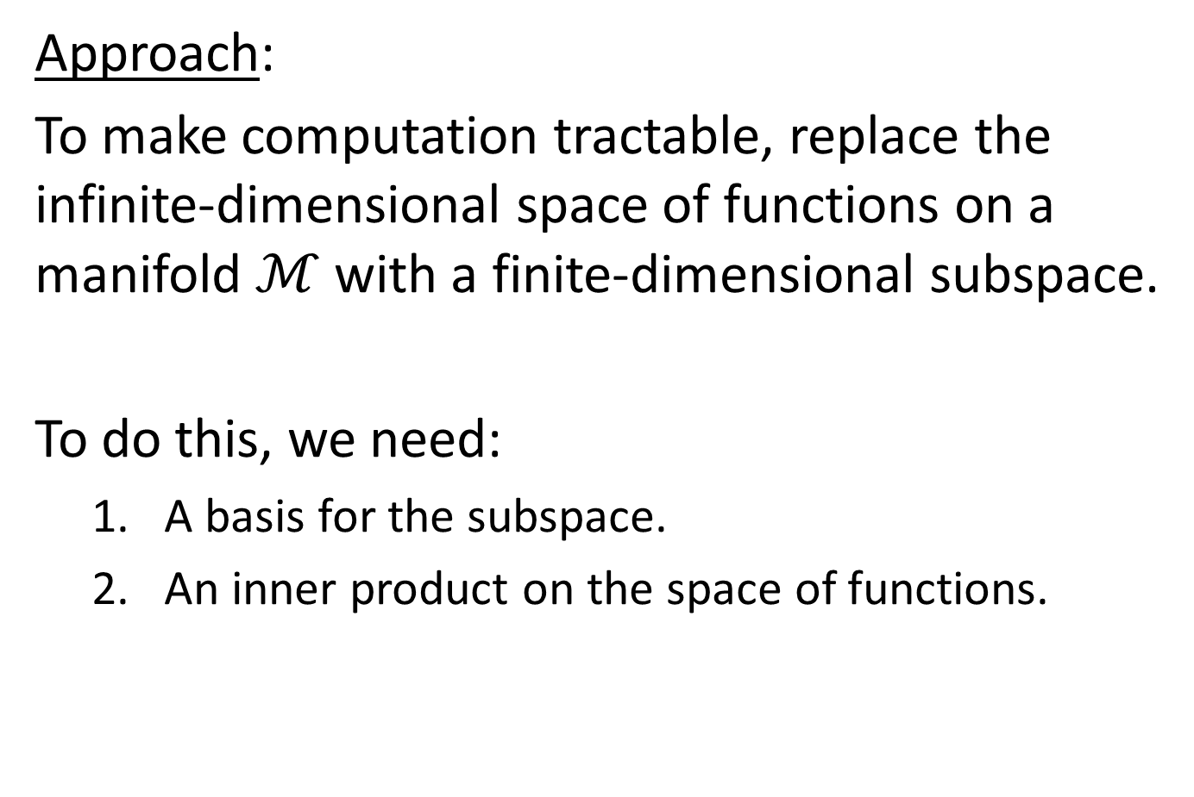
Discretization
Approach:
To make computation tractable, replace the infinite-dimensional space of functions on a manifold $ℳ$ with a finite-dimensional subspace.
To do this, we need:
  A basis for the subspace.
  An inner product on the space of functions.
Notes:
Note:
We won’t discuss the question of a basis because our discussion won’t depend on it.

Slide 16
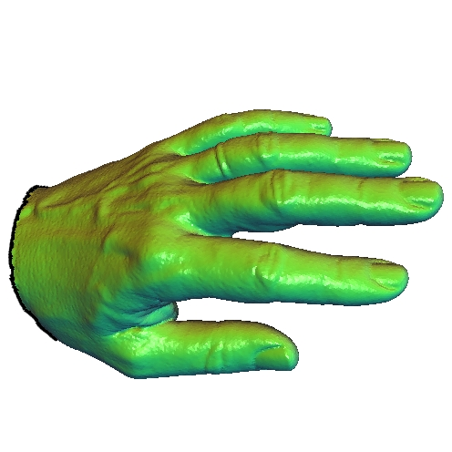




Discretization
Inner-Product:
Suppose we have an embedding $Φ:ℳ→ℝ^{3}$.
We define an inner-product on functions:
$${〈f,g〉}_{Φ}=\int_{ℳ}{f⋅g dμ}$$
where $dμ$ is the area measure defined by $Φ$.
$$Φ$$
$$ℳ$$
$$Φ\left(ℳ\right)⊂ℝ^{3}$$
Notes:
Note:
Throughout, $ℳ$ is the parameterization domain, not the embedding.

Slide 17
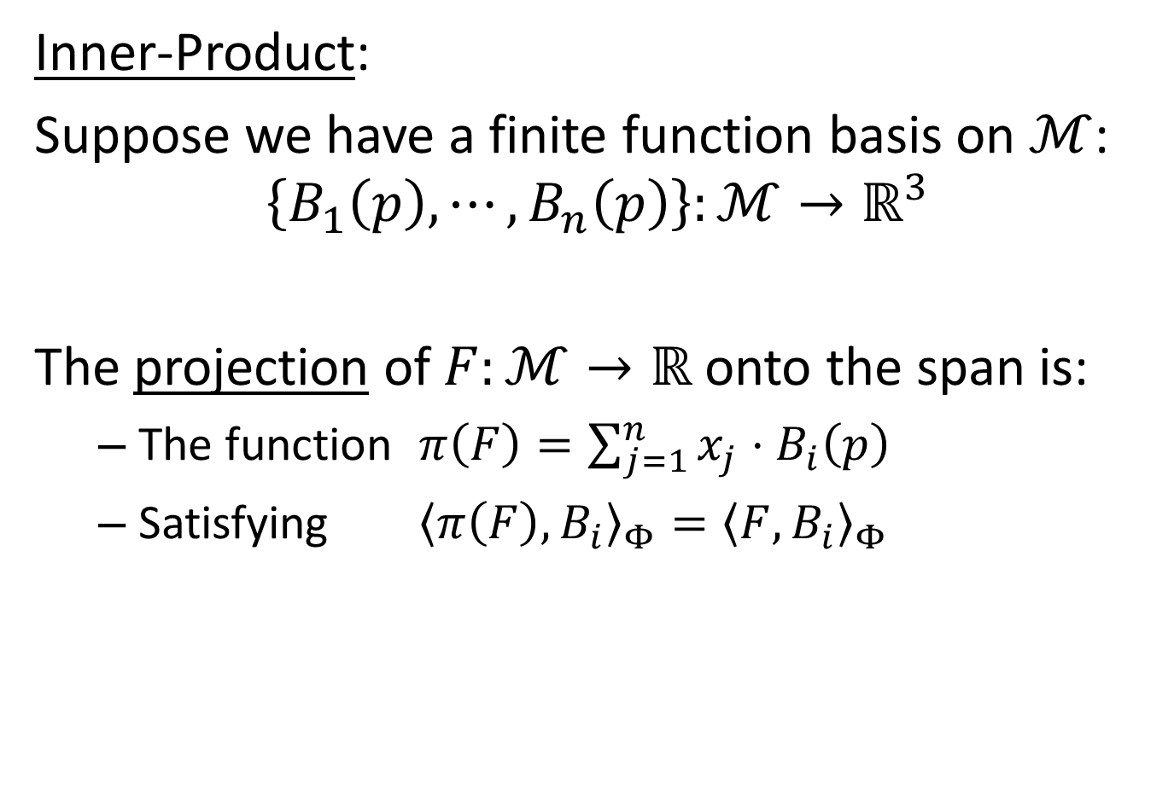
Discretization
Inner-Product:
Suppose we have a finite function basis on $ℳ$:
$$\left\{B_{1}\left(p\right),⋯,B_{n}\left(p\right)\right\}:ℳ→ℝ^{3}$$
The projection of $F:ℳ→ℝ$ onto the span is:
  The function $π\left(F\right)=\sum_{j=1}^{n}{x_{j}⋅B_{i}\left(p\right)}$
  Satisfying ${〈π\left(F\right),B_{i}〉}_{Φ}={〈F,B_{i}〉}_{Φ}$

Slide 18
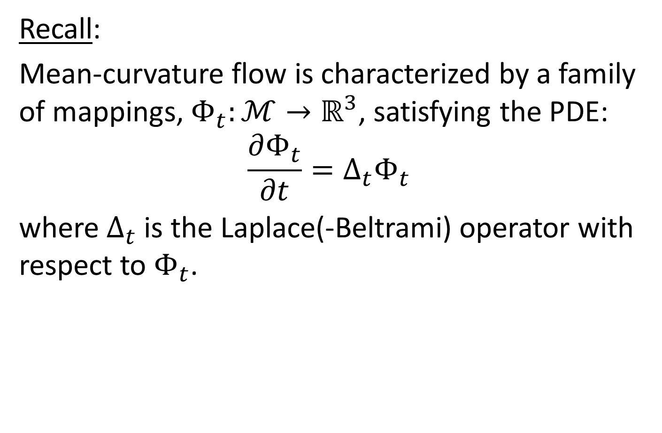
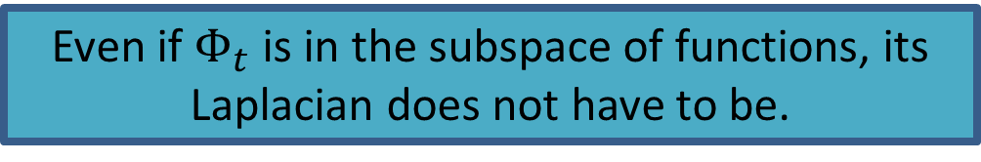
Discretization
Recall:
Mean-curvature flow is characterized by a family of mappings, $Φ_{t}:ℳ→ℝ^{3}$, satisfying the PDE:
$$\frac{∂Φ_{t}}{∂t}=Δ_{t}Φ_{t}$$
where $Δ_{t}$ is the Laplace(-Beltrami) operator with respect to $Φ_{t}$.
Even if $Φ_{t}$ is in the subspace of functions, its Laplacian does not have to be.
Notes:
Recall:
As with the previous description of mean curvature flow, the changing geometry implies that the definition of the LB operator changes as the surface evolves.

Slide 19
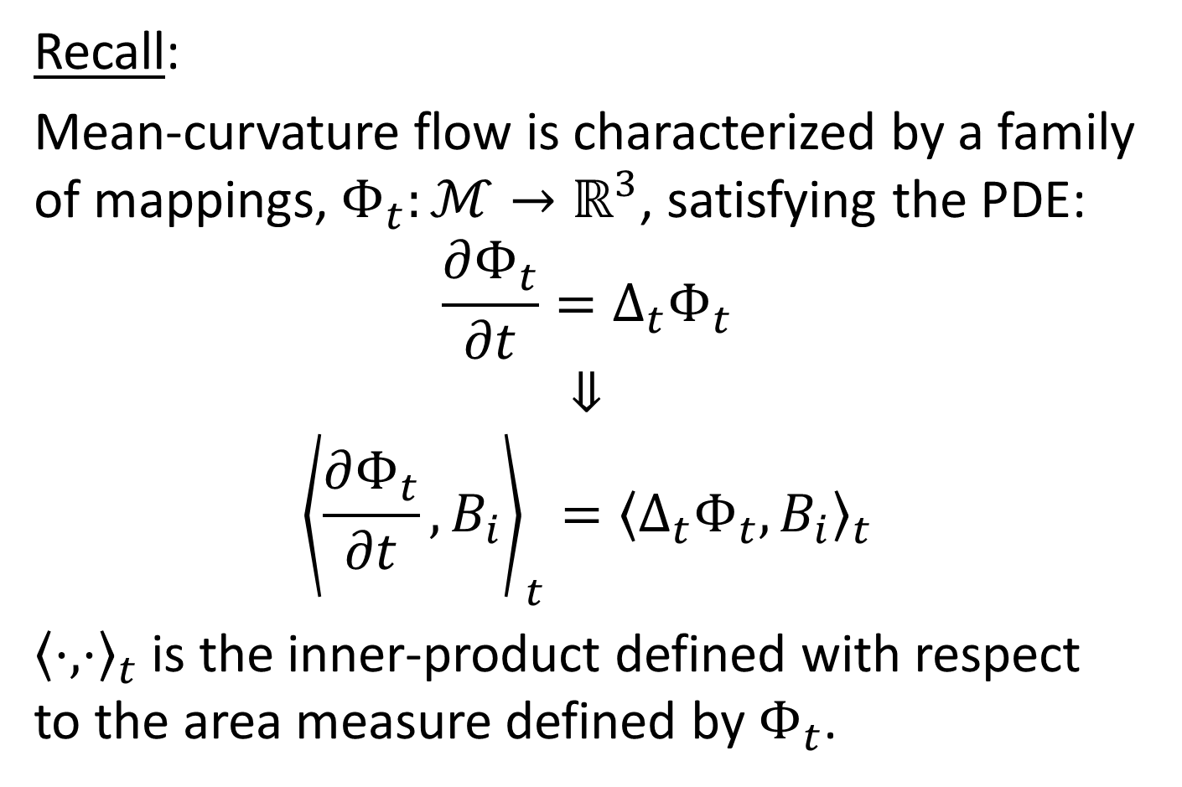
Discretization
Recall:
Mean-curvature flow is characterized by a family of mappings, $Φ_{t}:ℳ→ℝ^{3}$, satisfying the PDE:
$$\frac{∂Φ_{t}}{∂t}=Δ_{t}Φ_{t}$$
$$⇓$$
$${\left\langle \frac{∂Φ_{t}}{∂t},B_{i}\right\rangle }_{t}={〈Δ_{t}Φ_{t},B_{i}〉}_{t}$$
${〈⋅,⋅〉}_{t}$ is the inner-product defined with respect to the area measure defined by $Φ_{t}$.

Slide 20
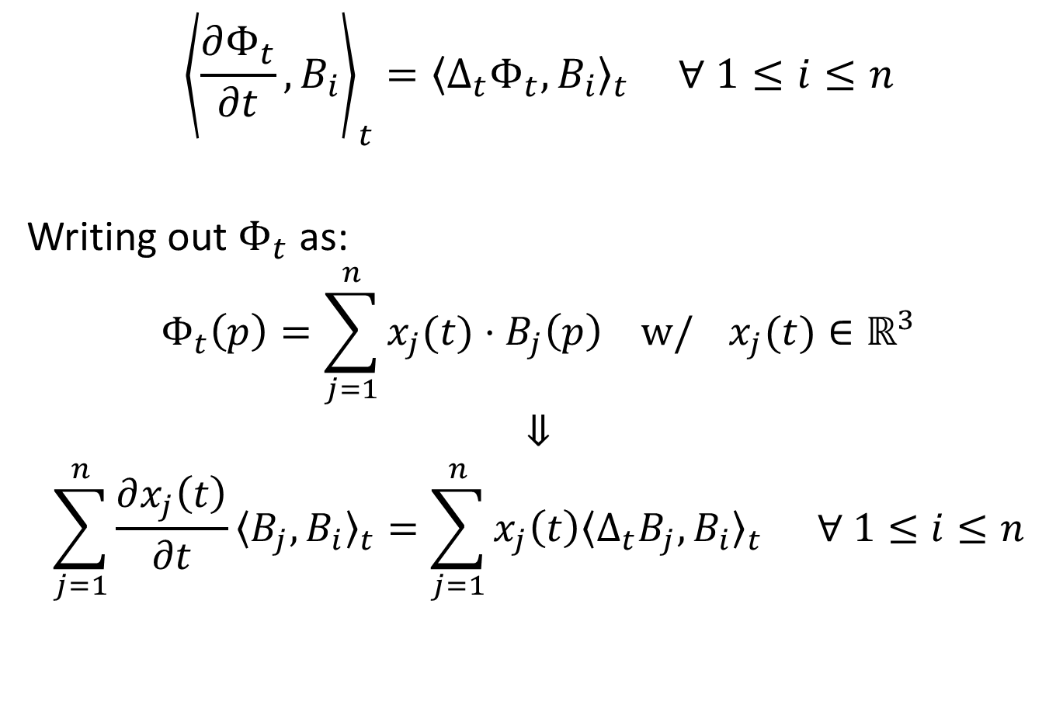
Discretization
$${\left\langle \frac{∂Φ_{t}}{∂t},B_{i}\right\rangle }_{t}={〈Δ_{t}Φ_{t},B_{i}〉}_{t} ∀ 1≤i≤n$$
Writing out $Φ_{t}$ as:
$$Φ_{t}\left(p\right)=\sum_{j=1}^{n}{x_{j}(t)⋅B_{j}\left(p\right) w/ }x_{j}(t)∈ℝ^{3}$$
$$⇓$$
$$\sum_{j=1}^{n}{\frac{∂x_{j}\left(t\right)}{∂t}{〈B_{j},B_{i}〉}_{t}=\sum_{j=1}^{n}{x_{j}\left(t\right){〈Δ_{t}B_{j},B_{i}〉}_{t}} ∀ 1≤i≤n}$$

Slide 21
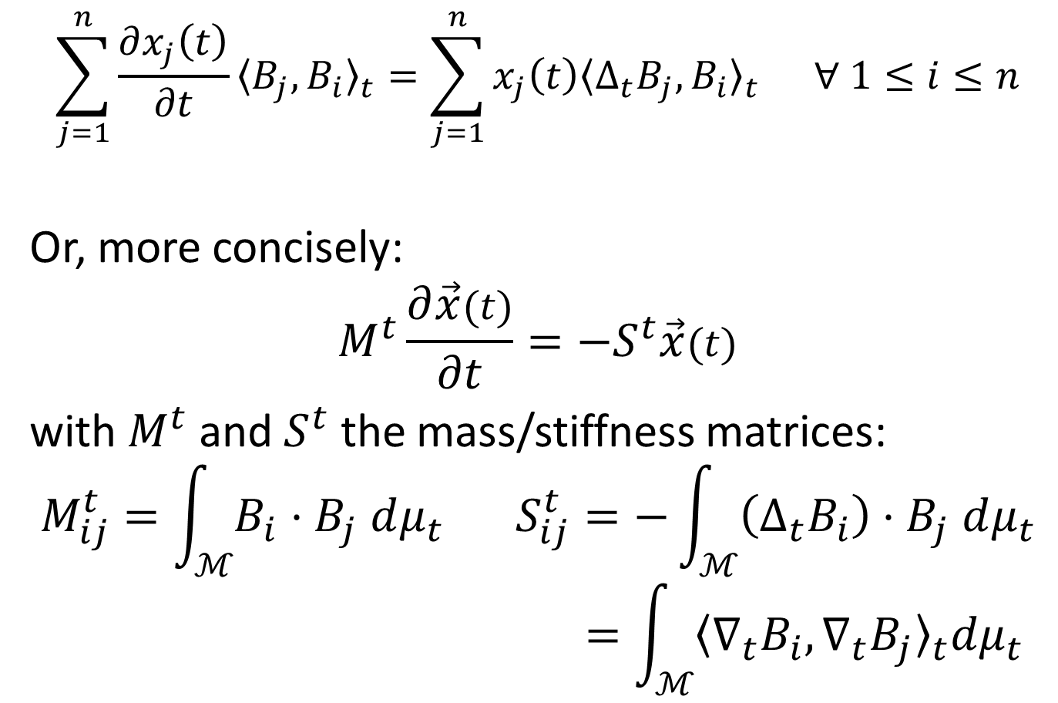
Discretization
$$\sum_{j=1}^{n}{\frac{∂x_{j}\left(t\right)}{∂t}{〈B_{j},B_{i}〉}_{t}=\sum_{j=1}^{n}{x_{j}\left(t\right){〈Δ_{t}B_{j},B_{i}〉}_{t}} ∀ 1≤i≤n}$$
Or, more concisely:
$$M^{t}\frac{∂\vec{x}(t)}{∂t}=−S^{t}\vec{x}(t)$$
with $M^{t}$ and $S^{t}$ the mass/stiffness matrices:
$$M_{ij}^{t}=\int_{ℳ}{B_{i}⋅B_{j} dμ_{t}} S_{ij}^{t}=−\int_{ℳ}{\left(Δ_{t}B_{i}\right)⋅B_{j} dμ_{t}}$$
$$=\int_{ℳ}{{〈{\text{∇}}_{t}B_{i},{\text{∇}}_{t}B_{j}〉}_{t}dμ_{t}}$$

Slide 22
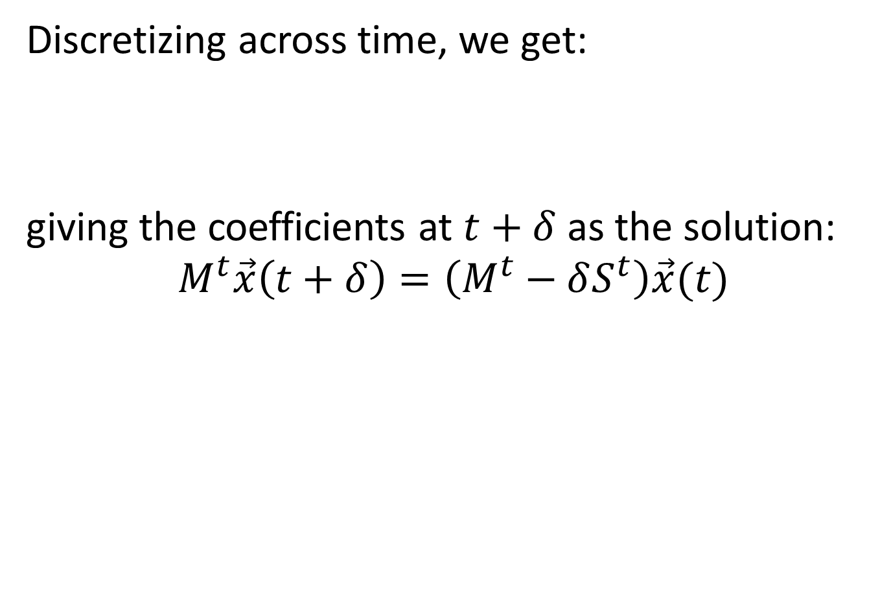
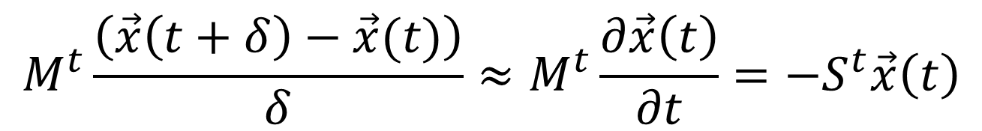
Discrete (Explicit*) MCF
Discretizing across time, we get:
giving the coefficients at $t+δ$ as the solution:
$$M^{t}\vec{x}\left(t+δ\right)=\left(M^{t}−δS^{t}\right)\vec{x}(t)$$
$$M^{t}\frac{\left(\vec{x}\left(t+δ\right)−\vec{x}(t)\right)}{δ}≈M^{t}\frac{∂\vec{x}\left(t\right)}{∂t}=−S^{t}\vec{x}\left(t\right)$$
*Discussion remains the same if we use (semi-)implicit integration.
Notes:
Note: We are performing explicit integration. Analogous results hold when performing

Slide 23
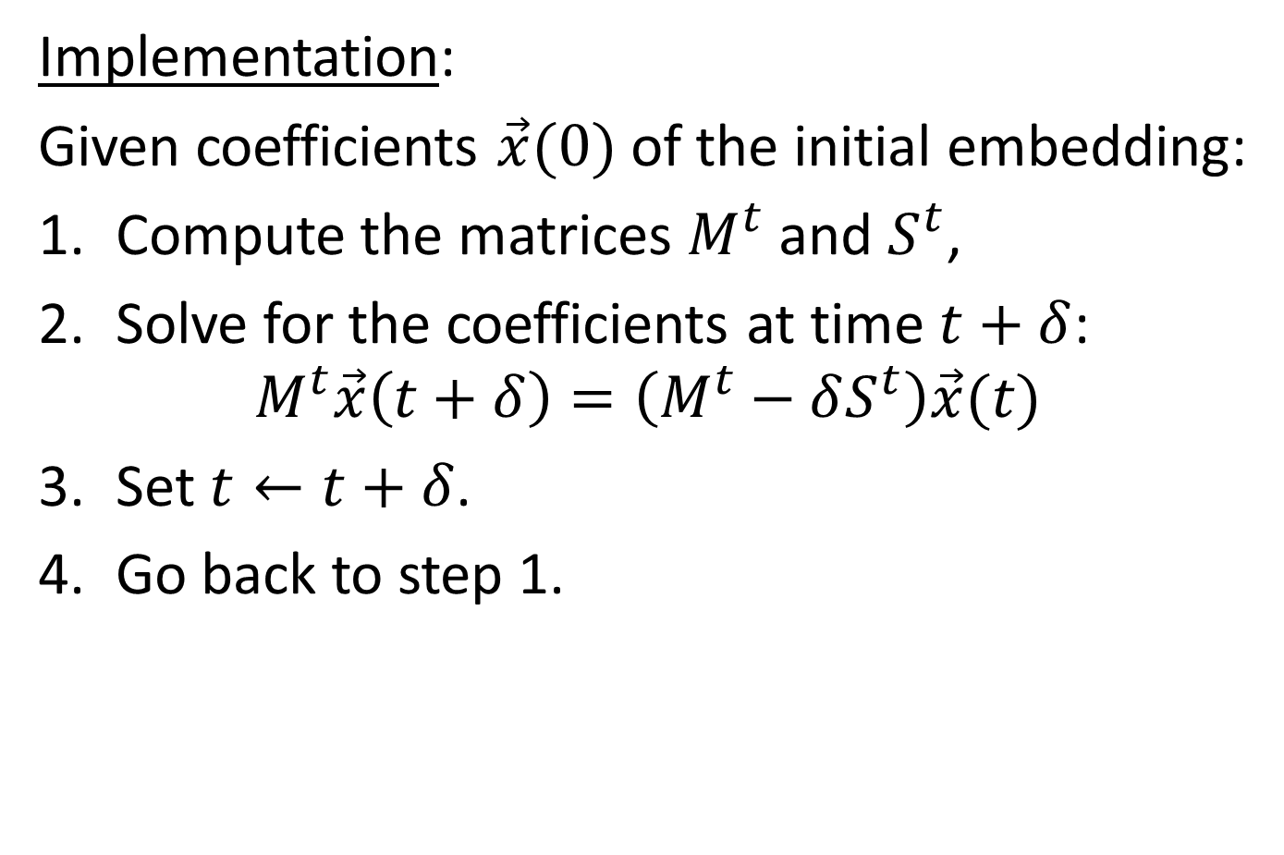
Discrete (Explicit) MCF
Implementation:
Given coefficients $\vec{x}(0)$ of the initial embedding:
Compute the matrices $M^{t}$ and $S^{t}$,
Solve for the coefficients at time $t+δ$:
$M^{t}\vec{x}\left(t+δ\right)=\left(M^{t}−δS^{t}\right)\vec{x}(t)$
Set $t←t+δ$.
Go back to step 1.

Slide 24
Outline
(Conformalized) Mean Curvature Flow
  Harmonic Flow
  Discretization
  Identifying and Modifying
    Division by zero
    Conformalization
  Evaluation
Mobius Registration
Optical Flow

Slide 25
Analysis
Observation:
If we scale a patch of surface
  Area increases
  Derivatives decrease
When the scaling is uniform, these cancel out.
Otherwise, things get messy.

Slide 26
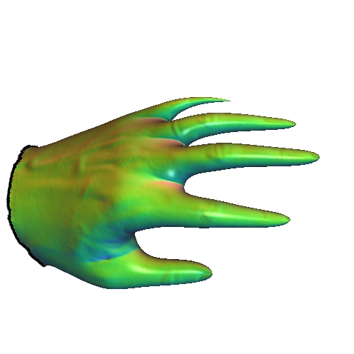







Analysis
$$M_{ij}^{t}=\int_{ℳ}{B_{i}⋅B_{j} dμ_{t}} S_{ij}^{t}=\int_{ℳ}{〈{\text{∇}}_{t}B_{i},{\text{∇}}_{t}B_{j}〉dμ_{t}}$$
Approach:
Study the collapse of the flow by expressing the integrals with respect to the initial embedding.
$$ℳ$$
$$Φ_{0}$$
$$Φ_{t}$$
$$Φ_{0}(ℳ)$$
$$Φ_{0}^{t}=Φ_{t}∘Φ_{0}^{−1}$$
$$Φ_{t}(ℳ)$$

Slide 27



Analysis
Small circles around $p∈Φ_{0}(ℳ)$ map to a small ellipses around $q∈Φ_{t}(ℳ)$.
$$p$$
$$q$$
$$Φ_{0}^{t}=Φ_{t}∘Φ_{0}^{−1}$$

Slide 28





Analysis
Find orthonormal $v_{1}$ and $v_{2}$ on the tangent space at $p$ that map to (orthogonal) principal directions $w_{1}$ and $w_{2}$ on the tangent space at $q$.
Compute the stretch along each $v_{i}$:
$${\left.dΦ_{0}^{t}\right|}_{p}v_{i}=λ_{i}^{t}w_{i}$$
$$p$$
$$q$$
$$v_{2}$$
$$w_{2}$$
$$v_{1}$$
$$w_{1}$$
$$Φ_{0}^{t}=Φ_{t}∘Φ_{0}^{−1}$$

Slide 29

Analysis
In terms of the initial embedding:
  Area measure scales by $λ_{1}^{t}λ_{2}^{t}$:
  $dμ_{t}=\left(λ_{1}^{t}λ_{2}^{t}\right)dμ_{0}$
  Derivative in $i$-th direction scales by $1/λ_{i}^{t}$:
  $\frac{∂B}{∂w_{i}}=\frac{1}{λ_{i}^{t}}\frac{∂B}{∂v_{i}}$
$$p$$
$$q$$
$$v_{2}$$
$$w_{2}$$
$$v_{1}$$
$$w_{1}$$
$$Φ_{0}^{t}=Φ_{t}∘Φ_{0}^{−1}$$

Slide 30

Analysis
For the mass matrix, we get:
$$M_{ij}^{t}=\int_{ℳ}{B_{i}⋅B_{j} dμ_{t}}=\int_{ℳ}{B_{i}⋅B_{j} \left(λ_{1}^{t}λ_{2}^{t} dμ_{0}\right)}$$
$$p$$
$$q$$
$$v_{2}$$
$$w_{2}$$
$$v_{1}$$
$$w_{1}$$
$$Φ_{0}^{t}=Φ_{t}∘Φ_{0}^{−1}$$

Slide 31

Analysis
For the stiffness matrix, we get:
$$S_{ij}^{t}=\int_{ℳ}{{〈{\text{∇}}_{t}B_{i},{\text{∇}}_{t}B_{j}〉}_{t}dμ_{t}} =\int_{ℳ}{{〈{\text{∇}}_{t}B_{i},{\text{∇}}_{t}B_{j}〉}_{t}(λ_{1}^{t}λ_{2}^{t} dμ_{0})}$$
$$=\int_{ℳ}{\sum_{k=1}^{2}{\frac{∂B_{i}}{∂w_{k}}\frac{∂B_{j}}{∂w_{k}}(λ_{1}^{t}λ_{2}^{t} dμ_{0})}}=\int_{ℳ}{\sum_{k=1}^{2}{\frac{∂B_{i}}{∂v_{k}}\frac{∂B_{j}}{∂v_{k}}\left(\frac{λ_{1}^{t}λ_{2}^{t}}{λ_{k}^{t}λ_{k}^{t}}dμ_{0}\right)}}$$
$$p$$
$$q$$
$$v_{2}$$
$$w_{2}$$
$$v_{1}$$
$$w_{1}$$
$$Φ_{0}^{t}=Φ_{t}∘Φ_{0}^{−1}$$

Slide 32
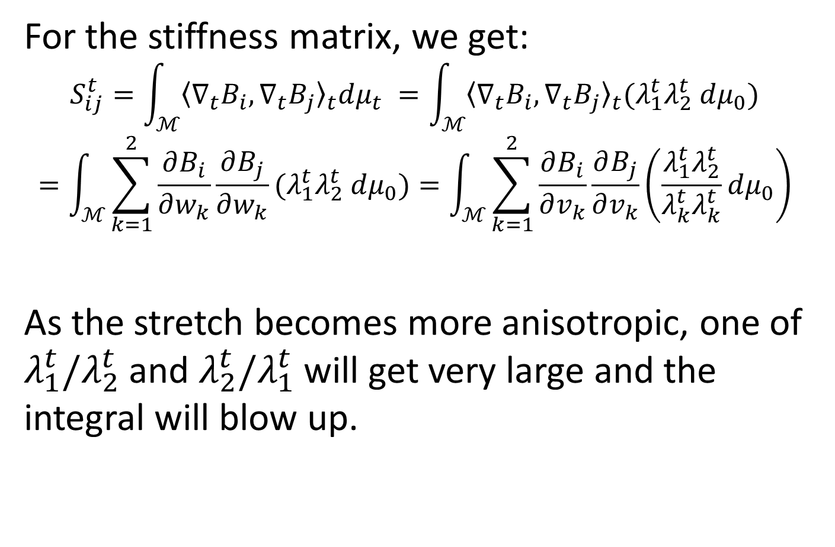
Analysis
For the stiffness matrix, we get:
$$S_{ij}^{t}=\int_{ℳ}{{〈{\text{∇}}_{t}B_{i},{\text{∇}}_{t}B_{j}〉}_{t}dμ_{t}} =\int_{ℳ}{{〈{\text{∇}}_{t}B_{i},{\text{∇}}_{t}B_{j}〉}_{t}(λ_{1}^{t}λ_{2}^{t} dμ_{0})}$$
$$=\int_{ℳ}{\sum_{k=1}^{2}{\frac{∂B_{i}}{∂w_{k}}\frac{∂B_{j}}{∂w_{k}}(λ_{1}^{t}λ_{2}^{t} dμ_{0})}}=\int_{ℳ}{\sum_{k=1}^{2}{\frac{∂B_{i}}{∂v_{k}}\frac{∂B_{j}}{∂v_{k}}\left(\frac{λ_{1}^{t}λ_{2}^{t}}{λ_{k}^{t}λ_{k}^{t}}dμ_{0}\right)}}$$
As the stretch becomes more anisotropic, one of $λ_{1}^{t}/λ_{2}^{t}$ and $λ_{2}^{t}/λ_{1}^{t}$ will get very large and the integral will blow up.

Slide 33


Conformalization
Modified Flow:
Since the matrix $S^{t}$ can explode when the local scaling is anisotropic, perform the computation as though the scaling was isotropic.
Compute the integrals as though the stretch along the principal directions were:
$${\tilde{λ}}_{1}^{t}={\tilde{λ}}_{2}^{t}= λ_{1}^{t}λ_{2}^{t}$$
$$p$$
$$q$$
$$v_{2}$$
$$w_{2}$$
$$v_{1}$$
$$w_{1}$$
$$Φ_{0}^{t}=Φ_{t}∘Φ_{0}^{−1}$$

Slide 34
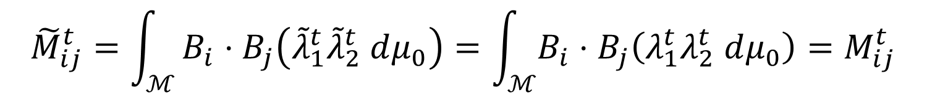
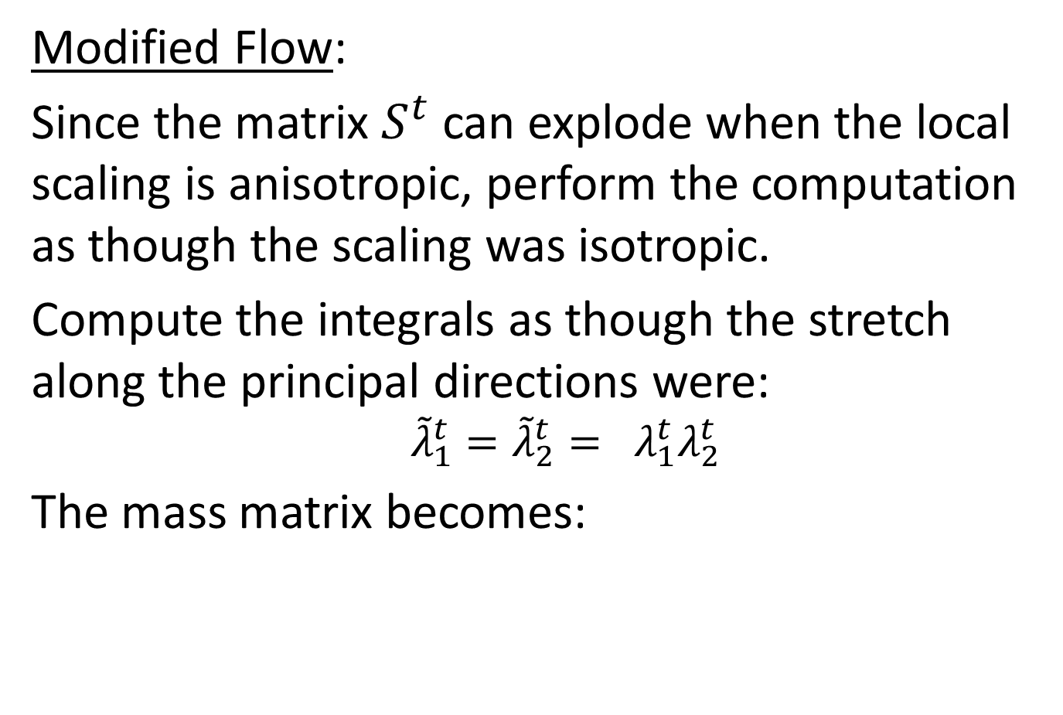
Conformalization
Modified Flow:
Since the matrix $S^{t}$ can explode when the local scaling is anisotropic, perform the computation as though the scaling was isotropic.
Compute the integrals as though the stretch along the principal directions were:
$${\tilde{λ}}_{1}^{t}={\tilde{λ}}_{2}^{t}= λ_{1}^{t}λ_{2}^{t}$$
The mass matrix becomes:
$${\tilde{M}}_{ij}^{t}=\int_{ℳ}{B_{i}⋅B_{j}\left({\tilde{λ}}_{1}^{t}{\tilde{λ}}_{2}^{t} dμ_{0}\right)=\int_{ℳ}{B_{i}⋅B_{j}\left(λ_{1}^{t}λ_{2}^{t} dμ_{0}\right)}=M_{ij}^{t}}$$

Slide 35
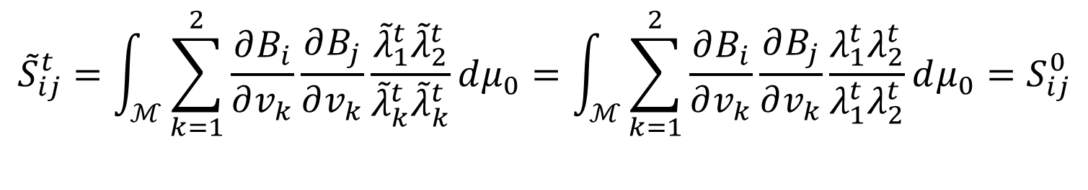

Conformalization
Modified Flow:
Since the matrix $S^{t}$ can explode when the local scaling is anisotropic, perform the computation as though the scaling was isotropic.
Compute the integrals as though the stretch along the principal directions were:
$${\tilde{λ}}_{1}^{t}={\tilde{λ}}_{2}^{t}= λ_{1}^{t}λ_{2}^{t}$$
The stiffness matrix becomes:
$${\tilde{S}}_{ij}^{t}=\int_{ℳ}{\sum_{k=1}^{2}{\frac{∂B_{i}}{∂v_{k}}\frac{∂B_{j}}{∂v_{k}}\frac{{\tilde{λ}}_{1}^{t}{\tilde{λ}}_{2}^{t}}{{\tilde{λ}}_{k}^{t}{\tilde{λ}}_{k}^{t}}dμ_{0}}}=\int_{ℳ}{\sum_{k=1}^{2}{\frac{∂B_{i}}{∂v_{k}}\frac{∂B_{j}}{∂v_{k}}\frac{λ_{1}^{t}λ_{2}^{t}}{λ_{1}^{t}λ_{2}^{t}}dμ_{0}}}=S_{ij}^{0}$$

Slide 36
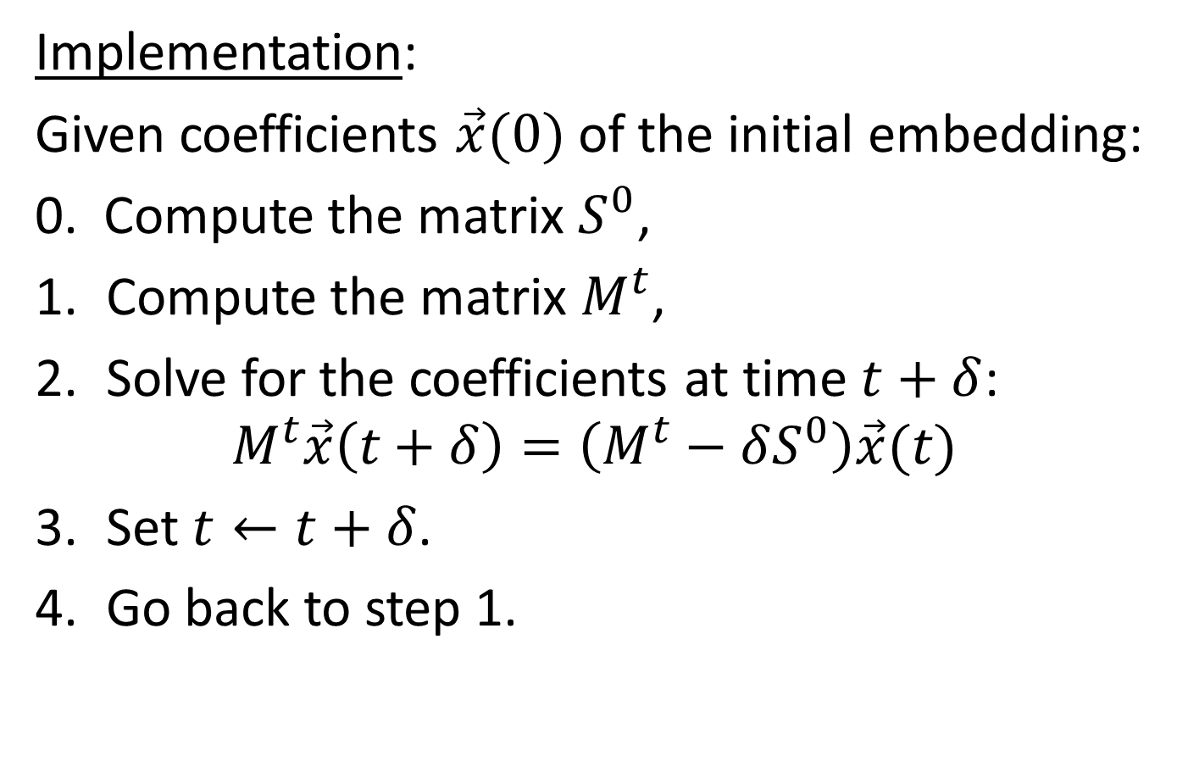
Discrete (Extrinsic) Conformalized MCF
Implementation:
Given coefficients $\vec{x}(0)$ of the initial embedding:
0. Compute the matrix $S^{0}$,
Compute the matrix $M^{t}$,
Solve for the coefficients at time $t+δ$:
$M^{t}\vec{x}\left(t+δ\right)=\left(M^{t}−δS^{0}\right)\vec{x}(t)$
Set $t←t+δ$.
Go back to step 1.

Slide 37
Outline
(Conformalized) Mean Curvature Flow
  Harmonic Flow
  Discretization
  Identifying and Modifying
  Evaluation
Mobius Registration
Optical Flow

Slide 38
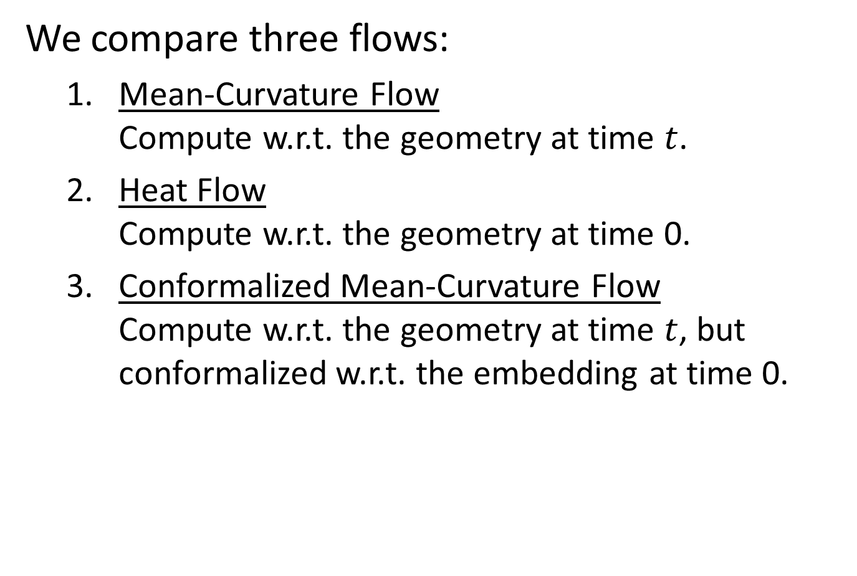
Evaluation
We compare three flows:
  Mean-Curvature Flow
  Compute w.r.t. the geometry at time $t$.
  Heat Flow
  Compute w.r.t. the geometry at time 0.
  Conformalized Mean-Curvature Flow
  Compute w.r.t. the geometry at time $t$, but conformalized w.r.t. the embedding at time 0.

Slide 39
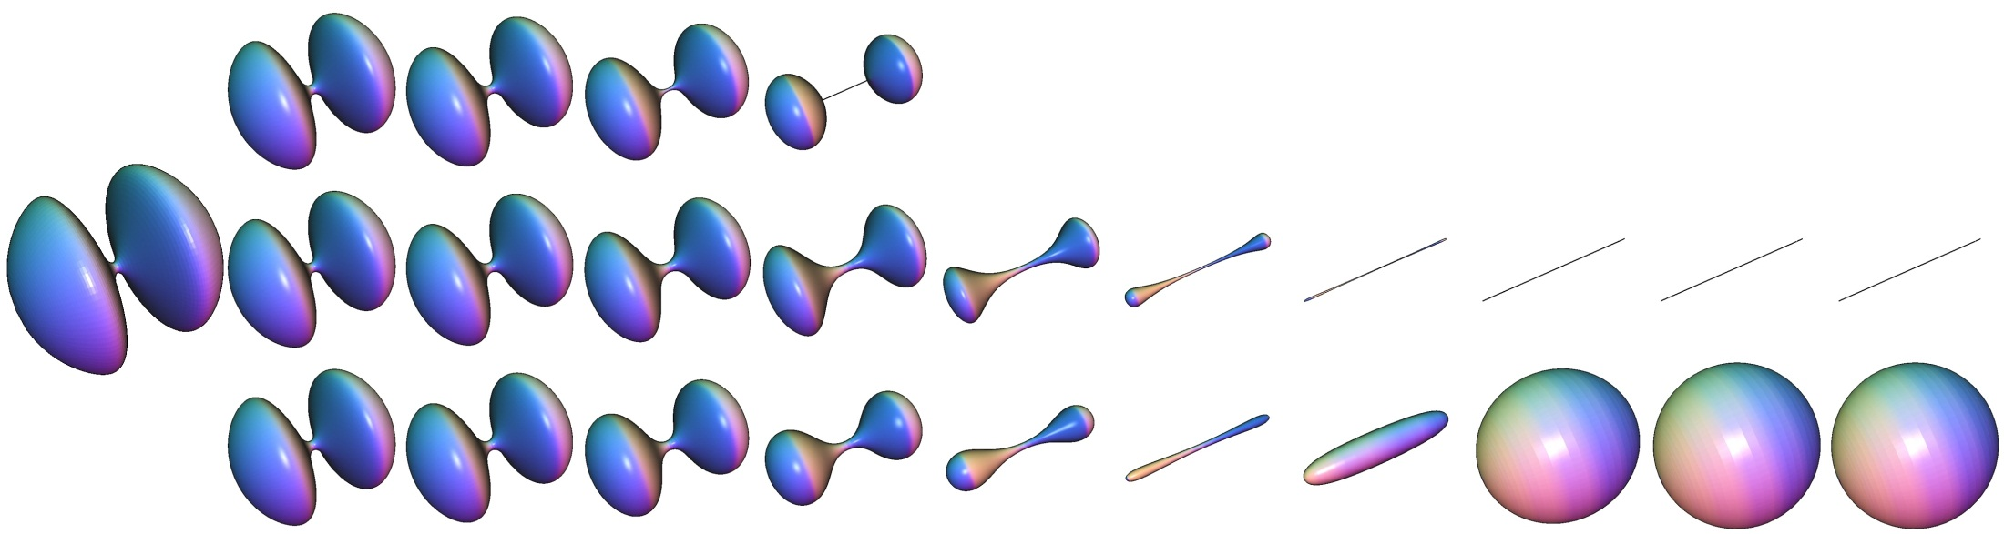
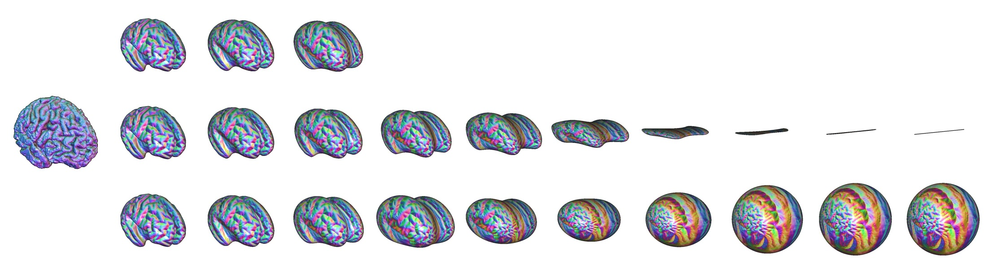
Empirical Evaluation

Slide 40
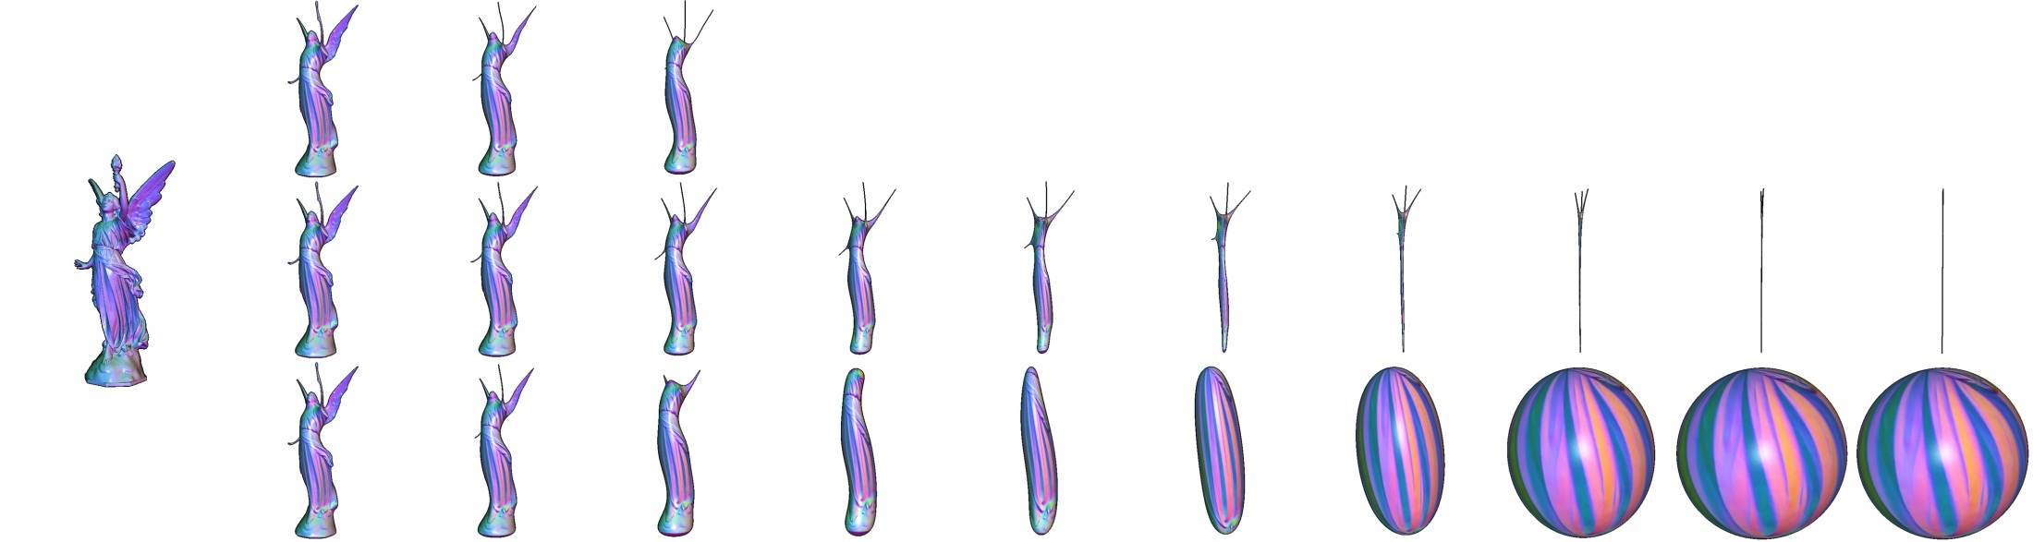
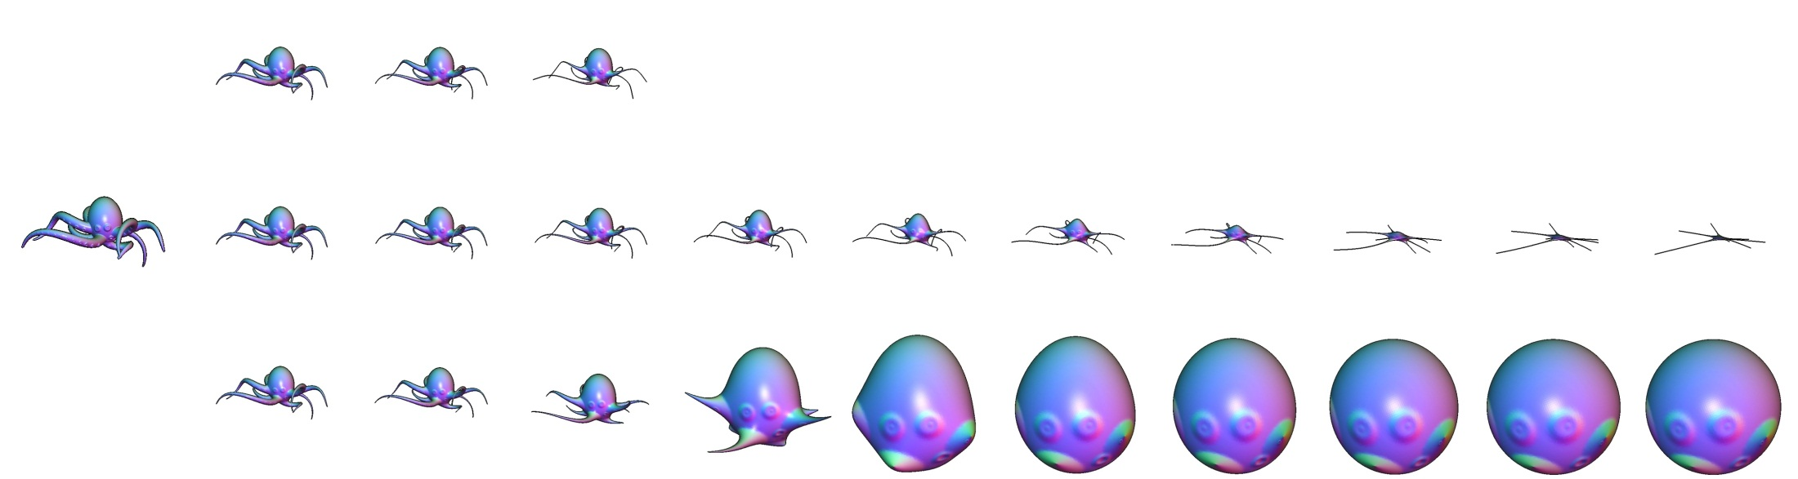
Empirical Evaluation

Slide 41
Demo
Notes:
Note:
First show results with small time-steps, then stress the advantage of being able to use unconditionally stable (semi-implicit) solvers to converge more quickly.

Slide 42
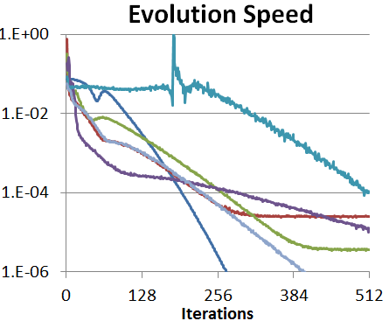
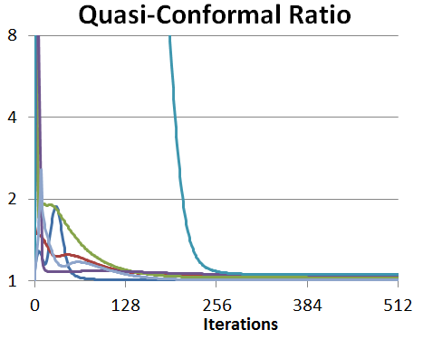
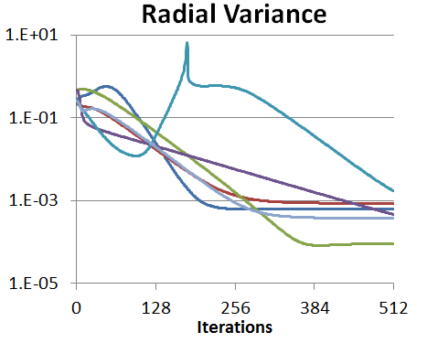

Empirical Evaluation
For Genus-Zero Surfaces:
Does it converge?
What does it converge to?
How does it converge?

Slide 43
Outline
(Conformalized) Mean Curvature flow
Mobius Registration
Optical Flow

Slide 44








Conformal Spherical Parametrization
    Discretization invariant
    Same parametrization for
    isometric deformations of
    the same shape…
    Up to Möbius transformation
inversions
rotations
Registration requires alignment over the group of Möbius transformation

Slide 45








Möbius Registration
Separately handle rotations and inversions
  Canonically center each shape w.r.t. inversions
  Optimally align pairs of shapes w.r.t. rotations
parametrization
canonical centering
optimal alignment

Slide 46
Outline
(Conformalized) Mean Curvature flow
Mobius Registration
  Registration
    Inversions: canonical centering
    Rotations: optimal alignment
  Point-to-point Correspondences?
Optical Flow

Slide 47




Circular Inversion (2D)
$$η_{c}\left(p\right)=\frac{1}{\overline{p+c}}=\frac{p+c}{{\left|p+c\right|}^{2}}$$
Invert the embedding space:
  Angle preserving map in 2D
  Takes circles to circles
$$c$$
$$c$$

Slide 48

Circular Inversion (2D)
$$η_{c}\left(p\right)=\left(1−{\left|c\right|}^{2}\right)\frac{p+c}{{\left|p+c\right|}^{2}}+c$$
Invert the embedding space:
  Angle preserving map in 2D
  Takes circles to circles
$$c$$
$$c$$
Composing with scaling and translation,
it takes the unit circle to itself

Slide 49





Spherical Inversion (3D)
As we move the center towards $c$…
… points on the sphere "flow" in direction $c$
$$c$$
$$c$$
Flow field: $\vec{v}\left(p\right)=2(Id.−p⋅p^{⊤})c$

Slide 50




Canonical Centering
Scale factors:
Given a spherical parametrization:
  How much surface sits over a point on the sphere?
dense
sparse
parametrization
$λ$: scale factors

Slide 51



Canonical Centering
Scale factors:
Given a spherical parametrization:
  How much surface sits over a point on the sphere?
dense
sparse
parametrization
$λ$: stretch factors

Slide 52



Canonical Centering
Goal:
Find the spherical inversion that makes the mass as uniformly distributed as possible
Measure uniformity by computing the
center of mass w.r.t. the stretch factors
$$μ=\int_{S^{2}}{p λ\left(p\right) dp}$$
parametrization
$λ$: stretch factors

Slide 53

Canonical Centering
Claim:
  There is a unique Möbius inversion that puts the center of mass at the origin.
$$μ=\int_{S^{2}}{p λ\left(p\right) dp}$$

Slide 54


Canonical Centering
Existence proof (sketch):
  Considering the centering energy:
  $$E={\frac{1}{2}\left|μ\right|}^{2} ⇒ ∇E=J_{μ}^{⊤}μ$$
  $⇒$ The gradient only vanishes when $μ$ is centered
  $⇒$ Local minima put the center of mass at the origin
  $⇒$ Gradient descent and you're there
Inversion about $c$ is flow along $\vec{v}\left(p\right)=2(Id.−p⋅p^{t})c$
Inversion about $c$ is flow along $\vec{v}\left(p\right)=2(Id.−p⋅p^{t})c$
$$⇓$$
The Jacobian $J_{μ}=2\int_{S^{2}}{\left(Id.−p⋅p^{t}\right) λ(p) dp}$ is SPD

Slide 55



Canonical Centering
Uniqueness proof:
  Suppose the mass is centered
  $⇒$ For any $c$, mass is "balanced" above and below $c$
  An inversion along $c$ shifts the mass towards $c$
  $⇒$ The mass will no longer be centered
$$c$$

Slide 56

Canonical Centering
Implementation:
  Input: Spherical mesh $(V,T)$; surface area function $A:T→ℝ$; threshold $ε$
  Output: Centered spherical mesh
  Get center of mass:
  $μ=\sum_{τ∈T}{Center\left(τ\right)⋅A(τ)}$
  If $\left|μ\right|≤ε$: break
  Get the Jacobian:
  $J_{μ}=2\sum_{τ∈T}{\left(Id.−Center\left(τ\right)⋅Center{\left(τ\right)}^{T}\right)⋅A\left(τ\right)}$
  Get the center of inversion (Gauss-Newton):
  $c={−\left(J_{μ}^{⊤}⋅J_{μ}\right)}^{−1}⋅J_{μ}^{⊤}⋅μ$
  Invert the spherical mesh:
  $v←\left(1−{\left|c\right|}^{2}\right)\frac{v+c}{\left|v+c\right|}+c, ∀v∈V$
  Goto #1

Slide 57

Canonical Centering
Taking a step back:
  (Infinitesimal) spherical inversion towards $c$is equivalent to flow along $\vec{v}\left(p\right)=2(Id.−p⋅p^{t})c$
  This is the gradient of the linear function $L_{c}\left(p\right)=2⟨c,p⟩$ restricted to the sphere
  Find an inversion centering the stretch factors:
  $μ=\int_{S^{2}}{p λ\left(p\right) dp}=0$
  Equivalently, making the inner-product of the stretch factors with all linear functions is zero

Slide 58

General Formulation
Given a space of (non-const.) functions $ℱ$ on $S^{2}$:
  Deformations: infinitesimal flow along gradients of functions in $ℱ$
  Centered: projection of the stretch factors onto $ℱ$ vanishes
As above:
  Define a centering energy as a function measuring the square norm of the projection

Slide 59
General Formulation
Theorem:
The gradient of the centering energy vanishes if and only if the stretch factors are centered.
[Identical proof: Show that the Jacobian is SPD]

Slide 60

General Formulation
Centering w.r.t. to Möbius inversions
$$⇕$$
Setting $ℱ$ to be the space of linear functions
(i.e. first-order spherical harmonics)
We could use higher-order harmonics!

Slide 61


General Formulation
1st order harmonics:
  Uniform mass distribution
  subject to conformality
1st order

Slide 62


General Formulation
Higher order harmonics:
  Trade conformality for more
  uniform area distribution
1st order
1st + 2nd order
1st + 2nd + 3rd order

Slide 63

General Formulation
Q. What transformations can't we center?
A. Those that don’t correspond to flows along gradients of functions
Möbius transformations:
  Gradients of linear functions give inversions
  Their orthogonal complements give rotations
$$⇓$$
The need for rotational alignment

Slide 64


Rotational Alignment
Find the rotation that best aligns the centered stretch factors of two parameterizations
$$λ_{s}$$
?
$$λ_{t}$$
parametrization + centering

Slide 65

Rotational Alignment
Find the rotation that best aligns the centered stretch factors of two parameterizations
$⇓$
Find the rotation minimizing
the $L_{2}$-distance between the
source and target stretch factors
$⇕$
Find the rotation maximizing
the correlation between the
source and target stretch factors
?

Slide 66


Rotational Correlation
  Sample the stretch factors to a spherical grid
?

Slide 67









Rotational Correlation
  Compute the forward (spherical) Fourier transform
?

Slide 68
Rotational Correlation
  Get the rotational harmonic coefficients of the correlation by cross-multiplying within the bands
?

Slide 69

Rotational Correlation
  Compute the inverse (rotational) Fourier transform and find the maximizing rotation
?

Slide 70
Outline
(Conformalized) Mean Curvature flow
Mobius Registration
  Registration
  Point-to-point Correspondences?
Optical Flow

Slide 71






Point-to-Point Correspondences?
Extremities are close, but not quite…
source
target

Slide 72


Point-to-Point Correspondences?
source
target

Slide 73


Point-to-Point Correspondences?
Small non-isometric deformations have small,
but far-reaching impacts on the parameterization.
This can have significant impact on regions that compress under the mapping!
source
target

Slide 74
Outline
(Conformalized) Mean Curvature flow
Mobius Registration
Optical Flow

Slide 75


Optical Flow
Approach (work in progress):
Given two Mobius-registered parametrizations on the sphere, refine the registration
Compute the optical flow field
Advect the source parametrization
towards the target
along the flow
source
target

Slide 76
Advection
Goal:
Given two signals on the sphere, compute the flow-field taking the source signal to the target.

Slide 77

Brightness Constancy
If $\vec{V}$ is a tangent vector field and $f$ is a signal, infinitesimal advection of $f$ by $\vec{V}$ is given by:
$$ℒ_{\vec{V}}f=−⟨\vec{V},∇f⟩$$
Given signals $f_{0}$ and $f_{1}$ we want the vector field $\vec{V}$ taking $f_{0}$ to $f_{1}$:
$$−⟨\vec{V},∇f_{0}⟩=f_{1}−f_{0}$$
$$⇓$$
$$\vec{V}=\frac{∇f_{0}⋅(f_{0}−f_{1})}{{\left|∇f\right|}^{2}}+φ{\left(∇f\right)}^{⊥}$$

Slide 78

Brightness Constancy
Solve for $\vec{V}$ minimizing two constraints:
  Interpolation:
  $E_{I}\left(\vec{V}\right)=\int_{S^{2}}{{\left(\left\langle \vec{V},∇f_{0}\right\rangle +f_{1}−f_{0}\right)}^{2}dp}$
  Smoothness:
  $E_{S}\left(\vec{V}\right)=\int_{S^{2}}{{\left|∇\vec{V}\right|}^{2}dp}$

Slide 79

Hierarchical Solve
$$E\left(\vec{V}\right)=E_{I}\left(\vec{V}\right)+ε⋅E_{S}\left(\vec{V}\right)$$
As the optical flow is non-linear/convex, solve in a coarse-to-fine manner.
  For images, use multi-res approach.
  For surfaces, solve multiple times with successively decreasing smoothness weight, $ε$

Slide 80


Point-to-Point Correspondences
source
flow field
target

Slide 81
Point-to-Point Correspondences
source
target

Slide 82


Point-to-Point Correspondences
source
flow field
target

Slide 83
Questions
Conformalized MCF:
  Proof of Convergence?
  Non genus zero surfaces?
  Flows on manifolds?
Mobius Registration:
  Non-linear centering?
  General manifolds?

Slide 84


Thank You!
http://www.cs.jhu.edu/~misha/Code/ConformalizedMCF/
http://www.cs.jhu.edu/~misha/Code/MoebiusRegistration/
http://www.cs.jhu.edu/~misha/Code/SurfaceOpticalFlow/

Slide 86

PDE Formulation
  Mean-Curvature Flow
  $\frac{∂Φ_{t}}{∂t}=Δ_{t}Φ_{t}$
  Heat Flow
  $\frac{∂Φ_{t}}{∂t}=Δ_{0}Φ_{t}$
  Conformalized MCF
  $\frac{∂Φ_{t}}{∂t}=\sqrt{\left|μ_{t}^{−1}⋅μ_{0}\right|}Δ_{0}Φ_{t}$

