Slide 1
An Adaptive Multigrid Solver for Applications in Computer Graphics
Misha Kazhdan and Hugues Hoppe

Slide 2
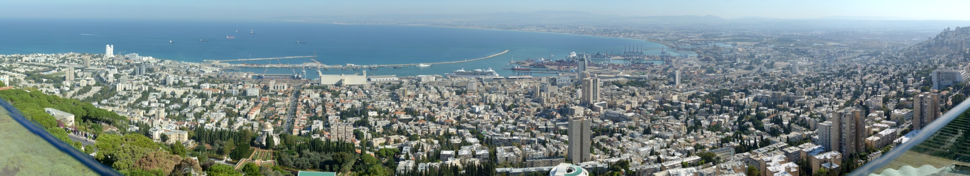
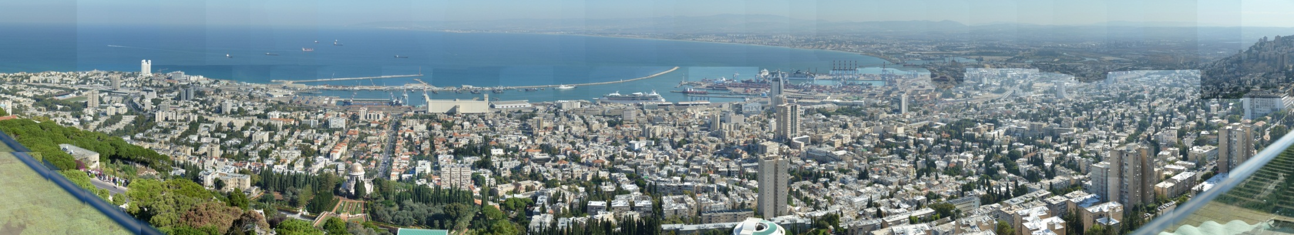

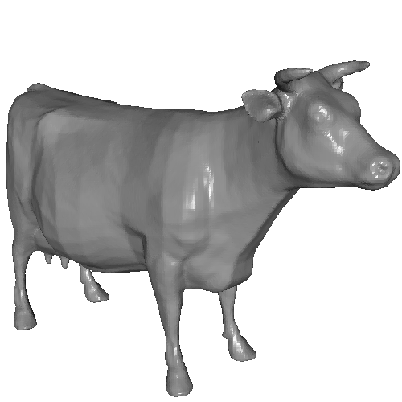
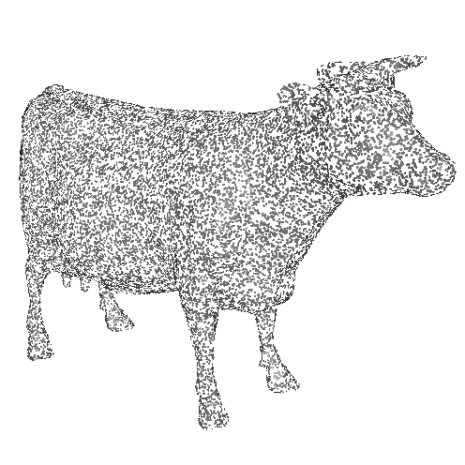
Motivation
Many applications in computer graphics require solving linear systems at high resolution

Slide 3
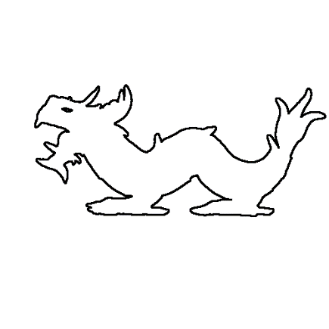
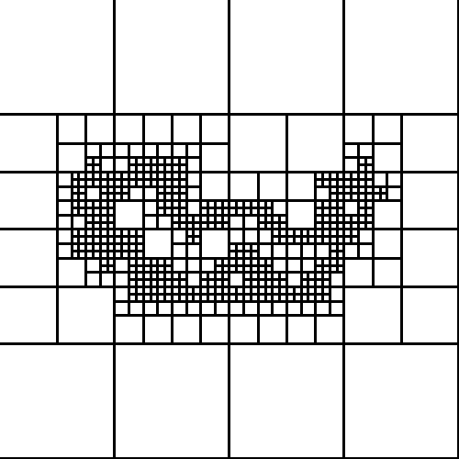
Motivation
Many applications in computer graphics require solving linear systems at high resolution
  When the system is "nice", the solution can be found efficiently using multigrid
  When only a sparse solution is needed, can use an adaptive discretization
Relax
Relax
Goal: Support multigrid solvers over adaptive discretizations
Down-
Sample
Up-
Sample
Solve

Slide 4
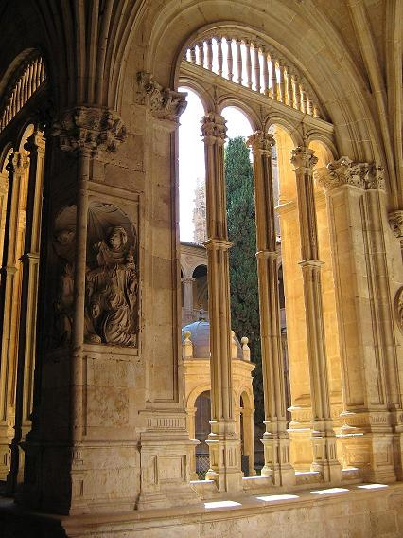

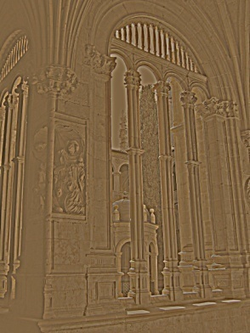


Multigrid
V-Cycle Algorithm:
The process is recursed for the low-res problem
Perform a few updates on the high-res problem
Compute the residual constraints
Down-sample, solve, and up-sample
Sum the low-res and high-res results
Refine the high-res problem
+
Constraint
Best-Guess
Best-Guess
Iterated
Iterated
-
Desired
Residual
Solved
Up-Sampled

Slide 5
Multigrid + Adaptive
Treat missing cells as though they were there,
with fixed value zero
0
0
0
0
0
0
0
0
0
0
0
0
0
0
0
0
0
0
0
0
0
0
0
0
0
0
0
0
0
0
0
0
0
0
0
0
0
0
0
0
0
0
0
0
0
0
0
0
0
0
0
0
0
0
0
0
Level 1
Level 2
Level 3
Level 4

Slide 6

Multigrid + Adaptive
Treat missing cells as though they were there,
with fixed value zero
✓ "Straightforward" to down-sample zero values
0
0
0
0
0
0
0
0
0
0
0
0
0
0
0
0
0
0
0
0
0
0
0
0
0
0
0
0
0
0
0
$$0$$
0
0
0
0
0
0
0
0
0
0
0
0
0
0
0
0
0
0
0
0
0
0
0
0
0
0
Level 1
Level 2
Level 3
Level 4

Slide 7

Multigrid + Adaptive
Treat missing cells as though they were there,
with fixed value zero
✓ "Straightforward" to down-sample zero values
✗ How do we up-sample non-zero values?
0
0
0
0
0
0
0
0
0
0
0
0
0
0
0
0
0
0
0
0
0
0
0
0
0
0
0
0
0
0
0
$$≠0$$
0
0
0
0
0
0
0
0
0
0
0
0
0
0
0
0
0
0
0
0
0
0
0
0
0
0
Level 1
Level 2
Level 3
Level 4

Slide 8
Outline
Motivation
Multigrid revisited
Challenges
Applications
Conclusion

Slide 9
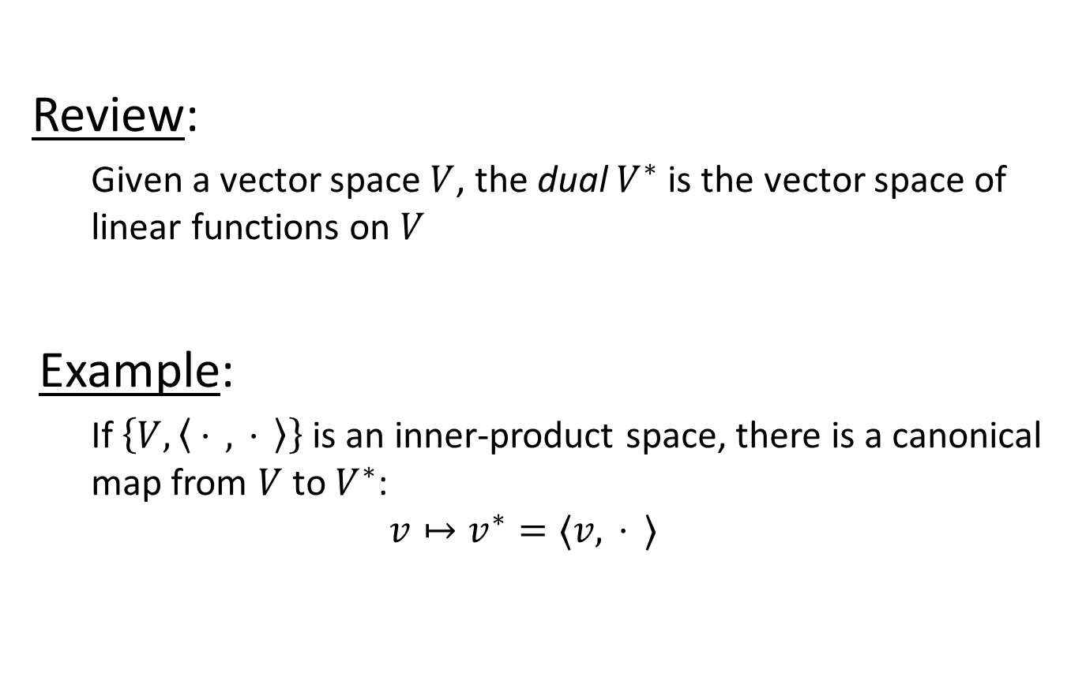
Multigrid Revisited
Review:
  Given a vector space $V$, the dual $V^{∗}$ is the vector space of linear functions on $V$
Example:
  If $\left\{V,\left\langle .⋅., .⋅.\right\rangle \right\}$ is an inner-product space, there is a canonical map from $V$ to $V^{∗}$:
  $$v↦v^{∗}=⟨v,.⋅.⟩$$

Slide 10



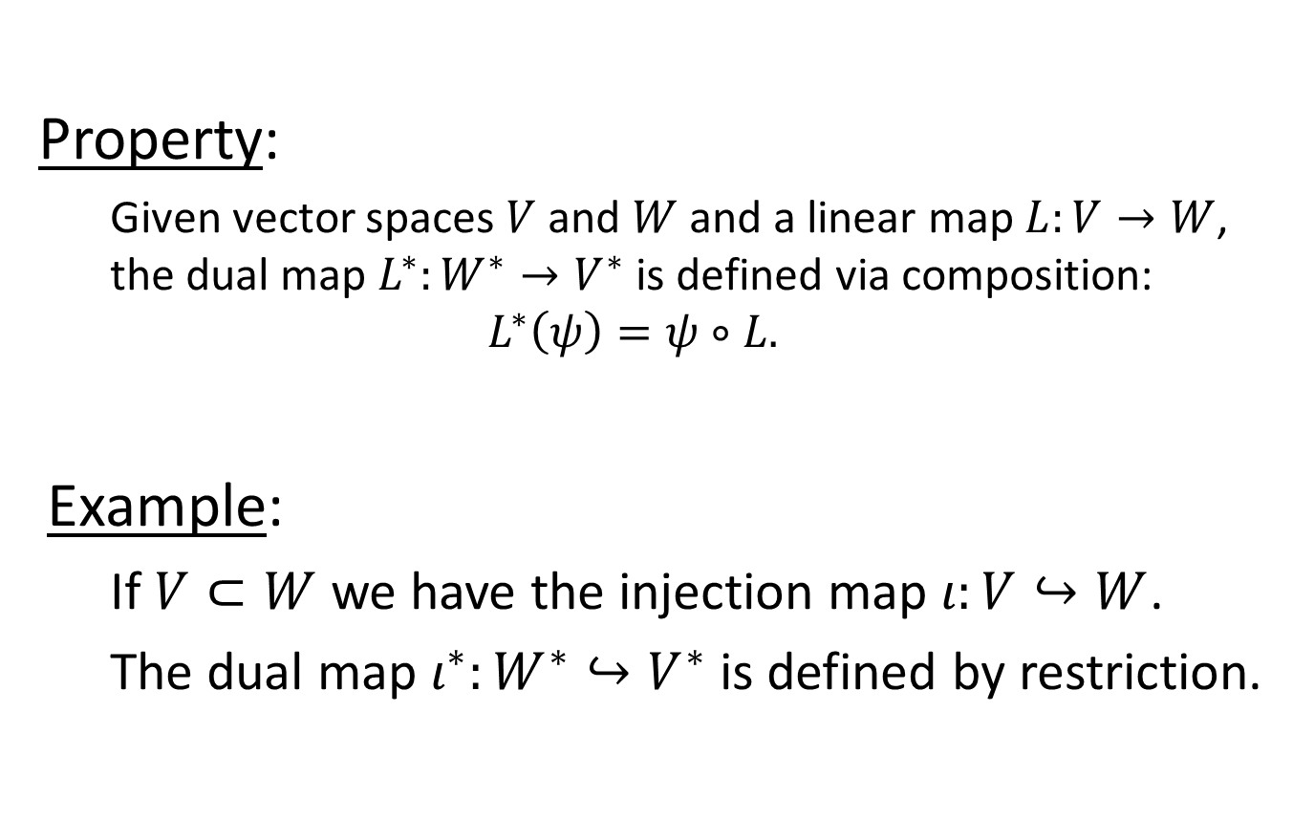



Multigrid Revisited
$$V$$
$$V^{∗}$$
Property:
  Given vector spaces $V$ and $W$ and a linear map $L:V→W$, the dual map $L^{∗}:W^{∗}→V^{∗}$ is defined via composition:
  $$L^{∗}\left(ψ\right)=ψ∘L.$$
Example:
  If $V⊂W$ we have the injection map $ι:V↪W$.
  The dual map $ι^{∗}:W^{∗}↪V^{∗}$ is defined by restriction.
$$L$$
$$L^{∗}$$
$$W$$
$$W^{∗}$$

Slide 11

Multigrid Revisited
Goal:
  Given a linear operator $ℒ$ and a constraint function $g$, solve for the function $f$ with:
  $$ℒ\left(f\right)=g$$

Slide 12
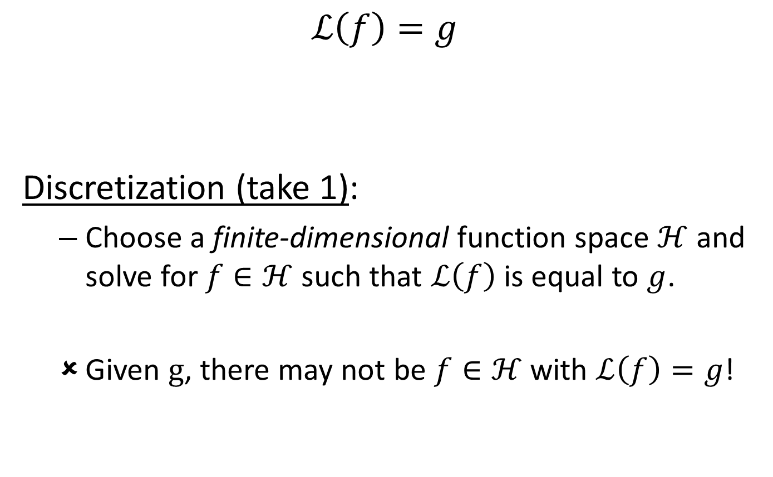
Multigrid Revisited
$$ℒ\left(f\right)=g$$
Discretization (take 1):
  Choose a finite-dimensional function space $ℋ$ and solve for $f∈ℋ$ such that $ℒ\left(f\right)$ is equal to $g$.
  Given $g$, there may not be $f∈ℋ$ with $ℒ\left(f\right)=g$!

Slide 13
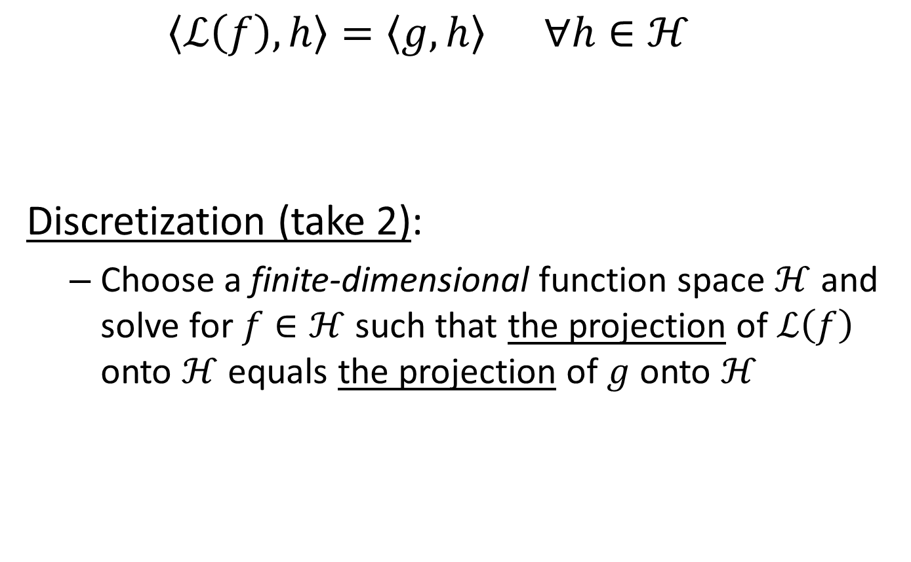
Multigrid Revisited
  $$\left\langle ℒ\left(f\right),h\right\rangle =\left\langle g,h\right\rangle ∀h∈ℋ$$
Discretization (take 2):
  Choose a finite-dimensional function space $ℋ$ and solve for $f∈ℋ$ such that the projection of $ℒ\left(f\right)$ onto $ℋ$ equals the projection of $g$ onto $ℋ$

Slide 14

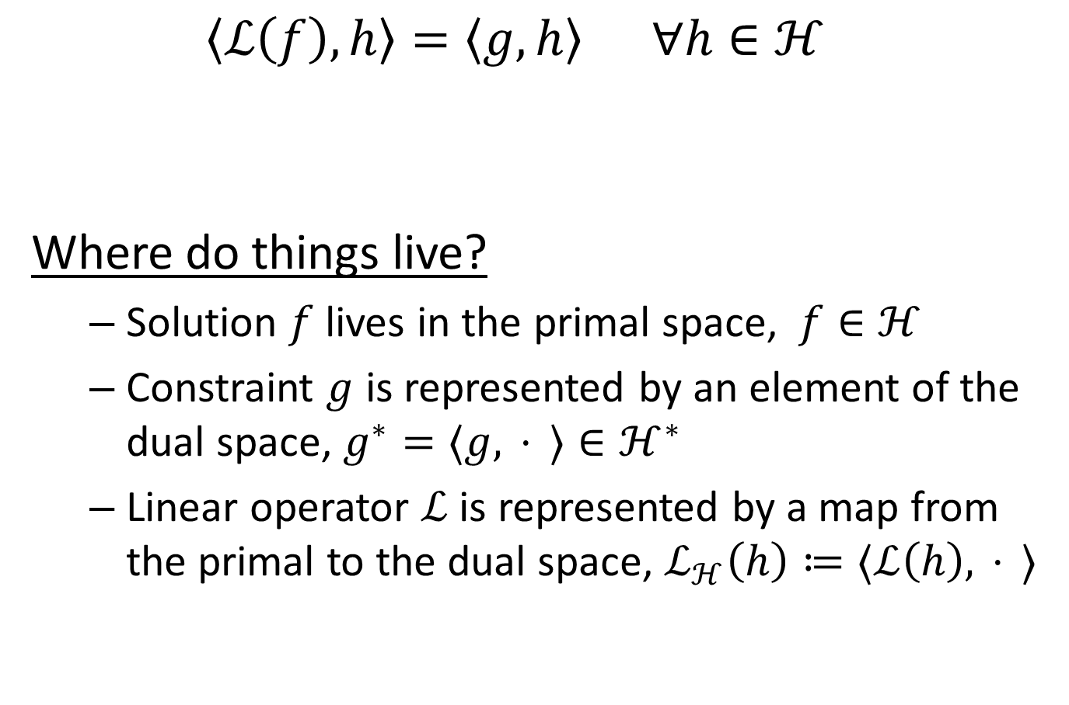


Multigrid Revisited
  $$\left\langle ℒ\left(f\right),h\right\rangle =\left\langle g,h\right\rangle ∀h∈ℋ$$
Where do things live?
  Solution $f$ lives in the primal space, $f∈ℋ$
  Constraint $g$ is represented by an element of the dual space, $g^{∗}=⟨g, .⋅.⟩∈ℋ^{∗}$
  Linear operator $ℒ$ is represented by a map from the primal to the dual space, $ℒ_{ℋ}\left(h\right)≔⟨ℒ\left(h\right),.⋅.⟩$
$$ℒ_{ℱ}$$
$$g^{∗}∈ℋ^{∗}$$
$$f∈ℋ$$

Slide 15









Multigrid Revisited
Multigrid:
  Choose a collection of nesting function spaces
  $ℋ_{1}⊂⋯⊂ℋ_{ℓ}$
    Fine-to-coarse relaxation
    Coarse solve
    Coarse-to-fine relaxation
$$ℒ_{ℓ}$$
$$g_{ℓ}^{∗}∈ℋ_{ℓ}^{∗}$$
$$f_{ℓ}∈ℋ_{ℓ}$$
$$⋯$$
$$⋯$$
$$ℒ_{1}$$
$$g_{1}^{∗}∈ℋ_{1}^{∗}$$
$$f_{1}∈ℋ_{1}$$

Slide 16

Multigrid Revisited
Multigrid:
  Choose a collection of nesting function spaces
  $ℋ_{1}⊂⋯⊂ℋ_{ℓ}$
    Fine-to-coarse relaxation
    Coarse solve
    Coarse-to-fine relaxation
$$ℒ_{ℓ}$$
$$g_{ℓ}^{∗}∈ℋ_{ℓ}^{∗}$$
$$f_{ℓ}∈ℋ_{ℓ}$$
$$⋯$$
$$⋯$$
$$ℒ_{1}$$
$$g_{1}^{∗}∈ℋ_{1}^{∗}$$
$$f_{1}∈ℋ_{1}$$

Slide 17
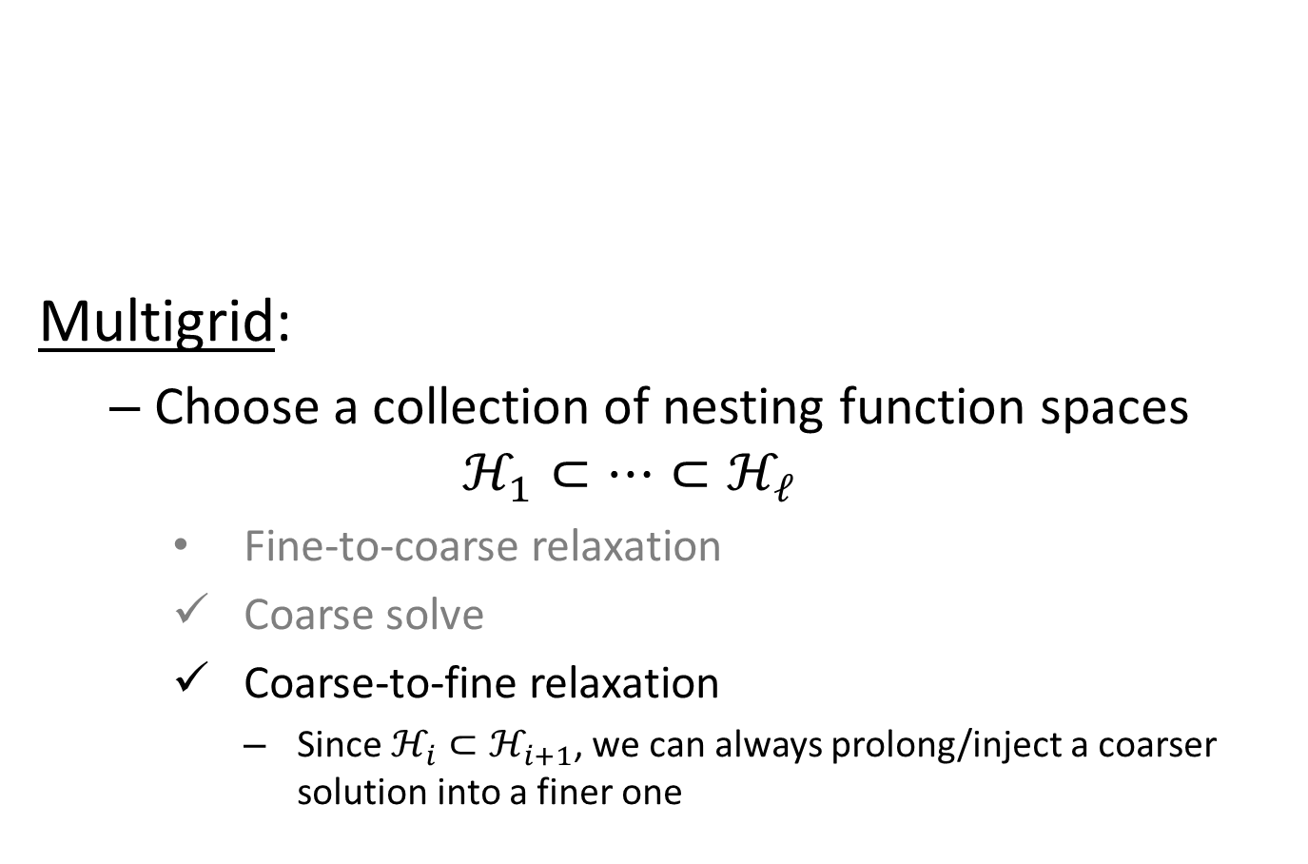
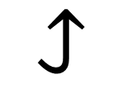
Multigrid Revisited
Multigrid:
  Choose a collection of nesting function spaces
  $ℋ_{1}⊂⋯⊂ℋ_{ℓ}$
    Fine-to-coarse relaxation
    Coarse solve
    Coarse-to-fine relaxation
      Since $ℋ_{i}⊂ℋ_{i+1}$, we can always prolong/inject a coarser solution into a finer one
$$ℒ_{ℓ}$$
$$g_{ℓ}^{∗}∈ℋ_{ℓ}^{∗}$$
$$f_{ℓ}∈ℋ_{ℓ}$$
$$⋯$$
$$↪$$
$$ℒ_{1}$$
$$g_{1}^{∗}∈ℋ_{1}^{∗}$$
$$f_{1}∈ℋ_{1}$$

Slide 18
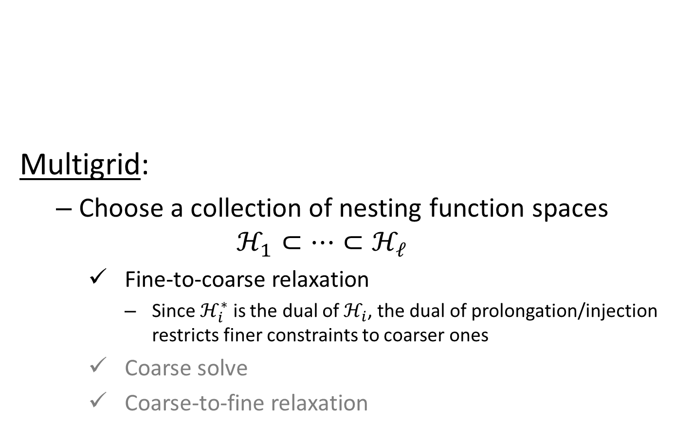
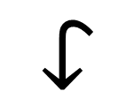
Multigrid Revisited
Multigrid:
  Choose a collection of nesting function spaces
  $ℋ_{1}⊂⋯⊂ℋ_{ℓ}$
    Fine-to-coarse relaxation
      Since $ℋ_{i}^{∗}$ is the dual of $ℋ_{i}$, the dual of prolongation/injection restricts finer constraints to coarser ones
    Coarse solve
    Coarse-to-fine relaxation
$$ℒ_{ℓ}$$
$$g_{ℓ}^{∗}∈ℋ_{ℓ}^{∗}$$
$$f_{ℓ}∈ℋ_{ℓ}$$
$$↪$$
$$↪$$
$$ℒ_{1}$$
$$g_{1}^{∗}∈ℋ_{1}^{∗}$$
$$f_{1}∈ℋ_{1}$$

Slide 19

Multigrid Revisited
Adaptive setting:
  No nesting
  $ℋ_{1}⊂⋯⊂ℋ_{ℓ}$
    $⇒$ We don't have prolongation/restriction
$$ℒ_{ℓ}$$
$$g_{ℓ}^{∗}∈ℋ_{ℓ}^{∗}$$
$$f_{ℓ}∈ℋ_{ℓ}$$
$$↪$$
$$↪$$
$$⋯$$
$$⋯$$
$$ℒ_{1}$$
$$g_{1}^{∗}∈ℋ_{1}^{∗}$$
$$f_{1}∈ℋ_{1}$$

Slide 20
Multigrid Revisited
[ - et al., 2013] (Prolong):
  Represent the solution as the sum of solutions from across levels
$$ℒ_{ℓ}$$
$$g_{ℓ}^{∗}∈ℋ_{ℓ}^{∗}$$
$$f_{ℓ}∈ℋ_{ℓ}$$
$$⋯$$
$$⋯$$
$$ℒ_{1}$$
$$g_{1}^{∗}∈ℋ_{1}^{∗}$$
$$f_{1}∈ℋ_{1}$$
Level 1
Level 2
Level 3
Level 4

Slide 21





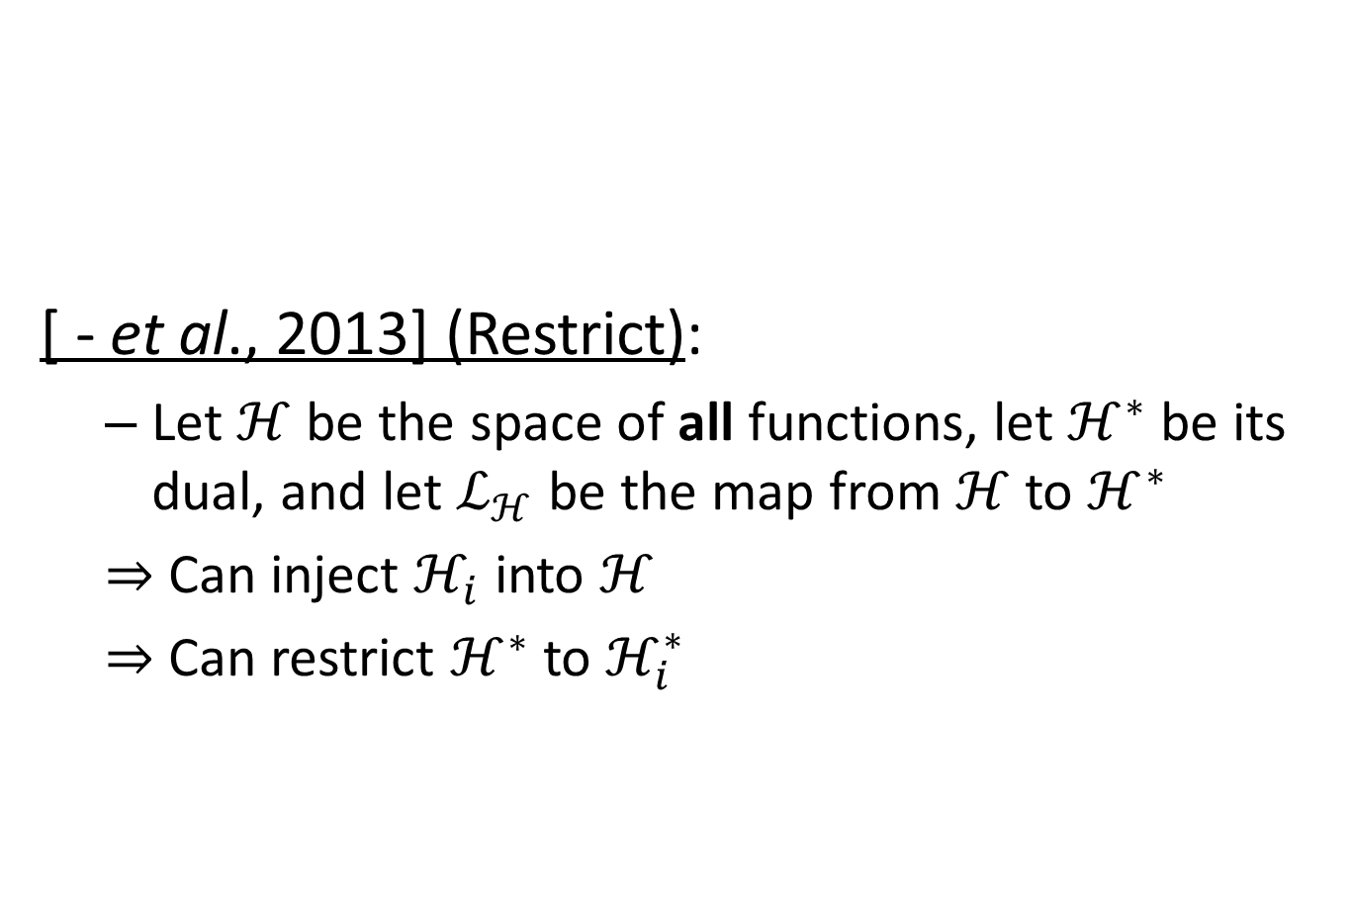






Multigrid Revisited
$$ℋ^{∗}$$
$$ℒ_{ℋ}$$
$$ℋ$$
[ - et al., 2013] (Restrict):
  Let $ℋ$ be the space of all functions, let $ℋ^{∗}$ be its dual, and let $ℒ_{ℋ}$ be the map from $ℋ$ to $ℋ^{∗}$
  $⇒$ Can inject $ℋ_{i}$ into $ℋ$
  $⇒$ Can restrict $ℋ^{∗}$ to $ℋ_{i}^{∗}$
$$ℒ_{ℓ}$$
$$g_{ℓ}^{∗}∈ℋ_{ℓ}^{∗}$$
$$f_{ℓ}∈ℋ_{ℓ}$$
$$⋯$$
$$⋯$$
$$ℒ_{1}$$
$$g_{1}^{∗}∈ℋ_{1}^{∗}$$
$$f_{1}∈ℋ_{1}$$

Slide 22
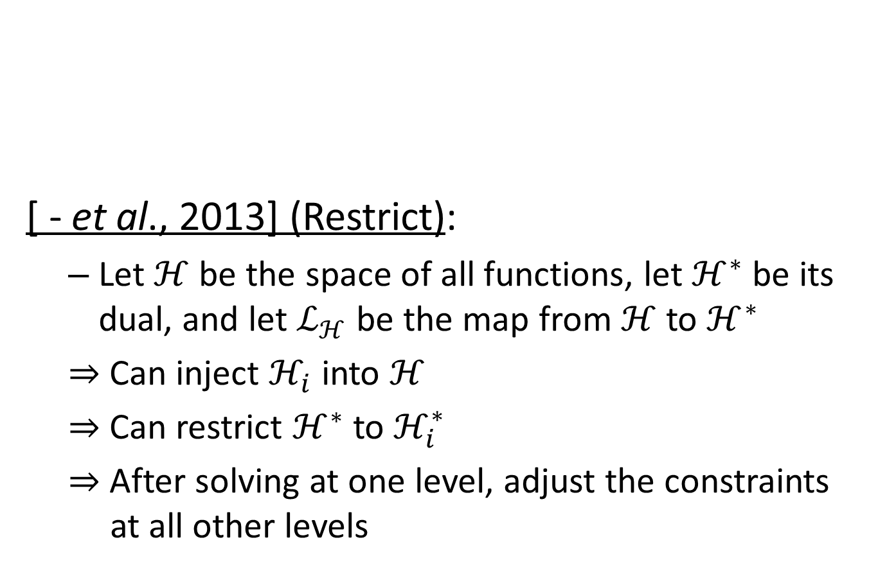

Multigrid Revisited
$$ℋ^{∗}$$
$$ℒ_{ℋ}$$
$$ℋ$$
[ - et al., 2013] (Restrict):
  Let $ℋ$ be the space of all functions, let $ℋ^{∗}$ be its dual, and let $ℒ_{ℋ}$ be the map from $ℋ$ to $ℋ^{∗}$
  $⇒$ Can inject $ℋ_{i}$ into $ℋ$
  $⇒$ Can restrict $ℋ^{∗}$ to $ℋ_{i}^{∗}$
  $⇒$ After solving at one level, adjust the constraints at all other levels
$$ℒ_{ℓ}$$
$$g_{ℓ}^{∗}∈ℋ_{ℓ}^{∗}$$
$$f_{ℓ}∈ℋ_{ℓ}$$
$$⋯$$
$$⋯$$
$$ℒ_{1}$$
$$g_{1}^{∗}∈ℋ_{1}^{∗}$$
$$f_{1}∈ℋ_{1}$$

Slide 23
Multigrid Revisited
[ - et al., 2013]:
  Poisson reconstruction
    Degree two B-splines
    Poisson equation
    Three dimensions
    CG relaxation
    Cascadic
This work:
  Adaptive multigrid
    Any degree B-splines
    Any (SPD) systems
    Any dimension
    GS relaxation
    V-Cycles

Slide 24
Outline
Motivation
Multigrid Revisited
Challenges
Applications
Conclusion

Slide 25
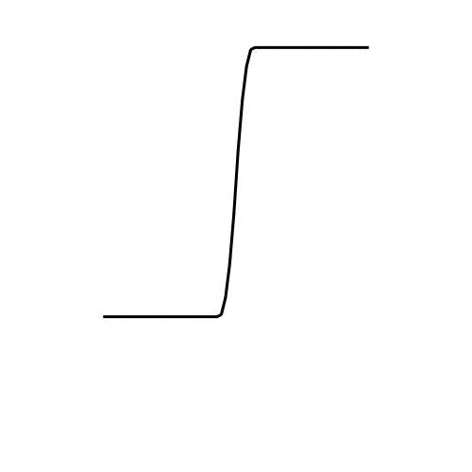
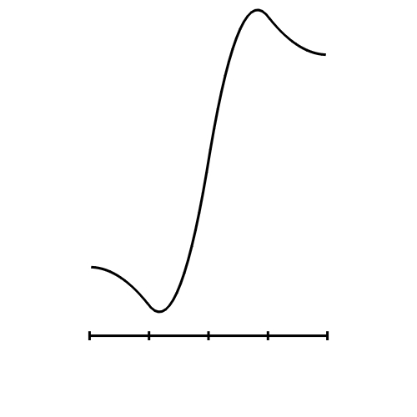
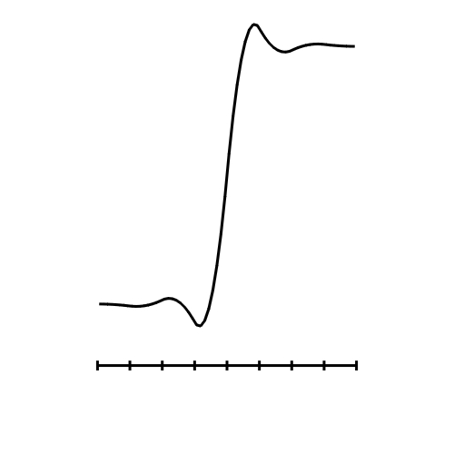
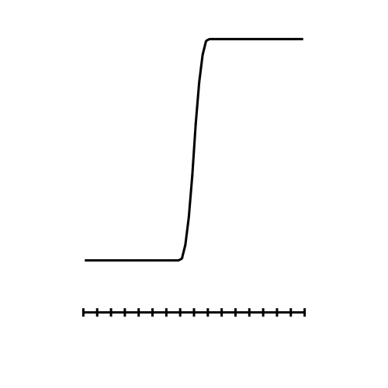






Challenges
  In MG we down-sample
  the constraints
  $⇒$ If the constraints are
  high-frequency, the coarse
  solution will have ringing artifacts
  Regular MG:
  finer levels remove the ringing
Relax
Relax
Down-
Sample
Up-
Sample
Solve
$$g(x)$$
$$f_{1}(x)$$
$$f_{2}(x)$$
$$f_{3}(x)$$
$$f\left(x\right)=g(x)$$
level 1
level 2
level 3

Slide 26
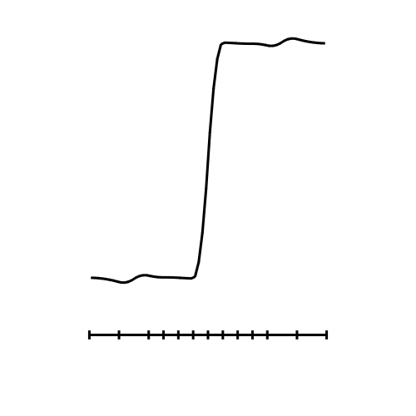

Challenges
  In MG we down-sample
  the residual constraints
  $⇒$ If the constraints are
  high-frequency, the coarse
  solution will have ringing artifacts
  Regular MG:
  finer levels remove the ringing
  Adaptive MG:
  finer levels may not have
  the resolution to remove
  the ringing
Relax
Relax
Down-
Sample
Up-
Sample
Solve
$$f_{2}(x)$$
$$f_{3}(x)$$
level 2
level 3

Slide 27
Challenges
Ringing:
  Content-based
    Removed by relaxing the finer
    solution before down-sampling
  Geometry-based
    In the fine-to-coarse solve dampen
    the relaxation near the interfaces between levels
Relax
Relax
Down-
Sample
Up-
Sample
Solve
$$g(x)$$
$$f_{3}(x)$$
level 3

Slide 28
Outline
Motivation
Multigrid Revisited
Challenges
Applications
Conclusion

Slide 29
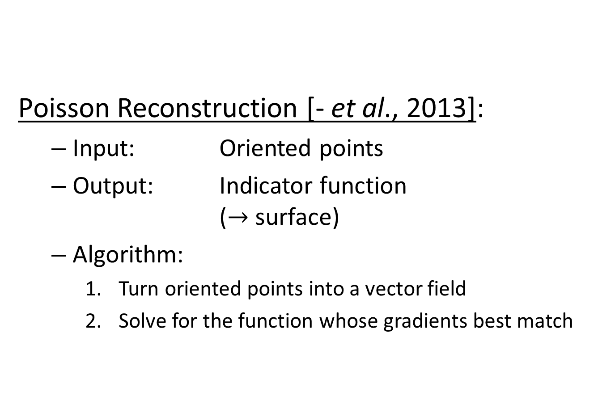
Applications (1/4)
Poisson Reconstruction [- et al., 2013]:
  Input: Oriented points
  Output: Indicator function
  ($→$ surface)
  Algorithm:
    Turn oriented points into a vector field
    Solve for the function whose gradients best match

Slide 30
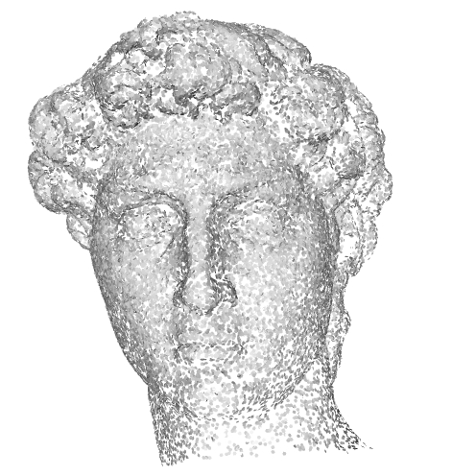
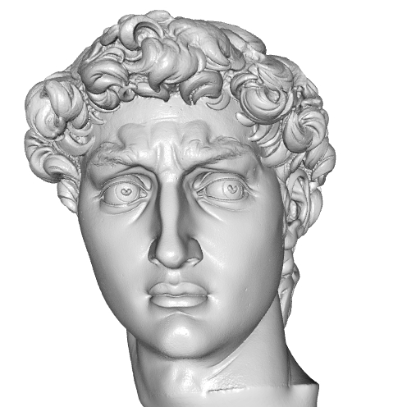

Applications (1/4)
Poisson Reconstruction:
  System: Laplacian
  Dimensions: $3$
  System degree: $≥1$
  Adaptation: input samples

Slide 31
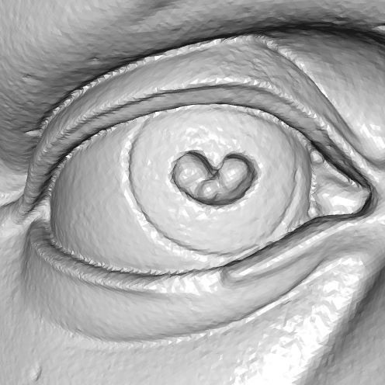


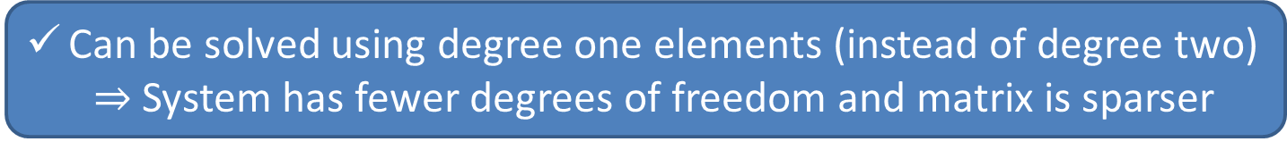
Applications (1/4)
adaptive multigrid
adaptive multigrid
[ - et al., 2013]
Time: 77 (s)
Memory: 1453 (MB)
Degree: 1
Time: 113 (s)
Memory: 1750 (MB)
Degree: 2
Time: 144 (s)
Memory: 2378 (MB)
Degree: 2
Can be solved using degree one elements (instead of degree two)
  $⇒$ System has fewer degrees of freedom and matrix is sparser
input points: 11M
resolution: 1024³

Slide 32
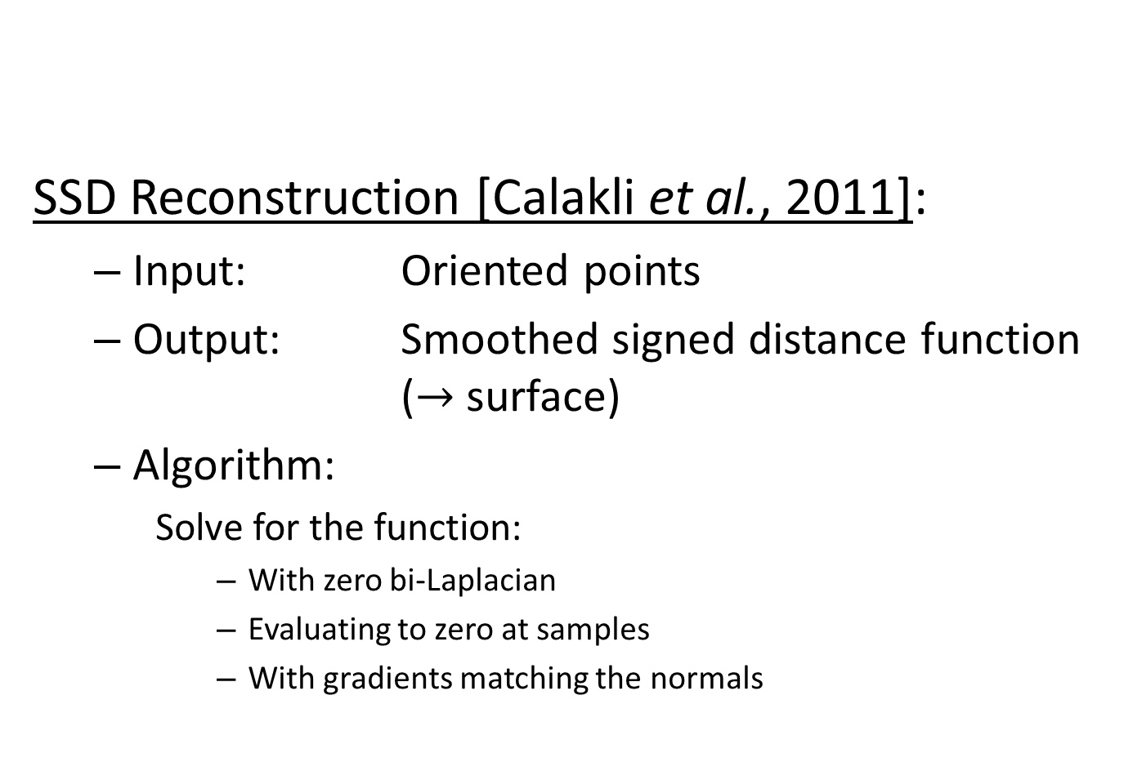
Applications (2/4)
SSD Reconstruction [Calakli et al., 2011]:
  Input: Oriented points
  Output: Smoothed signed distance function
  ($→$ surface)
  Algorithm:
    Solve for the function:
      With zero bi-Laplacian
      Evaluating to zero at samples
      With gradients matching the normals

Slide 33
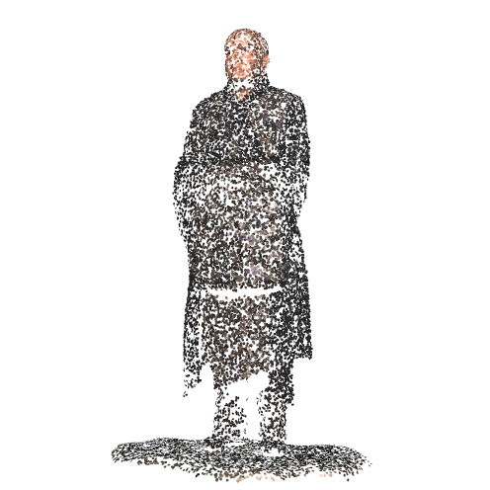
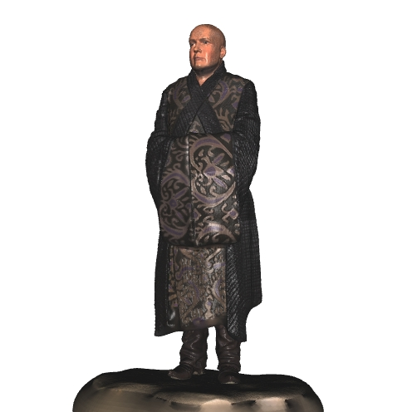

Applications (2/4)
SSD Reconstruction:
  System: bi-Laplacian
  Dimensions: $3$
  System degree: $≥2$
  Adaptation: input samples

Slide 34
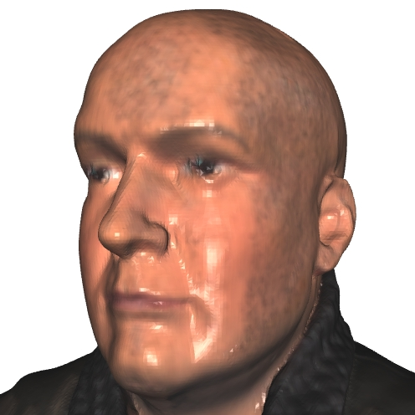

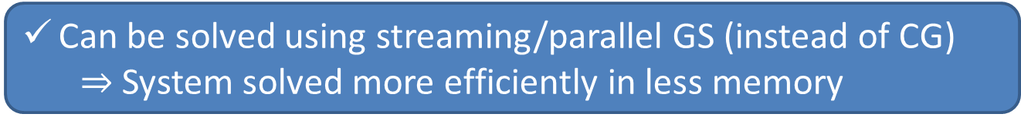
Applications (2/4)
adaptive multigrid
[Calakli et al., 2011]
Time: 31 / 77 (s)
Memory: 627 (MB)
Degree: 2
Time: 142 (s)
Memory: 2516 (MB)
Degree: 1 + finite-differences
Can be solved using streaming/parallel GS (instead of CG)
  $⇒$ System solved more efficiently in less memory
input points: 6M
resolution: 1024³

Slide 35
Applications (3/4)
Geodesics in Heat [Crane et al., 2013]:
  Input: Triangle mesh
  Output: Unsigned distance function
  Algorithm:
    Solve for the function:
      Diffuse a delta function of the mesh
      Compute the (negated) gradient and normalize
      Solve for the function whose gradients best match

Slide 36
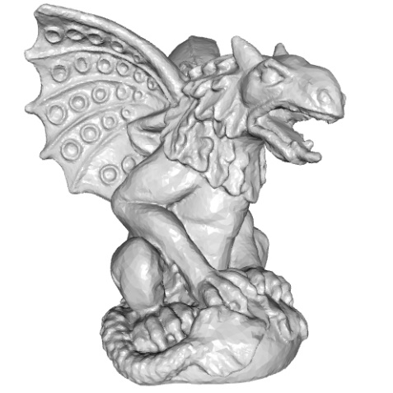
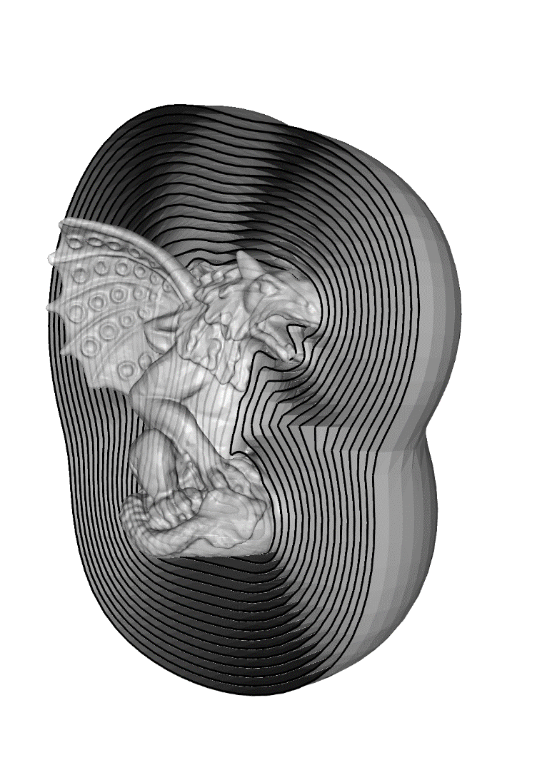

Applications (3/4)
Geodesics in Heat:
  System: Laplacian (2$×$)
  Dimensions: $3$
  System degree: $≥1$
  Adaptation: input surface

Slide 37
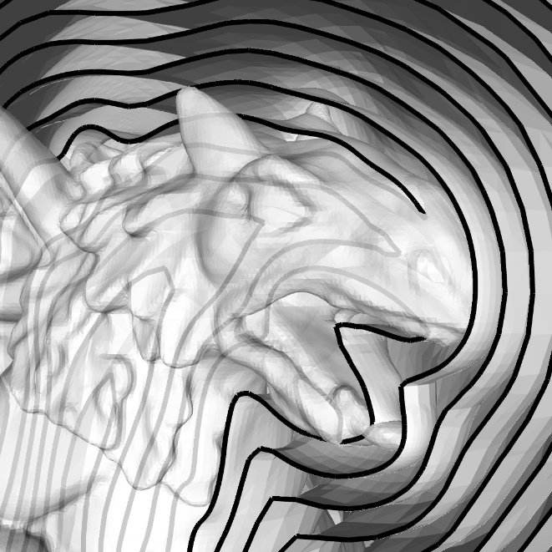
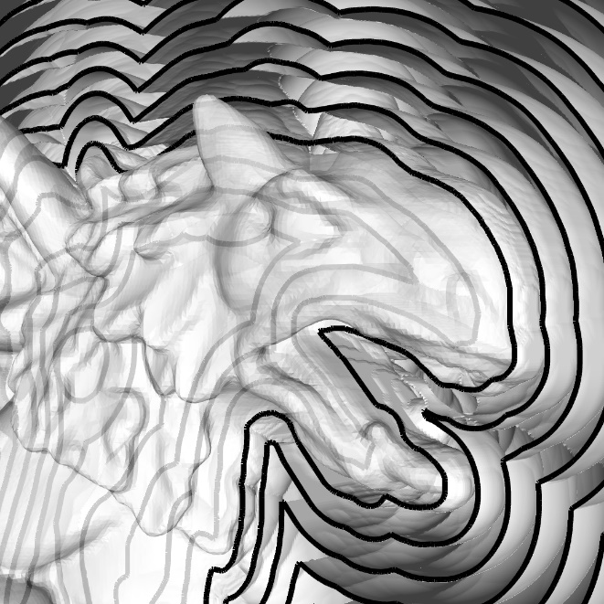
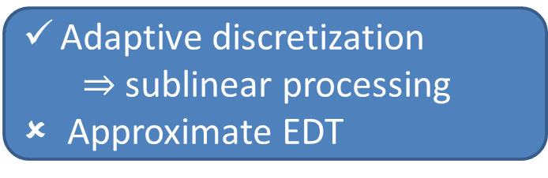
Applications (3/4)
adaptive multigrid
[Saito et al., 1994]
Time: 3 / 8 / 26 (s)
Memory: 47 / 157 / 586 (MB)
Time: 1 / 5 / 72 (s)
Memory: 141 / 1037 / 8205 (MB)
Adaptive discretization
  $⇒$ sublinear processing
Approximate EDT
input vertices: 214K
resolution: 256³ / 512³ / 1024³

Slide 38
Applications (4/4)
Image Stitching [Agarwala, 2007]:
  Input: Image composite
  Output: Seamless panorama
  Algorithm:
    Define a correction vector-field equal to
      negative of the composite gradient across the seams
      zero everywhere else
    Solve for the function whose gradient best matches
    Add the function to the composite

Slide 39



Applications (4/4)
Image Stitching:
  System: Laplacian
  Dimensions: 2
  System degree: $≥1$
  Constraint degree: $≥$1/0, 0/1
  Adaptation: seams

Slide 40






Applications (4/4)
resolution: 35K x 13K
input
stitched
w/o dampening
stitched
w/ dampening

Slide 41
Applications (4/4)
adaptive multigrid
adaptive multigrid
[ - et al., 2010]
[ - et al., 2010]
pixels
pixels
Complexity is linear in the seams, not pixels
Entire quadtree must be memory resident
input
stitched
w/o dampening
stitched
w/ dampening

Slide 42
Conclusion
Contribution:
  An adaptive multigrid solver supporting:
  general degree elements
  general SPD systems
  general dimensions
  etc.

Slide 43
Conclusion
Future work:
  Out-of-core
  Improve ringing heuristic
  Support boundary constraints

Slide 44






Thank You!
http://www.cs.jhu.edu/~misha/Code/PoissonRecon/

