Slide 1
How to Teach “Programming”
Kenneth.Church@jhu.edu
Lecture 1: Education for kids
  Lego Mindstorms (NQC: Not Quite C)
  Scratch
Lecture 2: Unix for Poets
  Request: bring a laptop if possible
    Windows Users: please install http://www.cygwin.com/
  Target audience: Grad Students in Linguistics
  Unix shell scripts (almost not programming)
  Small is Beautiful
Lecture 3: Symbolic Processing
  Target audience:
    MIT Computer Science Majors (circa 1974)
  LISP: Recursion, Eval, Symbolic Differentiation
  Lambda Calculus (“Small is Beautiful” beyond reason)

Slide 2
Agenda
Old Business
  Homework from last week
New Business
  Requests for Next Week
Today’s Lecture
  Unix for Poets

Slide 3
Requests for Next Week
Bring Laptops (again)
  Install LISP: http://www.newlisp.org/
  Read “The Roots of LISP” (see Lecture3/jmc.PDF on CD or http://lib.store.yahoo.net/lib/paulgraham/jmc.ps)
Homework (nothing to hand in):
  Read: Basics of the Unix Philosophy
    http://www.faqs.org/docs/artu/ch01s06.html
    Fun (optional): http://www.cs.dartmouth.edu/~sinclair/doug/?doug=mcilroy
  Continue exercises in Unix For Poets
    M&Ms/Lecture2/unix_for_poets.pdf
    Try to finish at least pp. 1-26 (better: pp. 1-37)
  Incompatibility notes:
    You may have to skip exercises that depend on “spell”
    Arguments to sort are not the same on Macs (see man)

Slide 4
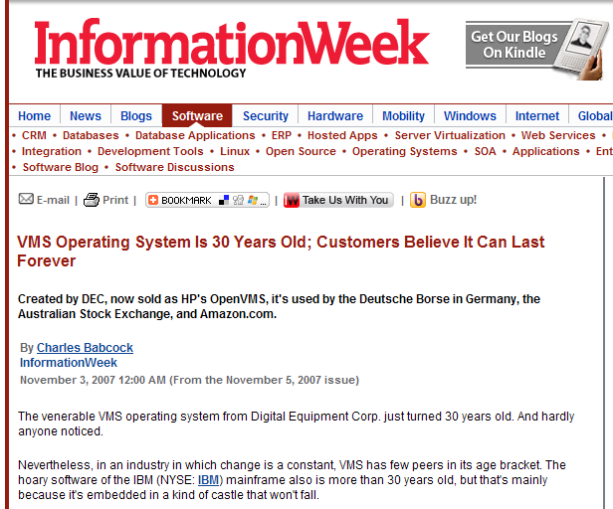
Unix has survived the test of time
Better than many… Why?
Doug McIlroy
Small is Beautiful
Portability
  Everything had to run everywhere
  Pipes → Parallelism (with multiple cores)
Documentation
  Taken seriously
  Publish or Perish
  Brian Kernighan

