Slide 1
Mesh Based Optical Flow
Fabian Prada and Misha Kazhdan
Capital Graphics Workshop
April 25th

Slide 2
Outline
Classical optical flow
Optical flow in meshes
Applications
Demo
Practical considerations

Slide 3
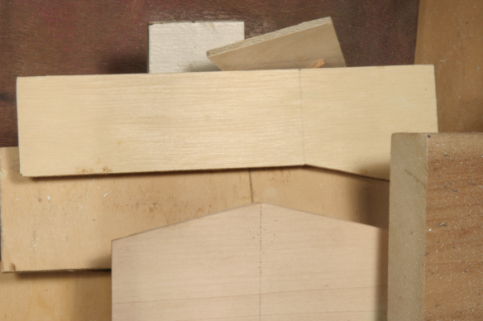
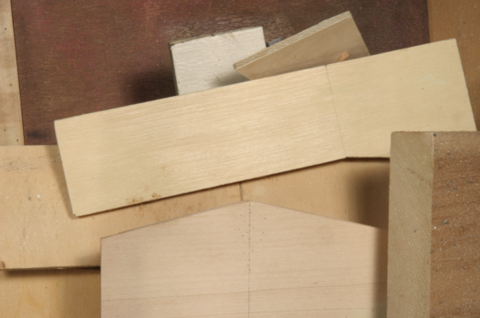
Classical Optical Flow
Input
Signal Pair
$$φ_{0,}φ_{1}:{\left[0,1\right]}^{2}×→ℝ^{n}$$
$$r+\vec{v} (r)$$
$$r$$
$$p$$
$$p+\vec{v}(p)$$
$$q$$
$$q+\vec{v}(q)$$
$$φ_{0}$$
Output
$$φ_{1}$$
Alignment vector field
$$\vec{v}:{\left[0,1\right]}^{2}→ℝ^{2}$$
Notes:
-classical formulation use a forward alignment

Slide 4
Brightness Constancy
Necessary condition:
$$φ_{0}\left(p\right)=φ_{1}(p+\vec{v}(p))$$
Warped target
Is it sufficient?
We must enforce a smooth motion:
$$\int{{\left(φ_{0}\left(p\right)−φ_{1}\left(p+\vec{v}\left(p\right)\right)\right)}^{2}+{ε\int{{\left|∇ \vec{v}\right|}^{2}}}^{}}$$
Notes:
Scene with no lighting variation points are registered with equal intensity
We can interpret the optical flow problem as the computation of a warping of the target signal that make it match the source.

Slide 5
Linear Model
$$\int{{\left(φ_{0}\left(p\right)−φ_{1}\left(p+\vec{v}\left(p\right)\right)\right)}^{2}+{ε\int{{\left|∇ \vec{v}\right|}^{2}}}^{}}$$
Linearize
Non linear
$\vec{v} ←$ EstimateFlow($φ_{0}$, $φ_{1},ε$)
Only provide a low order approximation of the alignment field!
Solve for $\vec{v}$ that minimizes:
$$\int{{\left(φ_{0}\left(p\right)−φ_{1}\left(p\right)−\left\langle ∇φ_{1}\left(p\right),\vec{v}\left(p\right)\right\rangle \right)}^{2}+{ε\int{{\left|∇ \vec{v}\right|}^{2}}}^{}}$$
Notes:
The Estimate Flow is the main bulting block of our algorithm.

Slide 6
Iterative Flow Correction
Idea: Update $\vec{v},$ making the warped target $,\overline{φ_{1}}\left(p\right)≡φ_{1}\left(p+\vec{v}\left(p\right)\right),$a better approximation to $φ_{0}$.
Initialize: $\vec{v}←0,\overline{φ_{1}}←φ_{1}$
Solve for
$\overline{φ_{1}} ←$ ApplyFlow($φ_{1}, \vec{v}$)
Solve for
$\vec{v} ←\vec{v}+$ EstimateFlow($φ_{0},\overline{φ_{1}},ε$)
$$\overline{φ_{1}}\left(p\right)=φ_{1}(p+\vec{v}\left(p\right))$$
Does not support large motion!
Does not support large motion!
Example:
ApplyFlow()
ApplyFlow()
EstimateFlow
EstimateFlow()
EstimateFlow()
$$φ_{0}$$
$$…$$
$$\overline{φ_{1}}$$
$$\overline{φ_{1}}$$
$${\overline{φ_{1}}=φ}_{1}$$

Slide 7
Hierarchical Flow Correction
Pyramidal Approach
Coarse
Fine
Solve for
$\vec{v} ←$ Upsample( $\vec{v}+$ EstimateFlow($φ_{0}^{l},{\overline{φ_{1}}}^{l},ε$))
$$φ_{0}$$
Solve for
$$φ_{1}$$
${\overline{φ_{1}}}^{l+1} ←$ ApplyFlow($φ_{1}^{l+1}, \vec{v}$)
Linear Scale Space
Coarse
Fine
Solve for
$\vec{v} ←$ $\vec{v}+$ EstimateFlow(${ G_{l}∗φ}_{0}^{},{G_{l} ∗\overline{φ_{1}}}^{},ε_{l}$))
$$φ_{0}$$
Solve for
$$φ_{1}$$
${\overline{φ_{1}}}^{} ←$ ApplyFlow($φ_{1}^{}, \vec{v}$)

Slide 8
Optical Flow in Meshes

Slide 9
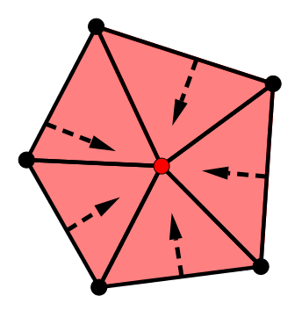
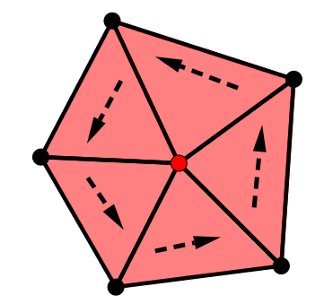
Discretization
Signal Discretization
Vector Field Discretization
$$f_{2}$$
$$p=(α_{0},α_{1},α_{2})$$
$$f_{1}$$
$$f_{0}$$
$$f\left(p\right)=α_{0}f_{0}+α_{1}f_{1}+α_{2}f_{2}$$
$${∇B}_{i}$$
$${J∇B}_{i}$$
$$f(p)=\sum{f_{i}B_{i}(p)}$$
$$\vec{v}=∇f+J∇g=\sum{f_{i}∇B_{i}+}\sum{g_{i }J∇B_{i}}$$
Piecewise Linear Functions
Piecewise Constant Vector Fields

Slide 10
EstimateFlow()
$$\int{{\left(φ_{0}\left(p\right)−φ_{1}\left(p\right)−\left\langle ∇φ_{1}\left(p\right),\vec{v}\left(p\right)\right\rangle \right)}^{2}+{ε\int{{\left|∇ \vec{v}\right|}^{2}}}^{}}$$
?
Piecewise Linear Function
Piecewise Constant Vector
Well defined!
How do we compute $\int{{\left|∇ \vec{v}\right|}^{2}}$?
For images is simple: use the Jacobian
For meshes….
Discretize the covariant derivative -> Hard!.
Define a connection -> Biased by the tessellation.
Measure smoothness from the divergence and curl of the vector field.
$$\vec{v}≡\left(v_{1}\left(x,y\right),v_{2}\left(x,y\right)\right)$$
$$∇\vec{v}=\left(\begin{matrix}\frac{∂v_{1}}{∂x} & \frac{∂v_{1}}{∂y} \\ \frac{∂v_{2}}{∂x} & \frac{∂v_{2}}{∂y}\end{matrix}\right)$$

Slide 11
Divergence and Curl
$\int{{\left|∇\vec{v}\right|}^{2}}≡$ $\int{{\left|∇⋅\vec{v}\right|}^{2}}+\int{{\left|(∇⋅J)\vec{v}\right|}^{2}}$
Divergence
Curl
$${∇B}_{i}$$
$${J∇B}_{i}$$
Curl free comp.
(${∇⋅J)∇B}_{i}=0$
Divergence free comp.
$${∇⋅(J∇B}_{i})=0$$
Proposition: If $\vec{v}=∇f+J∇g$, then
$\int{{\left|∇⋅\vec{v}\right|}^{2}}+\int{{\left|∇⋅J\vec{v}\right|}^{2}}$ = $\int{{\left|Δf\right|}^{2}}+\int{{\left|Δg\right|}^{2}}$
Using a FEM discretization,
$$\int{{\left|Δf\right|}^{2}}+\int{{\left|Δg\right|}^{2}}=\left[f\right]SM^{−1}S\left[f\right]\text{ +} \left[g\right]SM^{−1}S\left[g\right]$$
where $M,S$ are the mass and stiffness matrix

Slide 12
ApplyFlow()
$$\overline{φ}\left(p\right)={φ(p+\vec{v}\left(p\right))}_{}$$
Exponential Map
Field Integration
Robust to small perturbations
More spatially coherent motion.

Slide 13
Hierarchical Flow Correction
Linear Scale Space
For images:
Coarse
Fine
Solve for
$$φ_{0}$$
$\vec{v} ←$ $\vec{v}+$ EstimateFlow(${ G_{l}∗φ}_{0}^{},{G_{l} ∗\overline{φ_{1}}}^{},ε_{l}$))
$$φ_{1}$$
Solve for
${\overline{φ_{1}}}^{} ←$ ApplyFlow($φ_{1}^{}, \vec{v}$)
For meshes:
Solve for
$\tilde{φ}←$ Smooth($φ,σ$)
$\vec{v} ←$ $\vec{v}+$ EstimateFlow(Smooth($φ_{0},σ/4^{l}\text{)}$,Smooth($\overline{φ_{1}},σ/4^{l}$), $ε/4^{l}$)
Solve for $\tilde{φ}$ minimizing:
Solve for
$∫{\left|\tilde{φ} −φ\right|}^{2}+σ∫|∇\tilde{φ}{\left.​\right|}^{2}$
${\overline{φ_{1}}}^{} ←$ ApplyFlow($φ_{1}^{}, \vec{v}$)

Slide 14
Applications

Slide 15
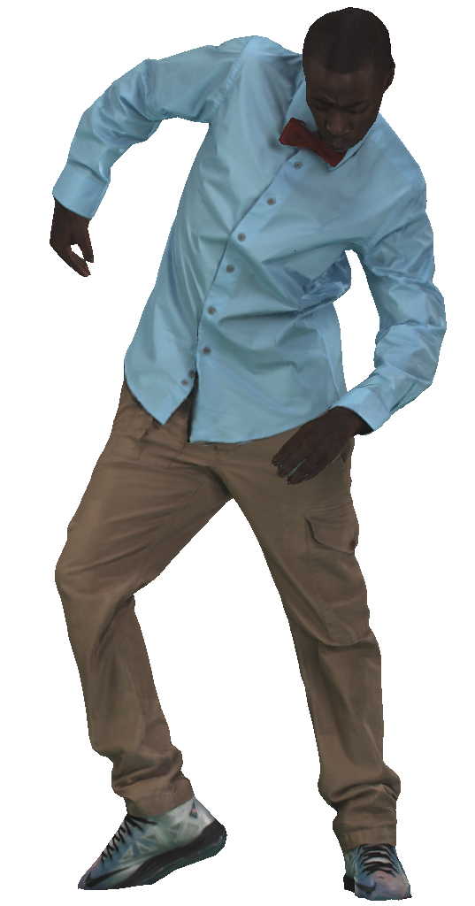
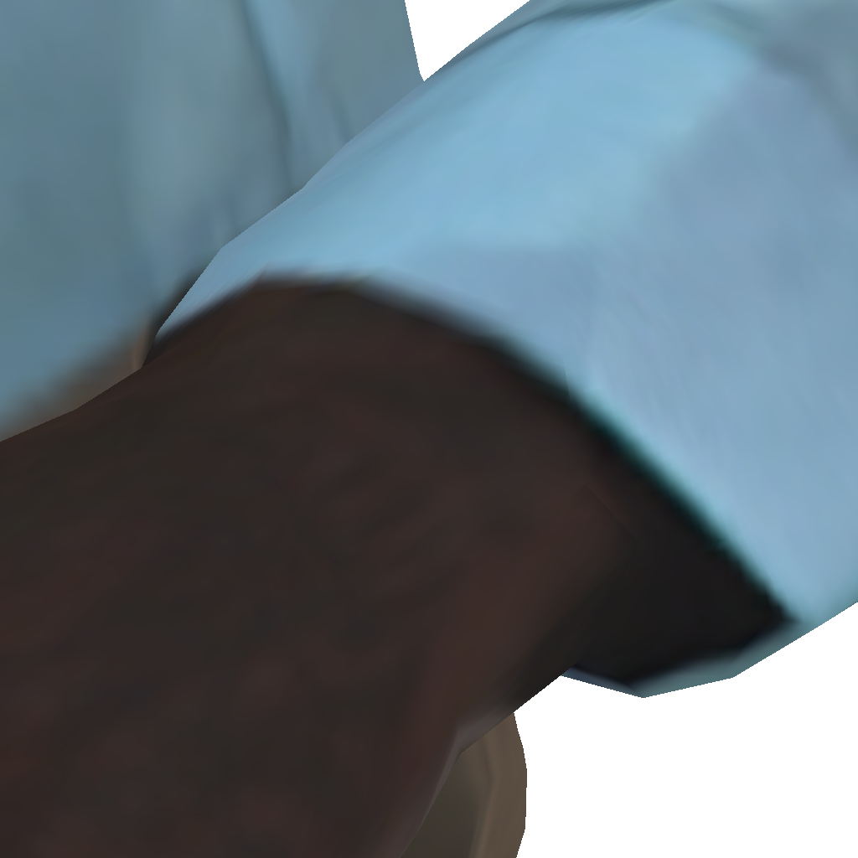
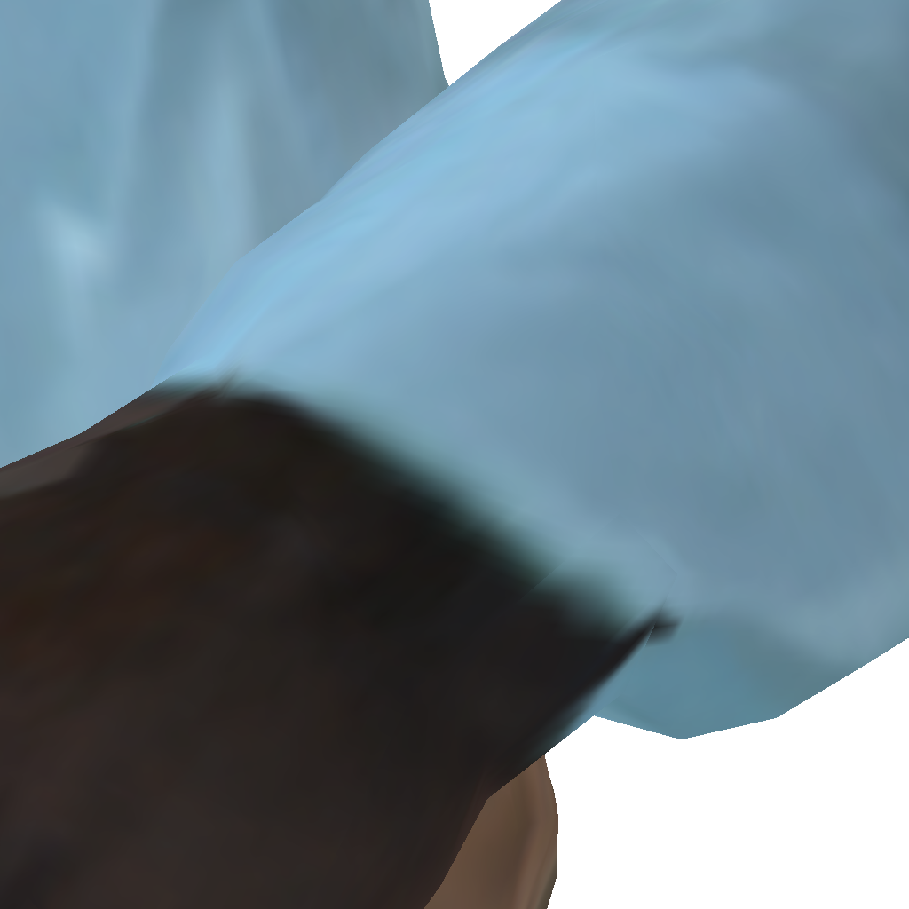
Texture interpolation
Source
Target

Slide 16
Texture interpolation
Source
Linear blend
Target

Slide 17
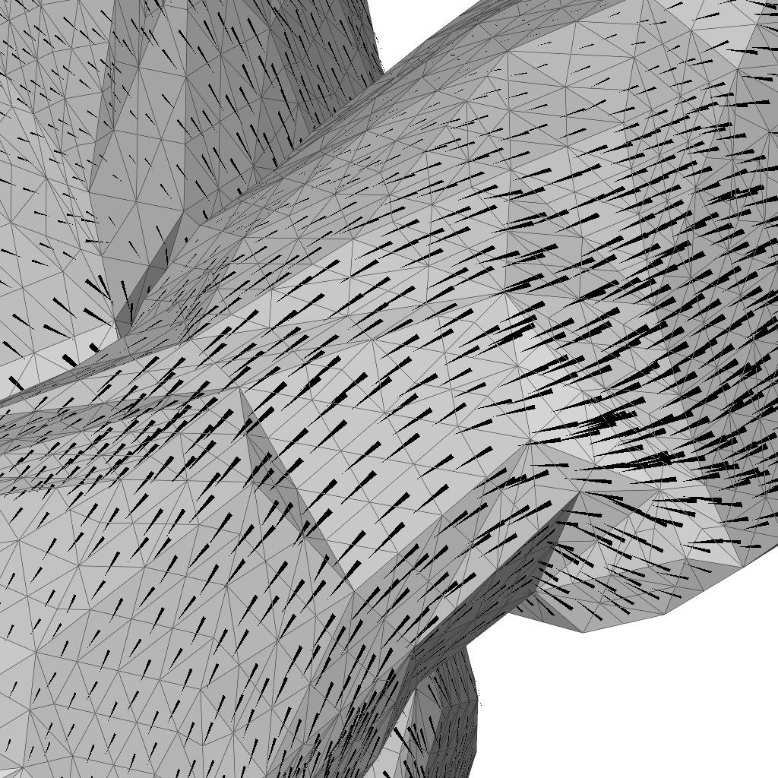
Texture interpolation
Optical flow vector field
Source to target advection

Slide 18
Texture interpolation
Source
Target

Slide 19
Texture interpolation
Source
Optical flow
Target

Slide 20
Texture interpolation
Notes:
Mesh based optical flow was an essential component on our work on motion graphs. From a multi camera stage you can construct a temporal sequence of textured meshes that can be rendered from an arbitrary view point. Our contribution was to generate a motion graph that provide a seamless transition between similar frames.

Slide 21
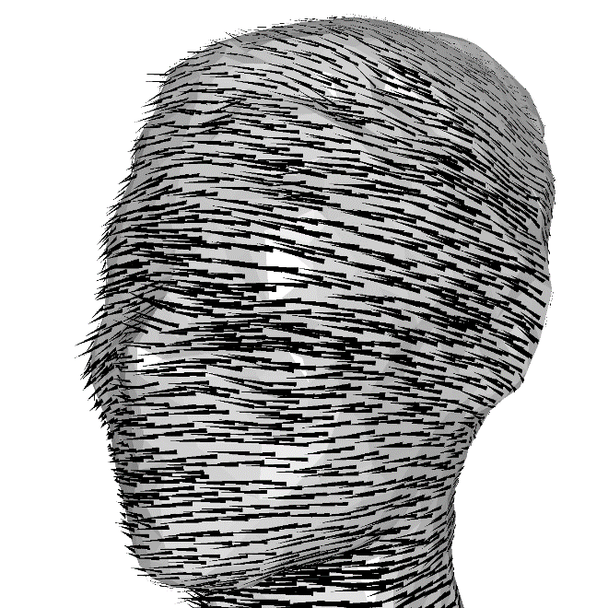
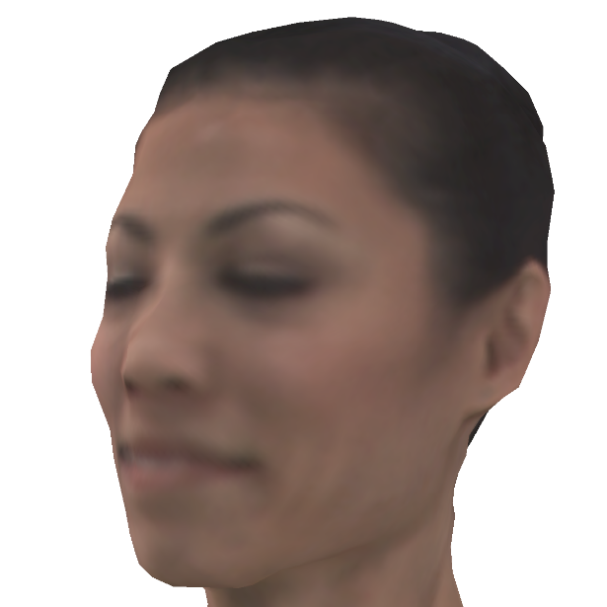
Texture tracking
Source texture
Optical flow
Target texture
Notes:
Proceeding as before, we compute the deformation and normal offset, mapping the source to the target
But now we note that we can associate two different texture maps to the deformed geometry
[CLICK] The original texture associated with the source and the texture associated by projecting from the target
[CLICK] We then solve the optical flow problem, computing the vector field that flows the source texture to the projected target texture.

Slide 22
Texture tracking
Flow-based correspondences
Tangential flow
Notes:
The goal of optical flow is to define a tangential motion that registers the source and projected target textures.
However we can also use the flow field to adjust correspondences between the source and target geometry,
[CLICK] allowing us to obtain an improved registration in a subsequent deformation pass

Slide 23
Texture tracking
10% reduction in compressed texture size
Without
With
Notes:
Here we show the impact of tracking with and without optical flow.
On the left we observe the severe texture motion when optical flow is disabled.
[CLICK] On the right, we see that the use of optical flow reduces the drifting artifact
[CLICK] The lack of drift makes the texture video more coherent and reduces the compressed video size.

Slide 24
Demo
Try our code from:
https://github.com/fabianprada/MeshOpticalFlow

Slide 25
Practical Considerations

Slide 26
Halfway Alignment
Given a pair of images $φ_{0} ,φ_{1}$, how we represent the alignment motion?
Forward Alignment
Halfway Alignment
$$φ_{0}\left(p\right)≈φ_{1}(p+w)$$
$$φ_{0}\left(p−w/2\right)≈φ_{1}(p+w/2)$$
Source
Target
Most intuitive
Used in OF benchmarks (http://vision.middlebury.edu/flow/)
Symmetric formulation
Can respresent occlusions using a smooth vector field!

Slide 27
Whitney Basis
$${\vec{v}}_{ij}≡ B_{i}∇B_{j}−B_{j}∇B_{i}$$
$$j$$
$${\vec{v}=∑ω_{ij}{\vec{v}}_{ij}}_{ }$$
$$i$$
Divergence and curl can be computed using DEC:
$\int{{\left|∇\vec{v}\right|}^{2}}≡$ $\int{{\left|∇⋅\vec{v}\right|}^{2}}+\int{{\left|(∇⋅J)\vec{v}\right|}^{2}}$
$$ω∗_{1}d_{0}{∗_{0}^{−1}d}_{0}^{t}∗_{1}ω$$
$$ω d_{1}^{t}{∗_{2}^{}d}_{1}^{}ω$$
Reproduce harmonic vector fields.
Produce sparser linear systems.

