Slide 1
Depth Perception in Medical Augmented Reality
Computer Aided Medical Procedures
Fabian Prada, Javad Fotouhi, Sunyan Lee

Slide 2
Problem Statement
Intuitive perception of depth
The goal is not to implement different depth cues, but to develop an interactive evaluation/training setup
Depth perception using different visualization depth cues:
Shadow
Fog
Reflection
Reference
Heat
Notes:
The problem here we are trying to address is the need for intuitive perception of depth and compelling graphics for proper integration of AR into clinical routines. Most proposed techniques suffer from poor depth perception. Lack of these depth cues, will show the objects (which are here say the lymph nodes) as floating objects on top of the other anatomical tissues.
Goal: The goal here is not to come up with novel depth cues, but to propose a framework which it can be used for both evaluation and training of the depth cues. Our observation which we come to it later is that great graphics solely cannot answer the problem, unless there would be proper training where the user gets comfortable working with.

Slide 3
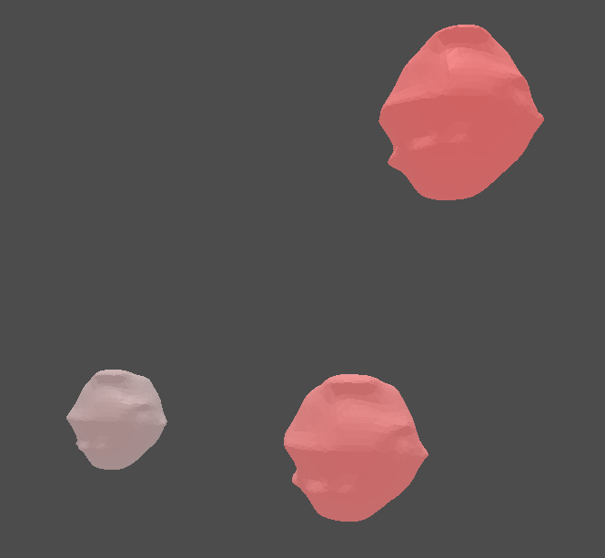
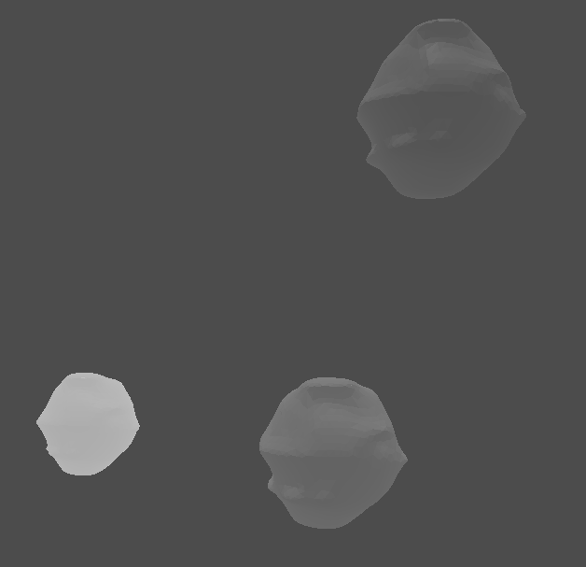
Related Work
Three different visualizations with time dependent animations
Transparency
Fog
Glowing
Notes:
This is the work from Felix and Anja where they demonstrated 3 different visualization techniques of transparency, fog, and glowing for 3 different models of the lymph nodes in the case of the breast cancer. For every trial they used different time varying animations to the user.

Slide 4
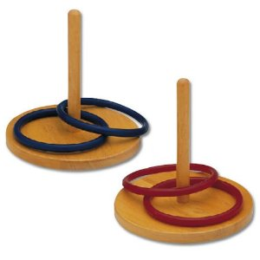
Motivation and limitations of a gaming framework
Motivation: Use the framework not just for the sake of evaluation, but for training purposes as well.
Limitations: Additional information
Blowing bubbles: Good for training purposes, however not suitable for evaluation.
Ring Toss: The initial idea was to have the user carrying the rings and position it properly on top of the poles. However, the rings moving with the tool in the space was an additional depth information. Likewise, this method was found only suitable for training purposes.
Notes:
Motivation: Well our intention was develop an interactive gaming framework, which on the first place is more interesting from user’s perspective, and secondly it could be used at the same time for training
Limitations: However, the bottle neck is many gaming scenarios give additional information to the user, which the rate of success will increase to a high level.
Blowing Bubbles: Assuming in this case, if the task is to have some virtual spheres (which represent the lymph nodes) and moving the tool until you hit the sphere, and then the sphere acts like a bubble which blows out when it gets hit. Now, in this scenario the user is informed that he has not hit the object, until it blows out. Thus, one can think of this method suitable for training purposes used until the user becomes comfortable with the depth of the objects, however it cannot be used for evaluation purposes.
Ring Toss: Likewise, imagine a game were there are a set of rings used as a substitute for the spheres, and is asked to place them correctly on a set of poles. In this scenario, the rings should be steered and moved according to the motion of the tool carried by the user. Thus, with moving rings, the user obtains additional depth information when it is synced to the motion of his hands.

Slide 5
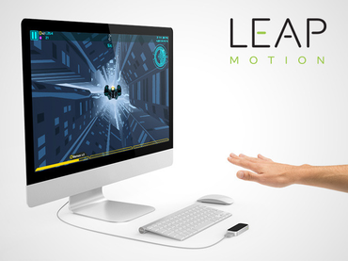
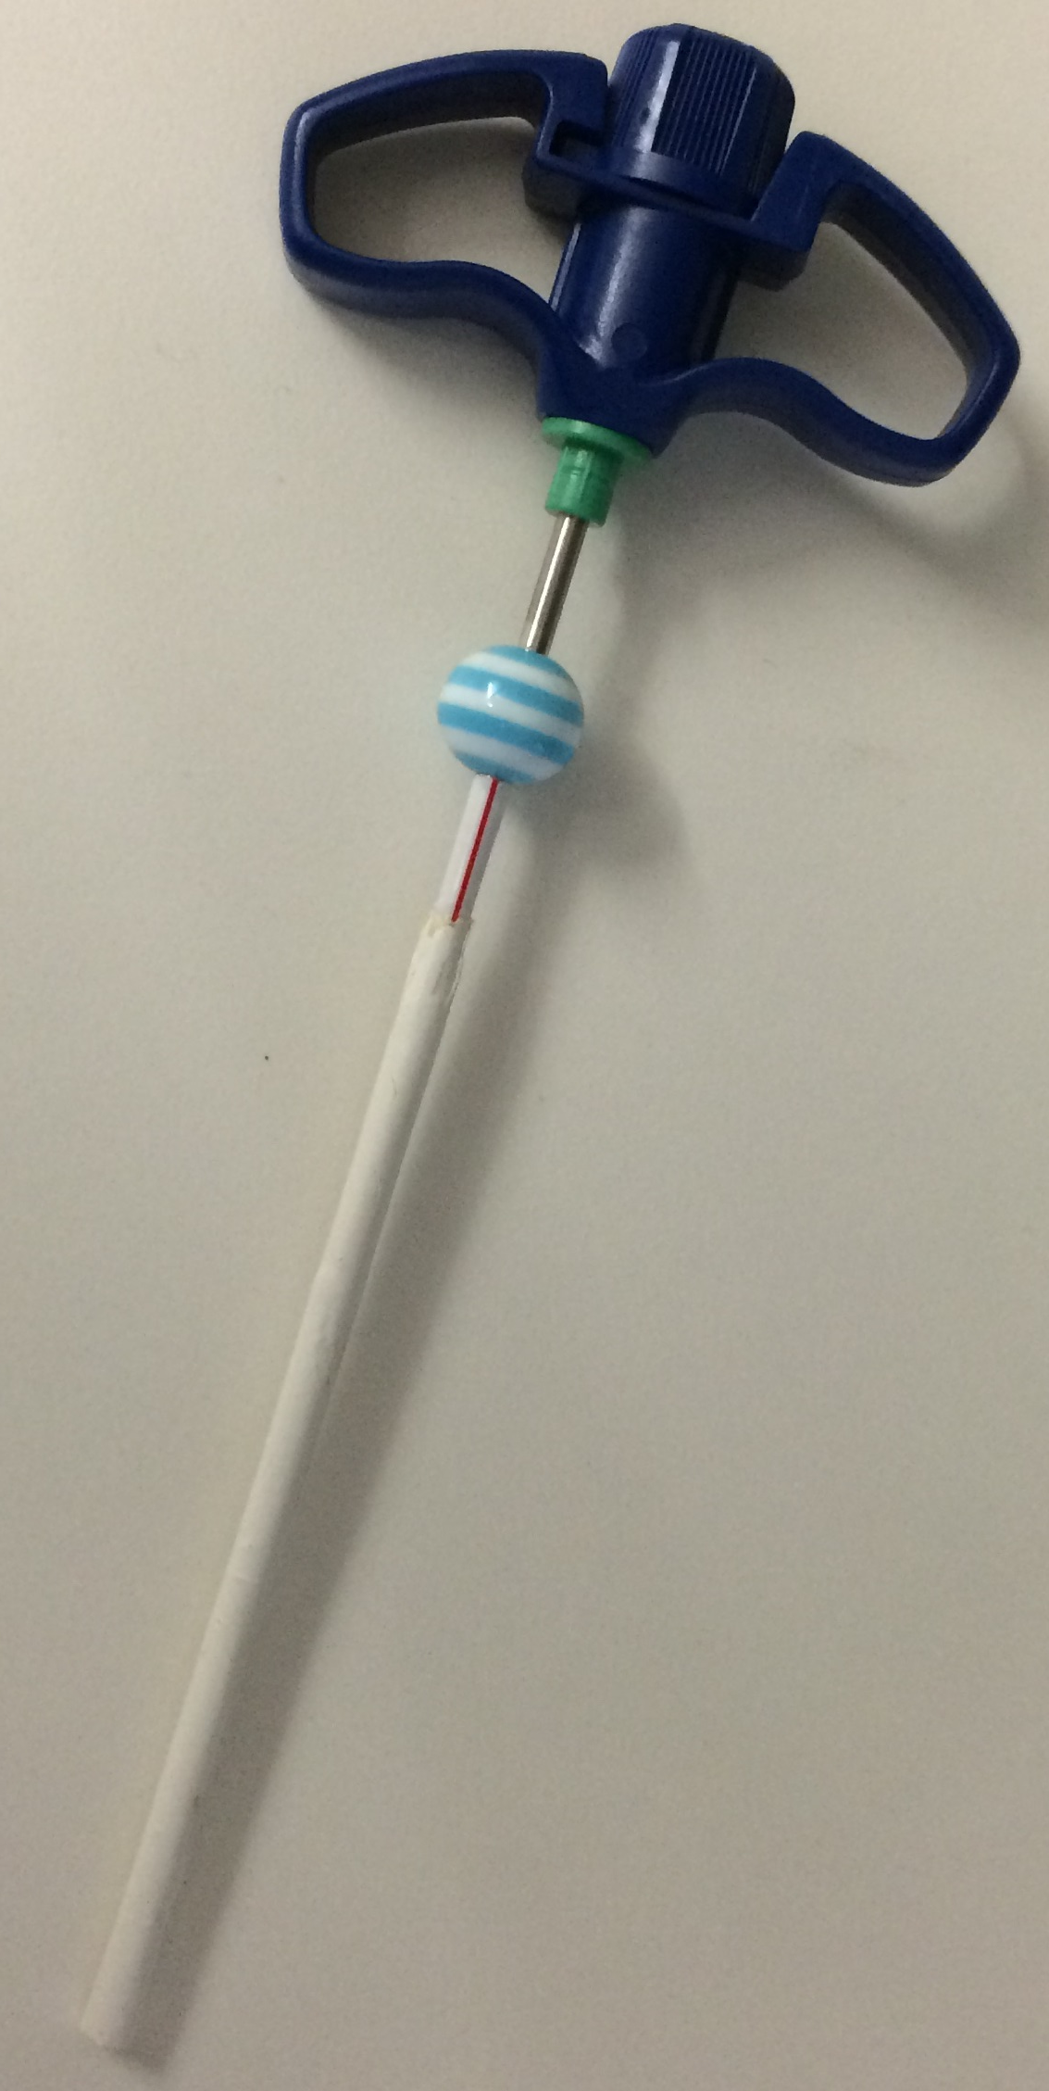
Requirements
Leap motion:
Senses the hand’s movements
Composed of 2 IR cameras
Similar to Kinect, but smaller
observation area with higher resolution
Elongated tool to perform the task
Notes:
Leap motion: The leap motion controller senses how you naturally move your hands and it demonstrates your hand (or tool) tracking in your system. The Leap Motion controller is a small USB peripheral device which is designed to be placed on a physical desktop, facing upward. Using two monochromatic IR cameras, the device observes a roughly hemispherical area, to a distance of about 1 meter away. The cameras generate almost 300 frames per second of reflected data, which is then sent through a USB cable to the host computer, where it is analyzed by the Leap Motion controller software by synthesizing 3D position data from the 2D frames generated by the two cameras. The smaller observation area and higher resolution of the device differentiates the product from the Kinect.

Slide 6
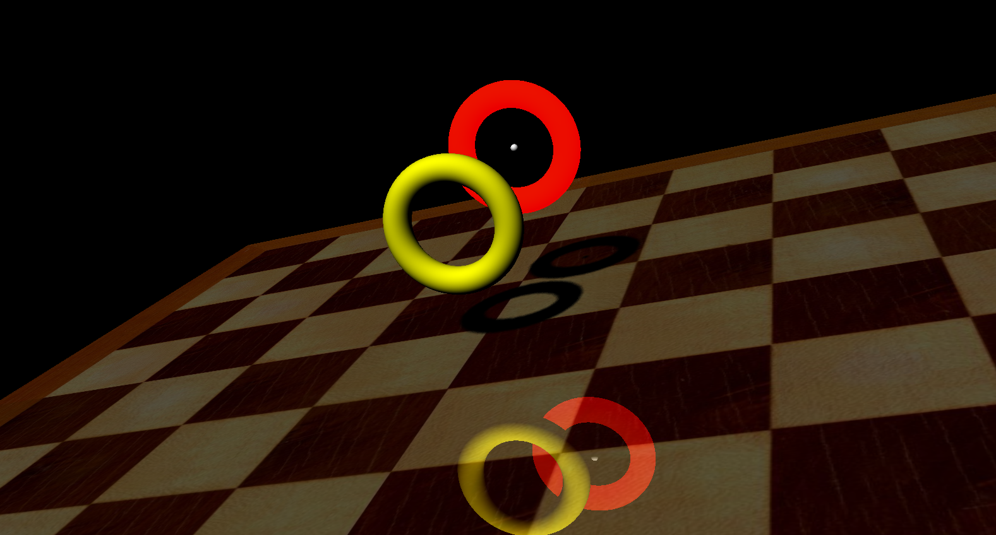
Demo

Slide 7
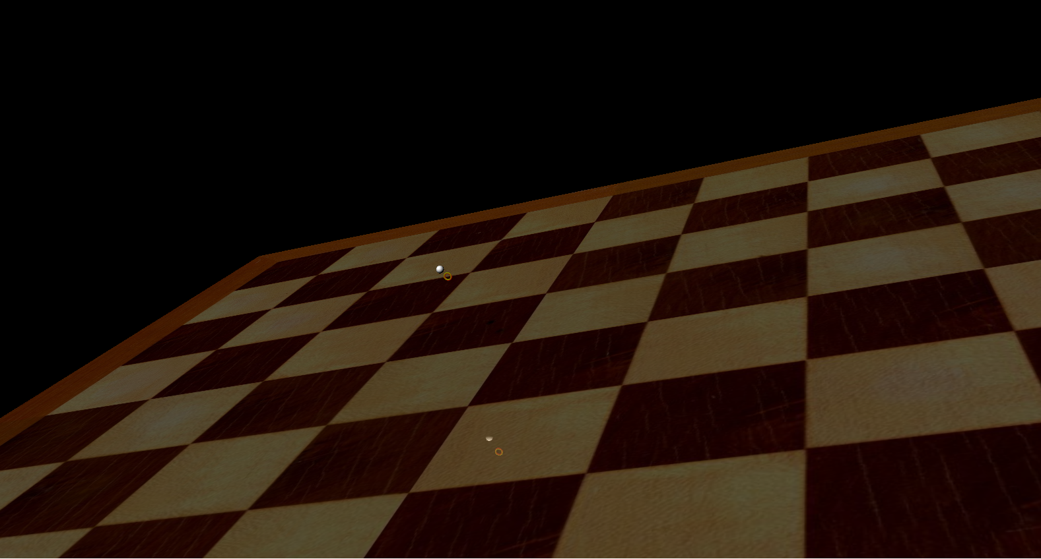
Precision Test
Maximum precision: 2mm

Slide 8
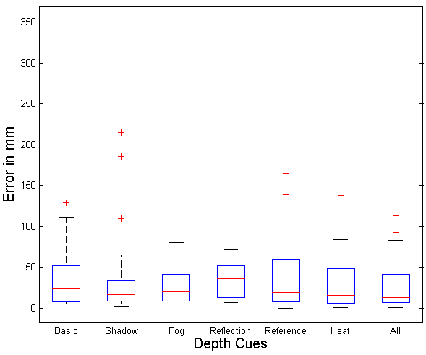
Evaluation
Results obtained from previous experiments
 | Animation 0 | Animation 1 | Animation 2 | Animation 3
Glow | 2 | 2 | 3 | 2
Transparency | 5 | 3 | 4 | 4
Fog | 6 | 2 | 2 | 4
$$\frac{9}{60}$$
$$\frac{16}{60}$$
$$\frac{14}{60}$$
Current evaluation on 5 separate depth cues

Slide 9
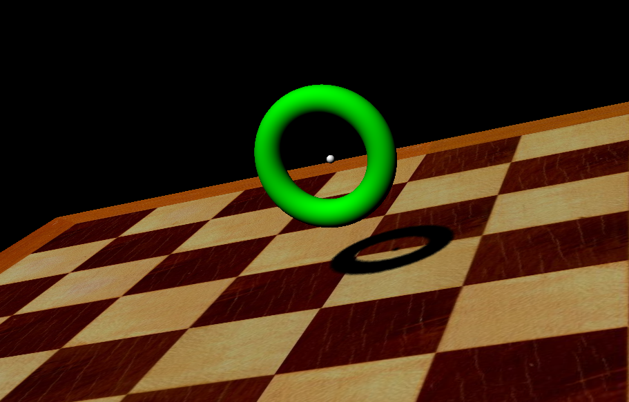
Conclusion
All these depth cues are necessary, but still cannot model the virtual world solely.
Participants found the Heat Map as the most helping cue.
Participants found Shadow and Reflection helping almost identically.

Slide 10
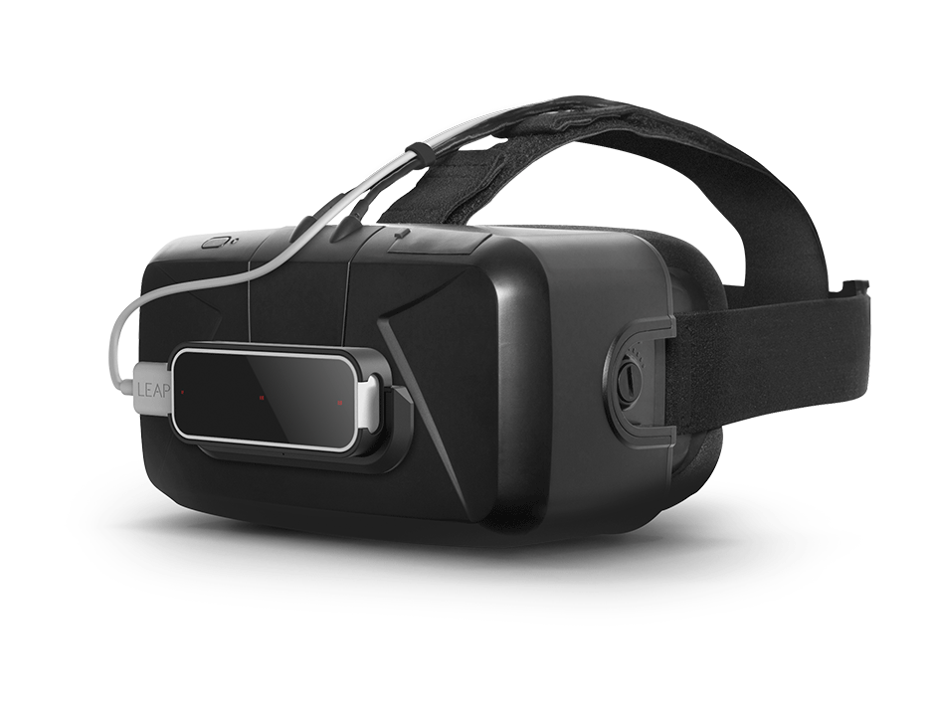
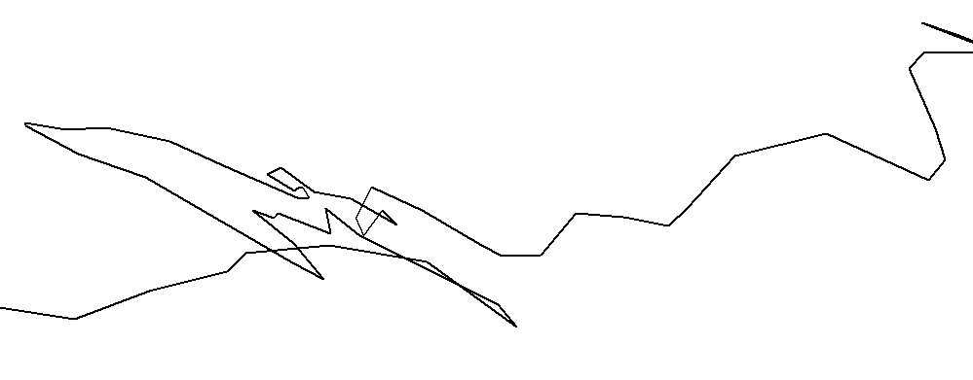
Future Development
Segmentation
Improved environment (e.g. Oculus Rift)
From VR to AR
Educating the user
Appealing UI
Improved smoothing
Frequency based sampling: zero crossing, change of gradient direction and using the normal information
State of the Art: iPhone video stabilization technique [1]
Leap signal
Leap signal zoomed in a ms window
1. Grundmann, Matthias, Vivek Kwatra, and Irfan Essa. "Auto-directed video stabilization with robust l1 optimal camera paths." In Computer Vision and Pattern Recognition (CVPR), 2011 IEEE Conference on, pp. 225-232. IEEE, 2011.
Notes:
It makes more sense for the user to observe his hands and tools in the virtual environment.
Oculus rift is a Virtual Reality head mounted display which provides a more realistic environment than the computer display, as the user can move his head and observe a 3D scene.
From VR to AR: To provide a more realistic evaluation, the evaluation environment should be as close as possible to the application. For the sake of medical purposes, an AR environment instead of a fully Virtual environment will lead to better evaluation.
Educating: Like any medical technology, you have to educate the user. Very realistic depth cues are great, but would be still very prone to error without training.
iPhone: automatic post-processing with adding constraints to mimic the natural move of the hand by avoiding sudden changes in the acceleration and constraints to reach constant velocity.

