Slide 1
MPC for Everyone
Aarushi Goel
Based on joint works with
Gabrielle Beck (JHU), Arka Rai Choudhuri (JHU), Matthew Green (JHU),
Abhishek Jain (JHU) & Gabriel Kaptchuk (BU)

Slide 2
Secure Multiparty Computation
$$x_{1}$$
$$y=f(x_{1},x_{2},x_{3},x_{4},x_{5})$$
$$y$$
$$y$$
$$y$$
$$y$$
$$y$$
$$x_{4}$$
$$x_{1}$$
$$x_{2}$$
$$x_{5}$$
$$x_{2}$$
$$x_{4}$$
$$x_{3}$$
$$x_{3}$$
$$x_{5}$$
Adversary learns the same amount of information in the two scenarios

Slide 3
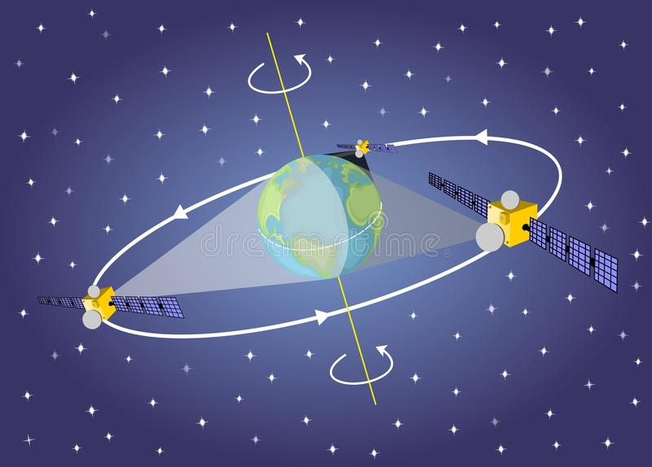
MPC and Real-Life Applications
Boston Women’s Workforce Council analyzed gender/racial wage gap.
Computing ad-clicks-to-sales conversion rates
Preventing satellite collisions

Slide 4
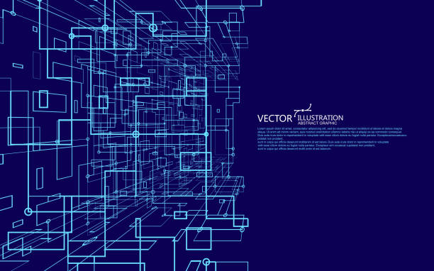
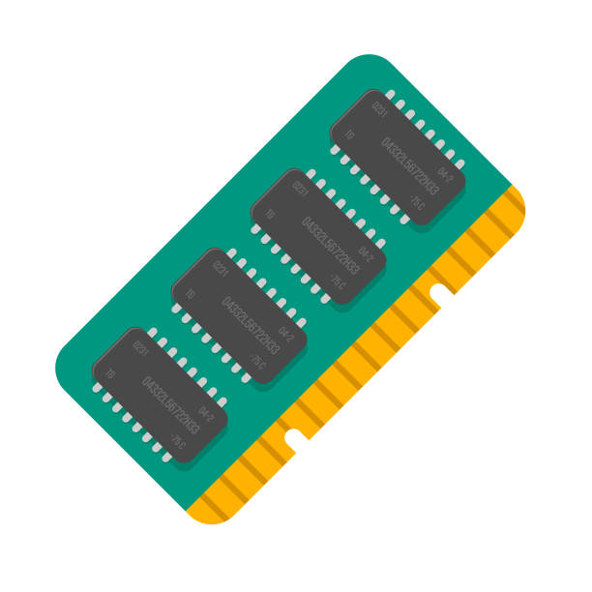
MPC and Emerging Applications
MPC protocols are becoming increasingly efficient.
Can be used to compute complex functionalities such as:
Training machine learning algorithms on massive, distributed datasets.
Optimization programs over a complex, high dimensional space, where the constraints of the dimensions are held by different players.
Simulating large RAM programs on distributed datasets
These are large computations on massive distributed datasets

Slide 5
Existing Efficient and Implemented Protocols
[HN06, DN07, LN17, CGHIKLN18, NV18, FL19, GSZ20]
No. of parties
Size of circuit
$O\left(n\left|C\right|\right)$: Total computation/communication complexity
Per-party work: $O(|C|)$
For large computations, these protocols may run for hours or even days.
For large computations, participants must have:
Large computing resources
Enough time availability

Slide 6
Main Question
Can we make MPC more usable for everyone?
Empower parties with less computational power and less time availability to also participate in large computations.
Easy access to large-scale outsourced MPC computations.

Slide 7
Better than $O\left(n\left|C\right|\right)$ ?
$\tilde{O}(|C|)$: Total computation and communication [DIKNS08, DIK10, GIP15]
$\tilde{O}$hides polynomial factors in $\log{|C|}$ and security parameter $κ$
Not concretely efficient
$O(|C|)$: Total computation and communication [DIK10, GIP15]
Only for SIMD circuits
No known implementations
Sub-Question #1
Can we design an $O(|C|)$MPC protocol for a larger class of circuits?

Slide 8
Advantages of $O(|C|)$ MPC protocols
Can be run with many many parties
Easier to justify honest majority
Supports division of work
Can be used with large volunteer networks such are Bitcoin and Tor
Parties with low computing resources can also participate
Could enable massive, crowd sourced applications such MPC-as-a-service

Slide 9
Result #1 [Beck-G-Jain-Kaptchuk-21]
An $O(|C|)$MPC protocol for Highly Repetitive Circuits
Semi-honest and maliciously secure protocols
$t<n\left(\frac{1}{2}−\frac{2}{ε}\right)$ static corruptions
Information theoretic
No setup assumptions
Security with Abort
Provide Implementation - first implementation of MPC that uses packed secret sharing

Slide 10
Single Instruction Multiple Data Circuits
Circuits that comprise of multiple parallel copies of the same sub circuit

Slide 11
Highly Repetitive Circuits
Example of (3,3)-repetitive circuit
$\left(A,B\right)$-Repetitive Circuits:
Composed of an arbitrary number of blocks of width at least $A$, that recur at least $B$ times.
Highly Repetitive Circuits:
$\left(A,B\right)$- repetitive circuit is highly repetitive w.r.t. $n$ parties, if $A ∈ Ω(n)$ and $B ∈ Ω(n)$

Slide 12
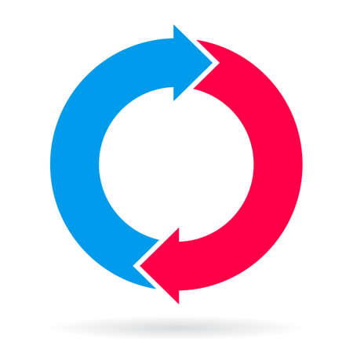
Examples of Highly Repetitive Circuits
For/While Loops
Machine Learning
Block Ciphers
Cryptographic Hash Functions

Slide 13
Is that sufficient?
Per party computation and communication complexity in $O(|C|)$protocol is : $O(\frac{\left|C\right|}{n})$
Work gets divided by the number of parties.
Work done by each party still depends on the depth of the circuit.
What if $O(\frac{\left|C\right|}{n})$ is still quite large?
Is there some other way to divide the work?

Slide 14
Prior Work: Static MPC
Round 1
Round 2
Round 3
…
…

Slide 15
Prior Work: Static MPC
Round 1
Round 2
Round 3
…
…
I need to leave
Dropped out due to connectivity issue
Requiring all participants to stay online throughout the computation is an unrealistic expectation.
Sub-Question #2
Can we design MPC protocols with Dynamic Participants?

Slide 16
MPC with Dynamic Participants
Again, after some time, a party has to leave
And an old party wants to re-join the computation
A group of parties start the computation
After some time two parties have to leave
This group will continue with the rest of the computation
And a new party wants to join the computation
Given this information, the new group continues with the rest of the computation
The previous group of parties securely distributes information about the computation so far, to the new group
This group will again securely distribute information about the computation thus far, with the new group of parties

Slide 17
MPC with Dynamic Participants
The minimum amount of work that any group needs to do should be small- ideally independent of the depth of the circuit

Slide 18
MPC with Dynamic Participants
This reduces the burden of computation on individual parties
Parties with low computational resources can also participate for a small time
While parties with more time and computational resources can help with the computation for a longer time

Slide 19
MPC with Dynamic Participants
This will result in a weighted, privacy preserving distributed computing system.

Slide 20
MPC as a Service
MPC with Dynamic Participants
Dynamic Peer-to-peer networks.
Powered by volunteer nodes- that can come and go as they wish.
Very Successful!
Allows Participants to join and leave at will
Reduces burden of computation on individual participants
Volunteer networks capable of private computation.
MPC-as-a-service framework - anyone can volunteer to participate irrespective of their computational power or availability.
Compatible with each other
Clients can delegate computations to such services.

Slide 21
MPC as a Service: Democratizes Secure Computation
Allows us to apply democratic principles to secure computation
MPC
everyone
everyone
Government for the people by the people
MPC-as-a-service framework - anyone can volunteer to participate irrespective of their computational power or availability.
Clients can delegate computations to such services.

Slide 22
Player Replaceability
Byzantine Agreement [Mic17, CM19] : After every round, the current set of players can be replaced by new ones.
Blockchains [GHMVZ17]: This idea is used in the design of Algorand.
Helps mitigate targeted attacks on chosen participants after their identity is revealed.
It would be great if this idea can be extended to MPC.

Slide 23
Related Prior Work
Proactive MPC [OY91]
Static participants
Mobile adversaries
Secret Sharing with dynamic participants [GKMPS20, BGGHKLRR20]
Computational setting
Guaranteed output delivery

Slide 24
Result #2 [Choudhuri-G-Green-Jain-Kaptchuk-21]
Fluid MPC: A formal model for MPC with dynamic participants
Semi-Honest BGW [GRR98] can be adapted to Fluid MPC Setting: each party is required to speak only in one round
A compiler that that transforms “certain” semi-honest Fluid MPC protocols into maliciously secure protocols:
security with abort
2 $×$communication complexity
Preserves fluidity
Provide Implementation of our protocol
Fluidity is the minimum commitment a party needs to make for participating in the protocol.

Slide 25
Fluid MPC Model

Slide 26
Modeling Dynamic Computation
Client-server model
Clients delegate computation to volunteer servers
Input Stage
Execution Stage
Output Stage
Clients pre-process their inputs and hand them to the servers
Dynamic servers participate to compute the function
Clients reconstruct the output of the function

Slide 27
Modeling Execution Stage
Execution Stage

Slide 28
Modeling Execution Stage
…
…
Epoch $i$
Epoch $i$+1
Epoch $i$+2
Compute Phase
Hand-off Phase
Compute Phase
Hand-off Phase
Compute Phase
Hand-off Phase
Committee $S^{i}$
Committee $S^{i+1}$
Committee $S^{i+2}$

Slide 29
Corruption Threshold
Clients: Honest Majority or Dishonest majority
Servers: Honest Majority or Dishonest majority
Our Choice
Honest majority of clients
Honest majority of servers in each committee

Slide 30
Fluid MPC Protocol
Committee Selection/Corruption
Protocol Execution given these Committees

Slide 31
Fluid MPC Protocol
Committee Selection/Corruption
Protocol Execution given these Committees
Committee Formation
Committee Corruption
Effect of Committee Corruption on Prior Epochs

Slide 32
Committees: When are they formed?
Epoch
Committee
1
2
3
Input Stage
Execution Stage
Static Committee Formation: Committee for each epoch is known at the start of the protocol.
Too Restrictive!

Slide 33
Committees: When are they formed?
On-the-fly Committee Formation: Committee for each epoch is known at the start of the hand-off phase of the previous epoch.

Slide 34
Committees: When are they formed?
Committee $S^{1}$
$S^{1}$is formed here
Input Stage
Compute Phase
Hand-off Phase
Compute Phase
Hand-off Phase
Compute Phase
On-the-fly Committee Formation: Committee for each epoch is known at the start of the hand-off phase of the previous epoch.

Slide 35
Committees: When are they formed?
Committee $S^{1}$
Committee $S^{2}$
$S^{1}$is formed here
$S^{2}$is formed here
Input Stage
Compute Phase
Hand-off Phase
Compute Phase
Hand-off Phase
Compute Phase
On-the-fly Committee Formation: Committee for each epoch is known at the start of the hand-off phase of the previous epoch.

Slide 36
Committees: When are they formed?
Committee $S^{2}$
Committee $S^{3}$
Committee $S^{1}$
$S^{1}$is formed here
$S^{2}$is formed here
$S^{3}$is formed here
Input Stage
Compute Phase
Hand-off Phase
Compute Phase
Hand-off Phase
Compute Phase
On-the-fly Committee Formation: Committee for each epoch is known at the start of the hand-off phase of the previous epoch.

Slide 37
Committees: When are they formed?
Committee $S^{2}$
Committee $S^{3}$
Committee $S^{1}$
$S^{1}$is formed here
$S^{2}$is formed here
$S^{3}$is formed here
Input Stage
Compute Phase
Hand-off Phase
Compute Phase
Hand-off Phase
Compute Phase
Our Choice
On-the-fly Committee Formation: Committee for each epoch is known at the start of the hand-off phase of the previous epoch.

Slide 38
Committees: How are they formed?
Committee $S^{2}$
Committee $S^{3}$
Committee $S^{1}$
$S^{1}$is formed here
$S^{2}$is formed here
$S^{3}$is formed here
Input Stage
Compute Phase
Hand-off Phase
Compute Phase
Hand-off Phase
Compute Phase
On-the-fly Committee Formation:
Volunteer: Anyone who volunteers can join the computation (Corruption threshold is difficult to enforce)
Elected: Anyone can nominate themself and an election process decides which nominees will participate (e.g., [BGGHKLRR20, GHMNY20] enforces it using proof-of-stake blockchains)

Slide 39
Committees: How are they formed?
Committee $S^{2}$
Committee $S^{3}$
Committee $S^{1}$
$S^{1}$is formed here
$S^{2}$is formed here
$S^{3}$is formed here
Input Stage
Compute Phase
Hand-off Phase
Compute Phase
Hand-off Phase
Compute Phase
On-the-fly Committee Formation:
Volunteer: Anyone who volunteers can join the computation (Corruption threshold is difficult to enforce)
Elected: Anyone can nominate themself and an election process decides which nominees will participate (e.g., [BGGHKLRR20, GHMNY20] uses proof-of-stake blockchains)

Slide 40
Fluid MPC Protocol
Committee Selection/Corruption
Protocol Execution given these Committees
Committee Formation
Committee Corruption
Effect of Committee Corruption on Prior Epochs

Slide 41
Committee Corruption
When can a server be corrupted?
Corrupted at the time of committee formation
Hand-off Phase
Compute Phase
Hand-off Phase
Static Corruption

Slide 42
Committee Corruption
When can a server be corrupted?
Hand-off Phase
Compute Phase
Hand-off Phase
Adaptive Corruption

Slide 43
Committee Corruption
When can a server be corrupted?
Corrupted at any time
Hand-off Phase
Compute Phase
Hand-off Phase
Adaptive Corruption

Slide 44
Committee Corruption
When can a server be corrupted?
Corrupted at any time
Hand-off Phase
Compute Phase
Hand-off Phase
Adaptive Corruption

Slide 45
Committee Corruption
When can a server be corrupted?
Corrupted at any time
Hand-off Phase
Compute Phase
Hand-off Phase
Adaptive Corruption

Slide 46
Committee Corruption
When can a server be corrupted?
Corrupted at any time
Hand-off Phase
Compute Phase
Hand-off Phase
Our Choice
Adaptive Corruption

Slide 47
Fluid MPC Protocol
Committee Selection/Corruption
Protocol Execution given these Committees
Committee Formation
Committee Corruption
Effect of Committee Corruption on Prior Epochs

Slide 48
Effect of Committee Corruption on Prior Epochs
What effect does corrupting a server have on the prior epochs where it participated?

Slide 49
Effect of Committee Corruption on Prior Epochs
What effect does corrupting a server have on the prior epochs where it participated?

Slide 50
Effect of Committee Corruption on Prior Epochs
What effect does corrupting a server have on the prior epochs where it participated?
Adv learns this private state

Slide 51
Effect of Committee Corruption on Prior Epochs
What effect does corrupting a server have on the prior epochs where it participated?
Adv learns this private state
Can be prevented by only allowing disjoint committees

Slide 52
Effect of Committee Corruption on Prior Epochs
What effect does corrupting a server have on the prior epochs where it participated?
Adv learns this private state
Can be prevented by only allowing disjoint committees
If there is overlap across committees, a server can only be corrupted if it does not violate the corruption threshold of prior epochs.

Slide 53
Effect of Committee Corruption on Prior Epochs
What effect does corrupting a server have on the prior epochs where it participated?
Adv learns this private state
Can be prevented by only allowing disjoint committees
If there is overlap across committees, a server can only be corrupted if it does not violate the corruption threshold of prior epochs.
Similar to being passively corrupted in prior epochs

Slide 54
Fluid MPC Protocol
Committee Selection/Corruption
Protocol Execution given these Committees
Committee Formation
Small Per-party work: independent of the depth of the circuit
Committee Corruption
Minimum time for which a party needs to stay online
Effect of Committee Corruption on Prior Epochs

Slide 55
High Fluidity
Compute Phase
Hand-off Phase
Compute Phase
Hand-off Phase
Compute Phase
Hand-off Phase
Committee $S^{i}$
Committee $S^{i+1}$
Committee $S^{i+2}$
Fluidity is the minimum commitment a server needs to make for participating in the protocol.
Measured by the number of rounds in an epoch

Slide 56
Maximal Fluidity
Our Choice
Essentially, each party is only required to communicate in one round
Compute Phase
Hand-off Phase
Compute Phase
Hand-off Phase
Compute Phase
Hand-off Phase
Committee $S^{i}$
Committee $S^{i+1}$
Committee $S^{i+2}$
Silent compute phase
1 Round of unidirectional hand-off phase
1 round epoch

Slide 57
Result #2 [Choudhuri-G-Green-Jain-Kaptchuk-21]
Optimized version of semi-Honest BGW [GRR98] can be adapted to achieve maximal fluidity
A compiler that that transforms this into a maliciously secure protocol:
security with abort
2 $×$communication complexity
Maximal fluidity

Slide 58
Summary
A step towards democratizing secure computations.
Anyone can volunteer to participate irrespective of their computational power or availability, and anyone can delegate computation to such services
Result #1 [BGJK21]: Design an $O(|C|)$ MPC for Highly repetitive circuits
Result #2 [CGGJK21]: Present a new model of MPC with dynamic participants and construct a protocol in this setting.

Slide 59
Thank You!

