Slide 1
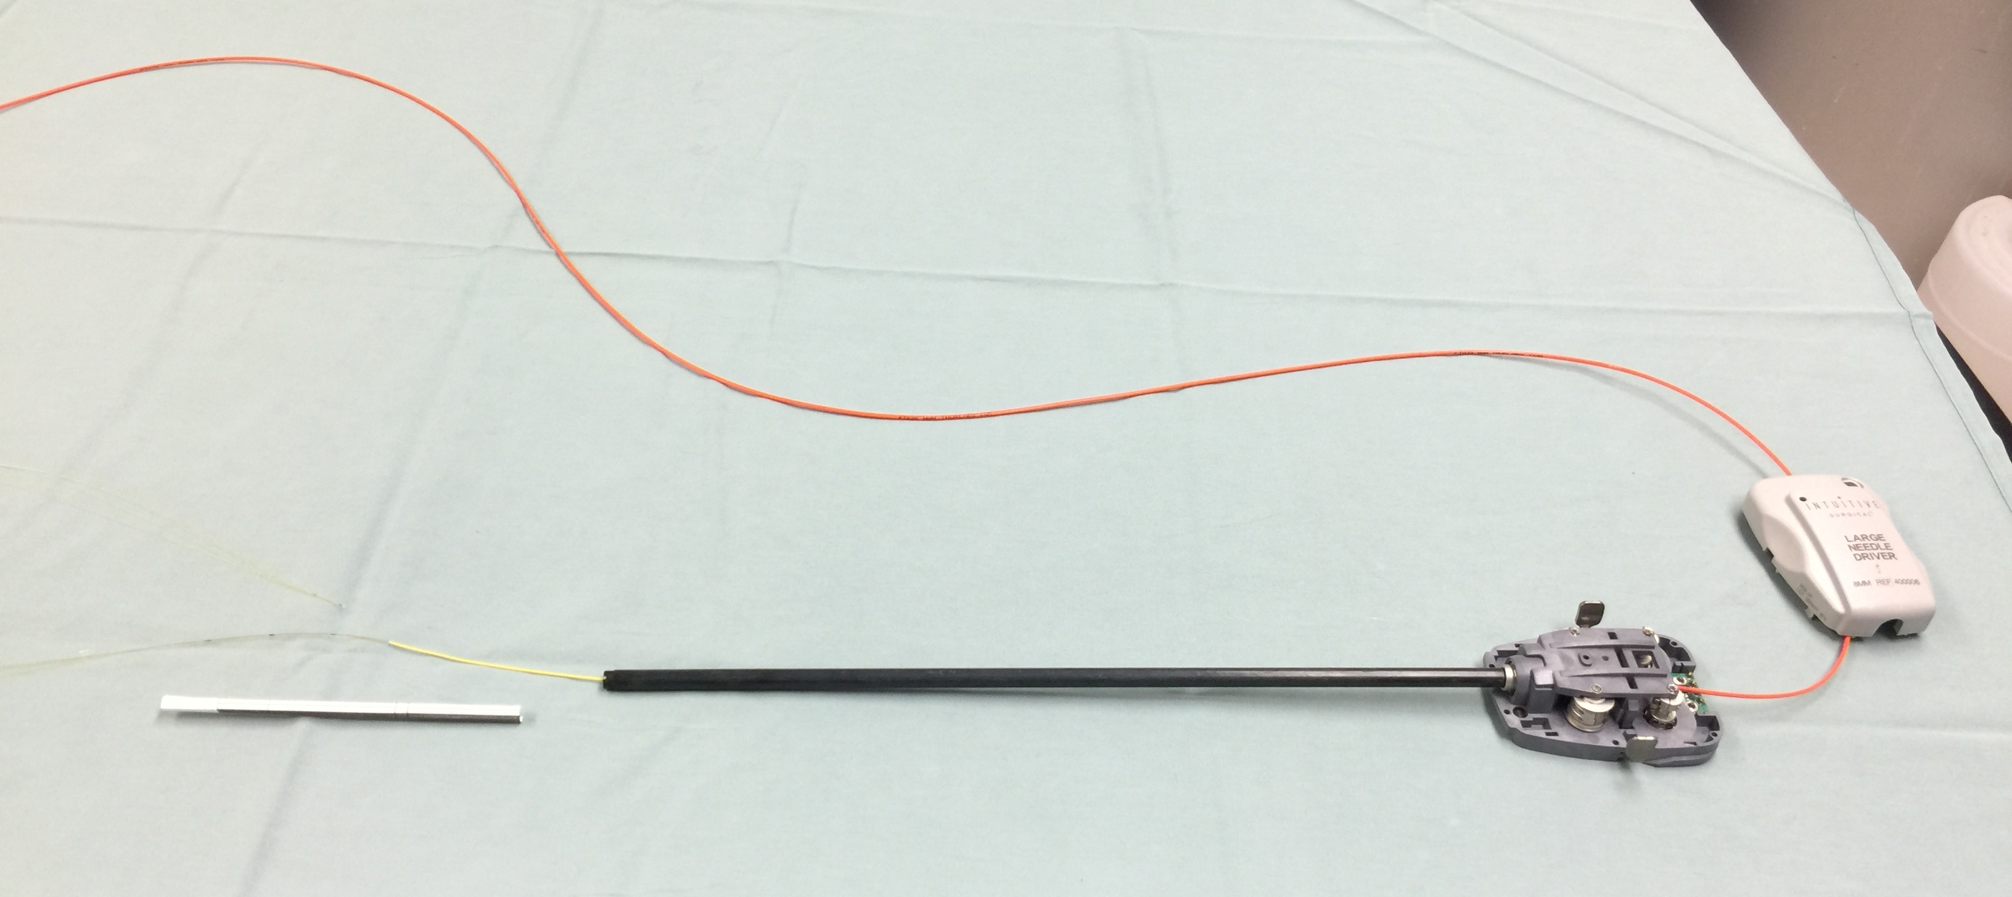
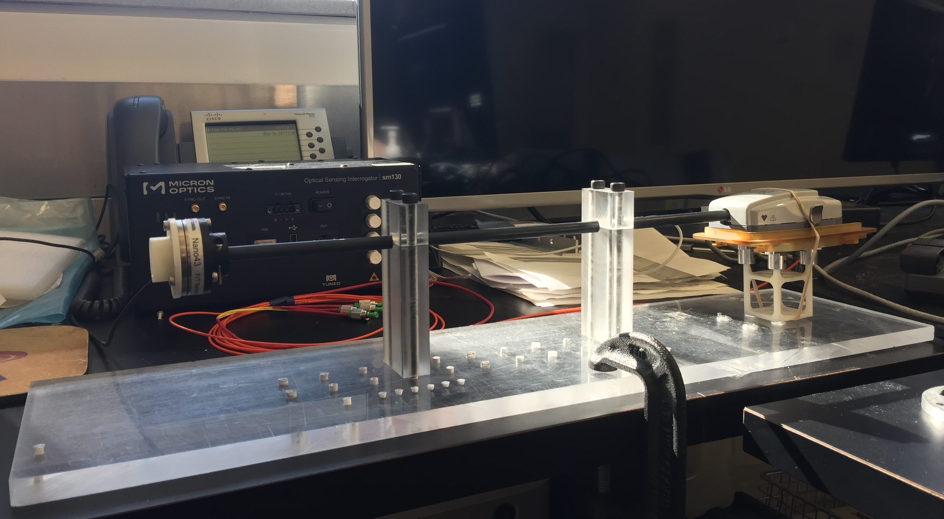
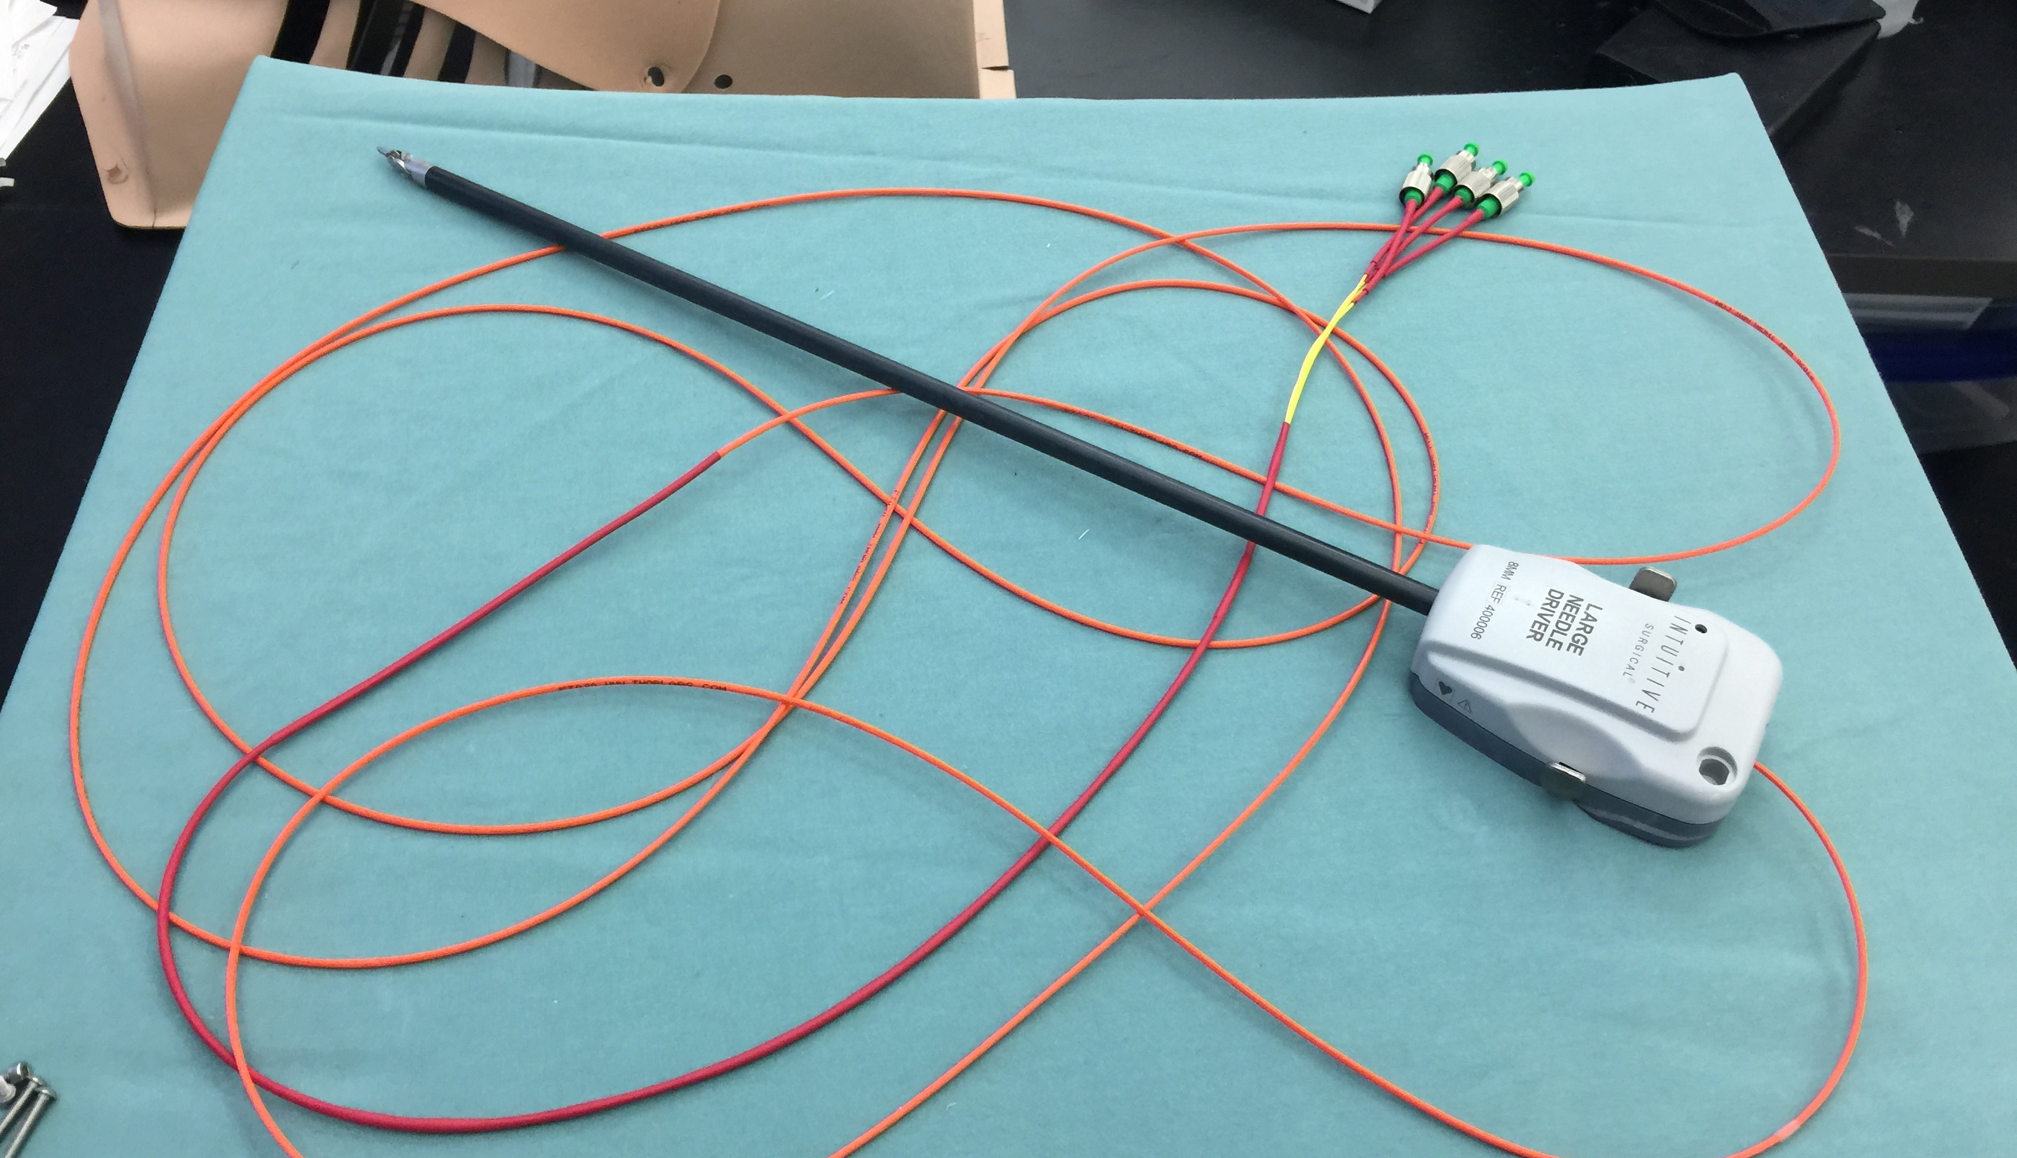
Calibration of Sensorized daVinci Tool
Goal :
Calibrate the tool equipped with FBGs for 3D force sensing
Validate against an ATI Force-torque sensor.
Group :
Recommended – 1
Experience : Undergrad or Master student with knowledge of
FBGs
Force sensor calibration
Matlab
Mentor(s) : Preetham Chalasani, Farshid Alambeigi
Contact : pchalas1@jhu.edu

