Slide 1
Beating CountSketch for Heavy Hitters in Insertion Streams
Vladimir Braverman
(JHU)
Stephen R.
Chestnut
(ETH)
Nikita
Ivkin
(JHU)
David P.
Woodruff
(IBM)

Slide 2
Streaming Model
…
4
3
7
3
1
1
2
Stream of elements a₁, …, a_{m} in [n] = {1, …, n}. Assume m = poly(n)
One pass over the data
Minimize space complexity (in bits) for solving a task
Let f_{j} be the number of occurrences of item j
Heavy Hitters Problem: find those j for which f_{j} is large

Slide 3
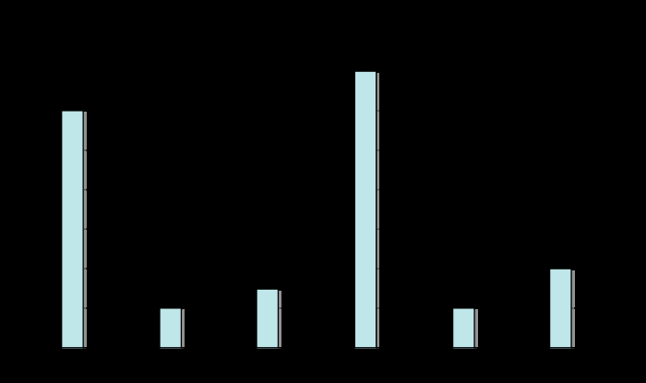
Guarantees
l₁ – guarantee
output a set containing all items j for which f_{j} $≥$ φ m
the set should not contain any j with f_{j} $≤$ (φ-ε) m
l₂ – guarantee
$F_{2}=\sum_{j}{f_{j}^{2}}$
output a set containing all items j for which f_{j} ² $≥$ ${\text{φ} F}_{2}$
the set should not contain any j with f_{j} ² $≤$ (φ-ε)${ F}_{2}$
This talk: φ is a constant, ε = φ/2
l₂ – guarantee is much stronger than the l₁ – guarantee
Suppose frequency vector is ($√n$, 1, 1, 1, …, 1)
Item 1 is an l₂-heavy hitter but not an l₁-heavy hitter
f_{1,} f₂ f₃ f₄ f₅ f₆

Slide 4
CountSketch achieves the l₂–guarantee [CCFC]
Repeat this hashing scheme O(log n) times
Output median of estimates
Ensures every f_{j} is approximated up to an additive $(F_{2}$/B)^{1/2}
Gives O(log² n) bits of space
Assign each coordinate i a random sign ¾(i) 2 {-1,1}
Randomly partition coordinates into B buckets, maintain c_{j} = Σ_{i: h(i) = j} ¾(i)¢f_{i} in j-th bucket
f₁ | f₂ | f₃ | f₄ | f₅ | f₆ | f₇ | f₈ | f₉ | f₁₀
. | Σ_{i: h(i) = 2} ¾(i)¢f_{i} | . | .
Estimate f_{i} as ¾(i) ¢ c_{h(i)}

Slide 5
Known Space Bounds for l₂– heavy hitters
CountSketch achieves O(log² n) bits of space
If the stream is allowed to have deletions, this is optimal [DPIW]
What about insertion-only streams?
This is the model originally introduced by Alon, Matias, and Szegedy
Models internet search logs, network traffic, databases, scientific data, etc.
The only known lower bound is Ω(log n) bits, just to report the identity of the heavy hitter

Slide 6
Our Results
We give an algorithm using O(log n log log n) bits of space!
Same techniques give a number of other results:
($F_{2}$ at all times) Estimate $F_{2}$ at all times in a stream with O(log n log log n) bits of space
Improves the union bound which would take O(log² n) bits of space
Improves an algorithm of [HTY] which requires m >> poly(n) to achieve savings
($L_{∞}$-Estimation) Compute max_{i} f_{i} up to additive (ε$F_{2}$)^{1/2} using O(log n log log n) bits of space (Resolves IITK Open Question 3)

Slide 7
Simplifications
Output a set containing all items i for which f_{i} ² $≥$ ${\text{φ} F}_{2}$ for constant φ
There are at most O(1/φ) = O(1) such items i
Hash items into O(1) buckets
All items i for which f_{i} ² $≥$ ${\text{φ} F}_{2}$ will go to different buckets with good probability
Problem reduces to having a single i* in {1, 2, …, n} with f_{i*} $≥$ (${\text{φ} F}_{2}$)^{1/2}

Slide 8
Intuition
Suppose first that $f_{i∗}≥n^{1/2}$log n and f_{i} in {0,1} for all i in {1, 2, …, n} \ {i*}
For the moment, also assume that we have an infinitely long random tape
Assign each coordinate i a random sign ¾(i) 2 {-1,1}
Randomly partition items into 2 buckets
Maintain
c₁ = Σ_{i: h(i) = 1} ¾(i)¢f_{i} and c₂ = Σ_{i: h(i) = 2} ¾(i)¢f_{i}
Suppose h(i*) = 1. What do the values c₁ and c₂ look like?

Slide 9
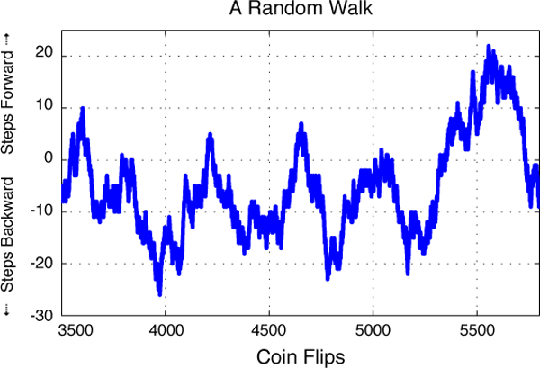
Eventually, f_{i*} > ${2Cn}^{1/2}, then we know$
$which bucket contains i∗!$
Only gives 1 bit of information. Can’t repeat log n times in parallel, but can repeat log n times sequentially!
c₁ = ¾(i*)¢f_{i*} + $\sum_{i≠i∗, h\left(i\right)=1}{σ\left(i\right)⋅f_{i} }$and c₂ = $\sum_{i≠i∗, h\left(i\right)=2}{σ\left(i\right)⋅f_{i} }$
c₁ - ¾(i*)¢f_{i*} and c₂ evolve as random walks as the stream progresses
(Random Walks) There is a constant C > 0 so that with probability 9/10, at all times,
|c₁ - ¾(i*)¢f_{i*}| < Cn^{1/2} and |c₂| < Cn^{1/2}

Slide 10
Repeating Sequentially
Wait until either |c₁| or |c₂| exceeds Cn^{1/2}
If |c₁| > Cn^{1/2} then h(i*) = 1, otherwise h(i*) = 2
This gives 1 bit of information about i*
(Repeat) initialize 2 new counters to 0 and perform the procedure again!
Assuming $f_{i∗}= Ω(n^{1/2}$log n), we will have at least 10 log n repetitions, and we will be correct in a 2/3 fraction of them
(Chernoff) only a single value of i* whose hash values match a 2/3 fraction of repetitions

Slide 11
Gaussian Processes
We don’t actually have $f_{i∗}≥n^{1/2}$log n and f_{i} in {0,1} for all i in {1, 2, …, n} \ {i*}
Fix both problems using Gaussian processes
(Gaussian Process) Collection {X_{t}}_{t in T} of random variables, for an index set T, for which every finite linear combination of random variables is Gaussian
Assume E[X_{t}] = 0 for all t
Process entirely determined by covariances E[X_{s}X_{t}]
Distance function d(s,t) = (E[|X_{s}-X_{t}|²])^{1/2} is a pseudo-metric on T
(Connection to Data Streams) Suppose we replace the signs ¾(i) with normal random variables g(i), and consider a counter c at time t: c(t) = Σ_{i} g(i)¢f_{i}(t)
f_{i}(t) is frequency of item i after processing t stream insertions
c(t) is a Gaussian process!

Slide 12
Chaining Inequality [Fernique, Talagrand]
Let {X_{t}}_{t in T} be a Gaussian process and let $T_{0}⊆T_{1}⊆T_{2}⊆⋯⊆T$ be such that $\left|T_{0}\right|=1$ and $\left|T_{i}\right|≤2^{2^{i}}$ for $i≥1$. Then,
$$E\left[\sup_{t∈T}{X_{t}}\right]≤O\left(1\right)\sup_{t∈T}{\sum_{i≥0 }{2^{i/2}d(t, T_{i})}}$$
How can we apply this to c(t) = Σ_{i} g(i)¢f_{i}(t)?
Let $F_{2}\left(t\right)$ be the value of $F_{2}$after t stream insertions
Let the $T_{i}$be a recursive partitioning of the stream where $F_{2}$(t) changes by a factor of 2

Slide 13
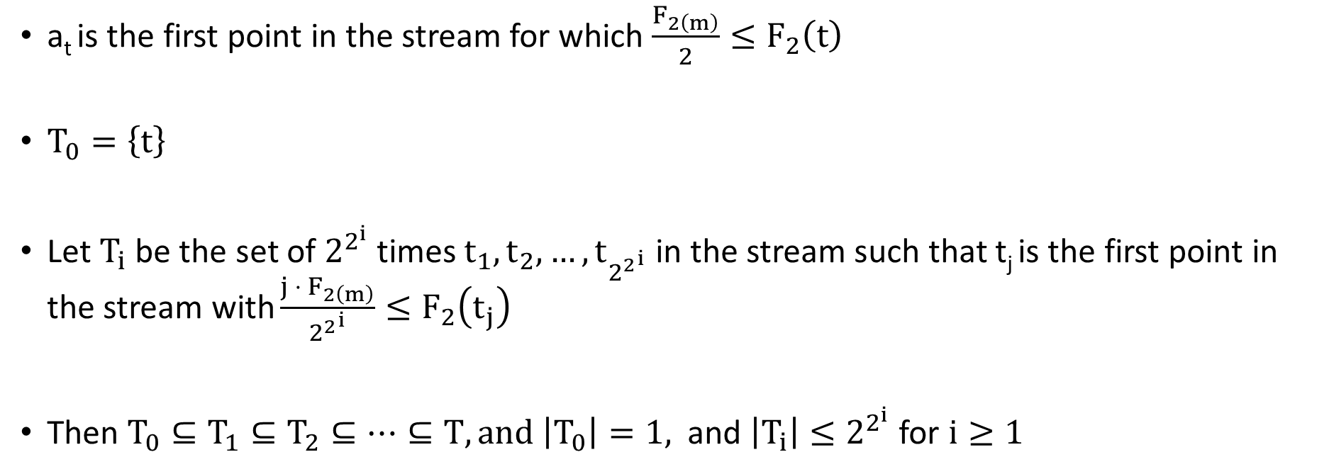
…
…
a₁
a₂
a₃
a₄
a₅
a_{t}
a_{m}
a_{t} is the first point in the stream for which ${\frac{F_{2\left(m\right)}}{2}≤F}_{2}\left(t\right)$
$T_{0}=\left\{t\right\}$
Let $T_{i}$ be the set of $2^{2^{i}}$ times $t_{1},t_{2},…, t_{{2^{2}}^{i}}$ in the stream such that t_{j} is the first point in the stream with ${\frac{{j ⋅ F}_{2\left(m\right)}}{{2^{2}}^{i}}≤F}_{2}\left(t_{j}\right)$
Then $T_{0}⊆T_{1}⊆T_{2}⊆⋯⊆T, and \left|T_{0}\right|=1,$ and $\left|T_{i}\right|≤2^{2^{i}}$ for $i≥1$
Apply the chaining inequality!

Slide 14
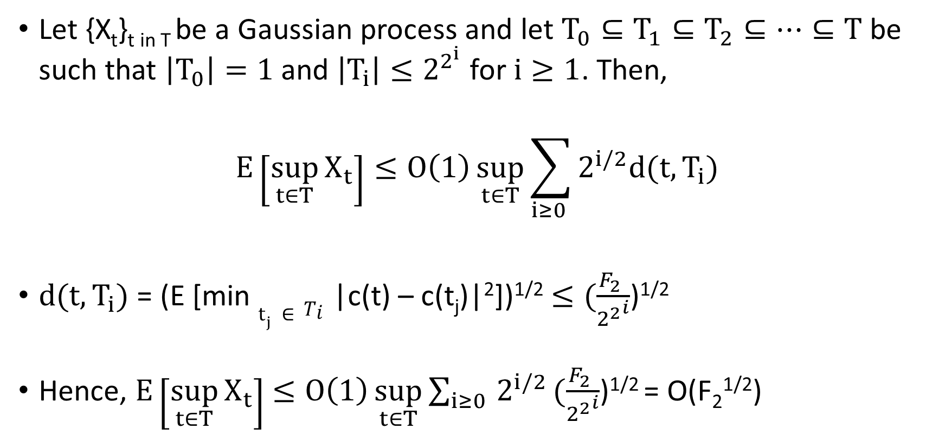
Applying the Chaining Inequality
Let {X_{t}}_{t in T} be a Gaussian process and let $T_{0}⊆T_{1}⊆T_{2}⊆⋯⊆T$ be such that $\left|T_{0}\right|=1$ and $\left|T_{i}\right|≤2^{2^{i}}$ for $i≥1$. Then,
$$E\left[\sup_{t∈T}{X_{t}}\right]≤O\left(1\right)\sup_{t∈T}{\sum_{i≥0 }{2^{i/2}d(t, T_{i})}}$$
$d(t, T_{i})$ = (E [min $t_{j}∈Ti$|c(t) – c(t_{j})|²])^{1/2} $≤(\frac{F_{2} }{{2^{2}}^{i}}$)^{1/2}
Hence, $E\left[\sup_{t∈T}{X_{t}}\right]$ $≤O\left(1\right)\sup_{t∈T}{\sum_{i≥0 }{2^{i/2}}}(\frac{F_{2} }{{2^{2}}^{i}}$)^{1/2} = O(F₂^{1/2})
Same behavior as for random walks!

Slide 15
Removing Frequency Assumptions
We don’t actually have $f_{i∗}≥n^{1/2}$log n and f_{j} in {0,1} for all j in {1, 2, …, n} \ {t}
Gaussian process removes the restriction that f_{j} in {0,1} for all j in {1, 2, …, n} \ {t}
The random walk bound of Cn^{1/2} we needed on counters holds without this restriction
But we still need $f_{i∗}≥F_{2}^{1/2}$log n to learn log n bits about the heavy hitter
How to replace this restriction with $f_{i∗}≥$ (φ F₂) ^{1/2}?
Can assume φ is an arbitrarily large constant by standard transformations

Slide 16
Amplification
Create O(log log n) pairs of streams from the input stream
(stream^{L}₁ , stream^{R}₁), (stream^{L}₂ , stream^{R}₂), …, (stream^{L}_{log log n} , stream^{R}_{log log n})
For each j in O(log log n), choose a hash function h^{j} :{1, …, n} -> {0,1}
stream^{L}_{j} is the original stream restricted to items i with h^{j}(i) = 0
stream^{R}_{j} is the remaining part of the input stream
maintain counters c_{L} = Σ_{i: hj(i) = 0} g(i)¢f_{i} and c_{R} = Σ_{i: hj(i) = 1} g(i)¢f_{i}
(Chaining Inequality + Chernoff) the larger counter is usually the substream with i*
The larger counter stays larger forever if the Chaining Inequality holds
Run algorithm on items with counts which are larger a 9/10 fraction of the time
Expected F₂ value of items, excluding i*, is F₂/poly(log n), so i* is heavier

Slide 17
Derandomization
We don’t have an infinitely long random tape
We need to
derandomize a Gaussian process
derandomize the hash functions used to sequentially learn bits of i*
We achieve (1) by
(Derandomized Johnson Lindenstrauss) defining our counters by first applying a Johnson-Lindenstrauss (JL) transform [KMN] to the frequency vector, reducing n dimensions to log n, then taking the inner product with fully independent Gaussians
(Slepian’s Lemma) counters don’t change much because a Gaussian process is determined by its covariances and all covariances are roughly preserved by JL
For (2), derandomize an auxiliary algorithm via a reordering argument and Nisan’s PRG [I]

Slide 18
Conclusions
Beat CountSketch for finding $l_{2}$-heavy hitters in a data stream
Achieve O(log n log log n) bits of space instead of O(log² n) bits
New results for estimating F₂ at all points and L$∞$ - estimation
Questions:
Is this a significant practical improvement over CountSketch as well?
Can we use Gaussian processes for other insertion-only stream problems?
Can we remove the log log n factor?

